Slide 1


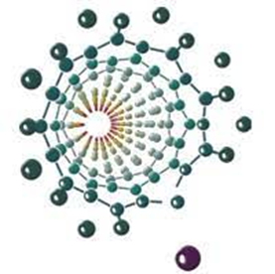
The effect of Cu doping on physicochemical properties of bismuth vanadate
Marko Jelić¹, Igor Pašti², Bojana Nedić Vasiljević², Jelena Erčić³, Danica Bajuk-Bogdanović², Zoran Jovanović¹, Sonja Jovanović¹
¹Laboratory of Physics, Vinča Institute of Nuclear Sciences – National Institute of the Republic of Serbia, University of Belgrade, Belgrade, Serbia
²Faculty of Physical Chemistry, University of Belgrade, Belgrade, Serbia
³Materials Science Laboratory, Vinča Institute of Nuclear Sciences – National Institute of the Republic of Serbia, University of Belgrade, Belgrade, Serbia

Slide 2
INTRODUCTION
What kind of material is BiVO₄ ?
  N-type semiconductor
  In nature, it exist in the form of mineral pucherit
  In laboratory, BiVO₄ crystalizes exclusively in zircon or scheelite type of structure
  Monoclinic and tetragonal scheelite systems are the most common
Monoclinic
Tetragonal

Slide 3
INTRODUCTION
Why is BiVO₄ interesting?
  In 1998. Kudo et al. discovered great photocatalytic effect of BiVO₄
  The material can accommodate a large number of defects and dopants, enabling a high degree of material engineering
Huge potential in the field of water splitting:
great visible light harvesting properties, band edge positions and low-cost synthesis method

Slide 4
INTRODUCTION
What is a major drawback?
  High degree of electron-hole recombination
  Poor charge transport
  Sluggish water oxidation kinetics
Strategies for the improvement?
  Morphology control
  Heterostructure formation
  Doping
  Copper doped BiVO₄

Slide 5
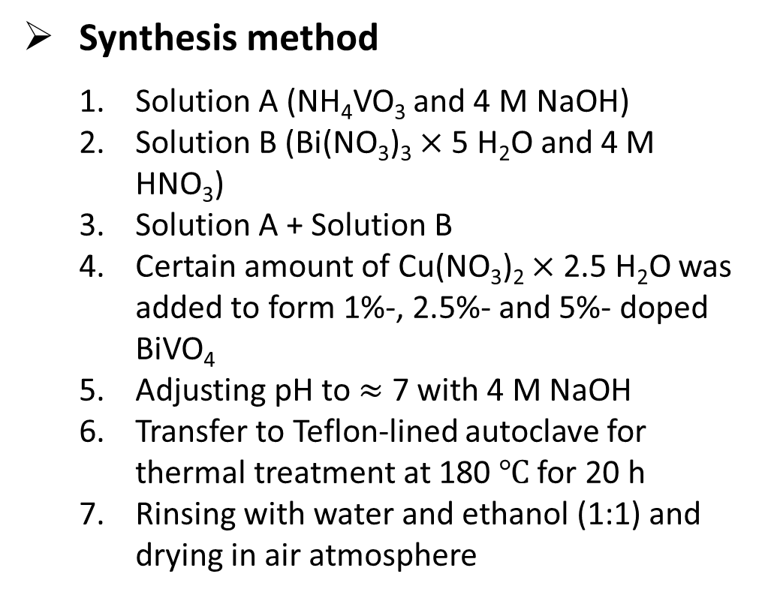
EXPERIMENTAL
Synthesis method
  Solution A (NH₄VO₃ and 4 M NaOH)
  Solution B (Bi(NO₃)₃ $×$ 5 H₂O and 4 M HNO₃)
  Solution A + Solution B
  Certain amount of Cu(NO₃)₂ $×$ 2.5 H₂O was added to form 1%-, 2.5%- and 5%- doped BiVO₄
  Adjusting pH to $≈$ 7 with 4 M NaOH
  Transfer to Teflon-lined autoclave for thermal treatment at 180 $℃$ for 20 h
  Rinsing with water and ethanol (1:1) and drying in air atmosphere
Characterization
  X-ray diffraction (XRD)
  Scanning Electron Microscopy (SEM)
  Raman spectroscopy
  Diffuse Reflectance Spectroscopy (DRS)
  Photoluminescence Spectroscopy (PL)

Slide 6
XRD
BiVO₄XCu
Material exists in monoclinic or tetragonal scheelite phase, but mixed phase composition is also possible
Pure monoclinic and tetragonal phase was formed in a case of pristine and 1% doped sample
Samples doped with 2.5% and 5% of copper showed mixed phase composition

Slide 7
XRD
5%
5%
2.5%
2.5%
1%
1%
0%
0%
Peaks around 19° that originates from monoclinic [101] and [011] reflections showed away shift compared to the non doped material with 5% doped sample preceding the others
Tetragonal peak that originates from [101] reflection showed shift to the lower values of 2θ for 5 % sample, while 1 % and 2.5 % samples exhibit no change in the position
Peak around 29° that exclusively originates from monoclinic phase showed the higher level of separation between components after doping

Slide 8
SEM
BiVO₄XCu
Size of the particles was 1-2 μm on average
Non-doped sample showed warm like morphology
1 % doped sample showed spherical morphology
2.5 % and 5 % showed combined spherical and prismatic morphology

Slide 9
RAMAN
BiVO₄XCu
Doping % | FWHM of symmetric streching V-O bond (cm⁻¹)
0 | 39.89
1 | 17.36
2.5 | 35.63 (M) 16.69 (T)
5 | 35.69 (M) 17.12 (T)
Non doped, 2.5 % and 5 % samples exhibit bands at 109, 127, 211, 327, 368, 717 and 827 cm⁻¹ which are characteristic for monoclinic scheelite phase
All three doped samples exhibit bands at 109, 192, 247, 366, 731, 760 and 854 cm⁻¹ which are characteristic for tetragonal scheelite phase

Slide 10
DRS
BiVO₄XCu
Dual transition was present for 2.5 % and 5 % samples indicating double phase composition
Band gaps of monoclinic samples were in 2.4 – 2.5 eV range, while tetragonal samples showed band gaps in 2.8 – 3 eV range

Slide 11
PHOTOLUMINESCENCE
434 nm excitation wavelength
Several states where recombination occur
Better recombination features for monoclinic samples
BiVO₄XCu

Slide 12
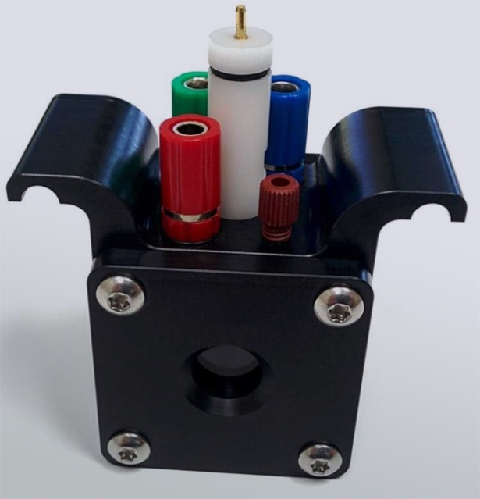
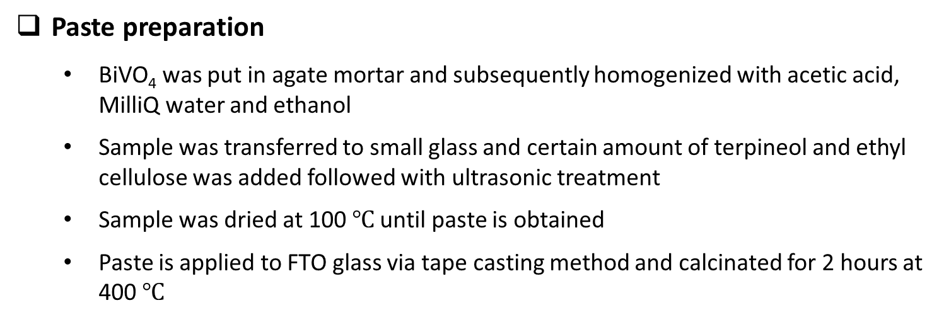
Photoelectrochemical Characterization
Linear Sweep Voltammetry
Chronoamperometry
For irradiation, Thorlab’s MCWHL6 LED was used
Paste preparation
  BiVO₄ was put in agate mortar and subsequently homogenized with acetic acid, MilliQ water and ethanol
  Sample was transferred to small glass and certain amount of terpineol and ethyl cellulose was added followed with ultrasonic treatment
  Sample was dried at 100 $℃$ until paste is obtained
  Paste is applied to FTO glass via tape casting method and calcinated for 2 hours at 400 $℃$

Slide 13
Linear Sweep Voltammetry
Material is light sensitive
Non doped materials showed lower onset potentials
5% doped sample showed the highest photocatalytic activity towards OER

Slide 14
Chronoamperometry
Sample | Stability after 250 s
BVO_20h | 23 %
BVO_20h_light | 28 %
BVO_20h_1% | 31 %
BVO_20h_1%_light | 40 %
BVO_20h_2.5% | 34 %
BVO_20h_2.5%_light | 37 %
BVO_20h_5% | 43 %
BVO_20h_5%_light | 58 %
Potential was maintained at 1.5 V
5% doped sample showed the highest stability after 250 s

Slide 15
CONCLUSIONS
Copper doped bismuth vanadate (BiVO₄) was hydrothermally synthesized
XRD pattern indicated that non-doped material had monoclinic schelite phase, but after doping phase composition was altered and pure tetragonal scheelite or dual phase compostion were observed
SEM images showed that non-doped material has irregular warm-like morphology and that after doping shape of material is significantly changed so that 1 % Cu-doped tetragonal sample showed spherical shape while 2.5 % and 5% doped samples showed combination of prismatic and spherical structures.
Results from Raman spectroscopy was in compliance with diffraction study
Optical properties show that, as in the structural analysis, phase composition should be paramether that could help to approximate band gap values. Samples that consists mostly of monoclinic phase had band gap in range 2.4 – 2.5 eV while samples with tetragonal scheelite phase showed values of band gap in range 2.8 – 3 eV. PL results showed that monoclinic samples had the best charge recombination features
Photoelectrochemical results imply that material is light sensitive and, after doping, it improves its photoelectrochemical performance towards oxygen evolution reaction.

Slide 16



Acknowledgment
Thank you for your attention!

Slide 18
XRD – Ritvield analysis
R_{P}= 6.97 | R-pattern
R_{WP}= 9.32 | R-weighted pattern
R_{e} = 5 | R-expected
R_{F} = 2.69 (M); 2.78 (T) | R-Structure factor
R_{B} = 3.05 (M); 3.63 (T) | R-Bragg factor
ꭓ² = 3.47 | Goodness-of-fit
79.86 % (M); 20.14 % (T) | Phase composition
6.22 g/cm³ (M); 5.945 g/cm³ (T) | Density
BiVO₄_2.5%_Cu

Slide 19
FTIR Spectroscopy
Results in accordance with Raman Spectroscopy
Monoclinic samples have 4 pronounced bands :
  406 cm⁻¹, 476 cm⁻¹, that correspond to the symmetric (A_{g}) and anti-symmetric (B_{g}) O-V-O bending modes
  632 cm⁻¹, 826 cm⁻¹ , that correspond to the symmetric (A_{g}) and anti-symmetric (B_{g}) stretching V-O bond
  Shift towards lower wavenumbers of symmetric stretching V-O mode is observed for doped samples
Tetragonal samples have 3 pronounced bands:
  406 cm⁻¹ that correspond to the symmetric (A_{g}) O-V-O bending mode
  741 cm⁻¹, 828 cm⁻¹ that correspond to the symmetric (A_{g}) and anti-symmetric (A_{g}) stretching V-O bond
BiVO₄XCu;
X = 0%, 1%, 2.5%, 5%

