Slide 1
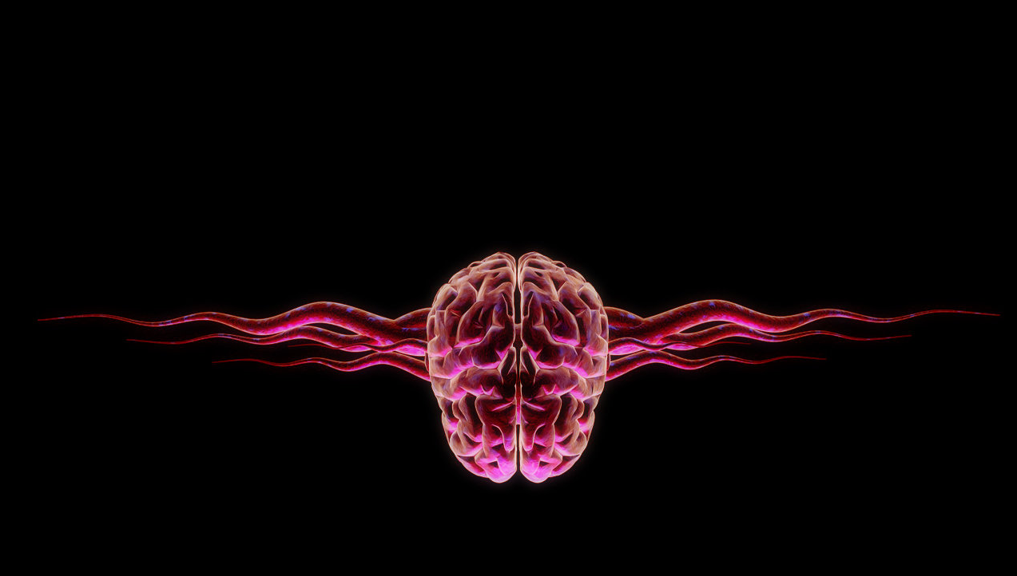
The XXVI International Scientific Conference of Young Scientists and Specialists (AYSS-2022)
Joint Institute for Nuclear Research, 24 - 28 October 2022
Biological effects of radiation exposure on the body, biomedical and pharmaceutical applications
Maria Lalkovicova, PhD.
lalkovicova@jinr.ru
Dpt. of Radiation Physiology
Laboratory of Radiation Biology
JINR, Dubna, Russia

Slide 2
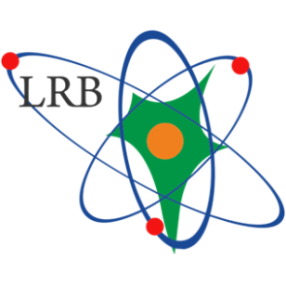
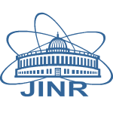
JINR and LRB
www.lrb.jinr.ru
JINR
1956 - JINR established
7 laboratories
18 collaborating countries and 6 states
LRB
1959 - first radiobiological experiments (synchrocyclotron, LNP)
1978 - Biological Research Sector
1988 - Biological Division at DLNP
1995 - The Department of Radiation
and Radiobiological Research
2005 - Laboratory of Radiation biology
Founder: acad. Prof. E. A. Krasavin
Director: Prof. Dr. A. N. Bugay

Slide 3
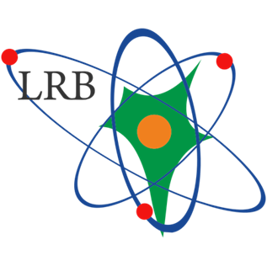
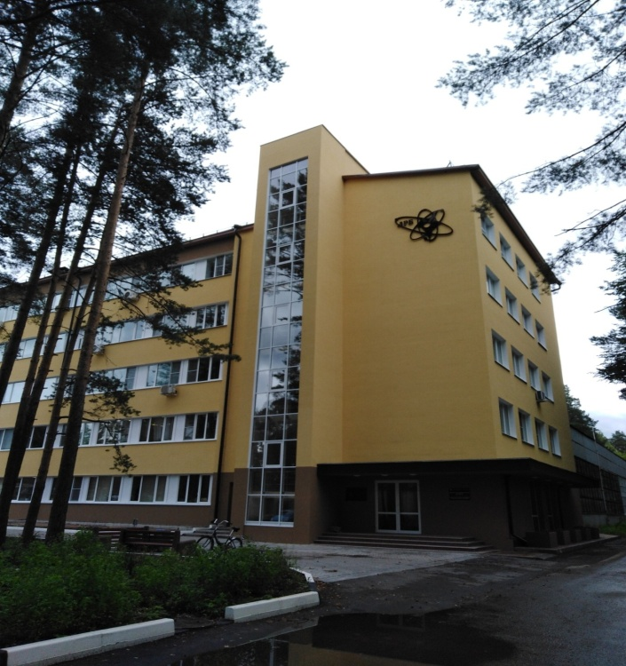
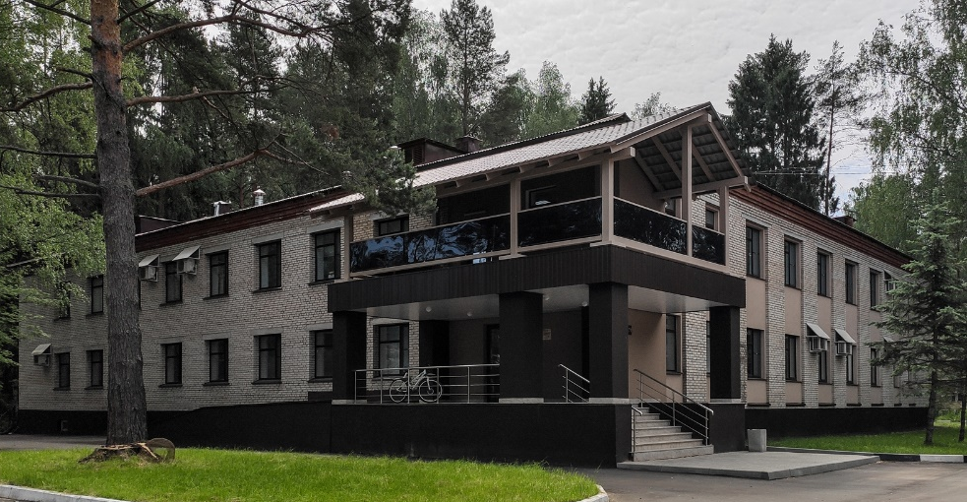
Main theme of research: The biological action of heavy charged particles of different energies
Department of Radiation Biology and Physiology:
Molecular Radiobiology Sector
Radiation Cytology Sector
Radiation Physiology Sector
Radiation Neurochemistry Sector
Mathematical Modeling Sector
Radiation Genetics Group
Department of Radiation Research:
Group for Modeling of Ionizing Radiation Interaction with Matter
Group for Studying Radiation Fields of JINR’s Basic Facilities and Environment
Astrobiology Sector
Website: lrb.jinr.ru
E-mail: lrb@jinr.ru

Slide 4
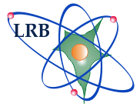
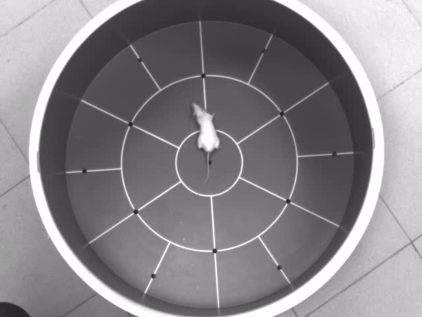
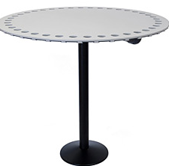
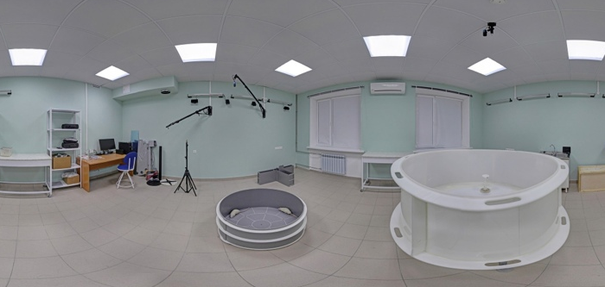
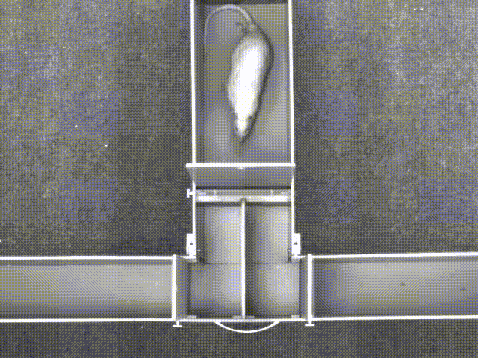
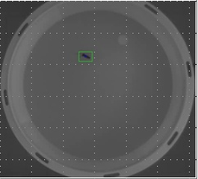
Sector of Radiation Physiology
study of behavioral disorders in irradiated animals
pathomorphological changes in various structures of the brain and spinal cord, and other organs
hematological tests
study of radioprotective and radiosensitizing properties of pharmacological drugs

Slide 5
What is Radiation & sources?
Natural radiation vs. Harmful radiation
Electromagnetic radiation
medical radiation
Plane travels
cosmic radiation

Slide 6
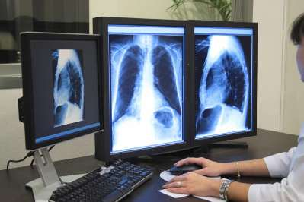
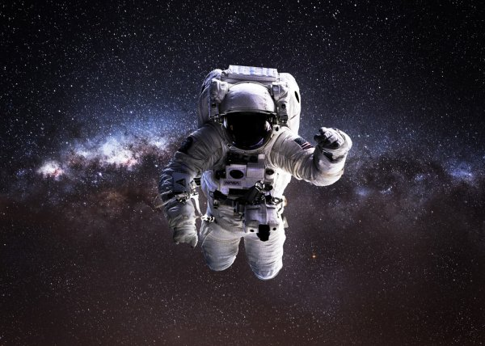
Other sources of radiation
"fallout" from nuclear tests
radiation from radioactive consumer goods and from electronic devices
radiation to occupationally exposed persons
other forms of radioactive contamination

Slide 8
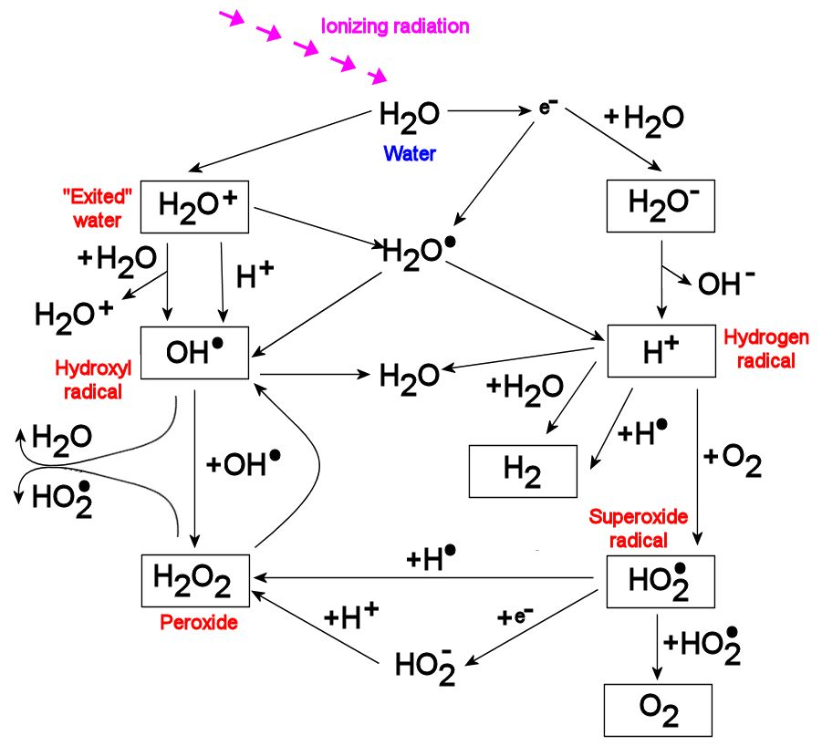
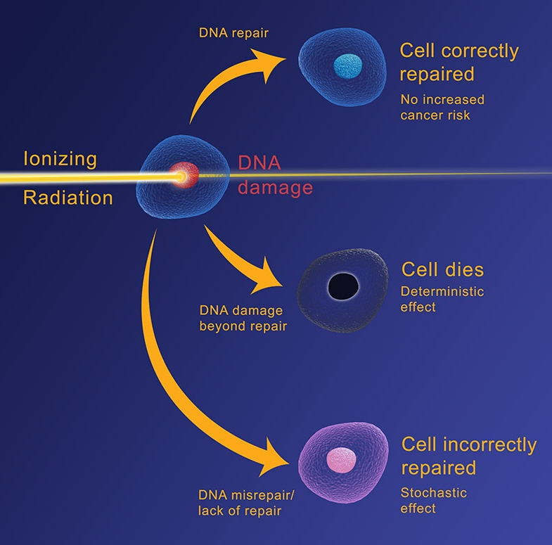
Radiation and the molecular basis of cell death
Cell damage – free radicals formation – DNA damage, double-strand breaks – cell death/ mutations
low - LET
high - LET
ionization
DNA lesion
Radiolysis of water
Notes:
Clustered double-strand break

Slide 9
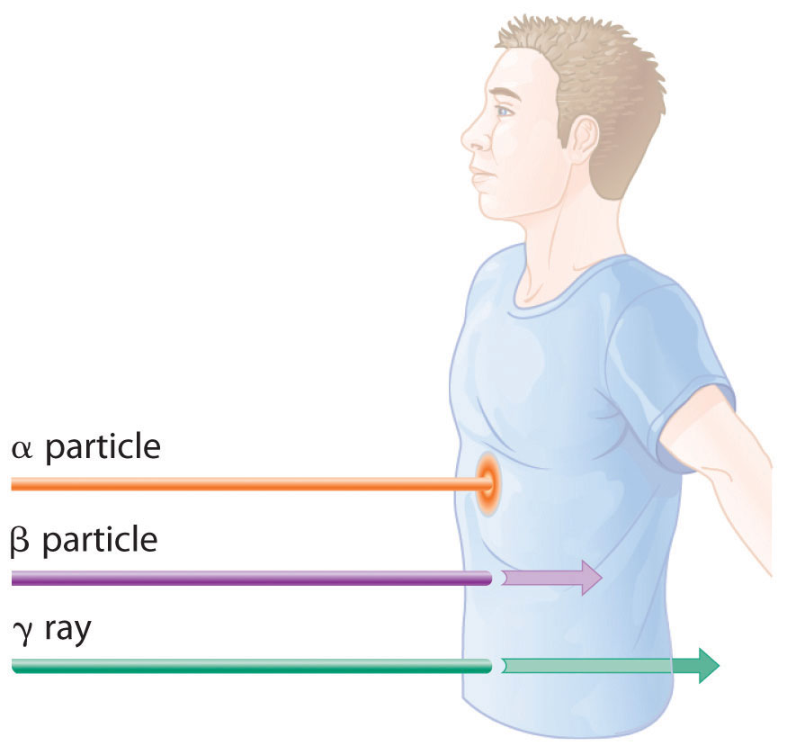
Which Is More Dangerous: Alpha, Beta, Or Gamma?
varying levels of danger - externally and internally
Alpha rays - poor penetration power, but the greatest mass
- the greatest ionizing power
- inside can cause maximum damage to the tissues
Beta particles - smaller, less tissue-damaging power internally
- greater penetrative power, skin burns
Gamma rays - the highest penetration power
- bone marrow and internal organs damaged
Notes:
This question is more complex than it seems at first. If an alpha particle somehow gets into the system through inhaling or swallowing, they become the most dangerous.
Marie Curie coined the term “radioactivity” when she and Pierre Curie started working on the phenomenon that Becquerel had discovered. Ernest Rutherford discovered three types of emissions from radioactive substances as he experimented with them between 1900 and 1903. He named them alpha, beta, and gamma radiation. They differ in their ability to penetrate matter.

Slide 11
Radiation exposure of human organism
Earth: 0.1 µSv/h; 1 mSv/year
0.1 mSv radiography chest, plane Brussels - Tokio
7 mSv CT chest
100 mSv 6 months at the ISS
Astronauts on a mission 50 to 2,000 mSv
Long flights: up to 10 µSv/h
ISS: 20 µSv/h; 100 mSv/6 months
Mars: 25 µSv/h; 300 mSv/500 days
Deep space: 75 µSv/h; 300 mSv/180 transit days
200 mSv +1% cancer risk
10000 mSv severe damage, death

Slide 12
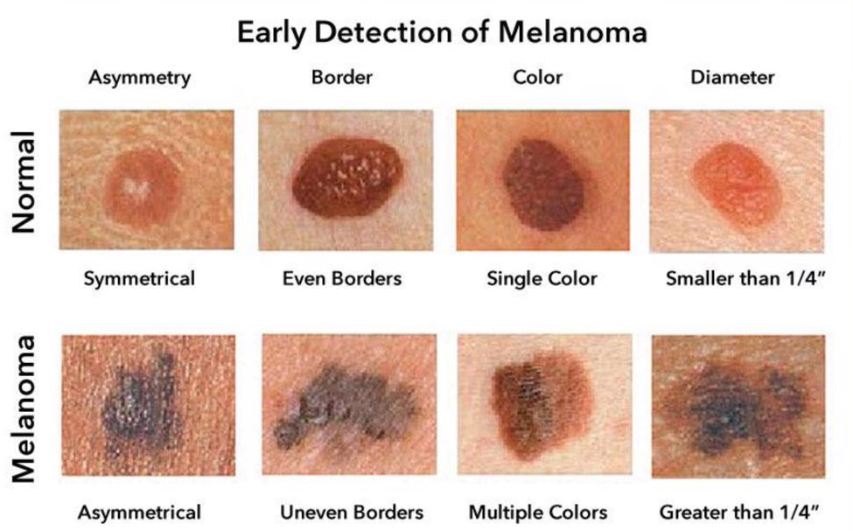
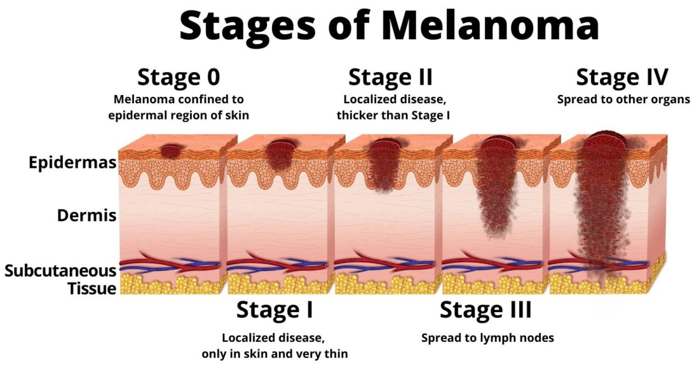
Sunburn
Solar radiation wavelength
Visible light – 400 to 760 nm
Ultraviolet radiation (UV) - >400 nm (sunburn)
Infrared radiation - <760 nm (heat)
UV radiation
Stimulates melanin (dark pigment) that absorbs UV protecting cells
Health Effects
2 to 3 million non-malignant skin cancers
130,000 malignant melanomas
Sunburn – acute cell injury causing inflammatory response (erythema)
Accelerates aging process

Slide 13
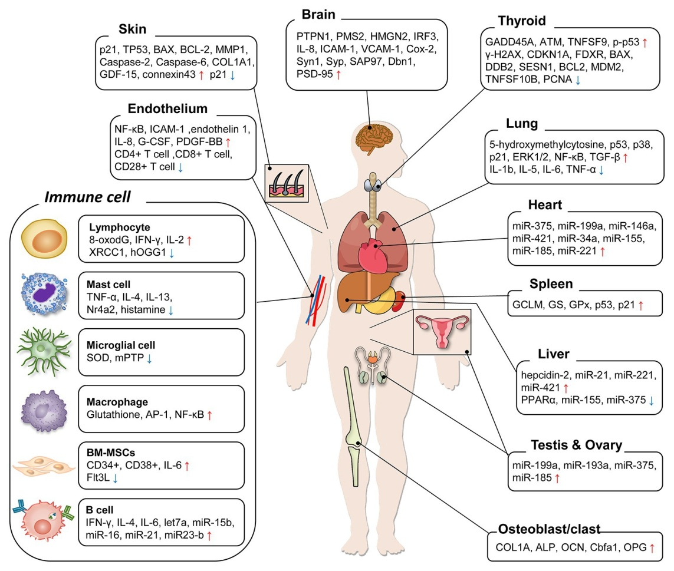
Organ-Specific Effects
of Low Dose Radiation Exposure
during medical diagnoses, exposure to radioactive elements
chronic diseases, leukemia and cardiovascular diseases etc.
Shin et al., 2020
Notes:
A diagram summarizing organ-specific biological markers by low-dose radiation (LDR) exposure. LDR basically caused the accumulation of DNA damages, controlled systemic immune systems, induced oxidative damages on peripheral organs, and even benefited the viability in some organs.
DNA damages, oxidative stress, and pro-inflammatory responses, alters gene expression
Many studies have shown that the lung ranks among the organs that are most resistant to LDR damage. Moreover, the protective roles of LDR in the lung have been demonstrated in various stress models. In these studies, LDR up to 0.5 Gy suppressed ROS generation, attenuated inflammatory responses (IL-1β, IL-5, IL-6, and TNF-α),
reproductive organs must be protected from mutations. Testicular tissues are highly vulnerable to damages induced by LDR exposure. LDR < 0.2 Gy increased the levels of ROS, which leads to induction of ER stress and apoptosis in testicular cells of irradiated mice

Slide 14
The law of Bergonie and Tribondeau
- the radiosensitivity of a biological tissue is directly proportional to the mitotic activity and inversely proportional to the degree of differentiation of its cells
neoplastic cells are more radiosensitive than the cells from which they originate; they reproduce much faster than healthy cells
- Cellular differentiation describes the extent to which a tumor resembles the normal tissue from which it derives. The more it differs from healthy tissue, the greater its radiosensitivity will be
Notes:
. This law underpins the field of radiation-oncology, although such a general law may not apply precisely in all cases.
Not mature enough cells more sensitive to radiation
RBE effectivness

Slide 15
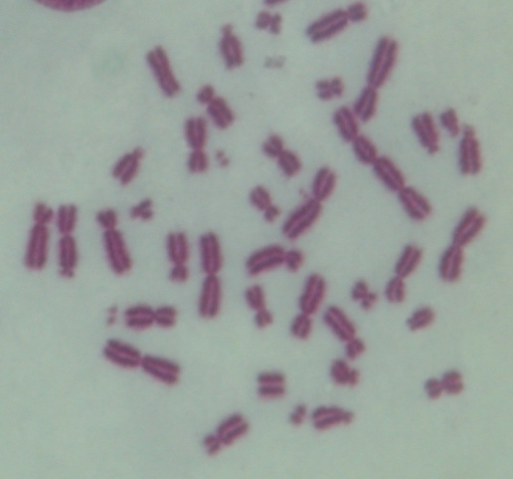
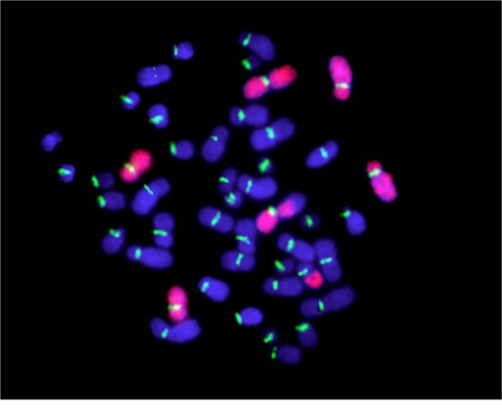
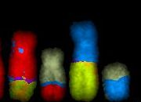
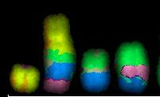
Radiation Cytogenetics
Evaluation of biological efficiency of particle beams at JINR facilities by cytogenetics methods
The effects of low-dose radiation exposure
Long-term consequences of radiation exposure
Evaluation of complex chromosome aberrations induction
visualization of chromosome aberrations by metaphase method
visualization of chromosome aberrations by FISH method
visualization of complex chromosome aberrations by mFISH method
Notes:
Let me briefly present you the main fields of our research.
MR studies induction and repair of DNA damage. The future task is to extend the study to tumor cell lines –for radiation medicine purposes, and to brain structures – which is important for space research and risk estimation.
RC was widely used to evaluate the biological efficiency of particle beams, low-dose ionizing radiations, etc.
Application of modern techniques allows us to study long-term consequences of radiation exposure

Slide 16
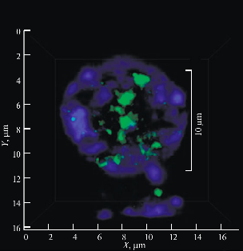
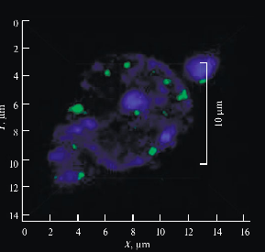
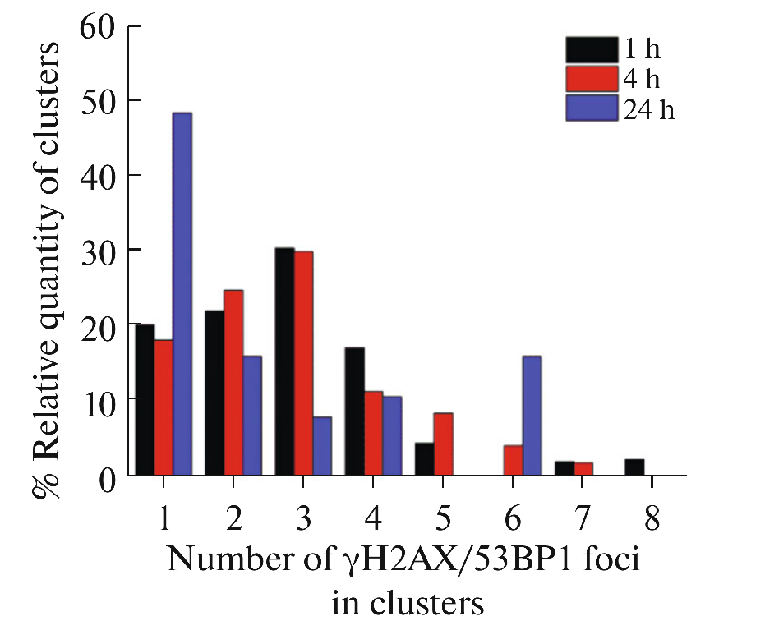
Formation of DNA Double-Strand Breaks in Rat Brain Neurons
after Irradiation of rats with Krypton Ions
krypton ions protons
DNA damage visualization in a dentate gyrus cell
Boreyko, Bulanova, et al, 2019

Slide 17
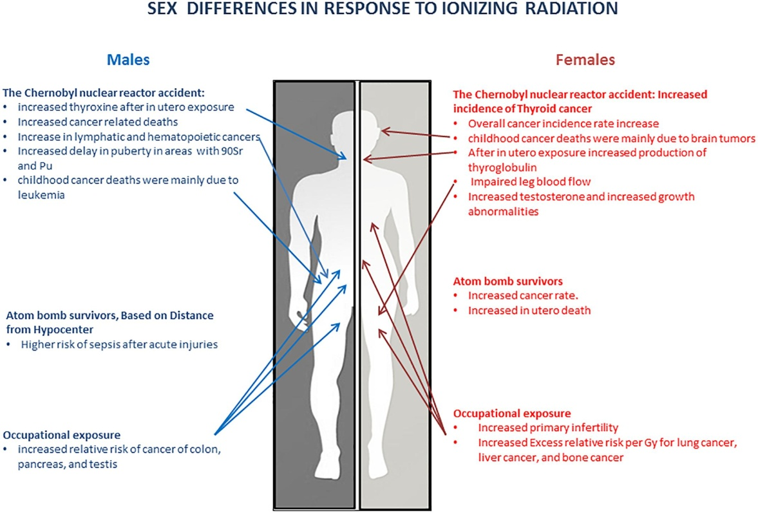

Slide 18
Sex-Specific Differences in Brain tumors
Glioblastoma (GBM)
the most common primary malignant brain tumor in adults
has the worst outcome
the protective role of estrogen, the upregulation of androgen receptors and testosterone
role of immune system, genetic and molecular differences
Carrano et al., 2021
Notes:
Considering that glioblastoma manifests differently and with different frequency in men versus woman—and even the immune system and the functions of some immune cells differ by sex in glioblastoma. Moreover, hormones and the immune system work in synergy to directly affect the GBM microenvironment (The prevalence of Parkinson disease is greater in men, and they have an earlier age of onset – immune system; in multiple sclerosis, women have increased rates of disease incidence, prevalence, and relapse –inflammatory response) Specific genes and molecular pathways, either upregulated or downregulated depending on sex, could potentially directly dictate GBM outcome differences. It appears that sexual dimorphism in GBM affects patient outcome and requires an individualized approach to management considering the sex of the patient, especially in relation to differences at the molecular level

Slide 19
Factors of the occurrence of health effects from exposure to ionizing radiation
Type of radiation involved. How much energy it has (how far it can penetrate into tissue) and how much energy it is able to transmit directly or indirectly to tissues.
Size of dose received. The higher the dose of radiation received, the higher the likelihood of health effects.
Rate the dose is received. Tissue can receive larger dosages over a period of time. If the dosage occurs over a number of days or weeks, the results are often not as serious if a similar dose was received in a matter of minutes.

Slide 20
Part of the body exposed. Extremities such as the hands or feet are able to receive a greater amount of radiation with less resulting damage than blood forming organs housed in the torso.
The age of the individual. As a person ages, cell division slows and the body is less sensitive to the effects of ionizing radiation. Once cell division has slowed, the effects of radiation are somewhat less damaging than when cells were rapidly dividing.
Biological differences. Some individuals are more sensitive to the effects of radiation than others

Slide 22
Radiation syndrome
Acute – higher doses of radiation (0.7 - 1 Gy and more)
- Hematopoietic/ bone marrow syndrome: decrease of the number of blood cells (aplastic anemia), infections, bleeding, anemia, poor wound healing
- Gastrointestinal: nausea, vomiting, loss of appetite, and abdominal pain
- Neurovascular (cardiovascular+CNS): dizziness, headache, or decreased level of consciousness
Chronic – lower dosis of radiation ( 0.1 Gy/yr)
- months or years of chronic exposure
Skin burns, cancer…
Cosmic radiation lethal for unprotected astronauts

Slide 23
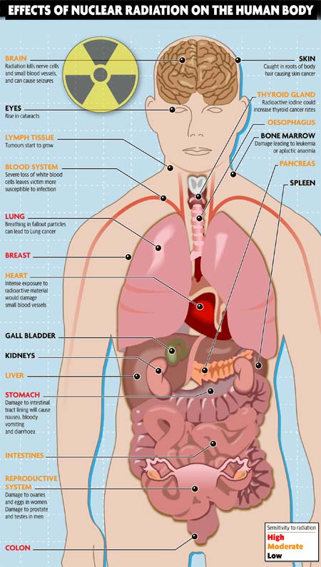
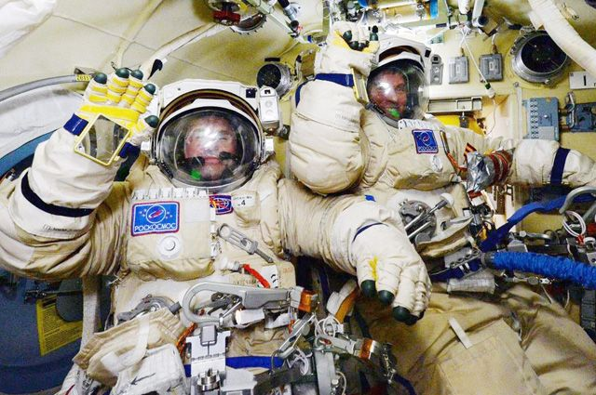
Radiation effects on organs and CNS during the cosmic flight
stress and psychological changes
space adaptation syndrome
muscle atrophy
bone loss
cardio-vascular problems
immunity changes
skin problems
changed sleep patterns
changes in microflora
digestive problems
motion sickness
water retention, kidney function lowers
cancer + cataract risk
changes in brain activity, decreased neurogenesis, altered neuron morphology
reduced neuronal connectivity, oxidative stress, onset of neurodegenerative diseases…

Slide 24
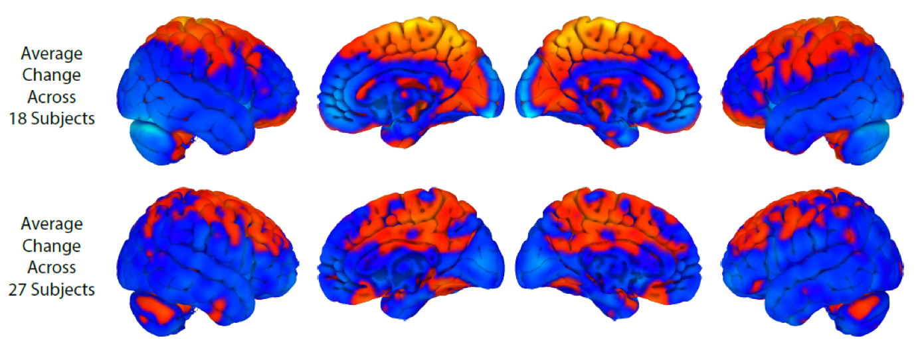
The structural brain changes in astronauts
MRI scans from 27 astronauts,
NASA Lifetime Surveillance of Astronaut Health
Koppelmans et al., 2016

Slide 25
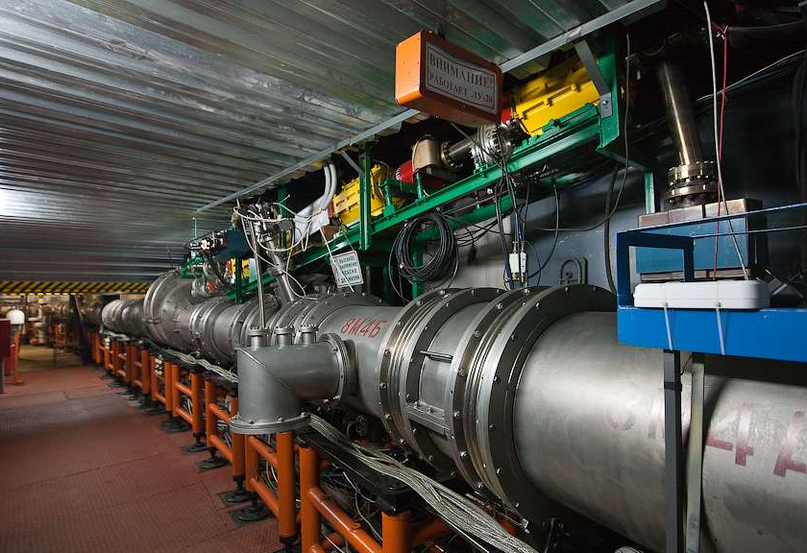
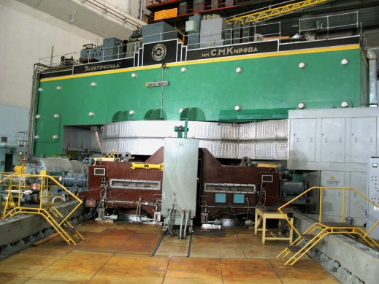
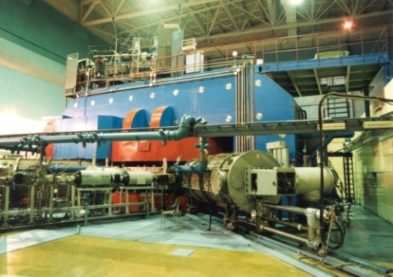
Accelerators in radiation medicine
Nuclotron, ¹²С 500 MeV/amu
Phasotron, protons 170 MeV
U-400M, up to 50 MeV/u Li, B, Ne ions

Slide 26
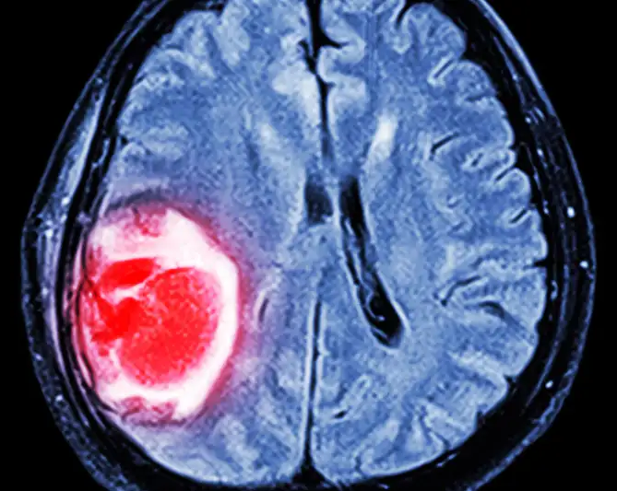
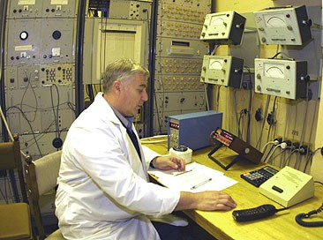
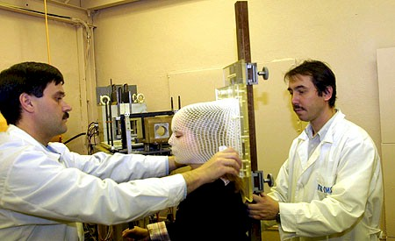
Radiation therapy
Tumor
Medical and Technical Complex of JINR

Slide 27
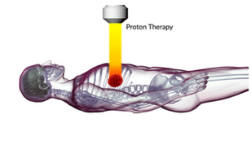

Slide 28
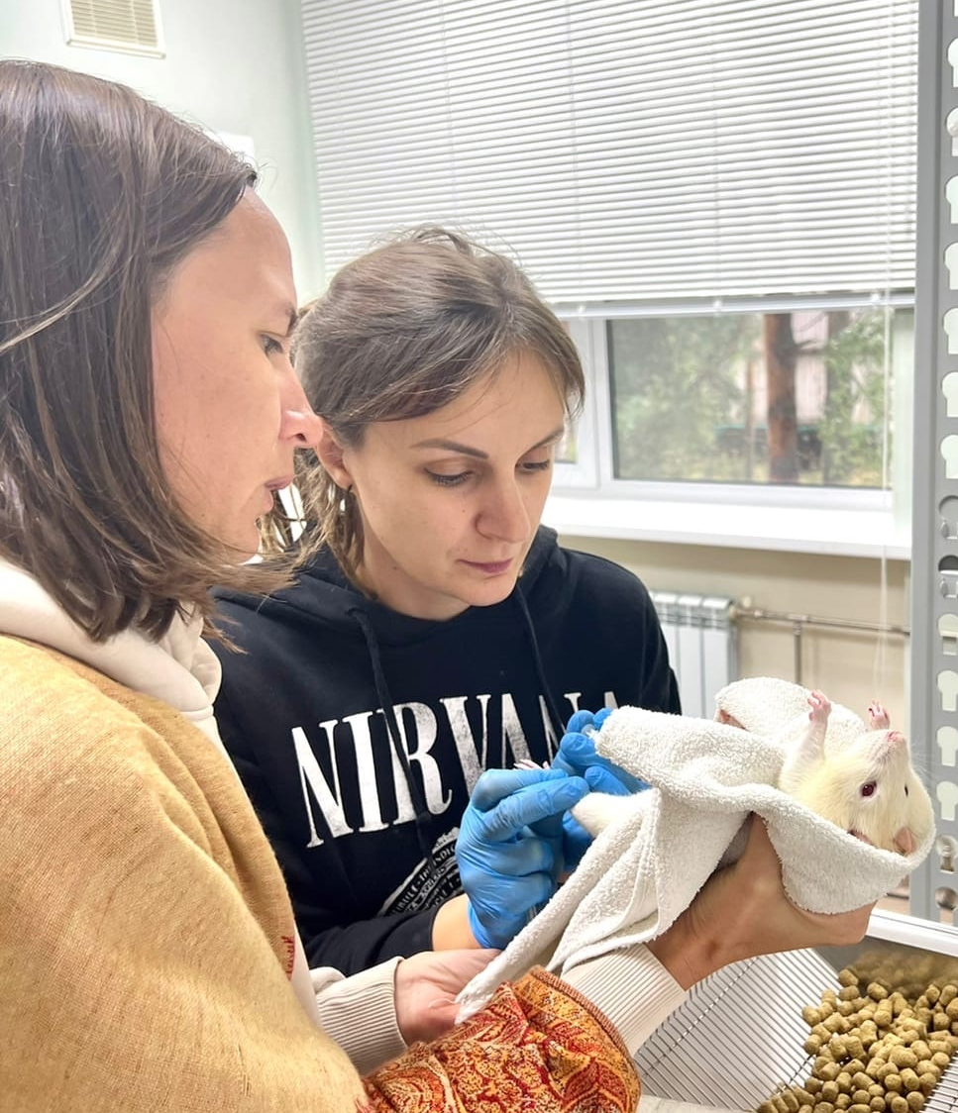
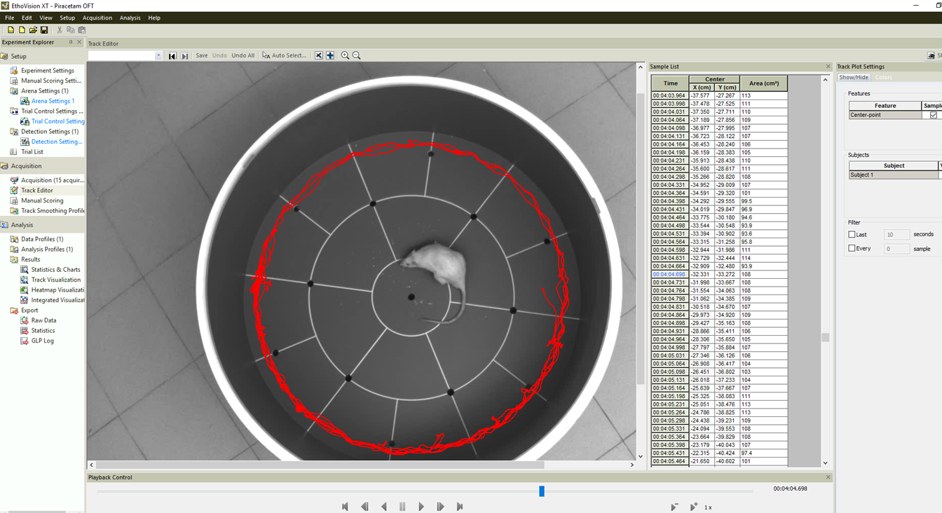
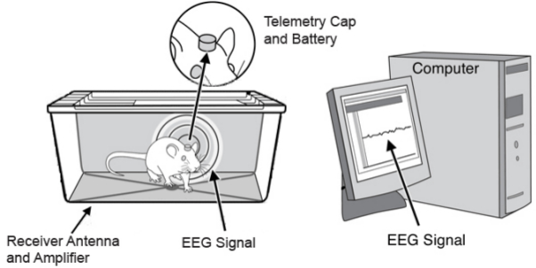
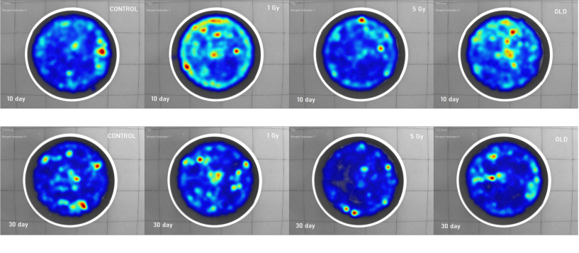
Radiation Physiology
Study of behavioral reactions and memory changes after IR
Open field
Т - maze
Morris water maze
Barnes maze
Video-tracking information system
wireless EEG system
Notes:
The next field of our research is RP, which is closely connected with space radiobiology. C N S is now considered as a critical system when evaluating the radiation risk during the manned deep space flights. Our lab performs large-scale animal experiments to evaluate the radiation induced damage to brain structures, the mechanisms of CNS disorders, and new drugs which can prevent them. And of course, the top priority research is the irradiation of monkeys performed in collaboration with leading Russian experts in this field. The main goal is to simulate manned deep space flight conditions at accelerators of heavy ions.

Slide 29
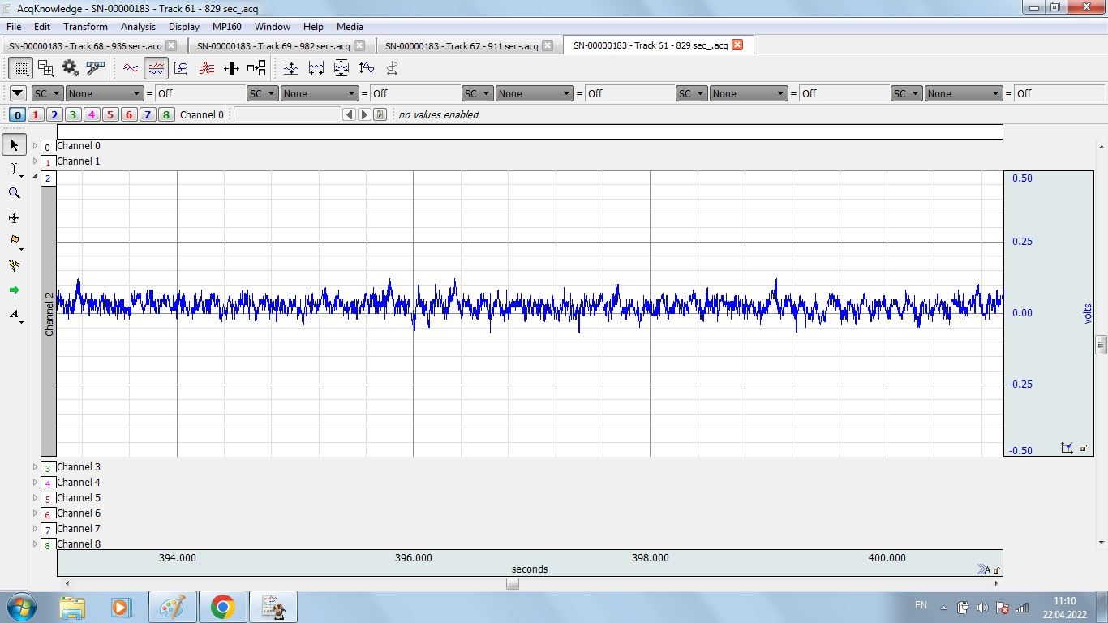
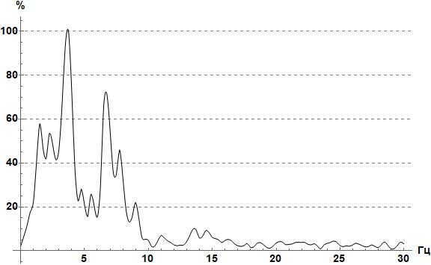
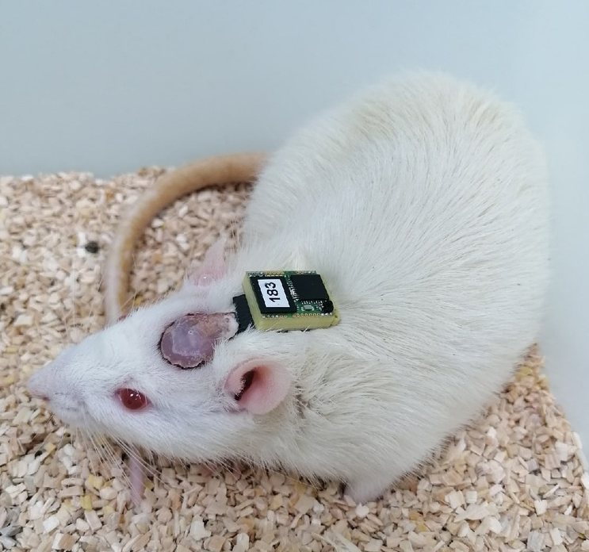
Electroencephalogram (EEG)
- recordings and analyses of brain activity

Slide 30
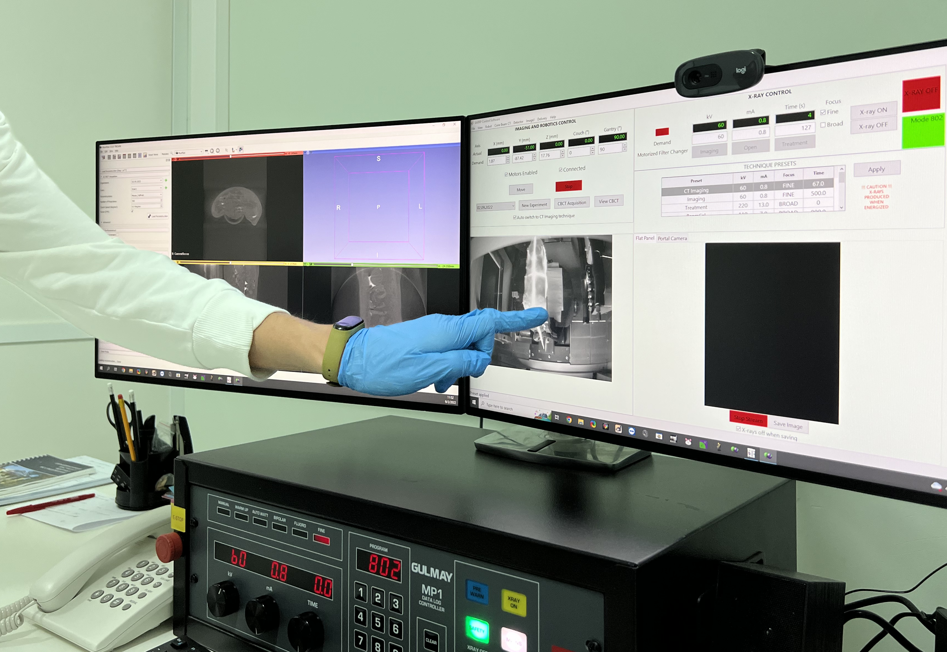
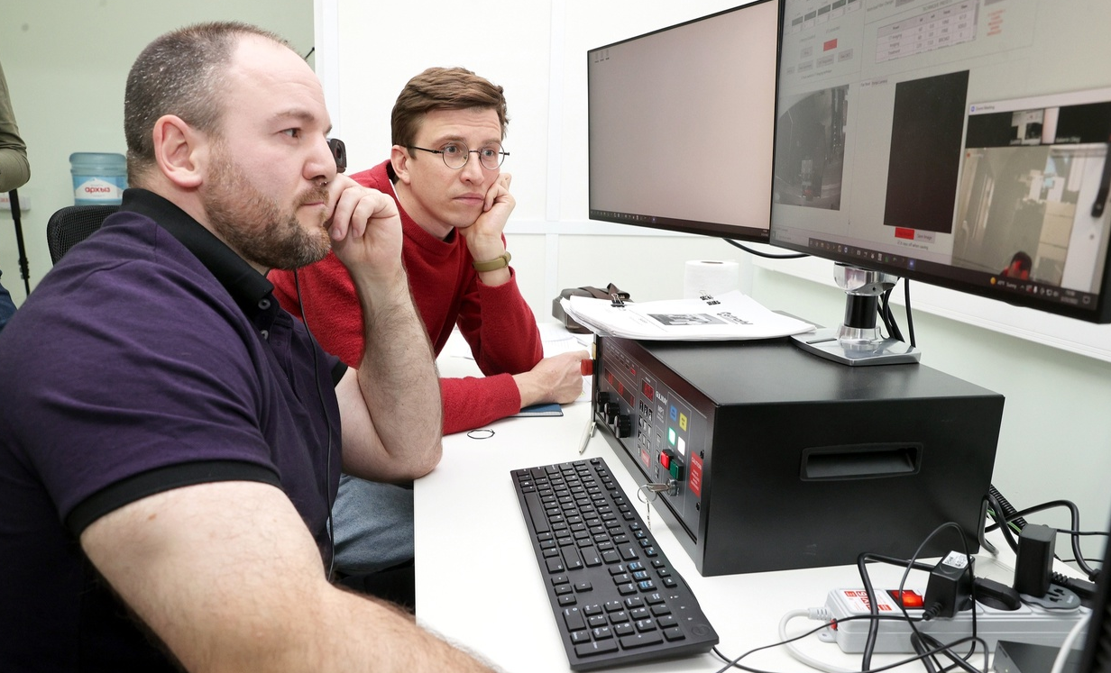
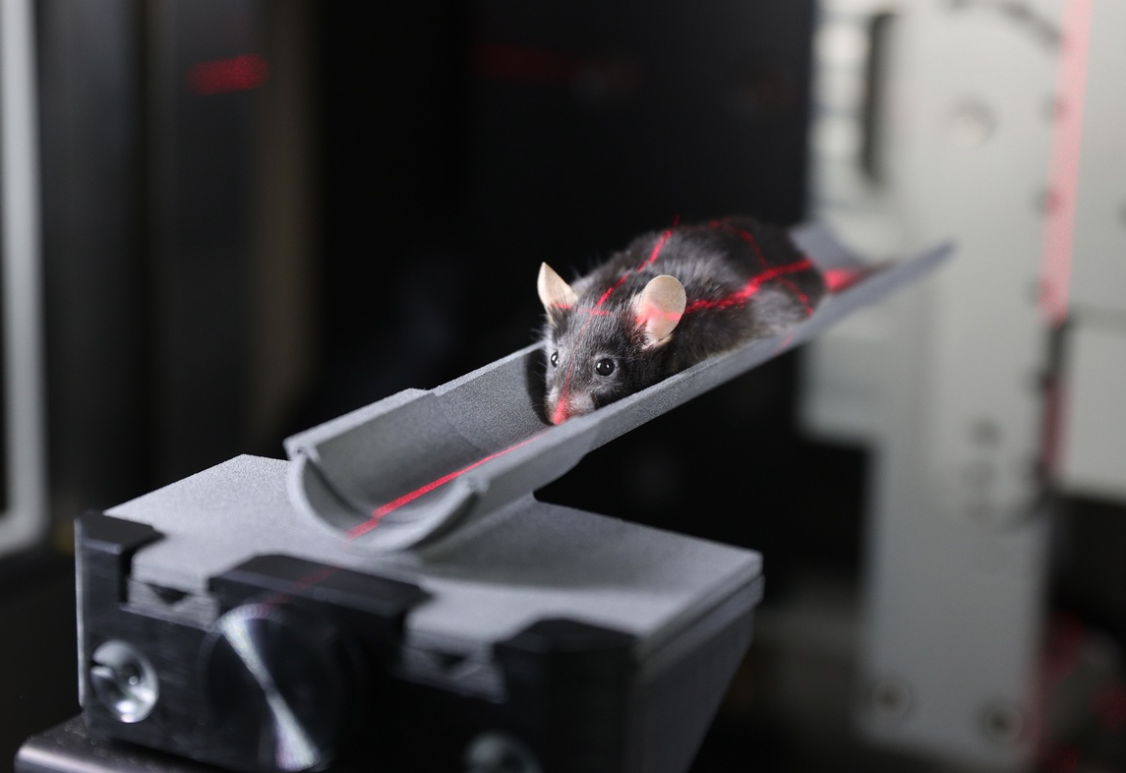
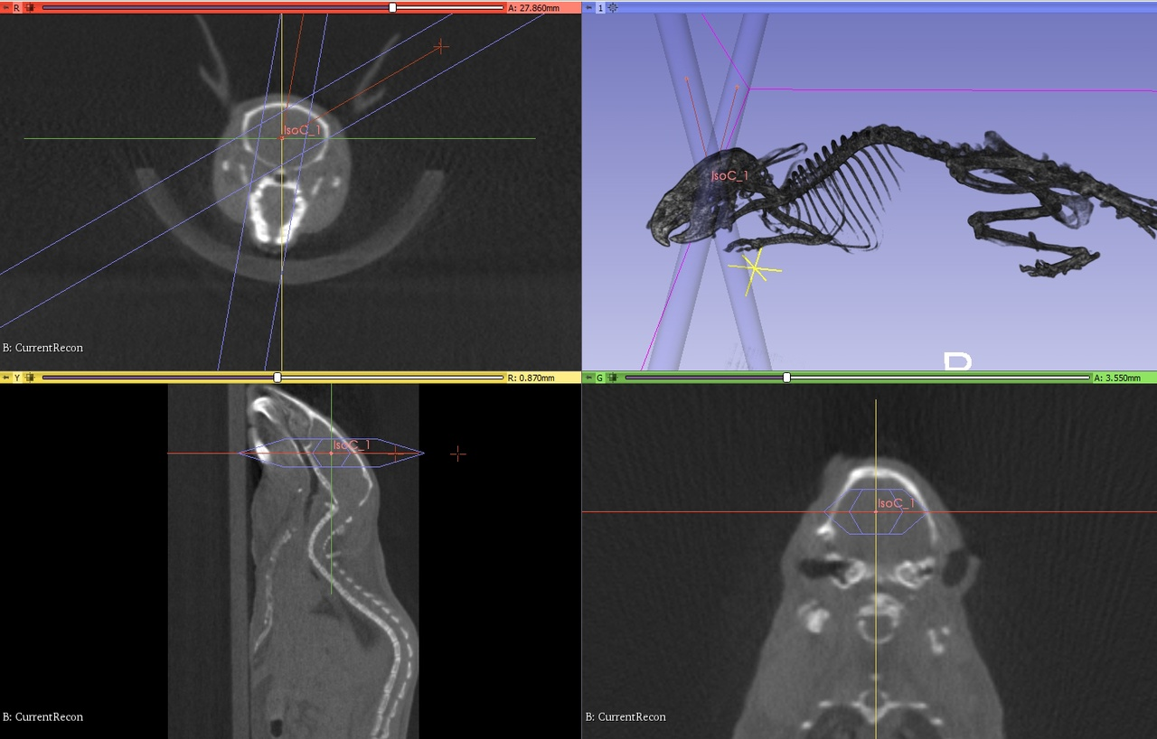
Computerized Tomography (CT)
Notes:
scan combines a series of X-ray images taken from different angles around your body and uses computer processing to create cross-sectional images (slices) of the bones, blood vessels and soft tissues inside your body. medical imaging technique used to obtain detailed internal images of the body

Slide 31
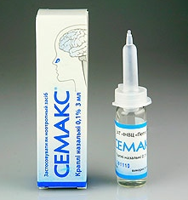
Medicinal agents in experiments
Piracetam-like Nootropics
2-oxo-1-pyrrolidine acetamide
Semax – 0.1% neuropeptid, Met-Glu-His-Phe-Pro-Gly-Pro
Cerebrolysin
Ginko Biloba based drugs

Slide 32
Pharmacological approaches of neuroprotection
Effect of piracetam after fractional gamma irradiation
(60Co; 0.5 Gy per fraction in a total dose of 5 Gy)
Severyukhin, Yu.S., Lalkovičova, M.*
et al. 2021

Slide 33
In search for new neuroprotective agents effective against radiation damage of CNS
Lalkovičová M (2022)

Slide 34
Clinical Radiobiology
A new promising method for cancer therapy:
increasing the biological effectiveness of γ- and proton radiation by special drugs
Induction of DNA damage in human cells (in vitro experiments)
DNA synthesis inhibitor
Ara C, cytarabine
without Ara C
with Ara C
15-fold increase of proton beam efficiency by DNA synthesis inhibitors
Protons 1.25 Gy with Ara C
Protons 1.25 Gy
¹¹B ions 1 Gy
Number of γH2AX/53BP1 foci/cell
AraC + IR
Time, h
Notes:
A new promising method for cancer therapy was invented in our Lab. It is based on the increase of the biological effectiveness of gamma and proton radiations by the special modifying agents (drugs). In vitro experiment revealed the sharp increase of DNA damage in the presence of these agents. And in recent experiments on animals with inoculated melanoma tumor the higher effectiveness of medical proton beam was also demonstrated.

Slide 35
Approaches to increase the efficiency of particle therapy Boron Neutron Capture Therapy
Selective accumulation of boron-containing drug in tumor cells, for example, using "vector" technologies;
Formation of a field of thermal neutrons with a high flux density in the tumor zone;
the destruction of the tumor cell but neighboring cells are not affected

Slide 36
Thank you!
“Everything is theoretically impossible, until it is done.” Robert A. Heinlein

