Slide 1


Deep neural networks and their application at JINR
AYSS-2022, XXVI International Scientific Conference of Young Scientists and Specialists, Laboratory of Information Technologies, JINR, Dubna, Russia, 24 - 28 October 2022
Gennady Ososkov
Laboratory of Information Technologies,
Joint Institute for Nuclear Research
141980 Dubna, Russia
email: ososkov@jinr.ru
http://gososkov.ru

Slide 2
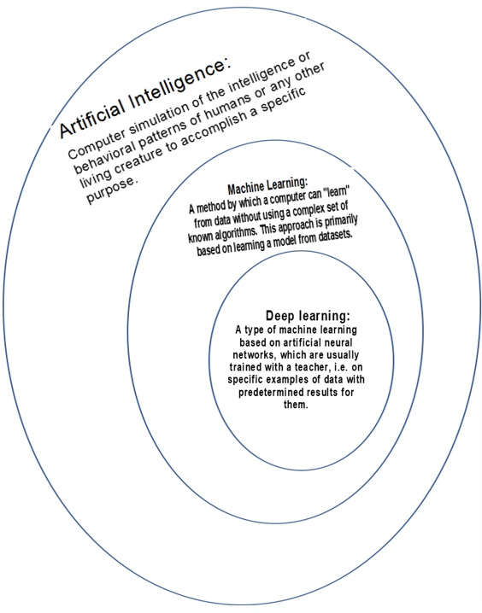
Machine and Deep Learning
Machine learning (ML) (in a sense a computer learning) is a type of artificial intelligence when a computer does not just use a pre-written algorithm, but itself learns to solve a given problem on a large sample of data.
Artificial neural networks (ANN) with their ability for learning and self-learning are one of effective tools of ML.
The label is the category that we are trying to predict. During training, the learning algorithm is supplied with labeled examples, while during testing, only unlabeled examples are provided.
Deep learning is the process of training such ANNs, which consist of several input, output and hidden layers, which allows to better simulate the processes being studied

Slide 3
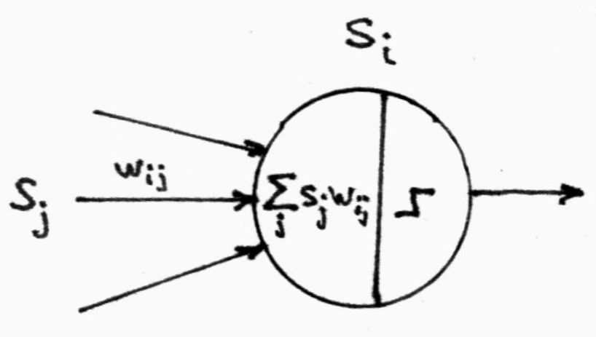
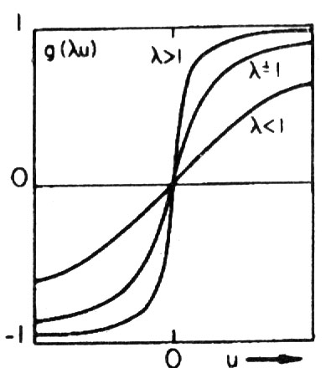
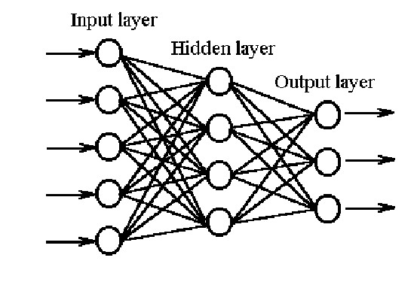
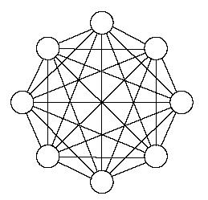
There are many ways to combine artificial neurons into a neural network.
Main types of neural nets applied in HENP for the time being
ANN formalism
Artificial neuron
Connection between i^{th} and j^{th} neurons is characterized by synaptic weight w_{ij}
the i-th neuron output signal h_{i}=g(Σ_{j}w_{ij} s_{j})
Activation function g(x). As usual, it is
sigmoid g(x)=1/(1+exp(-λx)), but not only
1. Feed-forward ANN. If there is one or more hidden layers it names as Multilayer Perceptron (MLP)
2. Fully-connected recurrent ANN
(Hopfield nets).
Supervised learning
Unsupervised self-learning

Slide 4
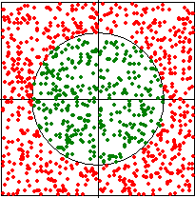
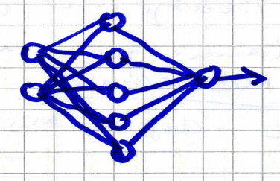


A simple example: train the network to determine whether a point is inside or outside the circle. A training sample of 1000 triples of numbers (X,Y, Z) - coordinates of point X,Y and a label Z (Z =1 - inside the circle or Z =0 - outside it). Solution: ANN with one hidden layer of 5 neurons, two input and one output
Secrets of Learning. What's inside ANN black box
To train ANN, the method of back propagation of errors is applied, when the error function of the network: E=Σ_{m}Σ_{ij} (y_{i} ^{(m)} – z_{i} ^{(m)} )² → min_{{wij} is minimized by all weights
$$\frac{∂E}{∂w_{ij}}=0$$
X
y
Thus, we must solve a system of 15 equations
with 15 unknown weights w_{ij} w_{jk}, which requires differentiability of the activation function g (x) that determines the output of each neuron
Choice of sigmoidal function
provides also a simple expression for its derivative.
h_{i}=g(Σ_{j}w_{ij} s_{j})
MLPs: 2-5-1, 15 weights only!
These derivatives are included in the formulas obtained by the anti-gradient descent for iterative (by training epochs) adjustment of weights. For output layer weights we have
and for the hidden layer where η is the convergence rate, which depends of the E surface. The network is considered trained when, at the training epoch t, the maximum learning error Е=max _{t,j} |y _{t,j} –z _{t,j} | decreases to the accuracy specified before
Although there is a great variety of neural packages available, but still, the choice of the structure of the ANN (number of hidden layers and hidden neurons), the choice of the activation, initialization of weights, - all this remains on the level of art or "magic". So in what follows I will try to give some hints on how to deal with this.

Slide 5
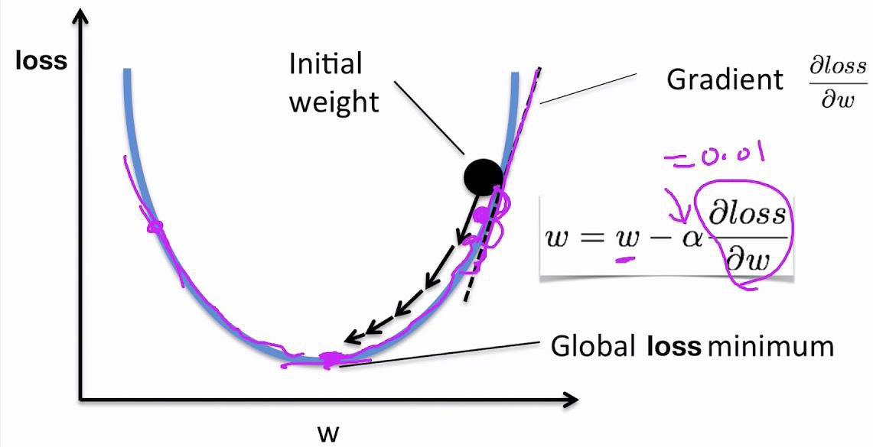
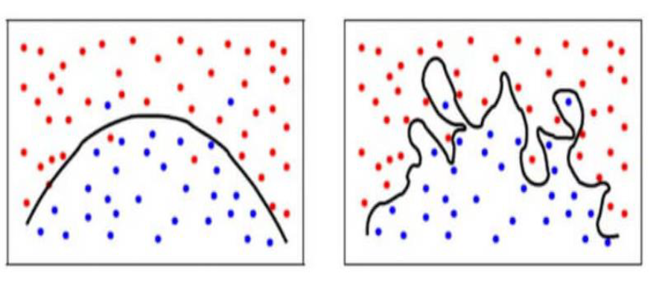
Minimization problems of the network error function
The common method of decision is the anti-gradient descent realized by the back-prop method
Iterative algorithms for finding the minimum of a multidimensional function using the fastest descent method require the following:
good choice of initial approximation: a choice of the interval of initial values (w0ij ,w0jk) cannot be taken arbitrary, initial weights should not be zero or too large, they must correspond to the problem.
optimal choice of steps in the parameter space or of the convergence rate η
There are many problems that arise when minimizing the loss function. The most common is overtraining caused by overfitting the result to the data, when an ANN with a surplus of hidden neurons solves the problem perfectly for the training sample data, but fails on the test data.
There are other problems, such as getting stuck at false minima or neural network paralysis.
We will talk about them and ways to solve them later
Correct classification overfitting

Slide 6
Why ANN are in demand in High Energy and Nuclear Physics (HENP)
Artificial neural networks are effective ML tools, so physicists accumulated a quite solid experience in various ANN applications in many HENP experiments for the recognition of charged particle tracks, Cherenkov rings, physical hypotheses testing, and image processing .
In particular, - MLP’s are quite popular in physics, moreover namely physicists wrote in 80-ties one of the first NN programing packages – Jetnet. They were also among first neuro-chip users.
Main reasons were:
after being trained ANN is one of the most appropriate tools for implementing many of data handling tasks, while on the basis of some new physical model physicists have possibility to generate training samples of any arbitrary needed length by Monte Carlo
For example, the highly relevant problem of selecting a small number of useful events in the megahertz data stream from modern track detectors, can be solved by using a very advanced hierarchy of intelligent triggers based on ANN.
development of TMVA - Toolkit for Multivariate Data Analysis with ROOT
Thus, there are many real problems solved on the basis of ANN in experimental physics as
- Object recognizing and classifying
- Statistical hypothesis testing
- Expert system implementing
- Approximation of many-dimensional functions
- Solution of non-linear differential equations
- etc

Slide 7
LIT Projects on the Use of Machine Learning in JINR Applications
Reconstruction of events from detector data - a key problem of experimental physics
Forecasting of the Atmosphere Pollution by Heavy Metals Using Space Images
Development of a cloud platform for detection and prevention of the agricultural plant diseases
Analysis of Fine Structure Properties in Mass Distributions of Nuclear Reaction Products
Development of the information system for radiation biology data storing and processing

Slide 8
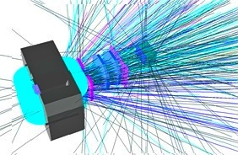
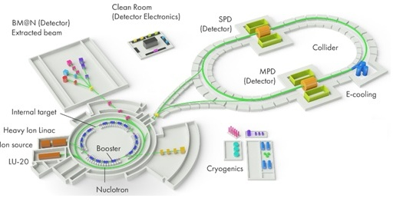
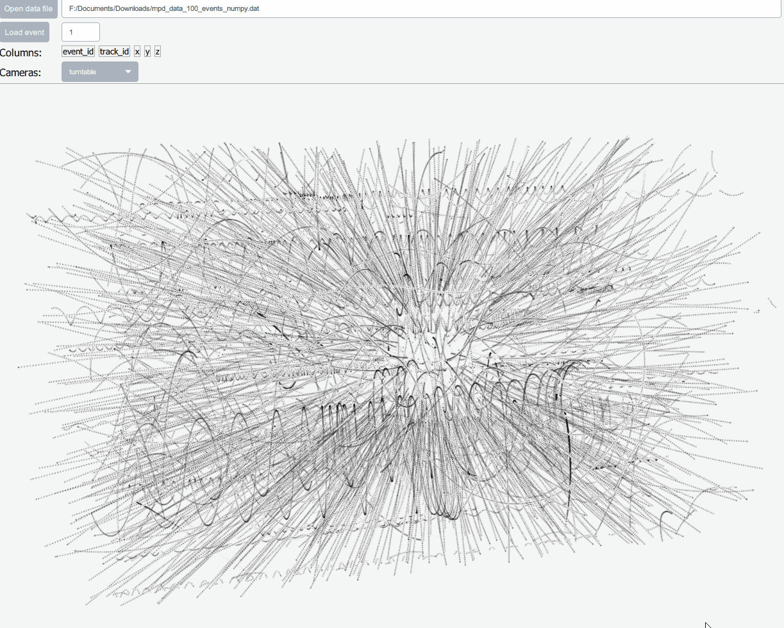
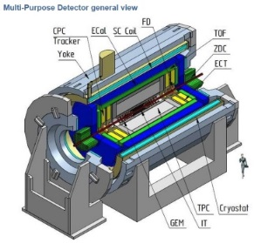
Experimental sources of measurement data
The main source of data at JINR is experimental high-energy physics (HEP)
NICA Megaproject at JINR
There are two types of HEP experiments - with fixed target (bm@n) and collider ones (MPD)
Experiment BM@N
Strip GEM detector
inside the magnet.
Simulated Au+Au event is shown
NICA performance forecast
Data transfer rate: 4.7 GB / s 19 billion events per year. After processing and analysis it gives 8.4 PB per year for storage
TPC track detector inside MPD magnet.
3D view of simulated event from the interaction of gold ions, generating thousands of tracks is shown
Scheme of the NICA complex with
experiments BM@N, MPD, SPD

Slide 9
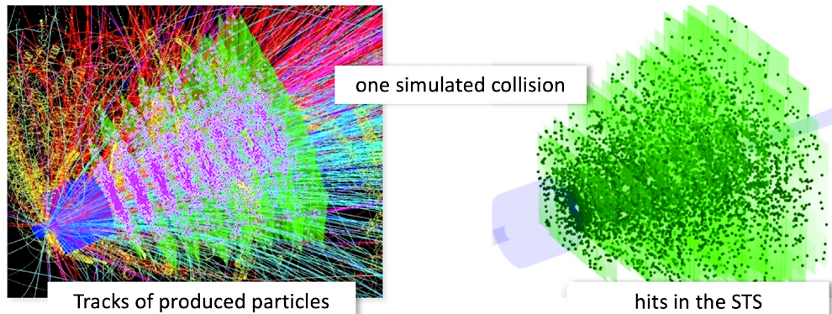
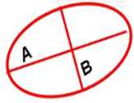
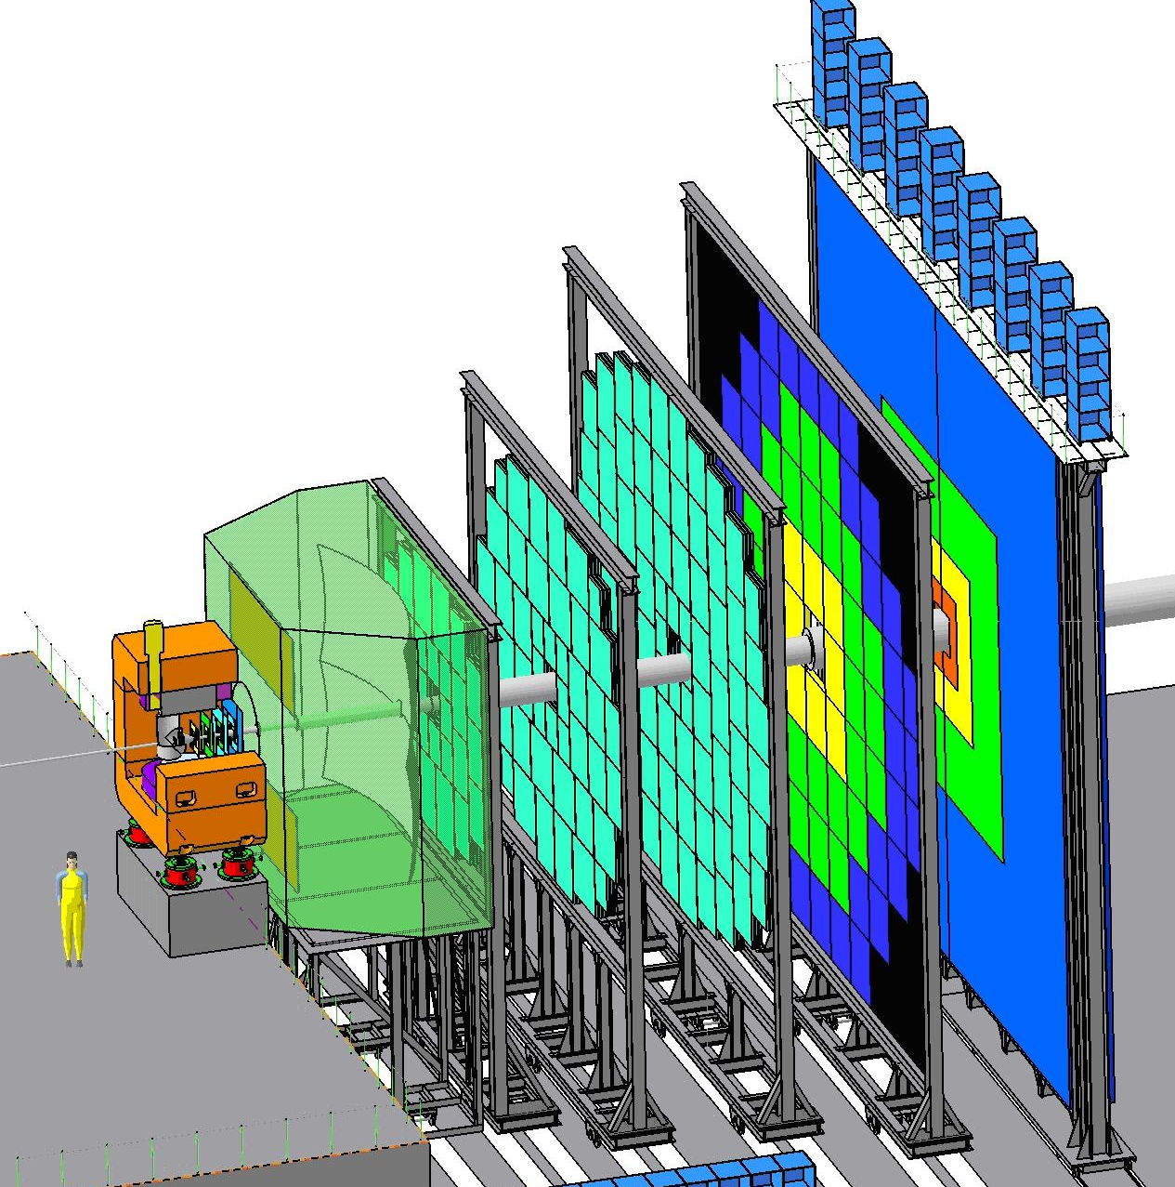
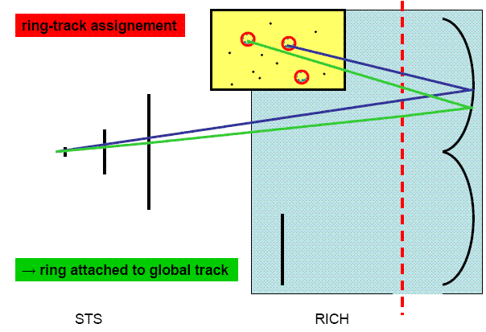
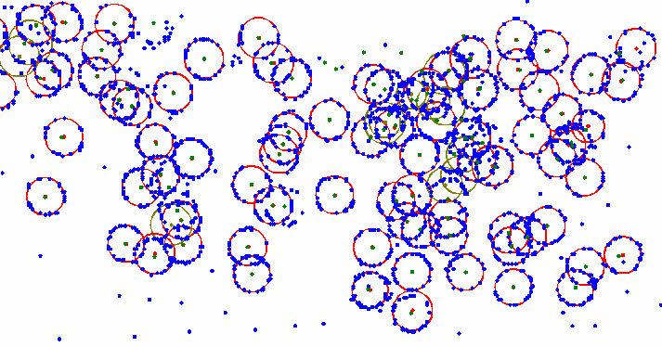
One more example of a HEP experiment
Condensed
Barion
Matter
СВМ experiment
(Germany, GSI, to be running in 2023)
Data rate:
10⁷ events per sec,
~1000 tracks per event
~100 numbers per track
Total: terabytes/sec !
ECAL
TOF
TRD
RICH
simulated event of the central Au+Au collision in the vertex detector
schematic view of the СВМ setup
Problems are to recognize all of these tracks and RICH rings and evaluate their parameters despite of their overlapping, noise and optical shape distortions lead to elliptic shapes of rings (ellipse fitting)
RICH – Cherenkov radiation detector, schematic view
A fragment of photodetector plane. In average there
are 1200 points per event forming 75 rings.

Slide 10
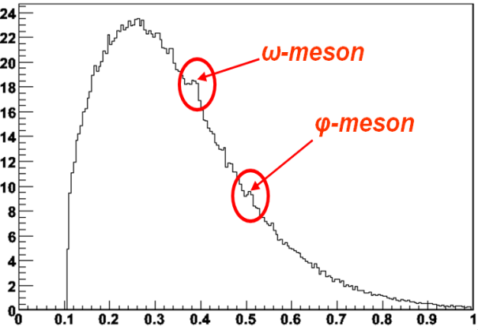

Data Analysis Chain in HEP experiments
Have to collect data from many channels on many sub-detectors (millions/sec)
Decide to keep a minority of useful events in memory or discard uninteresting events (Triggers of some levels)
Build the event (put info together)
Store the data
Analyze them
correct data for detector effects: calibration, alignment
  hit detection, tracking, vertex finding, revealing Cherenkov rings ,
  fake objects removing
  user analysis algorithms
  data volume reduction
do the same with a simulation!
  correct data for detector effects, deviations by coulomb scattering etc
Compare obtained results and theory
Invariant mass spectroscopy for short-lived particles
and resonances
  New inevitable issues of the WLCG and distributed computing era
  Grid-cloud technologies which changed considerably HEP data processing concept
  Parallel programming of optimized algorithms
  See Scientific data management in the coming decade
  https://dl.acm.org/doi/10.1145/1107499.1107503
Applied ML methods
Hough transforms,
cellular automata,
Kalman filter,
artificial neural networks,
robust estimation,
wavelet analysis, etc.
thanks to Anna Senger, CBM

Slide 11
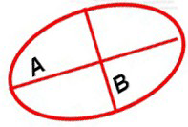
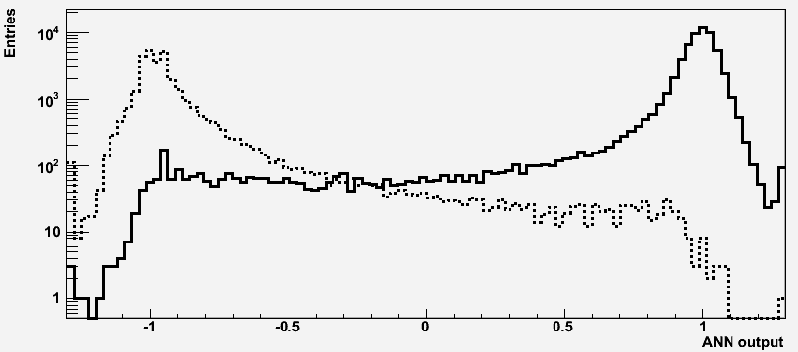
Example of a simple MLP application : RICH detector
It produces many Cherenkov radiation rings to be recognized with evaluating their parameters despite of their overlapping, noise and optical shape distortions.
In fact, it is a problem of choosing between two hypotheses.
It is solved with the help of two neural networks (NN)
The first NN selects the most significant characteristics of the obtained rings in order to remove false found rings,
The second NN performs particle identification among "good" rings
After careful study, the 9 most significant features has been chosen, such as number of points in the found ring, its distance to the nearest track, χ2 of ellipse fitting, both ellipse half-axes (A and B) etc.
The first 5 features were used to input into the first NN, which found good rings with 93% probability.
The second ANN had all 9 input neurons, 20 hidden and one output neuron and one output neuron.
Two samples with 3000 e (+1)and 3000 π (-1) have been simulated to train both ANN. Electron recognition efficiency was fixed on 90% Probabilities of the 1-st kind error 0.018 and the 2-d kind errors 0.0004 correspondingly were obtained
Cherenkov ring recognition is
the part of the more general event reconstruction problem
Identification of electron and pion rings
Elimination of fake rings
χ2

Slide 12



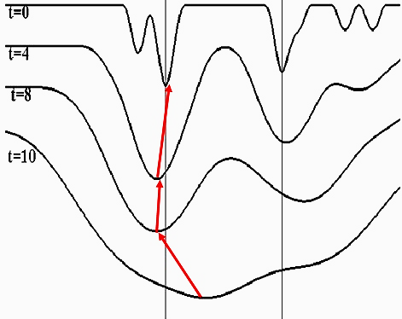
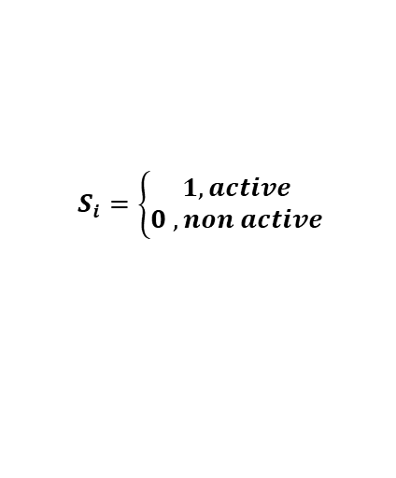
Fully connected recurrent neural networks
The recurrent fully connected NN considered as a dynamic system of binary neurons. All them are connected together with weights w_{ij.}
Hopfield’s theorem: the energy function
E(s) = - ½ Σ_{ij} w_{ij} s_{i} s_{j}
of a recurrent NN with the symmetrical weight matrix
w_{ij} = w_{ji}, w_{ii} = 0 has local minima corresponding to NN stability points.
$$S_{i}=\left\{\begin{aligned}1, active \\ 0 , non active\end{aligned}\right.$$
s_{i}
w_{ij}
s_{i}
However the usual way of E(s) minimizing by updating the equation system, which defines
the ANN dynamics: would bring us to one of many local minima.
Since our goal is to find the global minimum of E we have to apply the mean-field-theory (MFT). According to it, all neurons are thermalized by inventing temperature T, as λ=1/T and s_{i} are substituted by their thermal averages v_{i} = < s_{i} >_{T} , which are continuous in the interval [0,1]. Then ANN MFT dynamics is determined by the updating equation v_{i} =1/2(1+tanh(-∂E/∂v_{i} 1/T) =1/2(1+tanh(H_{i} /T),
where H_{i} = <Σ_{j} w_{ij} s_{j} >_{T} – is the local mean field of a neuron. Values of v_{i} are now defined the activity level of i^{th} neuron. Neurons with v_{i} > v_{min} determine the most essential ANN-connections
E
simulated annealing

Slide 13
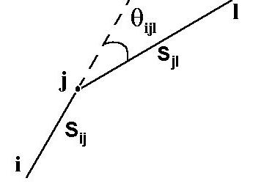

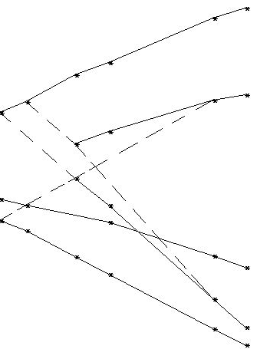
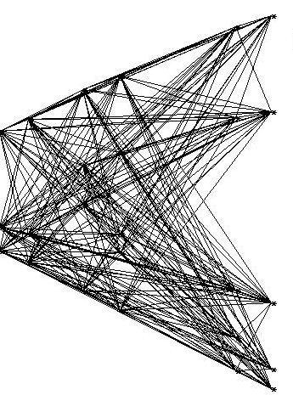
Recurrent ANN applications in HENP
Track recognition by Denby- Peterson (1988) segment model
The idea: support adjacent segments with small angles
between them. It is done by the special energy function:
Neuron s_{ij} is the segment connecting points i and j
E = E_{cost} + E_{constraint} , where
An easy example of the EXCHARM experiment with 6 multiwire proportional chambers registering a lot of hits from passing particle tracks and noise
w_{ijkl}
E_{constraint} punishes segment bifurcations and balances between the number of active neurons and the number of experimental points.
Note: adding even a single noise point would generate ~80 extra hampering neurons
After 30 iteration:
26 neurons with v_{ij} >0.5
Zero iteration: 244 neurons.

Slide 14
Preconditions and inevitability
of the deep learning appearance
Big Data era.
Technological achievements: HPCs, GPU, clouds.
Biological observations: The mammal brain is organized in a deep architecture, animal visual cortex perceive 3D objects.
Problems to be solved are now getting more and more complicated, so the ANN architecture needs to become deeper by adding more hidden layers for better parametrization to obtain more adequate problem modelling.
However in most cases deepening, i.e. the fast grow of inter-neutron links, faces the problem known as the “Curse of dimensionality”, which leads to overfitting or to sticking the minimized BP error function in wrong local minimum.
Hopfield NN could not also be effective enough in cases of noisy and dense events.
Challenge for deep neural networks and new methods of their training, ensuring high performance, parallelism and scalability of implementation.

Slide 15
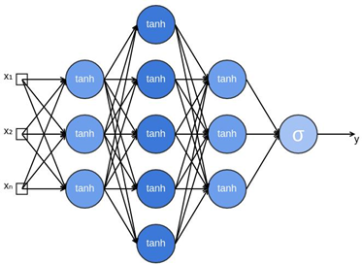
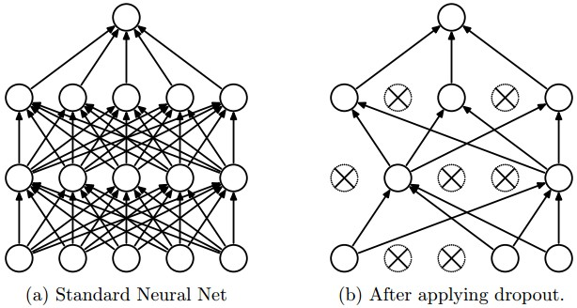
Brief intro to different types of deep neural networks and their training problems
    Multilayered feed-forward neural network
    Set the training sample (X_{i},Z_{i}). We initiate weights w_{ij}, select the activation function g(x) (usually sigmoid σ(x)) and train the network.
    Previous experience: to train a network to apply the method of back propagation of error, when the method of gradient descent for all weights to minimize a quadratic error function of the network: E=Σ_{m}Σ_{ij} (y_{i} ^{(m)} – z_{i} ^{(m)} )² → min_{{wij}}
    Emerging problems:
    curse of dimensionality
    overtraining
    getting stuck E in a local minimum
    vanishing or explosive gradient
    How to solve those problems
    Reducing the dimension of the network
    two methods:
    a drastic compression of the input data, because they are usually strongly correlated. Effective neural network method - autoencoder,
    Random decimation of neurons – dropout, when each weight is reset to zero with probability p or multiplied by 1 / p with probability 1-p. Dropout is used only for network training.

Slide 16
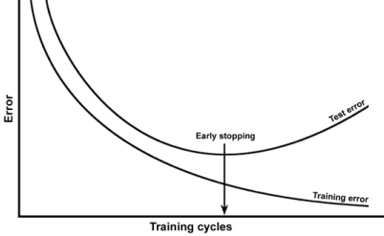

2) Overtraining of deep neural networks, how to avoid
Overtraining (overfitting) is unnecessarily exact match
of the neural network to a particular set of training examples, in which the network loses its ability to generalize and does not work on the test samples.
Correct classification overfitting
Often this problem occurs, if the network is trained with the same data for too long time, so the network fits too much to seen noise of data, and do not generalize well.
Simple solution – early stop of training.
In addition, retraining can be caused by an unnecessary complication of the model due to an excessive number of hidden neurons. Then one of the effective means is the same dropout.
More general is the regularization method that restricts the reaction of the neural network on the effect of noise by adding penalty to the member function of a network error
The coefficient λ should not be large and usually λ=0.001

Slide 17

3) Local minima of the network error function
To solve this issue, the method of
simulated annealing is used.
Stochastic gradient descent (SGD) is more known
method in which only one pass through the training data
is required, when the gradient value is approximated by the gradient of the error function calculated on only one training element, while the normal gradient descent on each iteration scans the entire training sample, and only then the weight changes.
Therefore, SGD works much faster for large arrays of data. The choice of learning point in SGD occurs randomly, but alternately from different classes, which also increases the probability to exit from the local minimum.
In order not to "miss" at these jumps by the wanted minimum, a member of "moment of inertia" type Δw_{i}=η•Gradw+α•Δw_{i-1} is added in the formula of updating weights.
All these features include the Adaptive Moment Estimation (ADAM) method, which implements SGD and, in addition, calculates the adaptive learning rate and optimizes the step size in parameter space.

Slide 18
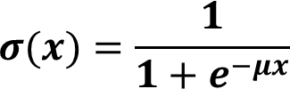
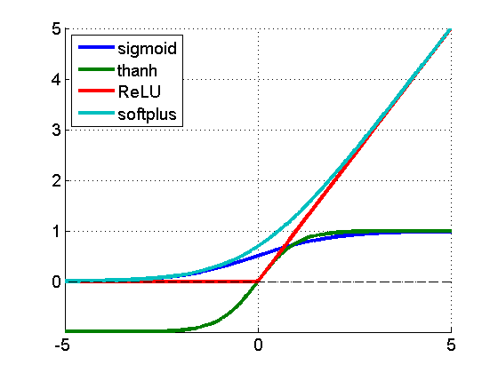
4) Vanishing or explosive gradient
The vanishing gradient problem is inevitably appeared in multilayer neural networks, especially in the case of the sigmoid activation function (note: σ'(x)≤¼; 0<x<1).
I
During BackProp training, an error is sent from the outputs to the input, distributed across all weights, and sent further down the network to the input. In this case, the gradient (derivative of the error) is running through the neural network back with many multiplications of σ'(x). When there are many layers in the neural network, the gradient in the layers close to the input becomes vanishingly small and the weights practically cease to change. It is a "paralysis of the network“
The opposite pattern is called "explosive growth of the gradient“. It happens when the weights were initialized with too large values.
To avoid a vanishing gradient situations you need to
choose the activation function correctly;
Rectified Linear Unit – ReLU: f(x) = max(0, x) is the most usable
use the correct initialization of adjustable NN parameters;
initial weights should not all be zero or just the same, you can not take them too large to avoid an explosive growth of the gradient.
K. He recommends initializing the weights of layer n_{j} with values normally distributed with mean 0 and variance 2/n_{j} ,
where n_{j} is the size of the previous jth layer
select the proper network error function.

Slide 19


Cross-entropy loss
So far we used a minimizing function of network error (loss function) of the quadratic form
E=Σ_{m}Σ_{ij} (y_{i} ^{(m)} – z_{i} ^{(m)} )², which according to mathematical statistics corresponds to the case, when errors, i.e. scatter of E function are distributed according to the normal law, which is not always true.
For problems of classification, for example, the result in the form of probabilities of that the object presented to the network belongs to this or that class, i.e. we need to estimate the probability that y_{i} ^{(m)} is different from z_{i} ^{(m)} . In this case, to estimate how close the predicted distribution p(x) is to the true distribution q(x), we use another loss function called cross-entropy
This formula also generalizes to the case of several classes in a natural way:
here q is the number of elements in the sample, l is the number of classes, and a_{ij} is the algorithm's response (probability) on the i-th object to the question of its belonging to the j-th class, y_{ij}=1, if the i-th object belongs to the j-th class, otherwise y_{ij}=0.

Slide 20
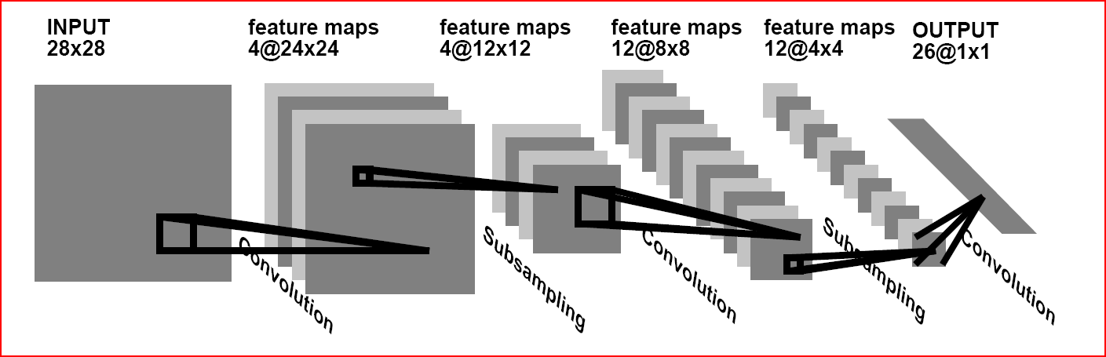
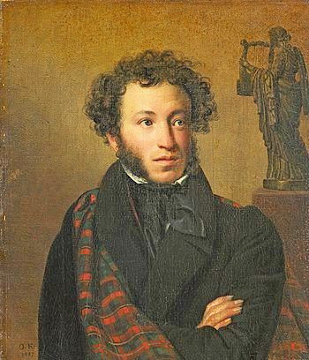
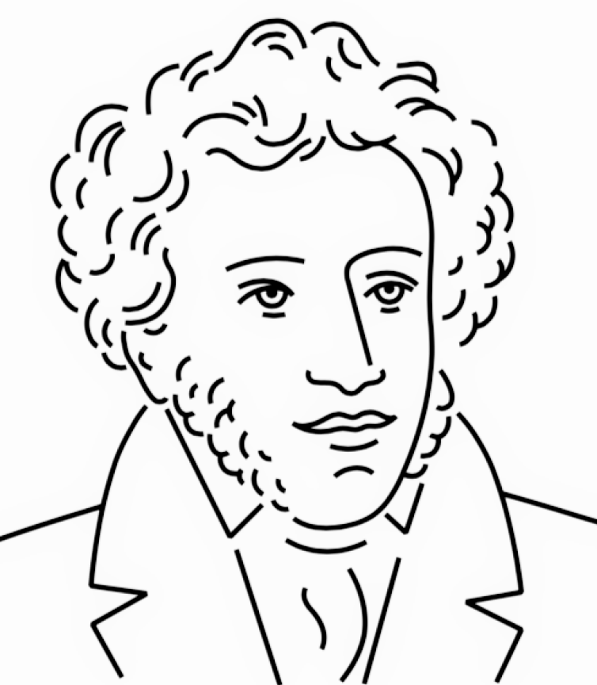
2. Convolutional Neural Networks for image recognition
Motivation:1. The learning time of multilayer perceptron's is very long
2. Direct applying regular neural nets to image recognition is useless because of two main factors:
(i) input 2D image as a scanned 1D vector means the loss of the image space topology; (ii) full connectivity of NN, where each neuron is fully connected to all neurons in the previous layer, is too wasteful due to the curse of dimensionality, besides the huge number of parameters would quickly lead to overfitting. Instead, neurons of Convolutional Neural Networks (CNN) in a layer are only connected to a small region of the layer before it producing a set of primitive features. They are informative enough for the reliable description every of image classes to be recognized. During training CNN learns how to distinguish individual classes according to the primitive features that convolutional filters create.
My explanation of how the convolutional neural network (CNN) works, can be made by an analogy with sketching.
Thus, the idea is to turn an image of many thousands of pixels into a small set of strokes - graphic elements of features, the sets of which are much easier and more confident to recognize. Any CNN with its convolutional and pulling layers performs just such transformations of images into feature sets, so then the output perceptron layer can classify them into several classes after being trained on training set of labeled images.
The input image of a person's face consists of thousands of pixels. However, if you draw it as a sketch with a few precise strokes, anyone will recognize this face.

Slide 21
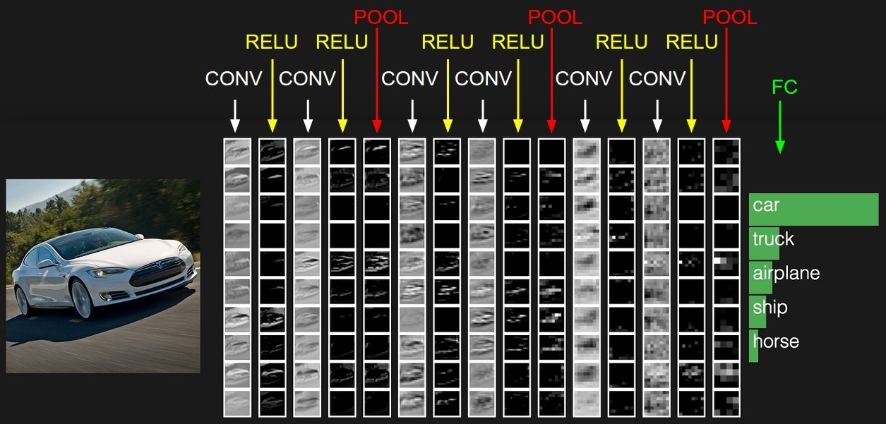
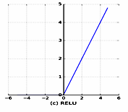
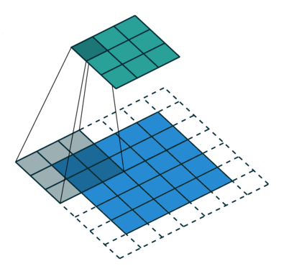
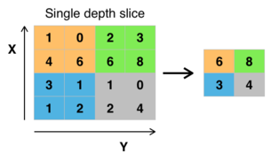
Basics of CNN architecture
The CNN architecture is a sequence of layers, and every layer transforms one volume of activations to another through a filter-convolution with the kernel.
There are three main types of layers to build CNN architectures: Convolutional Layer, Pooling (subsampling) Layer, and Fully-Connected Layer (just MLP with backprop). There are also RELU (rectified linear unit) layers performing the max(0,x)
Convolutional
layer
Activation: ReLU
Input or
feature map
Example of classifying by CNN
Each Layer accepts an input 3D volume (x,y,RGB color) and transforms it to an output 3D volume. To construct all filters of convolutional layers our CNN must be trained by a labeled sample with the back-prop method.
See in Russian https://geektimes.ru/post/74326/ or https://en.wikipedia.org/wiki/Convolutional_neural_network
Max pooling with a 2x2 filter

Slide 22

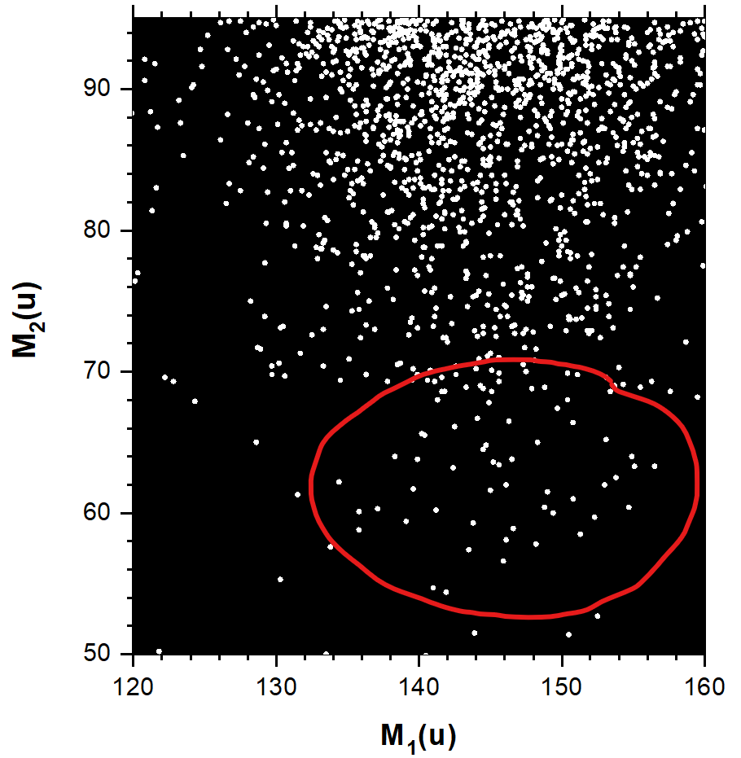
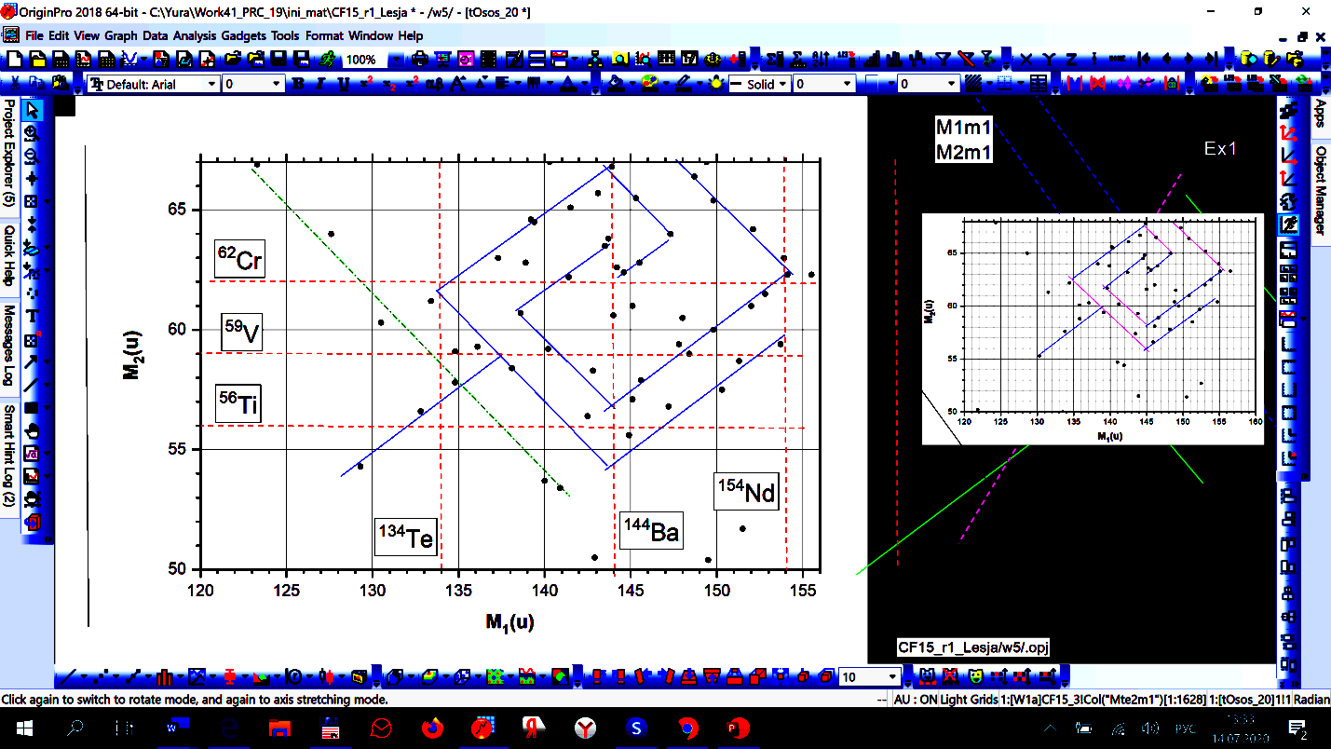
Data from Nuclear reactions: Californium ²⁵²Cf fission analysis
Example of CNN application-1
Mass-mass correlation plot of Californium spontaneous fission provided by the team of prof. Yu. Pyatkov
Note: the red dashed lines mark the masses of magic nuclei
Task: prove that this “Nuclear rose" is not a random set of points
Solution:
develop a numerical model of "rose"
create a dataset for training a convolutional ANN used as a neural-classifier
train a convolutional ANN-classifier to distinguish a set of noise points from the "rose" and to make sure that the probability of the wrong prediction of the “rose” among a set of noise points is negligible

Slide 23

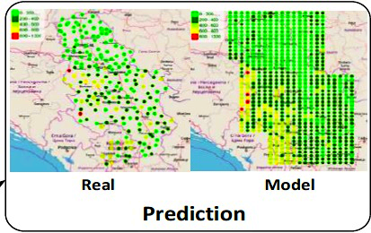
Two more NN application examples
Data from IBR-2 neutron pulced reactor and neutron activation analysis
The time series is to be predicted for the operational control of the reactor work
International Program for the monitoring and evaluation of effects of air pollutants on vegetation (ICP Vegetation).
Mosses are ideal absorbers of polluted air. Volunteers collect mosses in some places, send them to JINR for the neutron activation analysis to find out what kind of harmful substances pollute the air in a given area.
Task: extrapolate this data from discrete points of moss collecting on the surrounding area for each of the pollutant taking into account the specifics of the environment, such as wind and gutters directions
Solution: Data Management System (DMS) is developed at the JINR cloud platform providing its users with modern unified system of collecting, analyzing and processing of biological monitoring data. DMS allows organizing flexible data collection in respect to heterogeneity of raw data, automatic verification of imported
Liquid sodium flow rate through the core IBR-2M
Task: predict the liquid sodium flow rate through the core of the IBR–2M during a reactor operation
Solution: by applying nonlinear autoregressive neural network (NAR) with the lag n-44 for training and switching on feedback for predicting.
data, calculate its statistic parameters, geo-indexes and so on. Now more than 6000 sampling sites from 47 regions of different countries are presented at the DMS

Slide 24
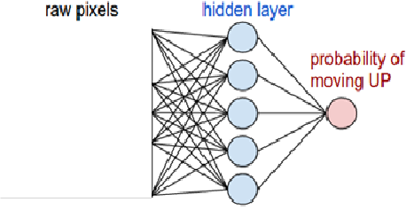
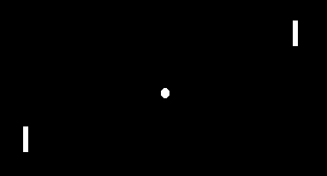
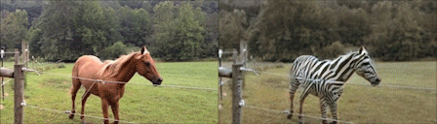
There are other types of deep neural networks
Recurrent neural networks. They contain feedbacks, which allow to store information. Particularly important among them are LSTM (Long Short-Term Memory) networks, which contain four interacting layers allowing to remove, store and change information from the previous state of a cell with the help of filters - gates. Using a simplified version of the LSTM - Gated Recurrent Unit (GRU), we were able to solve the problem of reconstructing the trajectories of elementary particles in the GEM detector of the BM@N experiment at JINR.
Reinforcement learning neural networks. They implement such reinforcement learning, when a neural network agent, being in some state, interacts with the environment, which rewards agent for his actions and informs which state the agent went to after that in order to increase the total reward.
Reinforcement learning application : robots, self-driving cars, trading bots for playing the stock market, chat bots that learn from dialogue to dialogue, game program development, etc
Generative Adversarial Networks (GAN). GAN implements an adversarial principle between a generative network and a discrimination network. The generative network G generates the most realistic sample, and the discriminative network D is trained to distinguish between genuine and fake samples
Example. Ping-pong game http://karpathy.github.io/2016/05/31/rl/
GAN applications: 1. obtaining photorealistic images and pictures;
2. creating movies and cartoons. 3. creating three-dimensional models of objects from projection images;
4. modeling complex physical processes in experimental physics detectors
The Danger of Dipfakes: Politics, Fraud, and Blackmail

Slide 25
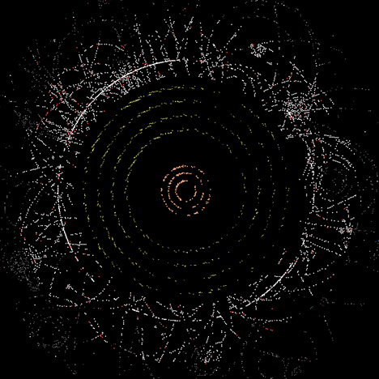
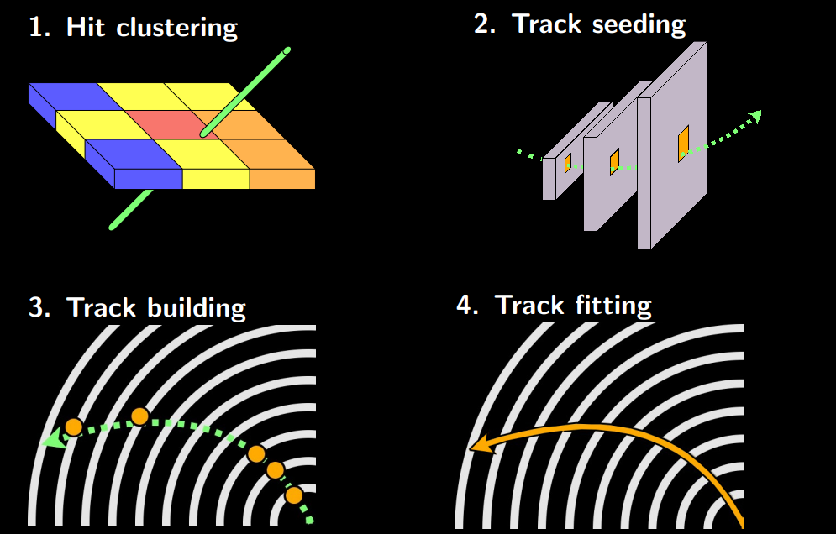
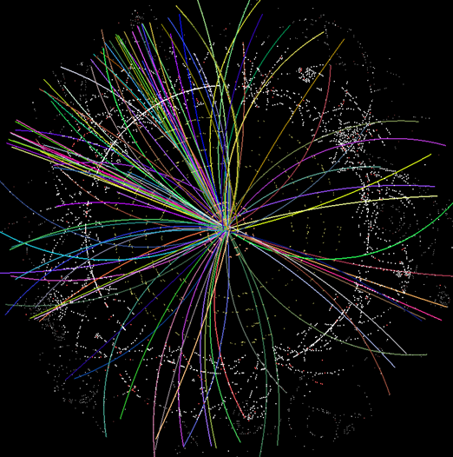
What is tracking?
Event reconstruction is the key problem of HEP data analysis
Event reconstruction consists on determination of parameters of vertices and particle tracks for each event. Traditionally tracking algorithms based on the combinatorial Kalman Filter have been used with great success in HENP experiments for years.
Tracking or track finding is a process of reconstruction the particle’s trajectories from data registered in high-energy physics detector by connecting the points – hits that each particle leaves passing through detector’s planes.
XY view of LHC run 2 event
After hit finding tracking includes phases of track seeding, building and fitting
This event after tracking

Slide 26
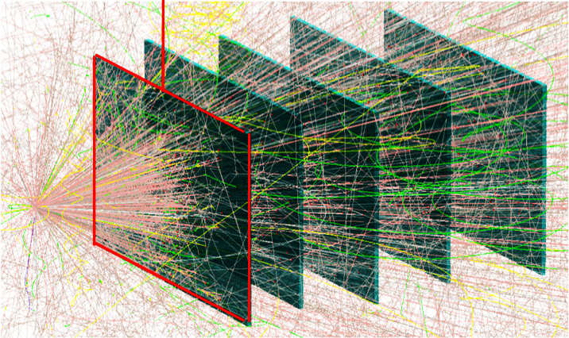
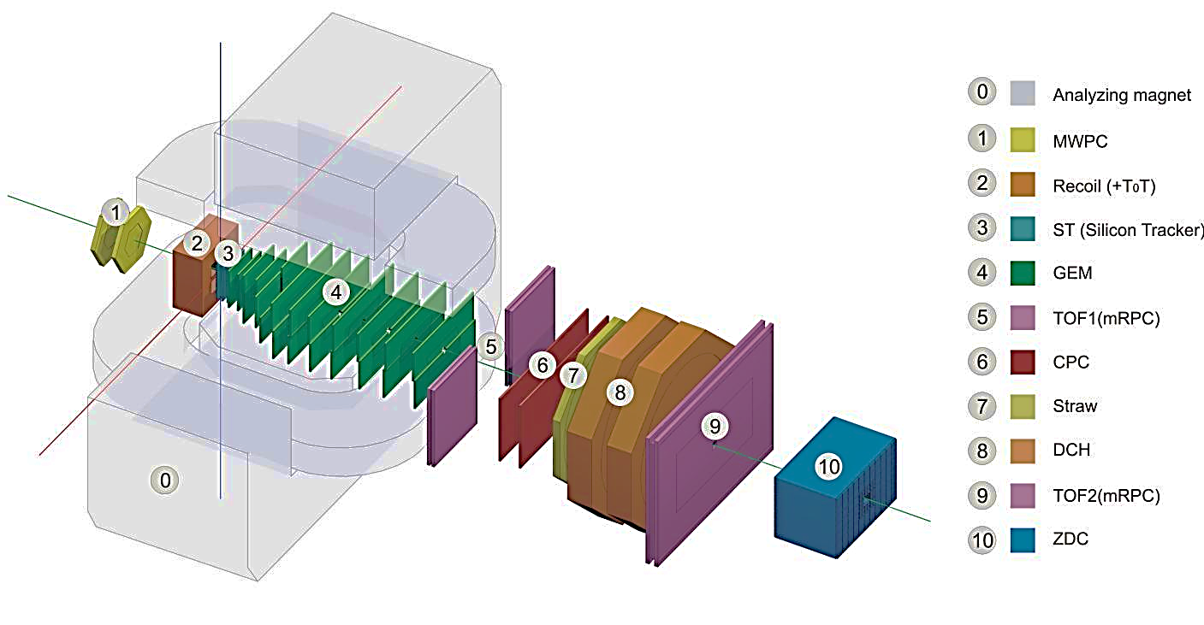

Baryonic Matter at Nuclotron (BM@N)
Consider the BM@N experiment with a fixed target, in which one event (Au + Au) generates thousands of tracks recorded by strip detectors. A passing particle activates close strips, determining one coordinate; to obtain the second, a second strip plane of the corresponding GEM detector camera is needed.
Two ways of data acquisition: pad or strips.
Pads –more precise, easier to handle, but expensive and brig matter to the chamber volume. Therefore, strips or wires are common
Visualization of simulated Au+Au event
BM@N setup with all detectors
Our problem is to reconstruct tracks registered by
the GEM vertex detector with 6 GEM-stations
(RUN 6, spring 2017) inside the magnet.
All data for further study was simulated in the BmnRoot framework with LAQGSM generator.
GEM scheme, electron avalanches and strip clusters

Slide 27






Problems of microstrip gaseous chambers
The main shortcoming is the appearance of fake hits caused by extra spurious strip crossings. For n real hits one gains ${\text{n}}^{2}$- n fakes
Real hit (electron avalanche center)
- Spurious crossing
One of ways to decrease the fake number is to rotate strips of one layer on a small angle (5-15 degrees)
in respect to another layer
- hit
3D image of the C+C event with 9 tracks. Black dots are fakes
- fake
Angle between strips 90 degrees,
Au-Au, 4 A·GeV
Angle between strips 15 degrees,
Au-Au, 4 A·GeV
Although small angle between layers removes a lot of fakes, pretty much of them are still left

Slide 28


Local and global tracking approaches
Tere are two approaches to implement any tracking procedure:
Local tracking, when tracks are reconstructed one after the other, as in KF algorithm.
Drawbacks,- slow, no way to see the dependence between individual tracks or groups of tracks and such phenomenon as secondary vertices, the need to realize the next stage for looking the even vertex.
Global tracking, in which the recognition of tracks among noises is performed immediately across the entire picture of the event
1. Local tracking for the GEM detector of the BM@N experiment is especially difficult because of the giant number of fake hit presence, which makes it extremely difficult to search for those hits at subsequent detector stations that are a continuation of the track being processed.
However the flexibility of the recurrent neural net construction allowed us to overcome these difficulties by inventing the new network which combine both steps in one end-to-end TrackNETv2 with the regression part of four neurons, two of which predict the point of the center of ellipse on the next coordinate plane, where to search for track-candidate continuation and another two – define the semiaxis of that ellipse.
It gives us the opportunity to train a single end-to-end model using only true tracks, which can be extracted from Monte-Carlo simulation.
So we got the neural network performing track following like Kalman filter, although without its track fitting part
Scheme of the recurrent TrackNETv2
neural network
See https://doi.org/10.1063/1.5130102

Slide 29

2. Global tracking approach
Global recognition of tracks among the noises is carried out at once over the entire picture of the event.
The GraphNet program is based on the use of graph neural networks for tracking. An event is represented as a graph with hits as nodes, and then this graph is inverted into a linear digraph, when the edges are represented by nodes and the nodes of the original graph are represented by edges. In this case, information about the curvature of track segments is embedded in the edges of the graph, which simplifies the recognition of tracks in the sea of fakes and noises See http://ceur-ws.org/Vol-2507/280-284-paper-50.pdf
During training, the network receives as input a reverse digraph with labels of true edges - segments of real tracks.
The already trained neural network RDGraphNet (Reversed Directed Graph Neural Network,), as a result, connects each edge with the value x ϵ [0,1] at the output.
True track edges are those edges for which x is greater than some given threshold (> 0.5).
Note that, in contrast to the local neural network TrackNETv2, measured its productivity in tracks/sec, the productivity of the global neural network RDGraphNet is measured in the number of recognized events per second, which is very important for a large multiplicity of events.
Graphical representation of the C + C, 4 GeV event of the BM@N experiment. Black nodes and edges correspond to fakes, green nodes and yellow edges - found tracks

Slide 30




How to evaluate tracking results
The first naive estimation of tracking efficiency by the percentage ratio of found tracks to the total number of track-candidates (accuracy) is useless and even dangerous, since our sample is very unbalanced, and among track-candidates there may be too many false ones, formed from noise samples and pieces of different tracks. So among recognized tracks one has real tracks, but besides them there are also mistakenly recognized as tracks, although they are false (ghosts)
here $N_{true}^{rec}$ - is the number of real tracks found by the model;
$N_{in}$ - the number of all real tracks known from Monte Carlo simulation;
$N^{rec}$- the number of all tracks that the model reconstructed as real tracks.
In essence, it is a general question about the criteria for testing the correctness of hypotheses, main and alternative. There are two kinds of classification errors: FP and FN. In statistics, FP is called a first-order error, and FN is a second-order error.
One way to evaluate the model as a whole is AUC-ROC (or ROC AUC) - Area Under Curve, which is the Receiver Operating Characteristic curve.

Slide 31

Beyond of the field of physics
The era of Big Data has now embraced all areas of science and applications: biology, economics, medicine, etc. So the general demand for new data processing techniques such as deep learning has inevitably become urgent in these areas as well.
However, the almost fatal difference between these areas from physics lies in the absence of a replaced physical "standard model" that allows generating training samples of any desired length for reliable training of the developed deep neural networks.
The lack of labeled data for training becomes one of the main problems. In addition to the lack of theoretical prerequisites, the limited set of training data is explained by both the high cost of the experiments themselves and the cost of the work of experts who mark up the data obtained.
Let us take as an example the problem of some CNN agriculture applications
Disease detection on the plant leaves by deep learning
One can see our article DOI: 10.1007/978-3-030-01328-8_16 for details, where the web platform http://pdd.jinr.ru is decribed, which allows users to send photos and text descriptions of diseased plants through this web portal or mobile application and find out the cause of the disease.
Although there are many mobile applications for plants disease detection, as for example, famous plantix.net, but none of them allowed us to get a dataset suitable for use for us. We had to create our own, to work with photographs obtained in real conditions. To overcome the lack of labeled data obstacle we use a Siamese CNN with a special triplet loss function and a perceptron, as a classifier in the output layer, that shows 98% of accuracy for 25 classes of five crops.

Slide 32


Object detection is an important aspect of interacting with the environment
The philosophy of YOLO (You Only Live Once) - the desire to fulfill desires and enjoy right now, without giving it up for the sake of future prosperity.
YOLO (You Only Look Once) is a state-of-the-art deep learning algorithm that is widely used for object detection. It is so called because it involves inputting the entire image at once, which passes through the convolutional neural network (CNS) only once.
That is why it very quickly recognizes objects in real time. For detection, the image is divided into cells. A conventional CNN looks at the presence of an object in each cell many times, while in YOLO it is done only once. Several rectangles of different shapes are drawn around the cell to identify the object, and their positions, width and height are calculated relative to the center of this cell. After that, a special block analyzes all the possible rectangles and chooses the union of those where the object fits best (see https://habr.com/ru/post/514450/ ).
The YOLOv3 algorithm was trained on a dataset "Coco" consisting of 80 different classes

Slide 33


Deep learning needs a supercomputer
Test runs of deep tracking programs on the GOVORUN supercomputer and the HybriLIT cluster make it possible to evaluate the computing power gain of a special GPU with tensor cores compared to a conventional CPU and to optimize the sharing of resources between the training and validation parts of the tracking program.
The training part of any deep neural net performance is considerably more time consuming than its testing one.
The sequential nature of RNNs and the specific shape of input data make it reasonable to
execute training with the CPU, while
testing and then routine usage - on GPUs.
For example, the real inference productivity of TrackNETv2 after its training is over 2.5 millions of track-candidates per sec on GOVORUN GPU Tesla V100 what is 34 times faster than 71 thousands of track-candidates per sec on GOVORUN CPU Intel Xeon E5-2695.
RDGraphNet performance is ~ 980 events per second on the Tesla V100 versus ~ 31 events per second on the CPU processor, which means a 30x speedup.

Slide 34

Future of tracking
Particle track reconstruction in dense environments such as the Run-4 detectors of the CERN High Luminosity Large Hadron Collider (HL-LHC) as well as MPD NICA is a challenging pattern recognition problem.
To achieve such high luminosity, the particles are not accelerated individually, but in bunches, so that the moments of collisions occur so close to each other that the tracks of all these events overlap strongly.
For the SPD experiment, in which events are expected to arrive with a frequency of 3 MHz, the data acquisition is supposed to be performed in time slices, during one time slice with a length of 10 ms up to 40 events with totally 200 overlapping tracks may appear.
Of the entire stream of events, only a few percent are of interest to physicists.
Therefore, it is necessary to develop an intelligent online filter to sift out uninteresting events

Slide 35

Bunch collision
~15 cm
many p
many p
Current situation: 20 parasitic collisions
High Lumi-LHC : 200 parasitic collisions

Slide 36

3D viev of many thousands hits of a dense environment event
Deep tracking of such highly overlapping events awaits your enthusiasm!

Slide 37
Conclusions
Evolution of various HENP applications of artificial neural networks shows their remarkable power and flexibility in the solution of such important problems as physical object recognizing, classifying, testing statistical hypothesis.
Impressive results achieved by the deep learning network family are obtained due to their new architecture, as well as initialization and training mechanisms
Data analysis problems in HENP, especially tracking, are eagerly waiting for new deep learning approaches

Slide 38

Thanks for your attention!
Notes:
38

Slide 39


From Kalman filter to deep tracking
The Kalman filter (KF) is an efficient recursive filter that estimates the state of a linear dynamical system using a series of imprecise measurements.
The state vector is iteratively evaluated to predict the position of the track on the next coordinate plane taking into account changes in
the covariance matrix and error corridors.
Iterative track-following
2D KF scheme
KF allows one to take into account the inhomogeneity of the magnetic field, multiple scattering and energy losses when a particle passes through the detector medium. KF extrapolates the initial state of the track (as a rule, the first three points) to a small area on the next coordinate surface. Therefore tracking algorithms based on KF have been used traditionally with great success in HEP experiments for years.
However, the initialization procedure needed to start Kalman Filtering requires a tremendous search of hits aimed to obtain so-called “seeds”, i.e. initial approximations of track parameters of charged particles.
Besides these techniques are inherently sequential and scale poorly with the expected increases in detector occupancy to the exabyte level in new conditions as for modern and planned experiments as HL-LHC or NICA.
Thus, a new approach to the reconstruction of physical events observed in experimental detectors is inevitably required. It should be implemented by new, an order of magnitude faster, parallel and highly scalable algorithms.
Deep learning algorithms bring a lot of potential to this problem due to their capability to model complex non-linear data dependencies, to learn effective representations of high-dimensional data through training, and to parallelize on high-throughput architectures such as GPUs.

