Slide 1
Raman Spectroscopy
in Life Sciences
Grigory Arzumanyan
Sector of Raman Spectroscopy, FLNP
Centre “Nanobiophotonics”

Slide 2
OUTLINE
Introduction in brief: Raman effect
2. Enhanced Raman microspectroscopy:
CARS – Coherent antiStokes Raman Spectroscopy
SERS – Surface-Enhanced Raman Spectroscopy
TERS – Tip-Enhanced Raman Spectroscopy
…
3. “CARS” microspectrometer at FLNP – description and
operating modalities
4. Examples of applications in Life Science
2
2

Slide 3
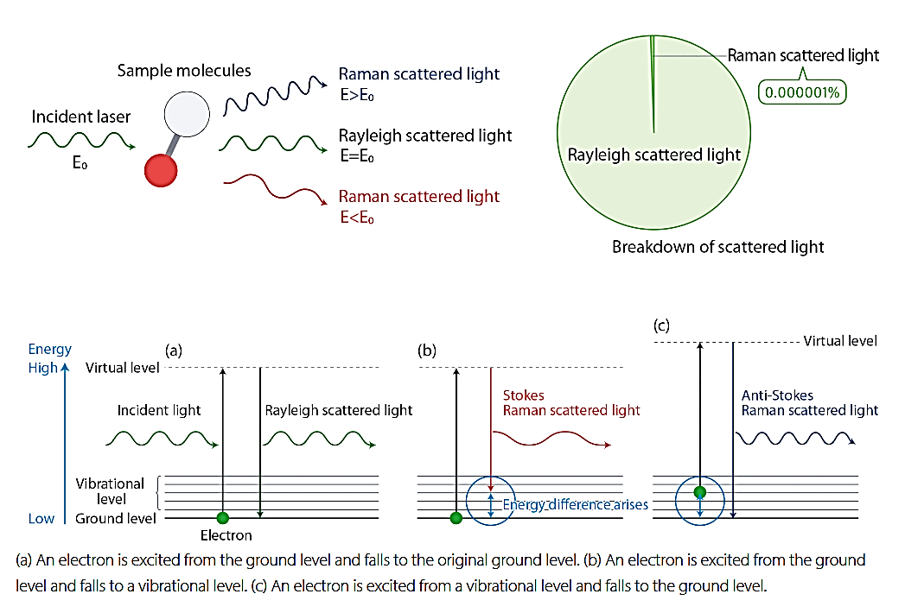
Raman effect is a vibrational molecular spectroscopy which derives from an inelastic light scattering process – a laser photon is scattered by a sample molecule and loses (or gains) energy during the process.
Diagram of the Rayleigh and Raman Scattering Processes
The amount of energy lost is seen as a change in energy (wavelength) of the irradiating photon. This energy loss is characteristic for a particular bond in the molecule.
3

Slide 4
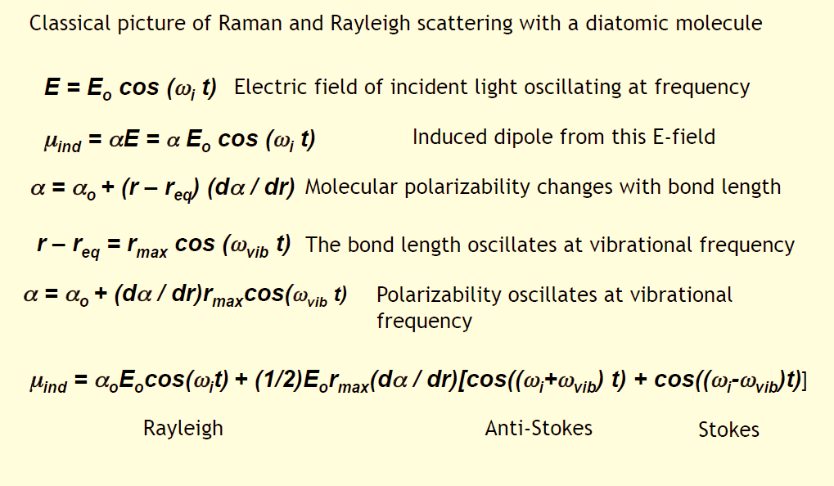
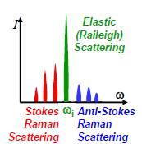
Classical Raman Physics
Polarizability induced dipole equation
The shift in frequency corresponds to the energy of the vibrational motion of the molecules – they are unique for each molecular spices.
4

Slide 5
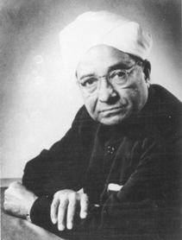
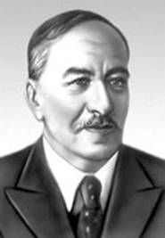
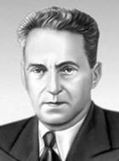
2023 – 95th anniversary of the Raman effect
C.V. Raman
K.S. Krishnan
L.I. Mandelstam
G.S. Landsberg
A.G. Smekal
Discovered by Prof. C.V. Raman and K.S. Krishnan (student of C.V. Raman) in liquids (Calcutta, 28 Feb., 1928),
and independently by
Academicians G.S. Landsberg and L.I. Mandelstam in crystals (Moscow, MSU, 21 Feb., 1928)
The effect was predicted theoretically by Adolf Smekal in 1923
The Nobel Prize in Physics in 1930 was awarded to Sir C. V. Raman "for his work on the scattering of light and for the discovery of the effect named after him."
5

Slide 6
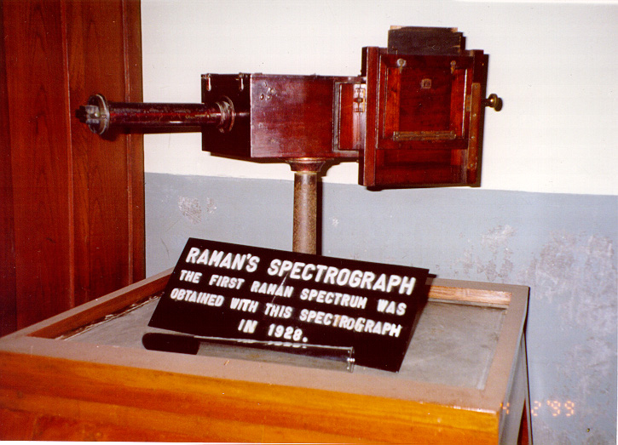
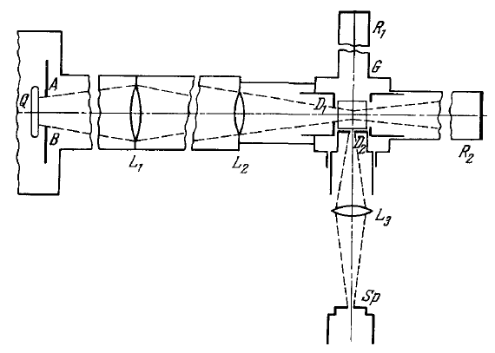
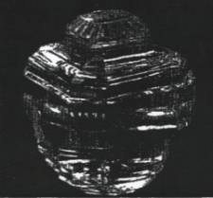
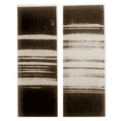
Historical photos of the discovery
Raman - Krishnan
Landsberg - Mandelstam
incident light
scattering spectrum,
benzene
scattering spectrum,
quarts seal (rhinestone)

Slide 7
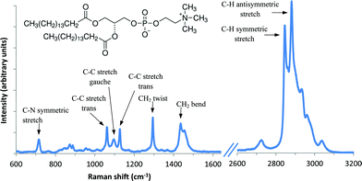
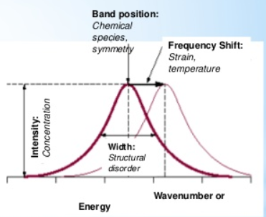
What can Raman spectra tell us?
Raman spectroscopy produces chemical and structural information.
Raman effect is also known as a “fingerprint spectroscopy” as each molecular species has its own unique fingerprint.
Raman spectroscopy can be used to study solid, liquid and gaseous samples.
Vibrational frequencies are characteristic of chemical bonds in a specific molecule.
Peak intensity is proportional to the concentration of a substance.
Shifts of vibrational frequencies are sensitive to local environment of a molecule, such as crystal phase, local strain, and degree of crystallinity.
The frequencies of vibration depend on the masses of the atoms involved and the strength of the bonds between them. Heavy atoms and weak bonds have low Raman shifts. Light atoms and strong bonds have high Raman shifts.
7

Slide 8
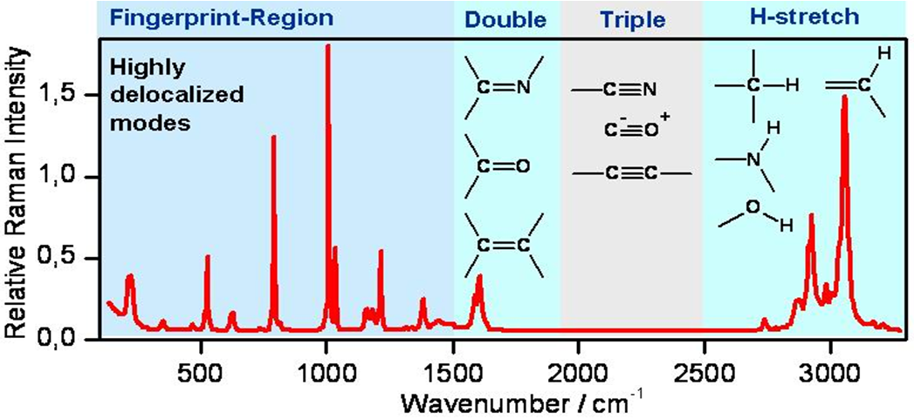
Interpretation of Raman spectrum
Raman effect is also known as a “fingerprint spectroscopy” as each molecular species has its own unique fingerprint.
Region - I : (below 1500 cm⁻¹) – “fingerprint region” – individual characteristic of each substance.
Region - II : (1900 – 1500 cm⁻¹) – “double bonds” – valent stretching modes: С=С, С=O, C=N, ...
Region - III : (2500 – 1900 cm⁻¹) – «triple bonds» С≡С, C≡N, …
Region - IV: (3700 – 2500 cm⁻¹) – “hydrogen region”: H-X, where Х: С, O, N, S
8

Slide 9
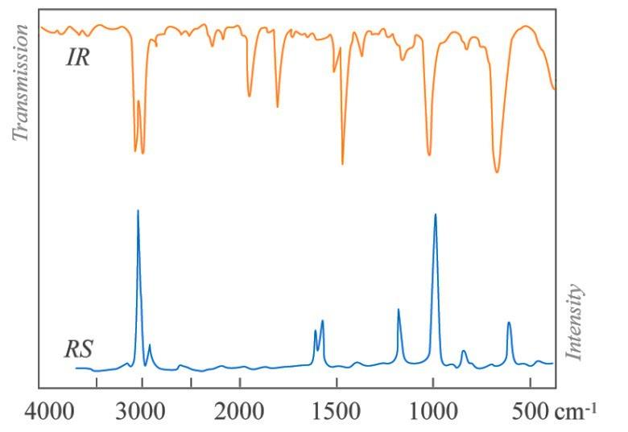
Raman and IR spectroscopy are complementary techniques.
The main specificity distinguishing Raman/IR spectroscopy from other spectroscopic methods – both of them are molecular vibrational spectroscopy
Although the spectral features of Raman and infrared spectra can be interpreted in a similar way the selection rules are different.
Infrared absorption is sensitive to the change of the dipole moment µ during the vibration.
A Raman active vibration is sensitive to the change of polarizability ɑ during the vibration.
9

Slide 10
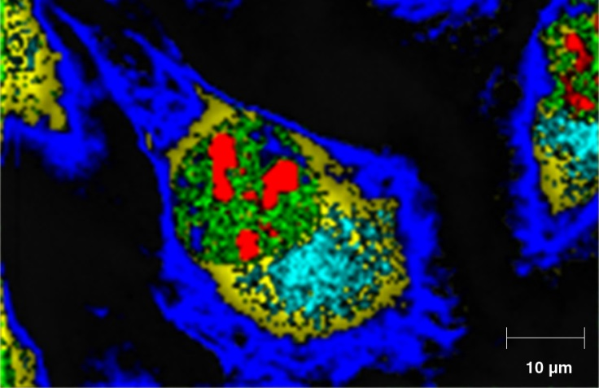
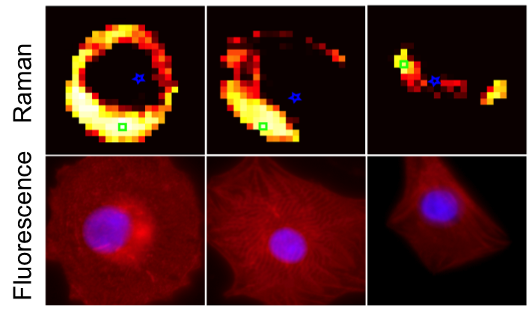
Raman microscopy (imaging) –
a powerful tool for generating selective chemical images based on analyte molecules Raman spectrum
Raman peak intensity yields images of analyte concentration and distribution.
Raman peak position yields images of molecular structure, conformation, etc.
Raman microscopy is a good alternative to fluorescence microscopy, and Raman has a remarkable advantage over it: no photobleaching of the fluorophore, stable work with live cells.
10

Slide 11
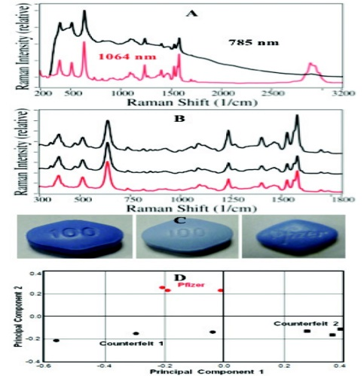
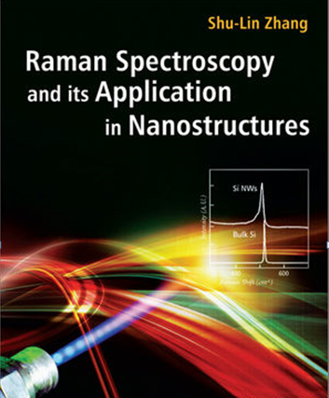
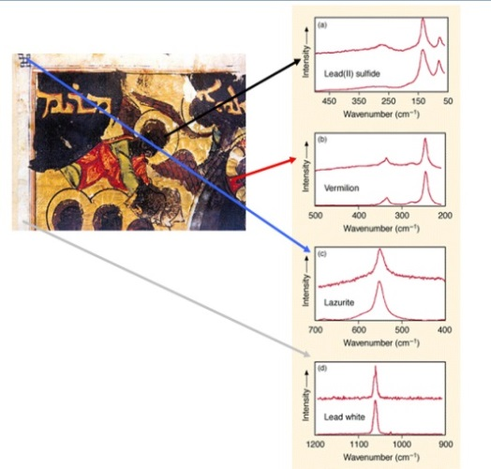
Raman applications
Raman spectroscopy is one of most versatile analytical techniques.
Key applications
Other applications – any application where non-destructive, microscopic, chemical analysis and imaging is required: pharmaceutics, forensics, art, etc., etc.
11

Slide 12
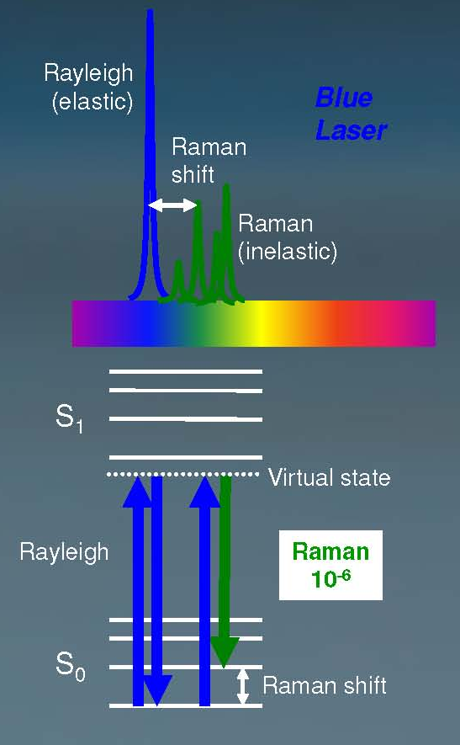
ADVANTAGES & LIMITATIONS of RAMAN MICROSPECTROSCOPY
Main advantages
very high sensitivity (enhanced Raman, SERS, CARS, …)
non-invasive probing (controlled by laser power & λ)
short-term analysis (a few seconds, enhanced Raman)
compatibility with water solutions (not the case for IR)
non-photobleaching signal for live cells studies
chemical imaging without exogenous tags
single excitation wavelength
a small sample volume and simplicity of preparation
Major limitation of spontaneous Raman:
weak signal which limits its practical application – 1 in 10⁶ incident photons are Raman scattered
12

Slide 13
OUTLINE
Introduction in brief: Raman effect
2. Enhanced Raman microspectroscopy:
CARS – Coherent antiStokes Raman Spectroscopy
SERS – Surface-Enhanced Raman Spectroscopy
TERS – Tip-Enhanced Raman Spectroscopy
…
3. “CARS” microspectrometer at FLNP – description and
operating modalities
4. Examples of applications in Life Science
13
13

Slide 14
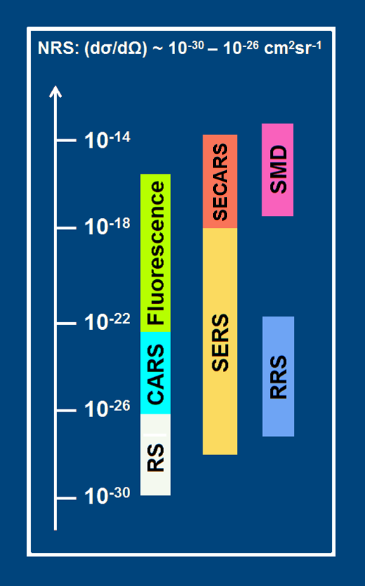
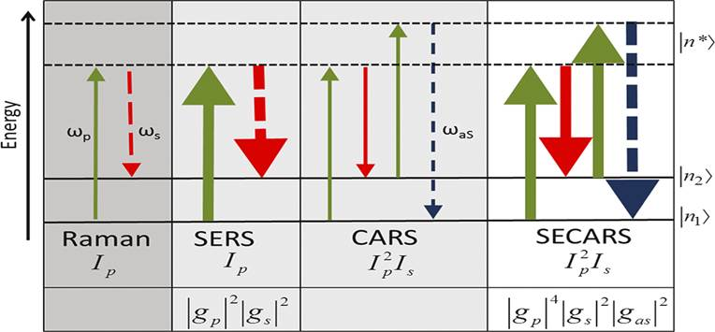
Modern modalities of enhanced Raman microspectroscopy
RS – Raman Scattering (spontaneous) – weak!
RRS – Resonance Raman Scattering – strong!
CARS – Coherent Anti-Stokes Raman Scattering – strong!
SERS – Surface Enhanced Raman Scattering – very strong!
SECARS – Surface Enhanced CARS
TERS – Tip-Enhanced Raman Spectroscopy – moderate!
10⁻¹⁴
10⁻¹⁸
10⁻²²
SMD – single molecule detection level ~ (10⁻¹⁵)
10⁻²⁶
10⁻³⁰
14

Slide 15
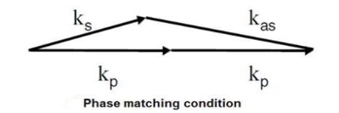
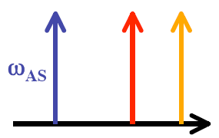
Physical background of CARS in brief
CARS is a third-order nonlinear process that involves a pump beam at a frequency ω_{p} and a Stokes beam at a frequency of ω_{s}. The signal at the anti-Stokes frequency is generated in the phase-matching direction.
ω_{AS} = 2ω_{pump} - ω_{Stokes}
The sample is stimulated through a four-wave mixing parametric process.
I_{CARS}(ω) ~ |χ_{CARS}⁽³⁾|² x I_{p}² I_{S} x N²
χ⁽³⁾ – third-order nonlinear susceptibility
The vibrational contrast in CARS is created when the pump-Stokes frequency difference matches molecular vibration of a particular chemical bond Δω = ω_{vib} and the oscillations of molecules with that bond are driven coherently. Thus, CARS provides a chemically specific signature of various molecules.

Slide 16
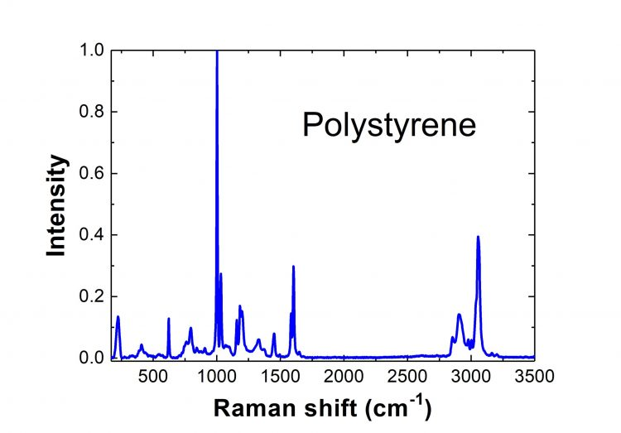
HOW it WORKS ?
3078 cm⁻¹
3078 cm⁻¹ corresponds to the pump beam at 803 nm

Slide 17
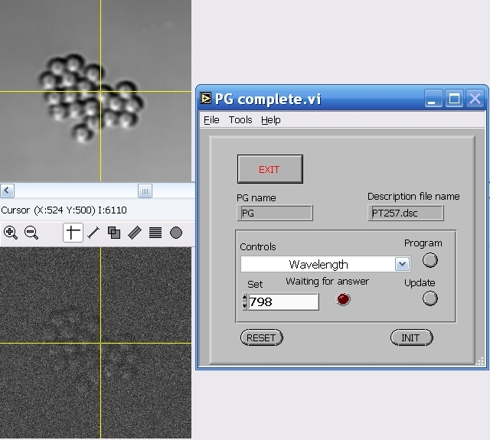
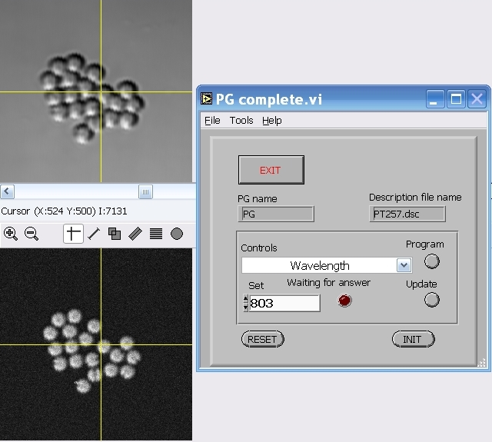
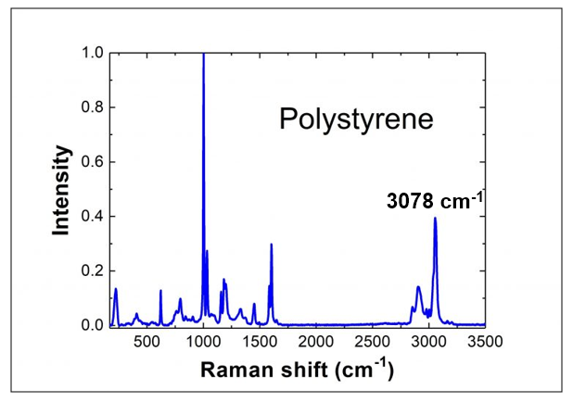
Raman resonance CARS-image of polysterene beads
Transmitted light
weak and
fuzzy image
F-CARS channel
CARS
resonance
797
798
799
800
801
802
803
804
805
λ (nm)
3101 cm⁻¹
3078 cm⁻¹
17

Slide 18
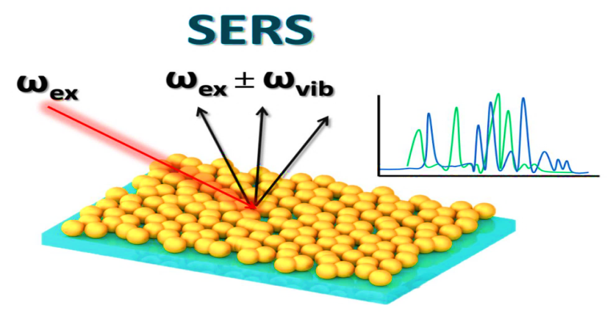
Surface Enhanced Raman Scattering (SERS) –
SERS is a plasmonic-based technique developed to detect extremely small quantities of molecules by determining their characteristic Raman signal.
Enhancement factors under suitable conditions can be as high as 10⁸⁻¹², in some specific cases even higher which allow a few molecule detection level.
Two main mechanisms of SERS enhancement:
1. Electromagnetic (dominant):
- collective oscillations of free electrons (plasmons) in the metallic nanostuctures upon a laser excitation. Enhancement by local optical fields close to surface of metallic NPs at resonance conditions – surface plasmon resonance (SPR).
2. Chemical (much weaker than 1):
- charge-transfer (electrons) process in the ground and excited states of the adsorbed molecule-metal system (metal-molecule bonds).
SERS involves inelastic light scattering by molecules adsorbed onto Ag or Au NPs with nanoscale roughness.
18

Slide 19
19

Slide 20
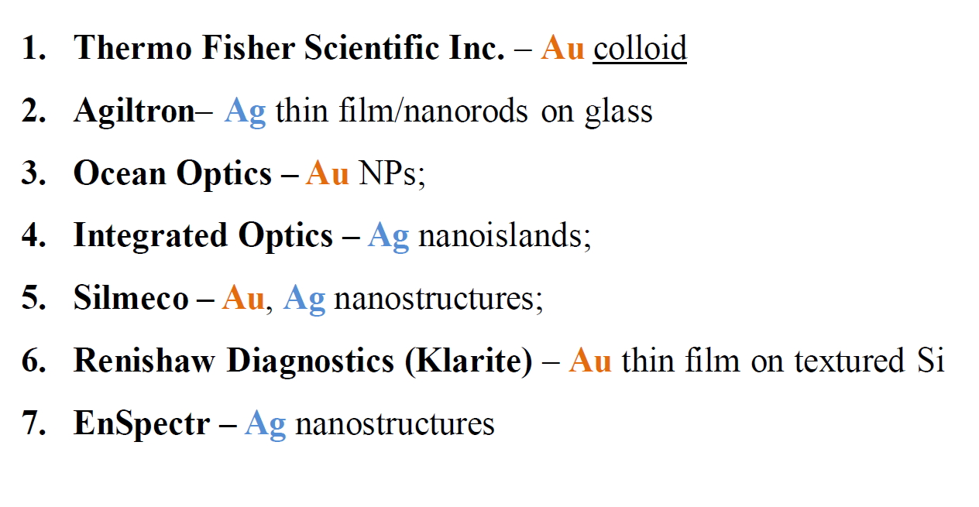
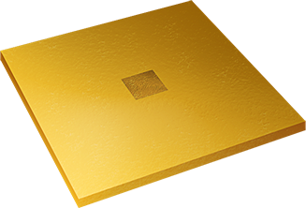
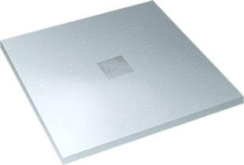
SERS-active substrates:
existing commercial products
At present the main challenge in SERS is a fabrication of the novel effective and inexpensive plasmon nanostructures with well-defined nanoscale geometry demonstrating strong, reproducible and stable Raman signal.
20

Slide 21
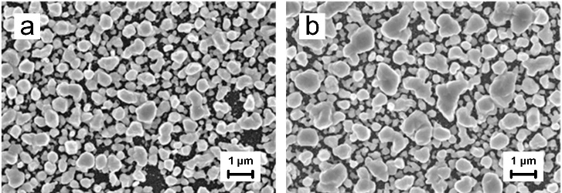
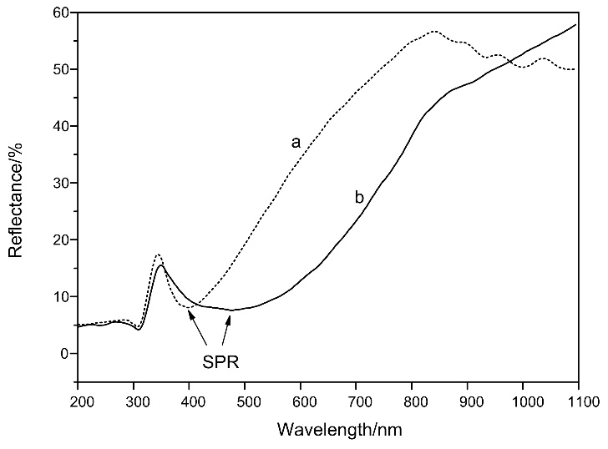
SERS-active substrates based on porous silicon
Plasmonic nanostructure design (developed in BSUIR, Minsk, Belarus):
Template: porous silicon (PSi) formed by an electrochemical anodization in a solution of HF (45%)
Ag nanoparticles: immersion plating in 1mM AgNO₃ aqueous solution with an ethanol additive during 5-25 min.
The formed PS layer has the thickness of 5 µm and the porosity of 75 %.
SEM images of the samples formed by the immersion deposition of silver on PS for (a) 5 and (b) 25 min
The packing density of the silver particles is estimated to be 60 % after 5 min immersion and 75 % after 25 min immersion.
Reflectance spectra of the samples:
for (a) 5 and (b) 25 min immersion.
21

Slide 22
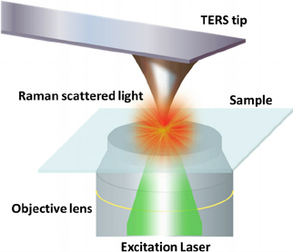
Tip Enhanced Raman Scattering (TERS) or nano-Raman –
brings Raman spectroscopy into nanoscale resolution imaging
TERS combines the chemical sensitivity of surface-enhanced Raman spectroscopy (SERS) with high spatial resolution of scanning probe microscopy (SPM) and enables chemical imaging of surfaces at the nanometer length-scale.
TERS imaging is performed with an AFM-Raman spectrometer, a SPM integrated with an optical micro-spectrometer.
TERS image of single wall carbon nanotubes with spatial resolution of ~ 30 nm
TERS signals are not strong enough because
there is only one tip working as a signal amplifier.
22

Slide 23
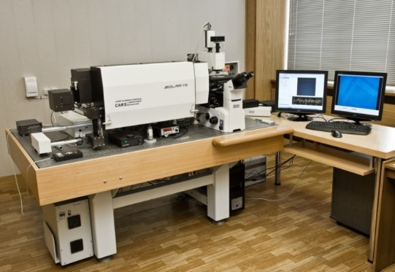
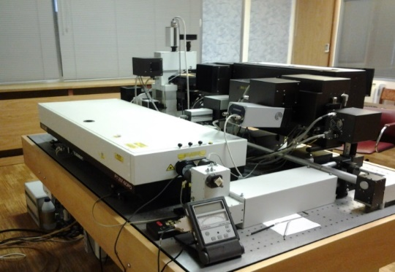
“CARS” microspectrometer
Laser scanning confocal luminescent microscope –
developed and fabricated at “SOLAR” / “SOL Instruments”, Minsk, Belarus
23

Slide 24
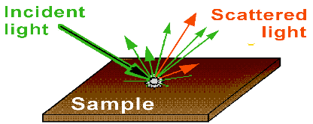
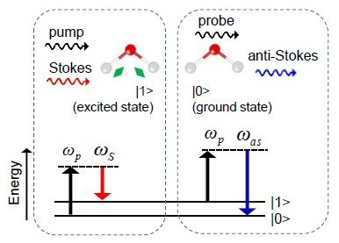
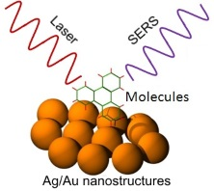
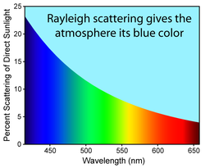
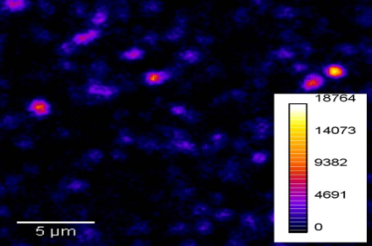
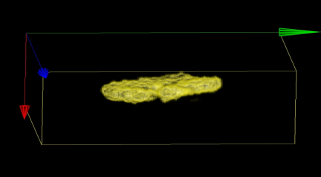
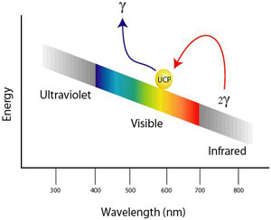
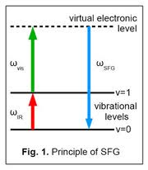
Multimodal optical platform at FLNP
Raman
F-CARS, E-CARS, P-CARS
SERS
Transmitted and reflected channels
SECARS
“CARS” microscope
Up-conversion luminescence
SHG, SONICC
Second harmonic &
sum frequency
generation
24

Slide 25
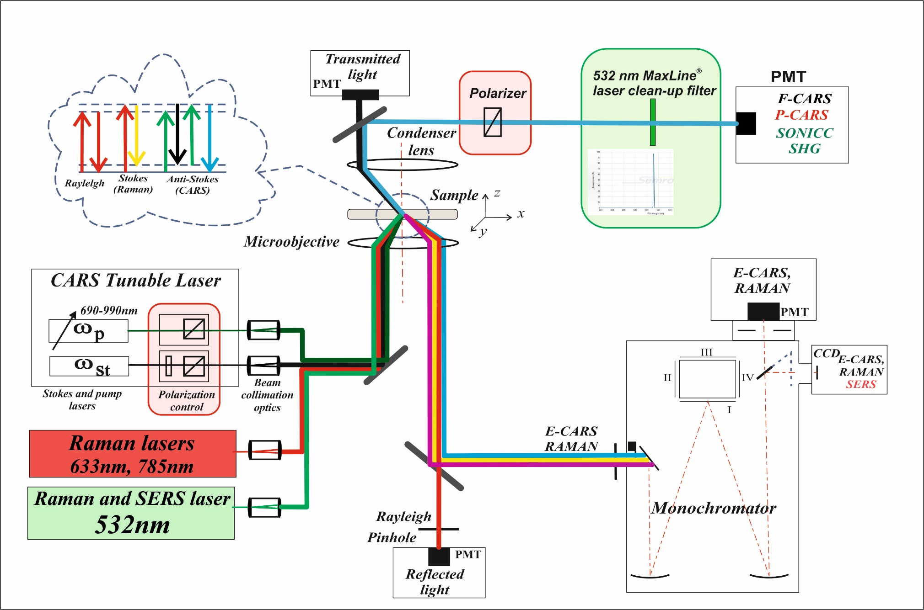
Optical layout of the “CARS” microspectrometer
25

Slide 26
Picosecond CARS laser, “EKSPLA” (Lithuania)
Nd:YVO₄ laser parameters:
Master oscillator – diode pumped mode-locked ND:YVO₄ laser:
- wavelength – 1064 nm
- pulse duration – 7 ps
- output power – 6 W @ 1064 nm and 2.5 W @ 532 nm
- repetition rate – 85 MHz
Synchronously pumped optical parametric oscillator (SOPO)
- pump wavelength: 532 nm
- tuning range: (690 – 990) nm
- pulse duration: 6 ps
- output power ̴ (150-350) mW
- spatial mode – TEM₀₀
- linewidth: < 7 cm⁻¹
- scanning step: 0.1 nm
2
1
4
3
1 – picosecond Nd:YVO₄ laser; 2 – picosecond SOPO (LBO); 3 – module for formation and combination of the pump (SOPO) and Stokes (Nd:YVO₄) beams; 4 – HeNe laser
26

Slide 27
OUTLINE
Introduction in brief: Raman effect
2. Enhanced Raman microspectroscopy:
CARS – Coherent antiStokes Raman Spectroscopy
SERS – Surface-Enhanced Raman Spectroscopy
TERS – Tip-Enhanced Raman Spectroscopy
…
3. “CARS” microspectrometer at FLNP – description and
operating modalities
4. Examples of applications in Life Science
27
27

Slide 28
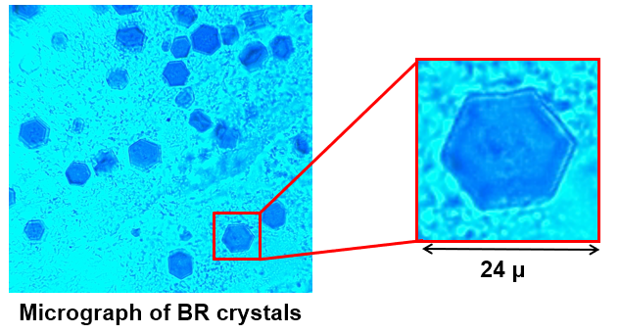
Raman, CARS and SHG (SONICC) imaging of bacteriorhodopsin (BR) crystals as a model of membrane proteins (MP)
1
MOTIVATION
Membrane proteins (MPs) are responsible for vital functions of the cells and their studies are of great importance for both science and practical medicine.
MPs represent roughly one-third of the proteins encoded in the human genome.
They are also extremely important drug targets (up to 60% of all existing drugs target MPs).
Structural study of MPs is a major challenge due to dramatic difficulties with growing, detection and imaging of the crystals suitable for X-ray crystallography.
28

Slide 29
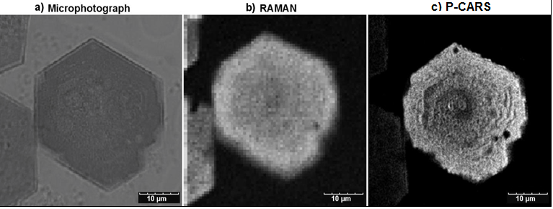
1529cm⁻¹
1529cm⁻¹
Optical microscope image gives an impression that the crystal is perfect with the only visible edge defect.
The same conclusion can be made with the Raman image.
P-CARS resolves tiny features of BR morphology and displays several defects visible as dark parts of the crystal, the edges of the crystal are not smooth.
Stair-like morphology of the surface of the crystal is well defined (useful in crystal growth).
1529cm⁻¹
29

Slide 30
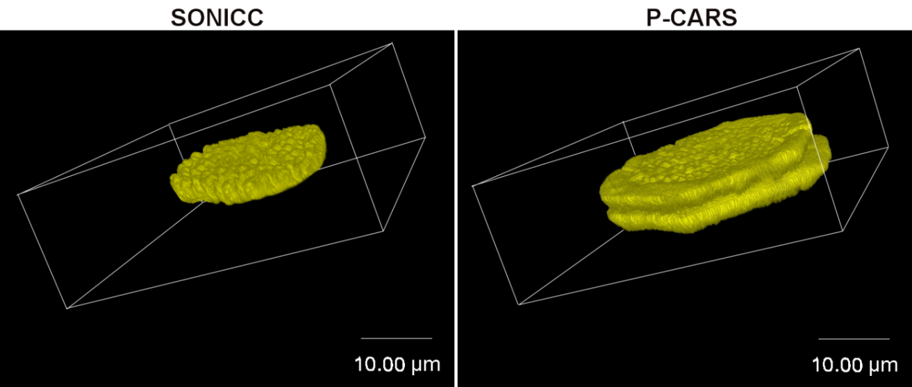
Imaging of twinned BR crystals –
one of the most common crystal-growth defects in protein crystallography.
P-CARS, 1529сm⁻¹
Scan area 48x48um, resolution: 2pl/1µm,
data accumulation time ~ 2s
3D-sectioning
The boundary rim is not well ordered part of the crystal
and SONICC fails to display any signs of the rim.
Raman spectra in the central part
of the BR crystal is similar to that of in the boundary rim.
30

Slide 31
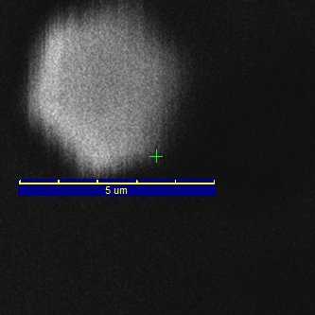
Identifying the smallest sized BR crystals (~4 µm down to submicron)
by P-CARS vs SONICC (SHG)
P-CARS, 8x8µm
P-CARS, 8x8µm
SONICC, 8x8µm
P-CARS, 8x8um
Scan area 8x8um
Resolution: 2pl/1µm
Data acquisition time ~2s
P-CARS image at ~ 1529cm⁻¹
SONICC image at SHG (532nm)
JACS, 2016, 138(41))
31

Slide 32
2
Raman detection of a few/single molecule(s)
for ultrasensitive biosensing
32

Slide 33
Ultrasensitive detection of lactoferrin molecules covered by graphene at attomolar concentration by Raman spectroscopy
Lactoferrin is a multifunctional glycoprotein that is widely represented in various secretory fluids, such as milk, salvia, tears, etc.
Lactoferrin is one of the components of the immune system of the body and is part of the innate defense.
Graphene heat sink –
overcoming the limitation
10⁻¹⁸M
Most of the lactoferrin Raman bands are presented in the spectrum at the 10⁻¹⁸ M concentration:
1002 cm⁻¹ (Phe), 1290 cm⁻¹ (Amide III), 1340 cm⁻¹ (Trp), 1440 cm⁻¹ (CH₂), 1605 cm⁻¹ (Tyr) and 1642 cm⁻¹ (Amide I).
SERS spectra of lactoferrin at 10⁻⁶ to 10⁻¹⁸ M concentrations obtained by the collection of the SERS spectra maps (10 х 10 µm)
Biosensors, 2019, 9, 34
33

Slide 34
Silver 3D dendrites in SERS
Advantages for SERS spectroscopy
Excitation upon a wide range of laser wavelengths (including IR) due to the wider spectral SPR (surface plasmon resonance) band due to the longitudinal and transverse modes.
Use of low laser powers and portable instrumentation for biosensing due to richly-developed dendrites’ morphology that possesses much more hot spots compared to the 2D nanostructures.
34

Slide 35
Silver 3D dendrites for attomolar limit of analyte
molecules detection by SERS
Raman reporter: DTNB
Dithionitrobenzoic acid
1338 сm⁻¹
1558 сm⁻¹
Distribution maps of 1338 cm⁻¹ band (intensity in the SERS spectra of DTNB molecules from solutions at concentrations: (a) 10⁻⁶ M ; (b) 10⁻¹⁸ M
-------------------------------------------------------------------------
1338 cm⁻¹ – symmetric nitro stretching mode ν_{s}(NO₂)
1558 cm⁻¹ – aromatic ring stretching mode
Average SERS spectra for three maps of the Ag dendrites/macro-PS kept in the DTNB solutions with different concentrations. The excitation wavelength 785 nm.
J. Appl. Phys, 2019, 126
35

Slide 36
3
Raman sturdy of conformational changes in model lipid membranes with additives: cholesterol and melatonin
Lipids are one of the most important classes of biomolecules involved in cell vitality – cellular signaling, energy storage and building of cellular membranes.
Addition of various molecules to the membrane can change its physical properties and alter its structure, which in turn may affect its functionality.
36

Slide 37
Ternary system – Lipid / Cholesterol / Melatonin
Cholesterol and melatonin incorporate into
the lipid bilayer at different positions
Cholesterol is located mainly in lipid tails region
Melatonin resides in the head-group region
37

Slide 38
Raman spectrum of pure DPPC
The spectral range of 1030 cm⁻¹ – 1150 cm⁻¹
is sensitive to trans/gauche conformations, has the three dominant Raman bands (1062 cm ⁻¹, 1096 cm ⁻¹, 1127 cm ⁻¹ ) and can serve as an spectroscopic markers indicating phospholipids’ hydrocarbon chains ordering and disoredering.
trans conformer
1096
1062
1127
gauche conformer
38

Slide 39
Schematic illustration of the preferential areas of influence of melatonin and cholesterol
Area of impact of melatonin
Area of impact of cholesterol
1062
1127
1096
Raman bands 1062 cm⁻¹ and 1096 cm⁻¹ are most sensitive to changes resulting from the addition of Melatonin
Raman band 1127 cm⁻¹ is most sensitive to changes resulting from the addition of Cholesterol
The dynamics of hydrocarbon chains represented by the ratio of trans/gauche conformers (S₁₀₆₂/S₁₀₉₆ , S₁₁₂₇/S₁₀₉₆) serves as an index of the strength of the lattice order/disorder effects in lipid bilayer

Slide 40
Сondensing effect of cholesterol and the fluidizing effect of melatonin
DPPC+Cholesterol
DPPC+Melatonin
The dynamics of hydrocarbon chains represented by the ratio of trans/gauche conformers (S₁₀₆₂/S₁₀₉₆ , S₁₁₂₇/S₁₀₉₆) serves as an index of the strength of the lattice order/disorder effects in lipid bilayer

Slide 41
MAIN RESULTS
Raman spectroscopy demonstrates high sensitivity to the
trans/gauche conformers alterations with additives.
With cholesterol lipid molecules become more ordered and membrane became stiffer and thicker (condensing effect).
Melatonin decrease order of lipid molecules and membrane became more fluidic and thinner (fluidizing effect).
41

Slide 42
4.
Raman biomarkers as a diagnostic tool
of various diseases
42

Slide 43
Stem cells – the earliest type of cell in a cell lineage
Comparison of Raman "fingerprint" bands of C6 glioma tumor cells and mesenchymal stem cells (MSC)
An area where there are no glioma tumor cells
Right hemisphere, C6
Left hemisphere, no C6
tumor focus
artificial holes
A horizontal section of a rat brain
The revealed spectral differences in the Amide-I (1600 – 1700 cm⁻¹) line of tumor and healthy cells are related to tumor C6 glial cells.
JSCRT, 1(1), 2016

Slide 44
CARS microscopy for tissue imaging
CARS images of physiological and pathological tissue of the colon
Healthy tissue,
CARS imaging at 2850 cm⁻¹
Cancer tissue,
CARS imaging at 2850 cm⁻¹
N. Vogler, Y. Popp, et al. @ 4th Int. Graduate Summer School: Biophotonics '09
44

Slide 45
5.
NETosis – a special form of programmed cell death
Classic or suicidal NETosis
Vital NETosis
Neutrophils are the largest population of myeloid leukocytes, which normally comprise 50-70% of all white blood cells

Slide 46
Neutrophils and NETosis
NETs – Neutrophil Extracellular Traps
Raman spectroscopy as an early diagnostic tool
Neutrophil cells are the immune system's first line of defense against bacterial, fungal and in viral infections
Protective capabilities of neutrophils
Phagocytosis
Chromatine decondensation
Formation of NETs
In the cytoplasm of neutrophil cells there are granules with antimicrobial agents
NET has an electrostatic charge which holds pathogens
46

Slide 47
Raman Marker of NETosis
NETs preformation: citrullination of histones (nuclear proteins)
The averaged Raman spectrum of neutrophils chemically activated (30 min)
The averaged Raman spectrum of neutrophils activated with bacteria (40 min)
Raman spectrum: low-frequency range of citrulline line evolution indicating the pre-activation of NETosis
Raman spectroscopy serves as an early diagnostic tool
Since NETosis is a process of programmed neutrophil cell death, the growth of the “citrulline” peak in Raman spectrum indicates that cell death will occur soon.
J. of Raman spectroscopy, 2020, https://doi.org/10.1002/jrs.5844

Slide 48
Light (UV and visible) induced NETosis
(the article is currently under publication)
Every day, the human skin is exposed to the wide spectrum of electromagnetic radiation of sunlight, including ultraviolet radiation (UV). The whole spectrum of UV covers the wavelengths between 200 and 400 nm and is divided into three ranges: UVA (400–315 nm), UVB (315–280 nm) and UVC (280–200 nm).
UVC is completely absorbed by gases in the Earth atmosphere, but 10% of UVB and almost 100% of UVA reach the Earth surface.

Slide 49
SUMMARY
Raman microspectroscopy is a powerful and sensitive tool for Life Science.
Nonlinear CARS microscopy is an efficient and fast technique for imaging with much stronger signal and chemical contrast without using tags.
SERS is a technique to detect extremely small quantities of molecules (single molecule level) by determining their characteristic Raman signal.
49

Slide 50
Thank you!
50

