Slide 1

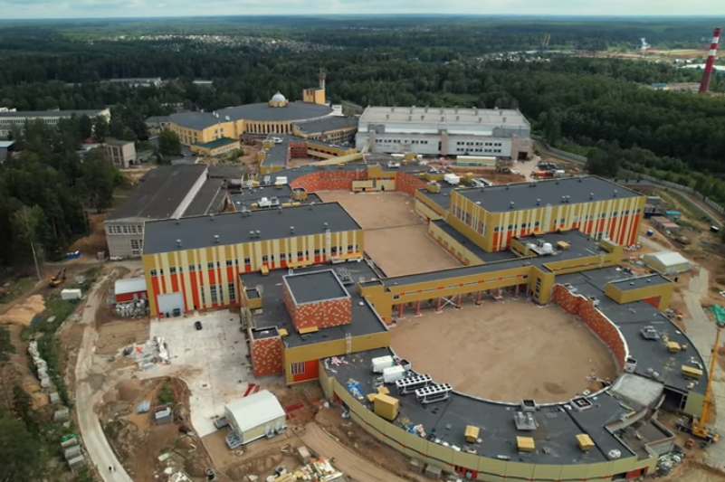
Nuclotron based Ion Colider fAcility
Heavy-Ion Collisions at Nuclotron-NICA Energies
Arkadiy Taranenko (NRNU MEPhI)
SPD
MPD
The XXVI International Scientific Conference of Young Scientists and Specialists (AYSS-2022), JINR, Dubna, 24-28 October, 2022

Slide 2

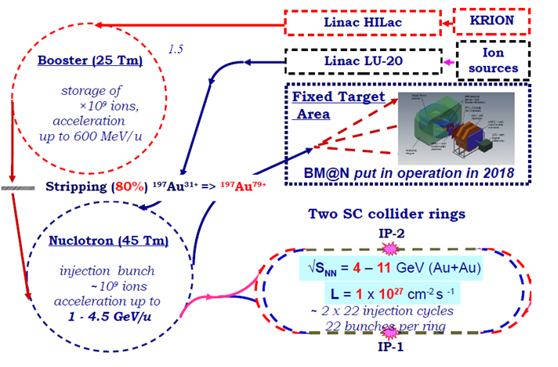
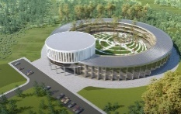
NICA Project
The first megascience project in Russia in 30+ years, which is approaching its full commissioning:
  already running in the fixed-target mode – BM@N since 2018
  start of operation in collider mode in 2023-2024 – MPD and later SPD
Lots of infrastructure built from scratch (ion source, booster, collider and transfer lines, cryogenics, electricity, etc.)
The project is approaching the most interesting times with first data taking with beams in the collider

Slide 3
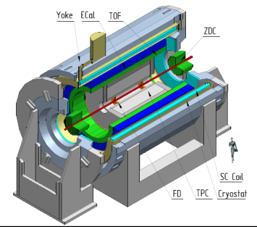
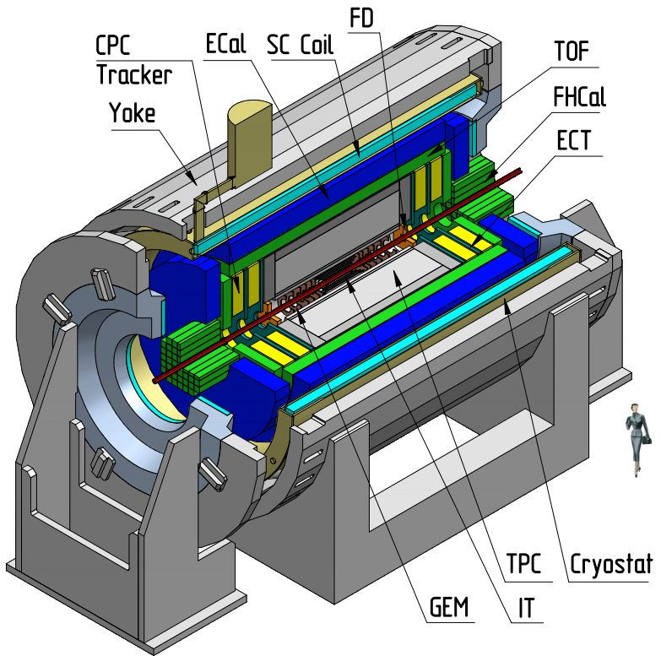
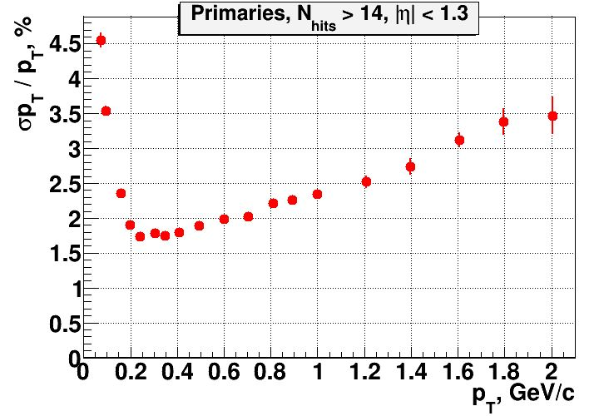
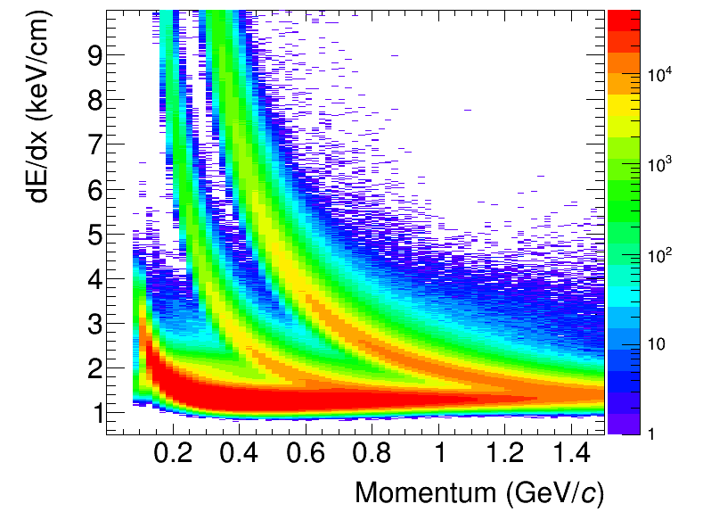
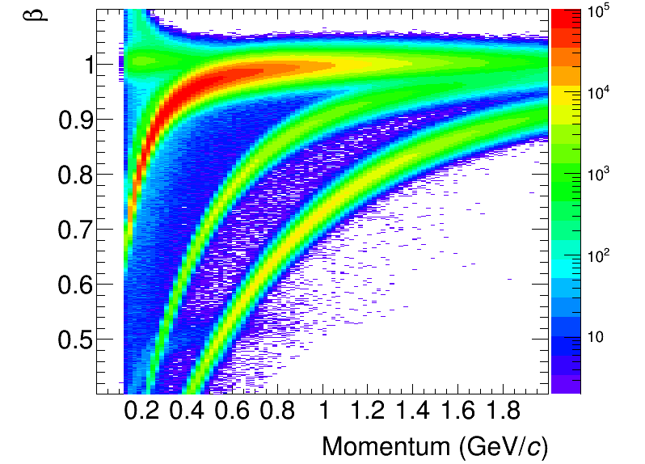
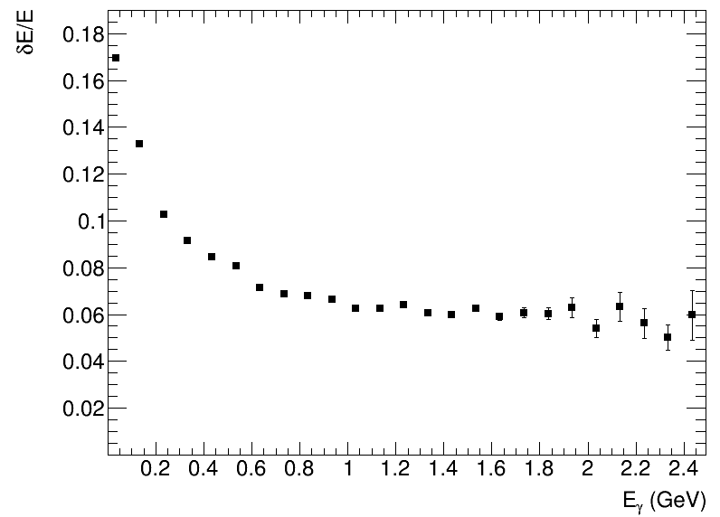
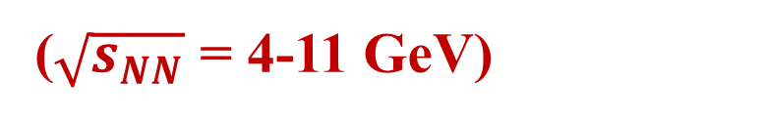
MPD - Multi-Purpose Detector (NICA)
Stage- I
($\sqrt{s_{NN}}$ = 4-11 GeV)
Stage- II
upgrade
+ ITS and forward spectrometers
2024?: first run with Bi+Bi @ 9.2 GeV with luminosity ~ 10²⁵ cm⁻²s⁻¹
TPC
ECAL
energy resolution
TPC momentum resolution
TOF

Slide 4
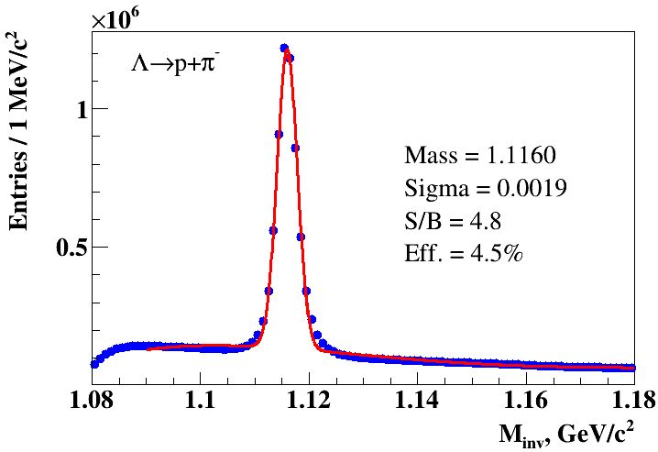
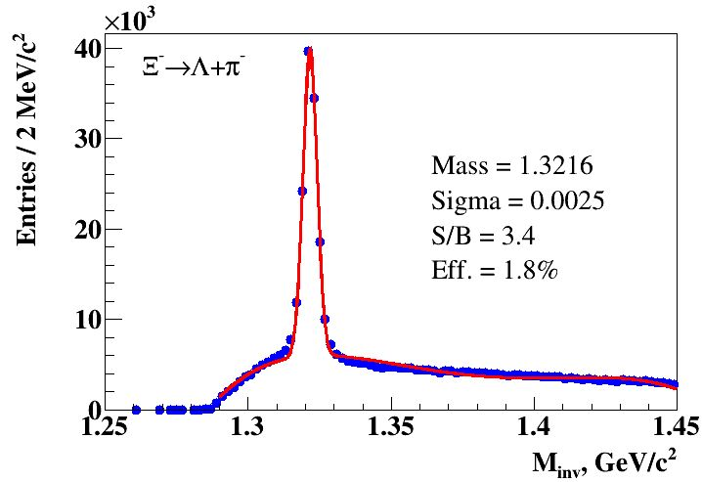
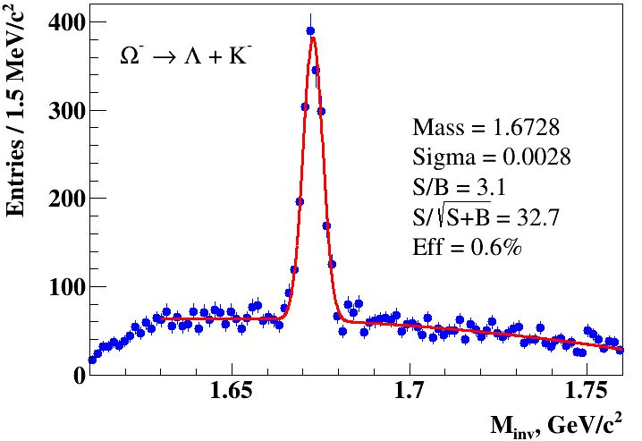
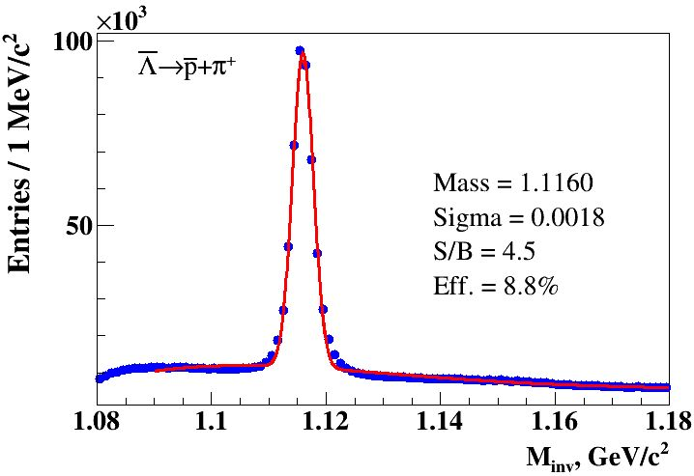
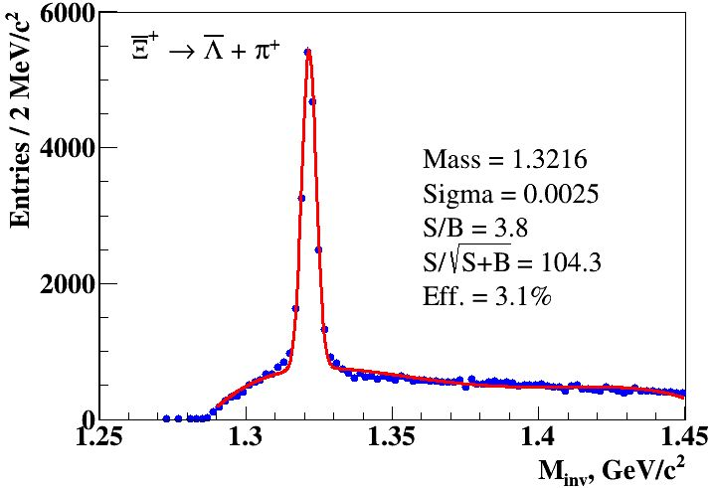
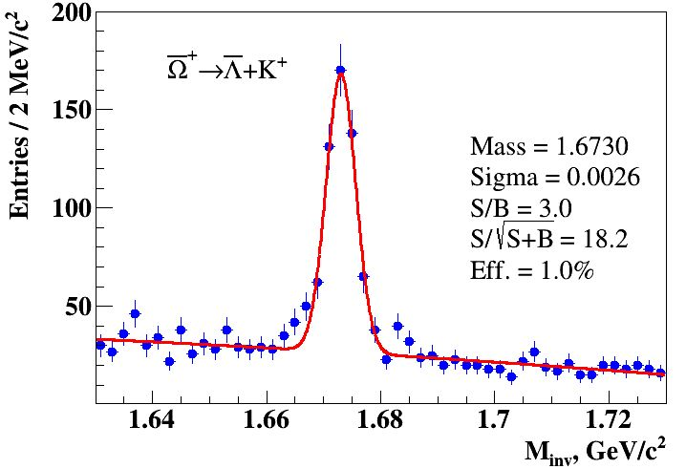
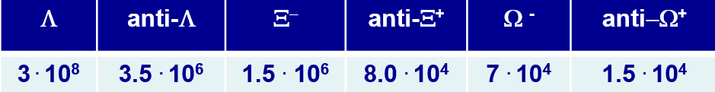
Weak decays of strange baryons (MPD)
Strangeness production probes the EoS, phase boundaries and onset of deconfinement
Antibaryon-to-baryon ratios at intermediate momenta are sensitive to CEP (a falling trend in contrast to a constant behavior in the scenario without CEP)
AuAu@11 GeV (PHSD):
Acta Physica Polonica B 14 (2021) 3, 529-532
  Strange baryons can be reconstructed with good S/B ratios using charged hadron identification
  in the TPC&TOF and different decay topology selections
  Relative yields of the baryons for ~ 500 M sampled events:

Slide 5
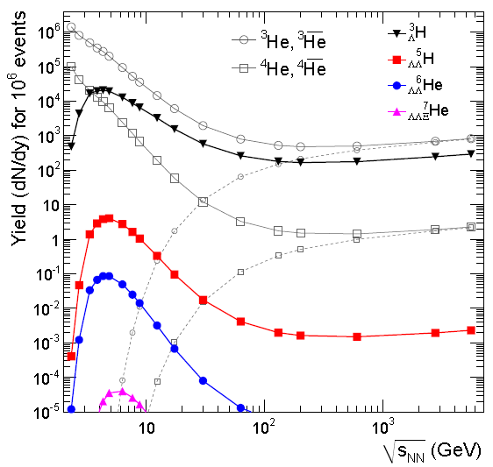

Reconstruction of hypertritons (MPD)
Information on YN interactions, strange sector of nuclear EoS, astrophysics
BiBi@9.2 GeV (PHQMD), 40 M sampled events:
Phys. Lett. B697 (2011) 203
Phys.Part.Nucl.Lett. 19 (2022) 1, 46-53
Thermal model predicts an enhanced hypernuclear production in the NICA energy range
  Spectrum is reconstructed up to p_{T}=4.5 GeV/с
  dN/dt = p0*exp(-t/p1), p1 - lifetime
  265 ± 4 ps (2%, 1%)

Slide 6
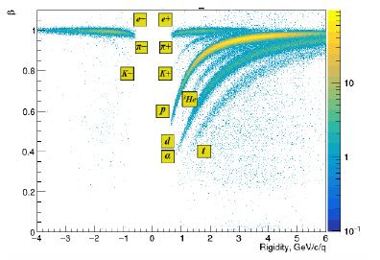
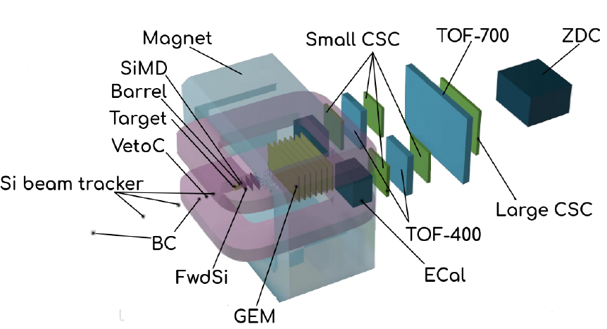
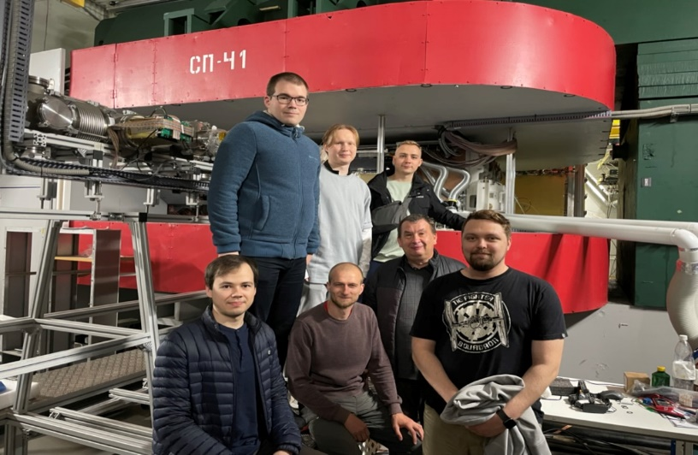
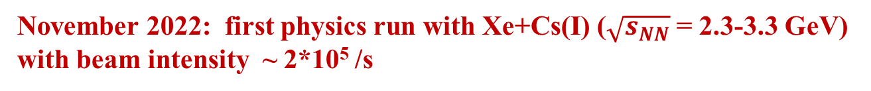
BM@N (Baryonic Matter @ Nuclotron)
November 2022: first physics run with Xe+Cs(I) ($\sqrt{s_{NN}}$ = 2.3-3.3 GeV) with beam intensity ~ 2*10⁵ /s

Slide 7
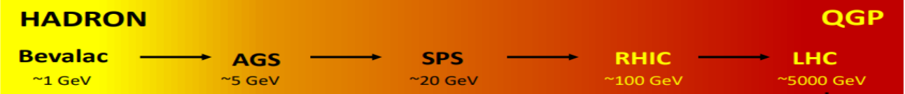
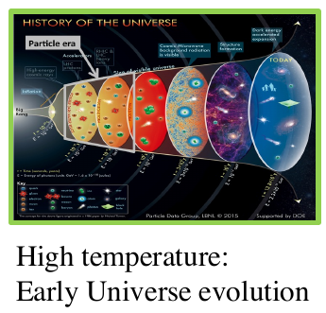
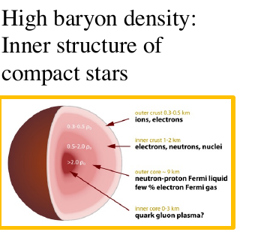
Relativistic Heavy-Ion Collisions and Quark Gluon Plasma (QGP)
It is the primordial form of QCD matter at high temperature or baryon density.
It was present during the first few microseconds of the Big Bang.
It provides an example of phase transitions which may occur at a variety of higher temperature scales in the early universe.
It can provide important insights on the origin of mass for matter, and how quarks are confined into hadrons.
M. Gyulassy, Nucl. Phys. A750, 30-63, 2005

Slide 8
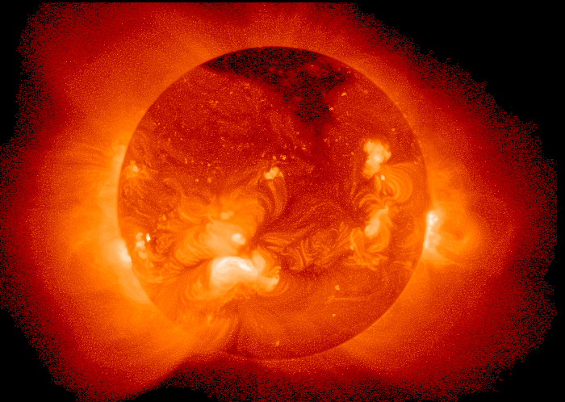
Temperature at the centre of the Sun ~ 15 000 000 K
A medium of 150-170 MeV is more than 100 000 times hotter !!!

Slide 9
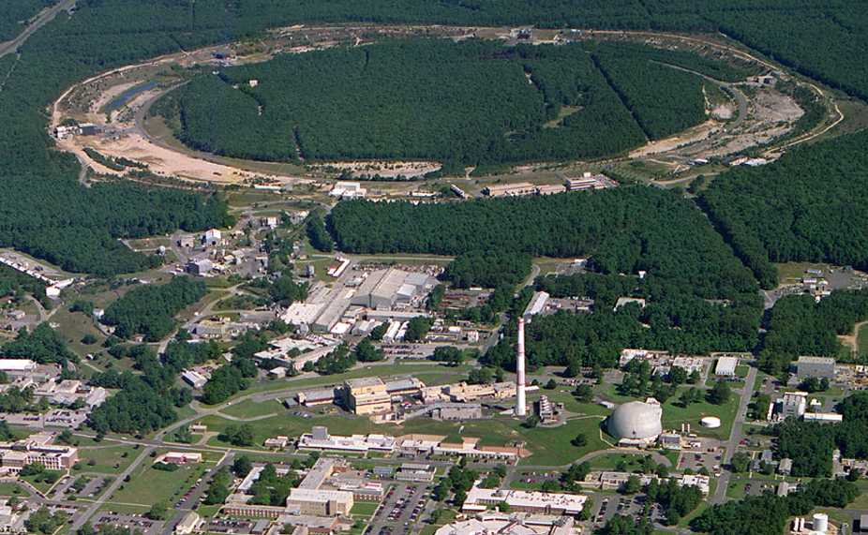

2005: Quark-Gluon Plasma is a “perfect liquid”
Relativistic Heavy-Ion Collider (BNL), Upton, NY (USA)
PHOBOS
BRAHMS
RHIC
PHENIX
STAR
v = 0.99995⋅c = 186,000 miles/sec
Au + Au at 200 GeV
AGS
TANDEMS

Slide 10
Challenge: find the good probes of QCD matter
vacuum
The good QCD matter probes should be:
Well understood in “pp collisions”
hadronic
matter
Affected by hadronic matter,
in a well understood way,
which can be accounted for
QGP
Strongly affected by the dense and
deconfined QCD medium...

Slide 11
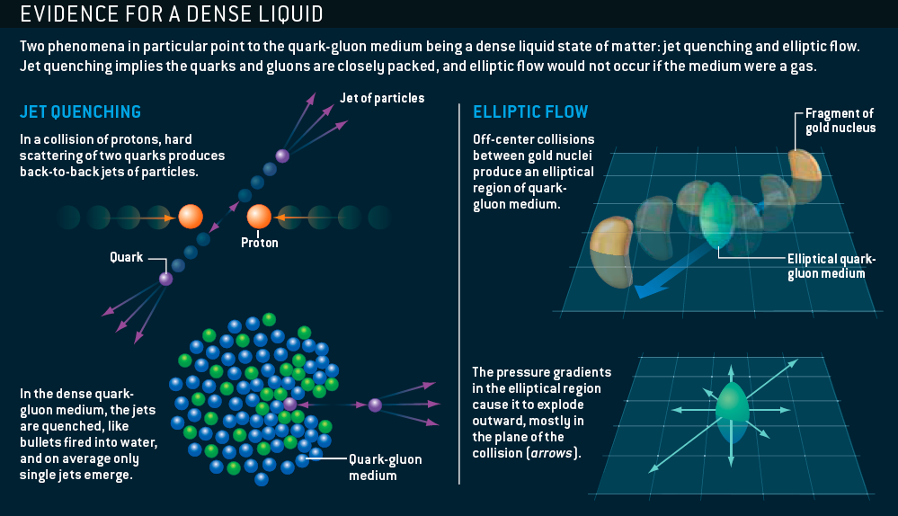
The sQGP Discovered at RHIC: 2005
M. Roirdan and W. Zajc,
Scientific American, May 2006

Slide 12
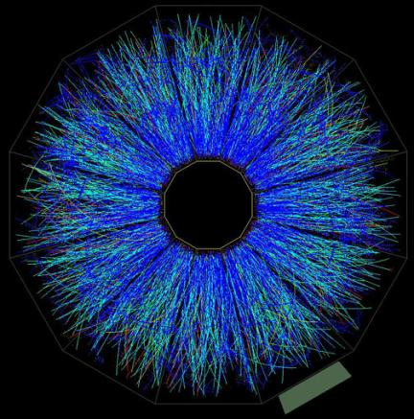
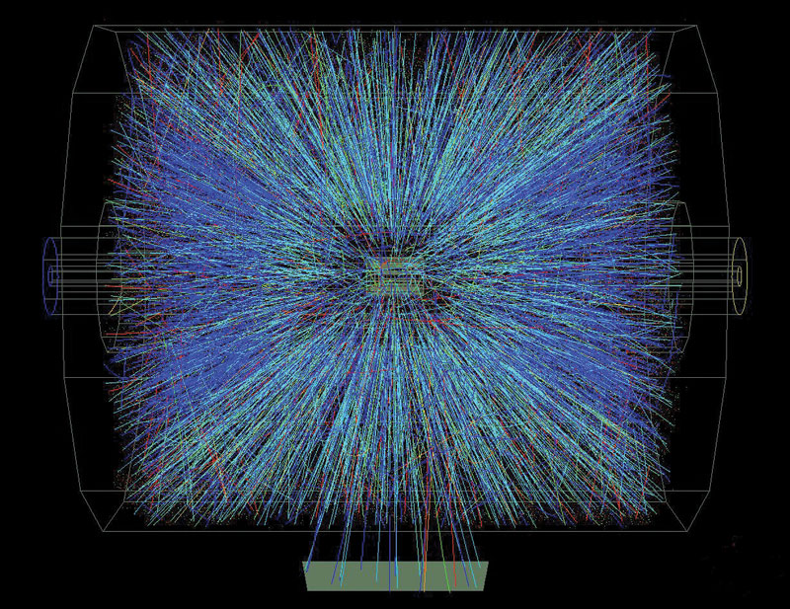
Definition of kinematical variables
Momentum , azimuthal angle φ and pseudo-rapidity (η) of the emitted particles are used to study the collision
y
φ
θ
x
z
φ
η

Slide 13
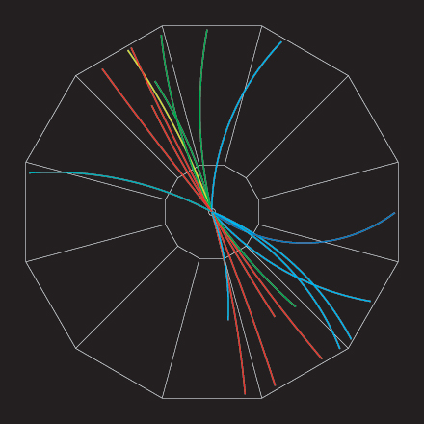
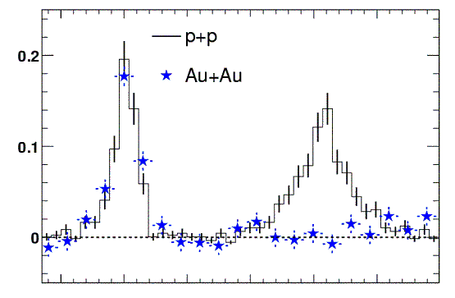
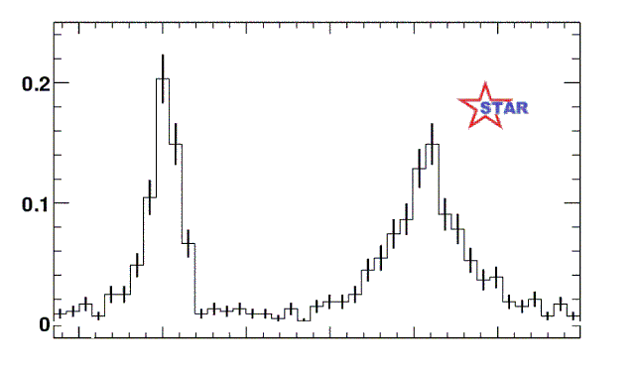
RHIC Experiment: “Jet quenching”
proton-proton jet event
Analyze by measuring (azimuthal) angle between pairs of particles
Number of pairs
0º
180º
Angle between high energy particles
In Au-Au collisions we see only one “jet” at a time !
How can this happen ?
Jet quenching!
q
q

Slide 14
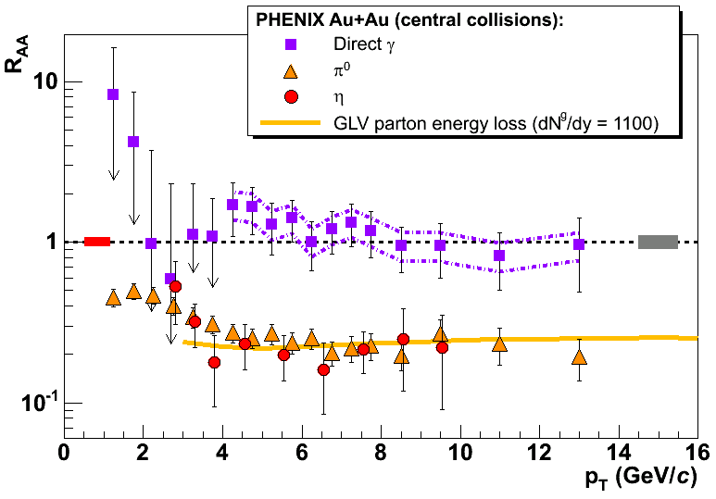
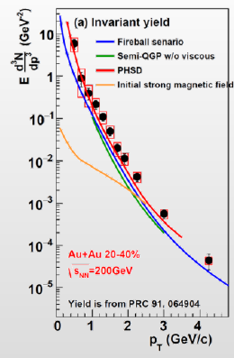
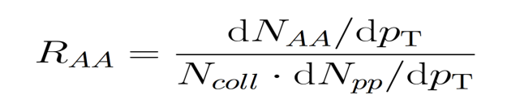
Jet quenching and direct photons in A+A collisions
reference process
photons
Measure the spectrum of thermal photons (non-interacting) emitted from the source.
The spectrum will display the average temperature over the full lifetime of the partonic source.
Determining the initial temperature requires modeling.
The meson yield in central Au-Au is
5 times lower than expected from
pp collisions but the direct photons are
not affected by the dense medium
PHENIX: T = 221±19±19 MeV)
Modeled Tinitial ~ 350 MeV

Slide 15
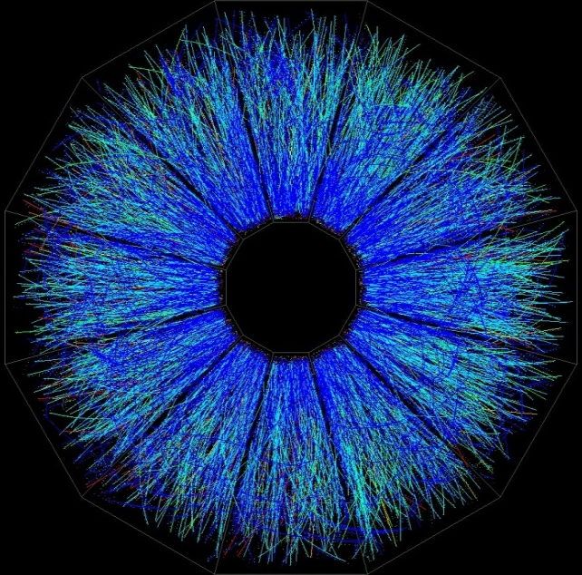
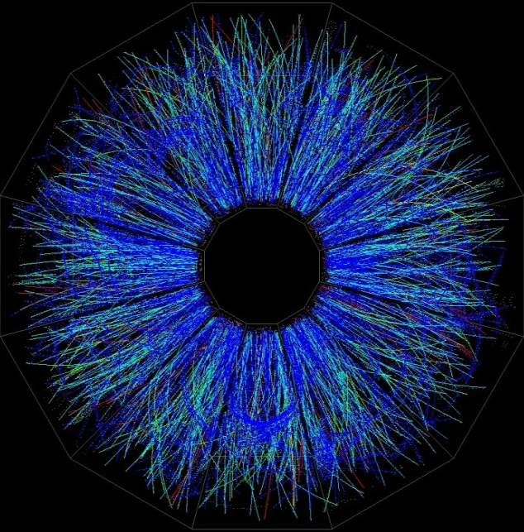
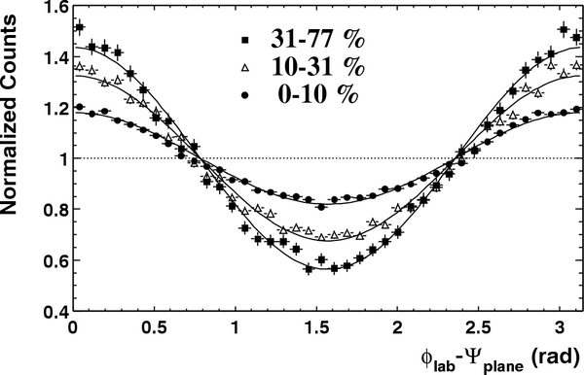
Azimuthal distributions at RHIC
b ≈ 6.5 fm
b ≈ 4 fm
“central” collisions
STAR, PRL90 032301 (2003)
midcentral collisions

Slide 16
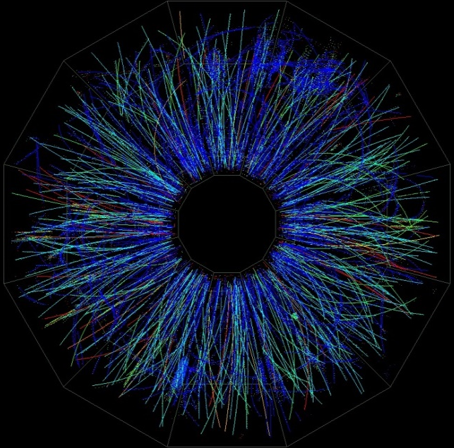
Azimuthal distributions at RHIC
b ≈ 10 fm
b ≈ 6.5 fm
b ≈ 4 fm
peripheral collisions

Slide 17
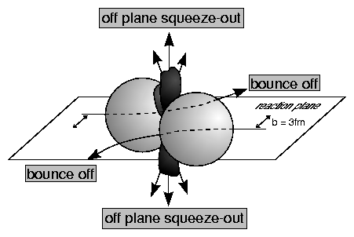
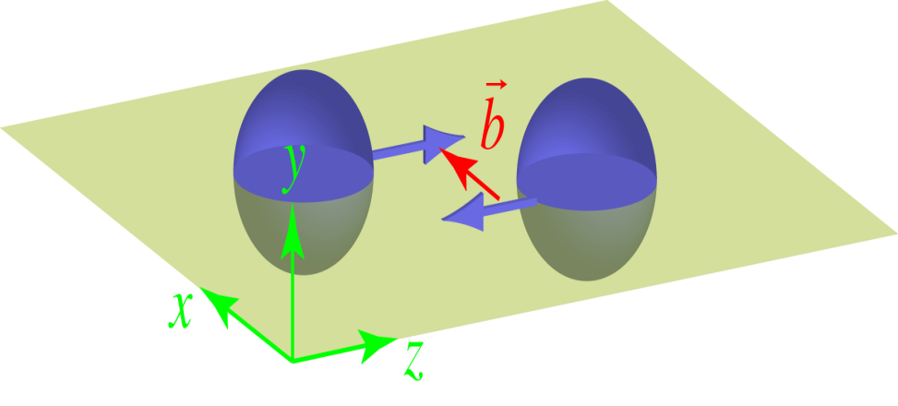
“Squeeze-Out” - First Elliptic Flow Signal in HIC
Diogene, M. Demoulins et al., Phys. Lett. B241, 476 (1990)
Plastic Ball, H.H. Gutbrod et al., Phys. Lett. B216, 267 (1989)
1989
Reaction plane
Reaction Plane
y
ɸ=φ-Ψ_{R}
v2 < 0
ψ_{R}
mid-rapidity
x
+/- 90deg

Slide 18
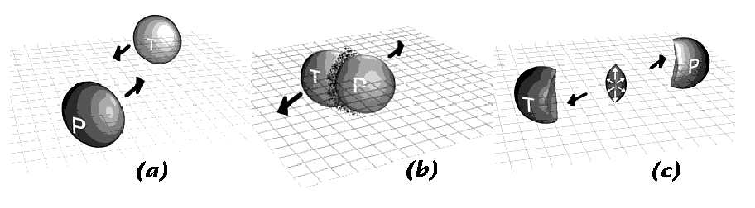
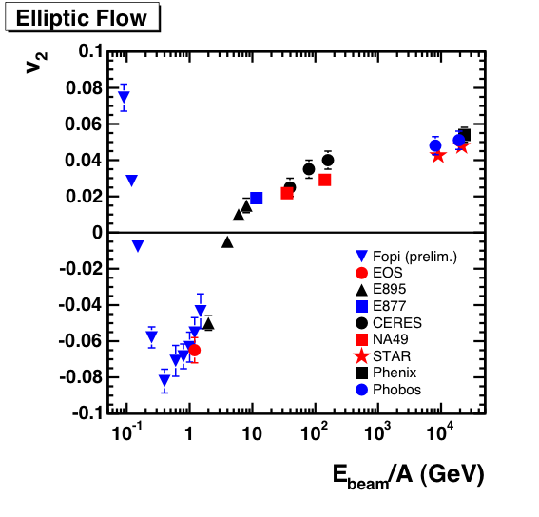
Elliptic Flow Measurements 1989-2002
RHIC
GANIL / MSU
SPS
AGS
y
ɸ=φ-Ψ_{R}
ψ_{R}
SIS18
x

Slide 19
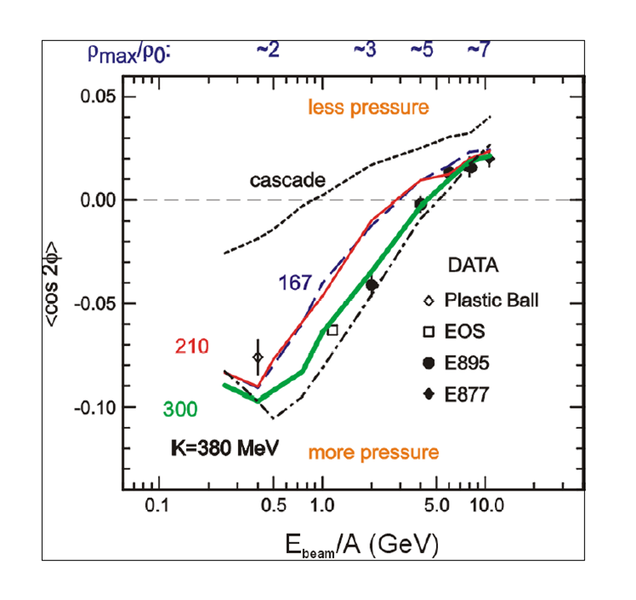
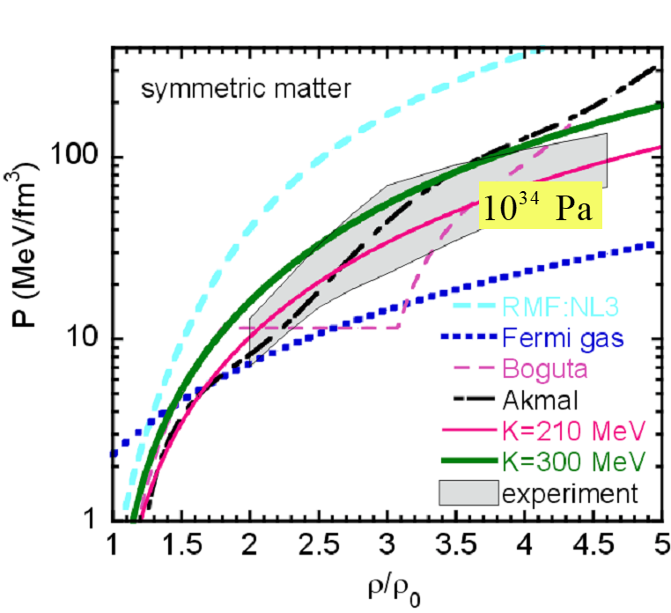
Flow at AGS: Constraints for the Hadronic EOS
Danielewicz, Lacey, Lynch, Science 298 (2002) 1592-1596
Passage time: 2R/(β_{cm}γ_{cm})
Expansion time: R/c_{s}
c_{s}=c√dp/dε - speed of sound
Flow at AGS/Nuclotron = Interplay of passage/expansion times

Slide 20
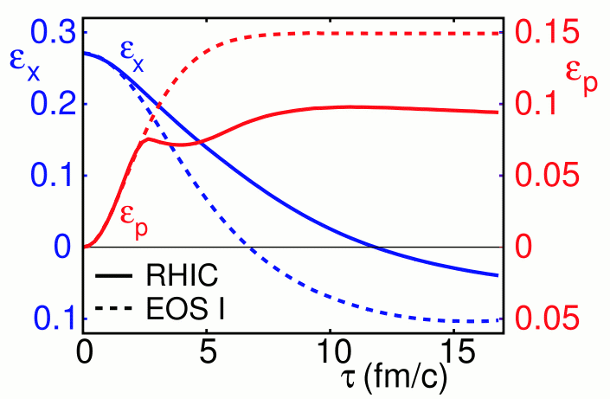
Elliptic Flow at RHIC
Z
Reaction plane
Y
X
P_{y}
P_{z}
The initial spatial anisotropy evolves (via interactions and density gradients ) →
Momentum-space anisotropy
P_{x}

Slide 21
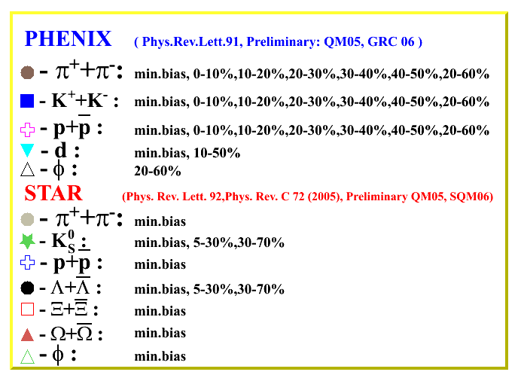
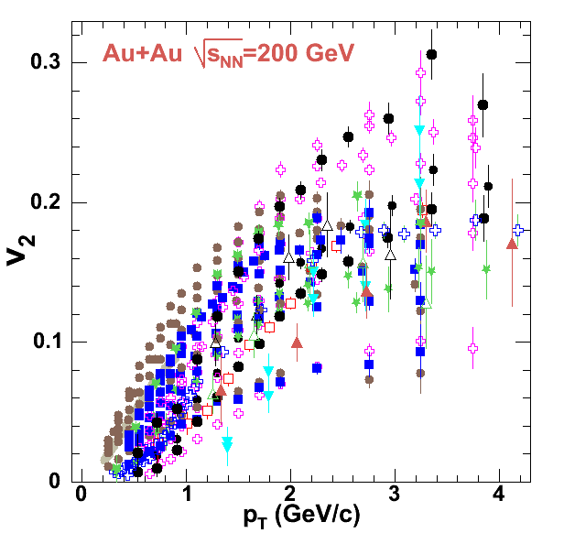
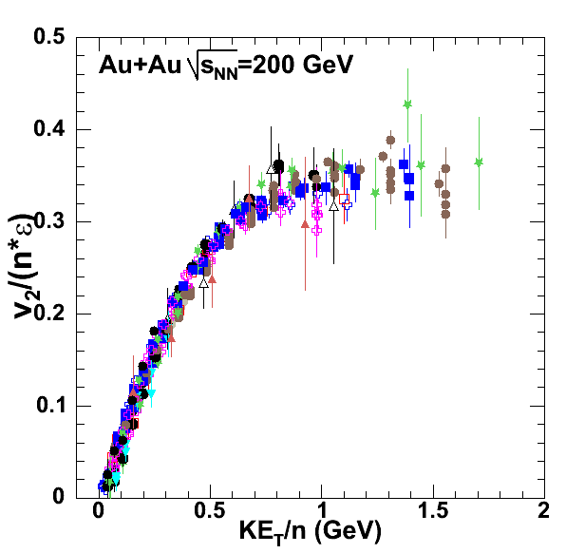


Anisotropic Flow at RHIC – scaling relations
= m_{T} – m
PoS 2006 (2006) 021
n=2 for mesons and n=3 for baryons

Slide 22







Anisotropic Flow at RHIC-LHC
Gale, Jeon, et al., Phys. Rev. Lett. 110, 012302
Phys. Rev. Lett. 122 (2019) 172301

Slide 23

Evolution of the system created in RHIC
Fireball is ~10⁻¹⁵ meters across and lives for ~10⁻²³ seconds
Initial state
QGP as a relativistic
fluid
Pre-equilibrium
dynamics
Hadronization
Transport/Freezeout
~20 fm/c
Time fm/c
0 fm/c
~1 fm/c
~10 fm/c
  Initial state (heavy Au+Au or Pb+Pb nuclei Lorentz contracted by ɣ~100 – RHIC, ɣ~ 1400 – LHC )
Pre-equilibrium state: hard parton scattering & jet production
Quark-gluon plasma formation: thermalization (viscous hydrodynamics)
Hadronization
Transport/Freeze-out: Rescattering & chemical freeze-out, Kinetic freeze-out (stop interacting)
~400 nucleons in 10⁻²² seconds = 1000-30000 hadrons

Slide 24










vHLLE+UrQMD: Elliptic and triangular flow in Au + Au collisions at 200 GeV
$$π^{±}$$
$$p,\overline{p}$$
3D hydro model vHHLE + UrQMD ( XPT EOS), η/s= 0.08
Reasonable agreement between results of vHLLE+UrQMD model and published PHENIX data

Slide 25


Slide 26


2022: Imaging the initial condition of heavy-ion collisions and nuclear structure across the nuclide chart
The extraction of the properties of the QGP, is currently limited by our poor knowledge of the initial condition, in particular how it is shaped from the colliding nuclei
To exploit collisions of selected species to precisely assess how the initial condition changes under variations of the structure of the colliding ions. (https://arxiv.org/abs/2209.11042)

Slide 27



2022: Nuclear structure via $V_{n}$ ratio
Phys.Rev.C 105 (2022) 1, 014901 • e-Print: 2109.00131
The $V_{n}$ ratio for isobars – not affected by final state – is a good tool for precision studies of nuclear shapes.

Slide 28


Relativistic Heavy-Ion Collisions and QCD Phase Diagram

Slide 29





Collision Energy and System Scan Programs
Map turn-off of QGP signatures
Location of the Critical End Point (CEP)?
Location of phase coexistence regions?
1st order phase transition signs
Detailed properties of each phase?
29
Notes:
29

Slide 30

Analogy: Phase Diagram of Water
Cross over
Critical point
1st order
phase boundary

Slide 31

STAR BES-I and BES-II Data Sets

Slide 32


Possible signals for the CEP
Lacey et. al,
Phys. Rev.Lett. 98 (2007) 092301
arXiv:0708.3512 (2008)
Csernai et. al,
Phys.Rev.Lett. 97 (2006) 152303
A. Dobado et. al,
Phys. Rev. D 79, 014002 (2009)
H₂O
Argon
At the CEP or close to it, anomalies in the dynamic properties of the medium can drive abrupt changes in transport coeﬃcients
Anisotropic flow (v_{n}) measurements are an invaluable probe

Slide 33

0.04
(a)
STAR Preliminary
Au+Au
0-40%
v₂/2
(b)
n = 3
0.3
v₃ v₄
STAR Preliminary
0.03
_{β}′ ′
0.2
v_{n}
0.02
0.01
0
0.1
10
100
10 100
√s_{NN}[GeV]
√s_{NN}[GeV]
V_{n} shows a monotonic increase with beam energy. The viscous coefficient, which encodes the transport coefficient (𝜼/𝒔), indicates a non-monotonic behavior as a function of beam energy.

Slide 34

STAR data: Anomalies in the Pressure and ɳ/s?
PRL 112,162301(2014)
PRL 116, 112302 (2016)
Region of interest √s_{NN}≲20 GeV, however, is complicated by a changing B/M ratio, baryon transport dynamics, longer nuclear passing times, etc. Requires concerted modeling effort.

Slide 35



Beam Energy Dependence of Elliptic Flow (v₂)
EPJ Web Conf. 204 (2019) 03009
Strong energy dependence of v₂ at √s_{NN} = 3-11 GeV
  v₂≈0 at √s_{NN} = 3.3 GeV and negative below

Slide 36




Elliptic Flow (v₂) at NICA energies: Models vs Data
at √s_{NN} ≥ 7.7 GeV pure string/hadronic cascade models underestimate v₂ – need hybrid models with QGP phase (vHLLE+UrQMD, AMPT with string melting,…)

Slide 37



Anisotropic Flow at Nuclotron/NICA energies: Models vs Data
Phys.Rev.C 103 (2021) 3, 034908
at √s_{NN} ≥ 3-4.5 GeV pure hadronic models give similar v₂ signal compared to STAR data

Slide 38



Why do we need new measurements at BM@N and MPD?
Au+Au at 200 Gev
The main source of existing systematic errors in $v_{n}$ measurements is the difference between results from different experiments at the same collision energy.
A good measurement should be reproducible; in particular, it should be done in such a way that one can easily compare results from different experiments, using different detectors.
Phys.Rev. C87 (2013) 4, 044907, Matthew Luzum, Jean-Yves Ollitrault

Slide 39

v₂ for pions and protons (MPD)
Flow has high sensitivity to the transport properties of the QCD matter: EoS, speed of sound (c_{s}), specific viscosity (η/s), etc.
Lack of existing differential measurements of v_{n} vs. p_{T}, centrality, species, etc.)
15 M of reconstructed UrQMD events for AuAu@7.7 GeV
Reconstructed and generated v₂ of pions and protons are in good agreement for all methods
Notes:
39
39
39
39

Slide 40


Possible signals for the CEP
Dirk Rischke and Miklos Gyulassy
Nucl.Phys.A608:479-512,1996
Dirk Rischke and Miklos Gyulassy
Nucl.Phys.A608:479-512,1996
In the vicinity of a phase transition or the CEP, the sound speed is expected to soften considerably.
In the vicinity of a phase transition or the CEP anomalies in the space-time dynamics can enhance the time-like
component of emissions.
HBT measurements are an invaluable probe

Slide 41
Finite-Size Effects and search for CEP
In HIC, both the size (L) and duration of formed system are finite.
Critical behavior changes with L
If the L is too small, the correlation length ξ can not be fully
developed to cause a phase transition.
if the correlation length
the finite-size effect is not negligible and only a pseudo-critical point, shifted from the genuine CEP, is observed.
large L
small L
Note change in peak heights
positions & widths with L
Finite-size effects have a specific dependencies on size (L)
The scaling of these dependencies give access to the CEP’s location, it’s critical exponents and scaling function.

Slide 42


HBT measurements
Two particle Interferometry Studies
caused by quantum (Bose or Fermi) interference
between the two identical particles.
Fits to the correlation functions
→ HBT radii (R_{out}, R_{side}, R_{long}) as a function of centrality, m_{T}, etc
$R_{long}$ is aligned with the beam direction, $R_{out}$ points along the center-of momentum of the particle pair, and $R_{side}$ is perpendicular to both.

Slide 43


HBT Radii
STAR - 1403.4972
ALICE -PoSWPCF2011
Exquisite data set for combined RHIC-LHC results?

Slide 44

Interferometry as a susceptibility probe
.
Adare et. al. (PHENIX) arXiv:1410.2559
Hung, Shuryak, PRL. 75,4003 (95)
Chapman, Heinz, PRL.74.4400 (95)
Makhlin, Sinyukov, ZPC.39.69 (88)
emission
duration
emission
lifetime
  (R_{side} - R_{init})/ R_{long} sensitive to c_{s}
Specific non-monotonic patterns expected as a function of √s_{NN}
  A maximum for (R²_{out} - R²_{side})
  A minimum for (R_{side} - R_{initial})/R_{long}

Slide 45
Roy A. Lacey
Phys.Rev.Lett. 114 (2015) 14, 142301
Data from L. Adamczyk et al. (STAR)
Phys.Rev. C92 (2015) 1, 014904
Large L
small L
The data validate the expected patterns for Finite-Size Effects
  Max values decrease with decreasing system size
  Peak positions shift with decreasing system size
  Widths increase with decreasing system size

Slide 46

High-energy heavy-ion reaction data
Galactic Cosmic Rays composed of nuclei (protons, … up to Fe) and E/A up to 50 GeV
These high-energy particles create cascades of hundreds of secondary, etc. particles
Cosmic rays are a serious concern to astronauts, electronics, and spacecraft.
The damage is proportional to Z², therefore the component due to ions is important
Damage from secondary production of p, d, t, ³He, and ⁴He is also significant
Need input information for transport codes for shielding applications (Geant-4, Fluka, PHITS, etc.):
  total, elastic/reaction cross section
  particle multiplicities and coellecense parameters
  outgoing particle distributions: d²N/dEdΩ
Notes:
46
46
46
46

Slide 47



High energy heavy ion reaction data
NICA can deliver different ion beam species and energies:
  Targets of interest (C = astronaut, Si = electronics, Al = spacecraft) + He, C, O, Si, Fe, etc.
No data exist for projectile energies > 3 GeV/n
dE/dx vs momentum in TPC
m² vs. momentum in TOF
MPD has excellent light fragment identification capabilities in a wide rapidity range → unique capability of the MPD in the NICA energy range
Notes:
47
47
47
47

Slide 48


Summary
NICA open unique opportunities for the exploration of the properties of dense nuclear matter. Complementary energy range, large discovery potential.
Preparation of the MPD detector and experimental program is ongoing, all activities are continued
All components of the MPD 1-st stage detector are in advanced state of production
Commissioning of the MPD Stage-I detector is expected in 2023
Start of data t aking with BiBi@9.2 in 2024
BM@N first physics run with Xe+CsI ($\sqrt{s_{NN}}$ = 2.3-3.3 GeV) – November 2022
Further program will be driven by the physics demands and NICA capabilities

Slide 49


Multi-Purpose Detector (MPD) Collaboration
MPD International Collaboration was established in 2018
to construct, commission and operate the detector
10 Countries, >450 participants, 31 Institutes and JINR
Organization
Acting Spokesperson: Victor Riabov
Deputy Spokesperson: Zebo Tang
Institutional Board Chair: Alejandro Ayala
Project Manager: Slava Golovatyuk
Joint Institute for Nuclear Research;
AANL, Yerevan, Armenia;
University of Plovdiv, Bulgaria;
Tsinghua University, Beijing, China;
USTC, Hefei, China;
Huzhou University, Huizhou, China;
Institute of Nuclear and Applied Physics, CAS, Shanghai, China;
Central China Normal University, China;
Shandong University, Shandong, China;
IHEP, Beijing, China;
University of South China, China;
Three Gorges University, China;
Institute of Modern Physics of CAS, Lanzhou, China;
Tbilisi State University, Tbilisi, Georgia;
FCFM-BUAP (Heber Zepeda) Puebla, Mexico;
FC-UCOL (Maria Elena Tejeda), Colima, Mexico;
FCFM-UAS (Isabel Dominguez), Culiacán, Mexico;
ICN-UNAM (Alejandro Ayala), Mexico City, Mexico;
Institute of Applied Physics, Chisinev, Moldova;
Institute of Physics and Technology, Mongolia;
Belgorod National Research University, Russia;
INR RAS, Moscow, Russia;
MEPhI, Moscow, Russia;
Moscow Institute of Science and Technology, Russia;
North Osetian State University, Russia;
NRC Kurchatov Institute, ITEP, Russia;
Kurchatov Institute, Moscow, Russia;
St. Petersburg State University, Russia;
SINP, Moscow, Russia;
PNPI, Gatchina, Russia;
Vinča Institute of Nuclear Sciences, Serbia;
Pavol Jozef Šafárik University, Košice, Slovakia

Slide 50
Weak decays of strange baryons - I
Strangeness production probes the EoS, phase boundaries and onset of deconfinement
Antibaryon-to-baryon ratios at intermediate momenta are sensitive to CEP (a falling trend in contrast to a constant behavior in the scenario without CEP)
AuAu@11 GeV (PHSD):
Acta Physica Polonica B 14 (2021) 3, 529-532
  Strange baryons can be reconstructed with good S/B ratios using charged hadron identification
  in the TPC&TOF and different decay topology selections
  Relative yields of the baryons for ~ 500 M sampled events:

Slide 51


More hypernuclei
Information on YN interactions, strange sector of nuclear EoS, astrophysics
BiBi@9.2 GeV (PHQMD):
The Monte Carlo event sample was enriched by hypernuclei distributed according to the η-p_{T} phase space predicted by the PHQMD generator
Signals for heavier hypernuclei can be seen with the equivalent statistics of ~140 M events

