Slide 1
SPD cryogenic system
Nikiforov Dmitry
1

Slide 2
Outline
Cryogenic system
Cryogenic equipment
2.1. Helium system
2.2. Nitrogen system
2.3. Other systems
3. Steps creation & costs
4. Conclusions

Slide 3
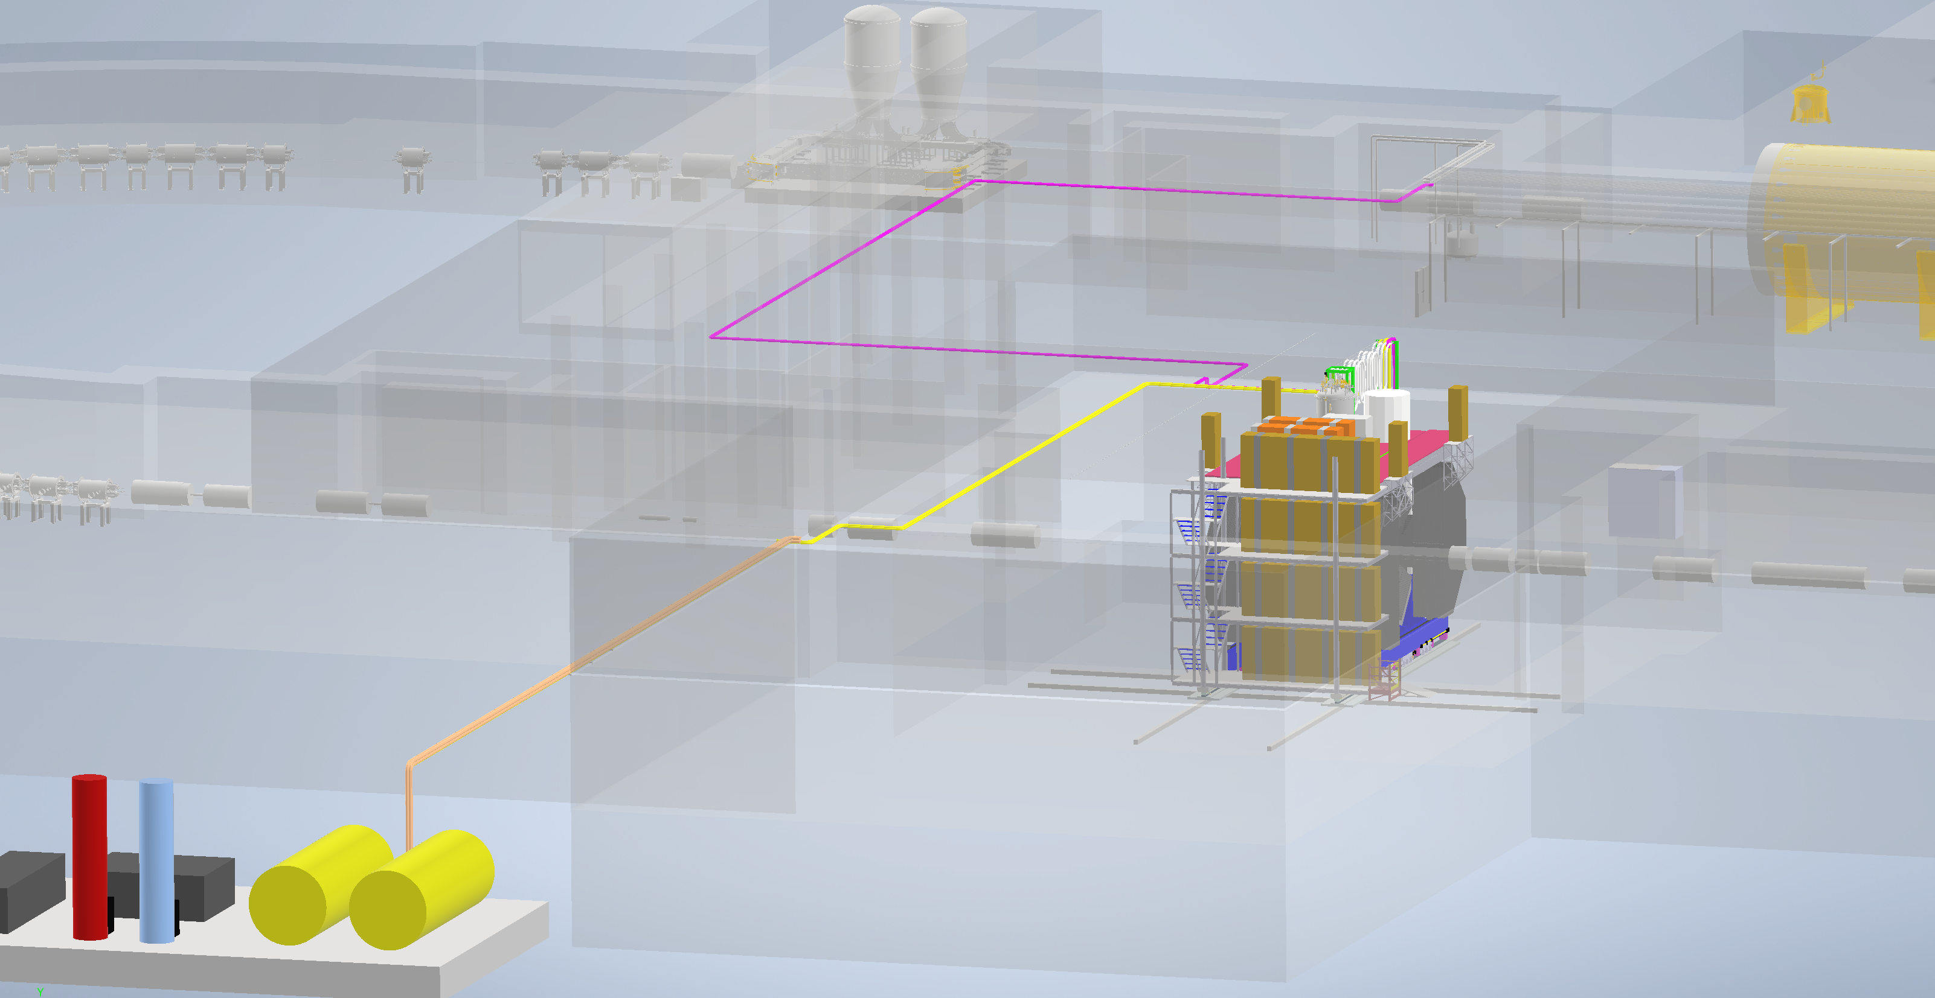
Cryogenic system
Helium pipeline
Helium refrigerator
N2 pipeline
N2, Ar, CO2 pipelines
Cryogenic storage tanks
3

Slide 4
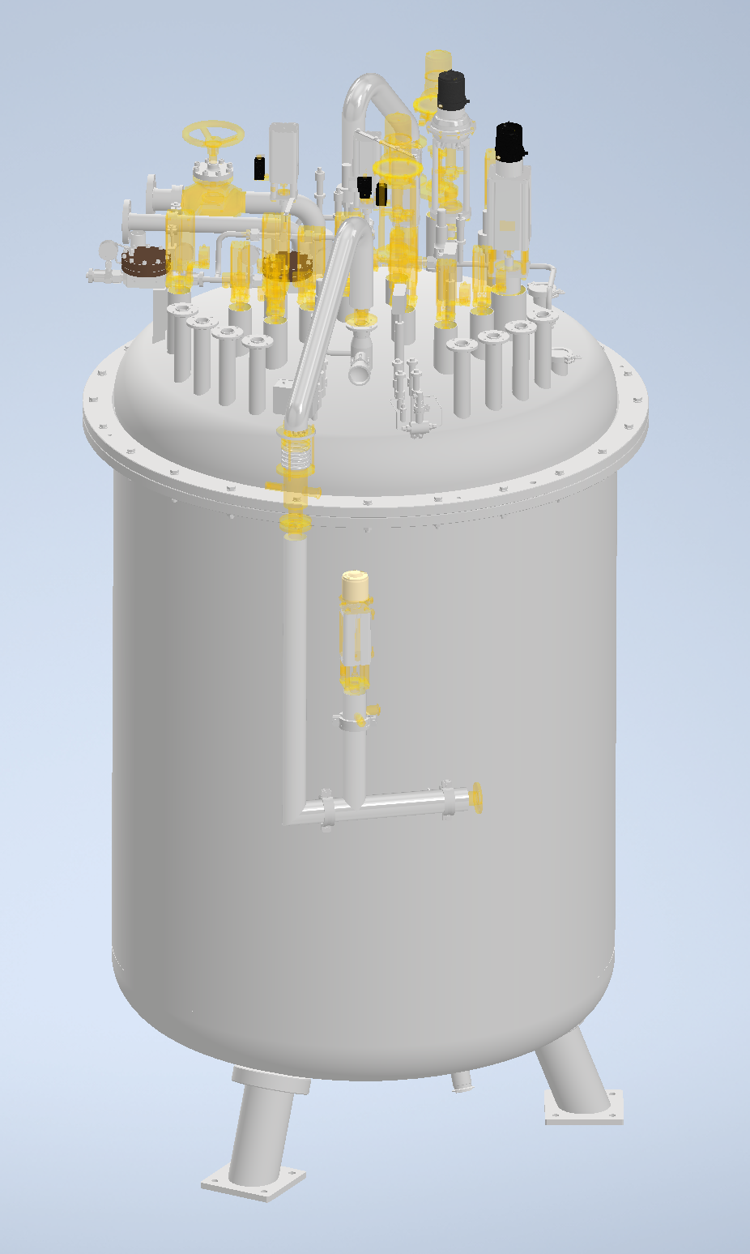
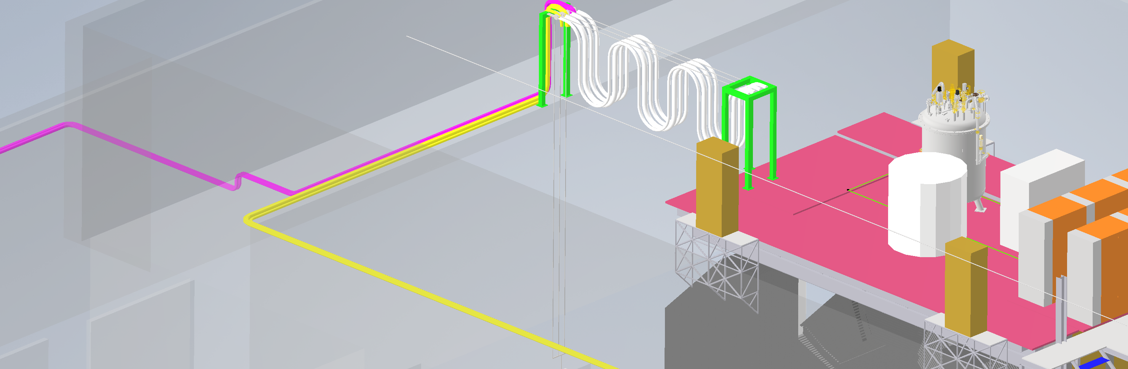
2.1. Helium system
Refrigerator
Pipelines
4

Slide 5
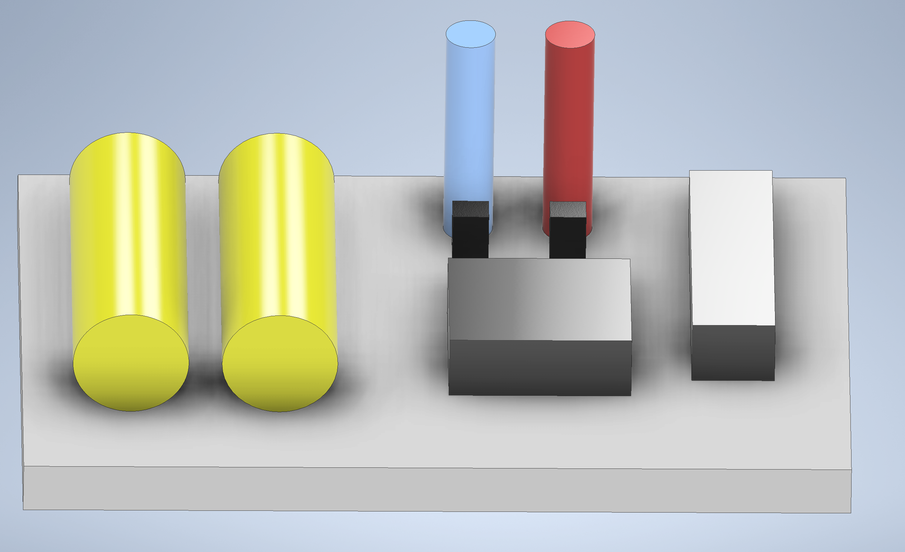
2.2. Nitrogen system
1
2
3
Pipelines
7
4
5
Cryogenic line
LN2 – 120 m (rigid tube)
LN2 – 40 m (flexible tube)
Warm line
Ar – 100 m (rigid tube)
N2 – 100 m (rigid tube)
CO2 – 100 m (rigid tube)
6
Cryogenic tanks platform
1 – Two storage tanks for LN2, 2 – Storage tank for LAr, 3 – Storage tank for LCO2, 4 – Evaporator for LAr, 5 – Evaporator for LCO2, 6 – Storage bottles, 7 – Equipment room.
5

Slide 6
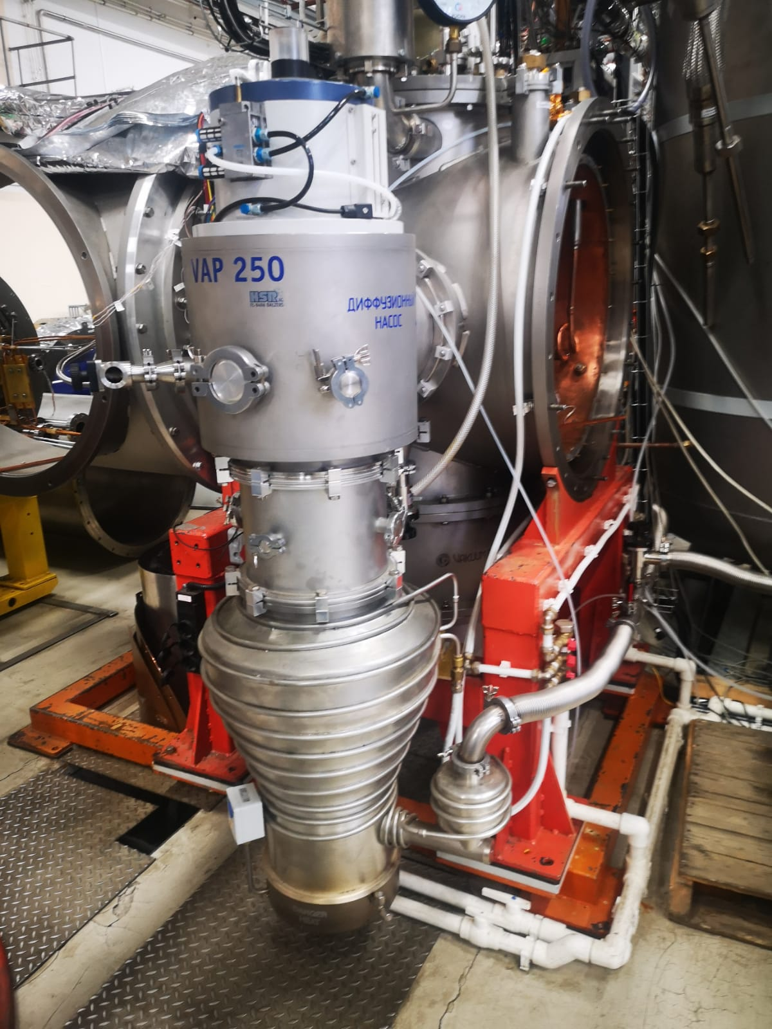
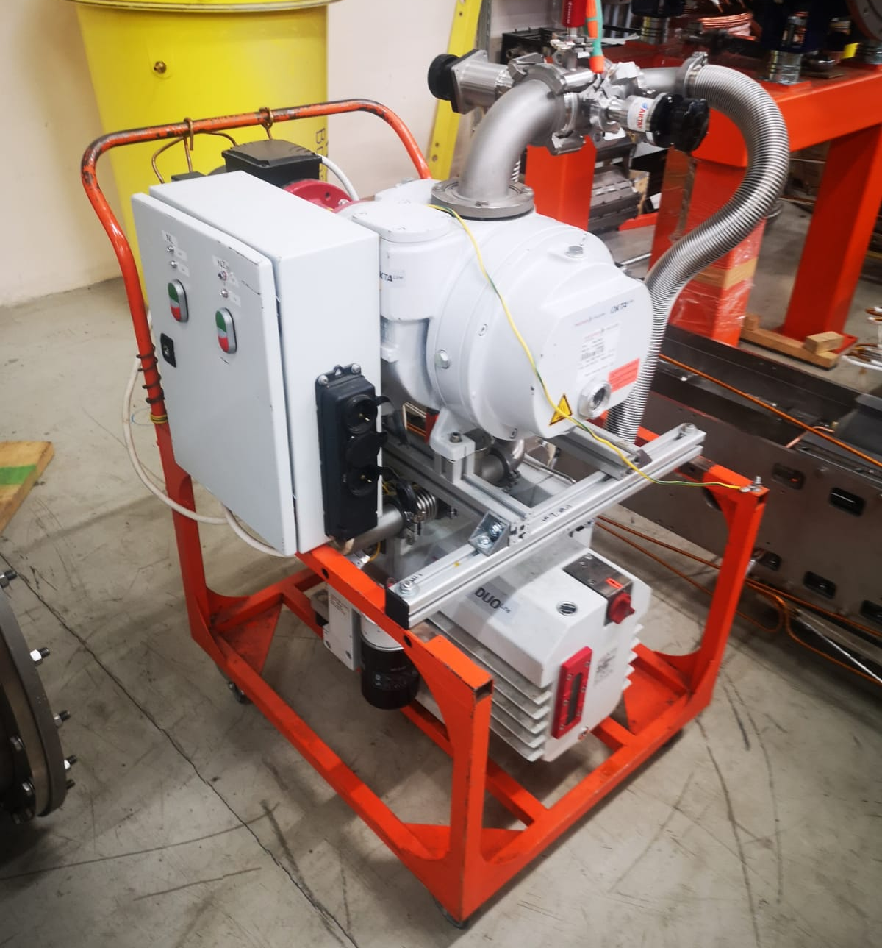
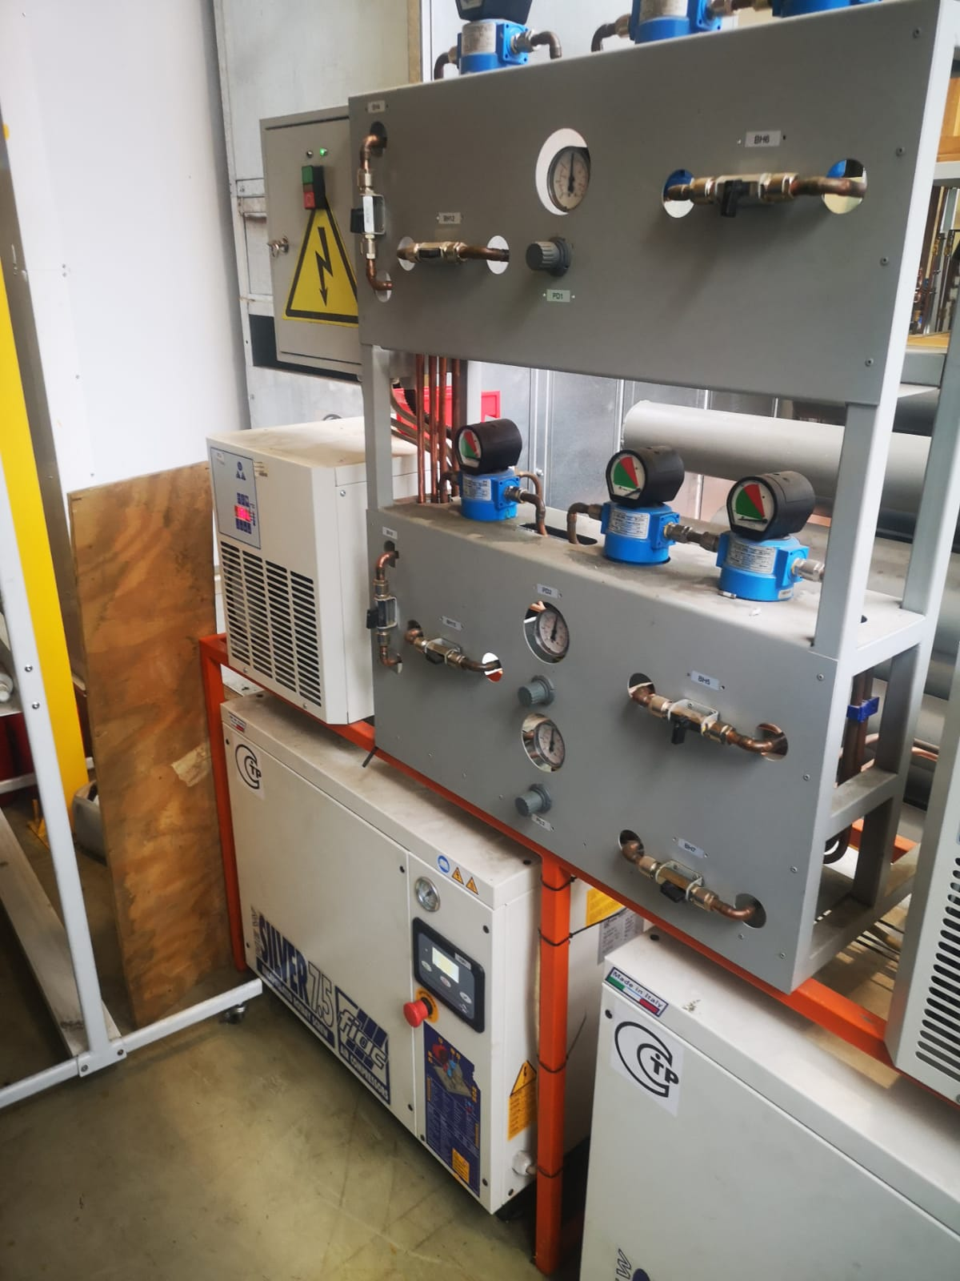
2.3. Other systems
- Vacuum system
- Pneumatic system
Diffusion vapor pump and pumping station with two foreline pumps
6

Slide 7
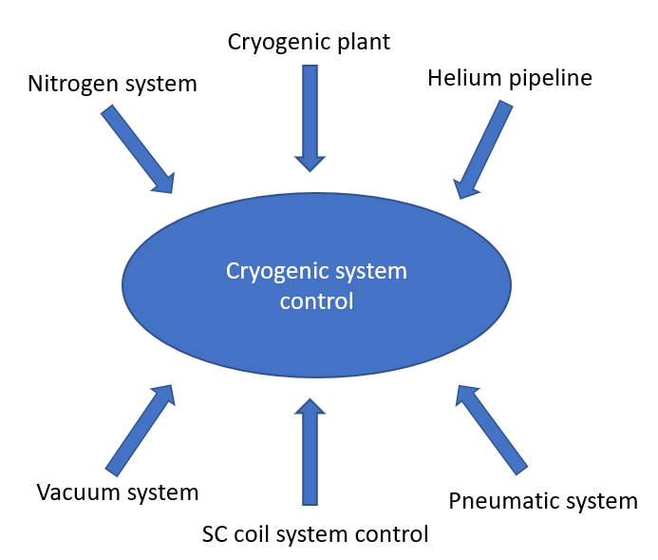
2.3. Other systems
- Cryogenic system control
7

Slide 8
3. Estimating the costs and power consumption of systems
 | Name of system | Costs, к$ | Power, kW
1 | Cryogenic plant | 3 330 | 2
2 | Helium pipeline | 500 | -
3 | Nitrogen system | 1 500 | 2
4 | Vacuum subsystem | 500 | 14
5 | Pneumatic subsystem | 50 | 3
6 | Cryogenic system control | 500 | 2
 | Total | 6 380 | 23
8

Slide 9
Steps creation
SPD | 2022 |  |  |  | 2023 |  |  |  | 2024 |  |  |  | 2025 |  |  |  | 2026 |  |  |  | 2027
 | I | II | III | IV | I | II | III | IV | I | II | III | IV | I | II | III | IV | I | II | III | IV | I | II | III | IV
Cryogenic plant
Helium pipeline
Nitrogen system
Vacuum system
Pneumatic system
Cryogenic system control
 |  | Technical task |  |  |  |  | Contract execution |  |  |  |  |  | Assembly & Test |  |  |  |  | Commissioning

Slide 10
4. Conclusions
The cooling capacity, mass flow rate and working cycles of the cryogenic plant are calculated.
The development of technical tasks for a cryogenic plant and a platform for cryogenic storage tanks is in the active phase.
The work is carried out according to the plan.

Slide 11
Thank for your attention!

