Slide 1
Straw Tracker Barrel status report
Notes:
Good moning. I want to told about straw tracker in the different experiment.

Slide 2
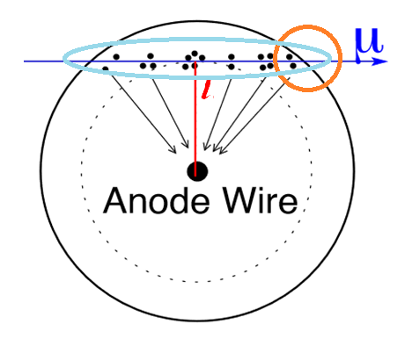
Detection process
Principle of a straw position measurement. A ionizing particle passes at the distance l from anode wire, creating ionization clusters along its path. The primary electrons will drift to the anode wire.
Explore the possibility of measuring the last electron in the track to use it as a trigger
It is necessary to measure the charge in the track to determine the value of dE/dx
Notes:
Principle of a straw position measurement. A ionizing particle passes at the distance r from anode wire, creating ionization clusters along its path. The primary electrons will drift to the anode wire. Measuring the drift time first came an electron we get the distance which flew from the anode a charged particle.

Slide 4
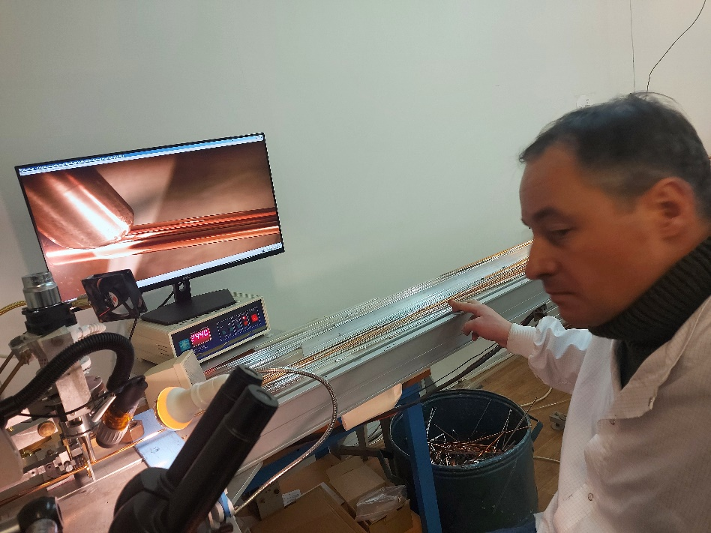
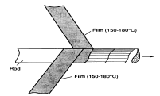
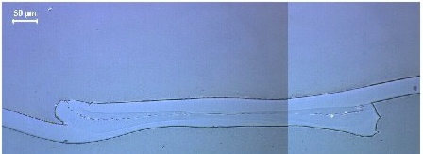
Two design of the straw-tube production
Straw winding. Two films revolve and stick together among themselves.
straw diameter from 2 mm to 18 mm
Ultrasonic welding of straws
straw diameter from 5 mm to 20 mm
both of these technologies are well developed at JINR
Notes:
The most popular two ways to manufacture straw. Wilding and ultrasonic welding. Two films revolve and stick together among themselves. This method has several drawbaks. One of which is elongation straw and falling tension. The advantage is a large overpressure limit. It is possible manufacture small radius straw-2mm.
Another method are ultrasonic welding and produced about 15km straw tubes in the NA62.

Slide 5
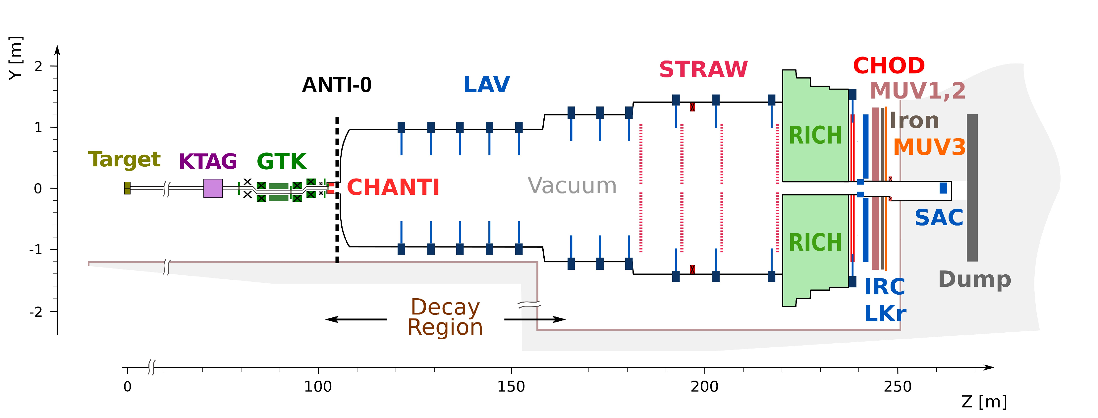
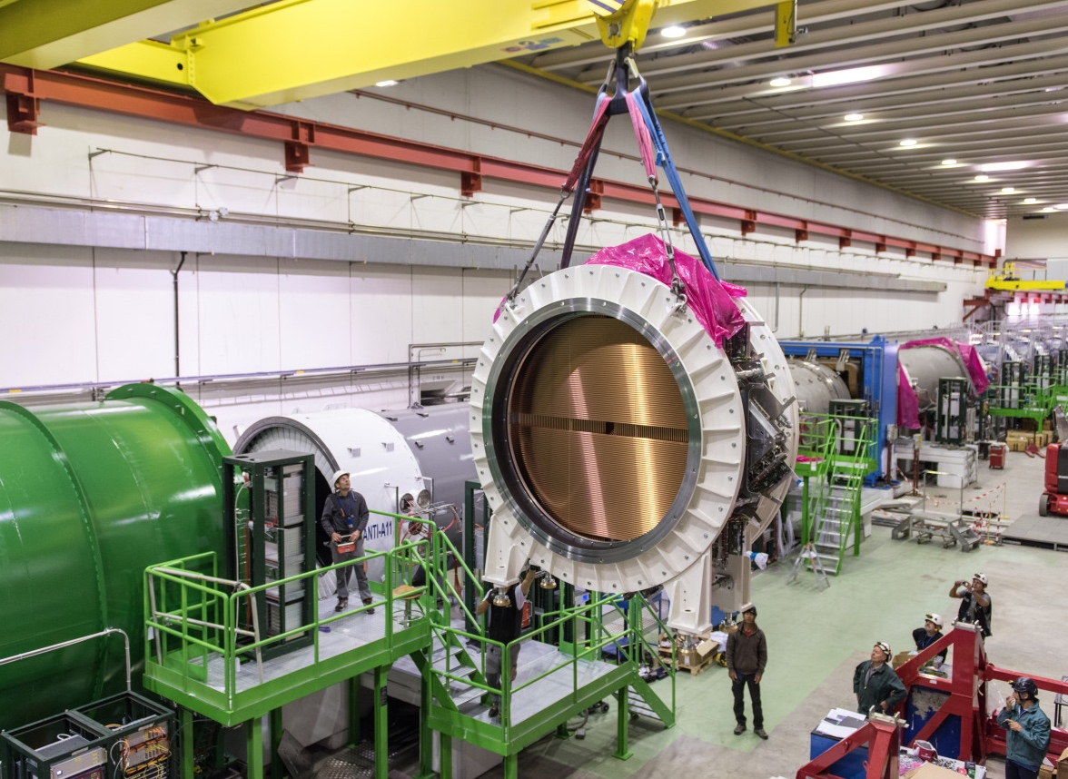
NA62(CERN,Geneva)
Current NA62 straw spectrometer:
Straw diameter: 9.8 mm
Material: 36 μm thick PET
Plating: 50 nm copper + 20 nm gold
Wire: 30 μm tungsten wire
Gas: Ar+CO₂ (70:30)
4 chambers, 7168 straws in vacuum
$∼$30 straw hits per track
Total material budget: 1.7% X₀
Dominated by the PET (70%)
Single straw timing performance:
Maximum drift time: $∼$150 ns
Leading time resolution: 3-4 ns
Trailing time resolution: $∼$30 ns
New straw detector, main features:
Smaller straw diameter: 4.8 mm
Maximum drift time reduced to $∼$80 ns
Trailing time resolution improved to $∼$6 ns
Keeping the 4 chambers layout, $∼$21000 straws
Number of hits per track increased to $∼$40
Thinner straw material: 19 or 12 μm thick PET
Lower total material budget: 1.0 – 1.5% X₀
Depending on the PET thickness option
Still dominated by the straw wall (60 – 70%)
Notes:
in this experiment, we made about 8000 straws.
the detector showed high reliability
Out of 8 thousand channels, only 1 channel failed in 5 years

Slide 6
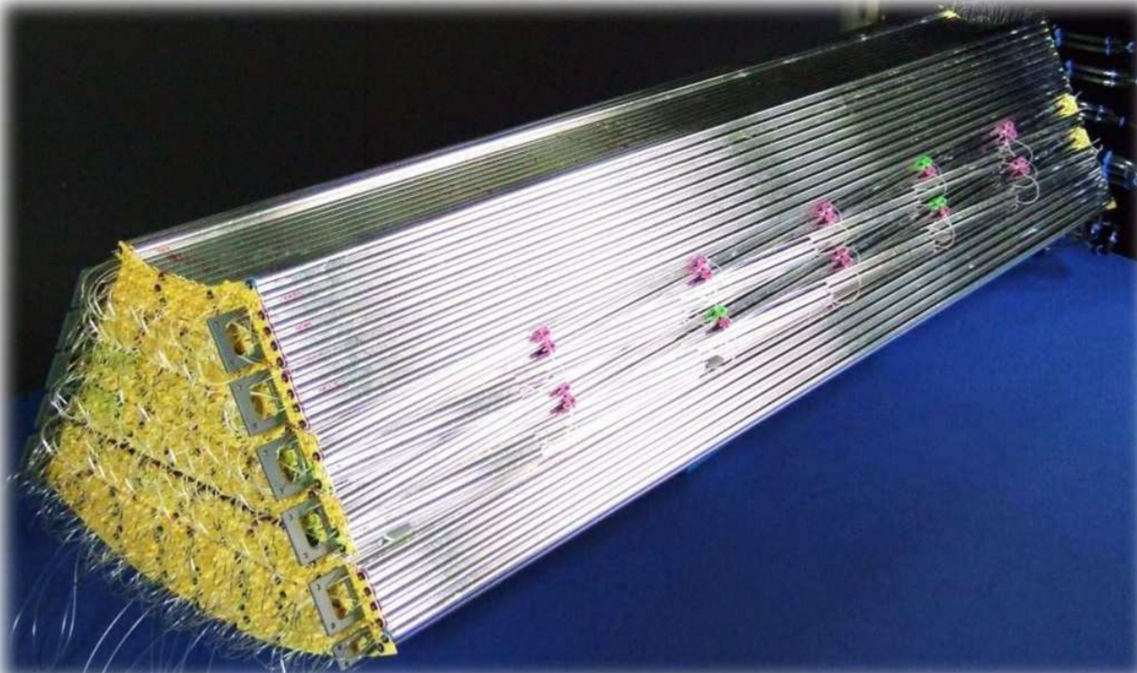
PANDA(FAIR,Darmstadt)
Notes:
the next experiment is panda
the idea of the design seems very original to us

Slide 7
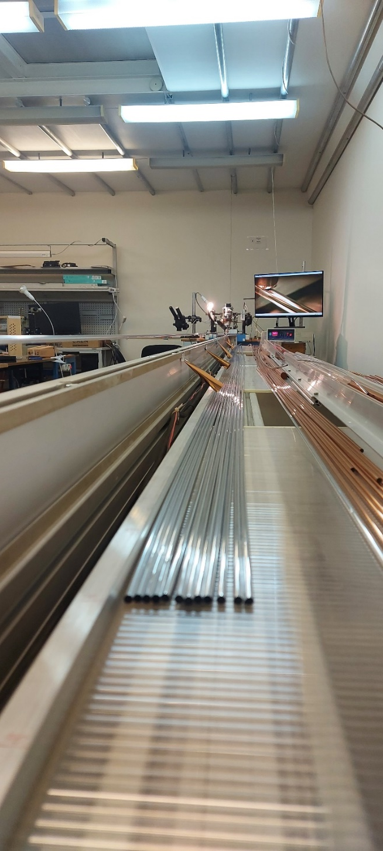
Mechanics
STRAW
Production- 1м/мin
Lenth- 5.5м
Diameter-от 5, 10, 20мм
thickness-15, 20, 36, 50 мкм
The film is available in Russia
Coating is available in the Russian Federation

Slide 8
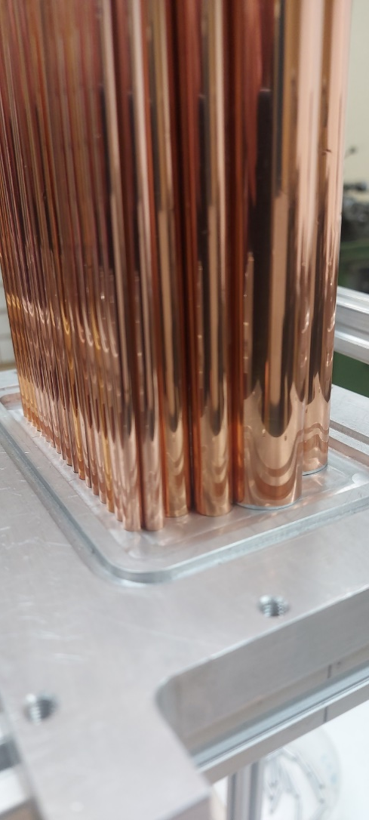
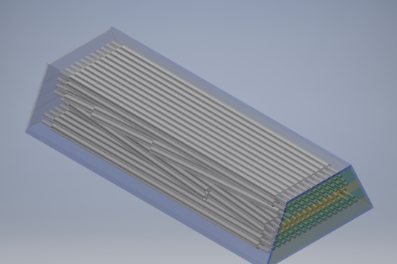
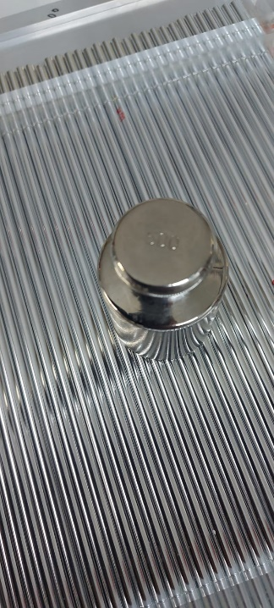
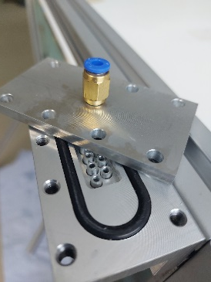
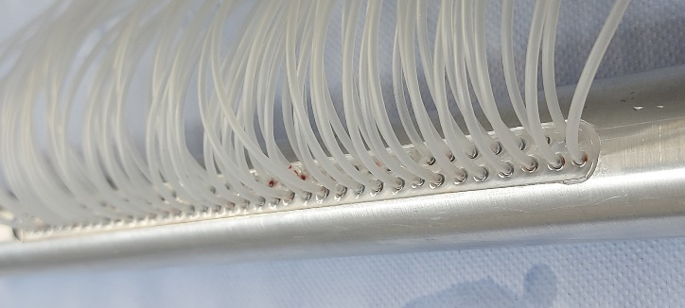
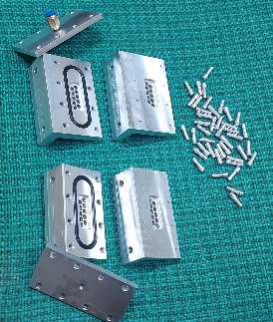
Mechanics
Components
Pins for anod
Endplag for straw
Adhesives
Crimpers
Prototypes
Straws different diameter 5,10,20mm(110str)
Prototyp ZUV(~110str)

Slide 9
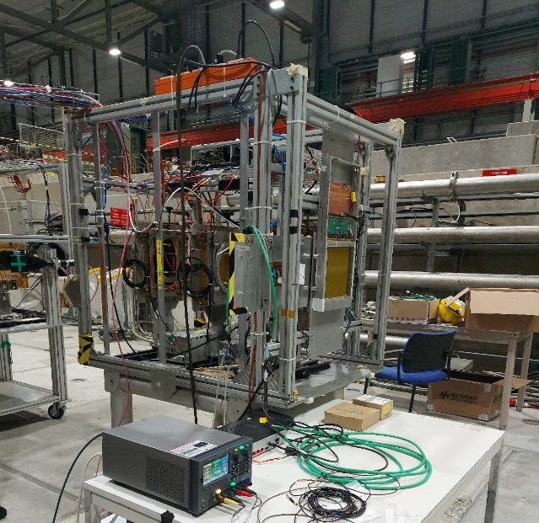
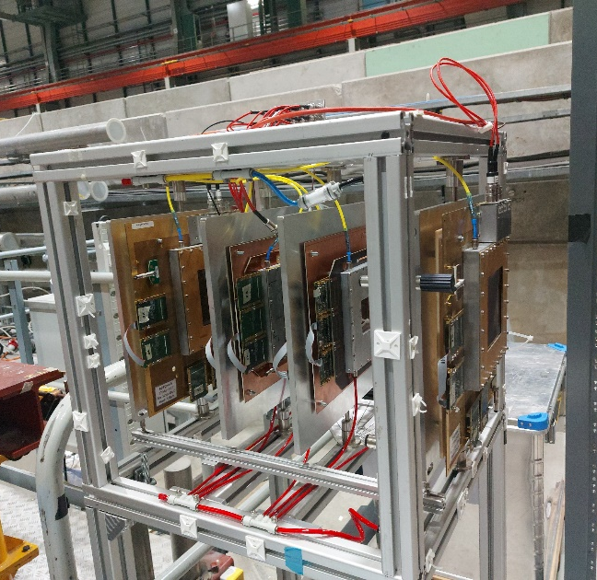
Test beam activities
Setup 1
Setup 2
Setup 3
CERN, H4
4GEM +straw station
VMM3a readout
CERN, H4
4GEM +straw station
VMM3 readout
SRS +APV25 readout
CERN, H4 + H8
4GEM +straw station
TIGER readout

Slide 10
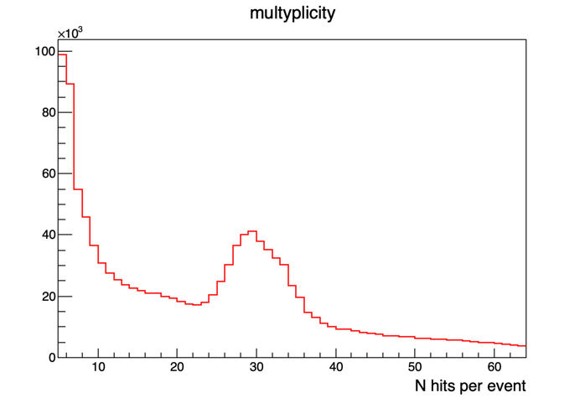
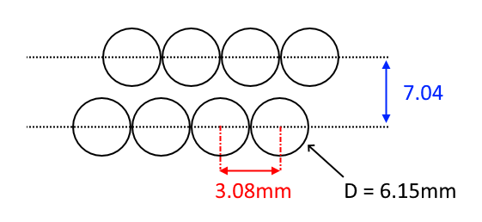
ROTATED SETUP
Goal:
Minimalistic (self)tracking with 32 straws – possibility to get rough(?) coordinate information from straws themselves
Possibility to get rough R-T dependence
Very rough estimate: O(100k) tracks for every HV and gain settings
Data treatment requites a quite sophisticated analysis
2x32 straws
Notes:
10

Slide 11
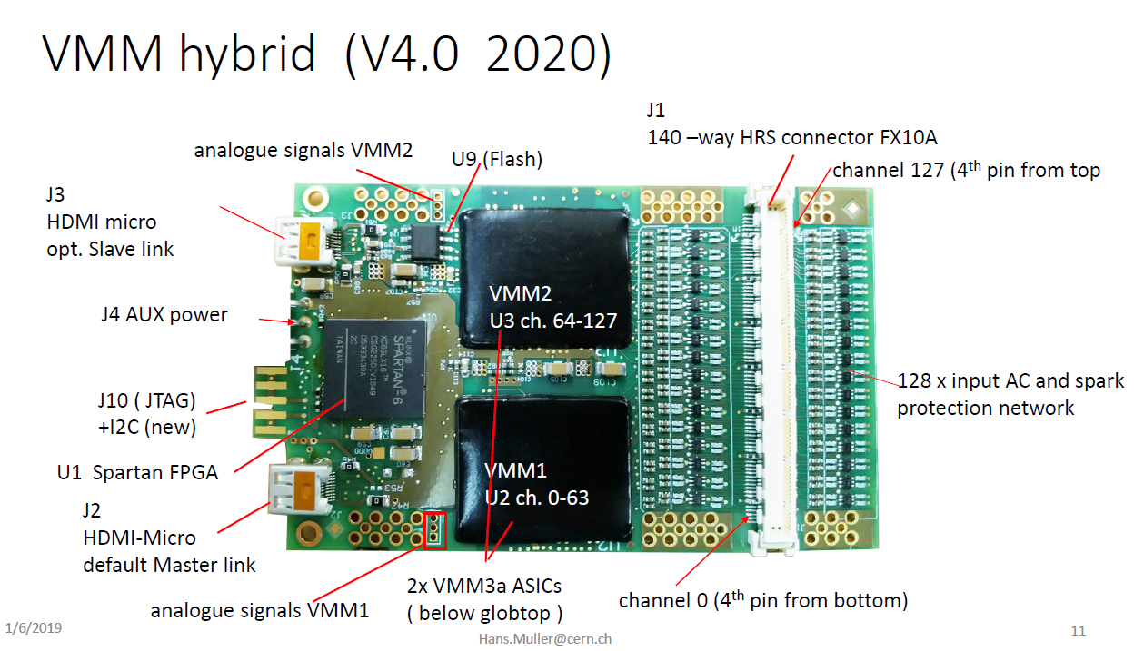
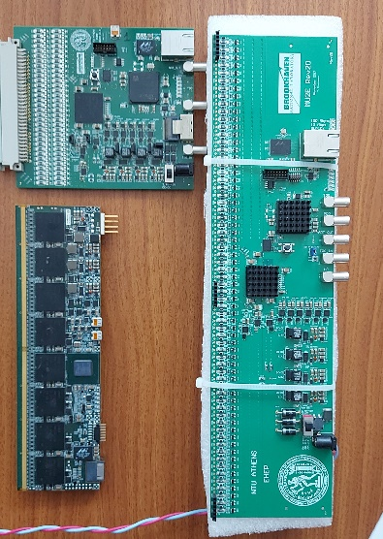
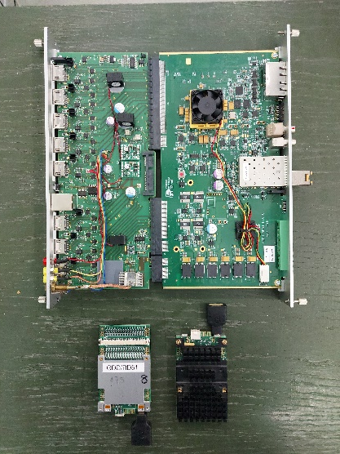
Conclusion
Decision on the choice of electronics
Works on the creation of ASIC.
Creating a prototype and obtaining experimental data on test beams
Reconstruction of the miniSPD stand (replacement of silicones, install GEM detectors)
Reconstruction of the miniDAQ stand (Konorov's import substitution)
Collaboration with RD 51, DUNE, NA62, NA64 to work in straw tracker to find the optimal solution for electronics

