Slide 1
SPD collaboration meeting
3-6 October 2022
SPD ECAL status 2022
ECAL position inside of Cryostat
ECAL Support inside of Cryostat
End-Cap Module design – cell sizes 55x55 mm² and 40x40 mm²
Test results with SiPm S14160-6015 and EQR15-60
04.10.2022
Oleg Gavrishchuk
1
Notes:
1
1

Slide 2
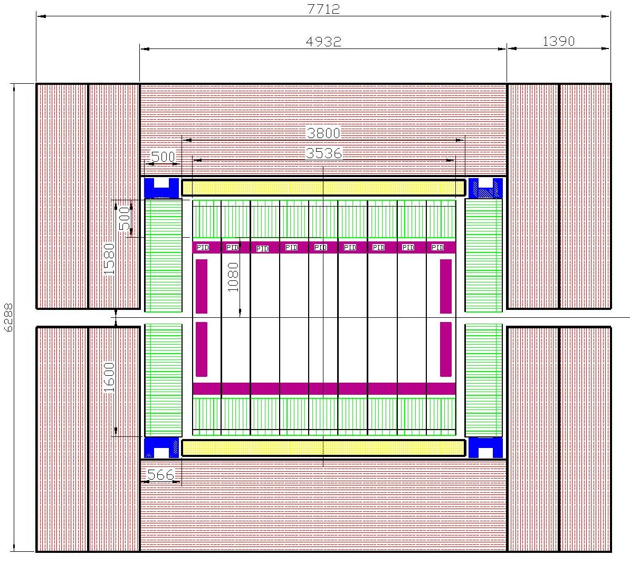
ECAL position (green) in the Cryostat (yellow), PID (magenta)
and RS (red)
EC-support (blue)
ECAL Barrel is located inside of Cryostat and Range System (RS), as shown by green hatched boxes.
ECAL End Cups are located inside of RS
The calorimeter sizes determine by :
Thickness itself;
Criostat diameter;
- Outer size of PID.
04.10.2022
Oleg Gavrishchuk
2
Notes:
2
2

Slide 3
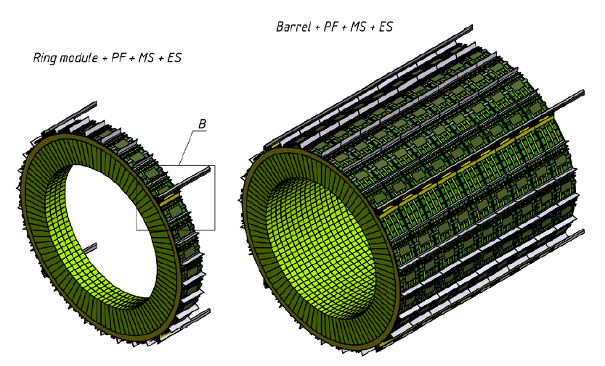
ECAL Barrel 3D View
04.10.2022
Oleg Gavrishchuk
3

Slide 4
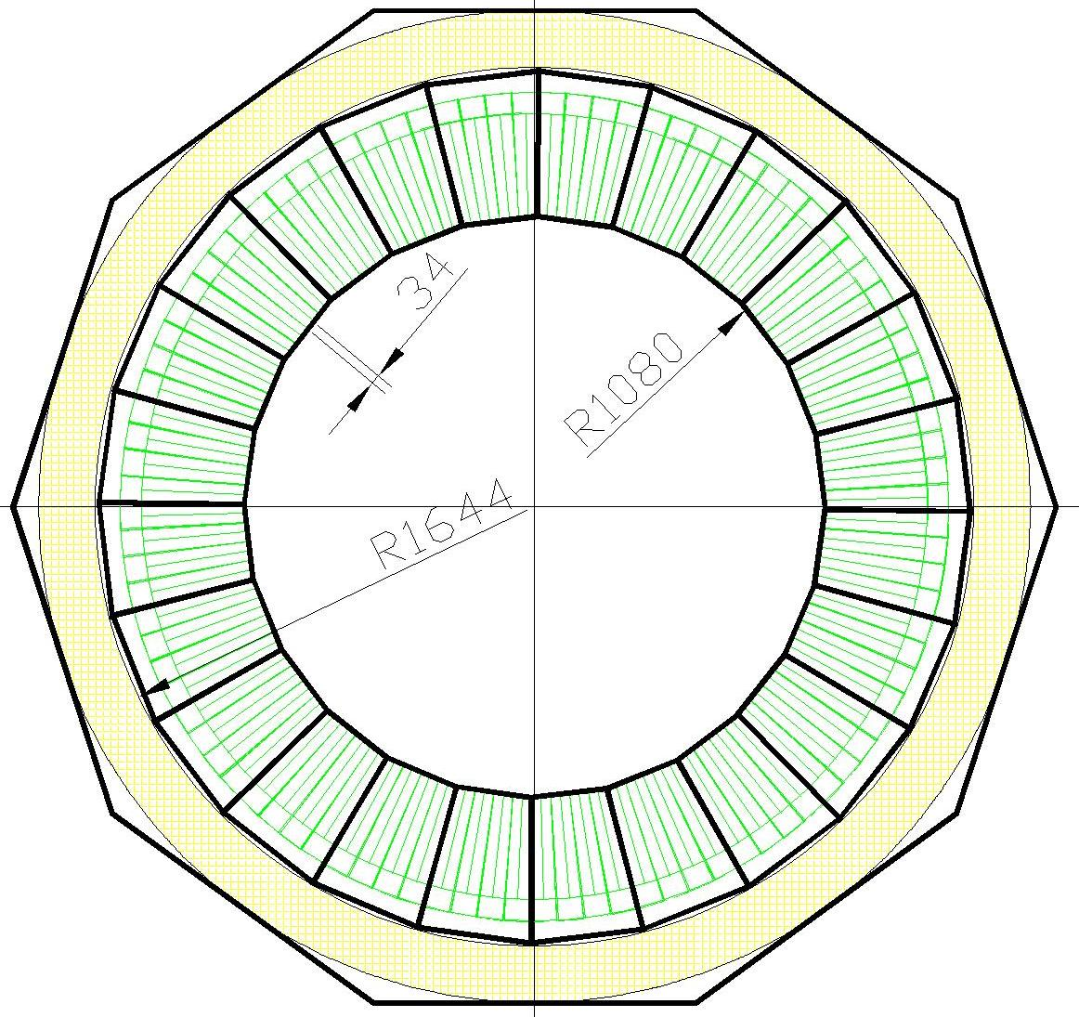
ECAL Barrel composition
Concept:
Barrel consist from 9 Rings
One Ring divided on 24 sectors
Sector connected to One ADC_64
Air cooling assumed
Cables can fixed along the sector
Ring : 1536 cells, ~4.0 t
9 Rings: 13824 cells, ~44 t
FrontEnd Numbers:
Channels: 13824
ADCs : 216
Frontend cards : 864
HV units: 10
Power (kW):
ADC : 4.8
Frontend cards : 1.0
HV: 1.1
Total: ~7.0
04.10.2022
Oleg Gavrishchuk
4

Slide 5
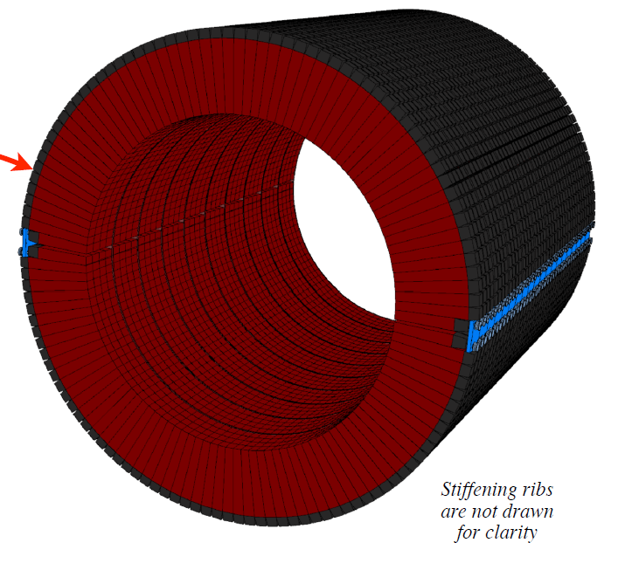
Barrel ECAL mounting inside of the cryostat
Concept:
Rails welded to Cryostat inner side
Roller fixed on the ECALs ring
ECAL ring is rolled into the cryostat
04.10.2022
Oleg Gavrishchuk
5

Slide 6
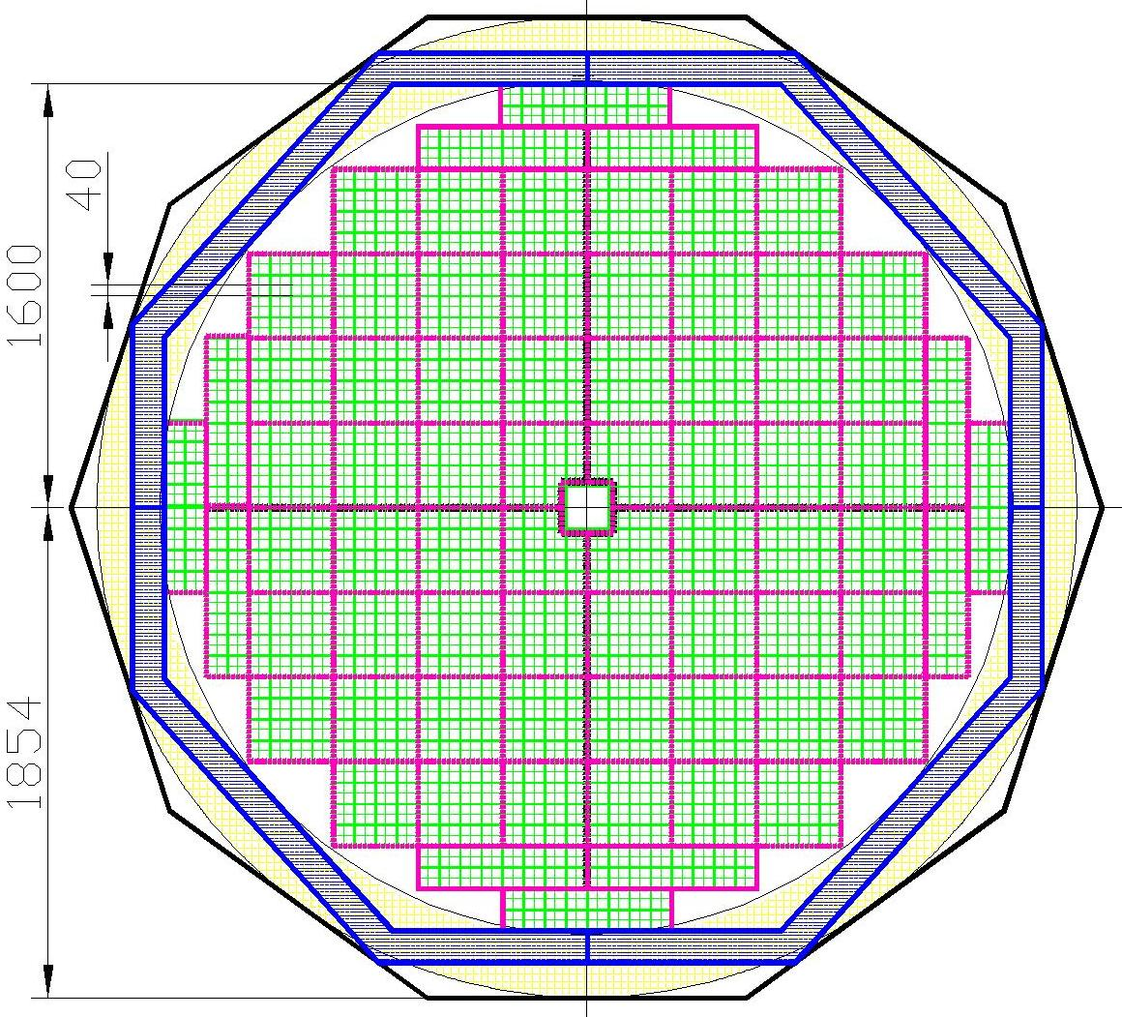
One End-Cap consists from: 3576 cells of 40x40 mm²; The weight – 12 tonn (include Frame) Frontend Numbers and Power : ADC64 – 56 – 1200 W Amp_16 ch – 224 – 200 W Power unit – 8 – 800 W Total Power (One) – 2.2 kW End-Cap – installed in a frame that supports it. The frame is mounted directly to the RS as shown in this figure. All dimensions on driving left are in millimeters. The hole size in center: 320 ×320 mm².
ECAL End Cup composition
6

Slide 7
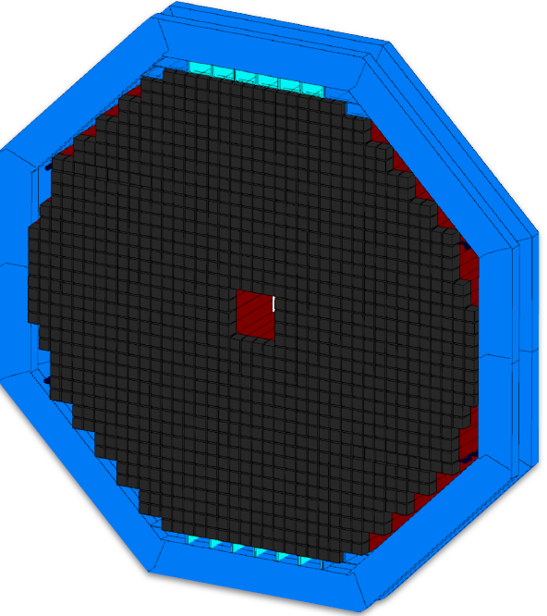
ECAL 3D view
End Cup mounted in Supported Frame.
The Frame is installed in Range System, as supported base.
Central hole is equal 320x320 mm² .
This hole size is equal of 16 modules of 80x80 mm² (matrix 4x4).
7

Slide 8
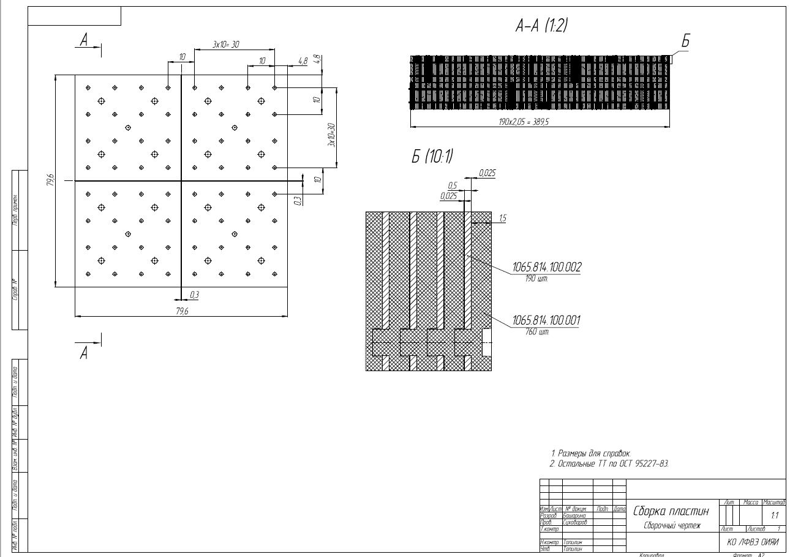
8
Possible Module design For End Cup :
module consist from 4 cells of 40x40 mm²
180 layers 1.5 mm Scint. and 0.5 mm Lead (380 mm active part)
Total lengt ~ 500 mm
Gavrishchuk O.
8
Notes:
8
8

Slide 9
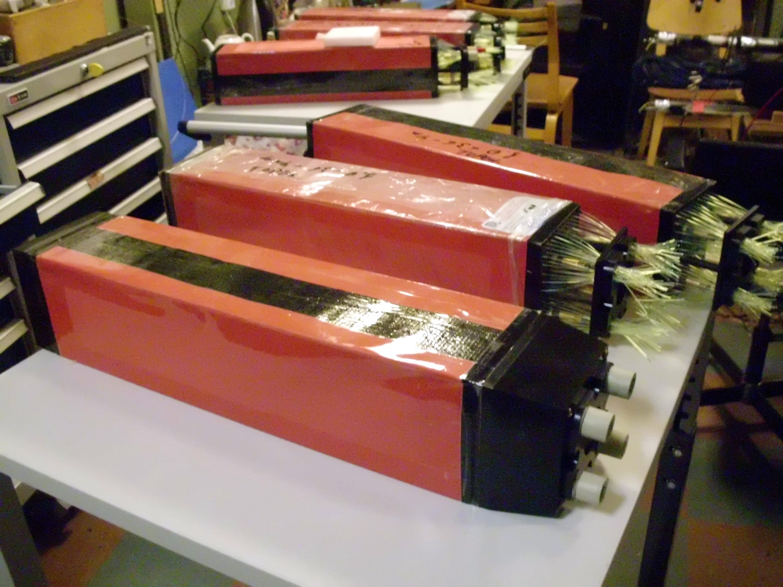
25 ECAL modules with cell size 55x55 mm² were manufactured in 2021-2022
9

Slide 10
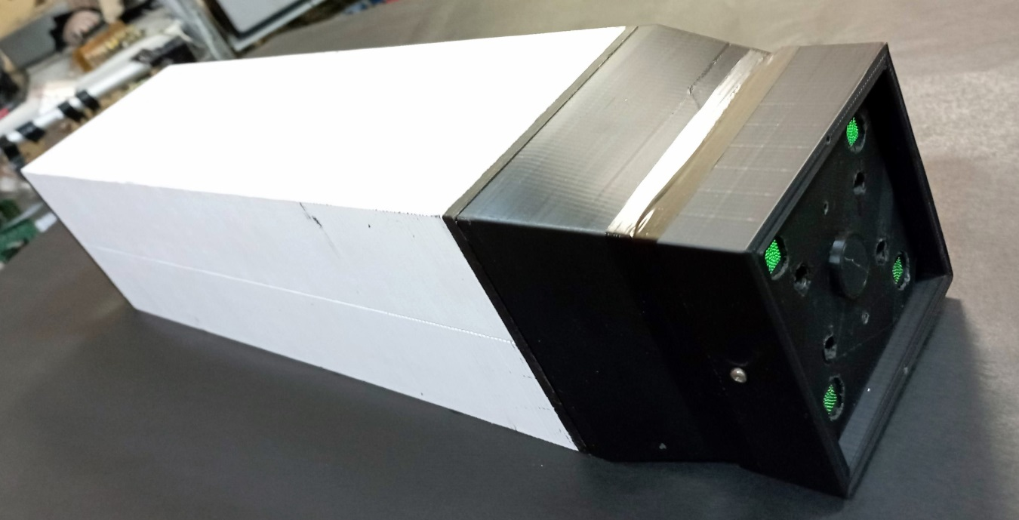
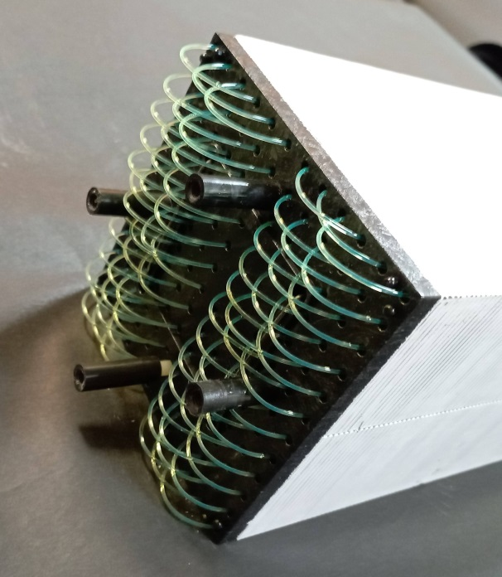
ECAL composition: - Modules consist from 4 cells 55x55 mm² - 36 WLS fiber 1 mm in dimeter Kuraray Y11(200) used for each cell - 200 layers: 1.5 mm and 0.5 mm Scintillators an Lead correspondently, ~17X₀ - Moliere Radius is about 58 mm - Energy resolution at 1 GeV electron is about 5% accoding to MC for E=50 MeV-10 GeV
Back module view:
4 WLS bundles of 36 fibers (1 mm diam)
fitted to 4 SiPm of 6x6 mm²
Front module view: 36 WLS fiber with U-shape End
10

Slide 11
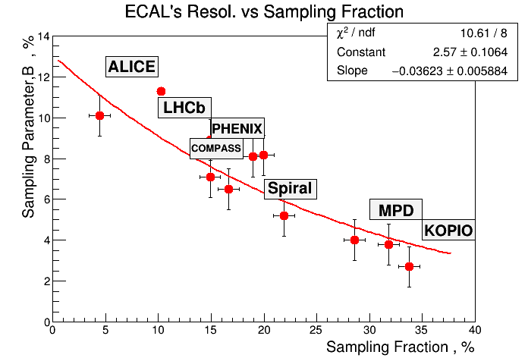
ECAL Energy resolution depended from Sampling Fraction value as: 180 layers: 1.5 mm and 0.5 mm Scintillators an Lead correspondently, ~17X₀ , B~ 5%. 180 layers: 1.5 mm and 0.8 mm Scintillators an Lead correspondently, ~25X₀ , B~ 6%.
SPD
11

Slide 12
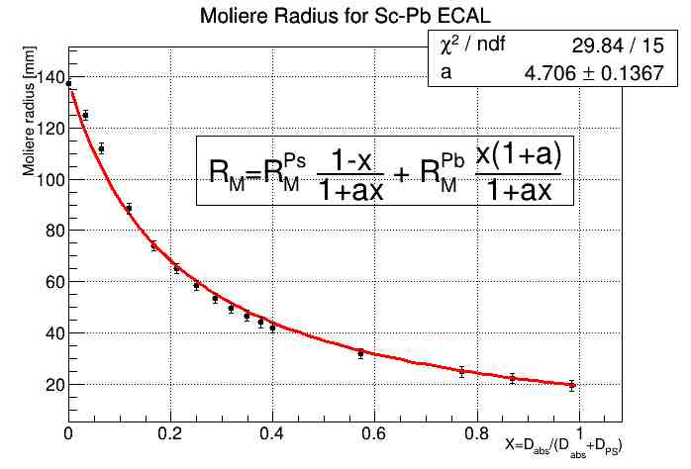
ECAL Moliere Radius depended from absorber and scintillator thickness. For 1.5 mm Polystyrene Scintillator + 0.5 mm Lead Absorber – X=0.25 , Rm~58 mm For 1.5 mm Polystyrene Scintillator + 0.8 mm Lead Absorber – X=0.34 , Rm~45 mm Simulation studies of the Moliere radius for em calorimeter materials O.P. Gavrishchuk (1), V.E. Kovtun (2), T.V. Malykhina (2) ((1) Joint Institute for Nuclear Research, Dubna, Moscow Region, Russia (2) V.N. Karazin Kharkiv National University, Kharkiv, Ukraine) https://arxiv.org/abs/2112.07215
SPD
12

Slide 13
ECAL Energy resolution for electrons detail described in: https://doi.org/10.26565/2312-4334-2020-3-09 SIMULATION STUDY OF ENERGY RESOLUTION OF THE ELECTROMAGNETIC SHASHLYK CALORIMETER FOR DIFFERENT OF LAYERS AND ABSORBER COMBINATIONS Oleg P. Gavrishchuka, Vladimir E. Kovtunb,*, Tetiana V. Malykhinab aJoint Institute for Nuclear Research (JINR), 6 Joliot-Curie St, Dubna, Moscow Region, 141980, Russia bKharkiv V.N. Karazin National University 4, Svobody sq., 61022, Kharkiv, Ukraine In ideality E resolutin can be reached as:
The energy leak for such calorimeters type is detail described in :
https://doi.org/10.46813/2021-133-076
EFFECT OF ENERGY LEAKAGE ON THE ENERGY RESOLUTION
OF E.M. SAMPLING CALORIMETERS
O.P. Gavrishchuk1, V.E. Kovtun2, T.V. Malykhina2
1Joint Institute for Nuclear Research (JINR), Dubna, Russia;
2V.N. Karazin Kharkiv National University, Kharkiv, Ukraine
The Energy resolution ( 1 GeV electron ) estimated as 5% for SPD ECAL with: 200 layers: 1.5 mm and 0.5 mm Scintillator and Lead correspondently, ~17X_{0 and} Moliere Radius is about 58 mm
13

Slide 14
ECAL module test in cosmic
New SiPm S14160-6015 (Hamamatsu) and EQR15-60 (China)
Pitch size - 15 microns
Sensitive area - 6x6 mm²
Pixels Number - 160.000
PDE ~ 30 %
Operation Overvoltage ~ dU=3-4 V:
Darc Curent ~ 400 nA
Temperature Sensitivity (dA/dT) ~1.5%
Gavrishchuk O.
14
Notes:
14
14

Slide 15
S14160-6015 Dark Current
EQR15-60 Dark Current
Gavrishchuk O.
15
Notes:
15
15

Slide 16
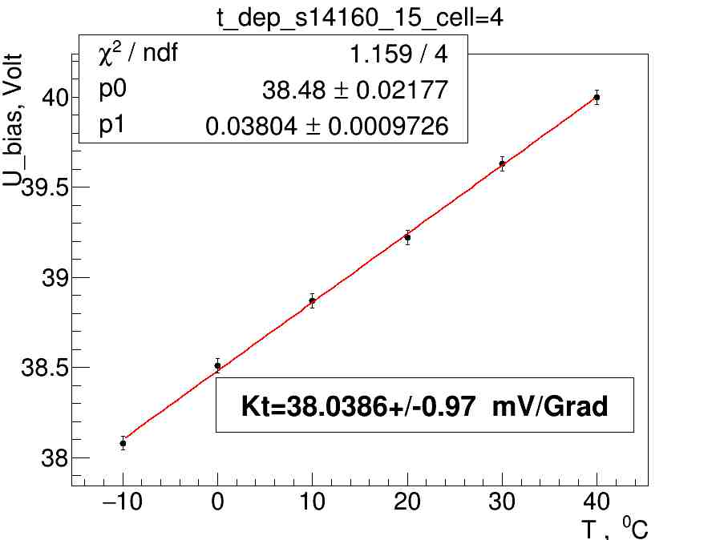
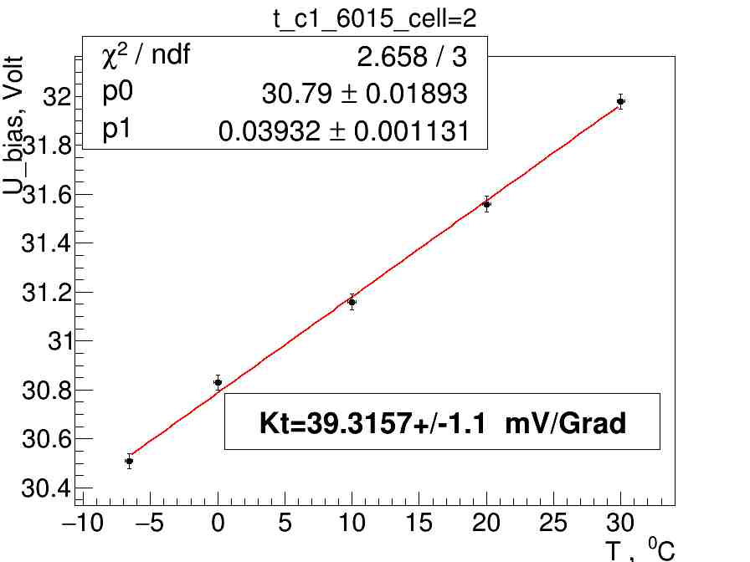
S14160-6015 and EQR15-60 Break Point vs Temperature
S14160-6015
EQR15-60
Gavrishchuk O.
16
Notes:
16
16

Slide 17
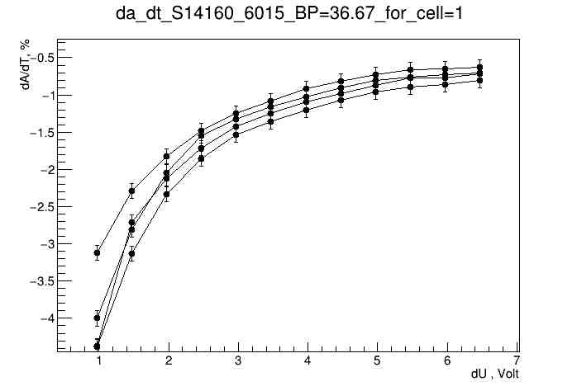
S14160-6015 Temperature Stability vs Overvoltage
Operation Point
Gavrishchuk O.
17
Notes:
17
17

Slide 18
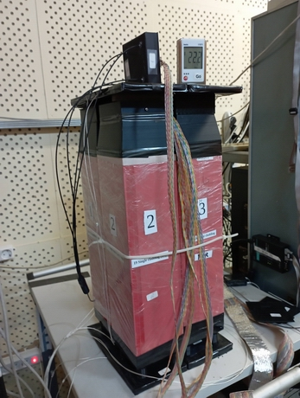
ECAL setup for cosmic tests:
New SiPm S14160-6015 emd EQR15-60
Performed the matrix of 2x2 modules
Module consist from 4 of 55x55 mm² cells
16 Cells matrix setup used for this test
Sampling :
- 190 layers;
- 1.5 mm Sc + 0.5 mm Pb.
ECAL properties:
- X₀=17,6 rad. length;
- R_{M} = 58 mm;
- L =500 mm – total module length
04.10.2022
Oleg Gavrishchuk
18
Notes:
18
18

Slide 19
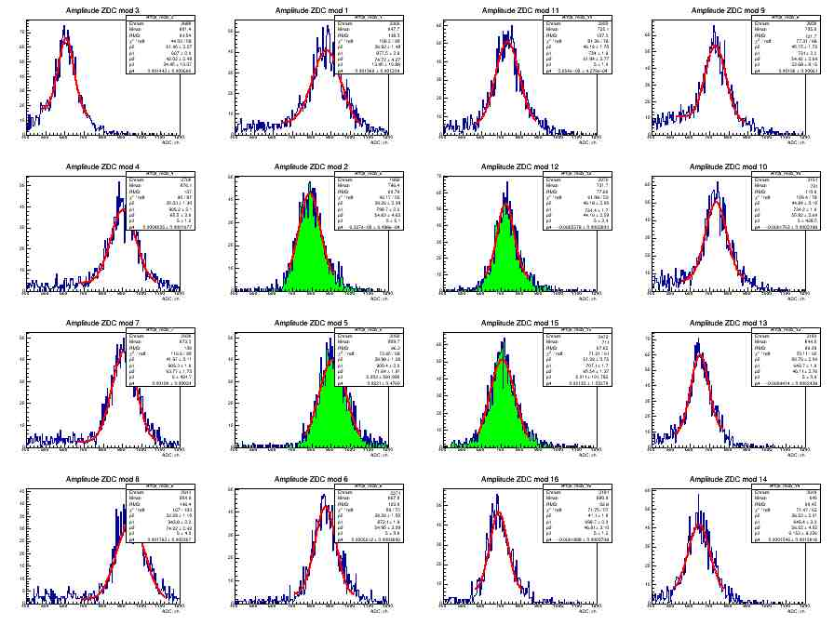
MIP peak for ECAL’s 16 cells with S14160-6015 SiPm
Green color corresponded to central cells.
Gavrishchuk O.
19
19
Notes:
19
19

Slide 20
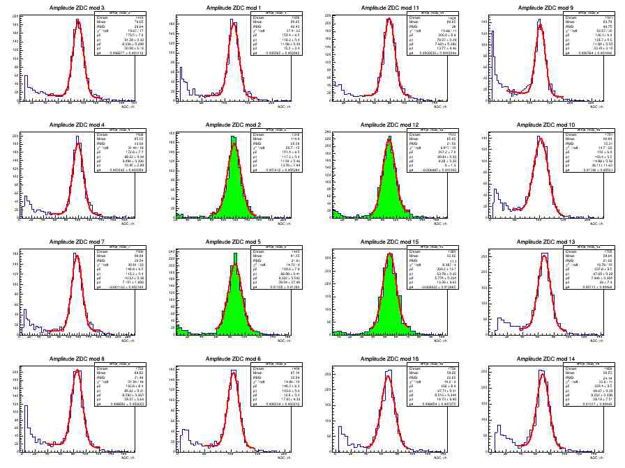
MIP peak for ECAL’s 16 cells with EQR15-60 SiPm
Green color corresponded to central cells.
Gavrishchuk O.
20
20
Notes:
20
20

Slide 21
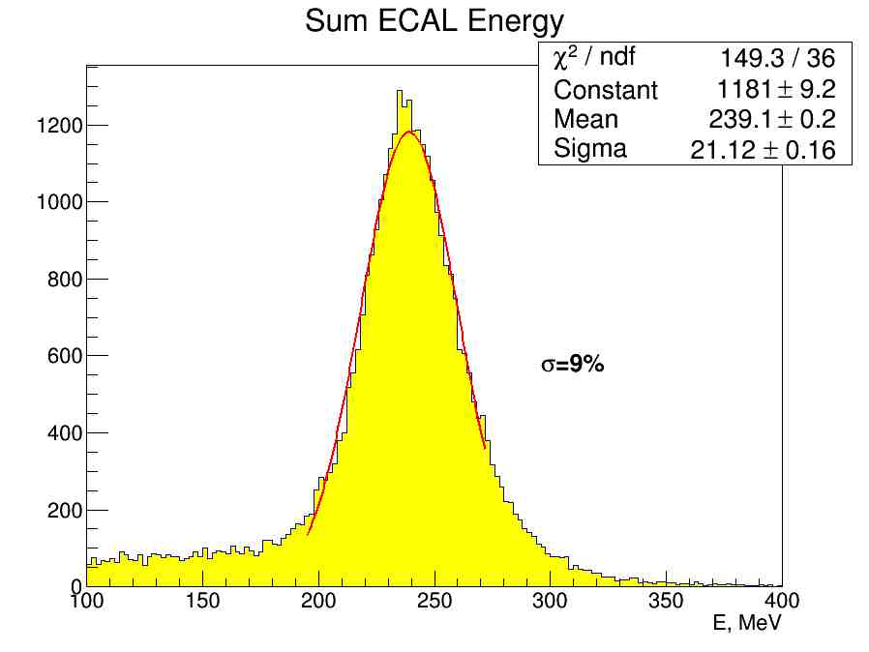
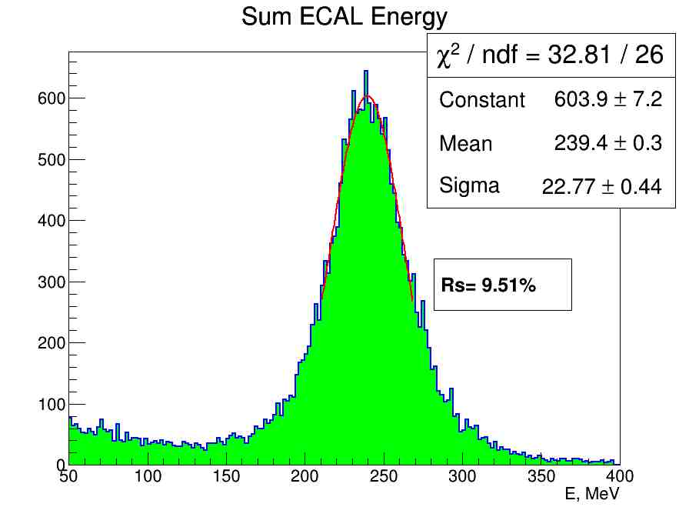
MIP peak for 16 cells - E resolution equal to 9% for S14160-5015
MIP peak for 16 cells - E resolution equal to 9.51% for EQR15-60
a)
b)
a)
04.10.2022
Oleg Gavrishchuk
21
Notes:
21
21

Slide 22
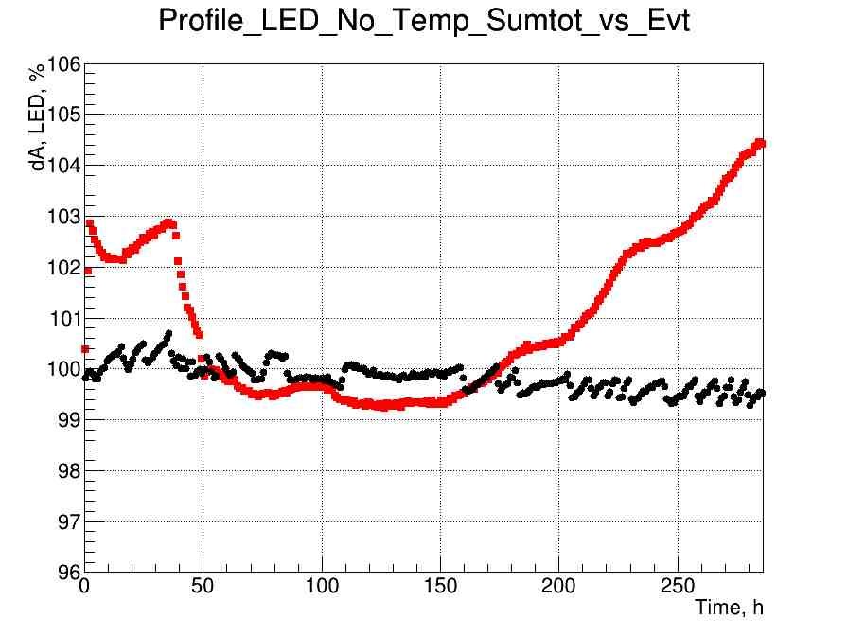
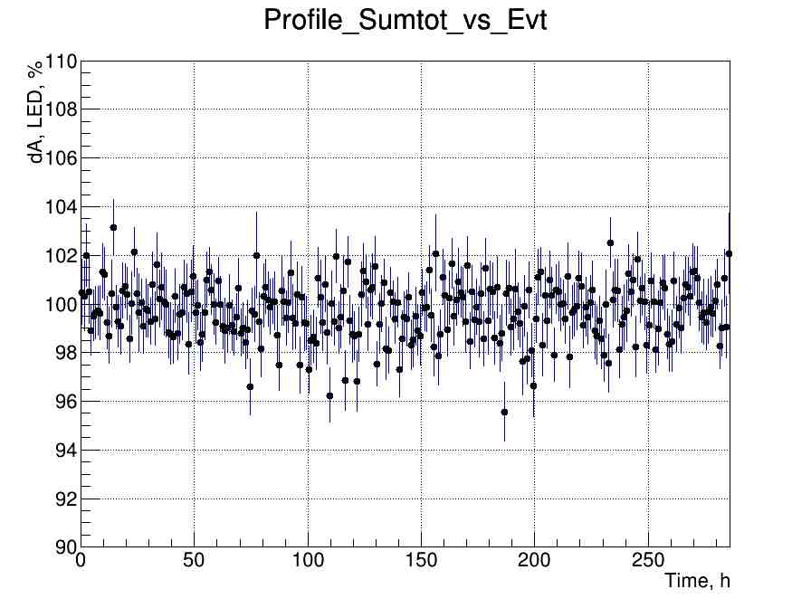
Long time signal behavior: a) - for LED , b) - for MIP
a)
b)
04.10.2022
Oleg Gavrishchuk
22
Notes:
22
22

Slide 23
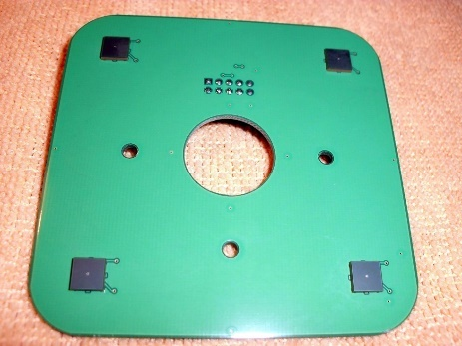
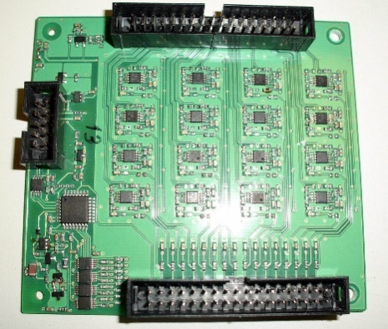
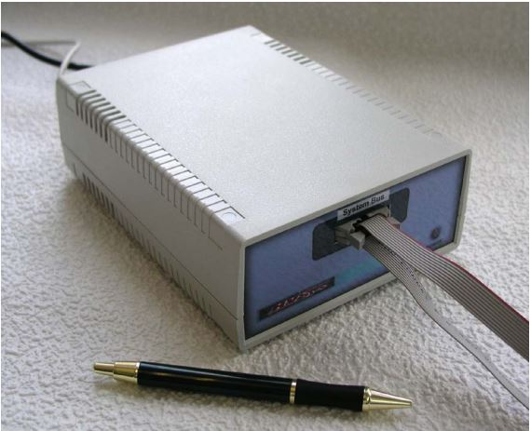
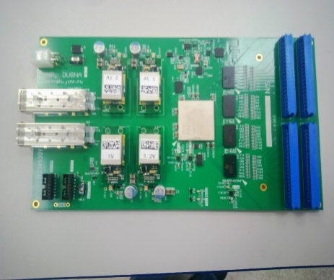
ECAL Front END Units
ECAL channels Numbers for:
Barrel = 16,896 ch
2 EndCup = 5,760 ch
Totally = 22,656 ch
For this channels Numbers should be supplied of:
SiPm board – 1416 pc.
16 ch Amplifier Card – 1416 pc.
Power unit for Amp. Cards – 32 pc.
ADCE-64 – Digitizer – 264+90 – 354 pc. for Barrel +2 EndCups
04.10.2022
Oleg Gavrishchuk
23
Notes:
23
23

Slide 24
SPD collaboration meeting
3-6 October 2022
Thanks everybody
for attention !
04.10.2022
Oleg Gavrishchuk
24
Notes:
24
24

