Slide 1
The SPeeDy framework
Valeriy Onuchin
JINR/DNLP/SPD

Slide 2
SPeeDy is based on Gaudy framework
The great features of Gaudi :
Modularity
Another programming paradigm
Easy configuration via Python scripting
Plug-in architecture
Flexibility
Multithreading is out of the box
It’s mature (24 years old) but still under active development
Adapted by old and new experiments
LHCb (CERN)
ATLAS (CERN)
BES III (IHEP, China)
Harp
FCC (CERN)
EIC (BNL, USA)
SCTau (BINP, Novosibirsk)

Slide 3
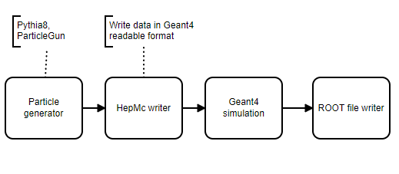
Modularity
Architecture consists in processing of independent modules (algorithms)
Algorithms the most important component of the framework. Algorithms are called once per physics event.
Minimal Geant4 simulation
Algorithm structure
Python script to set algorithm’s properties
C++ code of algorithm. Class inherited from GaudiAlgorithm. Implements initialize, execute, and finalize methods
Transient Event Store (TES) - stores data objects in a way to make them accessible to the rest of the framework, and parts of it can be made persistent in a ROOT format file. Imitates file system in memory, e.g. /Data/MyData/Event
Programming in Gaudi is similar to
to creating figure with LEGO constructor, connecting blocks together.

Slide 4
Configuration via Python scripting
Algorithms are a Configurable, which means they can be accessed in Python and Properties can be manipulated there. In the classic API, a property is declared in the constructor, using:
declareProperty("PropertyName", f_value, "Description of property");
Here, f_value is a reference to a variable for an int, string, etc. It is almost always a member variable for the class so that you can access it in the other methods.
To use a property, you can simply access it on the configurable in Python:
my_algorithm.PropertyName = 42
Another way to declare property is to define a member variable of type Gaudi::Property<>:
Gaudi::Property<int> m_some_int{this, "SomeInt", 0, "Description of some int"};

Slide 5
Plug-in architecture
from Gaudi.Configuration import *
from Constants import SystemOfUnits as units
# Data service
from Configurables import ScTauDataSvc
decKey = 'gun_geantino'
podioevent = ScTauDataSvc("EventDataSvc")
from Configurables import ParticleGun
from Configurables import GenAlg
from Configurables import HepMCToEDMConverter
from Configurables import HepMCFileWriter
from Configurables import Gaudi__ParticlePropertySvc
from PathResolver import PathResolver

Slide 6
Flexibility
Let’s consider the track reconstruction task.
For example we have 2 track finding algorithms:
Traditional
Machine Learning based algorithm
We have 3 track fitting algorithms:
Iterative KalmanFilter
Global fitting
HoughTransform
The framework allows to load (import) all of them into Python script which do processing
and by switching a single parameter one can run all 6 combinations without any recompilation.

Slide 7
SPeeDy development
I pursued 2 goals: minimize initial code and minimize dependencies
The main code was stolen from SCtau Aurora framework (only G4 Simulation part)
Build system (Cmake scripts) was stolen from LHCb/Gaudi
Dependency:
Gaudi ("/cvmfs/sft-nightlies.cern.ch/lcg/latest/Gaudi/master-4f9ac/x86_64-centos7-gcc10-opt")
ROOT 6.24
Geant4 ("/cvmfs/sft-nightlies.cern.ch/lcg/latest/Geant4/11.0.2-b78b7/x86_64-centos7-gcc11-opt")
DD4hep ("/cvmfs/sft-nightlies.cern.ch/lcg/latest/DD4hep/master-1c0dc/x86_64-centos7-gcc10-opt")
EDM4hep ("/cvmfs/sft-nightlies.cern.ch/lcg/latest/EDM4hep/00.04.01-d9194/x86_64-centos7-gcc11-opt")
Podio ("/cvmfs/sft-nightlies.cern.ch/lcg/latest/podio/00.14.01-642d4/x86_64-centos8-gcc10-opt")
CLHEP ("/cvmfs/sft-nightlies.cern.ch/lcg/latest/clhep/2.4.5.1-ebe73/x86_64-centos9-gcc11-opt")
HepMC3 (” /cvmfs/sft-nightlies.cern.ch/lcg/latest/hepmc3/HEAD-cfcd1/x86_64-centos7-gcc11-opt”)
All externals are precompiled. PATH, LD_LIBRARARY_PATH, ROOT_INCLUDE_PATH,PYTHONPATH are hardcoded.
The status of development:
Finally successfully built
The repository https://github.com/x2v0/SPeeDy created
The simple testing is under way:
ParticaleGun shoots electrons into Electromagnetic Calorimeter (primitive geometry)

Slide 8
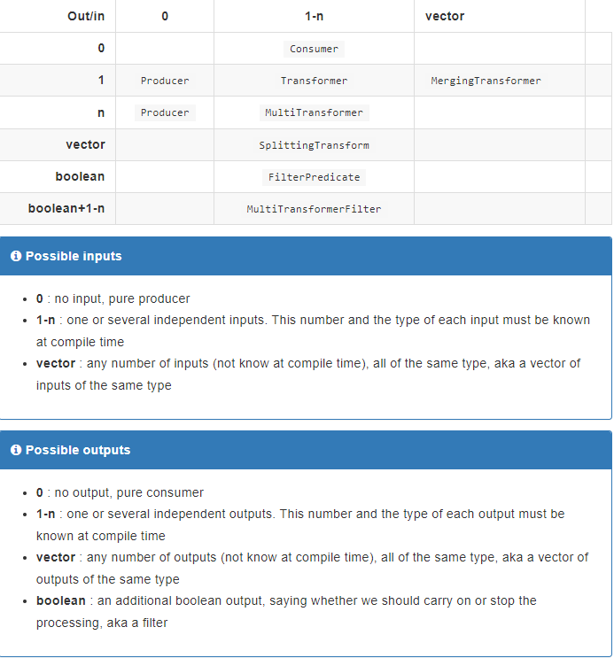
Gaudi Functional Algorithm

Slide 9
Which way to go ?
Recently I ran examples from FCCW including full Geant4 simulation based on Gaudi/key4hep.
I like it. These examples include calorimeter reconstruction.
Key4HEP is framework which claims to be an universal solution to all problems.
This collaborative effort of international team from many institutes, mostly from CERN.
Their slogan “Key4HEP - Turnkey Software for Future Colliders”.
https://key4hep.github.io/
My question - where to go?
Develop our minimalist framework or join this collaboration?

