Slide 1
Fast cluster finder for TPC detector
Alexander Krylov (LHEP)
Email: avkrylov@jinr.ru
Oleg Rogachevsky (LHEP)
Viktor Krylov (LNP)

Slide 2
ClusterFinder Task
TPC Digits
TPC Hits

Slide 3
Event Display for the MPD
Event Display help to:
visualize events online in the control room during run;
checking reconstruction and physics analysis algorithms;
look more closely in special events.

Slide 4
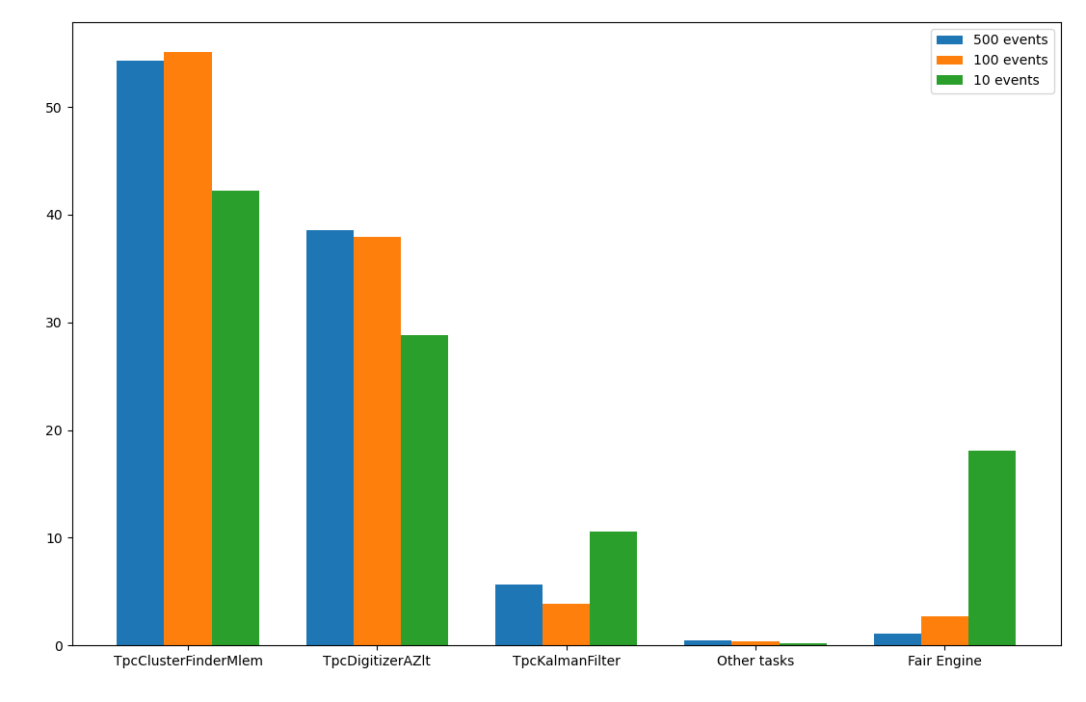
Reconstruction tasks' timing
A reconstruction of high multiplicity events reaches timings above 1 minute;
ClusterFinder task takes half of that time on itself;
We need fast ClusterFinder task for online visualization purposes.
Percent of reconstuction timing for different tasks

Slide 5
New Fast ClusterFinder algorithm
Fast ClusterFinder algorithm workflow

Slide 6
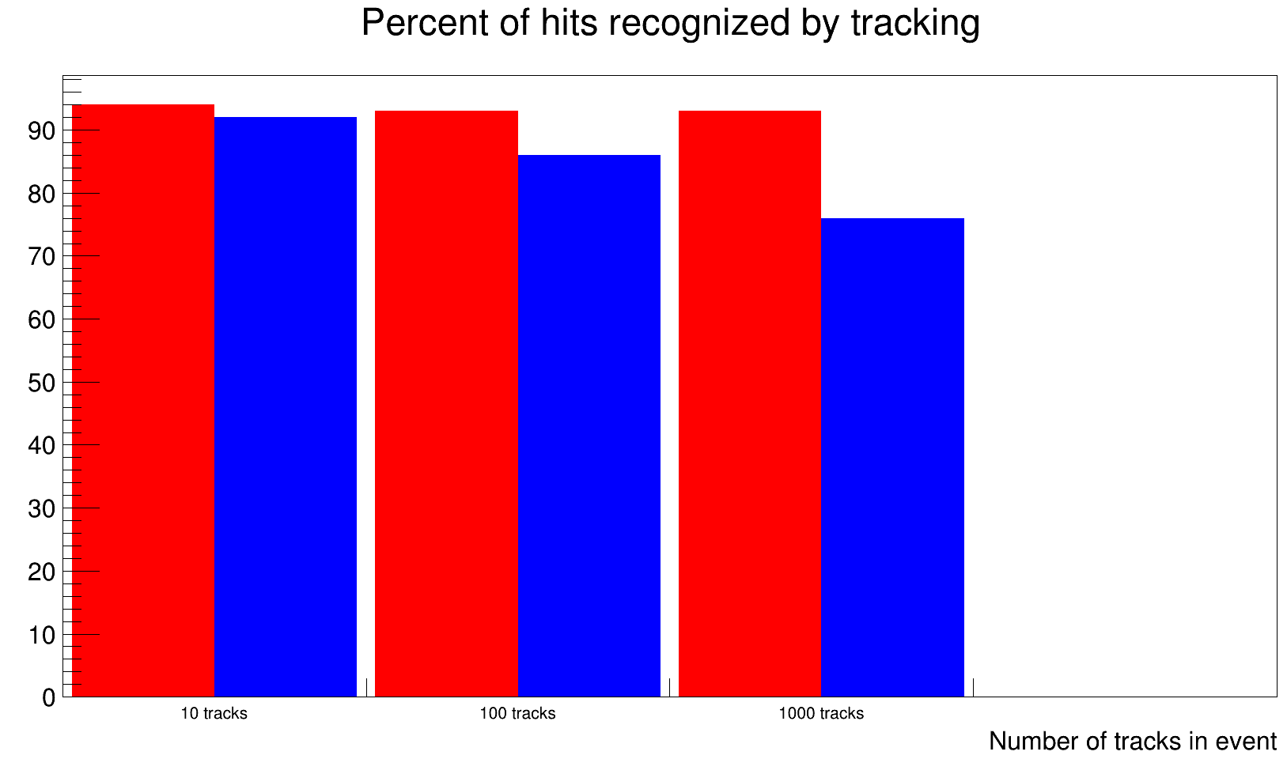
Tracking new hits with present Kalman filter
Quality of ClusterFinder with present Kalman tracking can be estimated by number of hits recognized as a track.
For 100 tracks in event tracking recognize:
93.55% hits for current ClusterFinder
86.72% hits for fast ClusterFinder
For all tests was used BOX generator with muons and Pt = 2.5 GeV/s

Slide 7
Number of reconstructed tracks
Also we can measure number of reconstructed tracks after ClusterFinder and KalmanFilter tasks.
Lack of work with "edge effect" sometimes gave us 2 different tracks for 1 primary track.
Number of recognized primary tracks for different multiplicity

Slide 8
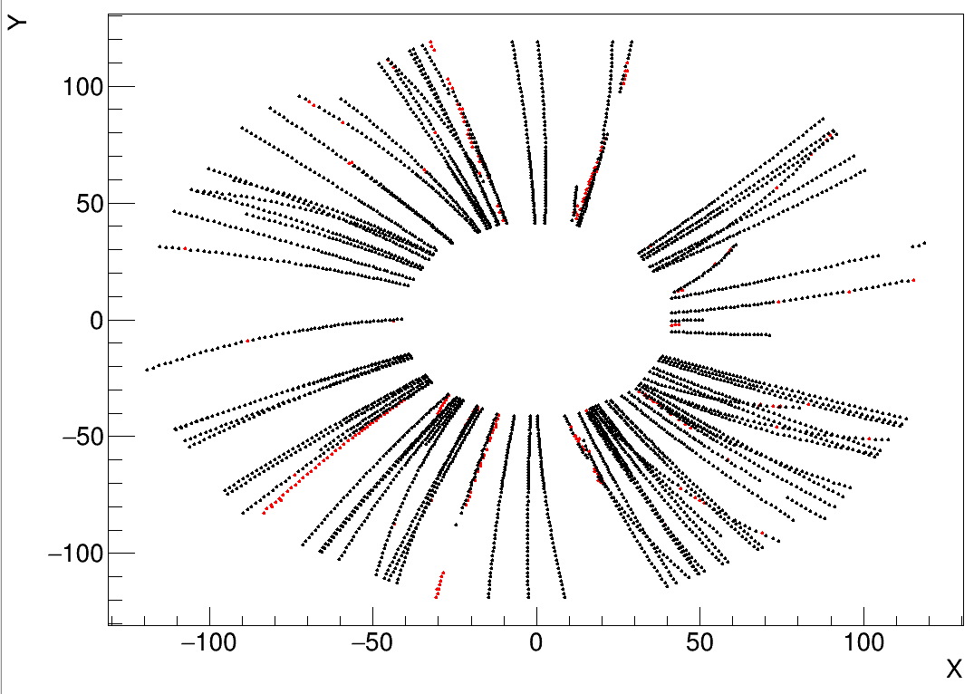
Hits recognized into a track
BOX generator was used:
Multiplicity – 100 muon tracks
Pt ≃ 2.5 GeV/c
Current Tasks:
ClusterFinderMlem + KalmanFilter
New Tasks:
ClusterFinder + KalmanFilter
​Current Cluster Finder
​Fast Cluster Finder

Slide 9
Online ClusterFinder Execution time for one Sector

Slide 10
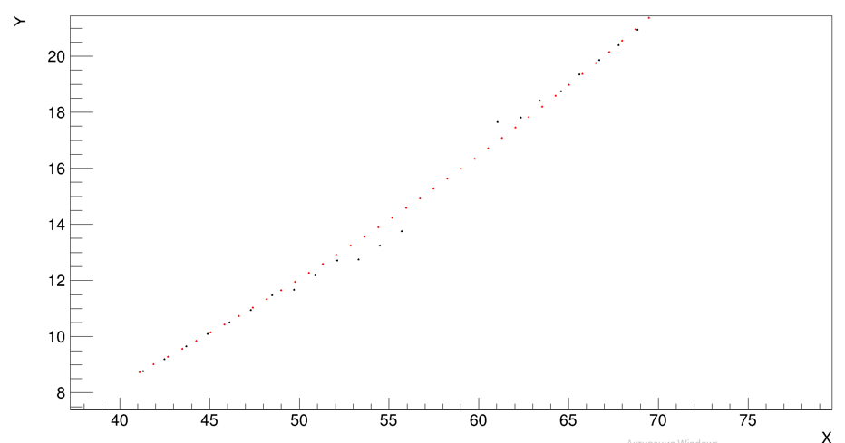
Unsolved problems
One Sector
Another Sector
"Edge effect" problem

Slide 11
To Do
1. Take into account the edge effect
2. Check performance on real generators (UrQMD, LAQGSM etc.)
3. Get rid of cos() and sin() methods to speed up clustering
4. Add parallelization
5. Implement ClusterFinder into the Event Display

Slide 12
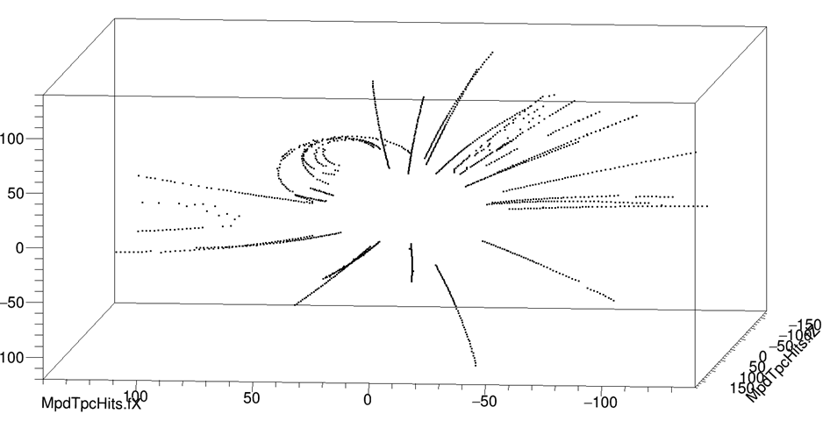
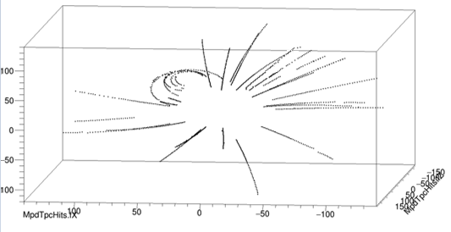
Some fixed errors

