Slide 1


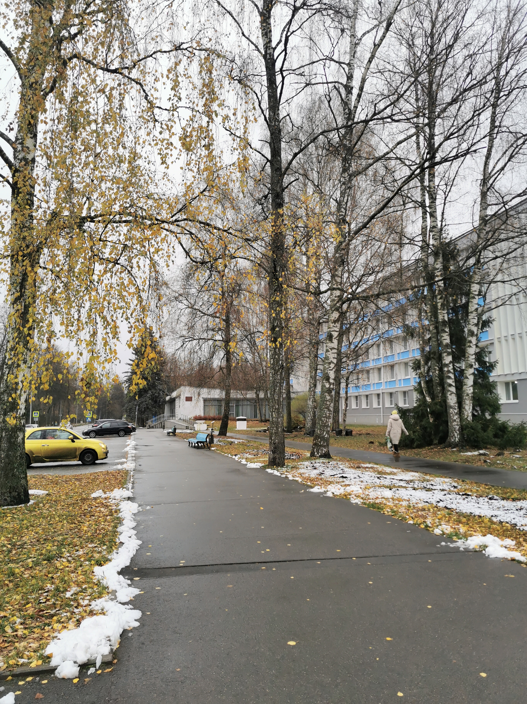
Global observables
in heavy-ion collisions at NICA
PWG1 Summary
A.Aparin (JINR), G. Feofilov (SPbSU)
Reported by G. Feofilov (SPbSU)
IX Collaboration Meeting of the MPD Experiment
at the NICA Facility
10.11.2022
https://indico.jinr.ru/event/3251/timetable/#20221109
Notes:
1

Slide 2
Layout of the talk
Introduction. Where we are today.
Overview of some reports at Cross-PWG meetings in summer-autumn 2022
Activity needed for the Physics Paper

Slide 3
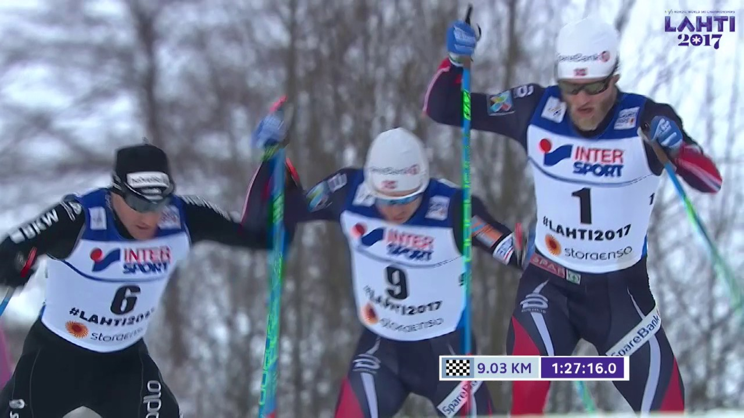
Where are we today?
There is a very strong competition between STAR@RHIC (BES 1 and BES II) and NA61/SHINE@SPS…and CBM@FAIR and MPD@NICA!

Slide 4
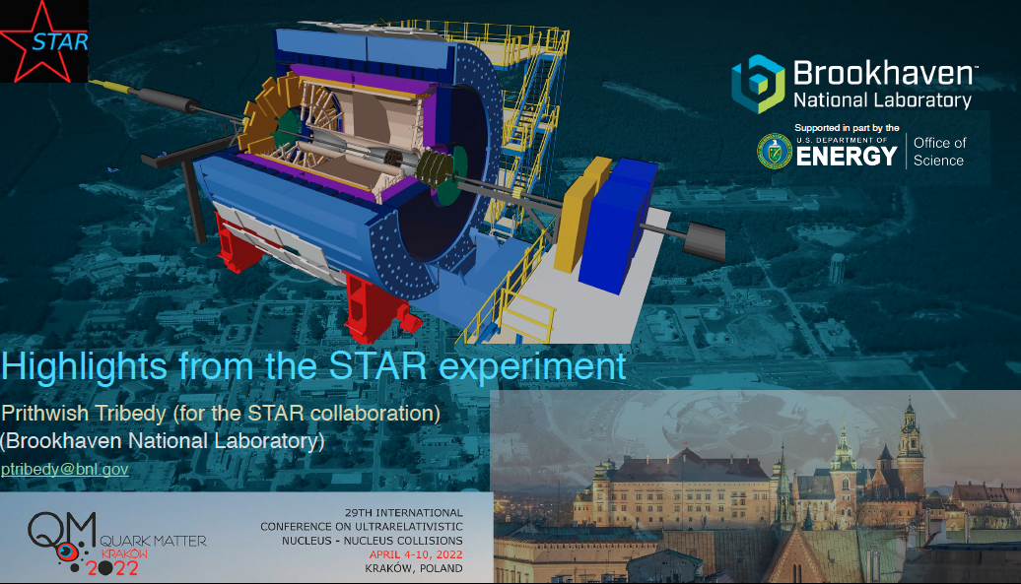
Some highlights from STAR@RHIC presented at QM-2022
https://indico.cern.ch/event/895086/contributions/4314628/

Slide 5
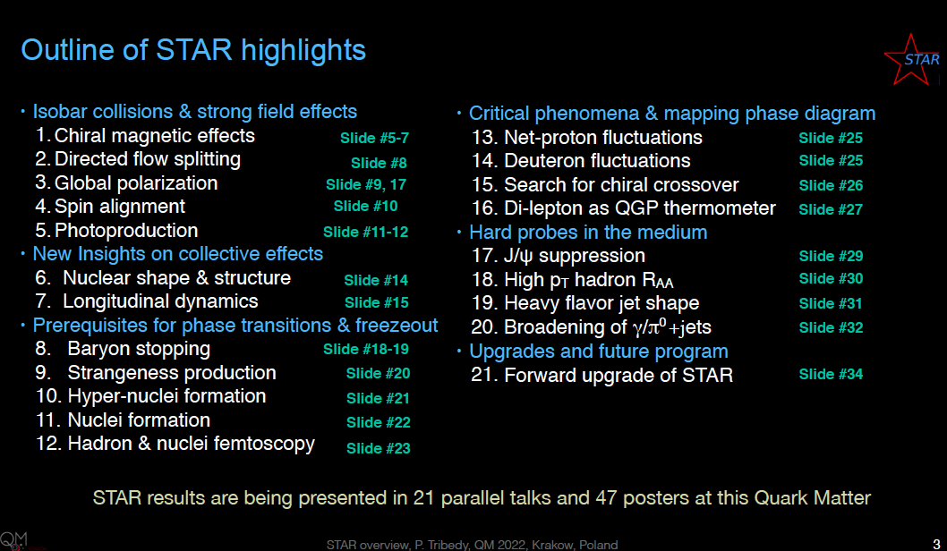
Some highlights from STAR@RHIC presented at QM-2022
https://indico.cern.ch/event/895086/contributions/4314628/

Slide 6
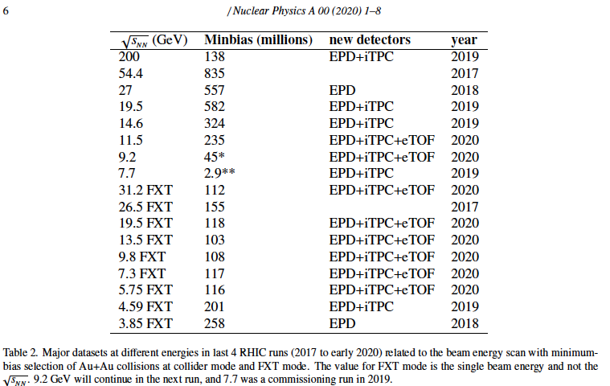
Very reach harvest by STAR@RHIC [1]
[1] https://www.osti.gov/servlets/purl/1762771
See also later today the talk by Alexey Aparin :
”Identified particle production at STAR (BES)”

Slide 7
Important questions:
What is expected to be new by the MPD,
compared to STAR ?
What are the tasks needed for the Physics Paper
in view of the Global Observables?
Notes:
Theoretical studies and approaches: what is new?
The propsal
Clusters of cold dense nuclear matter and particle production in the cumulative region of central rapidities and large transverse momenta at NICA MPD
Vladimir Vechernin Saint-Petersburg State University

Slide 8
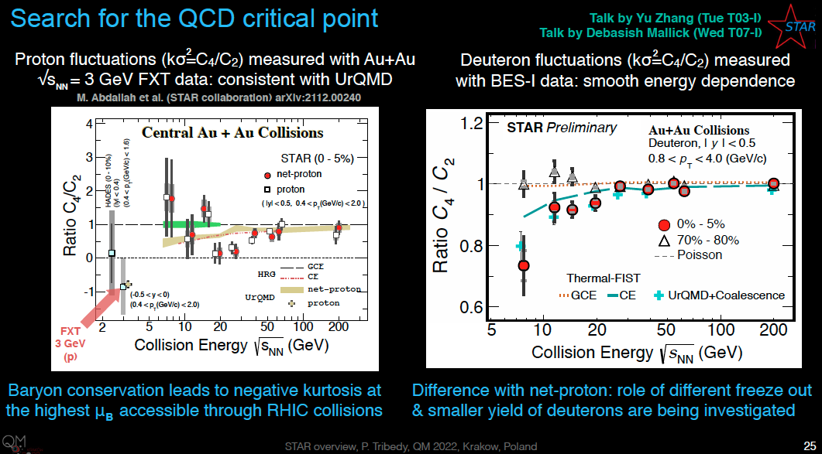
Some new STAR data: role of proton fluctuations
https://indico.cern.ch/event/895086/contributions/4314628/
Non-monotonic energy dependence of net-proton kσ² for 5% most central events
Not decribed by the HRG model

Slide 9
NEW!
Deviations from the HRG behavior by STAR
One of the possible theoretical explanations -
(by inclusion of the strongly interacting plasma screening properties)
-- could be found in the approach by Alejandro Ayala
using LSMq (the Linear Sigma Model with quarks) as an effective QCD model.
.
  Talk by A.Ayala at NUCLEUS-2022:
https://events.sinp.msu.ru/event/8/contributions/604/attachments/586/1067/The_role_of_screening_Nucleus_2022_talk.pdf
Eur. Phys. J. A 58 (2022), 87; e-Print:2108.02362 [hep-ph]

Slide 10
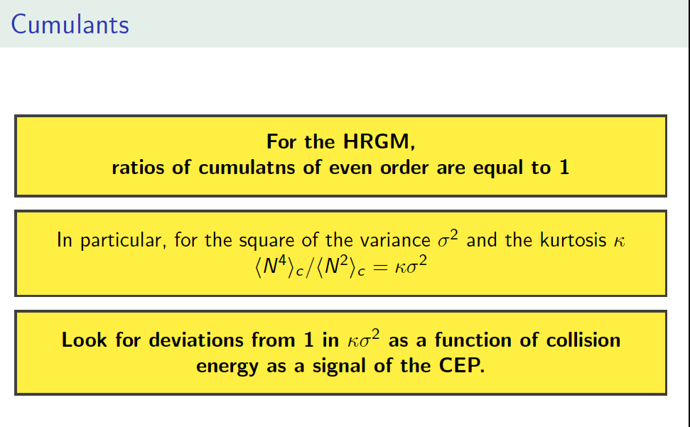
.
From the talk by A.Ayala at NUCLEUS-2022:
.
https://events.sinp.msu.ru/event/8/contributions/604/

Slide 11
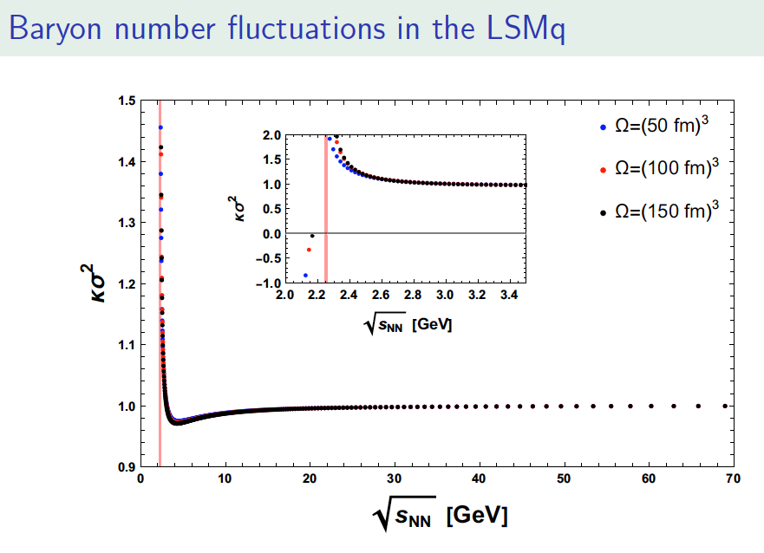
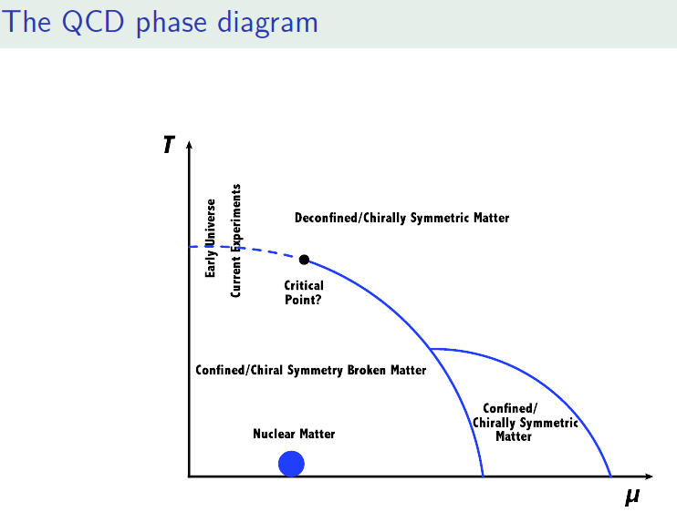
.
NEW!
From the talk by A.Ayala at NUCLEUS-2022:
https://events.sinp.msu.ru/event/8/contributions/604/
The CEP can be located for collision energies
of ~ 2 GeV per nucleon

Slide 12
A closer look at STAR data: role of fluctuations
https://indico.cern.ch/event/895086/contributions/4314628/
Class of 0-5% most central events – is it too narrow or too wide for studies of fluctuations?

Slide 13

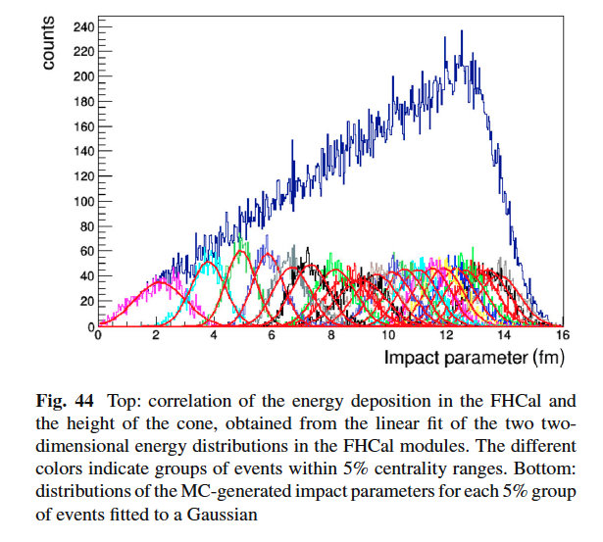
What is expected to be new by the MPD from the point of view of Global Observables?
0-5% centrality class is a mixture
of different events, where the volume
fluctuations are dominant, so:
we need more precise selection
of centrality classes
we need events with well defined initial
conditions and optimized class width
we need combination of several
observables -- proxies of centrality,
capable to minimize trivial volume
fluctuations
0-5% centrality
class

Slide 14
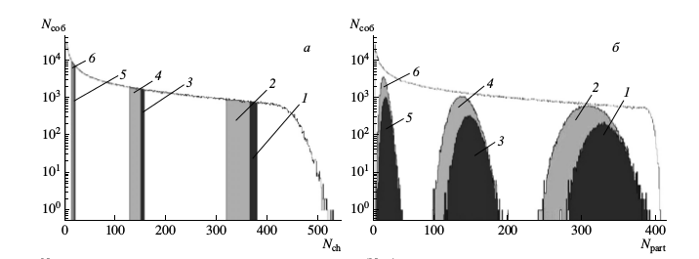
Centrality and multiparticle production in ultrarelativistic nuclear collisions
.
COMMENT : Narrow distribution in Nch DOES NOT mean
narrow distribution in Npart!
https://link.springer.com/journal/11450
Centrality determination and selection of classes by STAR should be taken with definite concern!
[1] T. A. Drozhzhova,V. N. Kovalenko,A. Yu. Seryakov,G. A. Feofilov, Physics of Atomic Nuclei, September 2016, Volume 79, Issue 5, pp 737–748

Slide 15
Question: with very reach harvest of STAR data at RHIC what is expected to be new by the MPD?
Classes of central collisions with optimized width [1] will eliminate considerably the trivial volume fluctuations and allow to get new results at the NICA energy:
  in flucand long-range correlations) tuations and correlation measurements (including short- range
  in elliptic flow measurements, flow fluctuations, analysis of cumulant ratious, in studies with strongly intensive observables, etc.
[1] T. A. Drozhzhova,V. N. Kovalenko,A. Yu. Seryakov,G. A. Feofilov, Physics of Atomic Nuclei, September 2016, Volume 79, Issue 5, pp 737–748

Slide 16
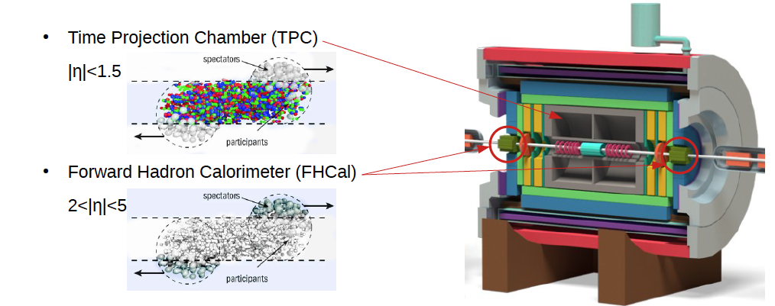
Current approaches to centrality class selection:
Charged particle Multiplicity classes by the TPC
Spectator energy classes by FHCal
Transverse energy classes by the ECAL
Machine learning with TOF MCP
NEW!
ECAL

Slide 17
PWG1 meetings: Sept.2021- March 2022
24 March 2022 Speaker: I.Maldonado (Universidad Autónoma de Sinaloa) ,"Update BiBi Collisions at 9.2 GeV
27 Jan 2022, A.Seryakov (SPbSU),” Influence of different centrality methods on multiplicity fluctuations: MPD case”
20 Jan 2022
G.Feofilov and A.Aparin. ”PWG1: planning of activity for 2022”
I.Maldonado (Universidad Autónoma de Sinaloa)”BiBi collisions at 9.2 GeV”
18 November 2021,
Dr. G.Musulmanbekov, “Nuclear fragments deposited in FHCal. DCM-QGSM or DCM-SMM?”
A.Aparin “Discussion concerning a way to establish a standartized procedure for basic QA”,
09 Sept. 2021
Pedro Antonio Nieto Marín "Centrality determination in MPD at NICA"¶ 20m
by "Centrality determination in MPD at NICA”.

Slide 18
Centrality related reports at Cross-PWG meetings in summer-autumn 2022
Andrey Seryakov, 31.05.2022, “Influence of different centrality methods on multiplicity fluctuations: MPD case “ https://indico.jinr.ru/event/3098/
Valerii Troshin, 14.06.2022, “Study of the systematics in determining the symmetry plane for Bi-Bi collision”, https://indico.jinr.ru/event/3120/
Viktor Riabov, 14.06.2022, “𝐸_𝑇 distributions and event centrality”, https://indico.jinr.ru/event/3120/
Victor Riabov, 12.07.2022, “Event centrality with TPC, ECAL and FHCAL” , https://indico.jinr.ru/event/3192/
Grigory Feofilov, 31.05.2022, Fast Beam–Beam Collision (FBBC) monitor based on Micro Channel Plate detectors (MCPs) https://indico.jinr.ru/event/3098/
Kirill Galaktionov, 18.10.2022, ”Machine learning based study of microchannel plate detector configurations for future NICA experiments”, https://indico.jinr.ru/event/3279/

Slide 19
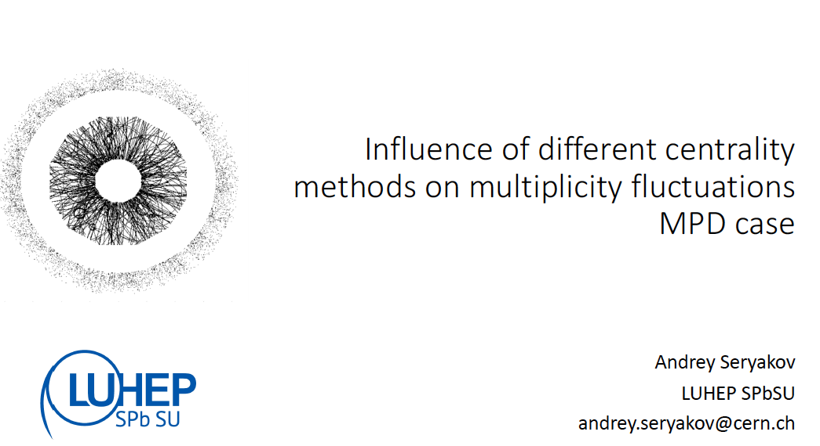
Andrey Seryakov, 31.05.2022, “Influence of different centrality methods on multiplicity fluctuations: MPD case “ https://indico.jinr.ru/event/3098/
NEW!
.

Slide 20
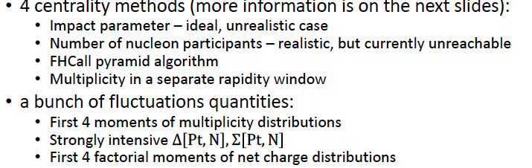
Andrey Seryakov, 31.05.2022, “Influence of different centrality methods on multiplicity fluctuations: MPD case “ https://indico.jinr.ru/event/3098/
What

Slide 21
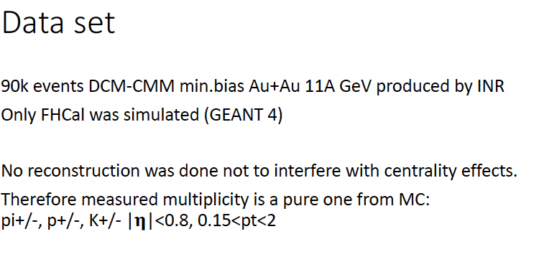
Andrey Seryakov, 31.05.2022, “Influence of different centrality methods on multiplicity fluctuations: MPD case “ https://indico.jinr.ru/event/3098/
What

Slide 22
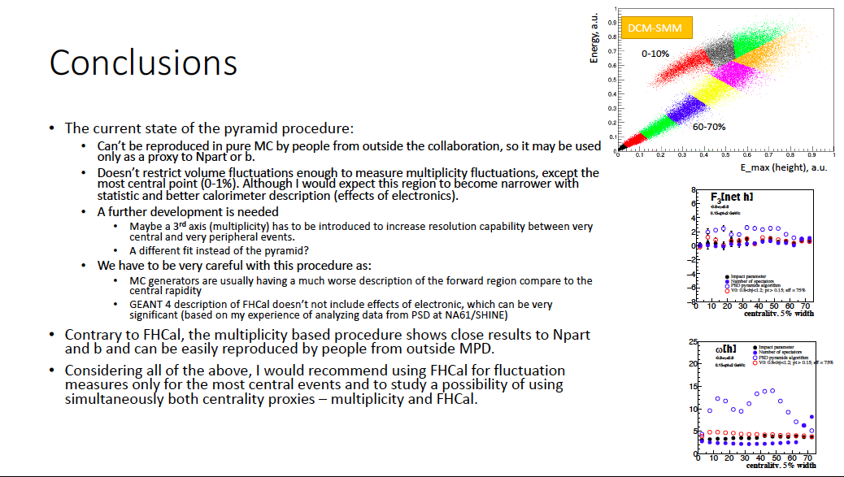
Andrey Seryakov, 31.05.2022, “Influence of different centrality methods on multiplicity fluctuations: MPD case “ https://indico.jinr.ru/event/3098/

Slide 23
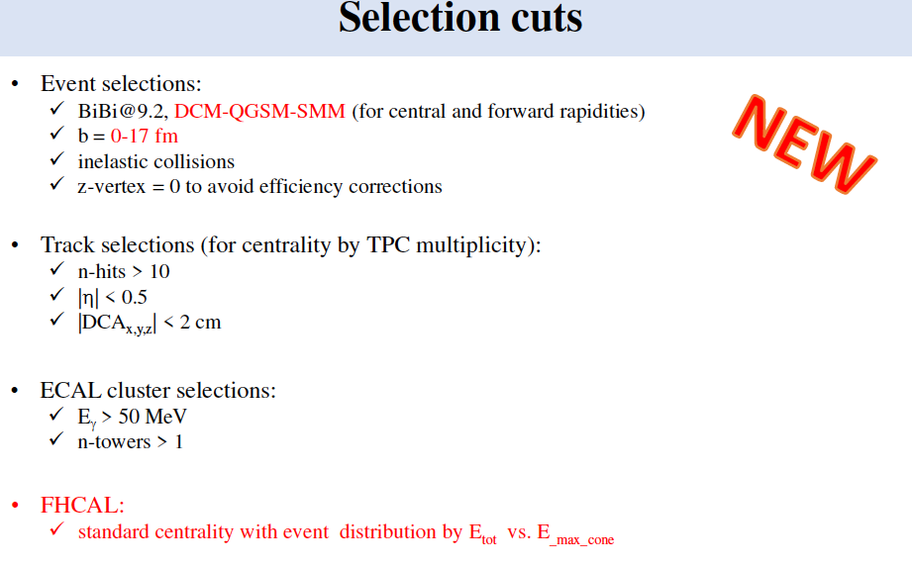
Victor Riabov, 12.07.2022, “Event centrality with TPC, ECAL and FHCAL” , https://indico.jinr.ru/event/3192/
NEW!
What

Slide 24
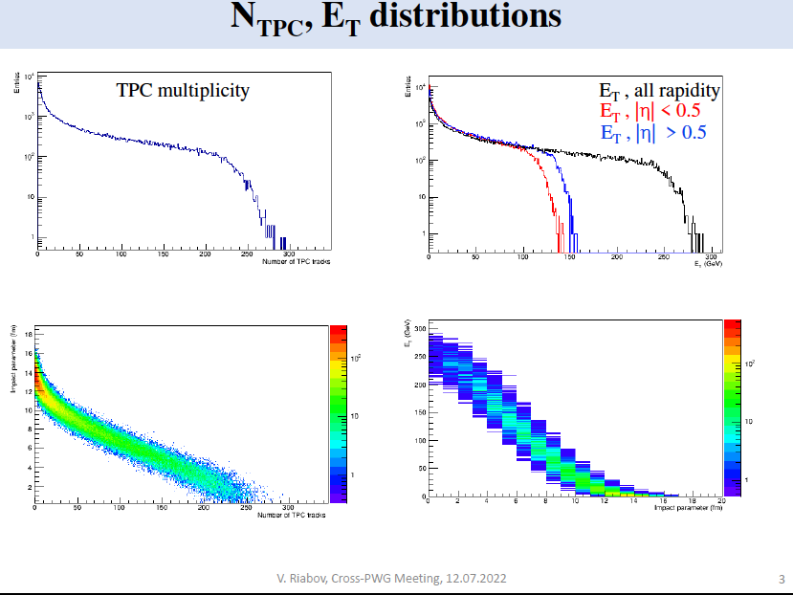
Victor Riabov, 12.07.2022, “Event centrality with TPC, ECAL and FHCAL” , https://indico.jinr.ru/event/3192/
NEW!

Slide 25
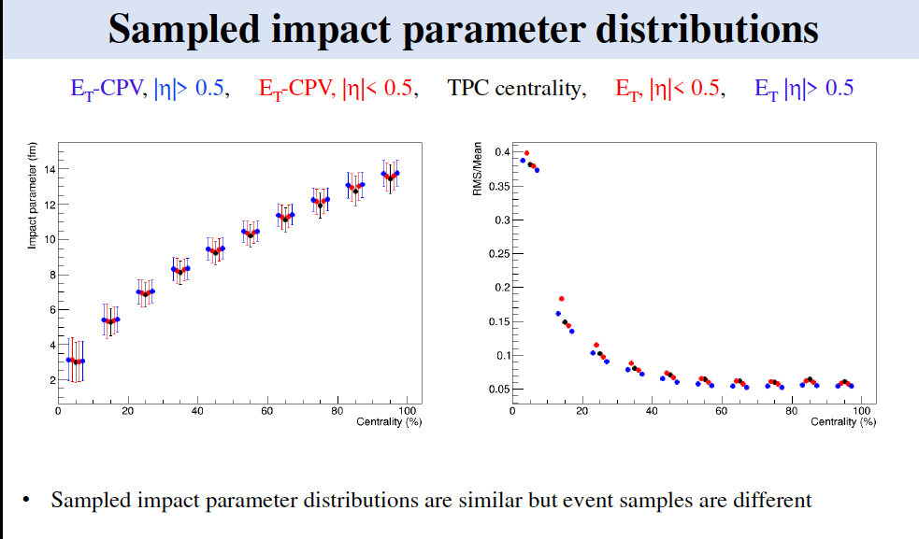
Victor Riabov, 12.07.2022, “Event centrality with TPC, ECAL and FHCAL” , https://indico.jinr.ru/event/3192/
NEW!
What

Slide 26
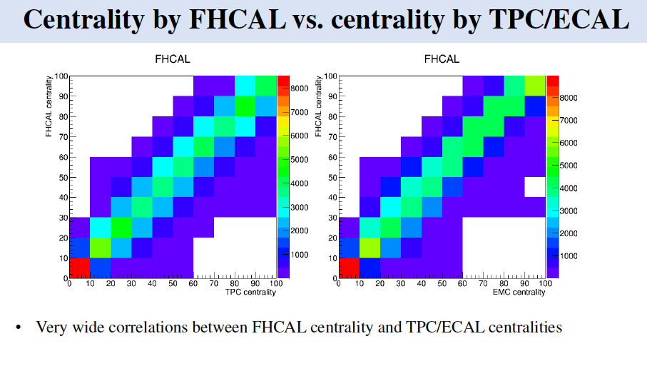
Victor Riabov, 12.07.2022, “Event centrality with TPC, ECAL and FHCAL” , https://indico.jinr.ru/event/3192/
NEW!
What

Slide 27
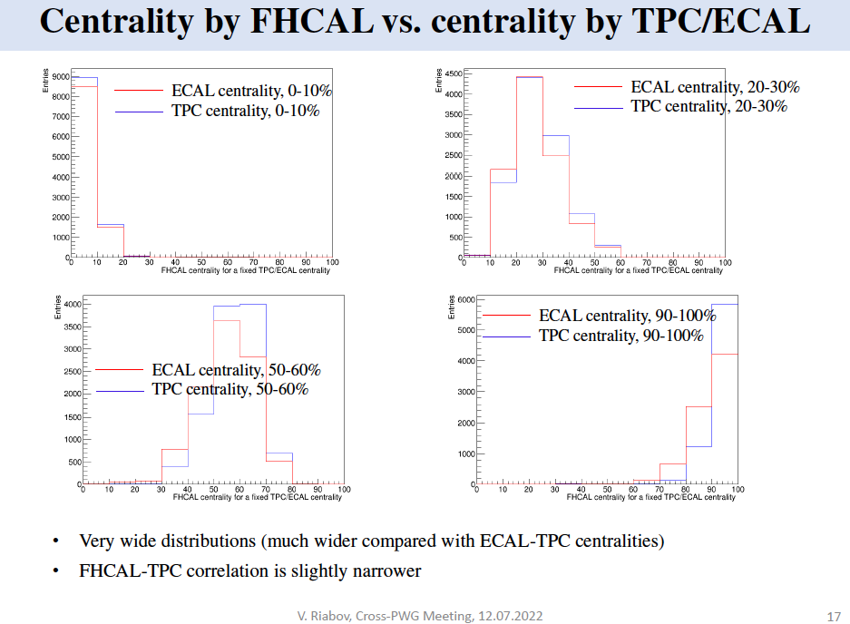
Victor Riabov, 12.07.2022, “Event centrality with TPC, ECAL and FHCAL” , https://indico.jinr.ru/event/3192/
NEW!
Note: the event samples appear to be different for different proxies of centrality!

Slide 28
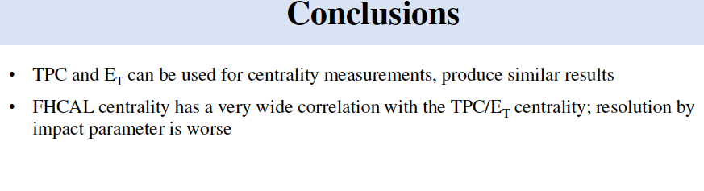
Victor Riabov, 12.07.2022, “Event centrality with TPC, ECAL and FHCAL” , https://indico.jinr.ru/event/3192/
NEW!
Note: these conclusions are in line with Andrey Seryakov estimates

Slide 29
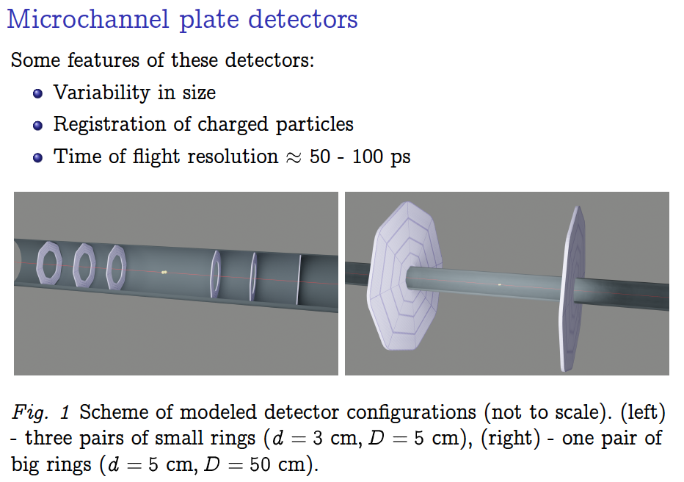
Kirill Galaktionov, 18.10.2022, ”Machine learning based study of MCP detector configurations for future NICA experiments” https://indico.jinr.ru/event/3279/
NEW!

Slide 30
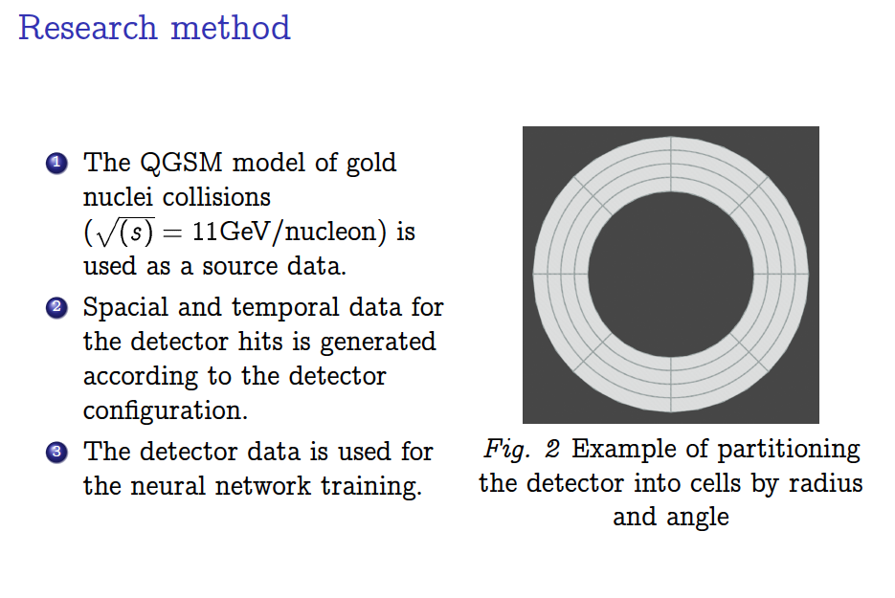
Kirill Galaktionov, 18.10.2022, ”Machine learning based study of microchannel plate detector configurations for future NICA experiments”, https://indico.jinr.ru/event/3279/
What

Slide 31
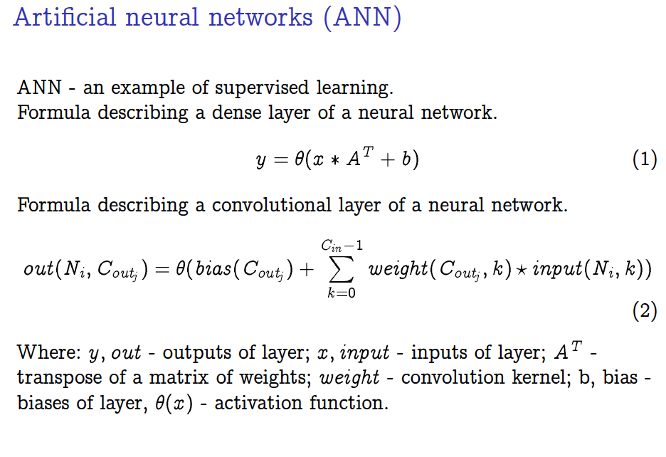
Kirill Galaktionov, 18.10.2022, ”Machine learning based study of microchannel plate detector configurations for future NICA experiments”, https://indico.jinr.ru/event/3279/
What

Slide 32
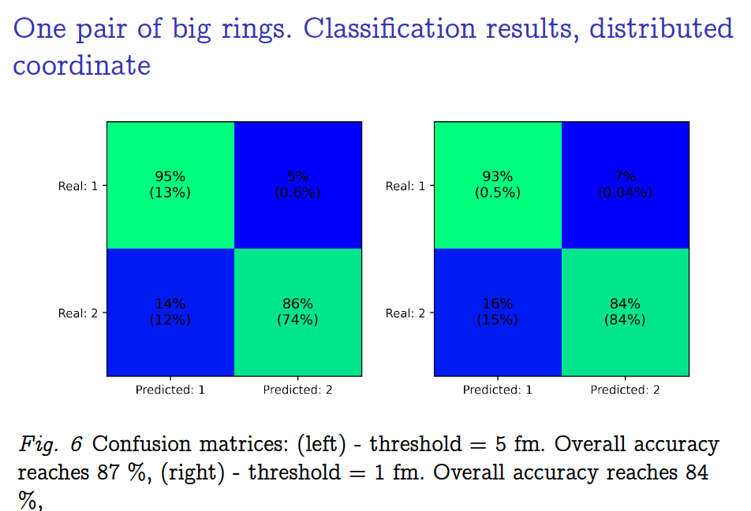
Kirill Galaktionov, 18.10.2022, ”Machine learning based study of microchannel plate detector configurations for future NICA experiments”, https://indico.jinr.ru/event/3279/
EXAMPLE:
NEW!
What

Slide 33
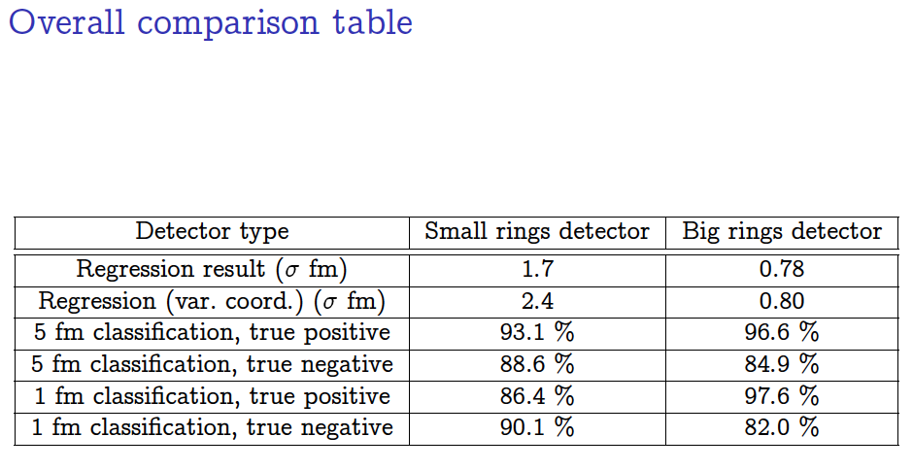
Kirill Galaktionov, 18.10.2022, ”Machine learning based study of microchannel plate detector configurations for future NICA experiments”, https://indico.jinr.ru/event/3279/

Slide 34
MC simulations and our activity needed for the Physics Paper
Statistics for Bi+Bi collisions at 9.2 GeV: ~ 100 mln min bias events
Central pseudorapidity intervals for TPC physics analysis: |η|<0.5 and |η|<1.0
Pseudorapidity intervals should be considered, for multiplicity and E_{T} classes selections, outside the midrapidity region – this is in order to avoid trivial autocorrelations :
TPC tracks in 0.5 <|η|<1.5
ECAL data in 0.5 <|η|<1.5
Other pseudorapidity intervals: e.g. FFDs, which are symmetrically placed to the MPD center along the beam line 2.5 ≤| η |≤ 3.2 (also mini-BeBe – ?) could be aslo considered for the multiplicity classes selection
Class-wise optimization of the class width: MC simulations fo Bi+Bi collisions at 9.2 GeV for 0-1%, 0-3%, 0-5%, 0-7%, 0-10%, 0-20% multiplicity based centrality classes (and similar optimization for the FHCal classes is needed)
Z-position of the interaction vertex should be taken into account in the new MC simulations production. Studies of z-cuts are needed.

Slide 35
Institutes – PWG1 participants
SPbSU (St.Petersburg),
JINR (Dubna)
INR RAS (Troitsk, Moscow),
MEPhI (Moscow) and
MexNICA Collaboration (Mexica)
PWG1 co-conveners:
Alexey Aparin (JINR) aparin@jinr.ru
Grigory Feofilov (SPbSU,RF) g.feofilov@spbu.ru
PWG1: 6 meetings in the period October 2021 –April 2022
Please, visit our PWG1 WEB page:
https://indico.jinr.ru/category/343/
Send us an e-mail to join the group!
Notes:
Include JINR (Dubna)

Slide 36
Institutes – PWG1 participants
We have the following experts today – Petr Parfenov, Vadim Volkov, Pedro Nieto, Mike Medina and Ivonne Maldonado ……
They may trigger via the PWG1 the requests on MC production at NICA clusters
Please, visit our PWG1 WEB page:
https://indico.jinr.ru/category/343/
Send us an e-mail to join the group!
Notes:
Include JINR (Dubna)

Slide 37
Thank you for your attention!

Slide 38
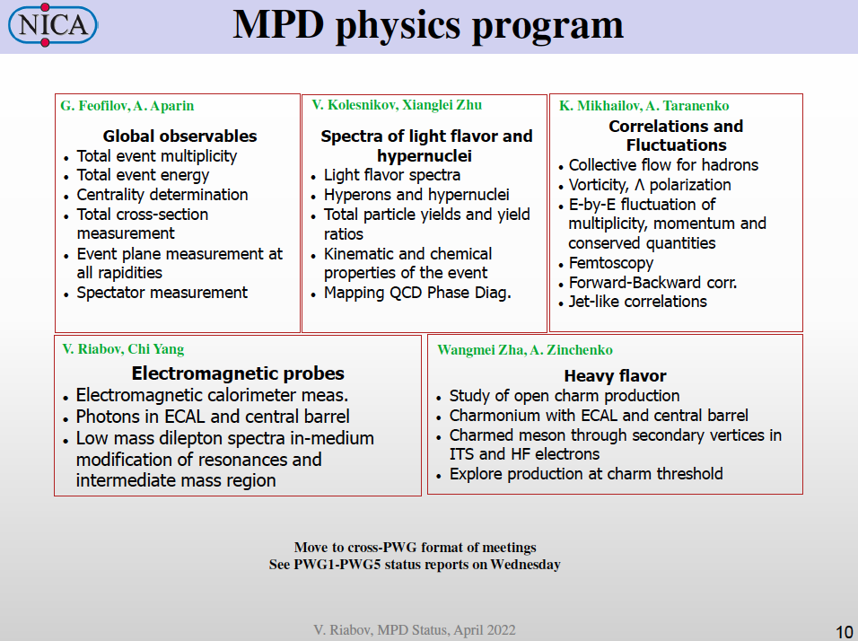

Slide 39
AS
What

Slide 40
AS
What

Slide 41
What are the novel studies and new results expected from the MPD@NICA?
What

Slide 42
What are the novel studies and new results expected from the MPD@NICA?
What

Slide 43
Organization of workflow:
PWG1 should prepare to provide expertise on global observables for other physics groups as soon as data are recorded
We need intensify efforts prior to the actual data taking in order to effectively using working time to prepare for that
Need to decide on effective way of communication of different analysis groups in PWG1 and with other PWG’s. Would it be mailing, forum, wiki-like structure, mattermost, etc.
Need to find people who will lead different analysis topics. Centrality calculation has volunteers, what else?

Slide 44
.
.

Slide 45
https://indico.cern.ch/event/895086/contributions/4314628/

Slide 46
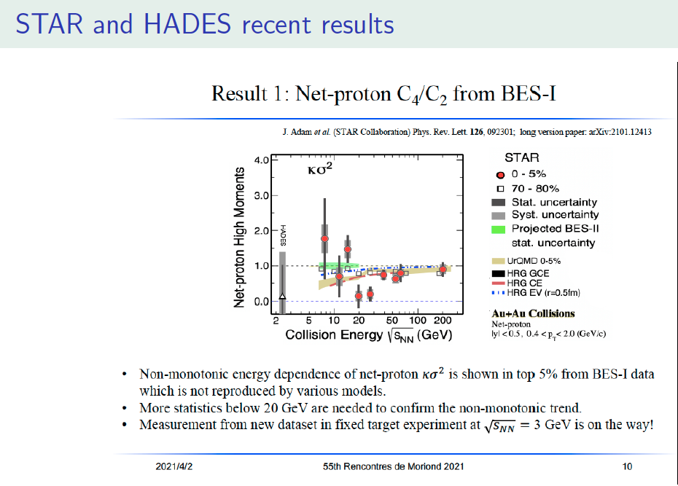
.
.

Slide 47
https://indico.cern.ch/event/895086/contributions/4314628/

Slide 48
Study of the systematics in determining the symmetry plane for Bi-Bi collisions at √S_{NN} 9.2 GeV in the DCM-QGSM-SMM model
Valerii Troshin NRNU MEPhI
Cross-PWG meeting in MPD
14.06.2022

Slide 49
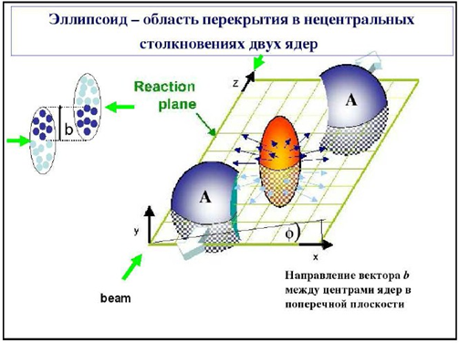

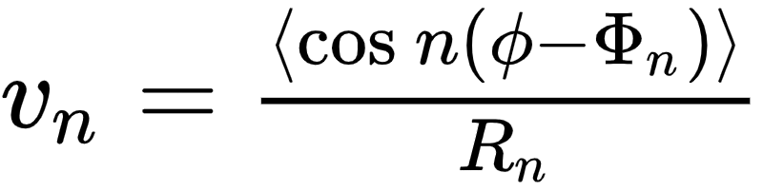
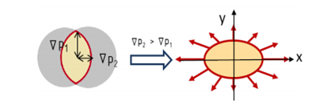

Collective anisotropic flow
The spatial asymmetry of the energy distribution at the initial moment of the collision of nuclei is transformed, through the strong interaction, into the momentum anisotropy of the produced particles
Fourier series expansion of particle distribution in azimuthal angle with respect to the reaction plane angle
The expansion coefficients:
In the experiment, we can get the event plane angle Φ_{n} , relative it:
R_{n} — Resolution of Φ_{n}
for the reaction plane angle Ψ_{RP}:

Slide 50
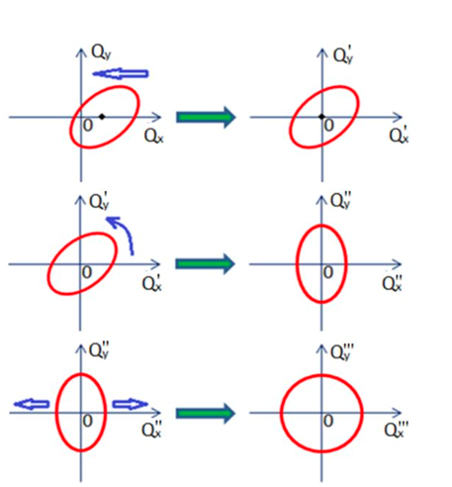
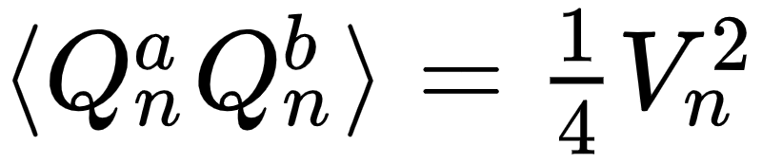
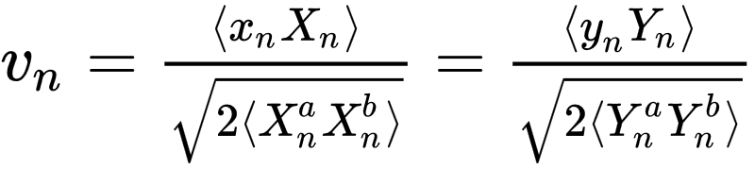
Scalar product method
Corrections for non-uniform acceptance
Each particle with an azimuthal angle ϕ is assigned a vector u:
recentering
The sum of these vectors determines the Q-vector of the event
twist
Event-averaged correlation of u-vectors with Q-vector depends on v_{n}
rescale
a,b - sub-events

Slide 51
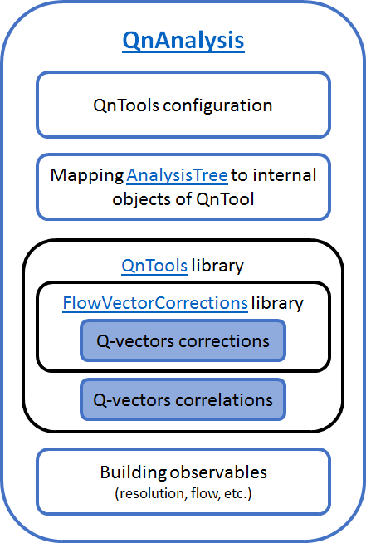
The QnAnalysis package
Motivation:
•Decoupling configuration from implementation
•Persistency of analysis setup
•Co-existence of different setups (easy systematics study)
•Unification of analysis methods
•Self-descriptiveness of the analysis results
QnAnalysis requirements:
•ROOT ver. ≧ 6.20 (with MathMore library)
•C++17 compatible compiler
•CMake ver. ≧ 3.13
Can be easily installed on NICA cluster using ROOT and CMake modules
Git repository: https://github.com/HeavyIonAnalysis/QnAnalysis

Slide 52
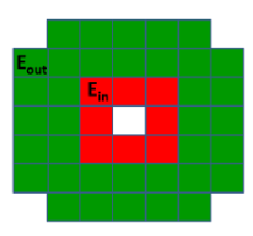
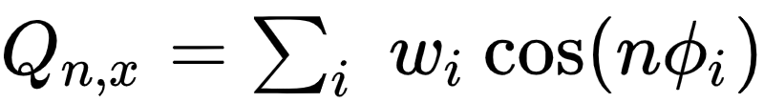
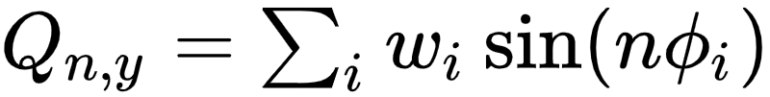
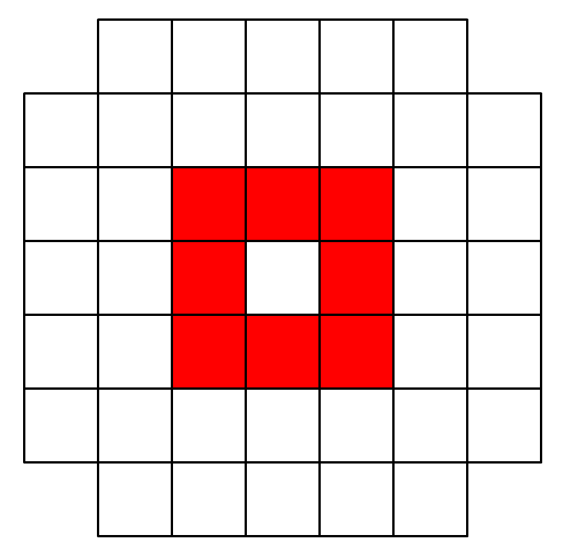
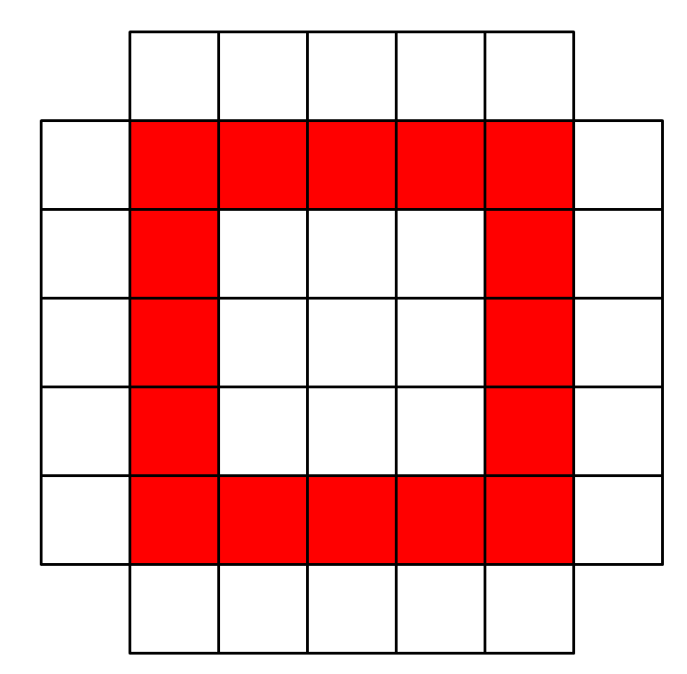
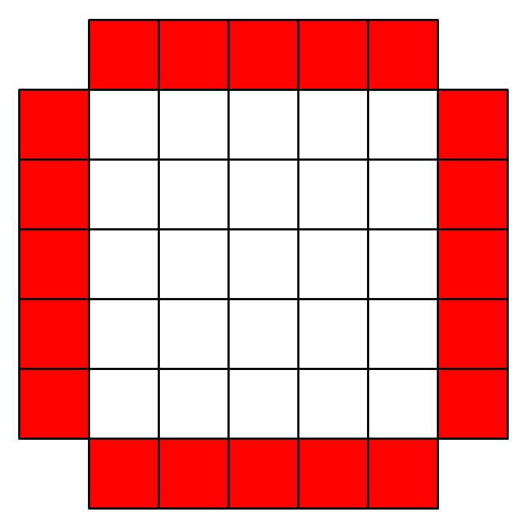
FHCal’s role in scalar product method
FHCal is used to form Q-vectors of sub-events according to the angular distribution of spectator energy in modules:
ϕ_{i} —azimuthal angle of modules № i in FHCal, w_{i} — energy in module
Sub-events can be formed by Right(South) and Left(North) FHCal and also by the rings of FHCal modules
Inner Middle Outer
When studying correlations, the following values is also considered:

Slide 53
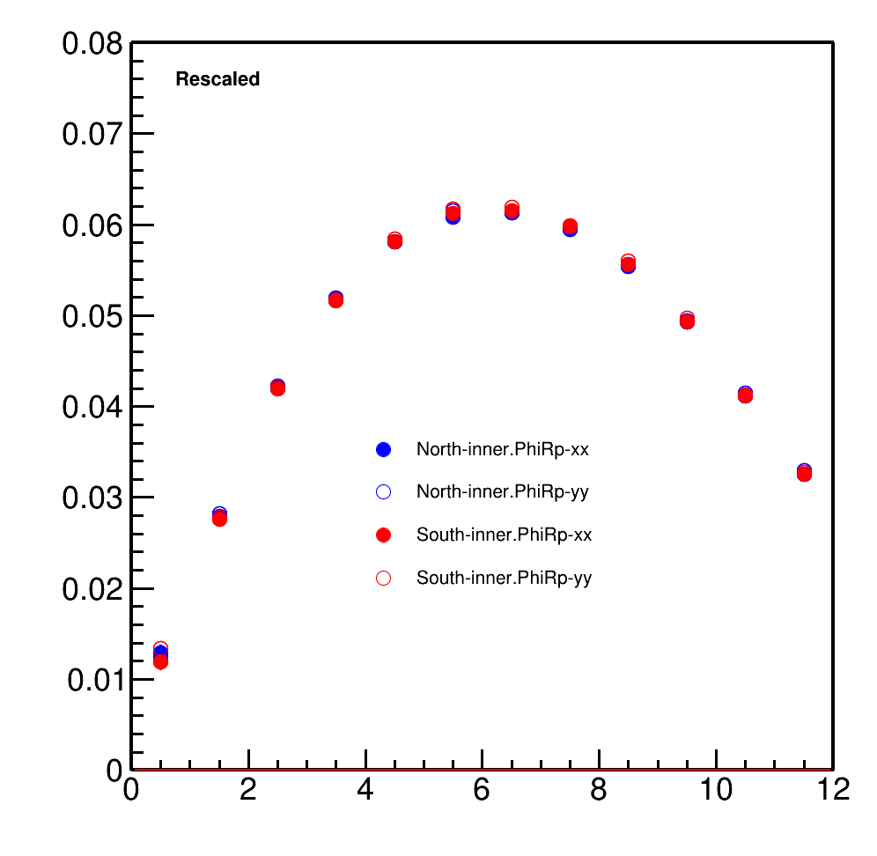
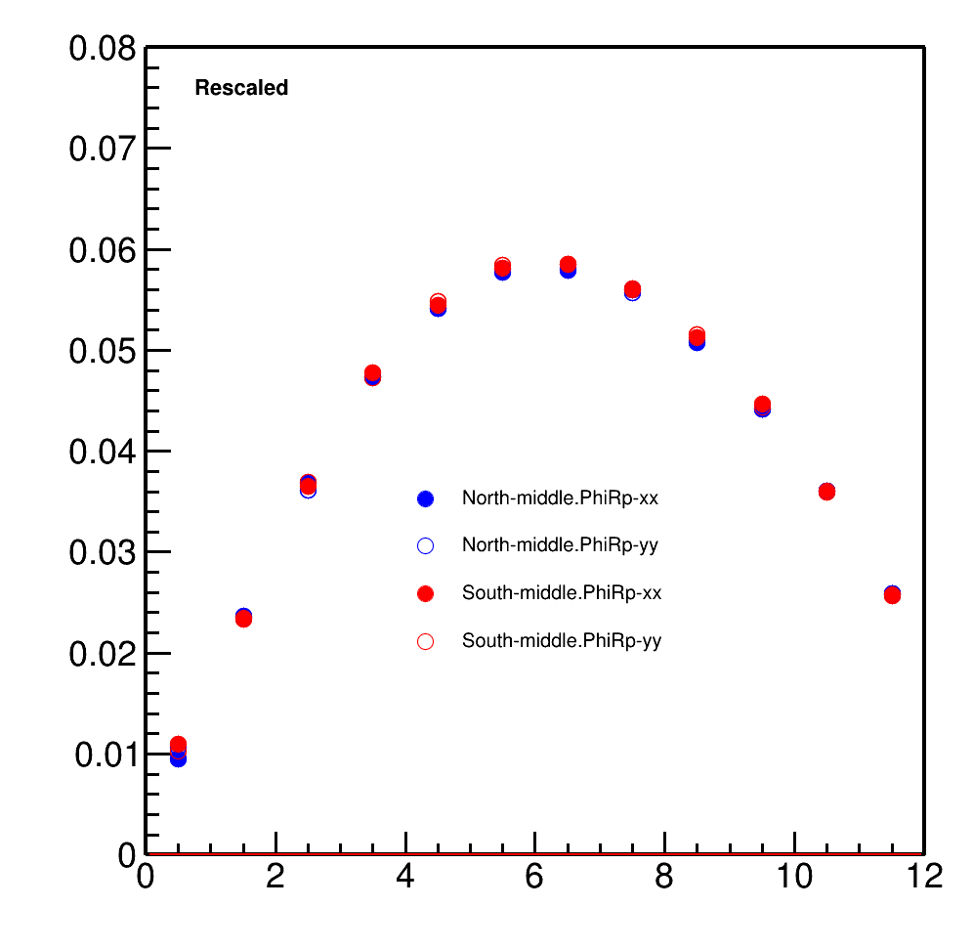
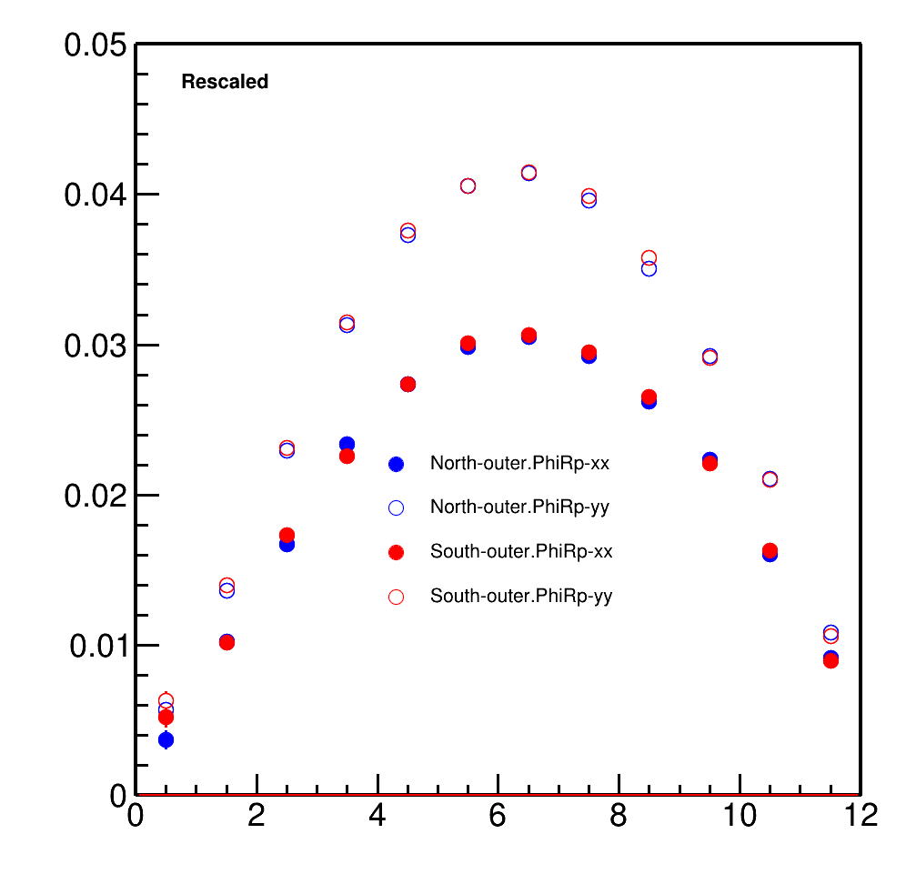
Correlation of Q-vectors in FHCal’s rings with reaction plane angle PhiRp
Inner ring
Middle ring
Outer ring
XX and YY components diverge for outer ring

Slide 54
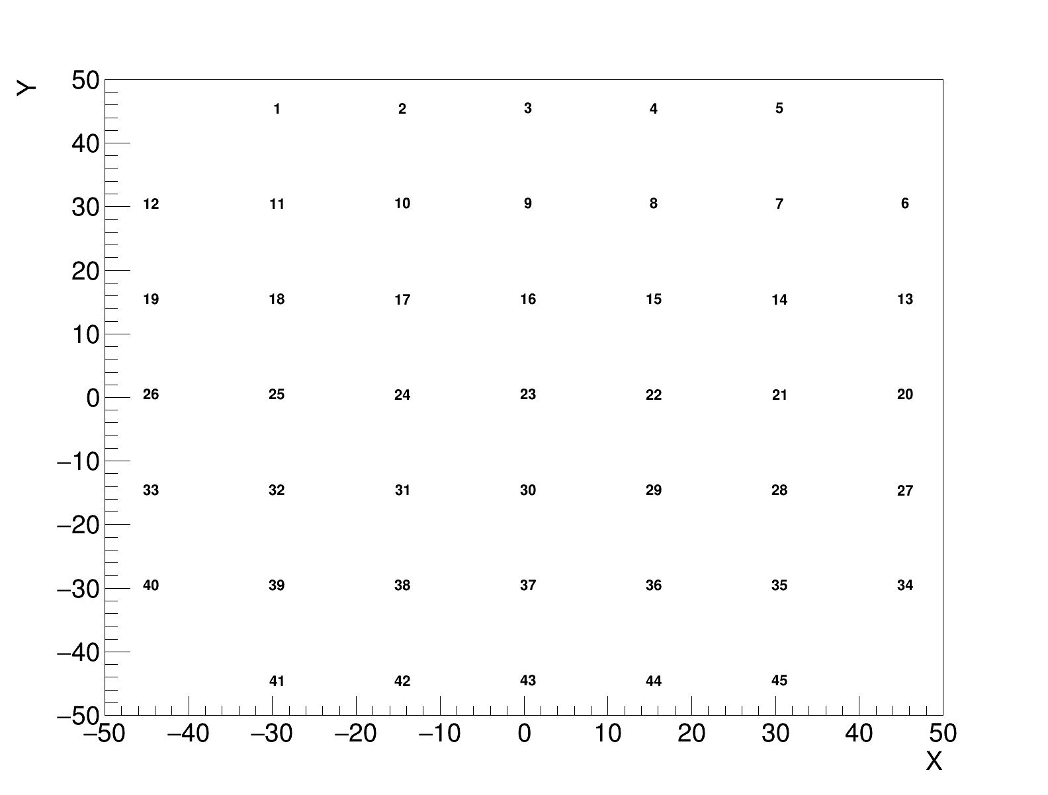
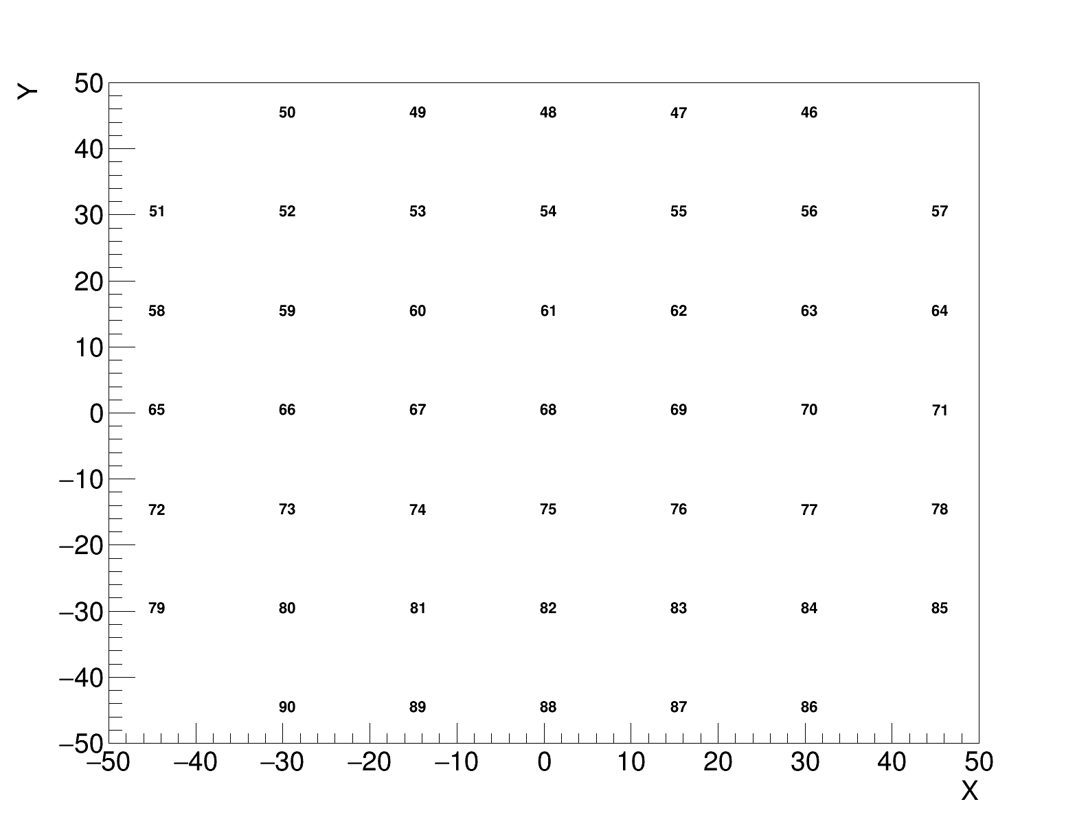
FHCal Module numbering
Left
Right
The first and last lines are numbered in the wrong direction. Can we obtain module coordinates from MPDROOT?

Slide 55
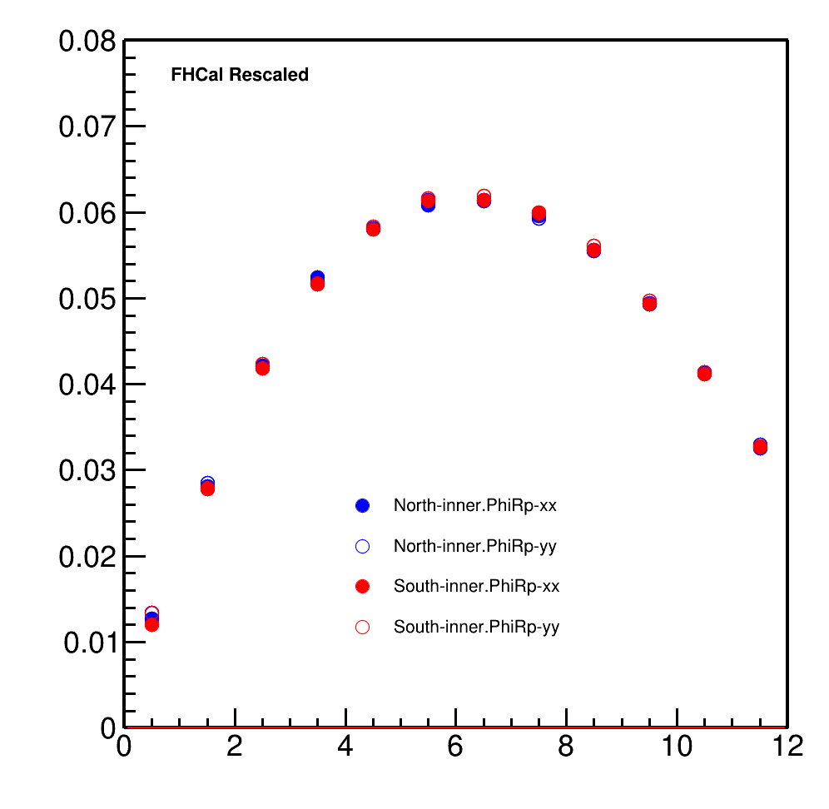
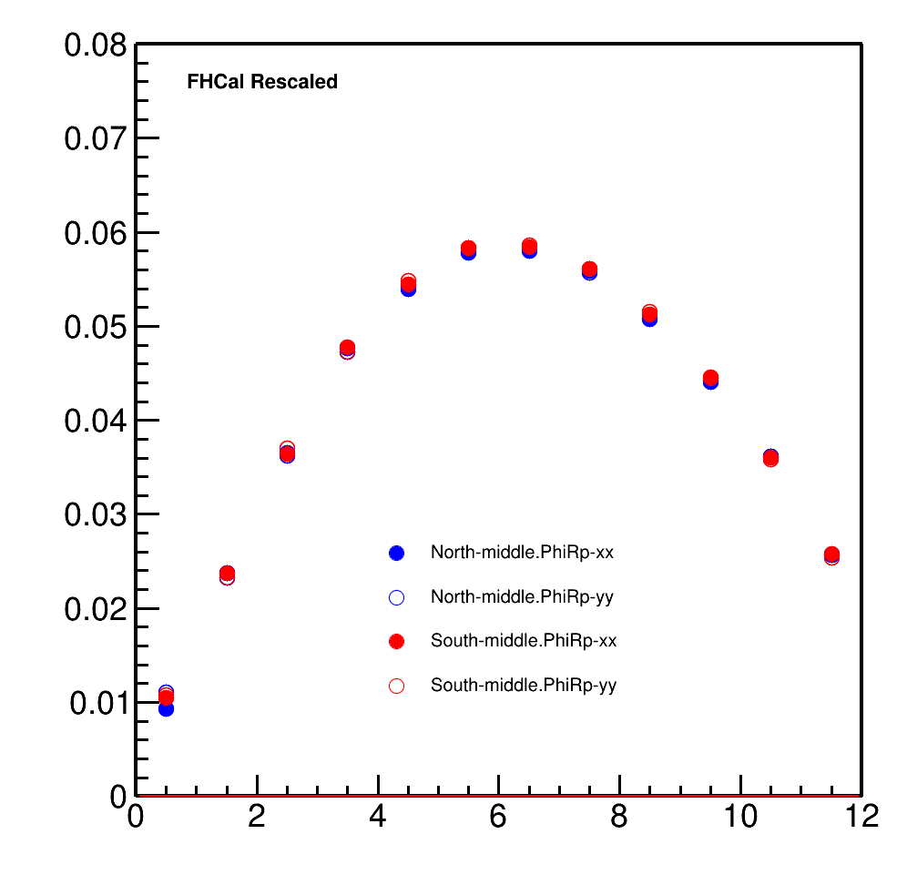
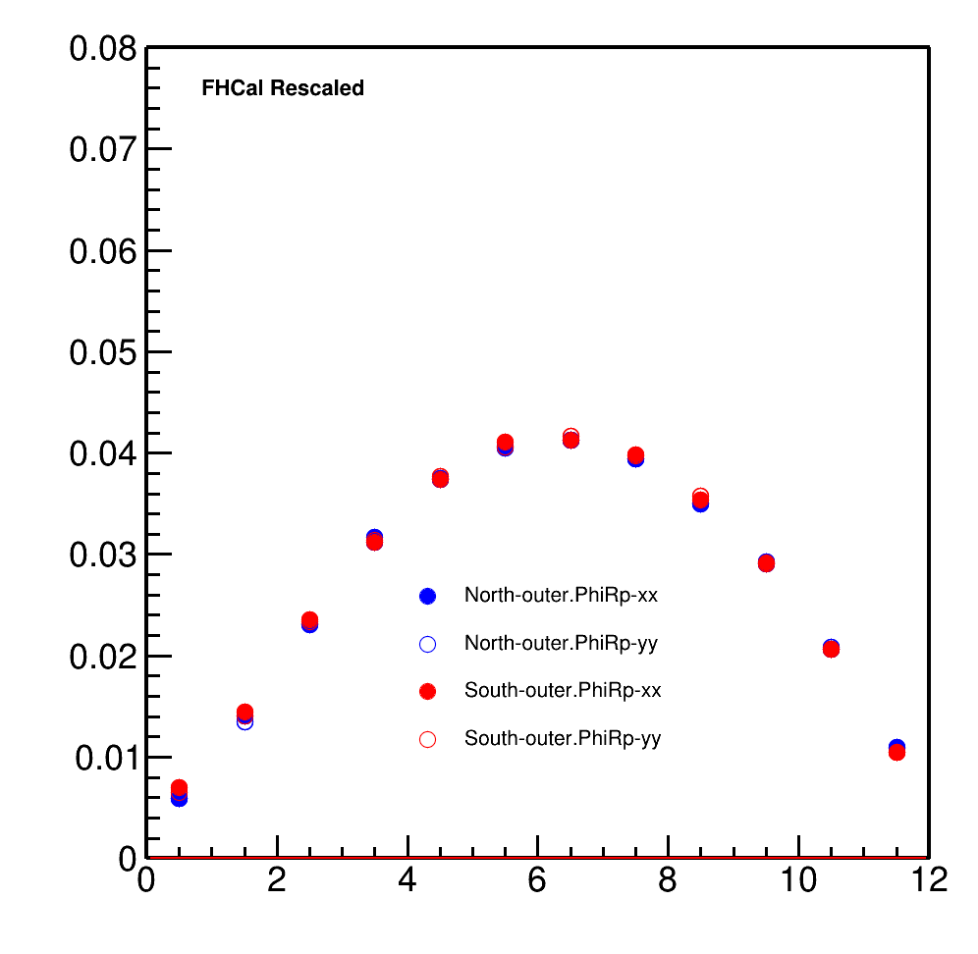
Correlation of Q-vectors in FHCal’s rings with reaction plane angle PhiRp
Inner ring
Middle ring
Outer ring

Slide 56


Ratio of True Resolution and Reco Resolution
good agreement for mid-central collisions
necessary to study difference for central collisions

Slide 57
Summary
An error was detected in the calculation of FHCal module coordinates
Two sub-events method is applicable to calculate first harmonic Resolution for mid-central collisions
It is necessary to study difference for central collisions
Three sub-events method is needed to study further

Slide 58
Thanks for your attention!

Slide 59
Application of neural networks for event-wise evaluation of the impact parameter
K.Galaktionov, V. Roudnev, F. Valiev
(St. Petersburg State University)
(Paper was submitted to PEPAN)
Evaluation of the impact parameter in a single event is crucial for correct and efficient data processing in collision-based nuclear and particle physics experiments. Real-time estimates of the impact parameter allows experimentalists to preselect the most informative events at the data acquisition stage, before any processing. The presented computational experiments prove application of neural network techniques for direct impact parameter evaluation useful for future experimental setups.

Slide 60


Application of neural networks for event-wise evaluation of the impact parameter
Fig.15.
(a)Segmentation according to angle and radius of ring MCP detector.
(b)Timing information obtained from detectors.

Slide 61



Application of neural networks for event-wise evaluation of the impact parameter
Рис.16. Матрицы ошибок: (а) - для сбора детектора в виде трех пар колец с учетом времени прилета, (б) - для сбора детектора в виде трех пар колец с учетом разниц времени прилета пионов и протонов.
Рис._17. Матрица _ошибок._ _Матрица _ошибок _для _бинарного _классификатора _с _границей _между _классами _в _7_ _ферми._

Slide 62
Impact parameter.
The application of neural networks for the event-wise estimation of the impact parameter from the data obtained from the MCP-based FBBC was tried out numerically. Au+Au collisions at √s=11 GeV were simulated using QGSM event generator. The simulated data set was divided into the reference and test samples with a ratio of 80/20. The reference sample was used to determination of the weights in the artificial neural network to match the given parameters in the best way. Then the network parameters were fixed and it was applied to processing the test sample. The obtained error matrix provided information on the network operation efficiency.
On the whole, the general accuracy of correct event identification in a certain class (part of the detector) was about 80%. Taking into account that average times of pion and proton arrival are close, an additional possibility of distinguishing between these types of particles would increase the network efficiency. It should also be noted that this approach proved quite efficient for separation between events with large and small impact parameters, demonstrating the highest error in the intermediate interval of impact parameters. For small impact parameters, which are of most interest in collision experiments, an additional binary classifier was constructed. This increased the accuracy of the network operation to 93%.
Thus, it is possible to use the developed numerical tools for processing experimental data from MCP-based BBC detector at SPD in order to select central collisions both on-line and in post-processing.

Slide 63
Testing in-lab
Microchannel plates circular plates with diameters of 18 mm and 25 mm.
MCPs were manufactured by VTC “Baspik” (Vladikavkaz, Russia)
Chevron MCP setups.

Slide 65
FBBC developments
Fig.20. Photograph of three MCP detectors in a chevron assembly
Fig.21. Pulse shape from MCP detector.
The voltage at the MCP assembly is 1.8 kV. The anode area is 0.25 cm2.
Signal edge <1 nsec, amplitude 300 mV

Slide 66

FBBC developments: electronics
A differential matched scheme is selected as a result of testing of the MCP detectors with different readout
systems.
This choice is associated with a lower sensitivity
to pickups up of the UHF noise signals by the fast readout electronics.

Slide 67

FBBC developments: electronics
Fig. 26. Block diagram of fast electronics and detailed diagram of one registration channel
We propose to develop a next prototype of a registration system basing on high-speed discrete comparators of the ADCMP572 / ADCMP573 type as primary recorders in a multichannel time-code converter based on the FPGA. These ADCMP572 / ADCMP573 type comparators feature a high switching rates (35 ps) with jitter of the order of 15 ps with a minimum signal duration of 85 ps.
Work is in progress.

Slide 68
FBBC developments:
first prototypes of electronics
Fig.29. Four-channel electronics module on discrete comparators with differential inputs for timing measurements.
Fig.34. Photo of the device of the two-channel fast electronics module based on discrete comparators. Work is in progress.

Slide 69
Conclusions-1
Two compact systems based on MCPs are proposed for the fast beam-beam collisions monitoring, event selection and determination of the precise timing signal (T0) of the collisions, We propose to use the MCP-based Beam Profilometer and the Fast Beam-Beam Collisions counters (FBBC) as devices potentially capable to extend the performance and the physics outreach of experiments at NICA.
This includes the event-by-event measurements of:
  Beam-beam IP location in z-coordinate
  3D-beam profile (2 dimensional + time structure)
  Luminosity
  Reaction plane
  Event centrality class in A-A collisions
  Precise timing signal (T0) of the collisions
  Beam-gas events suppression

Slide 70
Conclusions-2
We evaluated the effectiveness of the conceptual design of the proposed FBBC system using Monte Carlo simulation based on event generators SMASH, LAQGSM and UrQMD
We show the possibility of increasing the acceptance of the SPD setup up to 6 units of pseudorapidity by using several MCP-based ring detectors located inside the beam pipe of the NICA collider. This also provides an extension of the possibilities for physical measurements.
The Beam Profilometer was succesfully tested at the NUCLOTRON beams,
At the end of December 2020, the first test of a prototype multi-anode detector of the MCP system, made in the design of ultrahigh vacuum, was carried out on the line of the circulating helium ion beam of the NICA collider booster
Another test of a prototype was done during the latest Booster and Nuclotron run in January, 2022.

Slide 71
Conclusions-3
The technology for ultra-high vacuum (UHV) design of MCP detectors was tested. It allows the application of the MCP detectors inside the vacuum beam line.
The first prototypes were prepared in the UHV and UHF design. The in-lab and in-beam tests show subnanosecond MCP signal rise time (<800 ps)
We produced, using modern high-speed discrete comparators, the prototype of a multichannel fast electronics module for time reference to signals from MCP detectors
We proposed to develop a next prototype of a registration system basing on high-speed discrete comparators of the ADCMP572 / ADCMP573 type as primary recorders in a multichannel time-code converter based on the FPGA. These ADCMP572 / ADCMP573 type comparators feature a high switching rates (~35 ps) with jitter of the order of 15 ps with a minimum signal duration of 85 ps.
We applied the machine learning method using event-by-event information from MCP detectors in our studies of event-by-event selection of the primary collision vertex and for the fast selection of collision centrality class. We show the method to be feasible for the bunch-by-bunch crossing analysis at NICA.

Slide 72
BACK-UP SLIDES

Slide 73
Micro Channel Plates (MCPs)
as a MIP detector
[1]A.Baldin,G.Feofilov,F.F.Valiev et al. ,”Microchannel plates as a detector for 800 MeV/c charged pions and protons.” // JINR Rapid Communications. 1991. No 4/50/-91. p.27-36.
[2] A.A.Baldin, G.Feofilov,Yu.Gavrilov, A.Tsvinev,F.Valiev, “Proposals for a new type of microchannel-plate-based vertex detector”, // NIM A323. 1992. p. 439-444.
…
[3]V.Bondila, L.Efimov D.Hatzifotiadou, G.Feofilov, V.Kondratiev, V.Lyapin, J.Nysten, P.Otiougova, T.A.Tulina, W.H.Trzaska, F.Tsimbal, L.Vinogradov, C.Williams, Results of in-beam tests of an MCP-based vacuum sector prototype of the T0/centrality detector for ALICE, NIM A, Volume 478, Issues 1–2, 1 February 2002, Pages 220-224.
…
[4] G. Feofilov, V. Kondratev, O. Stolyarov, T. Tulina, F. Valiev, and L. Vinogradov, Development and Tests of MCP Based Timing and Multiplicity Detector for MIPs, ISSN 1547-4771, Physics of Particles and Nuclei Letters, 2017, Vol. 14, No. 1, pp. 150–159. © Pleiades Publishing, Ltd., 2017.
…
[5] A. Baldin, G. A. Feofilov, P. Har'yuzov, F. F. Valiev
NIMA, 958, 162154, 2019, Reported at the VCI2019
DOI:10.1016/j.nima.2019.04.108
...
[6] NONDESTRUCTIVE DIAGNOSTICS OF ACCELERATED ION BEAMS
WITH MCP-BASED DETECTORS AT THE ACCELERATOR COMPLEX
NICA. EXPERIMENTAL RESULTS AND PROSPECTS
A. A. Baldin, V. I. Astakhov, A. V. Beloborodov, D. N. Bogoslovsky, A. N. Fedorov,
P. R. Kharyuzov, A. P. Kharyuzova, D. S. Korovkin, A. B. Safonov, Joint Institute for Nuclear Research, Dubna, Russia
27th Russian Particle Acc. Conf. RuPAC2021, Alushta, Russia JACoW Publishing
ISBN: 978-3-95450-240-0 ISSN: 2673-5539 doi:10.18429/JACoW-RuPAC2021-WED05

Slide 74
In 2021 : The loading characteristics were studied in a range from single pulses to 5∙10⁶ particles/cm² s. Thus, the possibility of application of detectors of this type for BBC SPD was demonstrated.

Slide 75

A specialized portable vacuum chamber with thin (50 mkm) Ti windows was manufactured for investigation of particle registration efficiency by chevron MCPs in the case of particles with minimum ionizing power; two independent prototypes of MCP detectors can be installed in this vacuum chamber. It is planned to perform full-scale testing of registration efficiency, time resolution, and loading characteristics of such detectors at extracted beams of Nuclotron and electron beams of the linear accelerator LINAC-200 (LNP JINR).
Figure
shows the photo of the specialized vacuum chamber and its flanges.

Slide 77


Вакуумные испытания камеры с прогревом.
Достигнут вакуум 5*10⁻¹⁰ Торр

Slide 78

Figure 8 shows an example of C beam acceleration in the Booster from injection to transmission into Nuclotron (a total time of about 1.5 s).
Rice. Fig. 17. Horizontal (x) and vertical (y) beam profile versus time, measured with an MCP XY profilometer installed in the booster UHV beamline.

Slide 79



Slide 80

FBBC developments
Figure : Compact module of the Fast Beam-Beam Collision Monitor (FBBC) based on the circular MCPs. Sector cathode readout pads and two MCP set-ups are embedded into a separate flange with hermetic 50 Ohm signal feedthroughs
and
HV feedthroughs (the last ones are not shown).

Slide 81

Where are we today?
MPD collaboration is in preparations to start…

Slide 82

Some highlights from STAR@RHIC presented at QM-2022

Slide 83

Some highlights from STAR@RHIC presented at QM-2022

Slide 84
Some highlights from STAR@RHIC presented at QM-2022

Slide 85

Some highlights from STAR@RHIC presented at QM-2022: example

Slide 86
Comments to STAR data on chiral magnetic effect search in isobar collisions
Comment 1: it is a very interesting idea!
Comment 2: but, as one may see, the narrow centrality class selection is important to ensure the high resolution
Comment 3: first of all, the MPD has to start and compare results
of measurements in Bi+Bi collisions at 9.2 GeV with available Au+Au data by with STAR@RHIC

Slide 87
Very reach harvest of STAR data at RHIC
[1]
[1] https://www.osti.gov/servlets/purl/1762771 --we have to check the data-sets available!

Slide 88
Discussion of the MC production
Task 1: to start and compare with STAR@RHIC)
Selection of the pseudorapidity intervals and centrality classes with Bi+Bi at MPD to compare with STAR
STAR@RHIC: Au+Au collisions at √s _{NN}=9.2GeV, year 2008 , a short test run of ~3000 good events [2]
Energy dependence of particle ratios,π−/π+, p/p, K−/K+ and K/π, plotted as a function of √sNN. Results from 0–10% central Au+Au collisions at 9.2 GeV at midrapidity (|y|<0.5) are compared with those from AGS, SPS and RHIC.
Azimuthal anisotropy measurements
Pion interferometry measurements
[2] STAR Collaboration, Bulk Properties in Au+Au Collisions at √ s_{NN}= 9.2 GeV in STAR Experiment at RHIC, Nucl.Phys.A830:275c-278c,2009; arXiv:0907.1943v2

Slide 89

We have to start and compare with STAR@RHIC [2]
Energy dependence of particle ratios
[2] STAR Collaboration, Bulk Properties in Au+Au Collisions at √ s_{NN}= 9.2 GeV in STAR Experiment at RHIC, Nucl.Phys.A830:275c-278c,2009; arXiv:0907.1943v2
At midrapidity
(|y|<0.5)
Centrality
Class
0-10%

Slide 90

We have to start and compare with STAR@RHIC [2]
[2] STAR Collaboration, Bulk Properties in Au+Au Collisions at ‾‾‾√ sNN‾= 9.2 GeV in STAR Experiment at RHIC, Nucl.Phys.A830:275c-278c,2009; arXiv:0907.1943v2
Pion interferometry measurements
Centrality
class 0-30%

Slide 91

We have to start and compare with STAR@RHIC [2]
Azimuthal anisotropy measurements
[2] STAR Collaboration, Bulk Properties in Au+Au Collisions at √ s_{NN}= 9.2 GeV in STAR Experiment at RHIC, Nucl.Phys.A830:275c-278c,2009; arXiv:0907.1943v2
At midrapidity
(|η|<1.0)
Centrality
class 0-60%

Slide 92
Strange hadron production in Au+Au collisions at √s_{NN} = 7.7, 11.5, 19.6, 27, and 39 GeV with STAR@RHIC [3]
One may include later in the analysis recent STAR measurements of strange hadron (K⁰_{S} and ϕ) production at mid-rapidity (|y|<0.5) in Au+Au collisions at from √sNN = 7.7 to 39 GeV
[3] STAR Collaboration: J. Adam, et al., Phys. Rev. C 102, 034909 (2020) Related DOI: https://doi.org/10.1103/PhysRevC.102.034909
https://arxiv.org/abs/1906.03732

Slide 93

Strange hadron production in Au+Au collisions at ‾‾√sNN‾ = 7.7, 11.5, 19.6, 27, and 39 GeV [3]
Strange hadrons production in Bi+Bi collisions at NICA:
it is very interesting!
and it may be considered at later stages and added to STAR analysis
[3] STAR Collaboration: J. Adam, et al., Phys. Rev. C 102, 034909 (2020) Related DOI: https://doi.org/10.1103/PhysRevC.102.034909
FIG. 27: Energy dependence of Λ, antiΛ--, Ξ⁻, antiΞ⁺, Ω⁻, antiΩ⁺ to pions
ratios at mid-rapidity in central Au+Au collisions from STAR Beam Energy Scan (solid symbols). The STAR BES mid-rapidity pion yields are taken from [7].
[7] L. Adamczyk et al. (STAR Collaboration), Phys. Rev. C 96, 044904 (2017).
https://arxiv.org/abs/1906.03732

Slide 94
Centrality and multiparticle production in ultrarelativistic nuclear collisions
.
COMMENT : Narrow distribution in Nch DOES NOT mean
narrow distribution in Npart!
https://link.springer.com/journal/11450
So, centrality determination and selection of classes by STAR should be taken with definite concern!
T. A. Drozhzhova,V. N. Kovalenko,A. Yu. Seryakov,G. A. Feofilov, Physics of Atomic Nuclei, September 2016, Volume 79, Issue 5, pp 737–748

Slide 95
Question: with very reach harvest of STAR data at RHIC what is expected to be new by the MPD?
More precise selection of the centrality class in the MPD vs. STAR
  will provide more accurate determination of the number of binary collisions and of the RAA factor
Classes with narrow width of central collisions will eliminate considerably the trivial volume fluctuations and allow to get new results at the NICA energy:
  in fluctuations and correlation measurements,
  in elliptic flow measurements and flow fluctuations

Slide 96
Where are we today?

Slide 97
Where are we today? PWG1 meetings: Sept.2021- March 2022
24 March 2022 Speaker: I.Maldonado (Universidad Autónoma de Sinaloa) ,"Update BiBi Collisions at 9.2 GeV
27 Jan 2022, A.Seryakov (SPbSU),” Influence of different centrality methods on multiplicity fluctuations: MPD case”
20 Jan 2022
G.Feofilov and A.Aparin. ”PWG1: planning of activity for 2022”
I.Maldonado (Universidad Autónoma de Sinaloa)”BiBi collisions at 9.2 GeV”
18 November 2021,
Dr. G.Musulmanbekov, “Nuclear fragments deposited in FHCal. DCM-QGSM or DCM-SMM?”
A.Aparin “Discussion concerning a way to establish a standartized procedure for basic QA”,
09 Sept. 2021
Pedro Antonio Nieto Marín "Centrality determination in MPD at NICA"¶ 20m
by "Centrality determination in MPD at NICA”.

Slide 98
Two main approaches to centrality class(es selection:
1) Charged particle Multiplicity classes by the TPC (or…) and
2) Spectator energy classes by FHCal

Slide 99
Two main approaches to determination of classes of centrality
Multiplicity in TPC as centrality class estimator
-- method was suggested by MEPHI/GSI team
Report by Petr Parfenov at the MPD Physics forum 15.04.2021r:
See https://indico.jinr.ru/event/2065/
https://github.com/FlowNICA/CentralityFramework
https://github.com/Dim23/GammaFit
Draft of analysis note:
https://github.com/FlowNICA/CentralityFramework/blob/master/Documentation/Centrality_AnalysisNote.pdf
Spectator nucleons with FHCal
– by the INR RAS team, see the PWG1 meetings Report by Vadim Volkov at the PWG1 meeting 01 April 2021
https://indico.jinr.ru/event/2066/
or RFBR conference:
https://indico.jinr.ru/event/1469/contributions/9905/attachments/8135/12126/ivashkin_RFBR_2020.pdf
Codes: https://github.com/qweek2/Centrality_NICA/tree/master
  .
Global observables in heavy-ion collisions at NICA.
PWG1 status report , MPD Collaboration meeting 21.04.2021—23.04.2021, JINR, Dubna

Slide 100
Two main approaches to determination of classes of centrality
Spectator nucleons with FHCal
– by the INR RAS team, see the PWG1 meetings Report by Vadim Volkov at the PWG1 meeting 01 April 2021
https://indico.jinr.ru/event/2066/
or RFBR conference:
https://indico.jinr.ru/event/1469/contributions/9905/attachments/8135/12126/ivashkin_RFBR_2020.pdf
Codes: https://github.com/qweek2/Centrality_NICA/tree/master
It is important to proceed with the results presented by Genis in the report
G. Musulmanbekov, V. Zhezher , “Nuclear fragments deposited in FHCal. DCM-QGSM or DCM-SMM?”:
“DCM-QGSM-SMM is more reliable than DCM-QGSM-GEM for description of spallation of excited Nuclear Remnants”
see https://indico.jinr.ru/event/2658/
  .
Global observables in heavy-ion collisions at NICA.
PWG1 status report , MPD Collaboration meeting 21.04.2021—23.04.2021, JINR, Dubna

Slide 101
DCM-QGSM-GEM vs DCM-QGSM-SMM
DCM-QGSM-GEM
Step 1
Intranuclear Cascade
Step 2
Coalescence
Step 3 Residual Nucleus (RN)
Preequlibrium emission
Step 4
Fermi-break-up if A_{res} < 13
Generalized evaporation (GEM)
Fission
DCM-QGSM-SMM
Step 1
Intranuclear Cascade
Step 2
Coalescence
Step 3 Residual Nucleus (RN)
None
Step 4 Residual Nucleus (RN)
Fermi break-up if A_{res} < 13
Statistical Multifragmentation (SMM)
Secondary Fragmentation and Evaporation of excited fragments
Fission
see https://indico.jinr.ru/event/2658/

Slide 102


Conclusion
DCM-QGSM-GEM
DCM-QGSM-SMM
G. Musulmanbekov: DCM-QGSM-SMM is more reliable for estimation
E_{FHCal} and Centrality
see https://indico.jinr.ru/event/2658/

Slide 103

PWG1 meeting Thursday the 27th of Jan 2022
https://indico.jinr.ru/event/2794/

Slide 104


Slide 105


Slide 106


Slide 107


PWG1 meeting Thursday the 24th of March 2022
https://indico.jinr.ru/event/2781/

Slide 108


Slide 109

.

Slide 110

.

Slide 111

.
WORK IN PROGRESS

Slide 112
I show that in a strongly interacting plasma, the fluctuations responsible for deviations from those of a description based on a simple Hadron Resonance Gas Model naturally arise from the proper inclusion of the plasma screening properties. These are encoded in the contribution of the so called "ring diagrams" and thus in the introduction of a key feature of plasmas near phase transitions, namely, long-range correlations. I illustrate this property using the Linear Sigma Model with quarks which in the high temperature and chiral symmetry approximations renders analytical results. After fixing the model parameters using input from LQCD for the crossover transition at vanishing baryon chemical potential, I study the location of the Critical End Point (CEP) in the effective QCD phase diagram. I use the model to study baryon number fluctuations and show that in heavy-ion collisions, the CEP can be located for collision energies of order of 2 GeV per nucleon, namely, in the lowest NICA or within the HADES energy domain.

