Slide 1
STATUS OF THE NICA-MPD-PLATFORM
Author:
Alexander Fedunin
Sector No 3; Engineering Support Group
Joint Institute for Nuclear Research

Slide 2
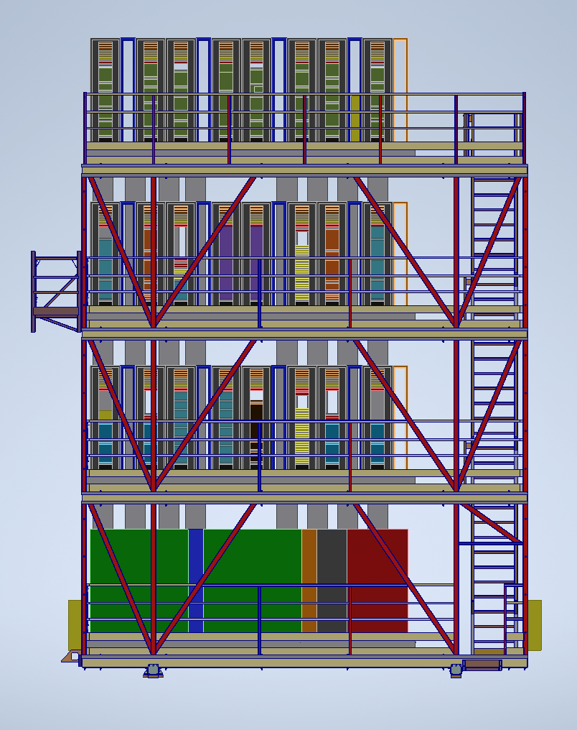
PARTS of NMP
IT RACKS on the NMP,
Raised floor,
Power Supply,
Cooling System,
Structed Cabling,
Access control and management system,
CCTV video surveillance system,
Fire extinguishing system,
Monitoring system

Slide 3
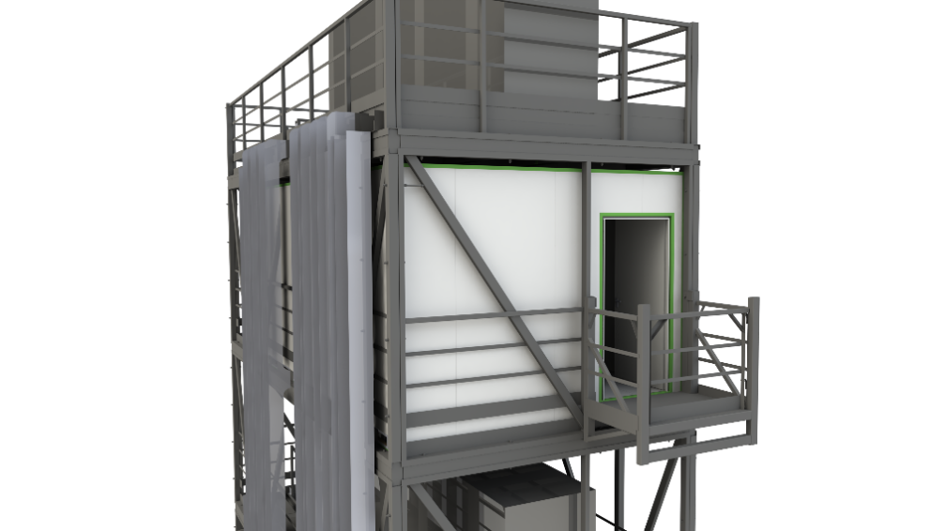
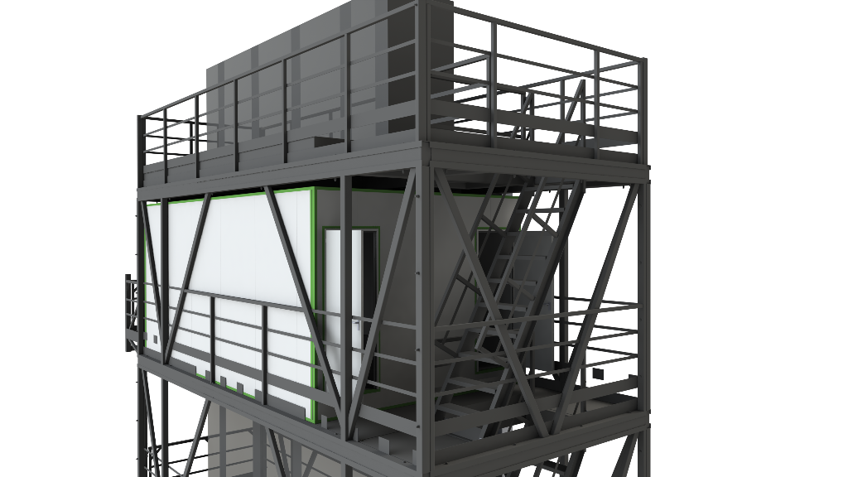
Concept (currently under modeling)
The concept of equipment cooling is a separate clean room with cold and hot corridors on each floor.
08.11.2022

Slide 4
Location of sub-detector equipment
1 floor: Sub-detector cooling system (design stage)
2 floor: FFD and ECAL detector equipment
3 floor: TOF detector equipment
4 floor: TPC detector equipment
08.11.2022

Slide 5
Power consumption calculation
Title: | installed power | demand coefficient | Cos j | tg j | required power |  |  | Peak current
 | kW | coefficient |  |  | kW | Q, kVA | S, kVA | I, 3phase, А
Nominal mode
1st Floor
Racks (with equipment), 1 х 9 kW | 15,00 | 0,60 | 0,95 | 0,3 | 9,0 | 3,0 | 9,5 | 13,7
Water preparation | 30,00 | 0,70 | 0,90 | 0,5 | 21,0 | 10,2 | 23,3 | 33,8
Air preparation | 30,00 | 0,70 | 0,90 | 0,5 | 21,0 | 10,2 | 23,3 | 33,8
Cooling Air System | 1,00 | 0,60 | 0,90 | 0,5 | 0,6 | 0,3 | 0,7 | 1,0
Engineering systems (lightning, access contol sys, and go on) | 1,00 | 1,00 | 0,95 | 0,3 | 1,0 | 0,3 | 1,1 | 1,5
Elevator | 5,50 | 1,00 | 0,90 | 0,5 | 5,5 | 2,7 | 6,1 | 8,9
Other consumption | 2,00 | 0,30 | 0,95 | 0,3 | 0,6 | 0,2 | 0,6 | 0,9
General consumption 1st Floor | 84,50 | 0,69 | 0,91 | 0,5 | 58,70 | 26,78 | 64,5 | 93,63
2nd Floor
Racks (with equipment), 8 х 9 kW | 120,00 | 0,60 | 0,95 | 0,3 | 72,0 | 23,7 | 75,8 | 109,8
Cooling Air System | 4,00 | 0,60 | 0,90 | 0,5 | 2,4 | 1,2 | 2,7 | 3,9
Engineering systems (lightning, access conrtol sys and go on) | 1,00 | 1,00 | 0,95 | 0,3 | 1,0 | 0,3 | 1,1 | 1,5
Other consumption | 2,00 | 0,30 | 0,95 | 0,3 | 0,6 | 0,2 | 0,6 | 0,9
General consumption 2nd Floor | 127,00 | 0,60 | 0,95 | 0,3 | 76,00 | 25,35 | 80,1 | 116,15
3rd Floor
Racks (with equipment), 8 х 9 kW | 120,00 | 0,60 | 0,95 | 0,3 | 72,0 | 23,7 | 75,8 | 109,8
Cooling Air System | 4,00 | 0,60 | 0,90 | 0,5 | 2,4 | 1,2 | 2,7 | 3,9
Engineering systems (lightning, access contol sys and go on) | 1,00 | 1,00 | 0,95 | 0,3 | 1,0 | 0,3 | 1,1 | 1,5
Other consumption | 2,00 | 0,30 | 0,95 | 0,3 | 0,6 | 0,2 | 0,6 | 0,9
General consumption 3rd Floor | 127,00 | 0,60 | 0,95 | 0,3 | 76,00 | 25,35 | 80,1 | 116,15
4th Floor
Racks (with equipment), 8 х 12 kW | 120,00 | 0,80 | 0,95 | 0,3 | 96,0 | 31,6 | 101,1 | 146,5
Cooling Air System | 4,00 | 0,80 | 0,90 | 0,5 | 3,2 | 1,5 | 3,6 | 5,2
Engineering systems (lightning, access contol sys and go on) | 1,00 | 1,00 | 0,95 | 0,3 | 1,0 | 0,3 | 1,1 | 1,5
Other consumption | 2,00 | 0,30 | 0,95 | 0,3 | 0,6 | 0,2 | 0,6 | 0,9
General consumption 4th Floor | 127,00 | 0,79 | 0,95 | 0,3 | 100,80 | 33,63 | 106,3 | 154,05
Other consumption
Cryogenic Plant Power Shield 4th Floor | 65,00 | 1,00 | 0,95 | 0,3 | 65,0 | 21,4 | 68,4 | 99,2
Fire alarm control panel | 1,00 | 1,00 | 0,95 | 0,3 | 1,0 | 0,3 | 1,1 | 1,5
Other general consumption | 66,00 | 1,00 | 0,95 | 0,3 | 66,00 | 21,69 | 69,5 | 100,69
Total general consumption on NMP | 531,50 | 0,71 | 0,94 | 0,4 | 377,50 | 132,81 | 400,2 | 580,65
08.11.2022

Slide 6
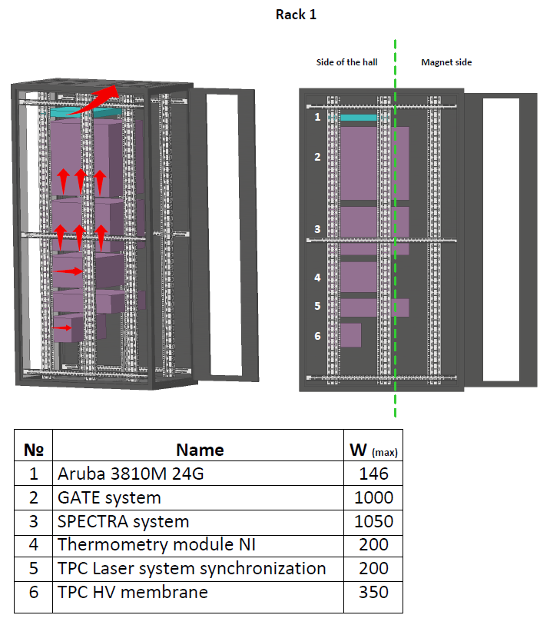
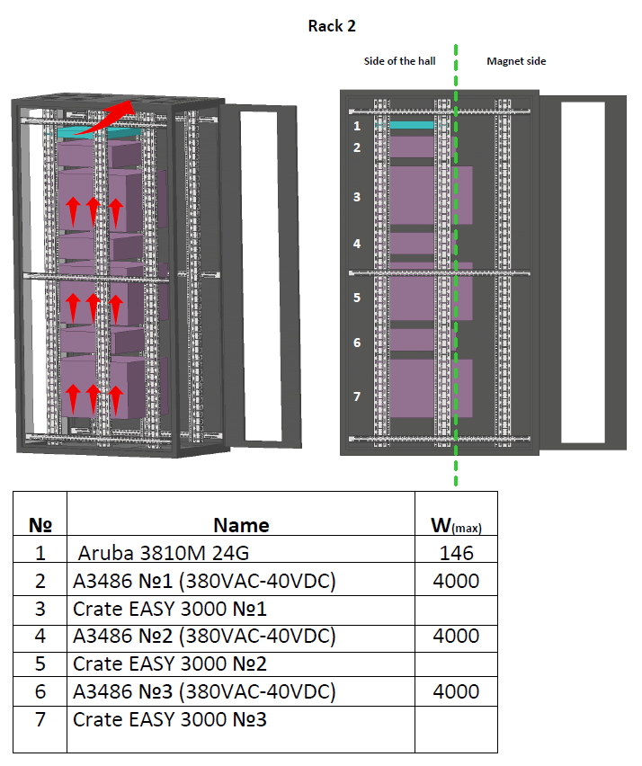
Air flows Visualization (4th floor)
Nominal power consumption of 8 racks on the 4th floor -55,396 kW
Max power consumption - 73,55 kW
The nominal weight of the equipment on the 4th floor of the platform – 1 481,5 kg
08.11.2022

Slide 7
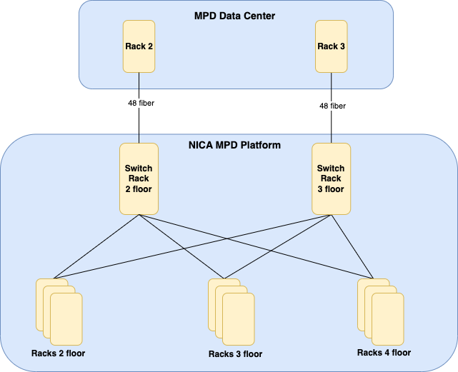
Structured Cabling System
08.11.2022

Slide 8
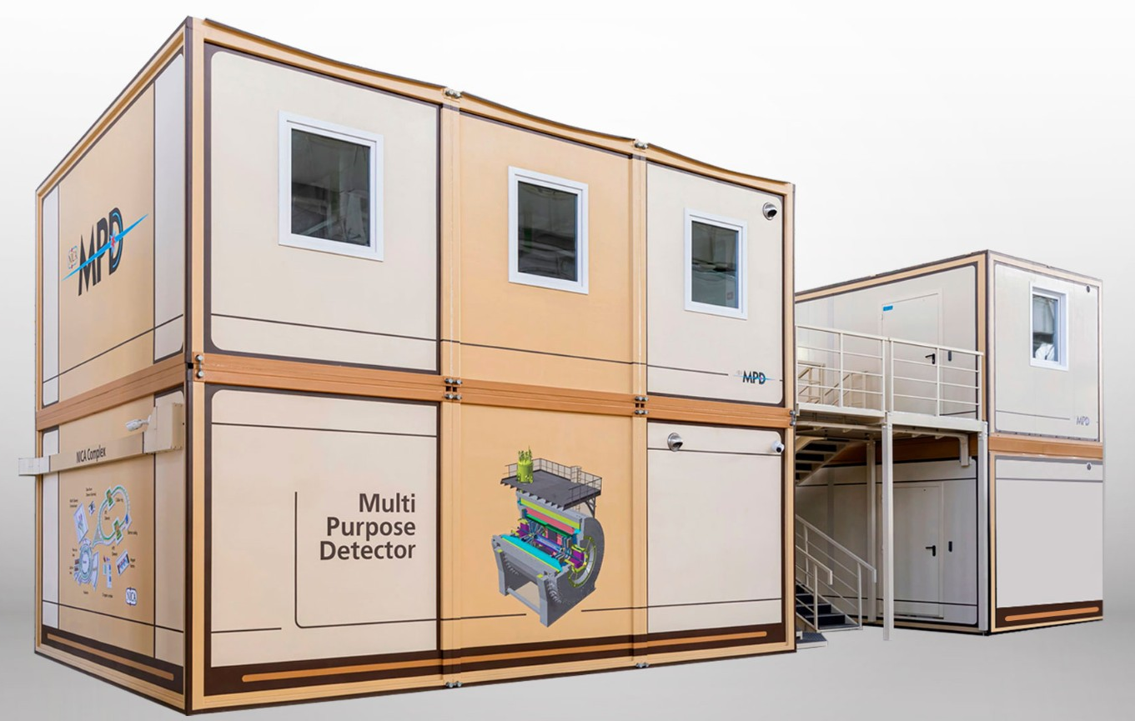
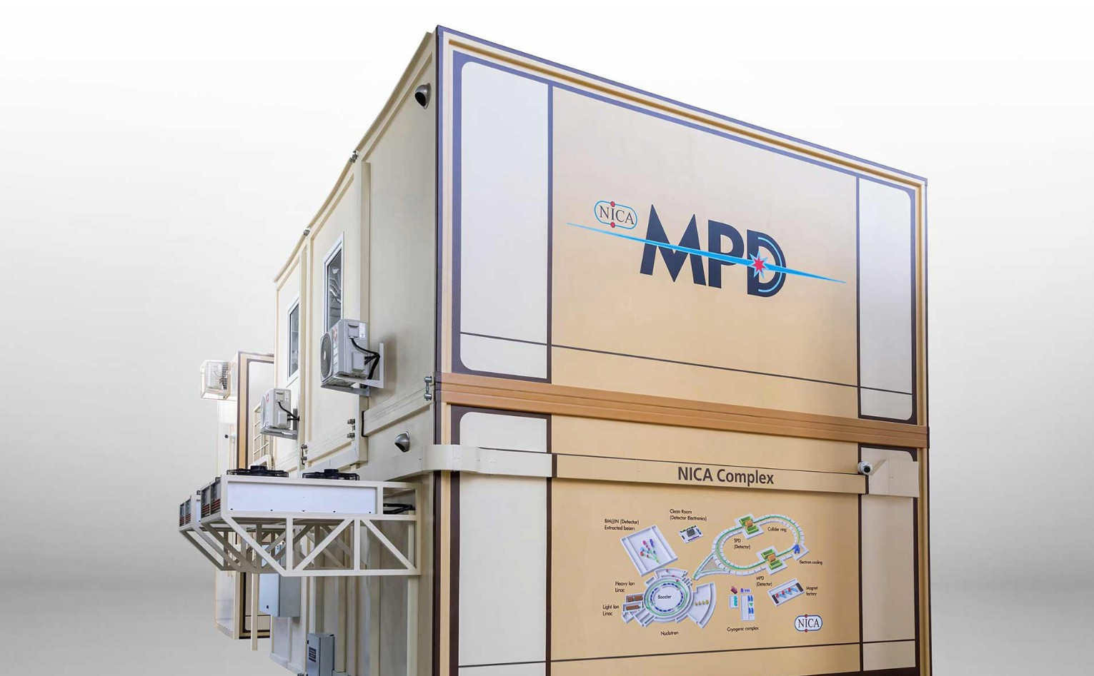
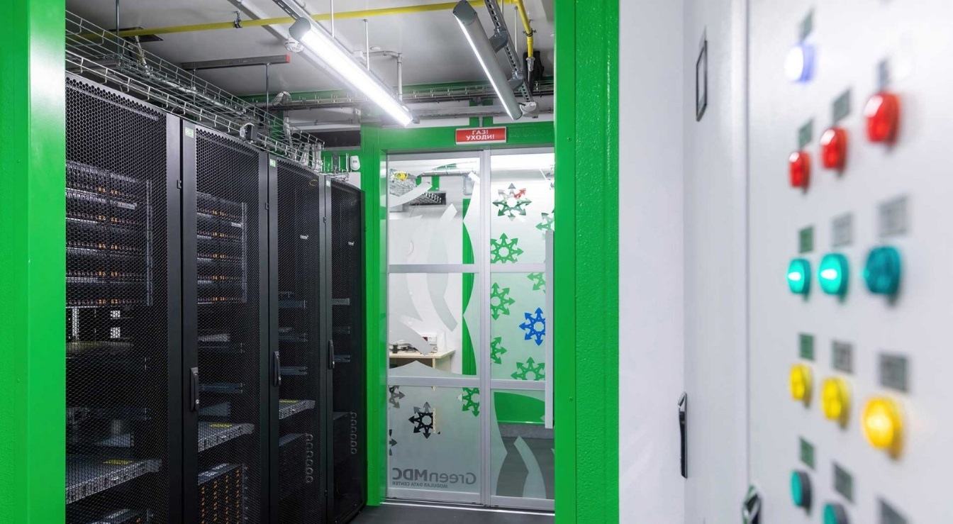
The platform's switching unit will be connected to the MPD Data Center.
08.11.2022

Slide 9
Project status NMP
 |  |  | October 2022 |  | November 2022 |  |  |  | December 2022 |  |  |  | January 2023 |  |  |  |  | February 2023 |  |  |  | March 2023 |  |  |  | April 2023 |  |  |  | May 2023
 |  | week progress | 1 | 2 | 3 | 4 | 5 | 6 | 7 | 8 | 9 | 10 | 11 | 12 | 13 | 14 | 15 | 16 | 17 | 18 | 19 | 20 | 21 | 22 | 23 | 24 | 25 | 26 | 27 | 28 | 29 | 30 | 31 | 32
№ | Stage
1 | Design and modeling | 8 | 1 | 2 | 3 | 4 | 5 | 6 | 7 | 8
2 | Manufacturing | 20 |  |  |  |  |  |  |  |  | 1 | 2 | 3 | 4 | 5 | 6 | 7 | 8 | 9 | 10 | 11 | 12 | 13 | 14 | 15 | 16
3 | Cooling system supply | 22 |  |  | 1 | 2 | 3 | 4 | 5 | 6 | 7 | 8 | 9 | 10 | 11 | 12 | 13 | 14 | 15 | 16 | 17 | 18 | 19 | 20 | 21 | 22
4 | Equipment supply | 1 |  |  |  |  |  |  |  |  |  |  |  |  |  |  |  |  |  |  |  |  |  |  |  |  | 1
5 | Assembly and testing of all systems | 7 |  |  |  |  |  |  |  |  |  |  |  |  |  |  |  |  |  |  |  |  |  |  |  |  |  | 1 | 2 | 3 | 4 | 5 | 6 | 7
08.11.2022

Slide 10
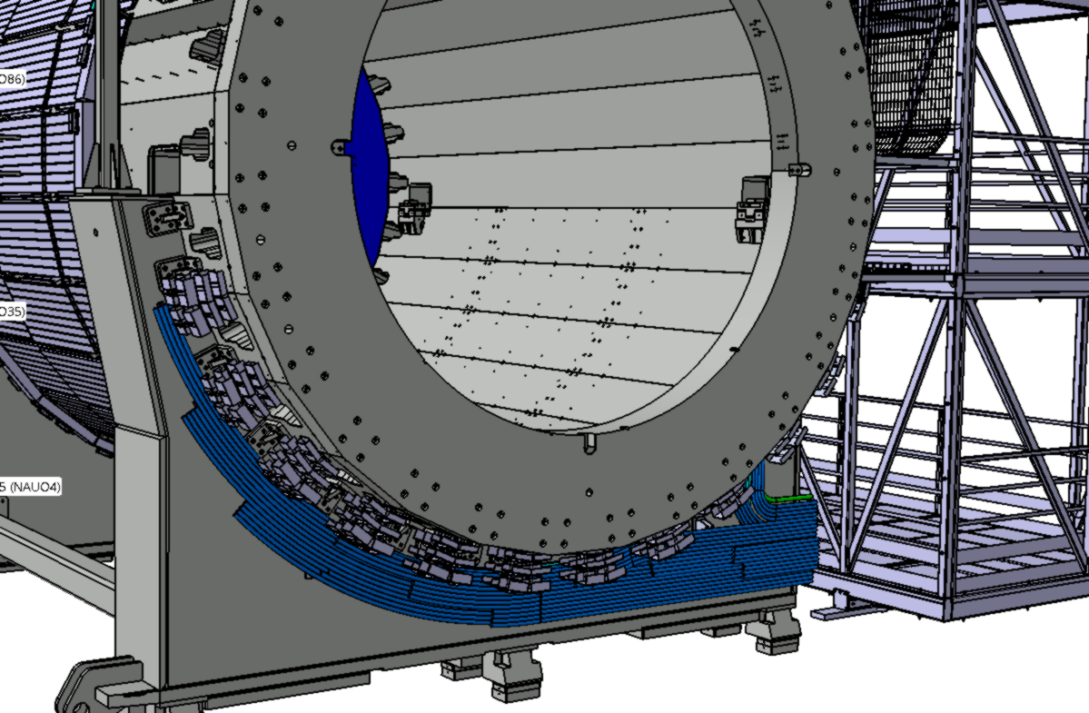
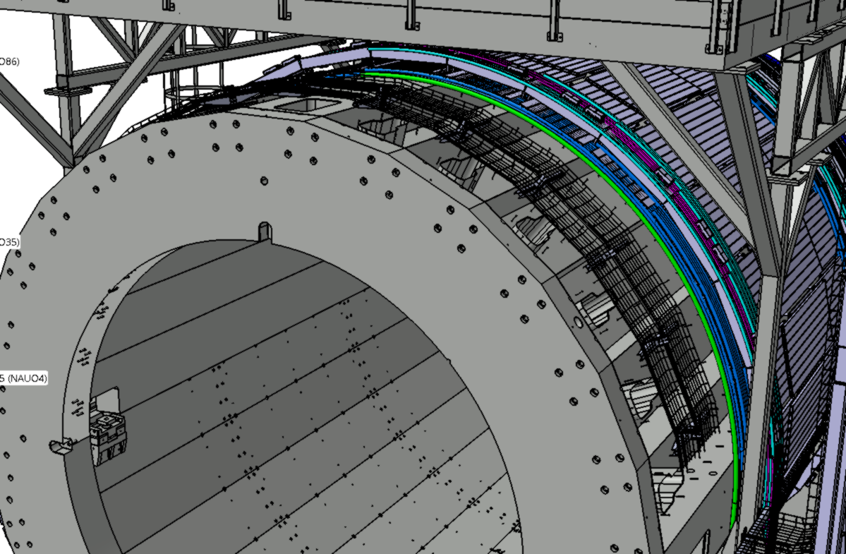
List of cables and pipes
 |  |  | 14 | 12 | 10 | 8 | 6 | 4 | 2 | 1 | 3 | 5 | 7 | 9 | 11 | 13
 | Purpose | Diameter, mm | Qty | Qty | Qty | Qty | Qty | Qty | Qty | Qty | Qty | Qty | Qty | Qty | Qty | Qty
EDTC | Data cable | 3 | 0 | 6 | 12 | 18 | 24 | 30 | 36 | 42 | 48 | 54 | 60 | 66 | 72 | 78
ESNC | Sense cable | 9,4 | 0 | 3 | 6 | 9 | 12 | 15 | 18 | 21 | 24 | 27 | 30 | 33 | 36 | 39
EPWC | Power cable | 14,7 | 0 | 3 | 6 | 9 | 12 | 15 | 18 | 21 | 24 | 27 | 30 | 33 | 36 | 39
ESRL | Service cable(1) | 1х13 | 0 | 3 | 6 | 9 | 12 | 15 | 18 | 21 | 24 | 27 | 30 | 33 | 36 | 39
EWCT | Wotercooling tubes | ~20 | 0 | 2 | 4 | 6 | 8 | 10 | 12 | 14 | 16 | 18 | 20 | 22 | 24 | 26
EACT | Air cooling tubes for FE and BOX | ~20 | 0 | 2 | 4 | 6 | 8 | 10 | 12 | 14 | 16 | 18 | 20 | 22 | 24 | 26
TSGC | Signal | 13 | 10 | 20 | 30 | 40 | 50 | 60 | 70 | 80 | 90 | 100 | 110 | 120 | 130 | 150
THVC | HV | 8,5 | 0 | 4 | 4 | 8 | 8 | 12 | 12 | 16 | 16 | 20 | 20 | 24 | 24 | 28
TLVC | LV Cable | 13 | 1 | 1 | 2 | 2 | 3 | 3 | 4 | 4 | 5 | 5 | 6 | 6 | 7 | 8
TUTC | UTP | 6 | 1 | 1 | 2 | 2 | 3 | 3 | 4 | 4 | 5 | 5 | 6 | 6 | 7 | 8
TTRL | Trigger (OR) | 10 | 2 | 2 | 4 | 4 | 6 | 6 | 8 | 8 | 10 | 10 | 12 | 12 | 14 | 16
TGST | Gas Pipes | 12 | 2 | 2 | 4 | 4 | 6 | 6 | 8 | 8 | 10 | 10 | 12 | 12 | 14 | 16
 | TPC gas system
TGTT | Purge TPC (in/out) | 40 | 0 | 0 | 0 | 0 | 0 | 0 | 0 | 1 | 1 | 1 | 1 | 1 | 1 | 1
 | LV
TLPC | LVDB: low-voltage cable supply | 12 | 0 | 8 | 8 | 16 | 16 | 24 | 32 | 32 | 32 | 32 | 40 | 40 | 48 | 48
TLSC | LVDB: sense wire | 2,5 | 0 | 4 | 4 | 8 | 8 | 12 | 16 | 16 | 16 | 16 | 20 | 20 | 24 | 24
TCPC | Controller: low-voltage cable supply | 12 | 0 | 2 | 2 | 4 | 4 | 6 | 8 | 8 | 8 | 8 | 10 | 10 | 12 | 12
TCSC | Controller: sense wire | 2,5 | 0 | 1 | 1 | 2 | 2 | 3 | 4 | 4 | 4 | 4 | 5 | 5 | 6 | 6
TLCC | LVDB: slow control cable | 9 | 0 | 2 | 2 | 4 | 4 | 6 | 8 | 8 | 8 | 8 | 10 | 10 | 12 | 12
 | DAQ
TDCC | Controller: slow control | 7 | 0 | 2 | 2 | 4 | 4 | 6 | 8 | 8 | 8 | 8 | 10 | 10 | 12 | 12
TDDO | Controller: DATA QSFP | opt. 3.3 | 0 | 1 | 1 | 2 | 2 | 3 | 4 | 4 | 4 | 4 | 5 | 5 | 6 | 6
TDTO | Controller: data and trigger/ sync SFP+ | opt. 3,9x1,8 | 0 | 1 | 1 | 2 | 2 | 3 | 4 | 4 | 4 | 4 | 5 | 5 | 6 | 6
TDTC | Controller: trigger | 6 | 0 | 1 | 1 | 2 | 2 | 3 | 4 | 4 | 4 | 4 | 5 | 5 | 6 | 6
TDRC | Controller: Reset | 6 | 0 | 1 | 1 | 2 | 2 | 3 | 4 | 4 | 4 | 4 | 5 | 5 | 6 | 6
TDSC | Controller: Sync | 6 | 0 | 1 | 1 | 2 | 2 | 3 | 4 | 4 | 4 | 4 | 5 | 5 | 6 | 6
TDQO | Reserve cables QSFP | opt. 3.3 | 0 | 1 | 1 | 1 | 1 | 1 | 2 | 2 | 2 | 2 | 2 | 2 | 2 | 2
TDSO | Reserve cables SFP+ | opt. 3,9x1,8 | 0 | 1 | 1 | 1 | 1 | 1 | 2 | 2 | 2 | 2 | 2 | 2 | 2 | 2
 | ROC chamber
TRAC | for ROC: HV power supply for anode sections | 4,1 | 0 | 0 | 4 | 4 | 8 | 8 | 8 | 8 | 12 | 16 | 16 | 20 | 20 | 24
TREC | for ROC: HV electrode adjusting supply | 4,1 | 0 | 0 | 1 | 1 | 2 | 2 | 2 | 2 | 3 | 4 | 4 | 5 | 5 | 6
TRNC | for ROC: HV locking grid | 4,1 | 0 | 0 | 2 | 2 | 4 | 4 | 4 | 4 | 6 | 8 | 8 | 10 | 10 | 12
TRCC | for ROC: cameras electrode (cathode), test signal | 4,1 | 0 | 0 | 1 | 1 | 2 | 2 | 2 | 2 | 3 | 4 | 4 | 5 | 5 | 6
TRSC | from ROC: signal cable (anode) | 4,1 | 0 | 0 | 4 | 4 | 8 | 8 | 8 | 8 | 12 | 16 | 16 | 20 | 20 | 24
 | Sensors
TSSC | Temperature sensor cable Pt100 | 8 | 0 | 0 | 3 | 3 | 6 | 6 | 6 | 6 | 9 | 12 | 12 | 15 | 15 | 18
TSPC | Cables from pressure sensers on pipes cooling + stabilization | 7,8 | 0 | 0 | 4 | 4 | 8 | 8 | 8 | 8 | 12 | 16 | 16 | 20 | 20 | 24
TSTC | Cables from temperature sensers on pipes cooling + stabilization | 7,8 | 0 | 0 | 4 | 4 | 8 | 8 | 8 | 8 | 12 | 16 | 16 | 20 | 20 | 24
 | HV TPC central membrane
THEC | Central HV electrode TPC | 8 | 0 | 0 | 0 | 0 | 0 | 0 | 0 | 0 | 1 | 1 | 1 | 1 | 1 | 1
THRC | low-voltage cable input for resistors (centr). HV electrode | 10 | 0 | 0 | 0 | 0 | 0 | 0 | 0 | 0 | 1 | 1 | 1 | 1 | 1 | 1
 | Thermostabilization
TTOT | external thermal screen stabilization pipes | 32 | 0 | 0 | 2 | 2 | 2 | 4 | 4 | 6 | 6 | 7 | 8 | 8 | 10 | 10
TTTT | end Thermal Shield Stabilization Pipes | 32 | 0 | 0 | 0 | 0 | 1 | 2 | 2 | 2 | 2 | 2 | 2 | 3 | 4 | 4
TTIT | inner thermal shield stabilization pipes | 32 | 0 | 0 | 2 | 2 | 2 | 2 | 2 | 2 | 2 | 2 | 2 | 2 | 2 | 2
TTRT | Pipes stabilisation ROC chambers housings | 32 | 0 | 0 | 0 | 0 | 0 | 0 | 0 | 0 | 0 | 2 | 2 | 2 | 2 | 2
TTFT | TPC flange stabilisation pipes with spokes | 32 | 0 | 0 | 0 | 0 | 0 | 0 | 1 | 3 | 4 | 4 | 4 | 4 | 4 | 4
TTST | Stabilization pipes FE SAMPA | 32 | 0 | 4 | 4 | 6 | 8 | 9 | 12 | 12 | 15 | 16 | 17 | 20 | 20 | 24
 | Cooling (12 loops)
TCLT | Cooling pipes LVDB, controllers & FE FPGA | 32 | 0 | 0 | 0 | 1 | 2 | 2 | 2 | 2 | 2 | 2 | 3 | 3 | 4 | 4
 | TPC laser system
TLWC | Cable for WEB camera control system floor laser beam | 7 | 0 | 0 | 1 | 1 | 1 | 1 | 1 | 1 | 1 | 2 | 2 | 2 | 2 | 2
 | TPC gas system
TGST | Purge of C1C2 and C3C4 (input/output) | 12 | 0 | 0 | 0 | 0 | 0 | 0 | 0 | 0 | 0 | 0 | 1 | 1 | 1 | 1
 | Hydraulic actuators
TSGC | Position centers hydraulic cylinder | 6 | 0 | 4 | 4 | 4 | 4 | 4 | 4 | 4 | 4 | 4 | 4 | 4 | 4 | 8

Slide 11
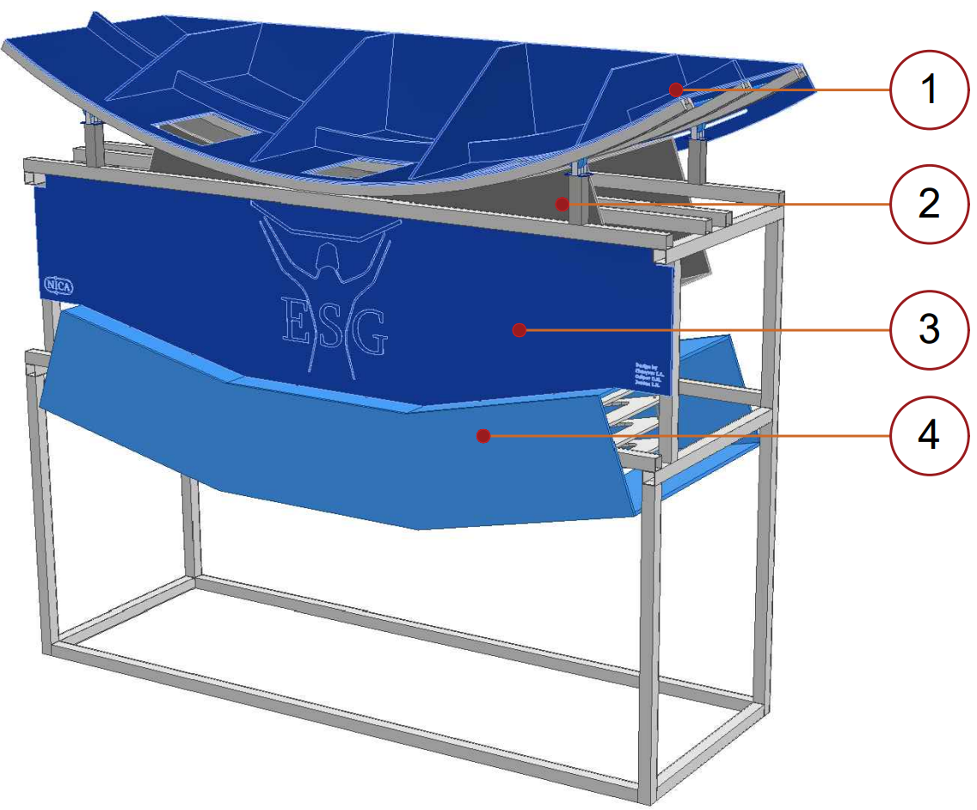
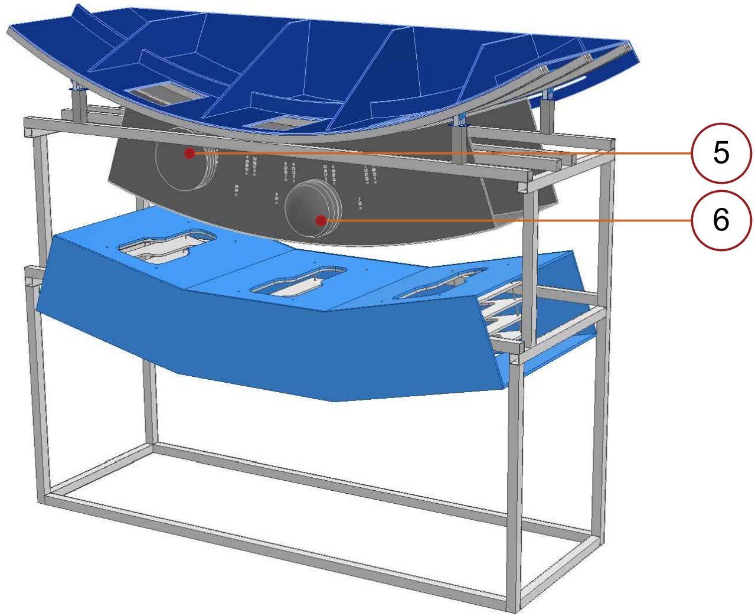
The design of full-size model
Description:
Power frame
Cryostat
Simulation of the inner side of the magnetic circuit flange
Magnetic circut beams
Flanges on the end parts of the cryostat
Simulation of welded cryostat plugs
08.11.2022

Slide 12
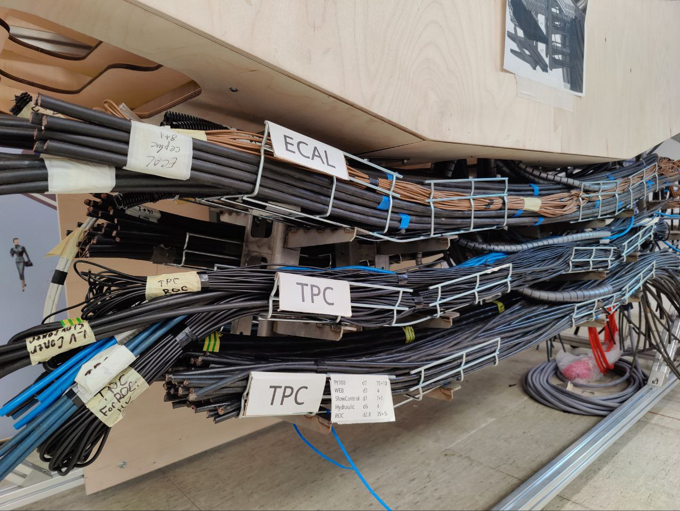
Completed work:
Cable tray rack prototype was assembled and adjusted for allocated space for cable routes.
Cable groups are distributed by trays according to detector groups Ecal, ToF, TPC and FFD installation order, and type of cables.
There have been laid cables and pipes from the windows of the power frame and to the yoke of the magnetic circuit for determining an occupied volume and free space.
We estimated the volume occupied by cable groups in windows and cable trays, and also the best way of their installation in a limited space.
08.11.2022

Slide 13
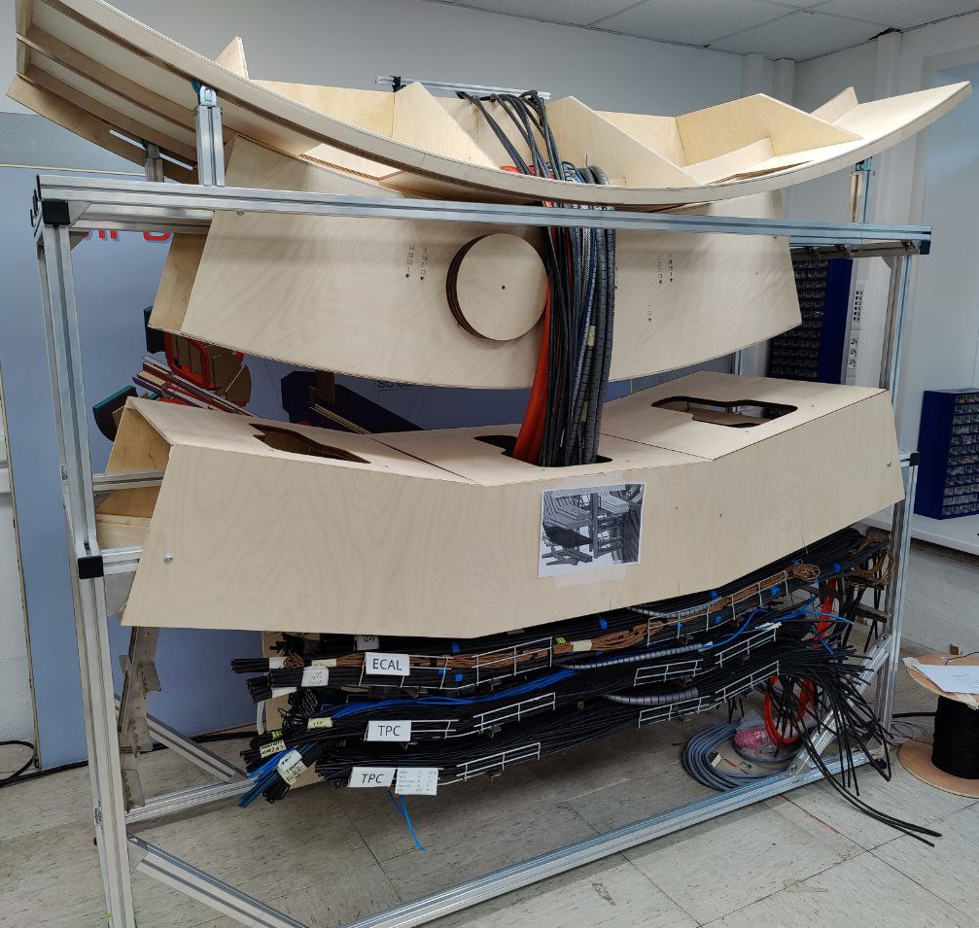
Solutions
The power cables of the TPC detector have been replaced with more flexible wires.
It was decided to use soft self-winding cable bandage for groups of cables with a small cross section when they go between windows of the power frame and the magnetic circuit.
The width of the cable trays was increased from 150 mm to 200 mm after the route left the area with limited space (seventh magnetic circuit window).
We have identified entry points in the NMP for subsequent distribution of cables on the floors.
08.11.2022

Slide 14
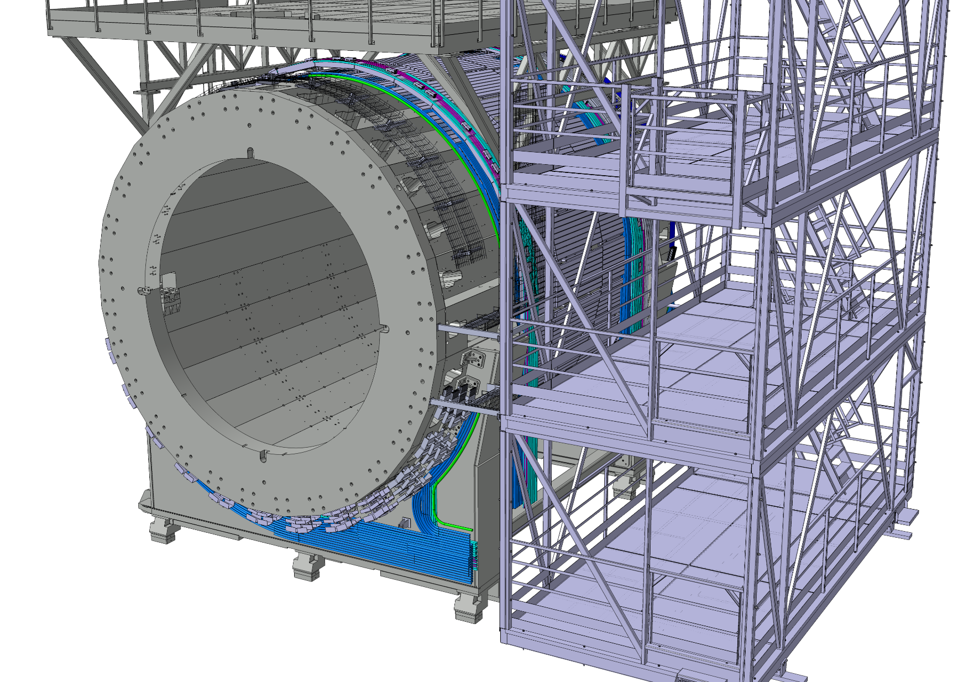
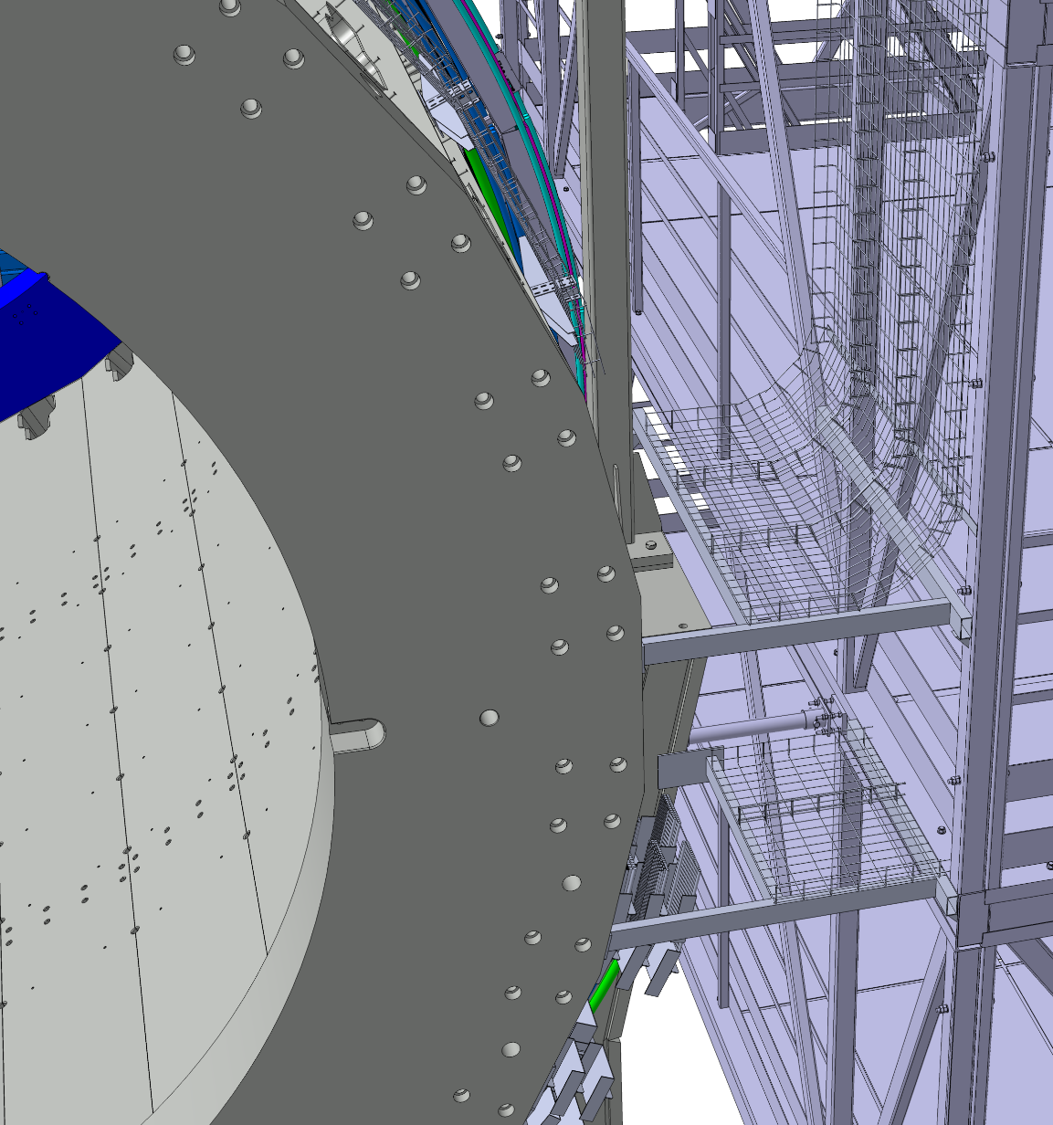
The cable trays system modeling
General view of cable routes
The cable tray in window №13
08.11.2022

Slide 15
Current difficulties
Absence or irregular supply of equipment (cables, …. etc) from abroad.
Sub-detector’s groups introduce changes in cable types, bend radius, diameter and quantity.
08.11.2022

Slide 16
Thank you
For
Attention
Author: Alexander Fedunin
Email: fediunin@lhep.ru
08.11.2022

Slide 17
Equipment in racks on the 2nd floor
08.11.2022
 | F2-R1 Platform-ECAL-LV |  |  | F2-R2 Platform-ECAL |  |  | F2-R3 Platform-ECALStage2 |  |  | F2-R4 Platform-Switching |  |  | F2-R5 Platform-FHCAL-FFD |  |  | F2-R6 Platform-ECALStage2 |  |  | F2-R7 Platform-ECAL |  |  | F2-R8 Platform-ECAL-LV
47 |  |  | 47 |  |  | 47 |  |  | 47 |  |  | 47 | Wiener VXS crate VXS6021x617 (max 3kW) Reserved |  | 47 |  |  | 47 |  |  | 47
46 |  |  | 46 |  |  | 46 |  |  | 46 |  |  | 46 |  |  | 46 |  |  | 46 |  |  | 46
45 |  |  | 45 |  |  | 45 |  |  | 45 |  |  | 45 |  |  | 45 |  |  | 45 |  |  | 45
44 |  |  | 44 |  |  | 44 |  |  | 44 |  |  | 44 |  |  | 44 |  |  | 44 |  |  | 44
43 |  |  | 43 |  |  | 43 |  |  | 43 |  |  | 43 |  |  | 43 |  |  | 43 |  |  | 43
42 |  |  | 42 |  |  | 42 |  |  | 42 |  |  | 42 |  |  | 42 |  |  | 42 |  |  | 42
41 |  |  | 41 |  |  | 41 |  |  | 41 |  |  | 41 |  |  | 41 |  |  | 41 |  |  | 41
40 |  |  | 40 |  |  | 40 |  |  | 40 |  |  | 40 |  |  | 40 |  |  | 40 |  |  | 40
39 | Cable organizer |  | 39 | Cable organizer |  | 39 | Cable organizer |  | 39 | Cable organizer |  | 39 | Cable organizer |  | 39 | Cable organizer |  | 39 | Cable organizer |  | 39 | Cable organizer
38 | Patch Panel Fiber |  | 38 | Patch Panel Fiber |  | 38 | Patch Panel Fiber |  | 38 | Patch Panel Fiber |  | 38 | Patch Panel Fiber |  | 38 | Patch Panel Fiber |  | 38 | Patch Panel Fiber |  | 38 | Patch Panel Fiber
37 | Aruba 3810M 24G (146W) |  | 37 | Aruba 3810M 24G (146W) |  | 37 | Aruba 3810M 24G (146W) |  | 37 | Aruba 3810M 24G (146W) |  | 37 | Aruba 3810M 24G (146W) |  | 37 | Aruba 3810M 24G (146W) |  | 37 | Aruba 3810M 24G (146W) |  | 37 | Aruba 3810M 24G (146W)
36 |  |  | 36 |  |  | 36 |  |  | 36 | Cable organizer |  | 36 | Wiener MPOD Mini Crate (nom.600W) |  | 36 |  |  | 36 |  |  | 36
35 |  |  | 35 | Cable organizer |  | 35 |  |  | 35 | Cisco 93180YC-EX (470W) |  | 35 |  |  | 35 |  |  | 35 | Cable organizer |  | 35
34 |  |  | 34 |  |  | 34 |  |  | 34 |  |  | 34 |  |  | 34 |  |  | 34 |  |  | 34
33 |  |  | 33 | Cisco 9336C-FX2 (800W) |  | 33 |  |  | 33 |  |  | 33 |  |  | 33 |  |  | 33 |  |  | 33 | Caen
32 | Caen |  | 32 | WRS-3/18 (80W) |  | 32 |  |  | 32 |  |  | 32 |  |  | 32 |  |  | 32 | WRS-3/18 (80W) |  | 32 | SY4527(3500W, 4200W max )
31 | SY4527(3500W, 4200W max ) |  | 31 | WRS-3/18 (80W) |  | 31 |  |  | 31 | Patch Panel Fiber |  | 31 | Cable organizer |  | 31 |  |  | 31 | WRS-3/18 (80W) |  | 31
30 |  |  | 30 |  |  | 30 |  |  | 30 | Cable organizer |  | 30 | Wiener VME 6023 custom crate (nom. 1.5kW max 3kW) |  | 30 |  |  | 30 |  |  | 30
29 |  |  | 29 | Cable organizer |  | 29 |  |  | 29 | Patch Panel Fiber |  | 29 |  |  | 29 |  |  | 29 | Cable organizer |  | 29
28 |  |  | 28 |  |  | 28 |  |  | 28 | Patch Panel Fiber |  | 28 |  |  | 28 |  |  | 28 |  |  | 28
27 |  |  | 27 |  |  | 27 |  |  | 27 | Cable organizer |  | 27 |  |  | 27 |  |  | 27 | VXS 6021 (1.5kW, 3.5kW max) |  | 27
26 | Cable organizer |  | 26 |  |  | 26 |  |  | 26 | Patch Panel Fiber |  | 26 |  |  | 26 |  |  | 26 |  |  | 26 | Cable organizer
25 |  |  | 25 |  |  | 25 |  |  | 25 | Patch Panel Fiber |  | 25 |  |  | 25 |  |  | 25 |  |  | 25
24 |  |  | 24 | Wiener |  | 24 |  |  | 24 | Cable organizer |  | 24 |  |  | 24 |  |  | 24 |  |  | 24
23 |  |  | 23 | VXS 6021 (1.5kW, 3.5kW max) |  | 23 |  |  | 23 | Patch Panel Fiber |  | 23 |  |  | 23 |  |  | 23 |  |  | 23
22 | Caen |  | 22 |  |  | 22 |  |  | 22 | Patch Panel Fiber |  | 22 | Cable organizer |  | 22 |  |  | 22 |  |  | 22 | Caen
21 | SY4527(3500W, 4200W max ) |  | 21 |  |  | 21 |  |  | 21 | Cable organizer |  | 21 | NIM600LCE (nom.600W) |  | 21 |  |  | 21 |  |  | 21 | SY4527(3500W, 4200W max )
20 |  |  | 20 |  |  | 20 |  |  | 20 | Patch Panel Fiber |  | 20 |  |  | 20 |  |  | 20 |  |  | 20
19 |  |  | 19 |  |  | 19 |  |  | 19 | Patch Panel Fiber |  | 19 |  |  | 19 |  |  | 19 |  |  | 19
18 |  |  | 18 | Cable organizer |  | 18 |  |  | 18 | Cable organizer |  | 18 |  |  | 18 |  |  | 18 | Cable organizer |  | 18
17 |  |  | 17 |  |  | 17 |  |  | 17 | Patch Panel Fiber |  | 17 |  |  | 17 |  |  | 17 |  |  | 17
16 |  |  | 16 |  |  | 16 |  |  | 16 | Patch Panel Fiber |  | 16 |  |  | 16 |  |  | 16 | VXS 6021 (1.5kW, 3.5kW max) |  | 16
15 |  |  | 15 |  |  | 15 |  |  | 15 | Cable organizer |  | 15 |  |  | 15 |  |  | 15 |  |  | 15
14 |  |  | 14 |  |  | 14 |  |  | 14 | Patch Panel Fiber |  | 14 | Cable organizer |  | 14 |  |  | 14 |  |  | 14
13 |  |  | 13 | Wiener |  | 13 |  |  | 13 | Patch Panel Fiber |  | 13 | patch panel |  | 13 |  |  | 13 |  |  | 13
12 |  |  | 12 | VXS 6021 (1.5kW, 3.5kW max) |  | 12 |  |  | 12 | Cable organizer |  | 12 | patch panel |  | 12 |  |  | 12 |  |  | 12
11 |  |  | 11 |  |  | 11 |  |  | 11 | Patch Panel Fiber |  | 11 | NPort 5650-16 (25W) |  | 11 |  |  | 11 |  |  | 11
10 |  |  | 10 |  |  | 10 |  |  | 10 | Patch Panel Fiber |  | 10 | FFD Analog multiplexer 15W |  | 10 |  |  | 10 |  |  | 10
9 |  |  | 9 |  |  | 9 |  |  | 9 | Cable organizer |  | 9 |  |  | 9 |  |  | 9 |  |  | 9
8 |  |  | 8 |  |  | 8 |  |  | 8 | Patch Panel Fiber |  | 8 | FFD Analog multiplexer 15W |  | 8 |  |  | 8 |  |  | 8
7 |  |  | 7 |  |  | 7 |  |  | 7 | Cable organizer |  | 7 |  |  | 7 |  |  | 7 |  |  | 7
6 |  |  | 6 |  |  | 6 |  |  | 6 |  |  | 6 | FFD Laser block (100W) |  | 6 |  |  | 6 |  |  | 6
5 |  |  | 5 |  |  | 5 |  |  | 5 | Wiener |  | 5 |  |  | 5 |  |  | 5 |  |  | 5
4 |  |  | 4 |  |  | 4 |  |  | 4 | VME64X Mini Crate (500W) |  | 4 |  |  | 4 |  |  | 4 |  |  | 4
3 |  |  | 3 |  |  | 3 |  |  | 3 |  |  | 3 |  |  | 3 |  |  | 3 |  |  | 3
2 |  |  | 2 |  |  | 2 |  |  | 2 |  |  | 2 |  |  | 2 |  |  | 2 |  |  | 2
1 |  |  | 1 |  |  | 1 |  |  | 1 |  |  | 1 |  |  | 1 |  |  | 1 |  |  | 1

Slide 18
Equipment in racks on the 3rd floor
08.11.2022
 | F3-R1 Platform-TOF-HV-LV-1 |  |  | F3-R2 Platform-REZERV |  |  | F3-R3 Platform-REZERV |  |  | F3-R4 Platform-Switching |  |  | F3-R5 Platform-TOF |  |  | F3-R6 Platform-TPC |  |  | F3-R7 Platform-REZERV |  |  | F3-R8 Platform-TOF-HV-LV-2
47 |  |  | 47 |  |  | 47 |  |  | 47 |  |  | 47 |  |  | 47 |  |  | 47 |  |  | 47
46 |  |  | 46 |  |  | 46 |  |  | 46 |  |  | 46 |  |  | 46 |  |  | 46 |  |  | 46
45 |  |  | 45 |  |  | 45 |  |  | 45 |  |  | 45 |  |  | 45 |  |  | 45 |  |  | 45
44 |  |  | 44 |  |  | 44 |  |  | 44 |  |  | 44 |  |  | 44 |  |  | 44 |  |  | 44
43 |  |  | 43 |  |  | 43 |  |  | 43 |  |  | 43 |  |  | 43 |  |  | 43 |  |  | 43
42 |  |  | 42 |  |  | 42 |  |  | 42 |  |  | 42 |  |  | 42 |  |  | 42 |  |  | 42
41 |  |  | 41 |  |  | 41 |  |  | 41 |  |  | 41 |  |  | 41 |  |  | 41 |  |  | 41
40 |  |  | 40 |  |  | 40 |  |  | 40 |  |  | 40 |  |  | 40 |  |  | 40 |  |  | 40
39 | Cable organizer |  | 39 | Cable organizer |  | 39 | Cable organizer |  | 39 | Cable organizer |  | 39 | Cable organizer |  | 39 | Cable organizer |  | 39 | Cable organizer |  | 39 | Cable organizer
38 | Patch Panel Fiber |  | 38 | Patch Panel Fiber |  | 38 | Patch Panel Fiber |  | 38 | Patch Panel Fiber |  | 38 | Patch Panel Fiber |  | 38 | Patch Panel Fiber |  | 38 | Patch Panel Fiber |  | 38 | Patch Panel Fiber
37 | Aruba 3810M 24G (146W) |  | 37 | Aruba 3810M 24G (146W) |  | 37 | Aruba 3810M 24G (146W) |  | 37 | Aruba 3810M 24G (146W) |  | 37 | Aruba 3810M 24G (146W) |  | 37 | Aruba 3810M 24G (146W) |  | 37 | Aruba 3810M 24G (146W) |  | 37 | Aruba 3810M 24G (146W)
36 |  |  | 36 |  |  | 36 |  |  | 36 |  |  | 36 |  |  | 36 |  |  | 36 |  |  | 36
35 |  |  | 35 |  |  | 35 |  |  | 35 | Cable organizer |  | 35 | Cisco 93180YC-EX (470W) |  | 35 | Cable organizer |  | 35 |  |  | 35
34 |  |  | 34 |  |  | 34 |  |  | 34 | Cisco 93180YC-EX (470W) |  | 34 |  |  | 34 |  |  | 34 |  |  | 34
33 | Wiener |  | 33 |  |  | 33 |  |  | 33 |  |  | 33 | Cable organizer |  | 33 | Patch Panel Fiber |  | 33 |  |  | 33 | Wiener
32 | MPOD crate HV |  | 32 |  |  | 32 |  |  | 32 |  |  | 32 |  |  | 32 |  |  | 32 |  |  | 32 | MPOD crate HV
31 | 7хEHS 4080p(n): |  | 31 |  |  | 31 |  |  | 31 | Patch Panel Fiber |  | 31 | Cisco 93180YC-EX (470W) |  | 31 |  |  | 31 |  |  | 31 | 7хEHS 4080p(n):
30 | 150W (600W Max) |  | 30 |  |  | 30 |  |  | 30 | Cable organizer |  | 30 | WRS-3/18 (80W) |  | 30 |  |  | 30 |  |  | 30 | 150W (600W Max)
29 |  |  | 29 |  |  | 29 |  |  | 29 | Patch Panel Fiber |  | 29 |  |  | 29 |  |  | 29 |  |  | 29
28 |  |  | 28 |  |  | 28 |  |  | 28 | Patch Panel Fiber |  | 28 | Patch Panel Fiber |  | 28 |  |  | 28 |  |  | 28
27 |  |  | 27 |  |  | 27 |  |  | 27 | Cable organizer |  | 27 | Patch Panel Fiber |  | 27 |  |  | 27 |  |  | 27
26 | Cable organizer |  | 26 |  |  | 26 |  |  | 26 | Patch Panel Fiber |  | 26 | Patch Panel Fiber |  | 26 |  |  | 26 |  |  | 26 | Cable organizer
25 |  |  | 25 |  |  | 25 |  |  | 25 | Patch Panel Fiber |  | 25 | Patch Panel Fiber |  | 25 |  |  | 25 |  |  | 25
24 |  |  | 24 |  |  | 24 |  |  | 24 | Cable organizer |  | 24 |  |  | 24 |  |  | 24 |  |  | 24
23 |  |  | 23 |  |  | 23 |  |  | 23 | Patch Panel Fiber |  | 23 |  |  | 23 |  |  | 23 |  |  | 23
22 | Wiener |  | 22 |  |  | 22 |  |  | 22 | Patch Panel Fiber |  | 22 |  |  | 22 |  |  | 22 |  |  | 22
21 | MPOD crate HV |  | 21 |  |  | 21 |  |  | 21 | Cable organizer |  | 21 |  |  | 21 |  |  | 21 |  |  | 21 | Wiener
20 | 7хEHS 4080p(n) |  | 20 |  |  | 20 |  |  | 20 | Patch Panel Fiber |  | 20 | Wiener |  | 20 |  |  | 20 |  |  | 20 | MPOD crate HV
19 | 150W (600W Max) |  | 19 |  |  | 19 |  |  | 19 | Patch Panel Fiber |  | 19 | VXS 6021 (1.5kW, 3.5kW max) |  | 19 |  |  | 19 |  |  | 19 | 7хEHS 4080p(n)
18 |  |  | 18 |  |  | 18 |  |  | 18 | Cable organizer |  | 18 |  |  | 18 |  |  | 18 |  |  | 18 | 150W (600W Max)
17 |  |  | 17 |  |  | 17 |  |  | 17 | Patch Panel Fiber |  | 17 |  |  | 17 |  |  | 17 |  |  | 17
16 |  |  | 16 |  |  | 16 |  |  | 16 | Patch Panel Fiber |  | 16 |  |  | 16 |  |  | 16 |  |  | 16
15 | Cable organizer |  | 15 |  |  | 15 |  |  | 15 | Cable organizer |  | 15 |  |  | 15 |  |  | 15 |  |  | 15 | Cable organizer
14 |  |  | 14 |  |  | 14 |  |  | 14 | Patch Panel Fiber |  | 14 | Cable organizer |  | 14 |  |  | 14 |  |  | 14
13 |  |  | 13 |  |  | 13 |  |  | 13 | Patch Panel Fiber |  | 13 |  |  | 13 |  |  | 13 |  |  | 13
12 | Wiener |  | 12 |  |  | 12 |  |  | 12 | Cable organizer |  | 12 |  |  | 12 |  |  | 12 |  |  | 12
11 | MPOD crate LV |  | 11 |  |  | 11 |  |  | 11 | Patch Panel Fiber |  | 11 |  |  | 11 |  |  | 11 |  |  | 11
10 |  |  | 10 |  |  | 10 |  |  | 10 | Patch Panel Fiber |  | 10 |  |  | 10 |  |  | 10 |  |  | 10 | Wiener
9 | 7хMPV8016l |  | 9 |  |  | 9 |  |  | 9 | Cable organizer |  | 9 |  |  | 9 |  |  | 9 |  |  | 9 | MPOD crate LV
8 | 14x41W = 574 W ≈ 600W |  | 8 |  |  | 8 |  |  | 8 | Patch Panel Fiber |  | 8 |  |  | 8 |  |  | 8 |  |  | 8 | 7хMPV8016l
7 | 1200W max |  | 7 |  |  | 7 |  |  | 7 |  |  | 7 |  |  | 7 |  |  | 7 |  |  | 7 | 14x41W = 574 W ≈ 600W
6 |  |  | 6 |  |  | 6 |  |  | 6 |  |  | 6 |  |  | 6 |  |  | 6 |  |  | 6
5 |  |  | 5 |  |  | 5 |  |  | 5 |  |  | 5 |  |  | 5 |  |  | 5 |  |  | 5
4 |  |  | 4 |  |  | 4 |  |  | 4 |  |  | 4 |  |  | 4 |  |  | 4 |  |  | 4
3 |  |  | 3 |  |  | 3 |  |  | 3 |  |  | 3 |  |  | 3 |  |  | 3 |  |  | 3
2 |  |  | 2 |  |  | 2 |  |  | 2 |  |  | 2 |  |  | 2 |  |  | 2 |  |  | 2
1 |  |  | 1 |  |  | 1 |  |  | 1 |  |  | 1 |  |  | 1 |  |  | 1 |  |  | 1

Slide 19
08.11.2022
Equipment in racks on the 4th floor
 | F4-R1 левый |  |  | F4-R2 LV |  |  | F4-R3 LV |  |  | F4-R4 |  |  | F4-R5 |  |  | F4-R6 (LV) |  |  | F4-R7 (LV) |  |  | F4-R8 (правый)
47 |  |  | 47 |  |  | 47 |  |  | 47 |  |  | 47 |  |  | 47 |  |  | 47 |  |  | 47
46 | Cable organizer |  | 46 | Cable organizer |  | 46 | Cable organizer |  | 46 | Cable organizer |  | 46 | Cable organizer |  | 46 | Cable organizer |  | 46 | Cable organizer |  | 46 | Cable organizer
45 | Patch Panel Fiber |  | 45 | Patch Panel Fiber |  | 45 | Patch Panel Fiber |  | 45 | Patch Panel Fiber |  | 45 | Patch Panel Fiber |  | 45 | Patch Panel Fiber |  | 45 | Patch Panel Fiber |  | 45 | Patch Panel Fiber
44 | Aruba 3810M 24G (146W) 6kg |  | 44 | Aruba 3810M 24G (146W) 6kg |  | 44 | Aruba 3810M 24G (146W) 6kg |  | 44 | Aruba 3810M 24G (146W) 6kg |  | 44 | Aruba 3810M 24G (146W) 6kg |  | 44 | Aruba 3810M 24G (146W) 6kg |  | 44 | Aruba 3810M 24G (146W) 6kg |  | 44 | Aruba 3810M 24G (146W) 6kg
43 |  |  | 43 |  |  | 43 |  |  | 43 |  |  | 43 |  |  | 43 |  |  | 43 |  |  | 43
42 | Система GATE |  | 42 | A3486 №1 (380VAC-40VDC) |  | 42 | A3486 №4 (380VAC-40VDC) |  | 42 | A3486 №7 (380VAC-40VDC) |  | 42 | A3486 №8 (380VAC-40VDC) |  | 42 | A3486 №9 (380VAC-40VDC) |  | 42 | A3486 №12 (380VAC-40VDC) |  | 42 | A3486 №15 (380VAC-40VDC)
41 | 40W x 12 камер = 500W |  | 41 | 3kW, max.4kW 380V/15A |  | 41 | 3kW, max.4kW 380V/15A |  | 41 | Питание SC для всех крейтов EASY |  | 41 | 3kW, max.4kW 380V/15A 30kg |  | 41 | 3kW, max.4kW 380V/15A |  | 41 | 3kW, max.4kW 380V/15A |  | 41 | max.3.5kW 380V/15A
40 | 220V/10A |  | 40 | 30kg |  | 40 | 30kg |  | 40 | 380V/15A, 3 kW (max 4 kW), 30kg |  | 40 | Питание+48V 2х крейтов EASY 3000 (HV) |  | 40 | 30kg |  | 40 | 30kg |  | 40 | 30kg
39 | 20kg |  | 39 |  |  | 39 |  |  | 39 |  |  | 39 |  |  | 39 |  |  | 39 |  |  | 39
38 |  |  | 38 | Crate EASY 3000 №1 |  | 38 | Crate EASY 3000 №4 |  | 38 | Crate EASY 3000 №8а (HV) |  | 38 | Crate EASY 3000 №8в (HV) |  | 38 | Crate EASY 3000 №9 |  | 38 | Crate EASY 3000 №12 |  | 38 | Crate EASY 3000 №15
37 | Система GATE |  | 37 | питание + 48V берется от А3486 |  | 37 | питание + 48V берется от А3486 |  | 37 | питание + 48V берется от А3486 №8 |  | 37 | питание + 48V берется от А3486 №14 |  | 37 | питание + 48V берется от А3486 |  | 37 | питание + 48V берется от А3486 |  | 37 | питание + 48V берется от А3486
36 | 40W x 12 камер = 500W |  | 36 |  |  | 36 |  |  | 36 |  |  | 36 |  |  | 36 |  |  | 36 |  |  | 36
35 | 220V/10A |  | 35 |  |  | 35 |  |  | 35 |  |  | 35 |  |  | 35 |  |  | 35 |  |  | 35
34 | 20kg |  | 34 | 42.5kg |  | 34 | 42.5kg |  | 34 | 42.5kg |  | 34 | 42.5kg |  | 34 | 42.5kg |  | 34 | 42.5kg |  | 34 | 42.5kg
33 |  |  | 33 |  |  | 33 |  |  | 33 |  |  | 33 |  |  | 33 |  |  | 33 |  |  | 33
32 |  |  | 32 |  |  | 32 |  |  | 32 |  |  | 32 |  |  | 32 |  |  | 32 |  |  | 32
31 | вент. панель |  | 31 | вент. панель |  | 31 | вент. панель |  | 31 | вент. панель |  | 31 | вент. панель |  | 31 | вент. панель |  | 31 | вент. панель |  | 31 | вент. панель
30 |  |  | 30 |  |  | 30 |  |  | 30 |  |  | 30 |  |  | 30 |  |  | 30 |  |  | 30
29 | Система SPECTRA |  | 29 | A3486 №2 (380VAC-40VDC) |  | 29 | A3486 №5 (380VAC-40VDC) |  | 29 | Crate SC для LVN9 |  | 29 | Crate SY4527 (HV) |  | 29 | A3486 №10 (380VAC-40VDC) |  | 29 | A3486 №13 (380VAC-40VDC) |  | 29 | Система GATE
28 | 1050W |  | 28 | 3kW, max.4kW 380V/15A |  | 28 | 3kW, max.4kW 380V/15A |  | 28 | 300W |  | 28 | 700W, max. 1.2kW |  | 28 | 3kW, max.4kW 380V/15A |  | 28 | 3kW, max.4kW 380V/15A |  | 28 | 40W x 12 камер = 500W
27 | 220V/15A |  | 27 | 30kg |  | 27 | 30kg |  | 27 | 220V/10A |  | 27 | 220V/10A |  | 27 | 30kg |  | 27 | 30kg |  | 27 | 220V/10A
26 | 50kg |  | 26 |  |  | 26 |  |  | 26 | 6kg |  | 26 | (8 модуле х 12ch=96ch+3.5kV/1mA + |  | 26 |  |  | 26 |  |  | 26 | 20kg
25 |  |  | 25 | Crate EASY 3000 №2 |  | 25 | Crate EASY 3000 №5 |  | 25 | (система медленного контроля |  | 25 | 2 модуля х 12ch = 24ch-500V/1mA) |  | 25 | Crate EASY 3000 №10 |  | 25 | Crate EASY 3000 №13 |  | 25
24 |  |  | 24 | питание + 48V берется от А3486 |  | 24 | питание + 48V берется от А3486 |  | 24 | платами LVN9 - 48 шт.) |  | 24 | 45kg |  | 24 | питание + 48V берется от А3486 |  | 24 | питание + 48V берется от А3486 |  | 24 | Система GATE
23 |  |  | 23 |  |  | 23 |  |  | 23 |  |  | 23 |  |  | 23 |  |  | 23 |  |  | 23 | 40W x 12 камер = 500W
22 | вент. панель |  | 22 |  |  | 22 |  |  | 22 | Crate VME8100/11 |  | 22 | вент. панель |  | 22 |  |  | 22 |  |  | 22 | 220V/10A
21 |  |  | 21 | 42.5kg |  | 21 | 42.5kg |  | 21 | 1.1kW, max. 2.5kW |  | 21 |  |  | 21 | 42.5kg |  | 21 | 42.5kg |  | 21 | 20kg
20 | Модуль термометрии NI |  | 20 |  |  | 20 |  |  | 20 | 220V/15A |  | 20 | Crate VME8100/11 |  | 20 |  |  | 20 |  |  | 20
19 | 200W |  | 19 |  |  | 19 |  |  | 19 | 30kg |  | 19 | 1.1kW, max.2.5W |  | 19 |  |  | 19 |  |  | 19
18 | 220V |  | 18 | вент. панель |  | 18 | вент. панель |  | 18 |  |  | 18 | 220V/15A |  | 18 | вент. панель |  | 18 | вент. панель |  | 18 | вент. панель
17 | 5kg |  | 17 |  |  | 17 |  |  | 17 |  |  | 17 | 30kg |  | 17 |  |  | 17 |  |  | 17
16 |  |  | 16 | A3486 №3 (380VAC-40VDC) |  | 16 | A3486 №6 (380VAC-40VDC) |  | 16 |  |  | 16 |  |  | 16 | A3486 №11 (380VAC-40VDC) |  | 16 | A3486 №14 (380VAC-40VDC) |  | 16 | Spare: Система SPECTRA
15 |  |  | 15 | 3kW, max.4kW 380V/15A |  | 15 | 3kW, max.4kW 380V/15A |  | 15 | вент. панель |  | 15 |  |  | 15 | 3kW, max.4kW 380V/15A |  | 15 | 3kW, max.4kW 380V/15A |  | 15 | 500W
14 | TPC Laser system synchronization |  | 14 | 30kg |  | 14 | 30kg |  | 14 |  |  | 14 |  |  | 14 | 30kg |  | 14 | 30kg |  | 14 | 220V/15A
13 | 200W, 220V |  | 13 |  |  | 13 |  |  | 13 | Crate NIM |  | 13 | вент. панель |  | 13 |  |  | 13 |  |  | 13 | 50kg
12 | 5kg |  | 12 | Crate EASY 3000 №3 |  | 12 | Crate EASY 3000 №6 |  | 12 | 610W, max. 1.15kW |  | 12 |  |  | 12 | Crate EASY 3000 №11 |  | 12 | Crate EASY 3000 №14 |  | 12
11 |  |  | 11 | питание + 48V берется от А3486 |  | 11 | питание + 48V берется от А3486 |  | 11 | 220V/10A |  | 11 | Crate NIM |  | 11 | питание + 48V берется от А3486 |  | 11 | питание + 48V берется от А3486 |  | 11
10 | TPC HV membrane - 30kV |  | 10 |  |  | 10 |  |  | 10 | 30kg |  | 10 | 610W, max. 1.15kW |  | 10 |  |  | 10 |  |  | 10
9 | 350W |  | 9 |  |  | 9 |  |  | 9 |  |  | 9 | 220V/10A |  | 9 |  |  | 9 |  |  | 9 | вент. панель
8 | 220V |  | 8 | 42.5kg |  | 8 | 42.5kg |  | 8 |  |  | 8 | 30kg |  | 8 | 42.5kg |  | 8 | 42.5kg |  | 8
7 | 7kg |  | 7 |  |  | 7 |  |  | 7 | вент. панель |  | 7 |  |  | 7 |  |  | 7 |  |  | 7 | Модуль термометрии NI
6 |  |  | 6 |  |  | 6 |  |  | 6 |  |  | 6 |  |  | 6 |  |  | 6 |  |  | 6 | 200W
5 |  |  | 5 | вент. панель |  | 5 | вент. панель |  | 5 |  |  | 5 | вент. панель |  | 5 | вент. панель |  | 5 | вент. панель |  | 5 | 220V
4 |  |  | 4 |  |  | 4 |  |  | 4 |  |  | 4 |  |  | 4 |  |  | 4 |  |  | 4 | 5kg
3 |  |  | 3 |  |  | 3 |  |  | 3 |  |  | 3 |  |  | 3 |  |  | 3 |  |  | 3
2 |  |  | 2 |  |  | 2 |  |  | 2 |  |  | 2 |  |  | 2 |  |  | 2 |  |  | 2
1 |  |  | 1 |  |  | 1 |  |  | 1 |  |  | 1 |  |  | 1 |  |  | 1 |  |  | 1

Slide 20
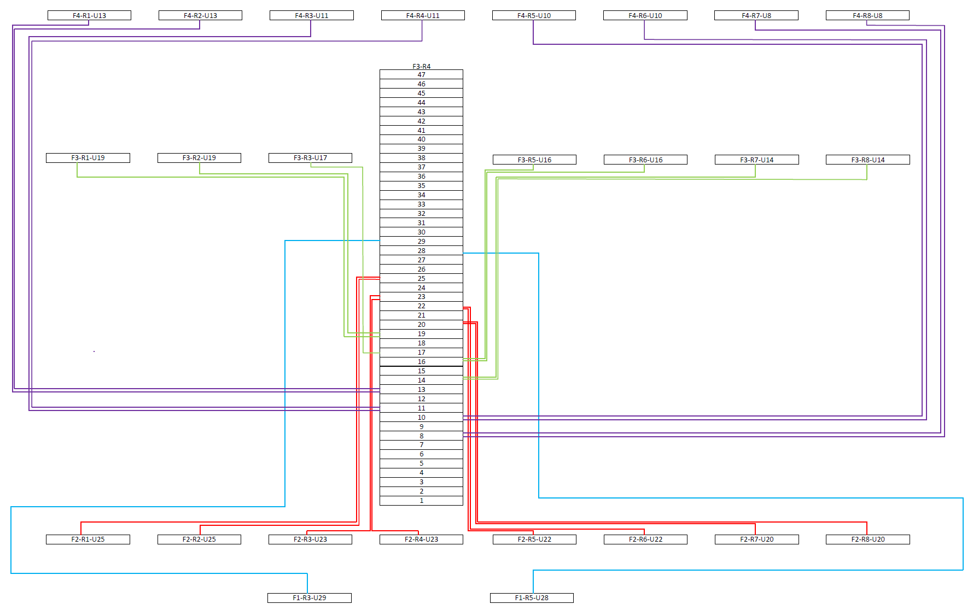
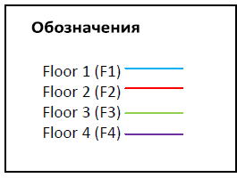
Racks connection diagram (3rd floor)
08.11.2022

Slide 21
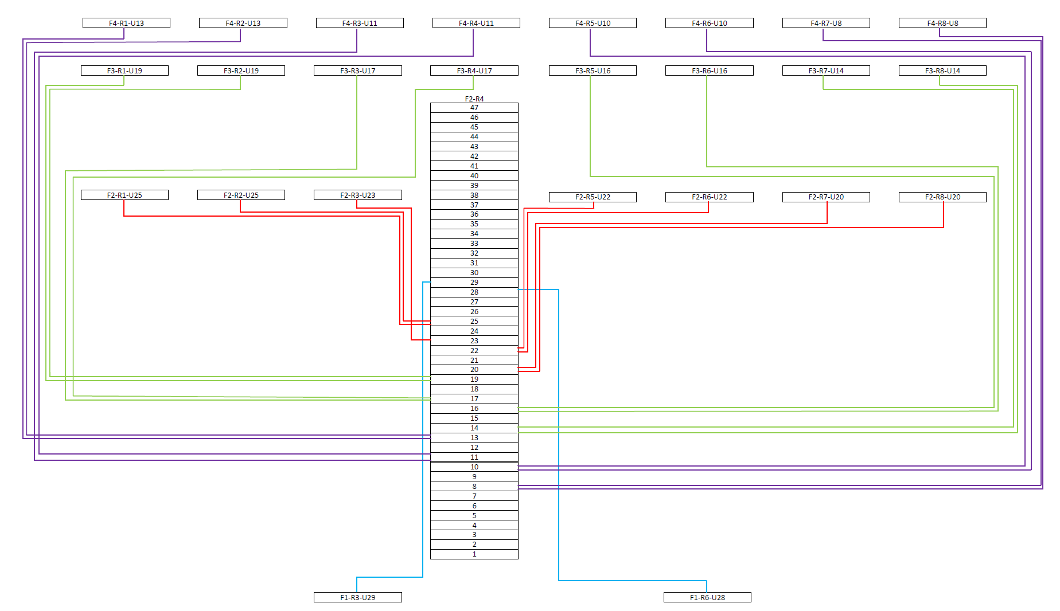
Structured Cabling System
Racks connection diagram (2nd floor, )
08.11.2022

