Slide 1

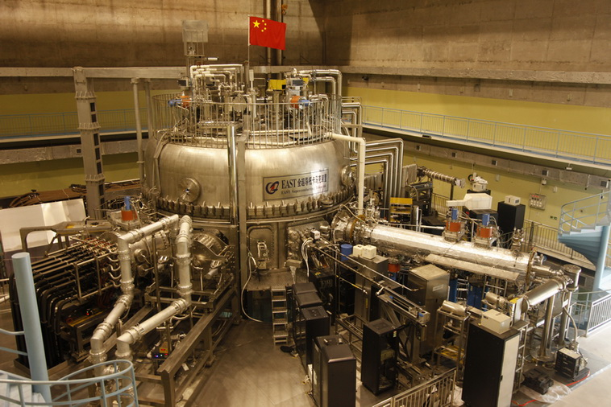
JINR –ASIPP (China) collaboration in the Frame of NICA Mega Science Project
В ОИЯИ в 2015 г. начаты совместные работы с Институтом физики плазмы Академии наук Китая (ASIPP) по разработке компактного сверхпроводящего протонного циклотрона SC200
JINR experience in proton therapy and cyclotron design
ASIPP experience: TOKAMAK, superconductivity …
Future accelerator SC200 =>
SC230 = Superconducting Cyclotron 230 MeV
EAST Tokamak
50 mln K for 2 minutes

Slide 2
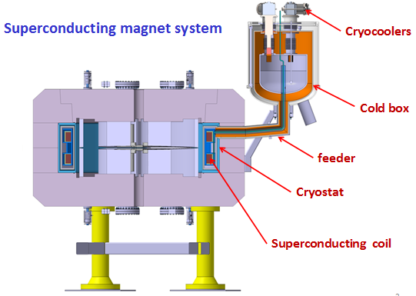
Superconducting cyclotron SC200
Magnet type | Compact, SC coil, warm yoke
Pole diameter (m) | 1.22
Magnet diameter (m) | 2.5
Magnet height (m) | 1.7
Average magnetic field (R_{o}/R_{extr}.) (T) | 3.0/3.6
Cryostat and coils weight (t) | 5
Total magnet weight (t) | 55
Proton energy (MeV) 200
RF cavities | warm
Number of cavities | 2
Operating frequency, MHz | 90
Harmonic number | 2nd

Slide 3
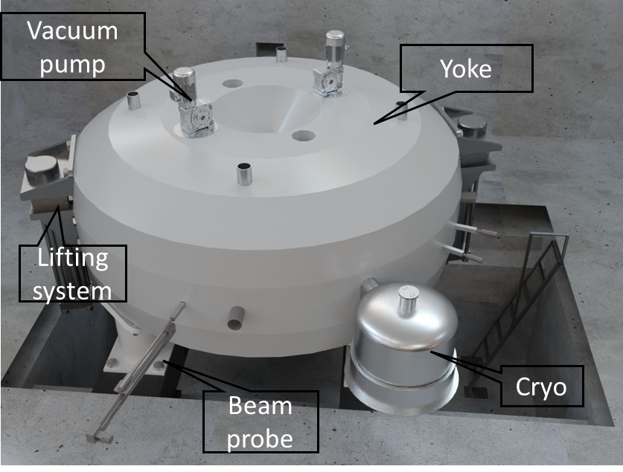
MSC230 view
Low power consumption.
Reasonable size.
Minimum engineering efforts and challenges.
Moderate conservativeness and reduced risks.
High quality of the beam.
Extracted beam current - at least 10 µA.
At least 5 Grey per 1 liter target in a pulse of about 50 ms.
Computer model

Slide 4
MSC230 specs
Magnet type | Compact, SC coil, warm yoke
Ion source | PIG
Final energy, MeV | 230
Pole radius, mm | 1070
Mean magn. field (center), T | 1.7
Dimensions (height×width), m | 1.7 × 3.7
Weight, tonnes | 100
Hill/Valley gap, mm | 50/700
A*Turn number | 320 000
RF frequency, MHz | 106.5
Harmonic number | 4
Number of RF cavities | 4
Voltage, center/extraction kV | 40/110
RF power, kW | 60
Number of turns | 500
Beam intensity, μA | 10
Extraction type | ESD
There are two most successful accelerators in the proton therapy: Varian Proscan and C235. Both cyclotrons have much smaller central field, 1.7 and 2.4 Tesla.
Both Varian and C235 have been designed in 1990s, both have problems.
We have combined best solutions and avoided the problems of those cyclotrons.

Slide 5
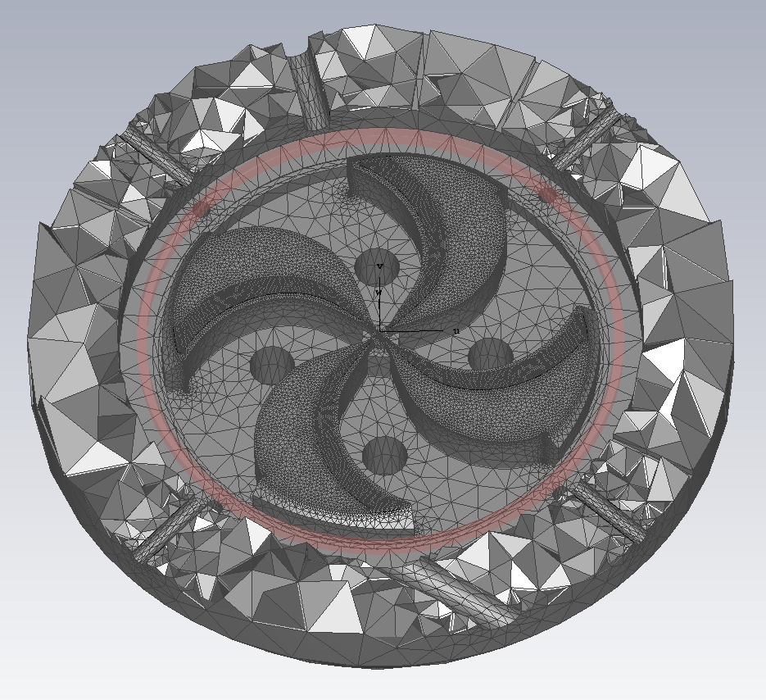
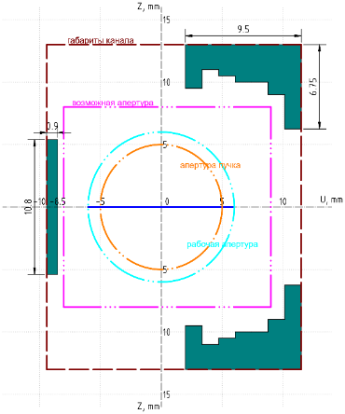
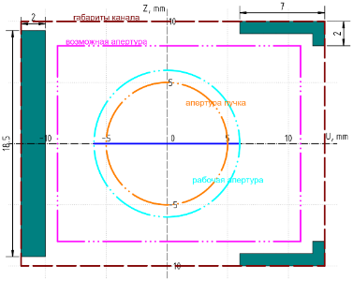
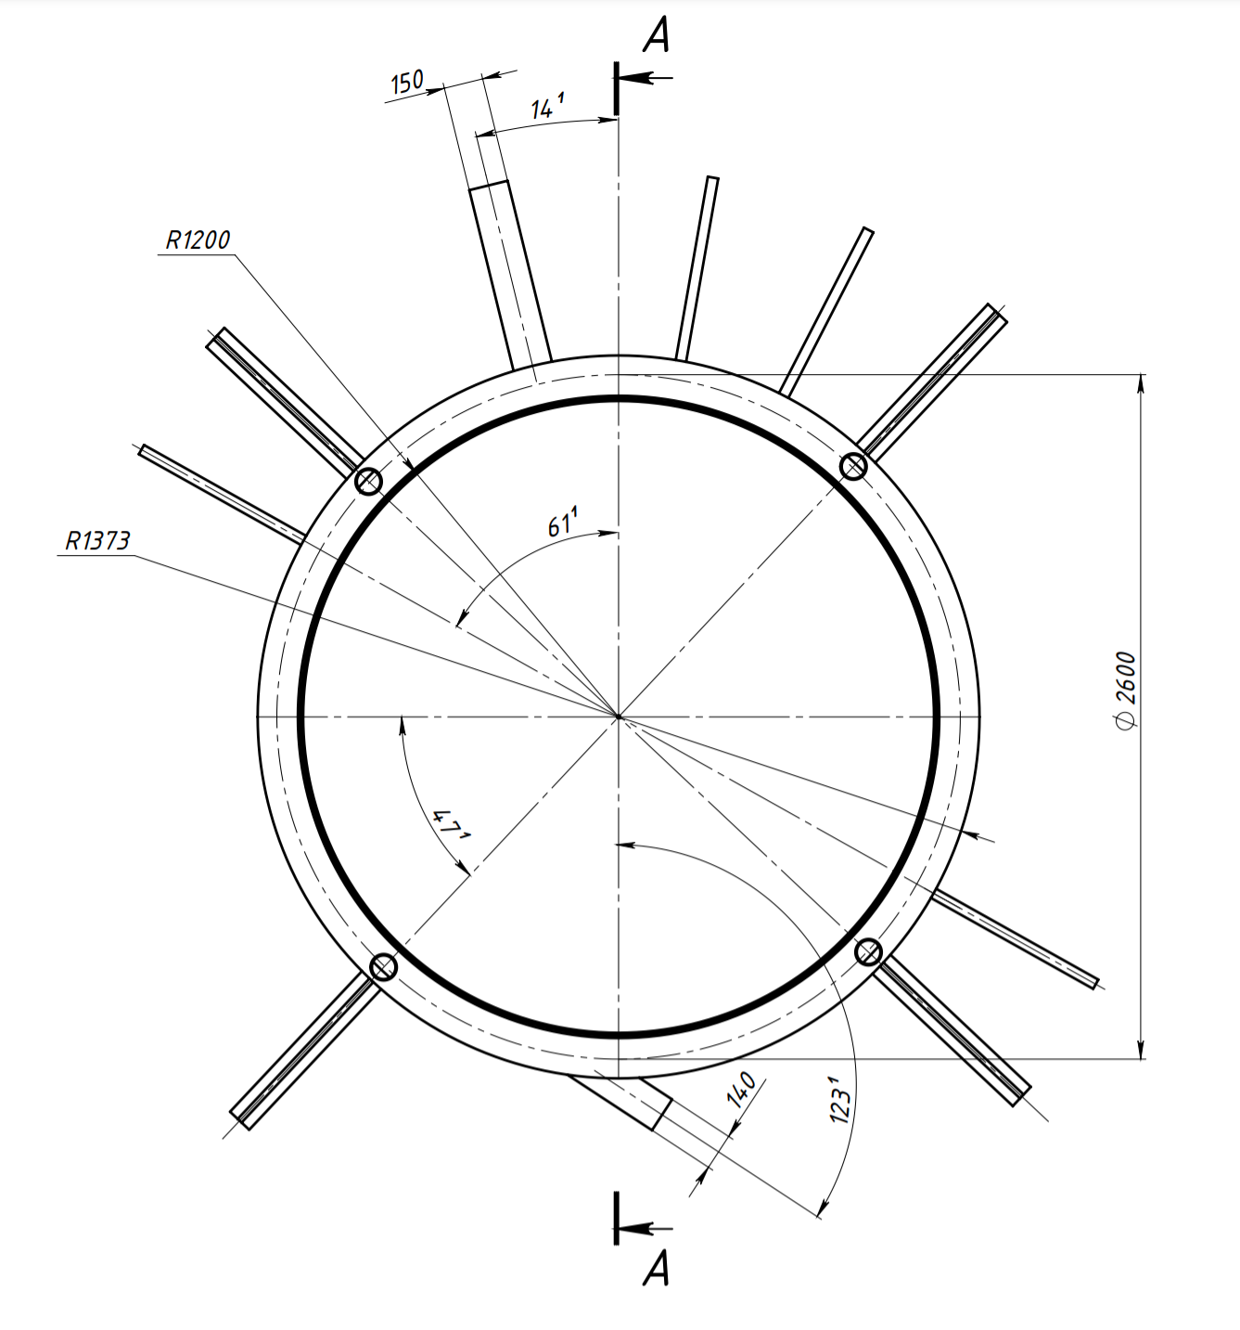
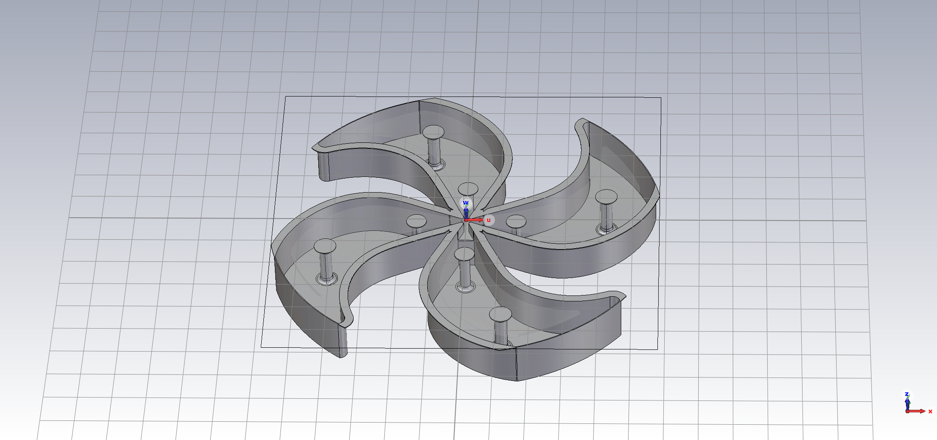
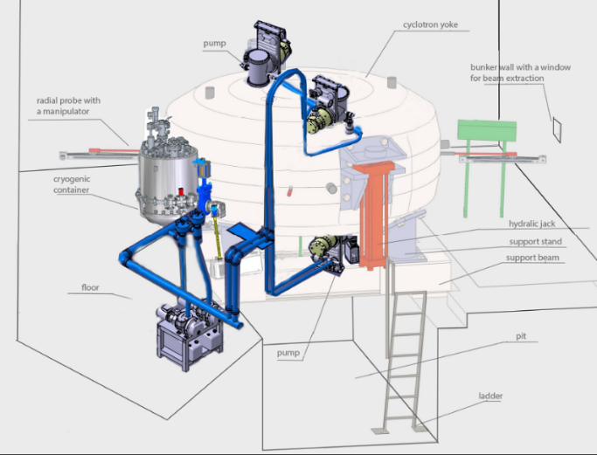
Current Status
The Magnet
Extraction System
Cryostat
All cyclotron systems were designed, simulated for beam dynamics, optimized, etc…
Design report was fully done.
It successfully passed the assessment and discussion of FLNR.
RF system
Center Region
Vacuum System

Slide 6

The agreement between Efremov Institute of Electrophysical Apparatus (NIIEFA), St.Petersburg and JINR on MSC230 creation has been signed in June 2022.
NIIEFA should provide: technical design report, elements and system manufacture, assembling, testing and in put in operation.
ASIPP could provide as subcontractor: manufacturing of some elements and systems according to the request of JINR and NIIEFA, in particular RF system elements and magnet yoke
SCHEDULE
Month ordinal |  |  | 1 | 2 | 3 | 4 | 5 | 6 | 7 | 8 | 9 | 10 | 11 | 12 | 13 | 14 | 15 | 16 | 17 | 18 | 19 | 20 | 21 | 22 | 23 | 24 | 25 | 26 | 27 | 28 | 29 | 30 | 31 | 32 | 33 | 34 | 35 | 36
WBS No. | WBS | Months | 1st year |  |  |  |  |  |  |  |  | 2nd year |  |  |  |  |  |  |  |  |  |  |  | 3rd year
SC230 | SC230 cyclotron |  | 01 | 02 | 03 | 04 | 05 | 06 | 07 | 08 | 09 | 10 | 11 | 12 | 01 | 02 | 03 | 04 | 05 | 06 | 07 | 08 | 09 | 10 | 11 | 12 | 01 | 02 | 03 | 04 | 05 | 06 | 07 | 08 | 09 | 10 | 11 | 12
SC230.0 | Kick-off | 0
SC230.1 | Final physical design | 0
SC230.2 | Final engineering design | 6
SC230.3 | Magnet System | 23
SC230.3.1 | Cryostat/Coil | 17
SC230.3.2 | Steel/sectors | 18
SC230.3.3 | Lifting | 8
SC230.3.4 | Bz mapper | 8
SC230.3.5 | Shimming | 6
SC230.4 | Ion Source | 10
SC230.5 | RF system | 14
SC230.6 | Beam extraction system | 10
SC230.7 | Radial Probe | 10
SC230.8 | Control System | 12
SC230.9 | Auxiliary System | 10
SC230.10 | Integration Assembly | 4
SC230.11 | Beam Commissiong | 9
The very preliminary timetable

Slide 7

MSC230
– JINR’s new superconducting cyclotron for proton FLASH therapy
G. Shirkov, G. Karamysheva, O. Karamyshev
Presenter: Dmitry Popov

Slide 8
Thank you for your attention!
¯\_(ツ)_/¯

Slide 9
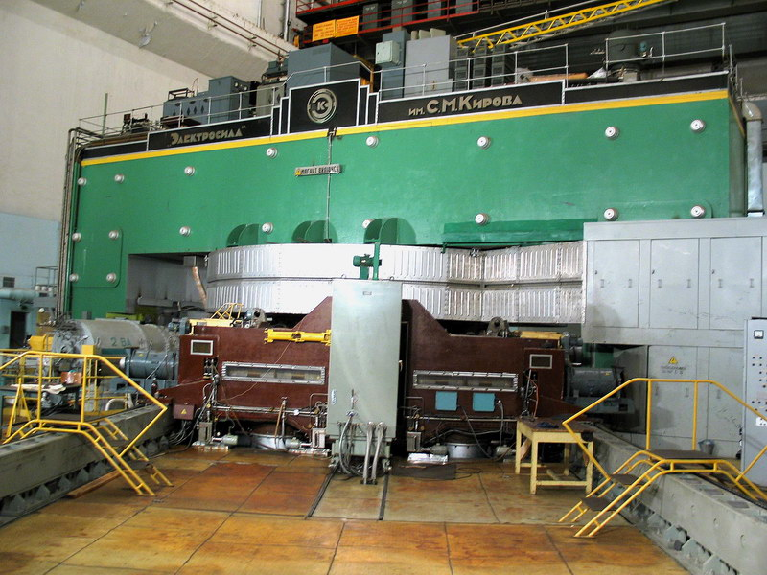
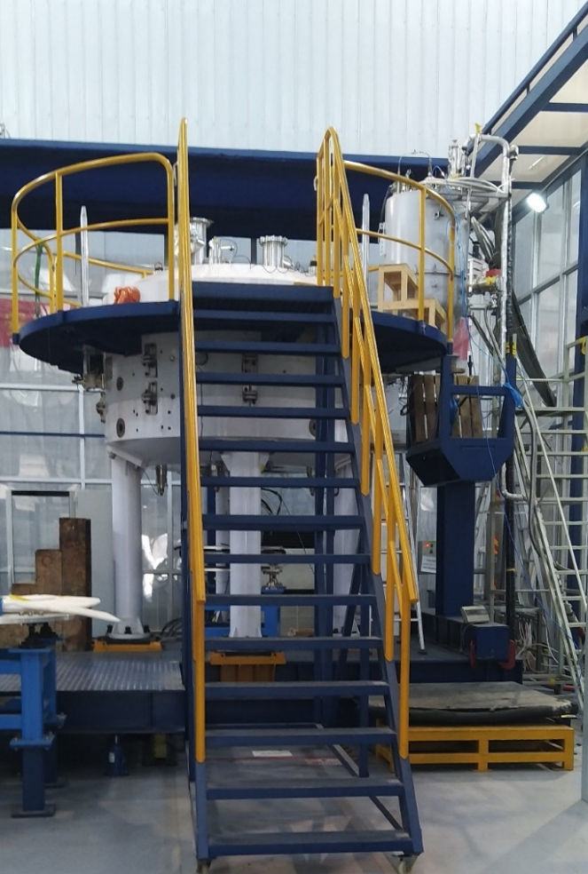
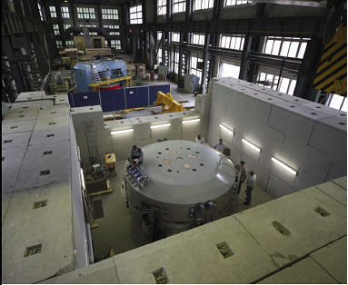
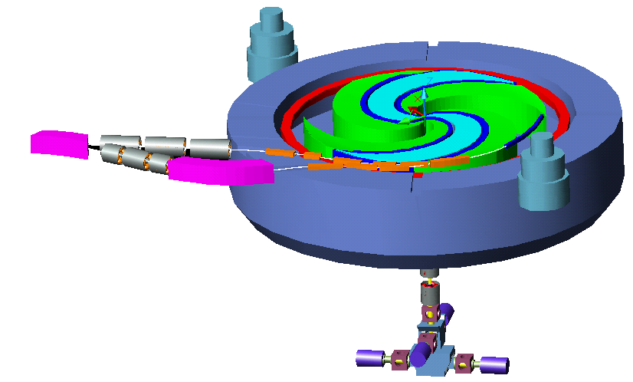
JINR’s experience in cyclotron production
Old good Phasotron with the parameters necessary for radiation therapy was created in 1967.
Collaboration with IBA (Belgium). Project of carbon superconducting cyclotron C400. Proton cyclotron C235-V3 for Dimitrovgrad.
Collaboration with ASIPP (Hefei, China). Superconducting proton cyclotron SC200, which was successfully started up recently!
Proton accelerator Phasotron
SC200 cyclotron
External re
-
condensers
Deflector
E
xtraction
lines
Ion sources
Injection line
C235-V3 DLNP JINR cyclotron
C400 for carbon therapy

Slide 10
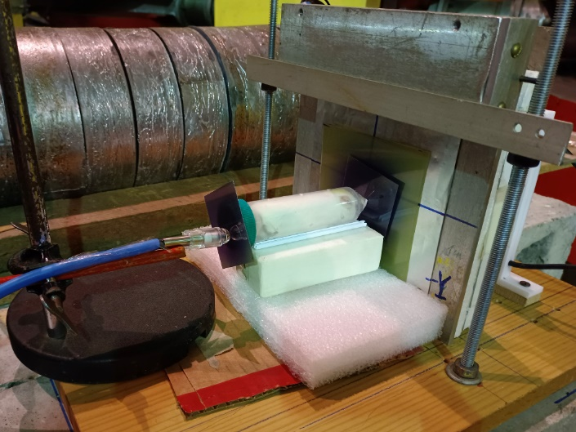
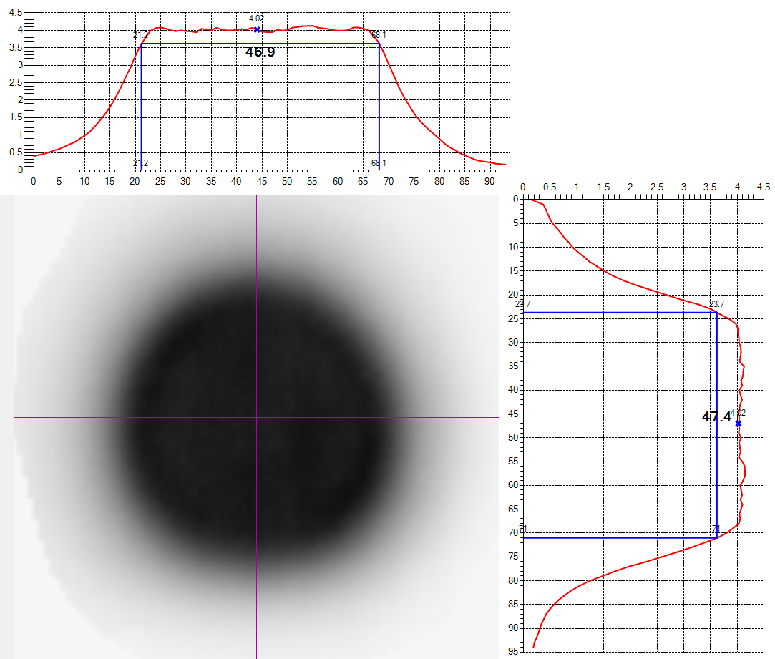
FLASH therapy
An experiment, studying the FLASH effect on mice
FLASH is a new method of radio-therapy, requires delivery of high dose to the tumor. 50 Gy/s in less than 0.5 seconds
Reduces the impact on healthy tissue
Allows for more effective treatment of radioresistant tumors, as well as recurrent diseases
Reduces the number of cases where the use of carbon ions is necessary
Reduces the number of treatments
Proton beam profiles for studying the effect of FLASH therapy on biological objects.
Dose field width at 90% level is ~47 mm
Dose field uniformity is not worse than ±5%

