Slide 1



Development of lithium-ion batteries with increased specific energy and power
.
Meir Yerdauletov^{[2,3,4]}, Philipp Napolsky^{[1,2]}, Mikhail Avdeev^{[1,2]}, Victor Krivchenko^{[1]}
^{[1]}Dubna University, Dubna, Moscow Region, 141980 Russia
^{[2]}Frank Laboratory of Neutron Physics, Joint Institute for Nuclear Research, Dubna, Moscow region, 141980 Russia
^{[3]}Institute of Nuclear Physics, Ministry of Energy of the Republic of Kazakhstan, Almaty, 050032 Kazakhstan
^{[ 4]}L.N. Gumilev Eurasian National University, Astana, 010000 Kazakhstan

Slide 2
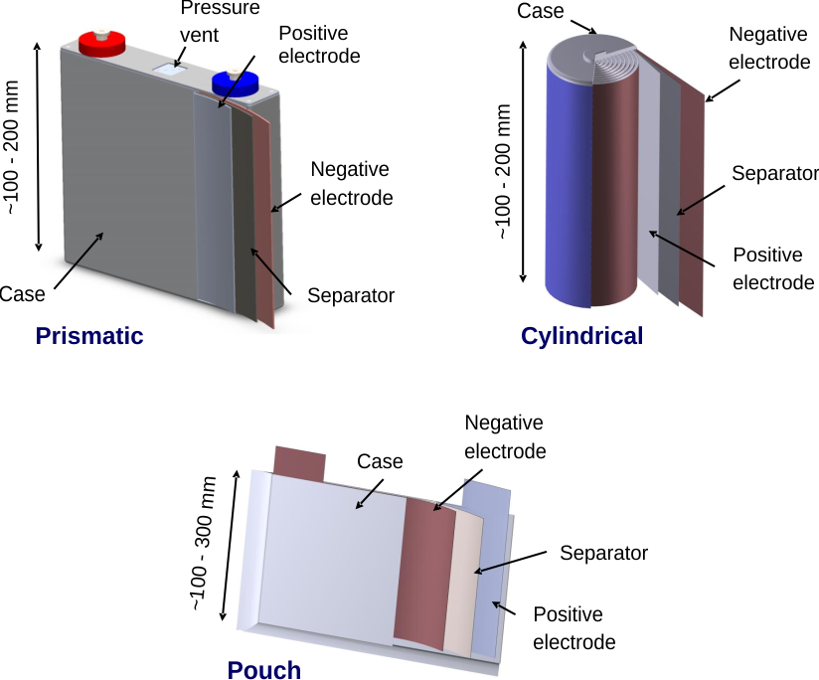
The aim of the work: Development of lithium-ion batteries/capacitors with increased specific energy and power
.
Tasks to be solved as part of the work:
Study of the electrochemical characteristics of positive electrodes based on activated carbons, obtained from various biowaste.
Prototyping a Lithium Metal Capacitor with Increased Energy Density prismatic form factor.
Investigate Lithium deposition with neutron radiography and tomography
Investigate Lithium-containing cathode materials with the addition of graphene with SANS

Slide 3
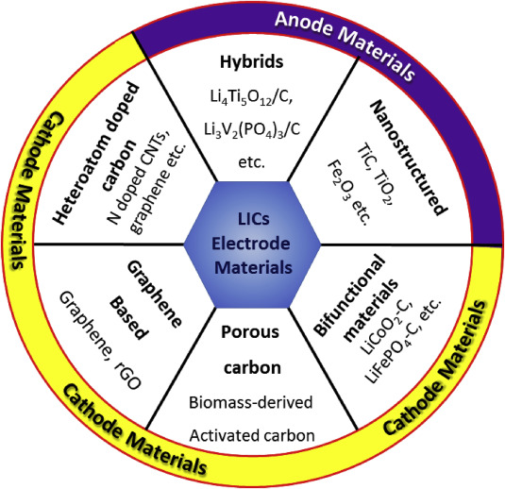
Energy storage systems
Comparison of specific energy and specific power of various energy storage systems. From the diagram, it can be seen that LICs bridge the gap between lithium-ion batteries and double-layer capacitors, making them promising for high power applications where long run times between recharges are important.

Slide 4
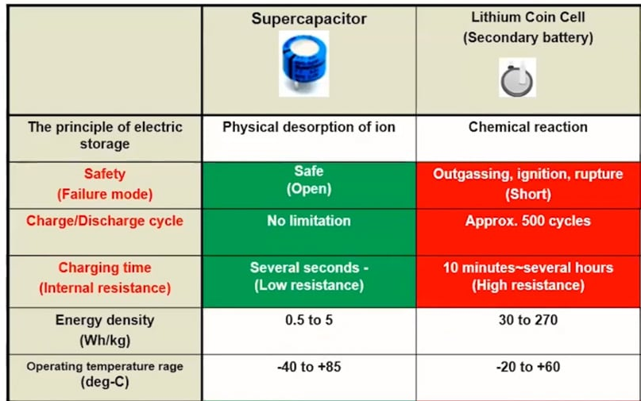
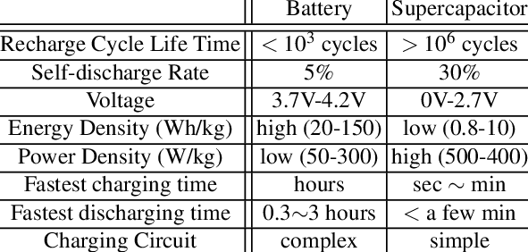
Li ion batteries vs Supercapacitors

Slide 5
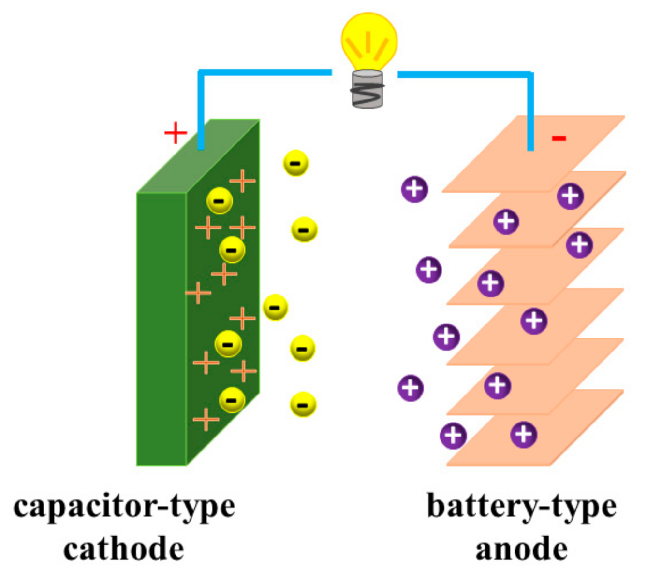
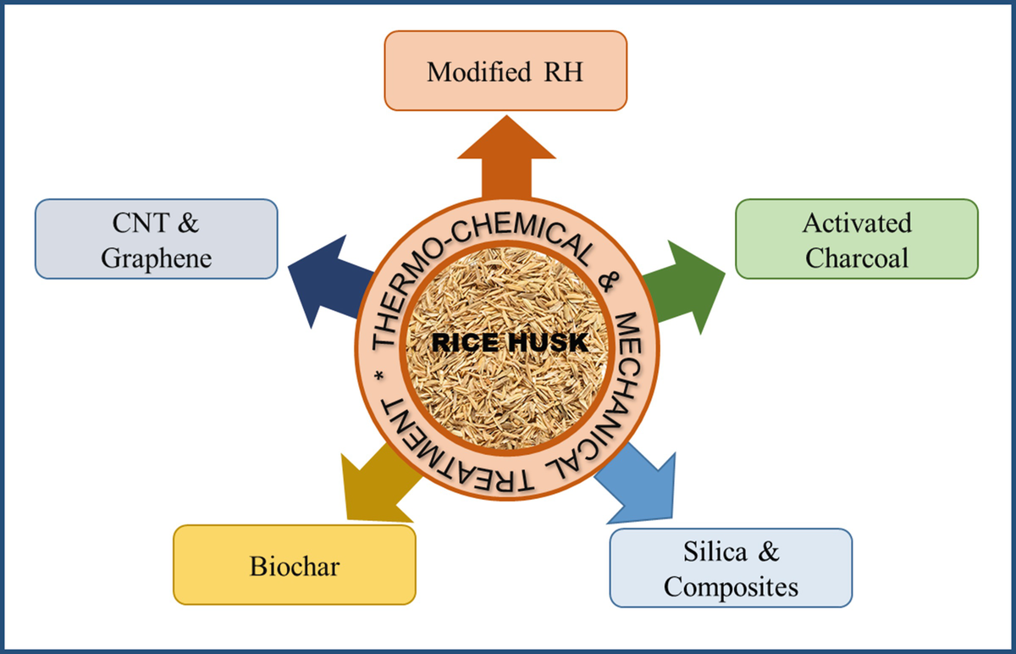
Hybrid Li ion capacitors

Slide 6
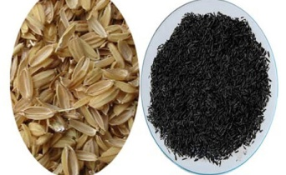
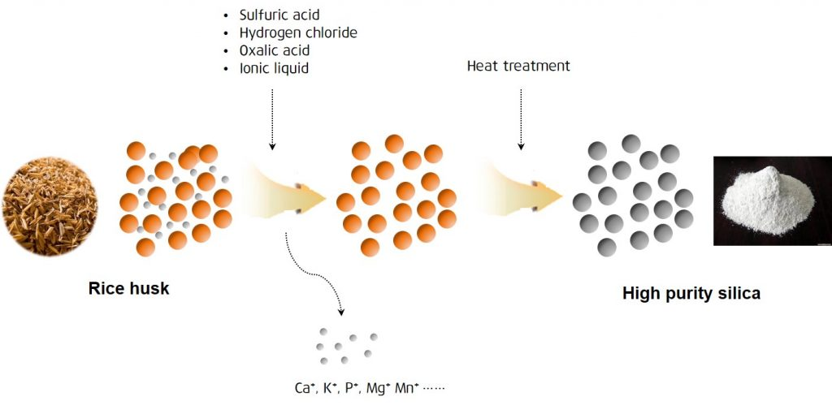
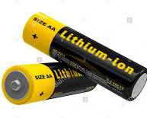
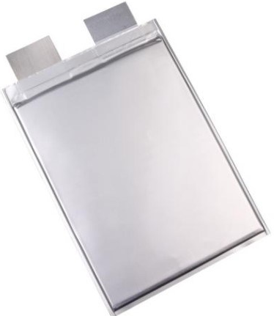
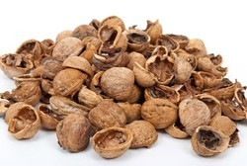
Synthesis and production of anode material from biowaste
Chemical activation
Carbonization (300-500°C)
anode material for Li-ion battery
Theoretical capacity = 4200 mAh/g
10 times bigger than graphite
Shell nut

Slide 7
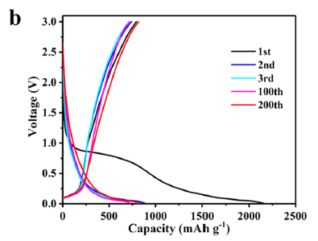
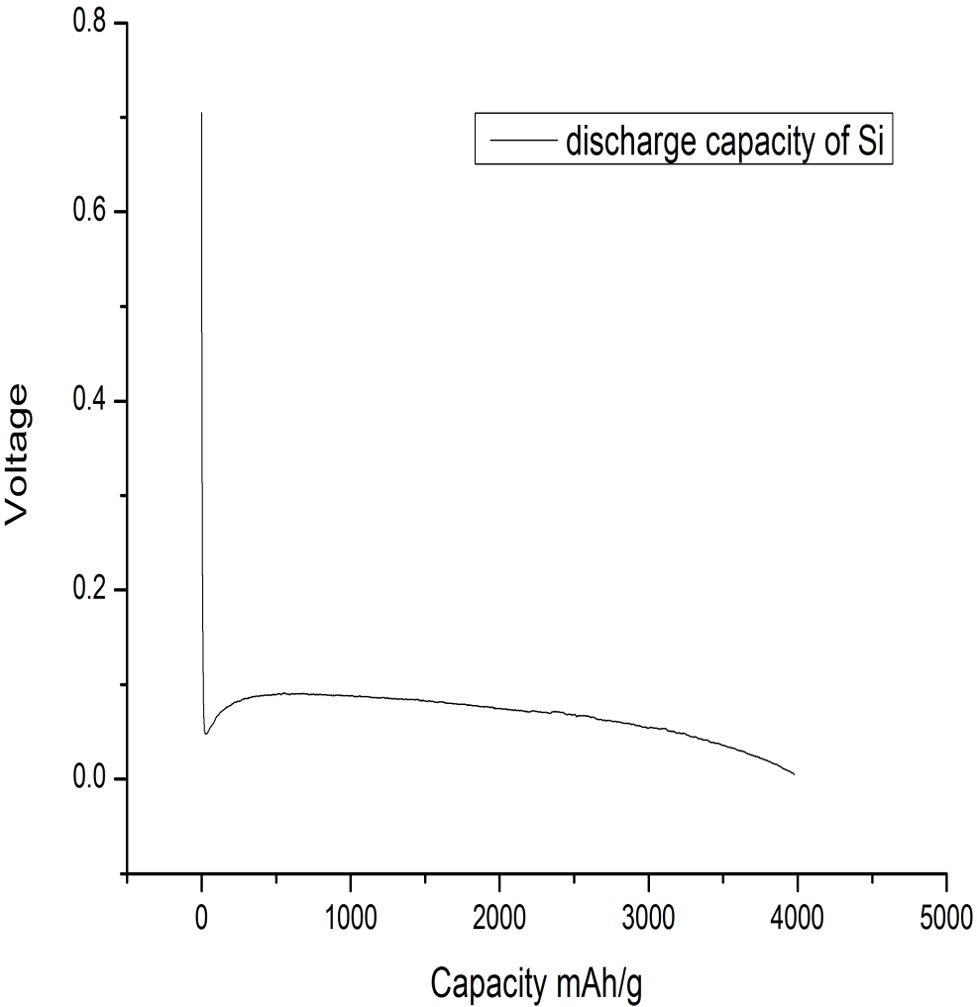
Galvanostatic curves
SiO2
Si
capacity = 4000 mAh/g

Slide 8
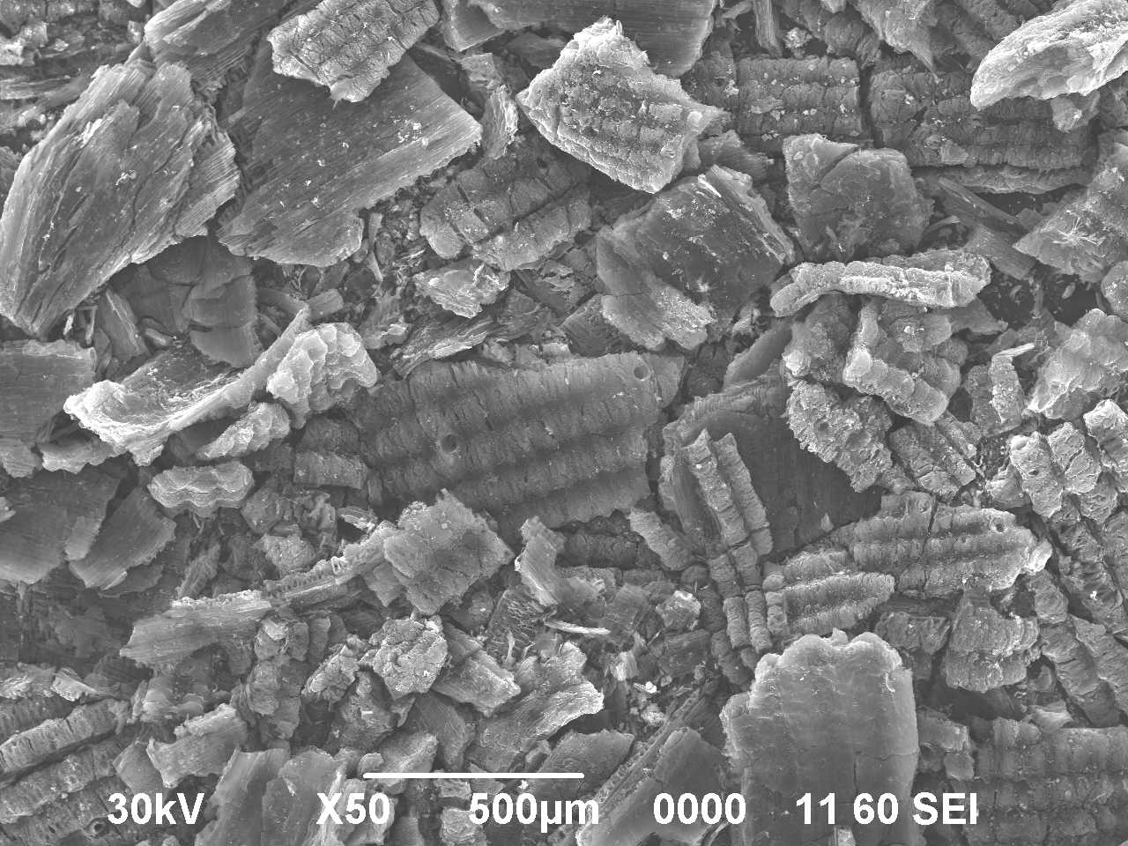
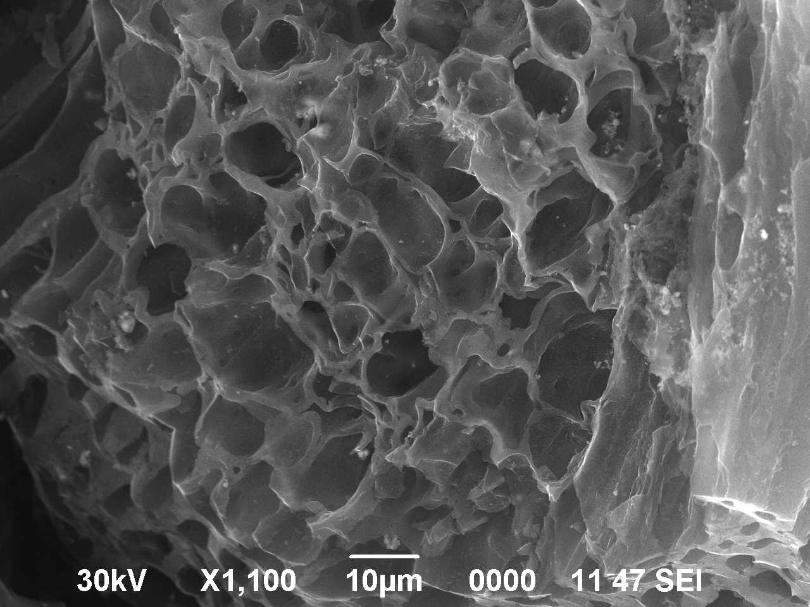
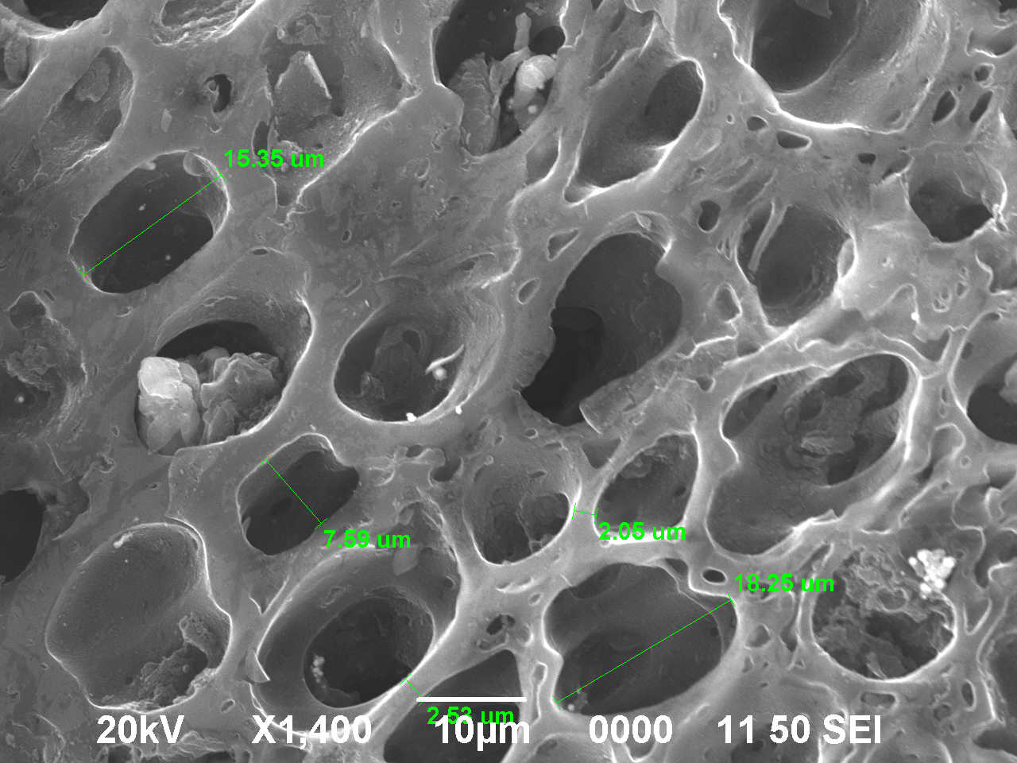
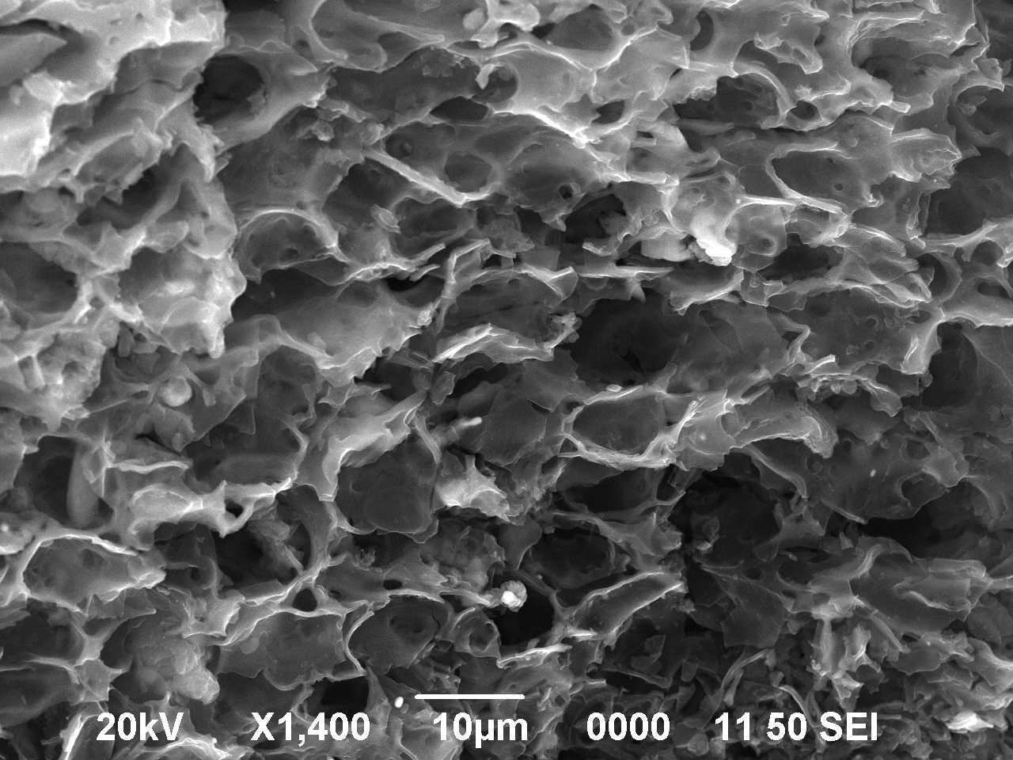
Results
Scanning electron microscopy (SEM, Jeol JSM-6490LA)
Transmission electron microscopy (TEM, JEM-2100analysis)
SEM micrographs of
carbonized Rice Husk
SEM micrographs of
activated Rice Husk
TEM micrographs of
activated Rice Husk

Slide 9
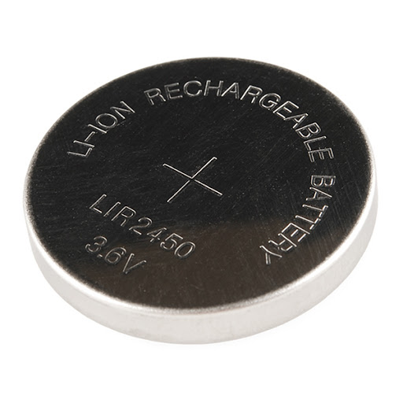
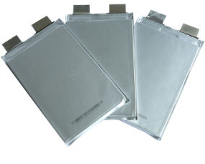
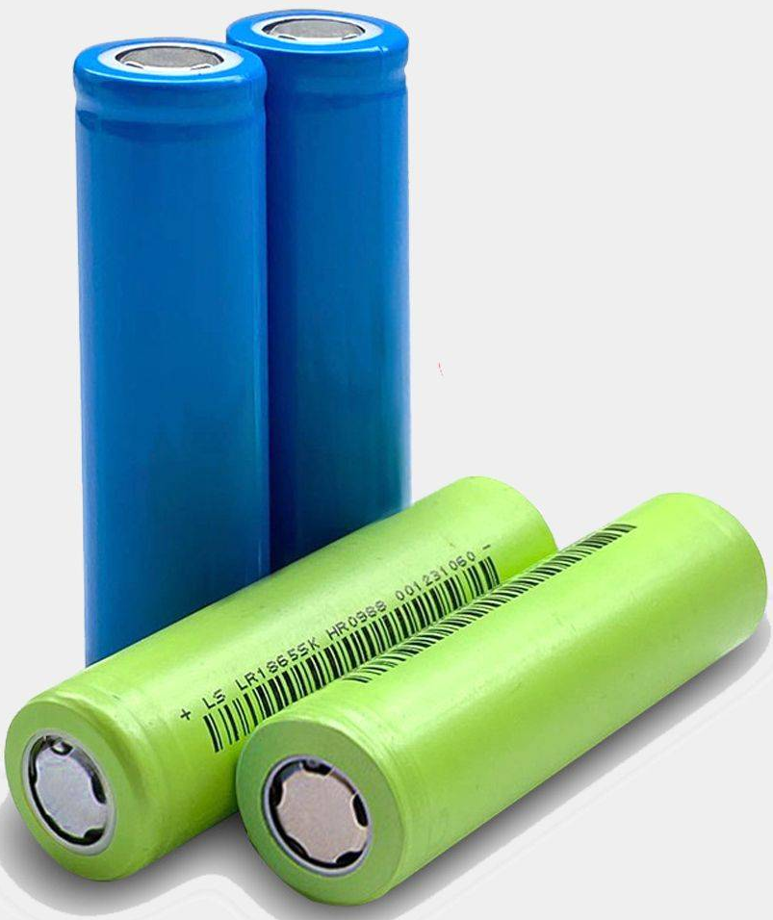
EXPERIMENTAL PARAMETERS
Electrolytes
1M LiClO4 in FEC-DME_3-7
1M LiDFOB in EC-DMC-DEC-1-1-1
1M LiDFOB in FEC-DME_3-7
1M LiDFOB in FEC-DME_3-7_LiNO3-3wt
1M LiDFOB in VC-DME_3-7
1M LiPF6 in EC-DMC-DEC-1_1_1(Sigma)
CATHODE COATING
Active material - activated carbon from rice husk [90%]
Conductive additive - carbon nanotubes [5%]
Polymer binder - PVDF [5%]
Mass loading of the electrode coating - 2.5 mg/cm2
Elements
Coin cell 2032
Anode
Lithium metal 150 µm thick
Separator
Celgard 2500

Slide 10
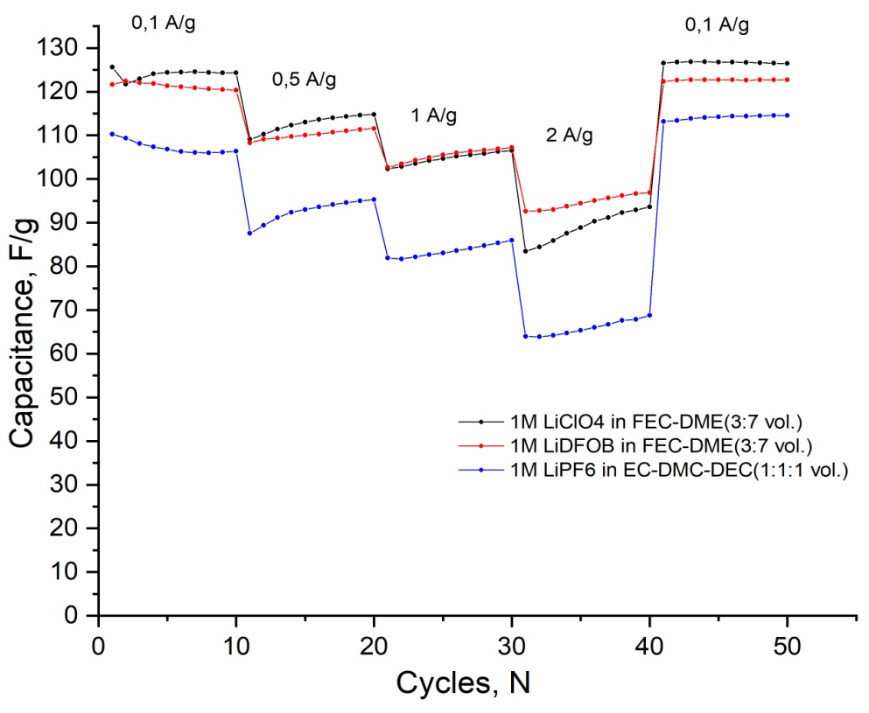
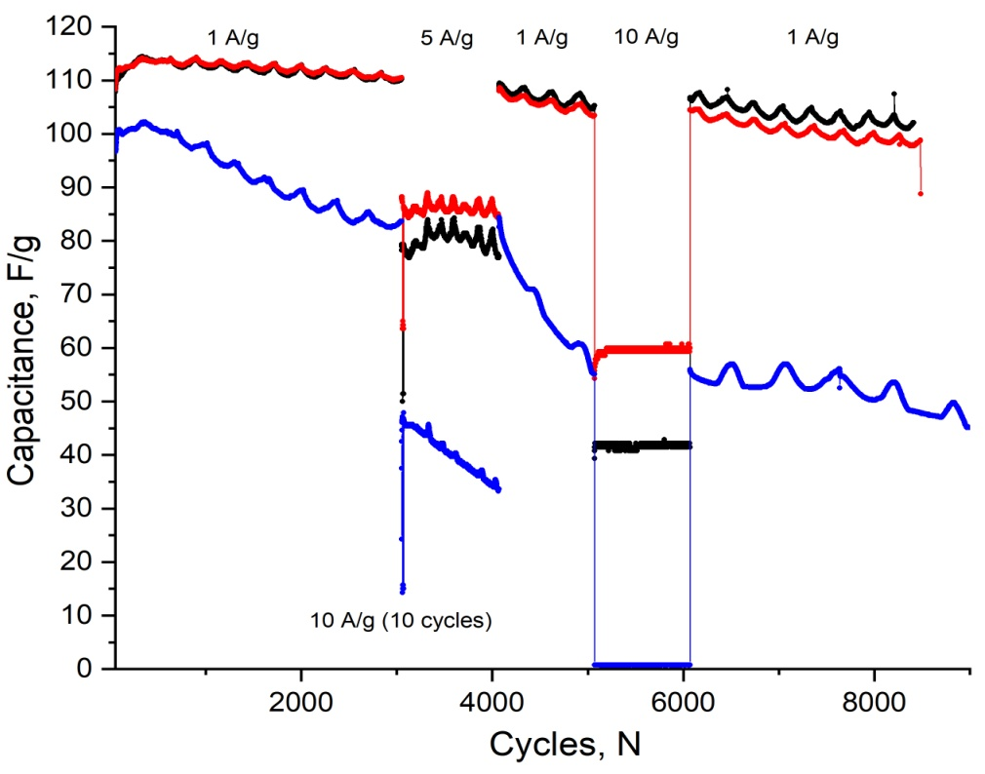
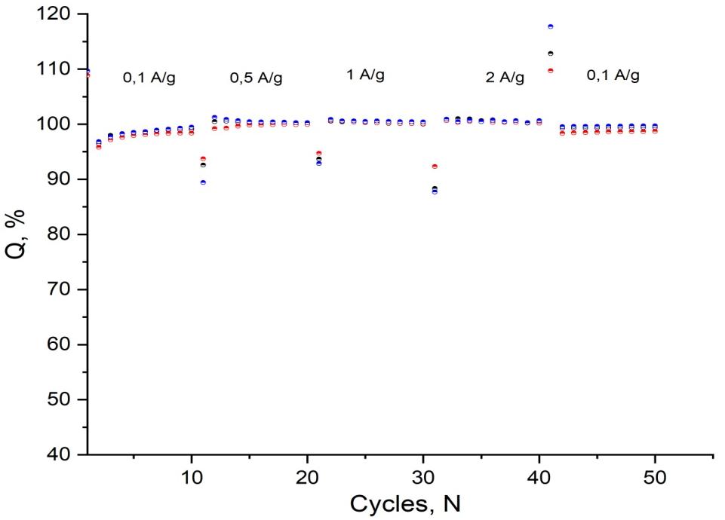
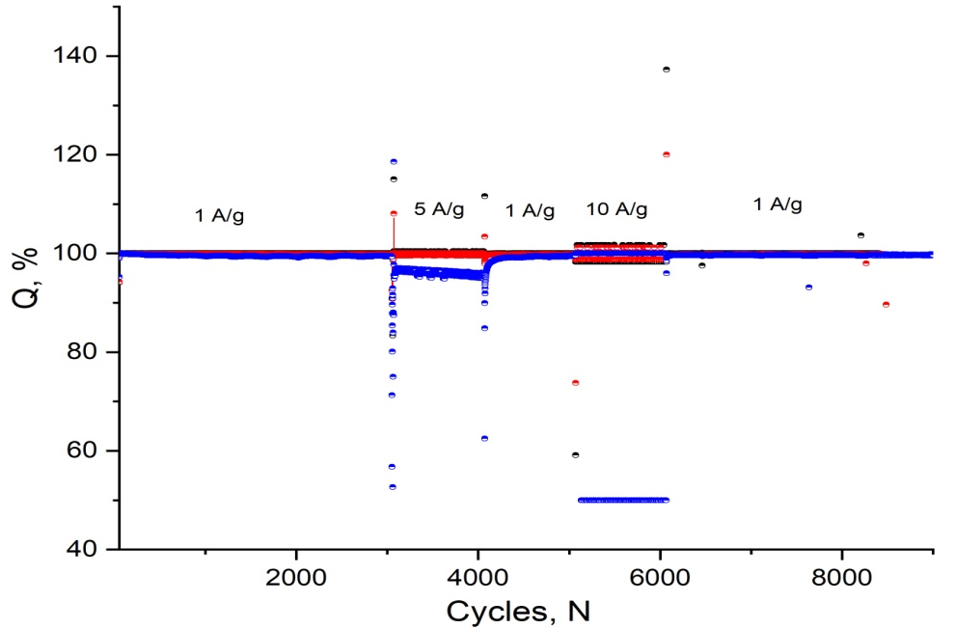
Galvanostatic curves

Slide 11
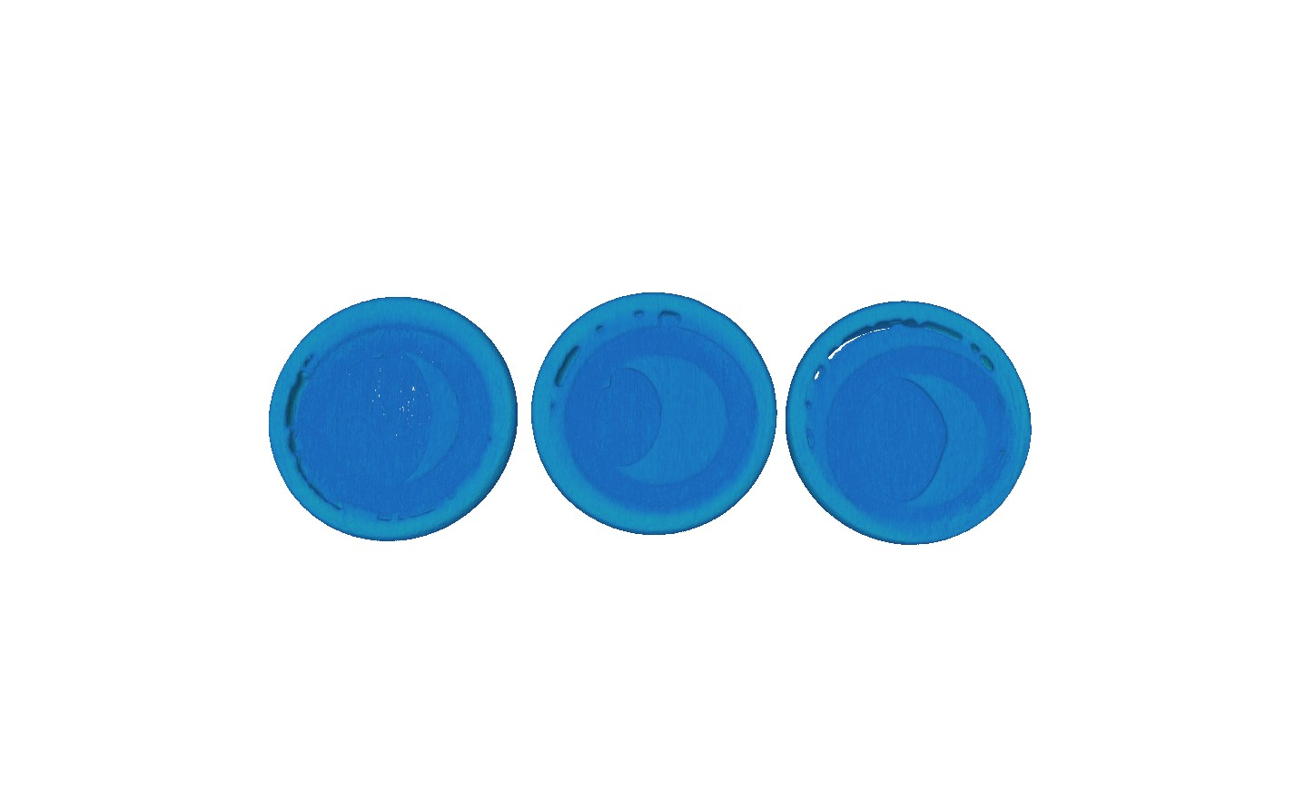
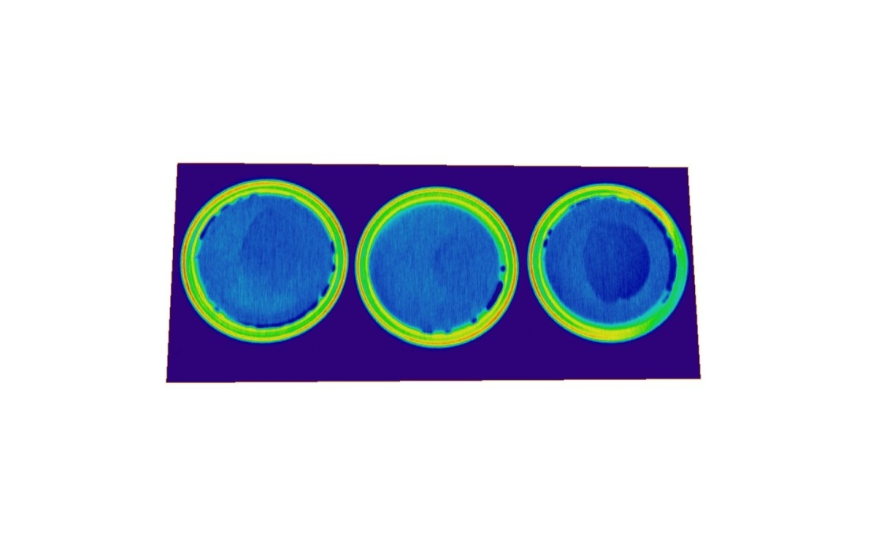
Neutron tomography
SANS
Capacity 100 %
Capacity 50 %
Capacity 0 %
The neutron tomography method was used to visualize the lithium and electrolyte distribution regions flowing inside the cell in the initial and final states of lithium-ion batteries.
Fig. 1. The smooth nature of the curves corresponds to the presence of polydisperse pores in the samples. Wetting with a deuterated electrolyte leads to an increase in the signal in large Q, similar to previous studies, associated with the contribution to the scattering of the electrolyte penetrated into the pores.
Tomography experiments were done at TITAN beamline of WWR-K reactor Almaty INP. As convertor used 6LiF/ZnS scintillators with thicknesses of 100 μm, Hamamats CCD -chip based camera, and L/D was typically set at 350. Pixel resolution was 45 μm.

Slide 12

Conclusions
F uture Plans
1)
All the carbon structure s use d in the
e xpe rime nts provide s kine tic transport of
lithium ions into the crystals of active
mate rial
1.
2.
3.
Mak ing prototy pe s of Li ion batte ries /capacitors in cylindrical form
De ve lopme nt of scie nt ific and te chno log ical
criteria for the creation of e le ctrolyte s,
e le ctrode coatings and de sign of lithium-ion
batte rie s, allowing to work in t he are a
of e xtre me ly low te mpe rature s (be low -40C).
2)
3)
4)
Cathode materials obtained from biowaste
4.
Prototype of Li ion capacitors were made
De ve lopme nt of te chno logica l solut io ns for
cre ating new ge ne ratio n lit hium-io n batte rie s at
the level prototypes wit h the ir s ubse que nt
introductio n into pilot and se rial productio n
Ne utron radiography showe d electrolyte deposition in Coin 2032 cells
The implementation of the work will also contribute to building Kazakh-Russian cooperation with leading scientific groups in Dubna and Kazakhstan

