Slide 1
Spontaneous fission prompt neutron multiplicity distributions. Experimental studies and restoring technique.
Roman Mukhin
JINR FLNR, Dubna, Russia
AYSS-2022

Slide 2
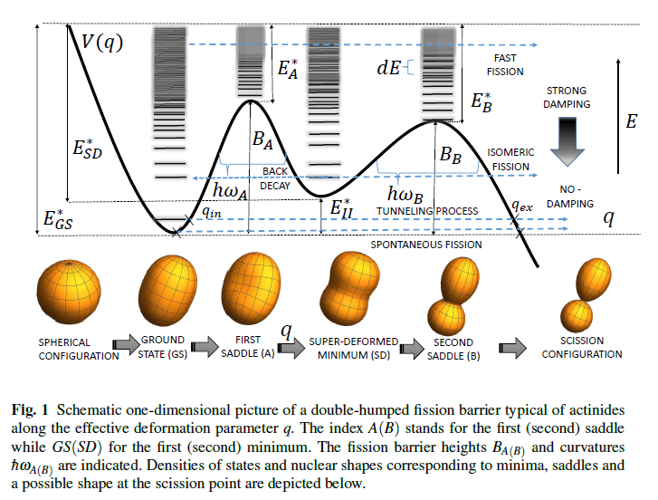
Spontaneous Fission process
Main characteristics of SF:
• Fragment mass distribution
• TKE spectrums of fragments
• Prompt neutrons multiplicity distribution
• Prompt gamma energy spectra and multiplicity distribution
Illustration from: Kowal, M. and Skalski, J. The Fission Barrier of Heaviest Nuclei From a Macroscopic-Microscopic Perspective

Slide 3
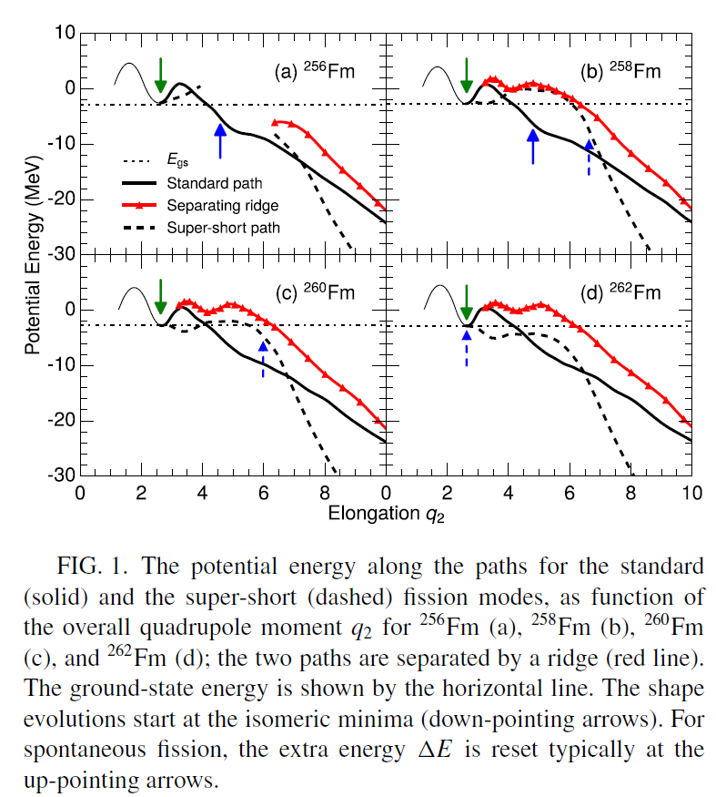
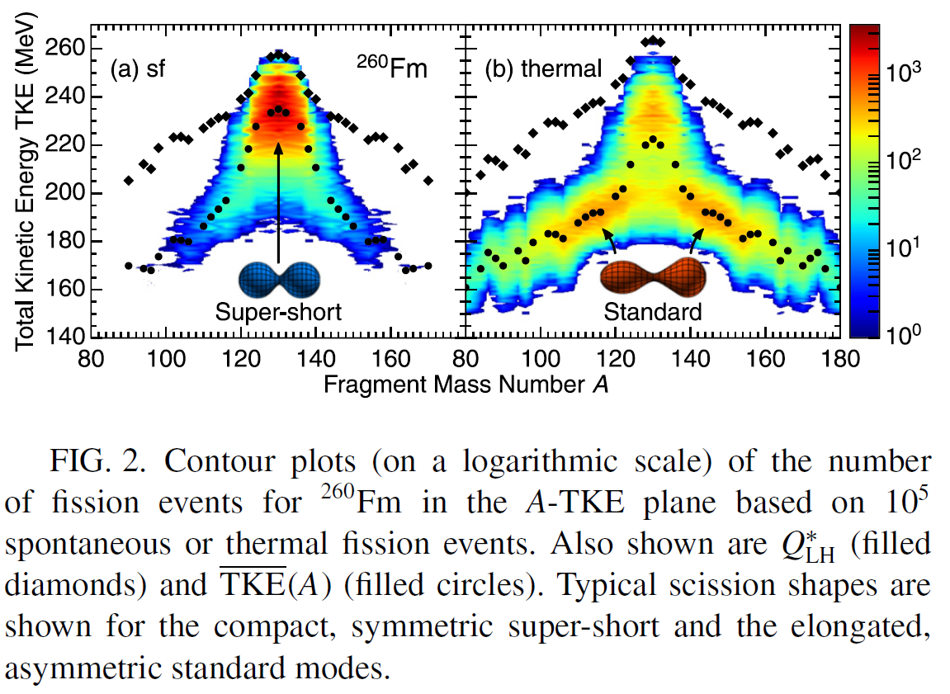
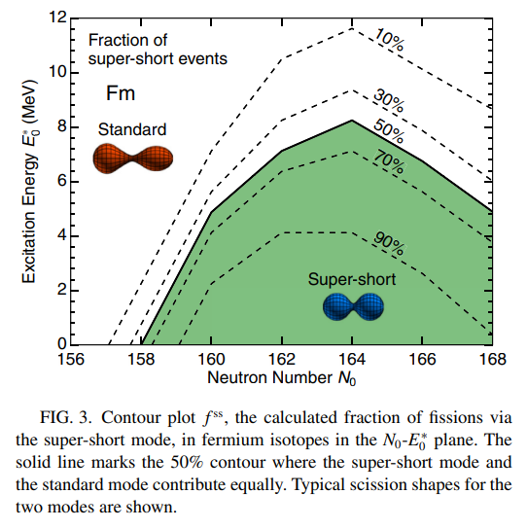
Neutrons multiplicity as an information about fission process
• Average number of emitted neutrons helps to restore energy balance equation of the spontaneous fission process
• Variance of the emitted neutrons multiplicity distribution can be used to estimate variance of fragments excitation energy
• Neutron multiplicity distribution shape is able to point at possible exotic modes of spontaneous fission.
M. ALBERTSSON et al., PHYSICAL REVIEW C 104, 064616 (2021)

Slide 4
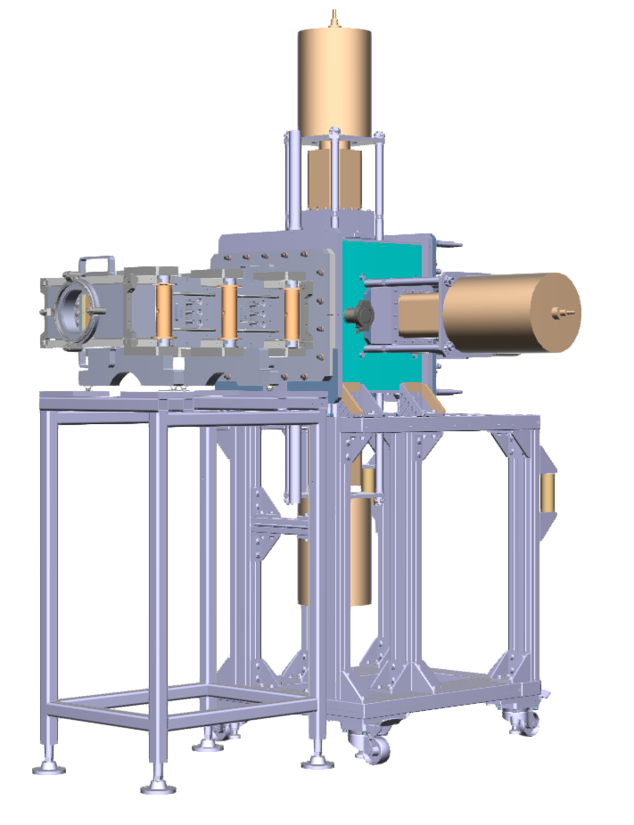
Experimental setup
• Velocity filter SHELS – electromagnetic separator
• Detecting systems:
GABRIELA for $α−, β−, γ−$spectroscopy
SFiNx for Spontaneous fission

Slide 5
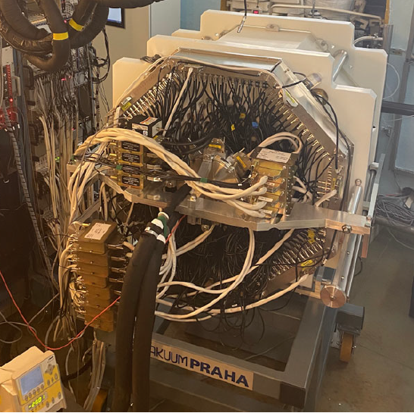
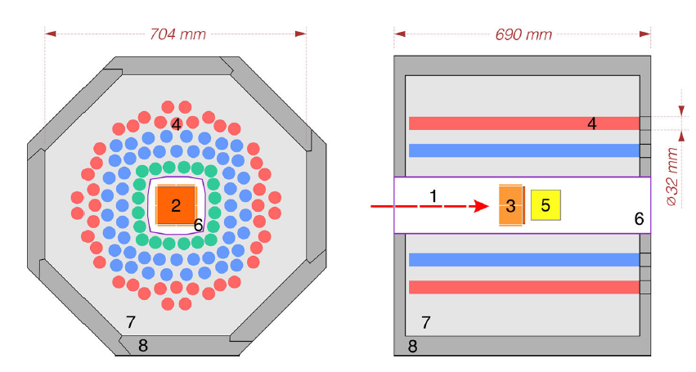
Neutrons ³He detector array
• To detect:
Neutrons
Prompt gamma-ray of spontaneous fission
• What is measured
Neutrons multiplicity
Two coordinates of counter that registered the neutron
• Spontaneous fission identification:
BGO detector to detect prompt gamma rays of spontaneous fission

Slide 6
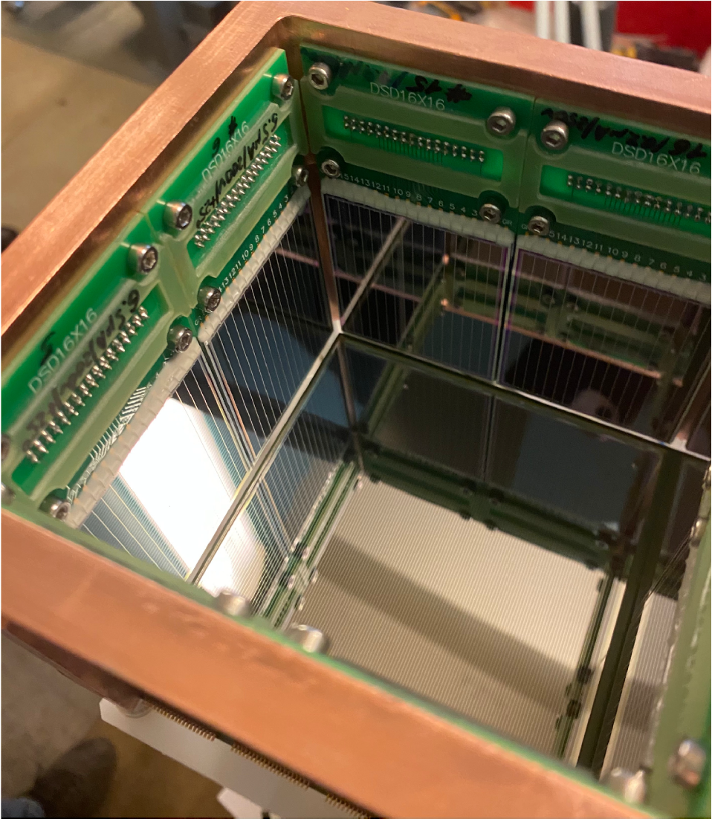
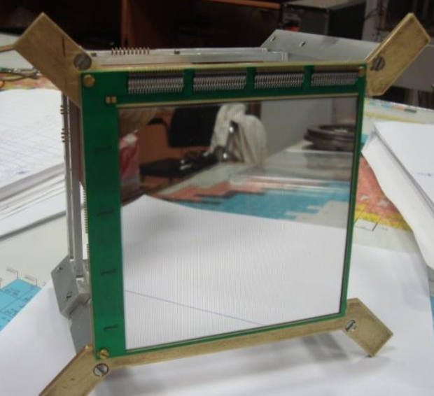
DSSD detectors box
• To detect particles emitted in decays or reactions of unstable nuclei:
Evaporation residue in complete fusion reactions
Alphas
Betas and conversion electrons
Protons
Fission fragments
• What is measured:
Energy
Emission time
Emission coordinates

Slide 7
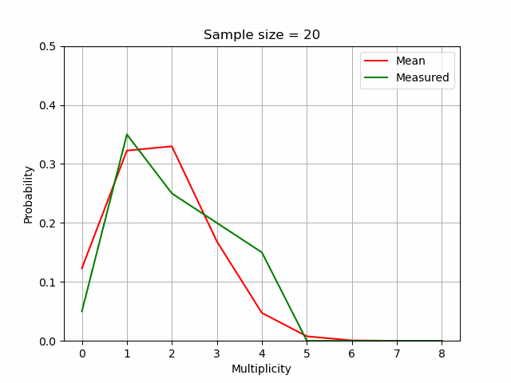
How detector affects the data
Dependence on the single neutron registration efficiency
Dependence on the data size

Slide 8
Restoring technique
• Due to detectors efficiency is far from 100% the measured distribution is heavily distorted.
• Let’s assume that registered number of neutrons is a random variable that follows the binominal distribution.
$n$ – maximum neutrons multiplicity
$x∈ℝ^{1, n}$ – real prompt neutrons multiplicity distribution vector
$K∈ℝ^{n,n}$ – detector response matrix
$ε$ – single neutron registration efficiency
$K_{i,j}=\frac{j!}{i!\left(j−i\right)!}ε^{i}{\left(1−ε\right)}^{j−i}$
$y∈ℝ^{1, n}$ – measured prompt neutrons multiplicity distribution vector
$y=Kx$
$x_{d}={\left(K^{T}K\right)}^{−1}Ky$ – direct solution of the problem
• Direct solution doesn’t make sense in most cases where the noise level (including statistical uncertainties) is quite high.

Slide 9
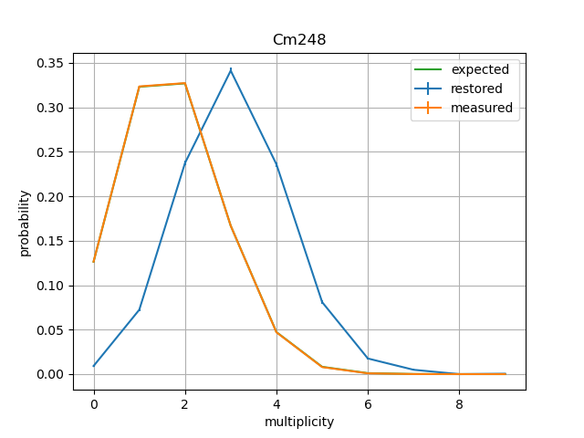
Direct solution examples
1 357 s.f. events
845 224 s.f. events
Single neutron registration efficiency $≈56\%$

Slide 10
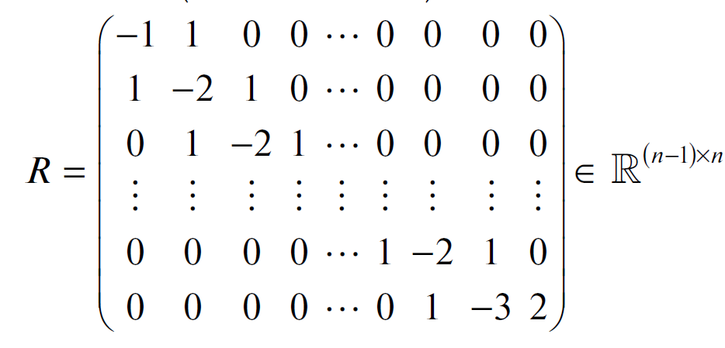
Regularization method
• The essence of the method is to use a priori information to find an approximate solution.
• Using a prior information:
Distribution is smooth
Distribution is flat at tails
• Regularization matrix:
• Regularized solution: $x_{r}={\left(L^{T}L+αs^{2}R^{T}R\right)}^{−1}L^{T}g$
$L\sim K;g\sim y$
$s=\sqrt[n]{\prod_{0}^{n}{s_{i}}};where s_{i} are uncertainties of the measured distribution$
$α$ – regularization parameter
$σ^{2}=s^{2}diag({\left(L^{T}L+αs^{2}R^{T}R\right)}^{−1})$ – uncertainties of regularized solution
R. Mukhin, et al., Physics of Particles and Nuclei Letters, 2021, V 18, 4, p 439

Slide 11
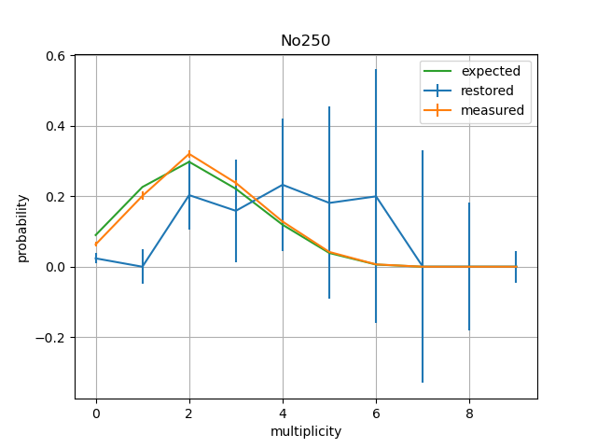
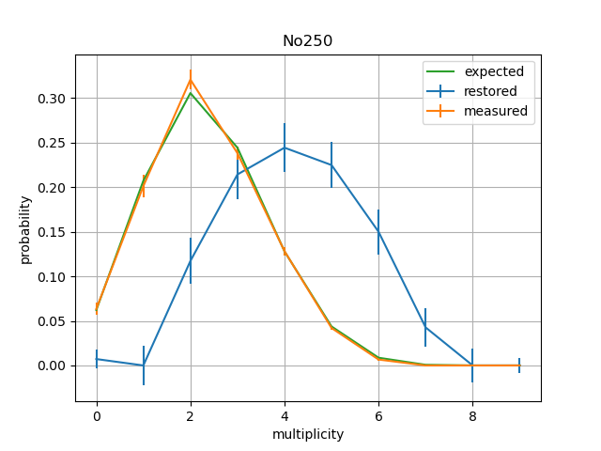
Restoring examples
$$α=89$$
$$α=89$$

Slide 12
Choice of regularization parameter
•Let’s define shape loss function as:
$loss\left(α\right)={\left\|<K,x_{r}\left(α\right)>−y\right\|}_{2}^{2}$
• We can choose regularization parameter as follow:
$α=argmin_{α}loss(α)$
• There is a risk to oversmooth the solution

Slide 13
Models used
ISP [3]
GEF [4]
• Improved scission point model
• Pros:
No adjustable or fitted parameters are used in the calculation of PES
• Cons:
Assumption of statistical equilibrium at the scission point
•The General fission model
• Pros:
Dynamics of motion along the PES is taken into account explicitly
• Cons:
PES is adjusted to fit experimental data
4. K.-H. Schmidt, et al., General description of fission, GEF model, © OECD 2014
3. A.V. Andreev, et al., EPJa, 2006, V. 30, 3, pp 579-589
*PES - potential energy surface

Slide 14
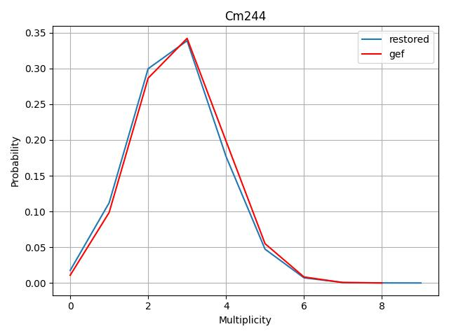
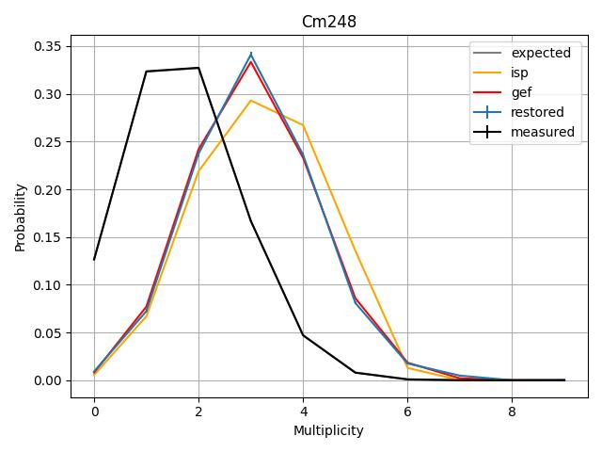
Symmetric distributions: Cm
• A = 248; Z = 96; N = 152
• $\overline{ν}=3.133±0.009$
• $σ_{ν}^{2}=1.$34
• Statistics: $>{10}^{6}$ s.f. events
• A = 244; Z = 96; N = 148
• $\overline{ν}=2.72±0.06 [5]$
• $σ_{ν}^{2}=1.27$
A. S. Vorobyev, et al., AIP Conference Proceedings 769, 613 (2005)

Slide 15
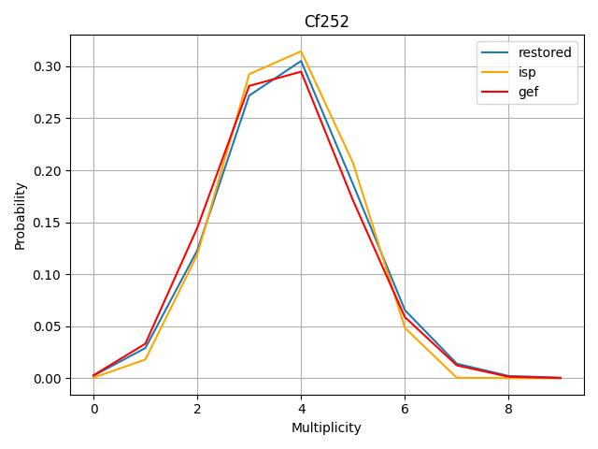
Symmetric distributions: Cf
• A = 252
• Z = 98
• N = 154
• $\overline{ν}=3.76±0.03$[5]
• $σ_{ν}^{2}=1.$62
A. S. Vorobyev, et al., AIP Conference Proceedings 769, 613 (2005)

Slide 16
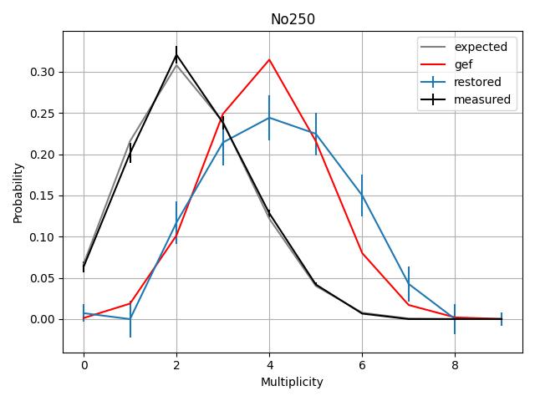
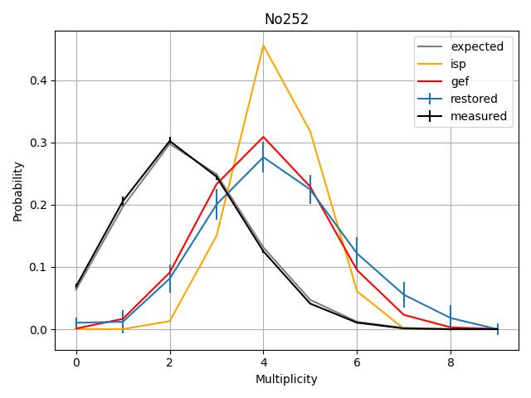
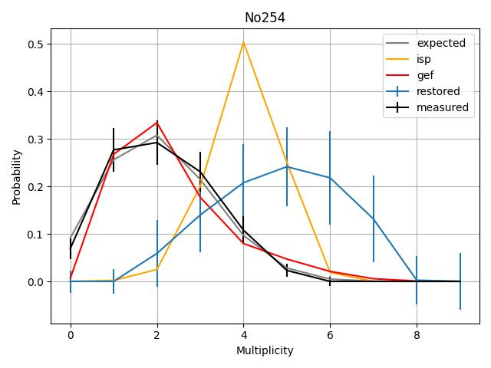
Symmetric distributions: No
• A = 250; Z = 102; N = 148
• $\overline{ν}=4.17±0.16$
• $σ_{ν}^{2}=2$
• Statistics: $1357$ s.f. events
• A = 252; Z = 102; N = 150
• $\overline{ν}=4.25±0.09$
• $σ_{ν}^{2}=\text{2.1}$
• Statistics: 3260 s.f. events
• A = 254; Z = 102; N = 152
• $\overline{ν}=4.88±0.53$
• $σ_{ν}^{2}=2$
• Statistics: 174 s.f. events

Slide 17
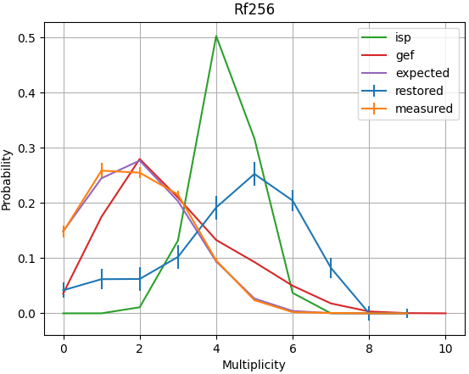
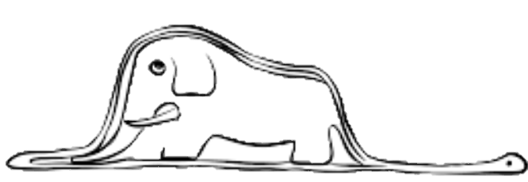
Asymmetric distributions: ²⁵⁶Rf
• 1345 s.f. events
• A = 256
• Z = 104
• N = 152
• $\overline{ν}=4.3±0.2$
• $σ_{ν}^{2}=3.2$

Slide 18
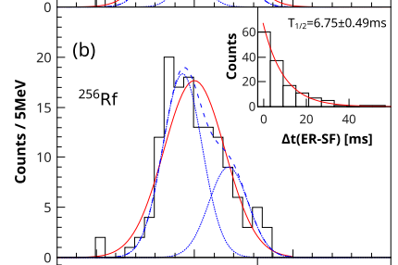
Bimodal fission of ²⁵⁶Rf: experimental data
Multiplicity
TKE [6]
6. P. Mosat, et al., PHYSICAL REVIEW C 101, 034310 (2020)

Slide 19
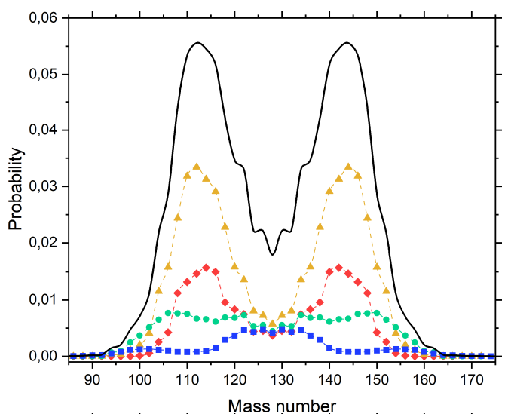
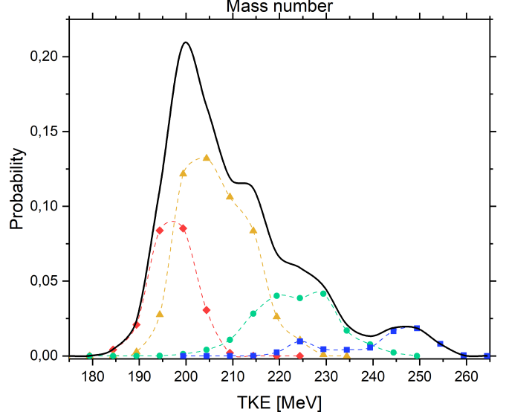
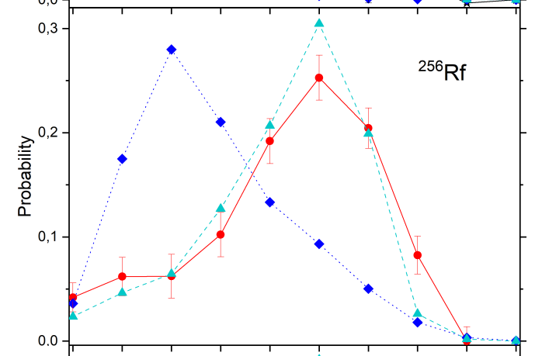
Bimodal fission of ²⁵⁶Rf: theoretical prediction
• New version of ISP model is under development
• Goal: taking dynamic of the process into account without any fitting parameters

Slide 20
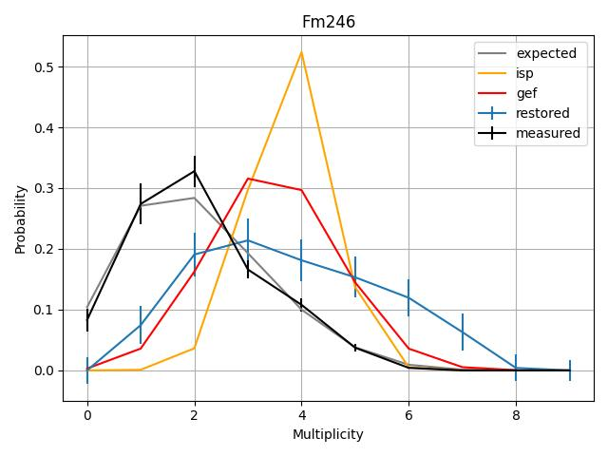
Asymmetric distributions: ²⁴⁶Fm
• 235 s.f. events
• A = 246
• Z = 100
• N = 146
• $\overline{ν}=3.8±0.$3
• $σ_{ν}^{2}=2.8$

Slide 21
Summary and outlook
• Using restoring technique it possible to analyze not just moments of distribution (mean and variance) but shapes too.
• Using the direct solution from Least Squares Problem doesn’t make sense in most of cases because of noisy data.
• The regularization technique allows to catch the exotic modes of spontaneous fission but it is difficult to analyze them in details.
• Emission probability distributions of spontaneous fission prompt neutrons for 8 isotopes was observed.
• 6 of them were classified as “symmetric” and 2 as an “asymmetric”
• Improved scission model that can handle dynamic part of the process is under development
• The probabilistic reconstruction technique that based on Bayesian approach is under development.

Slide 22
Thank you for your attention!
Contact: rmukhin@jinr.ru

