Slide 1



BIOHLIT for automation of biological research at JINR
MLIT/JINR: Y.A. Butenko, A.V. Nechaevskiy, D.V. Podgainy, A.V. Stadnik, O.I. Streltsova
Notes:
good afternoon dear colleagues my name is Yuri Butenko the topic of my report is

Slide 2
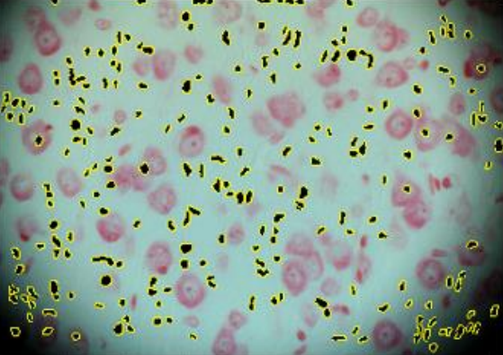
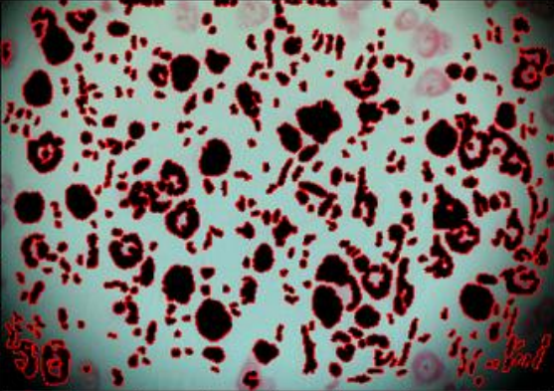
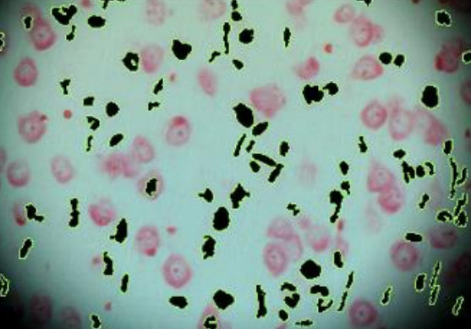
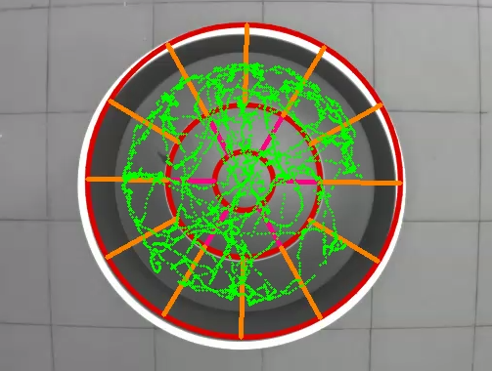
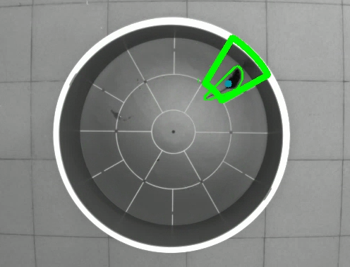
BIOHLIT information system for radiobiological studies
BIOHLIT information system for radiobiological studies
Joint project of LIT and LRB: aims at establishing an information system (IS) for analyzing behavioral and pathomorphological changes in the central nervous system when studying the effects of ionizing radiation and other factors on biological objects.
IS system is based on:
computer vision algorithms based on machine and deep learning technologies;
modern IT solutions for data storage, processing and visualization.
IT system will help to:
Speed up and simplify work on experimental data for different groups of researchers
Simplify and accelerate the diagnosis of CNS pathologies, in a particular case to use effective methods of prevention and protection from ionizing radiation.
https://bio.jinr.ru/

Slide 3






BIOHLIT information system for radiobiological studies
BIOHLIT information system for radiobiological studies
RADIOBIOLOGICAL STUDIES WORKFLOW
Experimental stage
Data analysis and processing stage
RESULTS
Pathomorphological
analysis
Exposure
Behavioral test’s
Data Processing
Data analysis
DATA AND METADATA

Slide 4
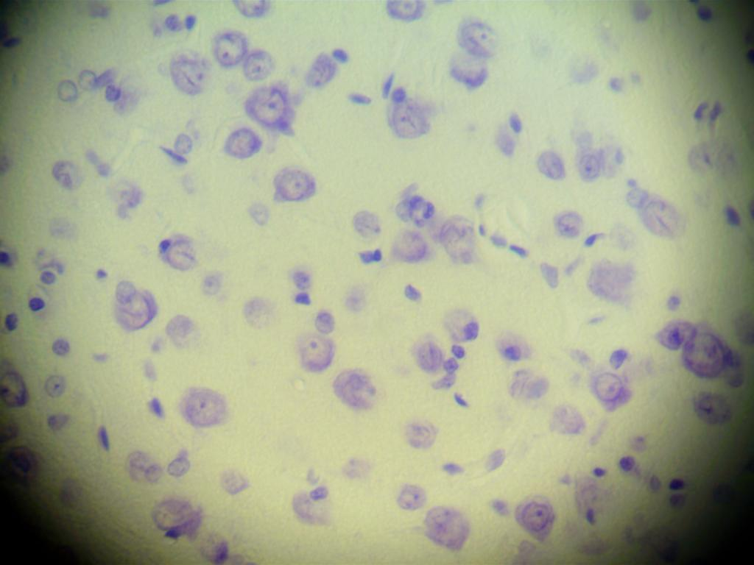


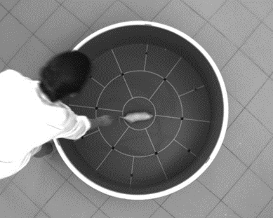
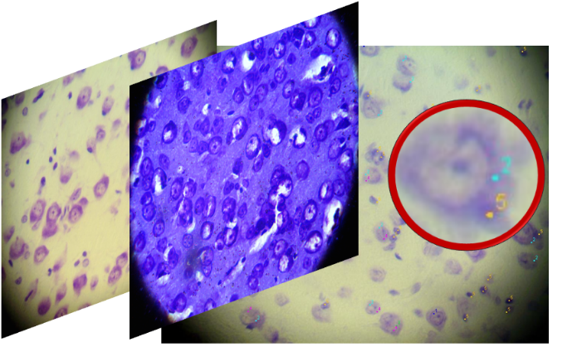
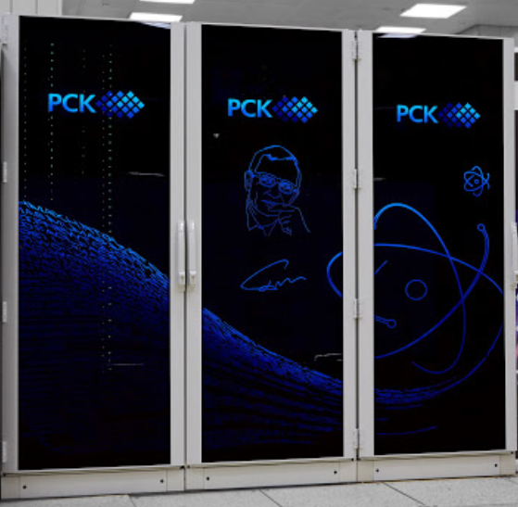
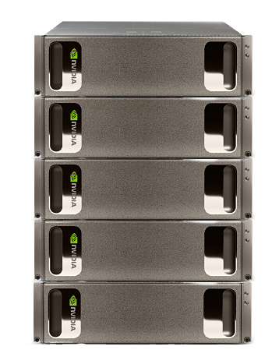
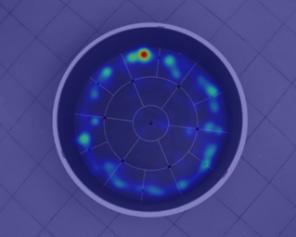














Webapp
Metadata DB
Supercomputer “Govorun”
metadata
Train, Inference,
Results
Jobs, resource allocation
Images, Videos, data
API-Server
Auth data, credentials
Train, Inference,
Dev
Batch-system
HLIT-storage, JINR EOS
Auth
ML\DL ecosystem

Slide 5

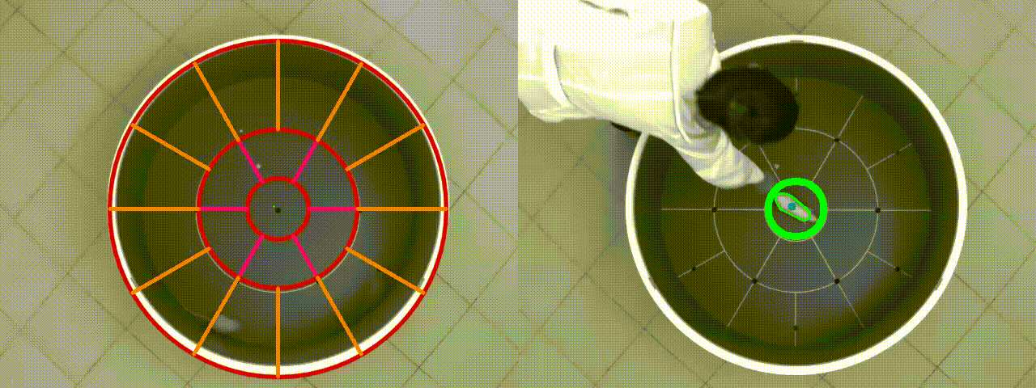
BIOHLIT information system for radiobiological studies
BIOHLIT information system for radiobiological studies
Processing conceptual scheme
Experimental data
Analysis
Result

Slide 6
BIOHLIT STORAGE
Data for processing
Data for processing
&
1
Restricted access
Hot
Warm+Hot
Users access the service after authentication. Data is a private.
LUSTE/DAOS
Experimental data
2
Work with experimental data
ZFS
Storing metadata of experiment in the DB, and their modification and deletion
Experimental data
Warm
ZFS
Archives and Datasets
3
Uploading and storing files
Archives and Datasets
Cold
Saving photos and videos from experiments in storage system.
Cold
JINR EOS
JINR EOS
Current state
Upgrade
In future

Slide 7
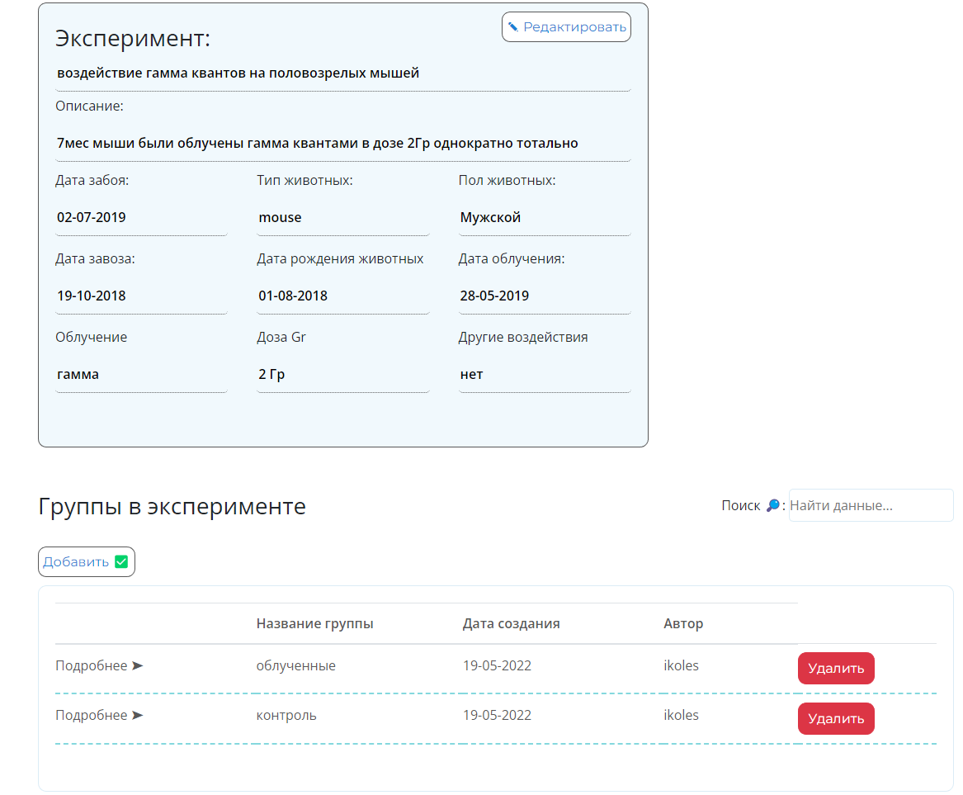
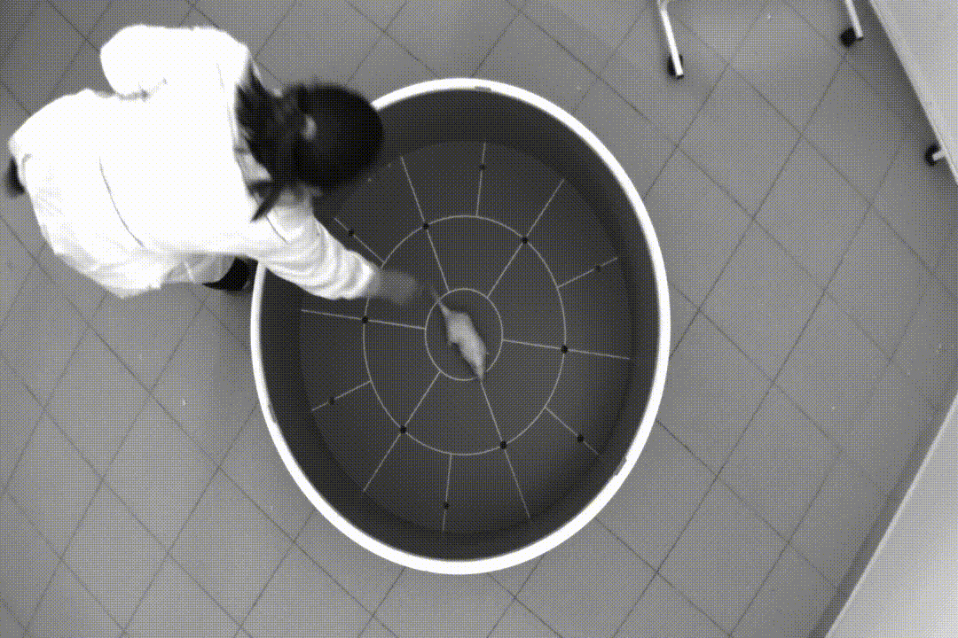
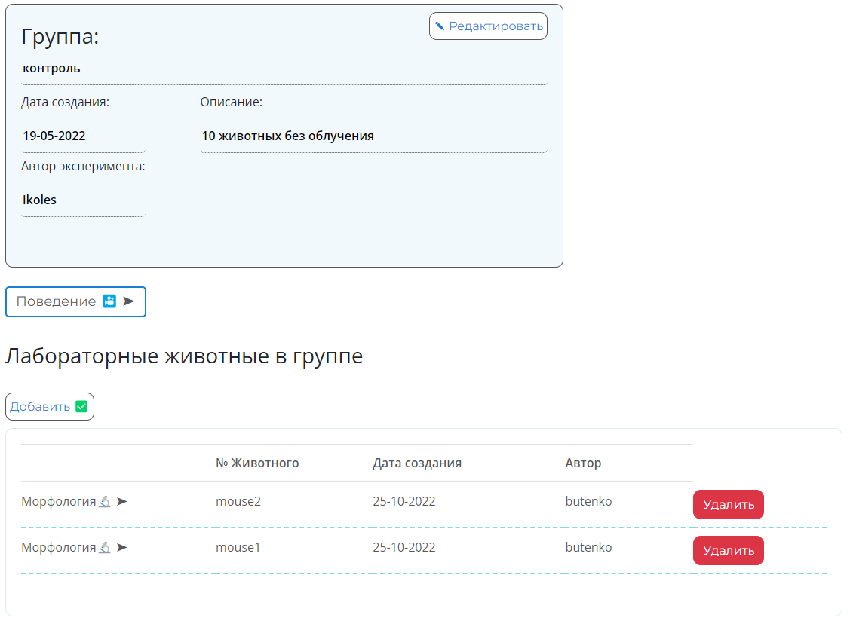
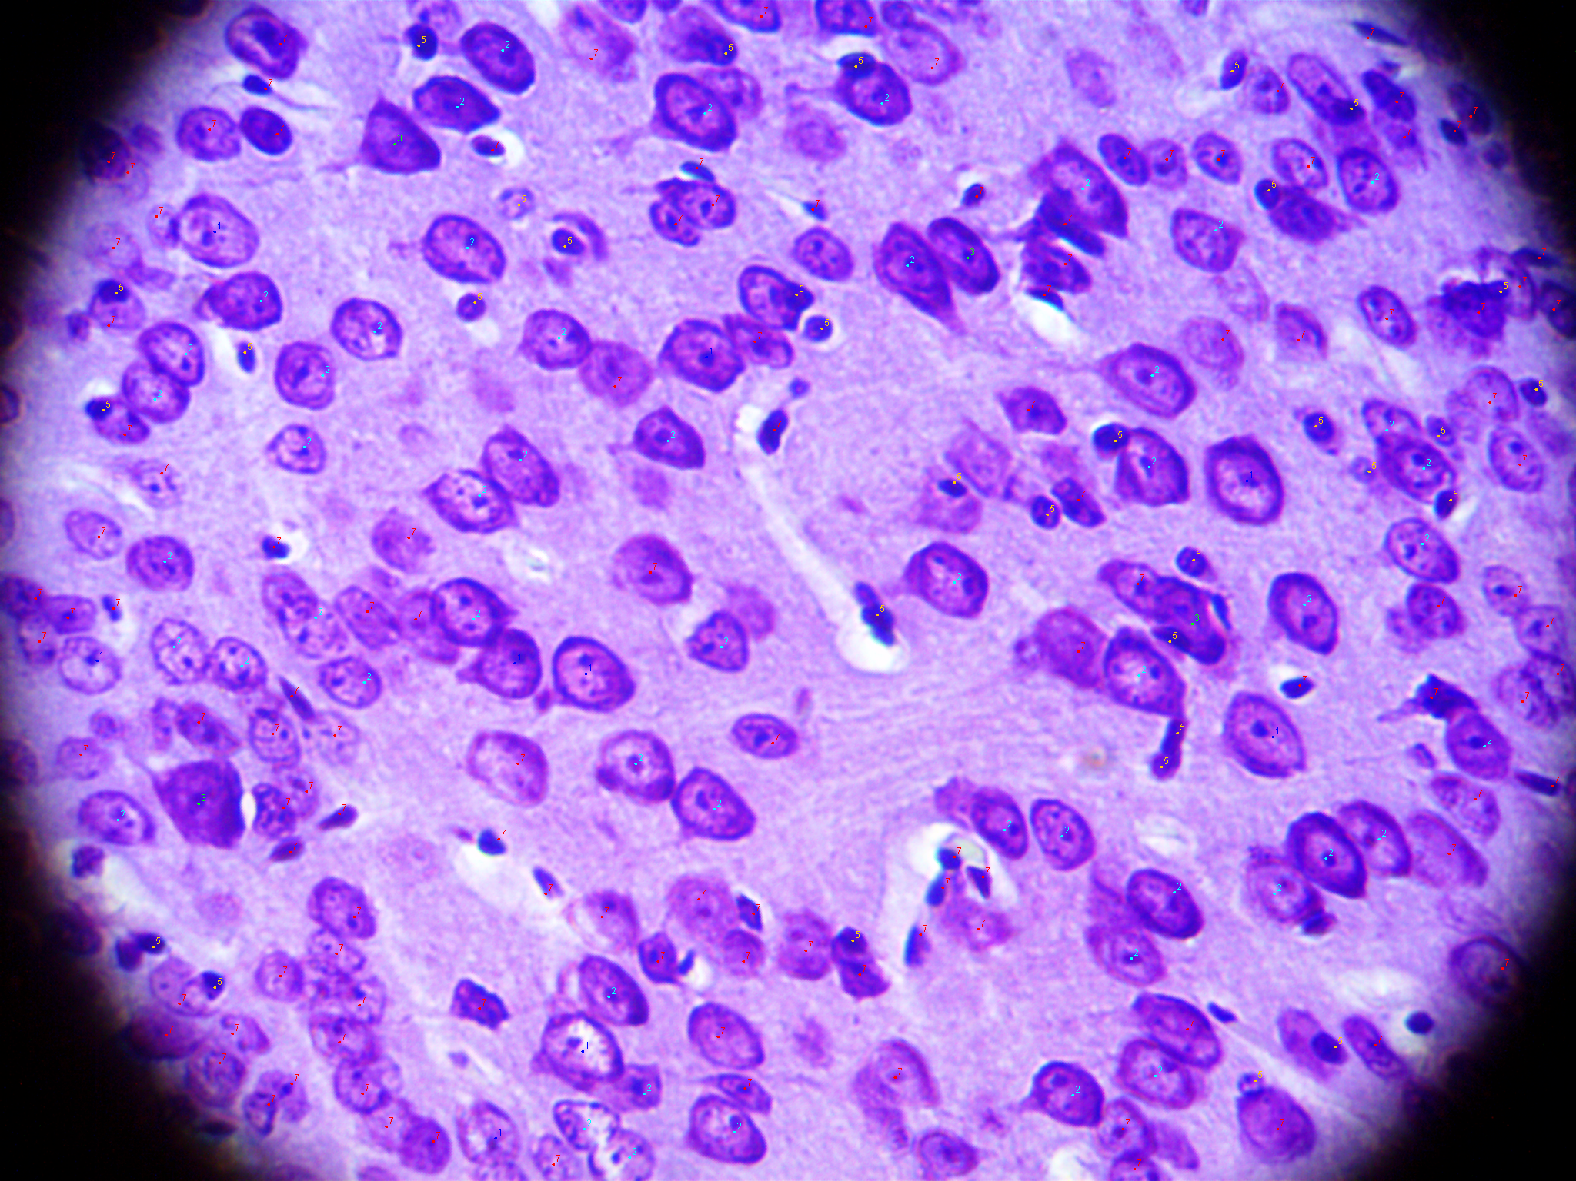
BIOHLIT STORAGE
Experiment:
Experiment name
Description
Animals type
Impact
Dose
Date of impact
Arrival date
Animal Date of Birth
Slaughter date
Gender
Owner
Creation date
Group:
Behavioral test
Group Name
Description
Owner
Creation date
Videos
Objects:
Histological slices
Object name
Owner
Creation date
Images

Slide 8
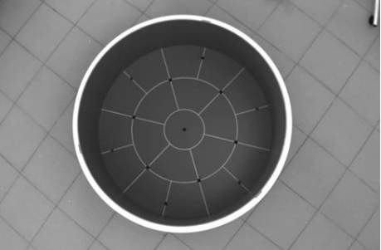
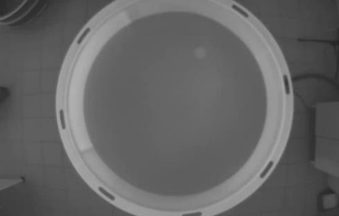
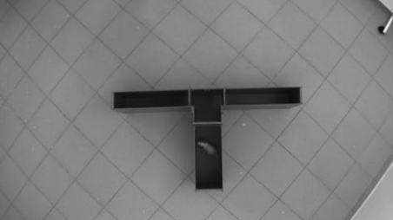
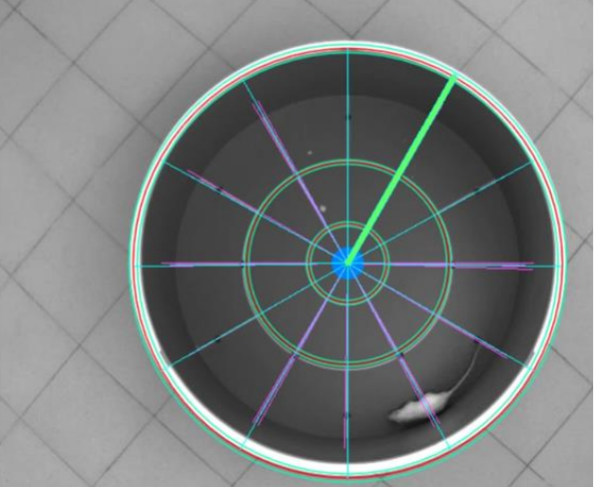
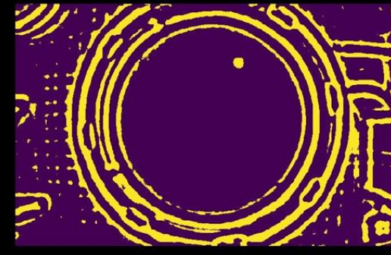
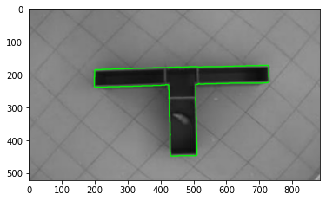
Tasks of the algorithmic block of the information system
Analysis of the experimental field markup
Tracking the position of the animal as part of the experiment
Classification and determination of the type of animal activity (grooming, fading, etc)
Segmentation of neurons in images of histological slices
Classification of neurons by type and belonging to the layer
Statistical analysis of behavioral patterns and correlations with pathomorphological analysis

Slide 9
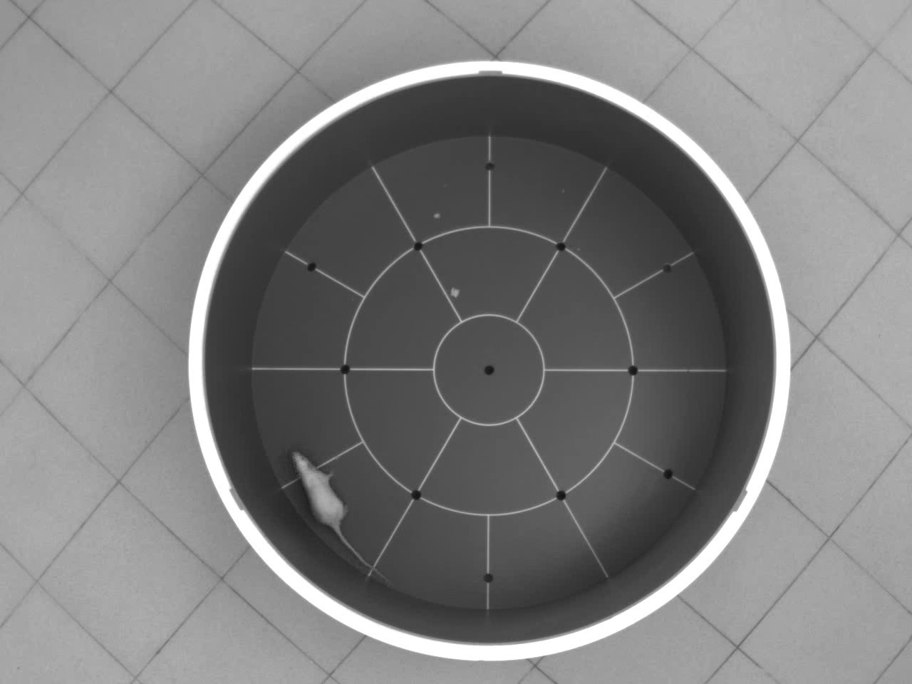
Behavioral test: Open Field
Open field behavioral test it 's a round arena with marked sectors and bottom holes. The test takes 6 minutes.
The “Open Field” allows to register the general activity of experimental animals. To aim this required to counting number of: sectors passed, intersections of the center, fading's, climbs, movements in place, grooming, urination and defecations.

Slide 10
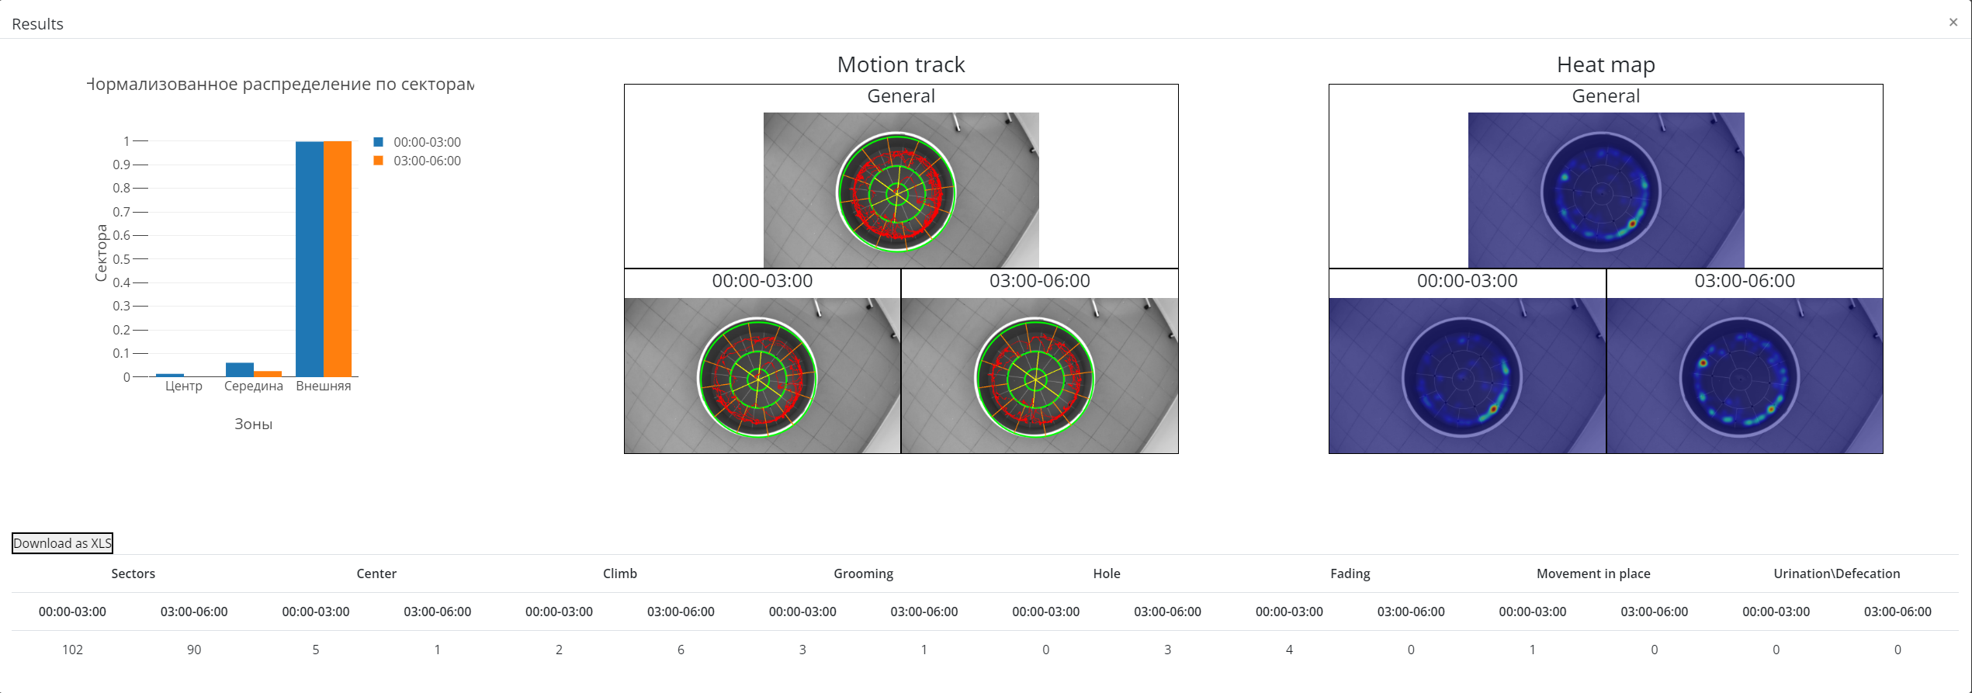
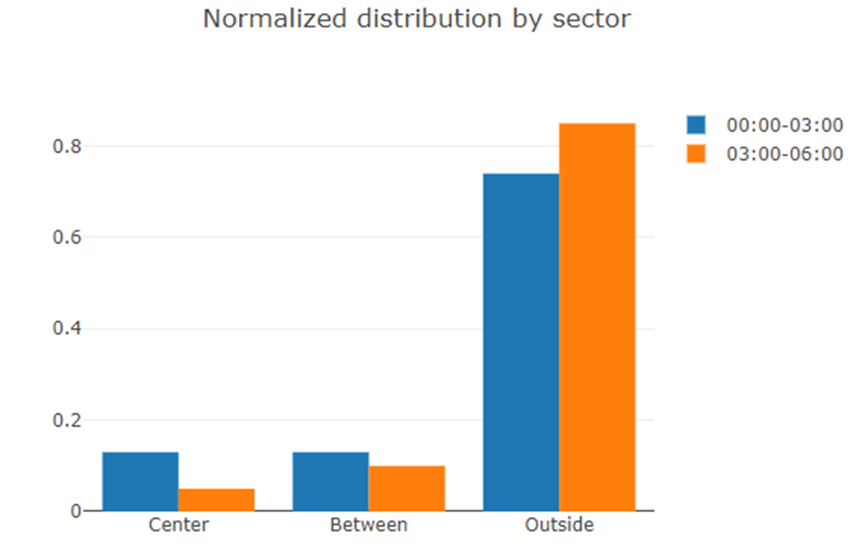
BIOHLIT information system for radiobiological studies

Slide 11


ML/DL and data analysis ecosystem + JLabHPC
BIOHLIT information system for radiobiological studies
Easy and fast prototyping of ML/DL algorithms in Jupyter Notebook environment
4x GPU Volta V100 is available for learning of convolutional neural networks
Popular frameworks and software for DL/ML/CV/Data Processing (Tensorflow, Keras, Pytorch, OpenCV, Matlab, etc.) are assembled and ready for use.
Large specter of available Python libraries for data analysis and visualization
Specifications:
GPU: 4x Nvidia Volta V100-SXM2 *NVLink* 32Gb HBM2
CPU : 2x Intel Xeon Gold 6148 CPU @ 2.40GHz
20 Cores/40 Threads
RAM: 512 GB DDR4 2666MHz
SSD: 2*240 GB

Slide 12




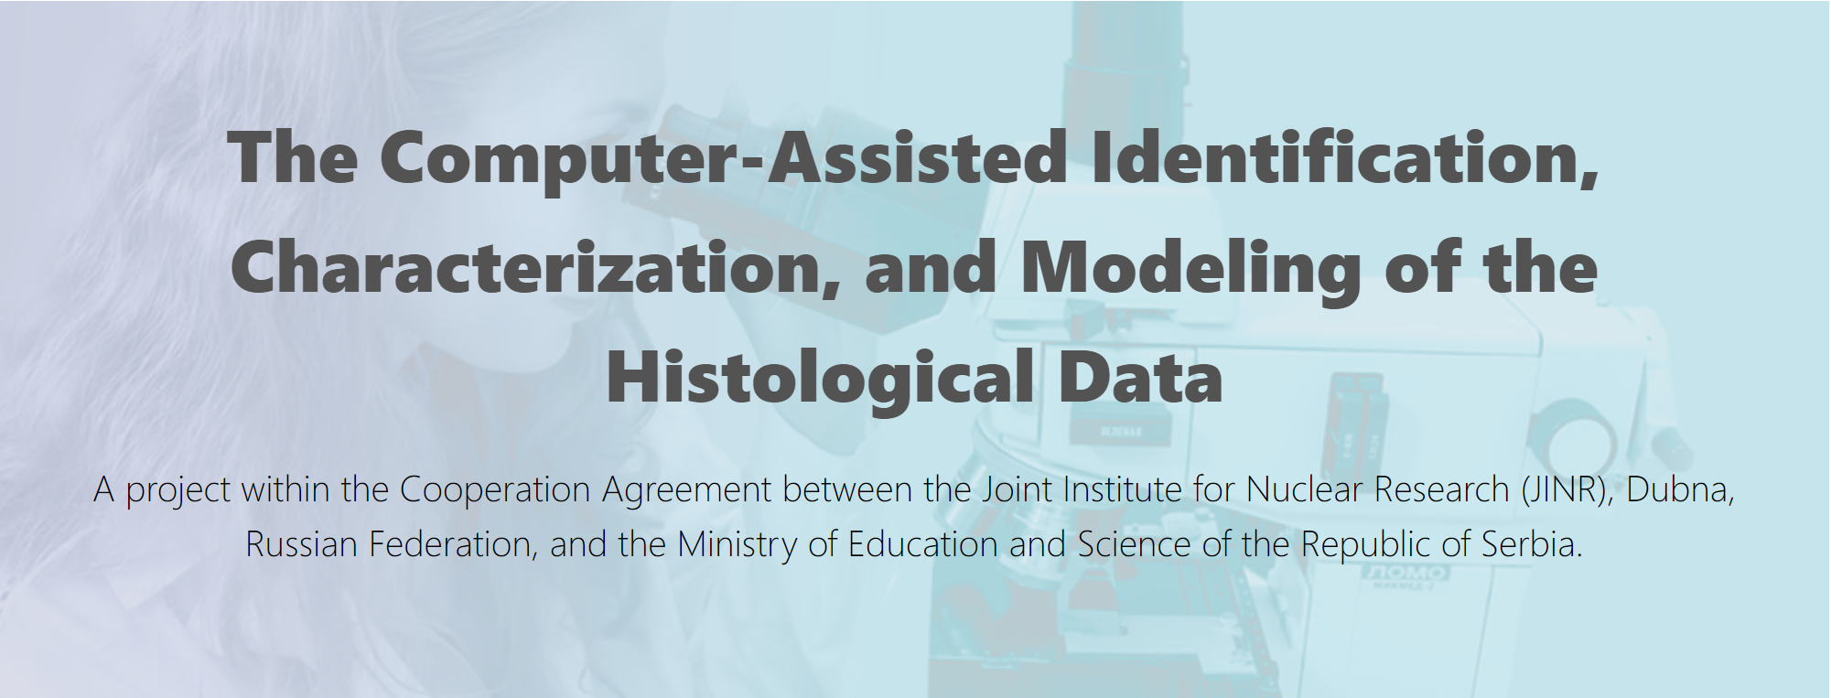
We plan to develop of the automated information system (AIS), based on the machine learning techniques, for systematic acquisition and preprocessing of experimental data, followed by automated segmentation, identification, and characterization of the biologically relevant structures. This system will enable efficient manipulation and visualization of obtained results, which are necessary prerequisites for advanced statistical analysis and modeling.
AIS will enable the systematization of the accumulated results. identification of hidden patterns in the biological data and characterize the damaging effect of ionizing radiation or any other carcinogen. While modeling the observed patterns could lead to significant advances in diagnosis, prevention, and treatment of cancer.
https://it4bio.jinr.ru/

Slide 13
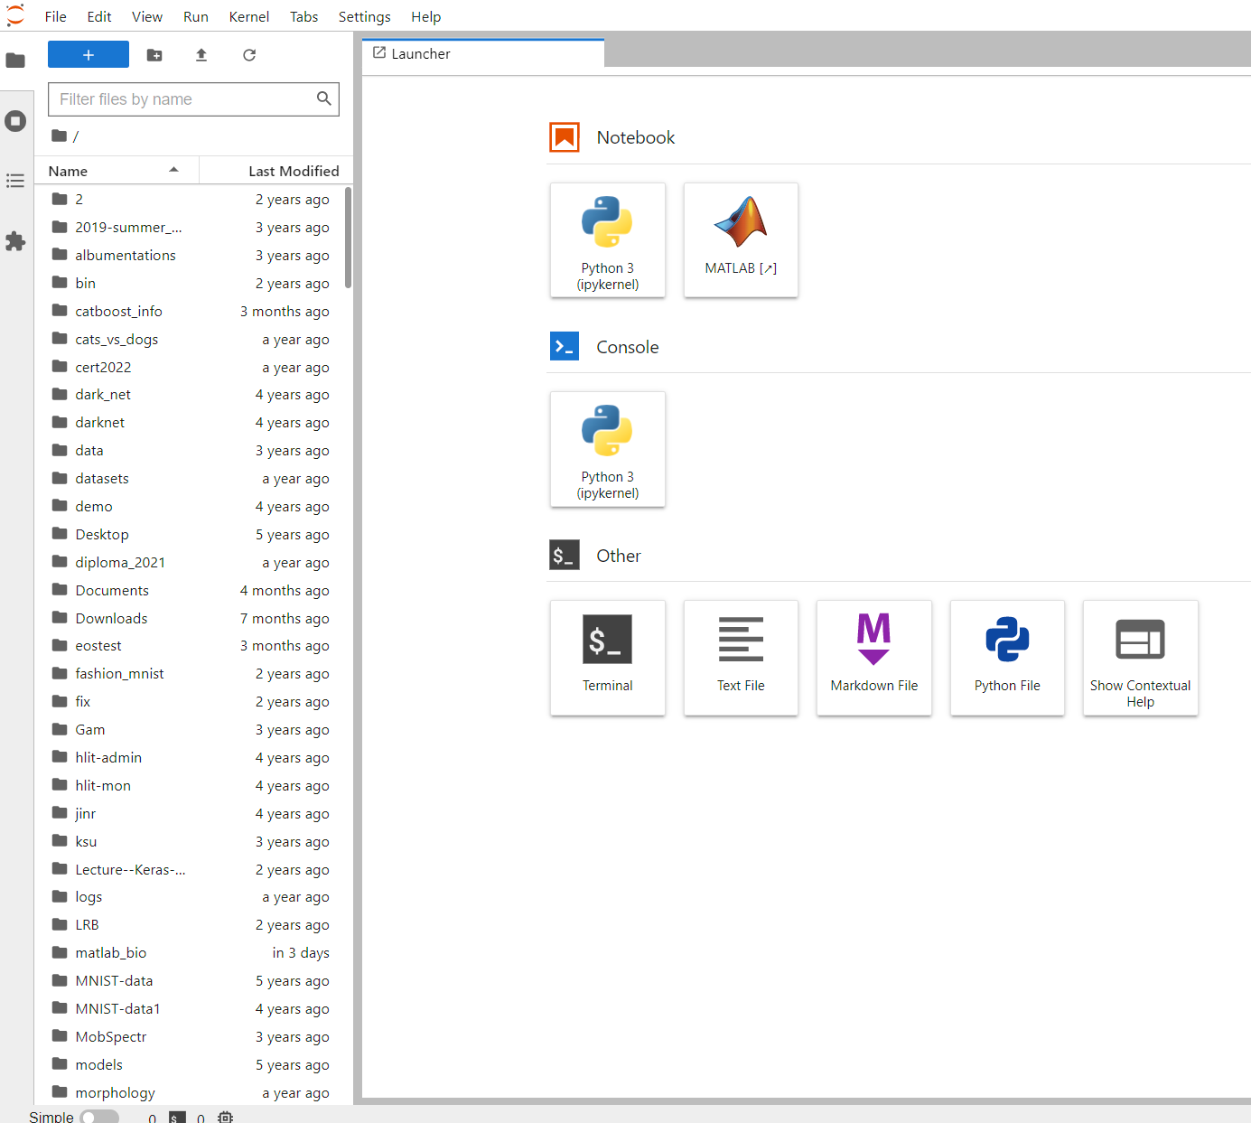
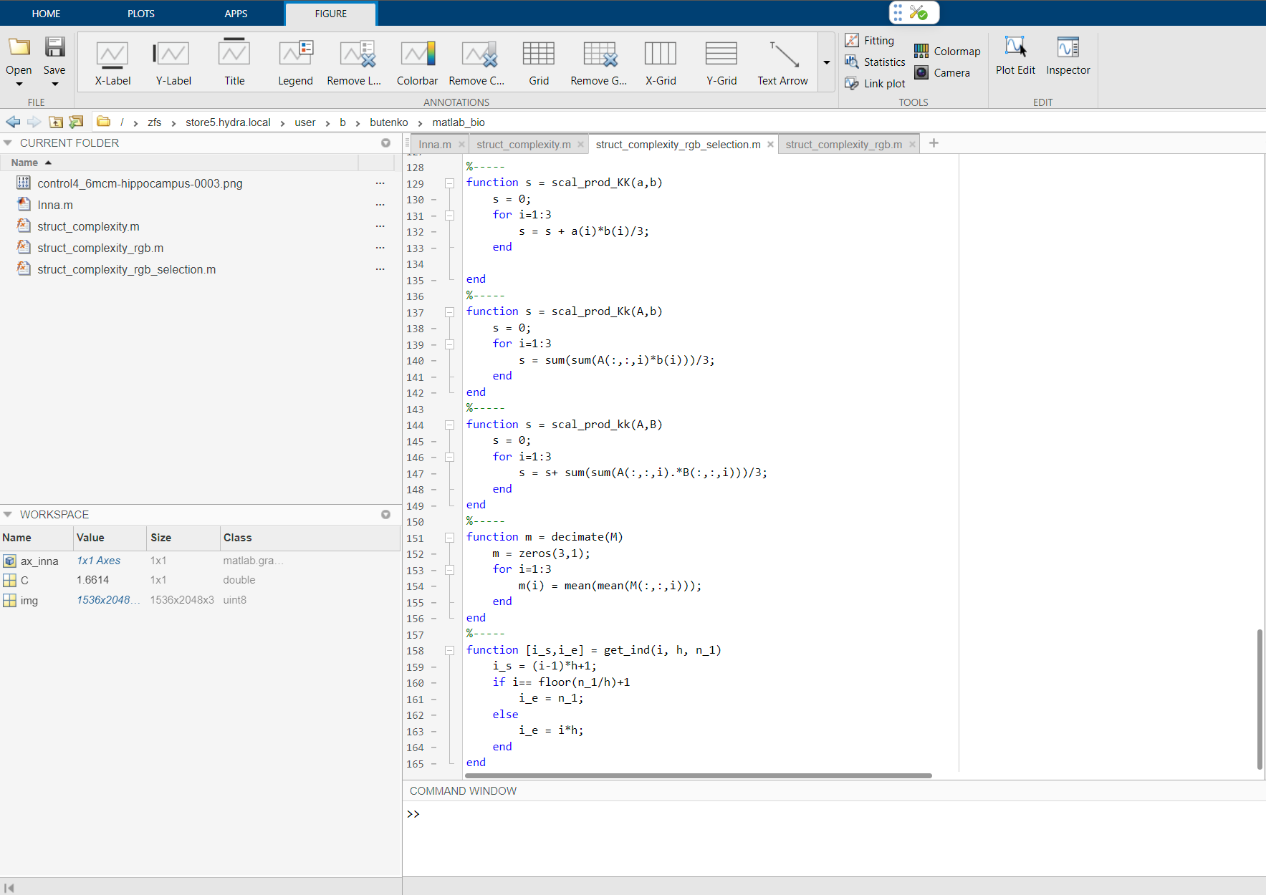
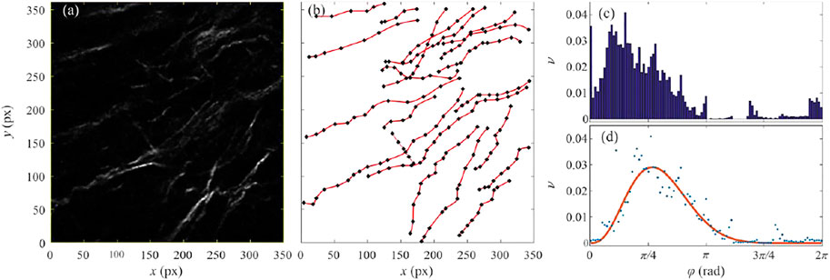
MATLAB in ML/DL Ecosystem
Available 6 licenses for Matlab in JupyterHub environment as part of ML/DL Ecosystem

Slide 14
Information system for radiobiological research
(Joint project of LIT and LRB)
Conclusions
  Information system has been implemented as a web application and it has a client-server architecture. The server is Node.js and the client is written using the React library.
  IS takes over all necessary manipulations of the DB (database), file storage, Batch-system and other components of the HybriLIT platform;
  IS provides a convenient interface for: processing, storing, modifying and adding experimental data;
  Web applications advantages:
  No installation or update required;
  Available on all devices with the Internet (PC’s, Pad’s);
  All calculations/processing will take place on a remote dedicated server.
  Based on the results and technologies of this project, several another projects have been launched:
  Virtual Research Environment NanoHLIT for Hybrid Nanostructures Research on the HybriLIT Platform;
  The Computer-Assisted Identification, Characterization, and Modeling of the Histological Data.

Slide 15
Thanks for your attention!
Our team:
MLIT/JINR
Anikina A.I.
Butenko Yu.A.
Zuev M.I.
Nechaevskiy A.V.
Podgainy D.V.
Stadnik A.V.
Streltsova O.I.
LRB/JINR
Boreyko A.V.
Zadnepryanec M.G.
Kolesnikova I.A.
Lalkovicova M.G.
Golikova K.N.
Severiukhin Yu.S.
Utina D.M.
Chausov V.N.
Chramko T.S.
In collaboration with University of Belgrade
Coordinator: Dr Marko Ćosić
https://bio.jinr.ru/
http://hlit.jinr.ru/
https://it4bio.jinr.ru/

