Slide 1
Dilution cryostats as a part of Atomic Hydrogen Target for electron beam polarimetry. Frozen Spin Targets.
Ivan Gorodnov - JINR DLNP LTD
«The XXVI International Scientific Conference of Young Scientists and Specialists»
2nd stage. JINR, Dubna, Russia 07 Dec 2022

Slide 2
Эксперименты в физике элементарных частиц, Hydro - Møller @ P2 Experiment @ MESA.
Тип ускорителя
С неподвижной мишенью
Коллайдер
Поляризация пучка
Поляризация мишени
Неполяризованный пучок
Поляризованный пучок
Поляризованная мишень
Неполяризованная мишень
P2 Experiment @ MESA
Германия, Майнц
Precision e-Beam polarimeter ∼ 150 µA, ∼ 155 MeV polarization ∼ 85%

Slide 3
P2 Experiment @ MESA
Germany, Johannes Gutenberg University Mainz.
The new Mainz Energy-Recovering Superconducting Accelerator (MESA).
P2-experiment: precision measurement of the weak mixing angle.
∆sin 2 (θ W ) = 0.14%.
Experiment collect ∼ 10¹¹ s⁻¹ for 11000 h (∼ 1,25 yr).
e-Beam current ∼ 150 µA, beam energy ∼ 155 MeV.
Continuous spin polarized electron beam, polarization ∼ 85%.
High stability of position, energy and intensity of beam.
High beam polarization and polarization measurement accuracy significantly contributes in the precision.
The beam: unpolarized LH₂-target, L = 600 mm, ℒ = I_{beam} /e × ρ_{part} × L = 2.4 × 10³⁹ cm⁻² s⁻¹.

Slide 4
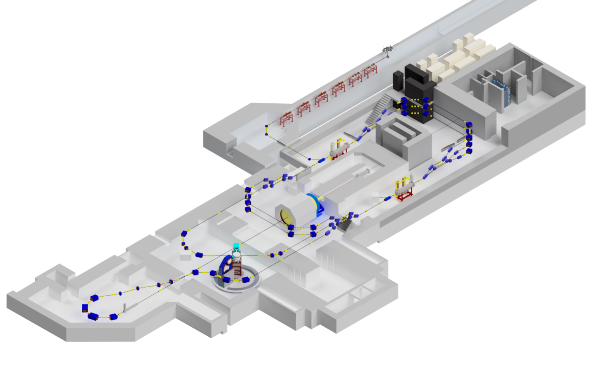
Schematic arrangement of units of experimental installations @ MESA accelerator (Mainz, Germany). Mainz Energy-Recovering Superconducting Accelerator
Double Mott Polarimeter at 0.100 MeV
offline
Mott Polarimeter at 5.0 MeV
offline
Online
Hydro - Møller Polarimeter at 155.0 MeV
P2 detector (10¹¹ s⁻¹)
60 cm L⁴He unpolarized target
150 µA eBeam, polarization ∼ 85 %
The goals at MESA: P_{Mott, double} = P _{Mott, 5.0 MeV} = PMøller, H, Accuracy ∆P/P ≤ 0.5%
(offline) (offline) (online)

Slide 5
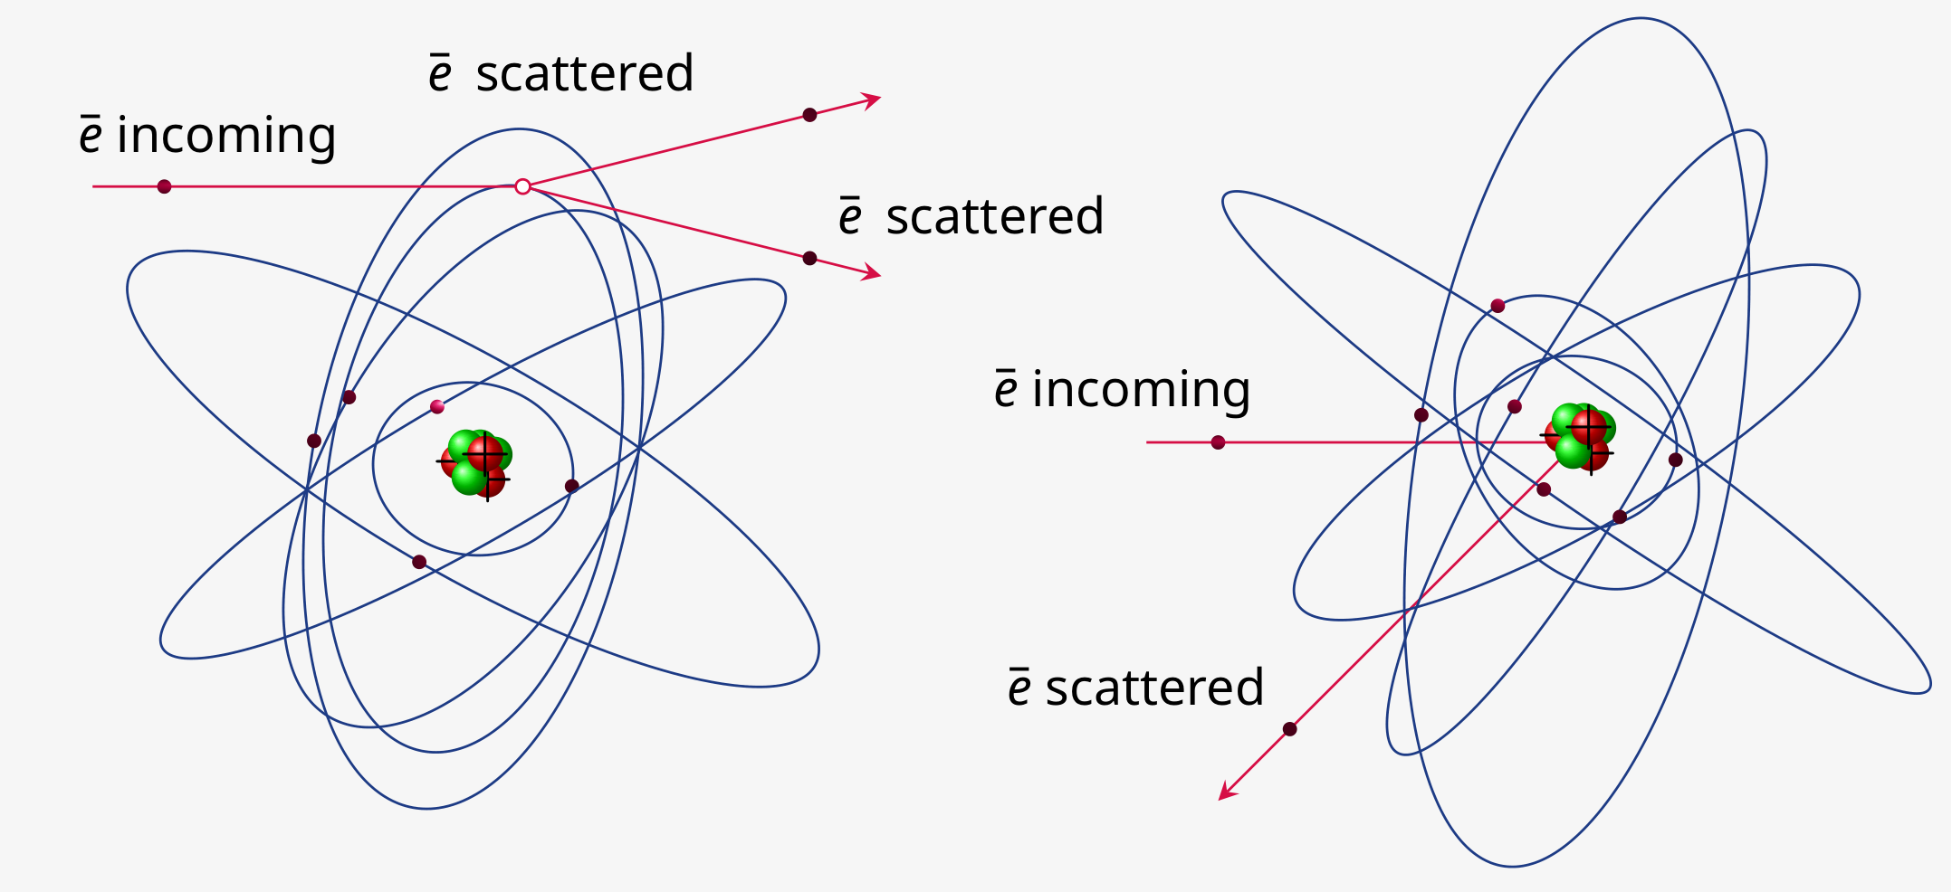
Møller and Mott scatterings
Møller electron-electron scattering
Mott spin-coupling inelastic Coulomb scattering

Slide 6
Hydrogen target for Møller polarimeters (Hydro- Møller)
Scattering on hydrogen electron
Target H, Z=1, A=1
Ionization energy = 13.6 eV
Cell density: ρ_{H}[cm⁻³] × L_{H} = 6.0 × 10¹⁶ cm⁻²
Energy range: 0.15 − 12.0 GeV
Current up to 1000.0 µA
Overall accuracy of ≤ 0,5%
Gas properties:
Atom velocity ≈ 80 m/s
Atomic collisions ≈ 1.4 × 10⁵ s⁻¹
Mean free path λ ≈ 0.6 mm
ē scattered
ē incoming
ē scattered
H⁺
Molecular hydrogen H₂ opposite electron spin
Atomic hydrogen H : $\vec{μ}$ ≈ $\vec{μ_{e}}$ in magnetic field
Polarization of hydrogen target P^{T} ∼ 0.9999
Idea was proposed by Chudakov and Luppov

Slide 7
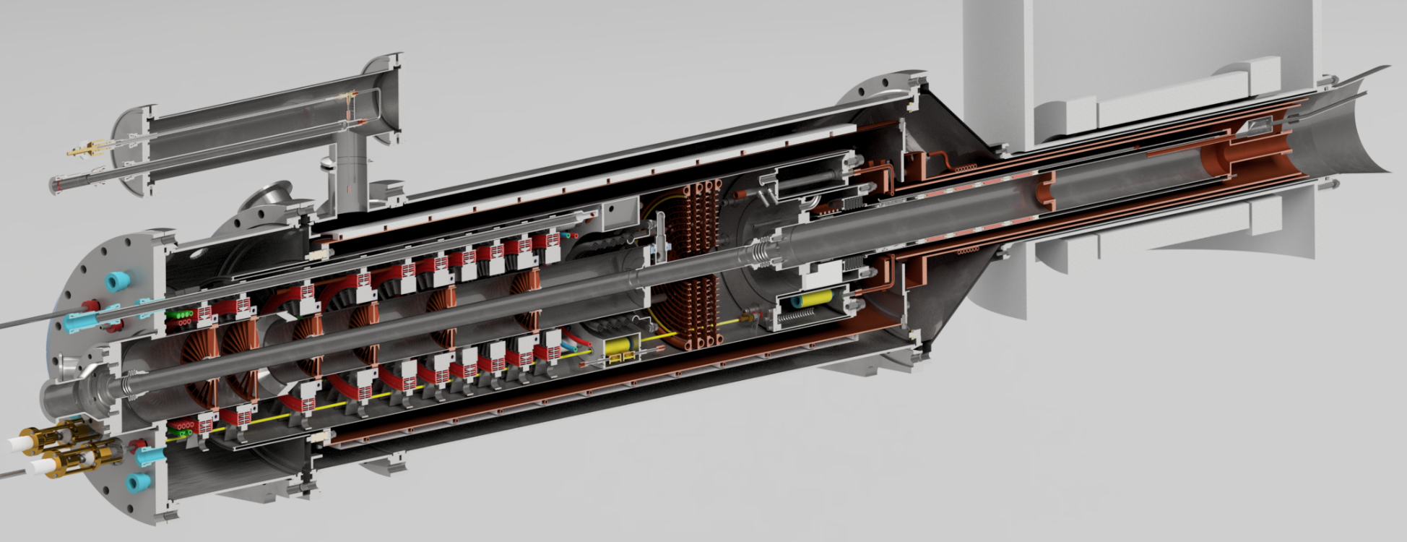
Cross-section of a model of a new Hydro Møller polarimeter based on a dilution refrigerator for the P2 experiment @ new MESA accelerator in Mainz (Germany).
HE1 (300-10 K)
HE2 (10-4 K)
HE3 (4-1 K)
LHe evaporator ($\sim$1 K)
Magnet (4 K, 8 T)
H-dissociator 300 mK
e-beam channel (150 µA)
Screen 80 К
LHe separator (3.8-4.2 K)
Still ($\sim$0,8 K)
Screens 10K and 1K
H-Cell, Mixer (250 мК)

Slide 8
Technical parameters of a new dilution cryostat
For precision polarimeter Hydro Møller @ MESA:
• Mixer temperature 250 mK in a long term mode.
• Horizontal oriented dilution cryostat – mixing ³He in ⁴He.
• Cooling power 60 mW at temperature level 250 mK and circulation ${\dot{n}}_{{}_{}^{3}{He}}$ $\sim 4$0 mmol/s.
• Superconductive magnet separated from cryostat Holding field B = 8 T, field homogeneity ∆B/B < 10⁻⁴, Warm hole: D_{sole} =110-130 mm.
• H cell dimensions: L=400 mm, Ø=49 mm.
• L⁴He consumption < 8 L/hr. • Evaporator tempetarure$\sim$ 1.2 K, Separator tempetarure$\sim$ 4 K.
• Wall of storage cell is coated ∼ 50nm film of superfluid ⁴He at T_{wall} = 0.25 − 0.30K.
• Film burners for prevent leakage of superfluid ⁴He film.
• No screens in the e-beam path

Slide 9
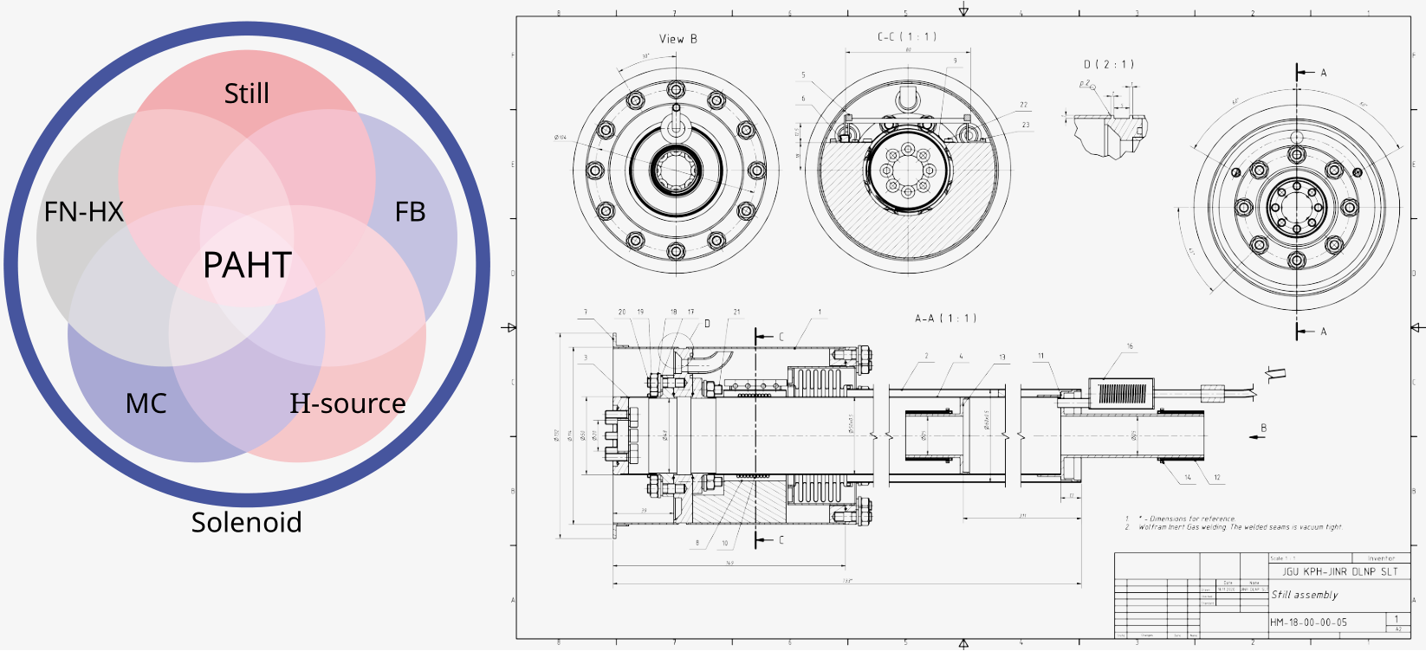
Dilution unit, FN-HX, still, MC, H-source, FB
The star of success
1) Still, 12) FB, 16) H-source at 1K, 2,4) MC, 2,4,10) FN-HX, Solenoid not shown
The star of success
All elements are highly interconnected
The key unit of cryostat
Discussed at JINR 2019, 2020
Valery, Tyukin (KPH, JGU)
Original technical drawing by N. Borisov, I.Gorodnov, JINR

Slide 10
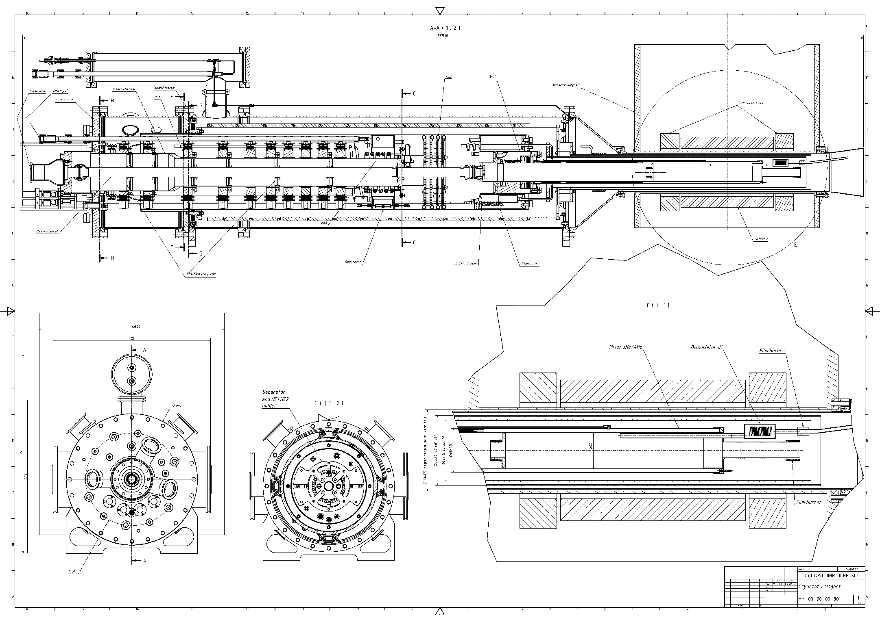
Under construction
Version: HM-00-00-00-30

Slide 11
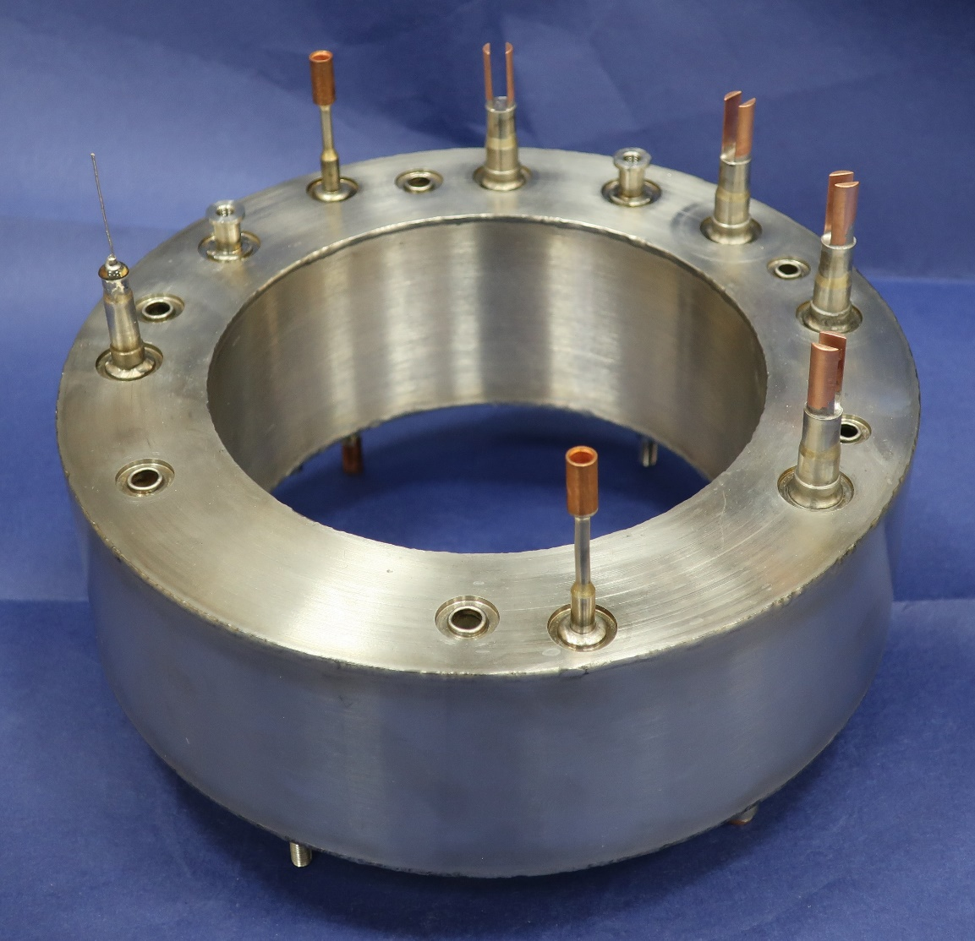
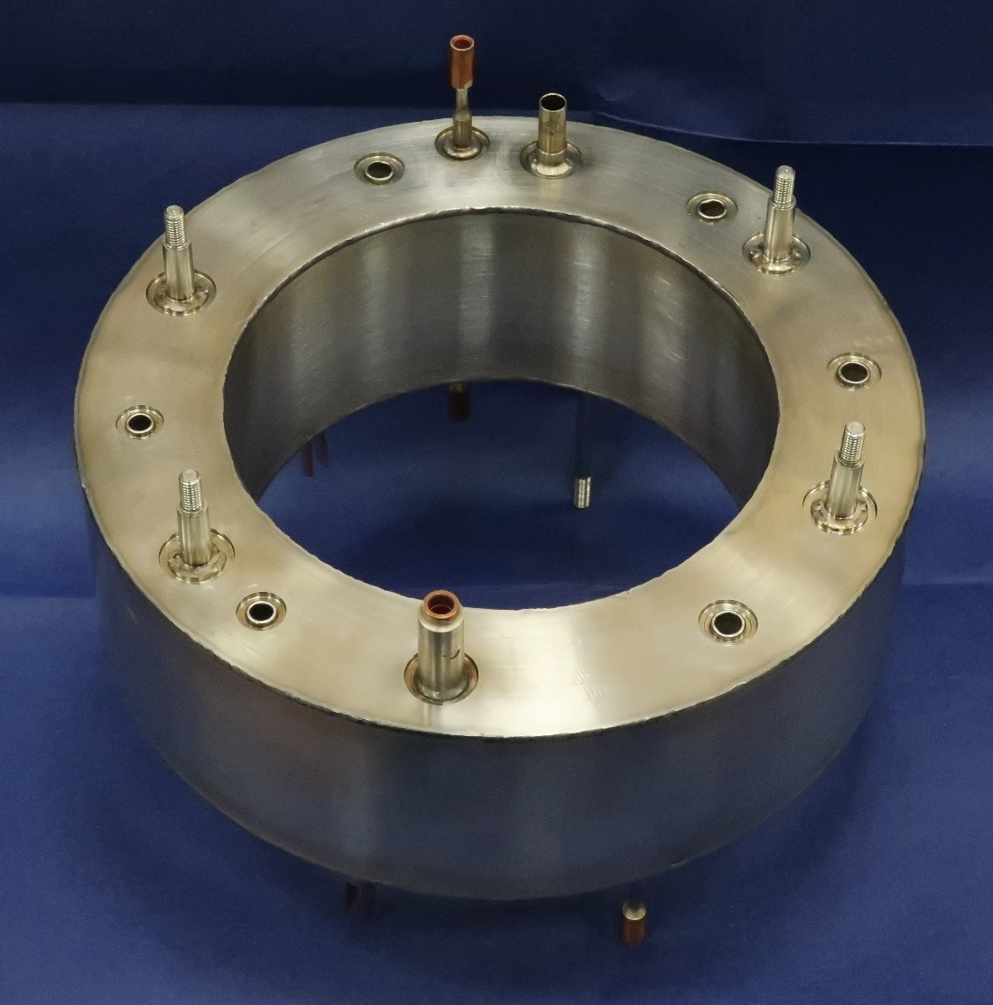
LHe Separator (4 K), Dubna 2022

Slide 12
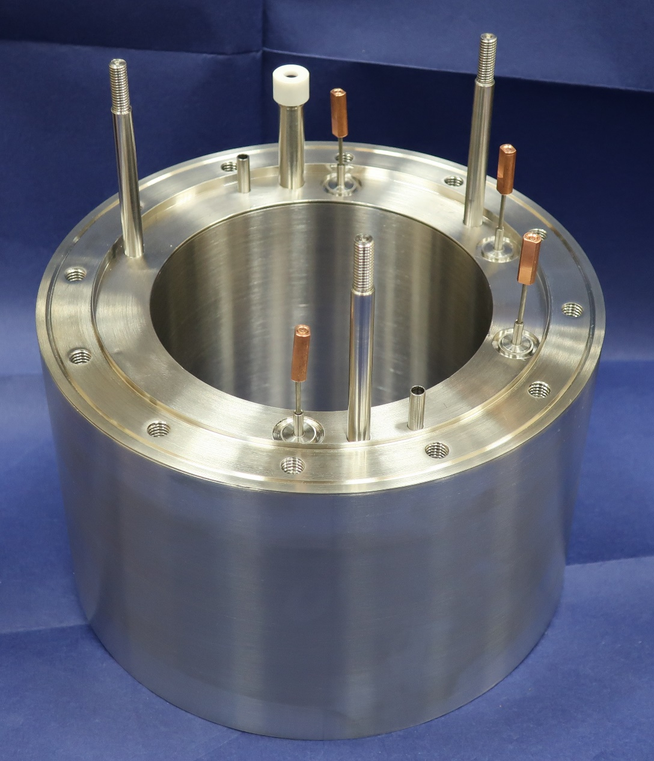
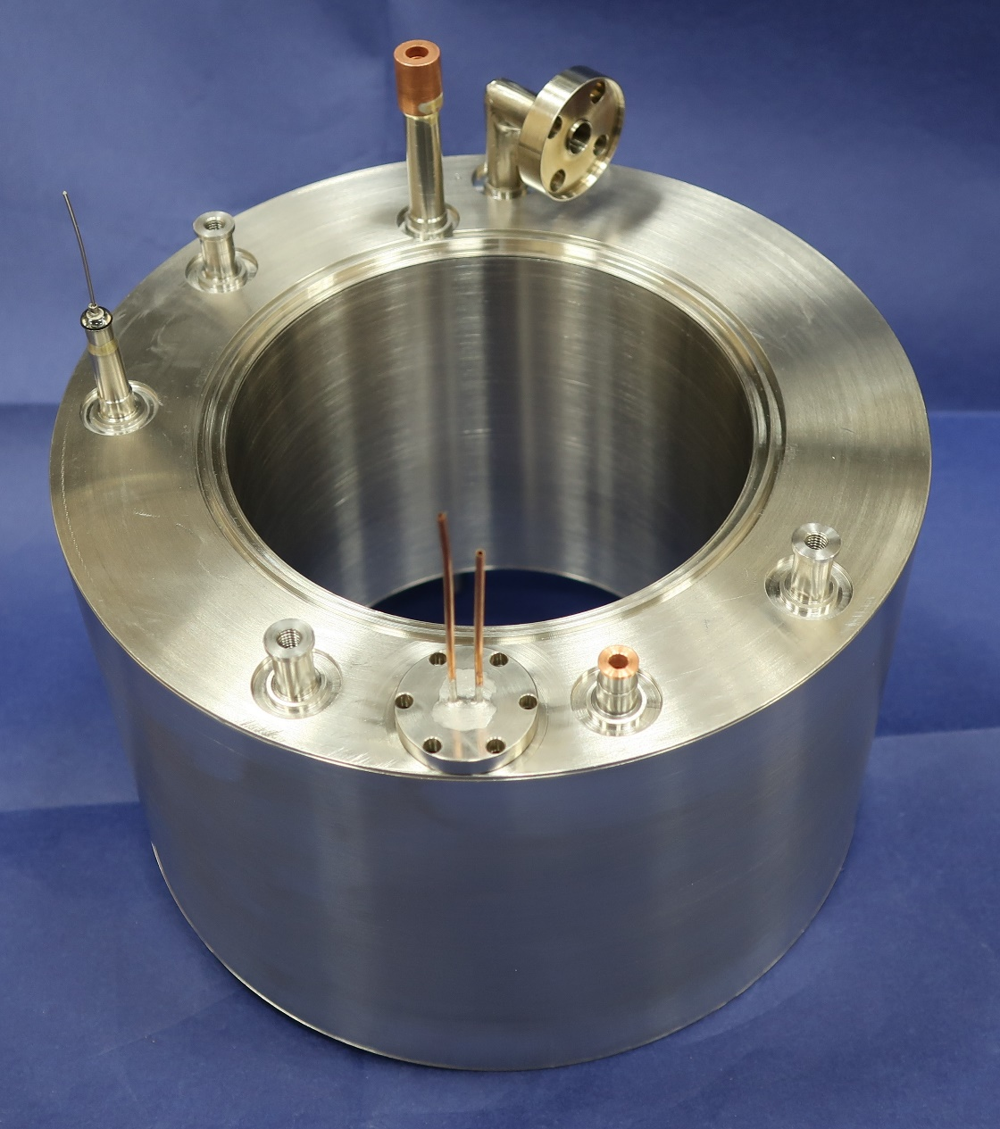
Evaporator (1 K), Dubna 2022

Slide 13
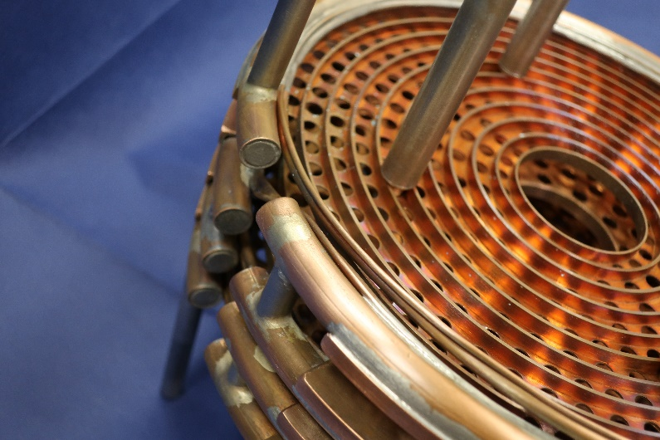
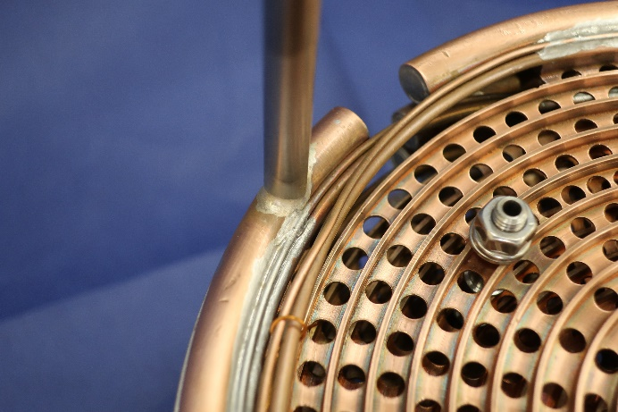
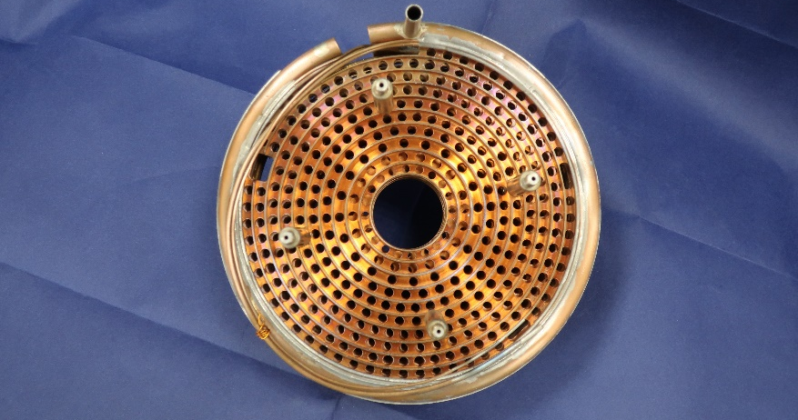
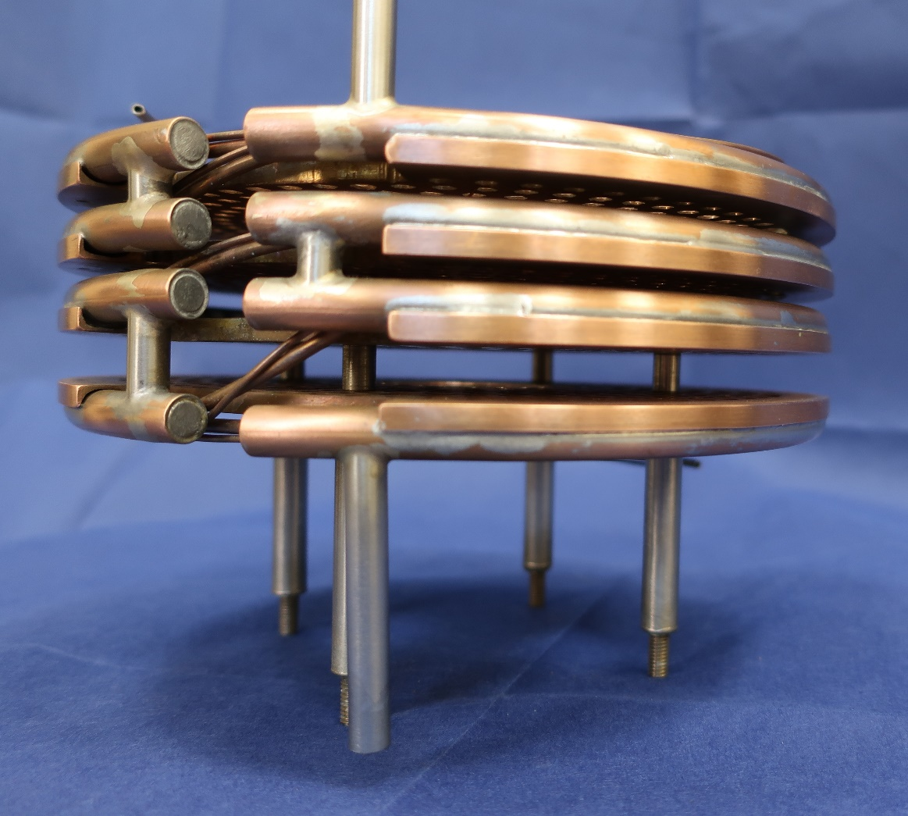
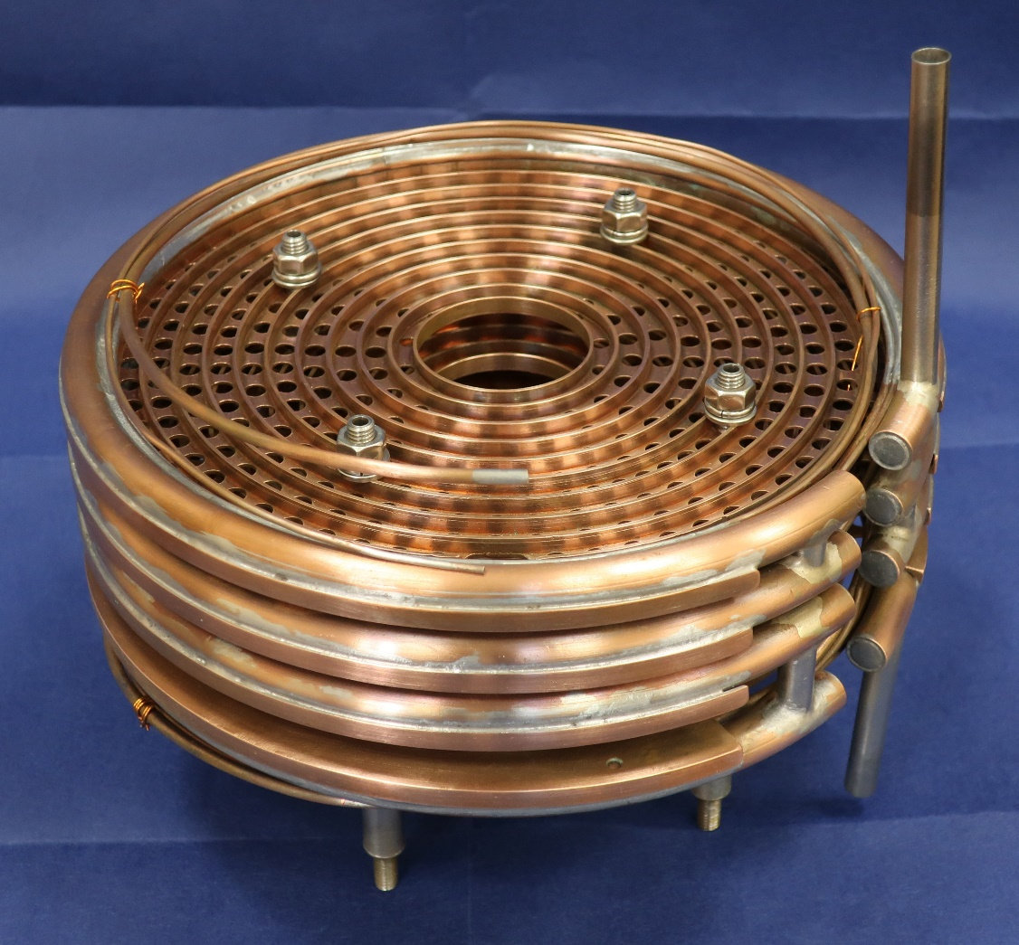
Heat Exchanger 3 (1.5-4.5 K) , Dubna 2021

Slide 14
Needle valves, Dubna 2022

Slide 15
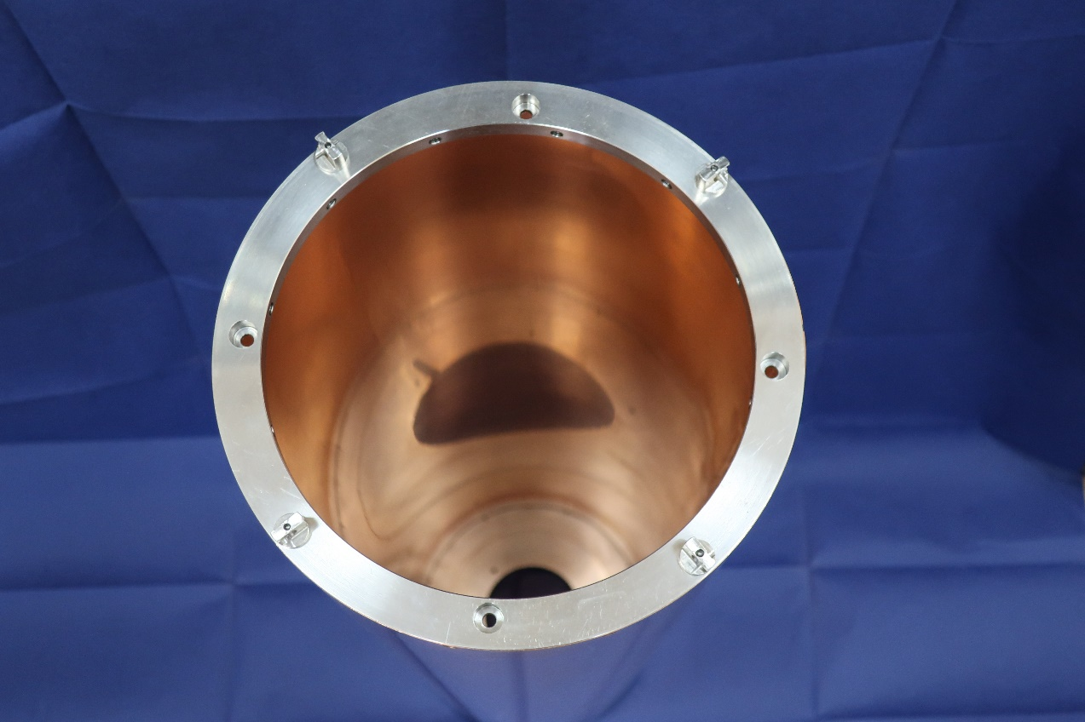
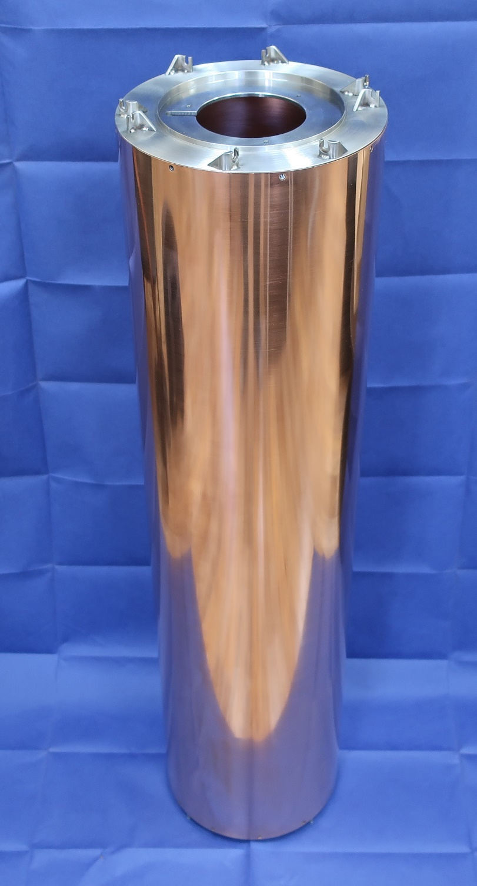
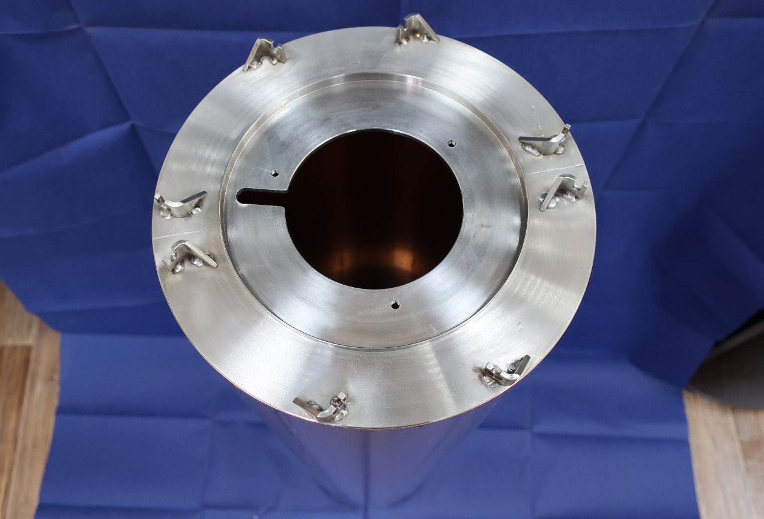
Screen 80 K (50-80 K, Gas ⁴He) ,2021

Slide 16
Works performed in JGU Mainz
Dubna

Slide 17
Эксперименты в физике элементарных частиц, Frozen Spin Targets
Тип ускорителя
С неподвижной мишенью
Коллайдер
Поляризация пучка
Поляризация мишени
Неполяризованный пучок
Поляризованный пучок
Поляризованная мишень
Неполяризованная мишень
Двойной поляризационный эксперимент
Германия
Прага
Россия

Slide 18
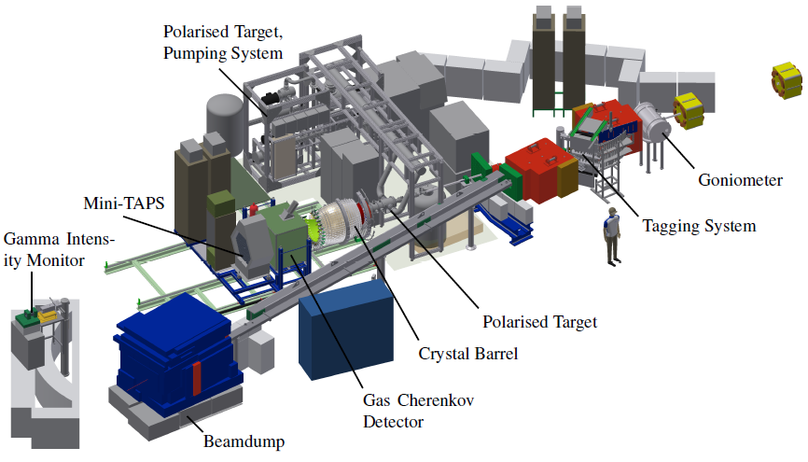
Experimental setup of the CBELSA/TAPS experiment

Slide 19
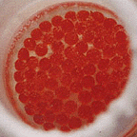
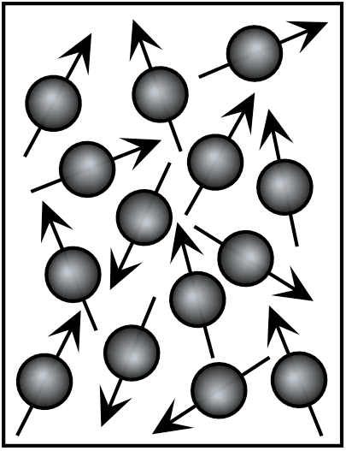
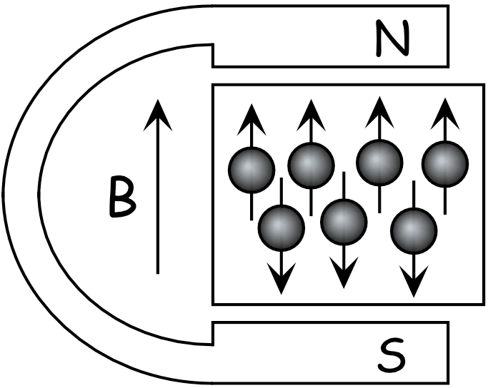
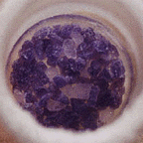
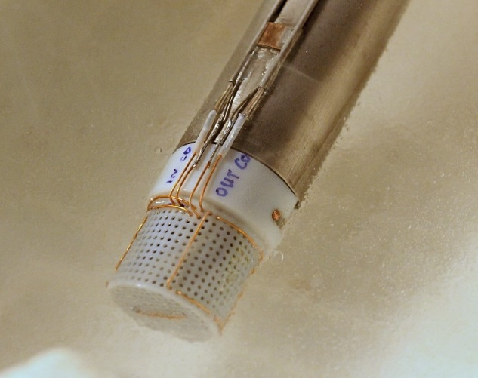
Polarized target
Polarisation = Orientation of Spins in a magnetic field
Tempo
+
CH₃
CH₃
CH₃
N
CH₃
O
Butanol
Ammonia
Ideally: All spins in field direction
P = ±100%
Container with target material and 2 NMR coils on Inner Insert in liquid nitrogen
2cm

Slide 20
Freezing the spins
Dynamic Nuclear Polarization was first suggested by A.W. Overhauser in 1953
Once DNP is stopped, the polarization begins to decay towards its natural, thermal-equilibrium value
Decay is exponential, with T₁ (spin-lattice time constant or relaxation time) of a few days to a few months
Holding field is typically ⁓½ Tesla (higher is better)
Temperature is typically < 50 mK (lower is better)
The typical time for data taking is 7-10 days, then re-DNP.
The typical maximum polarization in our targets is 80-85%
100%
DNP
Polarization
Relaxation
Data taking 7-10 days
P(t) = P_{o}e^{-t/T1} + P_{TE}
0%
0
Time

Slide 21
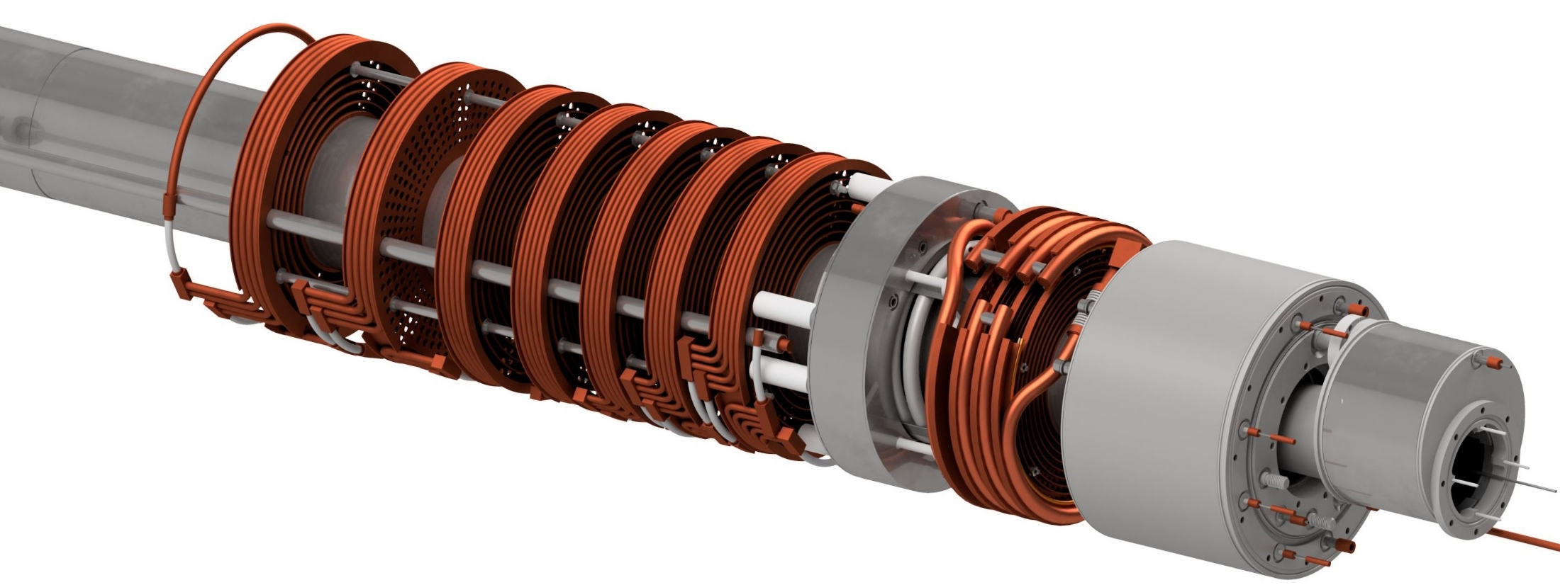
Principle of a dilution refrigerator
Precooling Stages
H.E.1
300K
Separator
4K
Evaporator 1K CND1 inside
10K
Insert channel
H.E.2 4.5K
H.E.3 1.2K
Still 0.8K CND2 inside
Heat Ex. № | Stages | Type | Temperature
H.E. 1 | 7 | Radial | 300K - 10K
H.E. 2 | 1 | Tube(1-7) in Tube | 10K – 4.5K
H.E. 3 | 4 | Radial | 4.5K – 1.2 K

Slide 22
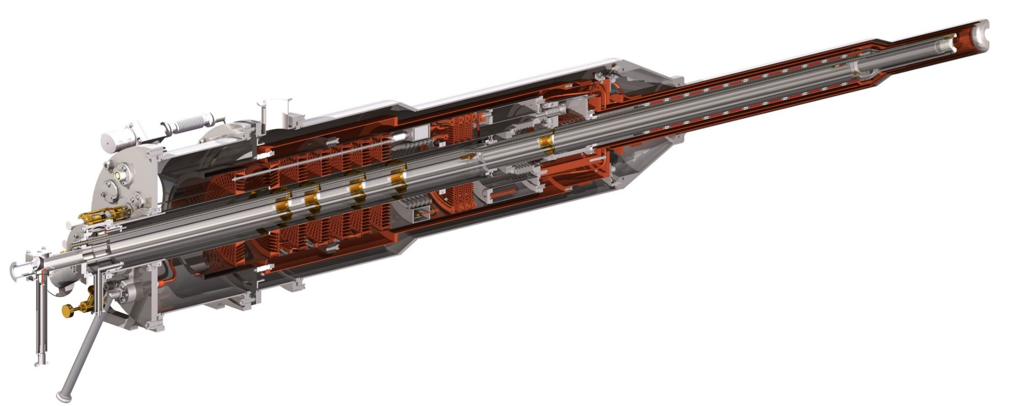
Principle of a dilution refrigerator
Dilution unit
Maximum cooling power:
Evaporator 1K
Still 0.8K
Q$=84\dot{n_{3}}T_{mc}^{2}$
Flow impendence
Mixing chamber
Pumps
Super-Liquid ⁴He
Condenser2
Liquid ⁴He
Condenser1
Heater
Sintered heat exchangers
Flow impendence

Slide 23
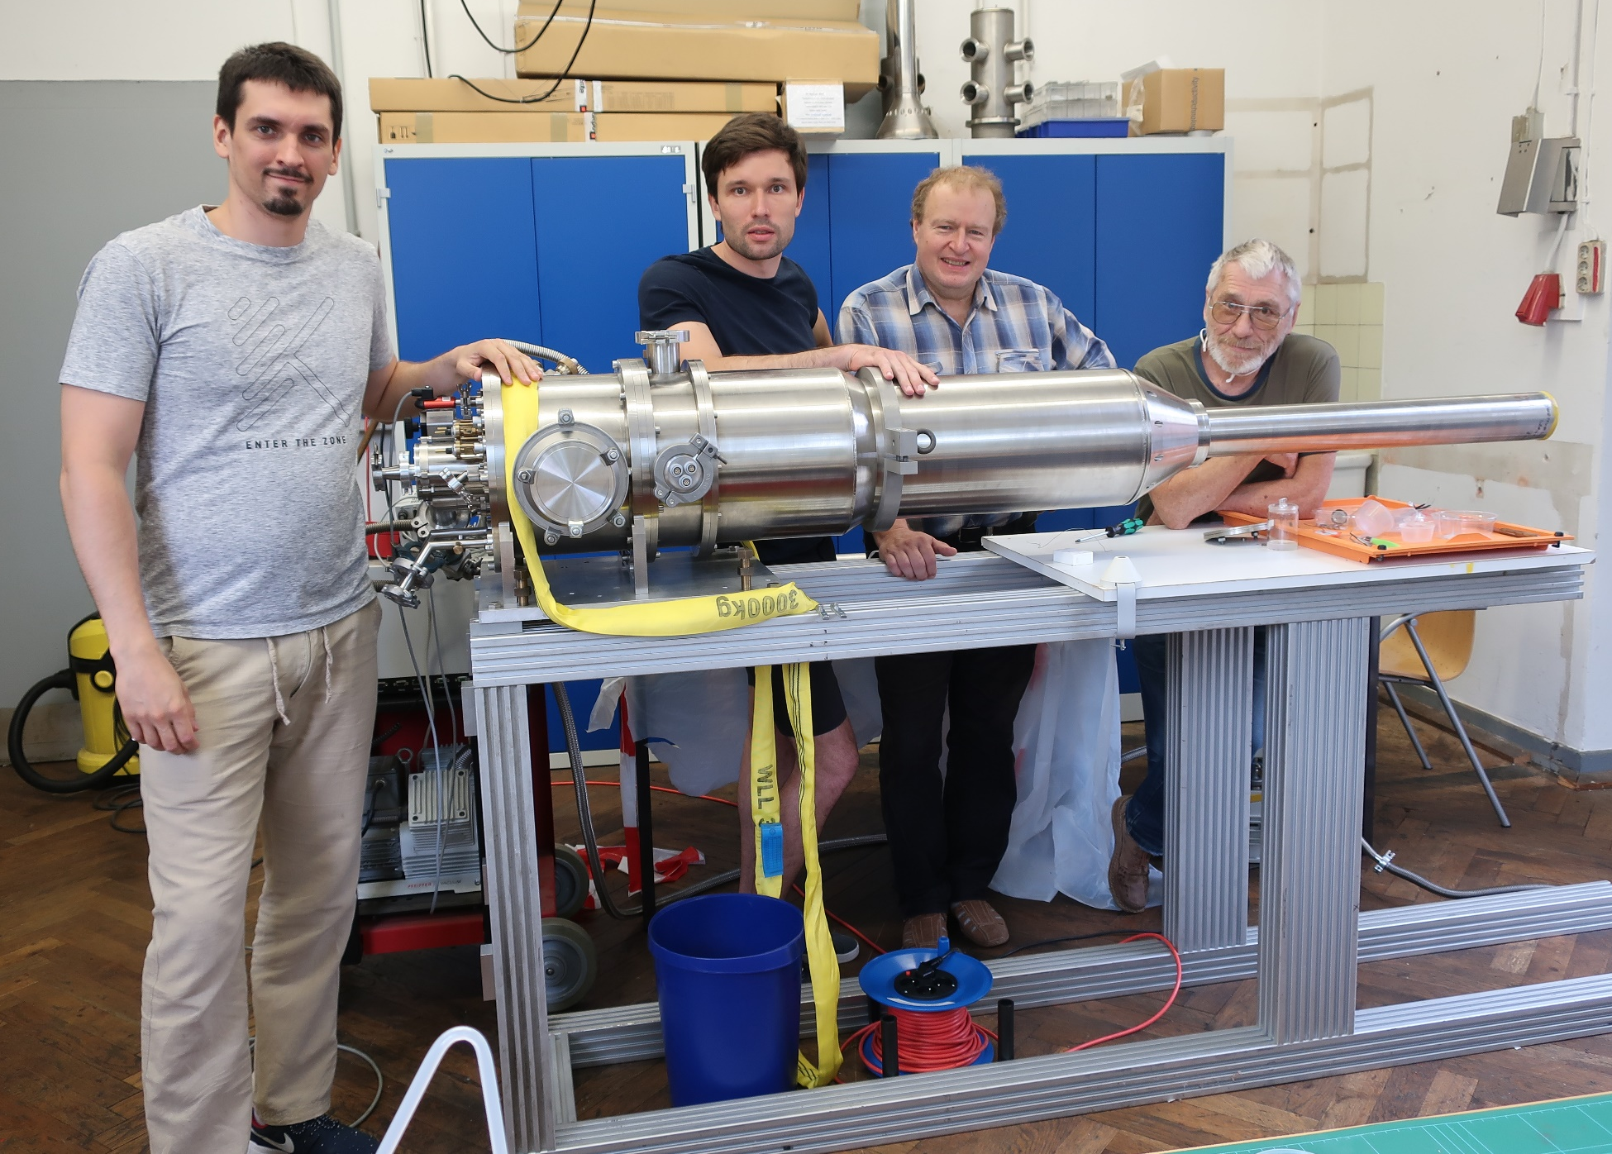
Дубненская команда на сборке нового криостата в г. Бонн (05.2021)

Slide 24
The map of LTD DLNP JINR activities
Thank you for your attention!
Physikalisches Institut
Universität Bonn
Bonn, Germany
ПИЯФ /PINP
Contract 200/1548
Gatchina, Russia
https://www1.cb.uni-bonn.de/
JINR Preprints 13-10253, 10-10257, Dubna 1976 Prib Techn. Exp. 2 (1978) 32
2460 km
645 km
Institut für Kernphisik Johannes Gutenberg University
2435 km
Mainz, Germany
JINR DUBNA
260 km
A2 collaboration on MAMI 2007-2018
https://wwwa2.kph.uni-mainz.de
2000 km
NIM A 372 (1996) 349
P2 experiment at MESA Hydro-Möller Polarimeter
https://www.mesa.uni-mainz.de
Czech Technical University
Prague, Czech Republic
Protvino, Russia
NIM A 345, (1994) 421-428
JINR Preprint 1-80-93, Dubna 1980

