Slide 1
TrackNET model inference
Starts from all first station hits
Model predicts elliptical area where to search for the next track hit
Brute force search for the nearest event hit using Euclidean distance
Filter event hits based on predicted semi-axis of the ellipse
Prolong track candidates

Slide 2
TrackNET for cylindrical detector
For the BM@N experiment, the model was trained to predict the ellipse on the next station
With cylindrical stations we can associate station number with phi coordinate, but due to its periodicity checking hits for being inside the predicted ellipse becomes difficult
To solve this problem, the model was changed to predict sphere with three cartesian coordinates. Reducing number of predicted radiuses to only one also simplifies the filtering stage of model inference

Slide 3
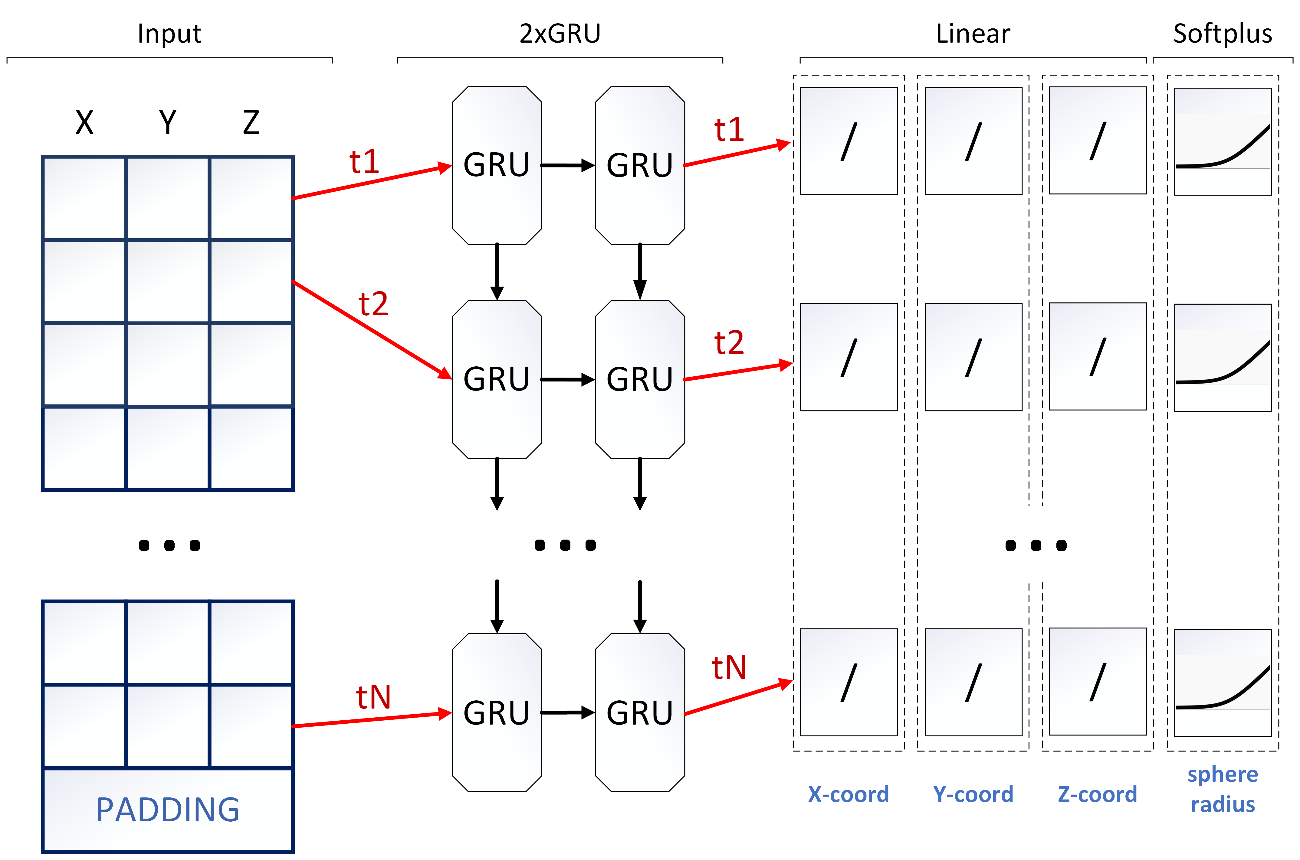
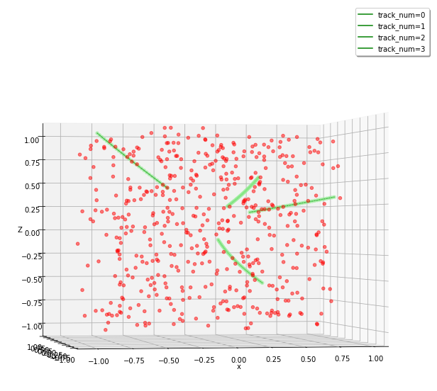
Local Tracking with TrackNET. Inference
1
3
Search for the sphere centers (x, y, z)
4
1 nearest hit with distance to each sphere center
Sphere predictions
(x, y, z, r)
2
5
6
Check sphere attendance
Prolong candidates and pass them to the model

Slide 4
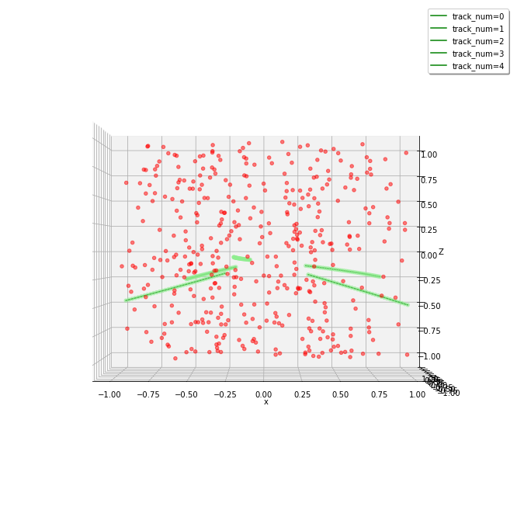
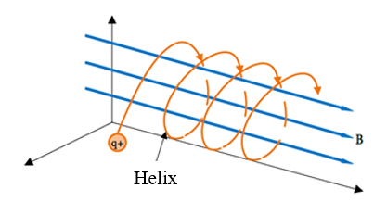
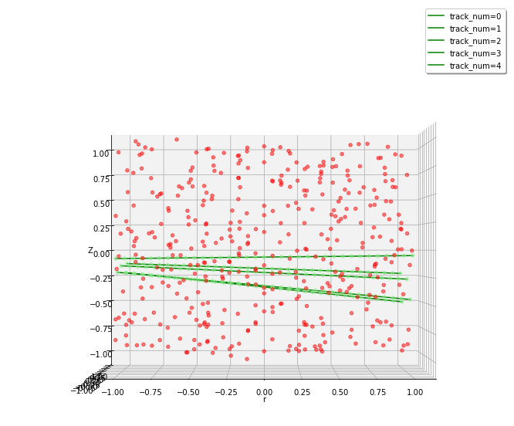
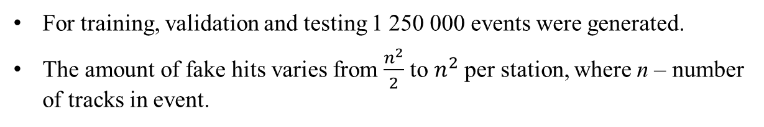
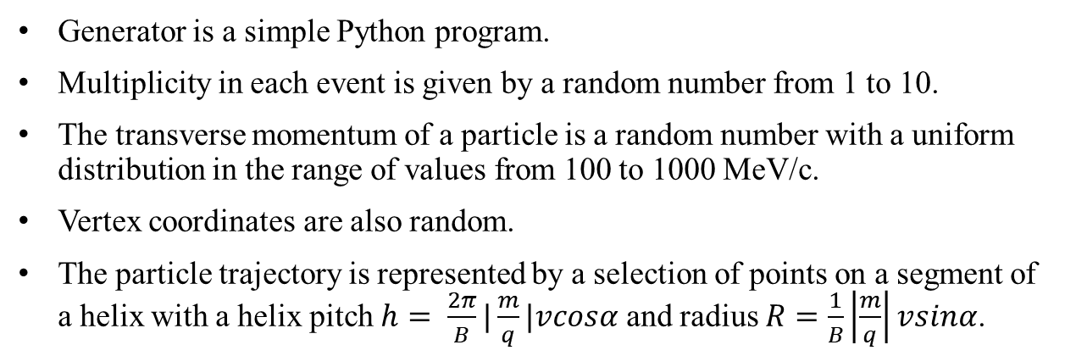
Data generation
Generator is a simple Python program.
Multiplicity in each event is given by a random number from 1 to 10.
The transverse momentum of a particle is a random number with a uniform distribution in the range of values from 100 to 1000 MeV/c.
Vertex coordinates are also random.
The particle trajectory is represented by a selection of points on a segment of a helix with a helix pitch $h= \frac{2π}{B}|\frac{m}{q}|vcosα$ and radius $R=\frac{1}{B}\left|\frac{m}{q}\right|vsinα$.
For training, validation and testing 1 250 000 events were generated.
The amount of fake hits varies from $\frac{n^{2}}{2}$ to $n^{2}$ per station, where n – number of tracks in event.

Slide 5
Time slices building
Time slices are modeled by combining 40 events together
Thus, on the average there are 200 tracks per time slice
The number of hits in time slices is about 1100 per station, 38200 in total
82,26% of all hits are fake

Slide 6
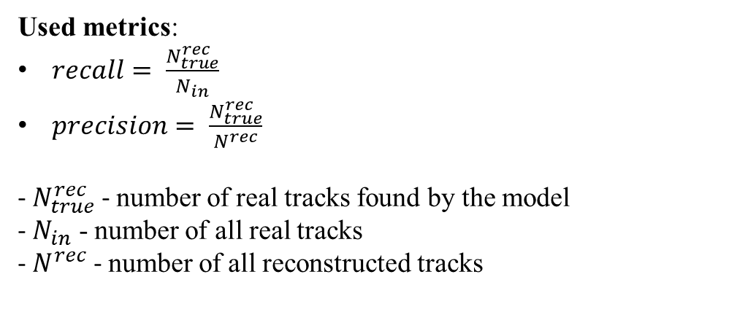
Results
Used metrics:
$recall= \frac{N_{true}^{rec}}{N_{in}}$
$precision= \frac{N_{true}^{rec}}{N^{rec}}$
- $N_{true}^{rec}$ - number of real tracks found by the model
- $N_{in}$ - number of all real tracks
- $N^{rec}$ - number of all reconstructed tracks
Testing setup:
25 000 generated events (625 time slices)
Xeon(R) Gold 6148 CPU @ 2.40GHz
Single Nvidia V100 32Gb GPU
 | Single events | Time slices of 40 events
Track efficiency (recall) (%) | 99,62 | 96,78
Track purity (precision) (%) | 99,52 | 88,02
Time slices / sec | 48,70 | 43,52 (*40 = 1741,19)

Slide 7
TorchScript optimizations
TorchScript is a statically typed subset of Python, focused specifically on the features of Python that are needed to represent neural network models in PyTorch
Any TorchScript program can be saved from a Python process and loaded in a process where there is no Python dependency, such as in standalone C++ program
Model execution:
high optimization of neural network models for the GPU execution
another method, ONNX, provides better performance for running with CPU, but doesn’t have full support for the GPU operations
Spatial search:
use of matrix multiplication to calculate Euclidean distance
previous approach (faiss library) has worse performance and is difficult to integrate into the overall algorithm
Filtering and prolonging track candidates:
all operations are vectorized and written with TorchScript

Slide 8
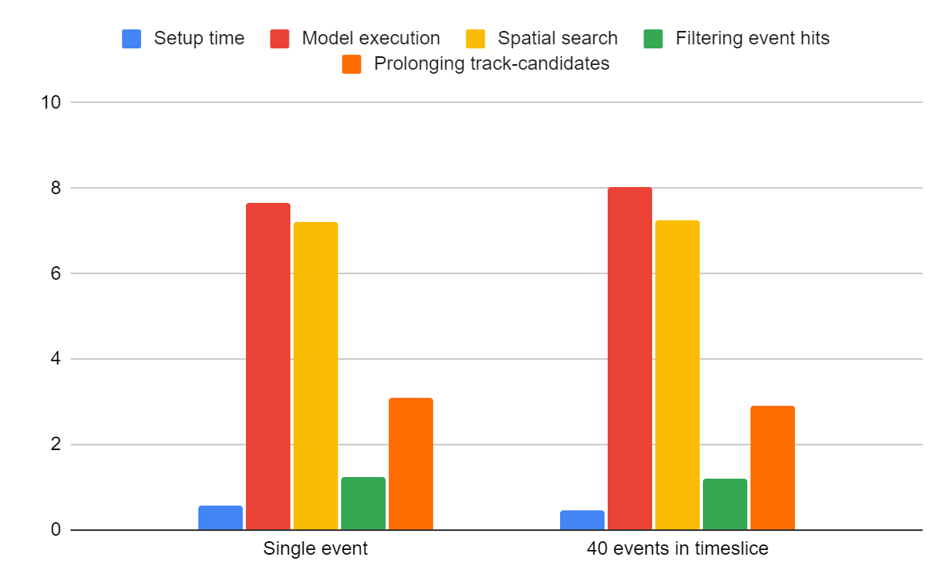
Performance analysis
Time needed to perform inference for time slice is almost the same as for single event
The most time-consuming stages are model execution and spatial search
GPU load is within 60% and memory consumption is about 2,5 Gb

