Slide 1

Structure and main directions of JINR research.
Scientific results in recent years and
the development of JINR for 2024–2030
Grigory V. Trubnikov

Slide 2
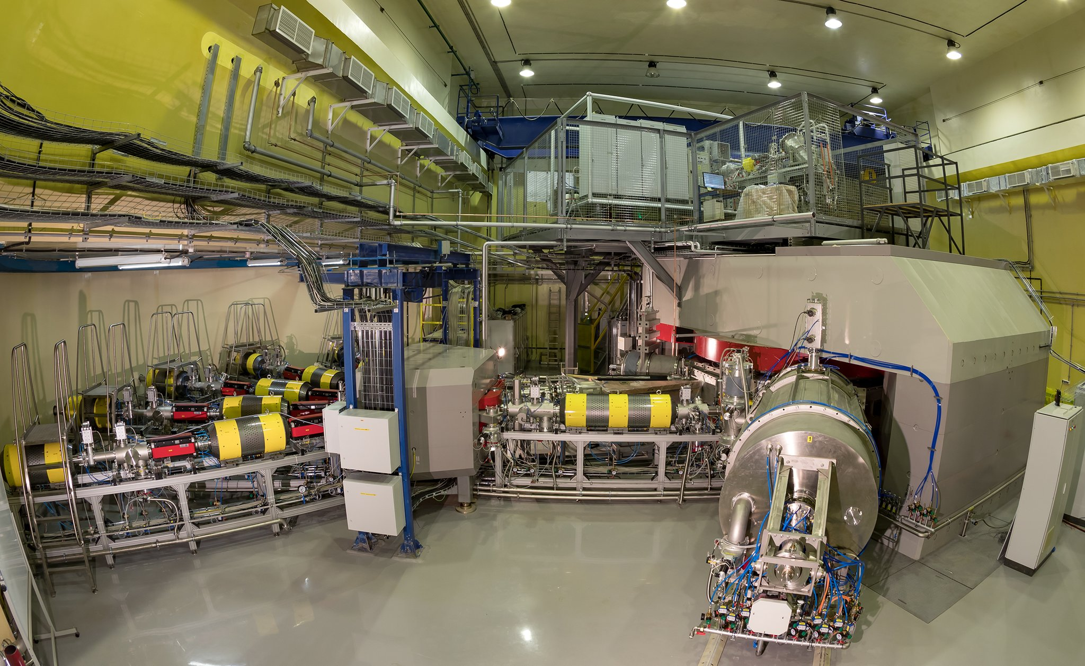
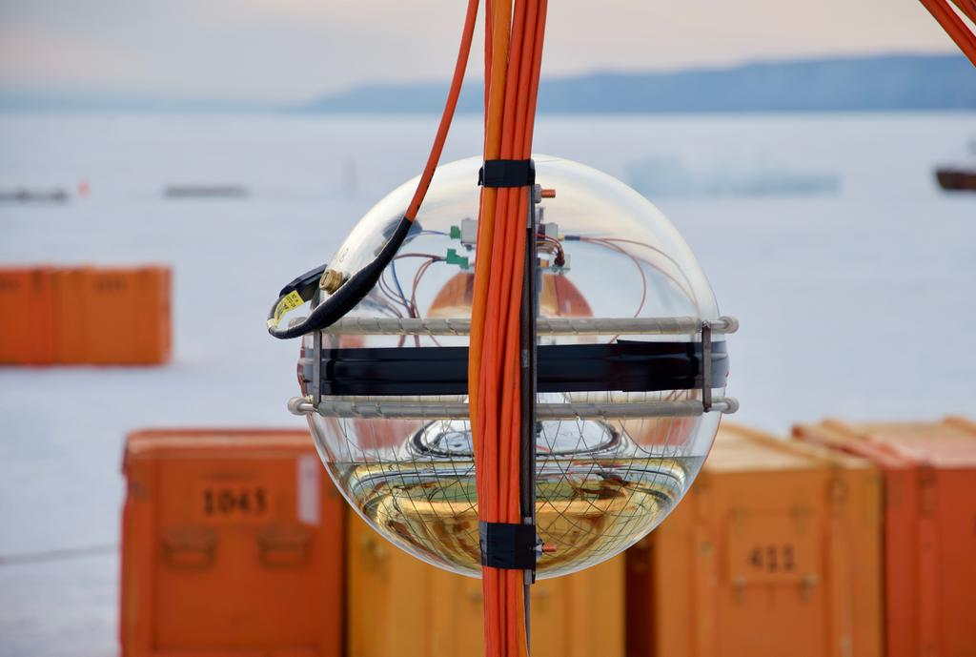
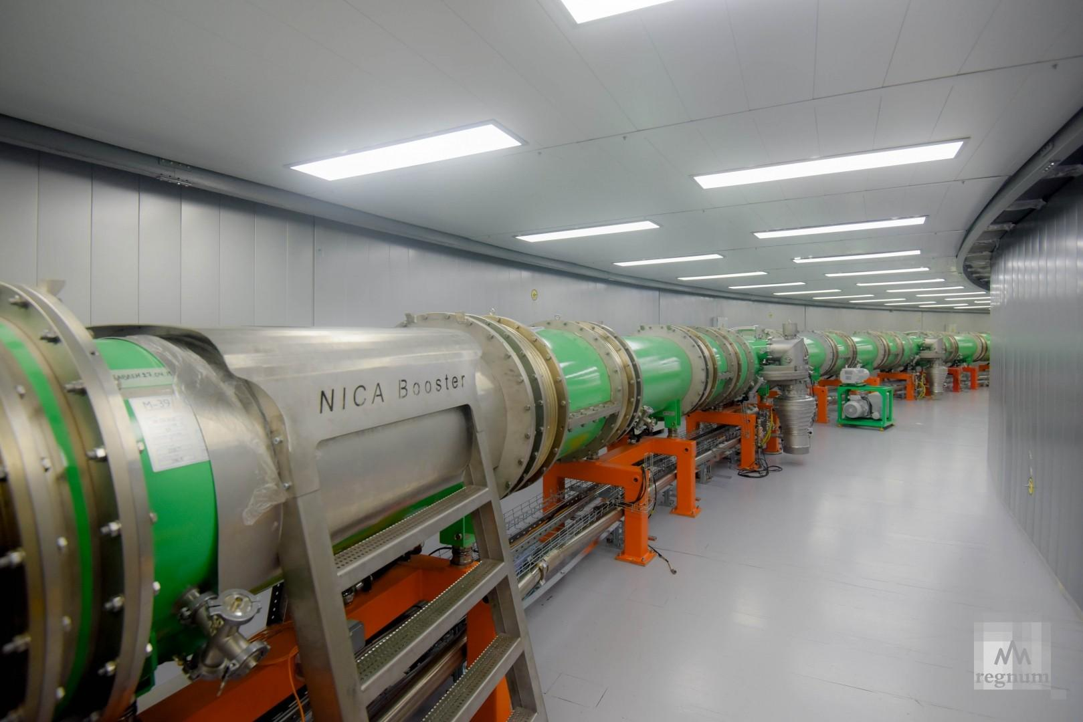
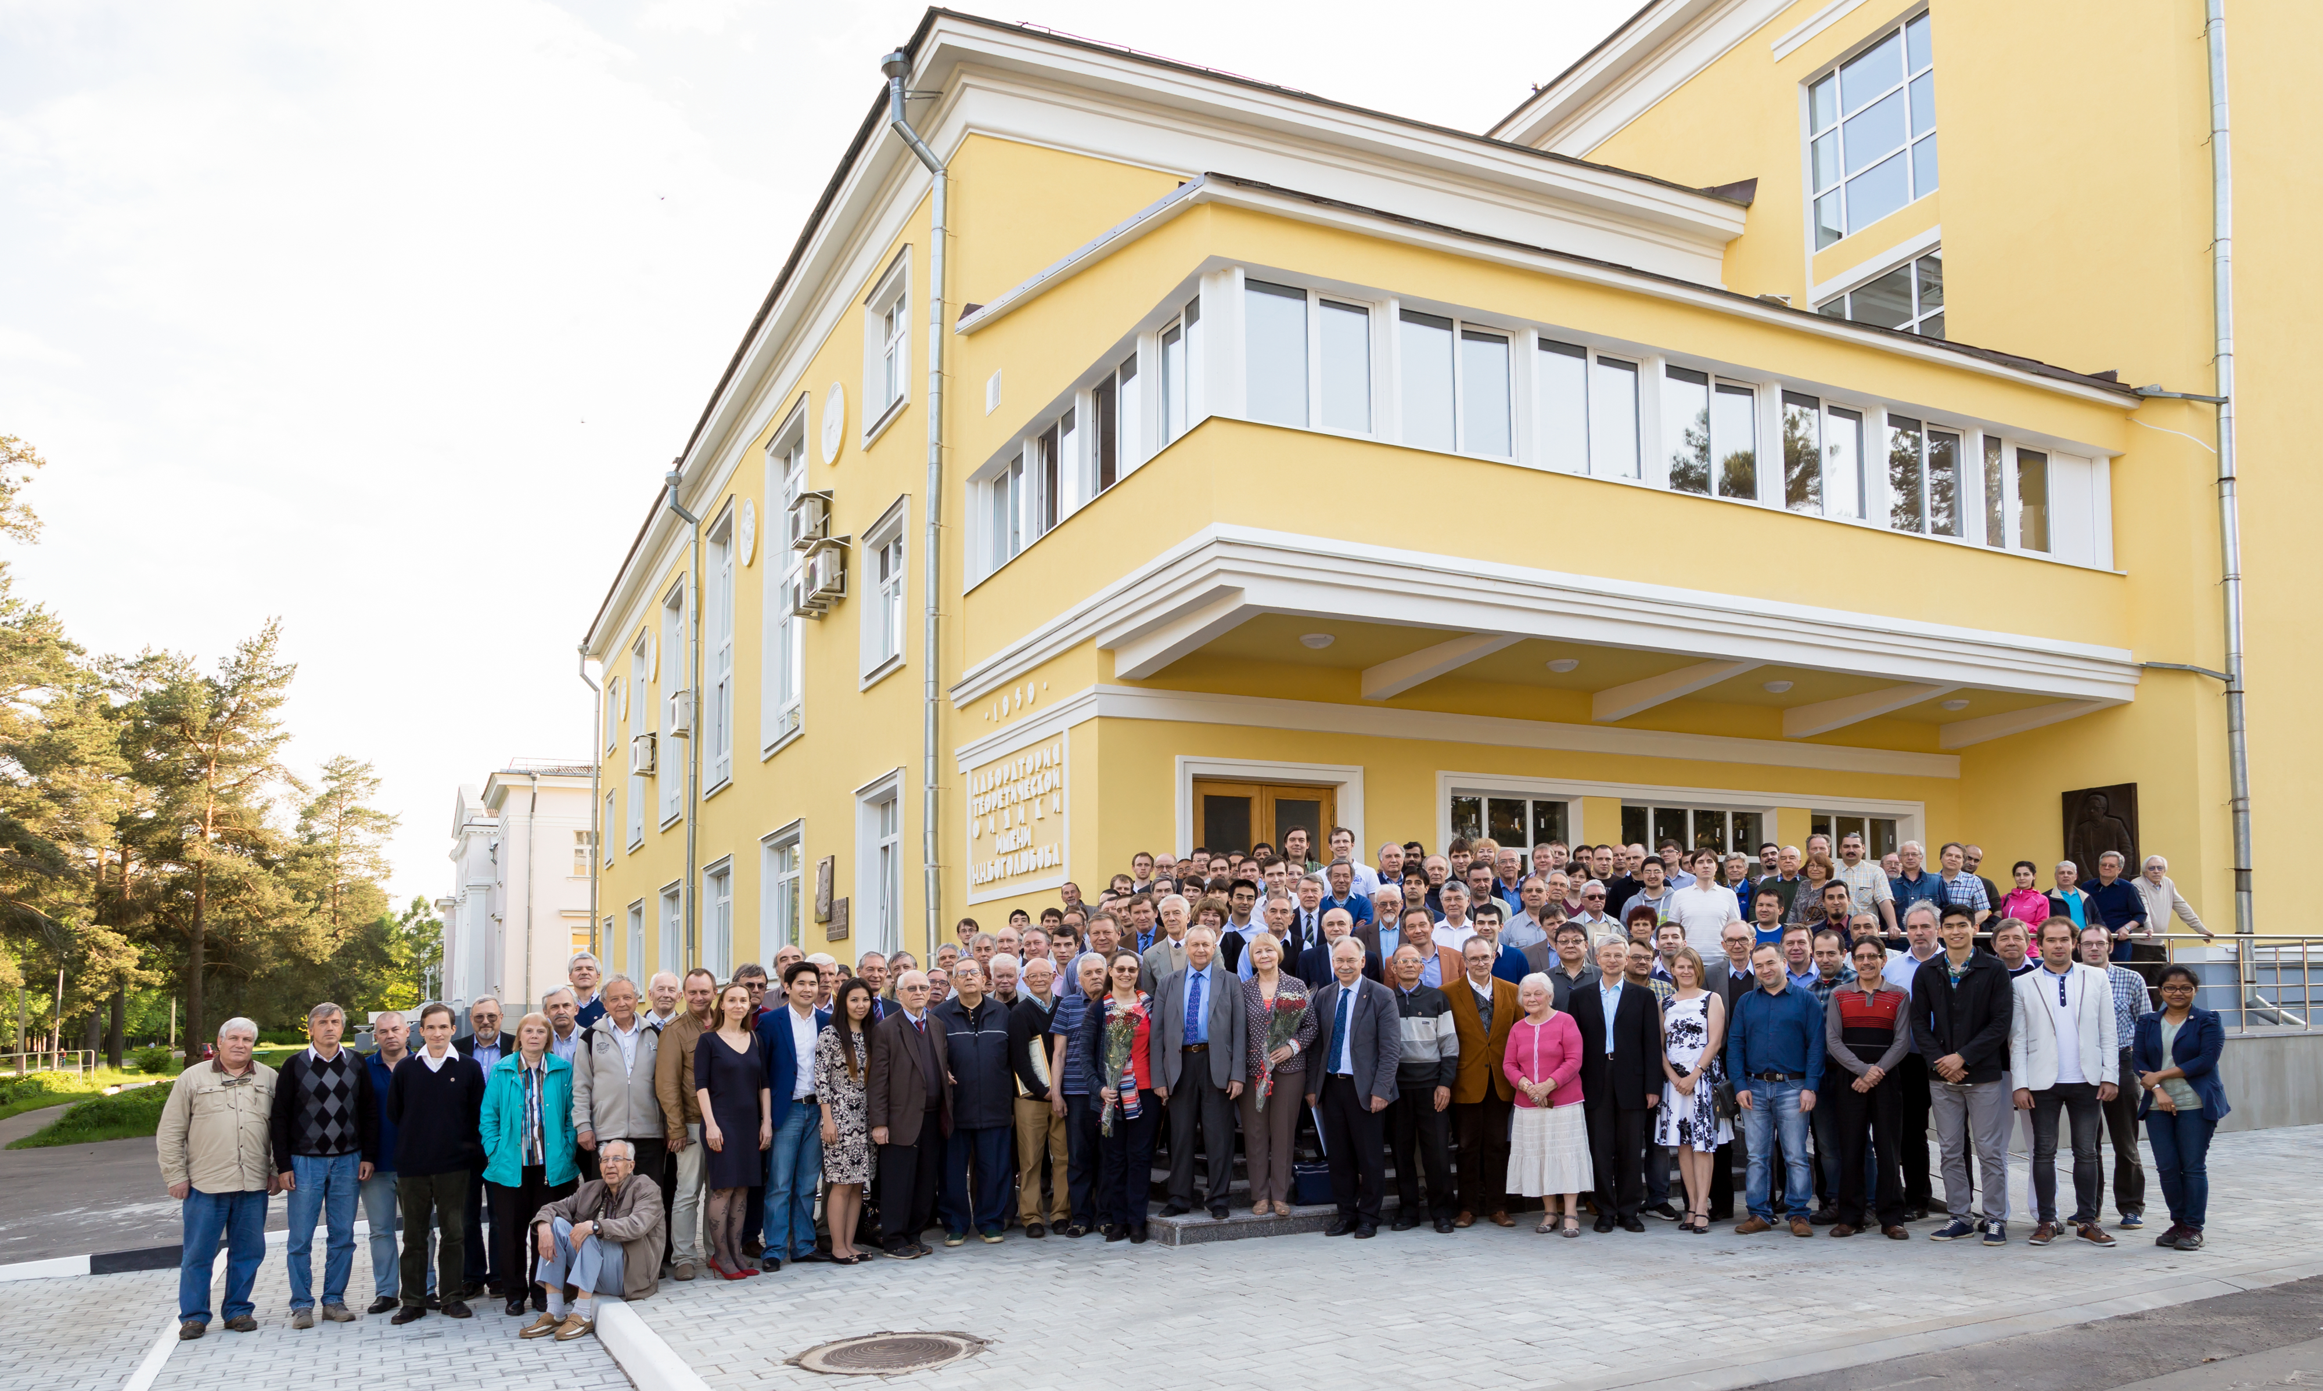

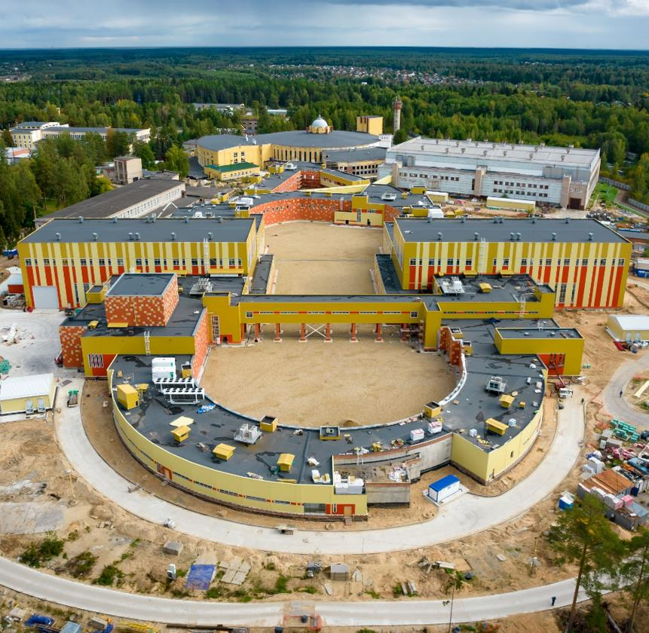
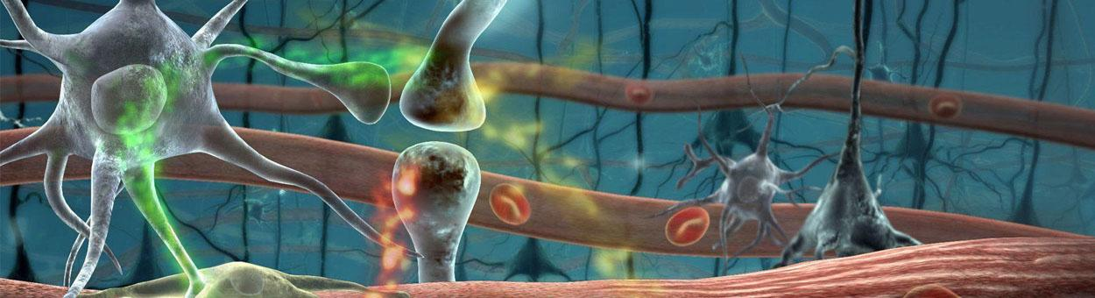
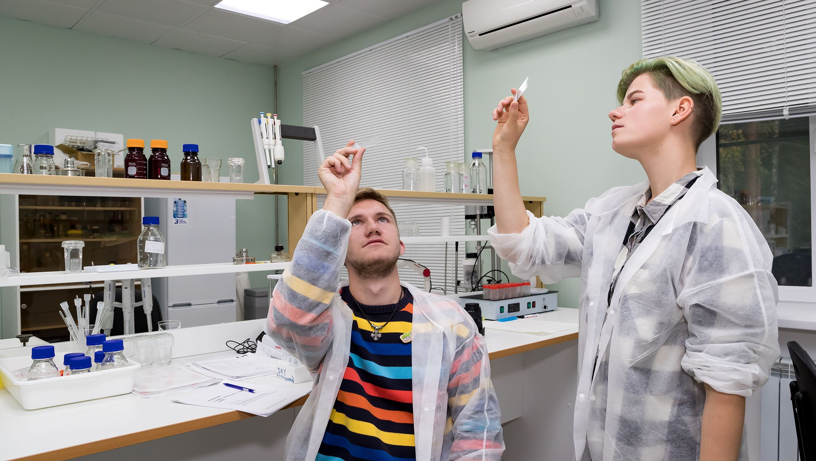
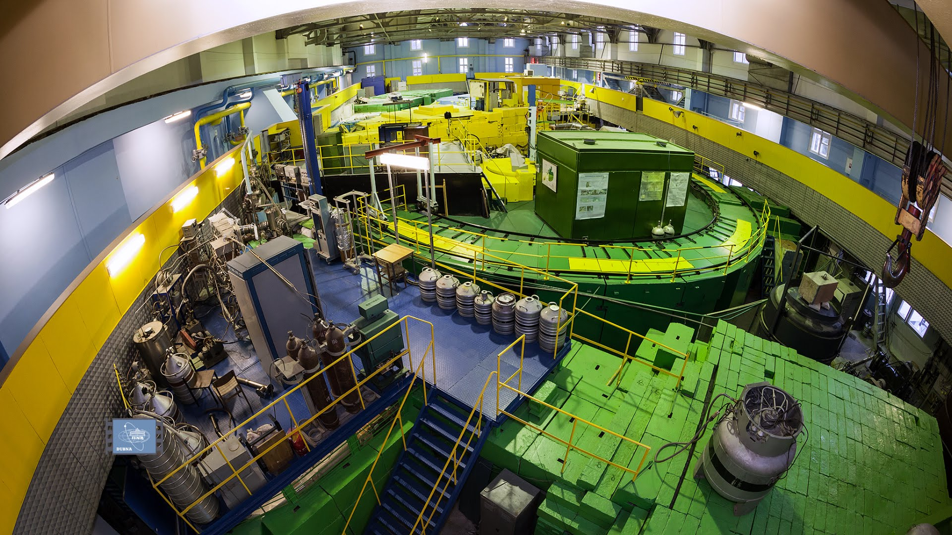
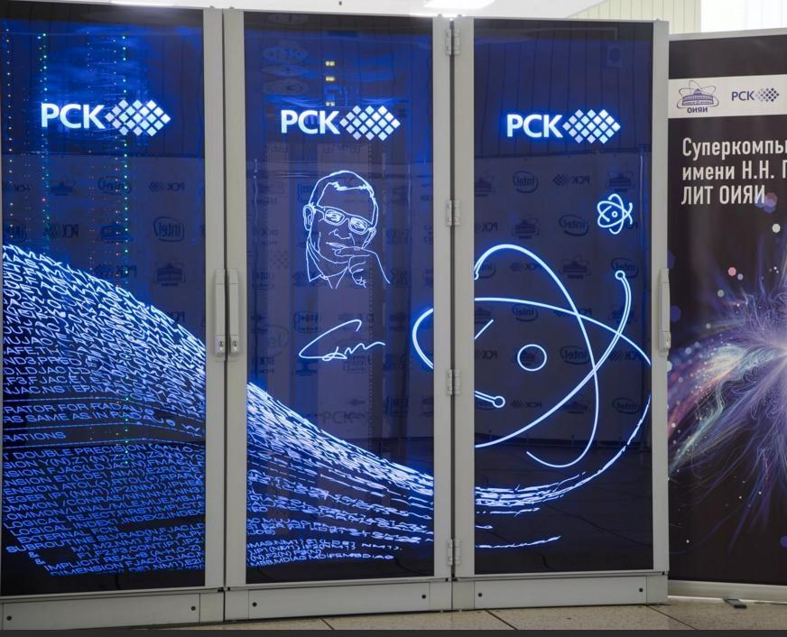

JINR - International Integration in Science and technology:Multidisciplinary complex of LRI
SHE Factory
JINR – integration form of international scientific and technical cooperation of 16 member states and 5 associated states, about 70 partner countries, more than 900 scientific organizations and universities.
- Construction of new LRI - complex «NICA» (BM@N, MPD,SPD collaborations), neutrino observatory «Baikal-GVD», partially operational
- Large scale international multidisciplinary research at LRIs in operation: SHE Factory, Reactor IBR-2М with spectrometer complex, Multi-purpose Information Computer Complex with supercomputer «Govorun», RI of the Laboratory of Radiation Biology, Bogoliubov Laboratory of Theoretical Physics.
- Training of scientific and engineering personnel for the JINR member countries at JINR University Centre.
These facilities represent a very large mutidisciplinary research infrastructure realizing the deeply integrated governance model of international scientific cooperation. This infrastructure complex is partially distributed across the territory of the Member States.
7 Laboratories with 5000+ employees from 32 countries (1500 scientists, 2000 engineers) and a budget of 230 million USD.
Baikal-GVD
Theoretical physics
Life sciences (LRB)
JINR
CENTRE
IBR-2
Central Information Computer Complex
University Centre
Innovation Centre

Slide 3
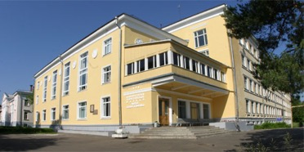
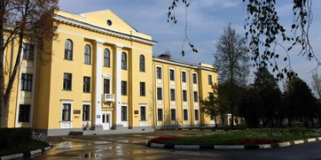
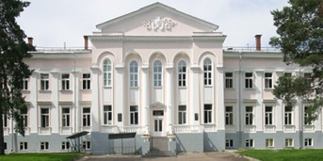
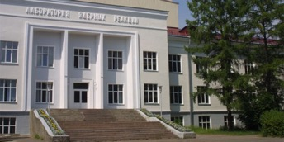
JINR structure: Laboratories
The Bogoliubov Laboratory of Theoretical Physics is one of the world’s largest institutions of theoretical physics. Research topics: fundamental interactions of fields and particles; theory of nuclear systems; theory of complex systems and advanced materials; modern mathematical physics: gravity, supersymmetry and strings. The Laboratory provides theoretical support for experimental research at JINR and in other research Centres with the participation of JINR.
The Veksler&Baldin Laboratory of High Energy Physics is implementing a project for the construction of an accelerator complex of the NICA megascience class, including the upgraded accelerator Nuclotron-M, a Booster and the heavy nuclei collider and polarized particles. The megaproject is aimed at recreating and studying nuclear matter under extreme conditions that arose in nature at the early stages of the evolution of the universe and in the bowels of neutron stars.
The Dzhelepov Laboratory of Nuclear Problems ― the oldest in JINR. The laboratory is mainly occupied with the research in neutrino physics and astrophysics, established by Bruno Pontecorvo. The laboratory is involved in the creation of the Baikal-GVD ― deep underwater neutrino telescope on a cubic kilometer scale ― one of the three largest telescopes in the world in terms of effective area and volume for observing natural neutrino fluxes and the largest in the northern hemisphere.
The Flerov Laboratory of Nuclear Reactions is a leading research centre in heavy ion physics, occupying a leading position in the field of synthesis and research of nuclear physical and chemical properties of new superheavy elements. The further development of this scientific direction is connected with the successful implementation of the unique project of the world’s first “the factory of superheavy elements” the basic installation of which is the new accelerator DC-280.
3

Slide 4
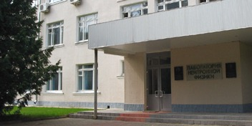
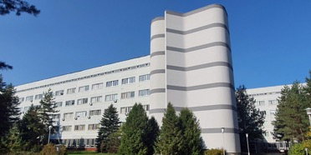
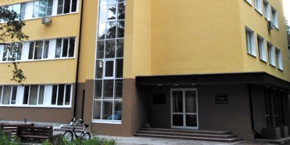
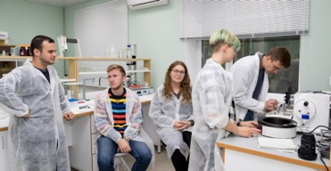
JINR Laboratories
The Frank Laboratory of Neutron Physics is developing an ambitious scientific programme of studies of the neutron as an elementary particle and its application in nuclear physics, condensed matter physics and other modern trends of applied research. The main basic facility of the laboratory is the IBR-2 pulsed neutron source with a spectrometer complex, which allows us to actively develop a user programme in a wide range of areas in the field of condensed matter physics, nuclear physics medicine and ecology.
The Meshcheryakov Laboratory of Information Technologies is a world-class supercomputer centre equipped with powerful high-performance computing and information tools integrated using high-speed communication channels into global computer networks. The laboratory has created and put into operation a unique supercomputer "GOVORUN" ― a heterogeneous computing platform for cardinal acceleration of complex theoretical and experimental research conducted at JINR.
The Laboratory of Radiation Biology develops research on radiation genetics and radiobiology, photoradiobiology, astrobiology, physics of radiation protection and mathematical modeling of radiation-induced effects. LRB is a member of the international biophysical collaboration, cooperates with scientific institutions of JINR Member States and other countries. Here, in particular, a number of studies have been carried out to assess the radiation risk of astronauts during long interplanetary flights and to develop methods of experimental space radiobiology.
The JINR University Centre was created to implement the educational programme of the Institute, aimed primarily at training highly qualified personnel for further work and research in JINR laboratories and research centres of the participating countries. The UC has created and regularly improves conditions for the participation of students and postgraduates in the work of scientific groups of the Institute.
4

Slide 5
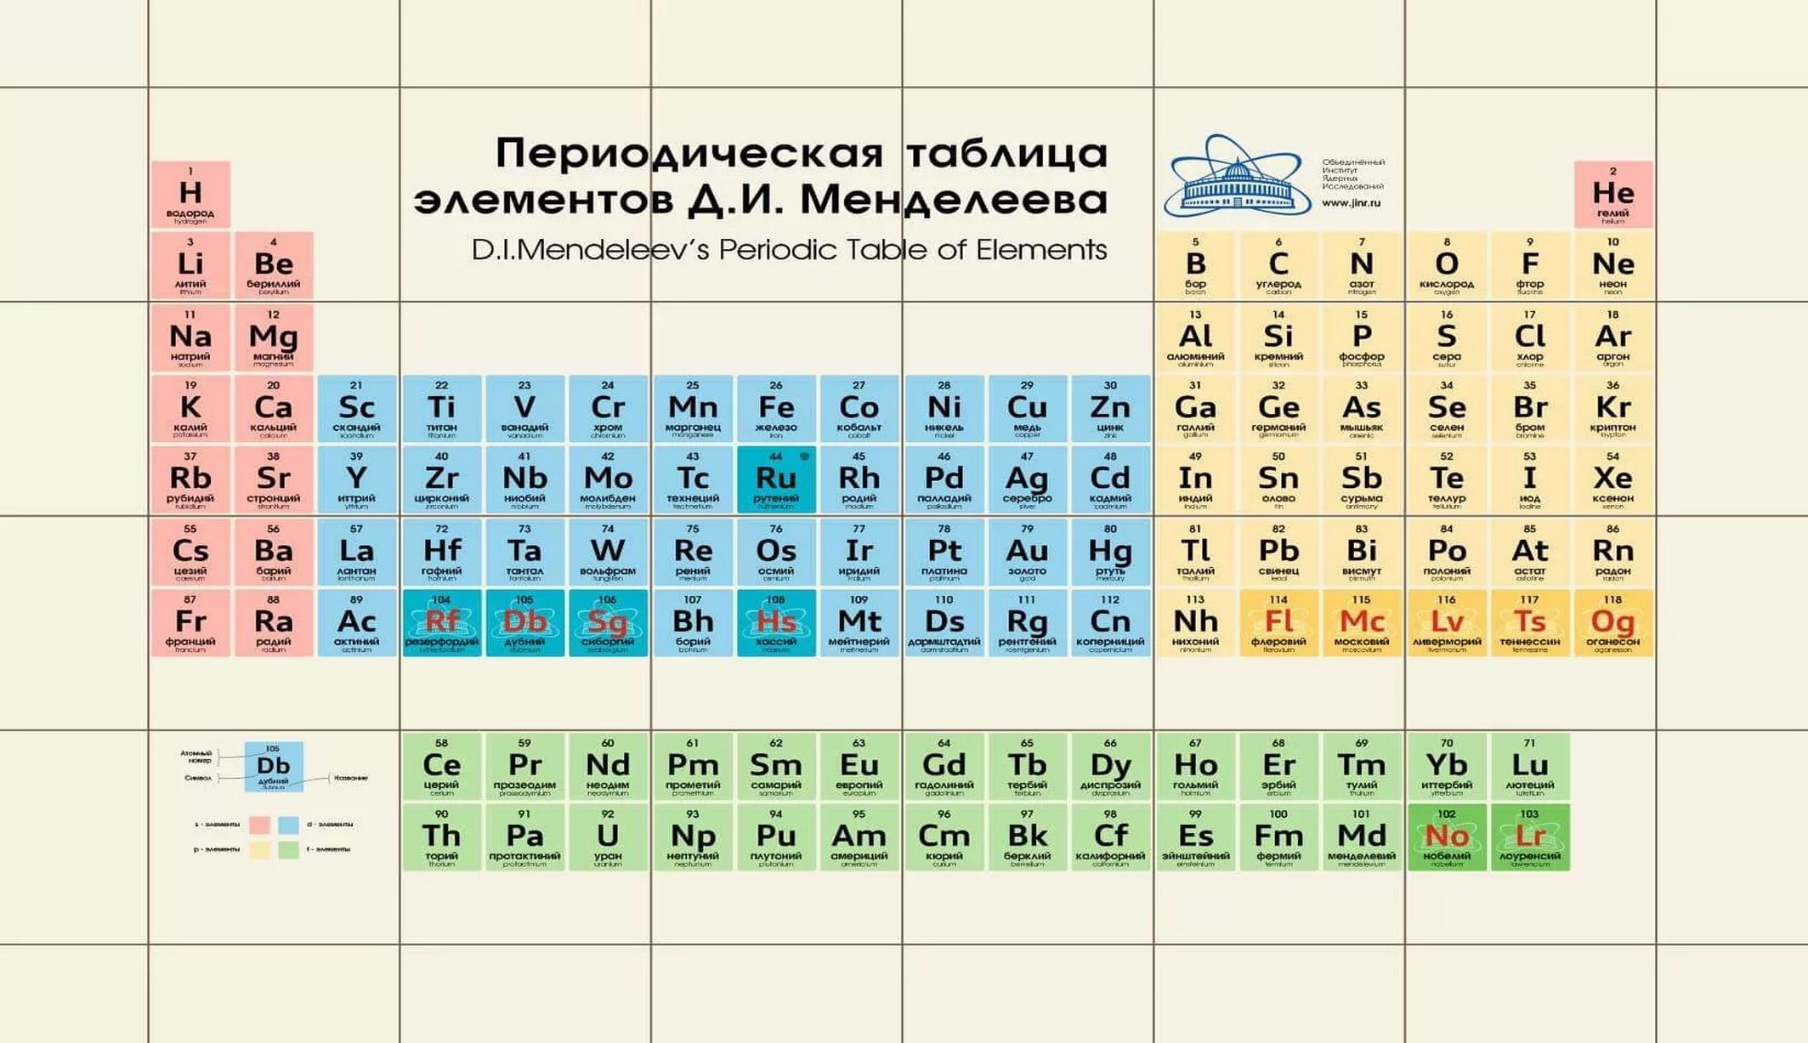
JINR at Global Scale
JINR's rank in the rating of Intergovernmental Research Organizations:
Personnel - 2 (after CERN)
Budget, natural sciences only - 4 (after CERN,European Molecular Biology Laboratory, European Southern Observatory)
Budget, all - 7 (after European Space Agency, CERN, UNESCO, Joint Research Centre, European Molecular Biology Laboratory, European Southern Observatory
Basic and applied research
- Elementary paricle physics and high energy heavy ion physics
- Nuclear physics
- Condensed matter physics
- Radiation research in life sciences
- Theoretical Physics
- Information technology
- Physics and technology of charged
particle accelerators
Research infrastructure
- Generation of pulsed reactors
- SC relativistic Ion accelerator Nuclotron
- Superheavy Element Factory DC-280
- "Baikal"Neutrino Gigaton telescope
- NICA Collider
- Hyperconvergent IT cluster
Notes:
5

Slide 6
Committee of Plenipotentiaries of the governments of the member states
Financial Committee of JINR
Scientific Council
Directorate:
Director of JINR, scientific supervisor of JINR,
vice-directors, chief engineer,
chief scientific secretary
Directors of JINR laboratories
PAC for Nuclear Physics
PAC for Particle Physics
PAC for Condensed Matter Physics
7 Laboratories & UC
Management departments
Services of Chief engineer
Services of Chief Scientific Secretary
Advisory and expert committees
dedicated to particular projects
JINR scientific and technical council

Slide 7
TOPICAL PLAN for JINR Research and International Cooperation Structure
Section I include:
-projects
-subprojects (optional)
-activities (optional)
Human and financial resources – also Projects
II Theoretical Physics
III Particle Physics
IV Nuclear Physics
Sections II-X include:
-Themes
-Projects
-subprojects (optional)
-activities (optional)
Section VIII include R&D:
Detectors and accelerators
IBR-2
DRIBS-III
I
Large research infrastructure projects
Topical Plan
V Condensed Matter Physics
NICA
BAIKAL-GVD
IX
Analytical and Methodological Problems
of Scientific Research Organization
MICC &
Govorun
VIII
Accelerator / Detector R&D, Applied research
VII Information Technology
VI
Life Sciences
X Educational Programme
SCIENTIFIC
DIRECTIONS

Slide 8
SEVEN-YEAR PLAN FOR THE DEVELOPMENT OF JINR FOR 2024–2030
DEVELOPMENT OF A LARGE RESEARCH INFRASTRUCTURE
NICA,
MPD, SPD
DRIBs-III (SHE, U-400R, DC-140, Radiochemical Lab Class-1)
IBR-2M, NEPTUN
BAIKAL-GVD
DEVELOPMENT OF ENGINEERING INFRASTRUCTURE
INNOVATION ACTIVITIES
STRENGTHENING HUMAN RESOURCES
ORGANIZATION OF SCIENTIFIC ACTIVITY
DEVELOPMENT OF JINR AS INTERNATIONAL ORGANIZATION
SCIENTIFIC PROJECTS,
EQUIPMENT AND MEDIUM-SCALE INFRASTRUCTURE
Elementary paricle physics and high energy heavy ion physics
Nuclear physics
Condensed matter physics
Radiation research in life sciences
Theoretical Physics
Information technology
Physics and technology of charged particle accelerators
STRATEGIC OUTRICH AND COMMUNICATIONS (IC, PR, GR)
DIGITAL JINR
FINANCIAL SUPPORT
MONITORING THE IMPLEMENTATION OF THE
SEVEN-YEAR PLAN AND THE STRATEGY OF DEVELOPMENT

Slide 9
Relativistic Heavy Ion Physics and Study of nucleon structure. Near and Long-Term Future
The timely completion of the NICA project, its commissioning and steady and efficient operation.
Completion of the detectors: BM@N, MPD and SPD at NICA and successful data taking over the decades to come. JINR will make significant contribution to the basic configuration of the SPD detector.
After several years of running of MPD, an Upgrade is foreseen, responding to an increase in luminosity of NICA. Adding detectors in the forward region as planned.
Studies of possible future extension of NICA for acceleration of electrons, opening new physics potential via e-p and e-A collisions.
ARIADNA
BM@N
MPD
SPD
Notes:
For the next two decades, the principal focus in heavy ion physics and spin physics, that will influence to a large extent the JINR strategic development is the timely completion of the JINR flagship facility - NICA. The aim of the NICA project is to create a world-class experimental infrastructure for fundamental research in contemporary High Energy Physics (HEP), applied research, and in development of novel nuclear power technology. The format of close interlaboratory cooperation will contribute to the development of modern detectors and to further achievements in the area of high-temperature superconductivity. This base should be utilized by a global scientific community of users from member and non-member states of JINR.

Slide 10
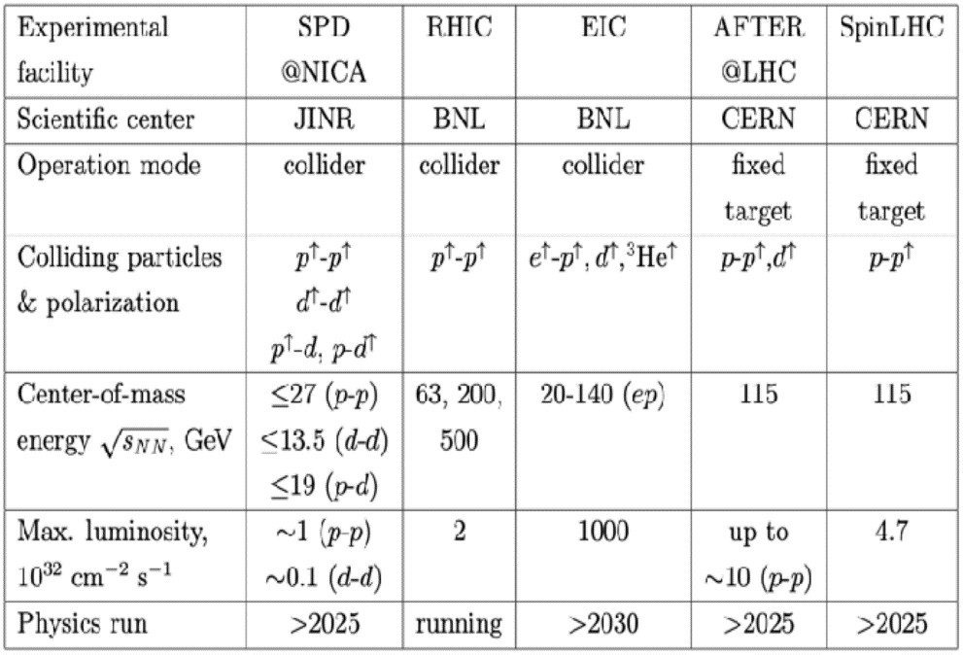

BM@N & MPD NICA SPD
The SPD experiment is aimed at studying the properties of strong interactions in the nonperturbative region, at measuring the proton and deuteron spin structures, and at the development of a three-dimensional model of the nucleon. It is unique in its methodology, breadth of coverage and variety of tasks.
MPD covers this interesting region providing powerful combination of large luminosity, collision energy and system size scan (including isobars), large and consistent acceptance, full centrality range.
NICA is complementary to existing and planned world facilities (FAIR, SPS), and will be a natural and necessary continuation and significant expansion of studies at RHIC BES.
Notes:
Advantages of the MPD & NICA
NICA covers an energy range where most important an interesting physics appears to take place - transition from hadronic to partonic effect dominance, possible appearance of first order phase transition in QCD phase diagram, transition from baryon to meson dominance in particle production. All of this is also connected to astrophysical studies which are strongly developing now and may pose additional questions for us. In summary there are a lot of interesting open questions and MPD has the capabilities to answer many of them.
MPD covers this interesting region providing powerful combination of large luminosity, collision energy and system size scan (including isobars), large and consistent acceptance, full centrality range.
NICA is complementary to existing and planned world facilities (FAIR, SPS), and will be a natural and necessary continuation and significant expansion of studies at RHIC BES.
Other facilities:
HADES and SIS18 provide energies below 3 GeV;
FAIR is not going to provide data before 2028 - so it will not provide data in timescale comparable to NICA;
SPS operates at higher energies, and is fixed target (and also mostly limited to highest centralities);
STAR BES (Beam Energy Scan) covered the energy range of 3-20, however:
- the data taking is finished,
- data sample of 100M at most energies may be
enough to "pose interesting questions", or
highlight the region of interest, but not provide
"definite answers",
- data below 8 GeV is in fixed-target mode,
- no collision system size scan was done,
- isobar run of RHIC showed new interesting physics
that may be explored at NICA.
BM@N
Baryonic Matter at Nuclotron (BM@N) experiment is focused on measurement of Au+Au collisions up to a kinetic beam energy of 3.8·A GeV in order to investigate the equation-of-state (EOS) and the microscopic degrees-of-freedom of QCD matter at neutron star core densities, as EOS defines relation between density, pressure, temperature, energy and isospin asymmetry of nuclear matter.
The “hot” topics of the experiment are:
Study isospin symmetric matter EOS at densities of ρ=3-5 ρ₀ (saturation density) by the following measurements:
- elliptic and direct flows of protons, mesons and hyperons,
- sub-threshold production of multi-strange hyperons and
anti-hyperons.
Constrain symmetry energy E_{sym} - difference between binding energy of isospin symmetric and asymmetric matter by the following measurements:
- collective flow of neutrons vs protons,
- sub-threshold production of particles with opposite isospin.
Searches for quark degrees-of-freedom and the critical endpoint of the first order phase transition at high baryonic densities.
Role of hyperons in neutron stars (ΛN and ΛNN interactions) by measurements of yields and lifetime of light hyper-nucleus at high baryonic densities.
О возможности изучения на NICA столкновений изобарных ядер, имеющих тот же атомный номер, но разный заряд: в частности - не можем ли мы столкнуть свинец-208 и висмут-208?
RICH закончил набор данных, но на последнем рабочем совещании (закрытом) они говорили об интересных результатах, которые могут быть очень важны для понимания структуры ядра. В этом плане низкие
энергии NICA могут быть дополнительным преимуществом. Если столкновения идут с большим прицельным параметром, то возникают
сильные электромагнитные поля и соответствующая физика - Chiral Magnetic Effect.
Есть давние работы по теме. Например, С.Волошин (Phys.Rev.Lett.105 (2010) 17230) предлагает сталкивать Ru-44 и Zr-40 (A=96).

Slide 11
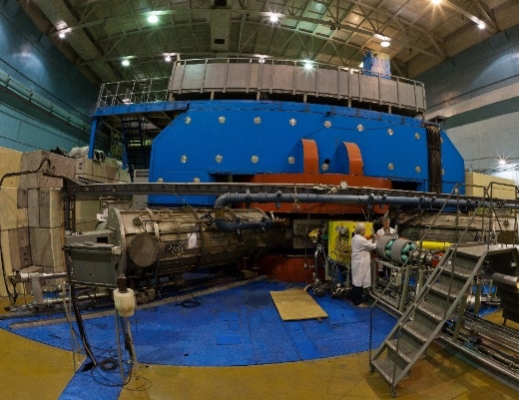
Synthesis of new elements @ SHE Factory
Radioactive Ion-Beam research Basic facility: U-400M
Nuclear reaction studies @ U-400R
Ambitions: up to 2.6 mA (U-beam)
10¹⁰⁻¹¹, smooth energy variation
Ambitions: E up to 80AMeV, I x 2
TARGETS:
Rosatom and ORNL (USA): Isotopically enriched heavy actinide materials;
Radiochemical Lab of class 1
Upgrade in 2023-25. Operation from 2026
Operation from end of 2023
Multinucleon transfer reactions:
Production of new isotopes of heavy,SH nuclei;
Study of properties of new nuclei.
Decay spectroscopy of heavy nuclei: actinides and light transactinides
Study of fusion-fission and quasifission reactions leading to heaviest nuclei
Low-energy and spontaneous fission of heaviest nuclei
Study of nuclei at high excitation energies (several hundred of MeV)
Nucleon halo, neutron skin;
Exotic decays:
b-delayed, 2p,2n radioactivity;
Soft excitation mode;
New magic numbers;
Spectroscopy of exotic nuclei;
Cluster states;
Reactions with RIBs;
Astrophysical applications.
BEAMS:
Production of high-intensity beams of ⁵⁰Ti, ⁵⁴Cr and others
New ECR-28 GHz (2024)
Notes:
Test reactions (2022-2023):
²³⁸U + ⁵⁴Cr → ²⁹²Lv*
²⁴²Pu + ⁵⁰Ti → ²⁹²Lv*
²⁴⁵Cm + ⁴⁸Ca→ ²⁹³Lv*
σ_{3n}= 4pb

Slide 12
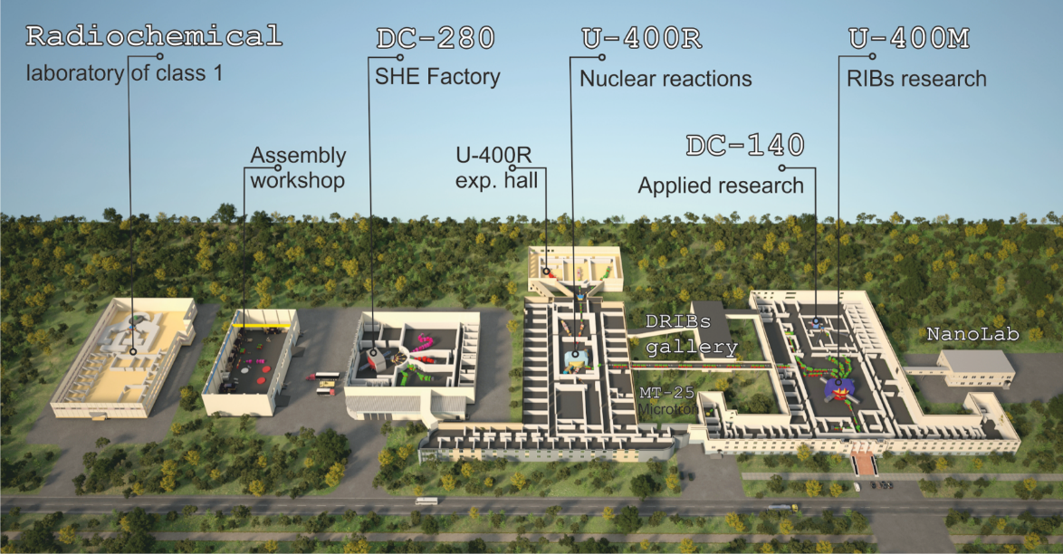
FLNR 2030
Notes:
A: Minimal+ program. RIBs on the base of the operating cyclotrons U400M+U400R
B: Maximal program. RIBs on the base of a tandem of new cyclotrons E1-E2 (100 AMeV), or 100 AMeV LINAC.

Slide 13
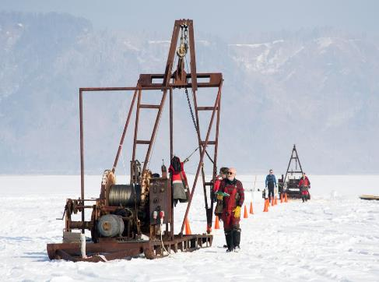
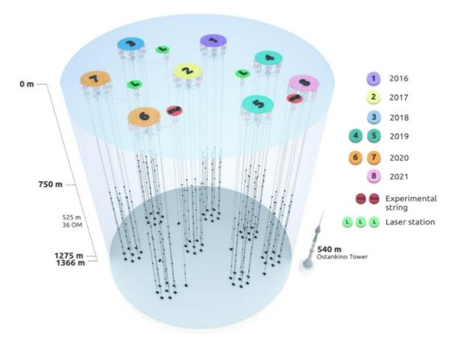
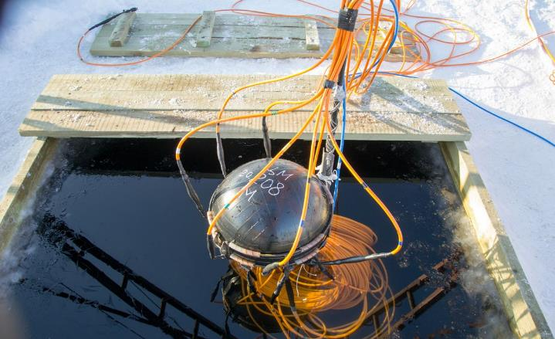
NEUTRINO AND ASTROPARTICLE PHYSICS
PROJECT BAIKAL-GVD
Baikal-GVD: Identification of astrophysical sources of ultra-high energy (exceeding tens of TeV) neutrinos. Actuality: their sources are still unknown. The identification of sources will help to elucidate mechanisms of galaxies creation and evolution.
Main advantage of Baikal-GVD: pure and t-stable water. Angular resolution of muon tracks 0.3-0.5 grad (IceCube: 0.5-1); angular resolution of shower direction 2-3 grad (IceCube: 15);
Northern detectors have better view to the Galaxy center.
Year | Number of clusters | Number of OMs
2016 | 1 | 288
2017 | 2 | 576
2018 | 3 | 864
2019 | 5 | 1440
2020 | 7 | 2016
2021 | 8 | 2304
2022 | 10 | 2880
2023 | 12 | 3456
2024 | 14 | 4032
Baikal-GVD: flagship experiment of JINR with a leading role in the collaboration. Gain new experience in the detector design, construction, deployment, maintenance, simulation and data analysis. Expected breakthrough discoveries.
More dense configuration, + light sensors, fiber vs Cu, smart data transmission, + radio-antennas → New Quality and Efficiency.
Global competence in 2030 horizon: Ice-Cube: 2025-2034 8km³ (w RA 100 km3 => PeV); Km3NET: few km³; Baikal-GVD (Phase II) = new type of OM, trigger-less operation, ML&AI, ~ 10 km³ ? (CDR in 2024).

Slide 14
Neutrino, Astroparticle Physics
Neutrino oscillation experiments
Determination of CP-violating phase: DUNE (5σ significance in just two years)
Determination of n mass ordering: NOvA (gaining new experience), JUNO
Precise determination of elements of the lepton mixing matrix: JUNO (gaining further experience with reactor neutrino), DUNE
Physical properties of neutrino
Determine if a neutrino is a Majorana particle: SuperNEMO, GERDA-LEGEND
Coherent elastic n-nucleus scattering process at reactors: nuGEN (GEMMA)
Sterile neutrino oscillation: DANSS
Motivation: involvement in possible major discovery, new instruments
1
Priorities
2
3
Astroparticle Physics, Dark Matter discovery
Existence of the dark matter particles: DarkSide, EDELWEISS
Sources of high-energy (exceeding tens of TeV) gammas: TAIGA
Determination of nuclear matrix elements via muon capture: MONUMENT
Motivation: involvement in possible major discovery, new instruments
JUNO,
NOvA-DUNE, EDELWEISS
SuperNEMO, GERDA-LEGEND, nuGEN,
DANSS
DarkSide, TAIGA, MONUMENT
Exp. Data Level&Scale | JINR recognition
Human Resources | Finance Resources

Slide 15

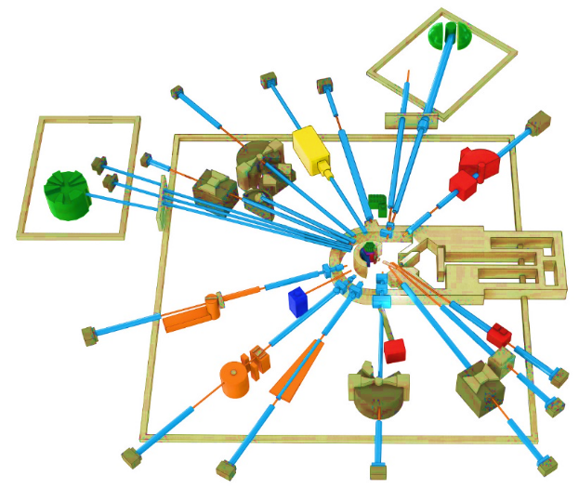
Condensed Matter Physics, Neutron Physics. Priority research in 2024-2030
THE IBR-2 FACILITY
SPECTROMETER COMPLEX
The service life of the core IBR-2 reactor is expected to end in 2032-35. The possibility to extend the operation of the IBR-2 until 2040 is being studied. To extend the reactor core campaign – new fuel (manufacture of FA with FR) around 2025.
Considering the present-day tendency, after 2030 only five sources will be available in Europe: ISIS (Didcot, UK), SINQ (PSI, Villige), FRM II (TU Munich), and two new sources: ESS (Lund, Sweden) and reactor PIK (NRC KI, Gatchina, Russia), both under construction with the start of operations planned for 2023-2024. Oak Ridge (STS SNS) –is planned in 2037.
Development of the basic configuration elements of the inverse geometry inelastic n-scattering spectrometer BJN.
Completion of basic configuration of the small angle n-scattering and imaging spectrometer.
BJN
(project)
HRFD
YuMO
EPSILON
DN-6
SKAT
RTD
KOLKHIDA
NERA
NRT
REMUR
FSS
REFLEX
DN-12
GRAINS
FSD
Modernization and reconstruction of spectrometers HRFD, YuMO, RTD, DN-6, DN-12, FSD, NERA, REMUR, REFLEX, SKAT, EPSILON, FSS, NRT, focused on improvement of technical parameters and extension of research capabilities.
Development of laboratory equipment for samples characterization and physical properties measurements.
Support and modernization of the complex of cryogenic moderators. New operating reliable UCN channel.
JINR provides FS for new neutron source (IBR-3 = “NEPTUNE”). The goal – is to have the best pulsed neutron source in the world by 2037: with brightness of 7*10^15 (for TN), and 9*10^14 (for CN)
Notes:
Эксплуатационный проектный ресурс установки ИБР-2, как одного из лучших нейтронных импульсных источников заканчивается в 2032-35 годах. В настоящее время в ЛНФ изучается возможность продления кампании реактора до 2040 года. Для этого, в частности, необходимо изготовить дополнительную партию свежего топлива с аналогичными характеристиками до 2025 года.
Учитывая существующие тенденции, после 2030 года в Европе для проведения исследований будет доступно 5 источников, включая три действующих: ISIS (Didcot, UK), SINQ (PSI, Villigen, Switzerland), FRM II (TU Munich, FRG), и два новых, начало эксплуатации которых планируется в 2023- 2024 годах: (ESS (Lund, Sweden) and steady-state reactor PIK (PNPI NRC KI, Gatchina, Russia). Ввод в эксплуатацию 2-х мишенной станции на источнике (STS SNS) of Oak Ridge National Laboratory (USA) планируется в 2037 году. Таким образом, потребность в новом поколении высокопоточных источников нейтронов возрастает на фоне общего уменьшения их количества в мире.
Приоритетными задачами развития комплекса спектрометров реактора ИБР-2 будут являться:
Разработка и создание элементов основной конфигурации нового спектрометра неупругого рассеяния нейтронов в обратной геометрии BJN.
Завершение работ по разработке и созданию основной конфигурации спектрометра малоуглового рассеяния и имиджинга.
Модернизация и реконструкция действующих установок HRFD, YuMO, RTD, DN-6, DN-12, FSD, NERA, REMUR, REFLEX, SKAT, EPSILON, FSS, NRT, направленная на улучшение технических параметров и расширение экспериментальных возможностей.
Развитие лабораторного оборудования для характеризации образцов и измерений физических свойств.
Поддержка и модернизация комплекса криогенных замедлителей

Slide 16
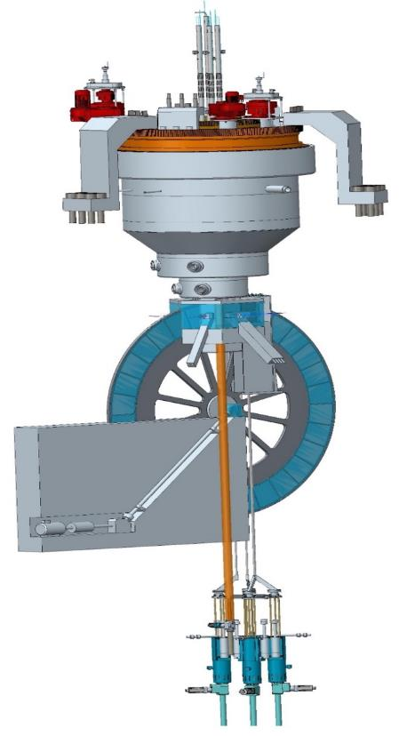
FLNP Long-term plan up to 2030
R&D of neptunium-nitride fuel of NEPTINE reactor (JSC VNIINM, 2022)
R & D for the development of fuel rods includes the following stages:
permit to use of nuclear materials, which is in federal ownership;
development of preliminary design specifications for neptunium nitride fuel;
development a complex of fuel characteristics’ measurement methods;
development a technology of fuel fabrication for experimental fuel rods;
carry out of fuel rods researches before reactor irradiation;
reactor irradiation of fuel rods (with dose of 77 dpa)
post-irradiation researches of fuel rods in hot cells
Notes:
The long-term plan for the development of the main elements of FLNP research infrastructure is presented in the table.

Slide 17
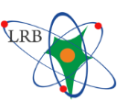






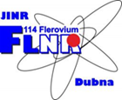

JINR Life Science Program: Basic and Applied Research
Applied Research and Innovation Committee at NICA (NICA ARIC) – core of future SAC: F. Cucinotta (Univ. of Nevada, USA), M. Durante (GSI, Germany), T. Hei (Columbia Univ, USA), Rubén García Alía (RADNEXT Project, CERN), C. Trautmann (GSI, Germany), A. Paccagnella (Univ. of Padua, Italy), A. Pesce (ESA),
Yu. Titarenko (ITEP KI, Russia), H. Sakurai (Nishina Center, RIKEN, Japan), A. Osipov (Burnasyan Center FMBA, Russia), F. Azaiez (iThemba LABS, South Africa).
Dzhelepov Laboratory of Nuclear Problems
Laboratory of Radiation Biology - Integrator
Veksler and Baldin Laboratory of HEP
Fundamental Radiobiology
Radiation Neuroscience
Clinical Radiobiology
Mathematical Modeling
Radiation Protection
Astrobiology
Study for p-therapy
Study of damage suppressor of tardigrades
Study of genetic modify’s due to radiation dose
Detectors and Tomography
Heavy ion beamlines for radiobiology, beam therapy, animal research
Infrastructure for molecular, cellular and animal research
Frank Laboratory of Neutron Physics
Flerov Laboratory of Nuclear Reactions
Beamline for neutron capture therapy of cancer
Structural biology
Ecology
Mecheryakov Lab. of Information Technologies
High performance computing
System for biological data storage and processing
Bioinformatics, Machine Learning
Ion beams for cellular research
Radionuclides synthesis for radiation medicine
Development of vivarium, animal imaging and tomography, super-resolution microscopy; Equipment for multi-OMICS research; Construction of radiochemical class III lab blocks; R&D on compact irradiators for cellular research.
Notes:
… В ОИЯИ взят курс на активное развитие фундаментальных и прикладных направлений, связанных с Life Science.
На серии институтских семинаров, Ученом Совете, совещаниях и круглых столах сформирована международная программа исследований.
Программа будет реализована на общеинститутском уровне путем тесной межлабораторной кооперации.
Интегрирующим звеном служит специализированная лаборатория – ЛРБ, которая реализует программу по двум трендовым мировым направлениям: науки о мозге (освоение космоса и борьба с нейрозаболеваниями), и радиационная медицина (новые подходы к пучковой и радионуклидной терапии рака).
Для этого используется инфраструктура ключевых институтских проектов: пучки тяжелых ионов сети ARIADNA прикладных каналов NICA, ионного циклотрона ЛЯР (DRIBSIII), нейтронов с реактора ИБР2,
суперкомпьютерной инфраструктуры ЛИТ. В рамках ИЦ планируется разработка нового медицинского протонного циклотрона, технологий производства изотопов, развитие технологий биотомографии.
Биологическая инфраструктура также будет активно развиваться, включая исследования на молекулярном, клеточном и тканевом уровне, задействуя омиксные технологии, а также работу с животными.
17

Slide 18
THEORETICAL PHYSICS (BLTP)
Theory of
Fundamental
Interactions
Theory
of Atomic
Nucleus
Theory of
Condensed
Matter
Modern
Mathematical
Physics
Interlaboratory cooperation
Research and
educational project
DIAS-TH
“Dubna International
Advanced School of
Theoretical Physics”
VBLHEP Hot and dense nuclear matter in heavy-ion collisions
FLNP
Condensed Matter,
New materials
DLNP
Neutrino physics
FLNR
Superheavy and exotic nuclei
FLNR
Nanoporous 2D membranes,
Ion irradiation
MLIT
Lattice QCD calculations
DLNP Few-body systems,
Exotic nuclei
MLIT Computational methods for
nuclear physics and quantum chemistry
Human strategy:
Attraction of leading scientists
Attraction of young researchers
Stimulation of scientific activity
Scientific strategy:
Extension of international collaboration
Keeping up with current scientific trends
Interplay of research and education

Slide 19

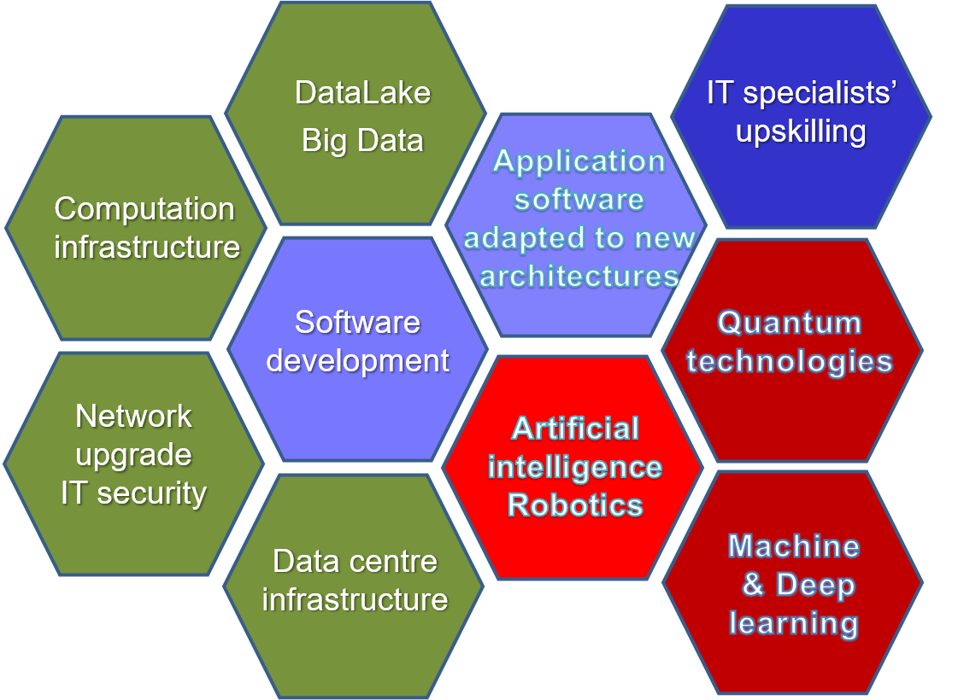
Strategy for Information Technology and Scientific Computing at JINR
Scientific IT ecosystem:
It will be steady implementation/upgrades of
Networking (Tb/s range),
Computing infrastructure within the Multifunctional Information & Computing Complex (MICC) and
“Govorun” Supercomputer,
Data center infrastructure,
Data Lake & long-term storage
for all the experiments.
The development of new data processing and analysis algorithms based on
ML/DL,
artificial intelligence,
Big Data
Quantum technologies.
A variety of means will be used for IT specialists upskilling.
The coordinated development of interconnected IT technologies and computational methods

Slide 20
Participation in experimental collaborations worldwide
JINR intends to participate in advanced external experiments in the relativistic heavy-ion physics, particle physics and neutrino physics, provided that the potential for discoveries in these experiments is high, JINR researchers can play a leading role, and partner scientific organizations show mutual interest in strengthening cooperation.
Relativistic heavy ion physics
JINR scientists will continue the study of the properties of nuclear matter under extreme conditions, in the search for quark deconfinement and possible phase transitions within the framework of common research programmes in the STAR experiment at RHIC, BNL, in the NA61 experiment at the SPS accelerator (CERN), in the ALICE experiment at LHC (CERN), and in the CBM experiment at FAIR (GSI).
JINR's participation will depend on the progress in implementing the NICA project, as well as on the need to consolidate work at the JINR accelerator complex.
The nucleon spin structure and other polarization phenomena in nucleon–nucleon and nucleon–nucleus interactions
The SPD research programme will extend the ongoing research programmes of the COMPASS++/AMBER experiment (at SPS, CERN) on hadron structure and spectroscopy investigations with high-intensity muon and hadron beams, as well as with polarized proton beams at the STAR facility (RHIC), in which teams of VBLHEP and DLNP scientists of JINR will continue to take part during 2024–2028.
JINR's participation in these programmes will be coordinated with the JINR's efforts on the creation of the SPD detector and its research programme.
Elementary particle physics
The search for physical phenomena beyond the Standard Model will be continued in the CMS and ATLAS experiments at CERN’s LHC. JINR will take part in the second phase of detectors’ upgrade during the LHC shutdown periods in 2026–2028 and will continue analysis of data from the LHC. The JINR group will continue to participate in the NA64 experiment to search for weakly interacting particles of dark matter at the SPS accelerator at CERN. JINR will also take part in a search for charged lepton flavor violation in muon-to-electron conversion in nuclei in the μ2е (FNAL) and COMET (J-PARC) experiments.

Slide 21
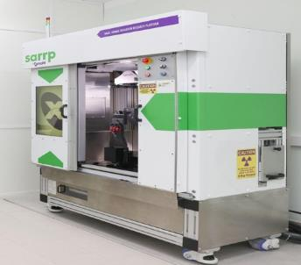
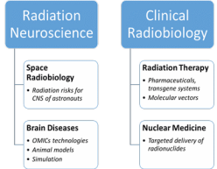
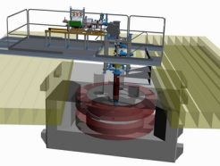

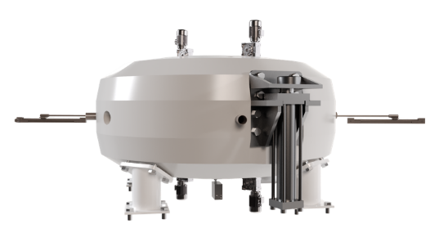
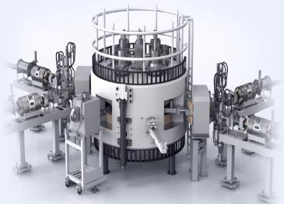
INNOVATIONS: International Centre for Nuclear Technologies Research:
Status and Progress
Development of technologies and methods in the field of nuclear and radiation medicine, radiation materials science, advanced training of specialists for JINR Member States for radiation biology, medical physics, material studies.
OMICS@LRB and neuro-RB studies. Radiation neuroscience. Approaches to increase radiosensitivity: pharmaceuticals, transgene systems, targeted delivery (molecular vectors) and radionuclide;
ARIADNA. Applied beams@NICA: radiobiological studies (400-800 MeV/n); radiation testing of semiconductor electronics (3; 150-350 MeV/n); nuclear physics @ 1-4.5 GeV/n. Start in 2023;
DC-140 cyclotron for electronic component testing, radiation material science, track pore membrane research. 2021–2023;
SC proton cyclotron (MSC-230) for R&D in beam therapy: treatment planning; radiomodificators for γ− and p- therapy, flash-therapy, pencil beam (10 µA, >5 Grey/l @ 50 ms pulse). 2022–2024.
Radiochemical Laboratory Class-I for production of radioisotopes (Ac²²⁵, ^{99m}Tc), nuclear medicine R&D in photonuclear reactions @ 40MeV (e-beam, Rhodotron). 2022–2027.
DC-140 (construction phase)
Radiochemical Lab Class-I
MSC-230 (general view)
Notes:
21

Slide 22
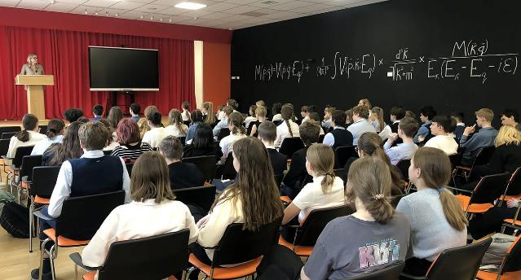
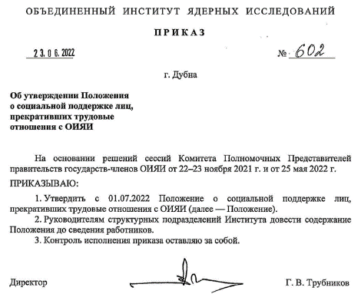
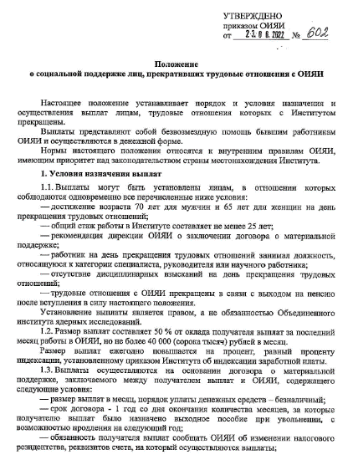
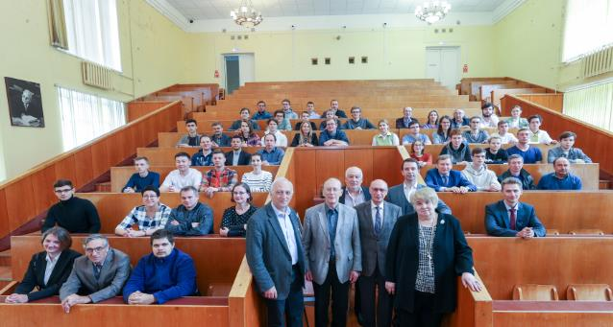
Directions of the Personnel Strategy 2024‒2030
Moscow Regional Physics and Mathematics Lyceum named after Academician V. G. Kadyshevsky
- Обновление персонала (непрерывное образование)
- Возможность выхода на пенсию (договор социальной поддержки)
- Изменение возрастной структуры
- Значительное увеличение ассоциированного персонала.
Moscow State Univ. Branch in Dubna
Departments of Elementary Particle Physics and
Department of Fundamental Nuclear Interactions
and
Departments at MIPT, MEPhI, SPbSU, Dubna University and several others.

Slide 23
7-YP (2024-2030):
- Physics, Data acquisition and analysis, ”Harvesting”. Reliable, open,
globally demanded Research (NICA, SHE, IBR2, νF, MICC, LS+IC)
- advanced R&D, Feasibility studies for new large-scale project @ JINR.
Research@Dubna: Topical Plan → Directions (Areas) → Projects → Activities.
Basic Research Landscape and Priorities: where Dubna has recognized groundwork, and level/scale of tasks is/definitely will be world leading. Projects (approach «plan/schedule/results”) – are instruments.
External Research (international cooperation): of great importance the Openness and the Institute's participation in experiments at world Research centers (CERN, FAIR/GSI, GANIL, BNL, DESY, INFN, IHEP, RIKEN, KEK etc), as well as in neutrino experiments and IT, where unique conditions for research are created. Key factors: JINR's participation should be recognizable and defined by the scientific significance/scale of the Physics data obtained, as well as on the role of scientists from JINR; The mutual benefit from exchange of new data, new scientific technologies and theoretical developments must be followed.

Slide 24

Matrix of JINR Key Projects
2020 | 2023 | 2026 | 2029 | ~ 2032 | ~ 2035 | ~ 2038
DRIBS, SHE-Factory
Operation and development
FRB @ Flerov Lab
R&D
Feasibility Studies + R&D
Decision
Phased construction
Operation
NICA MPD
Construction
Operation
upgrade
Operation
NICA SPD
R&D + Design
Construction and commissioning
Operation
upgrade
NICA - III (EIC, others)
Feasibility Studies + R&D
International Program + R&D
Technical design and prototyping
Operation
DNS-IV
Technical design and prototyping
Decision
Construction
Operation
Baikal - GVD
Construction and data acquisition
upgrade and data acquisition
Operation
ν & AP Physics
International scientific program
Life Science
Formulation of Internati-onal scientific program
International scientific program
FCC, ILC, GWI, …
Participation in Feasibility Studies, advanced R&D
Decision
Participation in construction
Innovation center
R&D + Design
Construction
Operation and regular modernization
Thank you !

Slide 25
Additional slides

Slide 26
Global trends and JINR
Distribution by fields of science
Large Research Infrastructures:
Large Hadron Collider (CERN)
European Spallation Source (ESS)
Facility for Antiproton and Ion Research (FAIR)
LBNF-DUNE (Neutrino experiment)
Future Circular Collider
SNOLAB (underground neutrino facility)
European Synchrotron Radiation Facility (ESRF)
Cubic Kilometre Neutrino Telescope (KM3NeT)
International Linear Collider
NICA (Nuclotron-based Ion Collider fAсility)
SCT (Super charm-tau factory)
Amundsen arctic research vessel
Extremely Large Telescope (ELT)
Square Kilometer Array (SKA)
…
The statutory for JINR fields of science occupy a priority position in the world scientific agenda and development of a large research infrastructure.
The analysis shows that almost half of modern projects in the field of basic sciences have accompanying programmes of applied research aimed at sustainable development goals (SDG).
Worldwide international dimension, the multi-disciplinary scientific programme and large infrastructure projects of JINR harmoniously complement the global scientific agenda and the worldwide landscape of mega-science infrastructure, assuming, along with the main goals in the field of fundamental research, the achievement of certain SDG.
Distribution by mission
Distribution by international dimension
About 40 LRI in a wide range of scientific fields that meet the criteria for a large research infrastructure (complexity, scale, uniqueness, mission), both operational and those under construction, as well as some planned ones – ICRI, GSF OECD, 2021

Slide 27
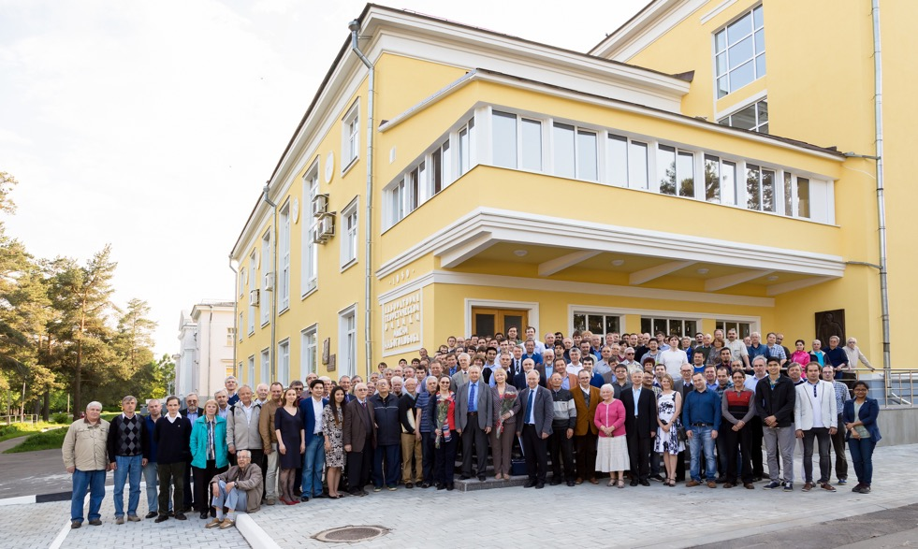
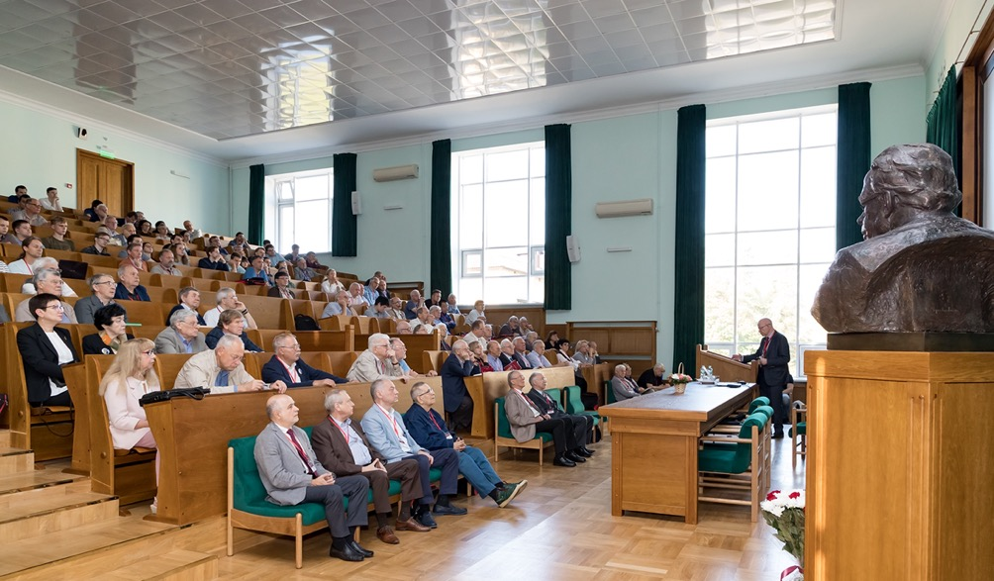
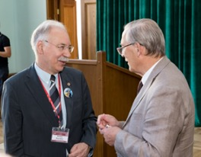
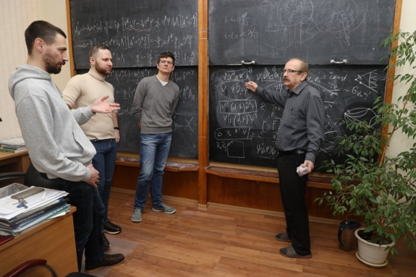

JINR Theorists
The difficulties of working in the conditions of the coronavirus pandemic did not prevent the staff of the Institute from obtaining bright results during the implementation of JINR flagship projects.
The achieved successes would not have been possible without the powerful theoretical support of experimental research at JINR, which is the most important component of the activity of the JINR theorists.
27

Slide 28
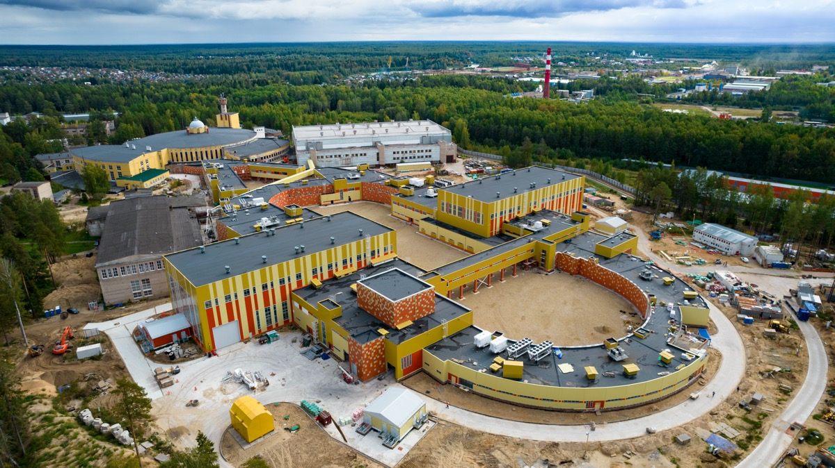
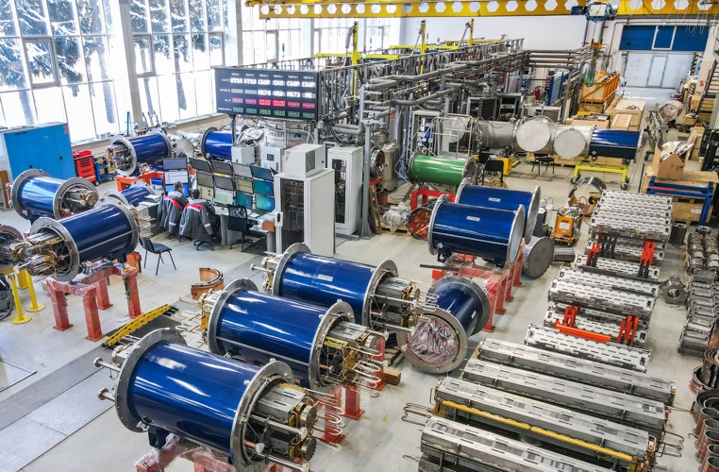
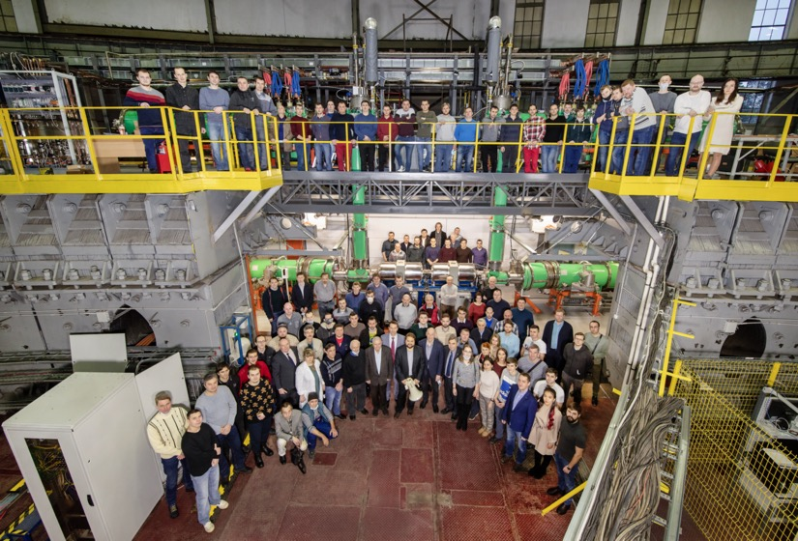
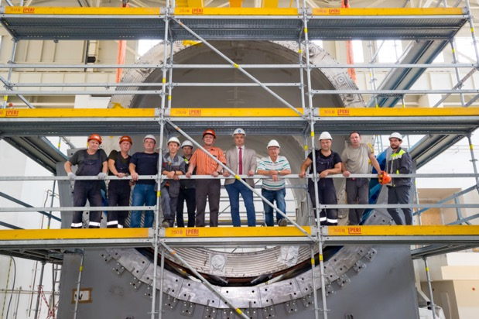
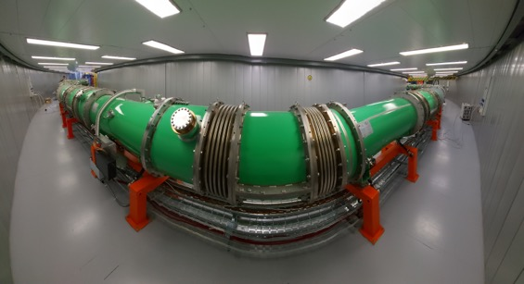
NICA Complex
28

Slide 29
Scientists and engineers of JINR are active participants of the projects of state-of-the-art international accelerator complexes: LHC, XFEL, FAIR, RHIC, GANIL, INFN centers, J-PARC, IMP CAS, HIAF, EIC, ILC, CLIC, FCC, etc. We will focus on R&D in the following areas:
BEAM PHYSICS AND ACCELERATOR TECHNOLOGIES
– highly charged intense ion sources for generating heavy-ion beams with a charge state (Z > 40+);
– superconducting magnetic technologies: high-field magnets with fields up to 14–20 T, fast-cycling high-field magnets (B > 4 T, ramp > 4 T/s), high-current cables and windings (I_cr >30 kA);
– studies in the field of high-temperature superconductivity, development of Dubna superconducting cable technologies;
– efficient fast cooling systems for intense hadron beams (~ 10–100 ms);
– superconducting resonators (RFQ and DTL) and cryomodules of RF structures for accelerating intense proton and ion beams, including those operating in the quasi-continuous mode at low initial particle velocities;
– research in the field of colliding beam accelerators: final optical structures, collision effects, focusing elements also based on radiation-resistant focusing on permanent magnets;
– issues of implementation of future colliders (FCC, ILC, CpeC, etc.);
– development of RF power systems based on solid-state power amplifiers;
– technologies of fast cycling synchrotrons for acceleration and accumulation of intense heavy-ion beams;
– R&D on beam therapy (flash, pencil beam, light ions, neutrons);
– deep machine learning for operation optimization and synchronization of systems of large accelerator complexes;
– development of modeling methods (including using artificial intelligence methods) of beam dynamics with the “real” accelerating and focusing electromagnetic fields in accelerator structures and in-flight beam parameters (emittance, intensity, charge composition, etc.).

Slide 30
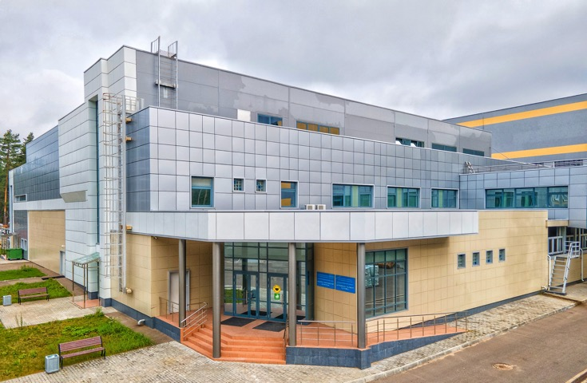
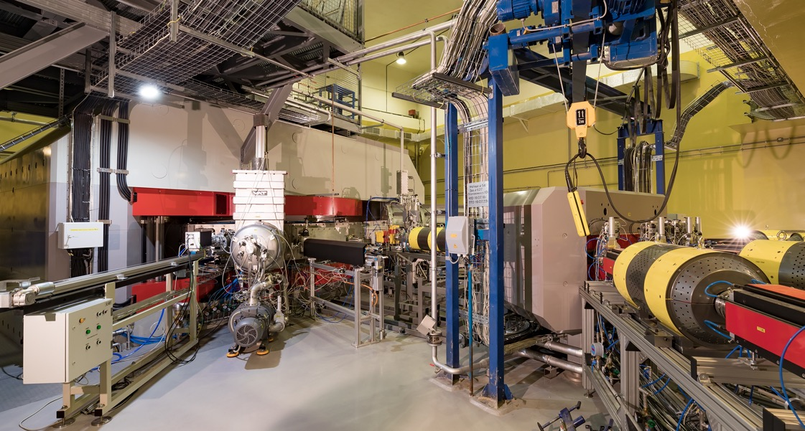
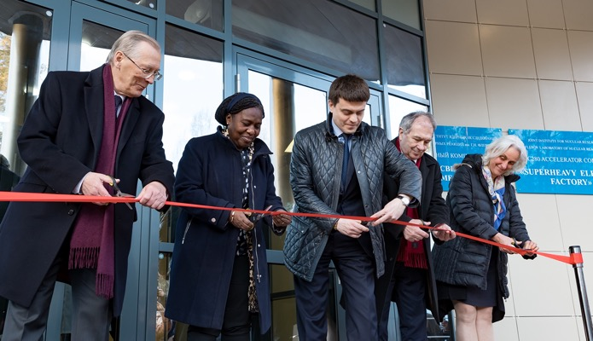

Factory of superheavy elements
DC-280 cyclotron is a key element
of the SHE Factory
Commissioning
of the DGFRS-3 separator
at the SHE Factory
Dubna, 25 March, 2019. The ceremonial launch of the SHE factory.
On photo (from left to right): JINR Director Academician V. Matveev, Plenipotentiary Representative of Russia to JINR, RF Minister of Science and Higher Education M. Kotyukov, Plenipotentiary Representative of Bulgaria L. Kostov, Director of the UNESCO Department of Scientific Policy P. E. Oti-Boateng and President of the CERN Council U. Bassler
30

Slide 31




Synthesis of Superheavy Elements
Advanced experiments on the synthesis of new elements have been carried out at the accelerator complex of the Flerov Laboratory of Nuclear Reactions (FLNR) of JINR since its foundation to the present.
Over the past 20 years, 5 new superheavy elements have been discovered at JINR, completing the seventh period of the Mendeleev’s Periodic Table, with numbers 114 (Flerovium), 115 (Moscovium), 116 (Livermorium), 117 (Tennessine) and 118 (Oganesson).
Moscow, 2 March, 2017. Participants of the festive ceremony on the occasion of the discovery and naming new chemical elements of the Mendeleev’s Periodic table with atomic numbers 115, 117 and 118. From left to right: Director of the Lawrence Livermore National Laboratory (LLNL) Dr. W. Goldstein, Director of the Flerov Laboratory of Nuclear Research S. Dmitriev, President of the International Union of Pure and Applied Chemistry (IUPAC)
N. Tarasova, Scientific Leader of FLNR Academician
Yu. Oganessian, Director of the Oak Ridge National Laboratory (ORNL) Dr. Th. Mason, JINR Vice-Director M. Itkis, Director of the RIKEN Nishina Center Hideto Enyo,Vice-President of the Royal Society of London for the Improvement of Natural Knowledge Sir M. Polyakoff
Wilhelmshaven, Germany, 25-30 August, 2019. Discoverers of chemical elements (from left to right): Professor P. Armbruster and Professor G. Münzenberg (GSI, Germany), Dr. K. Morimoto (RIKEN Nishina Center for Accelerator-Based Science, Wako, Japan), Professor Yu. Oganessian (JINR, Dubna)
31

Slide 32







Baikal-GVD Project
Baikal, 13 March, 2021. The ceremonial launch of the Baikal-GVD, the largest deep underwater neutrino telescope in the northern hemisphere, and the signing of a Memorandum of understanding between the Ministry of Education and Science of Russia and JINR for the development of the Baikal deep underwater neutrino telescope
32

Slide 33







Neutron Research
In 2020 the Institute celebrated the 60th anniversary of the launch of the IBR pulse reactor start-up (IBR) ― the only reactor in the world operating with a variable level of criticality. The implementation of the international user programme continues on the neutron beams of the IBR-2 reactor. The project of a new neutron pulse source of the 4th generation is being developed in partnership with leading scientific organizations.
33

Slide 34




JINR Digital EcoSystem (DES)
The digital platform “JINR Digital EcoSystem ” integrates existing and future services
to support
scientific,
administrative and social activities,
maintenance of the engineering and IT infrastructures
to provide
reliable and secure access to various types of data
to enable
a comprehensive analysis of information
using
modern Big Data technologies and artificial intelligence.
Digital technologies
Digital infrastructures
IT specialists and users
Single access point to all services

Slide 35





Information Technologies
14 November, 2019. Presentation of modernized JINR supercomputer named after N. N. Govorun
Scheme of the Integration of geographically distributed heterogeneous resources based on the DIRAC Interware
JINR Multifunctional Information and Computing Centre
35

Slide 36






Radiobiological
Research
Academicians V. Matveev, M. Ostrovsky, A. Rozanov, corresponding member E. Krasavin at the discussion of the scientific programme of the JINR LRB
The Laboratory of Radiation Biology (LRB) conducts unique experiments on mammals and primates to assess the radiation risks of CNS (central nervous system) disorders and carcinogenesis.
36

Slide 37






Life Science
JINR is committed to the active development of fundamental and applied areas related to Life Science.
The ongoing international research programme, the ideological centre of which is the JINR Laboratory of Radiation Biology, involves the development of two scientific directions:
brain sciences (space exploration and the fight against neuroscience);
radiation medicine (new approaches to beam and radionuclide cancer therapy).
Infrastructure used: heavy ion beams of the ARIADNA network of NICA application channels, the FLNR Ion Cyclotron (DRIBSIII), the neutrons of the IBR-2 reactor, the supercomputer infrastructure of MLIT.
It is planned to develop a new medical proton cyclotron, isotope production technologies, the development of biotomography technologies, biological infrastructure, including research at the molecular, cellular and tissue levels, the use of omics technologies (genomics, transcriptomics, proteomics, metabolomics), as well as work with animals.
37

Slide 38





Life Science Research Network at JINR
Laboratory of Radiation Biology
Veksler&Baldin Laboratory of High Energy Physics
Dzhelepov Laboratory of Nuclear Problems
Infrastructure for molecular,
cellular and animal research
Radiation Neuroscience:
  Space radiation risks
  Brain diseases
Proton therapy of cancer
Tomography
Molecular genetics
Clinical Radiobiology:
  New methods for particle therapy of cancer
  Radionuclide therapy
Heavy ion beamline for space radiobiology and animal research
Frank Laboratory of Neutron Physics
Flerov Laboratory of Nuclear Reactions
New methods for neutron capture therapy of cancer
Structural biology
Mecheryakov Laboratory of Information Technologies
Heavy ion beam for cellular research
Radionuclides for radiation medicine
High performance computing
System for biological data storage and processing
Phase transition in Life Science Research @ JINR:
- About 100 new researches (incl associate) by ~2025
- World uniqueness: animal research (MRT/KT), vivarium, spectra of irradiation - p, i, g, e;
- Wide energy spectrum for ions (MeV … GeV), space agencies (RSA, ESA, NASA, JSA)
38
Notes:
… В ОИЯИ взят курс на активное развитие фундаментальных и прикладных направлений, связанных с Life Science.
На серии институтских семинаров, Ученом Совете, совещаниях и круглых столах сформирована международная программа исследований.
Программа будет реализована на общеинститутском уровне путем тесной межлабораторной кооперации.
Объединяющим звеном служит специализированная лаборатория – ЛРБ, которая реализует программу по двум трендовым мировым направлениям: науки о мозге (освоение космоса и борьба с нейрозаболеваниями), и радиационная медицина (новые подходы к пучковой и радионуклидной терапии рака).
Для этого используется инфраструктура ключевых институтских проектов: пучки тяжелых ионов сети ARIADNA прикладных каналов NICA, ионного циклотрона ЛЯР (DRIBSIII), нейтронов с реактора ИБР2,
суперкомпьютерной инфраструктуры ЛИТ. В рамках ИЦ планируется разработка нового медицинского протонного циклотрона, технологий производства изотопов, развитие технологий биотомографии.
Биологическая инфраструктура также будет активно развиваться, включая исследования на молекулярном, клеточном и тканевом уровне, задействуя омиксные технологии, а также работу с животными.
38

Slide 39




Innovations
JINR Innovation Development Plans include:
applied innovation research at the NICA accelerator complex;
creation of an interlaboratory international innovation centre for nuclear physics research for the development of technologies and methods in the field of nuclear and radiation medicine, radiation materials science, and relevant information technologies.
The wide range of methods used by the JINR scientists includes X-ray fluorescent spectrometry, infrared spectroscopy, stratigraphy and optical microscopy, chemical microanalysis. These methods are used in various interdisciplinary scientific fields, including condensed matter physics, materials science, non-destructive structural diagnostics, archaeology, paleontology, etc.
Such areas as artificial intelligence and quantum technologies in MLIT and VBLHEP, superconducting energy storage up to 3 MJ, R&D in the field of superconducting linear accelerators, micropixel avalanche photodiodes, unique medipix detectors for tomographs, laser inclinometer are actively developing.
39

Slide 40







JINR Directorate
Director of JINR ― academician G. Trubnikov
Scientific Leader of JINR ― academician V. Matveev
Vice-Director of JINR V. Kekelidze
Vice-Director of JINR
S. Dmitriev
Vice-Director of JINR
L. Kostov
Chief Scientific
Secretary of JINR
S. Nedelko
Chief Engineer of JINR
B. Gikal
40

