Slide 1
Flerov Laboratory:
Status and proposals in the 7-year plan
of development for 2024 - 2030
Sergey Sidorchuk
56th meeting of the PAC on Nuclear Physics
January 26, 2023

Slide 2
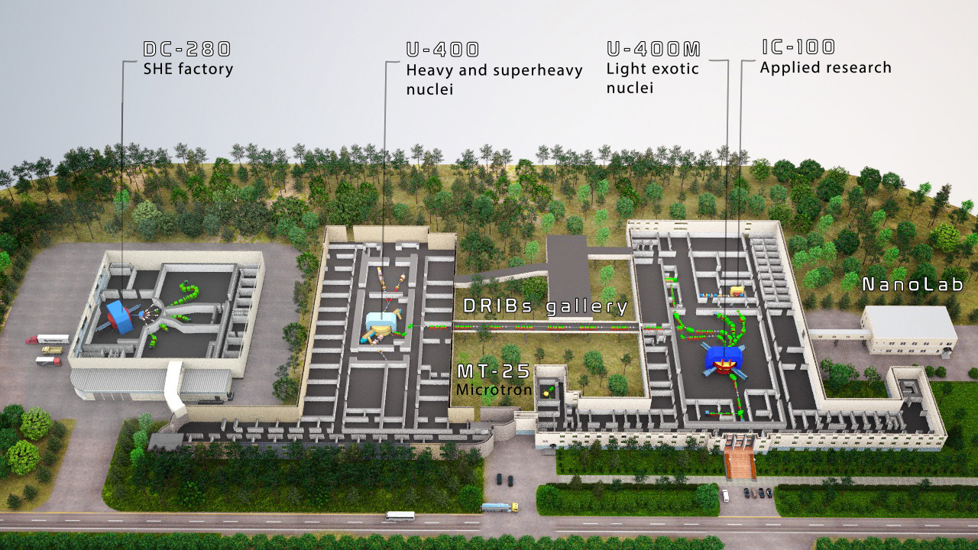
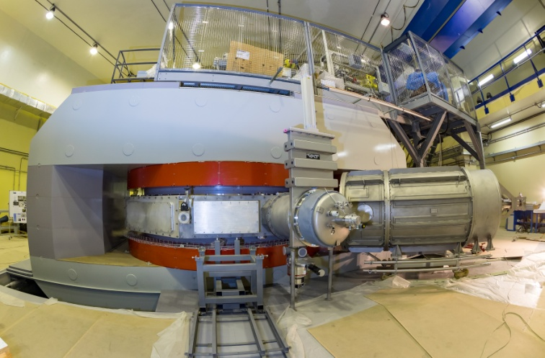
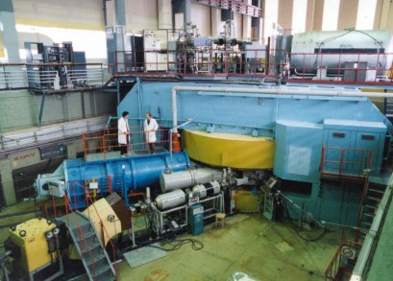
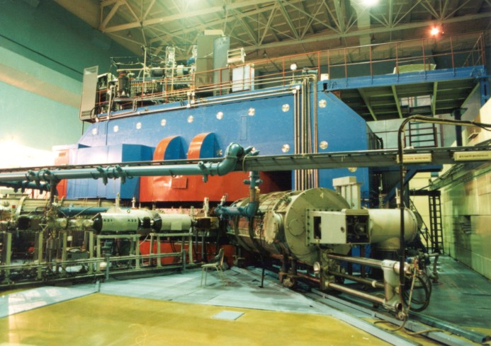
Flerov Lab:
Staff = 460 + 68 (APC);
114 scientists;
60 PhD;
14 ScD.
DC-280
U-400
U-400M

Slide 3
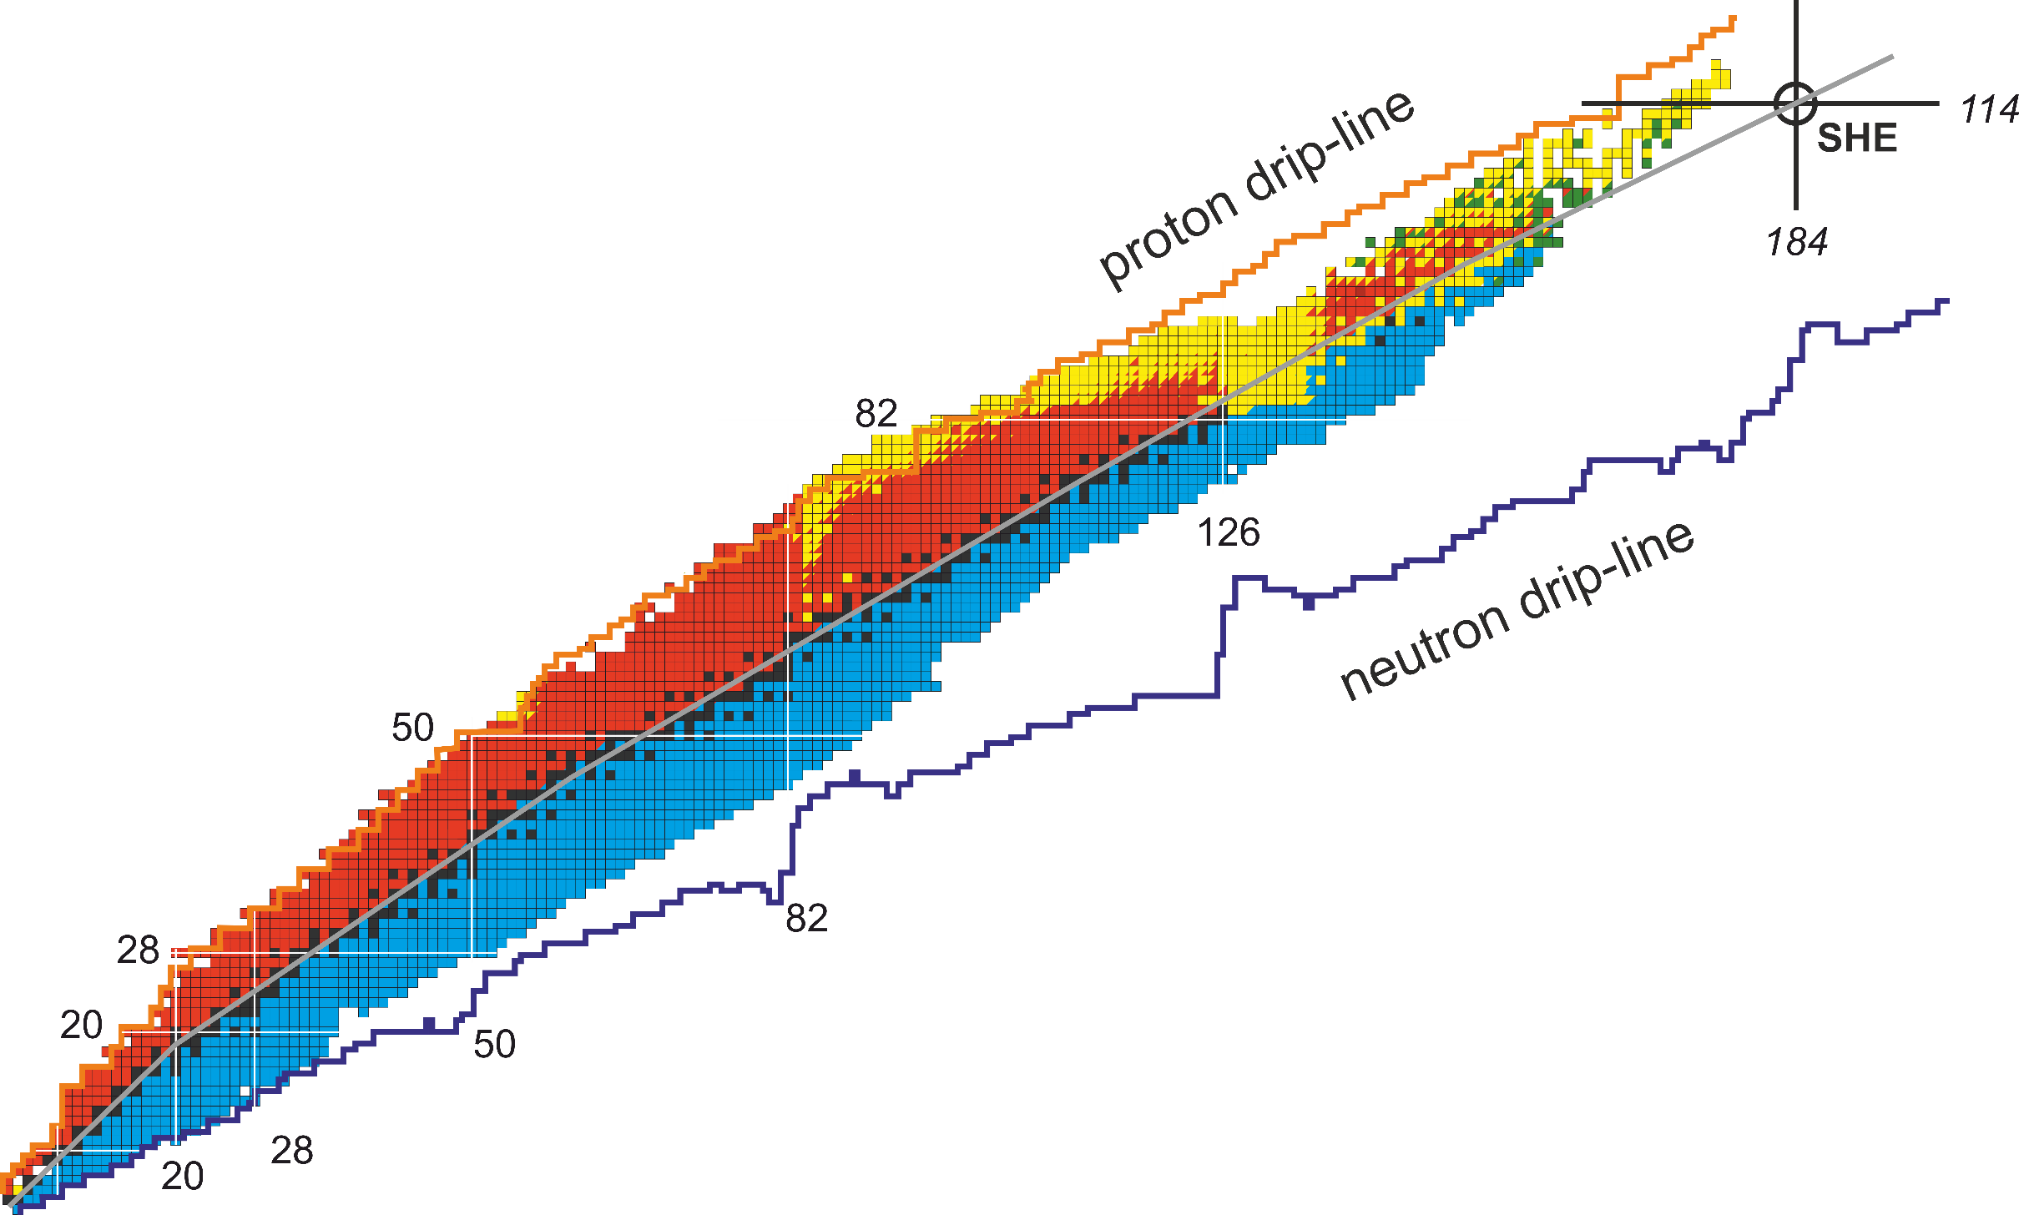
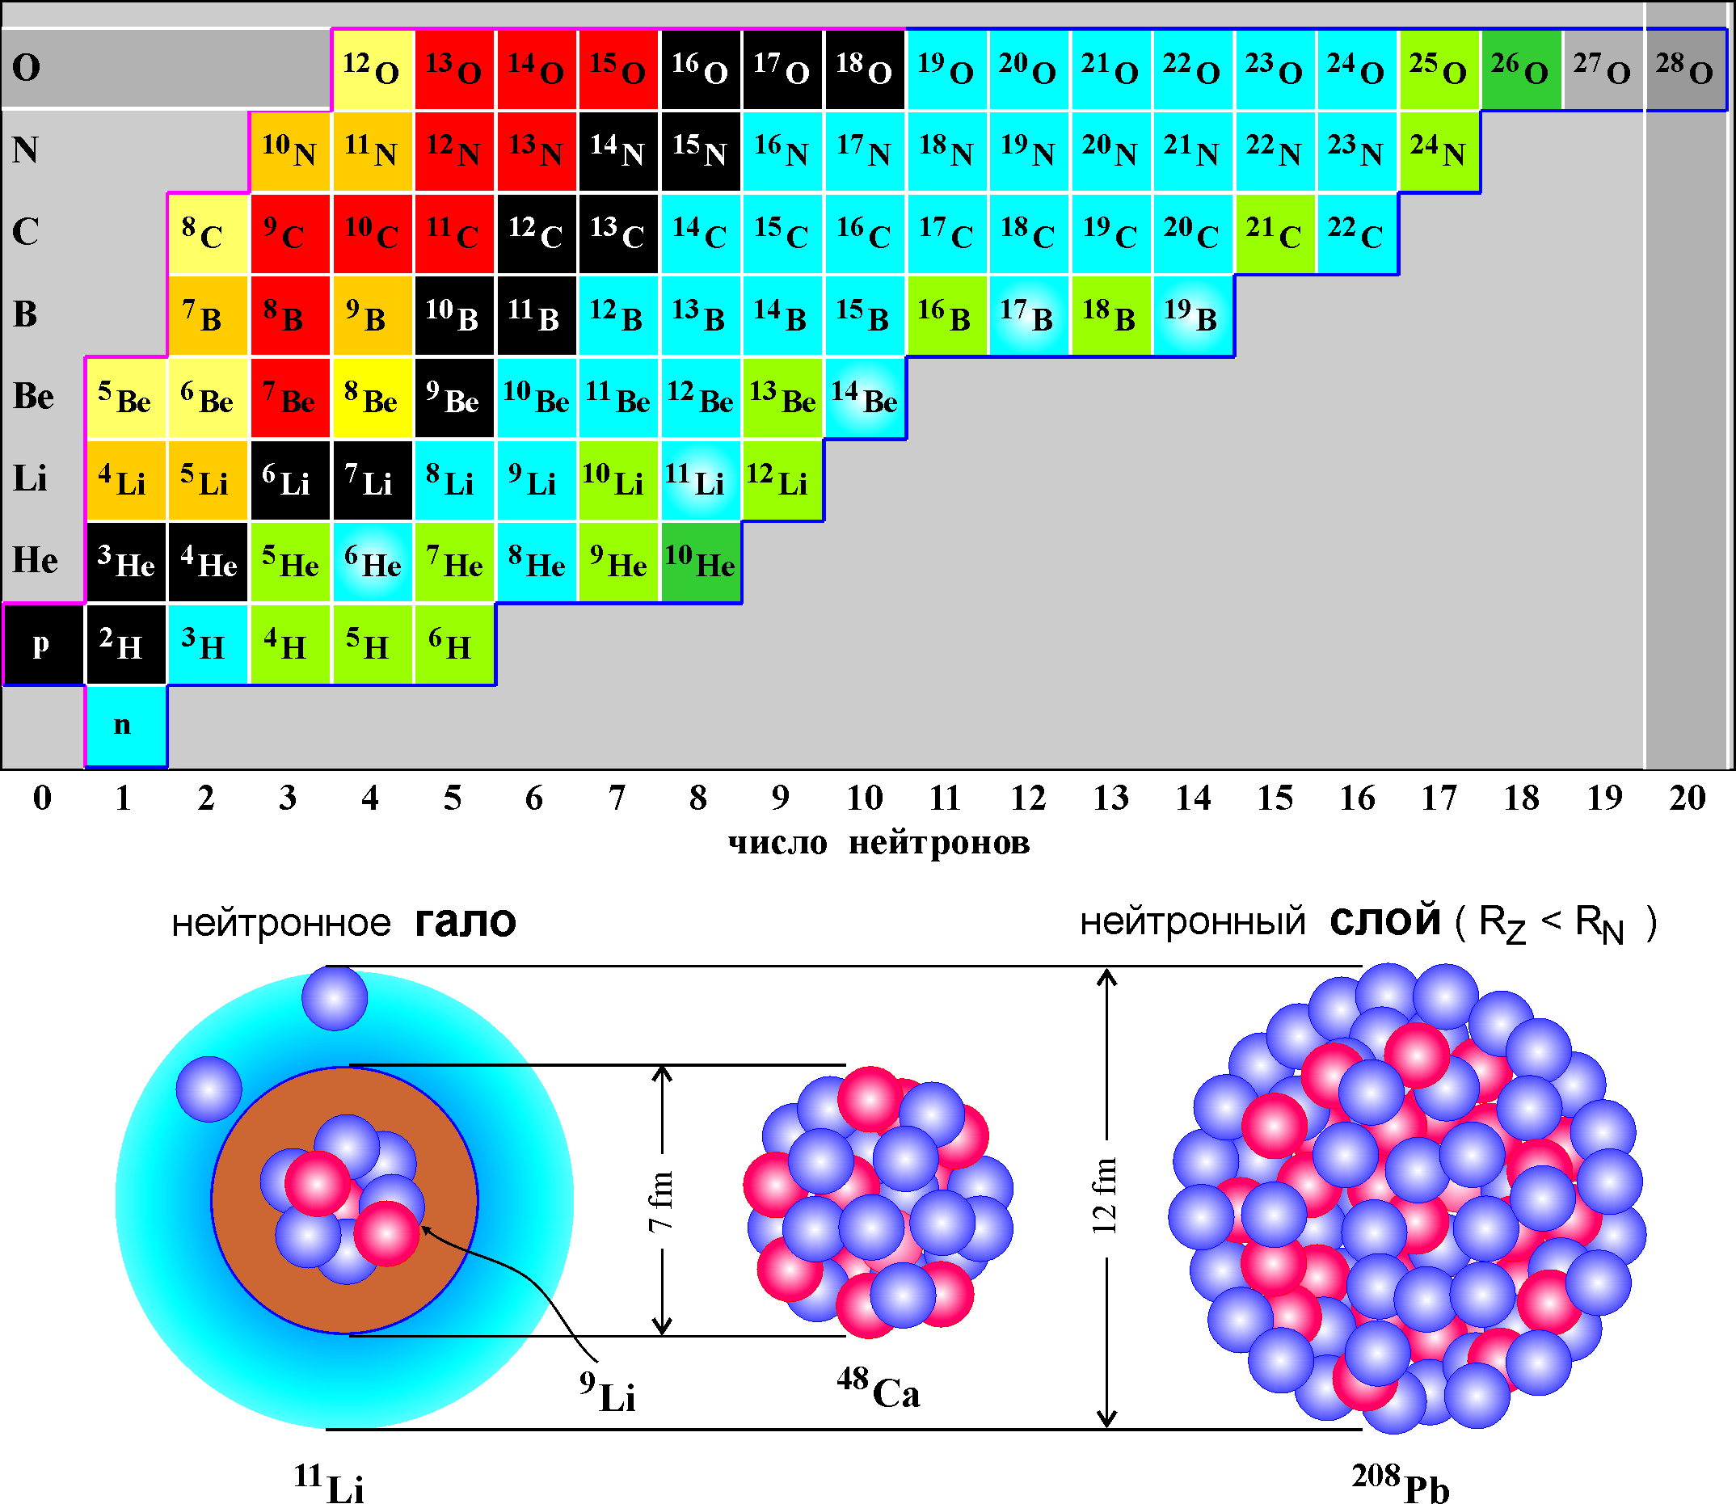
Флеровий 114
Московий 115
Ливерморий 116
Теннессин 117
Оганесон 118
Fl
Mc
Lv
Ts
Og
Flerovium
Moscovium
Livermorium
Tennessine
Oganesson
1. Study of heavy and superheavy nuclei:
synthesis and study of properties of super-heavy elements;
chemistry of new elements;
fusion-fission;
α-, β- and γ-spectroscopy of heavy nuclei.
DC280,
U400
Stability island
number of protons
2. Experiments with secondary beams of light radioactive nuclei:
properties and structure of light exotic nuclei near and beyond
the drip lines;
reactions with exotic nuclei.
U400M
number of neutrons
IC100,
APCenter
3. Radiation effects and physical groundwork of nanotechnologies.

Slide 4
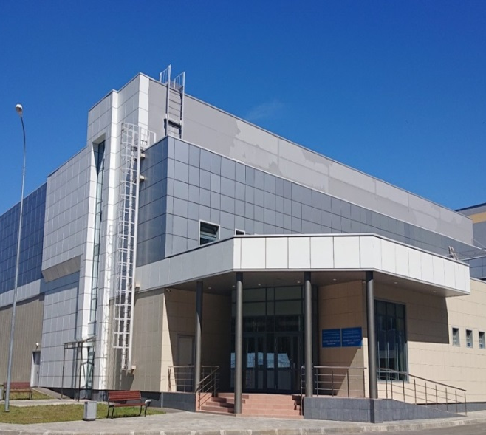
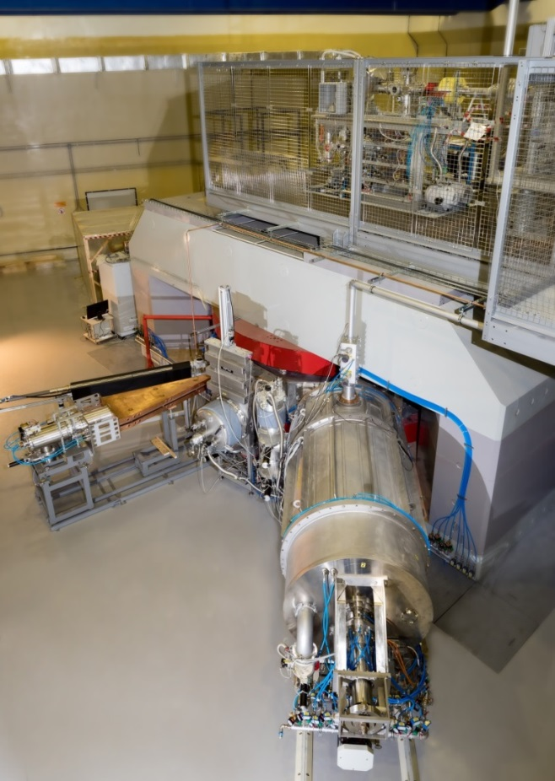
SHE Factory (DC280):
Put into operation in 2019. Experiments started in 2020
Main goals:
Experiments at the extremely low (σ<100 fb) cross sections:
Synthesis of new SHE in reactions with ⁵⁰Ti, ⁵⁴Cr ...;
Synthesis of new isotopes of SHE;
Search for rare decay modes of SHE;
Study of excitation functions.
Experiments requiring high statistics:
Nuclear spectroscopy of SHE;
Precise mass measurements;
Study of chemical properties of SHE.
Ion | E_{ion} [Mev/n] | I_{INJ} [pμA] | I_{EXTR} [pμA]
¹²C⁺² | 5.9 | 29,8 | 10
⁴⁰Ar⁺⁷ | 4.9 | 28.7 | 10.4
⁴⁸Ca⁺¹⁰ | 4.8 | 24 | 7.1
⁴⁸Ti⁺¹⁰ | 4.8 | 2.2 | 1
⁵²Cr⁺¹⁰ | 5.2 | 7 | 4
⁸⁴Kr⁺¹⁴ | 5.9 | 2.9 | 1.4

Slide 5
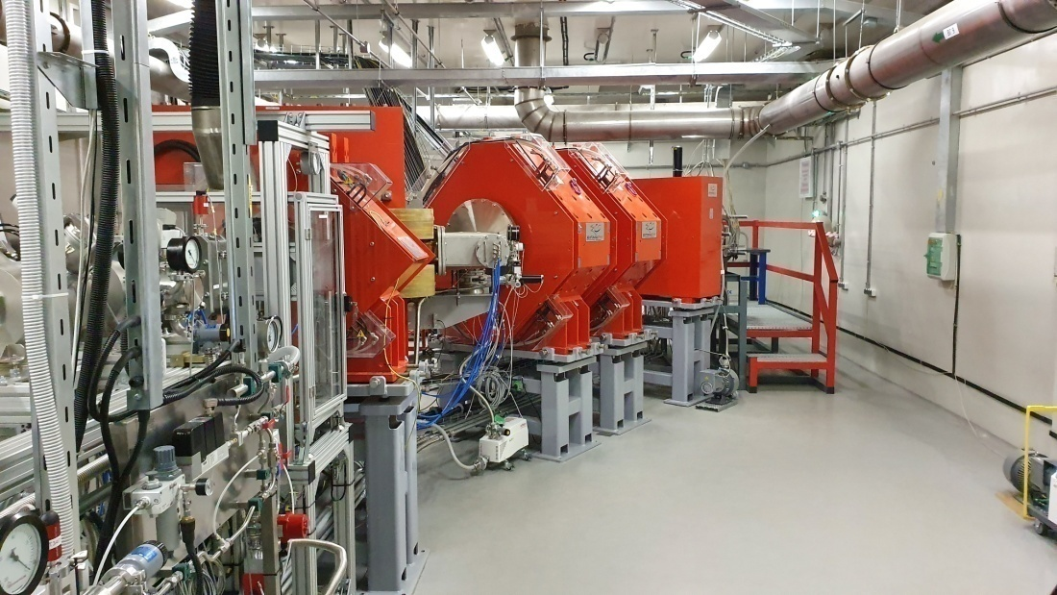
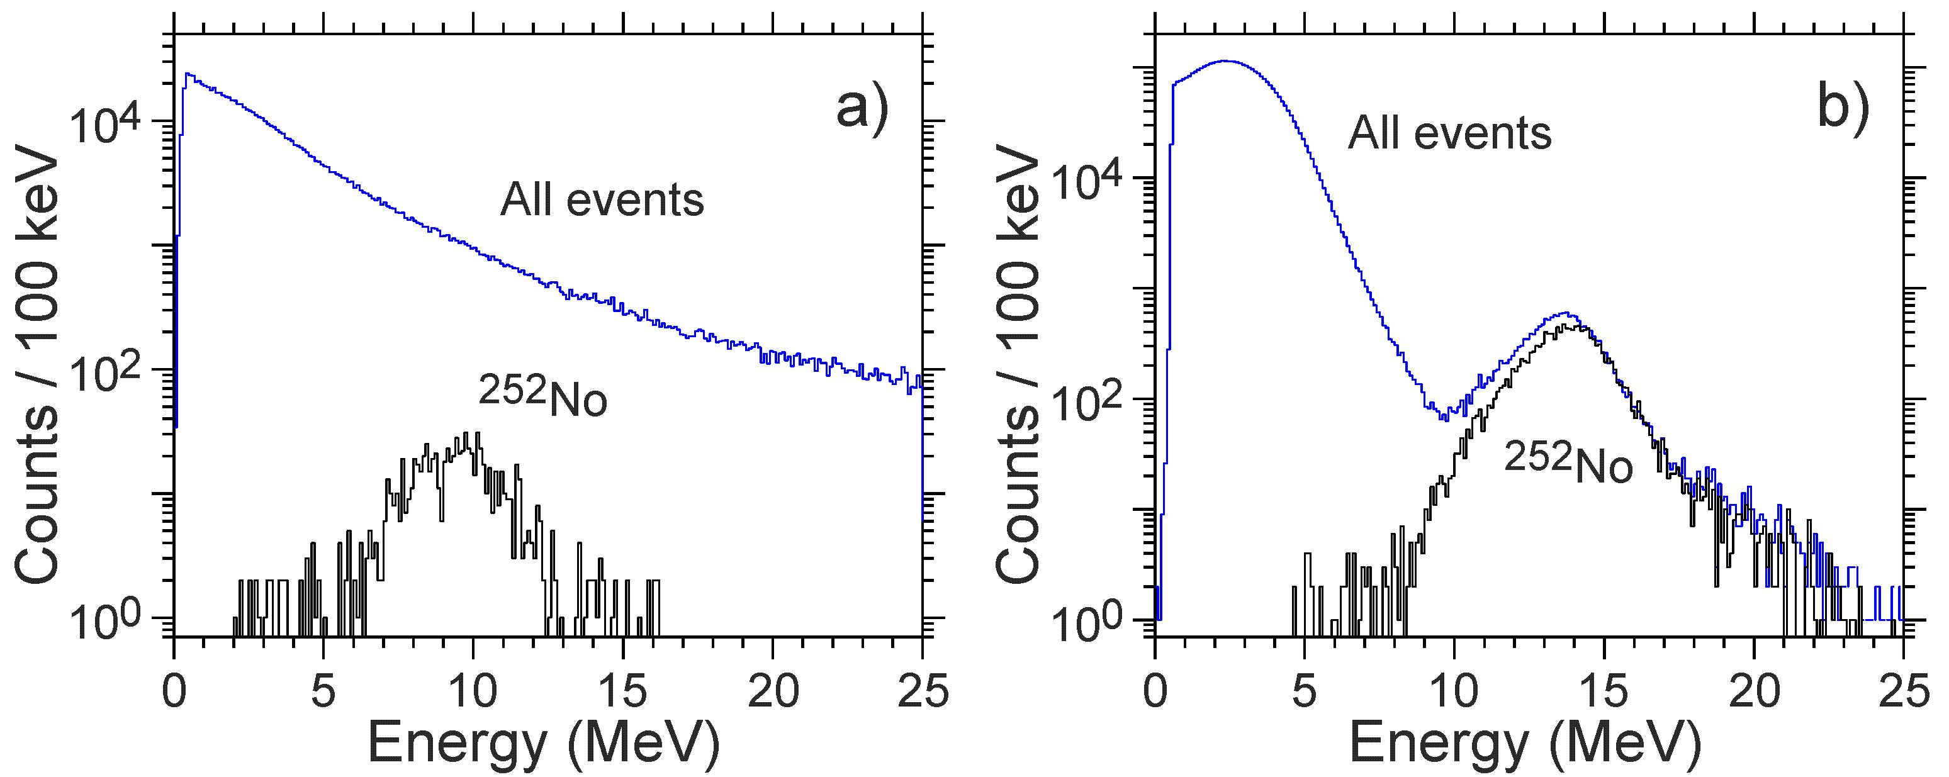
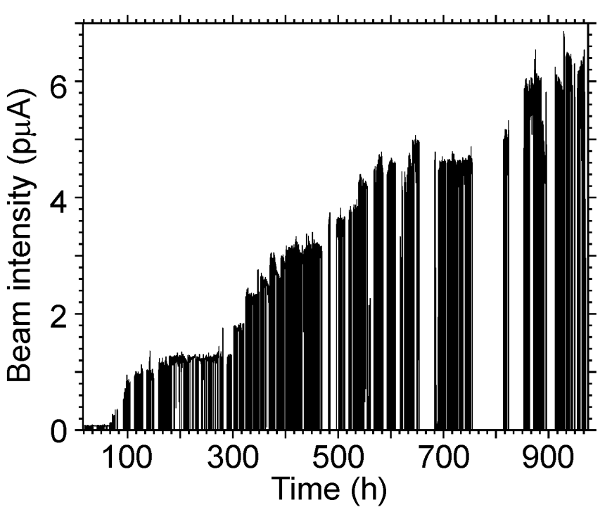
First experiments at SHE Factory (2020 -2022)
Experiments: ²⁴³Am + ⁴⁸Ca → ²⁹¹Mc* ²⁴²Pu + ⁴⁸Ca → ²⁹⁰Fl*
²³⁸U + ⁴⁸Ca → ²⁸⁶Cn*
²³²Th + ⁴⁸Ca → ²⁸⁰Ds*
238 new events of synthesis of superheavy nuclides
(3 times more than in the entire history of research);
Decay properties 33 isotopes;
New isotopes: ²⁸⁷Mc, ²⁶⁴Lr, ²⁷⁶Ds, ²⁷²Hs, ²⁶⁸Sg;
New decay modes: ²⁶⁸Db (alpha-decay), ²⁷⁹Rg (spontaneous fission);
Indication of the 1st excited state in ²⁸⁶Fl;
Test of target stability up to 6.5 pμA of ⁴⁸Ca;
DGFRS-2:
launch 2020
Yu. Ts. Oganessian et al., NIMA 1033 (2022)
Yu. Ts. Oganessian et al., Phys. Rev. C 106 (2022)
Yu. Ts. Oganessian et al., Phys. Rev. C 106 (2022)
DGFRS II vs. DGFRS I:
Increase of transmission by 2 times;
Increase of suppression of background nuclei
by more than factor of 200.
DGFRS I
DGFRS II
⁴⁸Ca + ²³⁸U

Slide 6
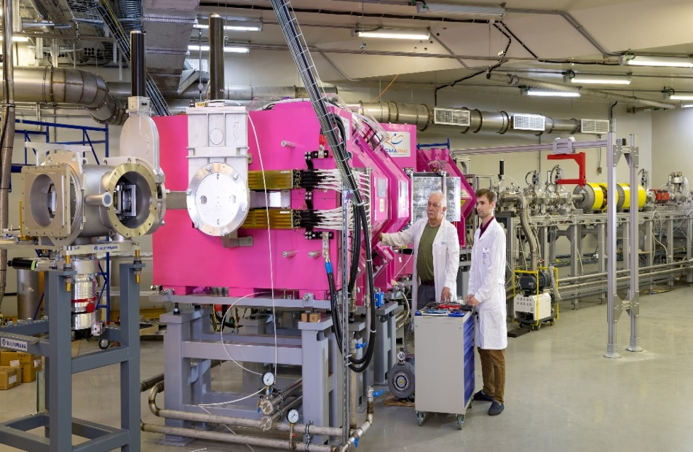
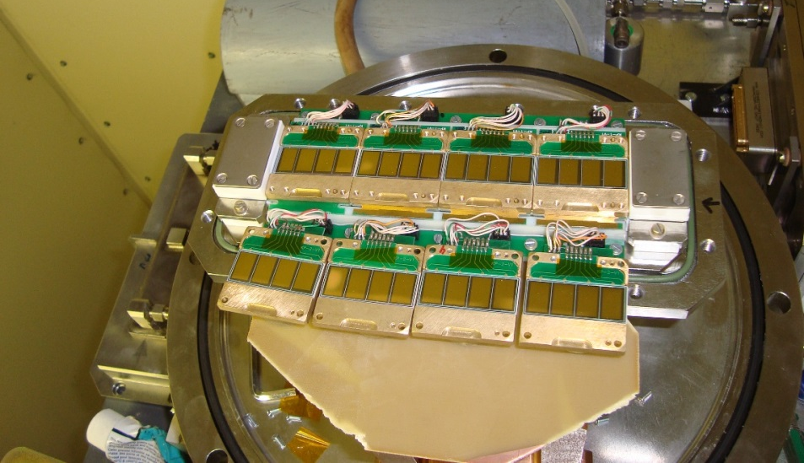
Chemistry of Cn&Fl: first runs
at the GRAND separator(launched in 2022)
Test measurements
⁴⁸Ca + ¹⁷⁴Yb → ²²²Th*
⁴⁸Ca + ²⁰⁶Pb → ²⁵⁴No*
First run (Nov.-Dec. 2022)
⁴⁸Ca + ²⁴²Pu → Fl*
Notes:
На Фабрике сверхтяжелых элементов продолжается подготовка к проведению первого эксперимента по изучению химических свойств 114 (флеровия) и 112 (коперниция) элементов в реакции калиций-48 + плутоний-242. Успешно прошли первые пуско-наладочные испытания сепаратора GRAND на пучке ионов кальция-48. Удалось получить достаточно компактное изображение ядер отдачи в фокальной плоскости детекторной камеры: 5 x 5.5 см, что позволяет перейти к следующим этапам подготовки эксперимента. Начала химического эксперимента намечено на конец весны – начало лета этого года.
At the Superheavy Element Factory, preparations are underway for the first experiment to study the chemical properties of elements 114 (flerovium) and 112 (copernicium) in the reaction of calcium-48 + plutonium-242. The first commissioning tests of the GRAND separator on a beam of calcium ions-48 have successfully passed. It was possible to obtain a fairly compact image of recoil nuclei in the focal plane of the detector chamber: 5 x 5.5 cm, which allows us to proceed to the next stages of the experiment preparation. The beginning of the chemical experiment is scheduled for late spring - early summer of this year.

Slide 7
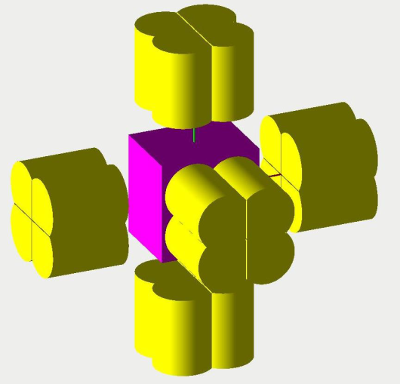
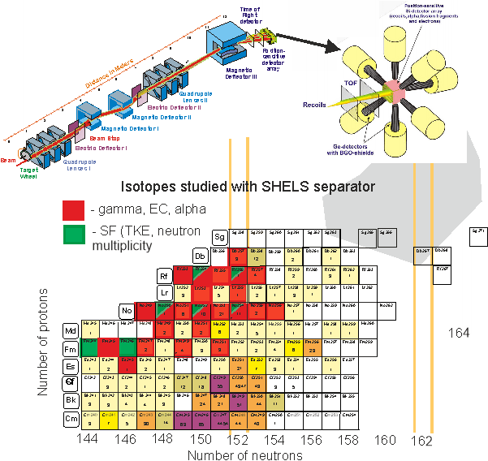
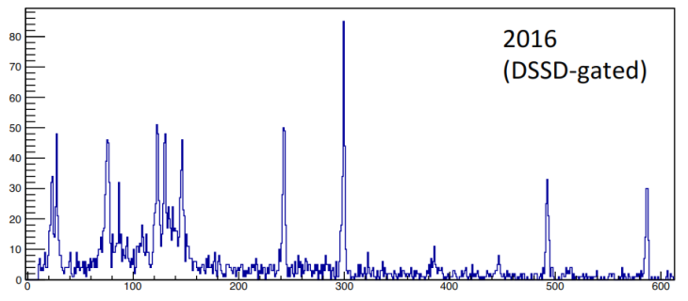
Spectroscopy of Heavy Isotopes at SHELS
U400 cyclotron:
Beams of ⁴⁰Ar, ⁴⁸Ca, ⁵⁰Ti, ⁵⁴Cr
Intensity 0.5 – 1.0 pµA
SHELS velocity filter
GABRIELA setup:
γ- spectroscopy (5 Ge clover detectors);
CE-spectroscopy;
High resolution α- spectroscopy.
Statistics 10³ – 10⁵ events.
Number of protons
⁴⁸Ca(²⁰⁹Bi,2n)²⁵⁵Lr

Slide 8
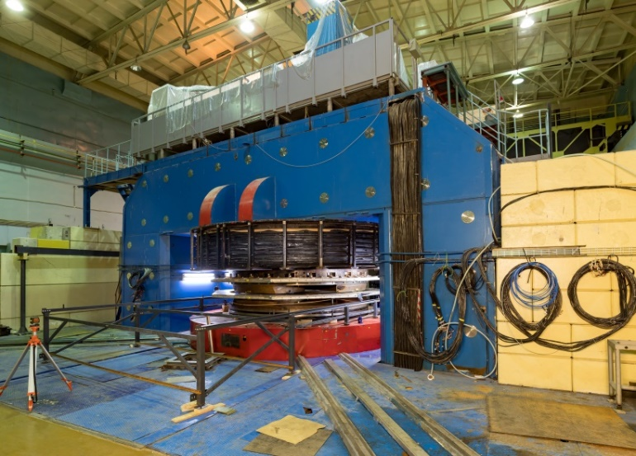
U400М: completion of modernization and launch in 2023
Primary beams
Ion | 2023
 | E (MeV/u) planned | I(pμA) planned
⁷Li | 39 | 10
¹¹B | 33 | 6
¹⁵N | 51 | 2
¹⁸O | 40 | 1.5
²²Ne | 50 | 1
³⁶S | 44 | 0.2
⁴⁸Ca | 38 | 0.1
Secondary beams
RIB* | Intensity, pps (at 1 pμA) | Energy, MeV/A
⁶He | 1x10⁷ | 22
⁸He | 8x10⁴ | 23
¹¹Li | 7x10³ | 33
¹⁴Be | 2x10³ | 35
²⁴O | 2x10³ | 23
²⁸S | 1x10³ | 38
Replacement:
Damaged winding;
Vacuum system;
Control system;
Radiation safety system
Expected results of the upgrade in 2023:
Stable operation;
Improved beam quality;
Increase of beam intensities.

Slide 9
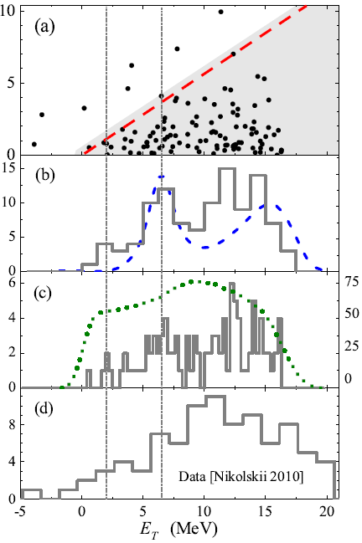
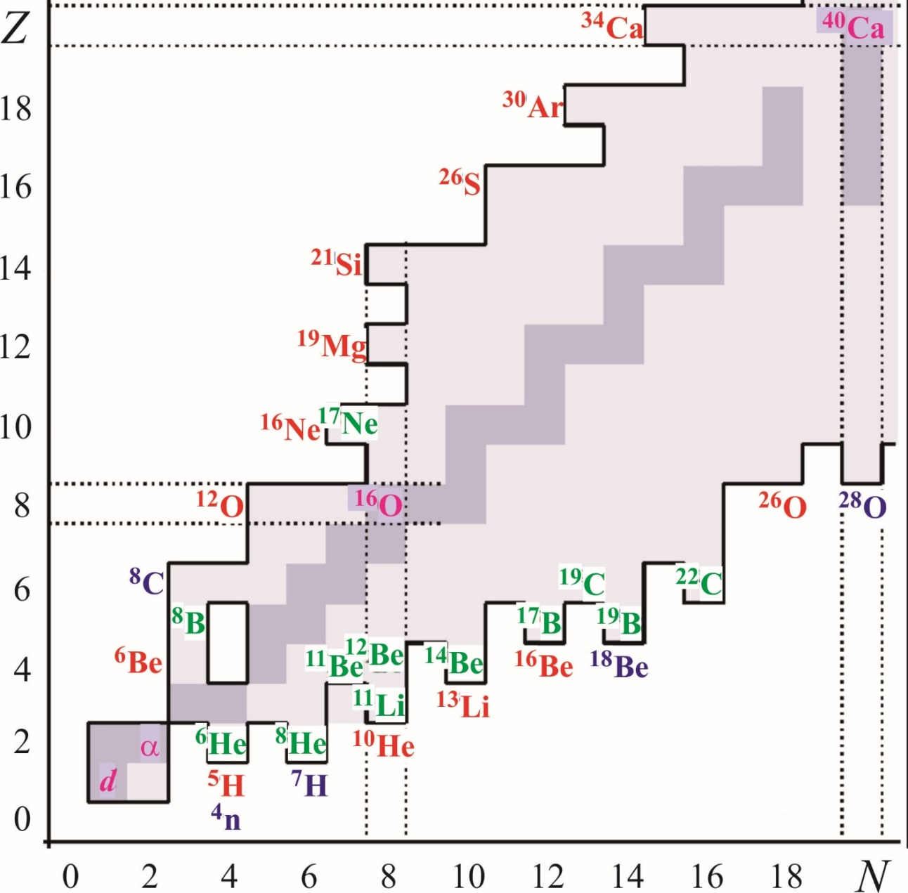
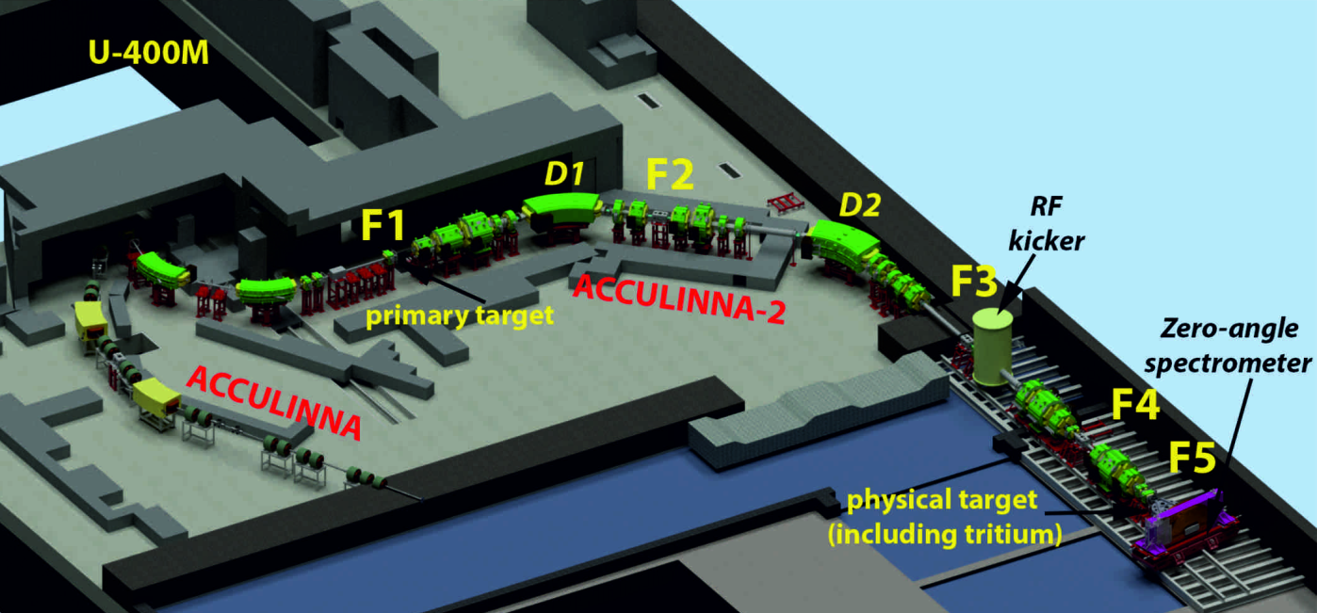
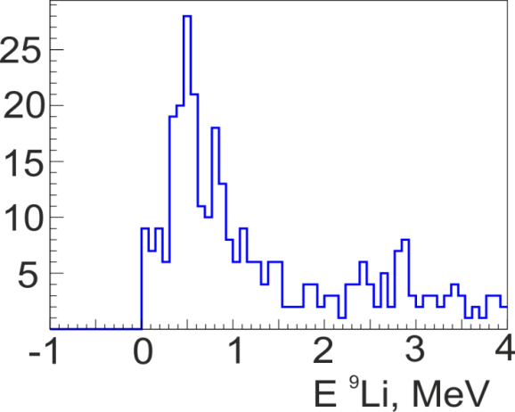
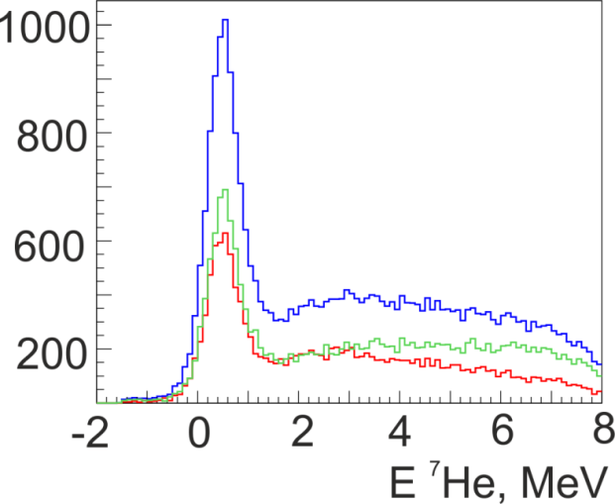
Light Nuclei far from the
β-Stability Line
⁸He(d,³He)⁷H
PRL 2020,
PRC 2021
Fragment-Separator ACCULINNA-II
(put into operation in 2017)
0
5
10
15
E ⁷H, MeV
I. A. Muzalevskii et al., Phys. Rev. C 103 (2021)
E. Yu. Nikolskii et al., Phys. Rev. C 105 (2022)
⁹Li(d,p)¹⁰Li
E ¹⁰Li, MeV
⁶He(d,p)⁷He
A. S. Fomichev et al., EPJ A 54 (2018)

Slide 10
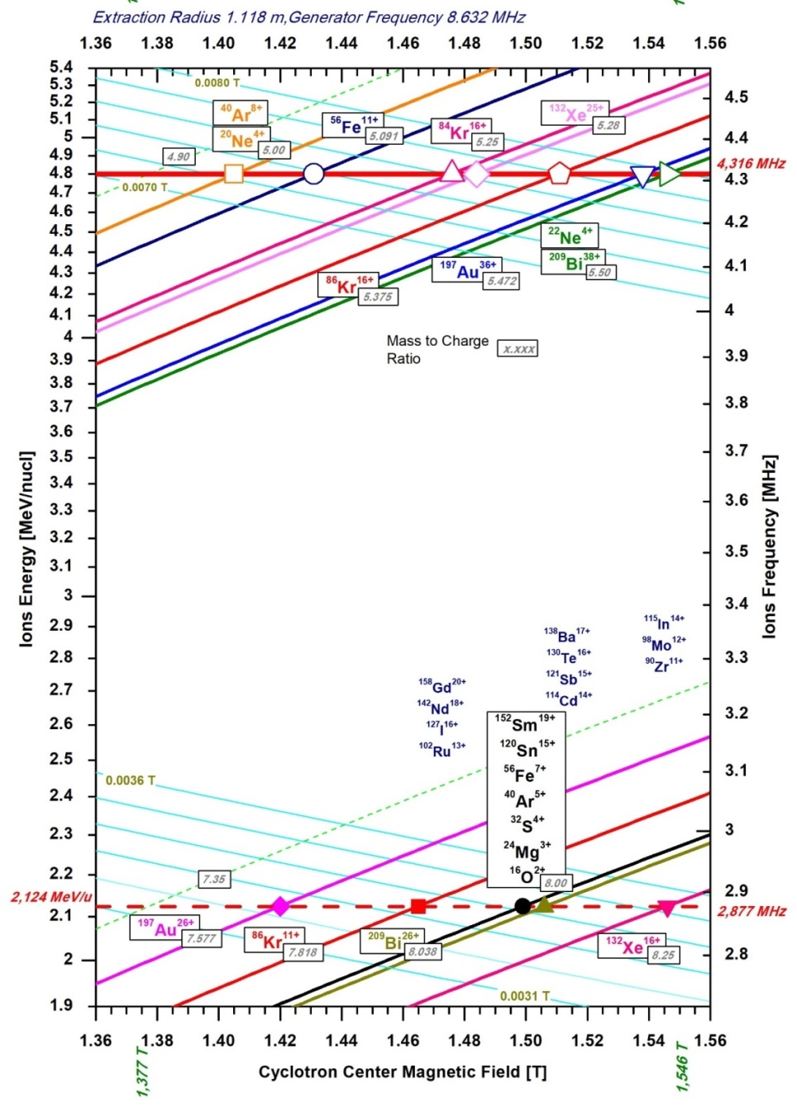
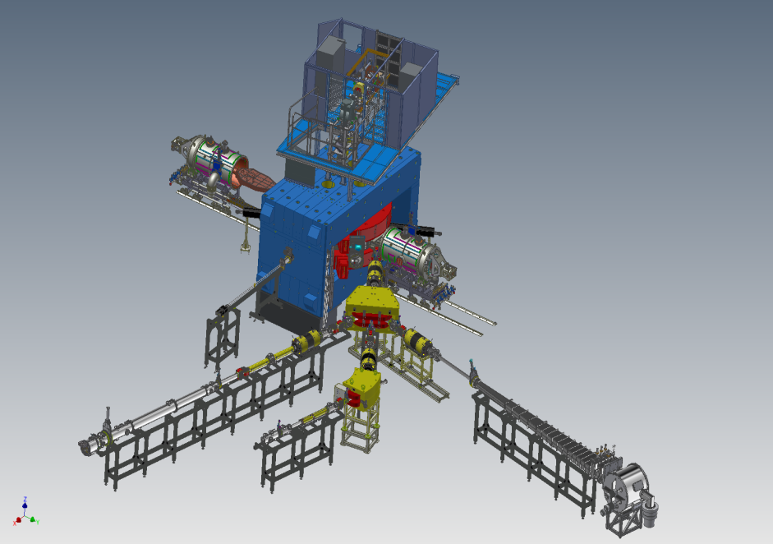
DC-140: heavy ion cyclotron
for applied studies (2020 -2023)
Ion beams from O to Bi with energies 4.8 and 2.1 MeV/n for applied studies.
The main goals of the project include studies within solid state physics, surface modifications of materials, production of track membranes and testing of electronic components for single radiation effects

Slide 11
Forthcoming 7-year period
2024 - 2030

Slide 12
Scientific Research for 2024 - 2030
Synthesis and Properties of Superheavy Elements, Structure of Nuclei at the Limits of Nucleon Stability
Heavy and Superheavy Nuclei
Light Nuclei
New Elements
DGFRS II
Structure of nuclei far from the β-stability line
ACCULINNA II
ACCULINNA I
Chemistry of SHE
GRAND
Spectroscopy of Heavy and SH isotopes
SHELS, GRAND
Study of exotic modes of decay
Reaction mechanisms, FF, MNT
Production mechanisms of light exotic nuclei
MAVR
CORSET
Theory
Theory

Slide 13
Technical Development for 2024 -2030
Development of the FLNR accelerator complex and experimental setups (DRIBs-III)
Accelerators
Separators
DC280
GASSOL
ECR-28 GHz
MR TOF
SHELS
U400R
STAR
New Building
SCIF
MAVR
U400M
ACCULINNA II
ACCULINNA I
DC140
Applied Studies

Slide 14
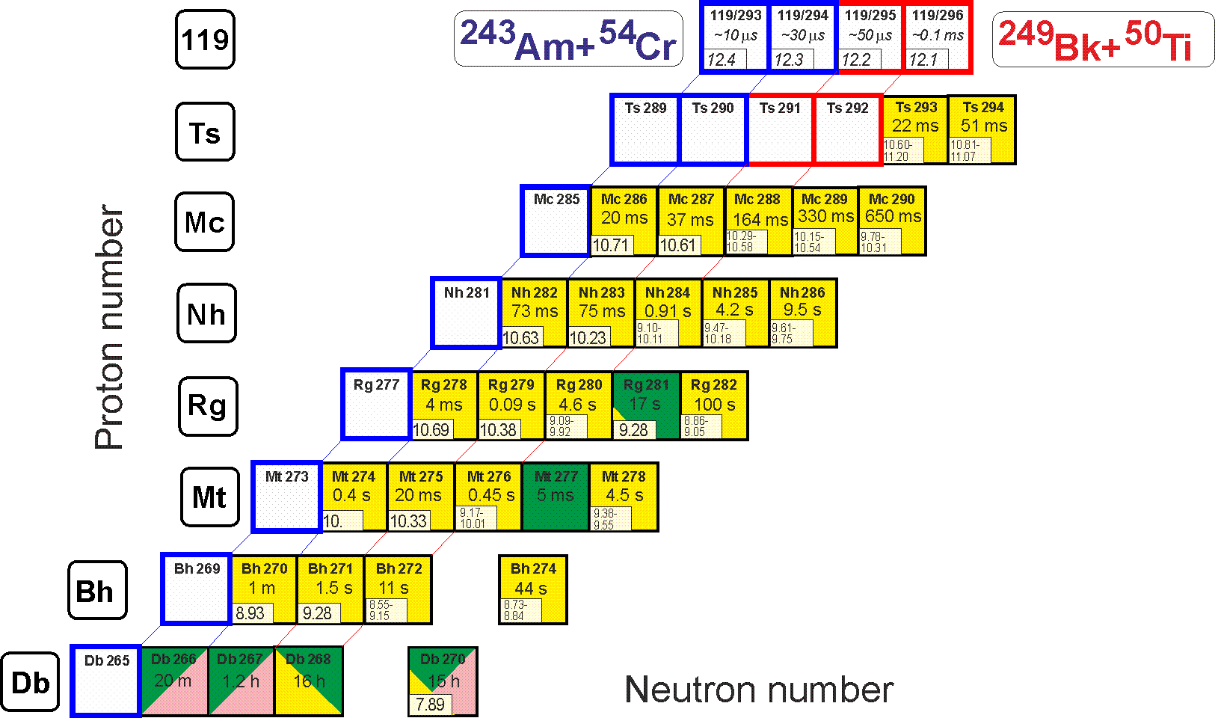
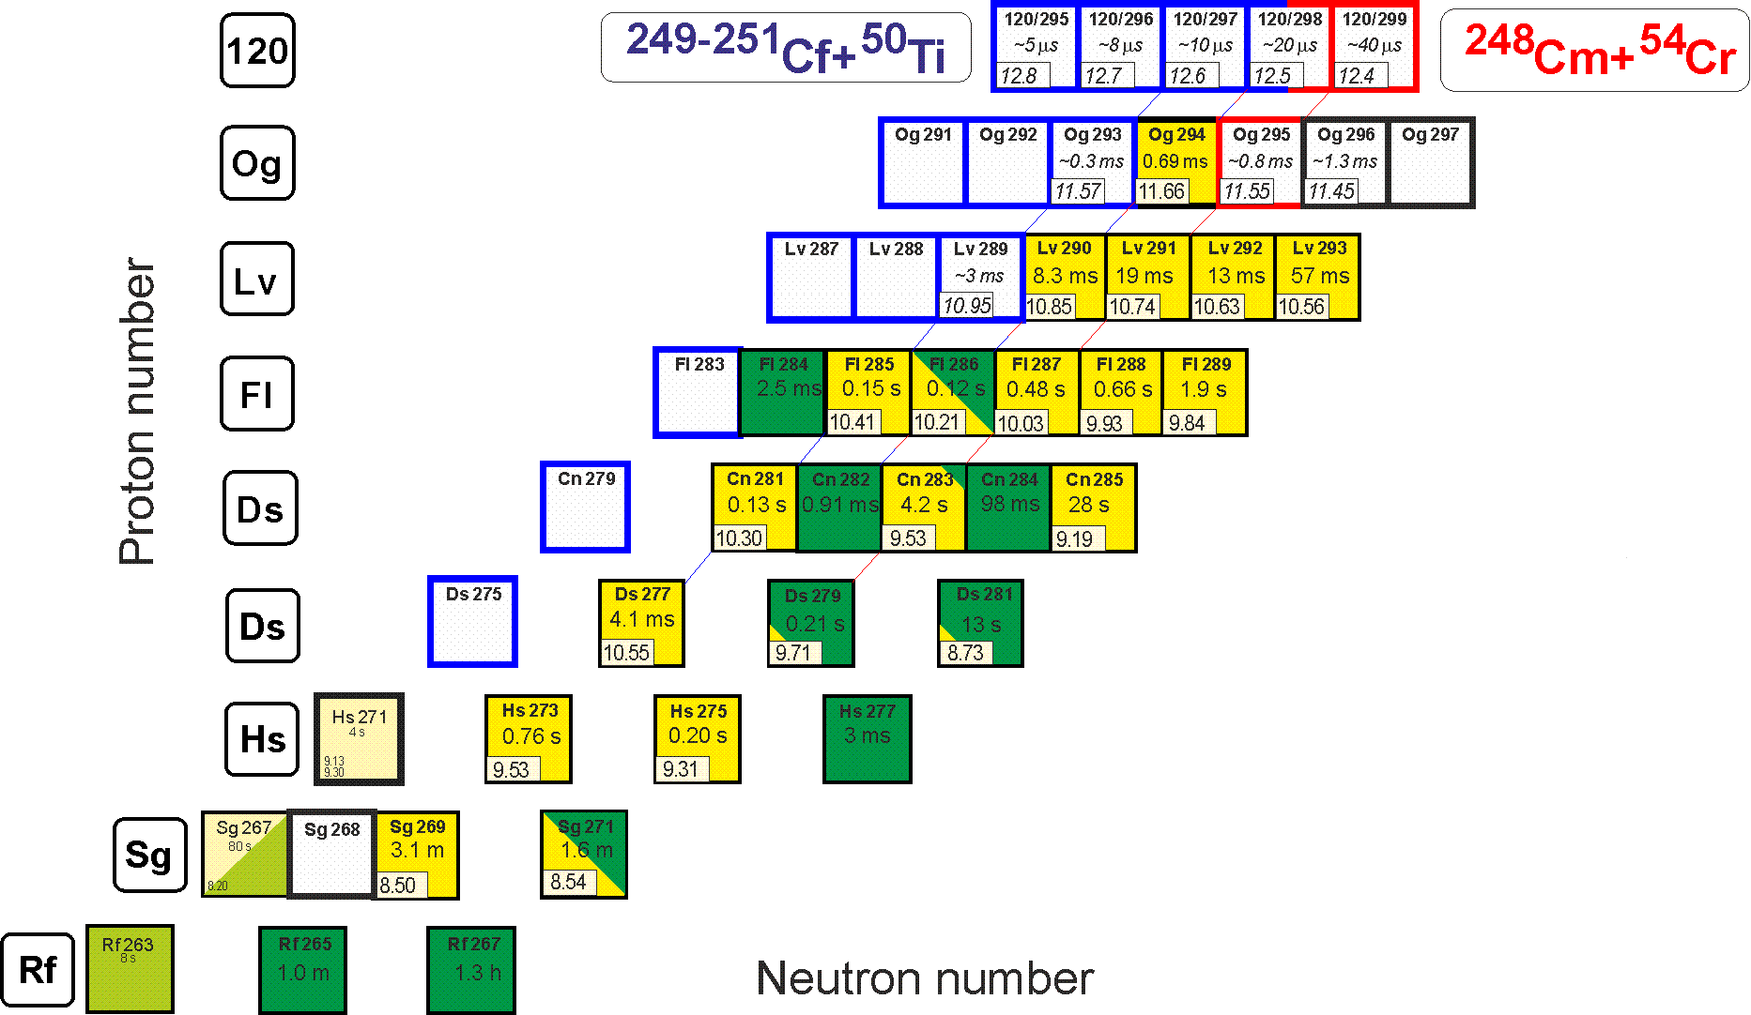
New elements
DGFRS II
²⁴³Am(⁵⁴Cr,3-4n)^{293,294}119 (σ ⁓ 0.01 pb)
²⁴⁹Bk(⁵⁰Ti,3-4n)^{295,296}119 (σ ⁓ 0.1 pb)
I_{beam}=3 pμA,
h_{t}=0.4 mg/cm²,
ε_{coll}=0.6,
σ=0.05 pb → ≈1 event per month
^{245,246,248}Cm(⁵⁴Cr,3-4n)²⁹⁵⁻²⁹⁹120
²⁴⁹⁻²⁵¹Cf(⁵⁰Ti,3-4n)²⁹⁵⁻²⁹⁸120
Tasks:
Beam intensity increase (⁵⁰Ti,⁵⁴Cr);
License to work with RM;
I class RCL at the SHE Factory (Bk,Cf).

Slide 15
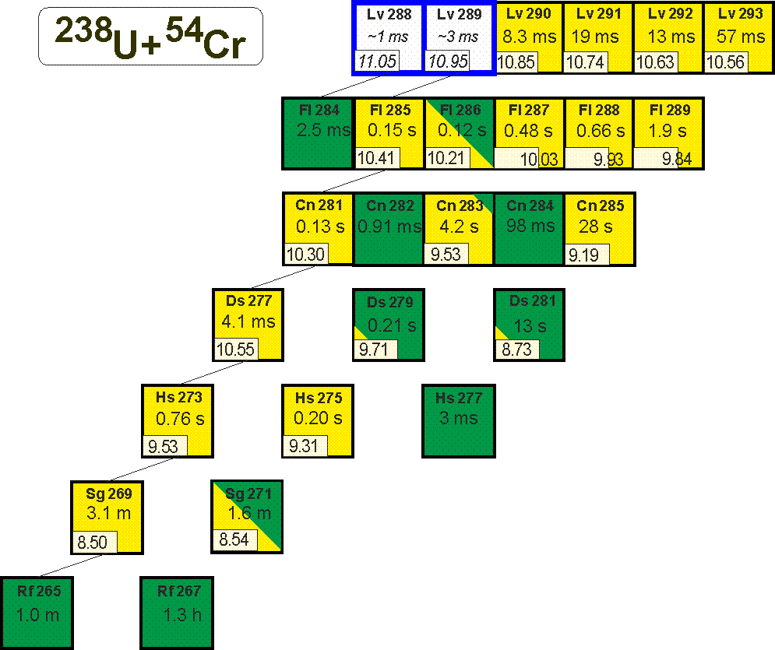
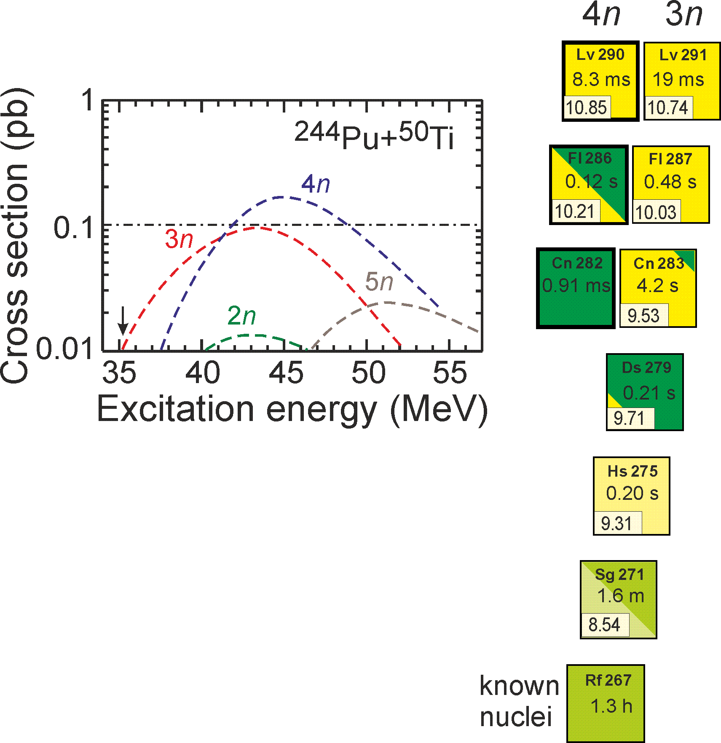
Cross Sections
DGFRS II
²³⁸U(⁵⁴Cr,3-4n)^{288,289}Lv
I_{beam}= 5 pμA,
h_{t}=0.8 mg/cm²,
ε_{coll}=0.5,
σ=0.015 pb → ≈ 3 event per 2 months
²⁴⁴Pu+⁵⁰Ti
²³⁸U+⁵⁰Ti
²³⁸U(⁵⁰Ti,3-4n)^{284,285}Fl
I_{beam}= 5 pμA,
h_{t}=0.8 mg/cm²,
ε_{coll}=0.5,
σ=0.2 pb → ≈ 3 event per 5 days
²⁴⁴Pu(⁵⁰Ti,3-4n)^{290,291}Lv
I_{beam}= 5 pμA,
h_{t}=0.3 mg/cm²,
ε_{coll}=0.6,
σ=0.2 pb → ≈ 7 event per 1 month

Slide 16
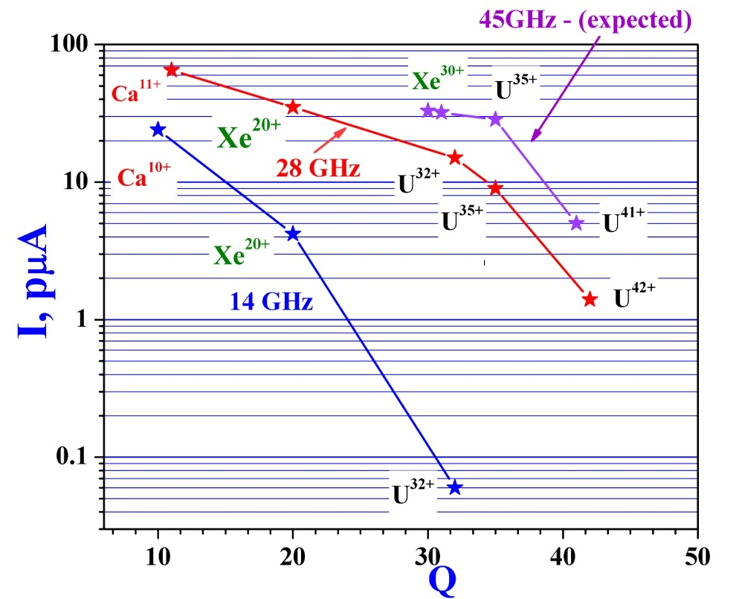
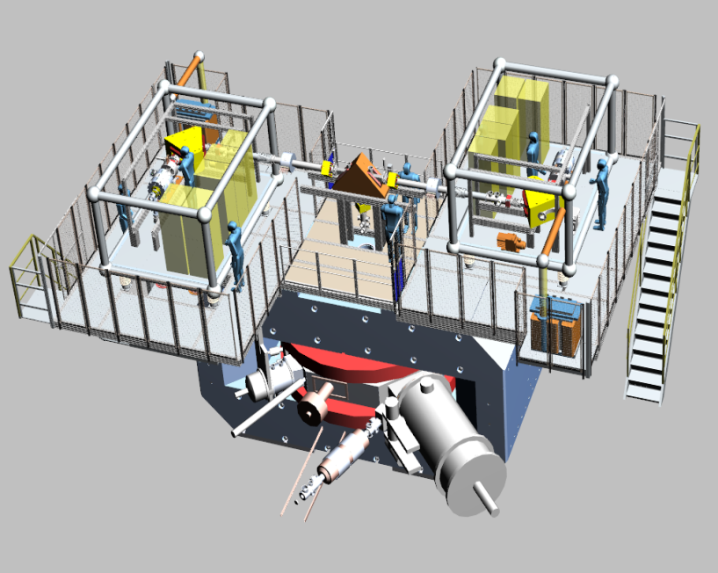
Some Tasks for the Near Future
Target materials:
Isotopes of Cm (available), Bk, Cf (start of deliveries in 2025);
License (2023), I class RCL;
Intensity of ⁵⁰Ti and ⁵⁴Cr beams >5 pμA.
High temperature oven, volatile chemical compounds of Ti and Cr.
New ion source SC-ECRIS 28 GHz (to be put into operation in 2025).
SC ECRIS 28 GHz
28 GHz SC-ECRIS
DECRIS-PM
100 kV
Platform

Slide 17
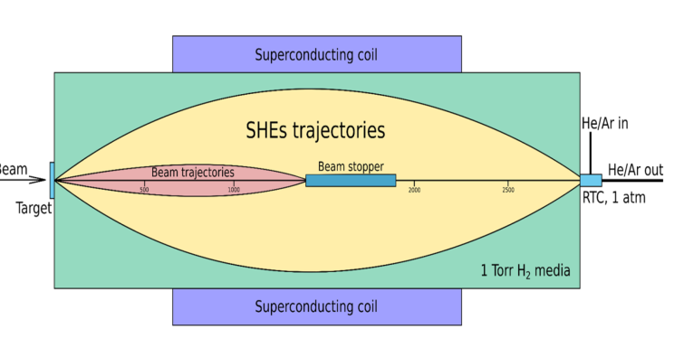
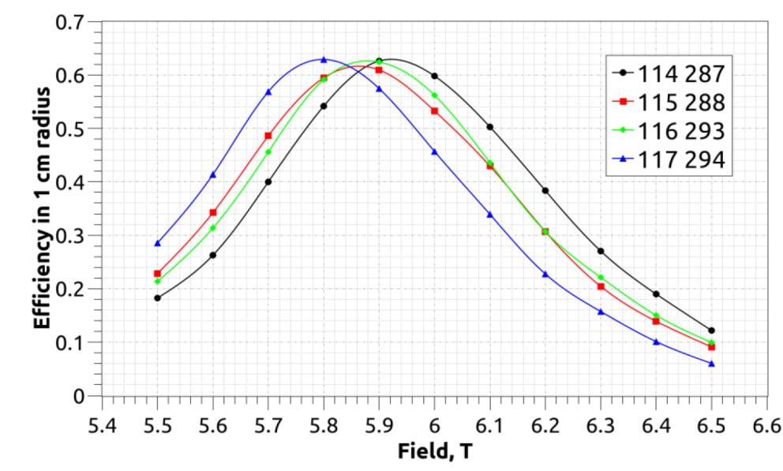
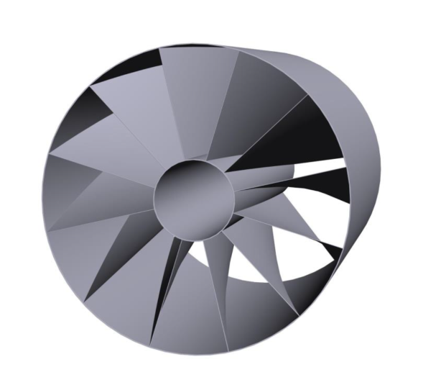
Chemistry of SHE: GASSOL
Superconducting gas-filled solenoid
²⁸⁷Fl (0.36 s), ²⁸⁸Mc (0.19 s), ²⁹³Lv (0.06 s), ²⁹⁴Ts (0.05 s), ²⁹⁴Og (0.07 s)
The task is:
To ensure the delivery of synthesized SH ions in a time comparable with their lifetimes;
To ensure a high level of separation.
Fast delivery of ions requires as little gas in a stopping cell as possible. Reaction products must be focused to the minimum size.
Fixed blades for beam suppression

Slide 18
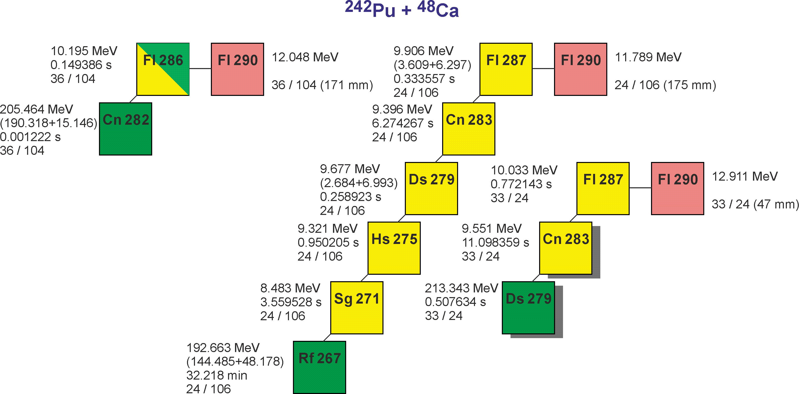
Precise mass measurements of SH isotopes
Measuring masses of SH isotopes
with accuracy 10⁻⁷ (30 кeV)
T_{1/2} < 0.5 s
Production rate $≤$ 1 event/day
Background rate $≥1$ event/s
Requirements for a facility:
High rate of analysis;
Low losses;
High degree of purification;
Accuracy 10⁻⁷ (30 кeV);
Mass range 266 – 294.
The mass measurement accuracy depends on
Mass resolution R_{m}
Statistics N
δm/m = 10⁻⁷, N = 5 => R_{m} = 2 000 000
The only type of spectrometers gives an opportunity to reach
Rm > 1 000 000 at the analysis time < 0.5 сек:
MR-TOF Mass-Analyser

Slide 19
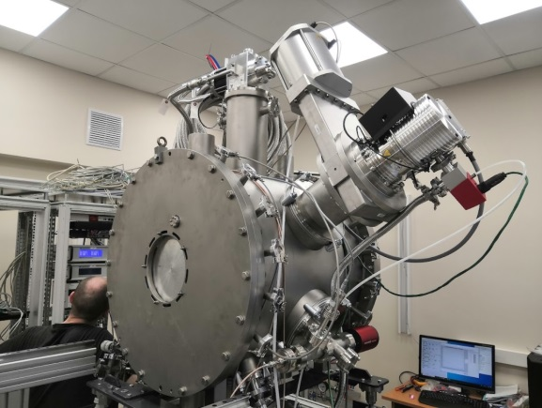
Scheme of the MR-TOF spectrometer
Concrete
shield
TOF Detector
Conceptual design
M. Yavor et al.
IAI RAS
S.-Petersburg
MR-TOF spectrometer
10⁻⁸
Тоrr
Gas cell
A = 266 – 294
(1+, 2+)
CID
cell
Calibrant
source
buncher
Cs
источник
Quadrupole mass-filter
Quadrupole
Mass-filter
RF Channel
2х10⁻² Тоrr He
банчер
Charge Selector
Детектор
α-распадов

Slide 20
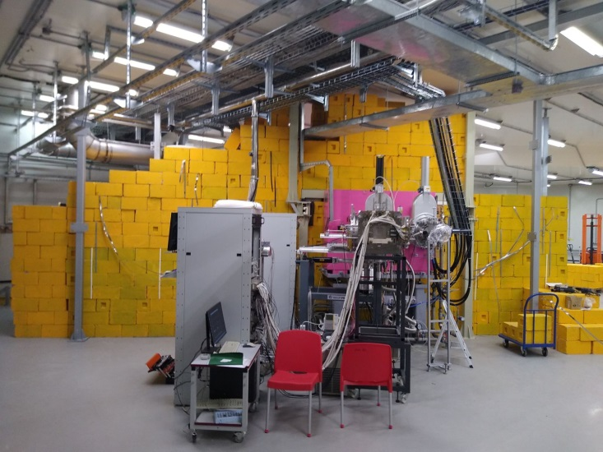
Spectroscopy of SH isotopes (SHE factory)
⁴⁸Ca + ²⁴²Pu → ²⁸⁷Fl +3n
⁴⁸Ca + ²⁴³Am → ²⁸⁸Mc +3n
Cross section ~ 10 pbarn;
Target thickness ~ 1.5x10¹⁸ at/cm²;
Beam intensity of ⁴⁸Ca
~ 3.3x10¹³ pps (5 pµA);
ε_{transmission} ~ 50 %;
12 events/day
100 days – integral flux about 10²⁰, about 300 events
300 chains → 250 gamma quanta detected, acceptable statistics.
Important information about level structure, K-isomers.

Slide 21
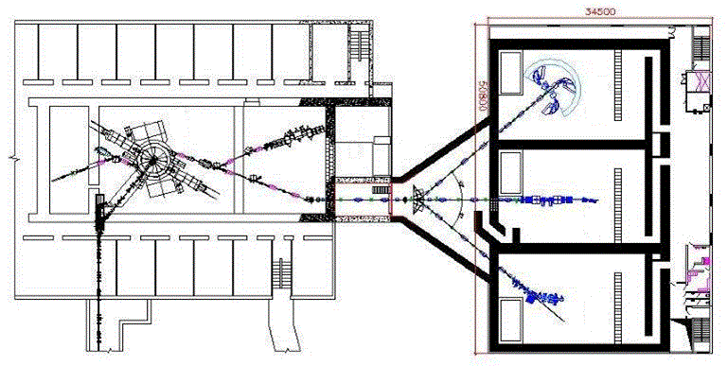
U400R Accelerator Complex
New Building
The main goals:
Ensuring a smooth variation of energy in the range 0.8 -28 MeV/n;
Decrease of the energy spread to ΔE/E=10⁻³;
Improvement of the emittance to 10π mm⋅mrad;
Increase of the intensity of accelerated ions.
No. | Works | 2023 | 2024 |  | 2025 |  | 2026
1. | Equipment picking
2. | Dismantling U400
3. | Assembling U400R and tuning
4. | Construction of the new building
5. | Launch of U400R
Ion | Ion Energy, (MeV/nucleon) | Intensity of the extracted beam
⁴ He ¹⁺ | 6.4 - 27 | 23 рμА *
¹⁶ O ²⁺ | 1.6 - 8 | 19.5 рμА *
¹⁶ O ⁴⁺ | 6.4 - 27 | 5.8 рμА *
⁴⁰ Ar ⁴⁺ | 1 - 5.1 | 10 рμА
⁴⁸ Ca ⁶⁺ | 1.6 - 8 | 2.5 рμА
⁴⁸ Ca ⁷⁺ | 2.1 - 11 | 2.1 рμА
⁵⁰ Ti ¹⁰⁺ | 4.1 - 21 | 1 рμА
⁵⁸ Fe ⁷⁺ | 1.2 - 7.5 | 1 рμА
⁸⁴ Kr ⁷⁺ | 0.8 - 3.5 | 1.4 рμА
¹³² Xe ¹¹⁺ | 0.8 - 3.5 | 0.9 рμА
²³⁸ U ²⁷⁺ | 1.5 - 8 | 0.1 рμА

Slide 22
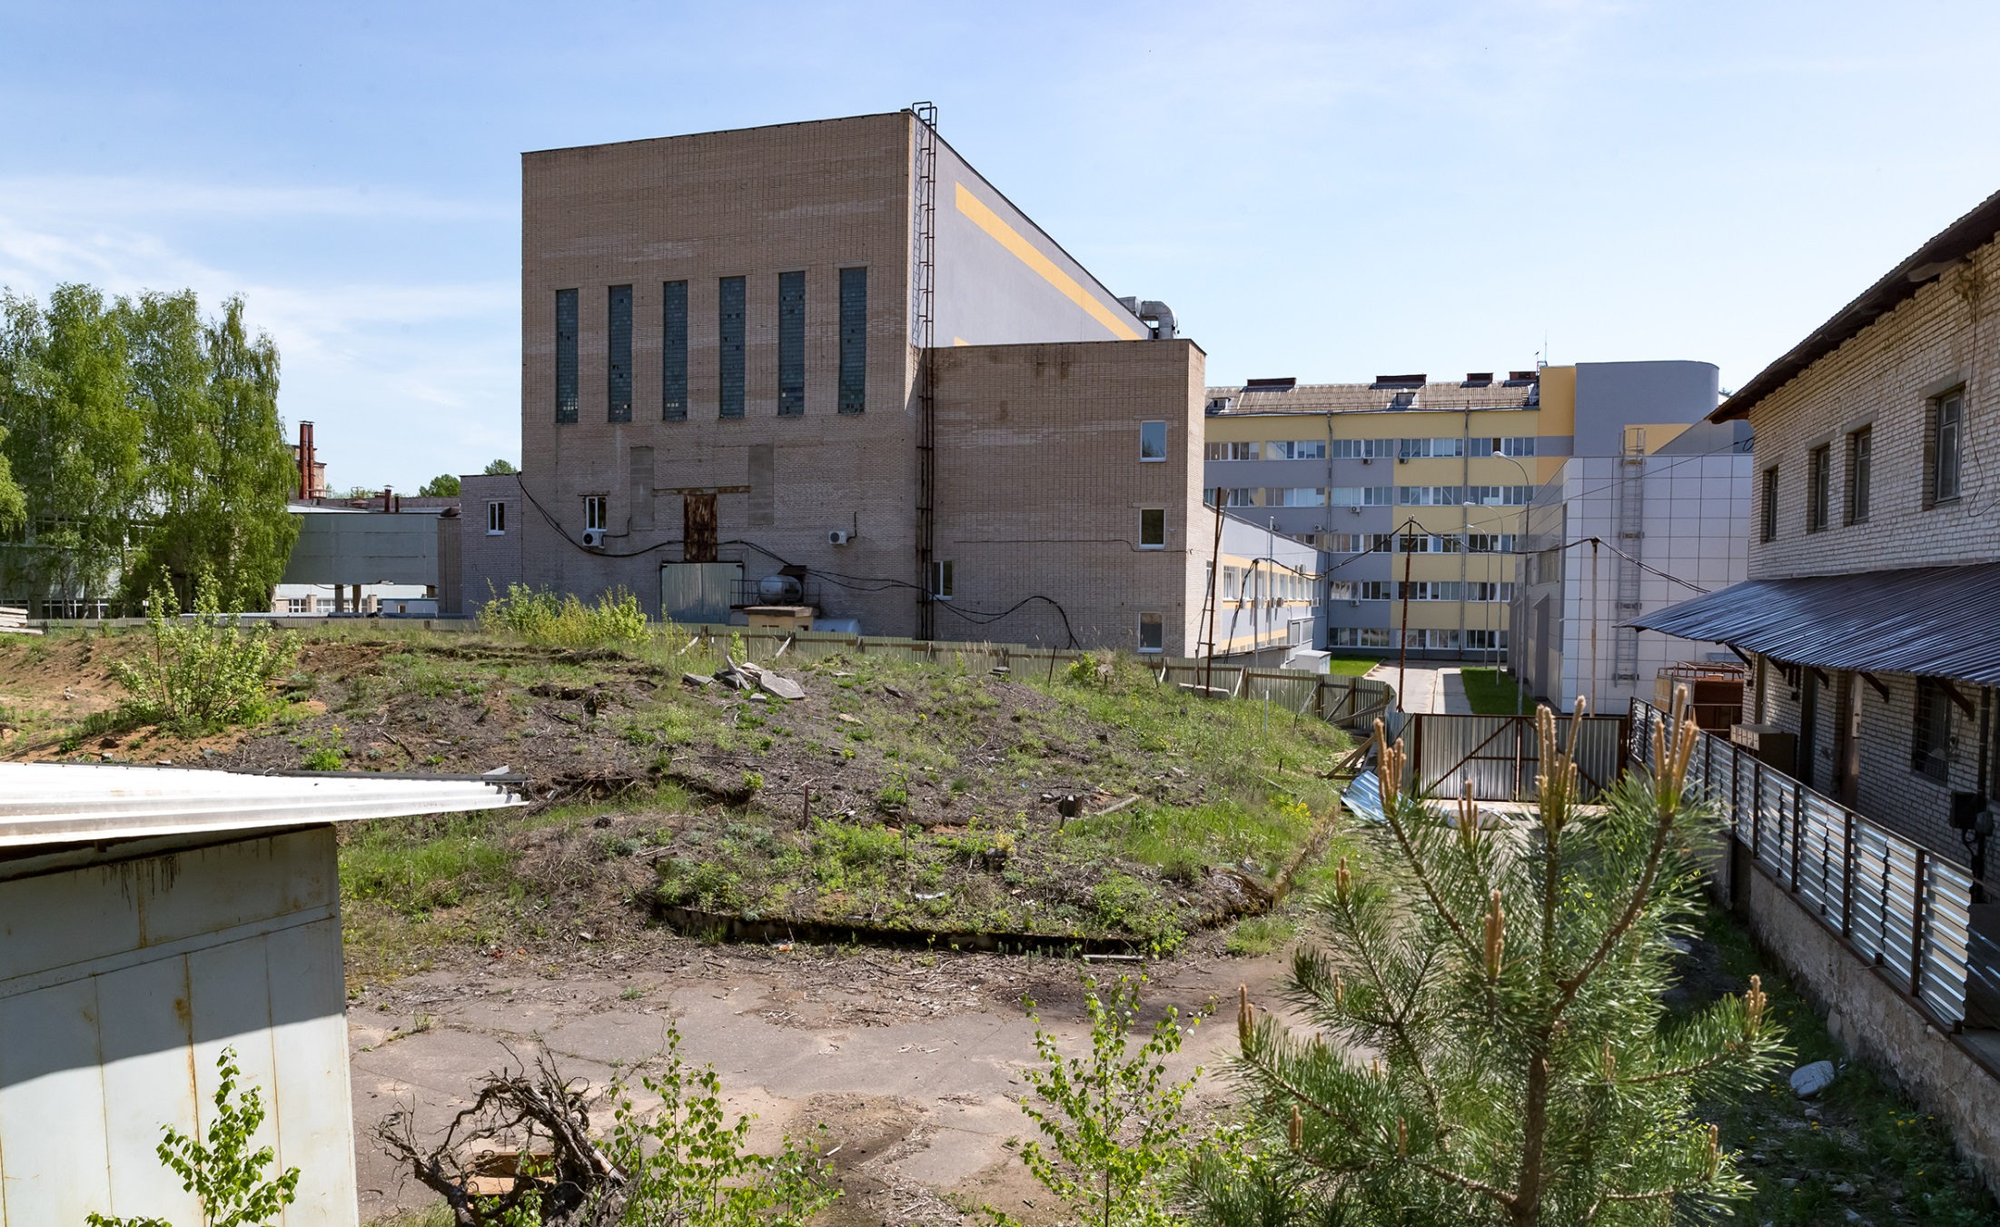
U400R: CONSTRUCTION SITE
for the NEW BUILDING (2023-2025)
The project received a positive conclusion of GLAVGOSEXPERTIZA
and permission of ROSATOM for the construction.
Process of selecting a contractor is currently underway
Start of construction in 2023.

Slide 23
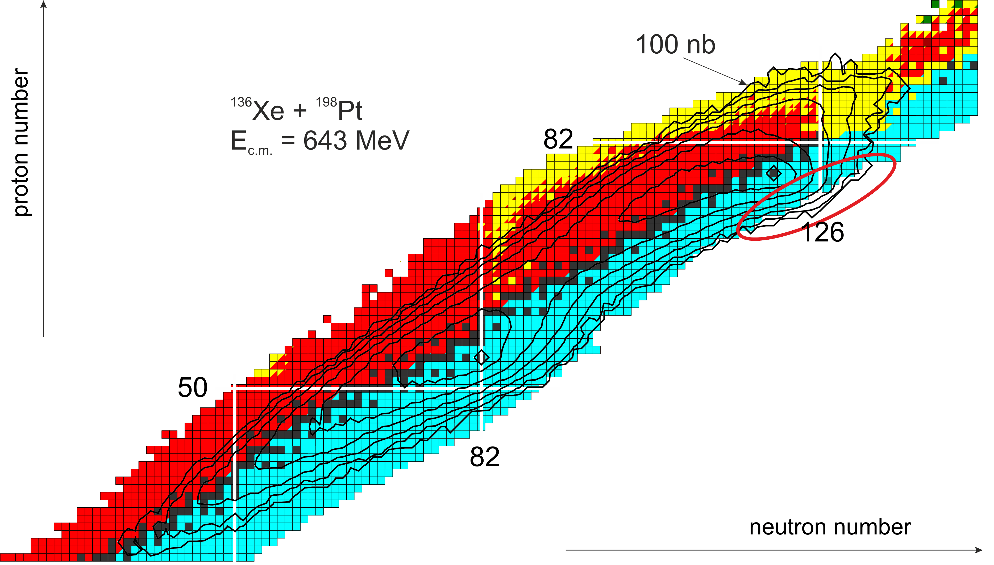
Multi-Nucleon Transfer Reactions
MNT is considered to be a promising way
of producing new nuclides
Structure of nuclei with Z = 70 ÷ 90 near the
closed neutron shell N=126
(¹³⁶Xe+¹⁷⁶Yb, ¹³⁶Xe+¹⁹⁸Pt);
²⁰²Os is the last known fragmentation of ²³⁸U (4.4 pb)
Influence of shell effects on the formation of fragments in MNT reactions to study the possibility of obtaining neutron-rich isotopes of SHE. (²³⁸U + ²³⁸U, ²³⁸U +²⁴⁸Cm);
Main mechanisms of the reactions with heavy ions (compound nucleus formation and quasifission) depending on the characteristics of the entrance channel (Coulomb parameter Z1⋅Z2 and the mass asymmetry α₀)
neutron number

Slide 24
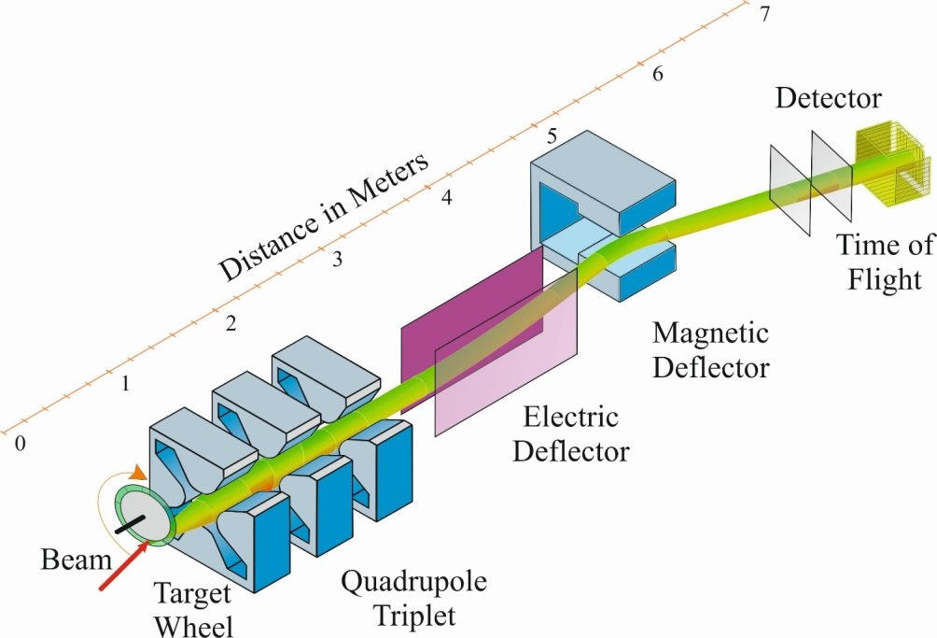
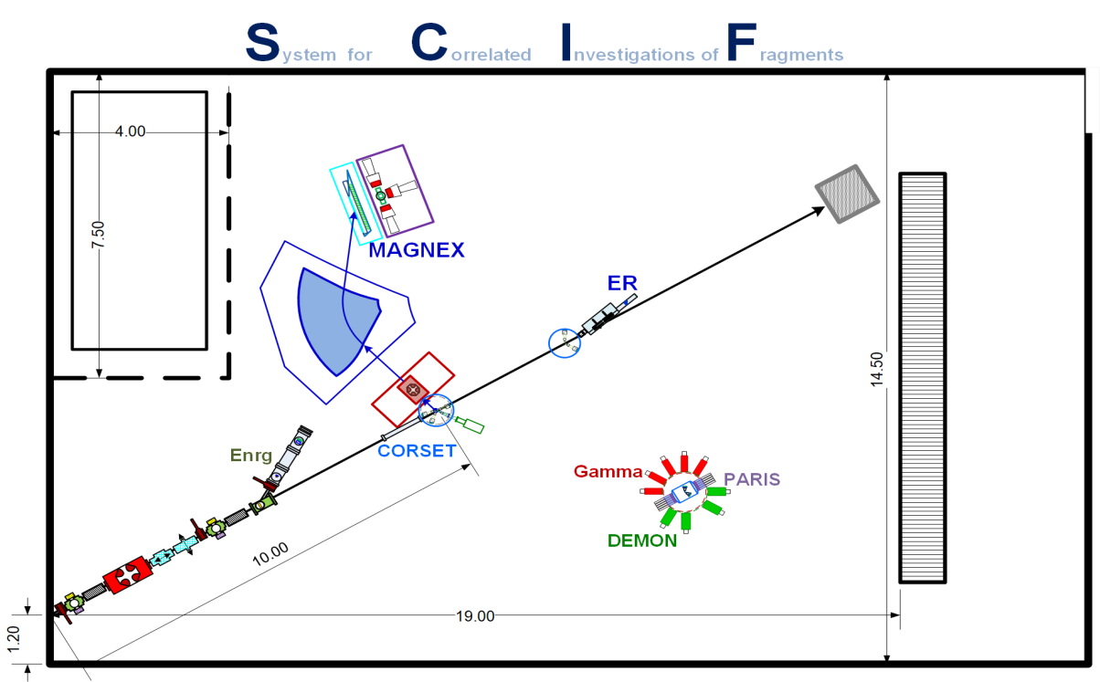
Separator for TransActinide Research
To be cleared up experimentally:
Angular distributions of reaction products. Energy dependence;
Cross sections of formation of neutron-rich nuclei. Energy dependence;
Energy dependences of reaction products;
Influence of a projectile (⁴⁸Ca,¹³⁶Xe,²³⁸U on a cross-section in the reactions Proj.+Act.
System for Correlated Investigation of Fragments
Facility for the study of mechanisms of FF&QF
Spectrometer CORSET masses, energies and angles of fragments;
Electrostatic deflector selection and detection of ER’s;
n- and γ-spectrometers;
Bragg chamber and magnetic spectrometer charge and mass distributions of fragments.
Magnetic spectrometer
Charged
particles
Neutrons

Slide 25
Light Nuclei near and beyond
the Nucleon Stability Line
DC280: Fusion
Stability island
number of protons
U400R: MNT
Upgrade of the cyclotron U400M
Gives more stable operation and higher beam intensities.
But we stay confined within the area of very light nuclei Z<15.
number of neutrons
U400M: Fragmentation

Slide 26
Planned research areas for 2024 – 2030
Beyond the nucleon stability line with 2n-transfer
¹⁰He, ¹³Li,¹⁶Be. Ligher neutron-rich isotopes like ^{6,8}Не, ¹¹Li, ¹¹⁻¹⁴Be are also in the zone of interest;
Structure of neutron-rich isotopes in (d,p) reactions;
Impact of the reaction mechanism on population
of low energy spectra of exotic nuclear systems;
Exotic radioactivity
(formation of 2-p radioactive nuclei in (³He,n) reactions, ²⁶S);
Isotopic symmetry of nuclear reactions
(³H,³He) and (³He,³H);
Total reaction cross-sections;
β-decays of neutron-rich nuclei, β-delayed decays.
¹⁴Be
-p
¹¹Li
-α
⁸He
¹⁰He
+2n
Instrumentation Development
In-beam detectors;
Neutron detector array (increase in number of modules);
Charged particles detector arrays (angular and energy acceptance);
RF-kicker (operational run with ion beam);
Zero-angle spectrometer hodoscope;
Cryogenic tritium target.

Slide 27
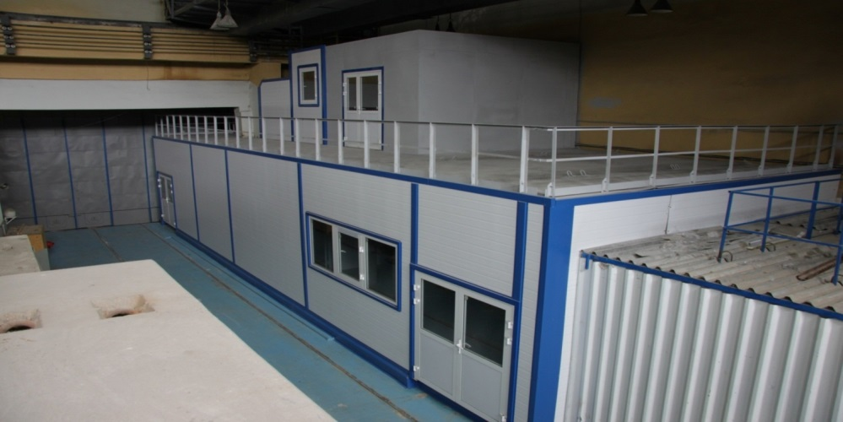
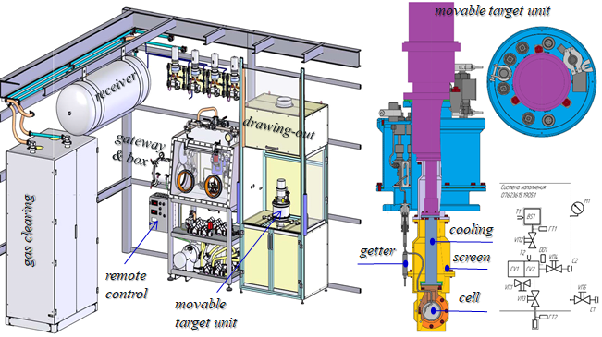
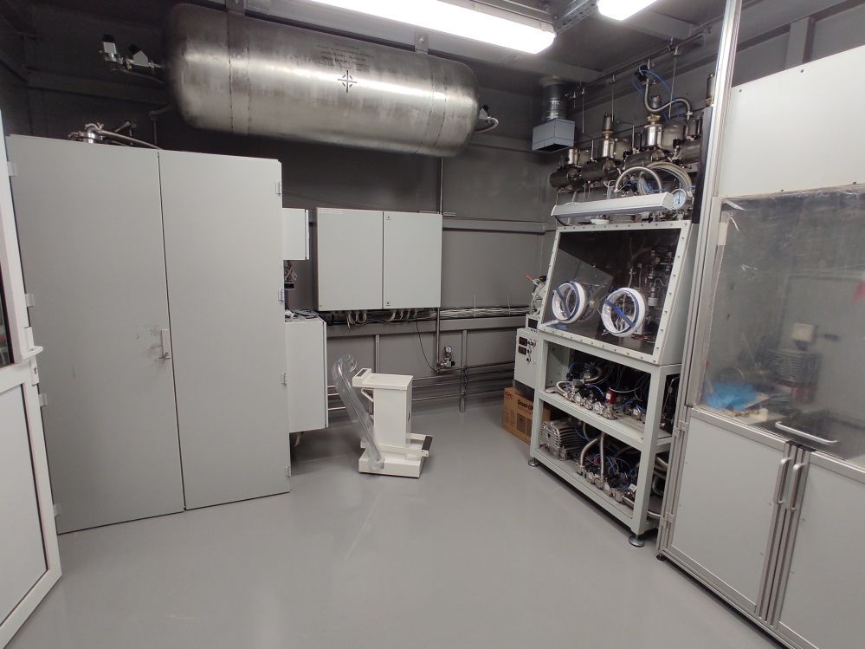
Tritium Target
supply system
1 kCi T₂;
Liquid (T⁓25 K): h=0.4 mm;
Gas: h=4 mm;
Three stages of radiation protection;
Radiation safety control;
Automatic control and parameter setting;
The cell can also be filled with H₂, D₂, ³He, ⁴He.

Slide 28
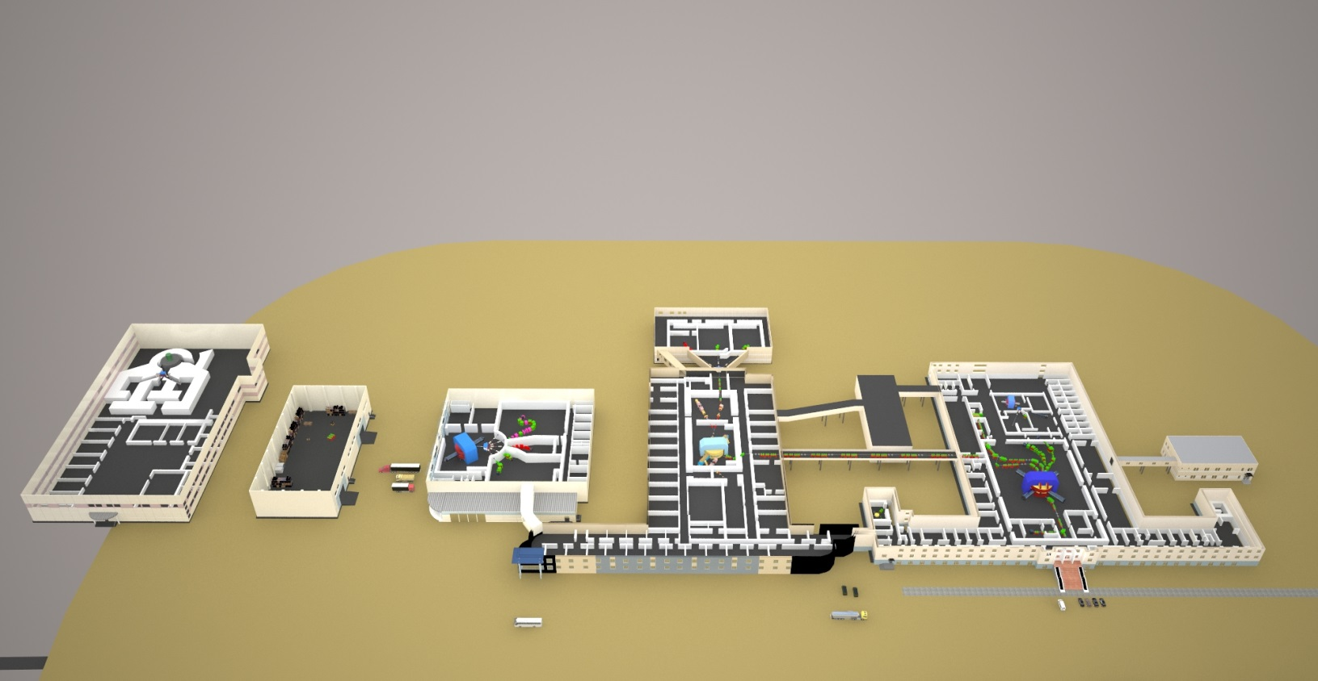
More Long-Term Plans
Projects being considered
Radiochemical Laboratory of Class I:
Manufacturing and regeneration of actinide targets for the SHE research;
Development of new technologies for production of radioisotopes and their extraction from irradiated targets for scientific, radioecological, medical and other applications;
Fundamental research program is under consideration.
RIB technique development:
New accelerator complex for an energy of about 100A MeV. (LINAC, cyclotron tandem).
Extending the mass range of RIB’s, high intensity of RIB’s.
Development of ISOL-technique of RIB production at the tandem of operating cyclotrons (U400M – U400R).
Intensity increase of RIB’s produced at the U400M cyclotron.

Slide 29
SH Nuclei
Heavy Nuclei
Nuclei far from SL
Applied
studies
2017
ACCULINNA II
Light exotics:
structure
mechanisms,
decays.
2018
2019
SHE Factory:
DC280
DGFRS II (synthesis);
GRAND (chemistry);
2020
2021
2022
U400M Upgrade
DC140
2023
New Building
U400→U400R
NEW FACILITIES
Heavy isotopes:
MNT, fusion,
fission and
quasifission,
spectroscopy,
masses.
2024
NEW FACILITIES.
SH isotopes:
synthesis,
chemistry, masses,
spectroscopy.
Experiments, development of systems
2025
2026
2027
New project
RI beams
New project
RCL I class,
e⁻ accelerator
2028
2029
2030
Construction?
Construction?
2031

Slide 30
THANK YOU!

