Slide 1
Programme Advisory Committee for Condensed Matter Physics
56th meeting (17-18 January 2023)
Dénes Lajos Nagy
133rd session of the JINR Scientific Council, 16-17 February 2023

Slide 2
Agenda of the 56th meeting of the PAC
Tuesday, 17 January 2023
 |  | 6.6. Theme “Theory of Complex Systems and Advanced Materials” | E. Anitas (20+5 min.)
 |  | Coffee break (15 min.)
 |  | 6.7. Status and prospects of the DLNP scientific programme | V. Glagolev (20+5 min.)
 |  | 6.8. Theme “Research on the Biological Effects of Ionizing Radiation with Different Physical Characteristics” | A. Bugay (20+5min.)
 |  | 6.9. Theme “Radiation Materials Science, Nanotechnological and Biomedical Investigations Using Beams of Accelerated Heavy Ions” | P. Apel (20+5min.)
 | 7. | General discussion | (1 h.)
10:00 MSK | 1. | Opening of the meeting | D. L. Nagy (10 min.)
 | 2. | Implementation of the recommendations of the 55th PAC meeting | D. L. Nagy (15 min.)
 | 3. | Information on the Resolution of the 132nd session of the JINR Scientific Council (September 2022) and on the decisions of the Committee of Plenipotentiaries of the Governments of the JINR Member States (November 2022) | L. Kostov (30 min.)
 | 4. | Status of the IBR-2 reactor in the framework of the new Seven-Year Plan for the Development of JINR | V. Shvetsov (30+5 min.)
 | 5. | Tasks and prospects for the operation of the IBR-2 reactor | A. Dolgikh (20+5 min.)
 |  | Coffee break (15 min.)
 | 6. | Reports on the themes to be included in the Topical Plan for JINR Research and International Cooperation for 2024
 |  | 6.1. Theme “Investigations of Functional Materials and Nanosystems Using Neutron Scattering”: main activities and projects in the framework of the Seven-Year Plan for the Development of JINR for 2024–2030 | D. Kozlenko (20+5 min.)
 |  | 6.2. Theme “Scientific and Methodological Research and Developments for Condensed Matter Investigations with IBR-2 Neutron Beams” | V. Bodnarchuk (20+5 min.)
 |  | 6.3. Theme “Optical Methods in Condensed Matter Studies”: current activities and the concept of further development | G. Arzumanyan (20+5 min.)
 |  | Lunch break
15:00 |  | 6.4. Theme “The New Neutron Source at FLNP JINR”: current status and plans for 2024–2030 | M. Bulavin (20+5 min.)
 |  | 6.5. Status and prospects of the MLIT scientific programme | O. Derenovskaya (20+5 min.)
Wednesday, 18 January 2023
10:00 MSK | 8. | Meeting of the PAC members with the JINR Directorate | (1 h.)
 | 9. | Scientific Report “Diagnostics of socially significant diseases using affine track membranes modified with DNA aptamers” | E. Zavyalova (20+5 min.)
 | 10. | Poster presentations by young scientists | (1 h. 30 min.)
 | 11. | Voting for and selection of the best poster presentations | (15 min.)
 |  | Coffee break (20 min.)
 |  | Closed session
13:30 | 12. | Preparation of the PAC recommendations including proposals for the next PAC meeting | (30 min.)
 | 13. | Closing of the meeting

Slide 3
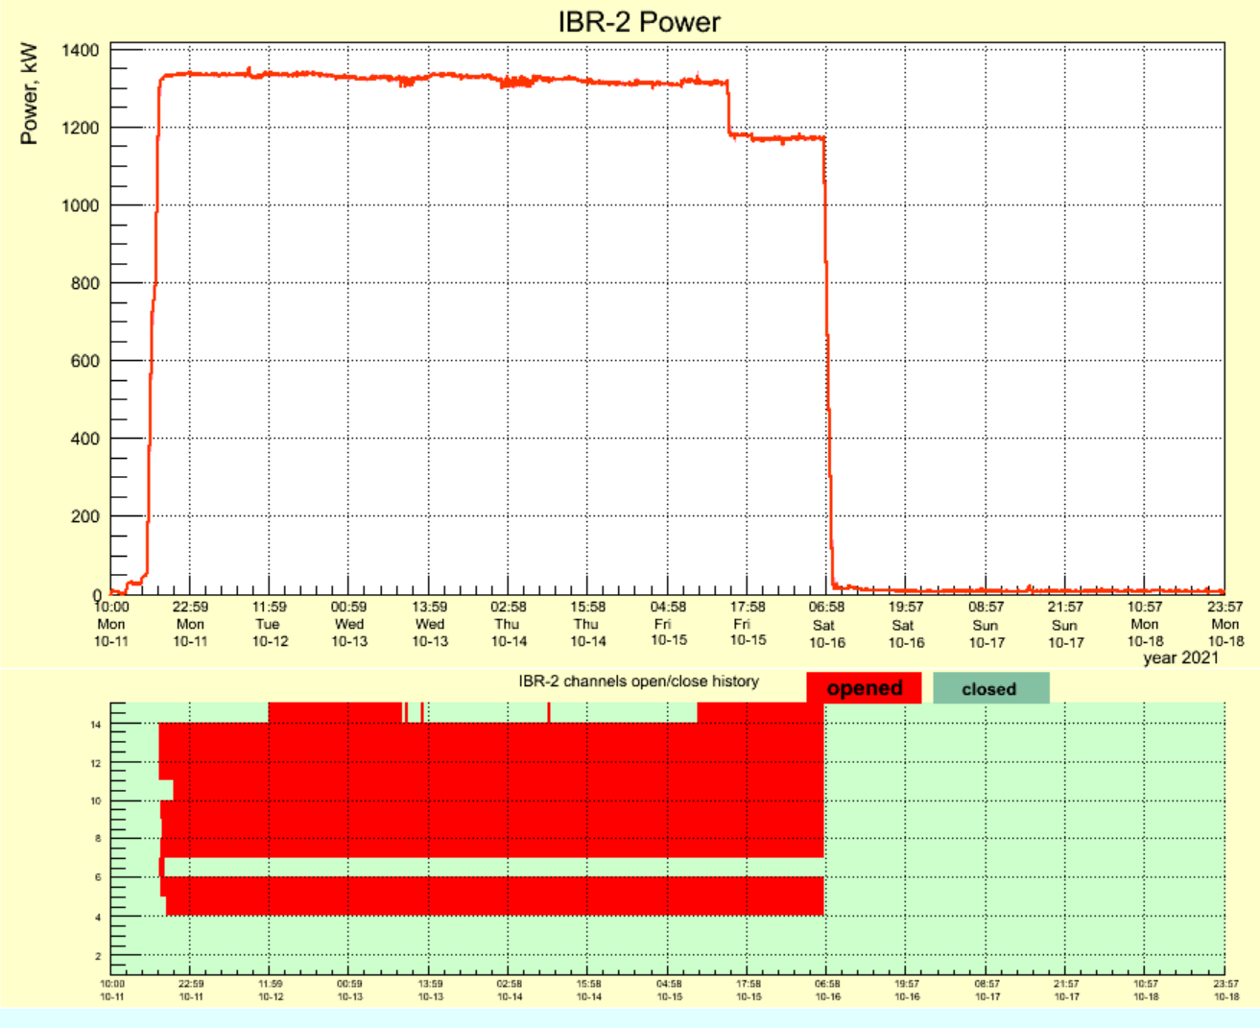
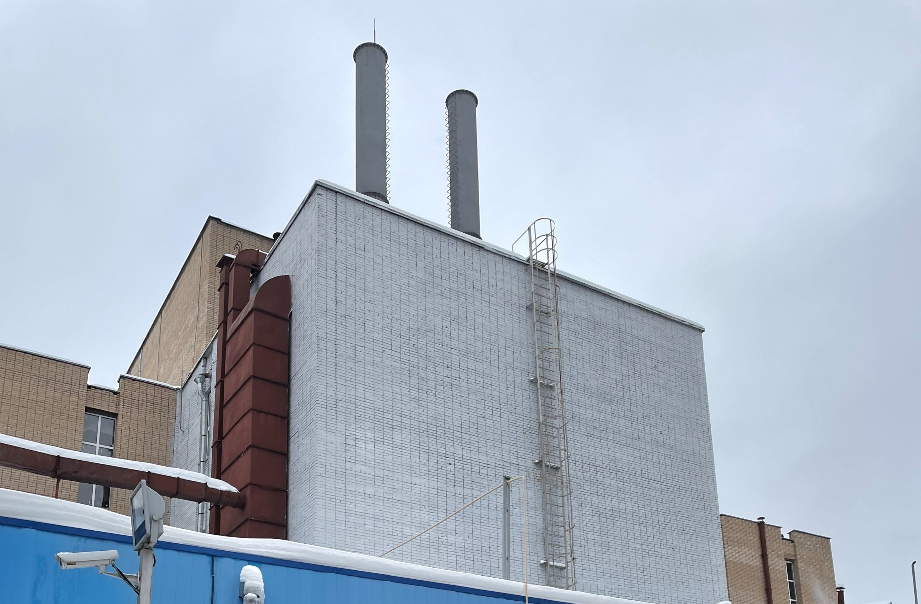
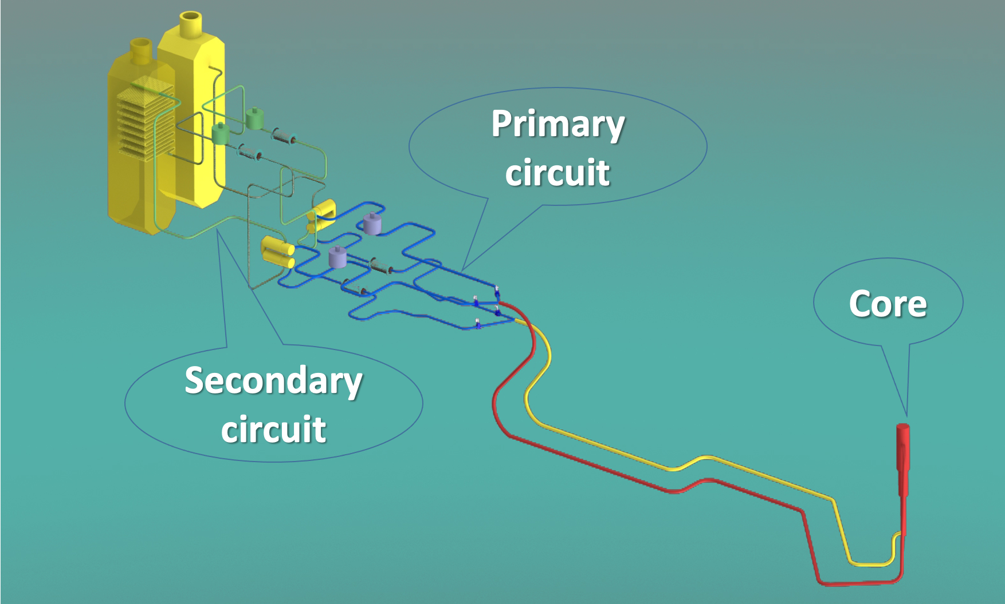
Status of the IBR-2 reactor
The PAC took note of the report on the status of the IBR-2 reactor in the framework of the new 7-Year Plan of JINR presented by Valery Shvetsov. The PAC was satisfied with the progress in replacing the air heat exchangers of the secondary reactor cooling circuit and obtaining an operating license.

Slide 4
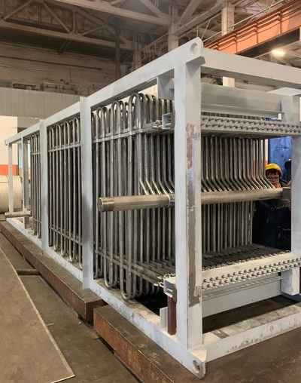
Actual time schedule for heat exchanger replacement
Heat exchanger issues
Similar breakdown of the heat exchanger occurred in May 2018
Repair of the heat exchanger;
Getting permission from Rostechnadzor;
Starting operation in November 2018;
Preparation of the unscheduled replacement of the both heat exchanger in secondary circuit;
The delivery of the equipment was scheduled for spring 2021 but due to the pandemic situation delivery was shifted for April 2022;
Obtaining the license – April 2023;
Replacement of the old heat exchangers with the new ones – Summer 2023;
Update of the documentation for licensing – August-September 2023;
Reactor startup – October 2023;

Slide 5
Studying the mechanism of the power pulse fluctuations at IBR-2
The PAC endorsed the FLNP plans for the next 7 years, which include the manufacturing of a new fuel load for IBR-2 in order to provide the necessary conditions for extending the reactor’s service life for the period after 2032. The PAC noted that a confirmation of the technical feasibility of its production and an estimate of the cost of the work have been obtained.
The PAC also appreciated the continuation of activity towards studying the mechanism of the occurrence of fluctuations in the power pulses of the IBR-2 reactor in cooperation with NIKIET and other organizations of Rosatom State Corporation.
Recommendation. The PAC supported the efforts on replacing the air heat exchangers of the secondary reactor cooling circuit and recommends that FLNP decide on the choice of the manufacturer of components for a new fuel load for IBR-2.

Slide 6
Tasks and prospects for the operation of IBR-2
The PAC took note of the report on problems and prospects for the operation of the IBR-2 presented by Andrey Dolgikh.
The PAC underlined the importance of obtaining a new license as soon as possible, which will enable to resume the operation of the IBR-2 facility for physics experiments, to carry out the planned upgrade of safety-related equipment and systems, including the further development of the suite of cryogenic moderators.
Recommendation. The PAC considered it a major task to resume regular operation of the IBR-2 facility for physics experiments in 2023.
Main tasks for the period up to 2030
Obtaining license from Rostekhnadzor for the operation of IBR-2.
The planned date of obtaining the license: April-May 2023. The requested validity period of the new Rostechnadzor license is until October 2032.
Ensuring the operation of the IBR-2 reactor for physics experiments.
Upgrade of the main safety-related equipment of the IBR-2 reactor.
Development and construction of a system of cryogenic moderators for IBR-2
Ensuring reactor safety.
Prospects for the operation of IBR-2.

Slide 7
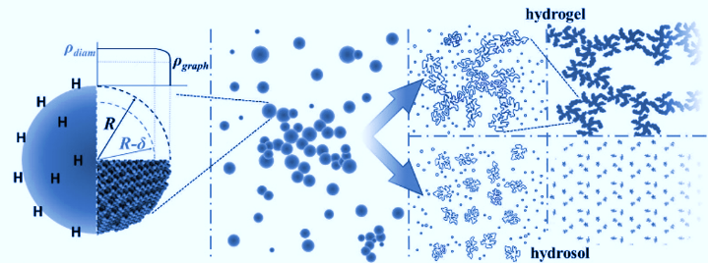
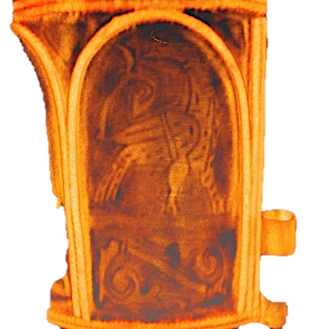
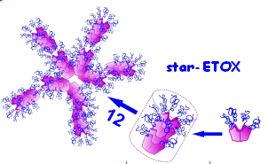
Reports on the themes to be included in the JINR Topical Plan for 2024 in the context of the New 7-Year Plan
The PAC took note of the report presented by Denis Kozlenko on the FLNP theme “Investigations of Functional Materials and Nanosystems Using Neutron Scattering”, which discussed main activities and projects in the framework of the Seven-Year Plan for the Development of JINR for 2024–2030.
The PAC appreciated timeliness and multidisciplinary character of the research activities planned within the theme. Further development of the IBR-2 instrumentation and realization of the project “Development of an inelastic neutron scattering spectrometer in inverse geometry at the IBR-2 reactor” will enable to maintain the research quality at the competitive level in comparison with world-leading neutron scattering centers and provide a basis for further extension of research activities. The PAC also noted that the implementation of the User Programme remains a very important activity in the framework of the theme.
Recommendation. The PAC supported main directions suggested for implementation within the theme and recommends that the authors present a detailed structure and content of the projects constituting the theme.
The priority research directions at the IBR-2 instruments:
Condensed Matter Physics and Materials Science
Physics of Nanosystems and Nanoscale Phenomena;
Physics of Complex Liquids and Polymers;
Biophysics and Pharmacology;
Applied Materials and Engineering Sciences.

Slide 8
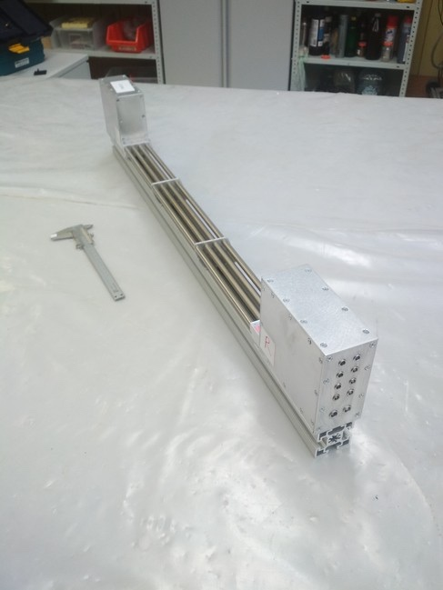
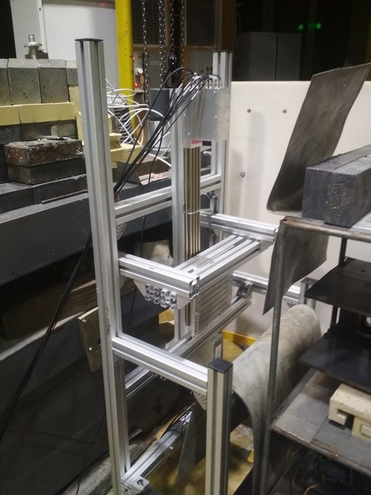
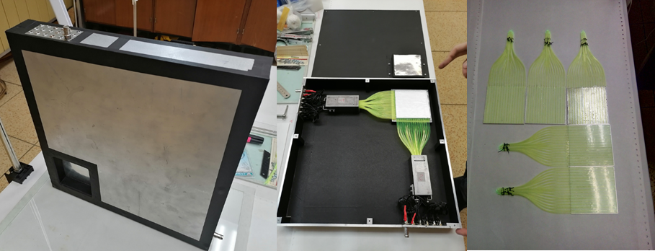
Reports on the themes to be included in the JINR Topical Plan for 2024 in the context of the New 7-Year Plan
The PAC took note of the report presented by Victor Bodnarchuk on projects and activities in the framework of the FLNP theme “Scientific and Methodological Research and Developments for Condensed Matter Investigations with IBR-2 Neutron Beams” for the next seven-year period. The PAC endorsed plans for the development of new technologies in the field of neutron detection for their application in the instruments of IBR-2 and the development of the corresponding infrastructure.
Recommendation. The PAC recommended supporting the projects and activities aimed at the development of the experimental infrastructure of the IBR-2 reactor.
Development of neutron PSD with He-3 converter with resistive anode
Development neutron detectors based on scintillators
2D PSD based on ZnS scintillators

Slide 9
Reports on the themes to be included in the JINR Topical Plan for 2024 in the context of the New 7-Year Plan
The PAC took note of the report on the new FLNP theme “Optical Methods in Condensed Matter Studies” presented by Grigory Arzumanyan. The PAC considered, in particular, the current activities within the ongoing theme “Modern Trends and Developments in Raman Microspectroscopy and Photoluminescence for Condensed Matter Studies”, which will be completed in 2023. Based on the results presented in the report, the PAC notes significant progress in the implementation of activities on this theme and especially the advances in life sciences.
The PAC noted that since the beginning of the new Seven-Year Plan for the Development of JINR for 2024–2030, it is proposed to open the new theme “Optical Methods in Condensed Matter Studies” and project “Nanobiophotonics”.
Recommendation. The PAC appreciated the progress made in experiments using optical methods and recommends closer collaboration on these topics with other laboratories of JINR, including LRB and MLIT.
Fluorescence microscopy to identify NETosis under the influence of UV- and visible radiation
Raman marker
of light-induced NETosis –
programmed cell death

Slide 10
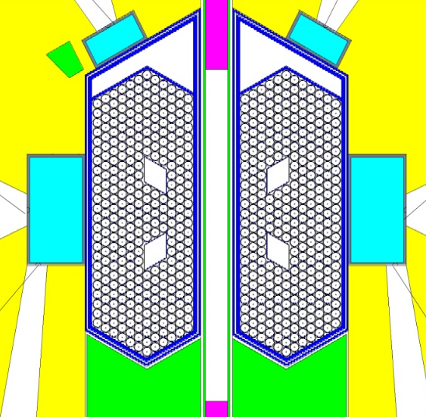
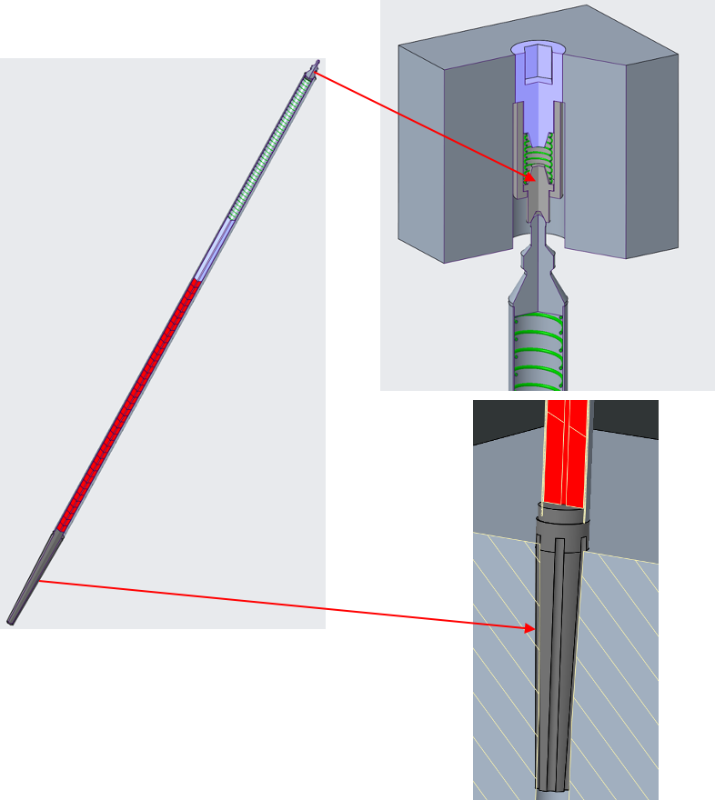
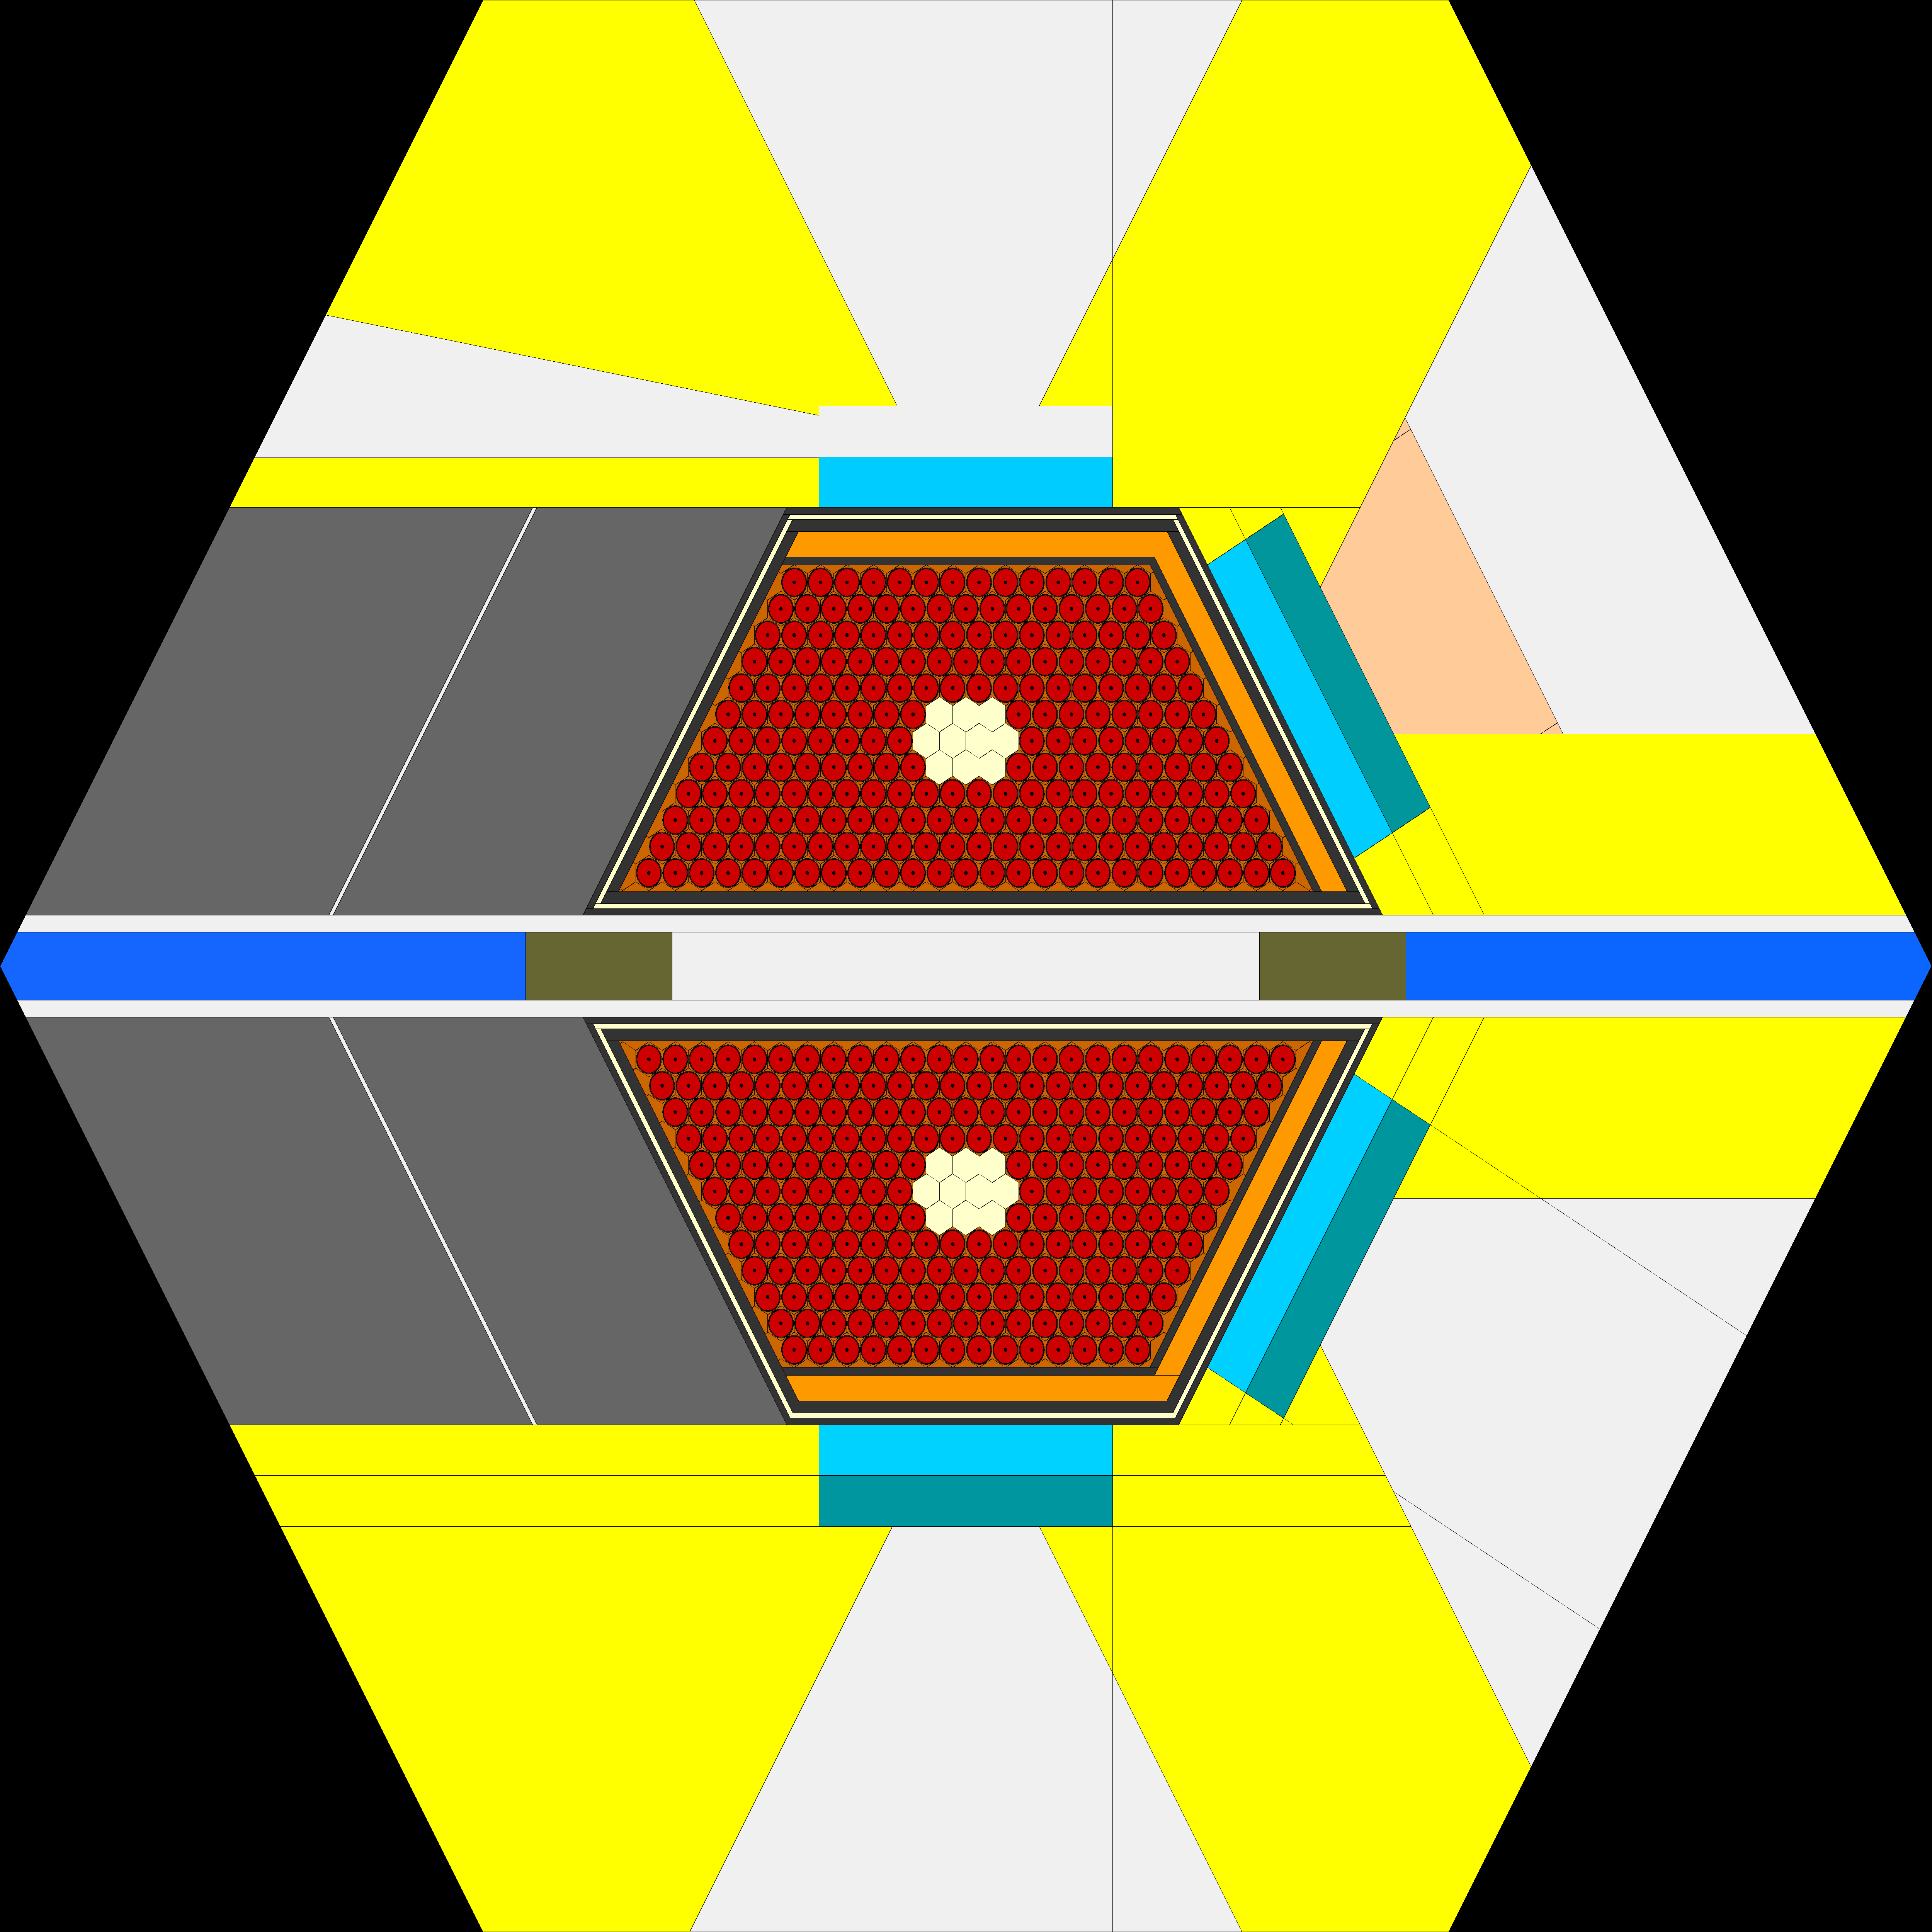
Reports on the themes to be included in the JINR Topical Plan for 2024 in the context of the New 7-Year Plan
The PAC took note of the report presented by Maksim Bulavin on the FLNP theme “Development of the Conceptual Design of a New Advanced Neutron Source – Fast Pulse NEPTUN Reactor at JINR”.
The PAC recognized the importance of the R&D programme for the development of the new NEPTUN reactor and the elaboration of the concept of complementary instruments for condensed matter physics, nuclear physics, and applied research, including the prototyping of individual components at IBR-2. The PAC also supported activities towards solving the formal issues related to the development of the new reactor, including the preparation of formal documents for government agencies, the submission of an application for the inclusion of a new facility in the federal target programme, and obtaining a license for the placement and construction of the reactor.
Recommendation. The PAC appreciated the scope of presented activities and recommends continuing the implementation of the project, as it was detailed in the talk.
Optimal design of fuel rods and the composition of the NEPTUN reactor active core
Optimization of NEPTUN reactor’s cold moderators
Rigid fixation

Slide 11
Reports on the themes to be included in the JINR Topical Plan for 2024 in the context of the New 7-Year Plan
The PAC took note of the report on the status and prospects for the development of the scientific programme of MLIT presented by Olga Derenovskaya.
The PAC supported the efforts aimed at providing the research underway at JINR with state-of-the-art computing facilities based on the Multifunctional Information and Computing Complex, including the “Govorun” supercomputer, as well as advanced studies in the field of numerical modelling of complex physical systems, experimental data processing and analysis, machine and deep learning, artificial intelligence and robotics, the development of methods of computer algebra, quantum information and computing, big data analytics.
Recommendation. The PAC noted that a distinctive feature of research areas related to information technology is close cooperation with all JINR laboratories, organizations of the JINR Member States and other countries, and recommends that research in this direction be continued.
Scientific IT ecosystem

Slide 12
Reports on the themes to be included in the JINR Topical Plan for 2024 in the context of the New 7-Year Plan
The PAC took note of the report on the plans for the development of the BLTP theme “Theory of Complex Systems and Advanced Materials” presented by Eugene Anitas.
The PAC was pleased with the overview of the current state of research within the theme and the composition of the following four projects proposed for implementation in 2024–2030: complex materials, mathematical models of statistical physics of complex systems, nanostructures and nanomaterials, and methods of quantum field theory in complex systems. The PAC welcomed the basic scientometric information on the theme as well as the composition of the personnel and the proposed types of collaboration.
Recommendation. The PAC supported the general composition of the theme “Theory of Complex Systems and Advanced Materials”, including four projects within it.
Issues addressed
Theoretical studies of physical phenomena and processes in condensed matter.
Investigations of properties of new advanced materials.
Constructing and analysis of theoretical models.
Development of analytical and computational methods for their solution.
Main research topics
Project 1: Complex materials
Project 2: Mathematical models of statistical physics of complex systems
Project 3: Nanostructures and nanomaterials
Project 4: Methods of quantum field theory in complex systems

Slide 13
Reports on the themes to be included in the JINR Topical Plan for 2024 in the context of the New 7-Year Plan
The PAC took note of the report on the DLNP themes “Development of Scientific DLNP Infrastructure for Research Using Semiconductor Detectors, Laser Metrology, Electrons, Positrons and Cryogenic Technology” and “Biomedical and Radiation-Genetic Studies Using Different Types of Ionizing Radiation” presented by Vladimir Glagolev.
The PAC noted the progress in the development of the LINAC200 facility and the demand for its electron beams by various research organizations. The PAC was pleased to learn about the project on laser metrology and noted the interest of the research community in the positron spectroscopy facility for testing samples of metals, compounds, nanocomposites, diamonds, and many others.
Recommendation. The PAC appreciated the wide range of R&D studies carried out and the high quality of the results obtained and supports further continuing these activities.
MSC 230 cyclotron

Slide 14
Reports on the themes to be included in the JINR Topical Plan for 2024 in the context of the New 7-Year Plan
The PAC took note of the report on the LRB themes “Research on the Biological Effects of Heavy Charged Particles of Different Energies” and “Research on Cosmic Matter on Earth and in Nearby Space; Research on the Biological and Geochemical Specifics of the Early Earth” presented by Alexander Bugay. The PAC noted the intention to close these themes after their implementation and to open a new consolidated theme “Research on the Biological Effects of Ionizing Radiation with Different Physical Characteristics” for the next seven years.
Recommendation. The PAC supported implementation of the research on biological effects of ionizing radiation with different physical characteristics within the next seven years and considers these topics important for general radiotherapy.

Slide 15
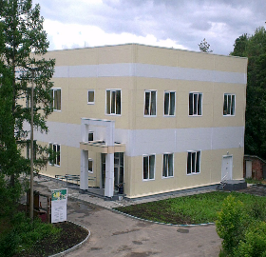
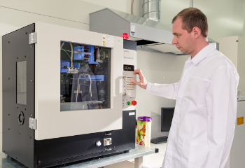
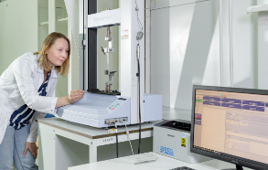
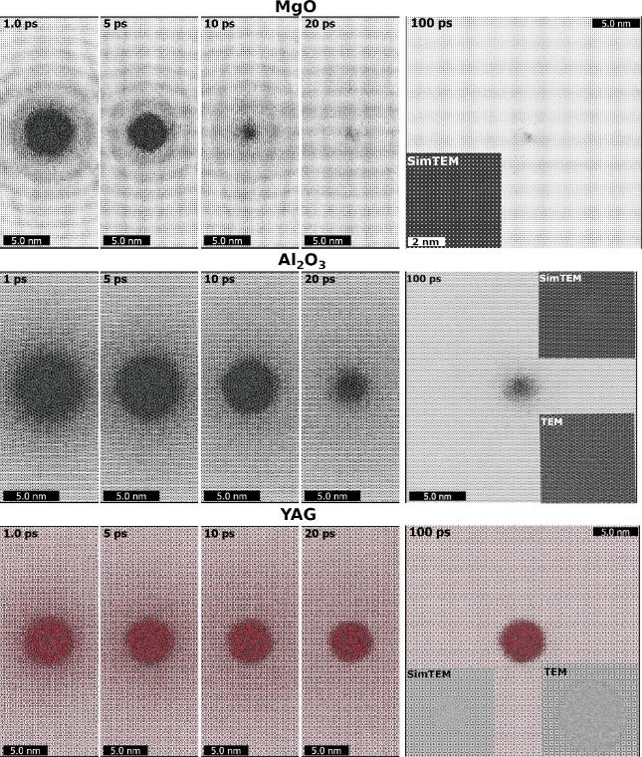
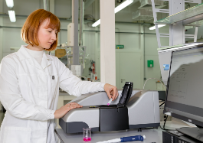
Reports on the themes to be included in the JINR Topical Plan for 2024 in the context of the New 7-Year Plan
The PAC took note of the report on the new FLNR theme “Radiation Materials Science, Nanotechnological and Biomedical Investigations with Accelerated Heavy Ion Beams” presented by Pavel Apel.
The PAC noted the results obtained in the framework of the ongoing theme, which show the relevance and demand of fundamental and applied research based on the use of accelerated heavy ion beams for the studies of material properties and materials modification.
The PAC was pleased that two new projects are proposed in the framework of this theme: “Radiation tolerance of materials to the impact of high-intensity heavy ion beams” and “Nanocomposite and functional track-etched membranes”. The PAC especially noted that the implementation of the theme will largely be based on the new DC-140 cyclotron developed at FLNR.
Recommendation. The PAC appreciated the structure of the presented theme and supports the development of biomedical applications of track-etched membranes and the research works on nuclear isotopes and ecological investigations, which will have the status of activities at the first stage of the theme.
Nano Center
Transmission electron microscope Talos F200i
(Thermo Fisher Scientific)
Nanofiber electrospinning machine
Nanon-01A (MECC)
Testing machine AG-S 50Н (Shimadzu)
Particle analyzer Zetasizer Nano ZSP
(Malvern)

Slide 16
General recommendations
The PAC wishes to hear full-length proposals on the projects constituting the considered themes at its next meeting.
The PAC welcomed the intention of the JINR Directorate to update the approach to the formation of the Topical Plan for JINR Research and International Cooperation by setting the duration of themes equal to seven years. The PAC also supported the introduction of a new mandatory condition for a theme to be active, which is an obligatory presence of at least one ongoing project within such theme.

Slide 17
Scientific report
The PAC heard with interest the scientific report “Diagnostics of socially significant diseases using affine track membranes modified with DNA aptamers” presented by Elena Zavyalova.
The PAC thanked the speaker for the excellent report and notes the prospects for close cooperation with FLNR team, which intends to develop this direction of research over the next seven-year period.

Slide 18
Virtual presentations by young scientists
The PAC reviewed 10 virtual presentations made by young scientists in the field of condensed matter physics and related fields of information technology.
The virtual poster presentation “Development of lithium-ion batteries with increased specific energy and power” made by Meir Yerdauletov was selected as the best presentation of the session
The PAC also noted two more virtual poster presentations of a high level: “BIOHLIT — information system for radiobiological research” by Inna Kolesnikоva and “Pressure-induced phase transition in a nanostructured zinc ferrite” by Nadezhda Belozerova. All three authors will be awarded diplomas of the PAC.
Recommendation. The PAC recommends the poster “Development of lithium-ion batteries with increased specific energy and power” for presentation at the session of the JINR Scientific Council in February 2023.

Slide 19
Next meeting of the PAC
The next meeting of the PAC for Condensed Matter Physics is scheduled for 15–16 June 2023.
The preliminary agenda for the next meeting of the PAC includes:
report by the PAC Chair on the implementation of the recommendations above;
report by the JINR Directorate on the sessions of the Scientific Council in February 2023 and of the Committee of Plenipotentiaries in March 2023;
discussion of the next Seven-Year Plan for the Development of JINR for 2024–2030 regarding condensed matter physics;
reports and recommendations on the projects to be included in new themes to be implemented within the next Seven-Year Plan for the Development of JINR;
progress in the development of the concept for the new neutron source of JINR;
status reports on the upgrade of FLNP instruments;
information about scientific meetings;
scientific reports (not more than three);
poster (or virtual presentation) session.

Slide 20
Thank you for your attention!

