Slide 1





Structural studies of lithium-ion batteries
in research of their functional characteristics
M.Yerdauletov^{[1,2,3]}, P.Napolsky^{[4,1]}, M.Avdeev^{[1,4]}, V.Krivchenko^{[4]}, K.Nazarov^{[1,2]}, B.Muhametuly^{[1/2]}
^{[1]} Frank Laboratory of Neutron Physics, Joint Institute for Nuclear Research, Dubna, Moscow Region, 141980 Russia
^{[2]} Institute of Nuclear Physics, Ministry of Energy of the Republic of Kazakhstan, Almaty, 050032 Kazakhstan
^{[3]} L.N.Gumilev Eurasian National University, Astana, 010000 Kazakhstan
^{[4]} Dubna State University ‘Dubna’, Moscow Region, 141980 Russia

Slide 2

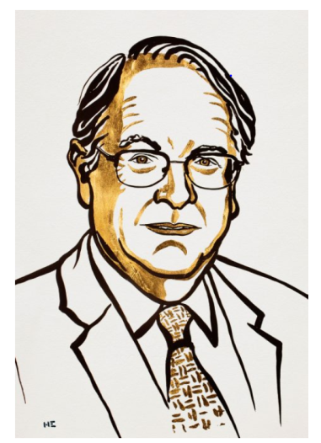
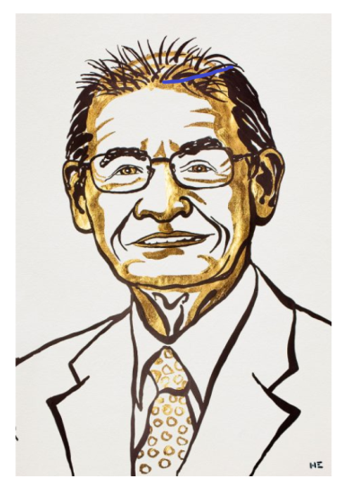

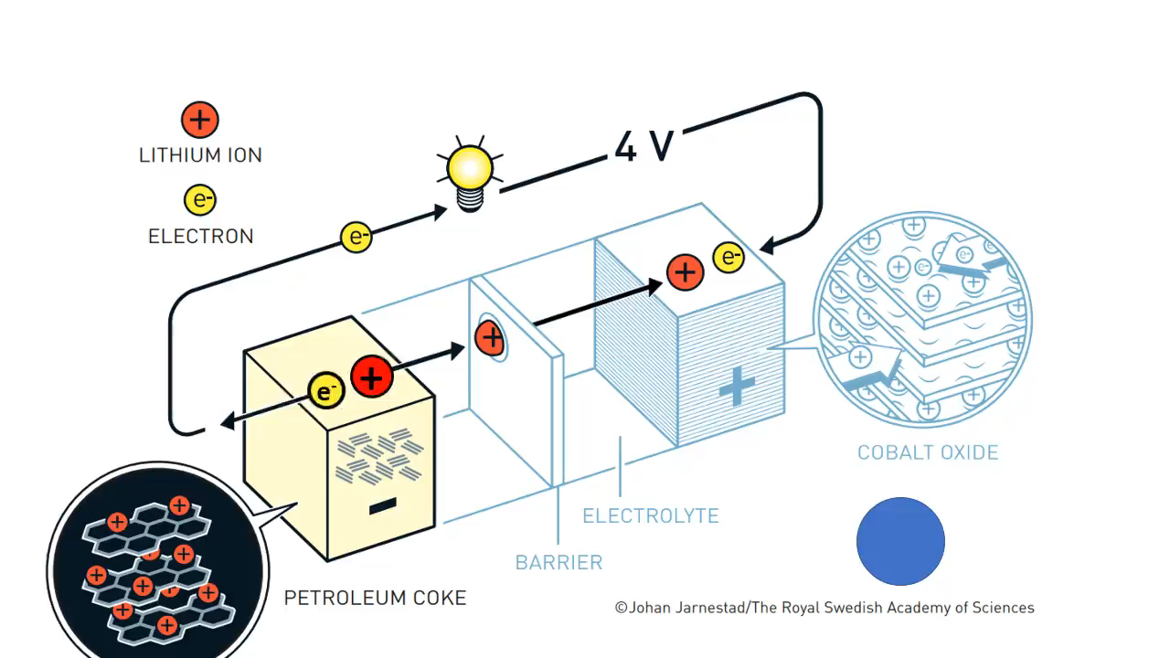
Development of lithium-ion batteries
John B. Goodenough
M. Stanley
Whittingham
Akira Yoshino
Nobel Prize in Chemistry 2019
Notes:
The beginning of widespread use in the mid-1990s of lithium power sources led to fundamental changes in the modern way of life. The importance of this type of energy storage devices was recently recognized by the Nobel Committee, which awarded the 2019 Chemistry Prize to M.S. Whittingham, J. Goodenough, and A. Yoshino "for the development of lithium-ion batteries." The use of layered cathodes and lithium salts in liquid electrolytes was a revolutionary step in the development of compact energy storage devices. The basis of corresponding lithium-ion batteries is the ability of electrode materials to intercalate and deintercalate lithium ions during the cyclic processes of charging/discharging the battery. Today such kind of energy storage devices demonstrate a competitive combination of energy capacity, price and satisfaction to ecological requirements, which is well illustrated by the fact of a continuous increase in sales of electric automobiles worldwide.

Slide 3
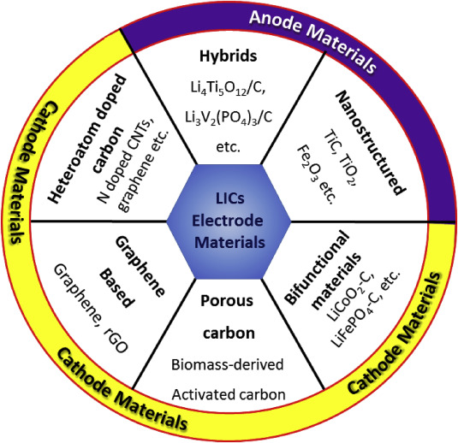
Energy storage systems
LIB – Li ion batteries
LIC – Li ion capacitors
EDLC – Electric double layer capacitors

Slide 4
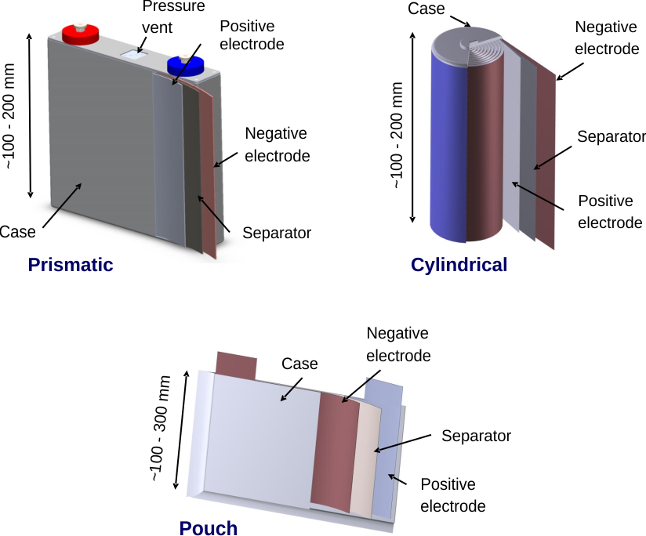
Aim: Structural studies of lithium-ion batteries and research by neutron methods
Tasks :
Effect of battery form
Research effects of additives to electrodes
by small-angle neutron scattering
Investigate Lithium and electrolyte deposition in batteries
by neutron tomography
Possibility for using activated carbon from biowastes
in electrodes

Slide 5
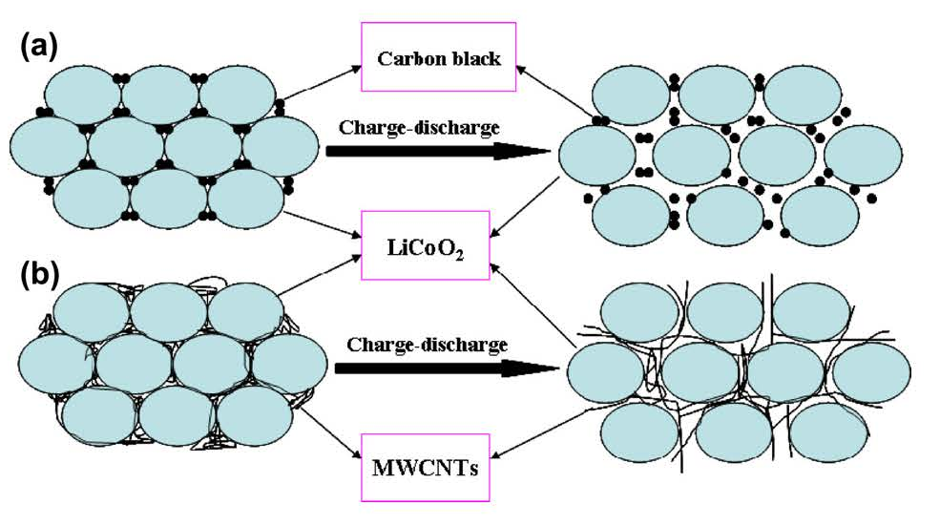
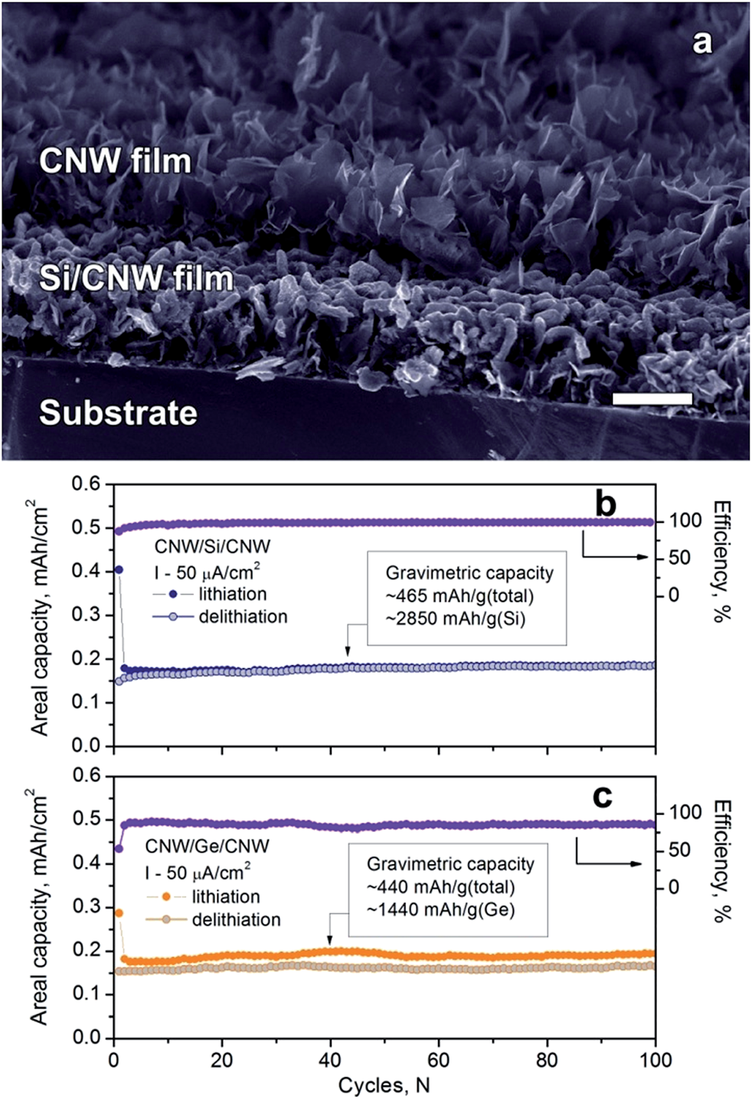
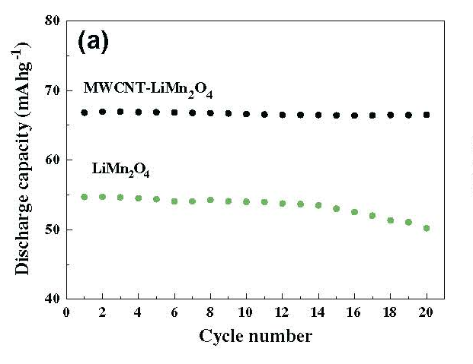
Nanostructured Conductive Additives
Carbon nanotube (CNT)-based composites
as electrode material for rechargeable Li-ion batteries
Gaining cycling stability of Si- and Ge-based negative Li-ion high areal capacity electrodes by using carbon nanowall scaffolds
Mironovich, K.V., Evlashin, S.A., Bocharova S.A.; Yerdauletov M.S.; Dagesyan S.A.;Egorov A.V.;Itkis, D.M., Krivchenko, V.A.
J. Mater. Chem. A 5 (2017) 18095
X.-M. Liu et al., Composites Science and Technology 72 (2012) 121

Slide 6

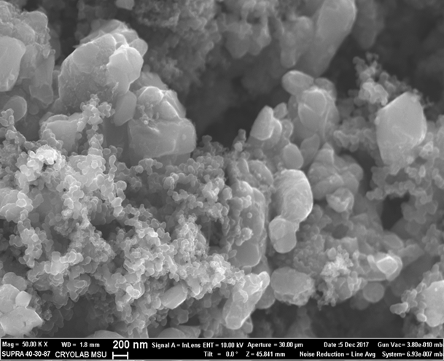
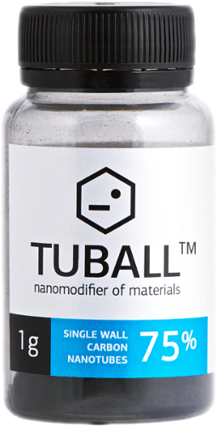
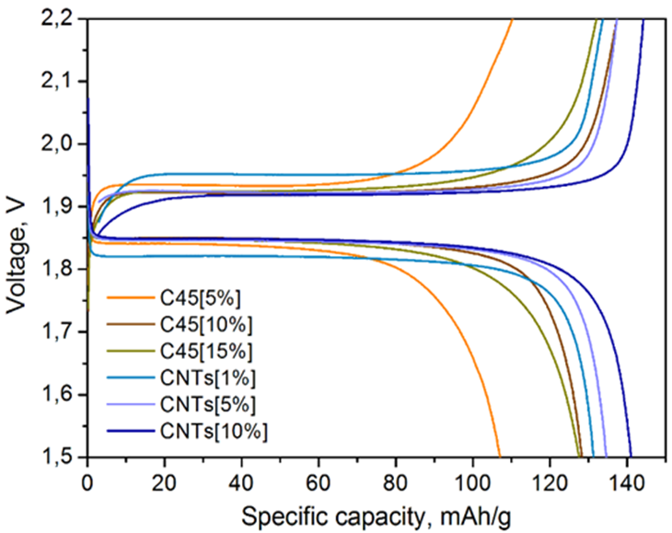
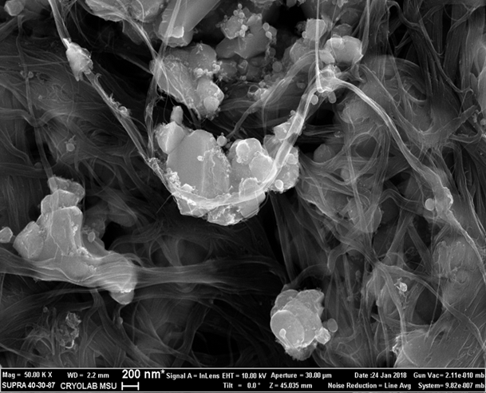

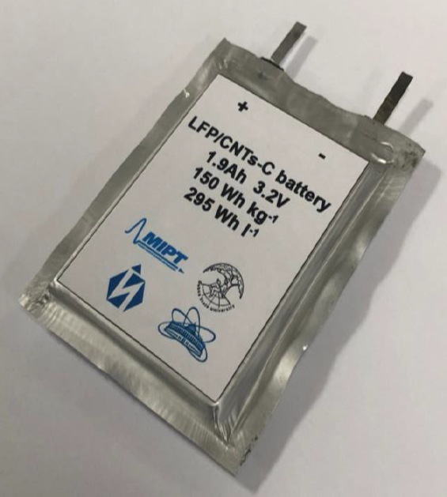
Carbon Nanotubes vs. Carbon Black
SEM
Technical specifications | Unit of measurement | Meaning
SWCNT content* | wt.% | 99 ± 0.5
SWCNT length | μm | > 5
Specific surface area | m2/g | 800—1600
LFP cathode

Slide 7
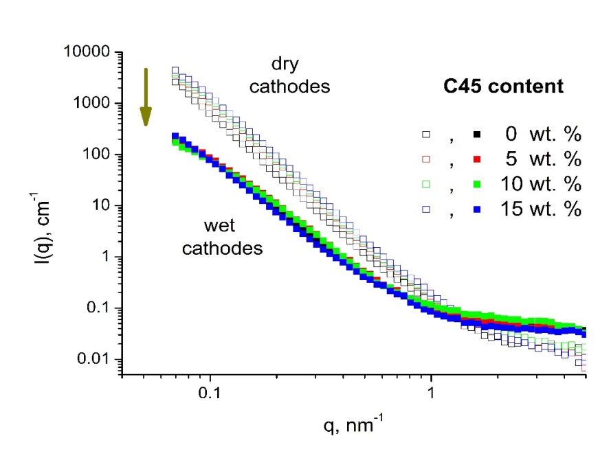
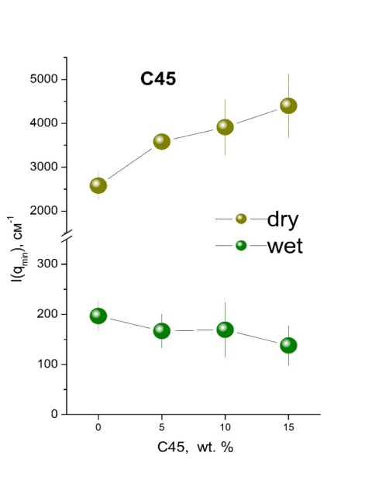
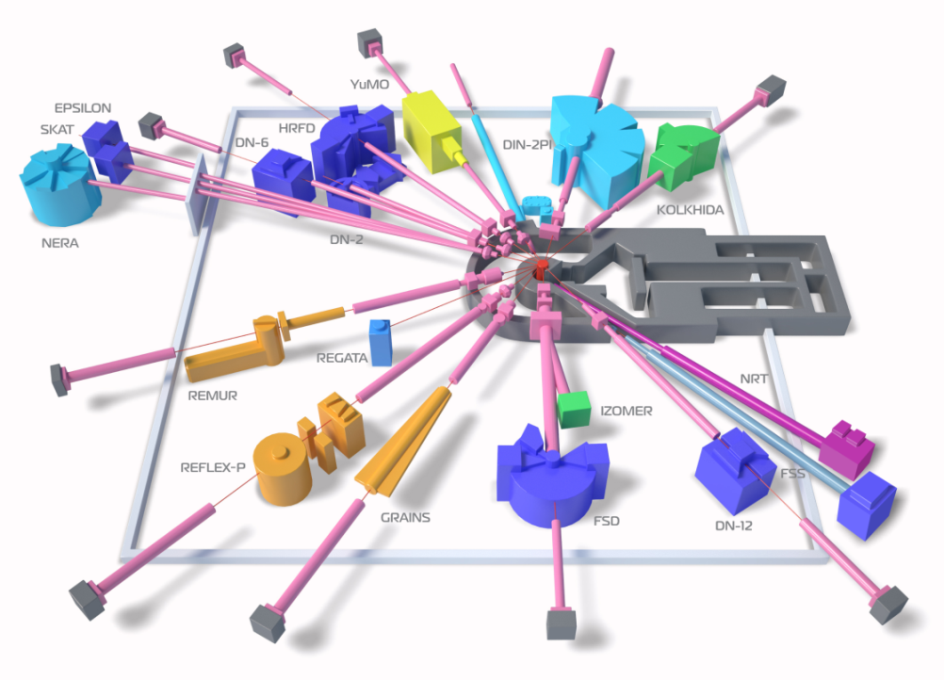
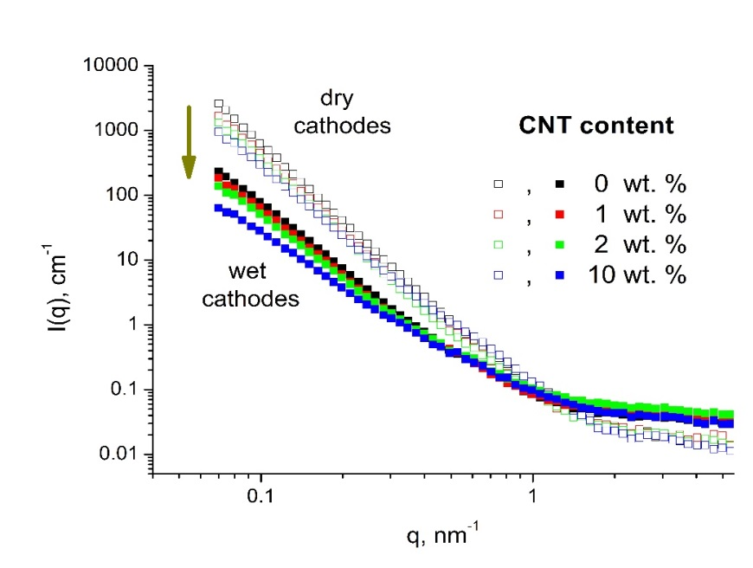
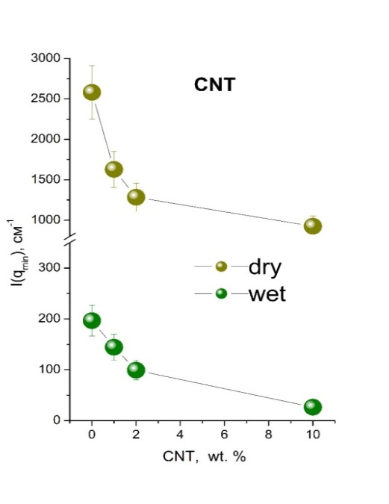
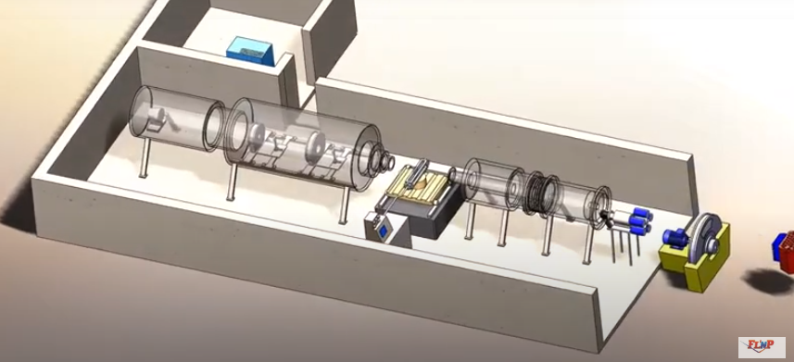
Small-angle neutron scattering from cathodes
IBR-2 reactor, FLNP JINR
YuMO (SANS)
YuMO
P. Napolsky, M. Avdeev, M. Yerdauletov, et al., Energy Technology 8 (2020) 2000146

Slide 8
Small-angle neutron scattering from cathodes
IBR-2 reactor, FLNP JINR
YuMO (SANS)
No incorporation of C45 into LFP matrix pores slight increase in wettability.
YuMO
Incorporation of CNTs into LFP matrix pores; significant improvement in wettability.
P. Napolsky, M. Avdeev, M. Yerdauletov, et al., Energy Technology 8 (2020) 2000146

Slide 9
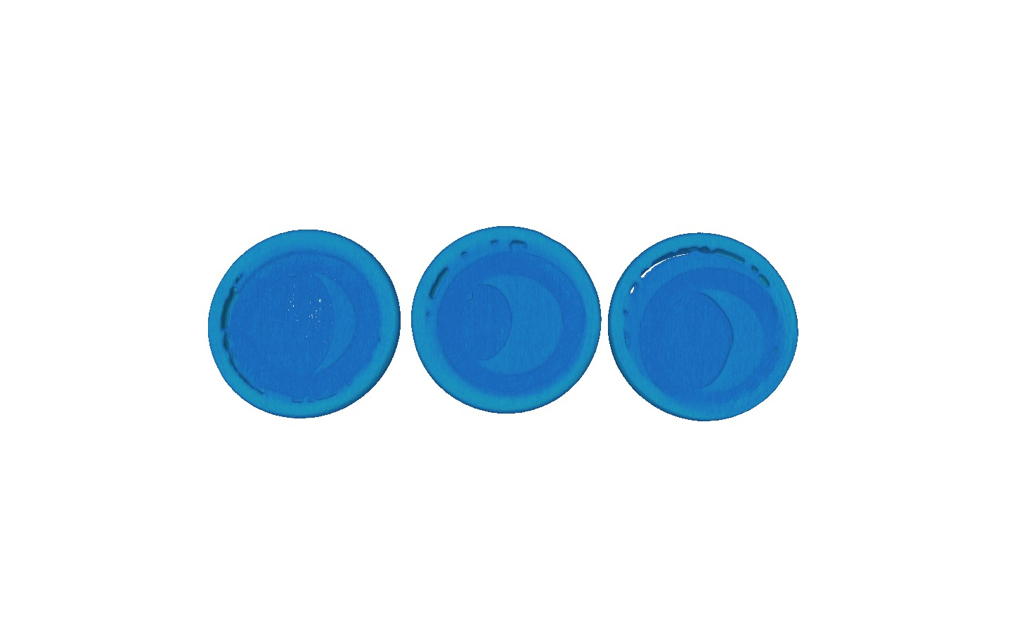
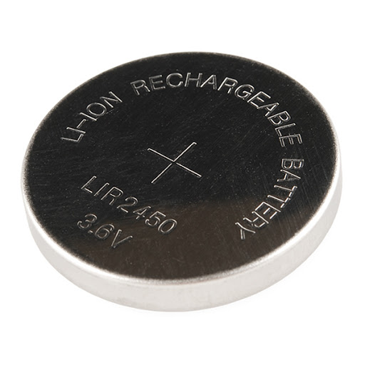
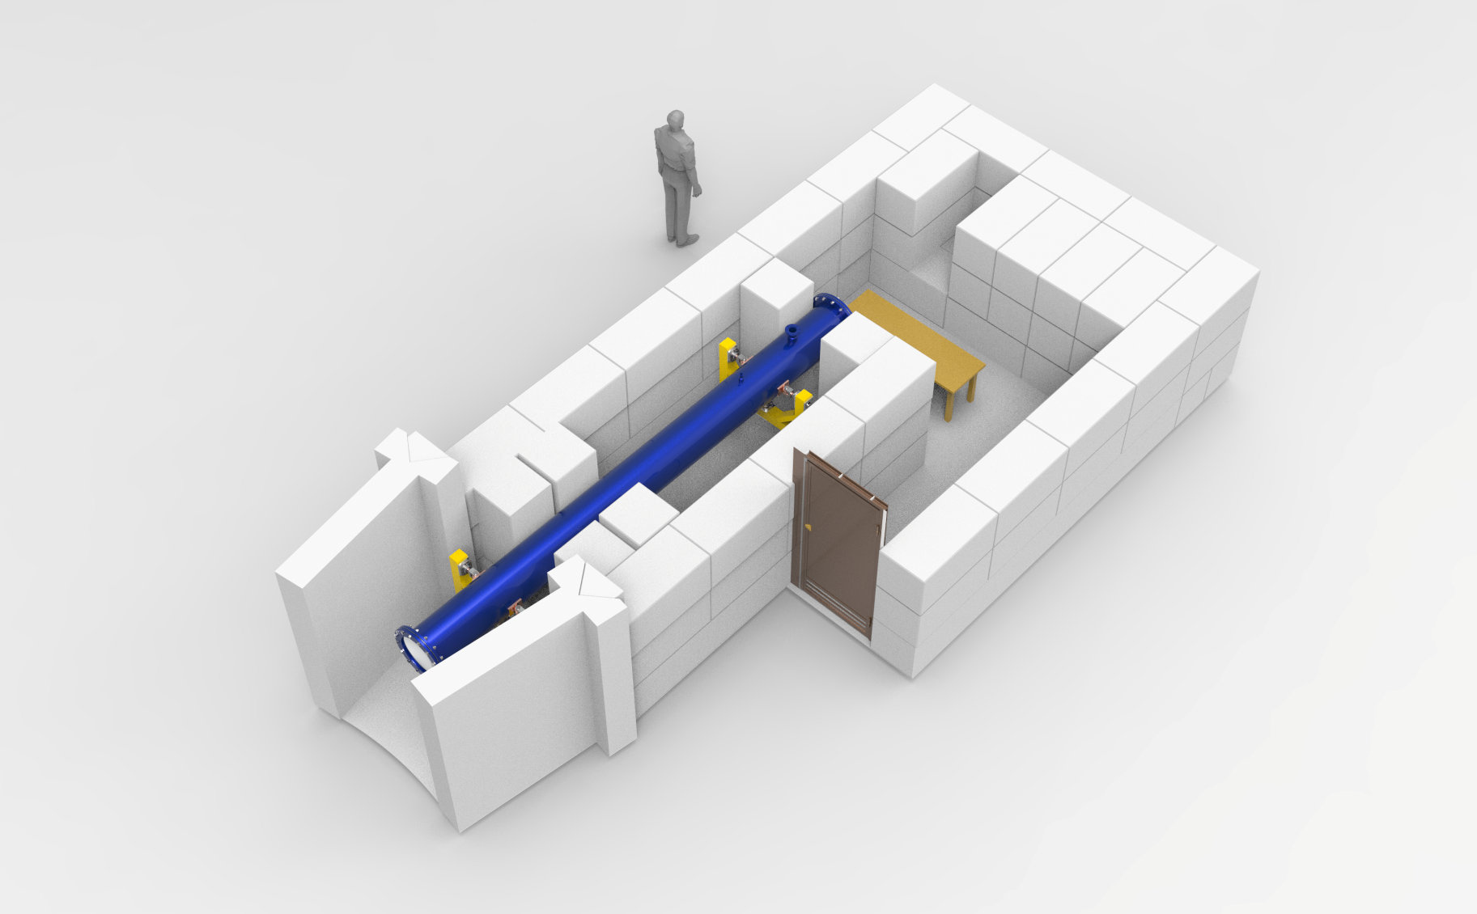
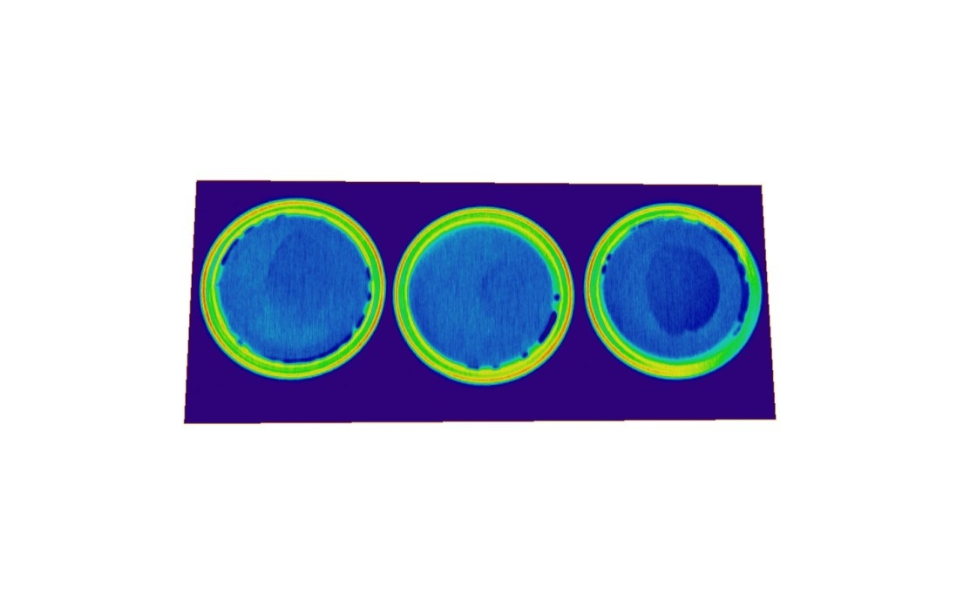
Neutron Tomography
WWR-K reactor INP, Almaty
Capacity 100 %
Capacity 50 %
Capacity 0 %
The neutron tomography method was used to visualize the lithium and electrolyte distribution regions flowing inside the cell in the initial and final states of lithium-ion batteries.
TITAN beamline
As convertor used 6LiF/ZnS scintillators with thicknesses of 100 μm, Hamamats CCD -chip based camera, and L/D was typically set at 350. Pixel resolution was 45 μm.
K.M. Nazarov, et al., Eurasian Journal of Physics and Functional Materials, 2021, 5(1), 6-14

Slide 10
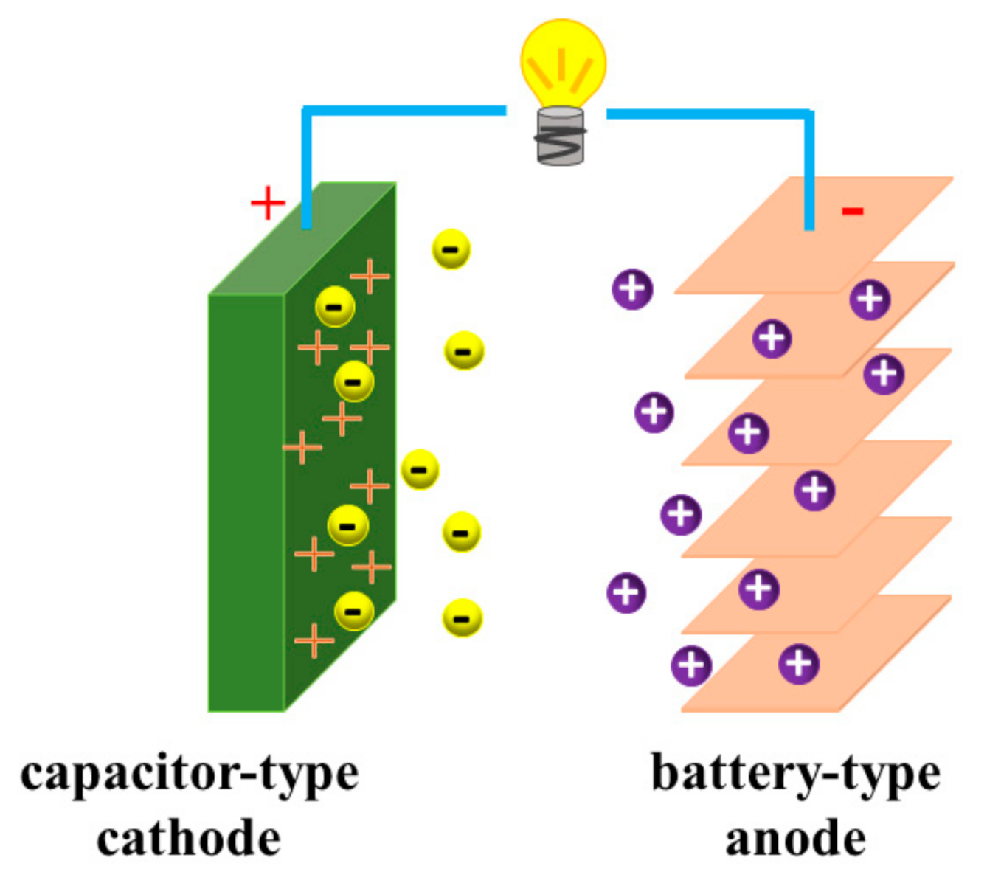
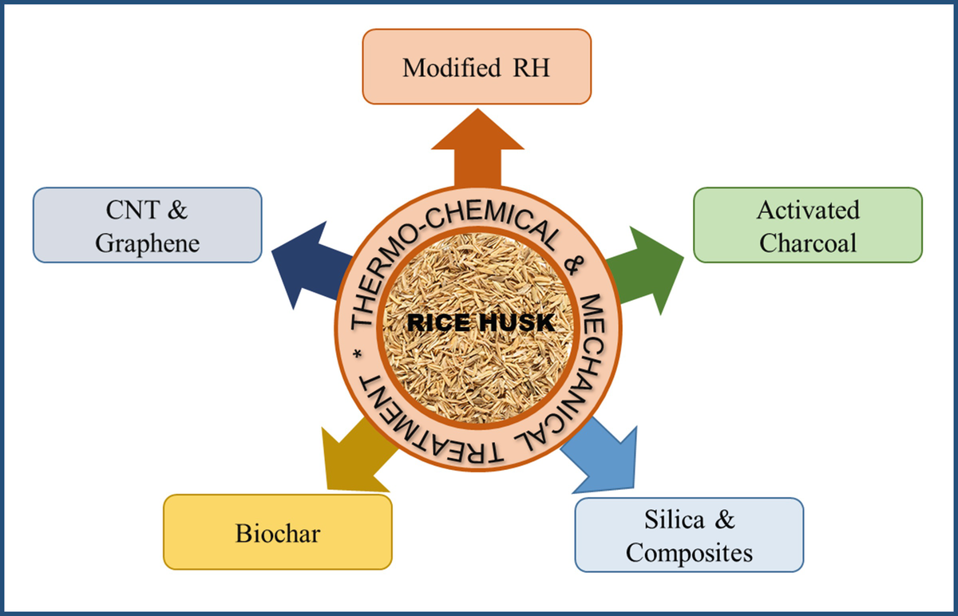
Hybrid Li ion capacitors

Slide 11
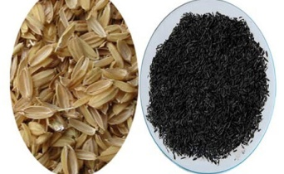
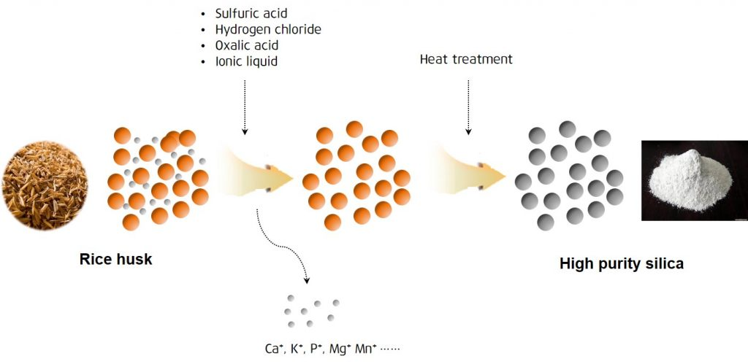
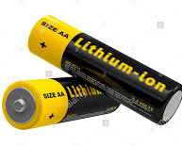
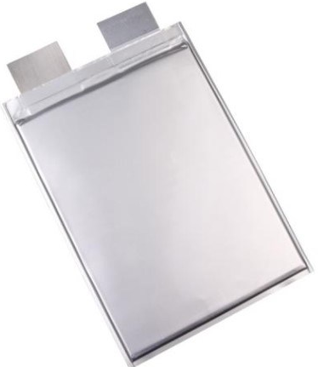
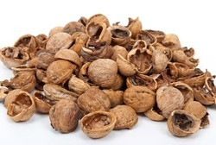
Synthesis and production of anode material from biowaste
Chemical activation
Carbonization (300-500°C)
anode material for Li-ion battery
Theoretical capacity = 4200 mAh/g
10 times bigger than graphite
Shell nut

Slide 12
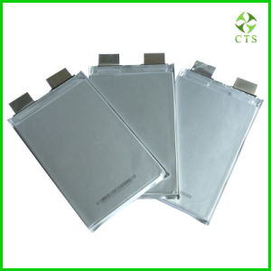
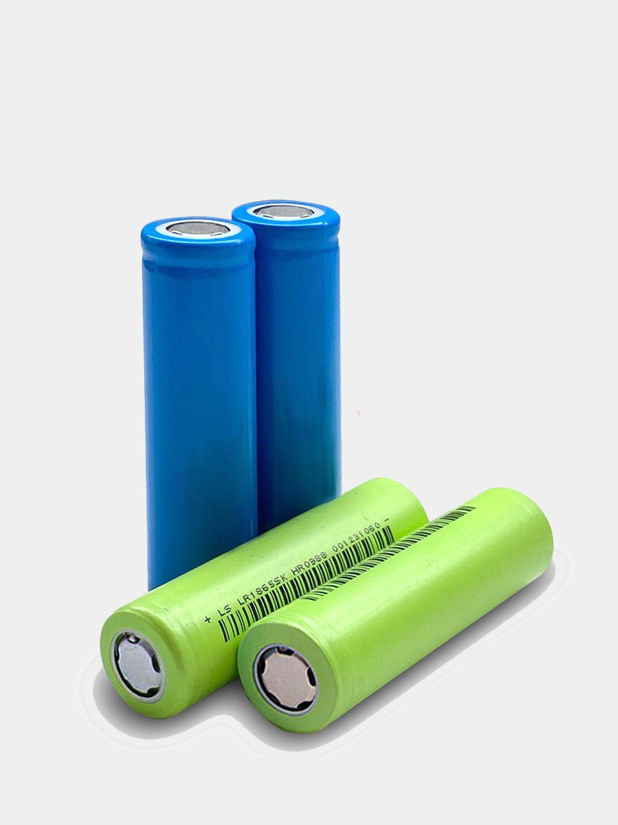
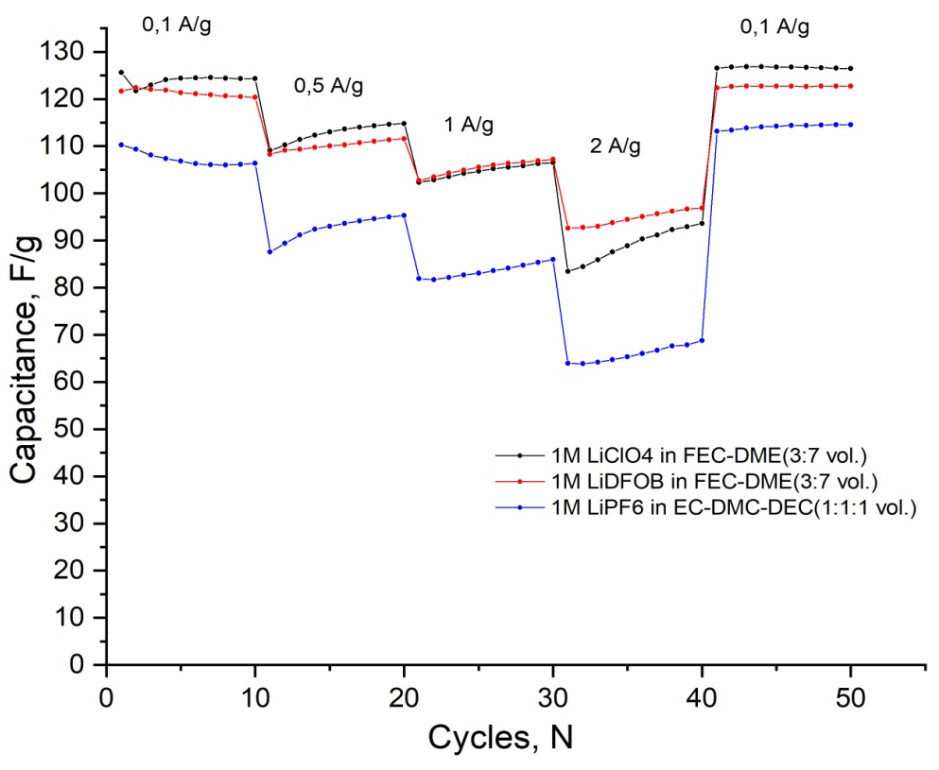
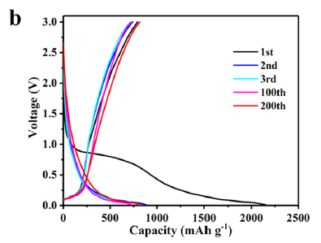
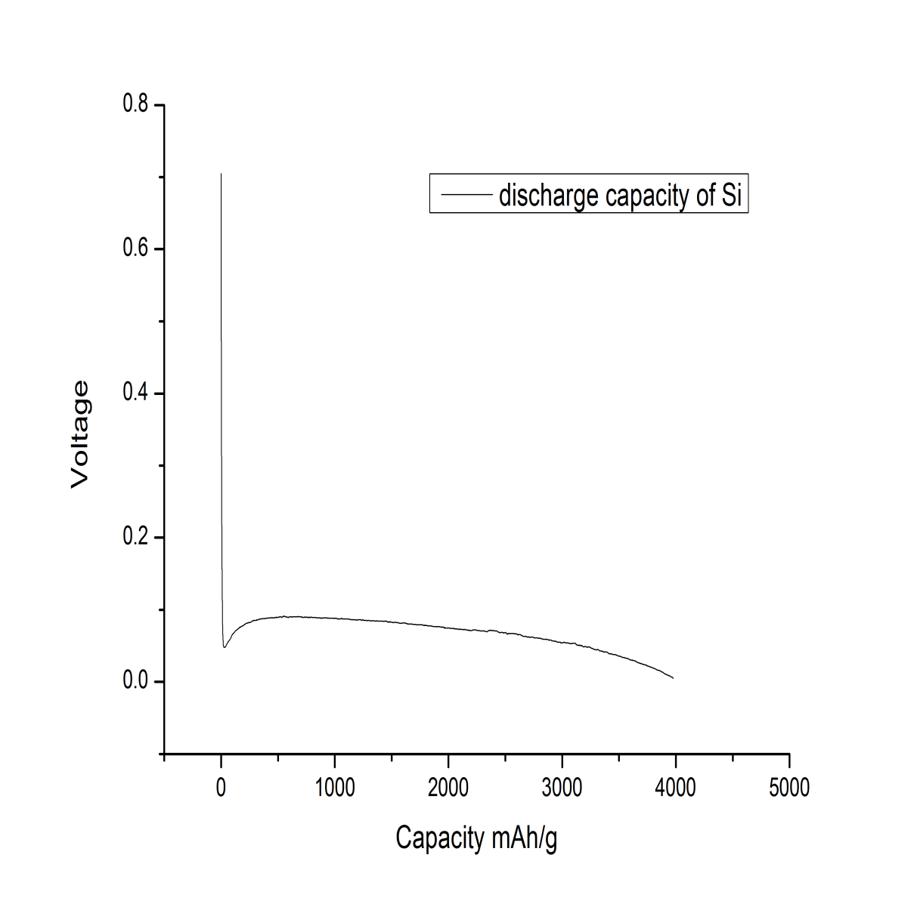
Electrochemical measurements from biowaste
SiO2
Si
Activated carbon
capacity = 4000 mAh/g

Slide 13
Conclusions
Carbon structures used in the experiments provide differerent kinetic transport of Li-ions into crystals of active materials;
SANS me asure me nts explained why CNT ne twork e mbe dde d in e le ctrode layer provide s its greater wettability by an e le ctrolyte compare d to carbon black use d as conductive additive ;
The neutron tomography method was used to visualize the lithium and electrolyte distribution regions flowing inside the cell in the initial and final states of battery charge;
Cathode and anode electrodes obtained from biowaste have much prospect for Li capacitor.
It is a good subject for further neutron research.
Acknowledgment: JINR-Kazakhstan Cooperation Program

Slide 14
Thank you for your attention

