Slide 1
Tasks and prospects for the operation of IBR-2
A.V. Vinogradov, A.V. Dolgikh

Slide 2
Main tasks for the period up to 2030
Obtaining license from Rostekhnadzor for the operation of IBR-2.
The planned date of obtaining the license: April-May 2023. The requested validity period of the new Rostechnadzor license is until October 2032.
Ensuring the operation of the IBR-2 reactor for physics experiments.
Upgrade of the main safety-related equipment of the IBR-2 reactor.
Development and construction of a system of cryogenic moderators for IBR-2
Ensuring reactor safety.
Prospects for the operation of IBR-2.

Slide 3
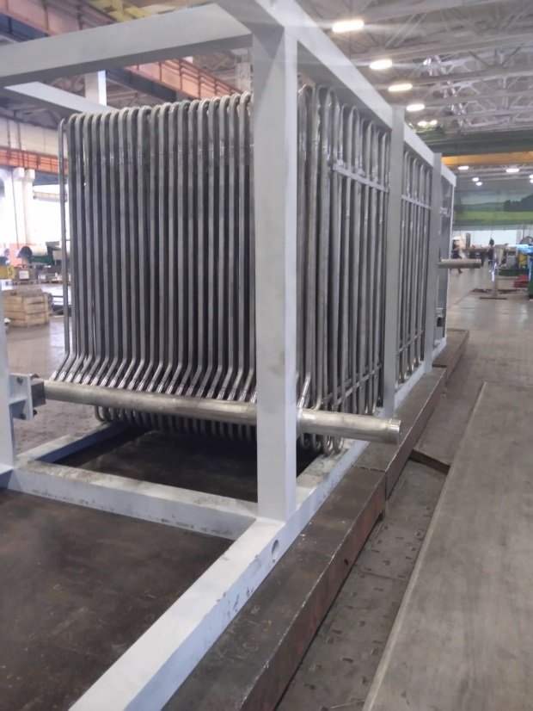
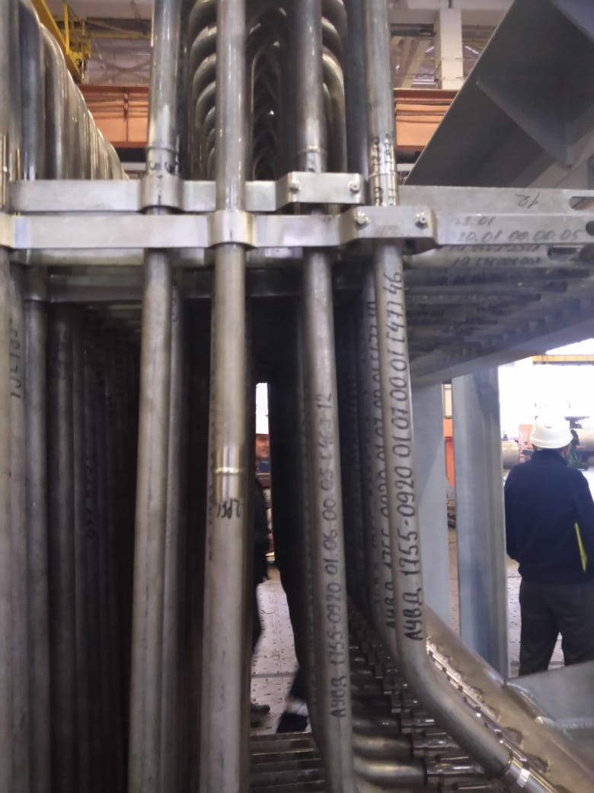
Operation for physics experiments
Replacement of air heat exchangers.
Completion date: August-September 2023
Technical preparation of the reactor for operation at power, amendments to the terms of the license.
Completion date: September 2023
Resumption of regular operation for physics experiments.
Completion date: October 2023

Slide 4
Upgrade of the IBR-2 equipment
Replacement of panels of control stations for special ventilation at IBR-2.
Completion date: 2023
Replacement of equipment (in/out cubicles and switchboards) of sections 1 and 2 of RP-118 in accordance with the reconstruction project.
Completion date: scheduled maintenance in 2024-2026
Bringing special cranes of IBR-2 (3 cranes) in compliance with requirements of federal rules and regulations (НП-043-184-2025).
Completion date: 2022-2027

Slide 5
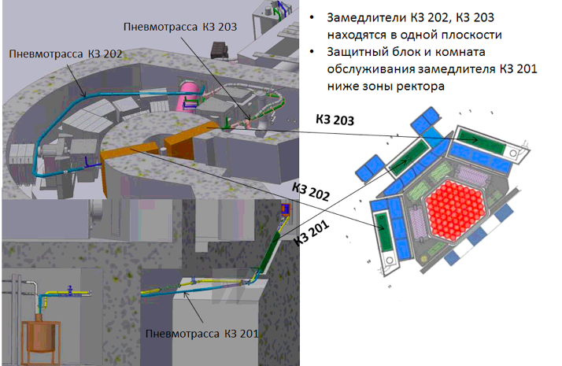
Development and construction of a system of cold moderators
Moderators CM-202, CM-203 are in the same plane.
Shielding and maintenance room for the CM-201 moderator are located under the reactor.
Pneumatic pipeline CM-203
Pneumatic pipeline CM-202
CM-203
CM-202
CM-201
Pneumatic pipeline CM-201

Slide 6
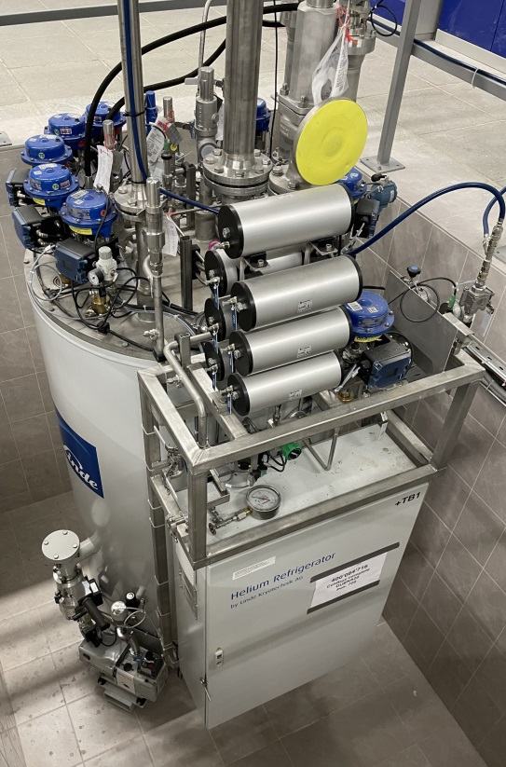
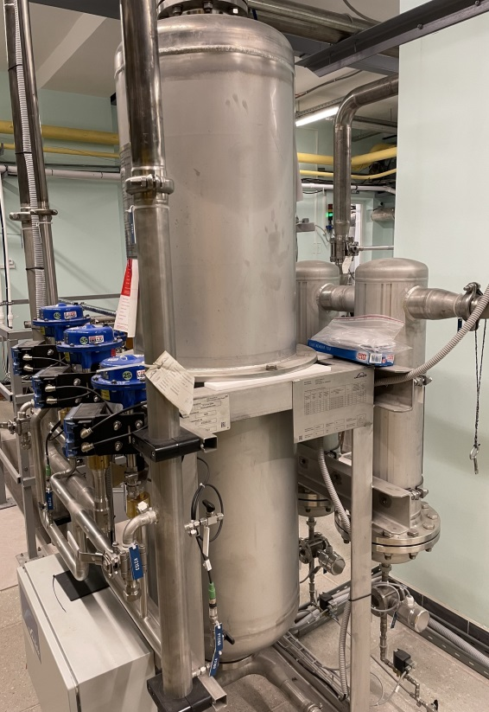
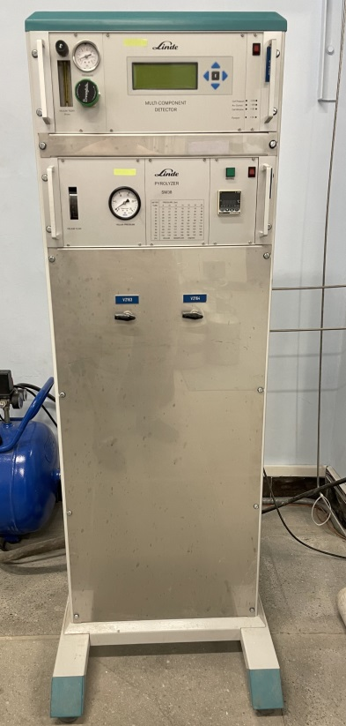
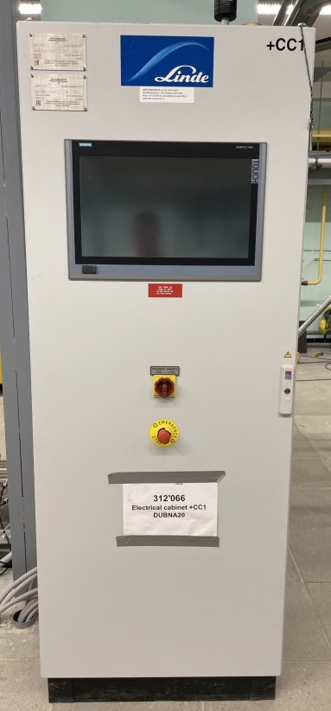
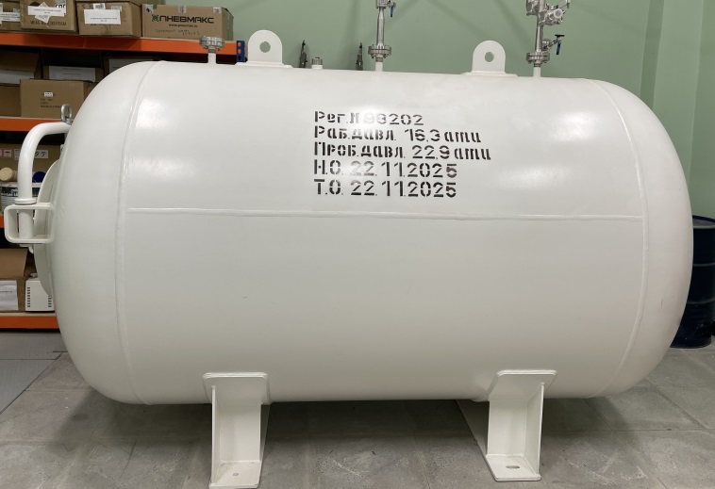
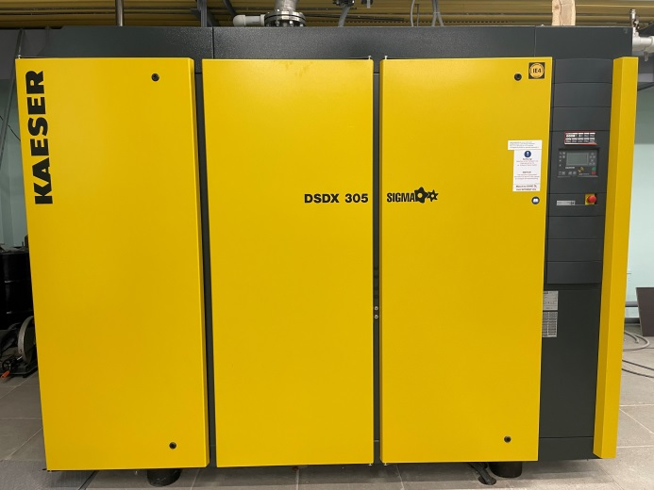
Equipment of KGU 1800

Slide 7
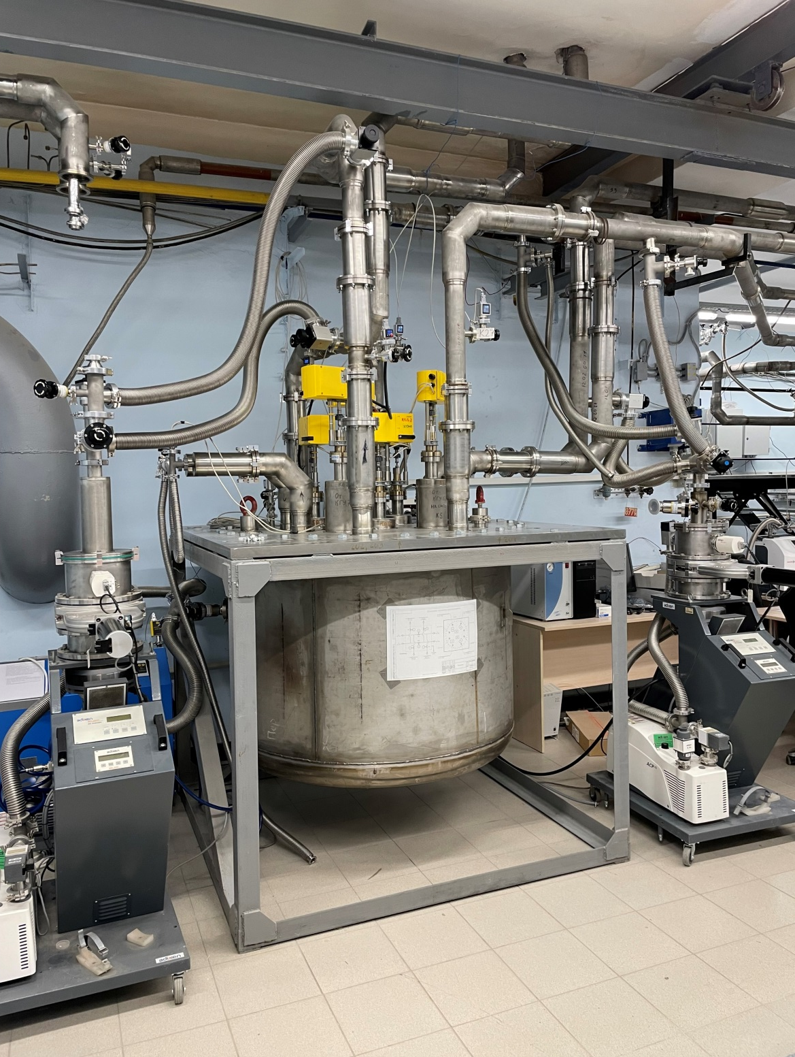
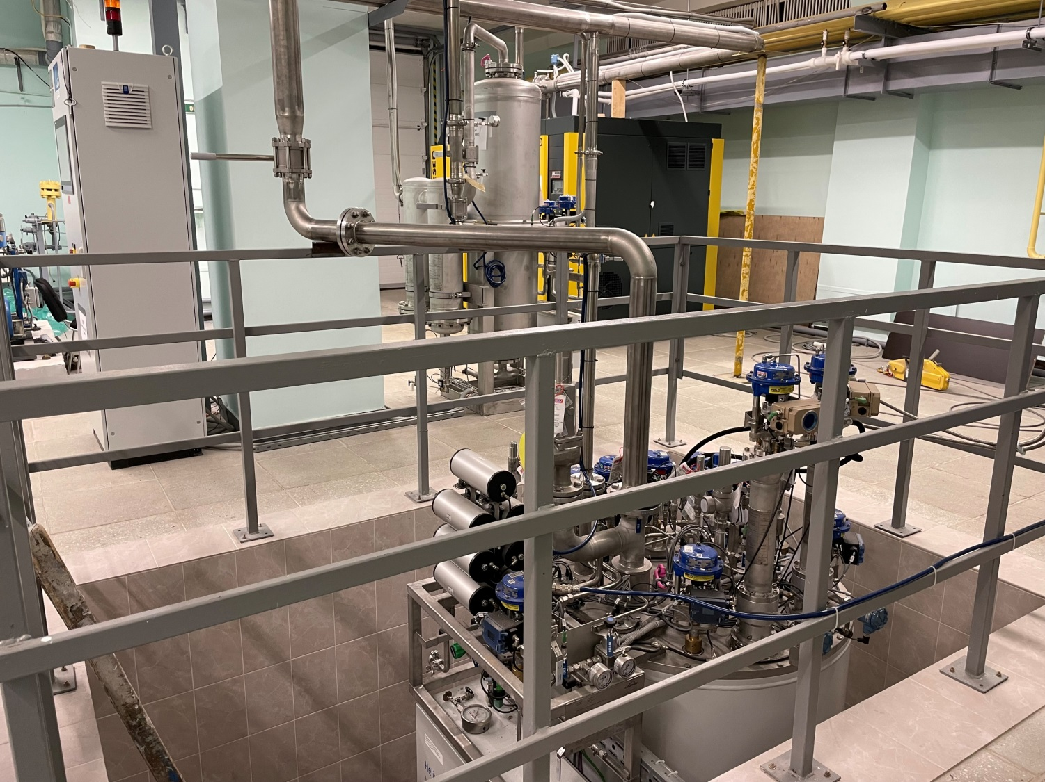
Equipment of KGU 1800
Cryogenic distribution collector

Slide 8
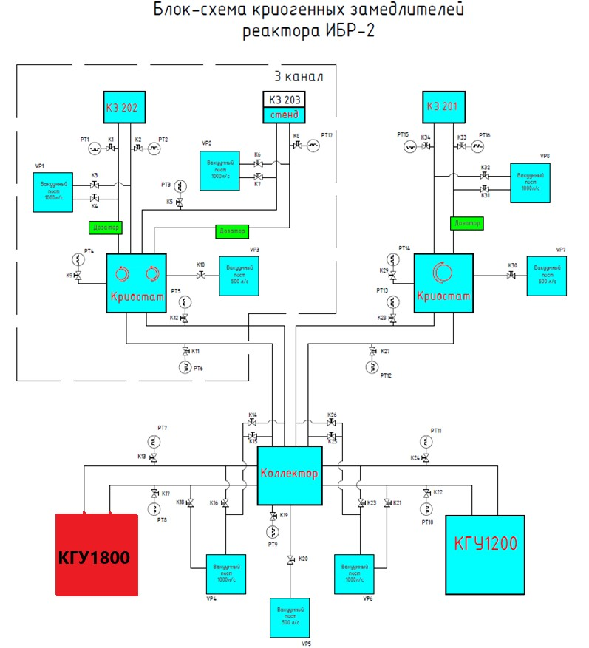
Integration of KGU 1800 into the system of cryogenic moderators
Block diagram of cryogenic moderators of the IBR-2 reactor

Slide 9
Operational safety of IBR-2
Inspection of building structures of building 117 of IBR-2 with calculations for resistance to progressive collapse.
Completion date: 2023
Monitoring of the state of nuclear safety during the entire period of IBR-2 operation.
Experimental and computational studies of the mechanism of vibrational instability during reactor operation at power.
Completion date: 2024-2026
Experimental studies of the state of structure and materials of IBR-2 fuel assemblies in JSC "Institute of Reactor Materials" (Zarechny).
Completion date: 2024-2025

Slide 10
Prospects for the operation of IBR-2 nuclear facility
Removal of unused NM and IBR-2 SFAs from the JINR site to the Mayak Production Association.
Estimated completion date: 2024-2026
Production of an additional batch of fresh fuel at the Mayak Production Association.
Estimated completion date: 2026
Loading the core of IBR-2M with fresh fuel.
Estimated completion date: before 2028. Depending on the readiness of an additional batch of fuel assemblies.
If the core is loaded in 2027-2028, the operation of IBR-2 is possible until 2040-2042 subject to obtaining a Rostekhnadzor license for operation of a nuclear facility.

Slide 11
Estimation of costs for the implementation of the main tasks
(in k$)
Activities | 2023 | 2024 | 2025 | 2026 | 2027 | 2028 | 2029 | 2030 | TOTAL
Development of IBR-2 (1105) | 794.0 | 1140.0 | 2066.0 | 1520.0 | 1200.0 | 1200.0 | 1200.0 | 1200.0 | 10320.0
Operation of IBR-2 | 1532.0 | 2076.0 | 1910.0 | 2480.0 | 2800.0 | 2800.0 | 2800.0 | 2800.0 | 19198.0

Slide 12
Thank you for your attention!

