Slide 1
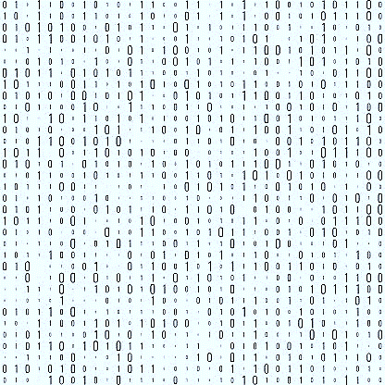
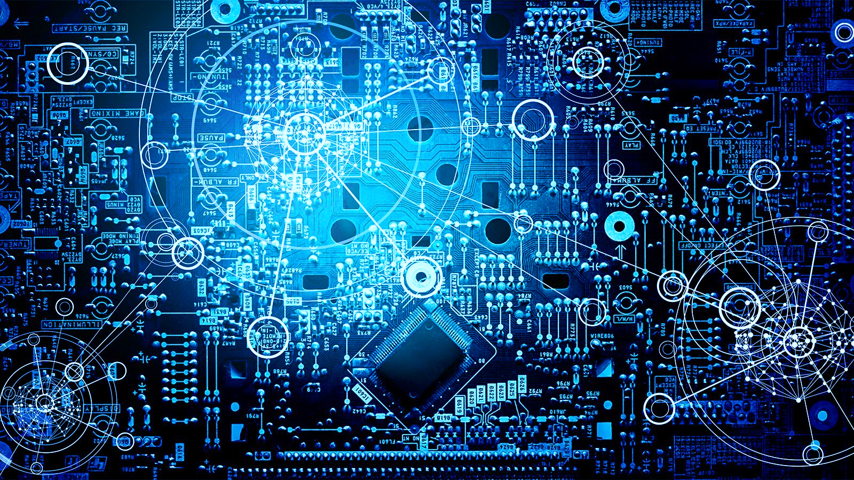

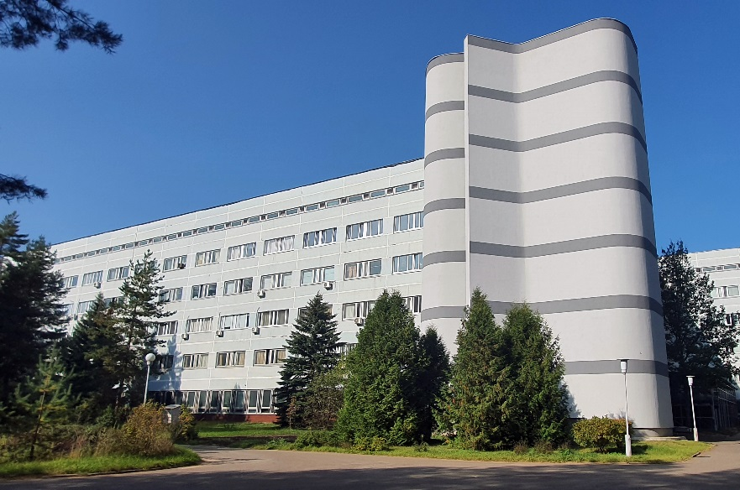
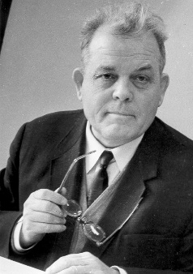
Status and prospects of the
Meshcheryakov
Laboratory of Information Technologies scientific program
Olga Derenovskaya
Scientific secretary of the Meshcheryakov Laboratory of Information Technologies, JINR
Joint Institute for Nuclear Research
2023

Slide 2

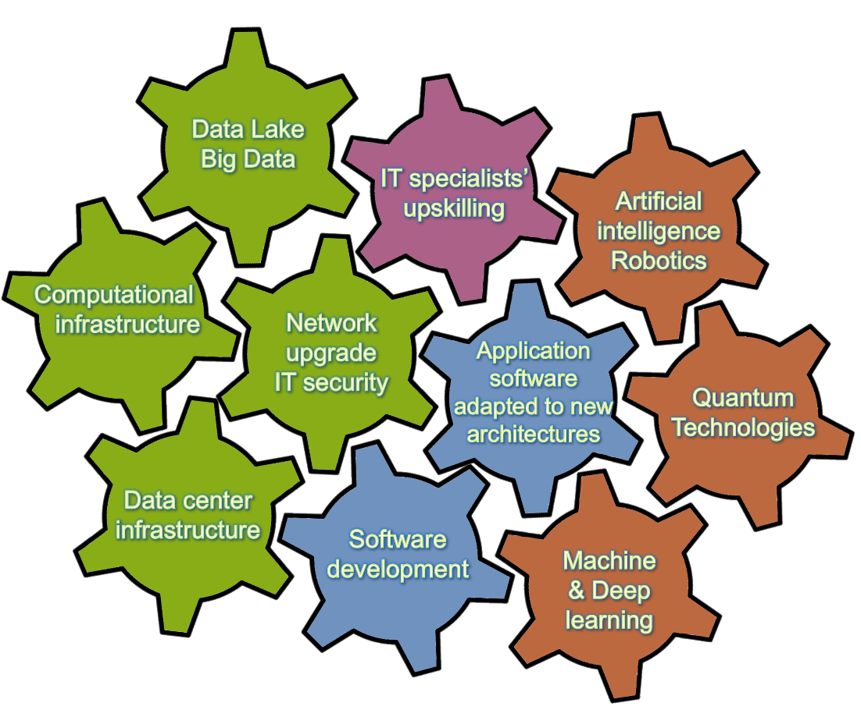
Strategy for Information Technology and
Scientific Computing at JINR
Scientific IT ecosystem:
It will be a steady implementation/upgrades of
Networking (Tb/s range),
Computing infrastructure within the Multifunctional Information & Computing Complex (MICC) and
“Govorun” Supercomputer,
Data center infrastructure,
Data Lake & long-term storage
for all experiments.
The development of new data processing and analysis algorithms based on
ML/DL,
Artificial intelligence,
Big Data
Quantum technologies.
A variety of means will be used for IT specialists’ upskilling.
Coordinated development of interconnected IT technologies and computational methods
Notes:
The concept of the development of information technology, scientific computing and Data Science in the JINR Seven-Year Plan provides for the creation of a scientific IT ecosystem that combines many different technological solutions, trends and methods Particular attention will be paid not only to increasing the performance of the computing systems and resources of the MICC storage systems, including the “Govorun” supercomputer, but also to the further development of the JINR network infrastructure. The most important tasks are the development of new data processing and analysis algorithms. The IT ecosystem will become a platform for training IT specialists engaged in developing algorithmic and software solutions for JINR tasks.

Slide 3
Cooperation with All JINR Laboratories
Particle Physics and HEP
- NICA computing
- Methods and algorithms for data analysis
- Intelligent control systems
- …
Nuclear Physics
Life Science
- Computations of the properties of atoms of superheavy elements
- Information System for Radiation Biology tasks
- Analysis of fine structures in the mass distribution of nuclear reaction products
- Analysis of Small-Angle scattering data from nanodrugs
- Environmental monitoring
- …
- Sub-barrier fusion and fission reactions
of heavy nuclei
- …
Information Technologies
(Scientific directions and information systems)
Condensed Matter
Theoretical Physics
- Analysis of polydisperse populations of phospholipid vesicles
- Calculations of lattice QCD
- Numerical simulation within effective theories of QCD
- Study of nanocomposite thin films using neutron and X-ray reflectometry methods
- Compton scattering
Neutrino Physics and Astrophysics
- Simulation of thermal processes occurring in materials
- …
- Support of the JINR neutrino program
- …
- Data acquisition system software for Baikal-GVD
- …
Notes:
a distinctive feature of research areas related to information technology is close cooperation with all the Laboratories of the Institute, institutes of the JINR Member States and other countries.

Slide 4
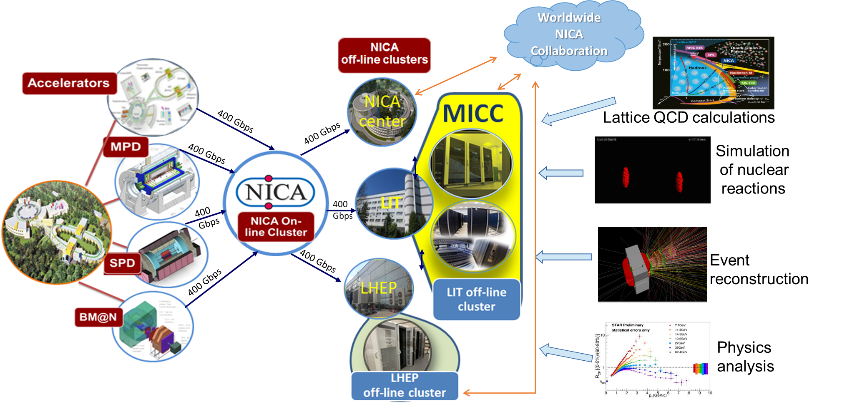
NICA Computing
Notes:
one of the main activities of the laboratory are connected with JINR flagship projects: computing for the NICA and

Slide 5

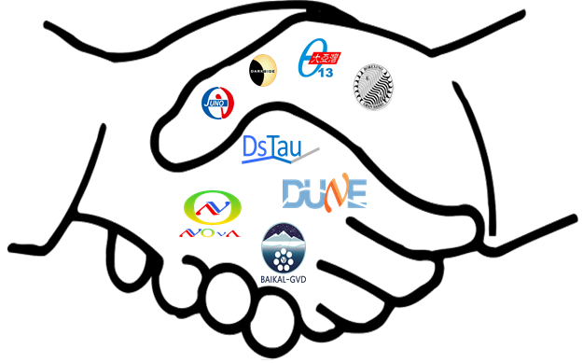
Support for the JINR Neutrino Program
MLIT contribution:
engineering infrastructure (electricity, UPS, cooling, network, racks, manpower)
DLNP contribution:
computing and storage resources (CPUs/GPUs&disks)
Computational resources for the JINR neutrino program using the cloud infrastructure of the MICC.
The NOvA, Baikal-GVD and JUNO experiments are the major users of the cloud infrastructure.
Notes:
Support for the JINR Neutrino Program including the Baikal-gvd experiment

Slide 6
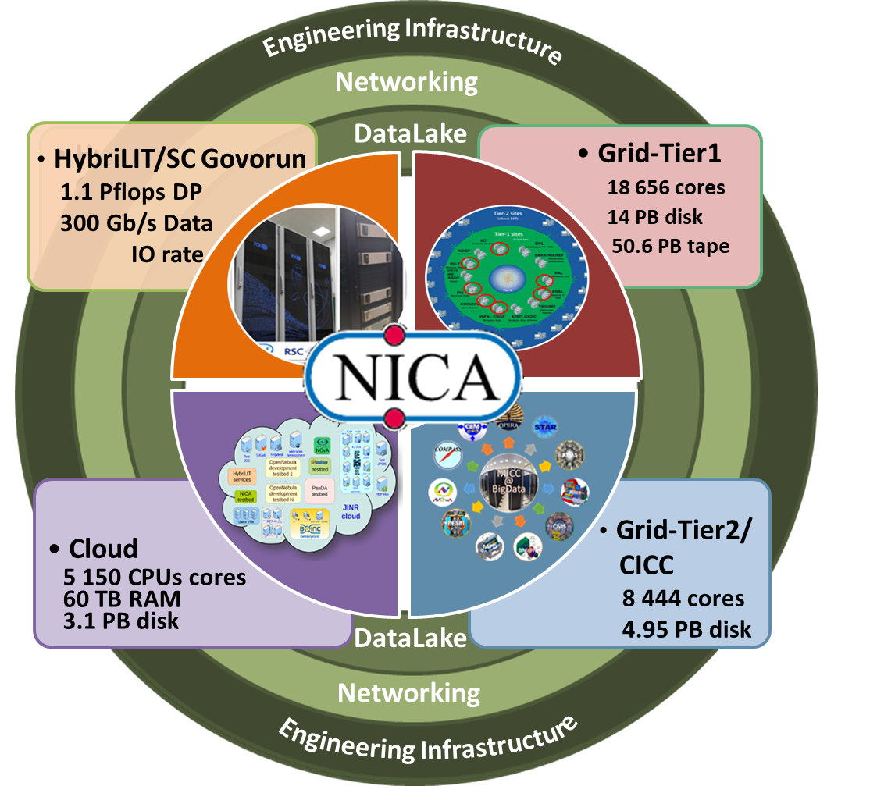
Multifunctional Information and Computing Complex at JINR
The MICC meets the requirements for a modern highly performant scientific computing complex:
multi-functionality,
high performance,
task-adapted data storage system,
high reliability and availability,
information security,
scalability,
customized software environment for different user groups,
high-performance telecommunications and modern local network.
The MICC should be considered as a basic scientific infrastructure project.
Notes:
The MICC is regarded as JINR’s unique basic facility and plays a defining role in scientific research, which entails modern computing power and storage systems. The MICC uniqueness is ensured by the consolidation of all state-of-the-art information technologies, including the network infrastructure and the distributed data processing and storage system based on grid technologies and cloud computing, the hyper-converged computing infrastructure with liquid cooling for supercomputer applications.

Slide 7
Network Infrastructure
The network infrastructure is a fundamental component of the IT infrastructure of JINR and of the MICC. It provides access to the Internet, computing resources and data storage systems, as well as enables experimental data processing and computing. MLIT ensures the reliable and fault-tolerant operation of all components of the network infrastructure:
The JINR LAN comprises:
9291 network elements
18044 IP-addresses
6355 users registered within the network
4477 *.jinr.ru service users
1455 digital library users
837 remote VPN
111 EDUROAM users
JINR-Moscow 3x100 Gbit/s
JINR-CERN 100 Gbit/s and JINR-Amsterdam 100 Gbit/s
multi-site cluster network with a bandwidth of 4x100 Gbit/s for the NICA megaproject
local area network with a bandwidth of 2x100 Gb/s
network traffic in 2022
29.56 PB - input
34.19 PB - output
Notes:
One of the most important components of JINR and the MICC providing access to resources and the possibility to work with Big Data is the network infrastructure.

Slide 8
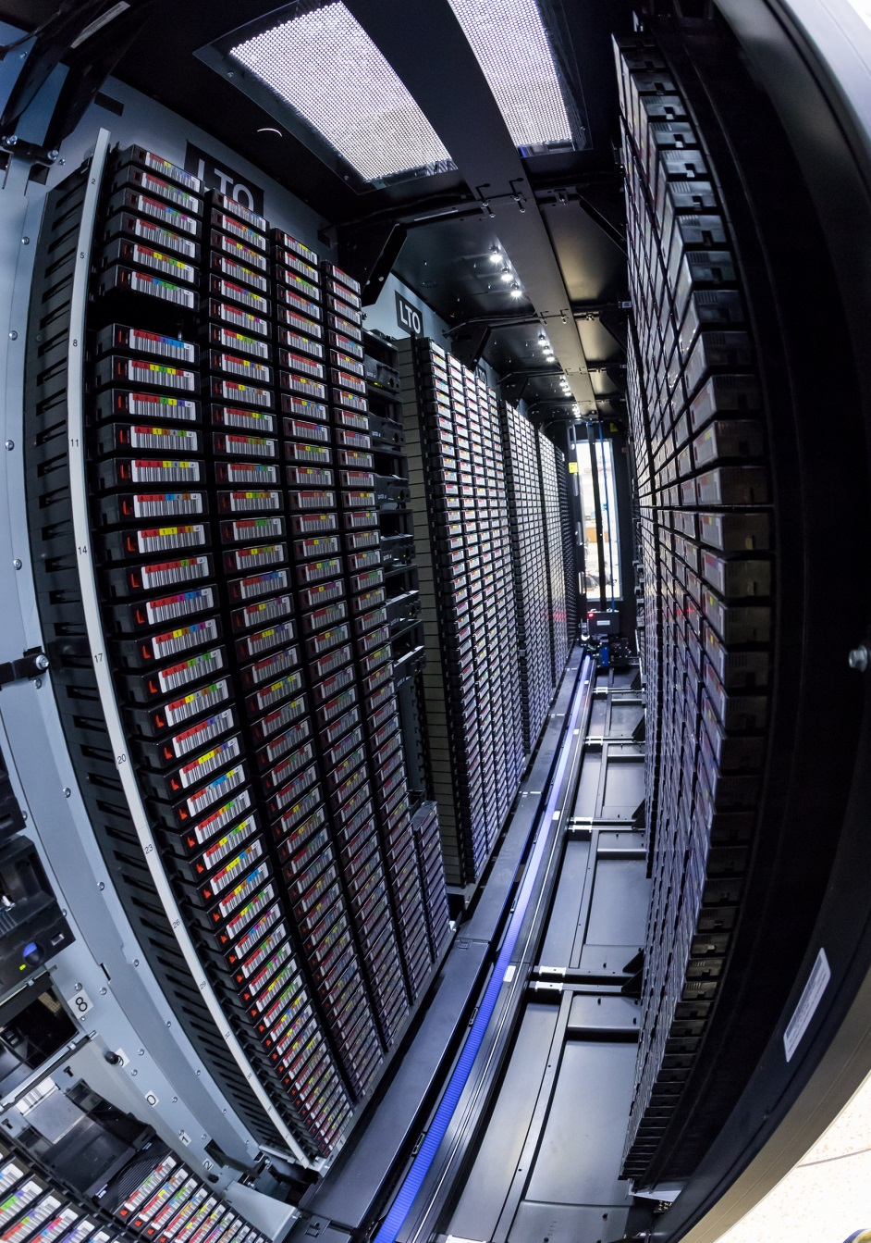
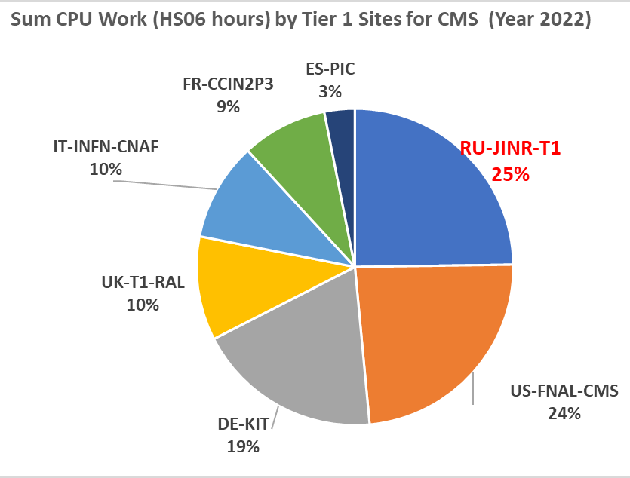
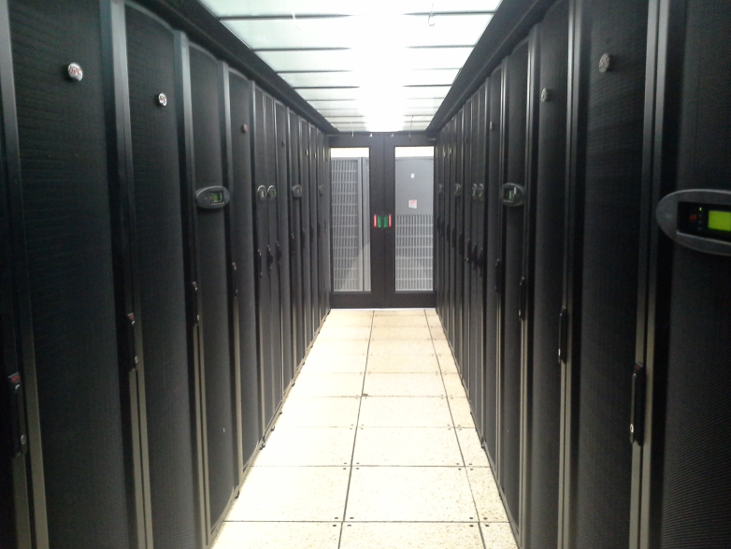
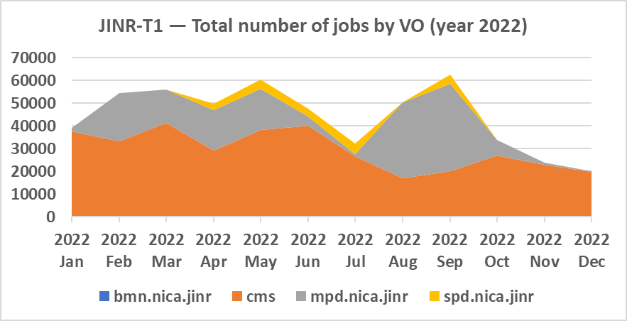
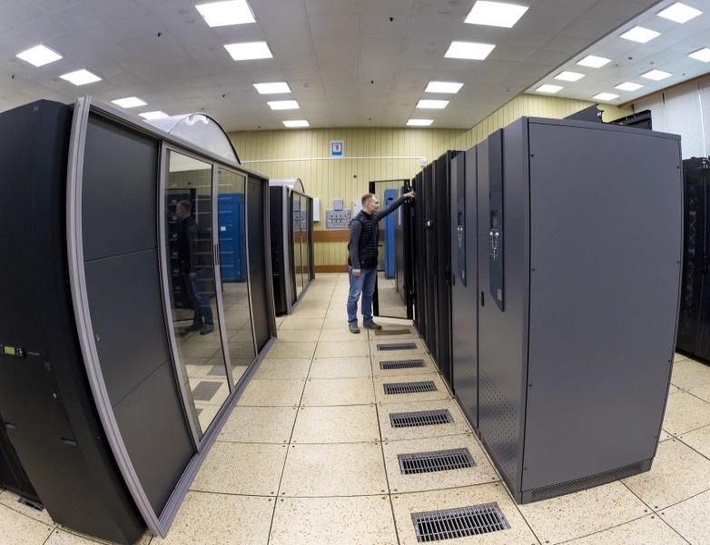
Tier1 at JINR
The JINR Tier1 center has demonstrated stable work not only for CMS (LHC), but also for MPD (NICA).
The Tier1 site for CMS is ranked first among world centers for CMS.
30% of all jobs executed at Tier1 JINR are NICA jobs
  18656 cores
  260 kHS06
  14 PB disks
  50.6 PB tapes
  100% reliability and availability
Notes:
The JINR grid infrastructure is represented by the Tier1 center for the CMS experiment at the LHC and the Tier2 center. In terms of performance, Tier1 (T1_RU_JINR) is ranked first among the Tier1 world centers for the CMS experiment. Since 2021, the Tier1 resource center has also been used to perform simulations for the MP experiment of the NICA project.

Slide 9
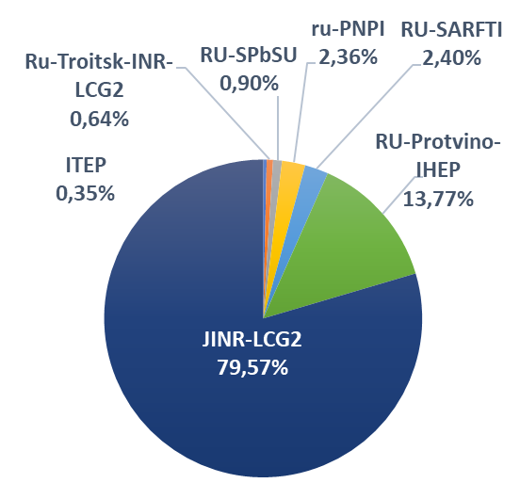
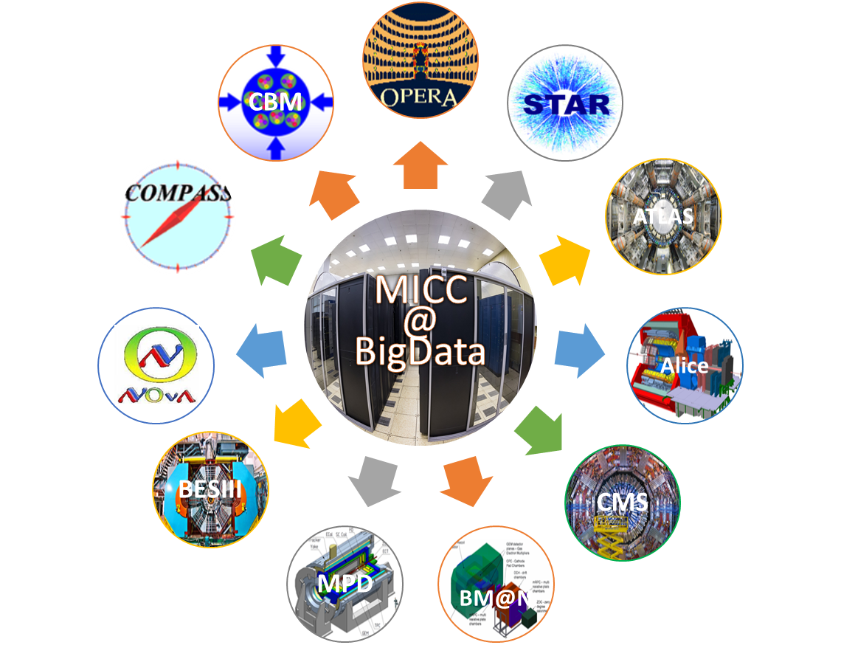
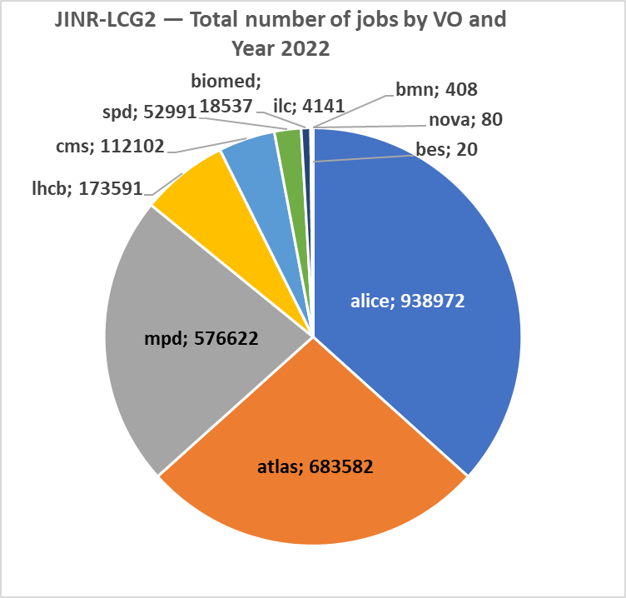
Tier2 at JINR
Tier2 at JINR provides computing power and data storage and access systems for the majority of JINR users and user groups, as well as for users of virtual organizations (VOs) of the grid environment (NICA, LHC, FAIR, etc.).
JINR Tier2 is the most productive in the Russian Data Intensive Grid (RDIG) Federation.
RDIG: distribution by the number of jobs by websites of organizations
(year 2022)
JINR Tier2: Sum CPU work (HS06 hours) by VO (year 2022)

Slide 10
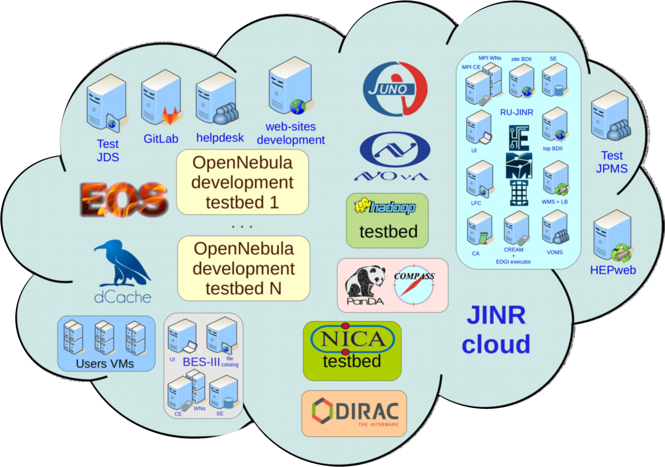
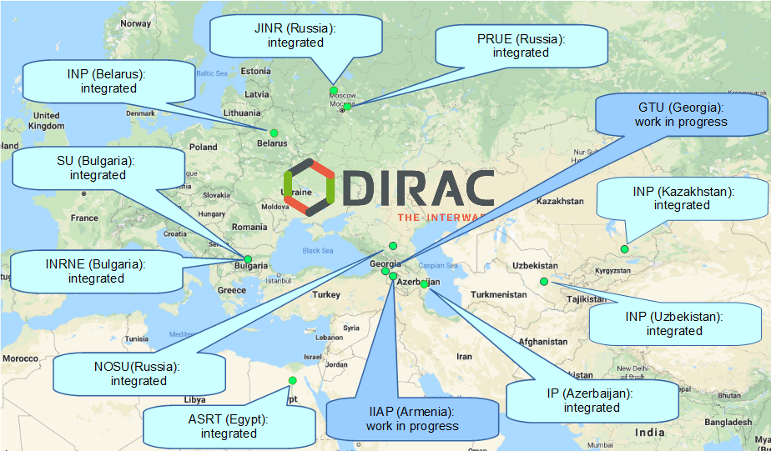
Cloud Infrastructure
Cloud Platform - OpenNebula
Virtualization - KVM
Storage (Local disks, Ceph)
Total Resources
~ 5,000 CPU cores; 60 TB RAM; 3.1 PB of raw ceph-based storage
- VMs for JINR users
  Computational resources for neutrino experiments
  Testbeds for research and development in IT
  COMPASS production system services
  Data management system of the UNECE ICP Vegetation
  Scientific and engineering computing
  Service for data visualization
  Gitlab and some others
DIRAC-based distributed information and computing environment (DICE) that integrates the JINR Member State organizations’ clouds
Notes:
A universal computing resource that supports individual scientists and provides a variety of common services, ranging from simple websites to complex multi-user computational systems. The main tasks are provision of Computational resources and support of users for the neutrino experiments and creation of distributed information and computing environment that integrates the JINR Member State organizations’ clouds.

Slide 11
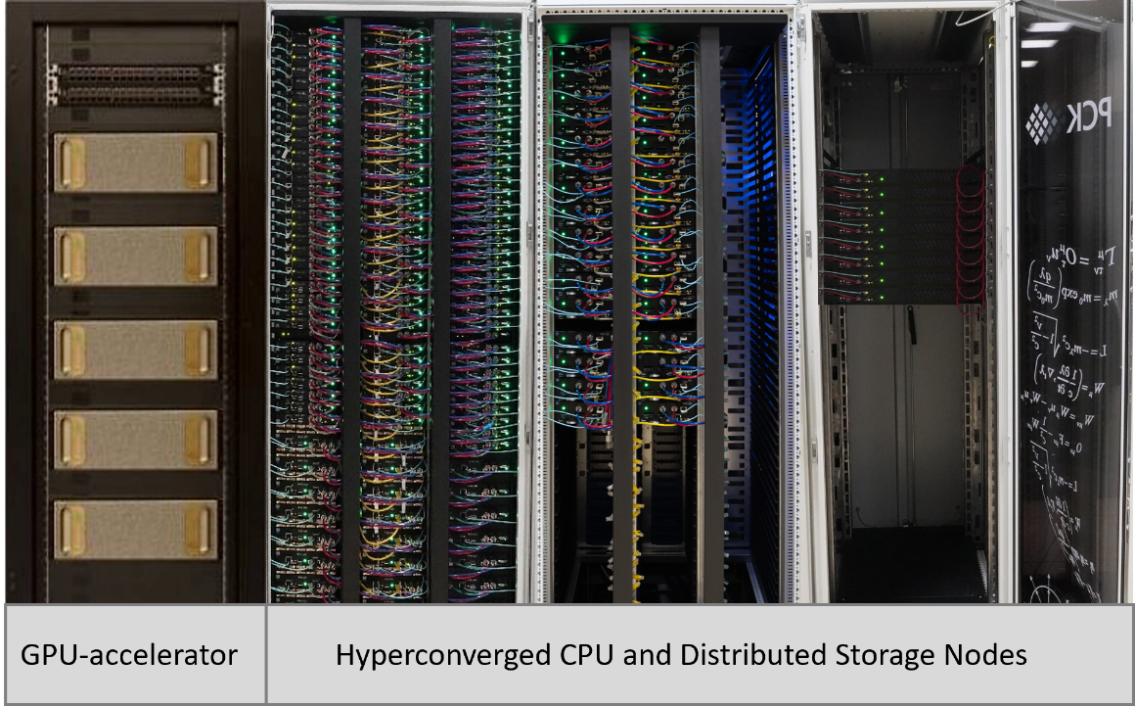
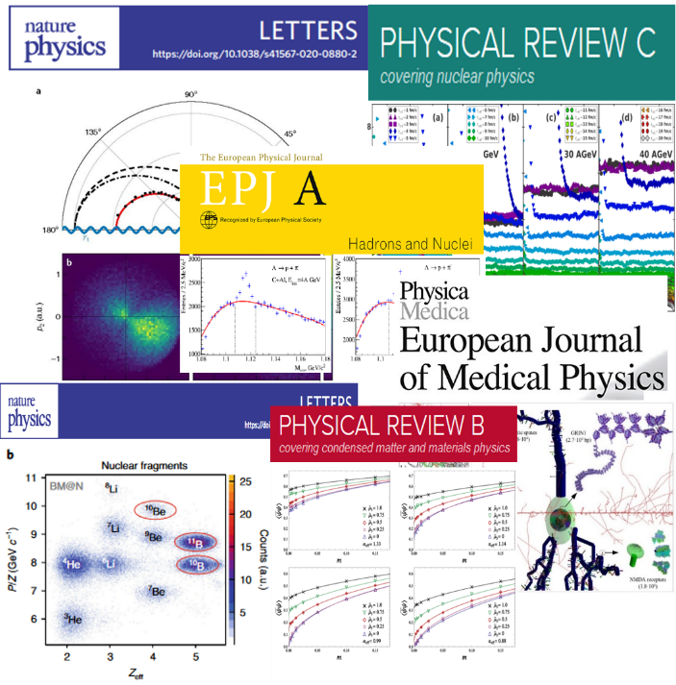
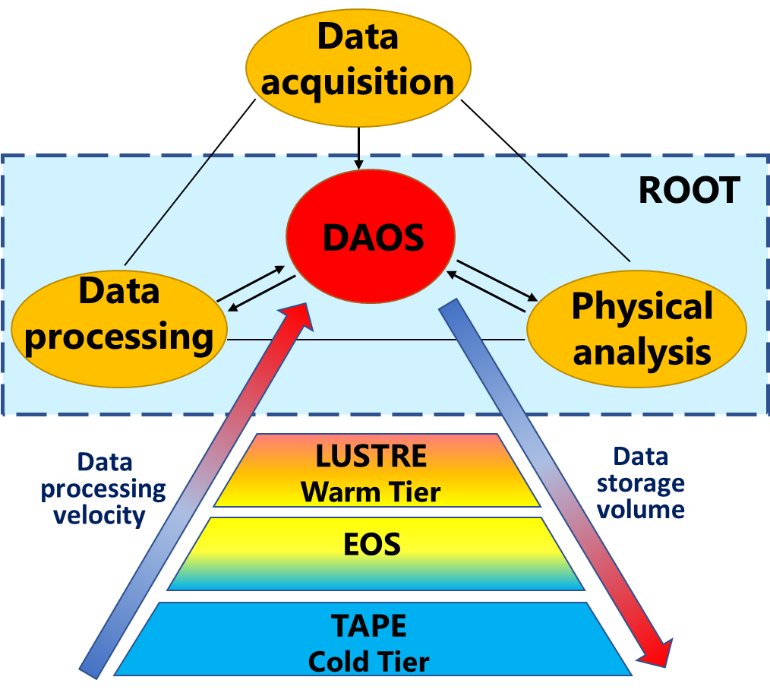
“Govorun” Supercomputer
Hyper-converged software-defined system
Hierarchical data processing and storage system
Scalable solution Storage-on-demand
Total peak performance: 1.1 PFlops DP
GPU component based on NVIDIA
CPU component based on RSC “Tornado” liquid cooling solutions
The most energy-efficient center in Russia (PUE = 1.06)
Storage performance >300 GB/s
The resources of the “Govorun” supercomputer are used by scientific groups from all the Laboratories of the Institute for solving a wide range of tasks in the field of theoretical physics, as well as for physics modeling and experimental data processing.
Key projects that use the resources of the SC “Govorun”:
NICA megaproject,
calculations of lattice quantum chromodynamics,
computations of the properties of atoms of superheavy elements,
studies in the field of radiation biology,
calculations of the radiation safety of JINR’s facilities.
Notes:
The JINR MICC heterogeneous infrastructure is represented by the HybriLIT platform, which involves the training and testing polygon and the “Govorun” supercomputer, driven by a common software and information environment. The “Govorun” supercomputer is a scalable liquid-cooled system with a hyperconverged and software-defined architecture and has unique properties for the flexibility of customizing the user’s task, ensuring the most efficient use of the computing resources of the supercomputer. The current configuration of the “Govorun” supercomputer involves computing modules containing GPU and CPU components, as well as a hierarchical data processing and storage system. In 2022 the next update of the supercomputer was held. Now The total peak performance of the “Govorun” supercomputer is 1.1 PFlops for double-precision calculations with a read/write speed of 300 GB/sec for the hierarchical data processing and storage system. The resources of the "Govorun" supercomputer are used by scientific groups from all JINR Laboratories to solve a wide range of problems both in the field of theoretical physics and for modeling and processing experimental data. Key projects that use the resources of the “Govorun” supercomputer: NICA megaproject, calculations of lattice quantum chromodynamics, computations of the properties of atoms of superheavy elements, studies in the field of radiation biology, calculations of the radiation safety of JINR’s facilities.

Slide 12
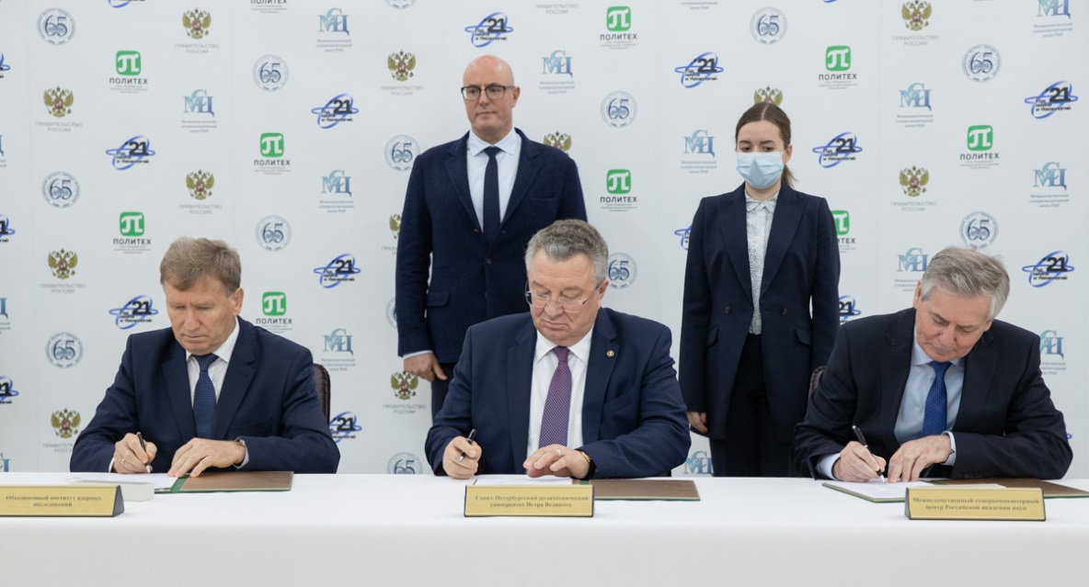
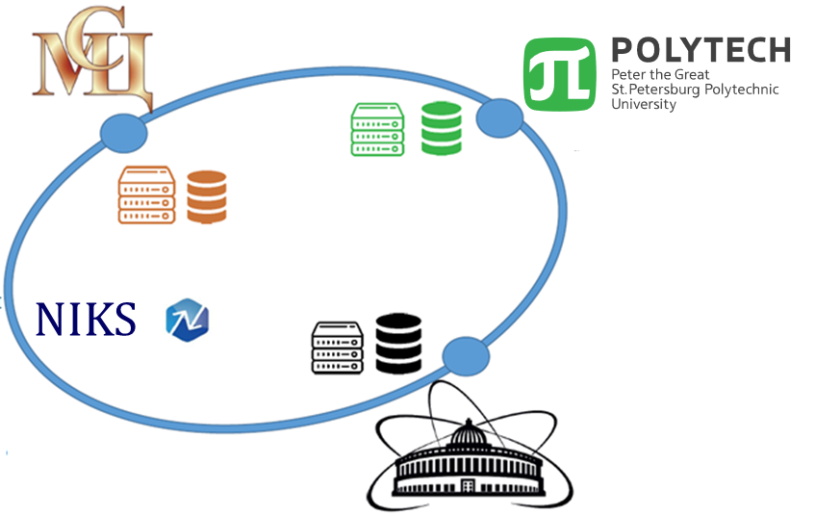
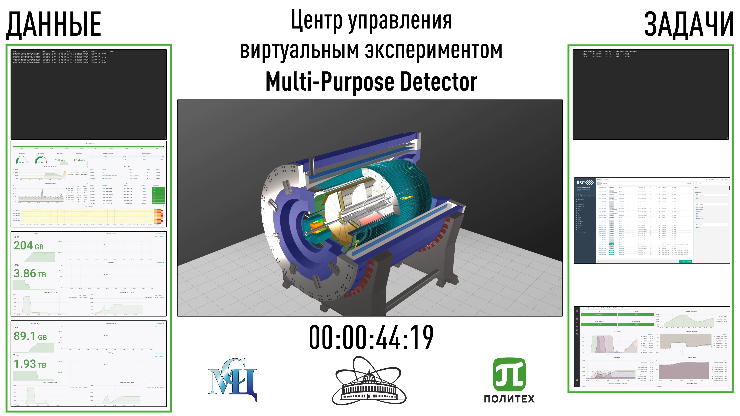
Unified Scalable Supercomputer Research Infrastructure
Based on the integration of the supercomputers of JINR, of the Interdepartmental Supercomputer Center of the Russian Academy of Sciences and of Peter the Great St. Petersburg Polytechnic University, a unified scalable supercomputer research infrastructure based on the National Research Computer Network of Russia (NIKS) was created. Such an infrastructure is in demand for the tasks of the NICA megaproject.
Notes:
Another area of research, in which the resources of the “Govorun” supercomputer are involved, is the creation of a unified scalable research supercomputer infrastructure based on the National Research Computer Network of Russia (NIKS). At present, in addition to the “Govorun” supercomputer, this infrastructure combines the supercomputers of the Interdepartmental Supercomputer Center of the Russian Academy of Sciences and Peter the Great St. Petersburg Polytechnic University. Such an infrastructure is in demand for the tasks of the NICA megaproject.
On the slide you can see the first successful joint experiment on the use of the unified supercomputer infrastructure for the tasks of the NICA megascience project in 2022.

Slide 13
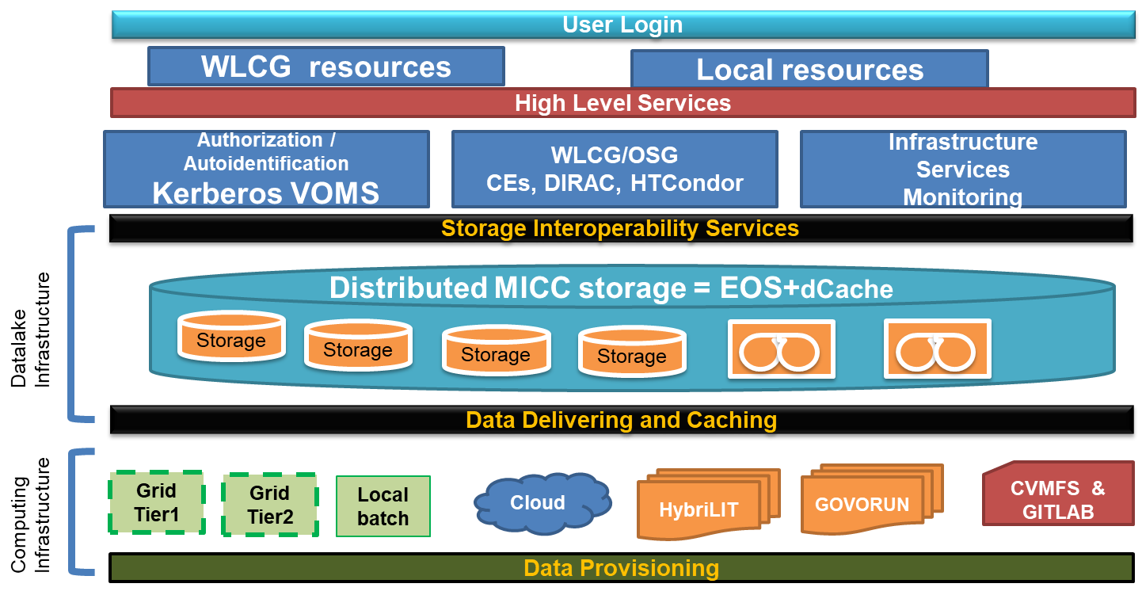
JINR in DataLakes
The JINR data lake was built as a distributed EOS storage system.
EOS is used for storing and accessing big arrays of information. It can be applied for collective data simulation, storage of raw data gathered from experimental setups, data processing and analysis.
There is currently 17 PB of disk space available for EOS.
Baikal-GVD, DANSS, FOBOS, JUNO, BM@N, MPD, SPD, PANDA are its major users.
Notes:
Much attention is paid to the development of distributed data storage - JINR DataLake, which can significantly enhance the efficiency of storing Big Data in combination with high data access speed.

Slide 14
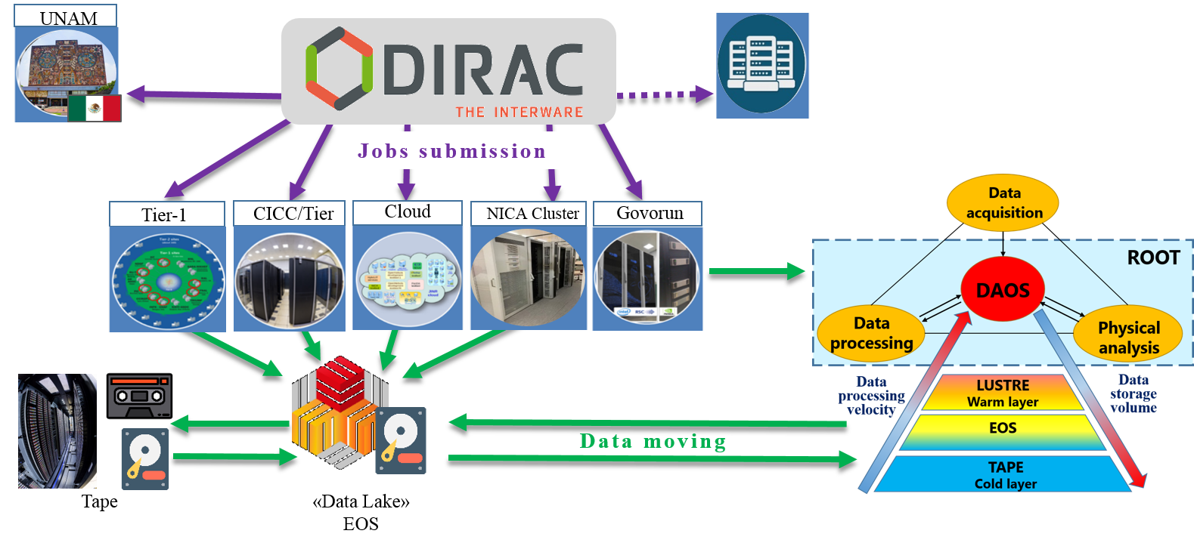


Heterogeneous Distributed Computing Environment
A heterogeneous computing environment, based on the DIRAC platform, was created for processing and storing data of experiments conducted at JINR. Tier1, Tier2, the “Govorun” supercomputer, the clouds of the JINR Member States, the NICA cluster, as well as the resources of the National Research Computer Network of Russia, the cluster of the National Autonomous University of Mexico (UNAM, within cooperation on the MPD project) and the cluster of Institute of Mathematics and Digital Technology (Mongolian Academy of Science), were integrated into
DIRAC. The distributed infrastructure is used by the MPD, Baikal-GVD, BM@N, SPD.
IMDT MAS
Notes:
A heterogeneous computing environment, based on the DIRAC platform, was created for processing and storing data of experiments conducted at JINR. By the end of 2021, all the MICC components, the clouds of the JINR Member States, the NICA cluster, as well as the cluster of the National Autonomous University of Mexico (NAUM, within cooperation on the MPD project), were integrated into DIRAC. The first physics jobs of the BM@N and SPD experiments were launched. For the time being, the distributed infrastructure is used by the following experiments: MPD, Baikal-GVD, BM@N, SPD.
This infrastructure is most actively utilized by the MPD collaboration; it is used for mass Monte Carlo data generation for all physical working groups.

Slide 15
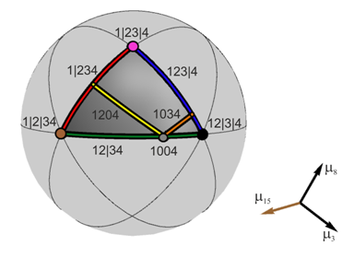
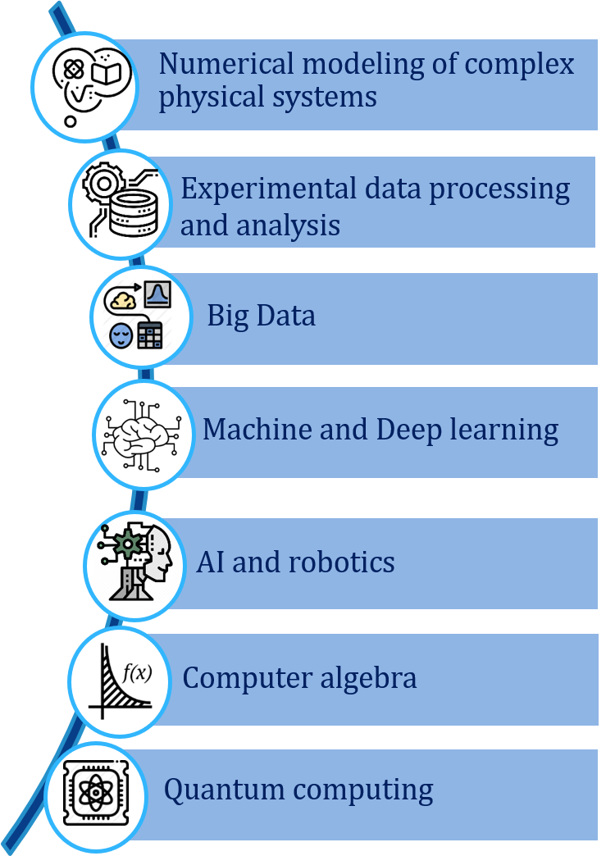
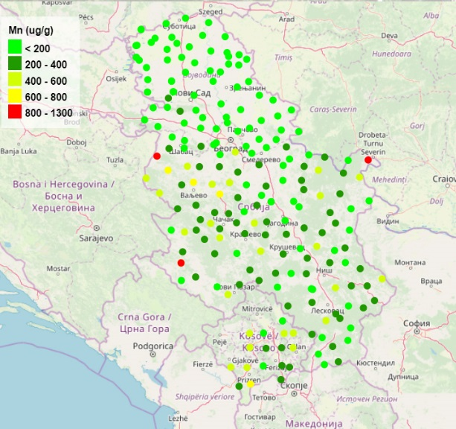
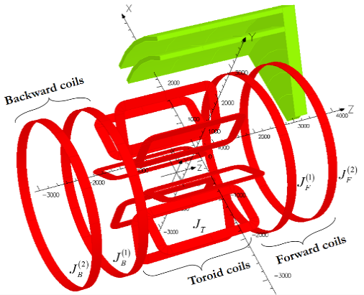
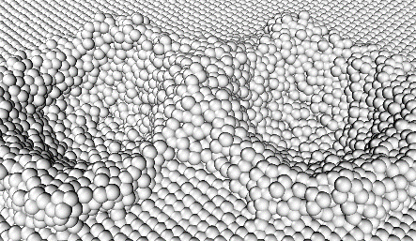
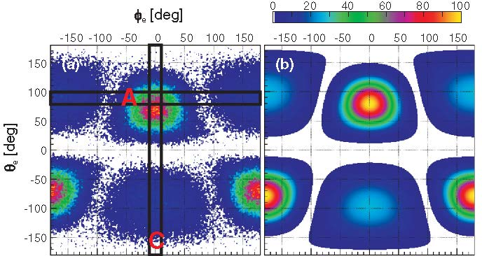
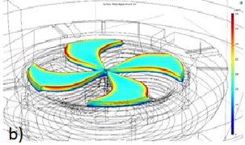
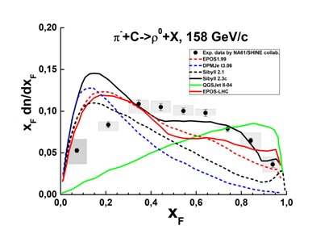
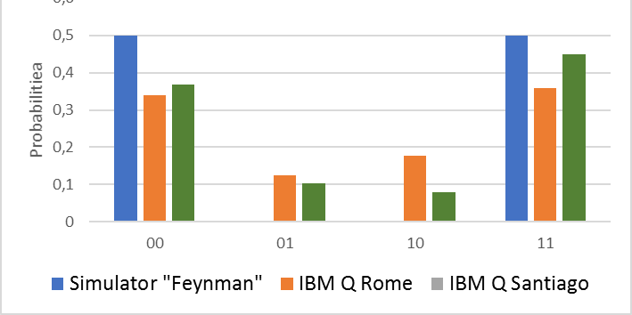
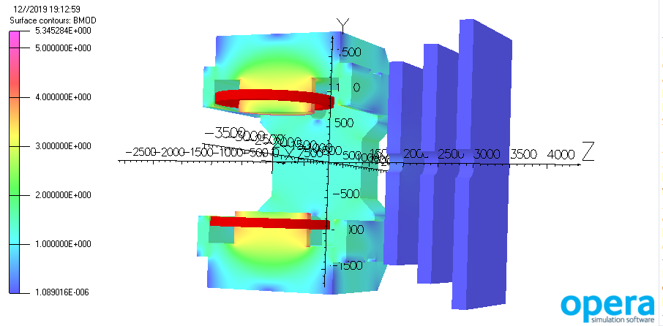
Methods, Algorithms and Software
Notes:
Other activities of MLIT are connected with the development and implementation of effective methods, algorithms and software for physical systems modeling, mathematical processing and experimental data analysis using the MICC resources for the successful achievement of the scientific program by scientists of JINR and its Member States. The most important tasks are the development of new data processing and analysis algorithms based on deep and machine learning, including artificial intelligence, and the development of modern Big Data methods and algorithms for solving applied problems. Research in the field of quantum computing will be aimed at developing algorithms for the intelligent control of JINR physical experimental facilities and at optimizing the solution of resource-intensive problems..

Slide 16
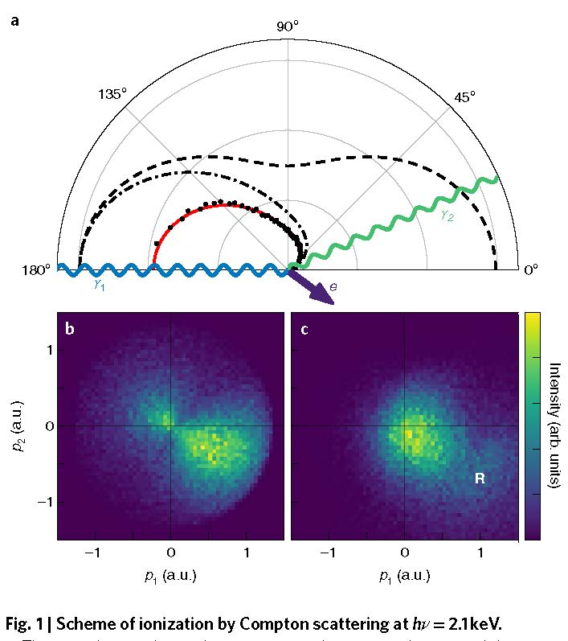
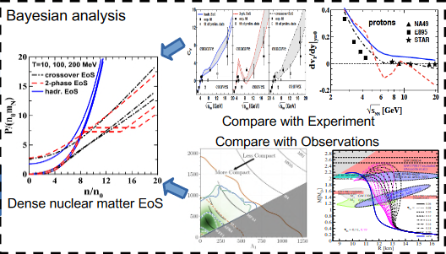
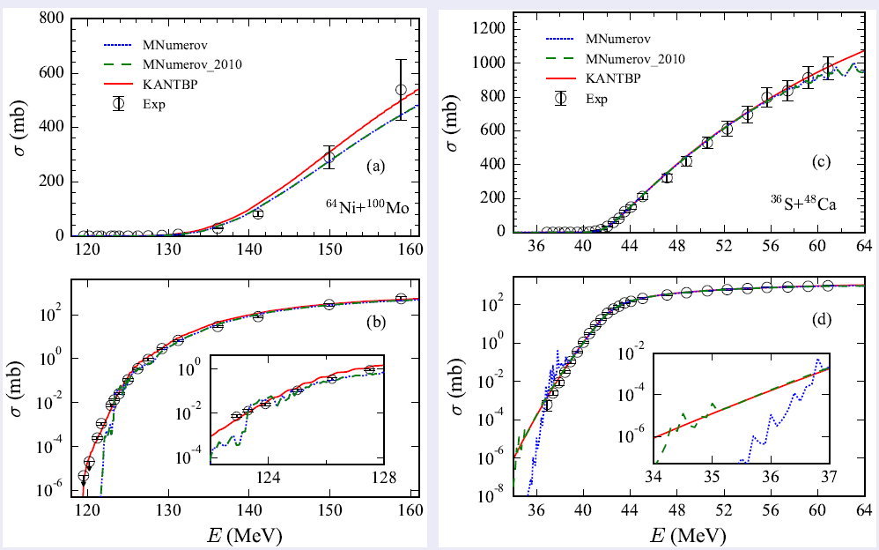
Methods of Mathematical Modeling, Computational Physics, and
High-Performance Computing for Complex System Studies at JINR
Simulating interactions of various types in nuclear-physical systems, including calculations of cross sections for sub-barrier fusion/fission reactions of heavy nuclei within the coupling channel method.
Studies of intricate processes in models of complex systems subject to external influences, including simulations of structural changes in materials under irradiation with charged particles and of superconducting processes in Josephson junctions.
Solving problems raised by the design and optimization of the operation of large experimental facilities, including specific simulations of magnetic field configurations.
Modeling physical phenomena based on the state equation of dense nuclear matter, including complex astrophysical systems and heavy ion collision processes in the NICA energy range.
Scheme of ionization by Compton scattering at hν= 2.1 keV
Sub-barrier fusion and fission reactions of heavy nuclei
In 2020-2022, over 150 publications in peer-reviewed scientific journals have been done in cooperation with colleagues from other JINR Laboratories and Member States; 4 problem-oriented software packages in the JINRLIB electronic program library; 2 computer programs were published in the CPC program library.
Notes:
Aims:
Development and use of mathematical and computational methods for modeling complex physical systems studied within the JINR Topical Plan. Development of approaches to effectively account for the features of physical processes and their mathematical models, described, as a rule, by systems of nonlinear, spatially multidimensional partial differential equations with a large number of parameters, the presence of critical modes and phase transitions.
Development of parallel algorithms and their implementation in software packages for high-performance simulation on modern computing architectures, including the MICC resources.
Carrying out, using the developed methods and software packages, computer simulation to obtain new fundamental information about the objects under study, necessary for the further development of theoretical approaches and planning of experimental projects.

Slide 17
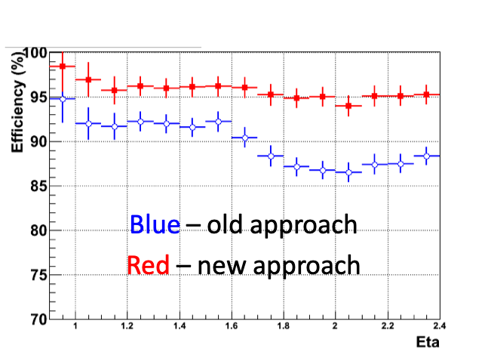
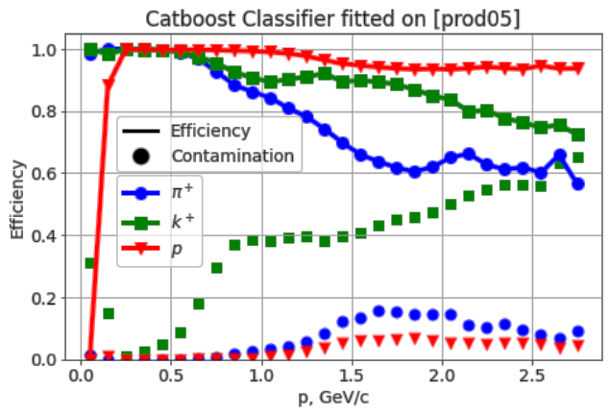
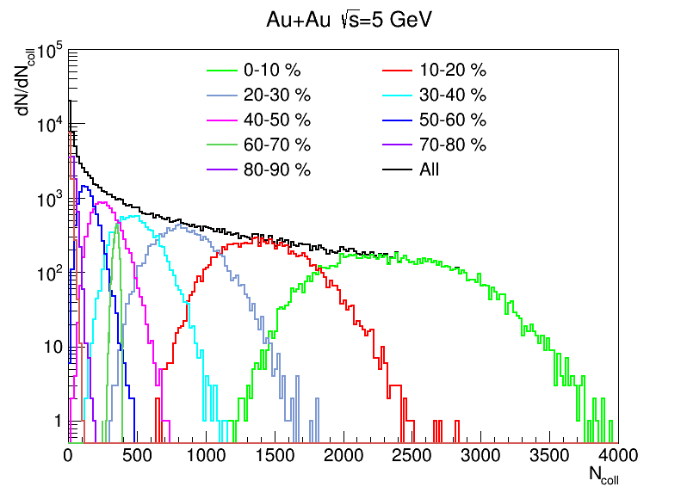
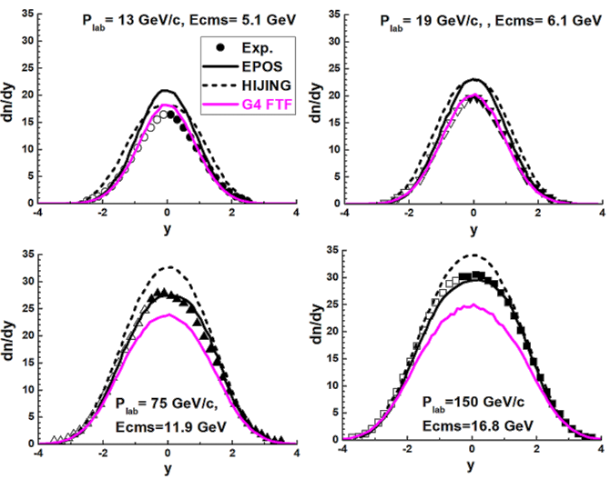
Mathematical Methods and Software
for Experimental Data Processing and Analysis
Physical processes modeling
- event simulations
- GEANT-simulation of experimental setups
Event reconstruction & data analysis
- particle trajectory reconstruction
- particle identification
- physical processes reconstruction
- data analysis
Missing mass method for the reconstruction of strange particles in CBM (FAIR) and STAR (BNL)
Effective algorithm for TeV muons reconstruction in CMS
Gradient-boosted decision trees for PID in MPD
Applied software and Data Bases
- DBs for experimental services
- experimental software frameworks
- data modeling and data processing
- event visualization and monitoring
Experiments DataBases:
ATLAS EventPickingService,
ATLAS CREST,
Geometry and Configuration DBs for BM@N
The team members published over 100 specific papers during the last 5 years. They co-authored over 500 papers as members of the international collaborations BM@N, MPD, Baikal-GVD, CMS, ATLAS, CBM, etc.
Monte-Carlo Generator DCM-QGSM-SMM for NICA
NA61/SHINE π−meson rapidity distributions (Geant4)
Notes:
Project “Mathematical Methods and Software for Experimental Data Processing and Analysis”
The aim of the project is the organization and provision of mathematical support for experiments conducted with the participation of JINR; development of software for modeling physical processes, processing and analyzing experimental data in high-energy physics, nuclear physics, neutrino physics and condensed matter physics.
The structure of the project consists of three main parts:
- modeling of physical processes, including both modeling of the interaction of particles and modeling of experimental setups themselves.
- reconstruction of events and analysis of experimental data
- IT support for the experiment, which includes the development and maintenance of databases, experimental software and other IT services.
Over the past 5 years, the project participants have published more than 100 papers, in addition, more than 500 papers have been published as part of international collaborations such as CMS, ATLAS, CBM, Baikal-GVD, BM@N, MPD, etc.
A number of achieved results by the project participants in the designated area are presented on the right side of the slide.
Top row from left to right:
1) An algorithm that allows reconstruction with a high efficiency of TeV muons in the endcap muon region of the CMS experiment was developed.
2) The gradient boosting approach was successfully used for the ensemble of decision trees with the use of the CatBoost library for PID on Monte-Carlo simulated data for different detectors.
3) The missing mass method was implemented for the reconstruction of strange particles in the CBM (FAIR) and STAR (BNL) experiments.
Bottom row from left to right:
1) The DCM-QGSM-SMM Monte-Carlo generator was designed for the NICA experiments.
2) Within Geant4, the π−meson rapidity distributions were described for the NA61/SHINE experiment.
3) Specialized databases were developed for the ATLAS and BM@N experiments.

Slide 18
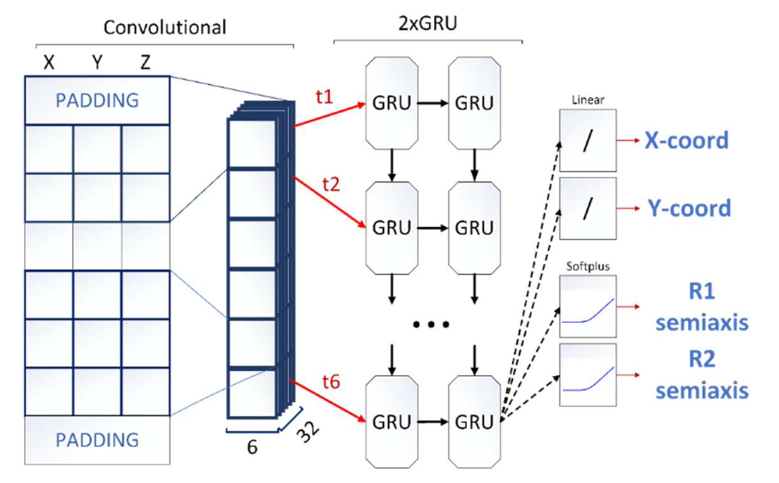
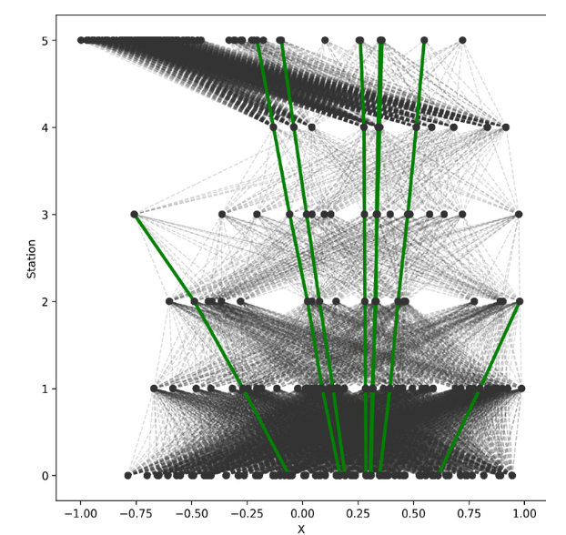
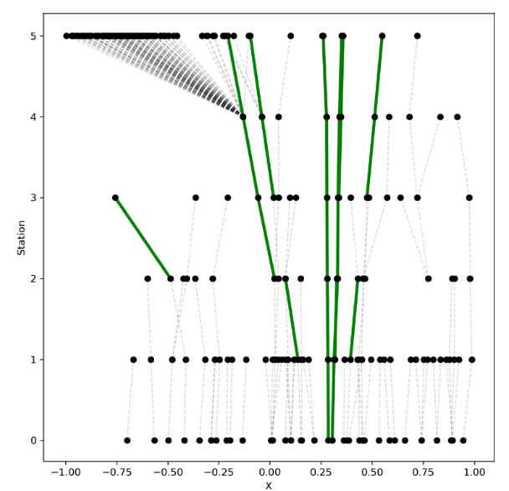
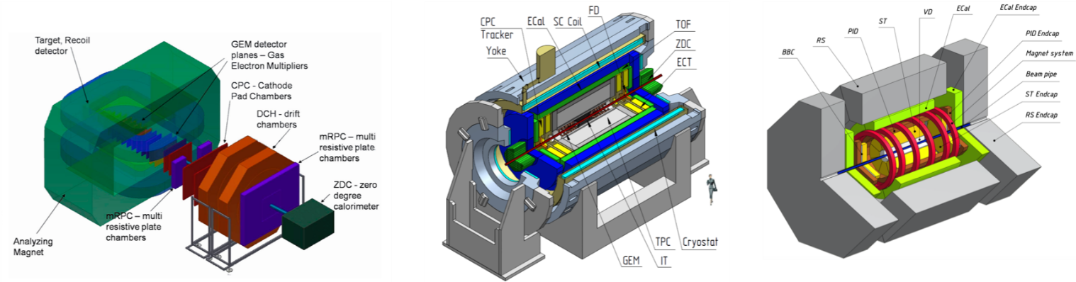
Implementation of ML/DL Methods for the Data Processing and Analysis of the NICA Experiments BM@N, MPD and SPD
Scientific and practical significance: expanding the scope of machine learning methods, in particular, in high energy physics; software for experimental data processing and analysis at the NICA accelerator complex; corresponding development of root-frameworks.
Foreseen areas for ML/DL application: hit finding, tracking, particle identification, decay reconstruction, global tracking.
ML/DL methods under study: Recurrent Neural Networks, Graph Neural Networks, Convolutional Neural Networks, Decision Trees, Gradient Boosting.
Gradient-boosted decision trees for PID in MPD
Deep GNNs for solving tracking problems in BM@N, BESIII, SPD
Graph Neural Networks for Tracking
The LIT team is actively involved in all the three targeted international collaborations, BM@N, MPD, SPD.

Slide 19
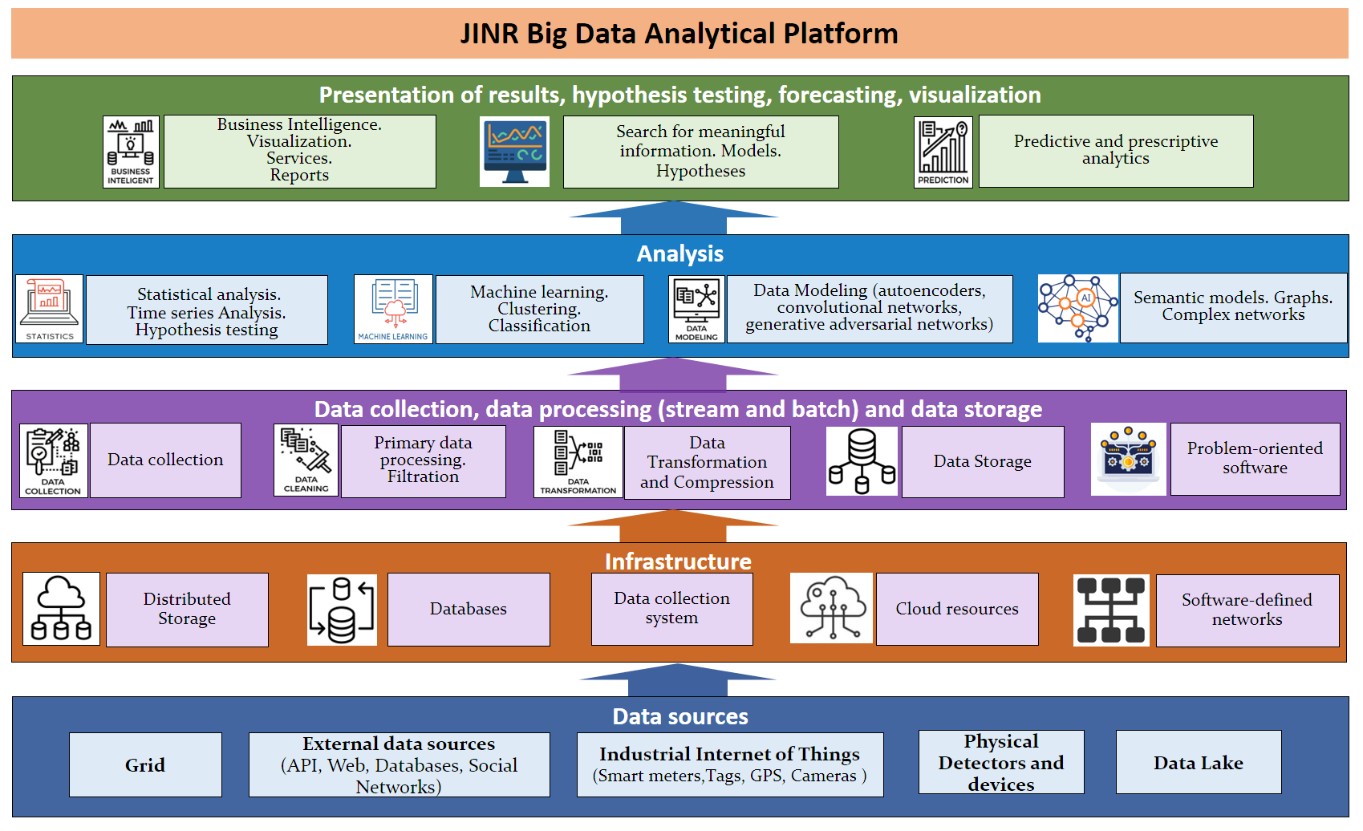
Methods of Artificial Intelligence and Big Data Analytics
Bringing best of Big Data approaches to JINR practices
Providing the Big Data infrastructure for users
Notes:
The Big Data development strategy at the Institute includes Bringing best of Big Data approaches to JINR practices and Providing the Big Data infrastructure for users
The Big Data development strategy at the Institute includes a wide range of research:
Creation of a platform for the intellectual analysis of Big Data.
Creation of Big Data analytics tools for the JINR Digital Ecosystem.
Development of artificial intelligence methods and their application within the Big Data platform for the analysis of large text arrays to extract scientific and technical information for solving JINR relevant tasks.
Enhancement of the used information security systems based on the Big Data approach with the application of artificial intelligence methods.
Creation of a Big Data analytics infrastructure for digital services and end users.
Elaboration and development of methods of data storage, processing and physics analysis for the experiments at the NICA collider within the Big Data approach.

Slide 20
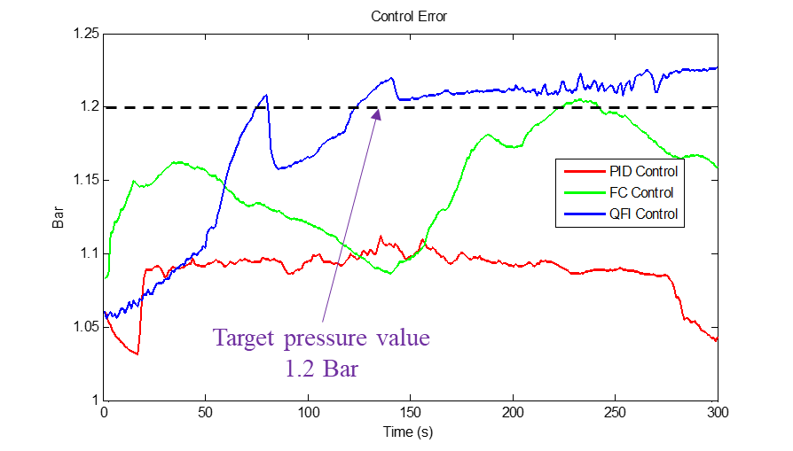
Quantum Intelligent Control of Technological Processes and Physical Facilities at JINR
A software and hardware platform has been developed on the basis of quantum fuzzy controllers embedded into the control loop to the control of the pressure and flow of liquid nitrogen of the superconducting magnets of the cryogenic system of the NICA accelerator complex.
Development of built-in quantum self-organizing controllers for systems of the intelligent control of technological processes, devices and facilities at JINR (including for unforeseen and unpredictable situations).
Development of an artificial intelligence platform based on quantum optimization for the tasks of intelligent cognitive robotics and quantum intelligent control in JINR projects.
Development of quantum software engineering methods for quantum deep learning based on quantum algorithms, quantum programming, quantum genetic algorithms and quantum soft computing.
The quantum controller demonstrated the highest speed in achieving the target value, low overshoot and accuracy of achieving the control goal compared to other types of controllers.
Butenko A.V., Zrelov P.V., Korenkov V.V., Kostromin S. A., Nikiforov D.N., Reshetnikov A.G., Semashko S.V., Trubnikov G.V., Ulyanov S.V. Intelligent system for remote control of liquid nitrogen pressure and flow in the cryogenic system of superconducting magnets: hardware and software platform // PEPAN Letters (accepted for publication).
Notes:
The first-priority task in the field of the development and application of quantum software engineering and quantum intelligent control is the creation of quantum systems of intelligent control of physical experimental facilities, including those for unpredictable situations.
the first successful results in this area were achieved last year

Slide 21

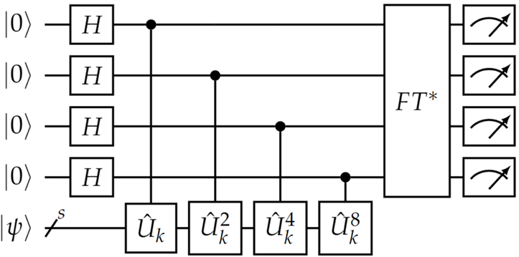




Quantum Computing and Quantum Algorithms
Software quantum simulators for computing on computers of a classical architecture using CPUs and GPUs is of particular interest for solving a number of problems in condensed matter, high-energy physics, quantum chemistry, AI, etc.
Form a list of QAs required to solve tasks within the studied physical models
Select the type of quantum simulator to simulate a classical architecture on computers
Define resources for the selected quantum-limiting capabilities of available computing simulators (number of qubits and computation time)
Search for exact solutions to urgent problems of quantum chemistry and study the chemical properties of heavy elements
Quantum algorithms
TASKS
Quantum simulators
SC “Govorun”
Notes:
Quantum computing is one of the most rapidly developing areas of quantum end-to-end technologies. Quantum simulation promises to find application in solving a number of problems in condensed matter physics, high-energy physics, atomic physics, quantum chemistry, cosmology, machine learning and artificial intelligence. For this purpose, quantum computing polygon was deployed on the govorun supercomputer to investigate different quantum algorithms

Slide 22







Information System for Radiation Biology Tasks
The joint project of MLIT and LRB is focused on creating an Information System (IS) as a set of IT solutions.
The information system allows one to store, quickly access and process data from experiments at LRB using a stack of neural network and classical algorithms of computer vision, providing a wide range of possibilities for automating routine tasks. It gives an increase in productivity, quality and speed of obtaining results.
Tasks of the IS algorithmic block
Analysis of the experimental field markup
Tracking the position of the animal as part of the experiment
Classification and determination of the type of animal activity (grooming, fading, etc)
Segmentation of neurons in images of histological slices
Classification of neurons by type and belonging to the layer
Statistical analysis of behavioral patterns and correlations with pathomorphological analysis
Conceptual scheme of the service
Notes:
tomorrow one of the reports at the poster session of young scientists will be dedicated to this project

Slide 23


Intelligent Environmental Monitoring Platform
Within the framework of cooperation between MLIT and FLNP, the work on the prediction of air pollution by heavy metals using biomonitoring data, satellite imagery and different technologies of machine and deep learning is in progress. On the MLIT cloud platform, the Data Management System (DMS) of the UNECE ICP Vegetation was created to provide its participants with a modern unified system of collecting, analyzing and processing biological monitoring data.
The studies are carried out using the HybriLIT platform.

Slide 24





JINR Digital EcoSystem
The digital platform “JINR Digital EcoSystem ” integrates existing and future services
to support
  scientific,
  administrative and social activities,
  maintenance of the engineering and IT infrastructures
to provide
  reliable and secure access to various types of data
to enable
  a comprehensive analysis of information
using
  modern Big Data technologies and artificial intelligence.
Single access point to all services
Notes:
One of the major tasks is the creation of a corporate platform “JINR Digital Ecosystem”, which integrates existing and prospective services maintaining scientific, administrative and social activities, as well as the engineering and IT support infrastructures of the Institute. The platform should provide reliable and secure access to various types of data produced by the Institute, from public to confidential. It should allow for a comprehensive analysis of information using modern technologies of Big Data and artificial intelligence.

Slide 25





O.Yu. Derenovskaya
O.Yu. Derenovskaya
O.Yu. Derenovskaya
Personal account of a JINR employee
Notifications in a personal account
Responsive interface, customizable by the user
Easy access, convenient navigation and search for information on a large-scale network of a wide variety of JINR services
O.Yu. Derenovskaya

Slide 26



Quick and easy search for information, both by services and by employees and buildings on an interactive JINR map

Slide 27





















Development of the system for training and
retraining IT specialists
Training courses, master classes and lectures
MLIT staff and
leading scientists from JINR and its Member States
Leading manufacturers of modern computing architectures and software
Parallel programming technologies
Tools for debugging and
profiling parallel
applications
Frameworks and tools for ML/DL tasks
Quantum algorithms,
quantum programming and quantum control
Work with applied software packages
Notes:
as I said at the beginning, much attention is paid and will be paid for training IT specialists engaged in developing algorithmic and software solutions for JINR tasks.
A variety of means will be used for IT specialists’ upskilling.

Slide 28


Information technology projects (I)
Critical basic scientific infrastructure project
Multifunctional Information and Computing Complex, including the “Govorun” supercomputer
(JINR Data and Networking Center):
  Engineering infrastructure (electricity and cooling)
  Networking (local and worldwide connectivity)
  HT Computing (Grid Tier1 and Tier2)
  HP Computing (“Govorun” supercomputer)
  Cloud Computing
  Data storage (long-term and middle-term Data lake)

Slide 29


Information technology projects (II)
Scientific directions and information systems
Methods of Mathematical Modeling, Computational
Physics, and High-Performance
Computing for Complex System
Studies
Mathematical Processing and
Analysis of Experimental Data
Implementation of ML/DL Methods
in Data Processing and Analysis
at the NICA Experiments
Development and application of methods of computational mathematics in quantum information theory
Digital JINR
Methods of Artificial Intelligence and Big Data Analytics
Quantum intelligent control of technological processes and physical facilities at JINR
IT School

Slide 30
Thank you for attention!

