Slide 1


Flow of strange and charged particles in pPb and PbPb collisions
Zhoudunming (Kong) Tu, Rice University
CMS collaboration
SQM, Dubna

Slide 2
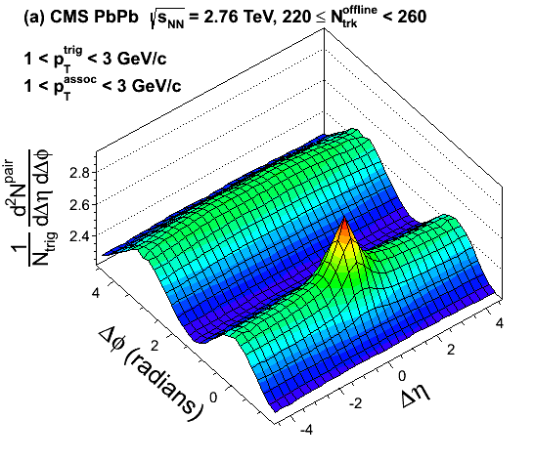

“Ridge” observed in small collision system
Pb
Pb
EPJC 74 (2014) 2847
Notes:
Quickly remind everyone what is going on here. What we have done to produce the ridge. In AA collisions, most of us believed that the “ridge” structure is due to the hydrodynamic flow and also have collectivity from this 2 particle correlation study.

Slide 3
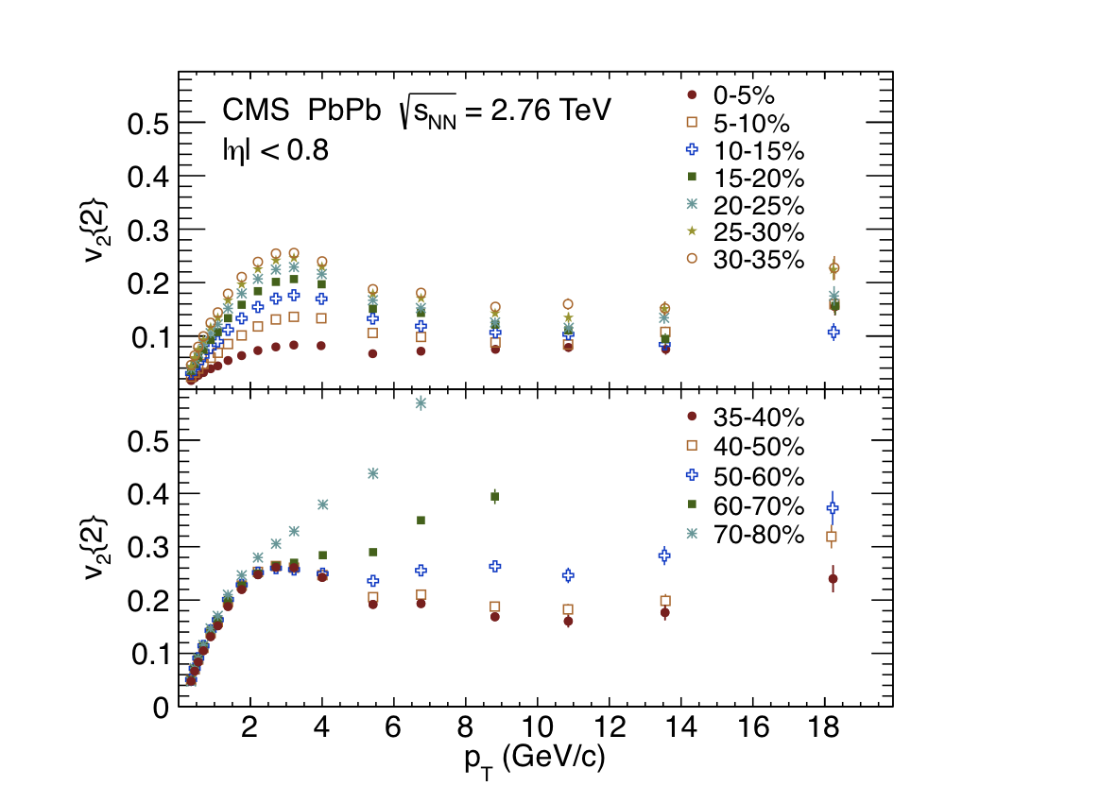
“Ridge” observed in small collision system
Pb
Pb
EPJC 74 (2014) 2847
PRC 87 (2013) 014902
Notes:
Quickly remind everyone what is going on here. What we have done to produce the ridge. In AA collisions, most of us believed that the “ridge” structure is due to the hydrodynamic flow and also have collectivity from this 2 particle correlation study.

Slide 4
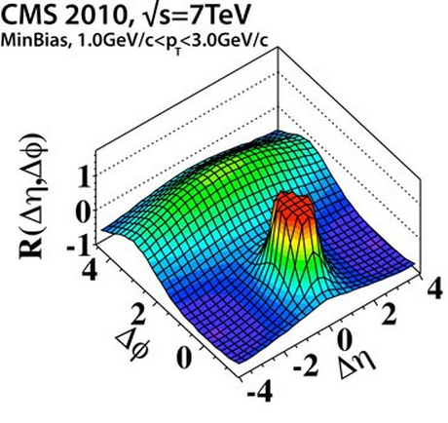
“Ridge” observed in small collision system
Pb
p
p
Pb
EPJC 74 (2014) 2847
JHEP 09 (2010) 091
PRC 87 (2013) 014902
Notes:
Quickly remind everyone what is going on here. What we have done to produce the ridge. In AA collisions, most of us believed that the “ridge” structure is due to the hydrodynamic flow and also have collectivity from this 2 particle correlation study.

Slide 5
“Ridge” observed in small collision system
Pb
p
p
Pb
EPJC 74 (2014) 2847
JHEP 09 (2010) 091
PRC 87 (2013) 014902
Notes:
Quickly remind everyone what is going on here. What we have done to produce the ridge. In AA collisions, most of us believed that the “ridge” structure is due to the hydrodynamic flow and also have collectivity from this 2 particle correlation study.

Slide 6
“Ridge” observed in small collision system
Pb
p
Pb
p
p
Pb
EPJC 74 (2014) 2847
PLB 718 (2013) 795
JHEP 09 (2010) 091
What is the origin of the “ridge” in small system?
Collectivity?
Hydrodynamic flow ? QGP?

Slide 7
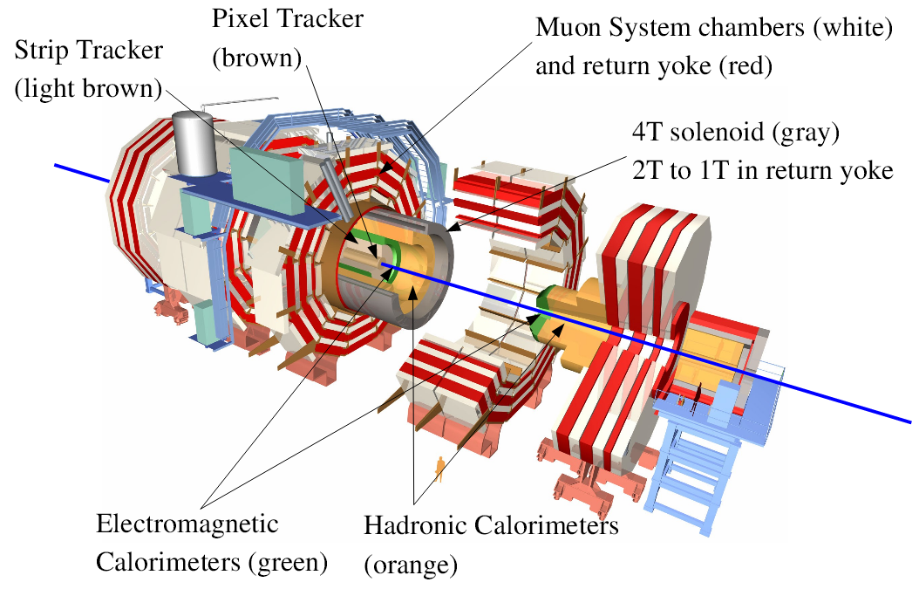
CMS detectors

Slide 8
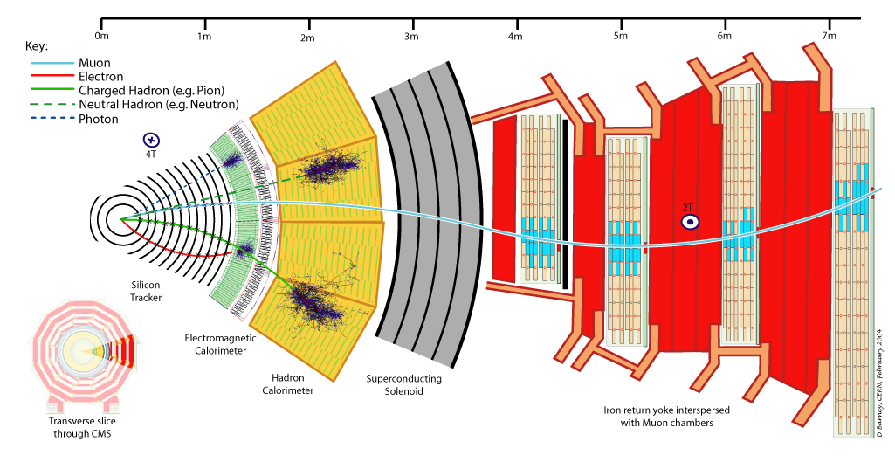
CMS detectors
High precision tracking system + large acceptance!

Slide 9
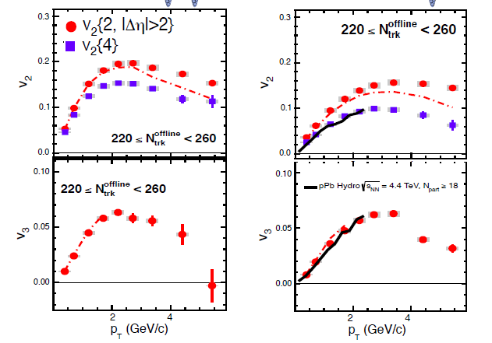
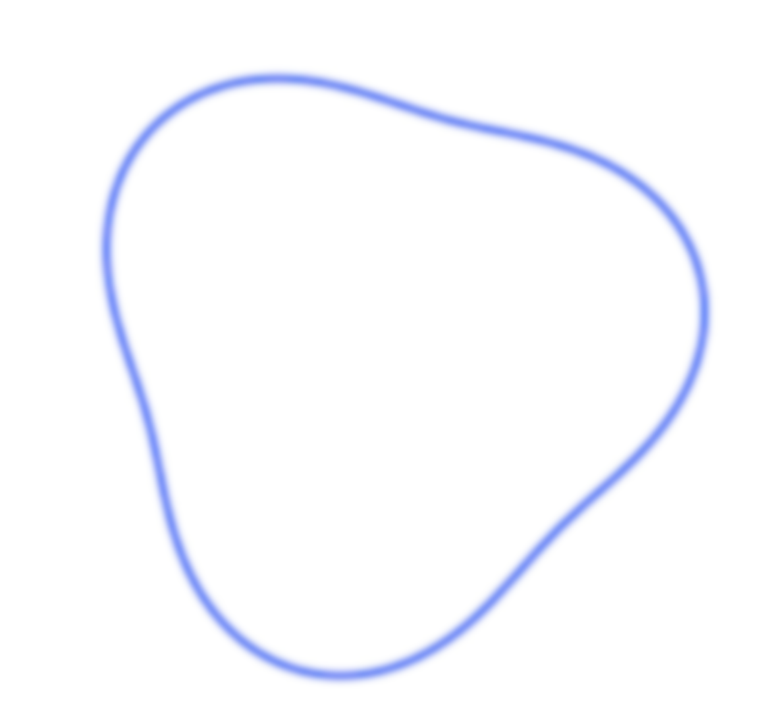
Remarkable similarities in azimuthal anisotropy between pPb and PbPb for the same multiplicities
Pb
p
Pb
Pb
Elliptic flow
Triangular flow
Phys. Lett. B 724 (2013) 213

Slide 10
Remarkable similarities in azimuthal anisotropy between pPb and PbPb for the same multiplicities
Phys. Lett. B 724 (2013) 213

Slide 11
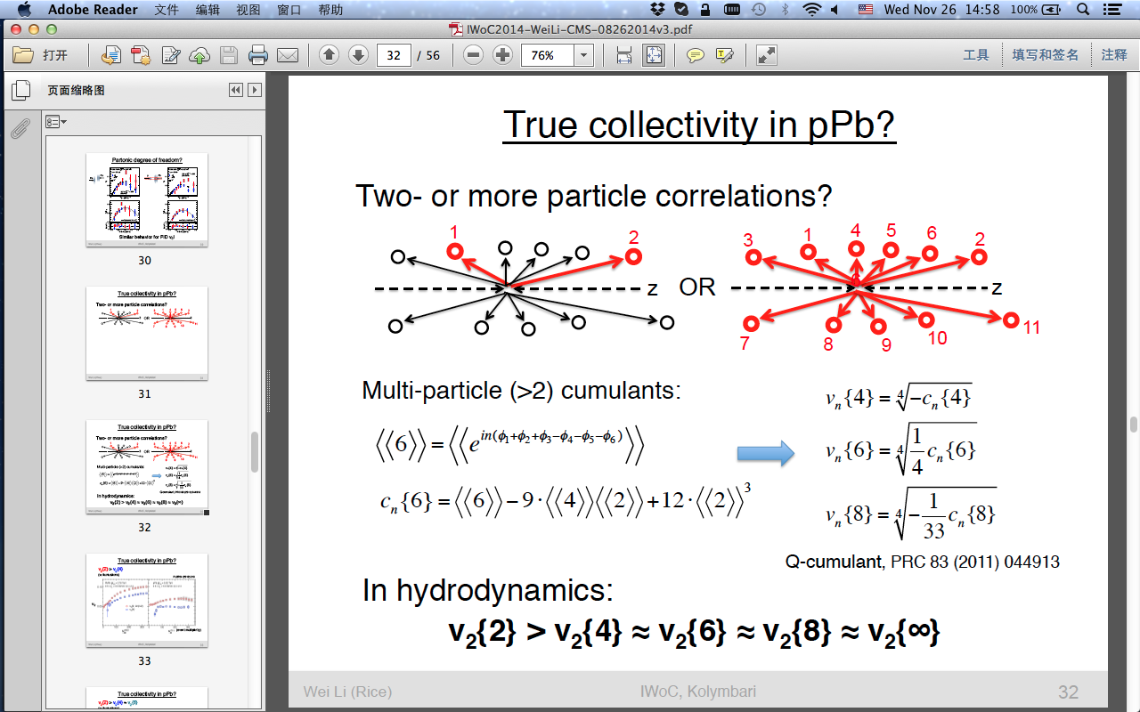
Collectivity?
Two-particle correlation
Multi-particle correlation
Largely Insensitive to non-flow effect
In hydrodynamics:
v₂{2} > v₂{4} ≈ v₂{6} ≈ v₂{8} ≈ v₂{∞}
Notes:
Another very important question about long-range correlations is whether there is collectivity. Are the correlations between only two particles, or are there more particles involved? In AA collision, it has been suggested that those correlations are due to the hydrodynamic collective flow. So how about pA collision? To answer this question, v2 is measured using four, six and eight particle cumulants. Those cumulants are insensitive to non-flow effect such as jet correlation, and the hydrodynamical expectation of v₂{2} > v₂{4} ≈ v₂{6} ≈ v₂{8} ≈ v₂{∞} can be tested.

Slide 12
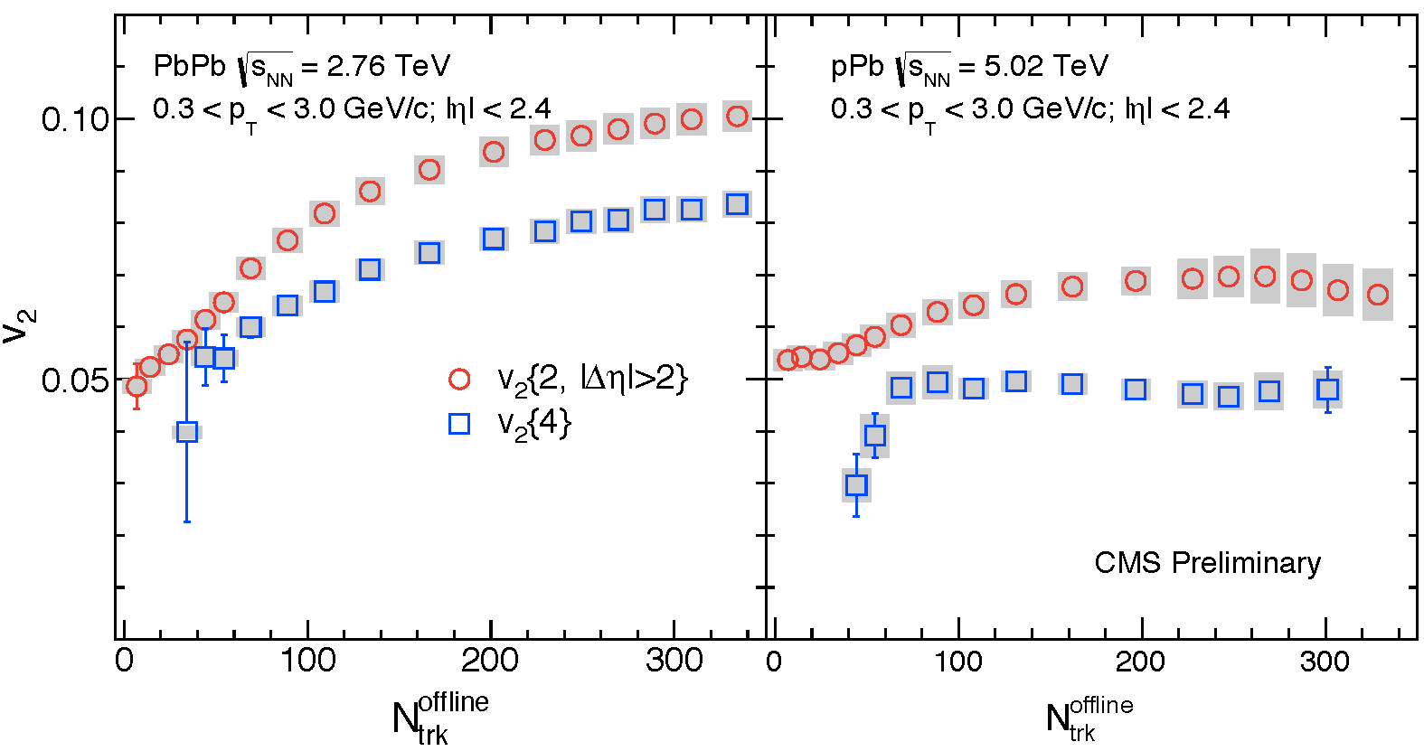
Collectivity?
v₂{2} > v₂{4}
Phys.Rev.Lett. 115, 012301 (2015)
Notes:
First, V2{2} and v2{4} are measured for pPb and PbPb as a function of multiplicity. V2{4} is consistently below v2{2} over the full multiplicity range, this is expected in hydro models due to different contribution from v2 fluctuations to v2{2} and v2{4}.
----- 会议笔记(12/1/14 17:28) -----
not non-flow, due to different contribution from fluctuation

Slide 13
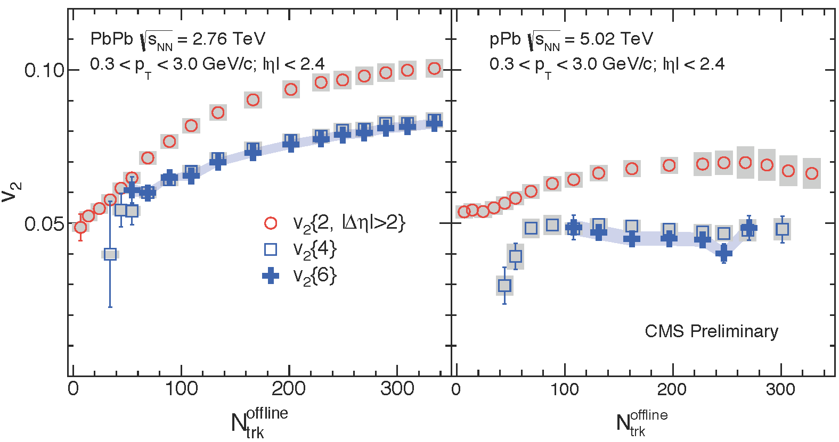
Collectivity?
v₂{2} > v₂{4} ≈ v₂{6}
Phys.Rev.Lett. 115, 012301 (2015)
Notes:
Then v2{6} is measured.

Slide 14
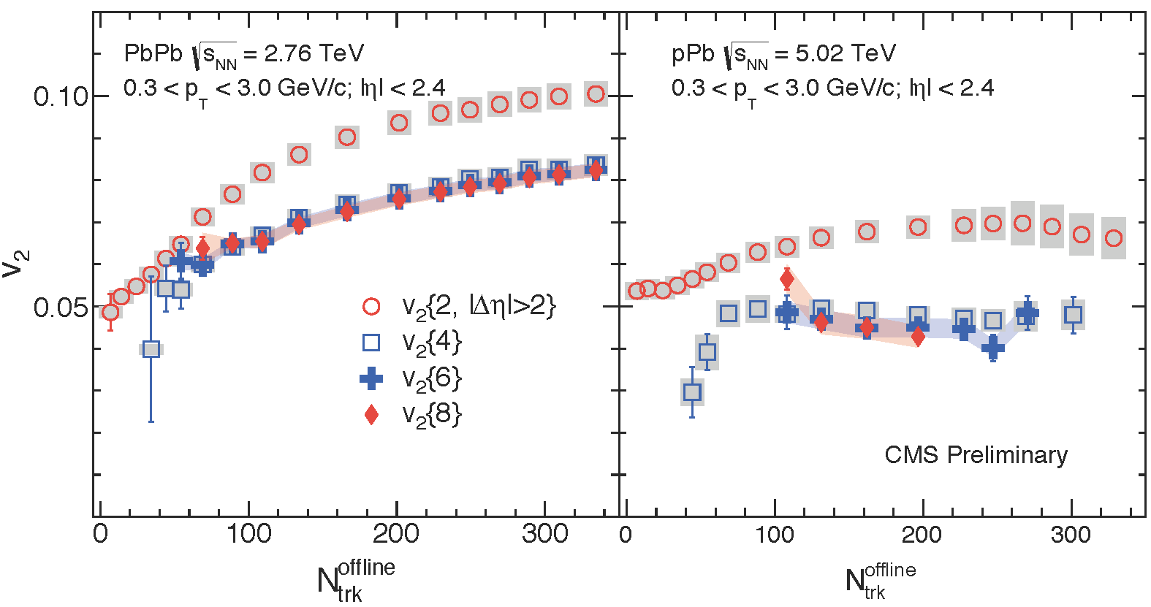
Collectivity?
v₂{2} > v₂{4} ≈ v₂{6} ≈ v₂{8}
Phys.Rev.Lett. 115, 012301 (2015)
Notes:
And also v2{8}. The values of v2{4}, v2{6}, and v2{8} are found to be in agreement in both pPb and PbPb collision.

Slide 15
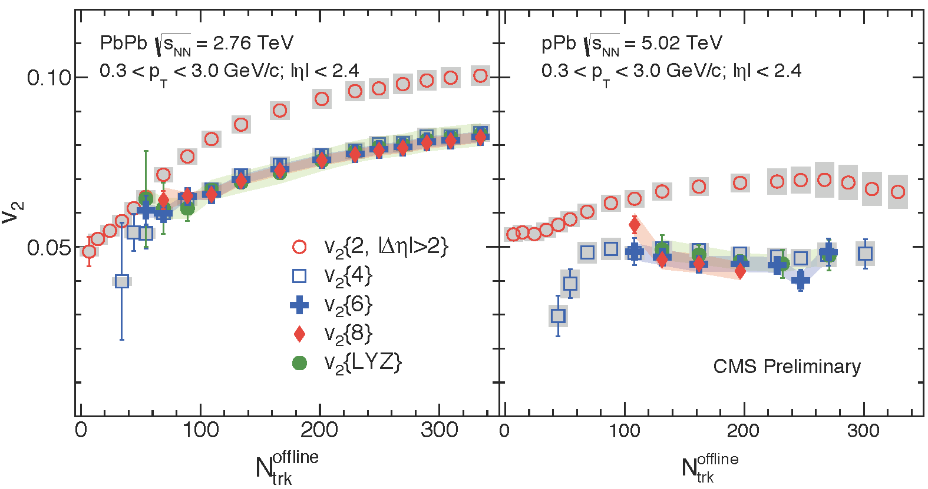
Collectivity!
Phys.Rev.Lett. 115, 012301 (2015)
v₂{2} > v₂{4} ≈ v₂{6} ≈ v₂{8} ≈ v₂{LYZ, ∞}
Evidence of the collective nature of correlations in pPb!
Notes:
Further more, v2 is also measured using the LYZ method which consider all the particles in a collision. Again, not suprisingly, v2{LYZ} agrees with v2{4,6,8}. Those results support the collective nature of the observed correlations in both pPb and PbPb and is inconsistent with any model with non-collective correlation. Although this agrees with expectation from hydro models and can be considered as a proof of collective flow in AA collision, it can not directly indicate hydro flow in pA collision.
----- 会议笔记(12/1/14 17:28) -----
Remove jet-related....
any correlations which is not collective can be killed by this result

Slide 16
“flow” of identified particle
What is the underlying mechanism of collectivity?
Hydro flow?

Slide 17
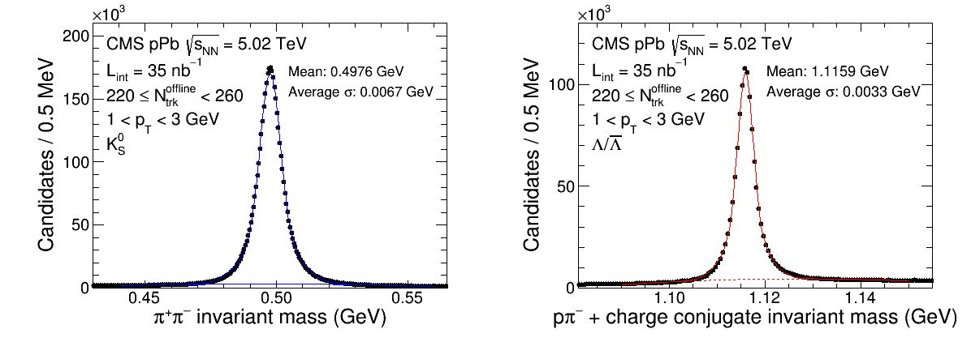
Particle identification

Slide 18
PID spectra in pPb
EPJC 74 (2014) 2847
Described better by model with flow effect

Slide 19
PID spectra in pPb
EPJC 74 (2014) 2847

Slide 20
PID spectra in pPb
EPJC 74 (2014) 2847

Slide 21
PID spectra in pPb
EPJC 74 (2014) 2847
π⁺/π⁻
Κ^{+/-}
p/p

Slide 22
PID spectra in pPb
EPJC 74 (2014) 2847
π⁺/π⁻
Κ^{+/-}
p/p
Indication of multiplicity dependence of radial flow in pPb

Slide 23
Elliptic flow of strange particle
PLB 742 (2015) 200
K⁰_{S}
Λ
Clean V⁰ signal from topological reconstruction
over the wide range of p_{T} and η

Slide 24
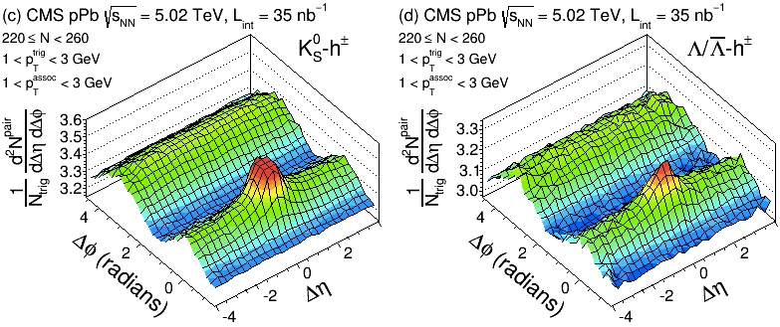
Elliptic flow of strange particle
K⁰_{S}
Λ
PLB 742 (2015) 200
Ridge observed in K⁰_{S} and Λ correlation in high multiplicity pPb events
Notes:
Two-particle correlation is studied for strange hadrons in pPb. K⁰_{S} and Λ candidates (generally referred to as V⁰) are reconstructed by combining pairs of oppositely charged tracks that are detached from the primary vertex and form a good secondary vertex with an appropriate invariant mass. V0 peaks can be clearly identified over a wide pT and eta range with little background for both species and the mean values of peaks are very close to PDG partile mass. The ridge structure is observed in two-particle correlation functions constructed for kshort-hadron and lambda-hadron in high multiplicity events.
----- 会议笔记(12/1/14 17:28) -----
re-order spectra before this slide
other effect might not give PID dependence in azimuthal

Slide 25
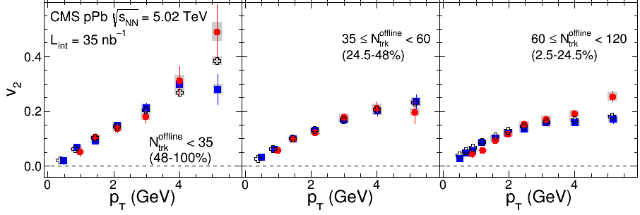
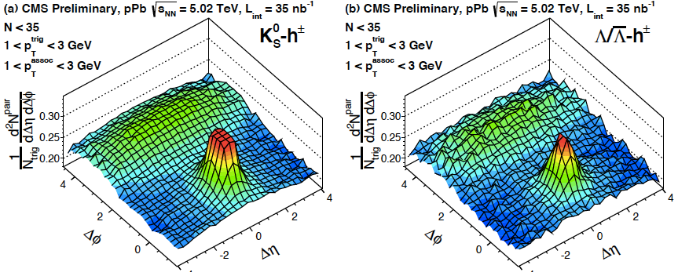
Identified strange particle v₂ in pPb
Low Multiplicity
N_{trk}^{offline} increases
PLB 742 (2015) 200
No PID dependence at low multiplicity from jet correlation
Notes:
For these events, v2 measured for kshort and lambda particles show a mass dependence at low pT region. At pT < 2GeV, the v2 values of K0S particles are larger than those for Lambda particles at each pT value. Both of them are consistently below the v2 values of inclusive charged particles. As most charged particles are pions, the data indicate that lighter particle species exhibit a stronger azimuthal anisotropy signal. This mass ordering behavior is consistent with expectations from radial flow in hydrodynamic models. Now we see both long-range correlation and mass ordering effect for idetified particles, those two features together strongly suggest there is hydro flow, but could it still be from other effect?
----- 会议笔记(12/1/14 17:28) -----
smooth end, afirmative, both long-range and mass ordering -> hydro

Slide 26
Identified strange particle v₂ in pPb
High Multiplicity
N_{trk}^{offline} increases
p
Pb
PLB 742 (2015) 200
Mass ordering at p_{T} < 2GeV in high multiplicity pPb collision->Radial flow?
Notes:
For these events, v2 measured for kshort and lambda particles show a mass dependence at low pT region. At pT < 2GeV, the v2 values of K0S particles are larger than those for Lambda particles at each pT value. Both of them are consistently below the v2 values of inclusive charged particles. As most charged particles are pions, the data indicate that lighter particle species exhibit a stronger azimuthal anisotropy signal. This mass ordering behavior is consistent with expectations from radial flow in hydrodynamic models. Now we see both long-range correlation and mass ordering effect for idetified particles, those two features together strongly suggest there is hydro flow, but could it still be from other effect?
----- 会议笔记(12/1/14 17:28) -----
smooth end, afirmative, both long-range and mass ordering -> hydro

Slide 27
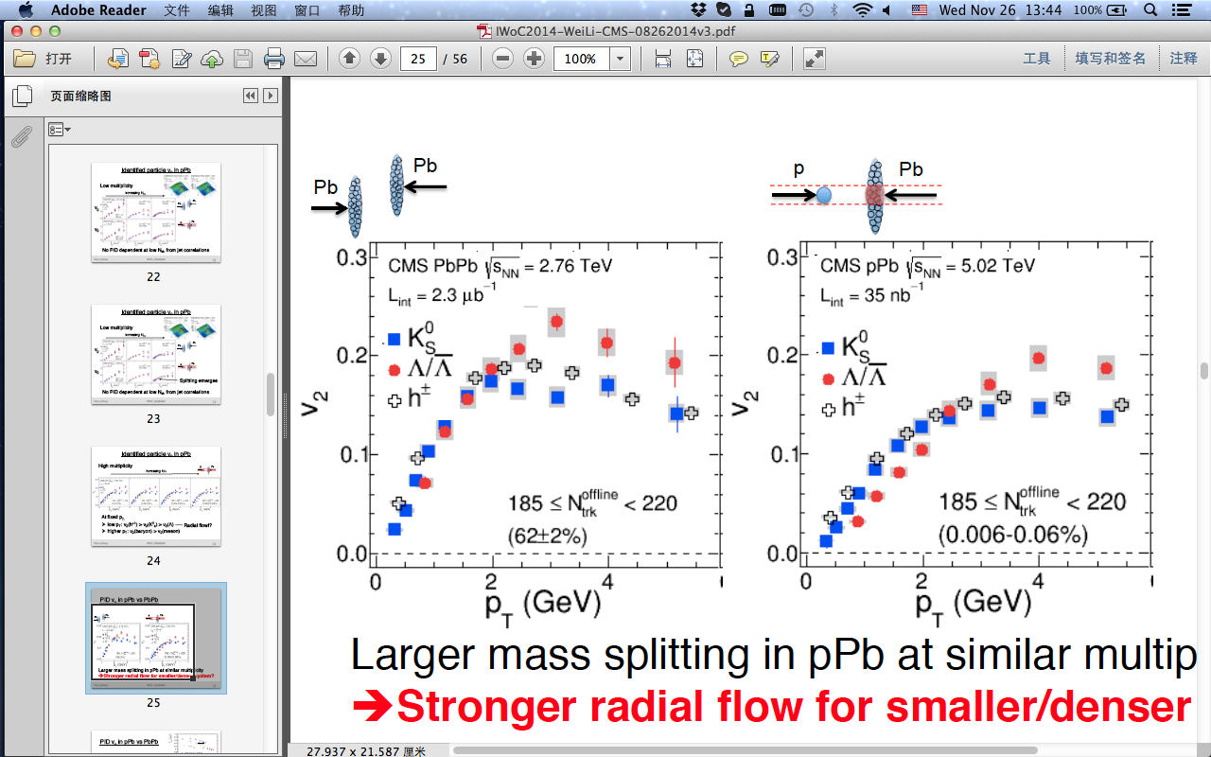
Identified strange particle v₂ in pPb vs PbPb
p
Pb
Pb
PLB 742 (2015) 200
Pb
Notes:
When comparing v2 for V0 candidates in high multiplicity pPb collision with same multiplicity PbPb collision. The mass ordering effect is found to be less evident in PbPb data than in pPb data. In hydrodynamic models, this may indicate a stronger radial flow is developed in the pPb system as its energy density is higher than that of a PbPb system due to having a smaller system size at the same multiplicity.
----- 会议笔记(12/1/14 17:28) -----
not another hint

Slide 28
Identified strange particle v₂ in pPb vs PbPb
p
Pb
Pb
PLB 742 (2015) 200
Pb
Larger mass splitting in pPb than in PbPb at same multiplicity
Larger radial flow in denser system?
Notes:
When comparing v2 for V0 candidates in high multiplicity pPb collision with same multiplicity PbPb collision. The mass ordering effect is found to be less evident in PbPb data than in pPb data. In hydrodynamic models, this may indicate a stronger radial flow is developed in the pPb system as its energy density is higher than that of a PbPb system due to having a smaller system size at the same multiplicity.
----- 会议笔记(12/1/14 17:28) -----
not another hint

Slide 29
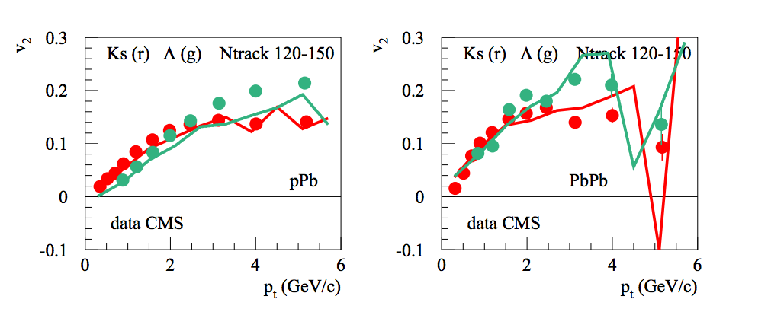
Identified strange particle v₂ in pPb vs PbPb
p
Pb
Pb
Pb
K.W, B.Guiot, Iu.Karpenko, T.Pierog, 31st WWND
Larger mass splitting in pPb than in PbPb at same multiplicity
Seen in EPOS simulation
Notes:
When comparing v2 for V0 candidates in high multiplicity pPb collision with same multiplicity PbPb collision. The mass ordering effect is found to be less evident in PbPb data than in pPb data. In hydrodynamic models, this may indicate a stronger radial flow is developed in the pPb system as its energy density is higher than that of a PbPb system due to having a smaller system size at the same multiplicity.
----- 会议笔记(12/1/14 17:28) -----
not another hint

Slide 30
Partonic degree of freedom?
Scale v₂ by number of quarks to test effect of
Number of Constituent Quark scaling(NCQ)
p
Pb
PLB 742 (2015) 200
Notes:
The scaling effect is tested in high multiplicity pPb for strange hadrons. After scaling by the number of quarks, the v2 distributions for K0S and Lambda particles are found to be in agreement. The data indicate that the scaling is valid over most of the KET/nq range. In AA collisions, this empirical scaling is believed to possibly provide evidence of deconfinement of quarks and gluons in the initial-state. Does the observation of this effect in pPb indicate the same fact? Is the initial-state a medium of deconfined quarks and gluons? Those questions need to be investigated not only by studying the NCQ for more particles, but also by other possible methods.

Slide 31
Partonic degree of freedom?
Scale v₂ by number of quarks to test effect of
Number of Constituent Quark scaling(NCQ)
p
Pb
PLB 742 (2015) 200
NCQ effect seen in high multiplicity pPb for strange hadrons
Indicates quark degree of freedom?
Notes:
The scaling effect is tested in high multiplicity pPb for strange hadrons. After scaling by the number of quarks, the v2 distributions for K0S and Lambda particles are found to be in agreement. The data indicate that the scaling is valid over most of the KET/nq range. In AA collisions, this empirical scaling is believed to possibly provide evidence of deconfinement of quarks and gluons in the initial-state. Does the observation of this effect in pPb indicate the same fact? Is the initial-state a medium of deconfined quarks and gluons? Those questions need to be investigated not only by studying the NCQ for more particles, but also by other possible methods.

Slide 32
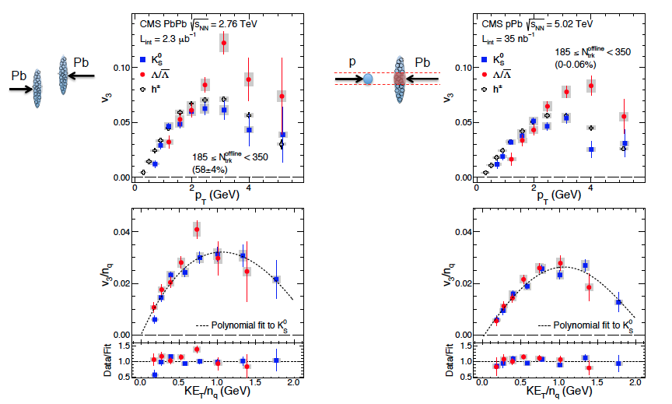
Similar NCQ behavior in v₃!
PLB 742 (2015) 200
Notes:
The scaling effect is tested in high multiplicity pPb for strange hadrons. After scaling by the number of quarks, the v2 distributions for K0S and Lambda particles are found to be in agreement. The data indicate that the scaling is valid over most of the KET/nq range. In AA collisions, this empirical scaling is believed to possibly provide evidence of deconfinement of quarks and gluons in the initial-state. Does the observation of this effect in pPb indicate the same fact? Is the initial-state a medium of deconfined quarks and gluons? Those questions need to be investigated not only by studying the NCQ for more particles, but also by other possible methods.

Slide 33
So, what comes next?

Slide 34
Stronger radial flow in Pb-going side in pPb?

Slide 35
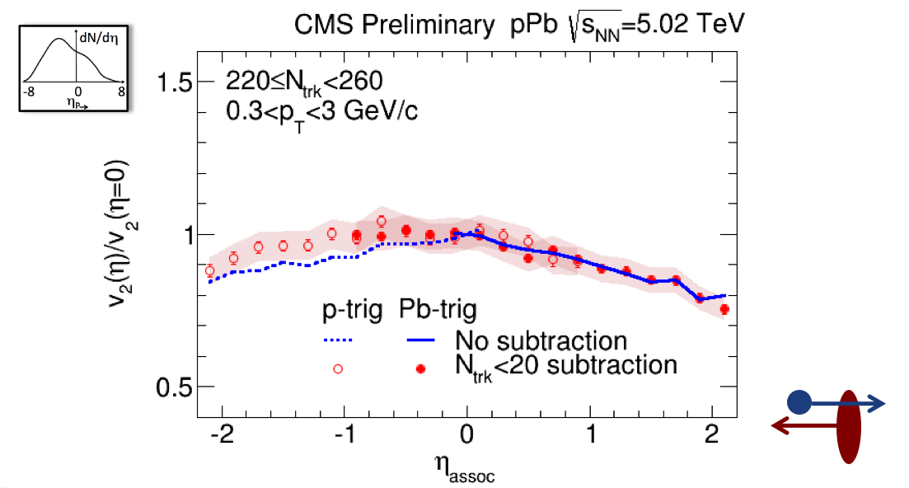
Stronger radial flow in Pb-going side in pPb?
CMS-HIN-14-008

Slide 36
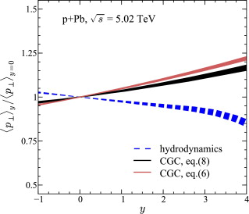
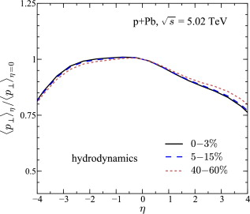
Stronger radial flow in Pb-going side in pPb?
Phys. Lett. B 728 (2014) 662
CMS-HIN-14-008
Hydro or CGC? Pb or p going side?
We could find out!

Slide 37
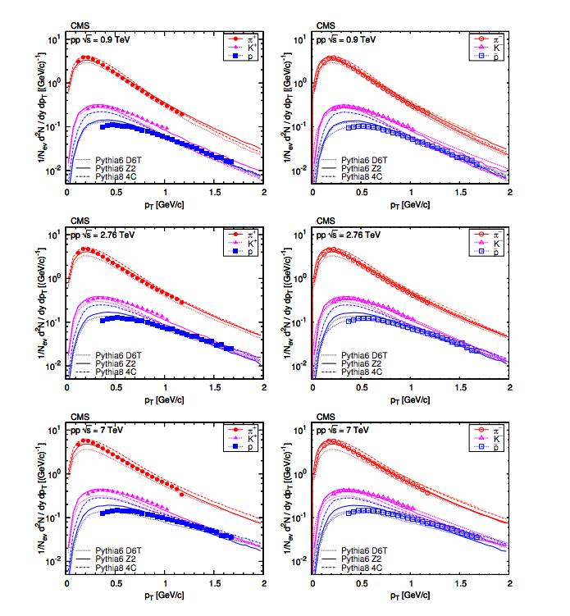
Stronger radial flow in pp?
MB pp
Eur. Phys. J. C72 (2012) 2164

Slide 38
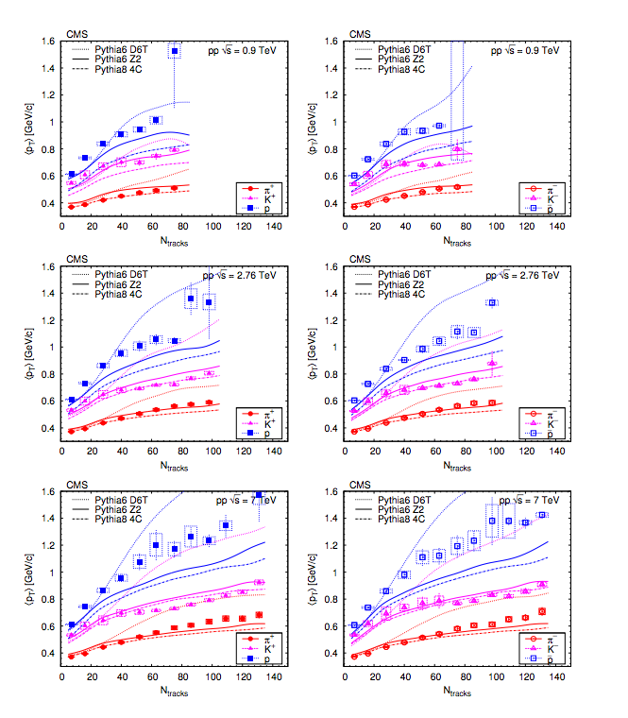
Stronger radial flow in pp?
MB pp
Eur. Phys. J. C72 (2012) 2164
Mass dependence

Slide 39
Let’s see where we are now!
p
p
p
Pb
Pb
Pb
Well studied!
Radial flow
v₂
v₃

Slide 40
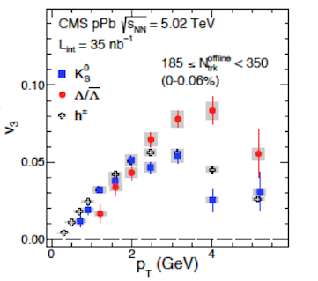
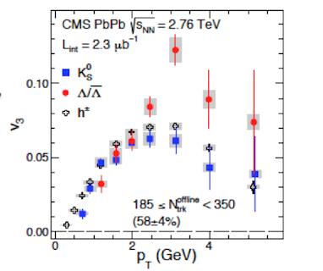
Let’s see where we are now!
p
p
p
Pb
Pb
Pb
Well studied!
Radial flow
v₂
v₃

Slide 41


Let’s see where we are now!
p
p
p
Pb
Pb
Pb
Well studied!
Radial flow
v₂
v₃

Slide 42
Summary
“flow” in PbPb collisions is well studied →collectivity→ hydro flow → QGP
Multi-particle correlation in pPb → collectivity!
Mass splitting from strange hadrons in pPb →indicates “flow” effect
Smaller system has stronger radial “flow”
NCQ in pPb → deconfinement?

Slide 43
Summary
“flow” in PbPb collisions is well studied →collectivity→ hydro flow → QGP
Multi-particle correlation in pPb → collectivity!
Mass splitting from strange hadrons in pPb →indicates “flow” effect
Smaller system has stronger radial “flow”
NCQ in pPb → deconfinement?
Look into multiplicity, rapidity and mass dependence of “flow” in small systems

Slide 44
See you again!
Thank you

