Slide 1
LHC is a GlueBall Factory! ... but where are all the GlueBalls gone?
Early proposals of two timescales for two phase transitions in RHICs:
Svetitsky et al, Pisarski&Wilczek, Raha&Sinha, Shuryak et al…
1. CGC Gluon Supersaturation
2. Gluon Equilibration
3. First Transition: 1.Order Phase Transition in YM pure gauge theory
4. Pure Gauge Theory vs. “physical” 2+1 Nf QCD
5. Glue Plasma vs Quark-Gluon Plasma 2.Transition: hadronization ?
6. Observable signals for GlueBalls in high multiplicity pp, pA - AA ?
HagedornStates, hadron ratios, pt-distributions, Flow-Ridge: pp & pA, Dileptons, Photons,… … vs. Multiplicity in pp, pA
Horst Stoecker, GSI Helmholtzzentrum f. Schwerionenphysik J. Eisenberg Laureatus
FIAS Frankfurt Institute of Advanced Studies , ITPJohann Wolfgang Goethe University

Slide 2
Acknowledgements
Transport colleagues: Zhou, Seizel, Xu, Zhuang, C. Greiner...
Hagedorn dynamics: Beitel, Gallmeister, C. Greiner...
FIAS: Schramm, Dietrich, Struckmeier, Vasak, ...
Early phase e-m probes colleagues: Raha, Sinha, Gorenstein, Vovchenko, Satarov, Mishustin, A. Srivastava, Csernai ...
Lattice colleagues: Fodor, Borsanyi, Szabo, Karsch, Philipsen...
Experimentalists: Giubellino, Harris, Oeschler, PBM, Masc..

Slide 3
Traditional picture of QCD matter in Heavy Ion Collisions
Initial Color Glass Condensate Glasma thermalizes fast equilibration of Gluons and Light flavor quarks high pressure, entropy hydrodynamic expansion flow as excellent probe of QCD matter.
Hadronization@T=155MeV: crossing of 2+1 flavor QCD.
Hadronic yields and v_n at RHIC and LHC measured.
Comparison of HRG, T= 155 MeV, with LHC data tests our understanding of QCD matter.

Slide 4
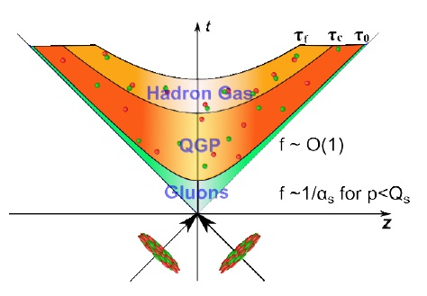
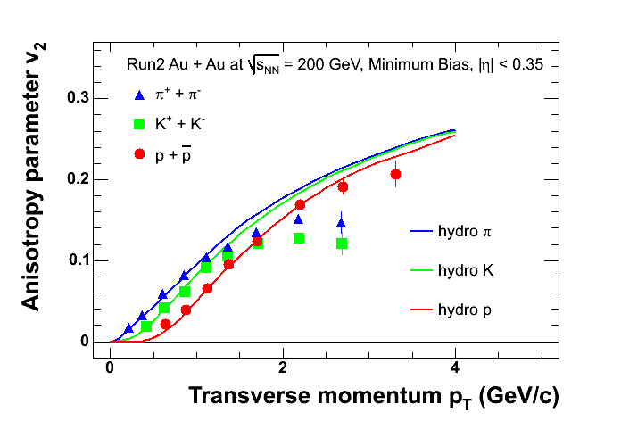
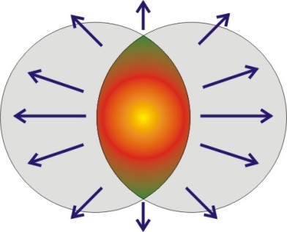
Introduction : Fast thermalization
“how the systems evolve
to thermal equilibrium in
a very short time scale”
Initial: far from equilibrium
2+1 QCD Hydrodyna.
Onset time ~ 1fm/c ?

Slide 5
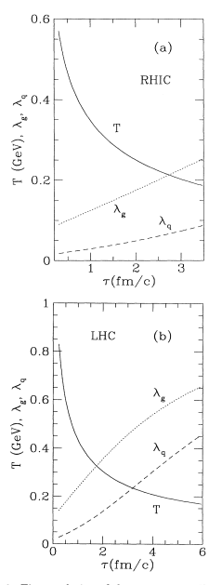
Time evolution of fugacity
of gluons and quarks (g, q)
from pQCD-based rate eq.
T. S. Biró et al, PRC48,1275 (1993)

Slide 6
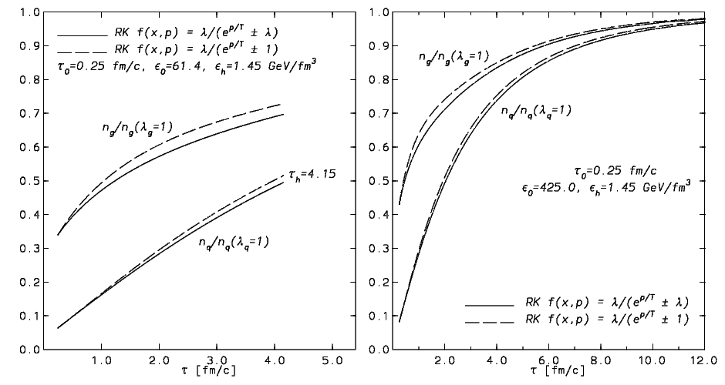
LHC
RHIC
Rate equation calculation
D.M. Elliott, D.H. Rischke,Nucl.Phys. A671,583 (2000)

Slide 7
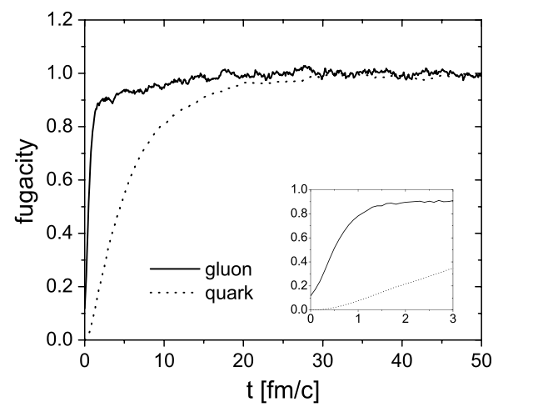
Time evolution of fugacity(g,q) is analog to Nf (t)
from BAMPS Box calculation
Z.Xu, C.Greiner,
PRC71,064901(2005)
Nf(t)
2
1
0.6
0.2
0.1

Slide 8
Introducing the Color Glass Condensate
CGC=effective field theory for hadrons at high energy limit
●
high energy
(time dilation)
fluctuation(sea partons) lifetime
internal interaction time scales
small x ( )l
gluon number increase at small x with increasing energy
●
gluon fusion
Saturation
●
Saturation momentum Qs(~GeV)
this feature can be inherited by initial
Glasma through indirect way

Slide 9
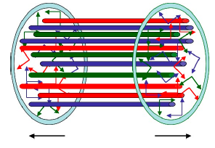
Introducting the Glasma
Glasma=non-equilibrium state in between CGC and QGP
●
using CGC as initial states for nuclei
highly anisotyopic initial glasma fields
(won't last longer than 1/Qs)
●
Instabilities -->wide range of unstable modes (up to Qs) grow exponentially untill saturation density
redistribute momentum ---> isotropization
free up quanta from classical field
initial condition amenable
for kinetic theory

Slide 10
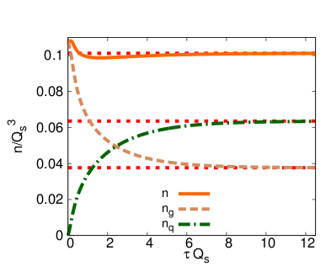
begin time evolution with
Glasma initial condition,
Use diffusion approximation
for Boltzmann equation
Jean-Paul Blaizot, Bin Wu, Li Yan, Nucl.Phys. A930,139(2014)

Slide 11
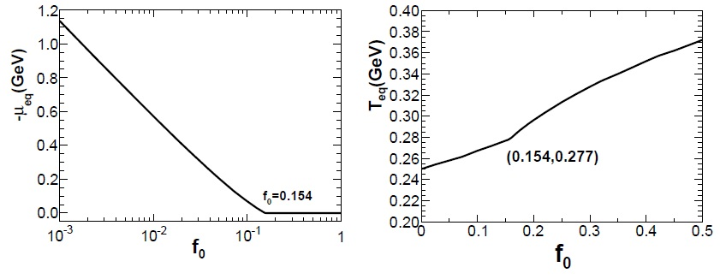
Introducting: Overpopulation
Overpopulation = the system contain more gluons than can
be accommodated by a Bose-Einstein distribution
initially:
expected final:
even for ,
still highly overpopulated

Slide 12
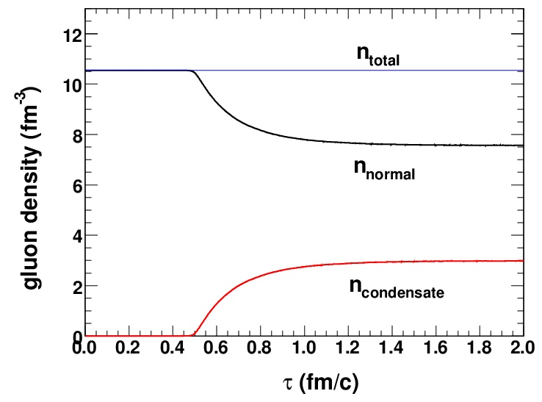
Kai Zhou, Zhe Xu, Carsten Greiner,

Slide 13
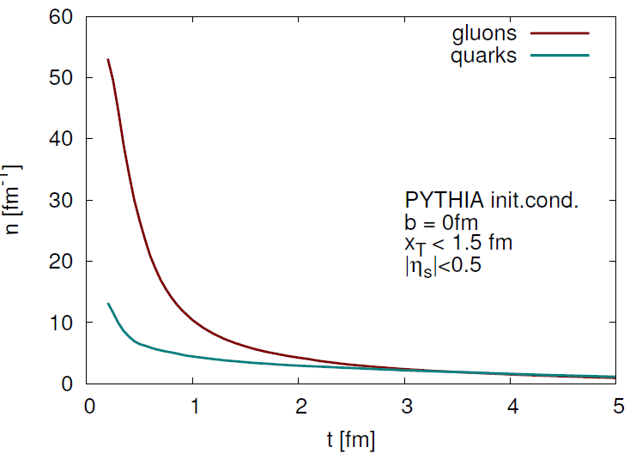
Gluon yields & quark yields, F. Senzel, Z. Xu, C. Greiner BAMPS
Gluons
quarks

Slide 14
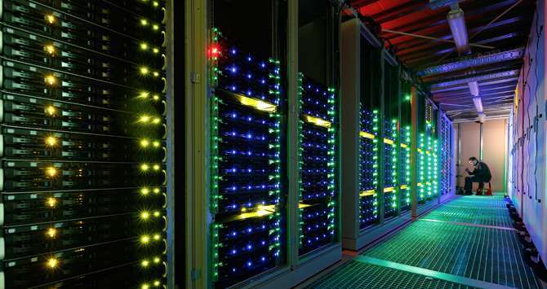
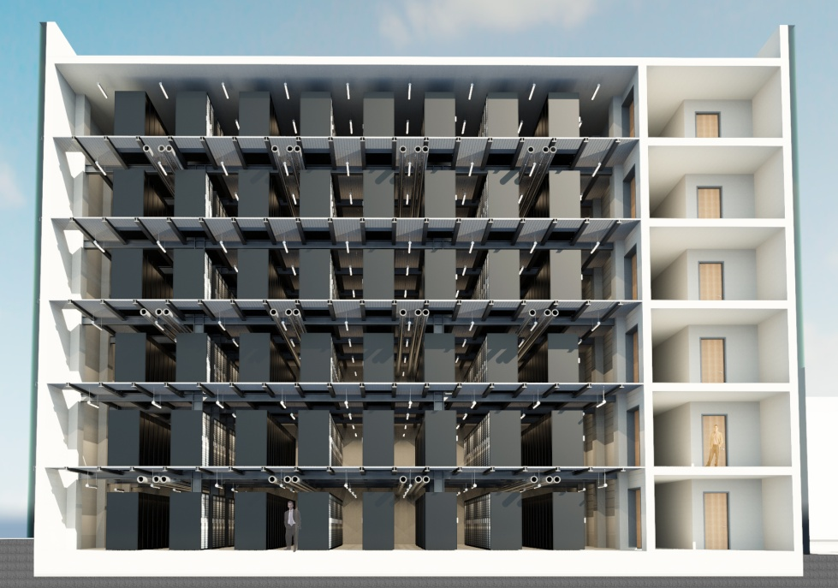
Extreme Computing Challenges !!!
=> the FAIR Tier 0 GreenCube Data Center
***No. 1*** Green500: Nov. 2014
5.27 GFlops/Watt - World Record
L-CSC GSI Darmstadt PUE <1.07
powerefficient Supercomputer
AMD FirePro GPU, Intel Xeon CPU
Tier-0 data center: FAIR GreenCube
Helmholtz funding 770 Racks 2.2m
12 M€ building cost
7 M€ initial HPC installation
Completion of CC in Q4/2015
Max cooling power 12 MW
Fully redundand (N+1)

Slide 15
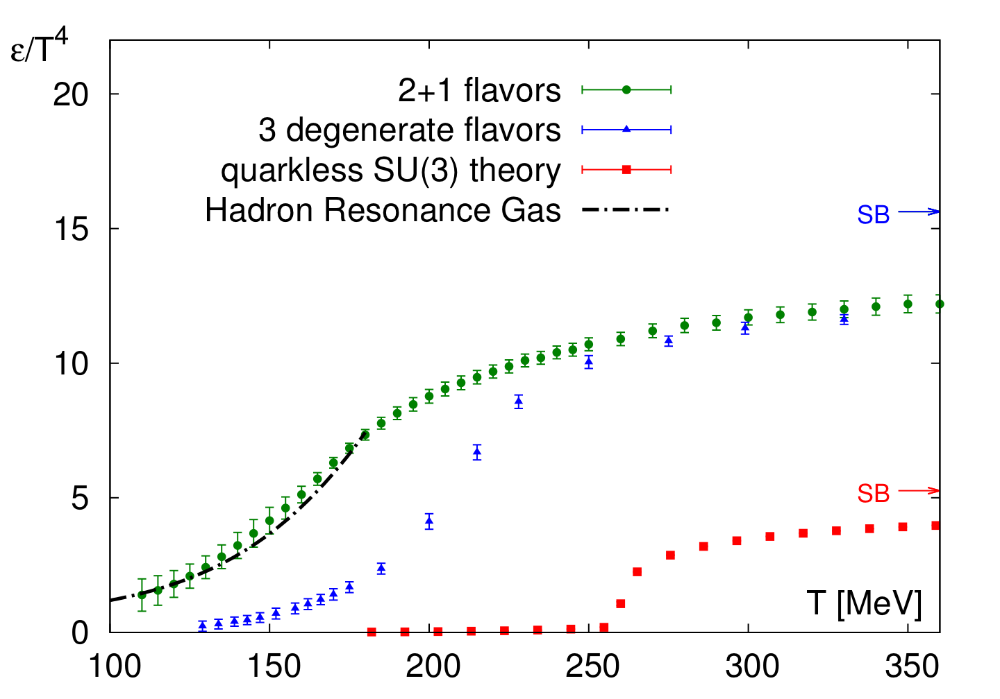
Pure YM LGT vs. 2+1 flavor Lattice QCD
Energy density (EoS) DIFFERENT for different quark masses
Energy density
Wuppertal-Budapest:
JHEP 1011, 2010,077;
PLB730, 2014, 99
“physical point” 2+1
T_c.o. = 155 MeV
N_f = 3, m_{u,d} = m_{s}
T_c.o. = 220 MeV
pure gauge YM
T_c = 270 MeV
Quenched:
JHEP 1207, 2012, 056
1. O.P.Transition glueplasma to GlueBall-Hagedorn St.
HagedornStates decay

Slide 16
Alternate Scenario: pure gauge matter in pp, pA – AA ?
Initial Color Glass Condensate Glasma thermalizes fast equilibration of Gluons, slow equil. of quarks high pressure, entropy gluon plasma fast hydrodynamic expansion of gluon plasma.
1. Order Phase Transition at T_c = 270 MeV of flavorless QCD.
Transition from glue plasma in GlueBall fluid
Glueballs’ Hagedorn states decay directly into Hadrons Comparison of theory with the experiments tests our understanding of QCD matter.

Slide 17
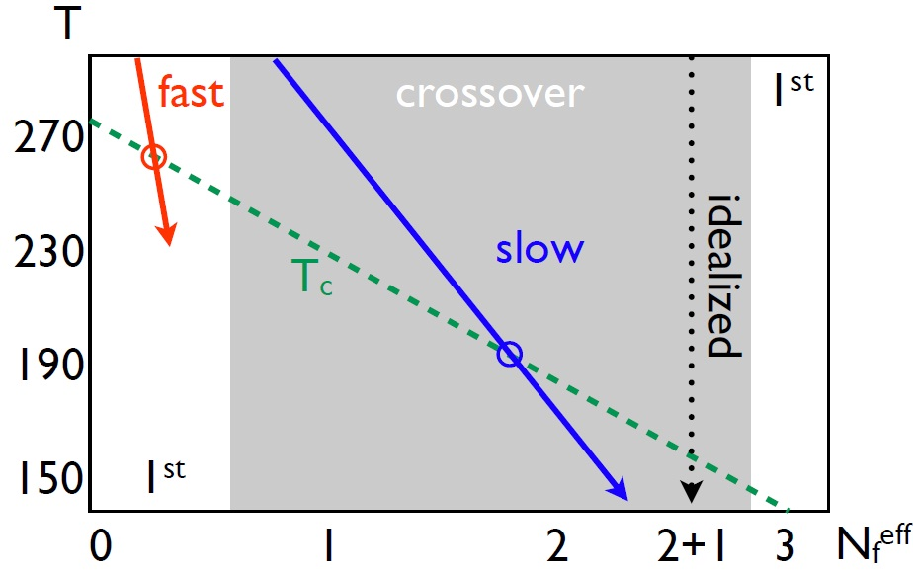

Slide 18
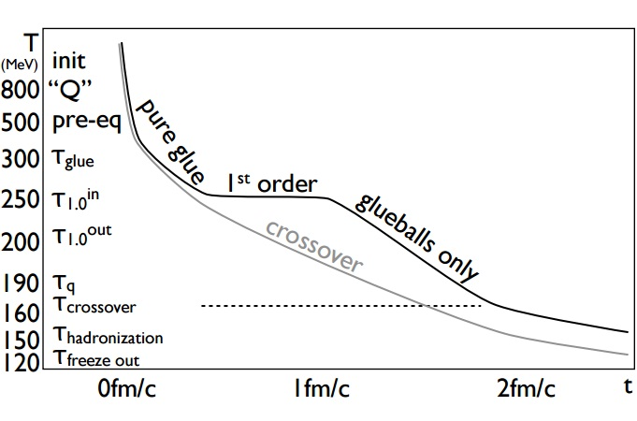
Eff.Nf(t)
0.0
0.1
0.2
0.3
0.6
0.9
Eff.Nf(t): 0.0 0.1 0.2 0.3 0.6 0.9 ….

Slide 19
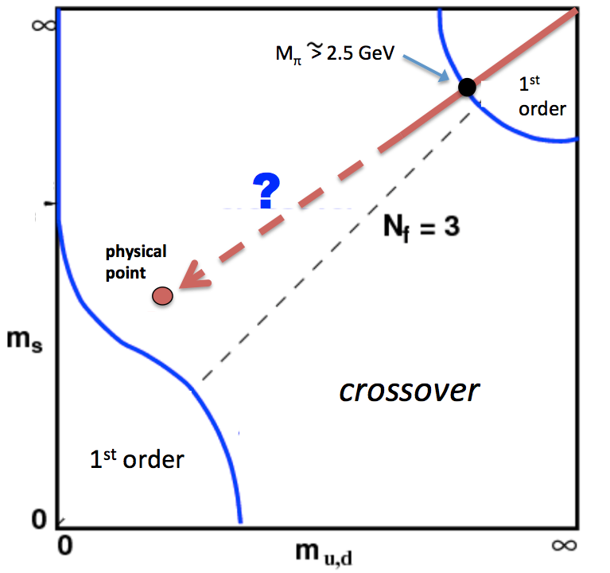
SU(3)_color Lattice Gauge Theory
Columbia Plot: Order of Phase Transition depends on quark masses
pure gauge: glue only!
t=0.1fm/c : No Quarks !
LHC/FCC: time evol. high mult. pp & AA
Quenched QCD: glue +GlueBalls
t=1fm/c
few heavy Quarks
T_cp =250 MeV
2fm/c: Quarkdensity
is not yet equilibrated
3fm/c Hadronization?
4fm/c Freeze Out ?

Slide 20
„Time dependence“ in Columbia plot: N_f (t)
pp (& AA?) initial: Color Glass Condensate t=0.1fm/c:
glue thermalizes fast ~ pure glue-plasma: N_f (t=0.1)=0.1
Pure Yang Mills Lattice gauge theory:
1. Order Phase Transition @ T_c = 270MeV
From glue plasma to GlueBall fluid
Expansion
Expansion to critical point
T_cp =240 MeV t~2 fm/c
more and more quarks produced
N_f (t=2fm/c) ~ 0.6
GlueBalls, Hagedorn States Mix
Sequential 2-body decays of Glueball-Hagedorn States can well explain the observed hadron yield ratios.

Slide 21
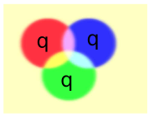
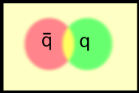
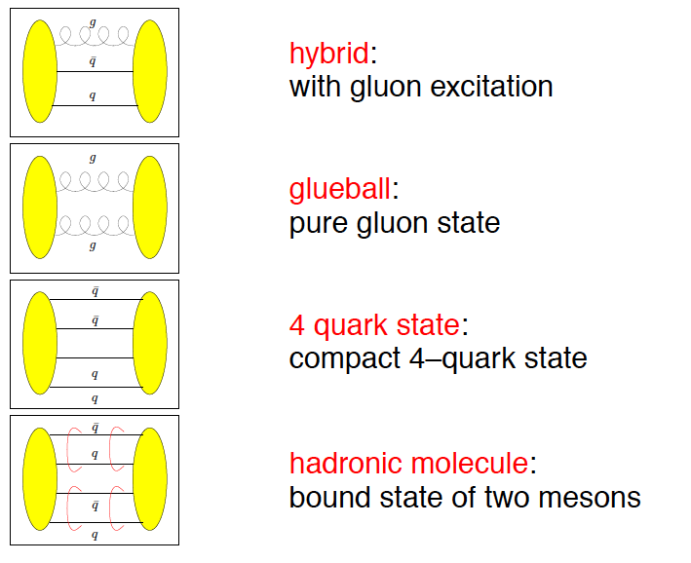
Beyond standard quark configurations
QCD allows much more than what we have observed:
Exotica
Baryons
Mesons
may have J^{PC} not allowed for qq
_
Courtesy C. Hanhart

Slide 22
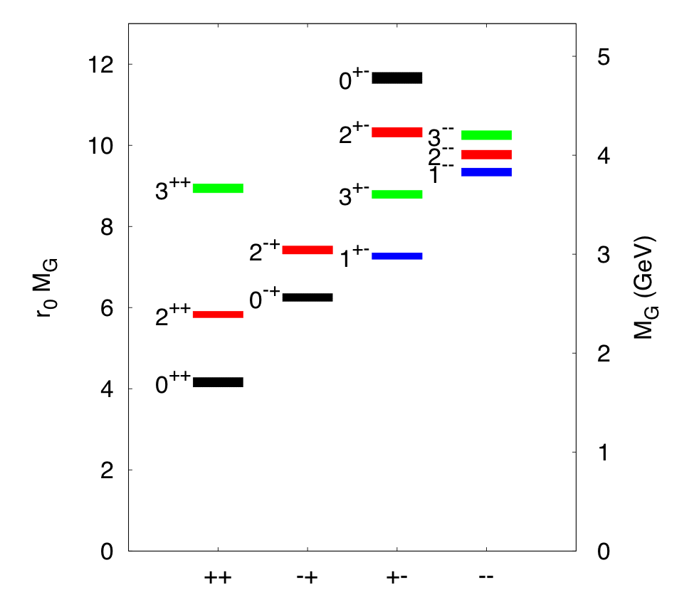
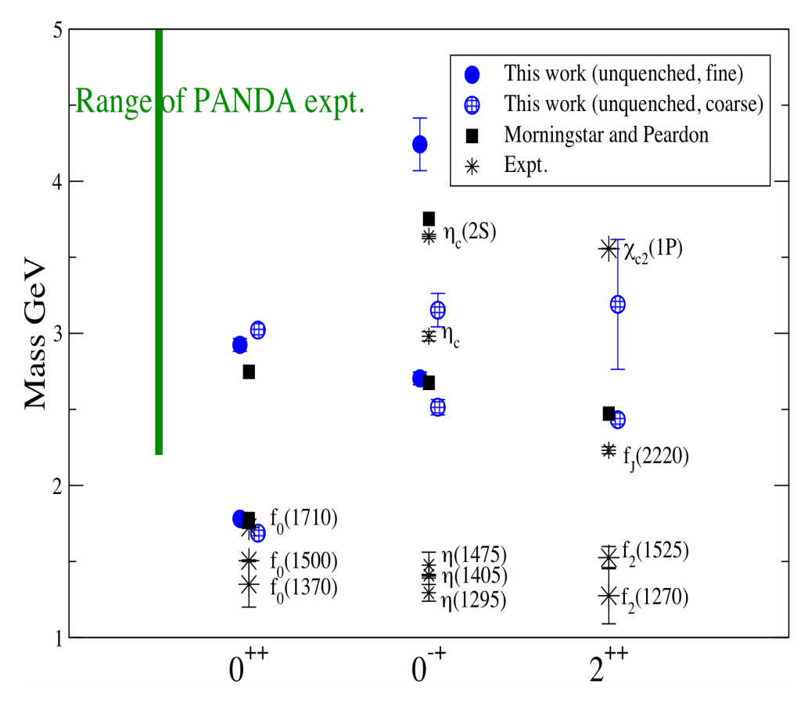
Glueball spectrum
Quenched results:
Morningstar-Peardon
Phys.Rev. D73 014516 (‘06)
First unquenched results:
pion mass 360 MeV
UKQCD coll. PRD82 (‘10) 34501

Slide 23
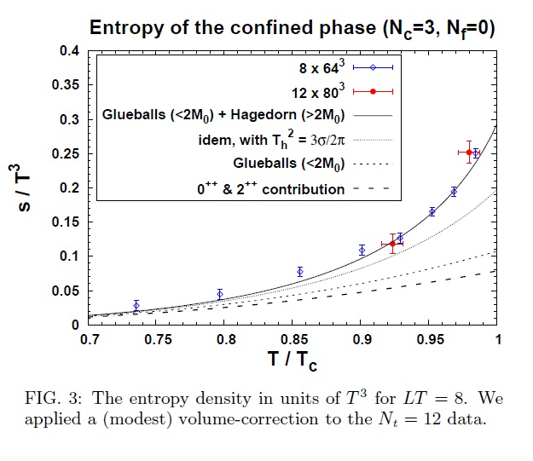
GlueBall-Matter at RHIC, LHC, FCC

Slide 24
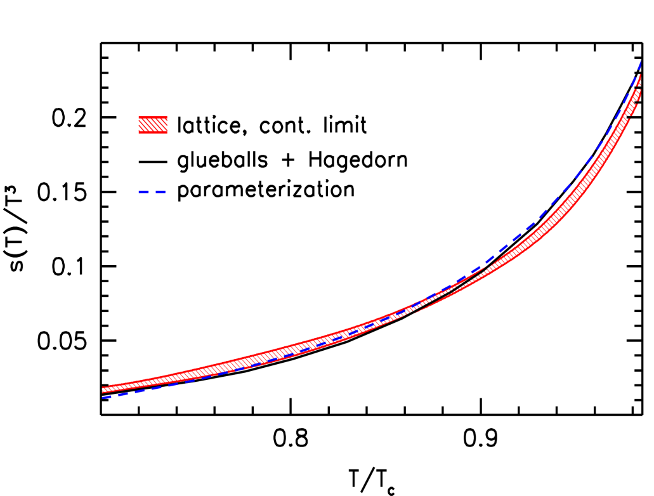
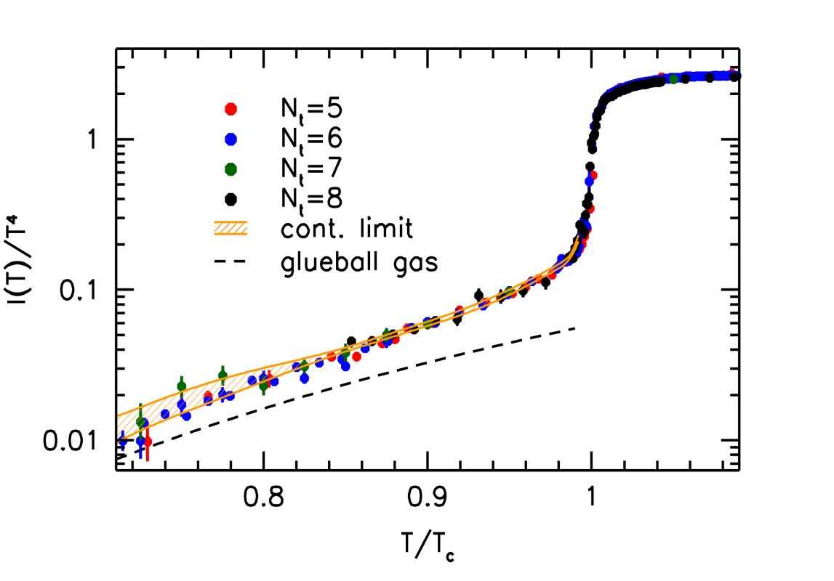
Thermodynamics of the glueballs
Glueball-Hagedorn-States
Glueball-Hagedorn-States
12 Glueballs
Wuppertal-Budapest (W.-B.)Collaboration: JHEP 1207 56 (‘12)
High precision continuum result for the quenched equation of state.
The low temperature behavior up to the transition point
can be described by the glueball spectrum.
W.-B. used 12 glueball states from Morningstar-Peardon
plus a Hagedorn particle tower (as proposed by Harvey Meyer).

Slide 25
Bootstrap (courtesy Max Beitel, Kai Gallmeister, Carsten Greiner)
Assumption: only 2-body (detailed balance!)
Bootstrap equation
Total decay width (via detailed balance)
cf. S. Frautschi, PRD 3 (1971) 2821
C. Hamer, S. Frautschi, PRD 4 (1971) 2125

Slide 26
GlueBalls & Hagedorn-States: exponentially increasing Mass-Spectra, Width
GlueBalls+HagedornStates
p-Baryon-HagedornStates
T quite independent of charges

Slide 27
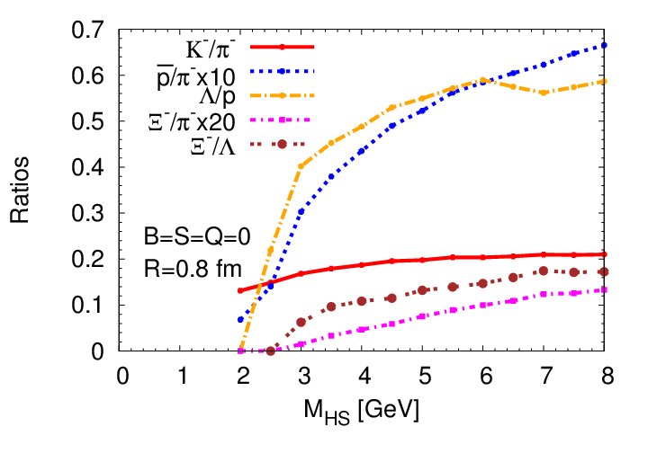
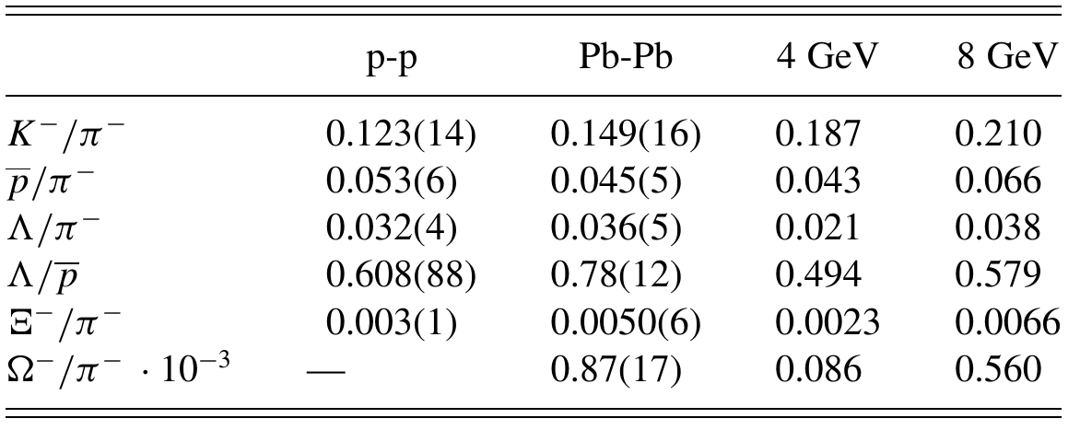
Single HS cascading decay: yield ratios vs ALICE
data: ALICE @ LHC
M.Beitel, KG, C.Greiner, PRC 90 (2014) 045203

Slide 28
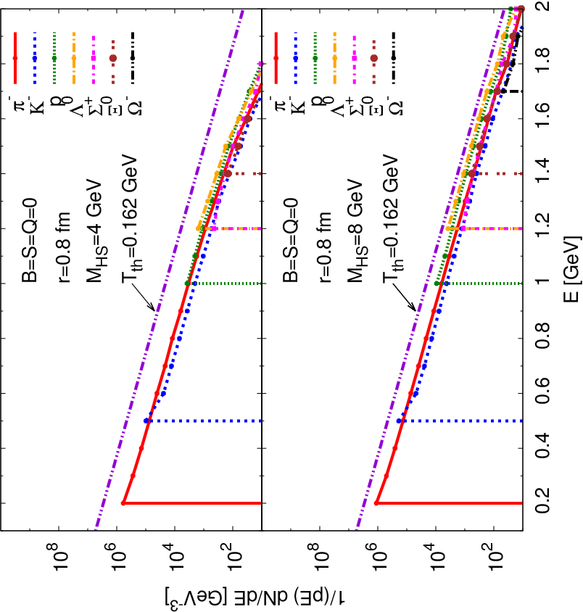
Slope of Single 4-GeV GlueBall-like Hagedorn State seq. 2-body decay cascade
Spectra/slopes of decay products of each single Hagedorn State cascading a sequential 2-body decay chain: slopes look thermal !!!
slopes equal Hagedorn temperature !
slope independent of mass, radius, charges of Hagedorn State
M.Beitel, KG, C.Greiner, PRC 90 (2014) 045203

Slide 29
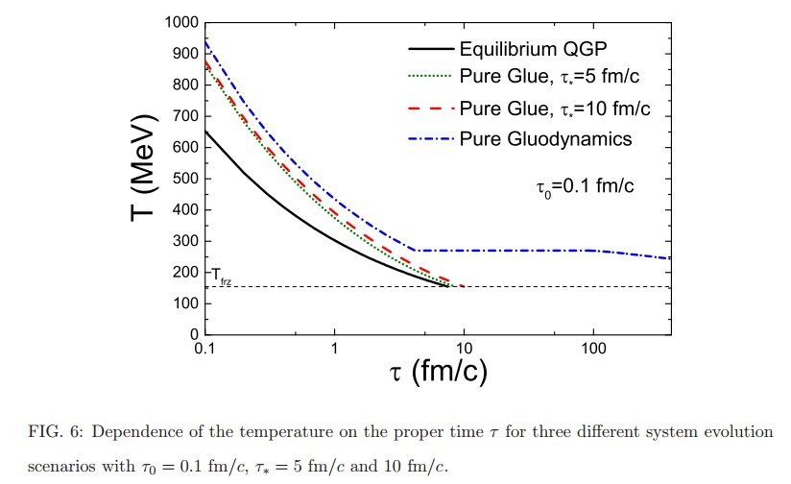

Slide 30
Eff.Nf(t)
0.0
0.1
0.2
0.3
0.6
0.9
Eff.Nf(t): 0.0 0.1 0.2 0.3 0.6 0.9 ….

Slide 31
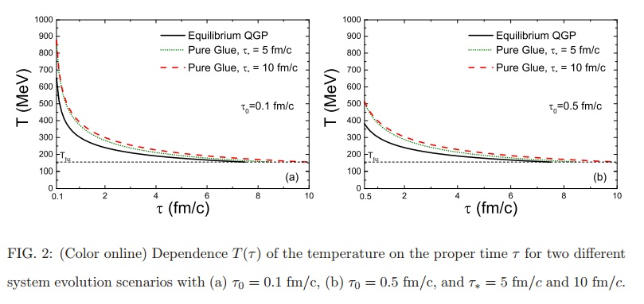
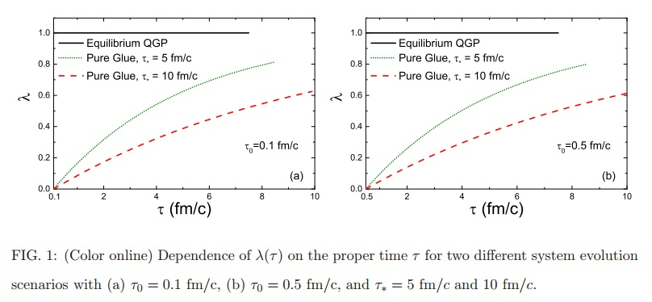

Slide 32
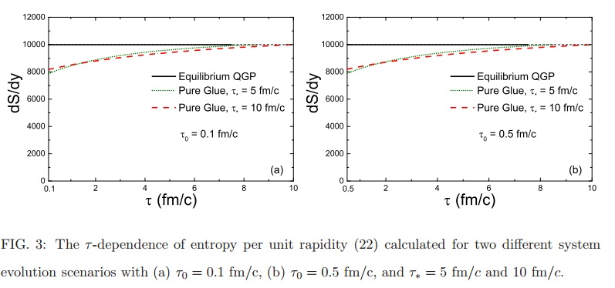
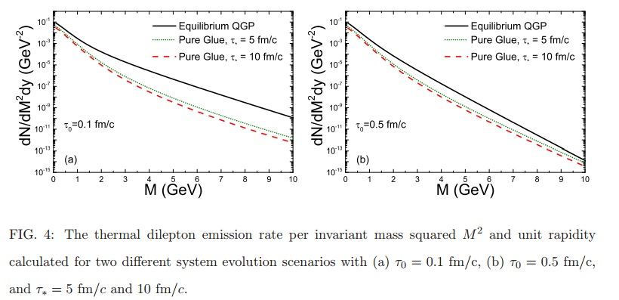

Slide 33
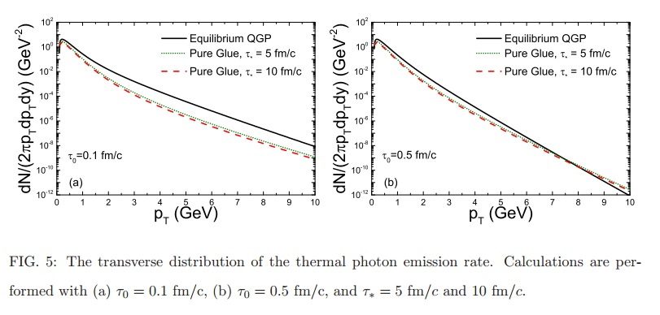
Photons

Slide 34
Outlook: Alternative Class of High M events in pp, pA @ LHC – AA?
Initial Color Glass Condensate Glasma thermalizes fast equilibration of gluons, slow equil. of quarks high pressure, entropy in gluon plasma fast hydrodynamic expansion of gluon plasma.
1. Order Phase Transition at T_c = 270 MeV of flavorless QCD.
Transition from glue plasma in GlueBall fluid
Glueballs’ Hagedorn states decay directly into Hadrons Comparison of theory with the experiments tests our understanding of QCD matter.

Slide 35
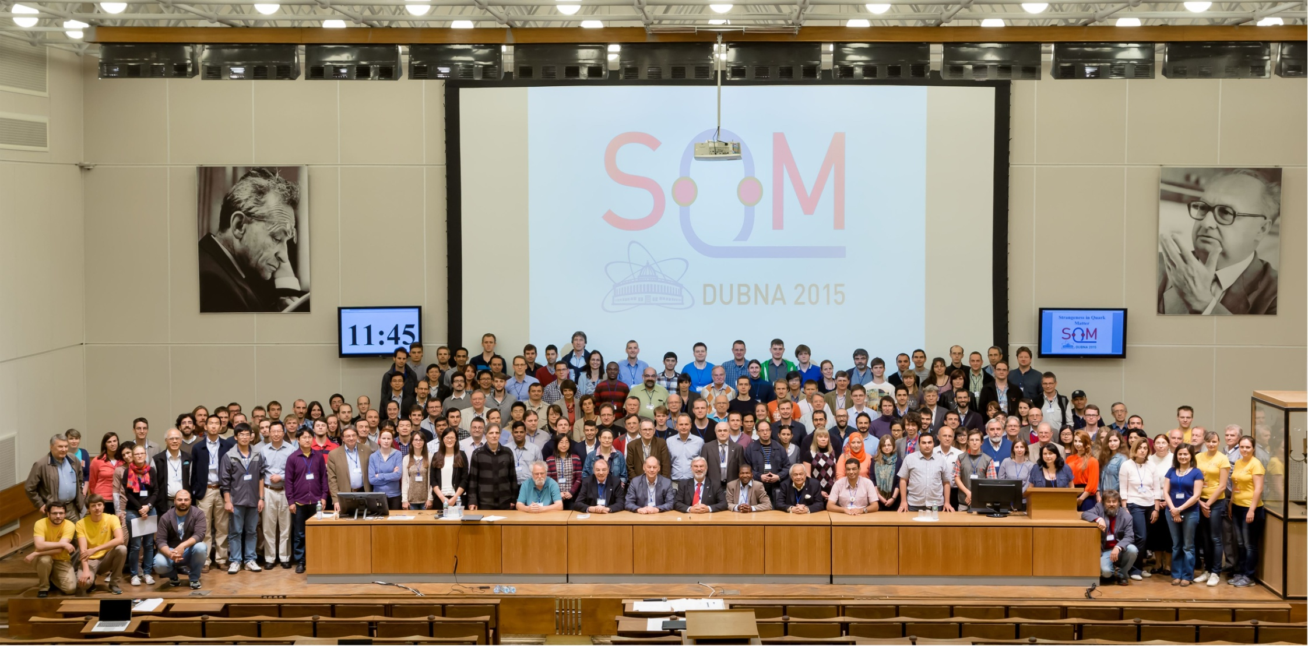
Wholehearted Congratulations, by all of us, to the Veksler-Baldin LHEP and NICA Team JINR Dubna !
Many thanks for Your Splendid Hospitality !

Slide 36
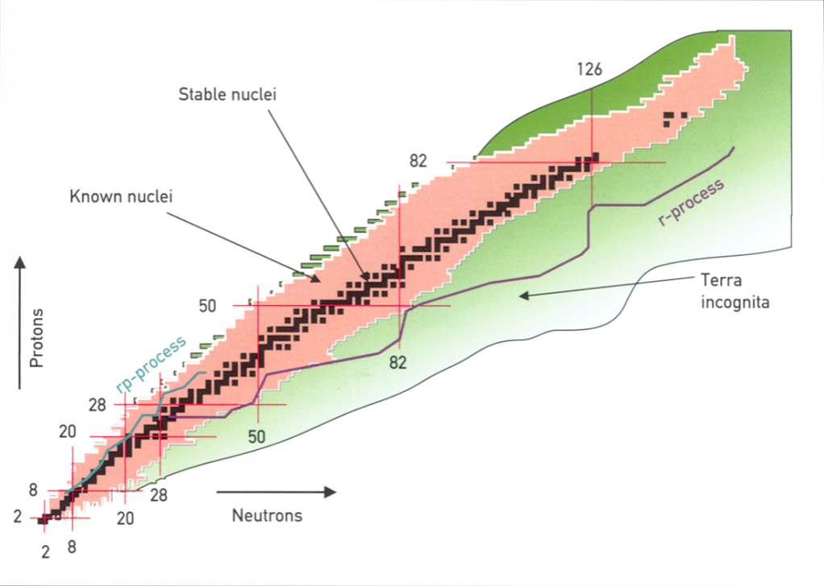
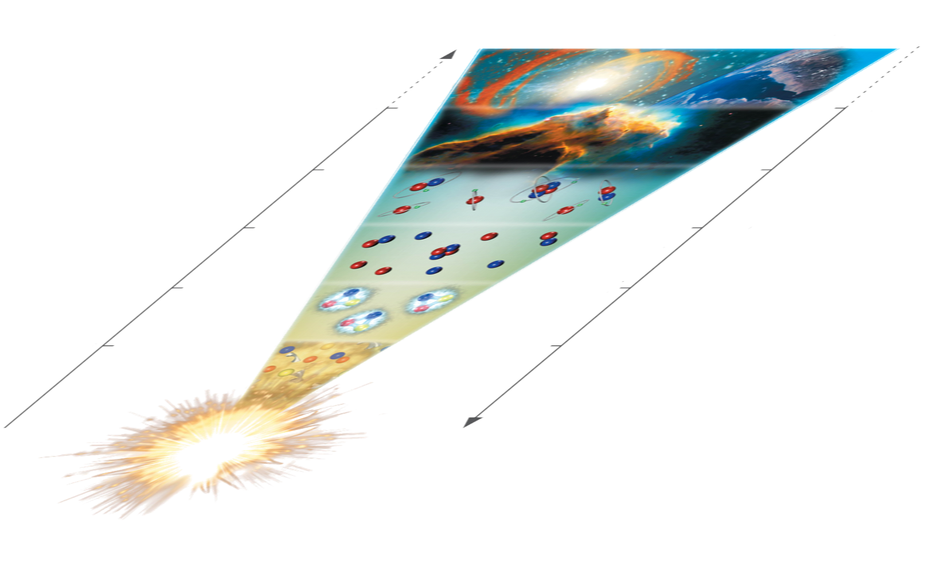
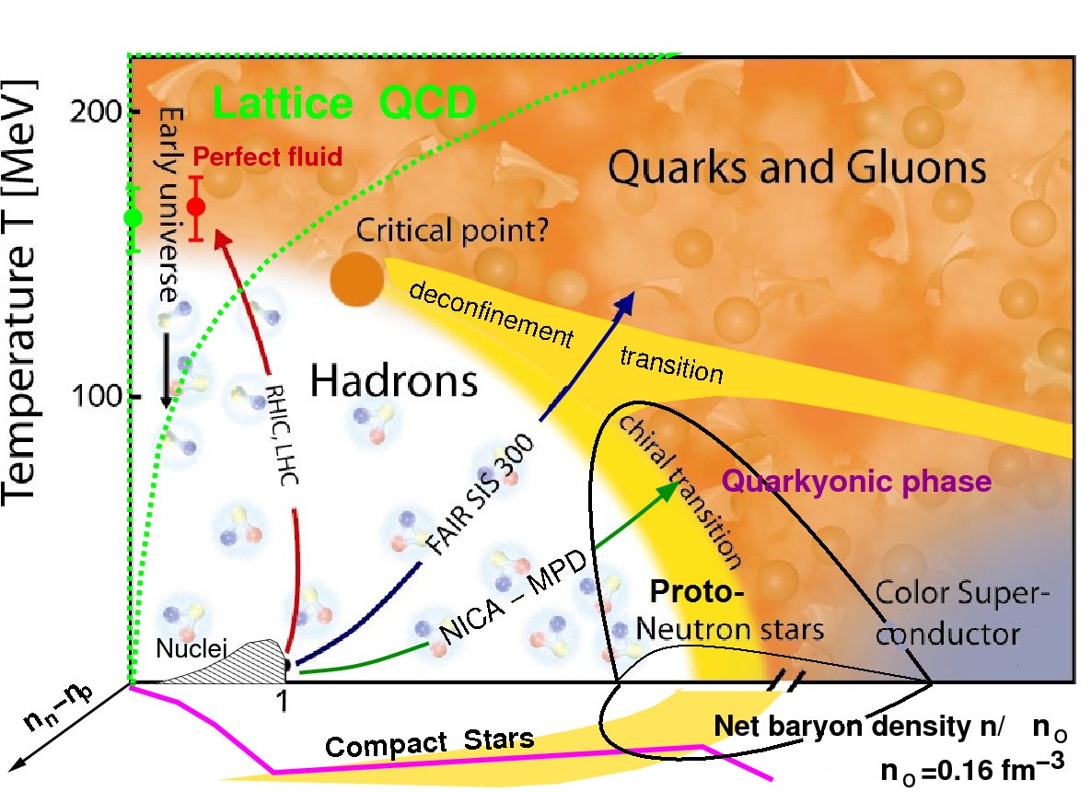
Cosmic Matter in the Laboratory
FAIR–RHIC-LHC
14 billion years
3 K
Creation of heavy elements in SN Explosions
in NS-NS-mergers: NuSTAR RIBs
1 billion years
20 K
Creation of A<60 nuclei in stars
400.000 years
3.000 K
H/He- Atoms form in ion-electron plasma
3 minutes
10⁹ K
Anti-Protons, Neutrons, Hadrons disappear
Create Anti-Baryons, Glueballs PANDA
5 microsec
Temperature
10¹² K
Gluons and quarks disappear CBM
time
Create Gluons, Quarks, Leptons…
Big Bang = Genesis
Notes:
The physics of hadrons and nuclei span a huge range in terms of
age of the universe
size of the universe
while the size of the object stays always in the ballpark of 1 fm (10⁻¹⁵m), the approx. range of the strong force
If we follow the bigbang, we can identify several regions of particular interest
Genesis of Quark
the Freeze-Out
almost Cold Hadrons
and Nuclei
The Genesis of Quarks is a different programme, so I leave it out for further discussions
All the others pose very remarkable questions
What kind of phase transition do exist in strongly interacting fundamental matter (among Quarks and Gluons) leading to the mapping of the phase diagram
The second important question is to understand quantitatively the mass of the proton (and all other hadrons) leading to the investigation of the binding among Quarks and Gluons
Finally the abundance of elements is critically defined by the dynamics of exotic nuclei, making the mapping of exotic nuclei the important challenge for understanding the appearance of our world

Slide 37


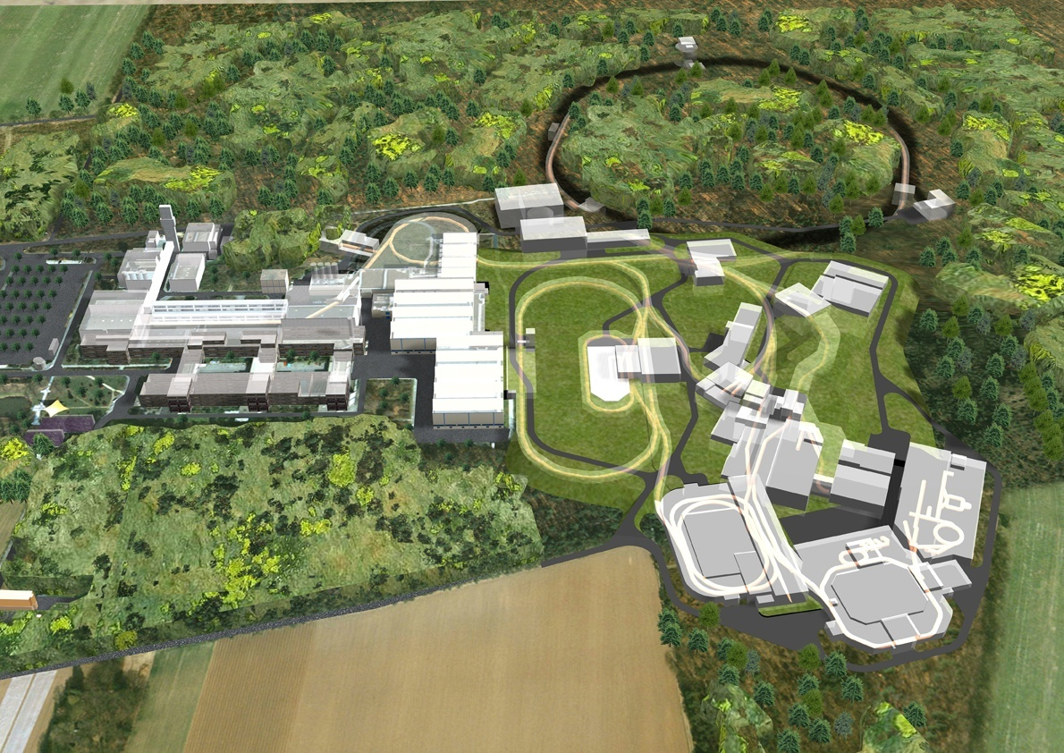
Brilliant Anti-proton beams
- Strange & Charm cosmic matter
SIS 100/300
50 MeV
SIS18
p-Linac
30 GeV Protons
HESR
ESR
Cu Target
10⁷ p/s @ 3 GeV
CryRing
High to low Energy pbars :
proton Linac 50 MeV
accelerate p in SIS18/SIS100
produce pbar on target
collect pbar in CR,
inject pbar into HESR
+ back to ESR+CryRing: FLAIR!
FLAIR
PANDA
Accelerating
Cooling
Collecting
Accumulating
Precooling
RESR/CR
100m
G.Boca GSI, Germany & U. Pavia, Italy
Courtesy Jim Ritman, FZJ

Slide 38
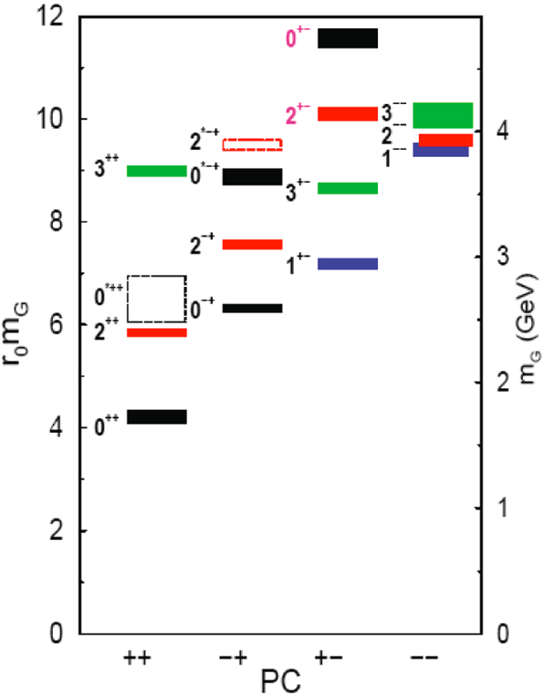
Search for Heavy Glueballs
Charmed Glueballs
  flavour blind decays
    charmed final states
  only a few charmed mesons around 3 - 4 MeV/c²
    less mixing
Exotic glueballs (oddballs), no mixing!
  m(2⁺⁻) = 4140(50)(200) MeV
  m(0⁺⁻) = 4740(70)(230) MeV
  decay modes φφ, φη, J/ψη, J/ψφ
  Narrow widths predicted
Morningstar & Peardon, PRD60(1999)34509
Morningstar & Peardon, PRD56(1997)4043 QUENCHED pure gauge Lattice theory
BMW uppertal coll., RBRC-Bielefeld coll, Owe Pilipsen, Goethe Uni Frankfurt

Slide 39
Updates and crosschecks: full N_{f}=2+1 EoS
PLB 730, 99
1309.5258

Slide 40
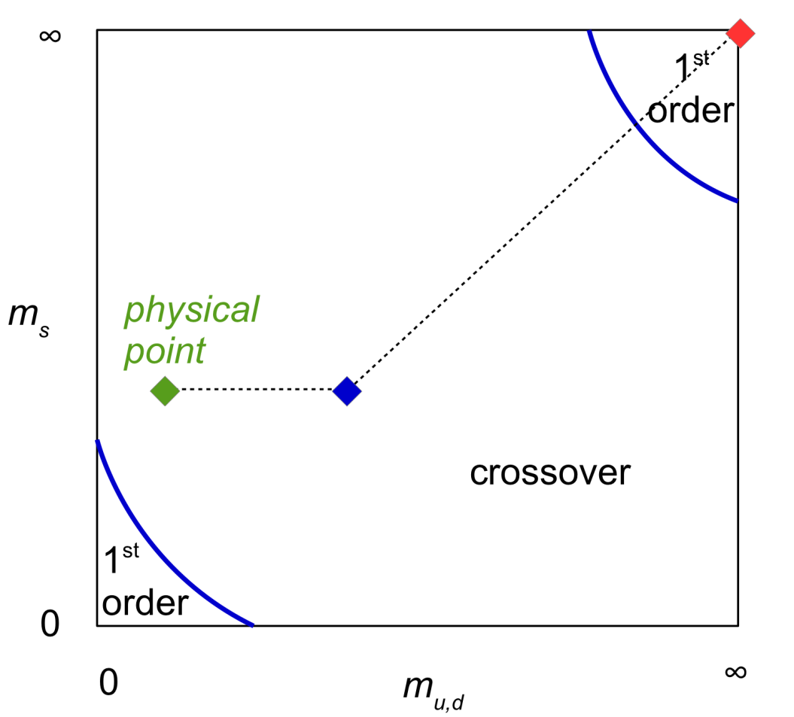
Energy density of QCD
Lattice QCD has determined the energy density (equation of state) for various quark masses at zero density.
Energy density Wuppertal-Budapest
physical point, quenched and m_{ud}=m_{s}
JHEP 1011,2010,077;PLB730,2014,99
Quenched: JHEP 1207,2012,056
Columbia plot: Brown et al.,
PRL 65, 2491 (‘90)
Nature of transition, in physical point
Wuppertal-Budapest,Nature443,675’06

Slide 41
time dependence in Columbia plot …... LHC – the Glueball Factory…
violent pp (& AA) collisions
initial state at LHC:
Color Glass Condensate
t=0.1fm/c: glue thermalizes
pure glue-plasma created
Quenched Lattice SU(3)_c :
T_c =270MeV
glue plasma -> GlueBall fluid
1. Order Phase Transition
Expansion to critical point
T_cp =240 MeV t~1-2 fm/c
GlueBalls + Hagedorn States Mix
more and more quarks produced: T_co =155MeV crossover transition
Observables from Columbia plot
T>T_cp: Zero e.m. radiation
Measure intermed. Dilepton mass
T_c: Flow collapse as barometer
T_cp: Critical Scattering,
Kurtosis , # fluctuations
T_c ~ 2*T_co =>
P_t(pp) ~ 2*p_t(AA)
M_GlueBalls 2GeV: „No“ Baryons
p/pi=0 : Yield p+pBar<<mesons
Glue Flavor blind !
K/pi=1 Yields: Kaons ~ pions

Slide 42
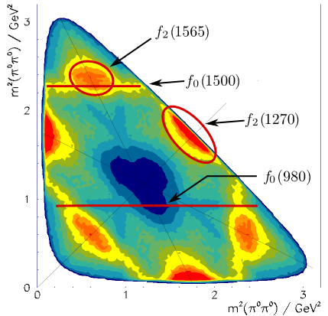
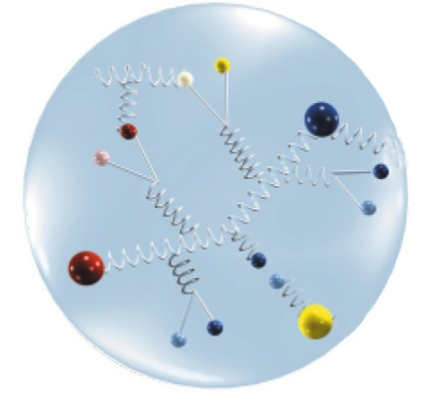
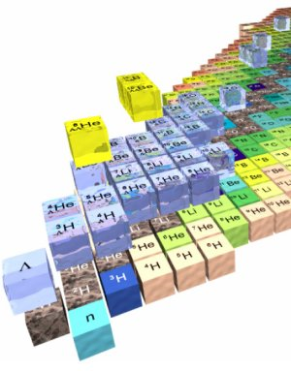
The PANDA Physics Program
Hadron Spectroscopy
Experimental Goals: mass, width & quantum numbers of resonances
Charm Hadrons: charmonia, D-mesons, charm baryons
➔ Understand new XYZ states, Ds(2317) and others
Exotic QCD States: glueballs, hybrids, multi-quarks
Spectroscopy with Antiprotons:
Production of states of all quantum numbers
Resonance scanning with high resolution
Baryon Spectroscopy: excited ss, sss, c baryons
Hadron Structure
Generalized Parton Distributions
➔ Formfactors and structure functions, Lq
Timelike Nucleon Formfactors
Drell-Yan Process
Nuclear Physics
Hypernuclei: Production of double Λ-hypernuclei
➔ γ-spectroscopy of hypernuclei, YY interaction
Hadrons in Nuclear Medium

Slide 43
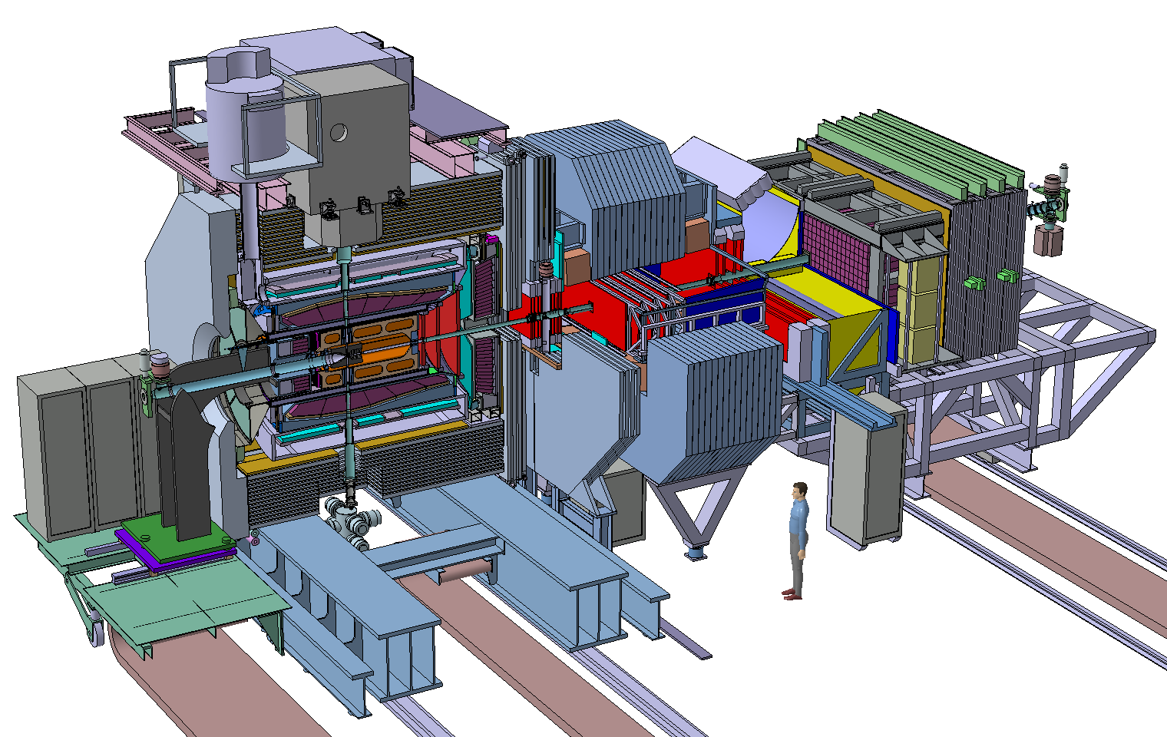
The PANDA Spectrometer at FAIR
Detector requirements:
4π acceptance
High rate capability:
2x10⁷ s⁻¹ interactions
Efficient event selection
➔Continuous acquisition
Momentum resolution ~1%
Vertex info for D, K⁰_{s}, Y
(cτ = 317 μm for D±)
➔Good tracking
Good PID (γ, e, μ, π, K, p)
➔Cherenkov, ToF, dE/dx
γ-detection 1 MeV – 10 GeV
➔Crystal Calorimeter

Slide 44
First Physics at PANDA (1/10-1/100 Lumi)
Time
order
Tests
Trigger tests, inclusive open/hidden charm cross sections
Charmonium (-like)
Excited states above DD threshold (J/Ψ π π )
Scan width of X(3872) (precision 50-100 keV) (BR X→pp ?)
Deuteron target (charged Z_{c} states)
Light Hadron Spectroscopy
Light Glueballs and Hybrids (< 2.4 GeV)
Excited s-Baryon spectroscopy
Hadron Structure
Proton G_{E} and G_{M} at “low” q²
QCD Dynamics
Lambda-LambdaBar production
HESR “Day-1 Experiment”
Antiproton-Proton elastic scattering cross section in wide t range.
1,2
_
_
2
1
2
1
0

Slide 45
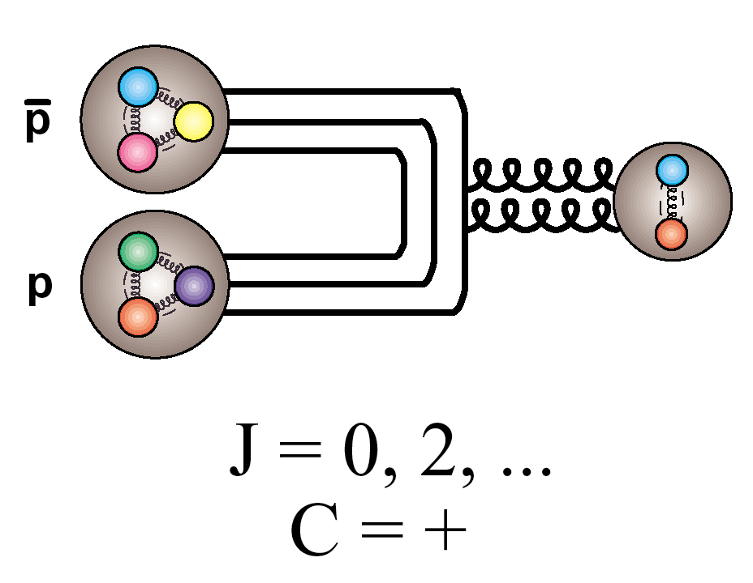
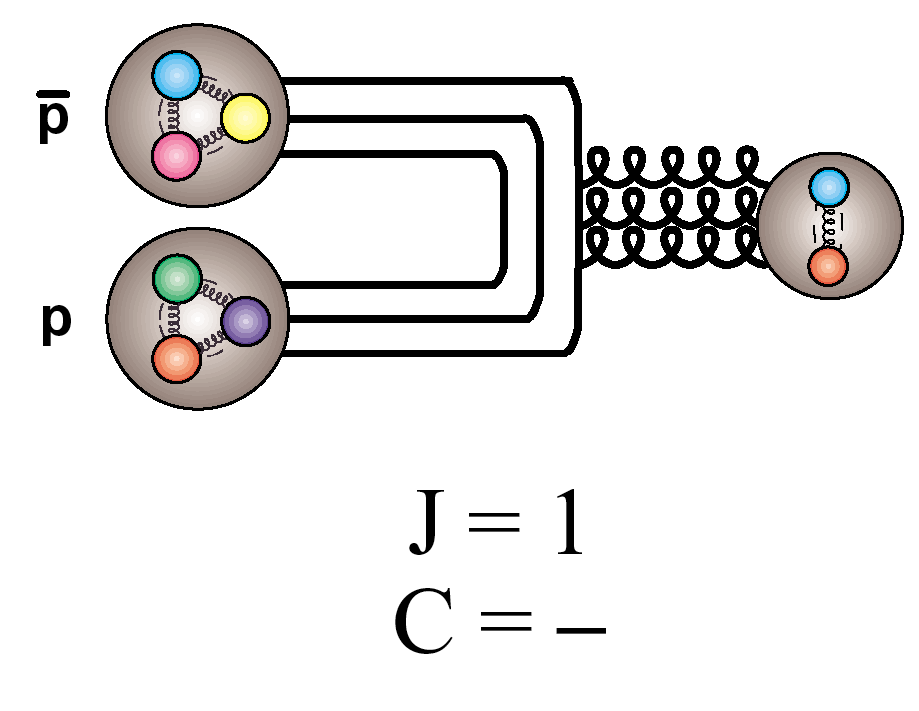
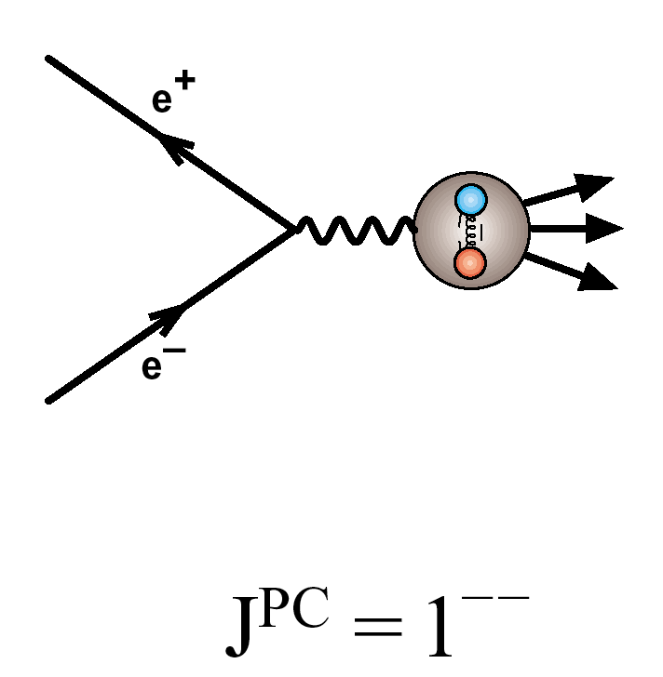
Particle production in pp collisions
_
Formation:
_
_
All J^{PC} allowed for (qq) accessible in p p
c.f.
Only J^{PC} = 1⁻⁻ allowed in e⁺e⁻
(to 1st order)

Slide 46
Suppression scheme
hadrons
e⁻, J/
partons
1)
production
2)
medium energy loss
3)
fragmentation
4)
decay
Initial momentum distributions for partons
Parton energy loss
Fragmentation functions of partons into hadrons
Decay of heavy mesons to single e⁻ and J/.

Slide 47
The PANDA Spectrometer at FAIR
Detector requirements:
4π acceptance
High rate capability:
2x10⁷ s⁻¹ interactions
Efficient event selection
➔Continuous acquisition
Momentum resolution ~1%
Vertex info for D, K⁰_{s}, Y
(cτ = 317 μm for D±)
➔Good tracking
Good PID (γ, e, μ, π, K, p)
➔Cherenkov, ToF, dE/dx
γ-detection 1 MeV – 10 GeV
➔Crystal Calorimeter

Slide 48
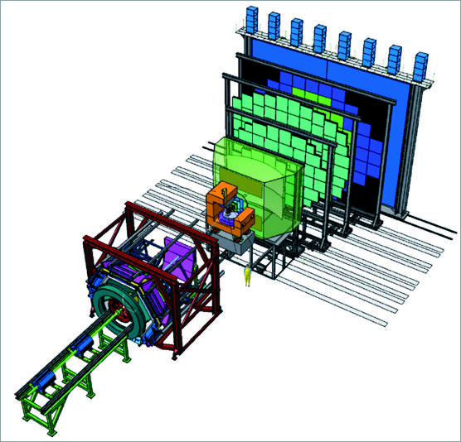
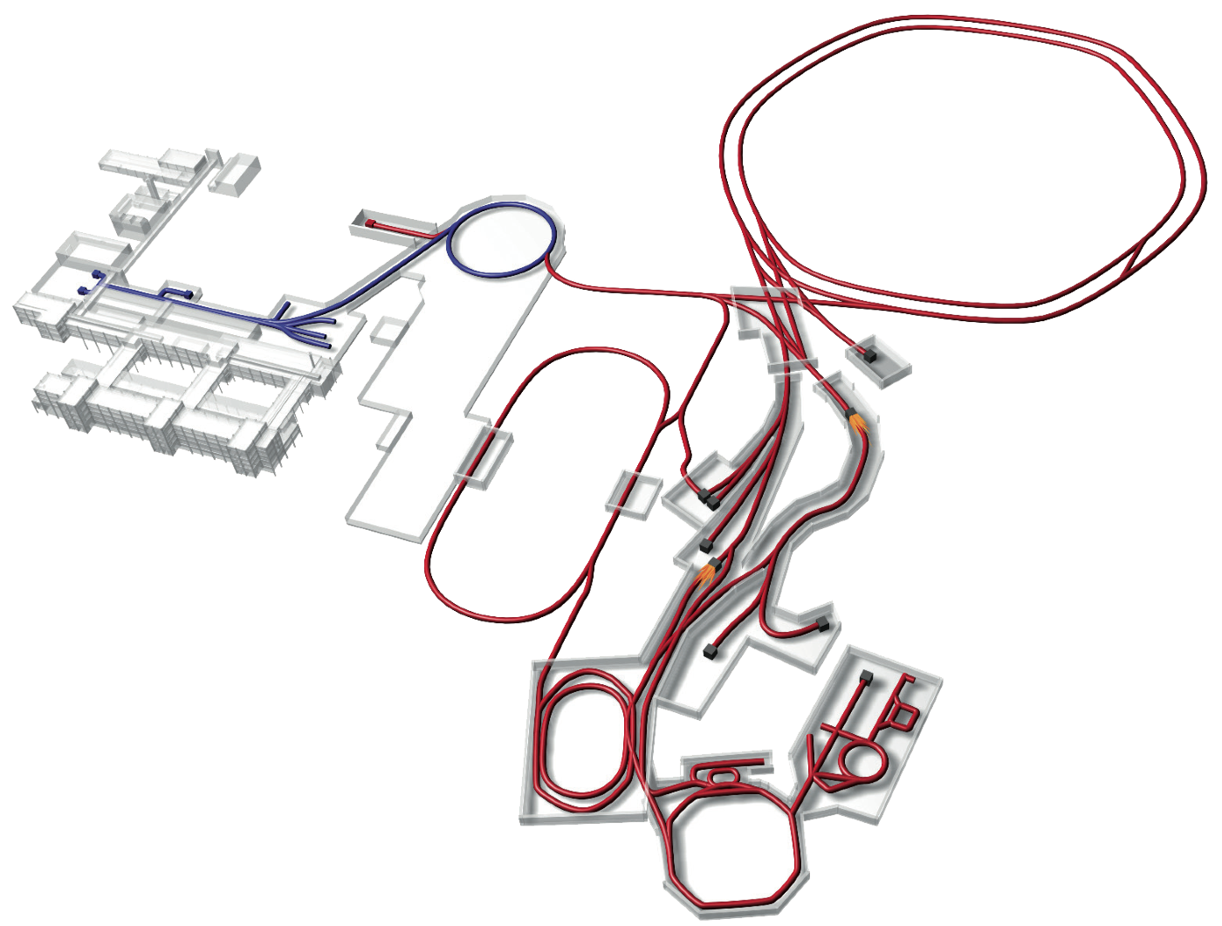

FAIR Experiments
CBM
APPA
NuSTAR
Super- FRS
PANDA

Slide 49
Jet energy loss
Initially, most of the energy loss calculations assumed only radiative energy loss, and a QCD medium composed of static scattering centers. (e.g. GW, DGLV, ASW,BDMPS...)
However, these calculations lead to an obvious disagreement with the experimental data.
Is collisional energy loss also important?
Yes, collisional and radiative energy losses are comparable!

Slide 50
Non-zero collisional energy loss - a fundamental problem
With such approximation, collisional energy loss has to be exactly equal to zero!
Static QCD medium approximation (modeled by Yukawa potential).
Introducing collisional energy loss is necessary, but inconsistent with static approximation!
However, collisional and radiative energy losses are shown to be comparable.
Static medium approximation should not be used in radiative energy loss calculations!
Dynamical QCD medium effects have to be included!

