Slide 1
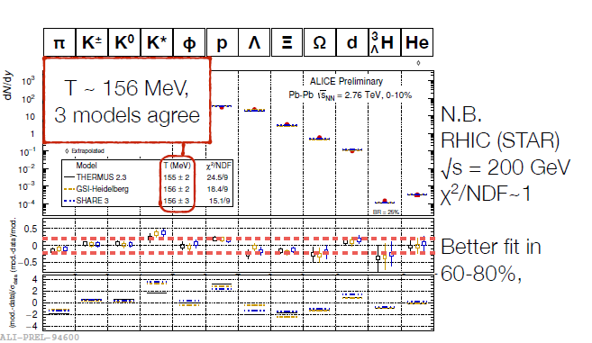
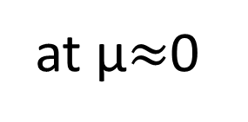
Strange Quark matter ??
We will never be sure because we can measure strange quark matter only via hadrons
at μ$≈$0
Floris monday
Deviations from
statistical model
probably due to
hadronic rescattering
Better we will never know !!
Questions one may ask:
Is the plasma in local equilibrium during the whole expansion (hydrodynamics)?
Does it come to equilibrium only close to the phase transition (NJL, Djordjevic)?
Is there a slow transition to local equilibrium (PHSD)?
Do hadrons come from glue balls?
Answer needs other observables ,like energy loss of heavy quarks of jets.

Slide 2
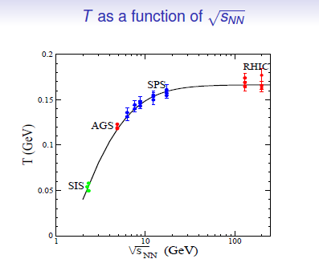
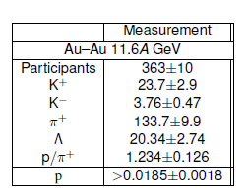
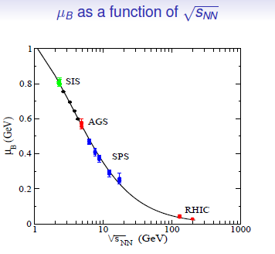
at μ$≫T$ the situation is worse
We have mainly AGS data (quite limited)
But:
at SIS energies
IQMD and HSD describe multiplicity AND spectra
$→$ no thermal equilibrium is established
Phys.Rept. 510 (2012) 119-200

Slide 3
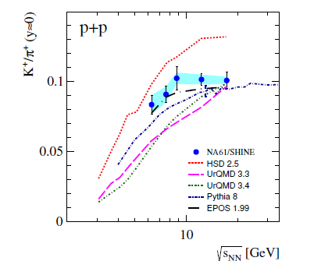
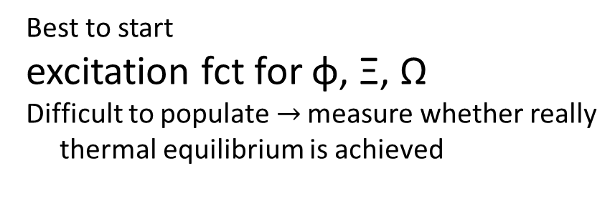
Hopefully NICA and Fair will give the answer whether
we find a hadron gas I statistical equilibrium
To find out whether the plasma is in equilibrium will be much harder:
μ$≫0 → lower beam energy → less particles produced$
$$→less rescattering →less chance to thermalized$$
In addition it may be a 1st order phase transition there
$→theoretically more complicated to rely quark$
$$with hadronic phase$$
For the moment:
Definitely interesting physics there
A lot of experimental work is required
Best to start
excitation fct for φ, Ξ, Ω
Difficult to populate$→$ measure whether really
thermal equilibrium is achieved

