Slide 1


Features of triangular flow of strange and non-strange hadrons in heavy-ion collisions at LHC
E. Zabrodin,
in collaboration with
L. Bravina, H. Brusheim Johansson, J. Crkovska, G. Eyyubova, V. Korotkih,
I. Lokhtin, L. Malinina, S. Petrushanko and A. Snigirev
SQM’2015 (JINR Dubna) 10.07.2015
Notes:
1

Slide 2
Outline
I. Introduction
II. HYDrodynamics with JETs++ model
III. Triangular flow v₃ in
relativistic heavy ion collisions
IV. Influence of resonance decays on v₃
V. Number-of-constituent-quark scaling
VI. Conclusions
Notes:
PANIC 2008 November
2

Slide 3
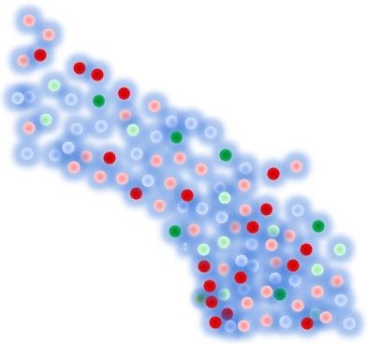
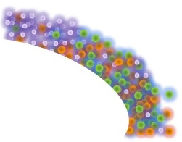
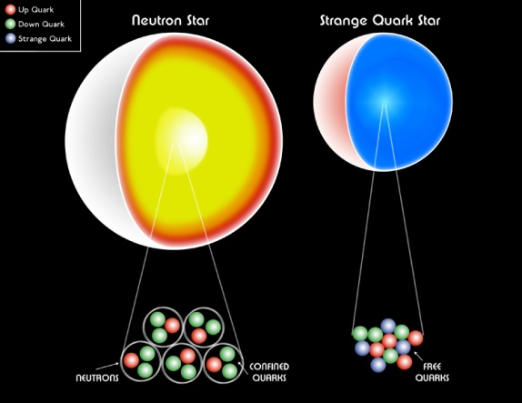
Phase diagram
SIS 2 AGeV (FOPI, TAPS, HADES)
AGS 10 AGeV (E896, E917, E910)
SPS 30-160 AGeV (NA49, NA50, NA60, WA98…)
RHIC 7-200 GeV (sPHENIX, STAR)
Universe
RHIC 7-200 GeV (BRAHMS, PHENIX, PHOBOS, STAR)
temperature
LHC 2.76-5.1 TeV (ALICE, CMS, ATLAS)
FAIR 30 AGeV (CBM)
NICA 10 GeV (MPD, SPD)
LHC
RHIC
SPS
FAIR
NICA
AGS
SIS
Superconductor
net baryon density
Diagram by S. Milov

Slide 4
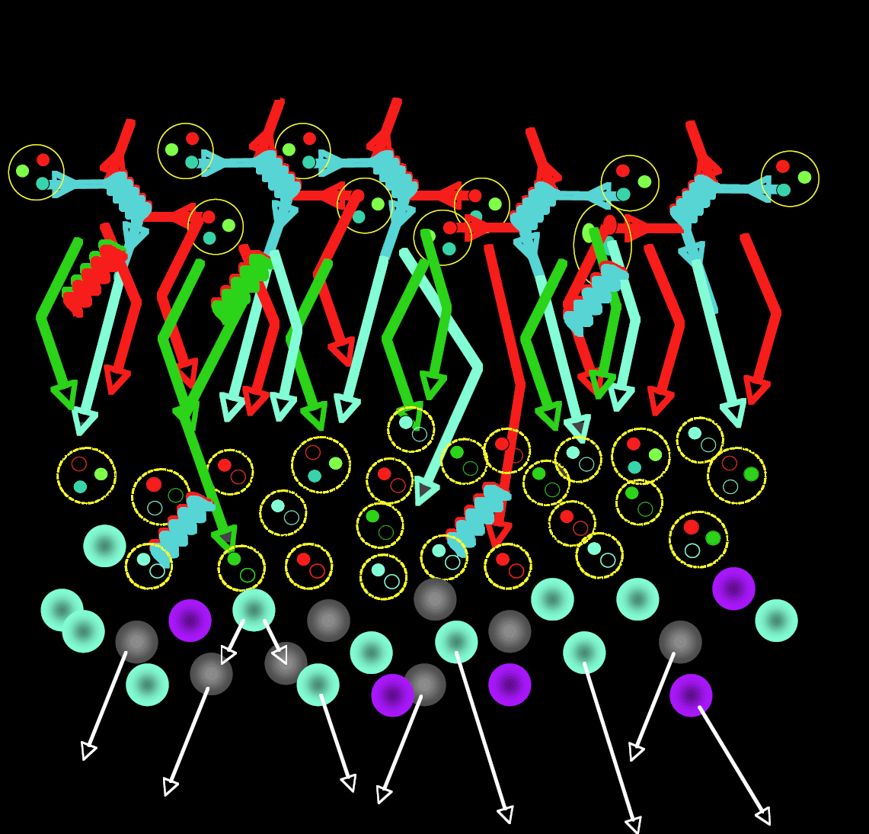
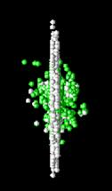
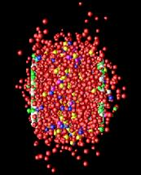
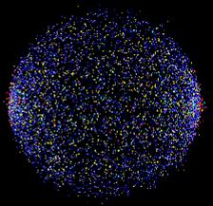
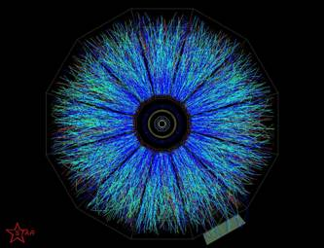
Dynamic Regimes
Parton distribution,
Nuclear geometry
Nuclear shadowing
Parton production &
regeneration
(or, sQGP)
Chemical freeze-out
(Quark recombination)
Jet fragmentation functions
Hadron rescattering
Thermal freeze-out
Hadron decays
4
Diagram by Peter Steinberg

Slide 5
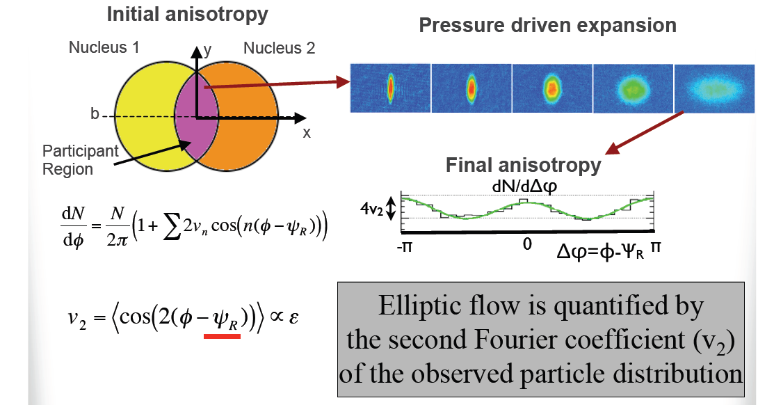
ELLIPTIC FLOW
Initial spatial anisotropy is converted to anisotropy in
momentum space
S.Voloshin, Y.Zhang, Z.Phys.C70 (1996) 665

Slide 6
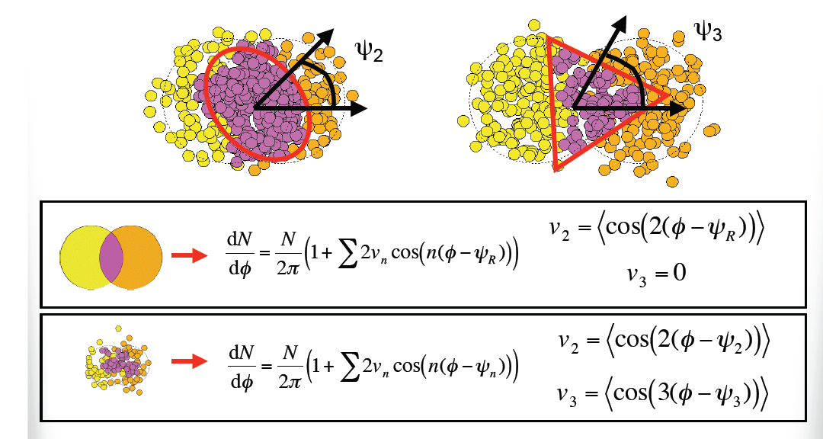
TRIANGULAR FLOW
B. Alver and G.Roland, PRC 81 (2010) 054905
The triangular initial shape leads to triangular hydrodynamic flow

Slide 7
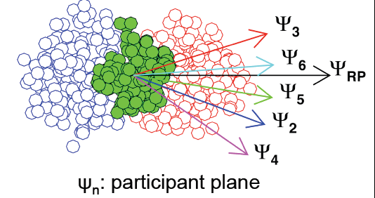
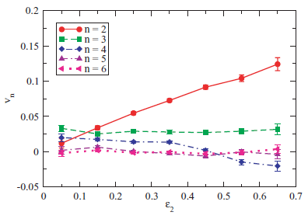
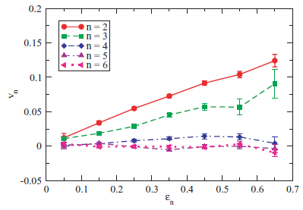
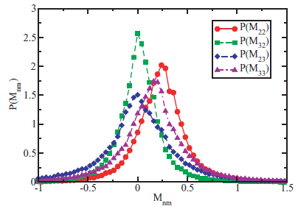

CROSS-TALK BETWEEN FLOW HARMONICS
G.-Y. Qin et al, PRC 82 (2010) 064903
Only the first few flow harmonics of final-state hadrons survive
after hydrodynamic evolution

Slide 8


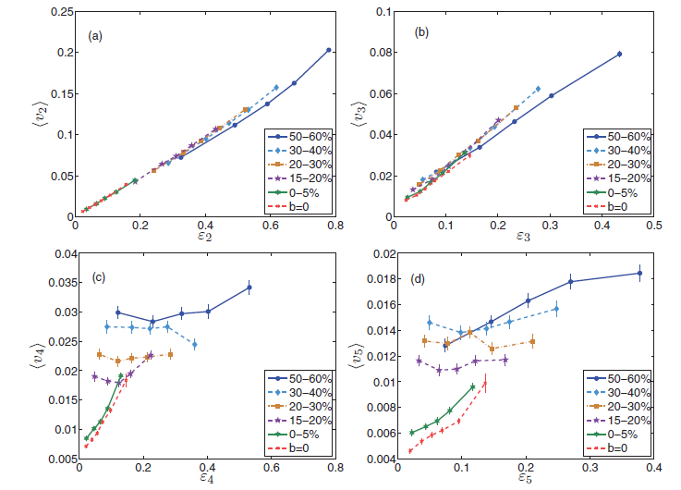
CROSS-TALK BETWEEN FLOW HARMONICS
Z. Qiu and U. Heinz, PRC 84 (2011) 024911
The basic response of v₂ and v₃ to eccentricities is approx. linear
Higher flow coefficients show poor correlation with the eccentricities
of the same order

Slide 9

II. HYDJET++ =
FASTMC + PYQUEN
Notes:
PANIC 2008 November
9

Slide 10
Relativistic heavy ion event generator HYDJET++
HYDJET++ (HYDrodynamics + JETs) - event generator to simulate
heavy ion event by merging of two independent components (soft
hydro-type part + hard multi-partonic state, the latter is based on
PYQUEN - PYthia QUENched routine).
http://cern.ch/lokhtin/hydjet++ (latest version 2.1)
[1] I. Lokhtin, L. Malinina, S. Petrushanko, A. Snigirev, I. Arsene,
K. Tywoniuk, Comp. Phys. Comm. 180 (2009) 77
[2] I. Lokhtin, A. Belyaev, L. Malinina, S. Petrushanko,
E. Rogochaya, A. Snigirev,
Eur. Phys. J. C 72 (2012) 2045
[3] L. Bravina, H. Brusheim Johansson, G. Eyyubova, V. Korotkikh,
I. Lokhtin, L. Malinina, S. Petrushanko, A. Snigirev, E. Zabrodin,
Eur. Phys. J. C 74 (2014) 2807
Notes:
10

Slide 11
HYDJET++ (soft):
hydrodynamics with resonances
Soft (hydro) part of HYDJET++ is based on the adapted FAST MC model:
Part I: N.S.Amelin, R.Lednisky, T.A.Pocheptsov, I.P.Lokhtin, L.V.Malinina,
A.M.Snigirev, Yu.A.Karpenko, Yu.M.Sinyukov, Phys. Rev. C 74 (2006) 064901
Part II: N.S.Amelin, R.Lednisky, I.P.Lokhtin, L.V.Malinina, A.M.Snigirev, Yu.A.Karpenko,
Yu.M.Sinyukov, I.C.Arsene, L.Bravina, Phys. Rev. C 77 (2008) 014903
fast HYDJET-inspired MC procedure for soft hadron generation
multiplicities are determined assuming thermal equilibrium
hadrons are produced on the hypersurface represented by a
parameterization of relativistic hydrodynamics with given
freeze-out conditions
chemical and kinetic freeze-outs are separated
decays of hadronic resonances are taken into account (360 particles
from SHARE data table) with severely modified decayer
written within ROOT framework (C++)
contains 16 free parameters (but this number may be reduced to 9)

Slide 12
Parton rescattering and jet quenching
see talk by I. Lokhtin, Fri.10, 18.00
Notes:
12

Slide 13
PYQUEN: physics frames

Slide 14
II. Triangular (and elliptic) flows in HYDJET++ : interplay of hydrodynamics and jets
Notes:
PANIC 2008 November
14

Slide 15
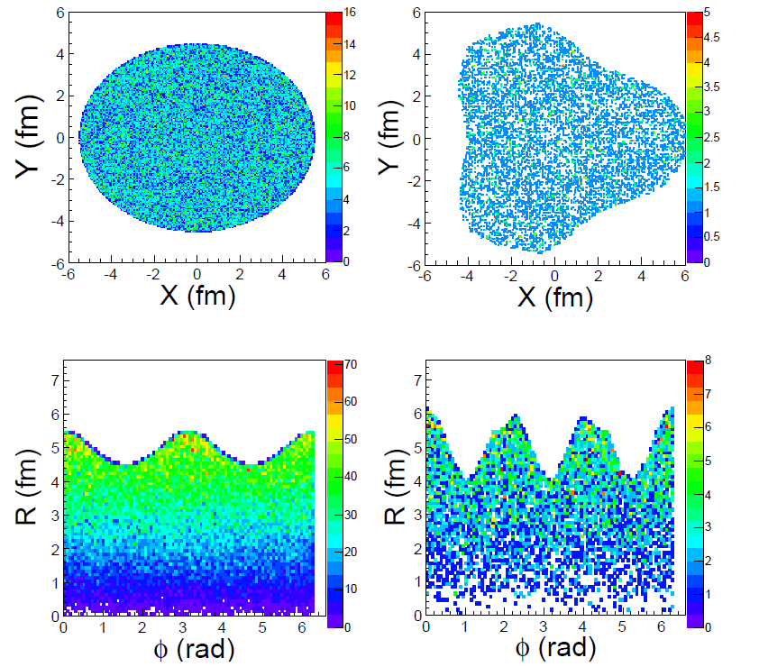


Generation of elliptic and triangular flows
V₃
V₂
Notes:
PANIC 2008 November
15

Slide 16
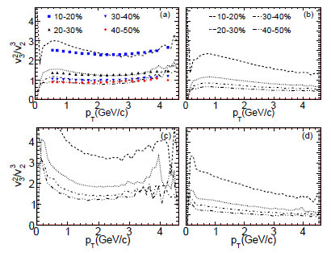
Ratio v₃²/v₂³ for different production modes
see talk by B.H. Brusheim Johansson, Mon.7, 18.00
(a) all ; (b) hydro + decays ; (c) directly produced ; (d) hydro w/o decays
Notes:
PANIC 2008 November
16

Slide 17
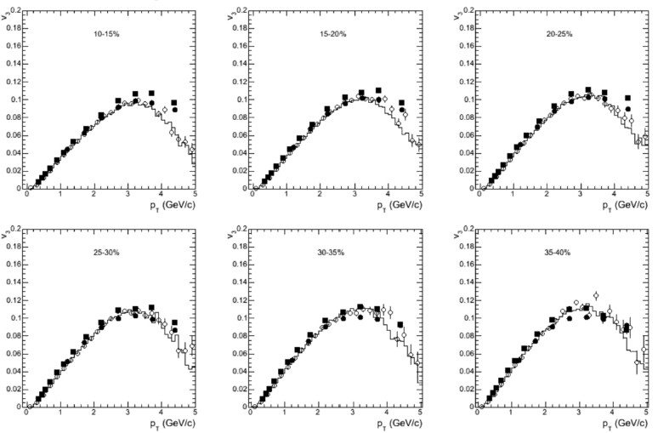
LHC data vs. HYDJET++ model
Triangular flow
Pb+Pb @ 2.76 ATeV
L. Bravina et al., Eur. Phys. J C74 (2014) 2807
Closed points: CMS data v₃{2Part & LYZ};
Open points and histograms: HYDJET++ v₃{EP & Psi3}
Notes:
17

Slide 18
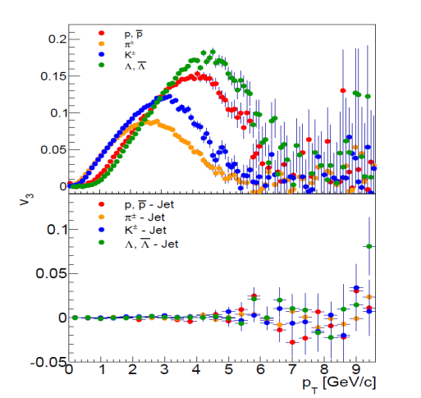
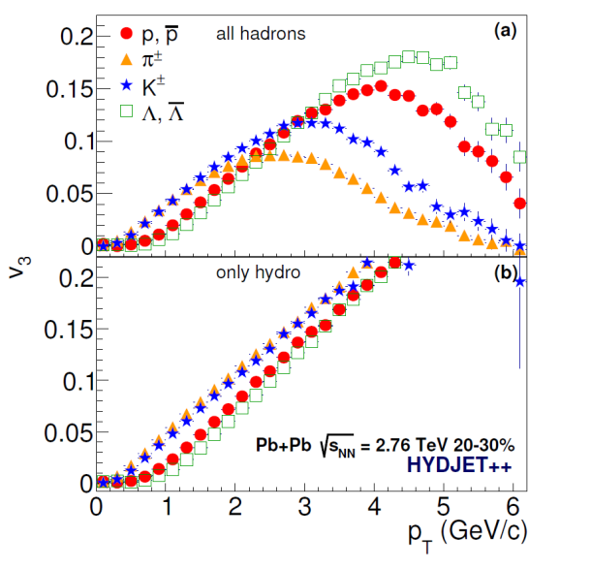
Interplay of hydrodynamics and jets
Triangular flow
Pb+Pb @ 2.76 ATeV
Hydrodynamics gives mass ordering of v3
The model possesses crossing of baryon and meson branches
The reason for the mass ordering break at 2 GeV/c is traced to hard processes (jets)
J. Crkovska et al., to be submitted
Notes:
18

Slide 19
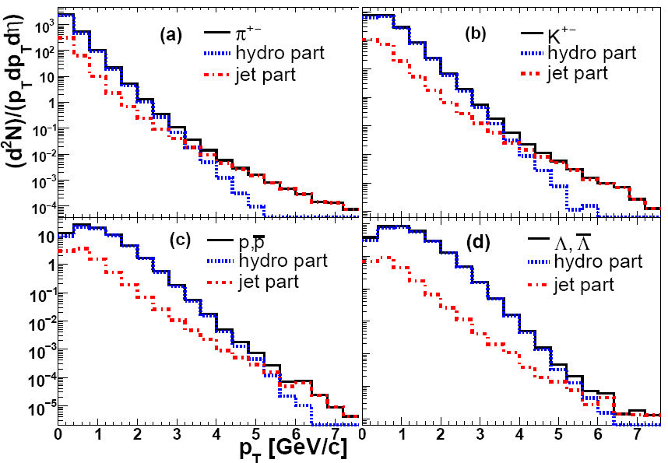
The p_{T} specta of π, K, p, Λ with HYDJET++ model (RHIC)
The slope for the hydro part depends strongly on mass:
- the heavier the particle -- the harder the spectrum
The hydro part dies out earlier for light particles than for heavy ones
Notes:
19

Slide 20
III . Influence of resonance decays
Notes:
PANIC 2008 November
20

Slide 21
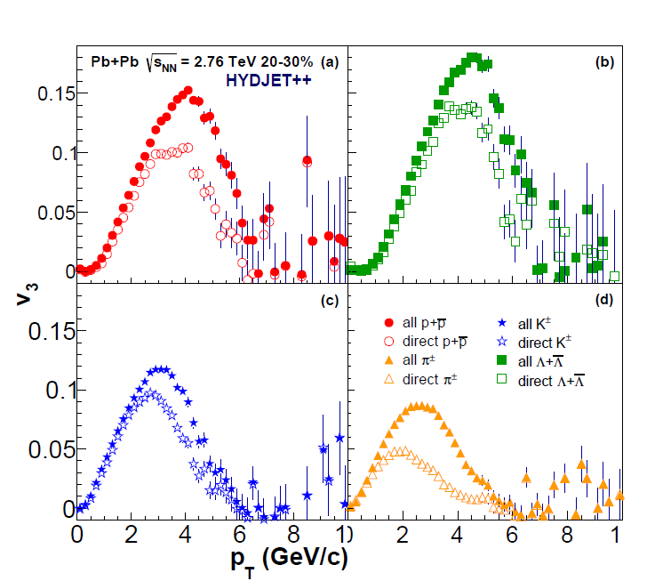
Influence of resonance decays on v₃ of different
particles at LHC
J. Crkovska et al., to be submitted
˄
Pions, Kaons, Baryons: the maximum of the resulting flow is shifted to higher p_{T} compared to the flow of directly produced particles
Notes:
PANIC 2008 November
21

Slide 22
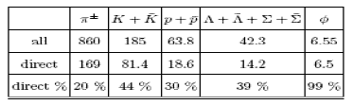
Transverse momentum of secondary particles
Δ→π + p
The secondary pion spectrum is much softer than proton spectrum
Notes:
PANIC 2008 November
22

Slide 23
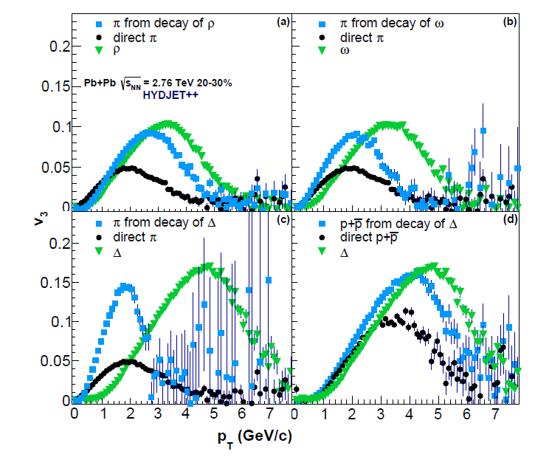
Triangular flow of direct and secondary particles at LHC
J. Crkovska et al., to be submitted
(Similar to elliptic flow): At low transverse momenta pions from decays of
Deltas and omegas enhance the flow whereas pions from rho-mesons reduce it
Notes:
PANIC 2008 November
23

Slide 24
IV. Number-of-constituent- quark (NCQ) scaling
Notes:
PANIC 2008 November
24

Slide 25
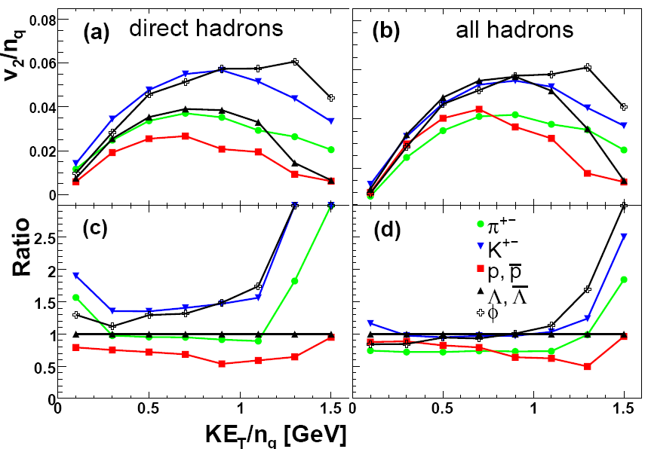
NCQ scaling for v₂ at LHC
No scaling for Appearance of the approximate
direct particles scaling for all particles
G.Eyyubova et al., PRC 80 (2009) 064907
LHC: NCQ scaling will be only approximate (prediction, 2009)
Notes:
PANIC 2008 November
25

Slide 26
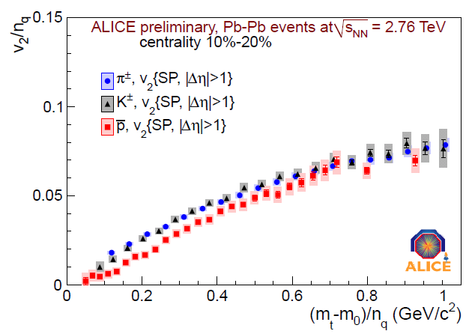
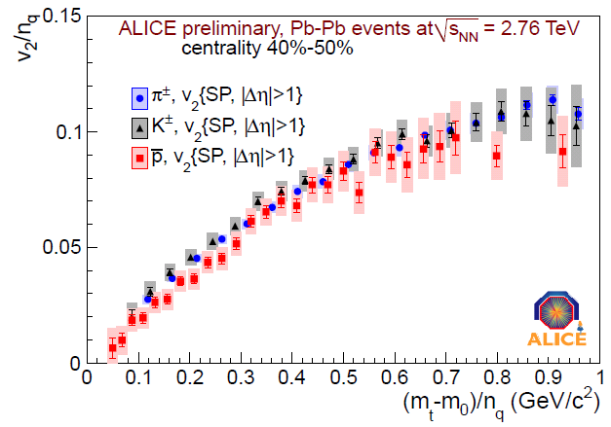
Experimental results (LHC)
ALICE Collaboration, M. Krzewicki et al., JPG 38 (2011) 124047
Semi-sentral collisions Semi-peripheral collisions
The NCQ scaling is indeed only approximate (2011)
Notes:
PANIC 2008 November
26

Slide 27
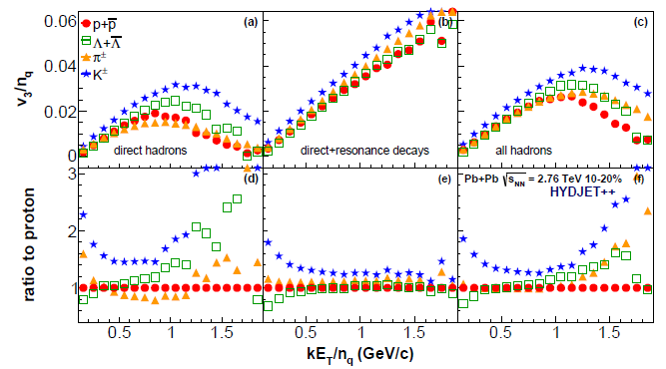
NCQ scaling for v₃ at LHC
No scaling for After resonance decays Approximate
direct particles scaling for all particles
J. Crkovska et al., to be submitted.
NCQ scaling for triangular flow is similar to that for the elliptic flow
Notes:
PANIC 2008 November
27

Slide 28
Conclusions
The HYDJET++ model allows us to investigate flow of hydro and jet parts separately, to look at reconstruction of pure hydro flow and its modification due to jet part. It also enables to study cross-talk of v₂ and v₃, while other harmonics are absent.
1. Jets result to dropping of triangular flow after a certain p_{T}.
2. Violation of mass ordering at high p_{T} is observed
3. Decays of resonances increase the maxima of v₂(p_{T}) spectra
and shift it to higher transverse momenta
4. Feed-down from resonances works toward the NCQ scaling
fulfilment for the triangular flow
5. Violation of the NCQ scaling for both v₂ and v₃ is traced to jets

Slide 29
Back-up Slides
Notes:
29

Slide 33
HYDJET++ (soft): input parameters
1-5. Thermodynamic parameters at chemical freeze-out: Tch , {µB, µS, µC,µQ}
(option to calculate Tch, µB and µs using phenomenological parameterization
µB(√s), Tch( µB) is foreseen).
6-7. Strangeness suppression factor γS ≤ 1 and charm enchancement factor γc ≥ 1
(options to use phenomenological parameterization γS (Tch, µB) and to calculate
γc are foreseen).
8-9. Thermodynamical parameters at thermal freeze-out: Tth , and µπ- effective
chemical potential of positively charged pions.
10-12. Volume parameters at thermal freeze-out: proper time τf , its standard
Deviation (emission duration) Δτf , maximal transverse radius Rf .
13. Maximal transverse flow rapidity at thermal freeze-out ρumax .
14. Maximal longitudinal flow rapidity at thermal freeze-out ηmax .
15. Flow anisotropy parameter: δ(b) → uμ = uμ (δ(b),φ)‏
16. Coordinate anisotropy:
ε(b) → Rf(b)=Rf(0)[Veff(ε(0),δ(0))/Veff(ε(b),δ(b))]1/2[Npart(b)/Npart(0)]1/3
For impact parameter range bmin-bmax:
Veff(b)=Veff(0)Npart(b)/Npart(0), τf(b)=τf(0)[Npart(b)/Npart(0)]1/3

Slide 34
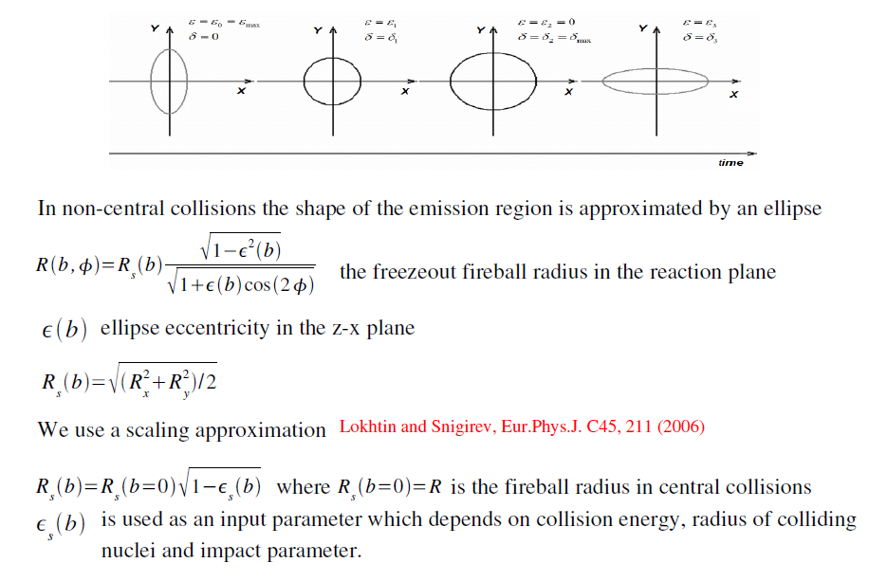
Freeze-out hypersurface for non-central collisions

Slide 35
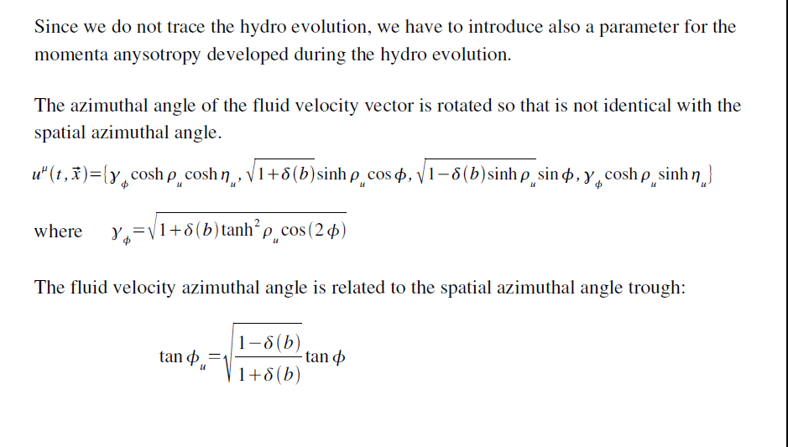
Momenta anisotropy

Slide 36
Monte-Carlo simulation of hard component
(including nuclear shadowing) in HYDJET/HYDJET++

Slide 37
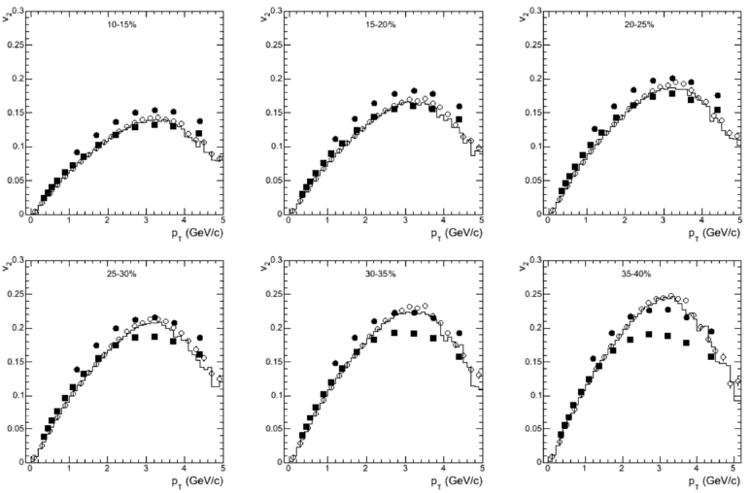
LHC data vs. HYDJET++ model
Elliptic flow
Pb+Pb @ 2.76 ATeV
L. Bravina et al., Eur. Phys. J C74 (2014) 2807
Closed points: CMS data v2{2Part & LYZ};
Open points and histograms: HYDJET++ v2{EP & Psi2}
Notes:
37

Slide 38
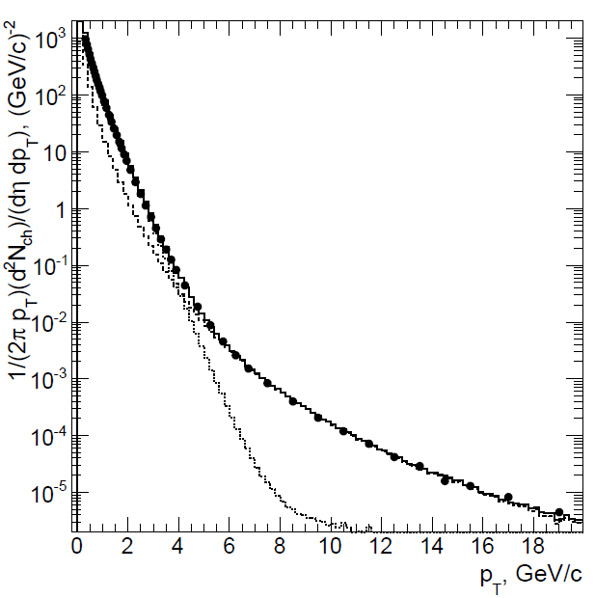
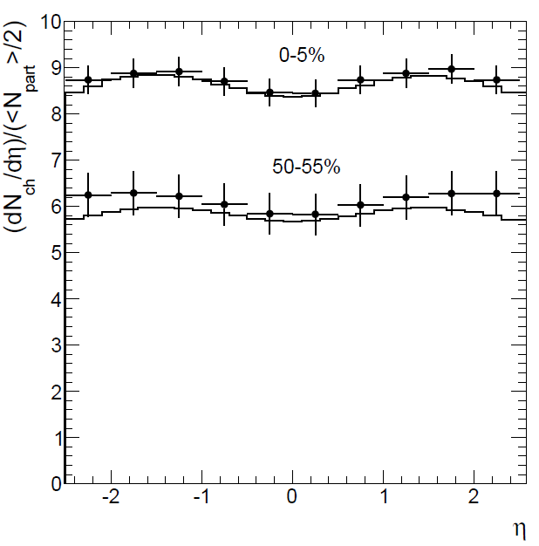
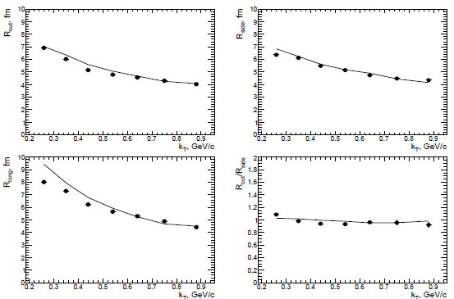
LHC data vs. HYDJET++ model
Transverse momentum
Pb+Pb @ 2.76 ATeV
Rapidity
I. Lokhtin et al., Eur. Phys. J C72 (2012) 2045
Correlation radii (femtoscopy)
Notes:
38

Slide 39
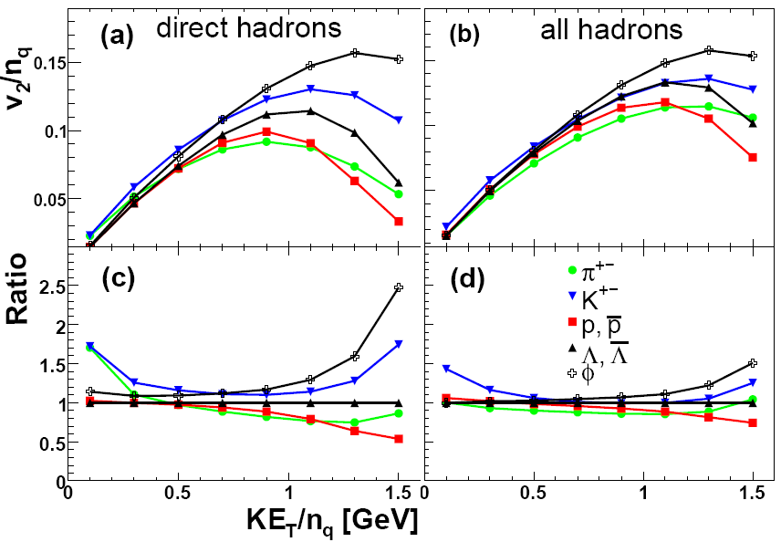
Number-of-constituent-quark scaling at RHIC
Direct particles: scaling is not good. All particles: KET/nq scaling
G.Eyyubova et al., PRC 80 (2009) 064907
One of the explanations of KET/nq scaling is partonic origin of the elliptic flow.
However, final state effects (such as resonance decays and jets) may also lead
to appearance of the scaling
Notes:
PANIC 2008 November
39

Slide 40
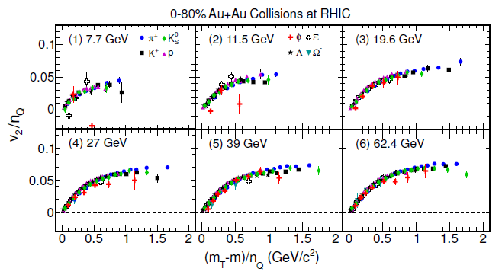
NCQ-scaling of elliptic flow at beam energy scan (RHIC)
STAR Collab., PRL 110 (2013) 142301
NCQ scaling holds for particles and anti-particles separately at lower energies
Our explanation: jets (more influental at higher energies) violate the NCQ-scaling,
whereas Hydro+Resonances work towards its fulfilment

Slide 41
Methods for v2 calculation
(1) Event plane method
Ψ2 is the calculated reaction plane angle:
(2) Two particle correlation method
(3) Lee-Yang zero method
Integral v2 is connected with the firs minimum r0 of the module of the G(ir):
Differential flow is calculated by the formula:
Notes:
41
PANIC 2008 November

Slide 42
Comparison of Event Plane and Lee-Yang zeroes methods (c=30%)
●- true value
■ - L-Y-Z method
EventPlane method
pT, GeV/c
Lee-Yang zeroes Method
Event Plane method overestimates v2 at high pt due to non-flow correlation (mostly because of jets).
Notes:
PANIC 2008 November
42

