Slide 1
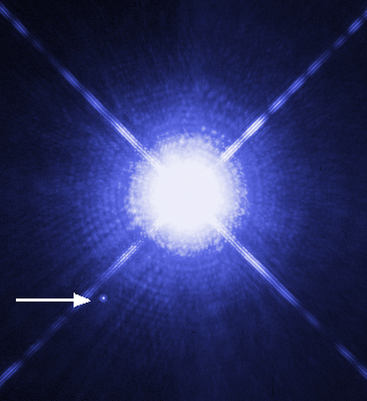
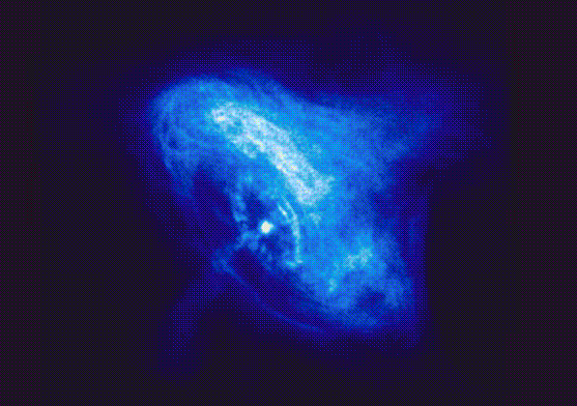



  THE QUESTION OF EXISTENCE
  OF THE THIRD FAMILY OF COMPACT STARS
Vazgen Bojukyan
Yerevan State University, Armenia
Supervisor: | H. Grigorian

Slide 2
OUTLINE
Introduction
Direct Problem
  Polytropic Equation Of State
  BSK20 Equation Of State
Inverse Problem
  Variation Method
  Scanning Method

Slide 3


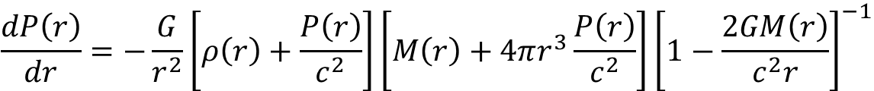
SPHERICALLY SYMMETRIC STATIC STARS
Tolman–Oppenheimer–Volkoff Equation
$$\frac{dP\left(r\right)}{dr}=−\frac{G}{r^{2}}\left[ρ\left(r\right)+\frac{P\left(r\right)}{c^{2}}\right]\left[M\left(r\right)+4πr^{3}\frac{P\left(r\right)}{c^{2}}\right]{\left[1−\frac{2GM\left(r\right)}{c^{2}r}\right]}^{−1}$$
Total Mass
$$\frac{dM\left(r\right)}{dr}=4πρ\left(r\right)r^{2}$$
Equation Of State
$$P=P\left(ρ\right)$$

Slide 4

SPHERICALLY SYMMETRIC STATIC STARS
Tolman–Oppenheimer–Volkoff Equation
$$\frac{dP\left(r\right)}{dr}=−\frac{G}{r^{2}}\left[ρ\left(r\right)+\frac{P\left(r\right)}{c^{2}}\right]\left[M\left(r\right)+4πr^{3}\frac{P\left(r\right)}{c^{2}}\right]{\left[1−\frac{2GM\left(r\right)}{c^{2}r}\right]}^{−1}$$
Total Mass
Mass, Pressure, Density
$$\frac{dM\left(r\right)}{dr}=4πρ\left(r\right)r^{2}$$
$$M\left(r\right),P\left(r\right),ρ\left(r\right)$$
Equation Of State
$$P=P\left(ρ\right)$$

Slide 5


SPHERICALLY SYMMETRIC STATIC STARS
Tolman–Oppenheimer–Volkoff Equation
$$\frac{dP\left(r\right)}{dr}=−\frac{G}{r^{2}}\left[ρ\left(r\right)+\frac{P\left(r\right)}{c^{2}}\right]\left[M\left(r\right)+4πr^{3}\frac{P\left(r\right)}{c^{2}}\right]{\left[1−\frac{2GM\left(r\right)}{c^{2}r}\right]}^{−1}$$
Total Mass
Mass, Pressure, Density
$$\frac{dM\left(r\right)}{dr}=4πρ\left(r\right)r^{2}$$
$$M\left(r\right),P\left(r\right),ρ\left(r\right)$$
$$r$$
Equation Of State
$$M\left(r\right)$$
$$P\left(r\right)$$
$$ρ\left(r\right)$$
$$P=P\left(ρ\right)$$

Slide 6
DIRECT PROBLEM
      POLYTROPIC EQUATION OF STATE
      BSK20 EQUATION OF STATE

Slide 7




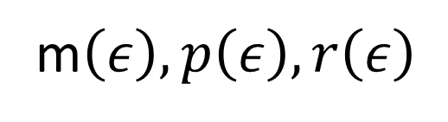

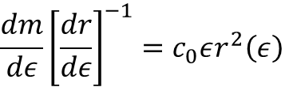

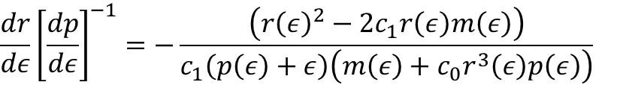




Equations For Numerical Calculations
Constants
$$\frac{dr}{dε}{\left[\frac{dp}{dε}\right]}^{−1}=−\frac{\left({r\left(ε\right)}^{2}−2c_{1}r\left(ε\right)m\left(ε\right)\right)}{c_{1}\left(p\left(ε\right)+ε\right)\left(m\left(ε\right)+c_{0}r^{3}\left(ε\right)p\left(ε\right)\right)}$$
$$r_{zero}≈0$$
$$c_{0}=1.126×{10}^{−5} {MeV}^{−1}$$
$$c_{1}=1.476 km$$
$$\frac{dm}{dε}{\left[\frac{dr}{dε}\right]}^{−1}=c_{0}εr^{2}\left(ε\right)$$
$$p=p\left(ε\right)$$
$$r$$
Initial Conditions
$$\begin{aligned}M=m(0) \\ R=r(0)\end{aligned}$$
$$ε_{c}$$
$$r\left(ε_{c}\right)=r_{zero}$$
$$r_{0}$$
mass, pressure, radius
$$m\left(ε_{c}\right)=\frac{c_{0}}{3}r_{zero}^{3}ε_{c}$$
m$\left(ε\right),p\left(ε\right),r\left(ε\right)$

Slide 8
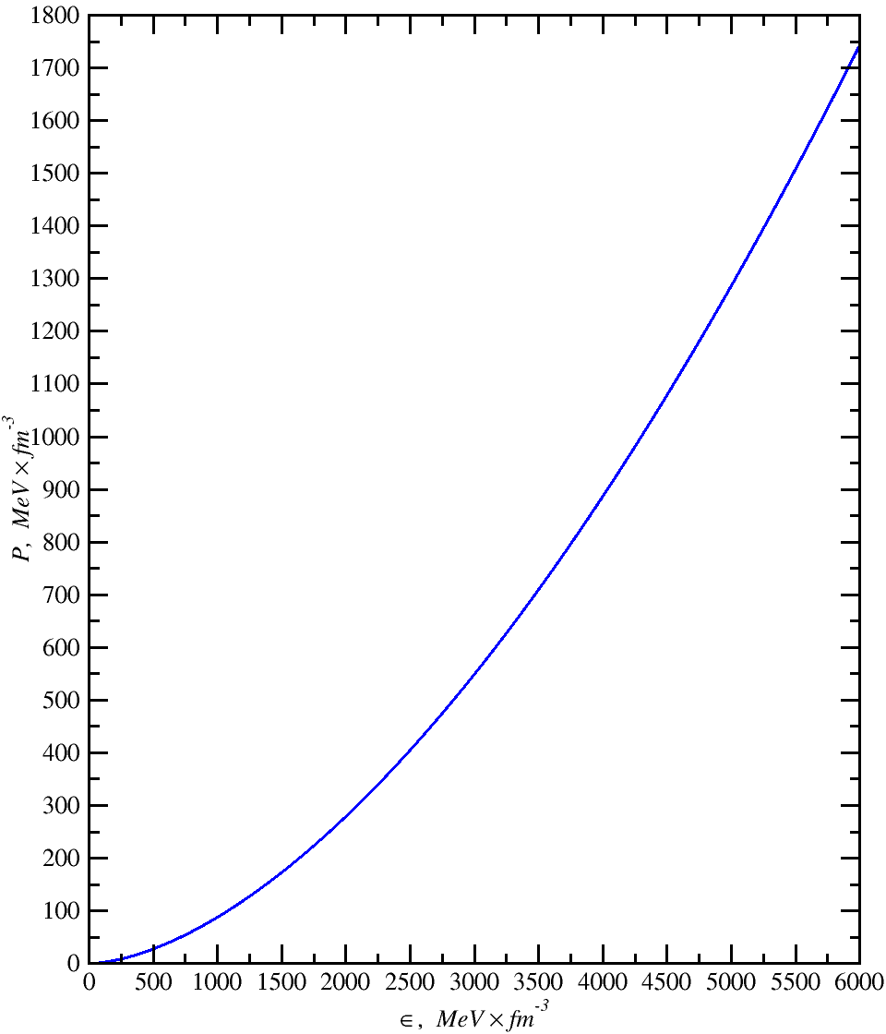
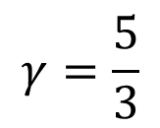

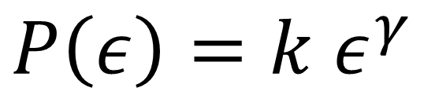
POLYTROPIC EQUATION OF STATE
$$P\left(ε\right)=k ε^{γ}$$
$$k=0.0008801{(MeV/{fm}^{3})}^{1−γ}$$
$$γ=\frac{5}{3}$$

Slide 9
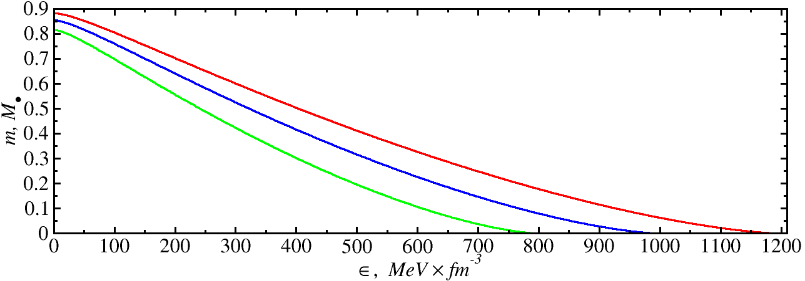
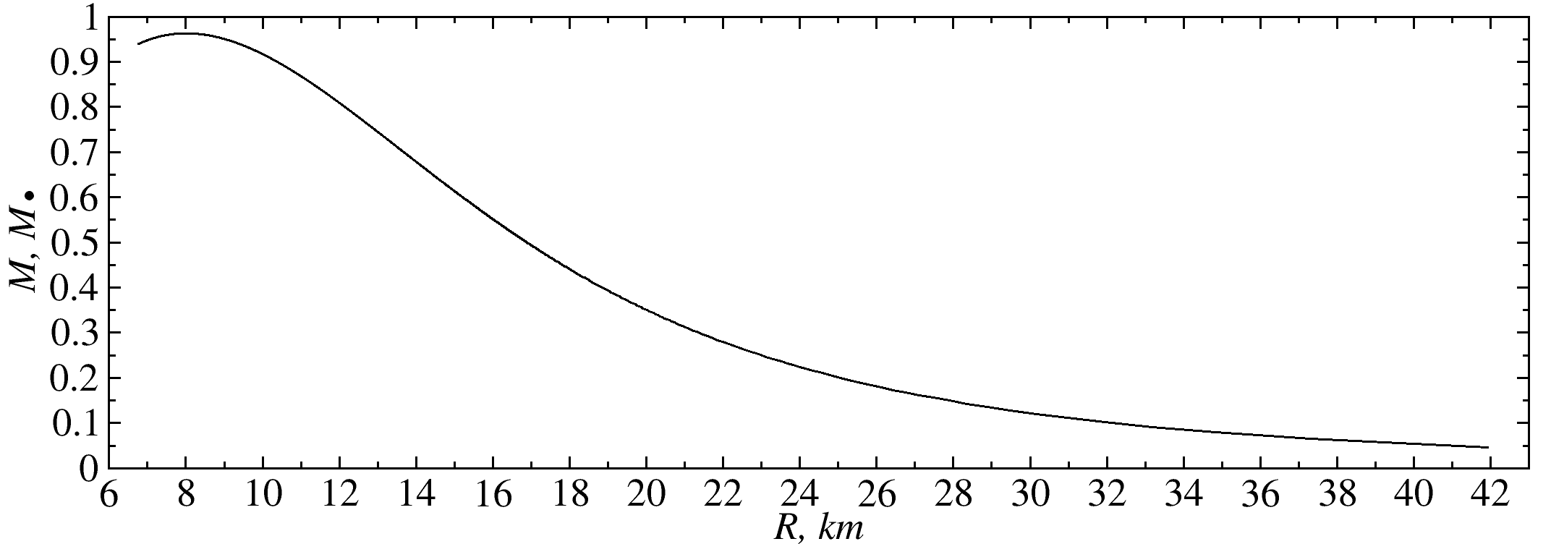
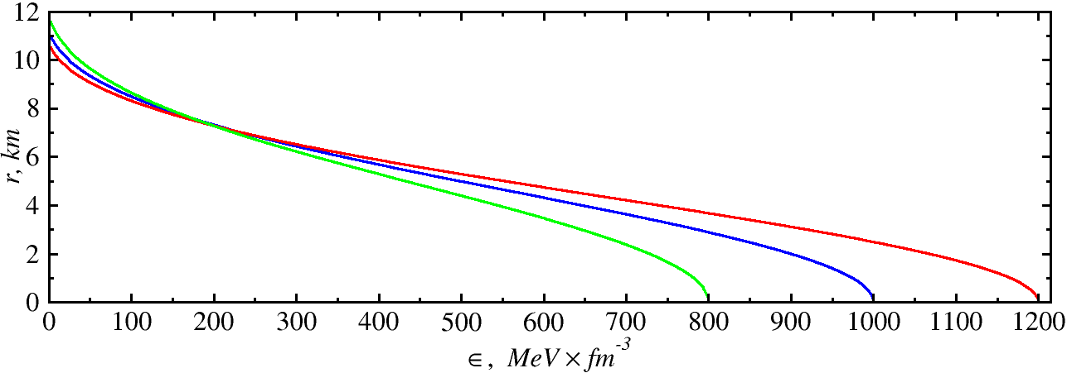
Mass Distribution
Mass And Radius Relation
Radius “Distribution”

Slide 10
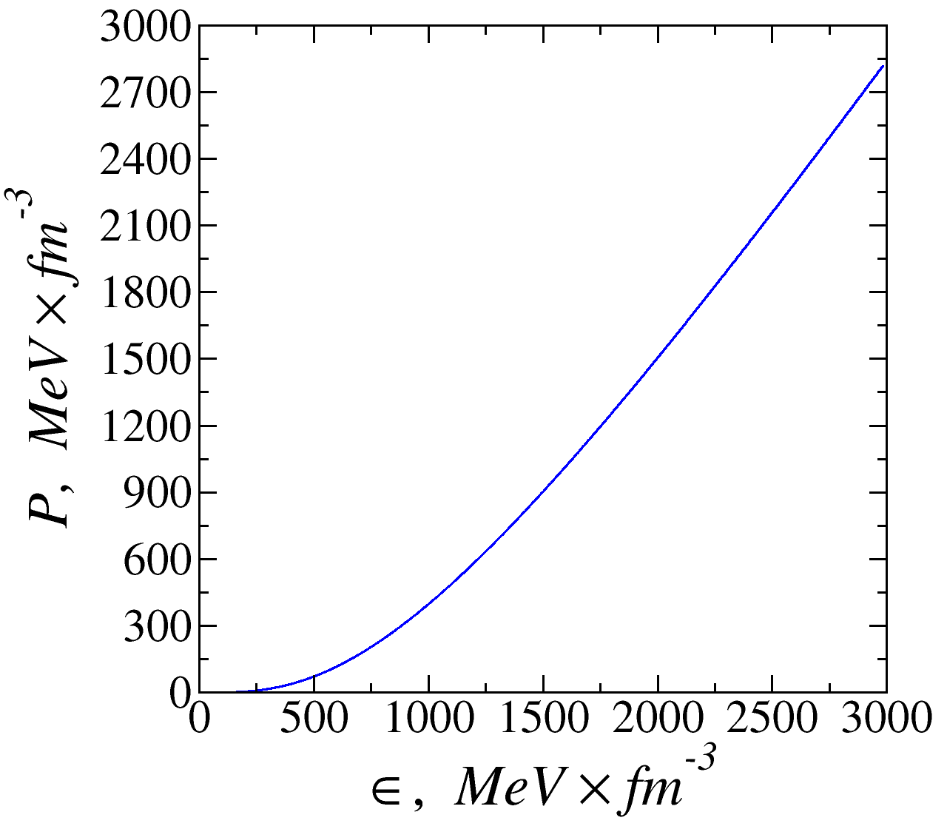


BSK20 EQUATION OF STATE
$$ζ=\log_{10}{P}$$
$$ξ=\log_{10}{ρ}$$

Slide 11
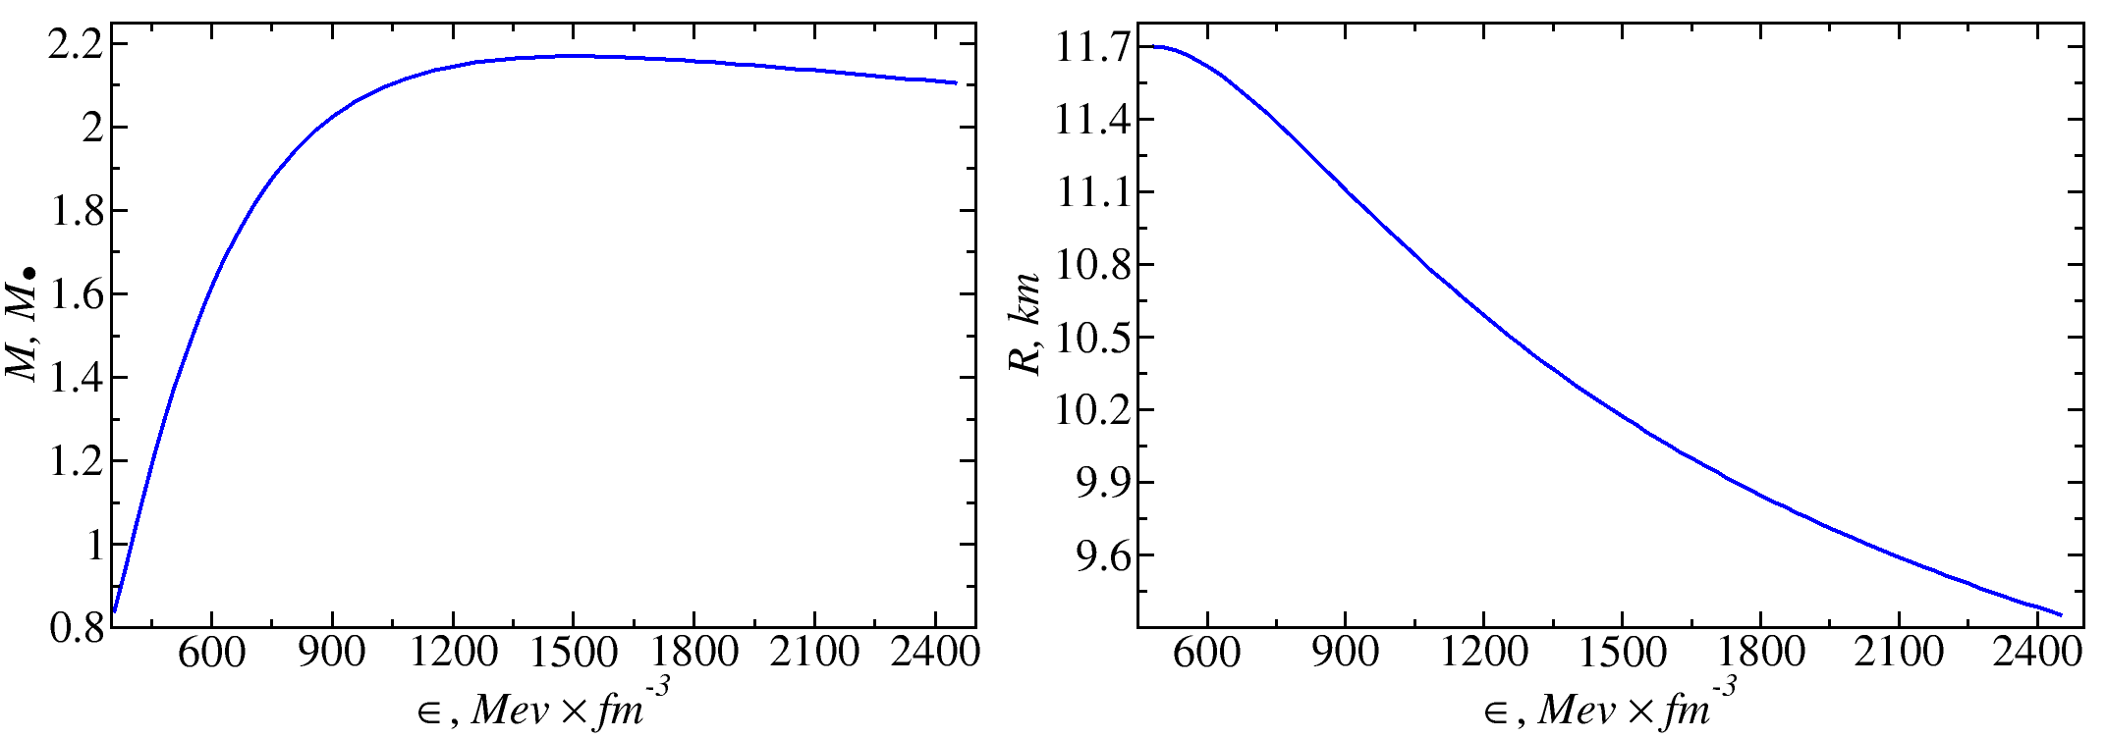
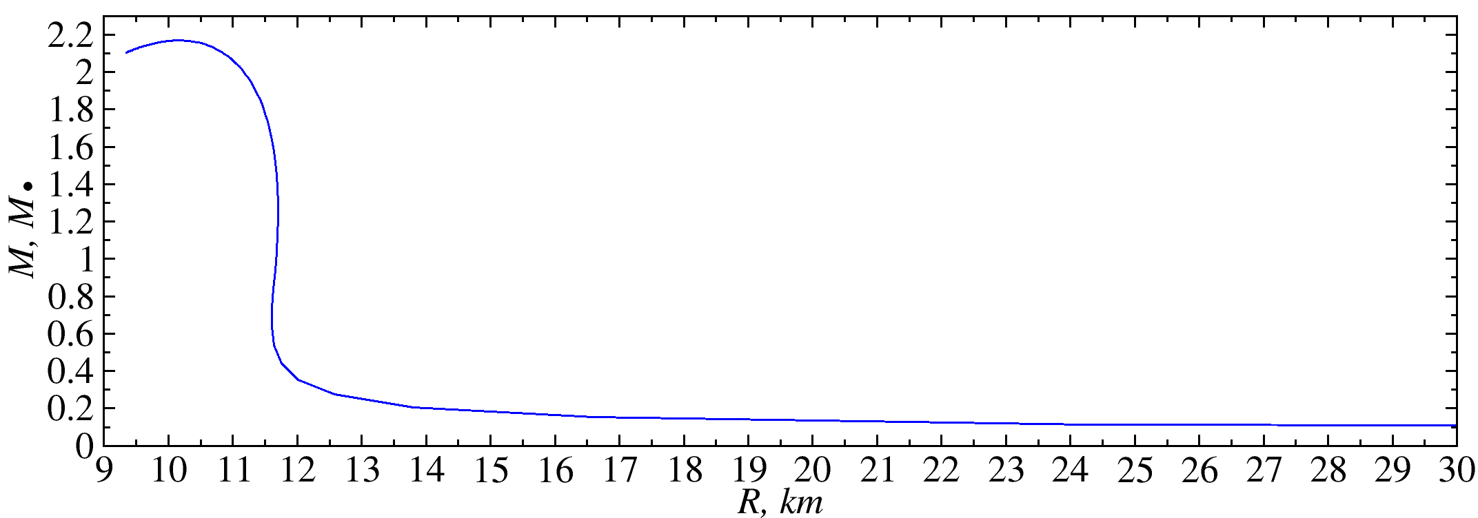
Mass Relation
Mass And Radius Relation
Radius Relation

Slide 12
INVERSE PROBLEM
      Variation Method
      Scanning Method

Slide 13


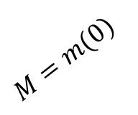

Fiducial And Close By Configuration
$$R=r(0)$$
$$M=m(0)$$
$$ρ_{0}$$
$$r$$
Fiducial

Slide 14

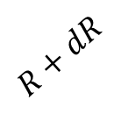
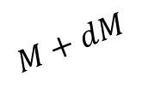




Fiducial And Close By Configuration
$$M+dM$$
$$R=r(0)$$
$$R+dR$$
$$M=m(0)$$
$${ρ<ρ}_{0}$$
$${ρ>ρ}_{0}$$
$$r$$
$$ρ_{0}$$
$$ρ_{0}+dρ$$
$$ρ_{s}=ρ_{0}$$
$$r$$
Fiducial
Close By

Slide 15

Fiducial And Close By Configuration
$$M+dM$$
$$R=r(0)$$
$$R+dR$$
$$M=m(0)$$
$${ρ<ρ}_{0}$$
$$r_{s}$$
$${ρ>ρ}_{0}$$
$$r$$
$$ρ_{0}$$
$$ρ_{0}+dρ$$
$$ρ_{s}=ρ_{0}$$
$$r$$
Fiducial
Close By

Slide 16

Fiducial And Close By Configuration
$$M+dM$$
$$R=r(0)$$
$$R+dR$$
$$M=m(0)$$
$${ρ<ρ}_{0}$$
$$r_{s}$$
$$r_{s}$$
$${ρ>ρ}_{0}$$
$$r$$
$$ρ_{0}$$
$$ρ_{0}+dρ$$
$$ρ_{s}=ρ_{0}$$
$$r$$
Fiducial
Close By

Slide 17





Fiducial And Close By Configuration
$$M+dM$$
$$R=r(0)$$
$$R+dR$$
$$M=m(0)$$
$${ρ<ρ}_{0}$$
$$r_{s}$$
$$r_{s}$$
$${ρ>ρ}_{0}$$
$$r$$
$${\overline{p}}_{s}$$
$$ρ_{0}$$
$$p_{s}$$
$$ρ_{0}+dρ$$
$$m_{s}$$
$${\overline{m}}_{s}$$
$$ρ_{s}=ρ_{0}$$
$${\overline{ρ}}_{s}$$
$$r$$
Fiducial
Close By

Slide 18



Fiducial And Close By Configuration
$$M+dM$$
$$R=r(0)$$
$$δm=\overline{m}\left(r\right)−m\left(r\right)$$
$$R+dR$$
$$M=m(0)$$
$$δp=\overline{p}\left(r\right)−p\left(r\right)$$
$$δρ=\overline{ρ}\left(r\right)−ρ\left(r\right)$$
$${ρ<ρ}_{0}$$
$$r_{s}$$
$$r_{s}$$
$${ρ>ρ}_{0}$$
$$r$$
$${\overline{p}}_{s}$$
$$ρ_{0}$$
$$p_{s}$$
$$ρ_{0}+dρ$$
$$m_{s}$$
$${\overline{m}}_{s}$$
$$ρ_{s}=ρ_{0}$$
$${\overline{ρ}}_{s}$$
$$r$$
Fiducial
Close By

Slide 19
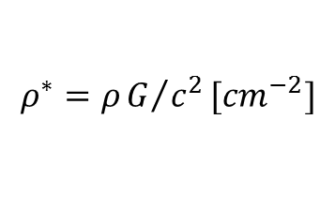
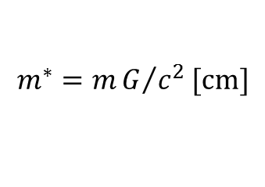
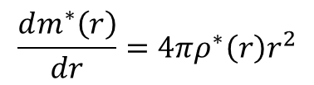
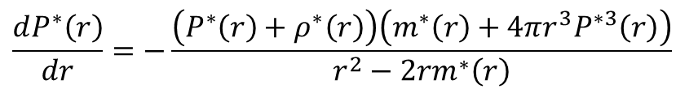
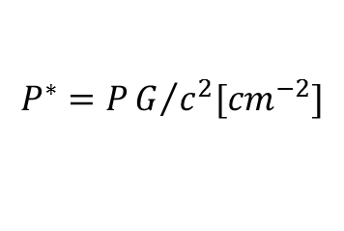
Tolman–Oppenheimer–Volkoff Equation Variation
$$\frac{dP^{∗}\left(r\right)}{dr}=−\frac{\left(P^{∗}\left(r\right)+ρ^{∗}\left(r\right)\right)\left(m^{∗}\left(r\right)+4πr^{3}P^{∗3}\left(r\right)\right)}{r^{2}−2rm^{∗}\left(r\right)}$$
$$\frac{dm^{∗}\left(r\right)}{dr}=4πρ^{∗}\left(r\right)r^{2}$$
$$ρ^{∗}=ρG/{c^{2}}[{cm}^{−2}]$$
$$P^{∗}=PG/{c^{2}[{cm}^{−2}]}$$
$$m^{∗}=mG/{c^{2}}[cm]$$

Slide 20
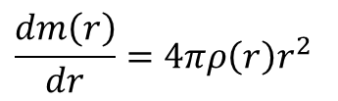
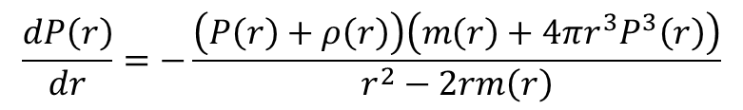
Tolman–Oppenheimer–Volkoff Equation Variation
$$\frac{dP\left(r\right)}{dr}=−\frac{\left(P\left(r\right)+ρ\left(r\right)\right)\left(m\left(r\right)+4πr^{3}P^{3}\left(r\right)\right)}{r^{2}−2rm\left(r\right)}$$
$$\frac{dP^{∗}\left(r\right)}{dr}=−\frac{\left(P^{∗}\left(r\right)+ρ^{∗}\left(r\right)\right)\left(m^{∗}\left(r\right)+4πr^{3}P^{∗3}\left(r\right)\right)}{r^{2}−2rm^{∗}\left(r\right)}$$
$$\frac{dm\left(r\right)}{dr}=4πρ\left(r\right)r^{2}$$
$$\frac{dm^{∗}\left(r\right)}{dr}=4πρ^{∗}\left(r\right)r^{2}$$
$$ρ^{∗}=ρG/{c^{2}}[{cm}^{−2}]$$
$$P^{∗}=PG/{c^{2}[{cm}^{−2}]}$$
$$m^{∗}=mG/{c^{2}}[cm]$$

Slide 21
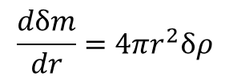
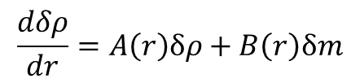
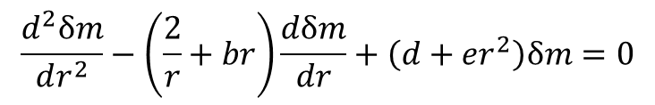
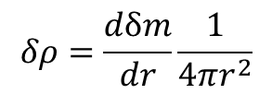
Tolman–Oppenheimer–Volkoff Equation Variation
$$\frac{dP\left(r\right)}{dr}=−\frac{\left(P\left(r\right)+ρ\left(r\right)\right)\left(m\left(r\right)+4πr^{3}P^{3}\left(r\right)\right)}{r^{2}−2rm\left(r\right)}$$
$$\frac{dP^{∗}\left(r\right)}{dr}=−\frac{\left(P^{∗}\left(r\right)+ρ^{∗}\left(r\right)\right)\left(m^{∗}\left(r\right)+4πr^{3}P^{∗3}\left(r\right)\right)}{r^{2}−2rm^{∗}\left(r\right)}$$
$$\frac{dm\left(r\right)}{dr}=4πρ\left(r\right)r^{2}$$
$$\frac{dm^{∗}\left(r\right)}{dr}=4πρ^{∗}\left(r\right)r^{2}$$
$$ρ^{∗}=ρG/{c^{2}}[{cm}^{−2}]$$
$$\frac{dδρ}{dr}=A\left(r\right)δρ+B\left(r\right)δm$$
$$\frac{dδm}{dr}=4πr^{2}δρ$$
$$P^{∗}=PG/{c^{2}[{cm}^{−2}]}$$
$$m^{∗}=mG/{c^{2}}[cm]$$
$$\frac{d^{2}δm}{dr^{2}}−\left(\frac{2}{r}+br\right)\frac{dδm}{dr}+\left(d+er^{2}\right)δm=0$$
$$δρ=\frac{dδm}{dr}\frac{1}{4πr^{2}}$$

Slide 22
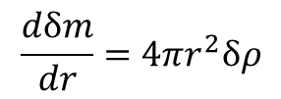




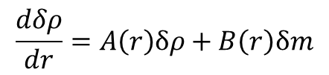



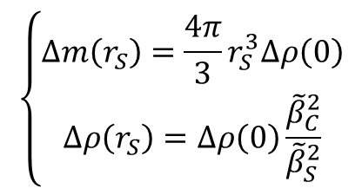


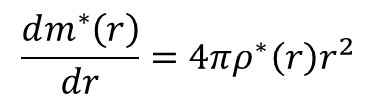
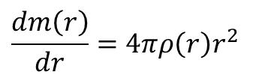

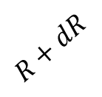
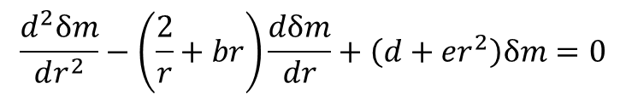



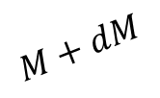
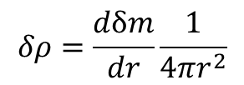


Tolman–Oppenheimer–Volkoff Equation Variation
$$\frac{dP\left(r\right)}{dr}=−\frac{\left(P\left(r\right)+ρ\left(r\right)\right)\left(m\left(r\right)+4πr^{3}P^{3}\left(r\right)\right)}{r^{2}−2rm\left(r\right)}$$
$$\frac{dP^{∗}\left(r\right)}{dr}=−\frac{\left(P^{∗}\left(r\right)+ρ^{∗}\left(r\right)\right)\left(m^{∗}\left(r\right)+4πr^{3}P^{∗3}\left(r\right)\right)}{r^{2}−2rm^{∗}\left(r\right)}$$
$$\frac{dm\left(r\right)}{dr}=4πρ\left(r\right)r^{2}$$
$$\frac{dm^{∗}\left(r\right)}{dr}=4πρ^{∗}\left(r\right)r^{2}$$
$$ρ^{∗}=ρG/{c^{2}}[{cm}^{−2}]$$
$$P^{∗}=PG/{c^{2}[{cm}^{−2}]}$$
$$\frac{dδρ}{dr}=A\left(r\right)δρ+B\left(r\right)δm$$
$$\frac{dδm}{dr}=4πr^{2}δρ$$
$$m^{∗}=mG/{c^{2}}[cm]$$
$$\frac{d^{2}δm}{dr^{2}}−\left(\frac{2}{r}+br\right)\frac{dδm}{dr}+\left(d+er^{2}\right)δm=0$$
$$δρ=\frac{dδm}{dr}\frac{1}{4πr^{2}}$$
$$R,M$$
$$R+dR$$
$$M+dM$$
$${ρ<ρ}_{0}$$
$$r_{s}$$
$$r_{s}$$
$$\left\{\begin{matrix}∆m\left(r_{S}\right)=\frac{4π}{3}r_{S}^{3}∆ρ\left(0\right) \\ ∆ρ\left(r_{S}\right)=Δρ\left(0\right)\frac{{\tilde{β}}_{C}^{2}}{{\tilde{β}}_{S}^{2}}\end{matrix}\right.$$
$$p_{s}$$
$$r$$
$$ΔP_{C}\left(r\right)=Δρ_{C}\left(r\right)β^{2}\left(r\right)$$
$${\overline{p}}_{s}$$
$$ρ_{0}$$
$$ρ_{0}+dρ$$
$${\overline{m}}_{s}$$
$$m_{s}$$
$${\overline{ρ}}_{s}$$
$$r$$
$$ρ_{s}=ρ_{0}$$
$$ΔP\left(r_{S}\right)=ΔP\left(0\right)$$
Fiducial
Close By

Slide 23
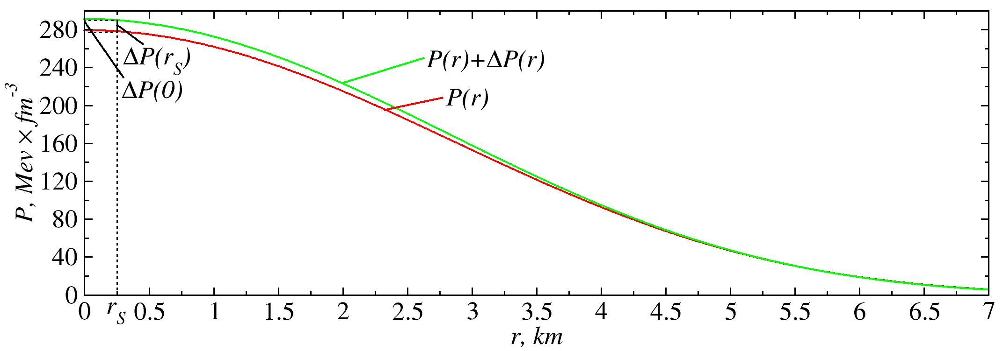
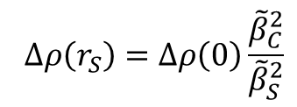


Pressure Variation
$$ΔP\left(r_{S}\right)=ΔP\left(0\right)$$
$$ΔP_{C}\left(r\right)=Δρ_{C}\left(r\right)β^{2}\left(r\right)$$
$$∆ρ\left(r_{S}\right)=Δρ\left(0\right)\frac{{\tilde{β}}_{C}^{2}}{{\tilde{β}}_{S}^{2}}$$

Slide 24
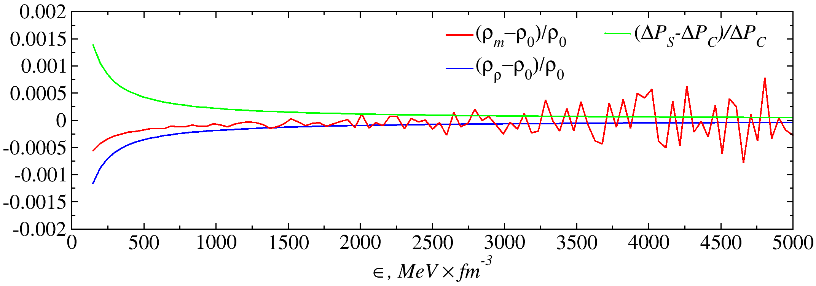
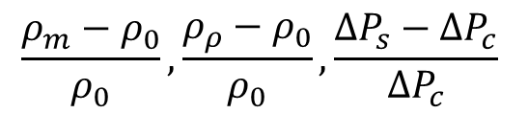
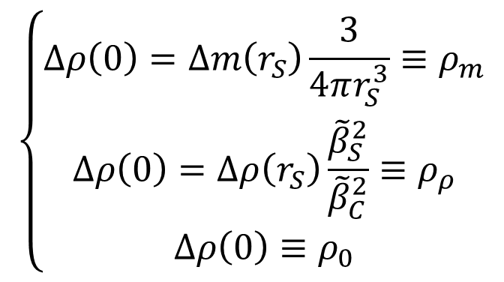
Verification Of An Equation
$$\frac{ρ_{m}−ρ_{0}}{ρ_{0}}, \frac{ρ_{ρ}−ρ_{0}}{ρ_{0}}, \frac{∆P_{s}−∆P_{c}}{∆P_{c}}$$
$$\left\{\begin{matrix}∆ρ\left(0\right)=∆m\left(r_{S}\right)\frac{3}{4πr_{S}^{3}}≡ρ_{m} \\ Δρ\left(0\right)=∆ρ\left(r_{S}\right)\frac{{\tilde{β}}_{S}^{2}}{{\tilde{β}}_{C}^{2}}≡ρ_{ρ} \\ Δρ\left(0\right)≡ρ_{0}\end{matrix}\right.$$

Slide 25
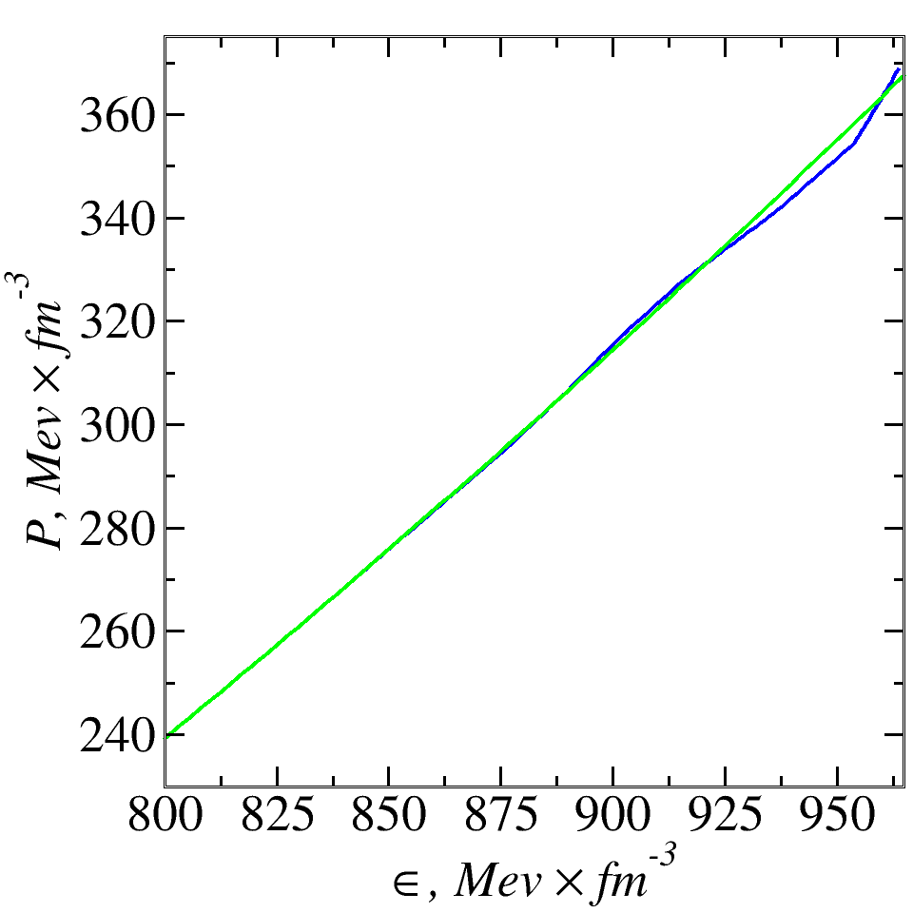


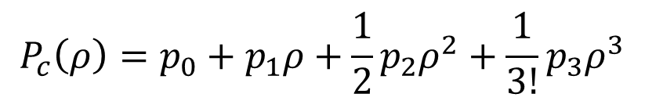
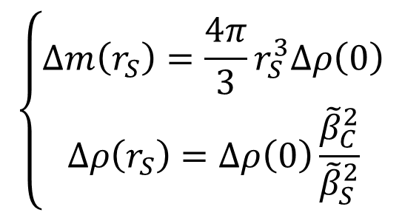
Equation Of Stat
$$P_{c}\left(ρ\right)=p_{0}+p_{1}ρ+\frac{1}{2}p_{2}ρ^{2}+\frac{1}{3!}p_{3}ρ^{3}$$
$$P_{c}\left(ρ_{C}\right)=\tilde{P_{C}}, P_{c}\left(ρ_{S}\right)=\tilde{P_{S}}$$
$${P′}_{c}\left(ρ_{C}\right)=\tilde{{β^{2}}_{c},}{P′}_{c}\left(ρ_{S}\right)=\tilde{{β^{2}}_{S}}$$
$$\left\{\begin{matrix}∆m\left(r_{S}\right)=\frac{4π}{3}r_{S}^{3}∆ρ\left(0\right) \\ ∆ρ\left(r_{S}\right)=Δρ\left(0\right)\frac{{\tilde{β}}_{C}^{2}}{{\tilde{β}}_{S}^{2}}\end{matrix}\right.$$

Slide 26
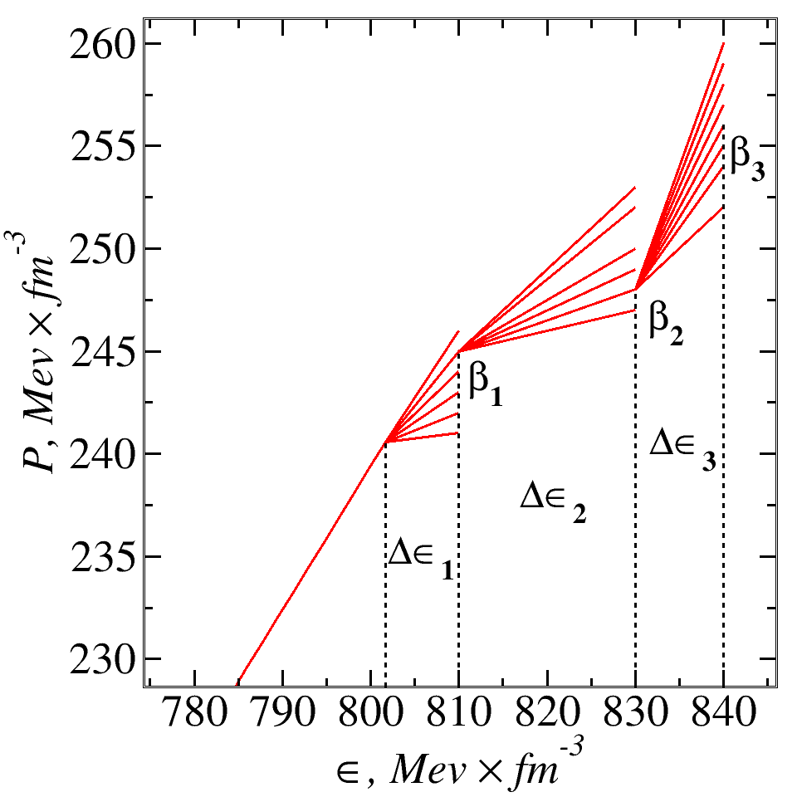
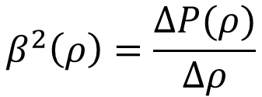
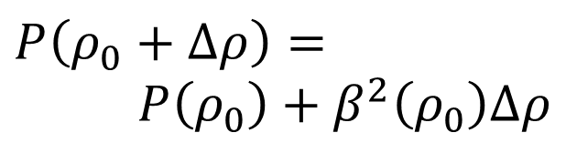
Speed Of Sound Scanning Method
$$P\left(ρ_{0}+∆ρ\right)=$$
$$P\left(ρ_{0}\right)+β^{2}\left(ρ_{0}\right)∆ρ$$
$$β^{2}\left(ρ\right)=\frac{∆P(ρ)}{∆ρ}$$

Slide 27

Speed Of Sound Scanning Method

Slide 28
Speed Of Sound Scanning Method

Slide 29

Speed Of Sound Scanning Method

Slide 30
Speed Of Sound Scanning Method

Slide 31

Speed Of Sound Scanning Method

Slide 32

Speed Of Sound Scanning Method

Slide 33


Calculation Resoults
Equation
Of
State
Mass And
Radius
Relation

Slide 34
Thanks for Attention!

