Slide 1


Fluctuations in Strong-Coupling
Heavy Quark Energy Loss
W. A. Horowitz
University of Cape Town
July 10, 2015
WAH, PRD91 (2015) 8, 085019 [1501.04693]
R. Morad and WAH, JHEP 1411 (2014) 017 [1409.7545]

Slide 2
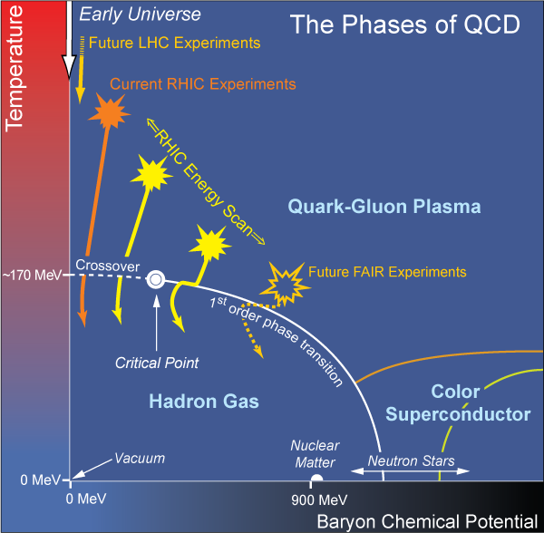
Motivation: Phenomenological QCD
  What are the emergent, many body dynamics of non-Abelian plasma?
  Seek coherent theoretical picture compatible with all observed data
Long Range Plan, 2008
Notes:
Seek coherent, self-consistent picture of physics that describes suite of observables

Slide 3
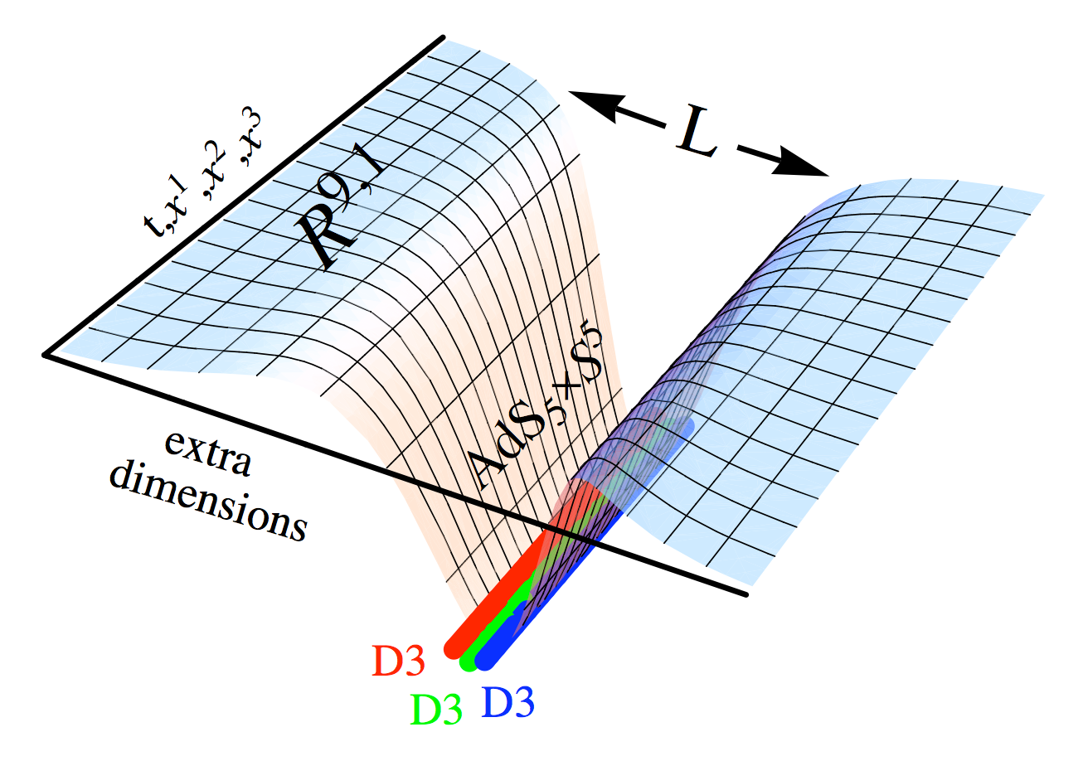
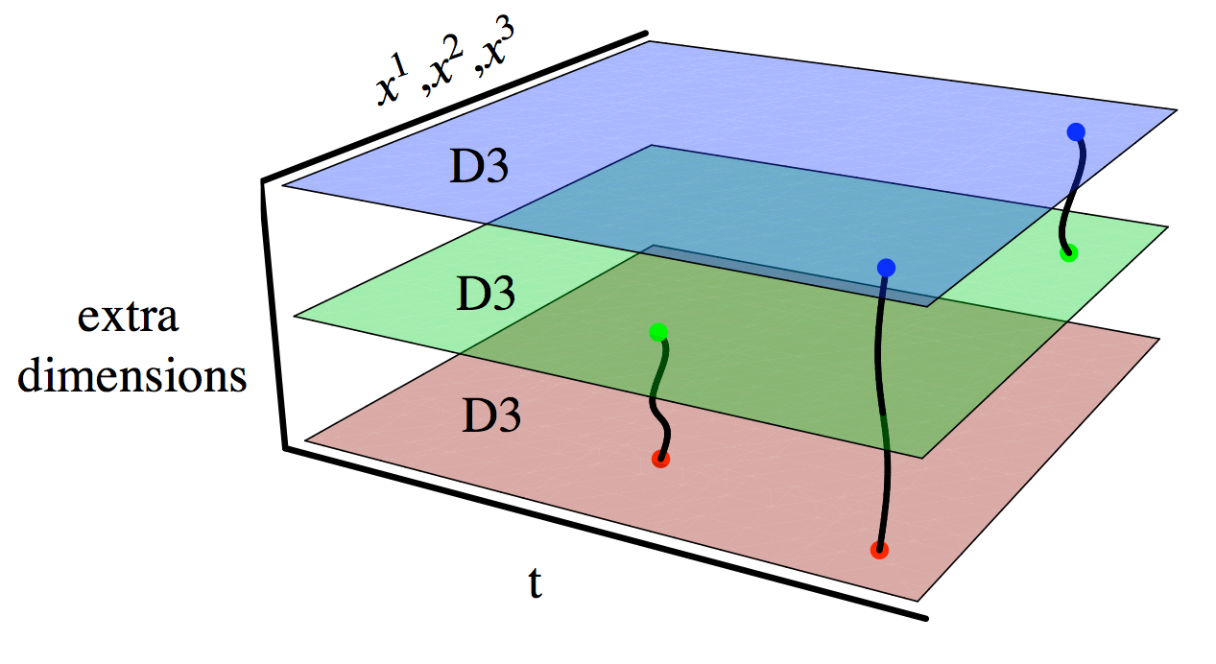
AdS/CFT Setup
Maldacena conjectures exact correspondence: N = 4 SYM ~ IIB ST
  4D field theory = 10D string theory
  Power: weak/strong connection
  Strongly coupled SYM ⬄ classical gravity

Slide 4
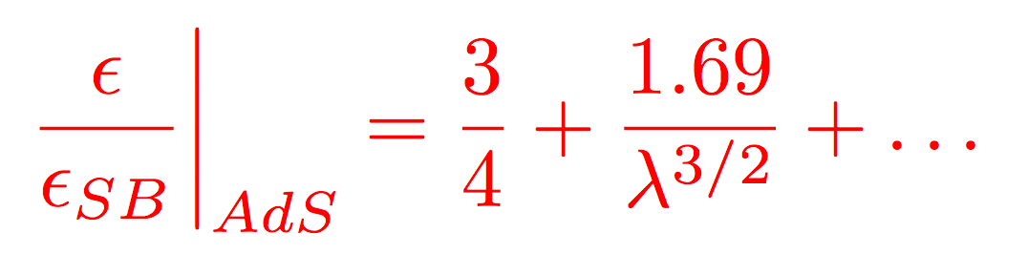
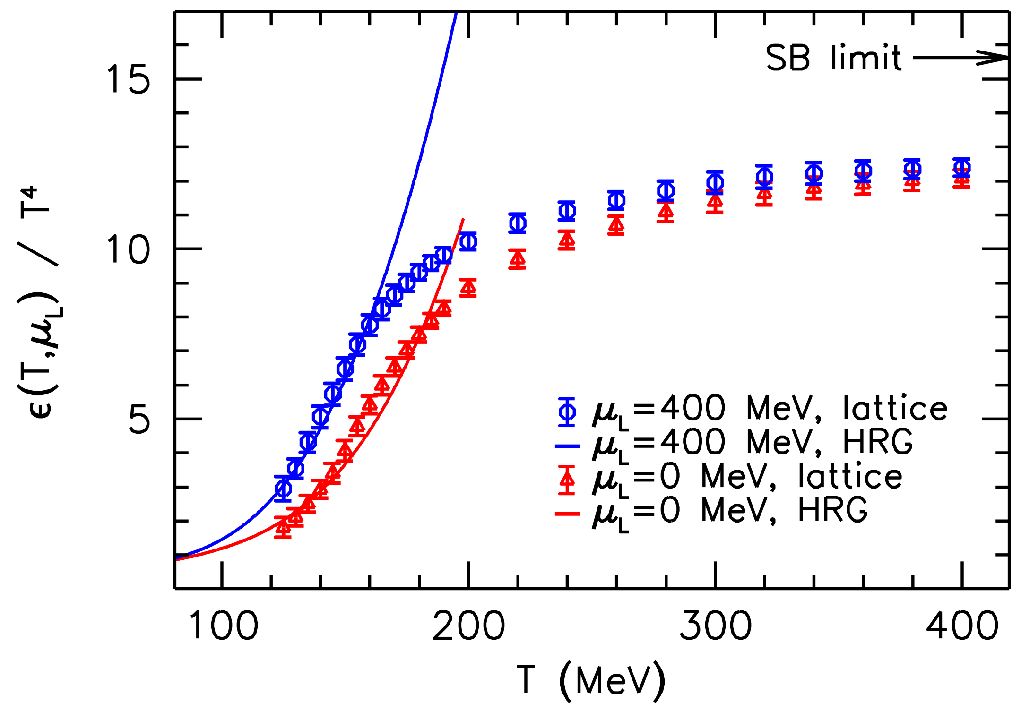
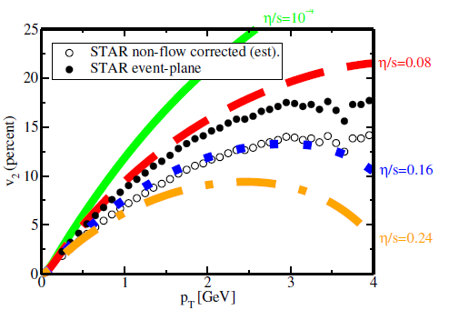
AdS/CFT Setup: Bulk Properties
Thermal SYM dual to AdS₅-Schwarzschild
  T_{BH} = T_{SYM;} s_{BH} = s_{SYM}; η_{AdS} from Kubo
    Scatter gravitons off BH ⬄ T_{mn}
    Claim: lower bound η/s = 1/4π at infinite coupling for very broad class of theories
Luzum and Romatschke, PC78 (2008)
Wuppertal, JHEP 1208 (2012) 053

Slide 5
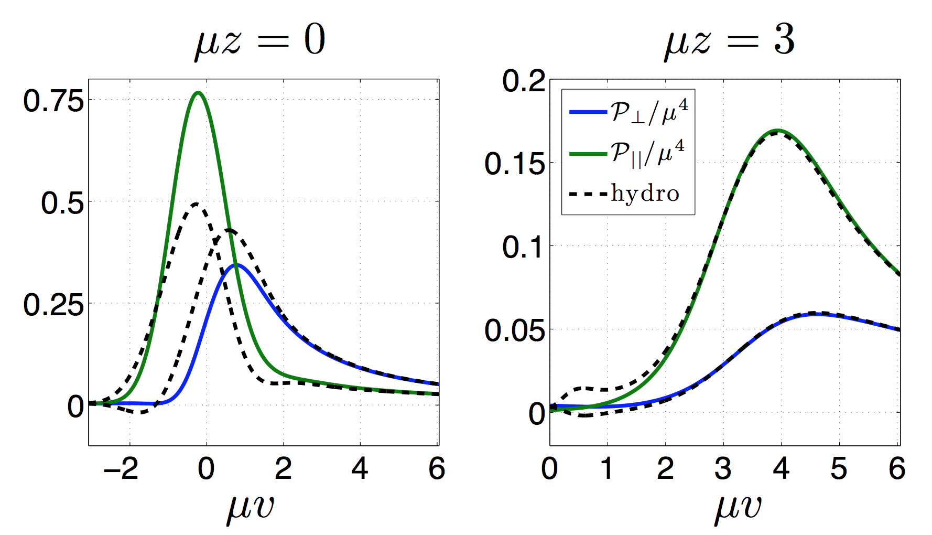
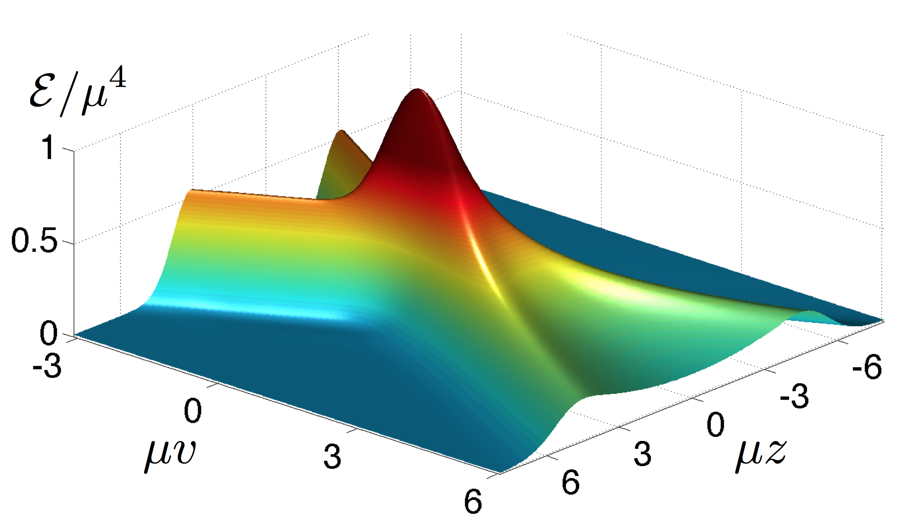
AdS/CFT Setup: Initial State
Represent nuclei as shock waves
  System rapidly described by hydro
  τ_{therm} ~ 0.35 fm
Chesler and Yaffe, PRL106 (2011)

Slide 6
Why AdS at High-p_{T}?
Perturbatively, 3 couplings for rad E-loss
  Not known at which scale(s) couplings run
T_{QGP} ~ Λ_{QCD} => g(2πT) ~ 2
  Always “small” scale in problem
  Perhaps low-Q² plasma physics dominates over high-Q² in E-loss physics?
    Factorization not proven in AA
Work here assumes all couplings strong
  Cf, e.g., Casalderrey-Solana et al. [JHEP 1410 19], Iancu et al. [JHEP 1506 3] for alternative hybrid models

Slide 7
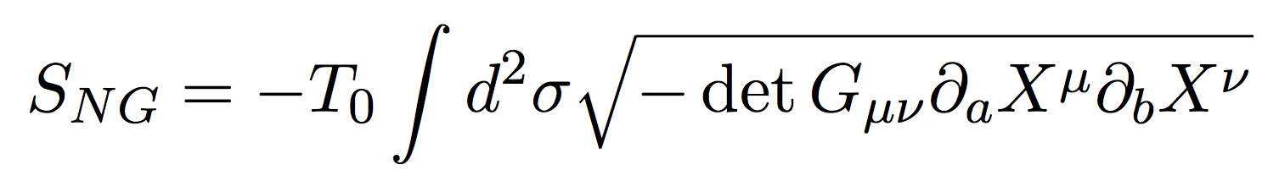
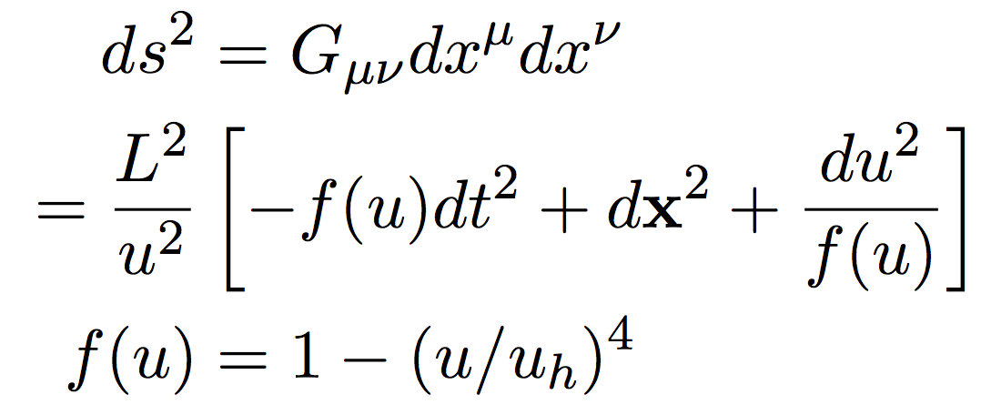
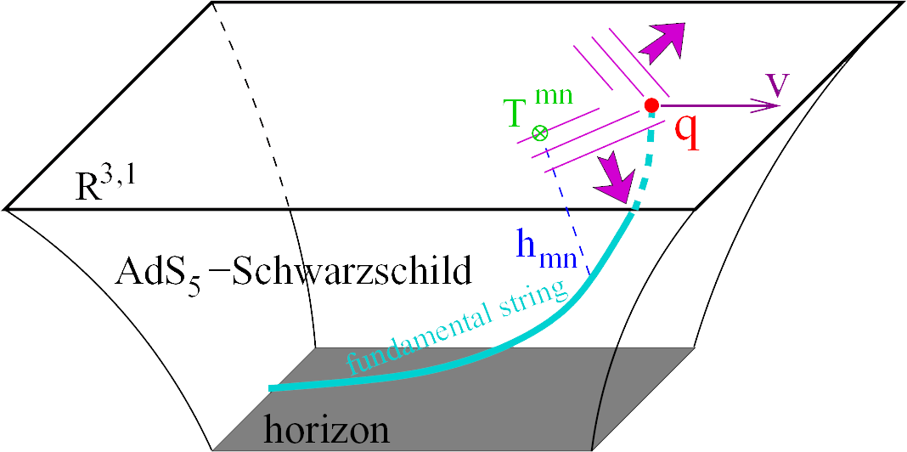
AdS/CFT Setup: Probe Partons
qqbar pair dual to open probe string
  Endpoints terminate on D7 flavor brane
  Dynamics from
  First applied to infinitely massive HQ
J Friess, et al., PRD75 (2007)

Slide 8
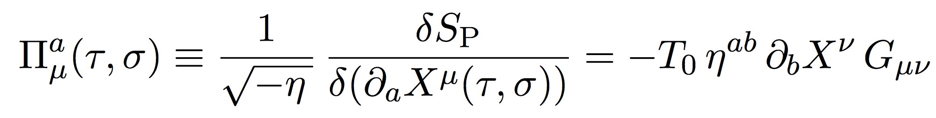
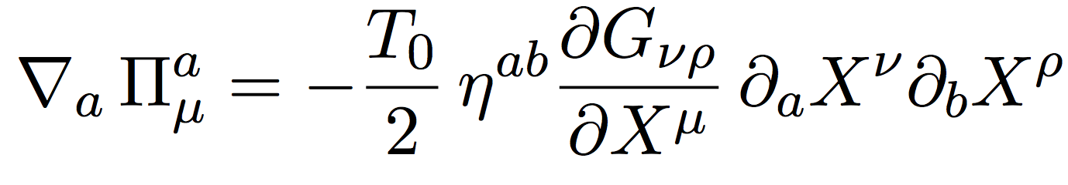
Asymptotic HQ Setup
Self-consistent:
  Integrate out 5th D, find S = −M_{Q} ∫dτ
  Find canonical momenta
    Flows down the string
  EOM
    Metric symmetry => conserved current

Slide 9
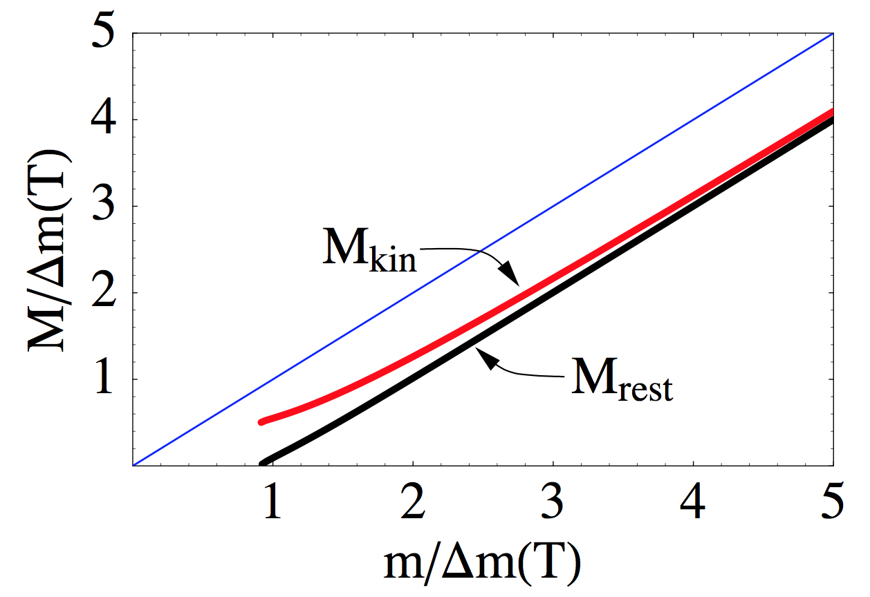
Asymptotic HQ E-Loss
Can compute plasma T^{μν}
  Energy conservation:
    Plasma heated exactly by energy lost from HQ
Natural breakdown of formalism
  More on this later
Questions:
  Unexpected dispersion
  rel’n
    As λ or T increase,
    M_{Q} decreases
Herzog et al., JHEP 0607

Slide 10
LO AdS for Heavy Quark E-Loss
Result is a drag:
  dp_{T}/dt = - μ p_{T}
  μ = πλ^{1/2} T²/2M_{q}
Herzog et al., JHEP 0607 (2006)
Gubser, PRD74 (2006)
  Similar to Bethe-Heitler
    dp_{T}/dt ~ -(T³/M_{q}²) p_{T}
  Very different from usual pQCD and LPM
    dp_{T}/dt ~ -LT³ log(p_{T}/M_{q})
J Friess, et al., PRD75 (2007)

Slide 11
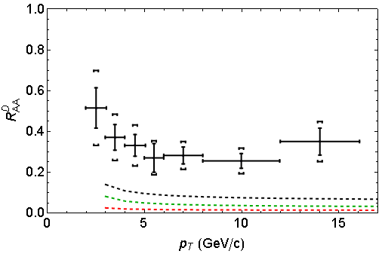
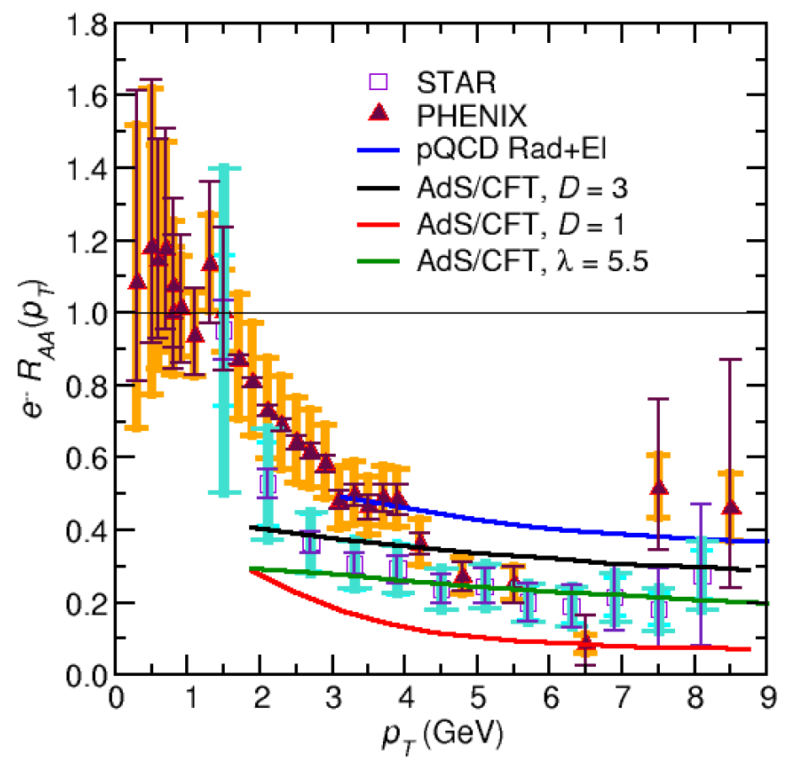
LO AdS HQ Phenomenology
Works well at RHIC (~2008)
Constrained by RHIC, oversuppresses LHC
  T² dependence of drag too strong
RHIC
LHC
ALICE 0-20%
D
(
(
]
(
(
(
WAH, PANIC11 (arXiv:1108.5876)
ALICE, JHEP 1209 (2012)
WAH, PhD Thesis, arXiv:1011.4316

Slide 12
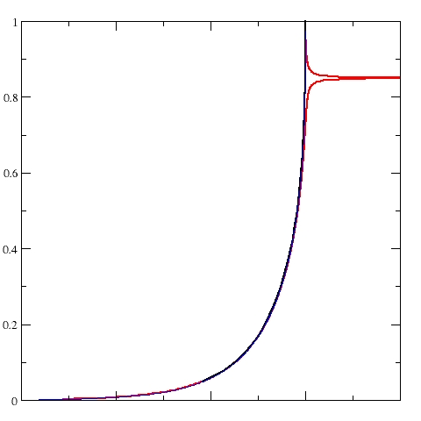
Limits on Heavy Flavor AdS Setup
For LO AdS:
  Space-like quark endpoint
    γ_{crit} = (1 + 2M_{q}/λ^{1/2} T)²
    ~ 4M_{q}²/(λT²)
  Mom. Loss Fluctuations
    γ_{crit} = M_{q}²/(4T²)
Speed limit from fluct parametrically larger, but numerically smaller
D7 Probe Brane
Q
Worldsheet boundary Spacelike if γ > γ_{crit}
x₅
Trailing
String
“Brachistochrone”
“z”
D3 Black Brane

Slide 13
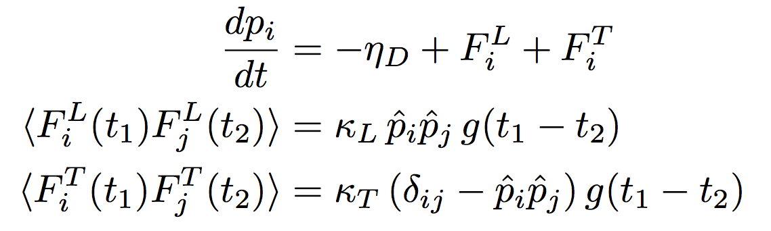
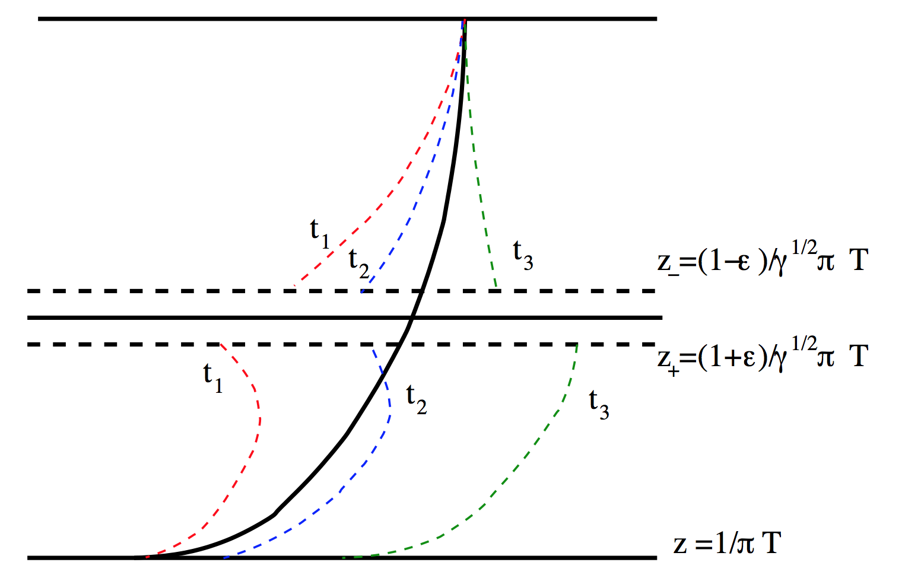
Including Fluctuations in AdS HF
Gubser, NPB790 (2008)
Obeys Einstein’s relations only at v = 0
Multiplicative Langevin problem!
  Results depend on time within timestep kicks are evaluated
    Ito, Stratonovich, Hänggi-Klimontovich
Non-Markovian:
  Colored (not white) noise
    Momentum kicks have a memory
Teaney and Casalderrey-Solana,
JHEP 0912 (2009) 066

Slide 14
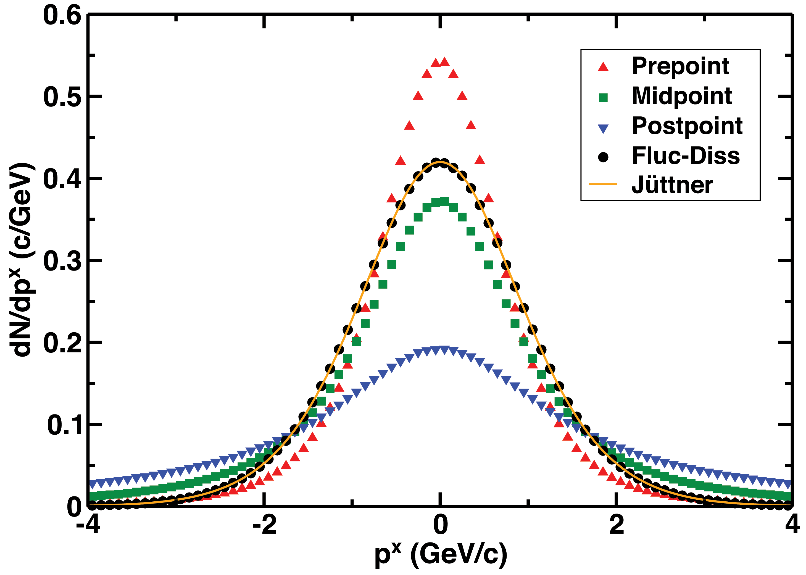
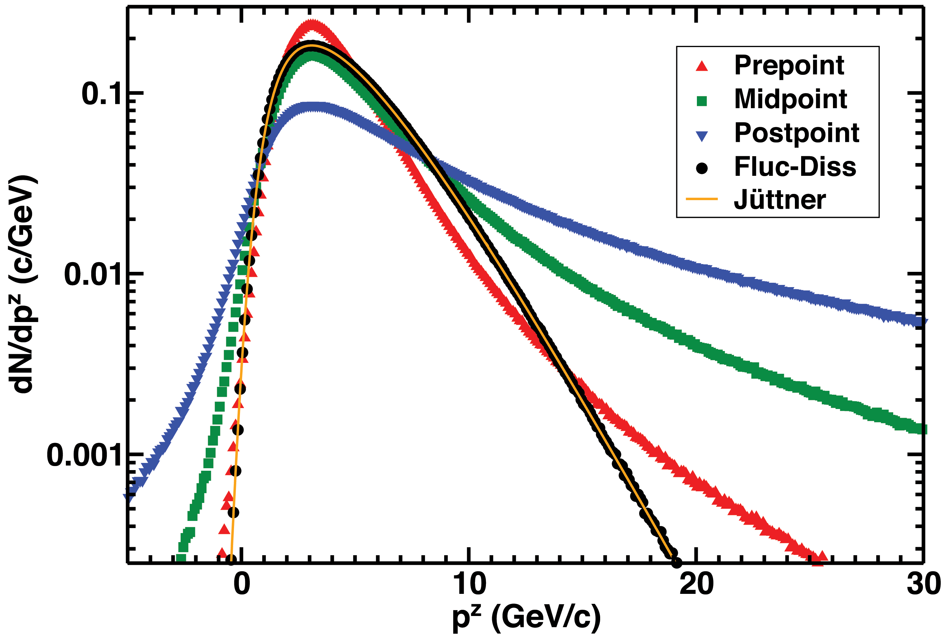
Discretization Ambiguity and Einstein
Ex: momentum space distribution of charm
    AdS fluctuations very diff from fluc-diss, which lead to relativistic thermal (Jüttner) distribution
      Recall that AdS particles DO NOT obey usual dispersion rel’n
    Huge diff btwn prescriptions
v = 0.9c in z-direction
WAH, PRD91 [1501.04693]

Slide 15
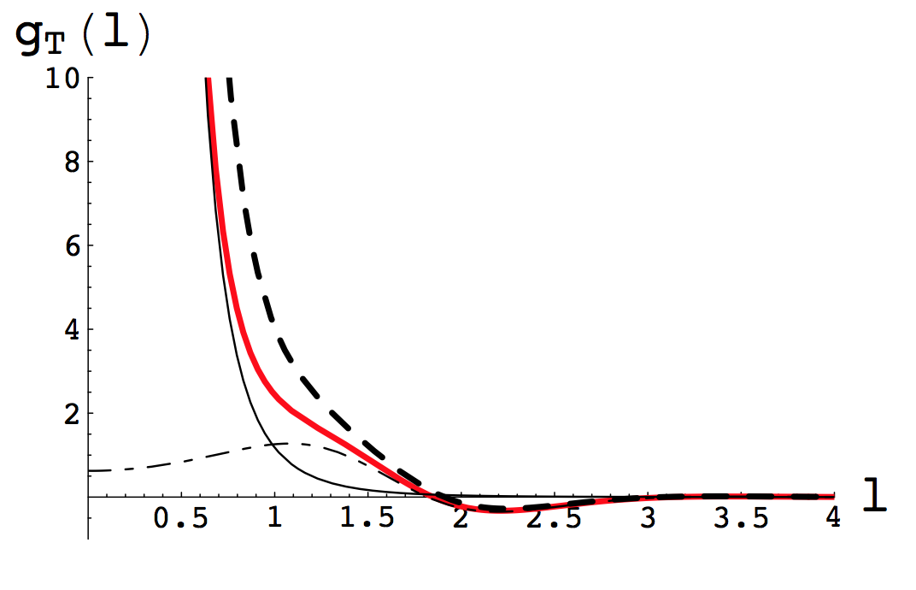


Resolving the Ambiguity
Saved by colored noise:
Wong-Zakai Theorem:
  As autocorrelation => 0, Langevin => Stratonovich
Gubser, NPB790 (2008)

Slide 16
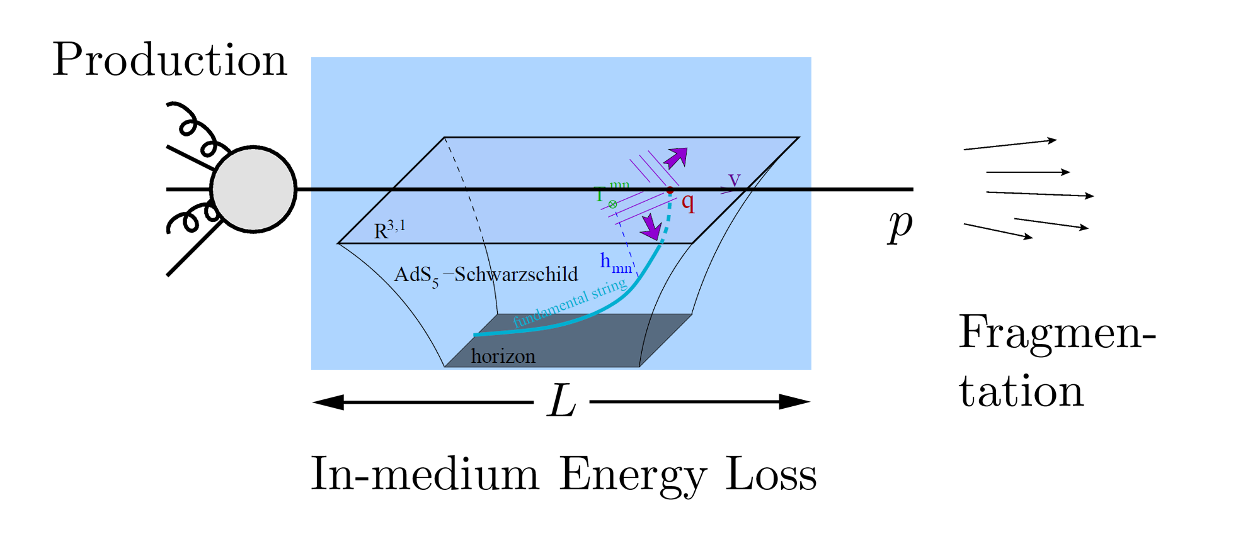
High-p_{T} Observables
Learn about E-loss mechanism
  Most direct probe of DoF(scale)
AdS/CFT Picture

Slide 17
Model Calculations
Input FONLL c, b production spectra
Discretized Langevin through VISHNU
  2+1D viscous hydro (Shen et al., 1409.8164)
FONLL FFs to B, D, e
Uncertainty in map from QCD to N = 4 SYM
  Explore systematics with two reasonable assumptions
    α_{s} = 0.3 (λ = 12), T_{SYM} = T_{QCD}
    λ = 5.5, T_{SYM} = T_{QCD}/3^{1/4}

Slide 18
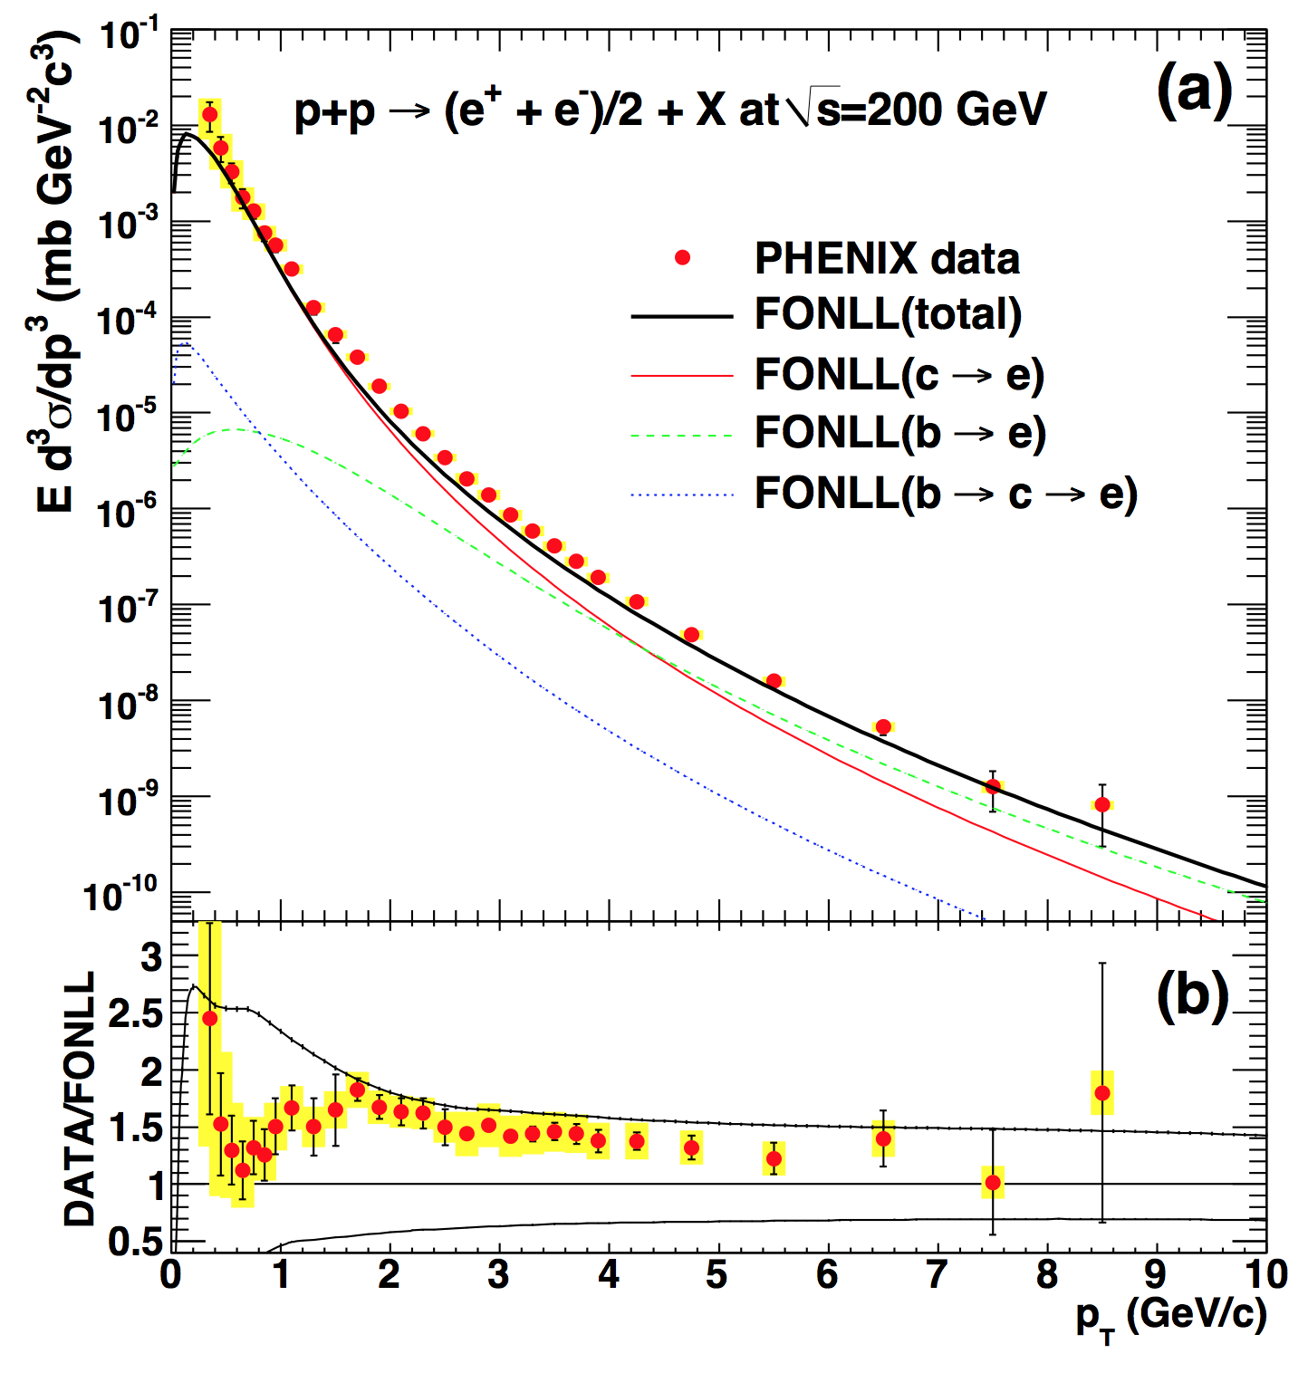
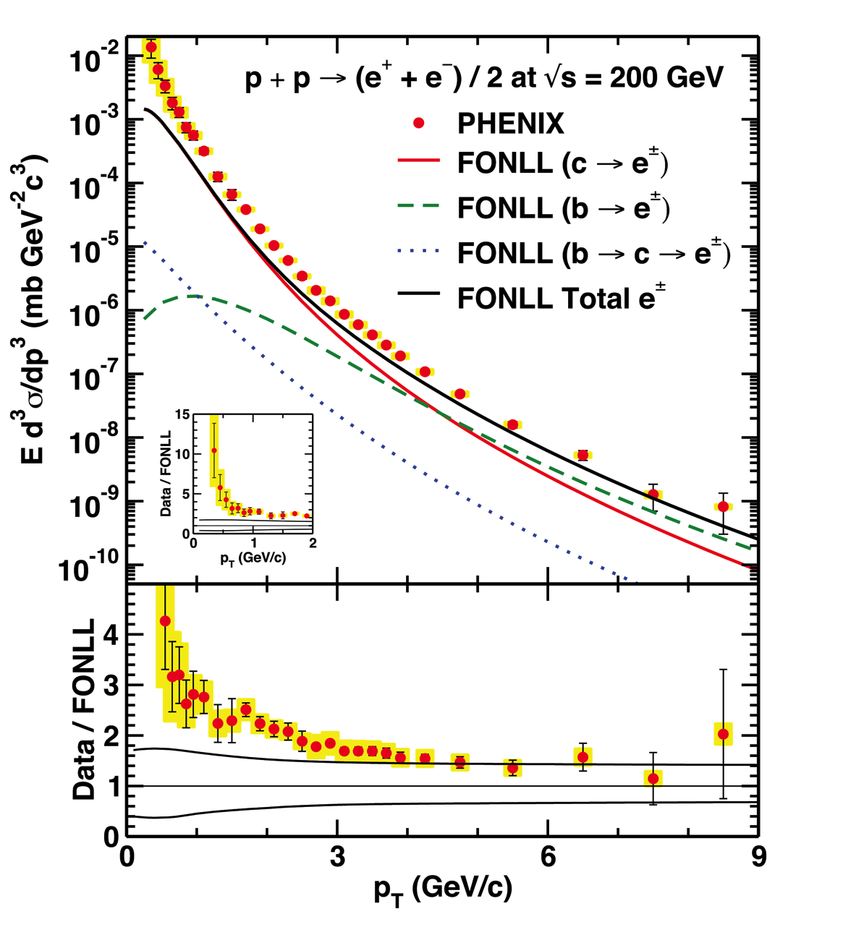
Nontrivial HF FFs
c,b => D, B; D, B => e⁻ break down at low-p_{T}
PHENIX PRC84 (2011) 044905
WAH, PRD91 [1501.04693]

Slide 19
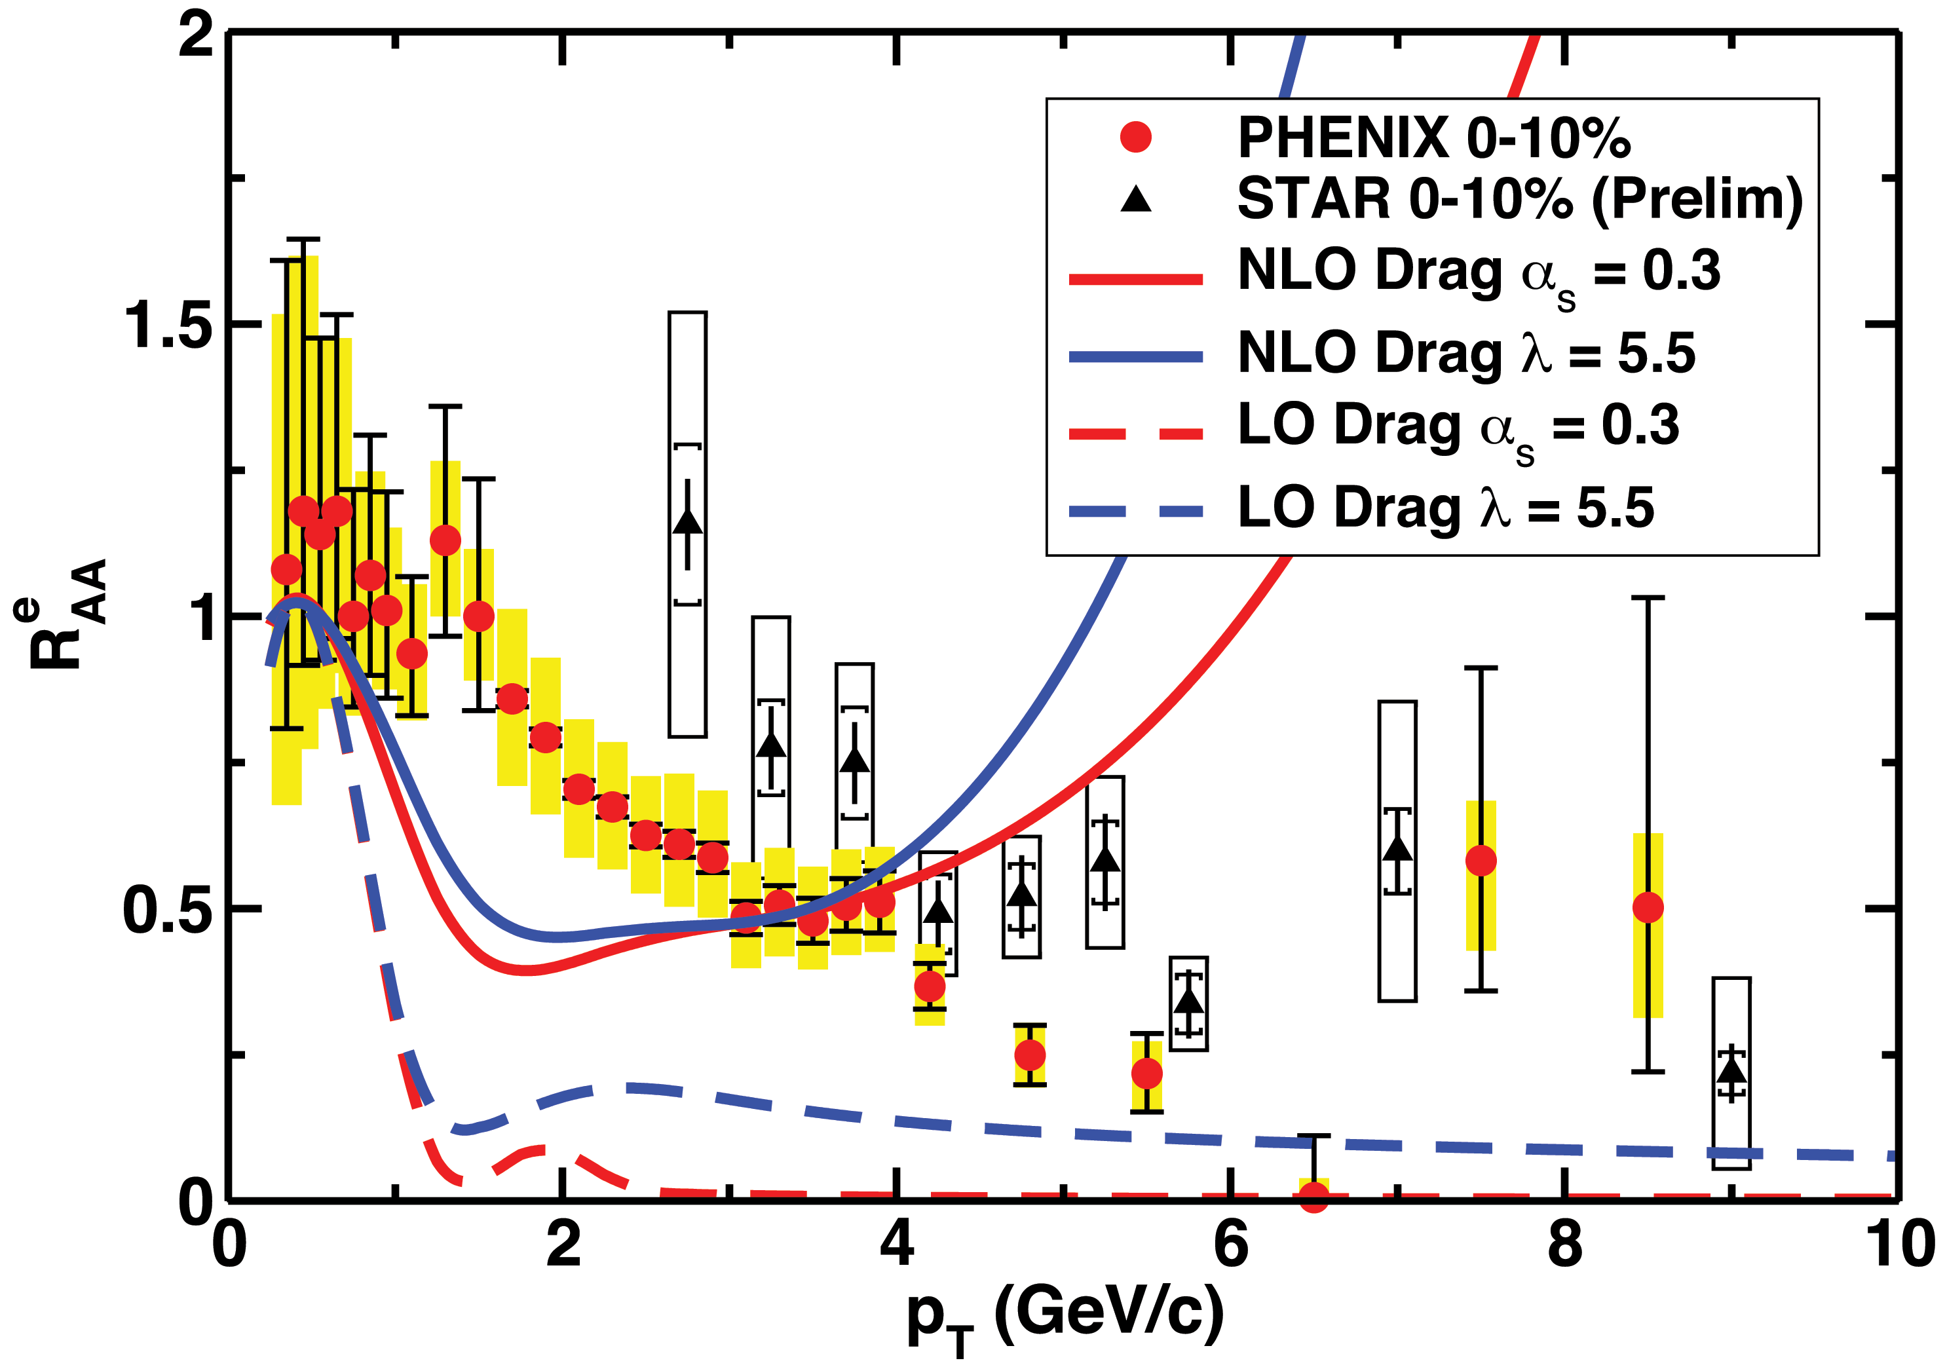
Compare to RHIC HF Electrons
WAH, PRD91 [1501.04693]
Agreement in sweet spot p_{T} ~ 3 – 4 GeV/c
  Below 3 GeV production unreliable
  Above 4 GeV theory corrections necessary (col. noise, non-const p)
NB: VISHNU medium hotter than from previous calc => larger LO supp.

Slide 20
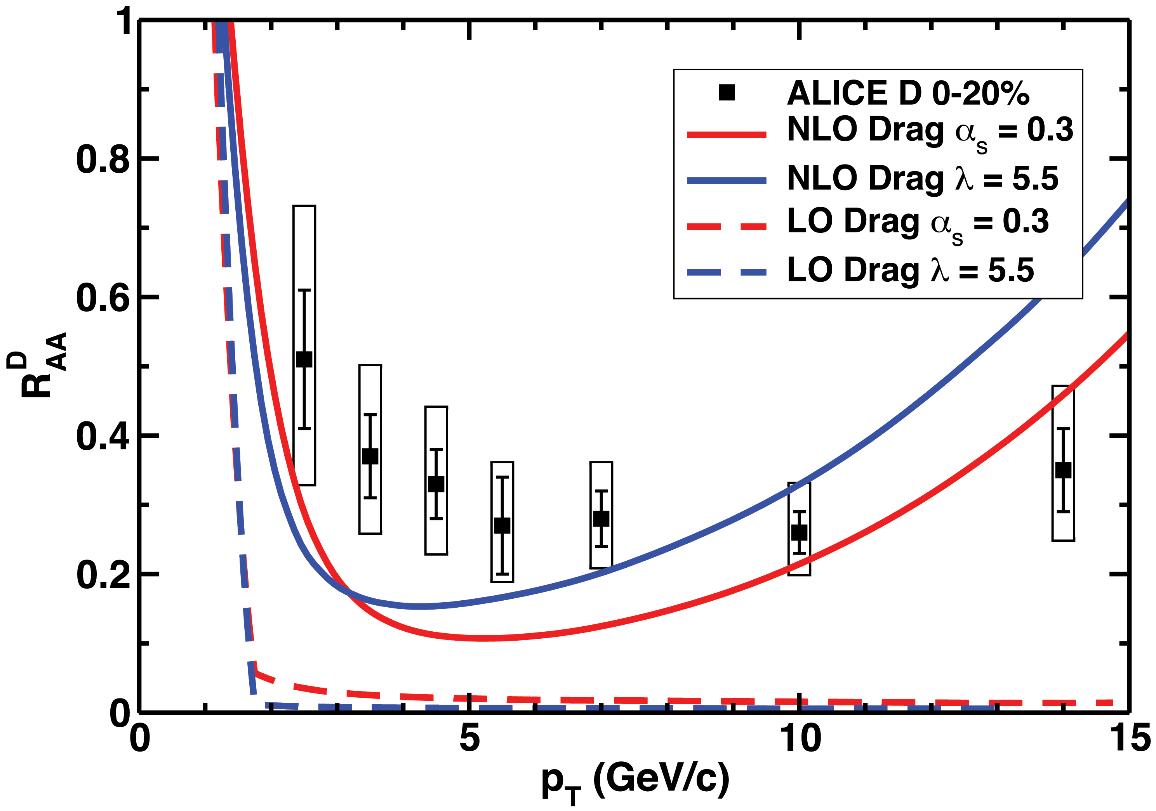
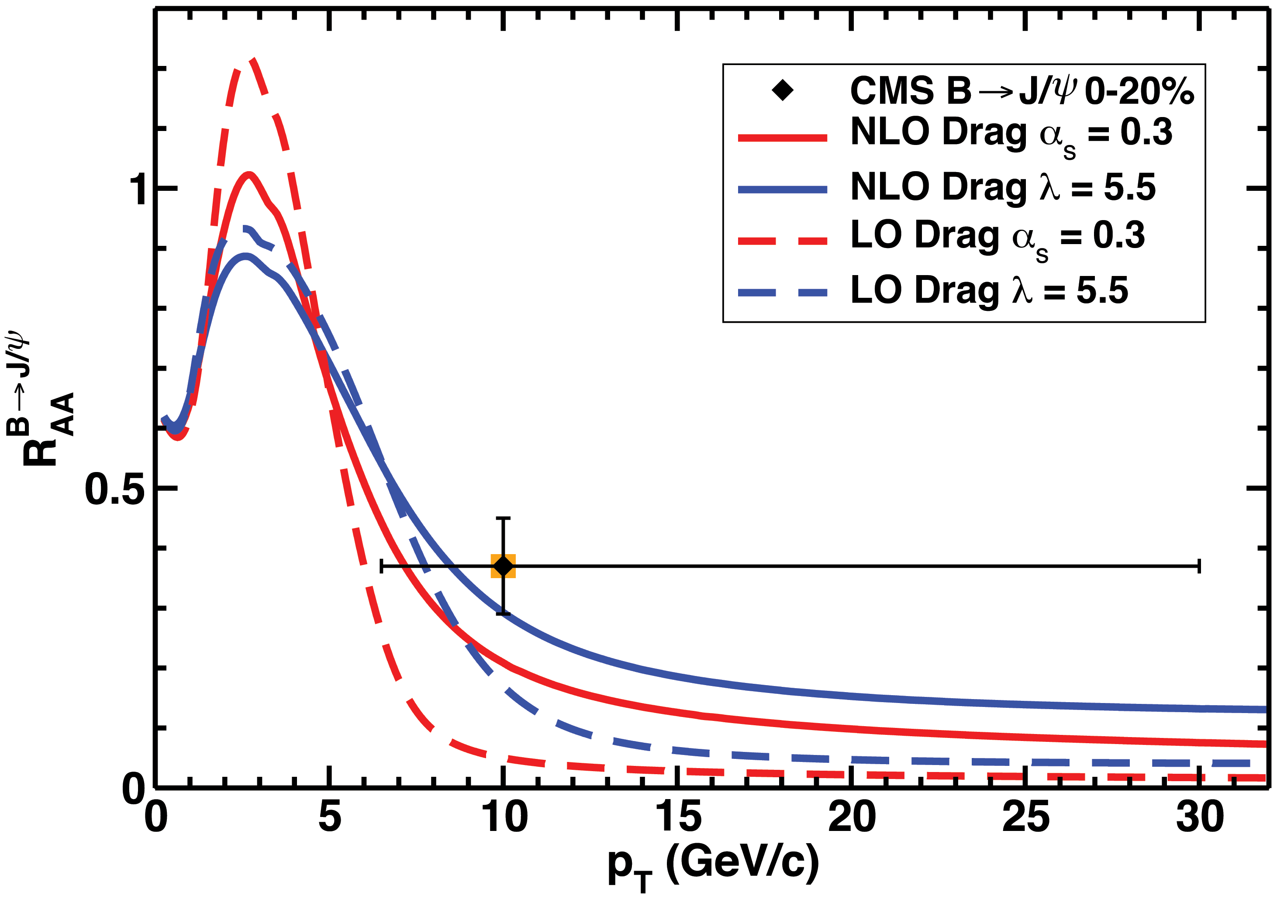
Compare to LHC: R_{AA}
D Mesons
Predictions qualitatively similar to data
  D harder than e; m_{B} => valid to higher p_{T}
B Mesons
WAH, PRD91 [1501.04693]

Slide 21
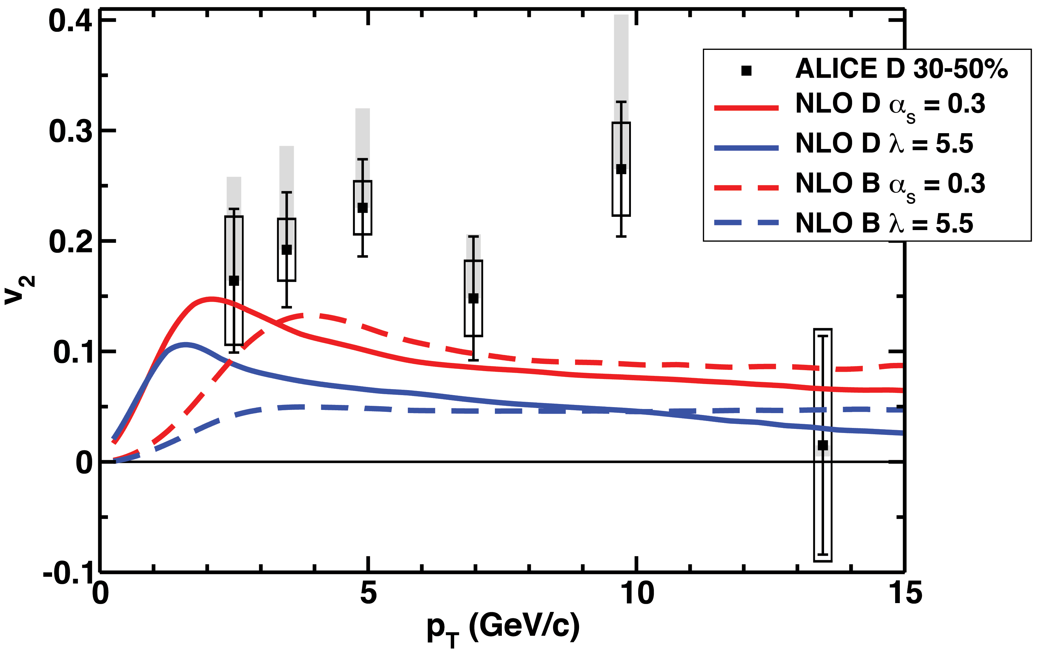
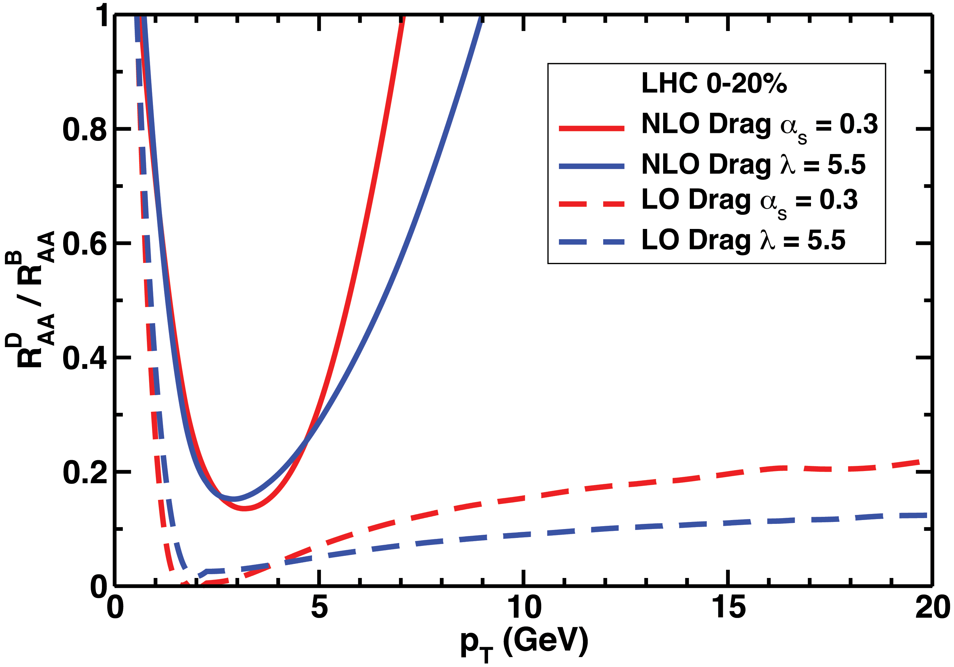
Compare to LHC: v₂ and D/B
D and B v₂
Anisotropy difficult to describe (non-pert FF effect?)
  B v₂ can be larger than D v₂
Complete change to qual. behavior of double ratio
Double Ratio
WAH, PRD91 [1501.04693]

Slide 22
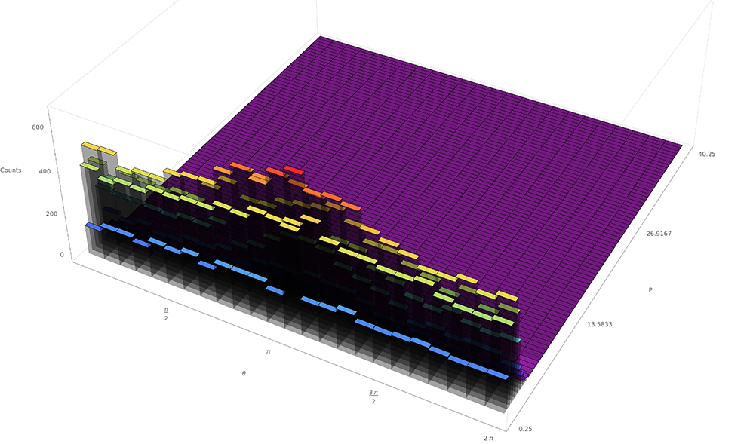
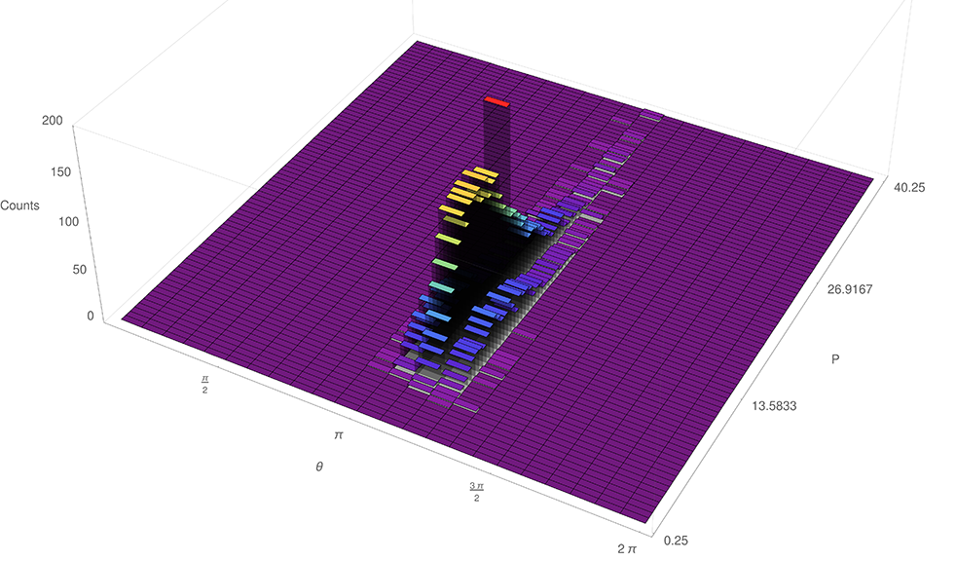
AdS HF and Correlations
b at 40-50% centrality LHC
Angular correlations increase with p_{T}
Momentum correlations decrease with p_{T}
  p¹_{T} ∈ 0 – 0.25 GeV/c; θ₁ ~ 0
  p¹_{T} ∈ 13.75 – 14.25 GeV/c; θ₁ ~ 0

Slide 23
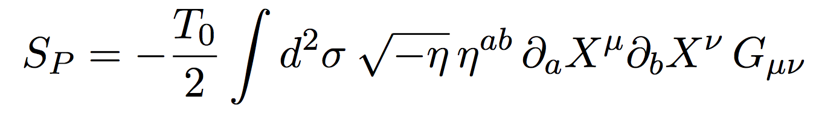
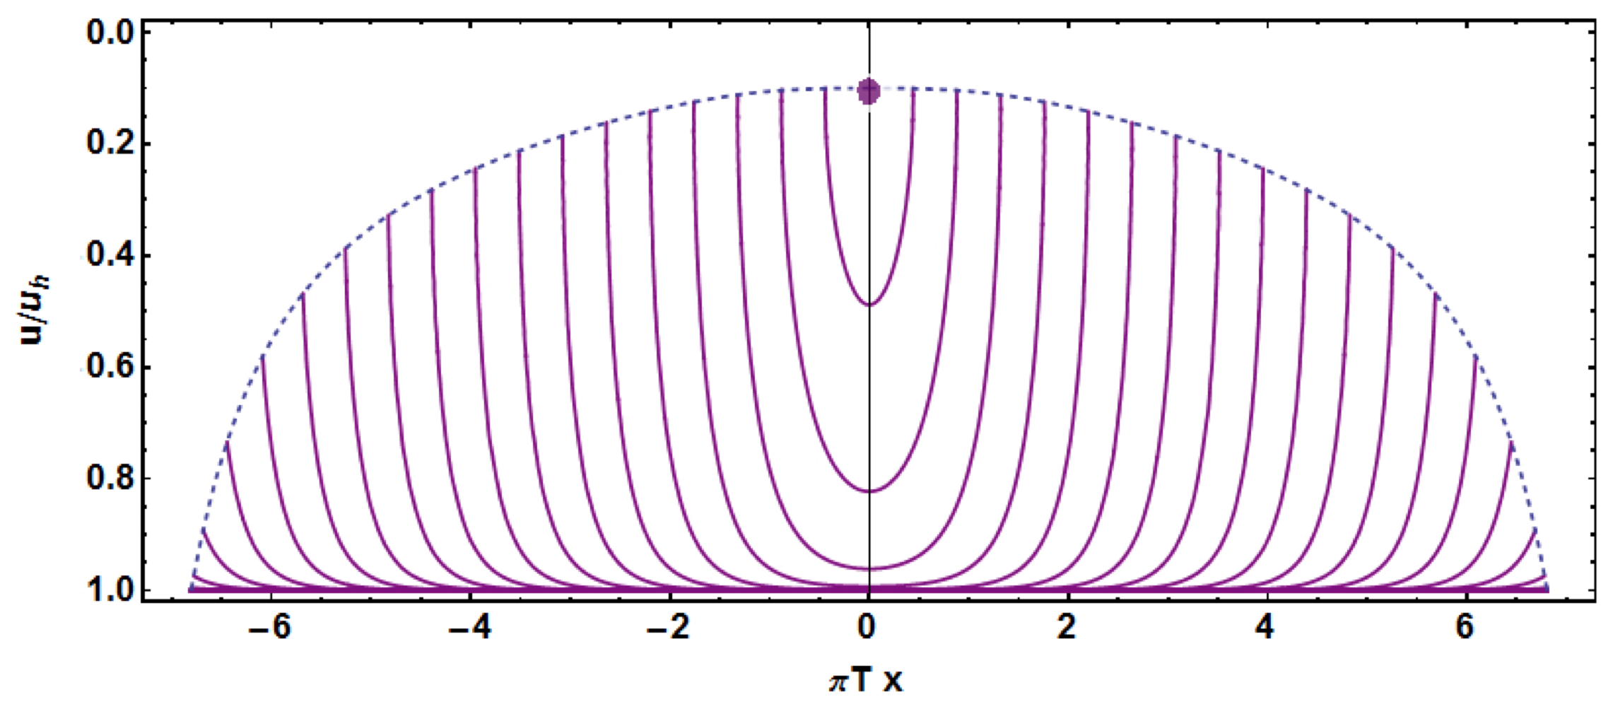
AdS Light Flavor Probe Partons
Dynamics from
  Must solve numerically
  Need to nontrivially invert t(τ, σ), x(τ, σ) to find relevant E, p, etc. as fcns of t or x
Minkowski Boundary
Snapshots of string evolution
5th Dimension
BH Horizon
Morad and WAH,
JHEP 1411 (2014) 017 [1409.7545]

Slide 24
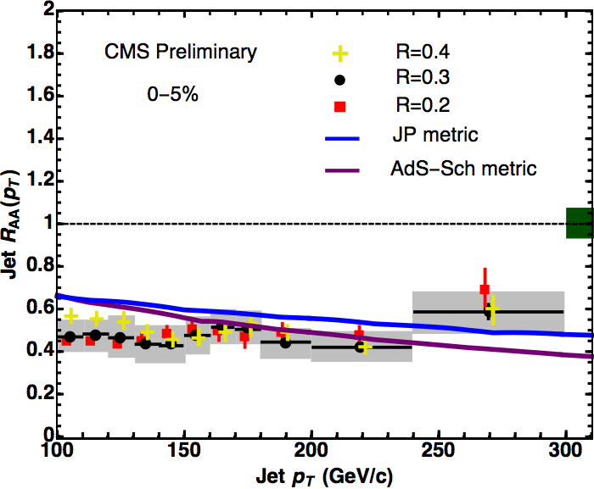
Renormalized Result
  Can we capture diff. btwn. naïve AdS pp & AA?
    Define renormalized R_{AdS} = “R_{AA} / R_{pp}”; cf CMS
      Use reasonable λ = 12 <=> α_{s} = 0.3: no fitting
    Similar results for renorm. via ΔE_{renorm} = ΔE_{AA} - ΔE_{pp}
Very first, fully
strongly coupled
jet R_{AA} calculation
R Morad and WAH, JHEP 11 (2014) 017

Slide 25


Conclusions and Outlook
Strong coupling energy loss consistent with RHIC, LHC data
  NLO fluctuations crucial for HF Eloss
  Renormalization necessary for light flavor jets
Qualitative consistency of sQGP picture for both low-p_{T} and high-p_{T} observables
Next steps:
  Fluctuations in light AdS Eloss
    Improve light, heavy flavor description
  Understand AdS objects better
    Examine strings with massive endpoints
  Hybrid strong/weak Eloss
    See poster by Ben Meiring
  Eloss in small systems
    See poster by Isobel Kolbé
Ben Meiring
Isobel Kolbé

Slide 26
Bonus Material

Slide 27
Finite Momentum String Endpoints
Ficnar and Gubser:
  arXiv:1306.6648
  What if string momentum concentrated at endpoints?
    Effect on stopping distance Δx, energy loss dE/dx?
  Modify L_{P} to include finite momentum at string endpoints
  Vary action for EOM

Slide 28
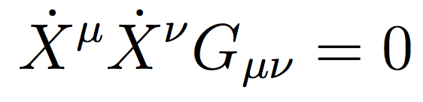
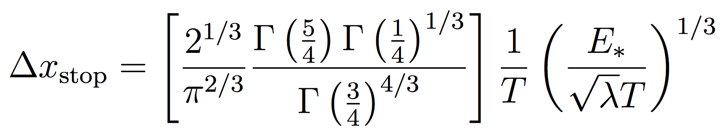
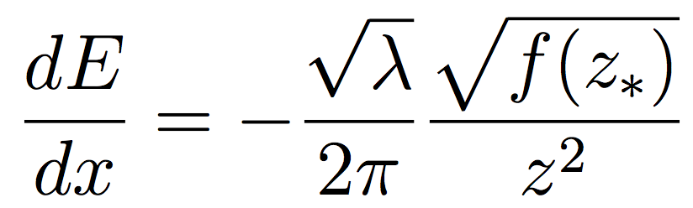
F&G Result
Endpoints follow light-like geodesics
Δx
  ~20% further than open strings w/o f.e.m.
dE/dx
  Smaller than open strings w/o f.e.m.

Slide 29
Finite Mass Endpoints
WAH and Kovchegov [PLB680 (2009)]:
HQ mass from glue cloud
  Hence reduction in mass as λ, T increase
Andrianavalomahefa and WAH:
  Generalize F&G: allow finite mass at endpoints

Slide 30
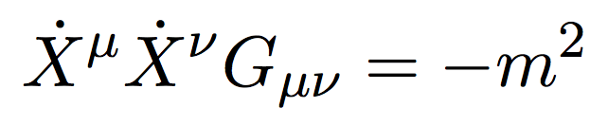

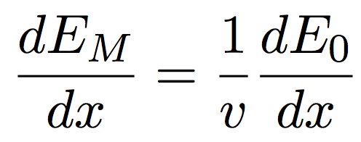
A & H Result
Endpoints follow time-like geodesics
Approximate motion as constant in z
  Gives upper bound on Δx
Δx
dE/dx:

Slide 31
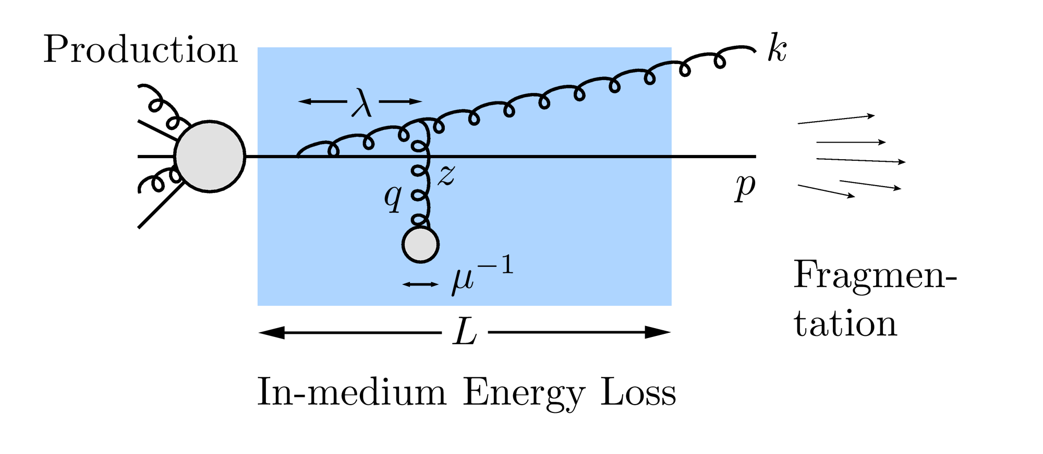
High-p_{T} Observables from pQCD
Learn about E-loss mechanism
  Most direct probe of DoF(scale)
pQCD Picture

Slide 32
pQCD Energy Loss
Use WHDG (nucl-th/0512076) as canonical example (see also Djordjevic & Heinz, 0802.1230)
  Weakly-coupled plasma
    Medium organizes into Debye-screened centers
  T ~ 350 MeV, α_{s} = 0.3 (=> g ~ 2)
    μ ~ gT ~ 0.5 GeV
    λ_{mfp} ~ 1/g²T ~ 1 fm
    R_{Au} ~ 6 fm
  Collisional 2 => 2 Processes: HTL from Braaten and Thoma
    dp_{T}/dL ~ T² log(p_{T}/M)
  Radiative 2 => 3 Processes: DGLV
    LPM => dp_{T}/dL ~ LT³ log(p_{T}/M)
  E-loss incorporated self-consistently, no tuning of weights
LO pQCD or FONLL production, KKP or FONLL FFs; reasonable geometry; no shadowing

Slide 33
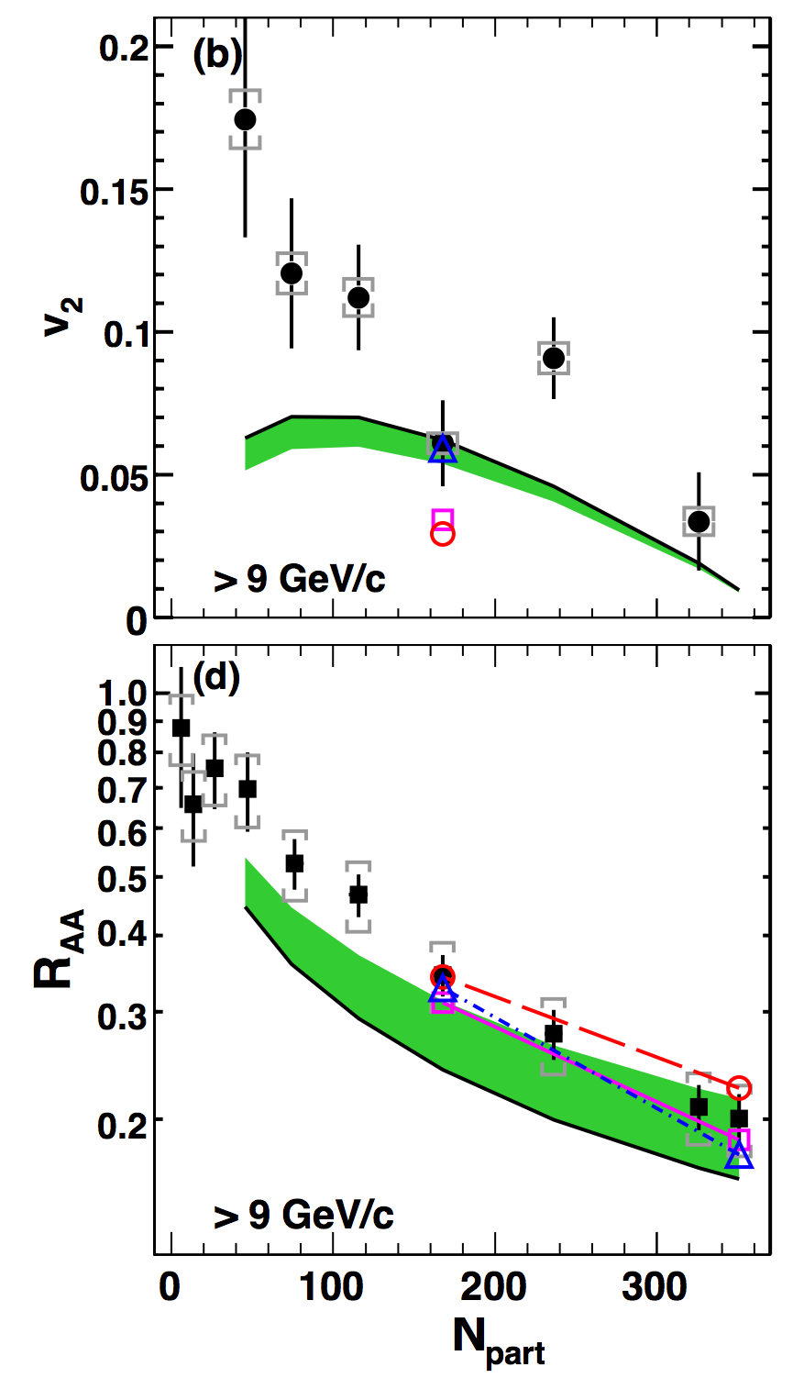
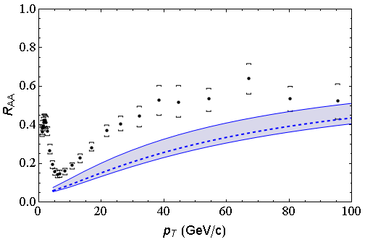
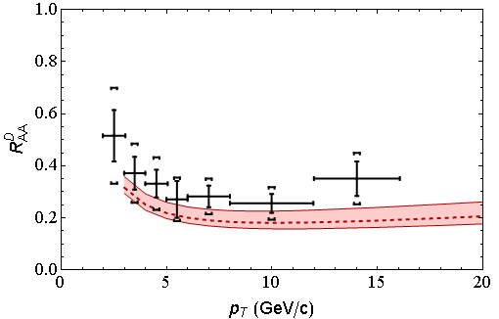
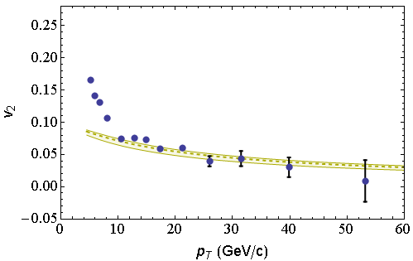
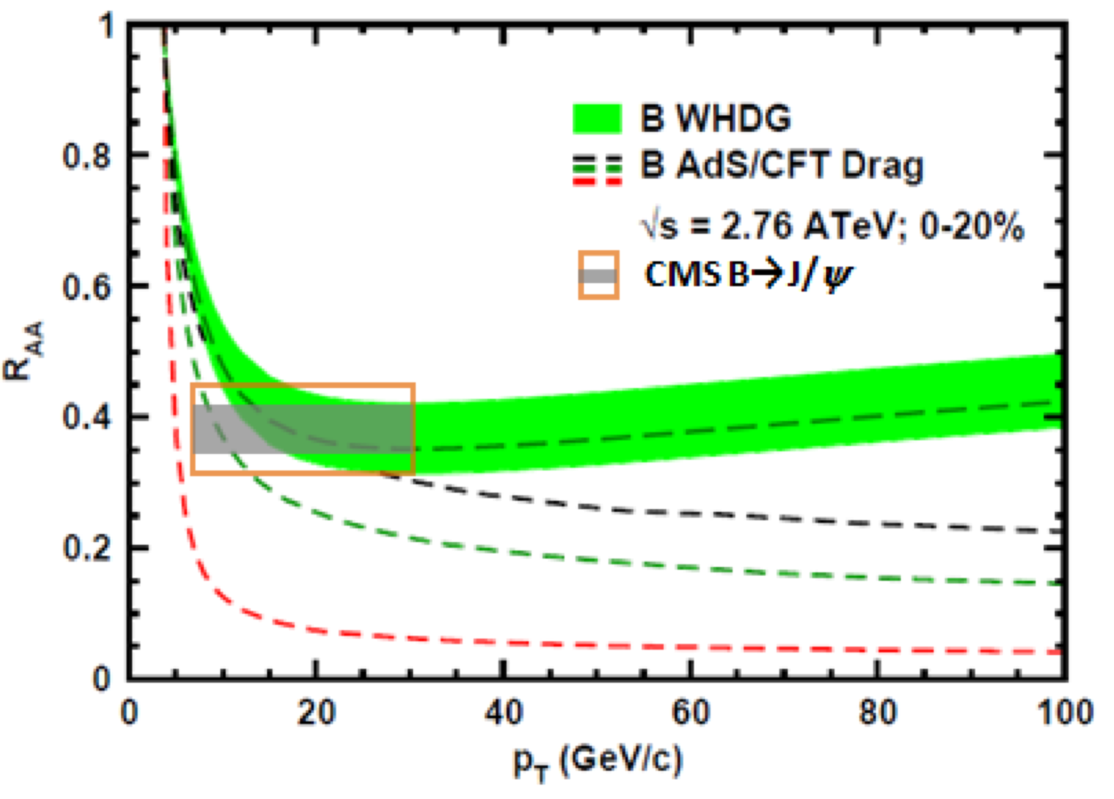
pQCD E-loss Describes RHIC/LHC
      Constrained by RHIC, LO pQCD predictions strikingly similar to LHC data
LHC
CMS h± 0-5%
WHDG π⁰
LHC
ALICE D
WHDG D
RHIC
RHIC
LHC
CMS h± 40-50%
WHDG π⁰
LHC
CMS, Eur.Phys.J. C72 (2012)
CMS, PRL109 (2012)
ALICE, JHEP1209 (2012) 112
CMS, JHEP 1205 (2012) 063
PHENIX PRL105 (2010)

Slide 34
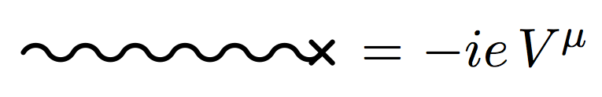
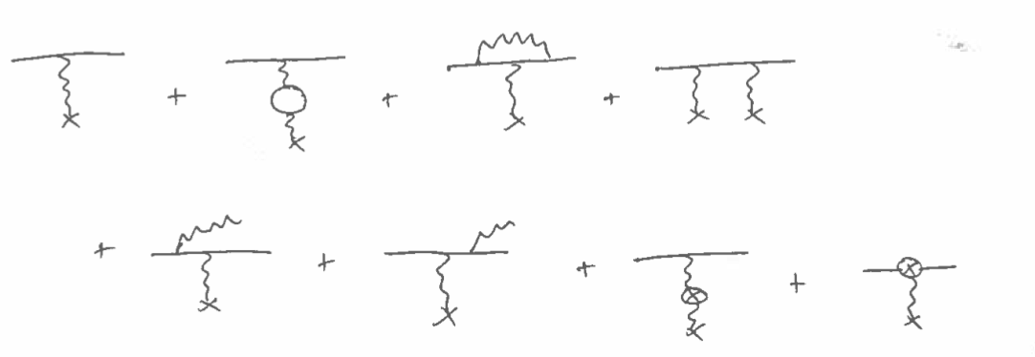
From Qualitative to Quantitative
Begin work on NLO calculation
  Baby step of NLO elastic QED Rutherford
    External source as scattering center with vel v^{μ}
  iM =

Slide 35
Preliminary Result
Use MSbar renormalization and dimensional regularization
  Unaware of MSbar extant in literature
  In limit m_{e} → 0 (equiv. q² → ∞)
Note:
  Unlike OS renorm, result finite as m_{e} → 0
  Interesting IR cancellation between e_{R} → e_{phys} and residue from LSZ
    OS renorm absorbs a IR div in counterterm

Slide 37
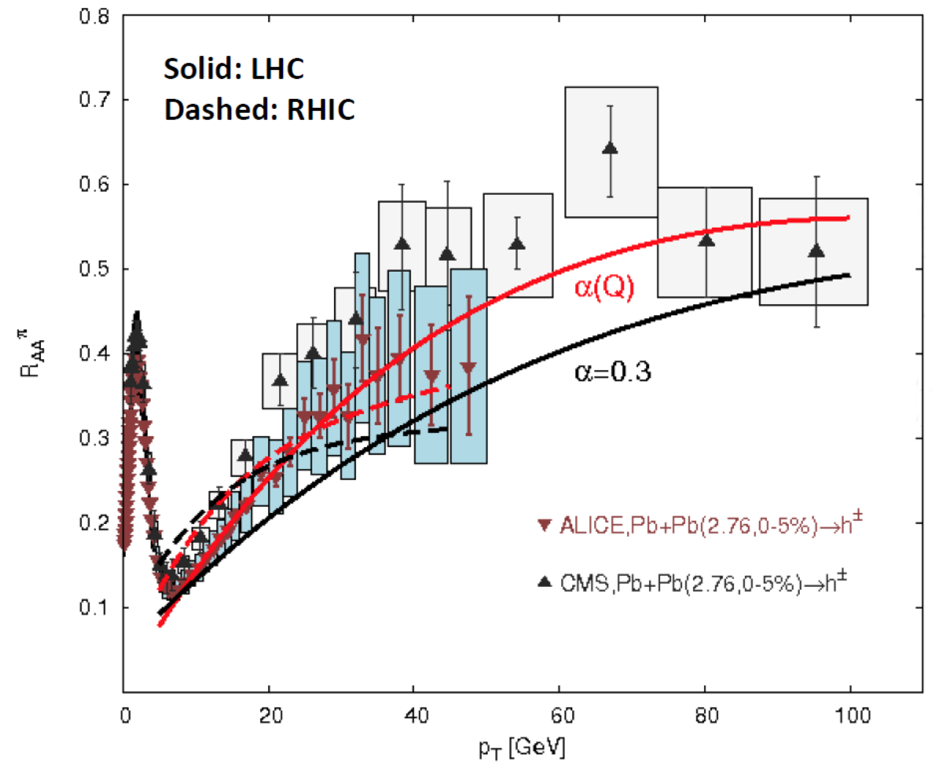
Improvement from running coupling ansatz
Buzzatti and Gyulassy, NPA910 (2013)

Slide 38
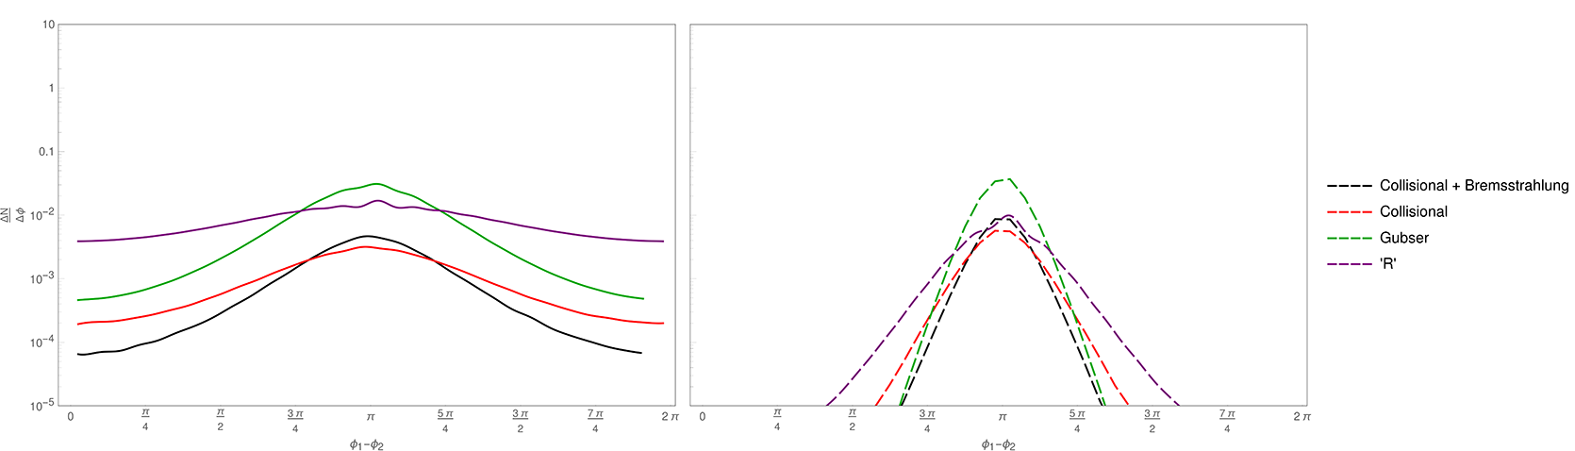
Cf pQCD Correlations
p1,p2 ∈ 1-4 GeV/c
AdS correlation can be an order of magnitude larger than pQCD
p1,p2 ∈ 4-10 GeV/c
Hambrock and Horowitz, in prep
pQCD from Narhgang et al., PRC90 (2014)

