Slide 1
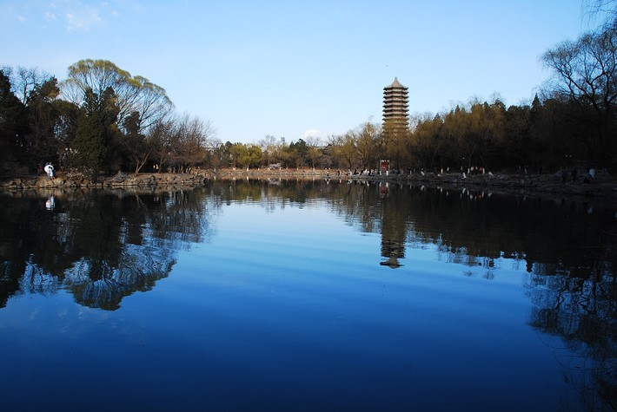
Correlated Fluctuations
Near the QCD critical Point
Huichao Song
宋慧超
Peking University
SQM 2015
JINR, Dubna, July 6-11, 2015
July 9, 2015

Slide 3
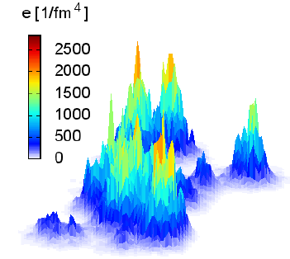
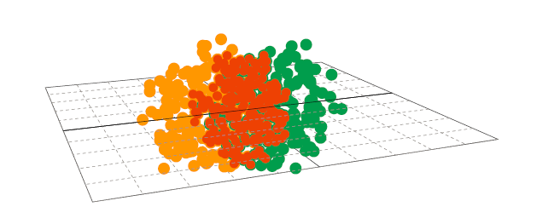
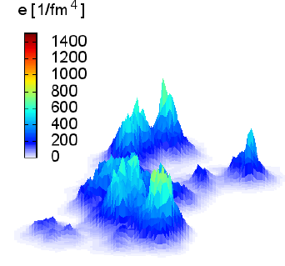
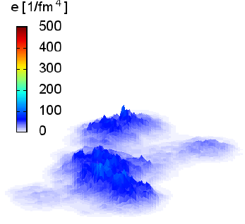
Fluctuations & Correlations
at RHIC and the LHC

Slide 4
Fluctuations & Correlations
at RHIC and the LHC
Hydro evolution

Slide 5
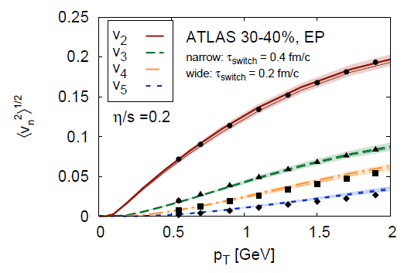
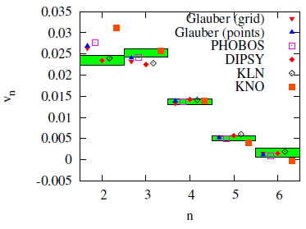
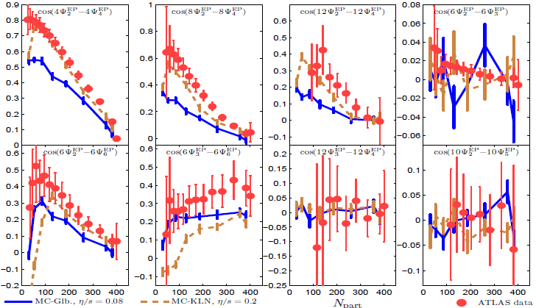
Observables for Higher Order Flow Harmonics
Luzum & Ollitrault, 2012-10
Qiu & Heinz,12-08
C. Gale et al.
12-09
-Nice descriptions from e-b-e hydrodynamic simulations
-They are all sensitive to the QGP viscosity

Slide 6
Correlated fluctuations near
the QCD critical point
Initial State Fluctuations
-QGP fireball evolutions smear-out the initial fluctuations
-uncorrelated (in general)
Fluctuations near the critical point
-dramatically increase near Tc
-Strongly correlated

Slide 7
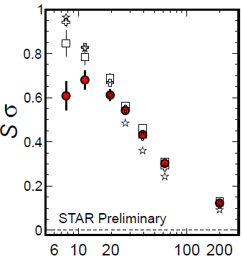
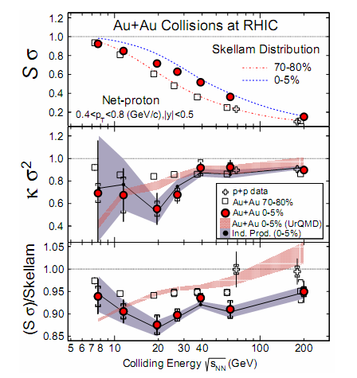
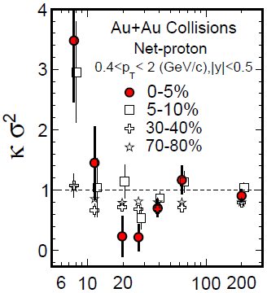
STAR BES: Cumulant ratios
STAR PRL 2014
Xiaofeng Luo CPOD 2014
PT=(0.4-2) GeV
PT=(0.4-0.8) GeV

Slide 8
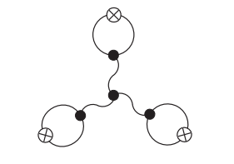
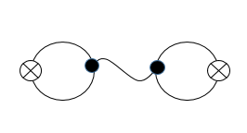
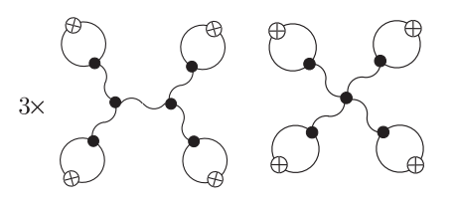
Theoretical predictions on critical fluctuations
Stephanov PRL 2009
Critical Fluctuations of particles :
At critical point : (infinite medium)
Finite size & finite evolution time:
It is important to address the effects from dynamical evolutions

Slide 9
Dynamical Modeling near
the QCD critical point

Slide 10
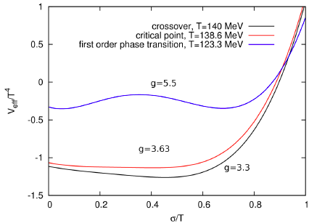
Chiral Hydrodynamics (I)
K. Paech, H. Stocker and A. Dumitru, PRC2003
the order of the phase transition is in charged by the coupling g.
order parameter
quark & anti-quark is treated as the heat bath (fluid), which interact with the chiral field via effective mass

Slide 11
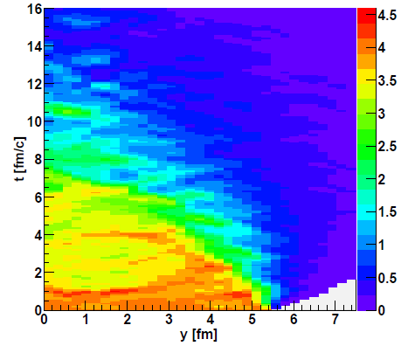
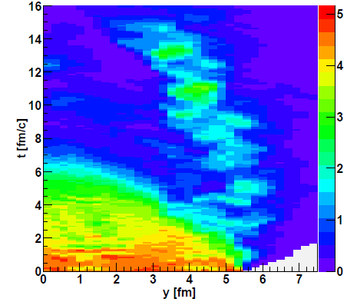
Chiral Hydrodynamics (II)
K. Paech, H. Stocker and A. Dumitru, PRC2003
(fluctuation is introduced by initial state)
fluid
g=3.7
fluid
g=5.5
-Chiral fluid dynamics with dissipation & noise
Nahrgang,et al., PRC 2011
-Chiral fluid dynamics with a Polyakov loop (PNJL)
Herold, et al., PRC 2013

Slide 12
fluid
g=3.7
Proper treatment of freeze-out
From dynamical evolution to experimental observables, it is important to properly treat the freeze-out procedure with external field

Slide 13
Jiang, Li & Song in preparation
Correlated fluctuations along the freeze-out surface near Tc
-theoretical models

Slide 14
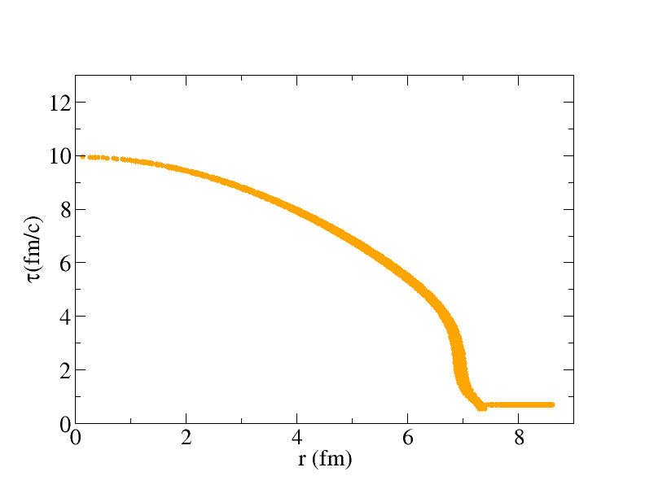
Particle emissions near Tc with external field
Jiang, Li & Song in preparation
Hydro freeze-out surface
Particle emissions in traditional hydro
Particle emissions with external field

Slide 15
For stationary & infinite medium:
--the results in Stephanov PRL09 are reproduced

Slide 16
Jiang, Li & Song in preparation
Hydro freeze-out surface
CORRELATED particle emissions along the freeze-out surface
--partially include the evolution effects and volume effects

Slide 17
For simplicity: We assume that the correlated sigma field only influence the particle emissions near Tc, which does not influence the evolution of the bulk matter
Input: hydro freeze-out surface; hydro has been tuned to fit dN/dy, spectra and V2
Hydro freeze-out surface
CORRELATED particle emissions along the freeze-out surface
--partially include the evolution effects and volume effects

Slide 18
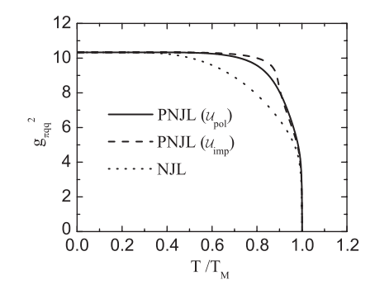
The choice of input parameters
A. Andronic, et al. NPA (2006); M. A. Stephanov, Phys. Rev. Lett. 102, 032301 (2009); S. P. Klevansky, Rev. Mod. Phys, Vol, 64, No.3 (1992); W. Fu, Y-x, Liu, Phys. Rev. D 79, 074011(2009); M. M. Tsypin, Phys. Rev. Lett. 73, 2015 (1994); M. M. Tsypin, Phys. Rev. B 55, 8911 (1997).; B. Berdnikov and K. Rajagopal, Phys. Rev. D 61, 105017 (2000).

Slide 19
Jiang, Li & Song in preparation
Correlated fluctuations along the freeze-out surface near Tc
-comparison with the experimental data

Slide 20
STAR data vs Thermal fluctuation baselines
Xiaofeng Luo CPOD 2014
PT=(0.4-2) GeV
Fluctuations measured in experiment: critical fluct. + thermal fluct. + …
The higher order cumulants shows large deviations from Poisson expectations

Slide 21
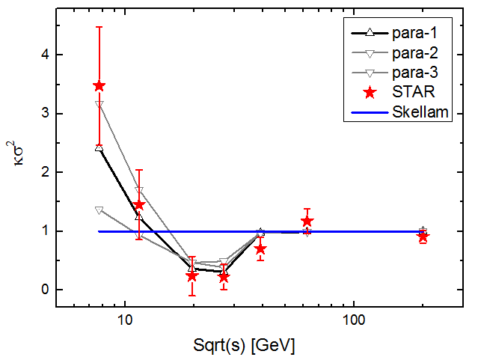
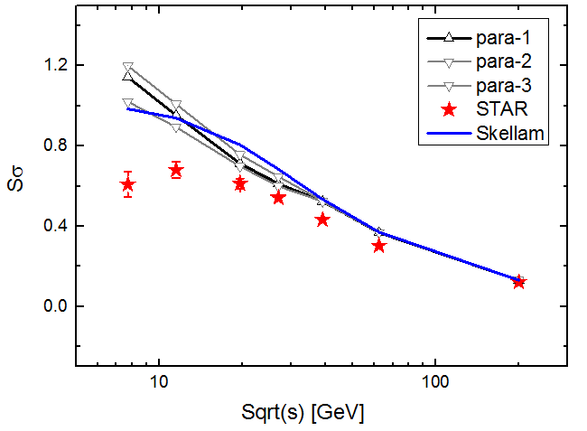
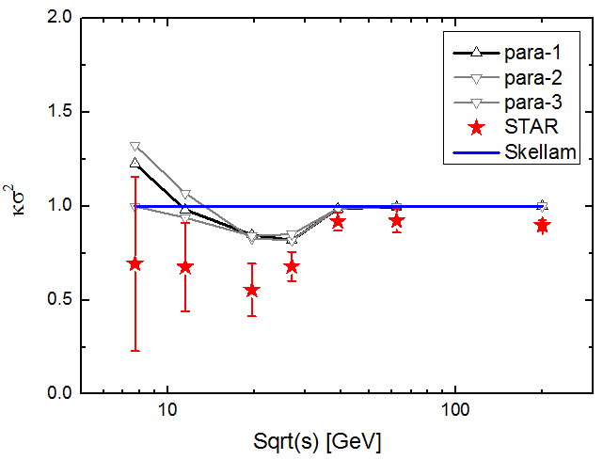
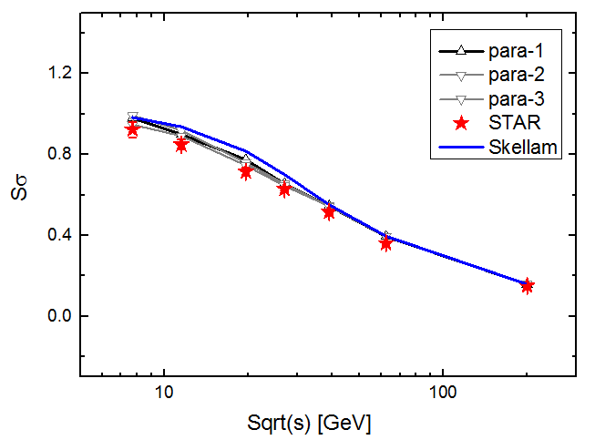
: ( Model + Poisson baselines)
Jiang, Li & Song in preparation
Net Protons: 0-5%
PT=(0.4-2) GeV
PT=(0.4-2) GeV
Preliminary
PT=(0.4-0.8) GeV
PT=(0.4-0.8) GeV

Slide 22
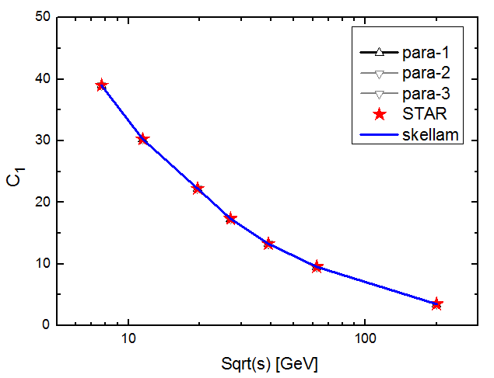
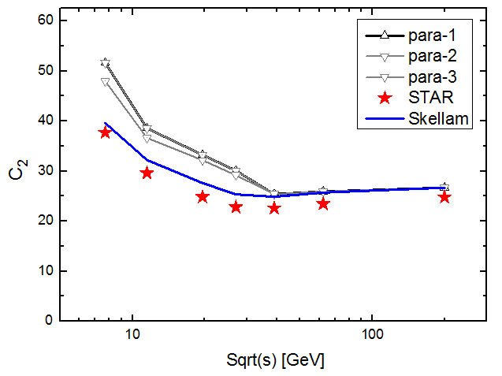
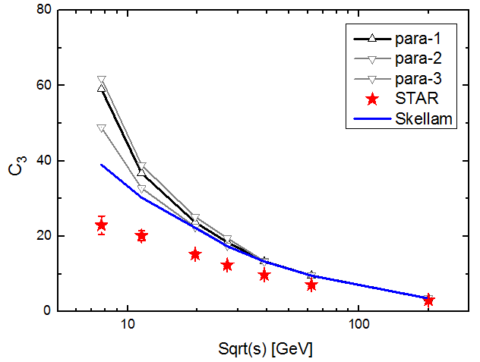
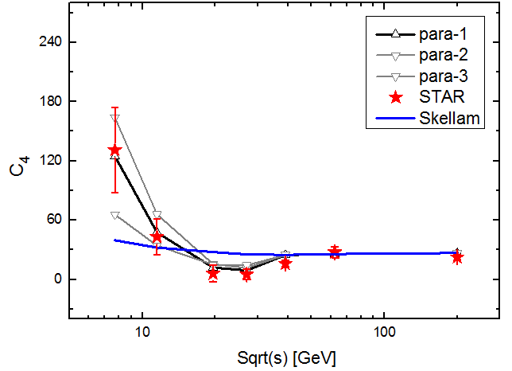
C1 C2 C3 C4: Pt-(0.4-2) GeV ( Model + Poisson baselines)
PT=(0.4-2) GeV
Jiang, Li & Song in preparation
Net Protons 0-5%
Preliminary
Critical fluctuations give positive contribution to C2 , C3; well above the poisson baselines, can NOT explain/describe the C2 , C3 data

Slide 23
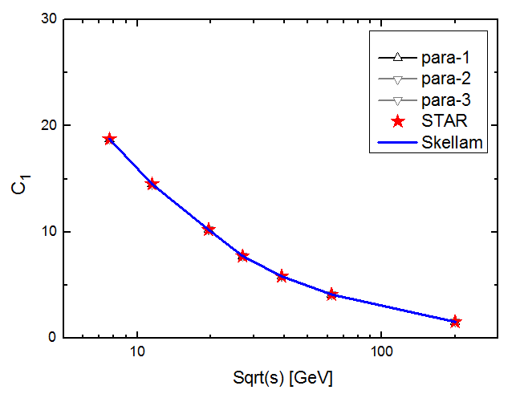
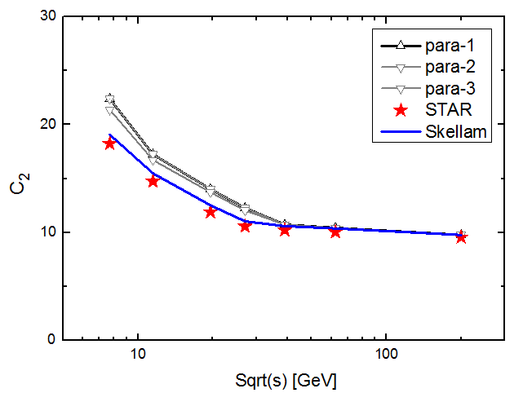
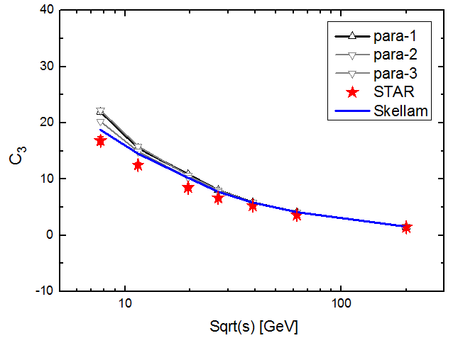
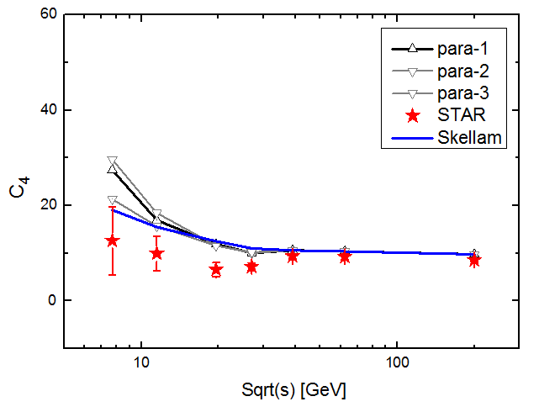
C1 C2 C3 C4 : Pt-(0.4-0.8) GeV ( Model + Poisson baselines)
PT=(0.4-0.8) GeV
Jiang, Li & Song in preparation
Net Protons: 0-5%
Preliminary
Critical fluctuations give positive contribution to C2 , C3; above the poisson baselines, can NOT explain/describe the C2 , C3 data

Slide 24
C1 C2 C3 C4: Pt-(0.4-2) GeV ( Model + Poisson baselines)
PT=(0.4-2) GeV
Jiang, Li & Song in preparation
Net Protons 0-5%
Preliminary
In this model (and also Stephanov PRL09 framework) critical fluctuations’s contributions to C2 , C3 are always positive

Slide 25
Summary
STAR BES give exiting new measurements from these net proton cumulants with pT=(0.4-2) GeV, showing its potential of discovery the QCD critical point
We calculate the correlated fluctuations along the hydro freeze-out surface near Tc through coupling the emitted particle with the fluctuating sigma field
-C4 and can be reproduced through tuning the parameters of the model
-However C2 , C3 are well above the poisson baselines, which can NOT explain/describe data
To claim the discovery of critical point, we need good theoretical models that describe both the cumulant ratios and the original cumulants C1, C2, C3, C4
Factors need to be considered in the future:
-- thermal fluctuation baselines: poisson or something else?
-- dynamical evolution near the critical point
-- …

Slide 26
Thank You

Slide 27
Boltzmann approach with external field
Stephanov PRD 2010
-analytical solution with perturbative expansion, please refer to Stephanov PRD 2010
Stationary solution for the Boltamann equation with external field
Effective particle mass:

Slide 28
STAR data vs Thermal fluctuation baselines (II)
Xiaofeng Luo CPOD 2014
Fluctuations measured in Experiment: critical fluct. + thermal fluct. + …
The binomial distributions (BD) better describe the data than Poisson, but still show large deviations for C3 and C4 at lower collision energies.

Slide 29
Jiang, Li & Song in preparation
Correlated fluctuations along the freeze-out surface near Tc
-comparison with the experimental data
A) Model + Poisson baselines
B) Model + Binomial baselines

Slide 30
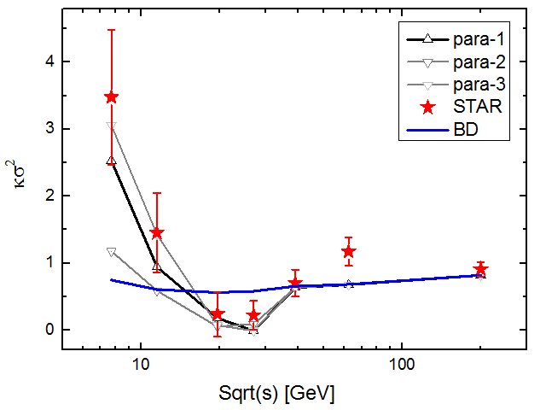
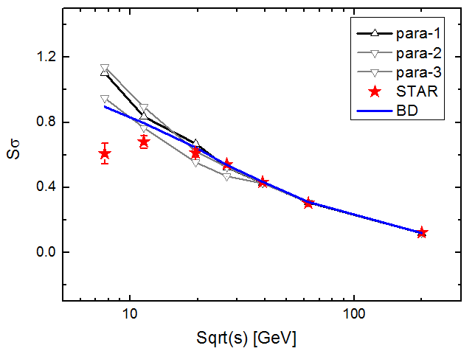
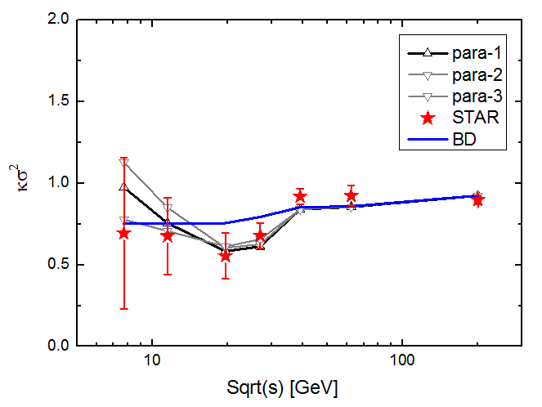
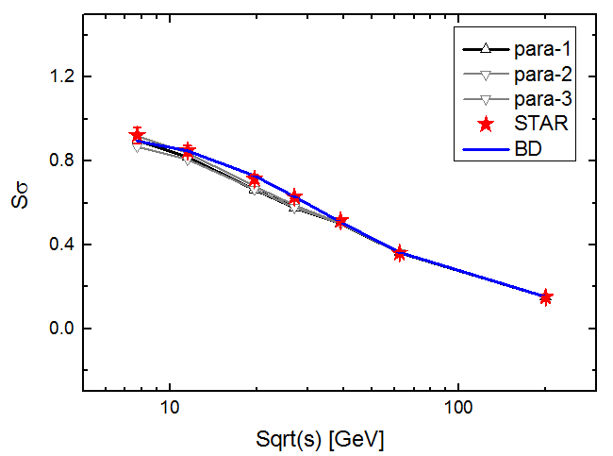
: ( Model + Binomial baselines)
Net Protons: 0-5%
Jiang, Li & Song in preparation
PT=(0.4-2) GeV
PT=(0.4-2) GeV
Preliminary
PT=(0.4-0.8) GeV
PT=(0.4-0.8) GeV

Slide 31
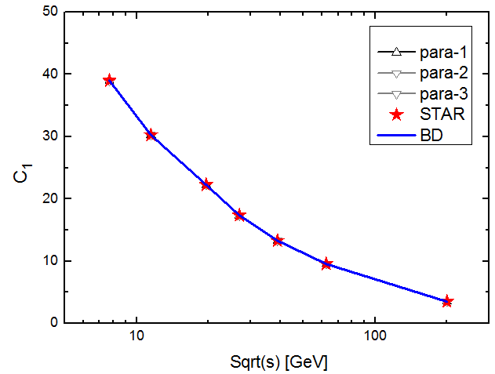
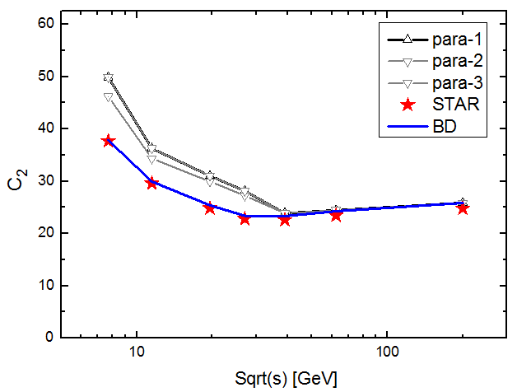
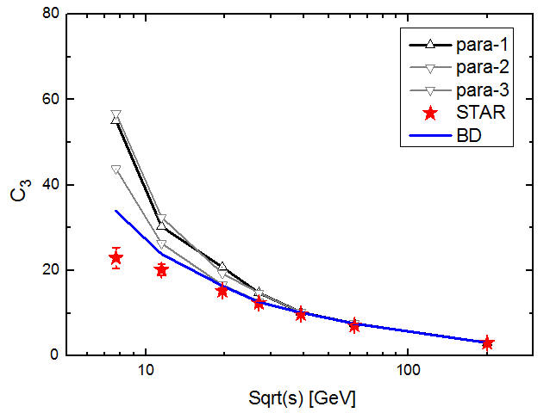
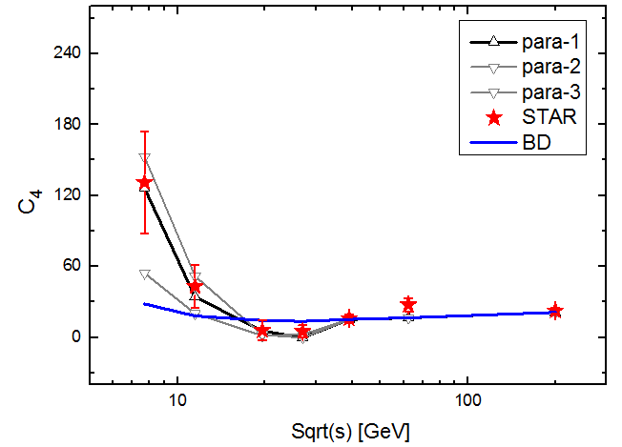
C1 C2 C3 C4 : PT-(0.4-2) GeV ( Model + Binomial baselines)
Jiang, Li & Song in preparation
Net Protons 0-5%
Preliminary
Critical fluctuations give positive contribution to C2 , C3; well above the binomial baselines, can NOT explain/describe the C2 , C3 data

Slide 32
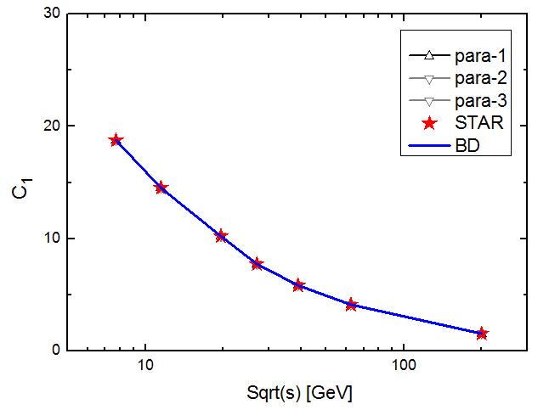
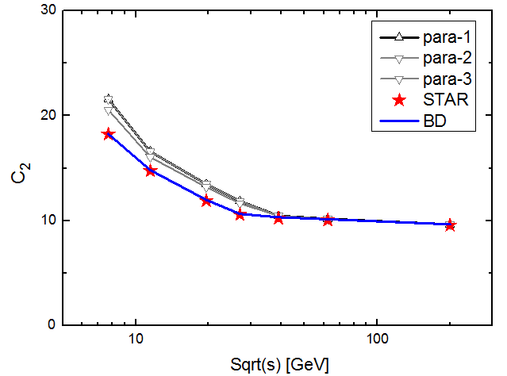
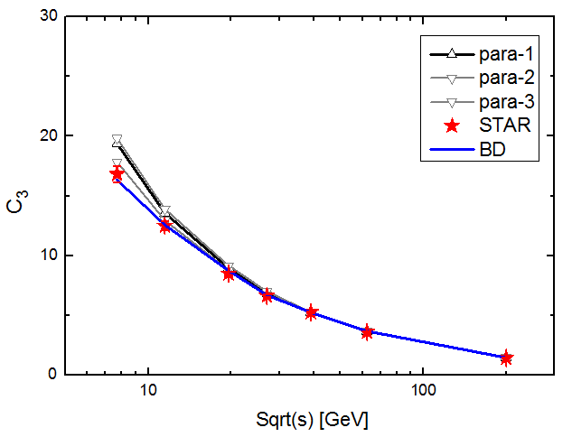
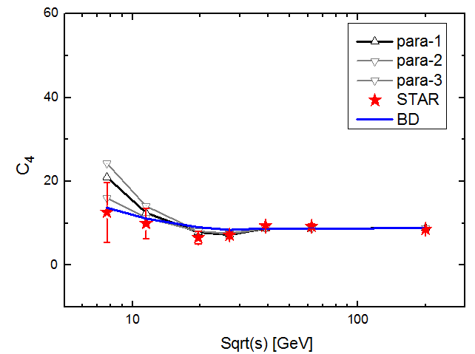
C1 C2 C3 C4 : PT-(0.4-0.8) GeV ( Model + Binomial baselines)
Jiang, Li & Song in preparation
Net Protons: 0-5%
Preliminary
Critical fluctuations give positive contribution to C2 , C3; above the
binomial baselines, can NOT explain/describe the C2 , C3 data

