Slide 1
Summary talk – Experiments low energies
Yvonne Leifels
GSI Darmstadt

Slide 2
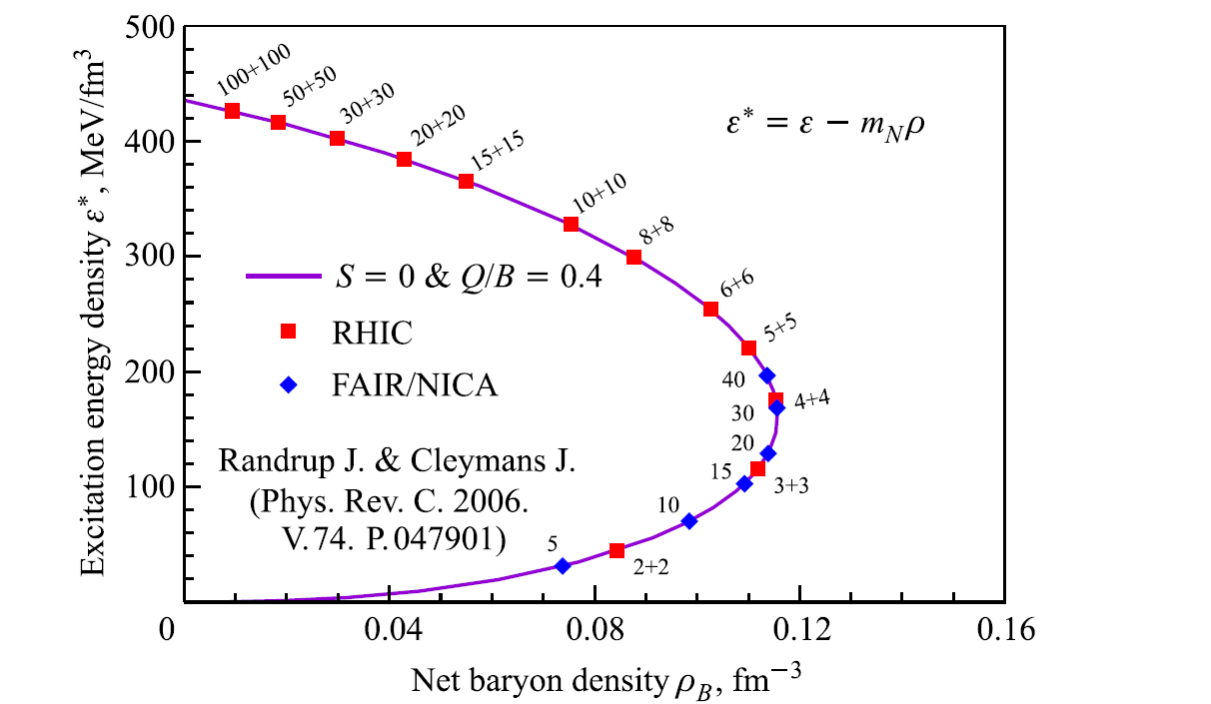
Investigation of Strangeness in Quark Matter at Low Energies
Environment
moderate temperatures and high baryonic densities

Slide 3
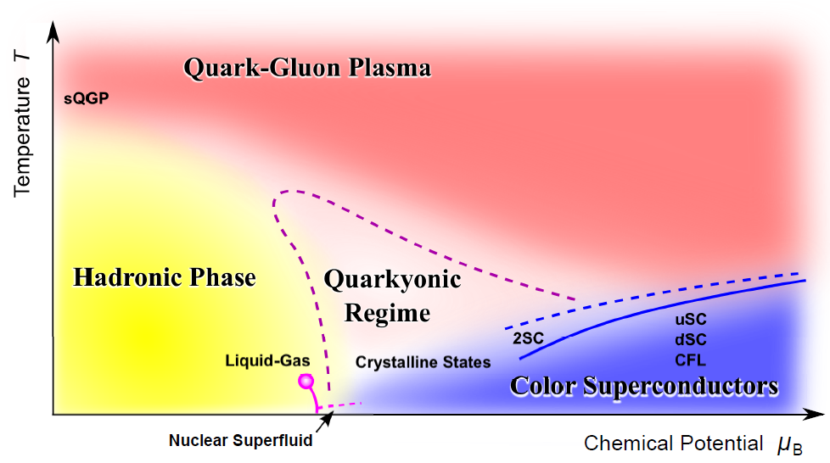
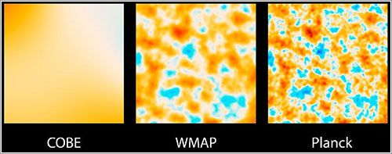
Heavy-ion collisions and QCD phase diagram
Systematic probing of the phase diagram by varying kinetic beam energy
K. Fukushima
Progress detector driven
SIS 18 energy regime:
beam energies of 1-2 AGeV for ions, baryon dominated rather long living system
Manuel Lorenz

Slide 4
Investigation of Strangeness in Quark Matter at Low Energies
Environment
moderate temperatures and high baryonic densities
Study
strange particle production
  produced during the collision
  strangeness is conserved, high thresholds, sensitive to density
  limited experimental information on elementary reactions under strange particles
  strong couplings
collective flows (radial, v₁, v₂)
  in – medium modifications of particles K^{+/-}, ρ, ω
excitation of resonances
study thermalization
production of (hyper)nuclei and search for exotica ΛΛ and Λn
search for the critical point

Slide 5
Key players

Slide 6
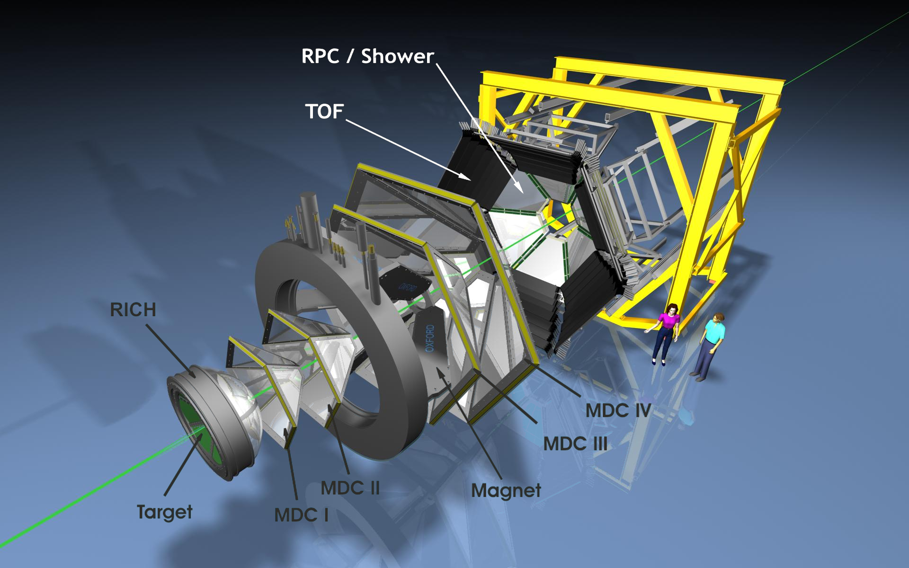
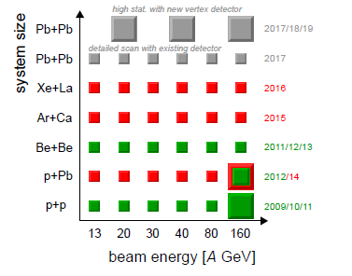
HADES and SHINE/NA61
Data taken:
p+p, p + Nb 3.5 GeV
Ar+KCl: 1.76A GeV
Au+Au: 1.25A GeV

Slide 7
Strangeness at SIS energies
1-2A GeV

Slide 8
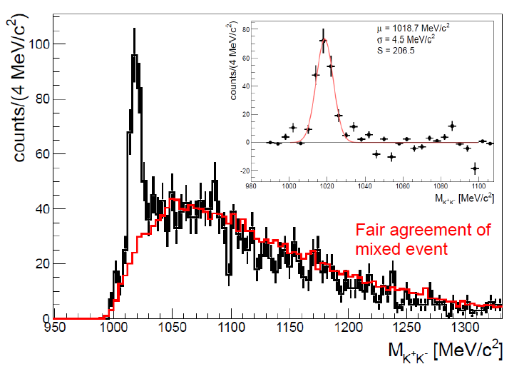

Φ and K⁻
Au + Au 1.25A GeV
#
Φ meson reconstructed via charged kaons
Strong rise of Φ/K⁻ ratio with decreasing
beam energy as predicted by stat. model
Manuel Lorenz
PhD H. Schuldes
# ratio at mid-rapidity

Slide 9
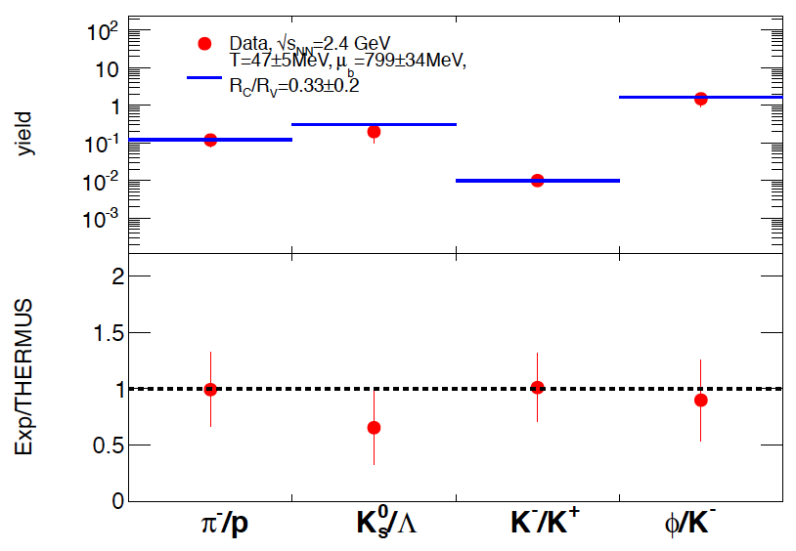
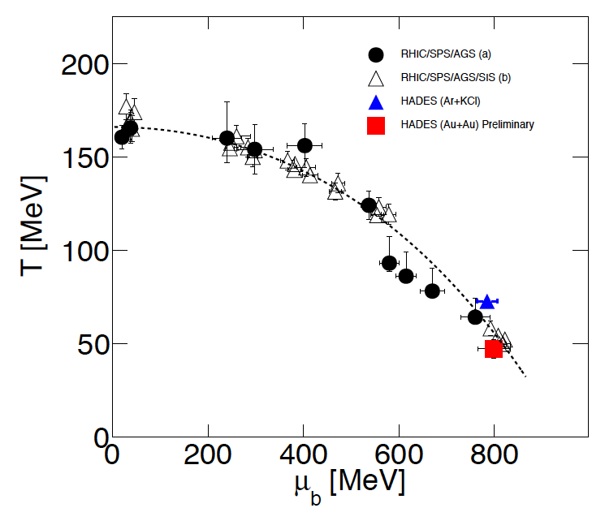
Statistical model fit: first attempt Au+Au
Data √s = 2.4 GeV
T = 47±5 MeV, μ = 799±34 MeV
R_{c}/R_{v} = 0.33±0.20
Au+Au 1.25A GeV
First attempt of statistical model fit to ratios gives reasonable values:
T= 47±5 MeV
µ_{B}= 799±34 MeV
R_{c}/R_{v}= 0.3±0.2 (no systematical errors!!)
Manuel Lorenz
THERMUS: S. Wheaton, J.Cleymans: Comput.Phys.Commun.180:84-106,2009

Slide 10
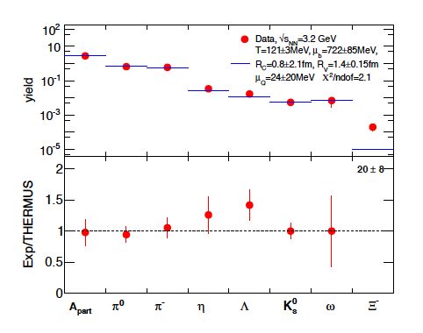
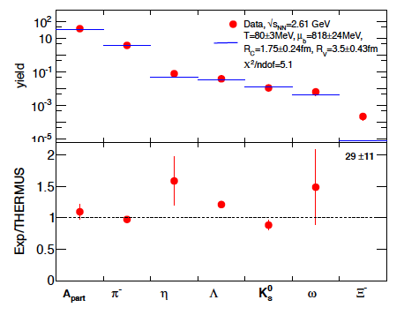
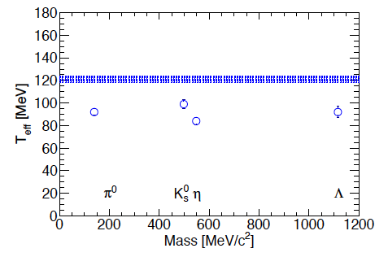
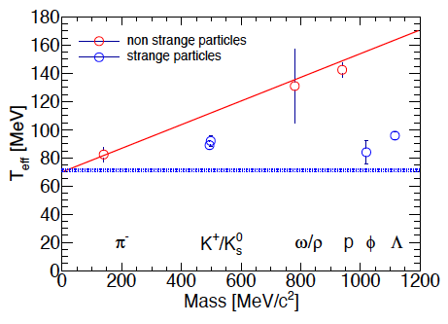
Statistical model fit to p+Nb data
p+Nb 3.5 GeV
Ar+KCl 1.8 AGeV
T_{chem}>T_{kin}
T_{chem}≤T_{kin}
Manuel Lorenz
Fit to p+Nb looks more reasonable ..?!

Slide 11
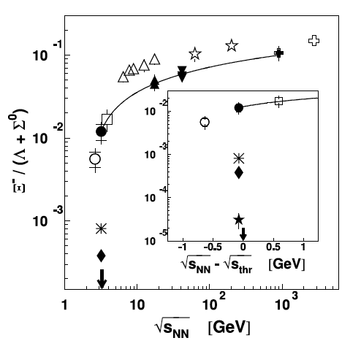
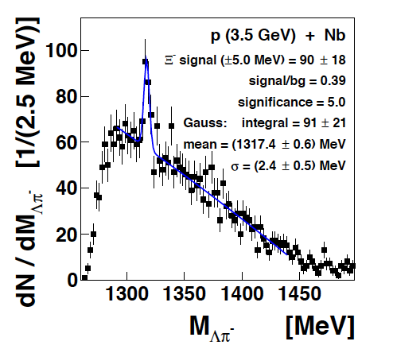
Exoticas: Subthreshold Ξ⁻
Phys.Rev.Lett. 114 (2015) 21, 212301
THERMUS
GiBUU
UrQMDv3.4
Subthreshold Ξ⁻ production in p+Nb collisions at
E_{beam}= 3.5 GeV →√s-√s_{th}=-70MeV
Parameterization: f(x)=C(1-(D/x)^{G})^{H}
Excess already present in
cold nuclear matter!
Manuel Lorenz
Notes:
Pro’s
• Infer matter properties/
potentials/equilibration times
• Provides hints for novel
processes (ropes?)
• Explore subthreshold
multi-step processes
• Explore canonical effects
Con’s
• Experimentally not well explored
• Difficult to measure (dileptons,multi-particlecorrelation)
• Theoretically not well understood

Slide 12
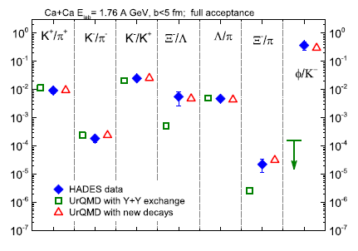
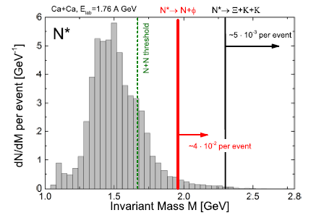
Modelling strangeness production in heavy ion reactions
Introducing branching ratios to Φ, Ξ
for heavy resonances:
constrained by elementary reactions (e.g. p+Nb or p+p data)
small and consistent with OZI rule
branching ratios needed in the tails of the resonances
Markus Bleicher
UrQMD
PHSD: Daniel Cabrera
Pierre Moreau
URQMD: Hendrik van Hees
Ref. calculations: Boris Tomasik...

Slide 13

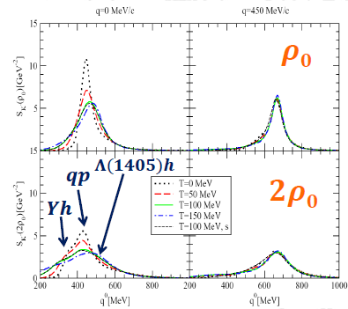
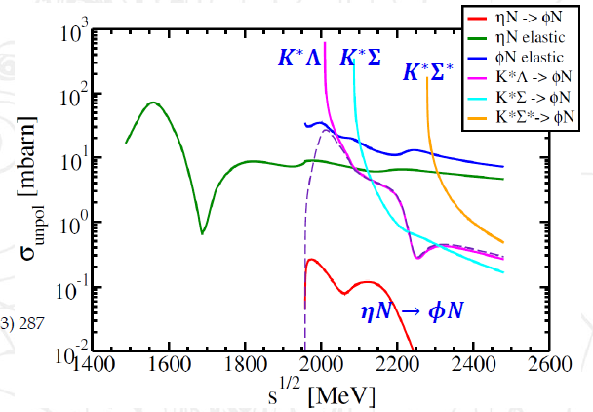
Modelling strangeness production in heavy ion reactions
K/KN in hot/dense matter: self-consistent and unitary coupled-channel approach
Binary reactions:
cross sections/transition rates
Propagation:
K, K and Y optical potentials
Production:
K, K (off-shell) spectral functions
ϕ and Ξ production in the hadronic phase
ηN channel small
strangeness exchange
Daniel Cabrera
K spectral function

Slide 14
Strangeness production mechanisms at SIS energies
Notes:
Disentangle contribution of different strangeness production mechnaismis in elementary reactions pp p+Nb

Slide 15
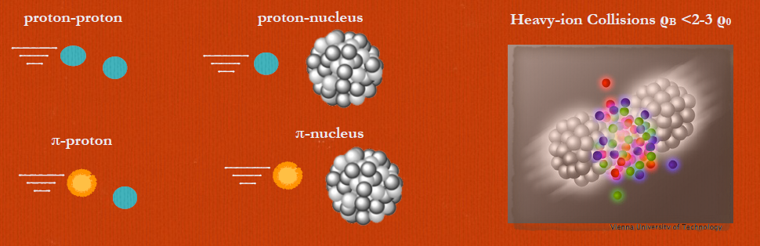
Elementary reactions
p+p/Nb Laura Fabbietti
Rafal Lalik
Oliver Arnold

Slide 16
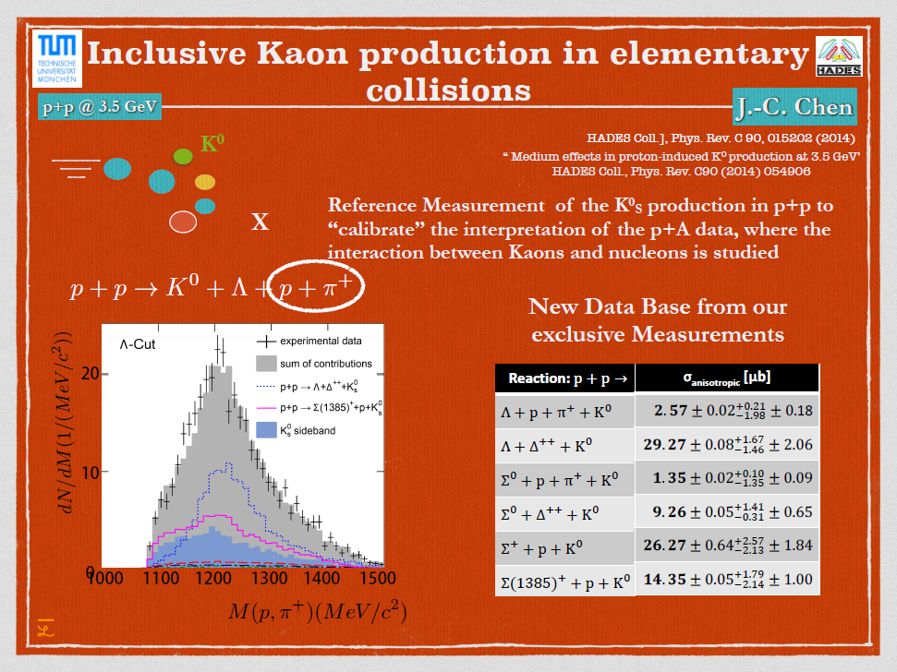
Laura Fabbietti

Slide 17
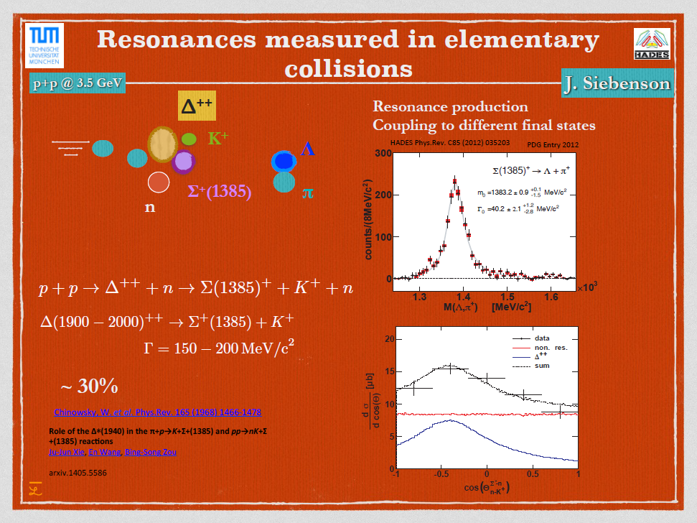
Laura Fabbietti

Slide 18
Search for the critical point

Slide 19
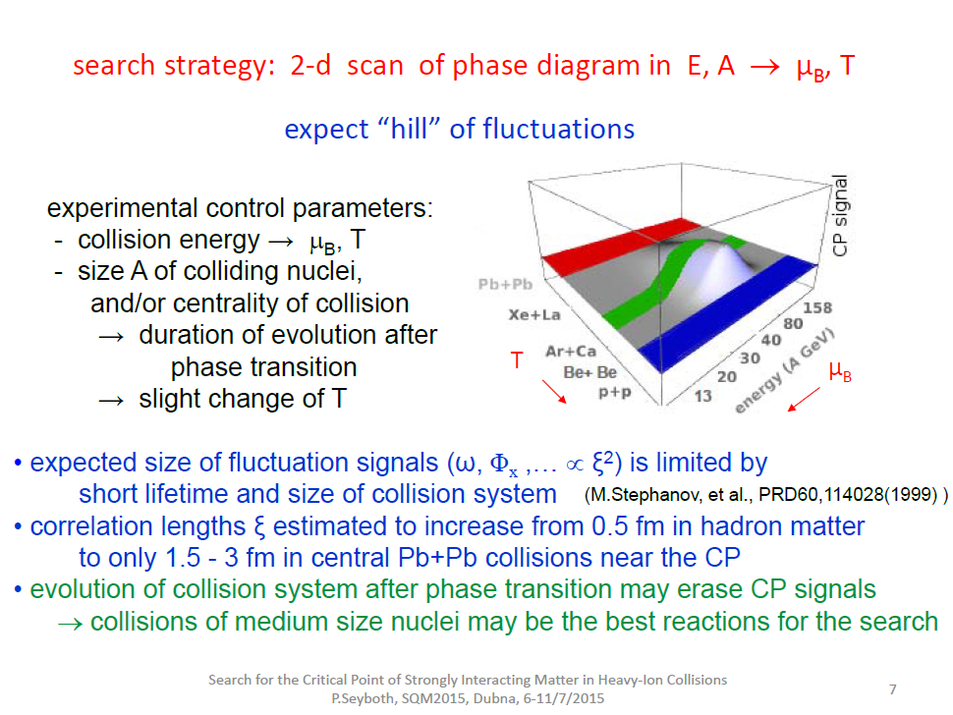

Peter Seyboth

Slide 20
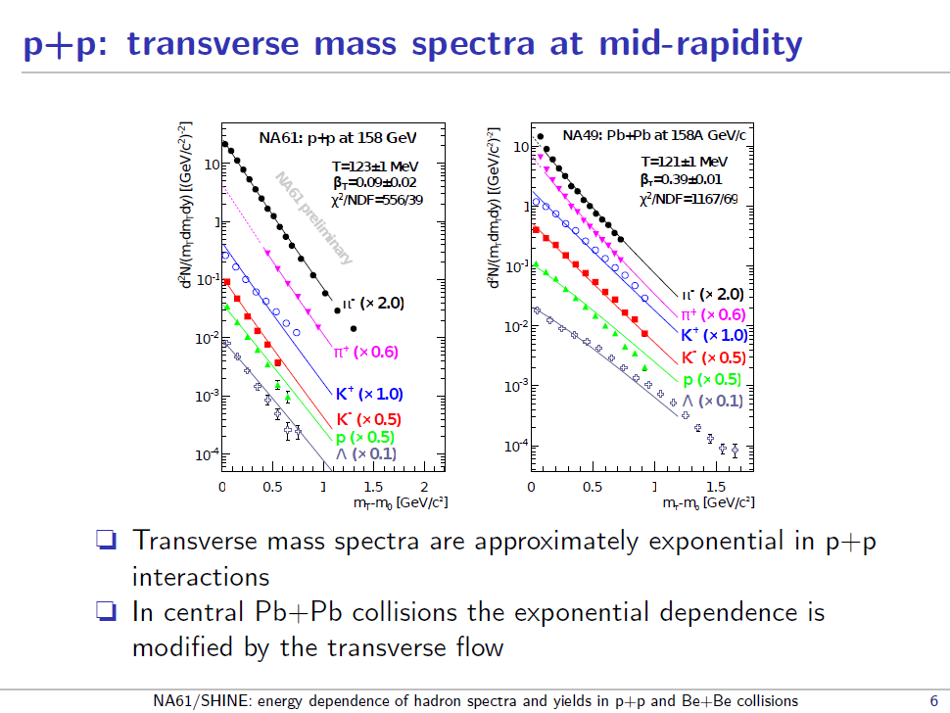
Dag Larsen

Slide 21
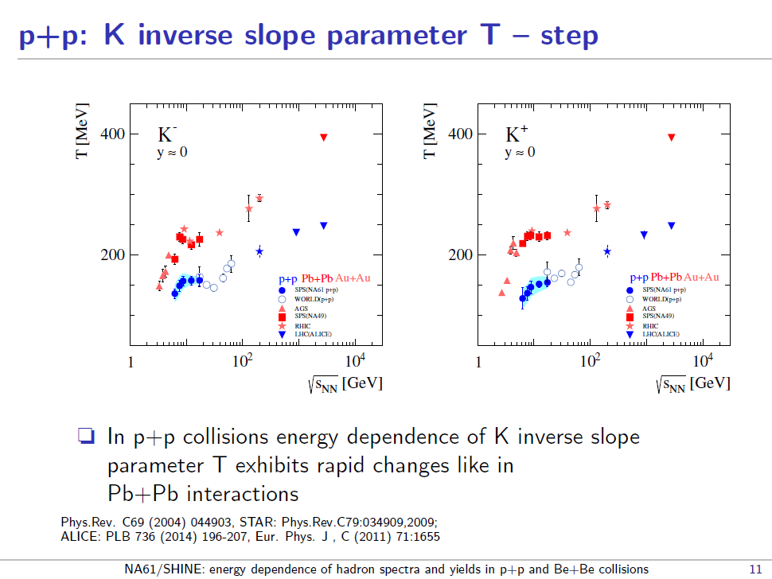
Dag Larsen
Andrey Seryakov
Evgeny Andronov

Slide 22
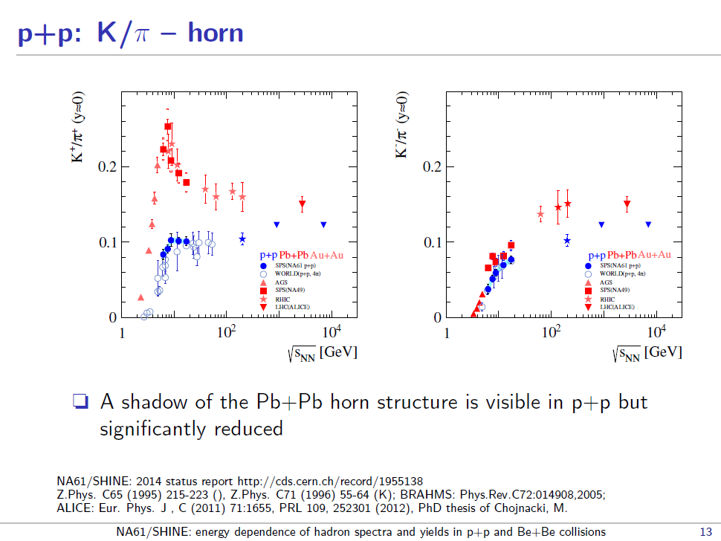
Dag Larsen

Slide 23
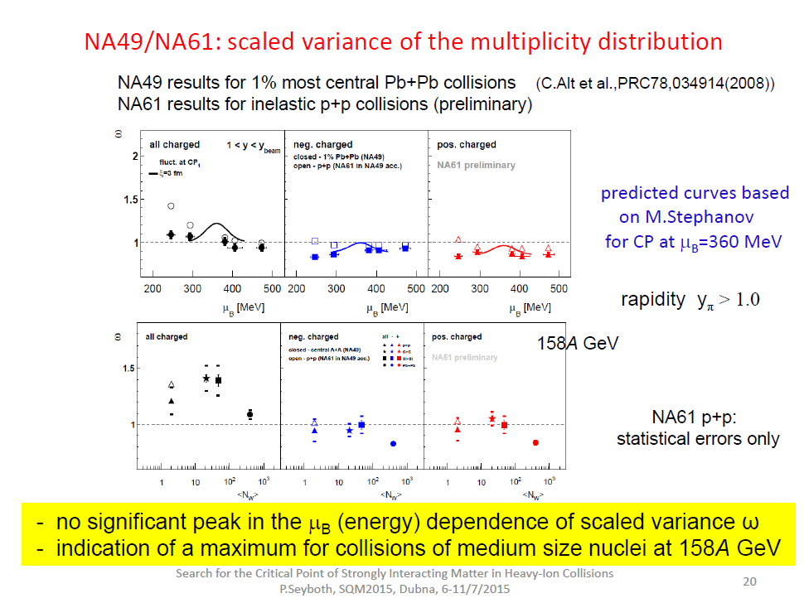
κ₂ = <(δN)²>
ω₂ = κ₂/<N>
P. Seyboth

Slide 24
Production of nuclei and hyper matter

Slide 25
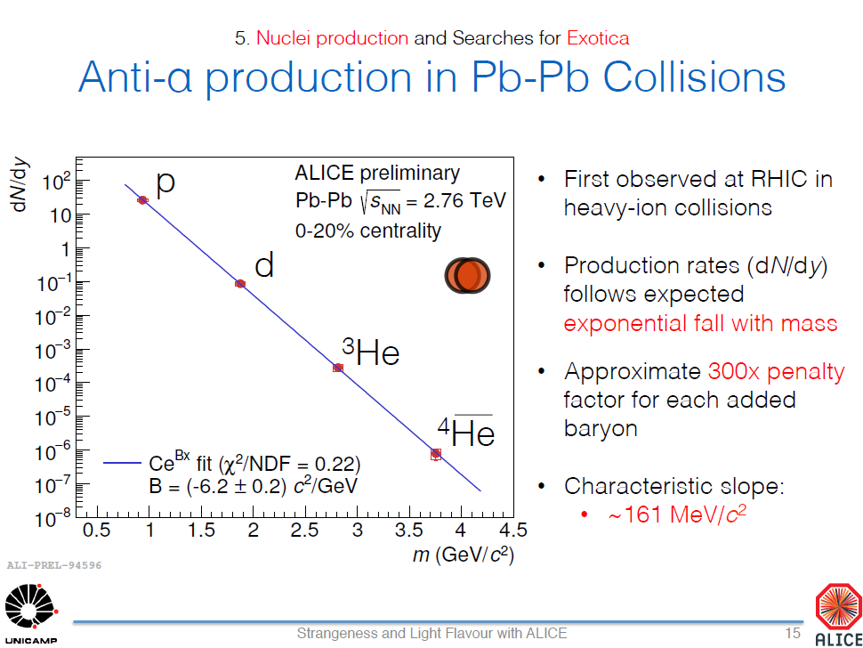
David Chinellato

Slide 26
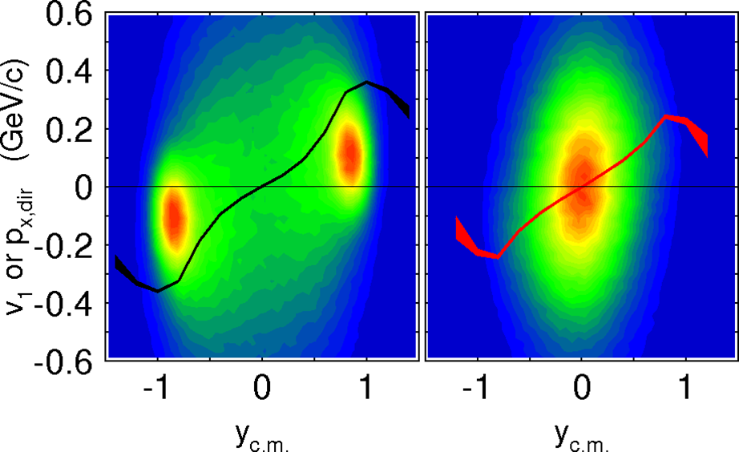
Hyperon interactions and hypernuclei production in heavy ion collisions
Protons
Lambdas
Experiments
SIS: HYPHI, FOPI, HADES
AGS: E864
RHIC: STAR
LHC: ALICE
Hypernuclei:
HYPHI C. Rappold
ALICE D. Chinellato
F. Barile
Theory A. LeFevre, V. Kireev
A. Botvina
Interactions:
STAR J. Shen
Hyperon puzzle:
I. Vidana, E. Kolomeitsev, D. Alvarez-Castillo, ....
Ni+Ni 2A GeV b<3.3 fm
no missing mass – invariant mass
rare fragments, population of n/p-rich isotopes
multi-strange objects - production of XXL-Hypernuclei

Slide 27
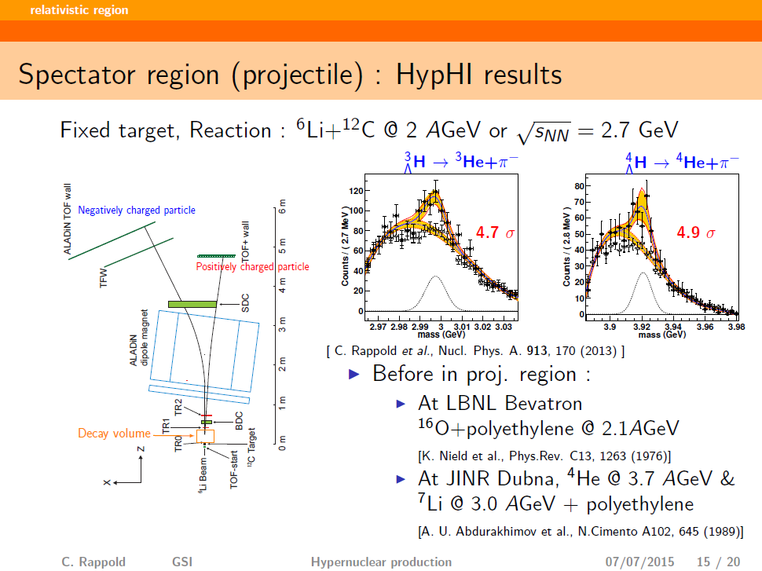
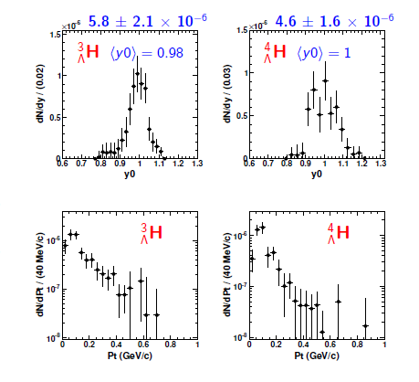
Christophe Rappold

Slide 28
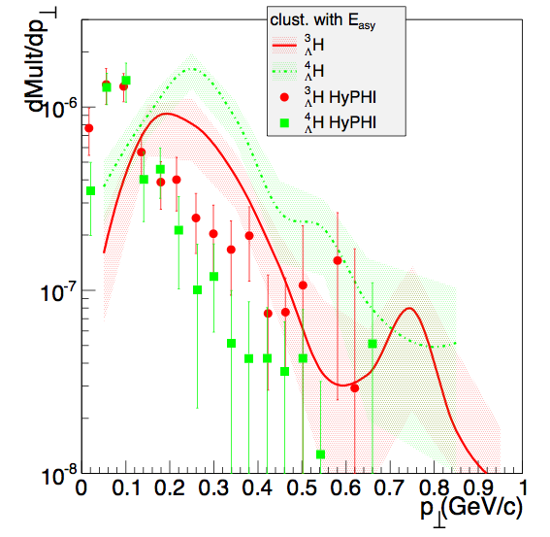
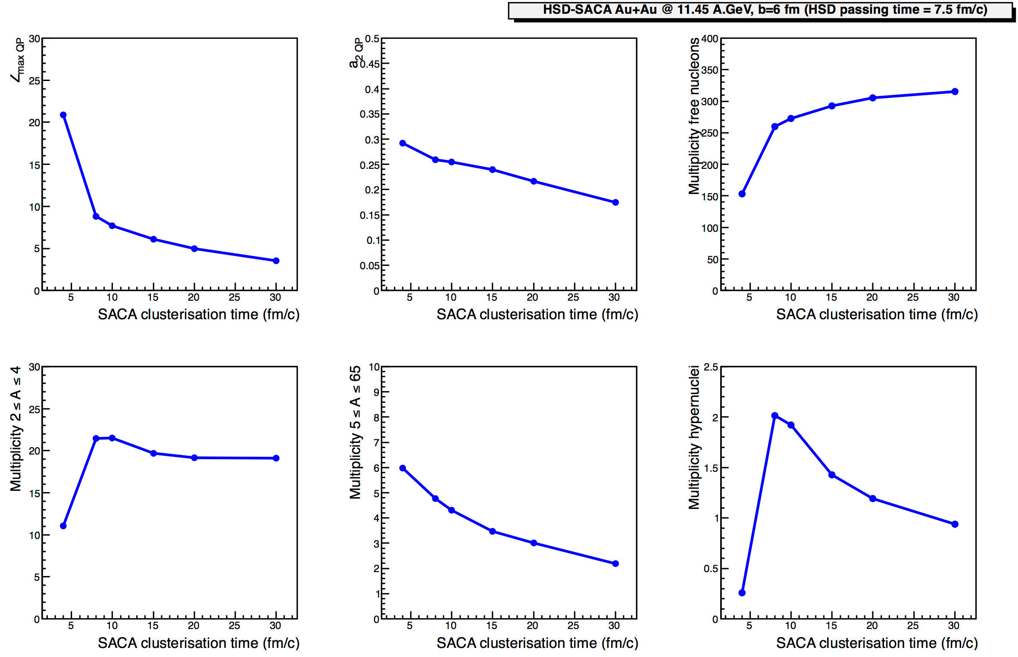
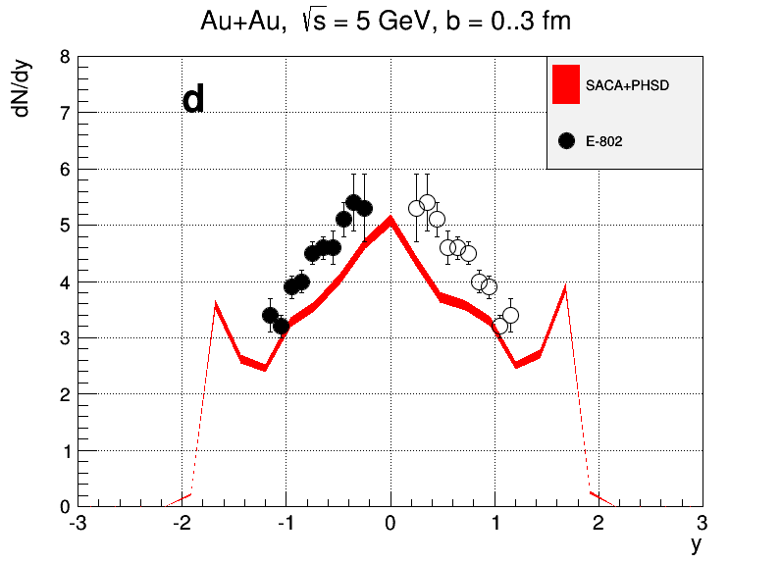
PHSD (IQMD) + FRIGA: Clusterisation time influence
on hypernuclei (phase space and yields)
Λt
n
p
Λ
An example: Au+Au @ 11.45 A.GeV, b=6 fm (passing time = 7.5 fm/c) from
Ingredients to the binding energy of the clusters:
Volume component: mean field (Skyrme, dominant), for NN, NΛ (Hypernuclei)
Surface effect correction: Yukawa term.
Asymmetry energy
Extra « structure » energy (N,Z,ρ) = BMF(ρ).((Bexp-BBW)/(BBW-BCoul-Basy))(ρ0)
³He+n recombination.
Secondary decays
(Zmax1 - Zmax2)
(Zmax1 + Zmax2)QP
Zmax1 QP
pHSD-FRIGA
t = 20 fm/c
AGS data E802
⁶Li + ¹²C
free nucleon
multiplicity
multiplicity
5 ≤ A ≤ 65
multiplicity
2 ≤ A ≤ 4
hypernucleus
multiplicity
FRIGA clusterisation time (fm/c)
Arnaud Le Fèvre

Slide 29
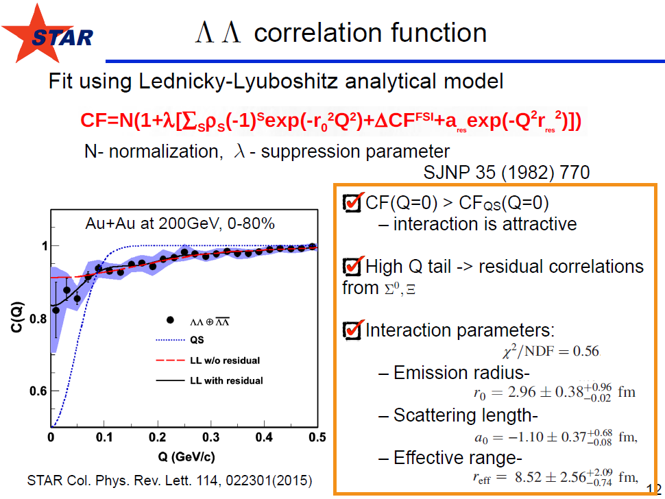
Jinhui Chen

Slide 30
Summary of the summary

Slide 31
Summary
New “high rate” experiments at SIS18 with
  high intensity beams and high quality data and rare probes
  exotica – double strangeness production at sub-sub-threshold energies
Elementary reactions to understand
  disentangle reactions channels for strangeness production at threshold energies, PWA analysis
  contribution of high mass resonances to strangeness production
  more data needed to disentangle role of resonances and production mechanisms of strange particles in HICs
Search for critical point
  baseline pp data from SHINE
  interesting hints were found in the energy and system size dependence of critical point sensitive fluctuation observables
Production of hyper matter
  understanding the ΛN and ΛΛ interaction in dense matter
  ΛΛ interaction at STAR
  (Anti) Hypernuclei production mechanisms?

Slide 32
Outlook
New facilities

Slide 33
Present and future HI machines
Fixed target:
L-limited by
detectors
Colliders:
scale of L,
in cm⁻²s⁻¹
20??
SIS-300 (FAIR)
10²⁷
10²⁵
10²³
2021
SIS-100 (FAIR)
2019
Expected region of phase transition at max baryonic density
NICA (JINR)
2017
Booster (JINR)
Nuclotron-M (JINR)
BES
RHIC (BNL)
in operation
SPS (NA-49/61, CERN)
AGS (BNL)
SIS-18 (GSI)
2
4
6
8
20
40
60
80
√S_{NN}, GeV
1
10
10²
for Au+Au

Slide 34
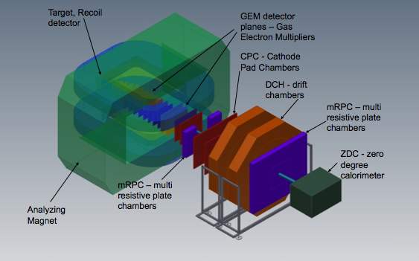

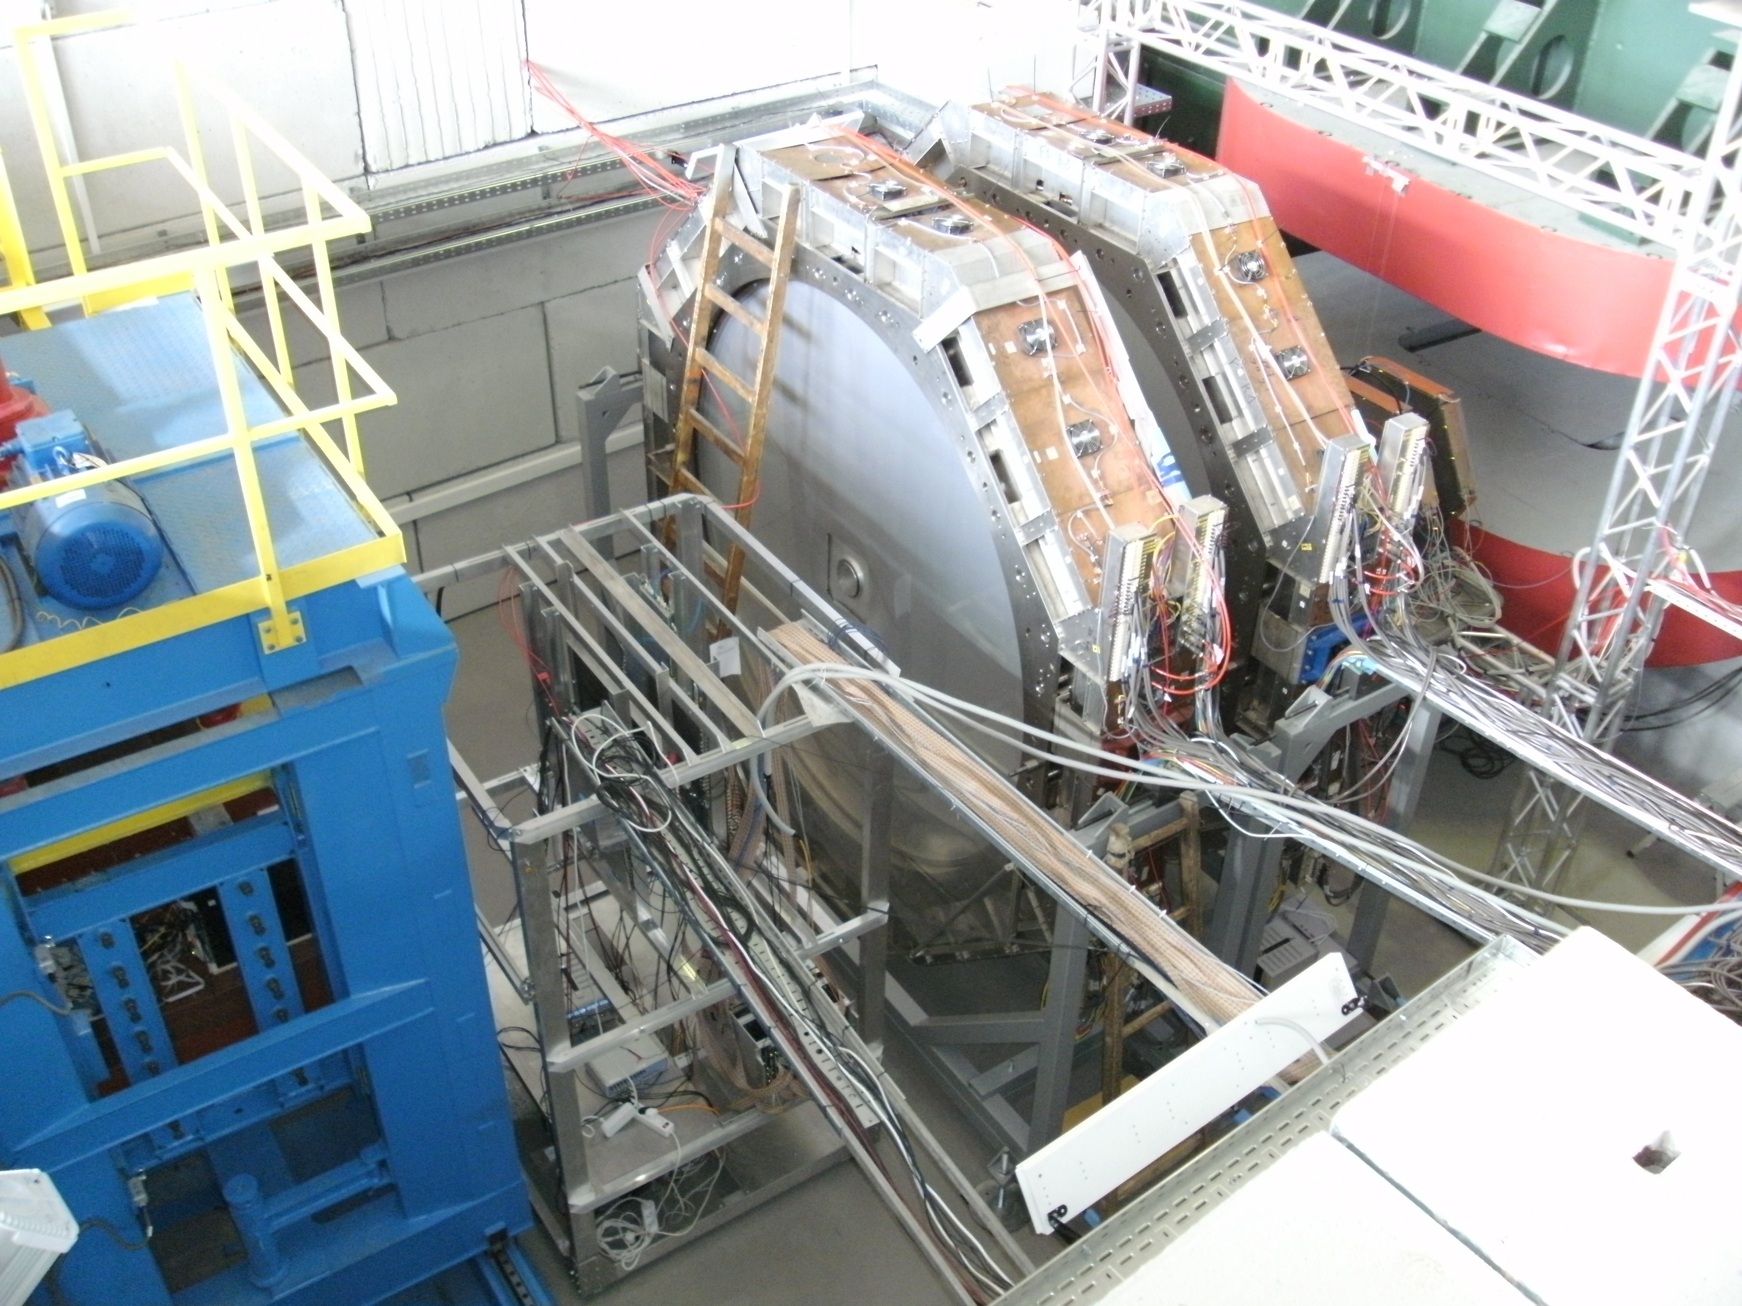
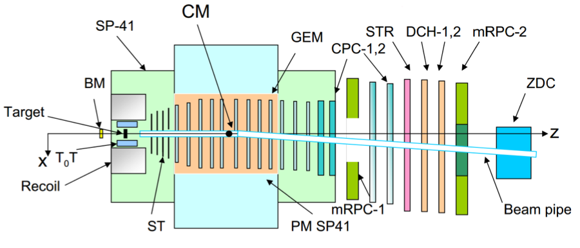
BM@N (Baryonic Matter at Nuclotron): the 1st stage
Expression of interest from scientists:
IN, SINP MSU, IHEP + S-Ptr Univ. (RF);
GSI, Frankfurt U., Gissen U. (Germany):
+ CBM-MPD IT-Consortium,
Physics:
hyperon production
hadron femtoscopy
in-medium effects for strange
& vector mesons
electromagnetic probes (optional)
BM@N schematic view
magnet
area prepared
for detector installation
DCH-1,2
ZDC
ToF-700
Scint-700

Slide 35
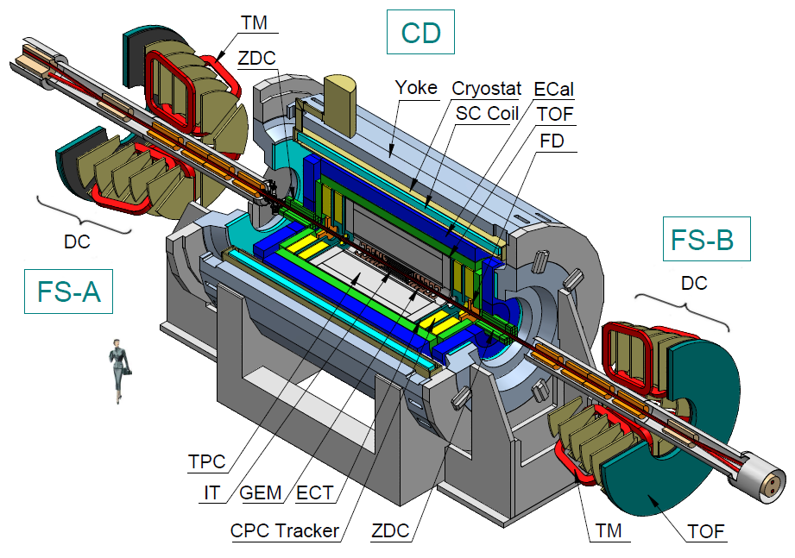
Experiments at NICA:
MultiPurpose Detector (MPD)
at the Collider

Slide 36

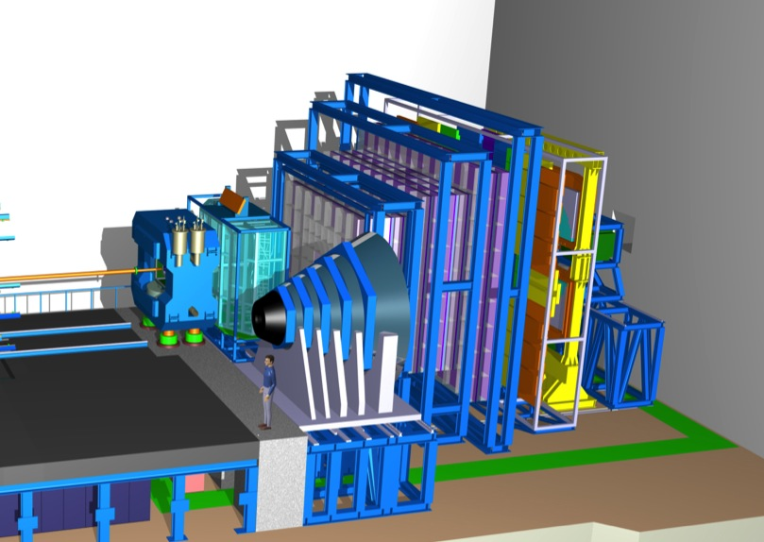
CBM: Experiment Systems
TRD
TOF
RICH
Dipole magnet +
Silicon Tracking System
PSD
Muon System

Slide 37
Thank you to all of you for making this conference a success and ...
thank you to the organizers

Slide 39
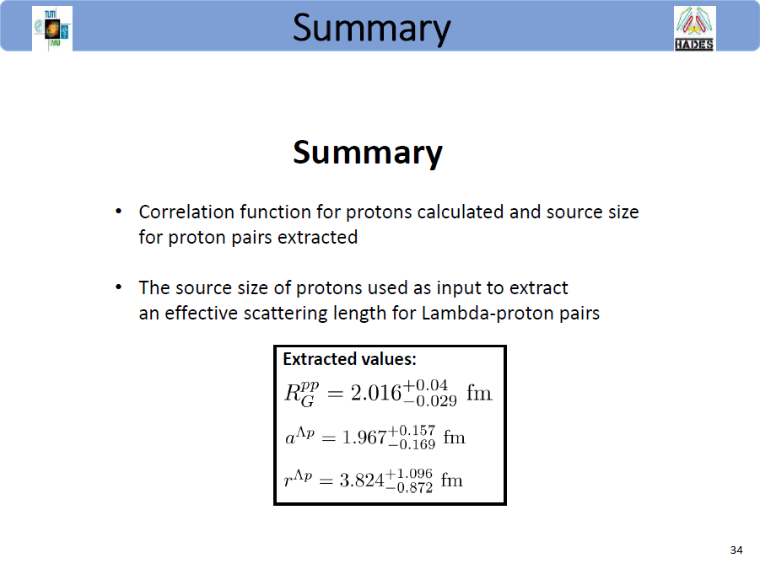
Oliver Arnold

Slide 40
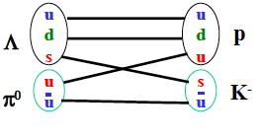
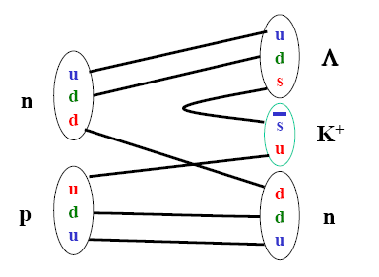
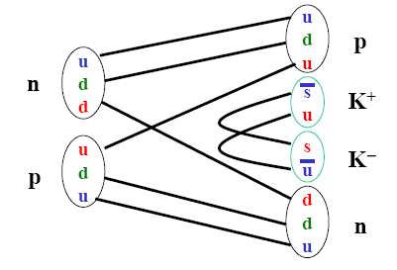
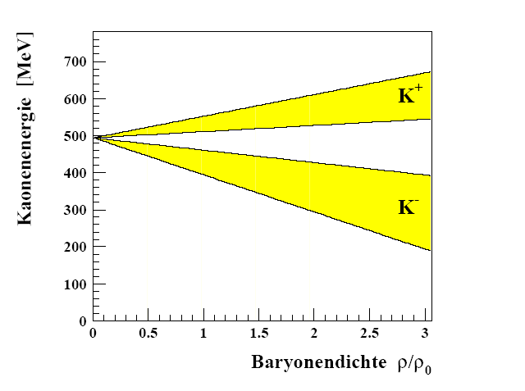
Strangeness production
Elementary collisions
Heavy-ion collisions
Accumulation of energy in multi–step processes
Strangeness exchange reactions + potentials
In-medium potentials
Schaffner-Bielich
Different production thresholds
for K⁺⁻ due to quark content

