Slide 1
Strangeness in Quark Matter Conference in Utrecht, the Netherlands in 2017
Approved by the IAC on 7 July 2015

Slide 2
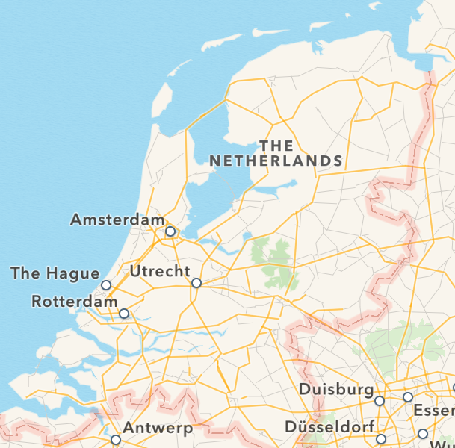
Location and transportation
How to reach Utrecht
By plane: Schiphol International Airport; fifth largest airport in Europe
Direct train connection to Utrecht every 30 min (travel time 30 min; free WLAN)
By train ICE and Thalys connections (3.5h to Frankfurt and Paris)
By car
airport

Slide 3
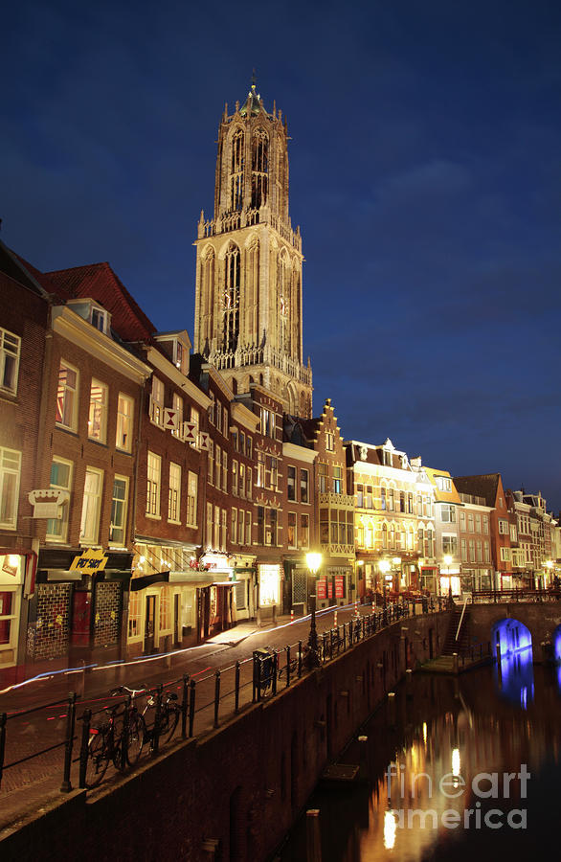
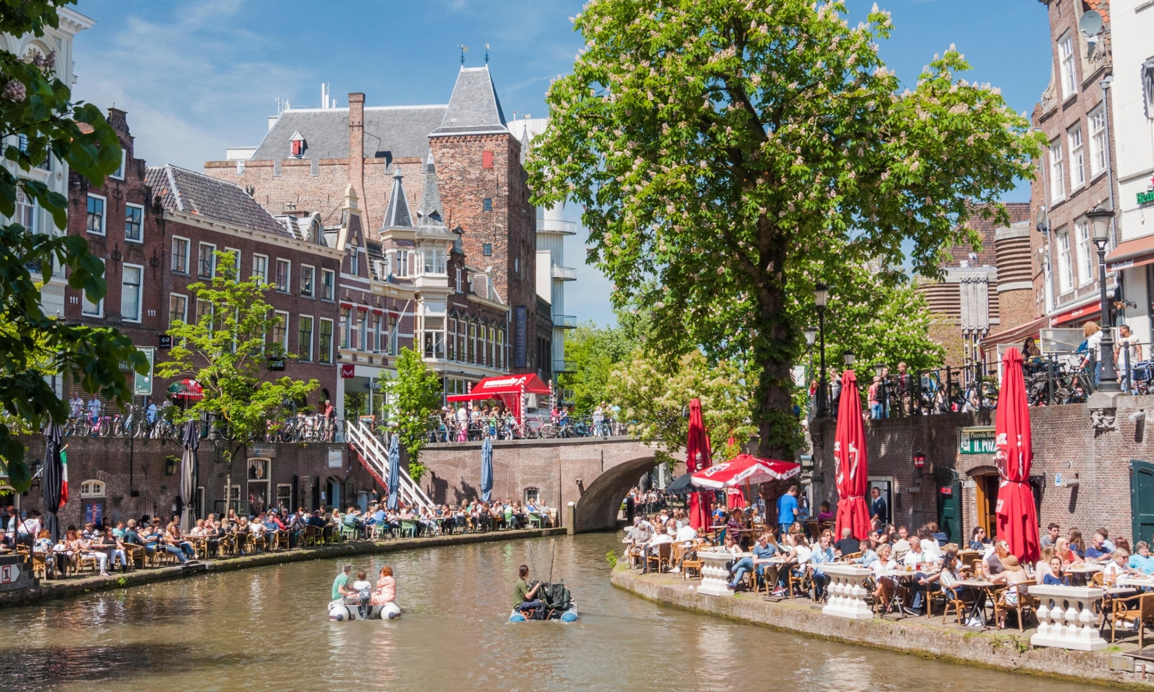
Utrecht
330,000 habitants
Many restaurants, cafés and bars
Hosted many big events, e.g. Start Tour de France 2015

Slide 4
Strangeness in Quark Matter Conference in Utrecht, the Netherlands in 2017
Looking forward to welcoming you in Utrecht

