Slide 1




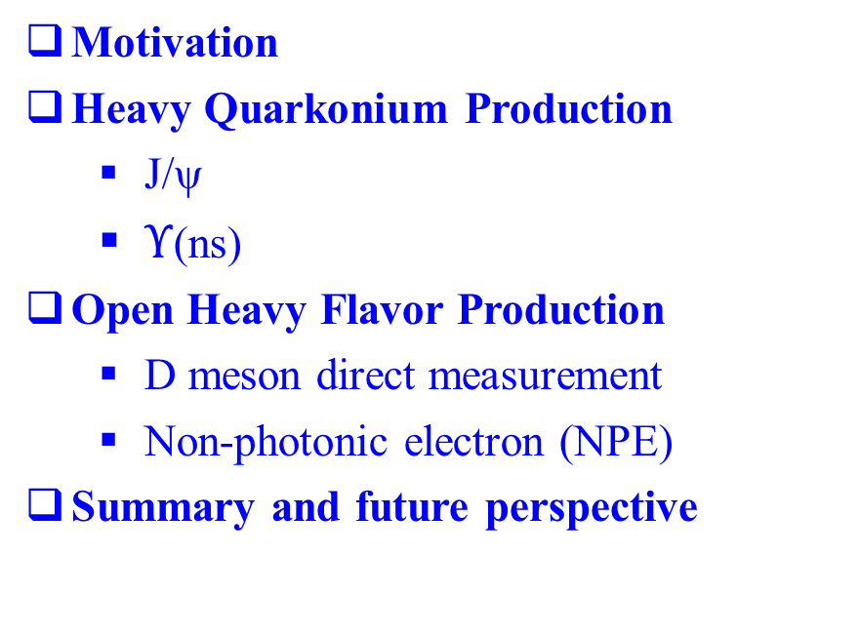
Heavy flavor production and the properties of sQGP at top energies
Wei Xie for STAR Collaboration
(PURDUE University, West Lafayette)
Motivation
Heavy Quarkonium Production
  J/ψ
  $Υ$(ns)
Open Heavy Flavor Production
  D meson direct measurement
  Non-photonic electron (NPE)
Summary and future perspective

Slide 2
Motivation
Heavy quarkonium production reveals critical features of the medium
  suppression from color screening or gluon scattering
  enhancement from coalescence
Heavy quarks interact with the medium differently from light quarks
  gluon bremsstrahlung radiation
  collisional energy loss
  collision dissociation
  Ads/CFT
Cold Nuclear effects
  Gluon shadowing , Color glass condensate, Initial state energy loss, etc
Sensitive to the nuclear gluon distribution and medium initial gluon density
    produced mostly from gluon fusion

Slide 3
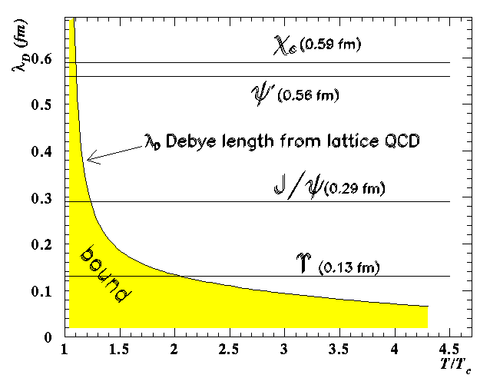
Quarkonium Suppression: “Smoking Gun” for QGP
Low temperature
Vacuum
c
c
Low temperature
Vacuum
J/ψ
High temperature
High density
(screening effect takes place)
d
d
Courtesy of Bill Zajc
D⁻
Sequential melting→a QGP thermometer
H. Satz, NPA 783 (2007) 249c.
D⁺

Slide 4
The life of Quarkonia in the Medium can be Complicated
Observed J/ψ is a mixture of direct production+feeddown (H.K.Wohri @QWG2014)
  Prompt J/ψ : ~ 60% J/ψ(direct) + 30% χ_{c} feed down + ~10% ψ(2s) feed down
  Non-prompt: B meson feed down.
    Important to disentangle different components
Suppression and enhancement in the “cold” nuclear medium
  Nuclear Absorption, nuclear PDF effects, initial state energy loss, Cronin effect and gluon saturation (CGC)
  Study p+A collisions
Hot/dense medium effects
  J/ψ, ϒ dissociation, i.e. suppression
  Recombination, i.e. enhancement
  Study different species, e.g. J/ψ, ϒ
  Study at different energies, e.g. RHIC, LHC
c
J/ψ
c
c
D⁺

Slide 5
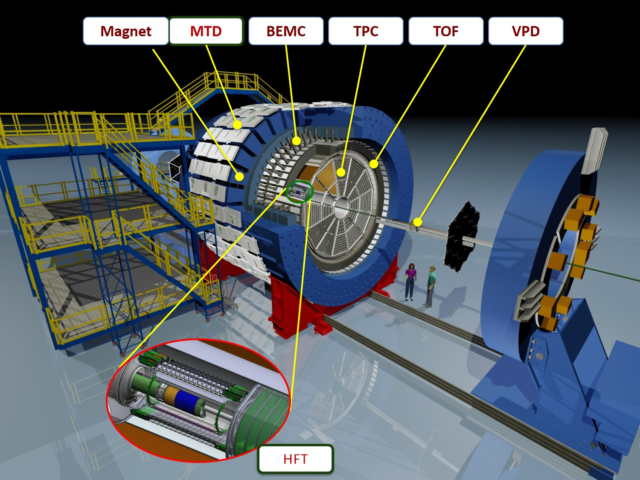
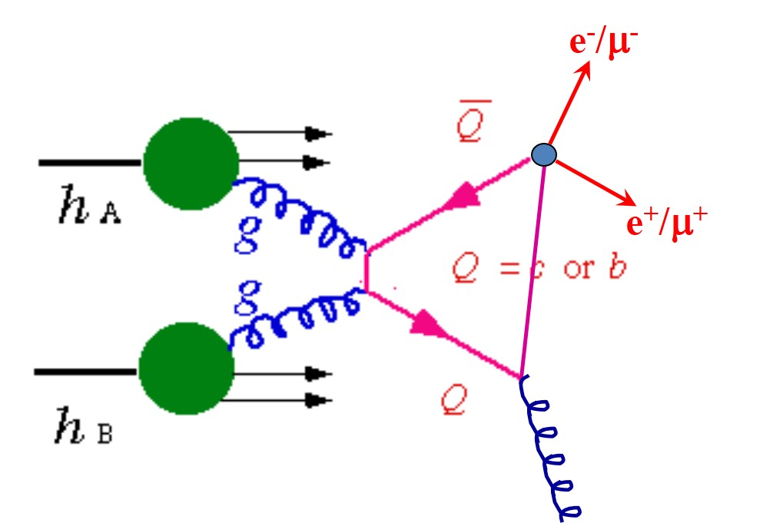




How does STAR Measure Heavy Quarkonia
Time Projection Chamber
(TPC)
$\left|η\right|≤1.0$, full azimuth
Tracking.
PID through dE/dx
Time of Flight (TOF)
$\left|η\right|≤0.9$, full azimuth
PID through TOF
Timing resolution: ~85 ps
Barrel Electromagnetic Calorimeter (BEMC)
$\left|η\right|≤1.0$, full azimuth
p/E for electron ID
Fast online trigger
High resolution SMD
e/h separation
Heavy Flavor Tracker (HFT)
$\left|η\right|≤1.0$, full azimuth
PIXEL: X/X₀: ~0.4%/layer
High DCA resolution
  46µm@p_{T} = 0.75GeV/c Kaon
  ~30µm@high p_{T}
Muon Telescope Detector (MTD)
$\left|η\right|≤0.5$, 45% in azimuth
Muon identification
Muon trigger
High timing reso.: ~95ps
Good hit position resolution: ~1cm

Slide 6
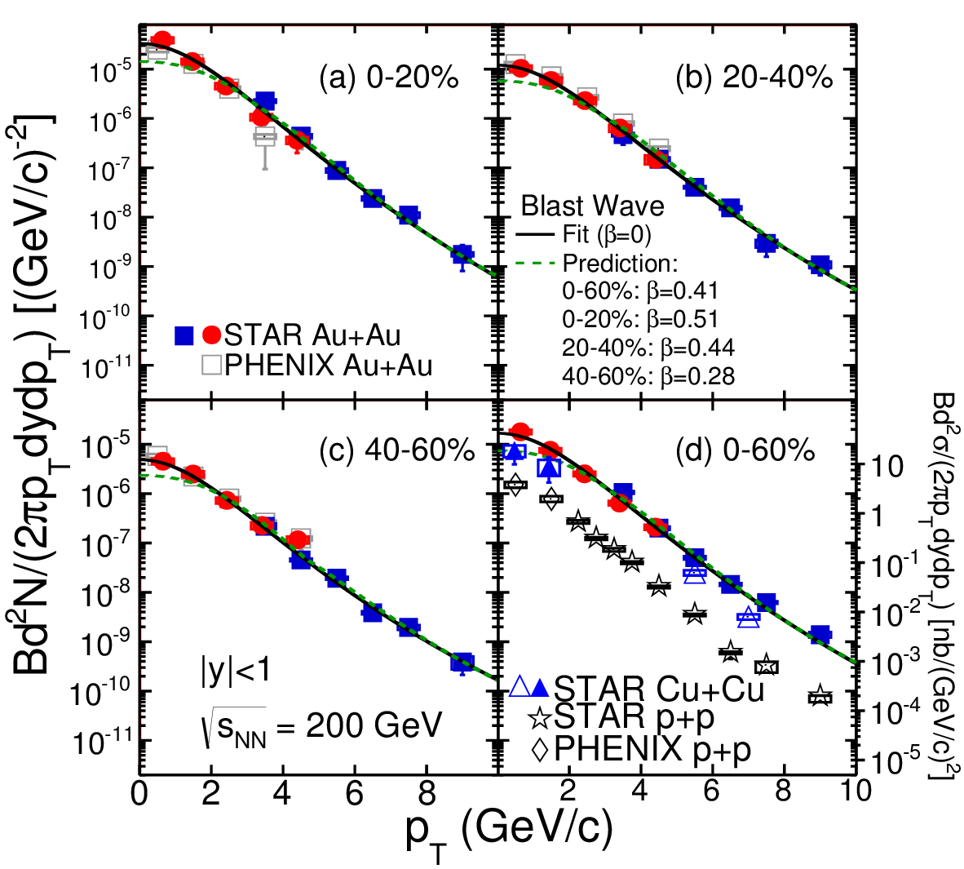
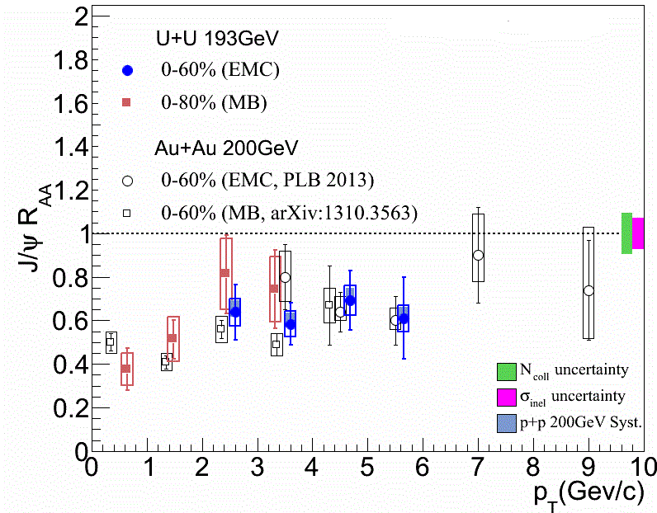

J/ψ R_{AA} in 200 GeV Au+Au Collisions
PRC 90, 024906 (2014)
Broad p_{T} coverage
TBW assuming J/ψ velocity
  zero (solid curve). Fit data well for all p_{T}
  same as light hadrons (dashed curve). Fit data at high p_{T}
Much smaller radial flow?
Regeneration at low p_{T}?
Tsallis Blast-Wave model: ZBT et al., arXiv:1101.1912.

Slide 7
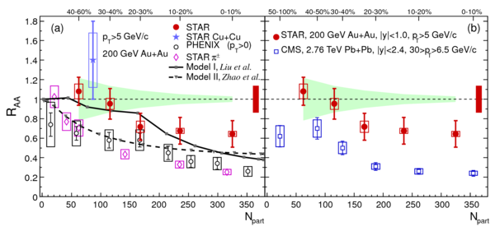
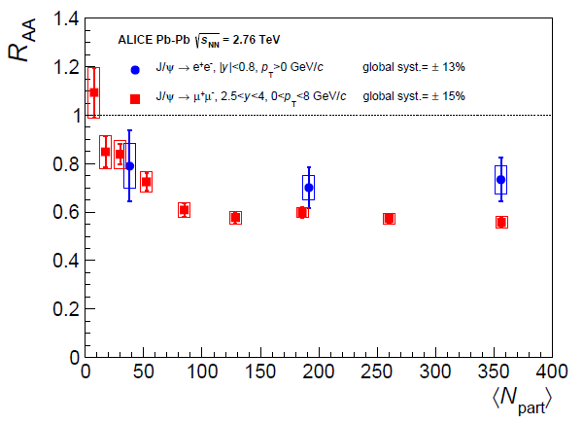
J/ψ Suppression Pattern: $\sqrt{S_{NN}}$ dependence
PLB 722(2013)55-62
CMS PAS HIN-12-014
arXiv:1311.0214
High p_{T} less suppressed than low p_{T}
  Cronin effect?
  Longer formation time?
Different dependence of R_{AA} on p_{T} at LHC
  Less suppression at lower p_{T} & higher collision energies
  Consistent with regeneration picture
Less regeneration than at LHC?
or larger shadowing at LHC?

Slide 8
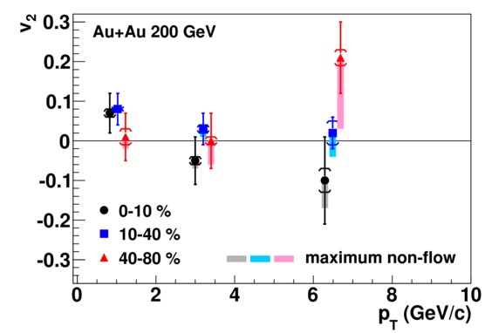
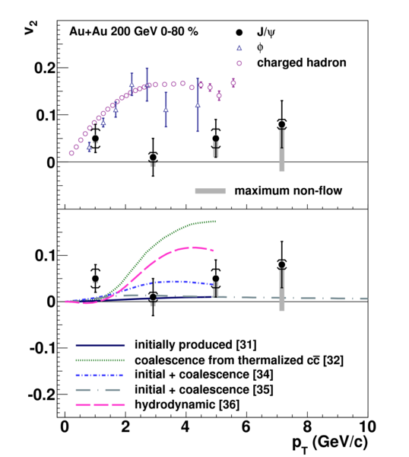
J/ψ Elliptic Flow in 200 GeV Au+Au Collisions
PRL 111, 052301 (2013)
Disfavors the case that J/ψ with p_{T} > 2.0 GeV/c is produced dominantly by coalescence from thermalized charm and anti-charm quarks
Finite v₂ from charm quark coalescence ?

Slide 9
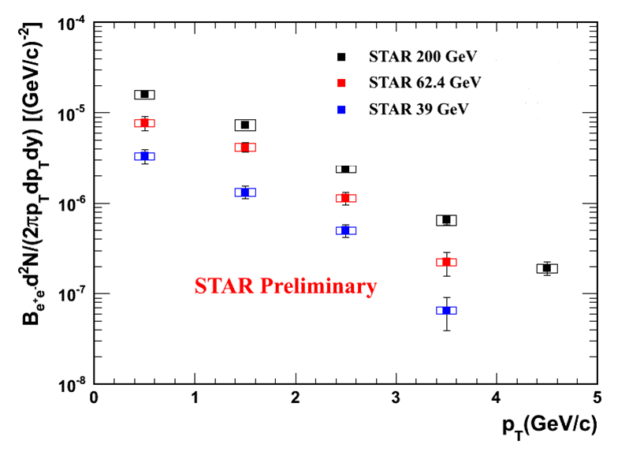
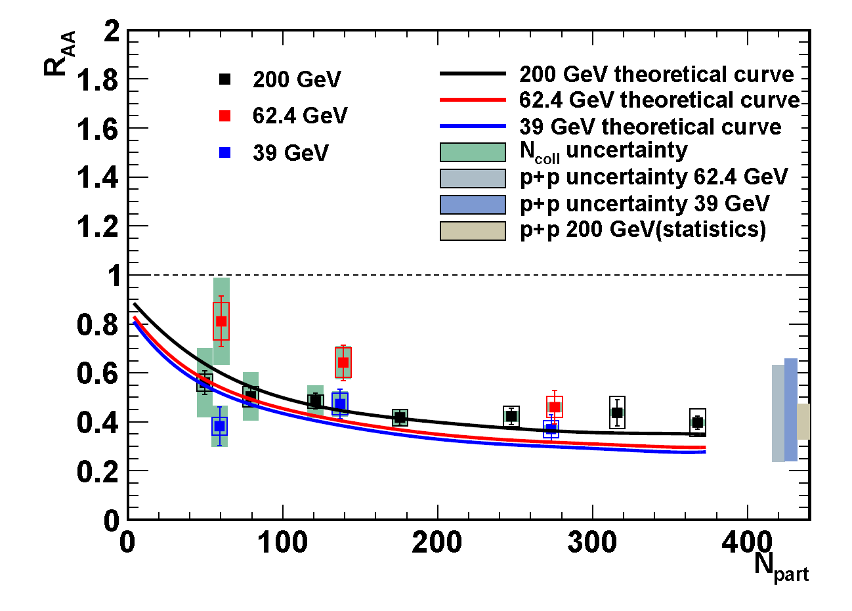
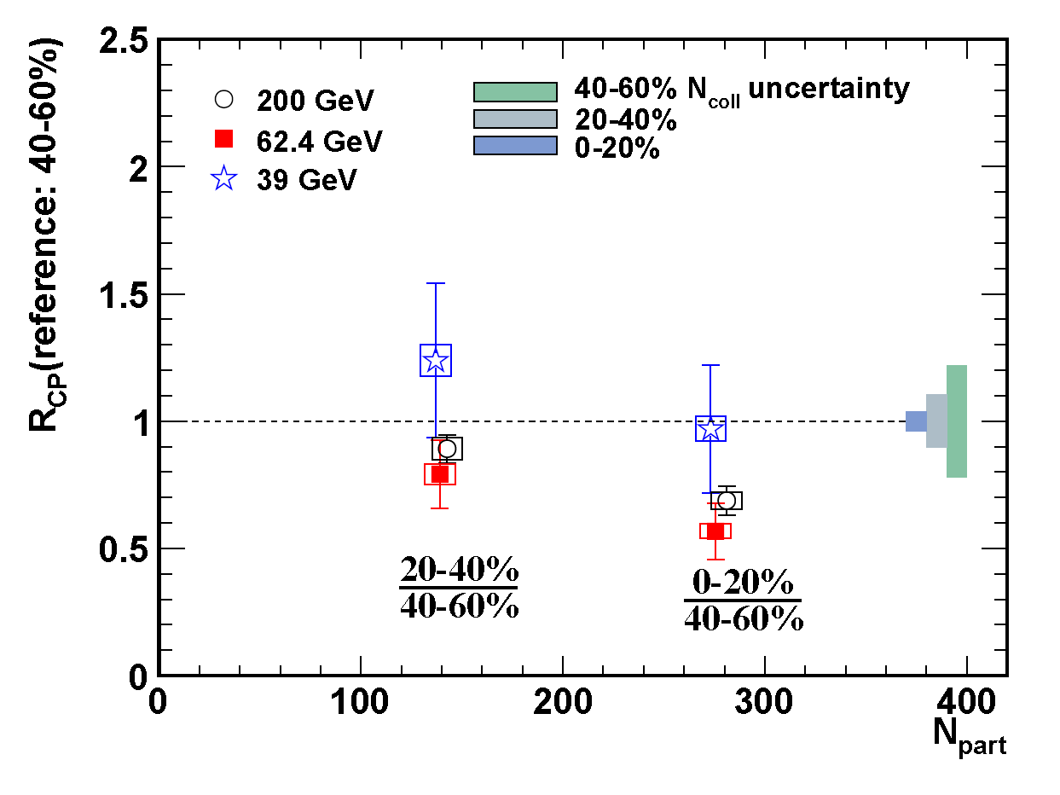
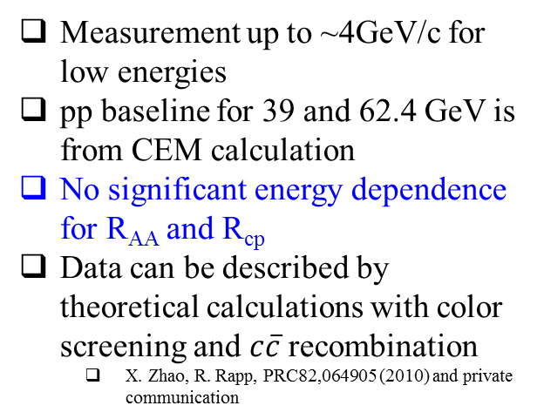
Suppression vs. Energy in Au+Au Collisions
Self-normalized Yields: ○(nS)/<○(nS)> Vs N_{tracks}
Measurement up to ~4GeV/c for low energies
pp baseline for 39 and 62.4 GeV is from CEM calculation
No significant energy dependence for R_{AA} and R_{cp}
Data can be described by theoretical calculations with color screening and $c\overline{c}$recombination
  X. Zhao, R. Rapp, PRC82,064905 (2010) and private communication

Slide 10
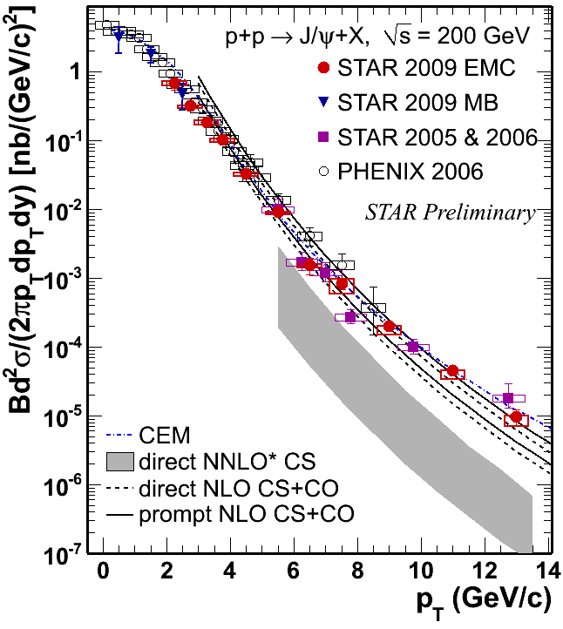
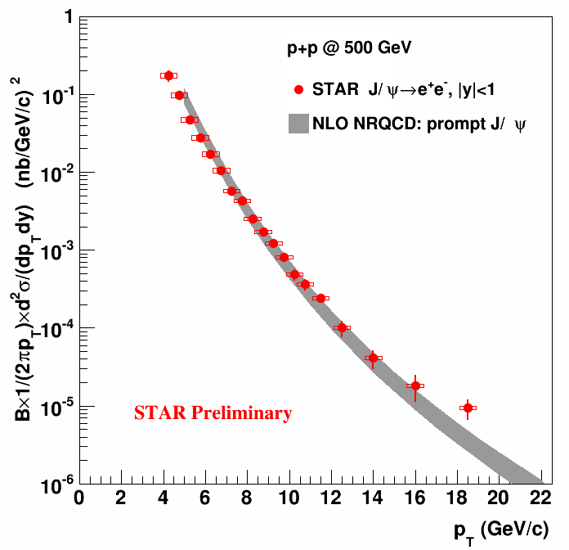
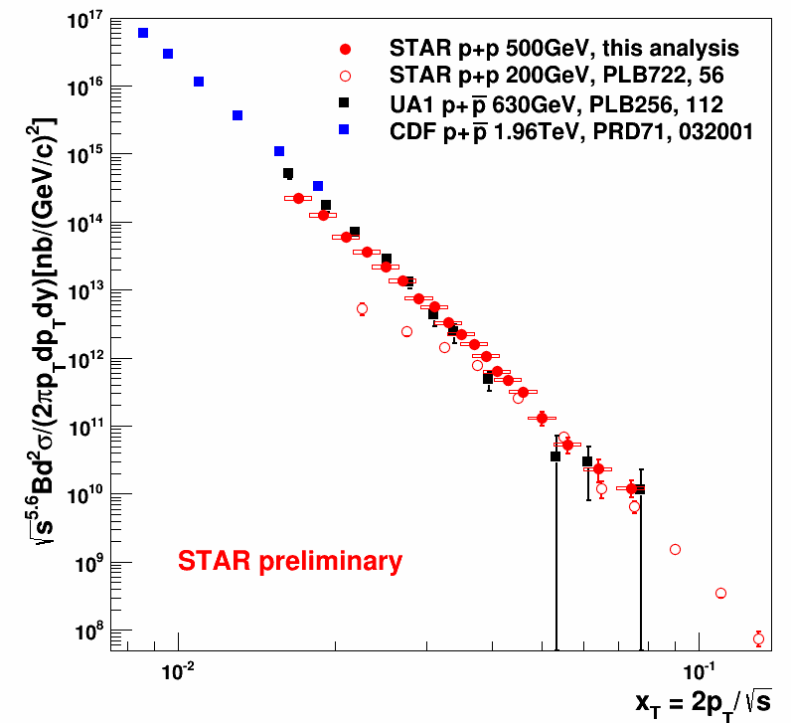
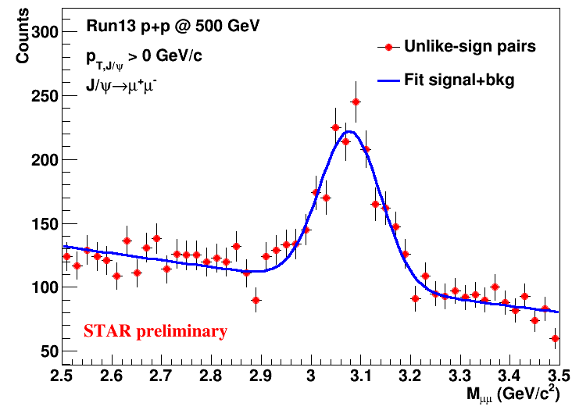
J/ψ Production in p+p Collisions
JPG38,124107(2011), PRC80,041902(R) (2009), PRC82,012001(2010)
Color singlet model (NNLO*CS)
  disagree with data
  P. Artoisenet et al., PRL. 101, 152001 (2008), and J.P. Lansberg private communication.
NLO CS+ CO & Color Evaporation Model & NRQCD
  agree with the data
  Y.-Q. Ma et al., Phys. Rev. D84, 51 114001 (2011), and private communication
  M. Bedjidian et al., hep-ph/0311048; R. Vogt private communication
Following x_{T} scaling in p+p collisions
MTD dimuon trigger greatly increase low p_{T} J/ψ accuracy
Details see B. Trzeciak’s talk
Notes:
NNLO*CS does not include feeddown from higher mass state
CEM include feeddown from Xc and psi’

Slide 11
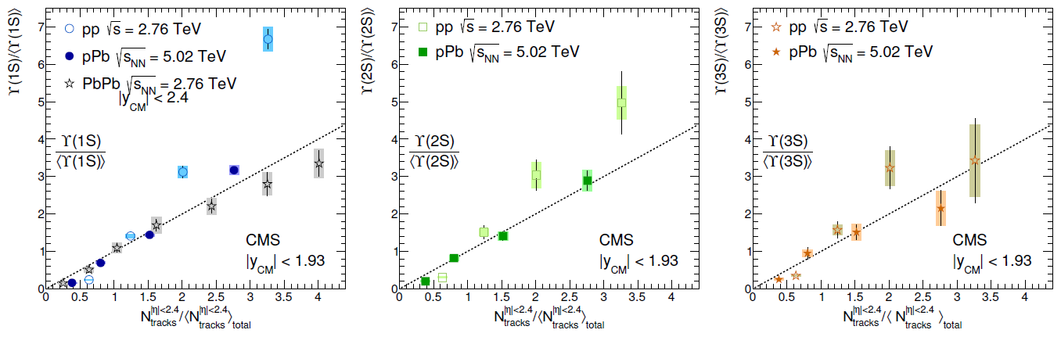
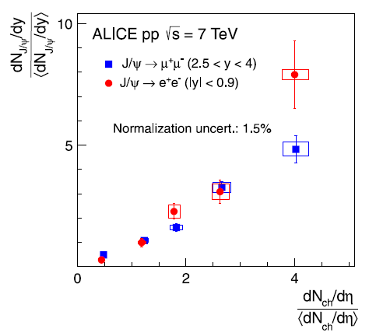
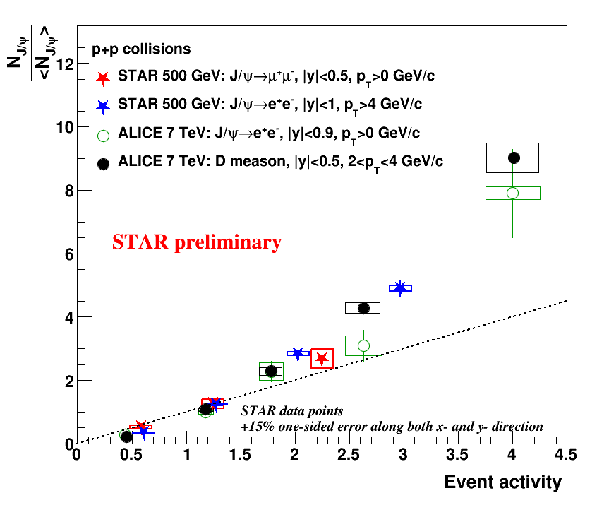
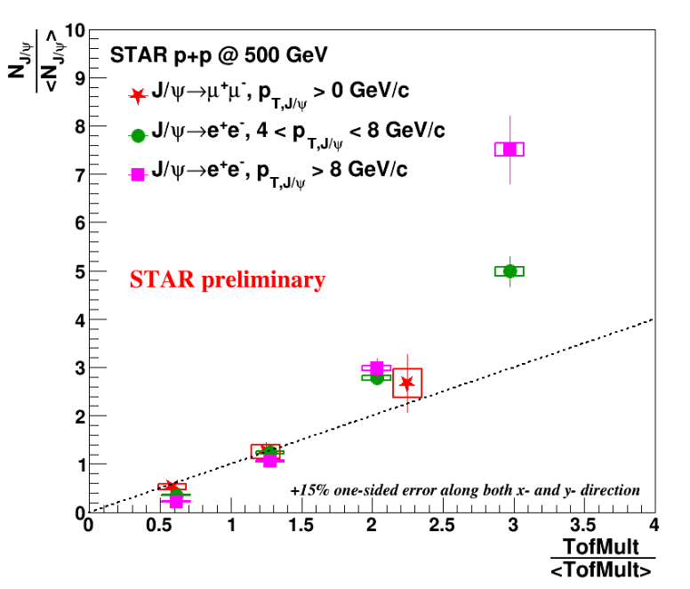
Enhancement in High Multiplicity p+p Collisions
Self-normalized Yields: ○(nS)/<○(nS)> Vs N_{tracks}
JHEP 04 (2014)103
PLB 712 (2012)165-175
HF production vs. event activity @LHC
  different trend in p+p and HI collisions
    Similar linear trend in p+Pb and Pb+Pb
    Faster rise in p+p
    Similar trend for J/ψ and D at mid-rapidity
Similar results in 500 GeV p+p @RHIC
  Rising trend seems similar
Multi-parton interaction, CGC in p+p collisions, etc?
How does it affect heavy-ion collisions?
Details see B. Trzeciak’s talk

Slide 12
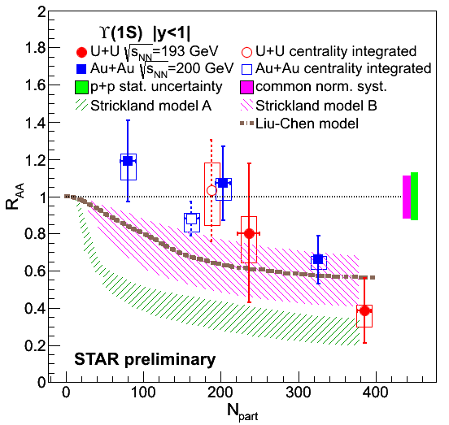
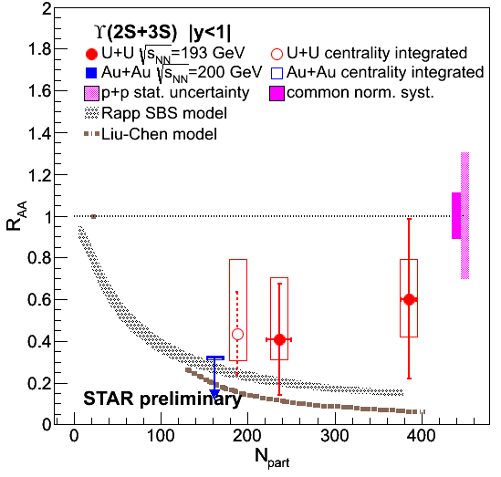
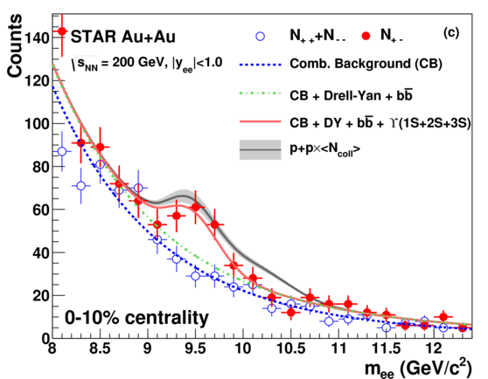
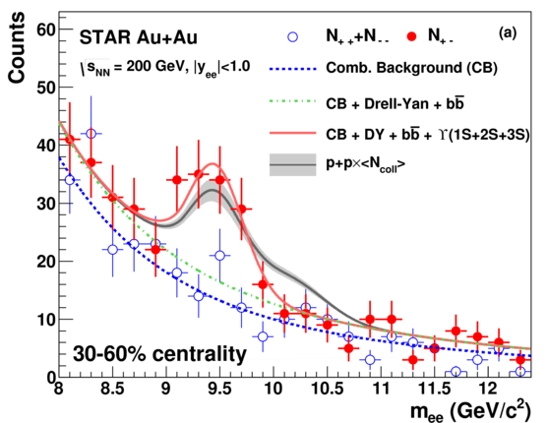
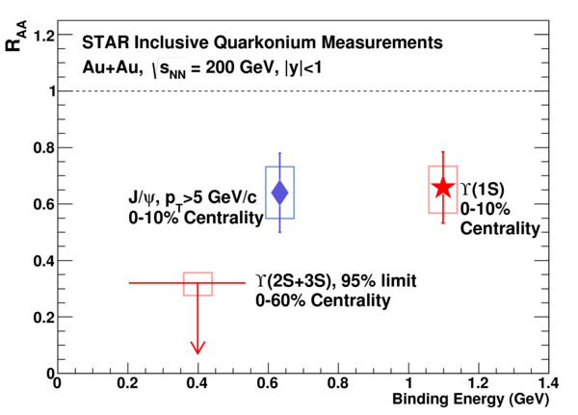
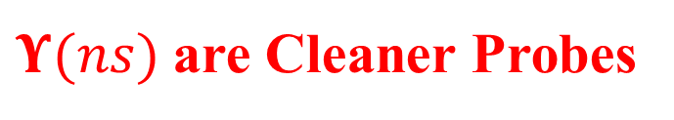


$Υ(ns)$are Cleaner Probes
PLB735,127(2014)
Compared to J/ψ
recombination can be neglected at RHIC
Final state co-mover absorption is expected to be small
Consistent with prediction from a model requiring strong 2S and complete 3S suppression
$Υ$(nS) suppression are ordered by binding E
For $Υ$(1S) more suppressed in more central collisions
Some models doesn’t include CNM effect.
  e.g. Strickland, Liu-Chen models

Slide 13
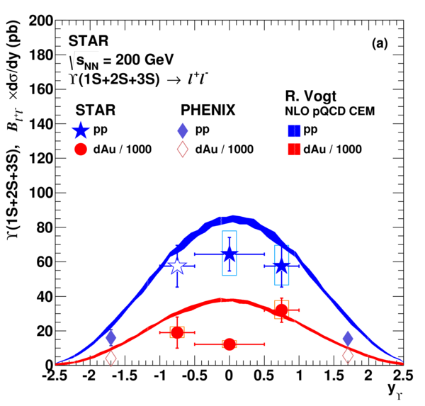
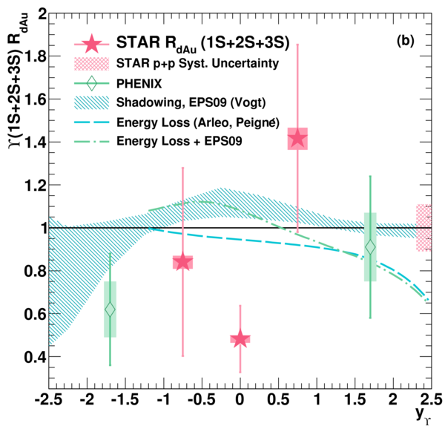
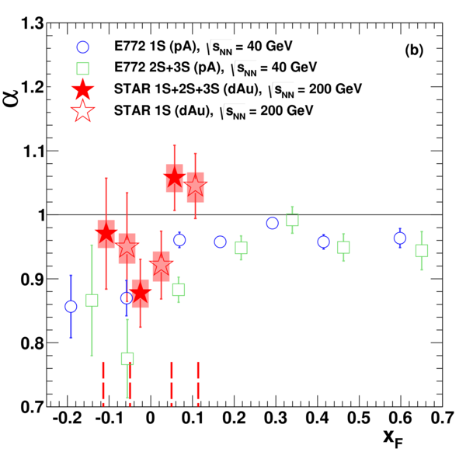

Cold Nuclear Matter Effect on Upsilon Production
PLB735,127(2014)
$$σ_{pA}=\frac{σ_{dA}}{2}= A^{α}σ_{pp}$$
$R_{dAu}\left(1S\right)=0.83±0.15(dAu stat.)±0.11{\left(pp stat.\right)}_{−0.07}^{+0.03}(dAu syst.)±0.10(pp syst.)$
$R_{dAu}\left(nS\right)=0.79±0.14(dAu stat.)±0.10(pp stat.)±0.03 (dAu syst.)±0.09(pp syst.)$
Indication of suppression in d+Au in |y|<0.5.
  Indicative of effect beyond shadowing, initial state E-loss or absorption by spectator nucleons
  The suppression is consistent with E772 results.

Slide 14
Essential to understand Open Heavy Flavor Production
A good reference to quarkonium production
  Similar initial state effects
    CGC, Shadowing, initial state energy loss, etc.
  Large cross section (compared to J/ψ).
    Accurate reference measurements
One of the most important probes for sQGP
  Dominated by initial hard scatterings
  Interactions between heavy quark and medium are quite different from the ones for light quarks
    gluon radiation, collisional energy loss, collisional disassociation, etc
  allow further understanding of the medium properties
  A “Gold Mine” to be fully explored very soon

Slide 15
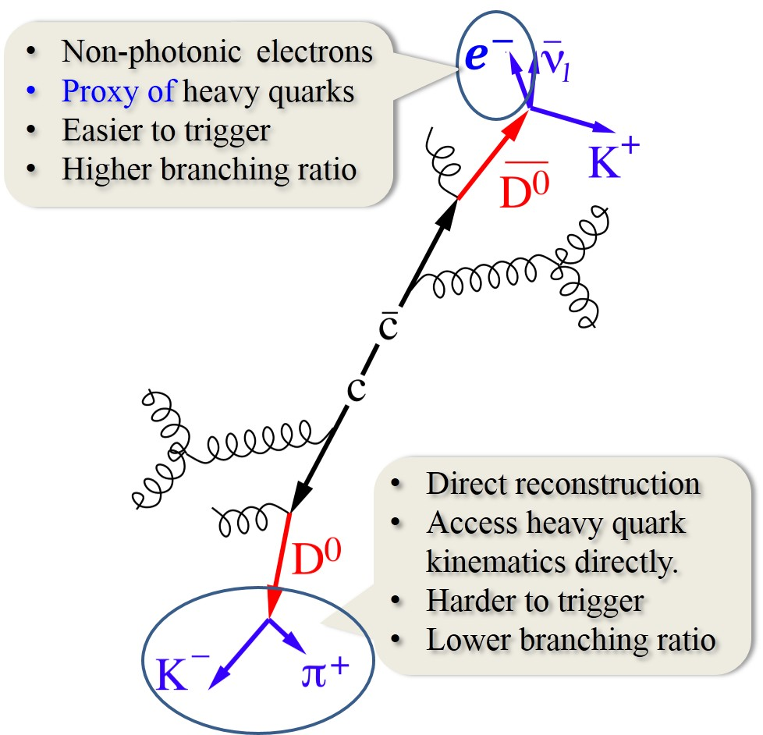


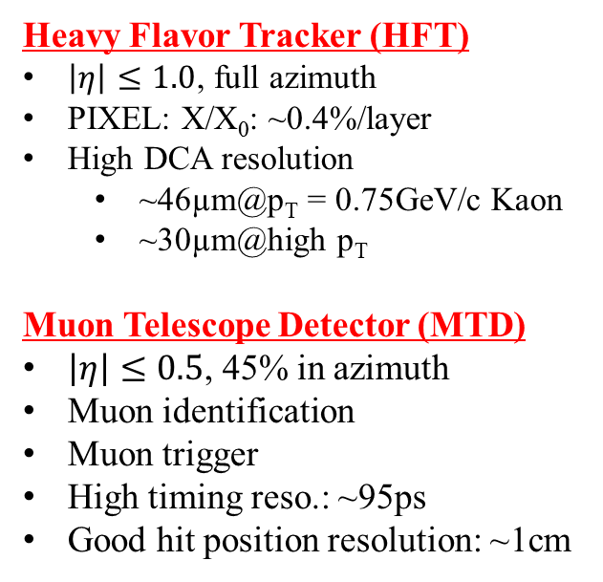
How does STAR Measure Heavy Open Heavy Flavors
Time Projection Chamber
(TPC)
$\left|η\right|≤1.0$, full azimuth
Tracking
PID through dE/dx
Time of Flight (TOF)
$\left|η\right|≤0.9$, full azimuth
PID through TOF
Timing resolution: ~85 ps
Barrel Electromagnetic Calorimeter (BEMC)
$\left|η\right|≤1.0$, full azimuth
p/E for electron ID
Fast online trigger
High resolution SMD
e/h separation
Heavy Flavor Tracker (HFT)
$\left|η\right|≤1.0$, full azimuth
PIXEL: X/X₀: ~0.4%/layer
High DCA resolution
  ~46µm@p_{T} = 0.75GeV/c Kaon
  ~30µm@high p_{T}
Muon Telescope Detector (MTD)
$\left|η\right|≤0.5$, 45% in azimuth
Muon identification
Muon trigger
High timing reso.: ~95ps
Good hit position resolution: ~1cm

Slide 16
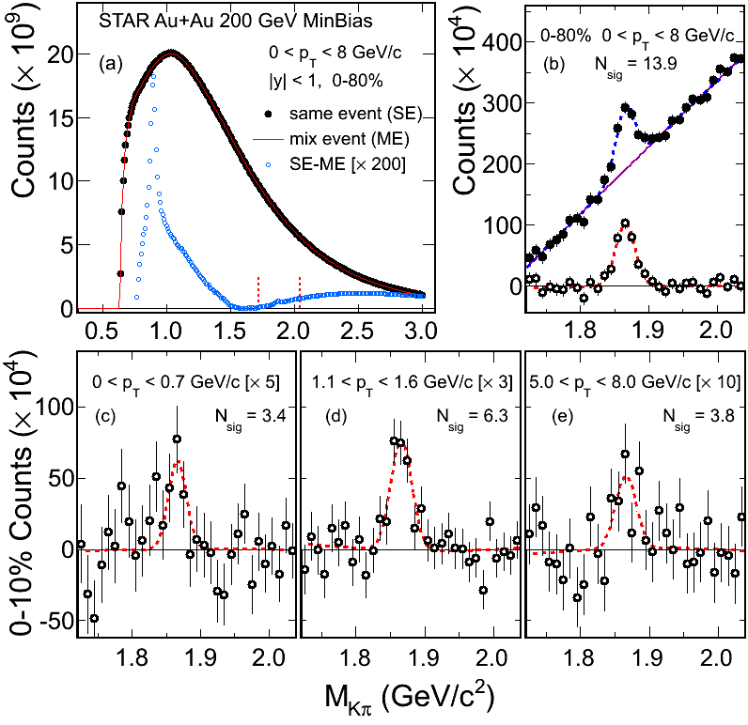
D⁰ Signal in Au+Au 200 GeV
PRL113, 142301 (2014)
Combining data from Run2010 & 2011
Total: ~800 M Min.Bias events
Significant signals are observed
In all centrality bins

Slide 17
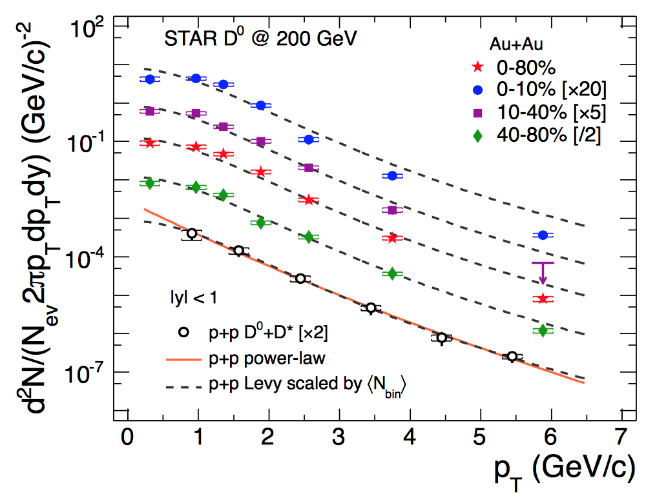
Centrality dependence of D⁰ Suppression in Au+Au 200 GeV
PRL113, 142301 (2014)
Suppression at high p_{T} in central and mid-central collisions
D suppression pattern is similar to that of charged pions

Slide 18
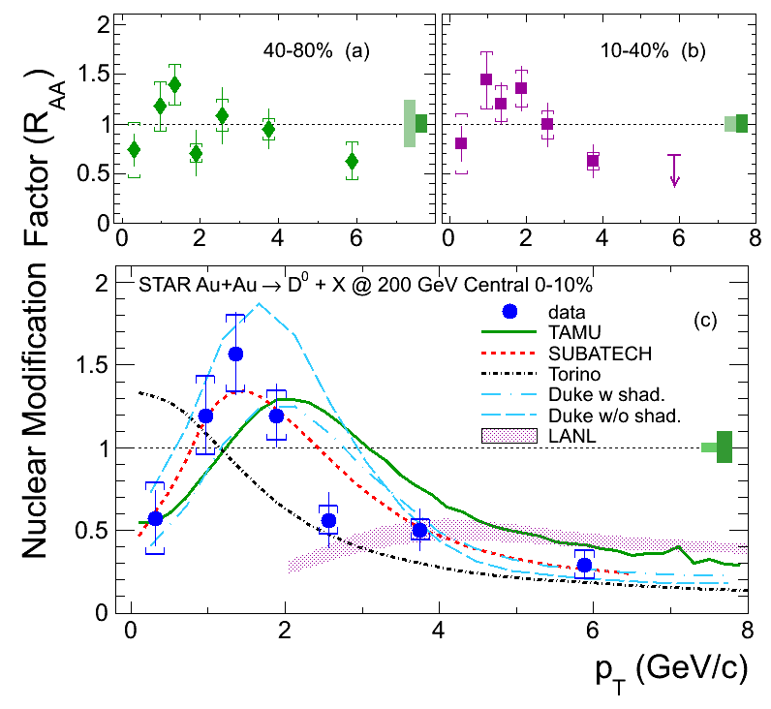
Enhancement of D⁰ production at Intermediate p_{T} in Au+Au 200 GeV
PRL113, 142301 (2014)
Suppression at high p_{T} in central and mid-central collisions
Enhancement at intermediate p_{T}
  Can be described by models including coalescence between charm quark and light quark
  Cold nuclear matter effects may also contribute

Slide 19
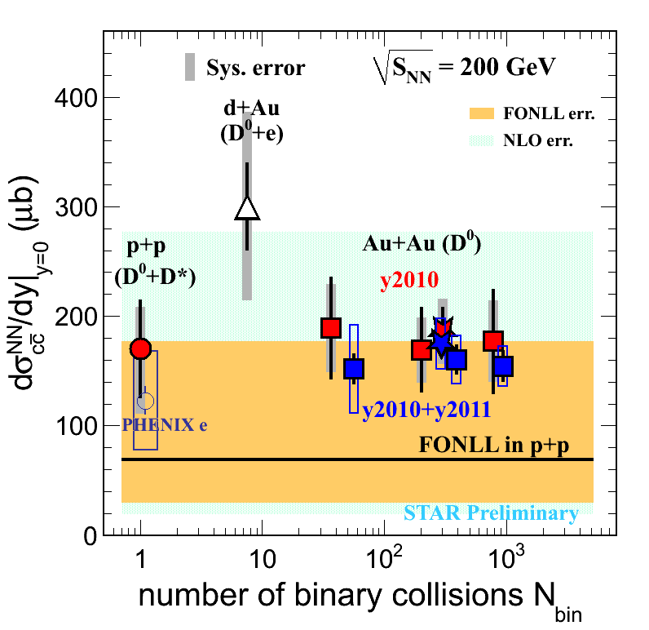
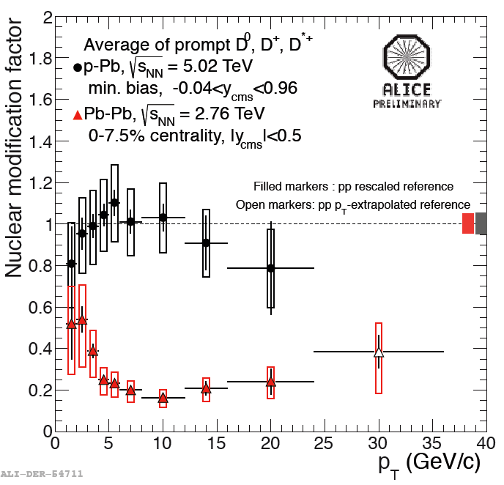
N_{coll} Scaling of D⁰ Production in Au+Au 200 GeV
[1] STAR d+Au: J. Adams, et al., PRL 94 (2005) 62301
[2] FONLL: M. Cacciari, PRL 95 (2005) 122001.
[3] NLO: R. Vogt, Eur.Phys.J.ST 155 (2008) 213
[4] PHENIX e: A. Adare, et al., PRL 97 (2006) 252002.
Charm quarks are mostly produced via initial hard scatterings
Quantify other sources of production via high luminosity and upgrade
Indication of a breakdown of the N_{coll} scaling at LHC
  Shadowing?

Slide 20
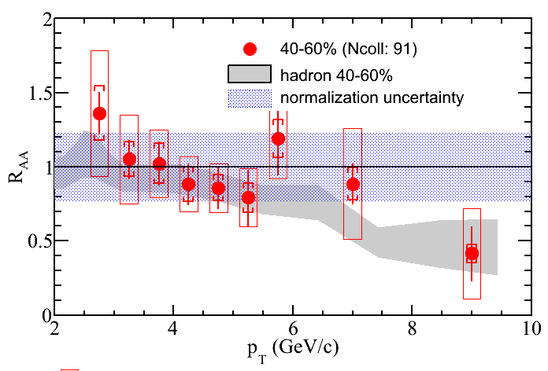
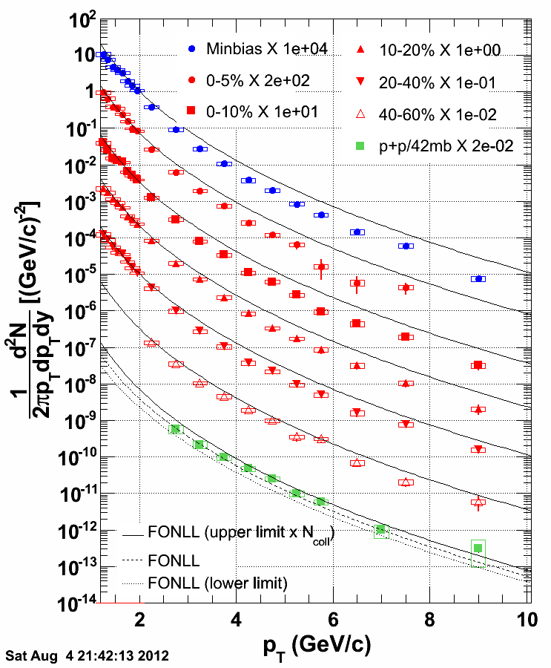
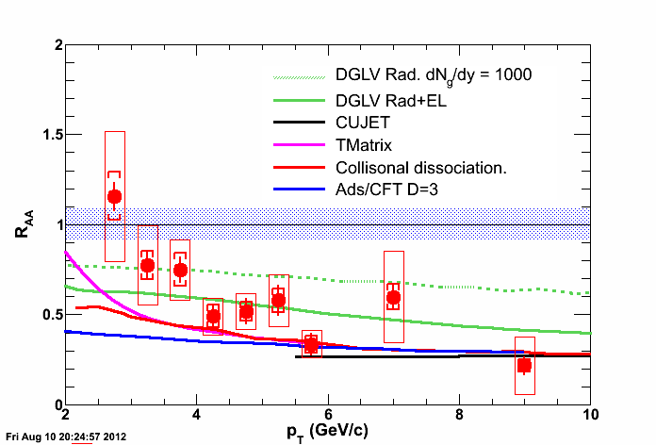
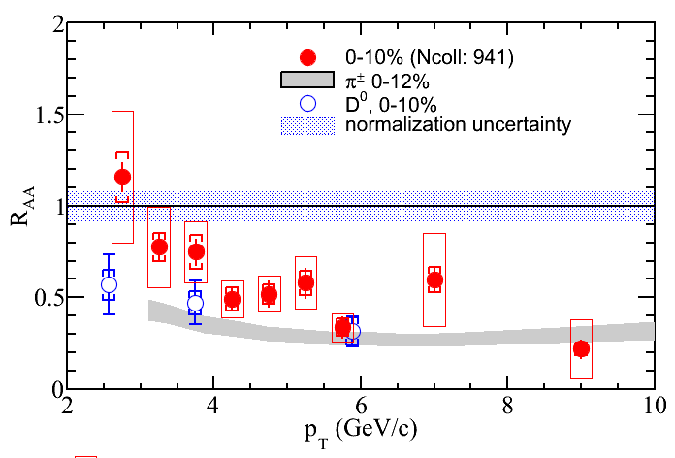
Non-photonic Electron R_{AA} in Au+Au 200 GeV
NPA904,905, 170c(2013)
~1 nb⁻¹ sampled luminosity in Run 2010 Au+Au collisions
Strong suppression at high p_{T} in central collisions
D⁰, NPE results seems to be consistent
  kinematics smearing & charm/bottom mixing
Models with radiative energy loss alone underestimate the suppression
  Uncertainty dominated by p+p
DGLV: Djordjevic, PLB632, 81 (2006)
CUJET: Buzzatti, arXiv:1207.6020
T-Matrix: Van Hees et al., PRL100,192301(2008).
Coll. Dissoc. R. Sharma et al., PRC 80, 054902(2009).
Ads/CFT: W. Horowitz Ph.D thesis.

Slide 21
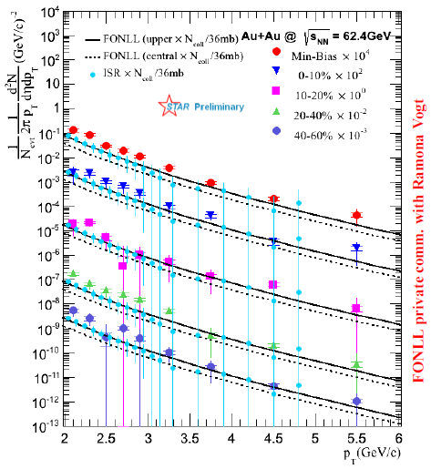
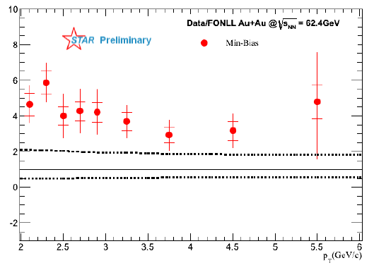
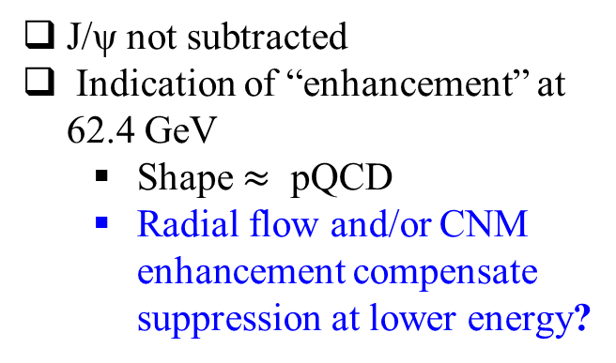
NPE Enhancement at Lower Energy
NPA904,905, 665c(2013)
J/ψ not subtracted
Indication of “enhancement” at 62.4 GeV
  Shape $≈$ pQCD
  Radial flow and/or CNM enhancement compensate suppression at lower energy?

Slide 22
NPE Elliptic Flow Depend on Energy
200 GeV Au+Au:
Large NPE v₂ observed at low p_{T}→strong charm-medium interaction
v₂ increase at p_{T} > 3 GeV/c
  Jet-like correlation
39 and 62.4GeV Au+Au:
v₂ consistent with zero
  different from 200GeV results (p-value: 0.0014@62.4GeV, 0.005@39GeV)
Might suggest charm –medium interaction is not as strong as in 200 GeV

Slide 23




New Era of Heavy Flavor Measurement at STAR
PIXEL:
high hit resolution: 20.7µm pitch
low thickness: X/X₀ = 0.4%/layer
Muon identification
Muon trigger
significantly enhance STAR capability on measuring heavy flavor production at RHIC.
  Direct D meson reco at low and high p_{T}
  B→J/ψ→µµ+X, $Υ$→µµ
  etc
study QGP thermal dilepton radiation
  Understanding background through e-µ correlation

Slide 24

Summary
No significant energy dependence for J/ψ R_{AA} and R_{cp}
J/ψ v₂ measurements disfavor the case that coalescence of thermalized $c\overline{c }$dominates the production at p_{T} > 2 GeV/c in 200 GeV Au+Au collisions
Upsilon suppression consistent with prediction from models requiring strong 2S and complete 3S suppression in 200 GeV Au+Au collisions
  Indication of suppression in 200 GeV d+Au collisions (CNM effect).
Large suppression of heavy quark production through NPE and D⁰ meson measurements in 200 GeV Au+Au collisions
Larger NPE v₂ in 200 GeV than in 39 and 62.4 GeV Au+Au collisions, indicating the strength of charm-medium interaction increase with energy
Indication of an enhancement of NPE production at 62.4 GeV
With HFT and MTD, more interesting results with good precision will come up soon

Slide 25
Backup Slides

Slide 26

 | TAMU | SUBATECH | Torino | Duke | LANL
HQ prod. | LO | FNOLL | NLO | LO | LO
QGP-Hydro | ideal | ideal | viscous | viscous | ideal
HQ eLoss | coll. | coll. +rad. | coll.+rad. | coll.+rad. | diss.+rad.
Coalescence | Yes | Yes | No | Yes | No
Cronin effect | Yes | Yes | No | No | Yes
Shadowing | No | No | Yes | Yes/No | Yes

Slide 27


Slide 28




Significant v₂ observed at high p_{T}
Non-zero v₂ observed at high p_{T}
  No significant dependence on y and p_{T}.
  V₂ =0.054$±$0.013$±$0.006 in |y|<2.4 for p_{T} > 6.5 GeV in 10-60% centrality.
  Indicating path length dependence of suppression
Indication non-zero v₂ at low p_{T}
  Consistent with regeneration from charm quark of significant v₂.
CMS PAS HIN-12-001
PRL 111(2013)162301

Slide 29


How CNM plays a role in the suppression
Upsilon double ratio:
Much lower in Pb+Pb.
Initial state effect likely cancelled in the comparison
Suppression in Pb+Pb is a final state effect.
J/ψ in pPb:
Significant suppression from CNM at low p_{T}
  Close to R_{PbPb}
  Pb+Pb partially compensated by regenerated J/ψ?

Slide 30


Suppression in Pb+Pb is a final state effect
b-jet
D
b→J/ψ
From low p_{T} to intermediate p_{T}
R_{AA}(D) ~ R_{AA}(π) within uncertainties
R_{AA}(B) > R_{AA}(D)
  Different energy loss?
  What’s the impact of, e.g. production spectrum.
At high p_{T}
R_{AA}(b-jet) ~ R_{AA}(all jets)
What’s the NLO effect,
e.g. FEX, GSP?

Slide 31
H.K. Wohri @ QWG2014

Slide 32
H.K. Wohri @ QWG2014

Slide 33


