Slide 1
Construction of the Equation of Sate
Evgeni Kolomeitsev
LTP, Joint Institute of Nuclear Resarch, Dubna
Matej Bel University, Banska Bystrica Slovakia
EoS at T=0. Constraint from neutron star physics and particle flow
EoS at T=/=0. Virial EoS. Classical and quantum results
EoS from Φ-derivable approach. New challenges

Slide 2
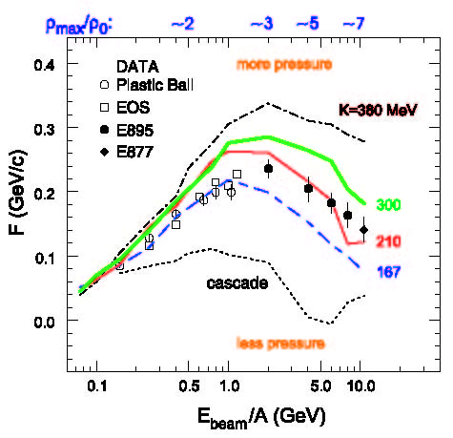
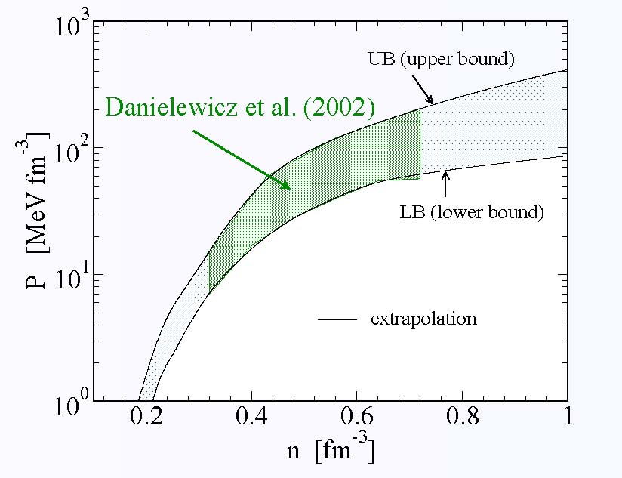

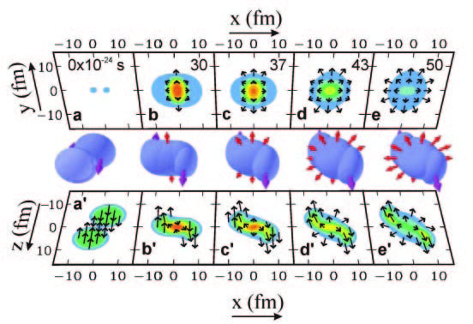
Constraint on the stiffness of nuclear EoS
[Danielewicz, Lacey, Lynch, Science 298, 1592 (2002)]
directed and elliptic flow of particles in heavy-ion collisions
- Boltzmann kinetic equation
- Mean-field potential
fitted to directed & elliptic flow
range for the pressure of isospin
symmetrical matter at T=0
maximum NS mass >1.98 M_{sol} requires stiff EoS restrict the pressure from above!
Hydrodynamic description of HIC to be improved
Flow pattern better studied
Viscosity to be taken into account

Slide 3



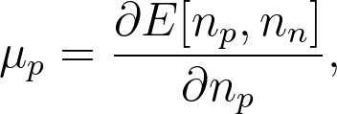
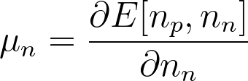
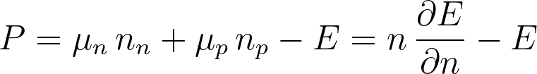
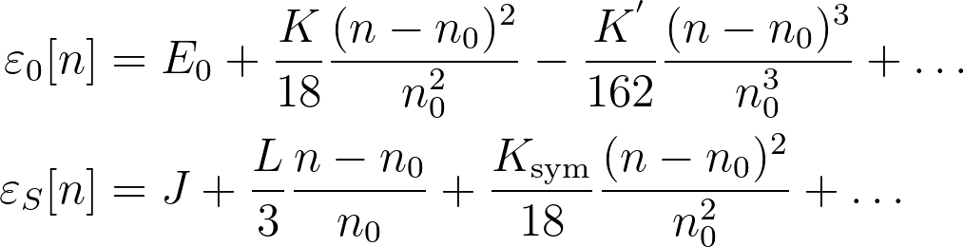
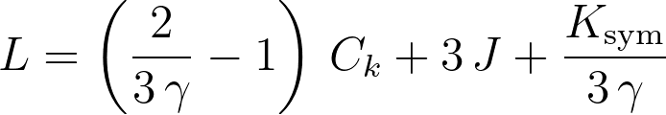
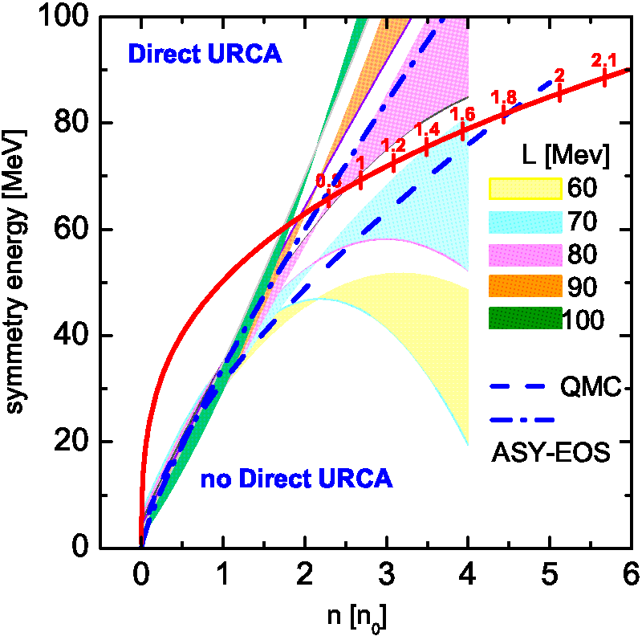
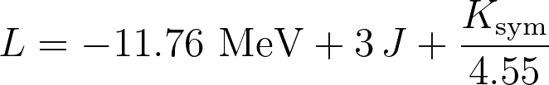

Infinite nuclear matter (T=0)
energy density as function of proton and neutron density:
binding energy per nucleon:
where
total density,
proton fraction
chemical potentials:
Pressure:
low-density parameters
Modeling density dependence induces correlation among parameters
Taking L, J, K_{sym} from models fitted to empirical data we see that this relation works and obtain parameters C_{k}, γ
too rapid
NS cooling
Correlations among parameters
n₀ vs E₀ –Coester line problem: role of TNF,
relativistic effects, chiral forces
RMF:
Stiffness of EoS
Skyrme
frequently characterized by
compressibility modulus K

Slide 4
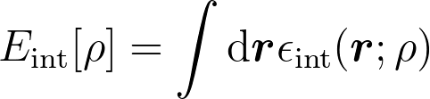

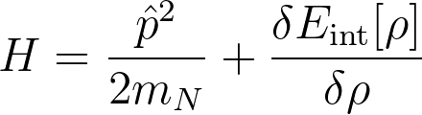
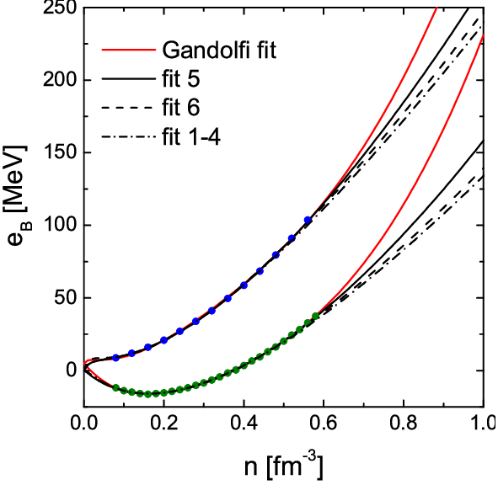
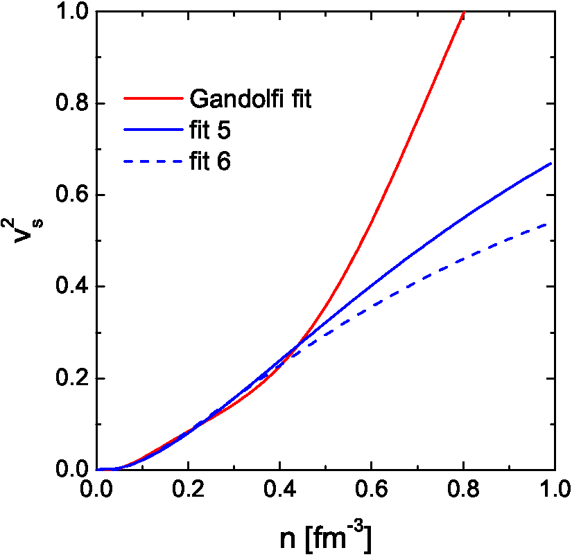
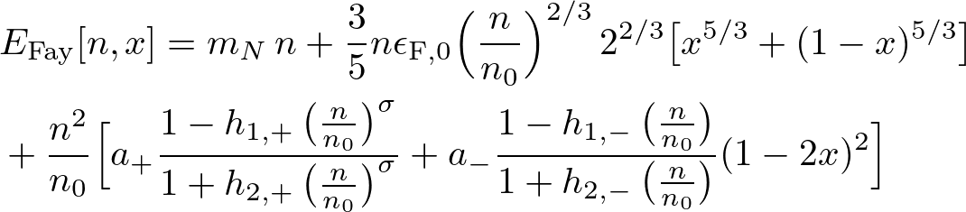
Model approaches to the nuclear EoS
Skyrme:
T. H. R. Skyrme, Philos. Mag. 1, 1043 (1956); D. Vautherin and D. M. Brink, Phys. Rev. C 5, 629 (1972)
density+gradient expansion
Effective force for
Hartree-Fock calculations
t₀₋₄ are fit parameters
density dependence of the binding energy per nucleon
Energy density functional (EDF) method:
functional of
single-particle Hamiltonian
Effects of pairing can be included
Fayans functional [S. Fayans 1998]
causal!
AFDMC EoS by Gandolfi et al

Slide 5

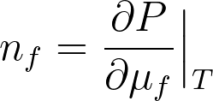
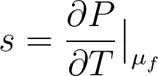
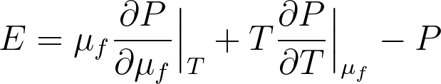


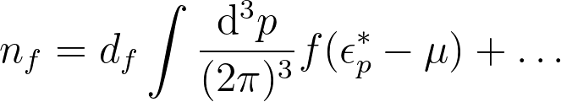
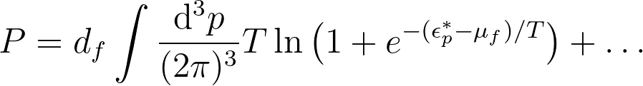
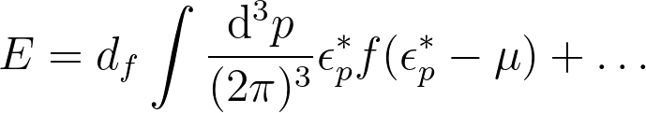
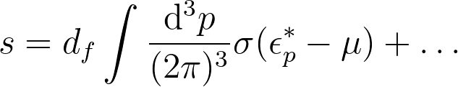
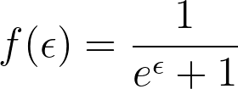
Consistency of an extension to finite temperatures
simple extension
ideal nucleon gas
[Raithel, Özel, Psaltis Finite-temperature extension for cold neutron star EoS, ApJ875 (2019) 12]
Thermodynamic consistency
particle
density
entropy
density
energy
density
pressure
What if we start from other thermodynamic quantity, e.g., entropy?
In Fermi-liquids one-article excitation mechanism exists even in strongly interacting systems, T<<T_{F}
Consistence with excitation spectra
if we have some model for
Is it possible to write ….?

Slide 6
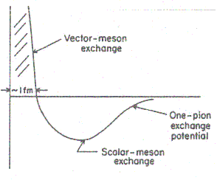
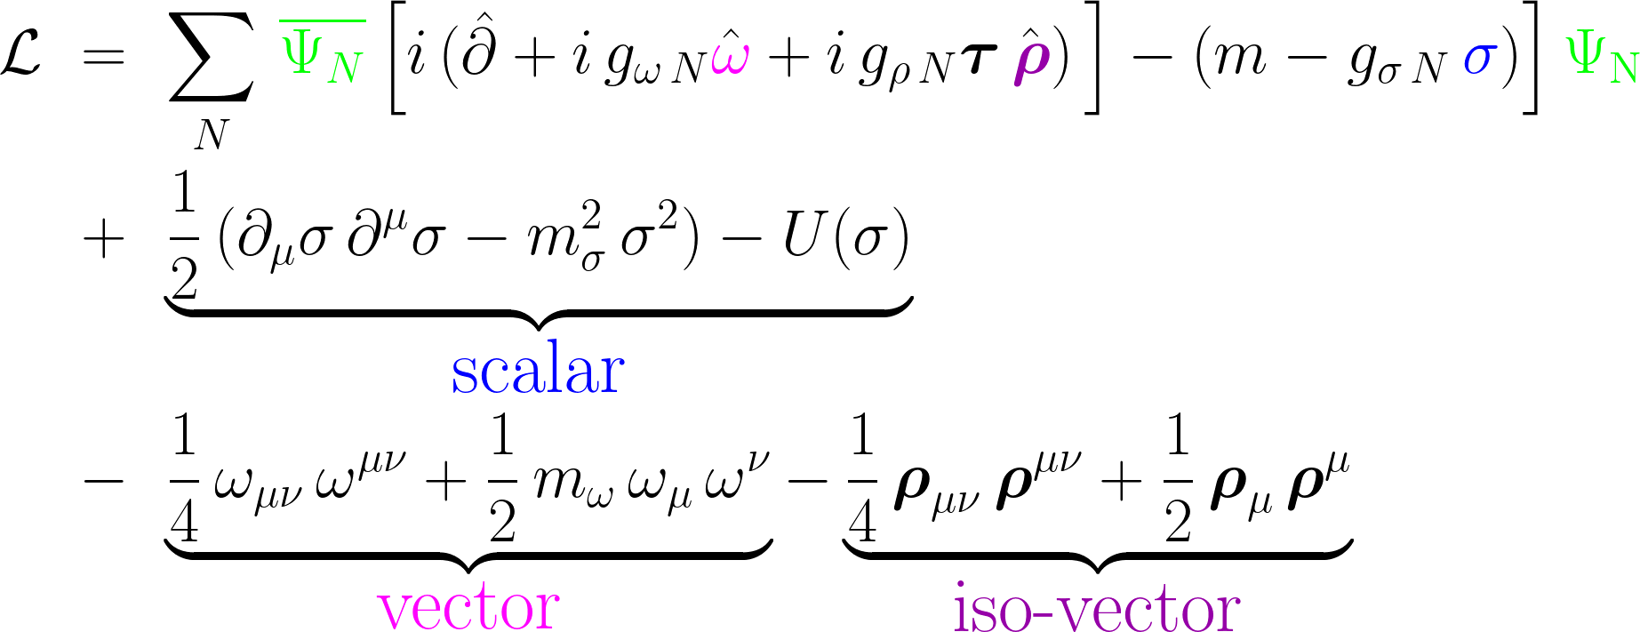
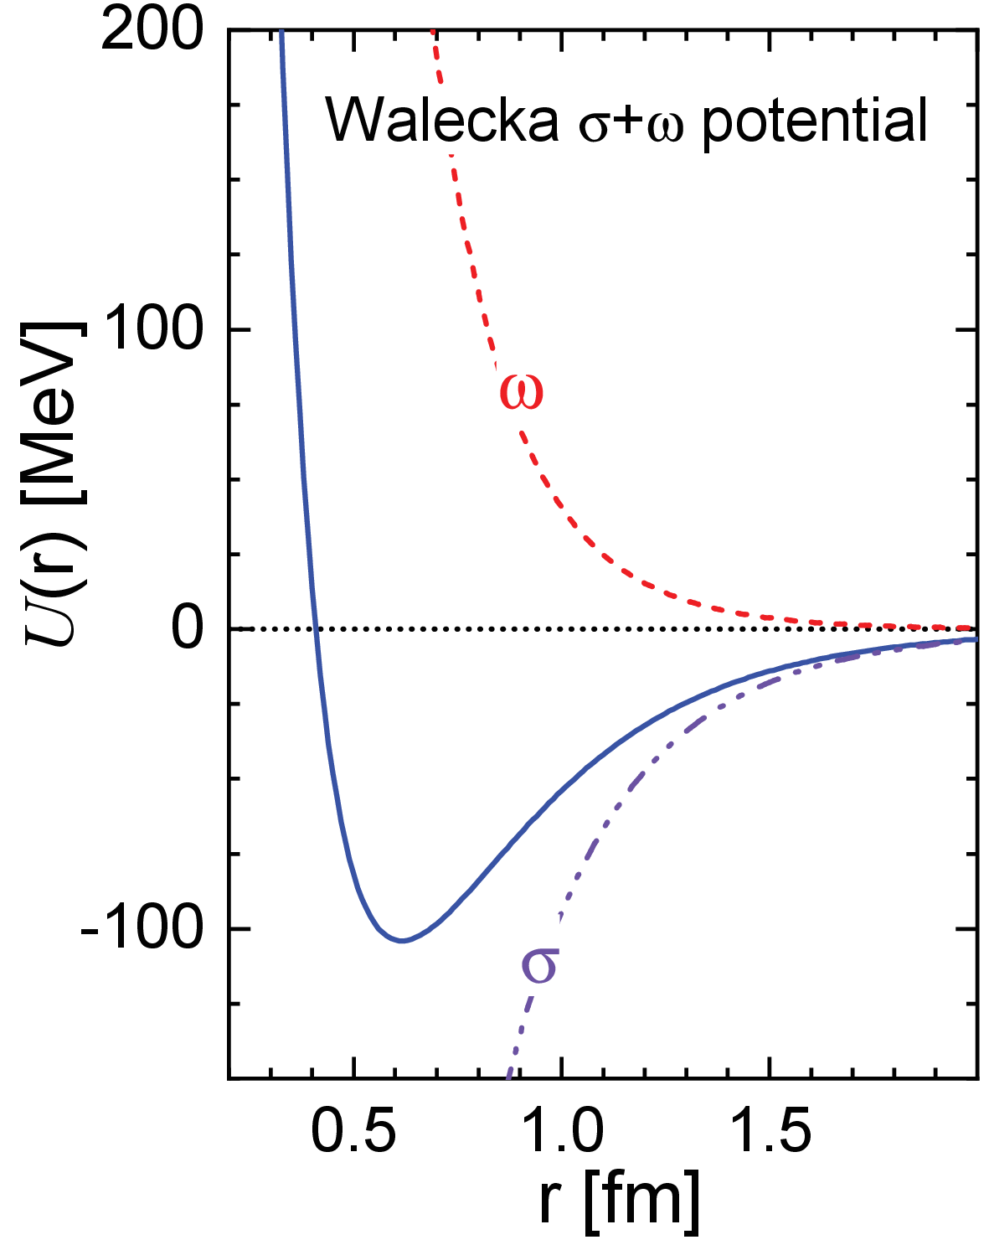
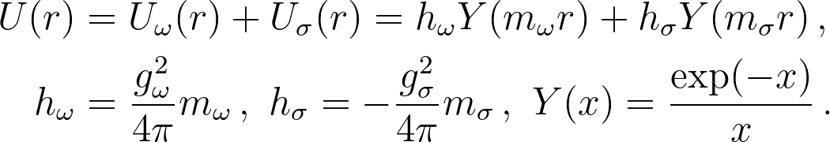
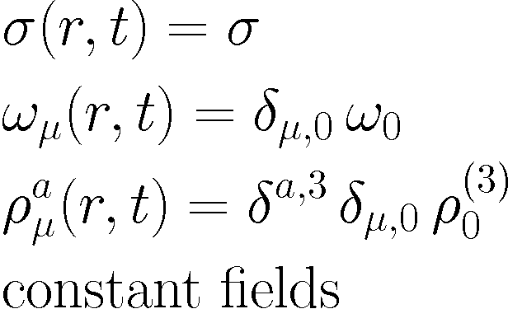
Relativistic mean-field models
nucleon-nucleon interaction
vacuum: one boson-exchange for NN-potential
+ Lippmann-Schwinger equations
[Serot, Walecka]
model
nucleon-nucleon potential
pion dynamics falls out completely in this approx.
medium: mean-field approximation

Slide 7
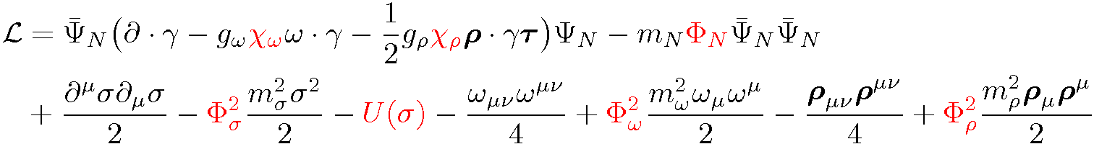
RMF models with effective hadron masses and coupling constants
Lattice QCD (SC-QCD): common drop of meson masses
[Ohnishi Miura Kawamoto Mod.Phys.Lett A23, 2459]
Sliding vaccua and double decimation concept [Brown, Rho PR396(2004)1]
Metag, PPNP 61 (2008)
“vector manifestation” [Harada, Yamawaki]
Half-skyrmion model of dense nuclear matter [Vento; Rho, Hyun Kyu Lee 1704.02775]
KVOR model [EEK and D.Voskresensky NPA 759 (2005) 373]
Vertex and mass scaling
(function of the scalar field)

Slide 8
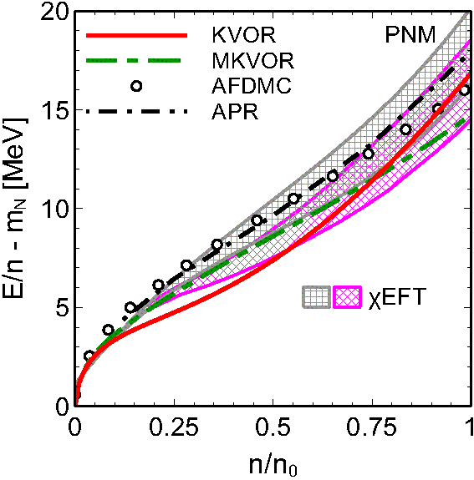
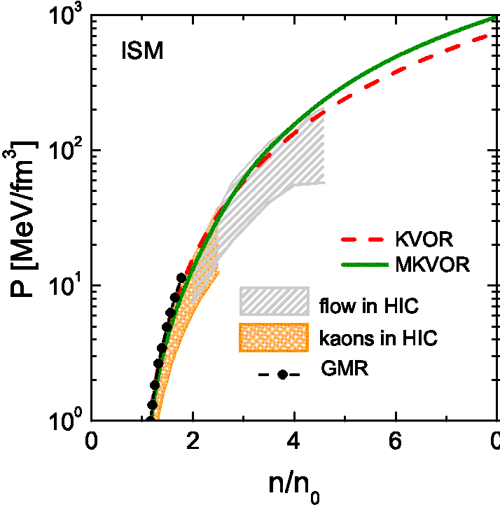
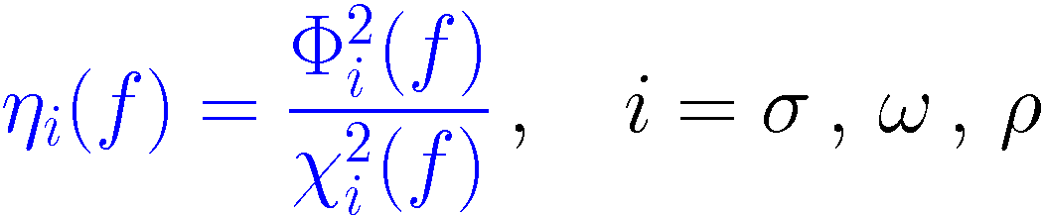

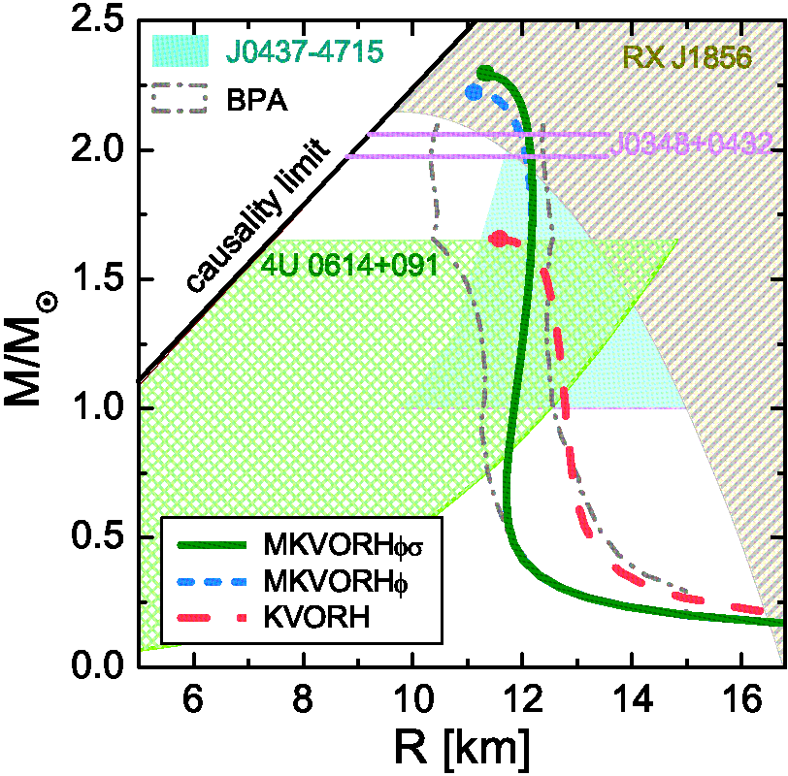
KVOR: EEK, Voskresensky, Nucl. Phys A 759 (2005) 373
MKVOR: Maslov, EEK, Voskresensky, NPA 950, 961, 970
Neutron stars
+hyperons
+hyperons +Δ

Slide 9
Extension to finite temperature
Khvorostukhin, Toneev, Voskresensky NPA 813 (2008) 313 based on KVOR
nucleon mass scaling
reduction of baryon couplings
to the scalar field
Lattice QCD: F. Karsch, E. Laermann, A. Peikert,
NPB 605 (2001) 579.

Slide 10
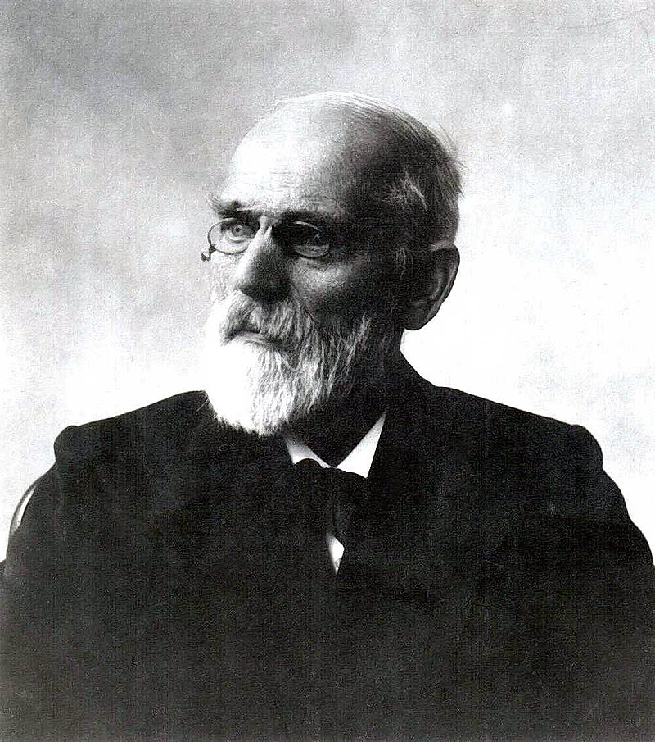
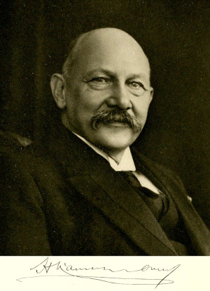
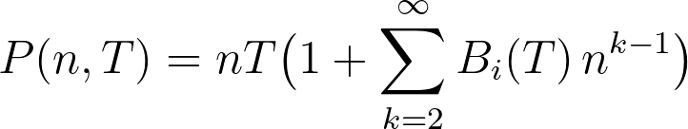


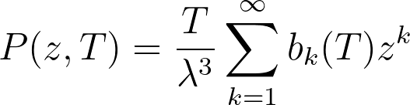
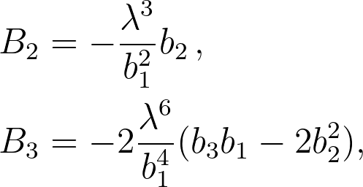
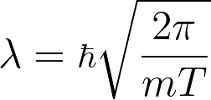
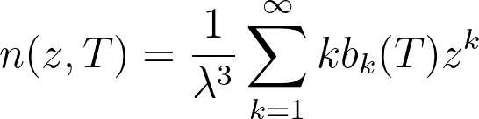
Virial Equation of State
1873 van der Waals proposed a fantastically simple extension of the ideal gas low which describes liquid-gas phase transition
1902 Kamerlingh Onnes proposed to express the pressure of one-component Boltzmann gas as series in powers of the density
van der Waals
Kamerlingh Onnes
This expansion can be easily generalized for
the multi-component gas mixtures
virial coefficients
can be measured
The derivation goes through an expansion of the pressure fugacity
parametric definition
of P=P(n,T)
thermal wave-length
of the particle
Applicable when z<<1, i.e., small densities large temperatures

Slide 11
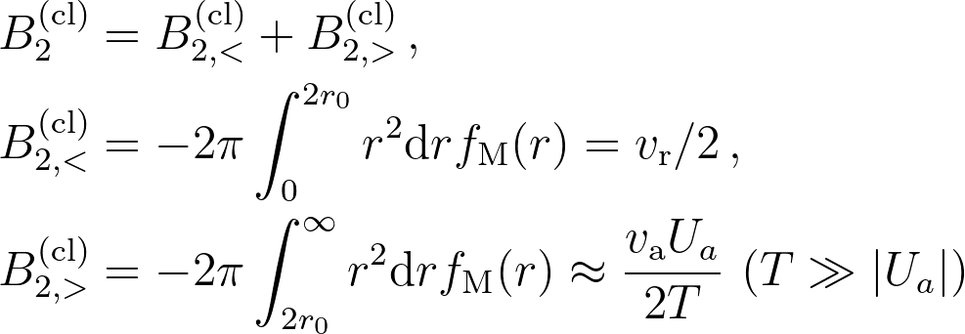
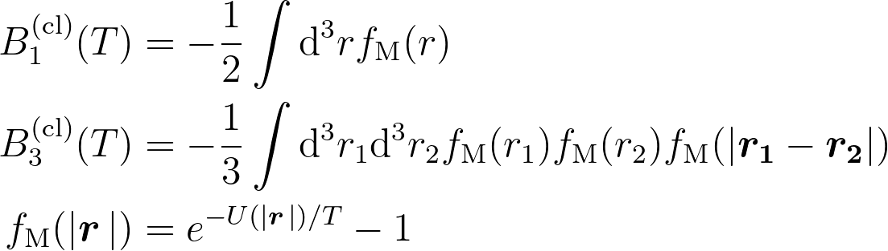
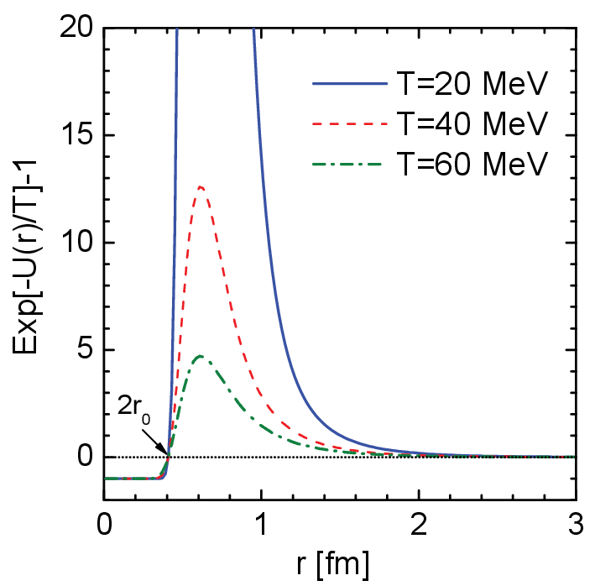
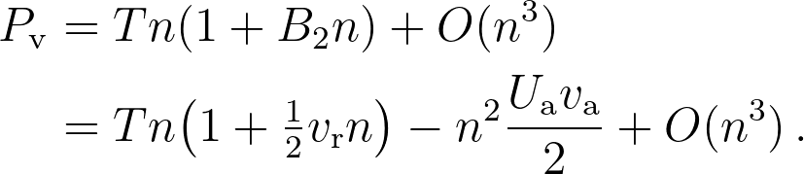
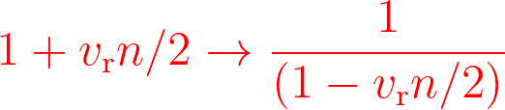
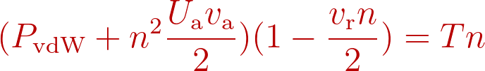

Classical virial coefficients
For the classical Boltzmann gas of particles interacting via a binary potential U(r) the viral coefficients can written as
the Mayer's f-function
v_{r} (v_{a}) repulsion (attraction) volume
Calculation of B_{n>3} is complicated task even for simple potentials
for Walecka potential
repulsion
2r₀
vdW wonder
attraction
U_{a}
vdW replacement assumes tower of virial coefficients

Slide 12
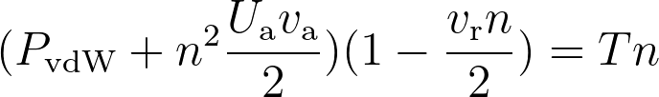
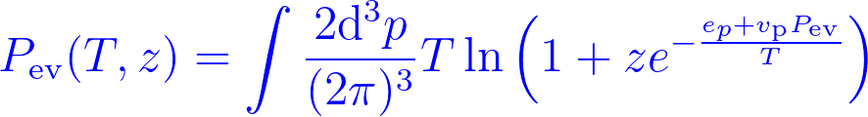
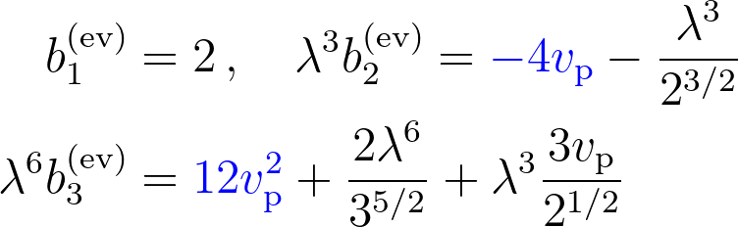

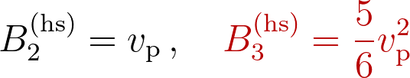
reduction of the volume allowed for the particle motion, V-> V-v_{p}N, because of the particle finite volume, v_{p}
excluded volume
This observation was used as motivation of excluded volume (ev) model, in which the canonical partition function is taken in the form
Gorenstein, Petrov, Zinovjev, Phys. Lett. B 106, 327 (1981)
Rischke, Gorenstein, Stoecker, Greiner, Z. Phys. C 51, 485 (1991)
includes the spin-statistics
classical limit
Expanding this equation in z we obtain:
Assuming that v_{p} is constant we can compare the virial coefficients for the excluded volume model with the results of calculations for the hard-sphere (hs) gas done over the years. The analytic calculations of the first two viral coefficients yield:
Excluded volume model is not fully equivalent to hard sphere model. Attraction is important for nuclear potentials

Slide 13







Quantum virial coefficients
1936 Gropper, Beth and Uhlenbeck
second virial coefficient
scattering phase shift as a function
of the center-of-mass energy
one type of fermions
L,S are good quantum numbers
l[S] are even (S=0) or odd (S=1)
strong LS coupling
J=L+S is good q.n.
Main advantage: one can calculate b₂ knowing experimental phase shifts. Practical for low T since only several first partial waves are needed.
Born approximation for scattering amplitude
Difficult to go to higher temperatures. Need more and more partial waves

Slide 14





For Walecka potential in the Born approximation
effective range expansion for scattering amplitude
Nijmigen PWA analysis ESC04:
Born approximation does not work for nuclear potentials!
Extension for multichannel inelastic scattering Pok Man Lo EPJC 77 (2017) 533

Slide 15





Second virial coefficient and its partial-wave contributions
not T^{1/2} behavior
A large scattering length is signal for quasi-bound state below threshold
Horowitz, Schwenk, PLB 638 (2006) 153
The quasi-bound state located close to the threshold should be very sensible to the Pauli-blocking and finite temperature effects. For densities with p_{F}~π/|a₀^{nn}| the quasi-bound state should be destroyed because of the action of the Pauli blocking. [Roepke, Schnell, Prog. Part. Nucl. Phys. 42 (1999) 53]

Slide 16








Φ-functional approach
Luttinger, Ward
grand canonical potential of free fermions
retarded
Green’s function
free spectral function
For a system of interacting fermions
Functional of the exact Green’s function G
is defined as the infinite series of all closed skeleton two-particle irreducible graphs, where all lines are full Green's functions G (Matsubara sums)
Closure relation:
Diagrammatically, this means that the expressions for the self-energies Σ can be obtained from Φ by removing one of Green's functions.

Slide 17



Examples of the Φ-functional
pair potential (===)
pion-nucleon-nucleon
contact ππNN coupling

Slide 18





Φ-derivable approximation
A remarkable so-called Φ-derivable approximation scheme was suggested by Gordon Baym, who showed that one may cut the series of diagrams in Φ on any term preserving nevertheless the thermodynamical consistency of the theory.
In this approximation for the `full’ Green's functions one obtains the 4-current densities and the energy-momentum tensor obeying the continuity equations.
Note that within the Φ-derivable approximation scheme with even one diagram retained in the Φ−functional one deals with an infinite sub-series of diagrams in the perturbation theory. Therefore, the term `full’ takes the sense of the sum of this sub-series.
for the pair-potential interaction

Slide 19


Spin averaged potential

Slide 20


Φ-derivable vs. virial
Including in the Φ-functional diagrams of higher order the difference between the Φ-derivable and virial approaches. Finally, for the Φ-functional with the infinite set of the so-called ring diagrams,
the difference will vanish completely since in this case the nucleon self-energy will be determined by the T-matrix satisfying the Lippmann-Schwinger equation instead of the amplitude in the Born approximation.
For the pair-potential interaction, all other not-ring diagrams do not contribute to the second virial coefficient, but contribute in part to the modification of the scattering amplitude in nuclear matter.
virial
Φ derivable

Slide 21





Noether density
Spectral density

Slide 22







Pressure
Form 1
Virial-like formula?
Form 2

Slide 23


Botermans-Malfliet density
This current follows from the first-gradient-order quantum kinetic Kadanoff-Baym equation written in the Botermans-Malfliet (BM) form valid for the system not too far from the equilibrium.
Leupold demonstrated that this current is conserved by the Kadanoff-Baym kinetic equation in the BM form with the local collision term (i.e. disregarding memory effects). This form of the kinetic equation allows to construct a test-particle method, which is behind some extended numerical transport codes used for simulations of heavy-ion collisions.
Exact conservation laws allow to keep control of numerical codes.

Slide 24



Entropy
In the quantum kinetics the term S^{(loc)} is the purely Markovian contribution, whereas S^{(mem)} is non-Markovian (memory) term appearing from gradient contributions of the diagrams with three and more vertices containing more than two time-arguments.

Slide 25



Energy
For T=0 Galitski-Migdal formula
It is remarkable that the energy can be calculated using only the spectral density of the fermions, whereas to calculate the entropy and the pressure using the finite number of diagrams in the Φ-derivable approach, in general case one needs to evaluate the Φ-functional explicitly.
This peculiarity of the expression for energy is used to calculate the energy of the fermionic system when some specific approximation for the fermion self-energy is assumed, e.g., G-matrix and T-matrix approximations.
However, equation for the energy is derived here for a spatial-derivative dependent pair-potential interaction among fermions.
Such interaction does not allow for retardation effects (frequency or time dependence of interaction).

Slide 26


Spectral functions for system of two species of fermions interacting via a scalar boson.
Case 1
Case 2
A_{s,f} is much sharper than A_{f} and B_{f}
B_{f} has a threshold enhancement

Slide 27
Conclusion
Neutron star physics and HIC physics give constraints on the hadronic equation of state
flow measurements are important mean-field potentials, stiffness of the EoS
Virial approach. Second virial coefficient from microscopic particle interaction (classical, high T limit)
or experimental scattering phase shifts (quantum, important for low T)
in-medium effects (Pauli blocking) may reduce the applicability of this approach to very low densities
Φ derivable approach gives consistent non-perturbative description
(but complicated if one goes beyond first diagrams)

