Slide 1

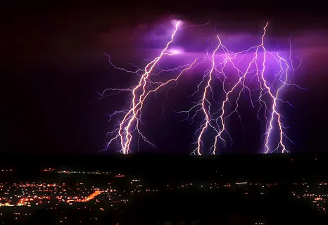
Phase transitions in nuclear matter: dreams and reality
D.N. Voskresensky
BLTF JINR

Slide 2
Conclusion
! Rich theory permitting strong in-medium effects and still poor their experimental manifestations. More trick measurements are required.
! Description of strongly interacting matter in nuclei, compact stars, HIC requires interdisciplinary efforts.
In-medium effects, soft modes and phase transitions, shear & bulk viscosity, and anomalies in fluctuations

Slide 3
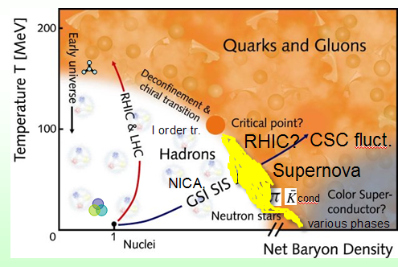
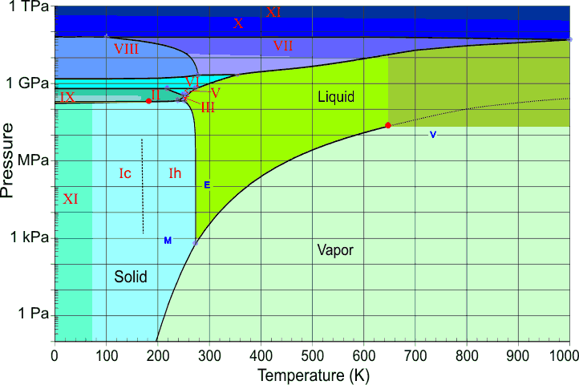
Phase Diagrams
Water and Nuclear Matter
various phases
Variety of phases: 12 crystalline,
3 glass, liquid, vapor, CEP
Crossover;
●
^{Quarkyonic?}
I order tr.
Chapline et al. (2007)
Low T, HIC (n<n₀ ≈2.7 .10¹⁴ g/cm³) nuclear liquid-gas 1-order ph.tr. With LG CEP;
Low T, n~n₀ -excited nuclei (high angular momentum states-shape tr., NN pairing);
Low T, high n:GRB,SN:NS,HS:π,K,ρ⁻ cond.; quarkyonic, HH then qq-pairing-CSC;
high T>m_{π} , low n (but number density>n₀): deconfinement tr. is crossover: early Universe, & in HIC at RHIC, LHC, with increasing n, decreasing T–CEP I order phase tr.(?) challenge for NICA, FAIR

Slide 4
Rotating nuclear systems
Deformed nuclei:
lemon, orange, mango, banana, pear shapes
and shape phase transitions
ω~10²⁰⁻²¹ Hz, vorticity, cf. Nesterenko talk, spin polarization,Coriolis force ef., Cooper pairing phase tr., etc.
Rapidly spinning fireballs (in peripheral HIC ω~10²¹⁻²² Hz), vorticity, spin polarization ef., etc., cf. Ivanov,Teryaev talks.
Rapidly rotating pulsars (ω<10⁴ Hz). NN pairing, superfluidity, Abrikosov lattice of vortices may occur at ω>ω _{c1} ~10⁻¹⁴ Hz, i.e. in all pulsars.
Charged fluids: In magnetars mag. field H~10¹⁵ G at surface, m.b. up to ~10¹⁸ -10¹⁹G (~m²_{π}) in centers of NS.
Strong magnet. fields in HIC ~10¹⁷ -10¹⁹ G., D.V, Anisimov .1980, Toneev et al. 2009.
Rotation and magnetic field affect phase transitions

Slide 5
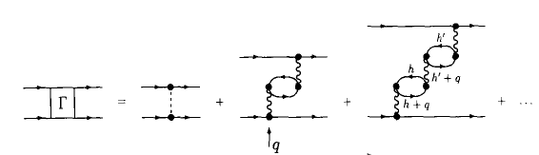
Cooper pairing in nuclei
Singlet pairing of nn, pp
(np-exp. Cederwall et al, Nature 2011)
Gezerlis, Bertsch,Luo,
PR 106, 252502, 2011
Triplet nn pairing
Mixture of singlet and triplet pairing
Fulde–Ferrell–Larkin–Ovchinnikov periodic Δ(r) for N ≠Z (not yet found in nuclei)
in-medium effects
Pairing influences moments of inertia of nuclei (exp.)

Slide 6
Pairing in NS and hybrid stars
Calcul.:1S₀-typical NN Δ <MeV,
For nn 3P₂ , Δ ~(0.01-0.1) MeV
In case of 2-order supercond.:vortex Abrikosov structure,
3P₂ :ferromag. superfluidity, DV PRD2020, anyon-vortices, Nitta2023, hadron-CSC, continuity (crossover), specific reaction on external mag. field, rotation.
^{n}_{centr} ^{<(6-8) n}₀
(exp.) Glitches of pulsars and post-glitch relaxation. Cooling of compact stars is sensitive to 3P₂ nn and 1S₀ pp,
+ hyperon-hyperon, and qq pairings in dense interiors

Slide 7
Color superconductivity below T_{c} and color fluctuations above T_{c} , for n> several n₀
Order parameter- matrix, Strongly interacting matter:
Typical values of superconducting diquark gap:
Δ~ 10-100 MeV ~ 10¹¹-10¹² K,
many different phases (2SC, CFL,CSL etc) in most massive NS.
Broad fluctuation range near T_{c} as in He-II
Precritical CSC fluctuations in HIC (?) at T<1.5 T_{c} ~100 -150 MeV (due to strong coupling, characterized by Gi=|T_{c}-T_{fl}|/T_{c} ~0.1-1)
Kitazawa et al PRD2002,PTEP2022, DV PRC2004, Kerbikov PRD2020,
cf. Kitazawa talk

Slide 8
EoS, masses of comp. stars
Bethe & Brown 1994: M<1.56 M_{sol}
PSR 2215+5135, M=2.27 M _{sol} (2022) ?
PSRJ0740-6620 Cromartie et al. Nature 2020
^{M=2.08+/- 0.07 M}_{sol}(68% cred.) Fonseca et al ApJ 2021
2207.05124
?
M_{max}>2.09 M_{sol} at 3σ, 2207.05124
R=13.7+2.6-1.5 km Miller et al. ApJ 2021 analysis of data
Analysis 2006.14601:M_{max} <2.2-2.3 M_{sol}
M_{min} <1-1.2 M _{sol}, HESS J1731-347: <0.97 M _{sol} SQS? Nat.Astr. 2022
^{ncentr <(6-8) n0}
Klahn et al PRC2006, cf. Taranenko talk
Implies nontrivial n-dependence of symmetry energy
Strangeness in NS for n>(2-4)n0 : Hyperon and Δ isobar puzzles - new modes still soften EoS cf. Pelicer,Kolomeitsev talks

Slide 9
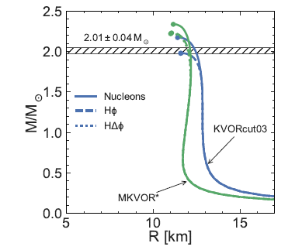
One of solutions: EoS with mass scalings in vector ω (KVORcut03), and isovector ρ (MKVOR) channels, HΔφ - hyperons and Delta are included
Maslov et al PhLB2015, NPA2016, Kolomeitsev et al NPA 2017
Next puzzle: HQ phase tr.: softer EoS--smaller M_{max} , cf. Grigorian talk

Slide 10
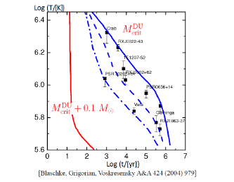
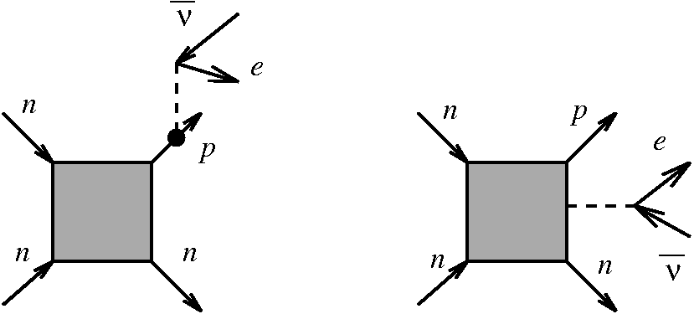
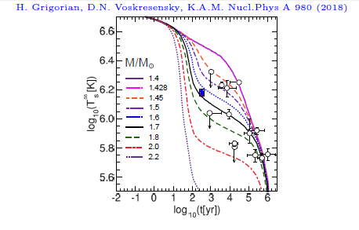
Neutrino cooling of NS, symmetry energy and DU constraint
for 10²s<t<10⁶yr, T<1 MeV λ_{ᵛ} >>R :
^{Direct Urca reactions}
yield too rapid cooling of pulsars
To occur DU needs >11-15% of protons
EoS is such that <10-15% p in most NS, at M<1.5 M_{sol}
Again constraint
on n-dependence of symmetry energy
N
N
MMU
processes
PBF
processes
Masses of cooling NS are different +
strongly n-dependent NN interaction
DV,Senatorov1984,1986
+NN pairing allow describe NS cooling data
+ in-med. ef. on thermal conduct. for young NS

Slide 11
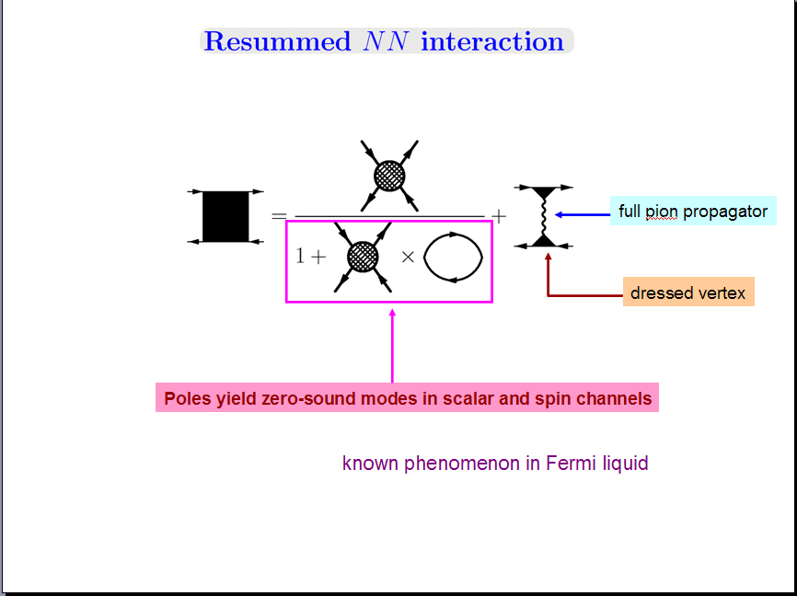
Low energy excitations in nuclear Fermi liquid (Migdal approach)
No free pions in matter! Strong p-wave pion-nucleon interaction!
based on a separation of long and short scales
cf. Debye screening
Info. on short-range interact. is extracted from atomic nuclei exp. and model calcul.
P wave vertices
includes s-wave inter. & pion fl.
Migdal Rev.Mod.Phys. 50, 1978, Migdal,Saperstein,Troitsky,D.V. Phys.Rep.192 (1990).

Slide 12
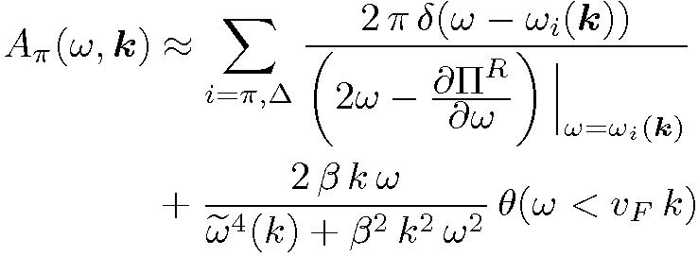
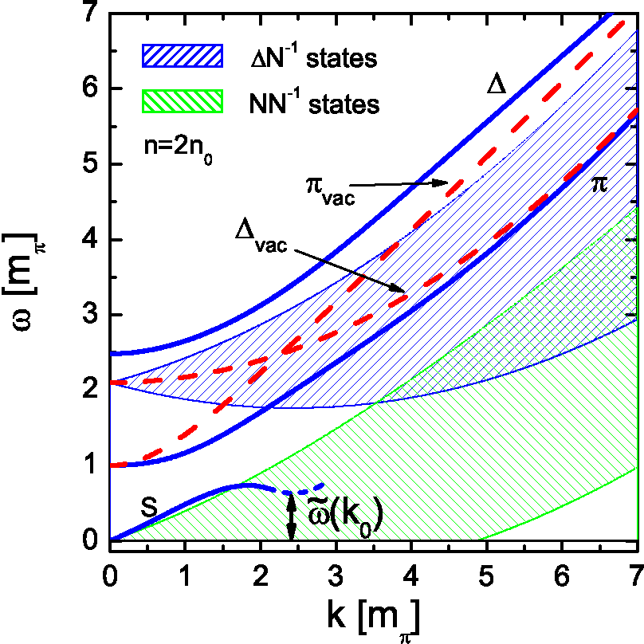
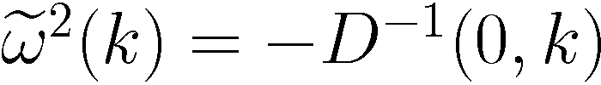

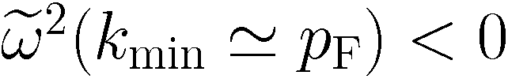
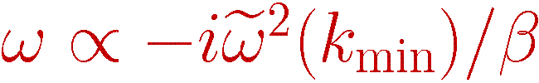
Pion spectrum in iso-symmetric nuclear matter
in simplified quasiparticle-based picture
-
=
Attraction at $π$ branch is in accord. with $π$atom data
Instead of
Landau damping
<m_{π}
for n> n _{c1}~0.5-0.8 n₀
n=n₀
at k≠ 0 (p-wave) strong pion fluctuations
for T ≠0, n>n_{c1} DV NPA 1993
liquid phase of quantum pion condensate
for
(for n>n _{c}~ (1.5-3) n₀)
instability
P-wave crystal-like phase of pion cond.
Always 1-order phase tr.
S-wave pion cond. In HIC:to be or not to be? DV, PRD2022
Pion in matter is very complex collective excitation

Slide 13
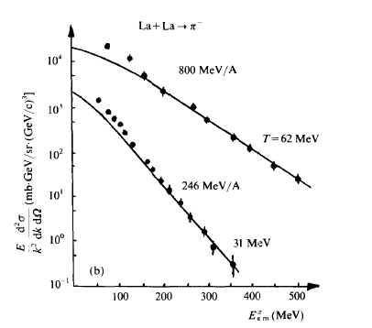
Pion production in La+La collisions
from D.V. Nucl. Phys. A555 (1993)
Low p-enhancement is described by
radiation of pions in direct reactions
λ_{π}(n,T)>R(n) at n>n_{b}
From prompt freeze out
With in-medium effects included, pions with k>(150-200) MeV have short mean-free path and radiate from thermal freeze-out, n≈0.6 n₀, pions with smaller momenta radiate from an earlier stage.

Slide 14
Diagram: age– rotation period why there are no rapid young pulsars?

Slide 15
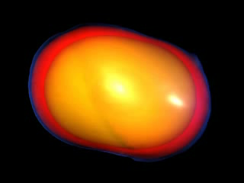
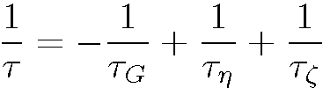
r-mode (Rossby) instability of rotating neutron star and viscosity
In NS Coriolis force is the source of r-mode instability
Andersson ApJ 1998, Friedman and Morsnik ApJ 1998
surfaces of const density (0.8, 0.1, 0.005,
0.0001, оf central NS density)
r-modes can either destroy the star
or the star stops
r-mode is stable due to shear/bulk viscosity
>0
In presence of “soft pion mode” bulk viscosity increases that helps to explain data, Kolomeitsev, DV PRC 2015,
cf. Shternin, Kraav talks
In-medium pion effects in supernovas and pNS:
Portion ~1% per baryon of π⁻ flow! Fore,Reddy PRC 2020

Slide 16
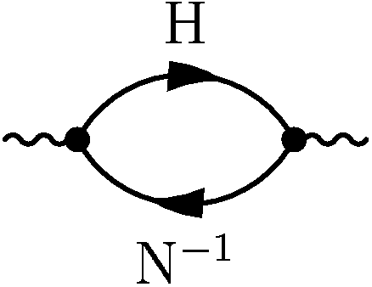
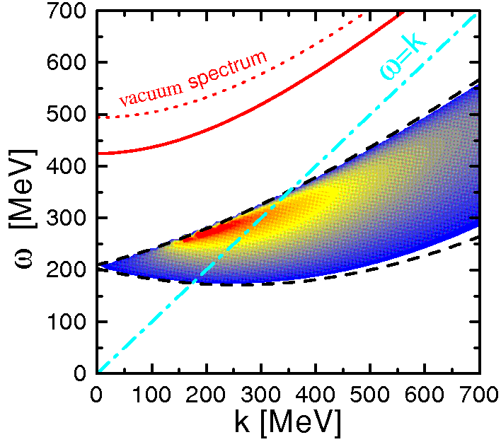

Strangeness kaon and hyperon-nucleon particle-hole modes
Attractive s/p-wave potential manifested
in K⁻ atoms via
regular part of Π (mainly s-wave)+
p-wave Lambda proton modes
μ_{ε}
n=n₀
Hyperonization of NS matter
for n>(2-4) n₀
and m.b. antikaon s or p-wave condensation
in dense NS matter, e → K⁻ for ω_{K}<μ_{e}
Kolomeitsev et al NPA1995,IntJModPh 1996

Slide 17
Dileptons in HIC at energies SIS/HADES - RHIC-BES
A general description (see vanHees Lect.2016) is similar to that for neutrino emissivity from NS, and direct soft photon radiation in HIC cf. Knoll, DV AnPh 1996
self-energies) mass shift and broadening in the medium
Rapp,Wambach 1999, …,

Slide 18
Viscosity again. High HIC energies, elliptic p-flow and non-ideal (viscous) hydro
Role of viscosity
Various calcul,2111.08145
η/s – ratio of shear viscosity to entropy density. A small viscosity is required!
Even at LHC energies– not weakly interacting gas but strongly interacting quark-gluon plasma (!), ɳ ≠0.State of pQGP is expected only for n_{B}>40n₀ or for T>3T_{c}
Elliptic flow for N, π, kaons, hyperons, even for photons (at LHC)

Slide 19
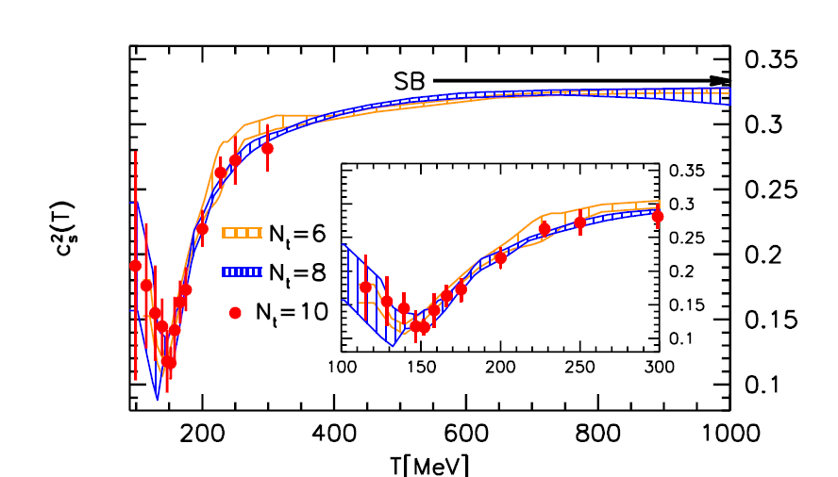
QCD and gluodynamics on lattice
μ_{B}=0 - crossover
Second-order cumulants
Bollweg et al, 2021
Black-body limit is not reached even at LHC strongly interacting QGP – almost ideal liquid, not gas! Shear and bulk viscosities are also calculated on lattice, cf. Braguta talk

Slide 20
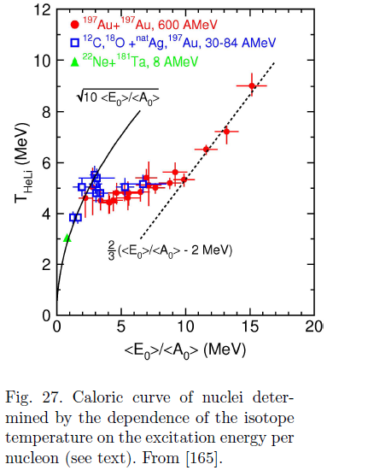
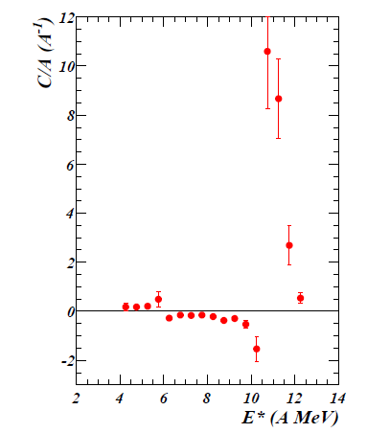
LG 1-order phase transitions in HIC: G-L & m.b. HQ
LG tr. at low HIC energies:
Schulz, Munchow,Roepke, Schmidt PhLB 1982, Bertsch, Siemens PhLB 1983,
Schulz,DV, Bondorf PhLB 1983…see Review Borderie 2019 (ALADIN,INDRA )
^{Region with Cp <0}
Borderie et al., EPJA, 56, 101 (2020)
^{Pochodzalla et al (1995)}

Slide 21
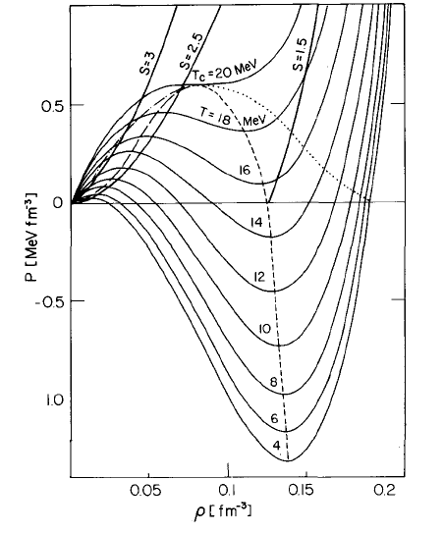
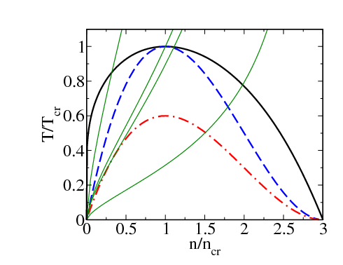
CEP, I-order phase transition. Van der Waals-like EoS, nonequilibrium effects: spinodal and fluctuations
LG tr. in RMF EoS, Schulz et al PhLB 1983
^{Lines S = const}
fl. region
Gi
SV
ITS
OL
AS,
region of instability
in ideal hydro
- - isothermal spinodal (ITS) unstable region, isothermal compressibility K_{T}<0,
- . - . - adiabatic spinodal (AS), solid line - Maxwell construction

Slide 22
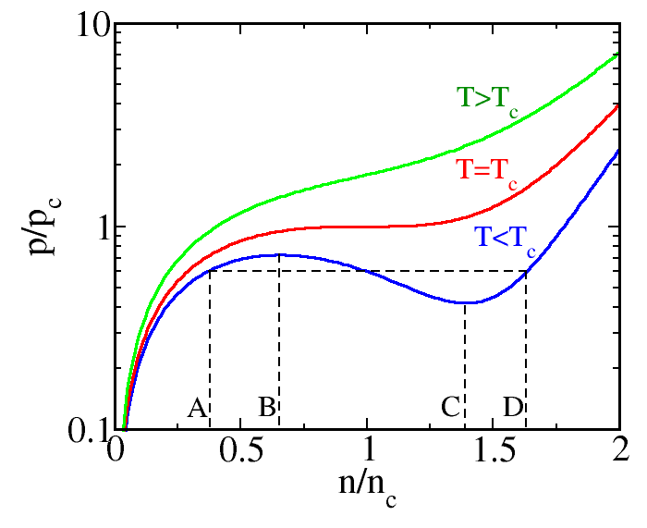
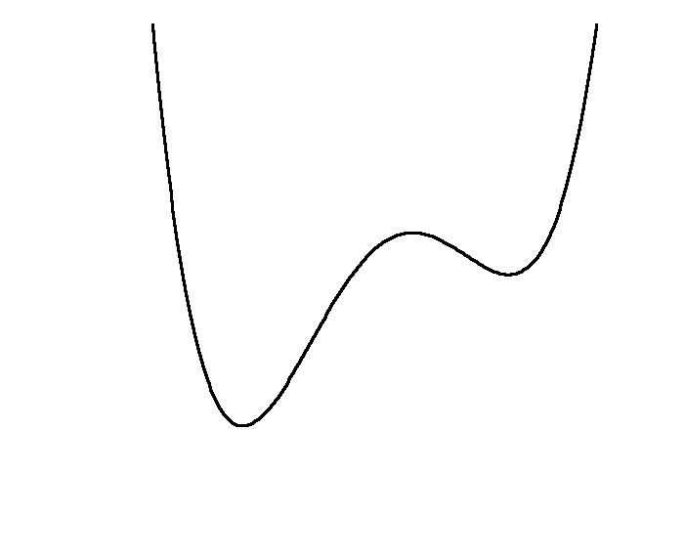


I order phase transition
^{F} ^{(φ)}
^{CEP}
●
^{Volume}
^{energy gain}
----------------------------------------------
,
^{Surface energy loss}
Viscosity and thermal cond. are driving forces of phase tr.
Nuclear rain and fog. Again viscosity and thermal conductivity

Slide 23

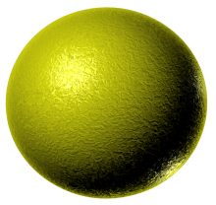
I order phase transition
^{F(φ)}
●
-------------------------------------------------------------------------
▼
^{Region} ^{spinodal}
^{Instability}
Fog, rain k=0, water-- ice k≠0
▼
-----------------------------------------
,
^{In} spinodal region perturbations at k(t) ≠0 grow exponentially:
^{Opening of champagne bottle.}

Slide 24
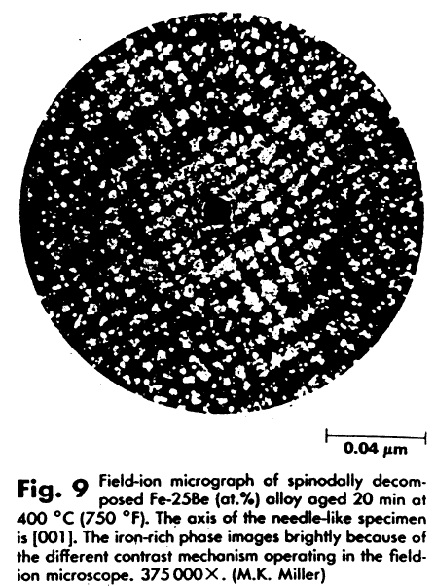
^{quasiperiodic structures}
^{in spinodal region}
^{in Fe-Be alloys}

Slide 25
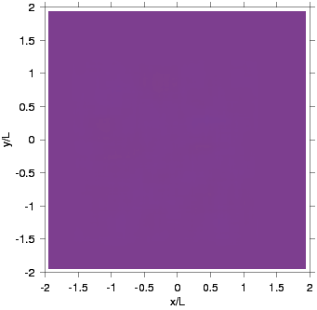
Spinodal instability at QH phase tr.
Hydro simulations: Dynamics of spinodal decomposition
Blue – hadrons
Red – quarks.
Skokov,DV, NPA2009

Slide 26

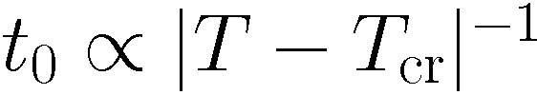
Fluctuations. Normalized variance of the baryon number
^{Maslov, D.V. EPJA55 (2019)}
In equilibrium matter
n/n₀ =
^{diverges on ITS line}
Higher fl. momenta–skewness and kurtosis–
^{are still stronger diverging} ^{at crossing of}
isothermal spinodal line than variance
→0
In HIC effects of crossing of ITS line m.b. easier to observe via increased fluctuations of conserved charges and quasiperiodic structures
^{and anomaly in} ^{production} ^{of light nuclei}
rather than by effects of the closeness to the critical point (due to a critical slowing down in latter case )

Slide 27
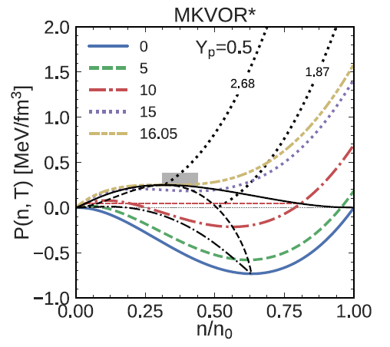
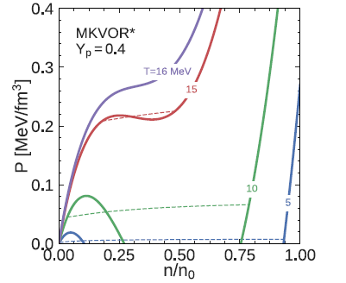
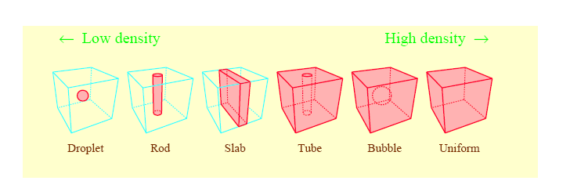
P(n) isotherms for LG tr. in ISM (N=Z) and IASM (N≠Z)
N≠Z, two conserved charges: Maxwell construction from horizontal line transforms into curve - mixed phase, on spinodal both w_{B} ^{and w}_{Q} ^{diverge}
In comp. stars at 1-order phase tr. -- structured pasta phase. Global el. charge neutrality: balance of surface tension + screening – WZ cells
^{In HIC at N≠Z no} ^{global charge neutrality: but}
neutron distillation+surface tension would result in redistribution of charge within WZ cells, if R(t) were >>RWZ
^{Features of pasta in HIC (?)}

Slide 28
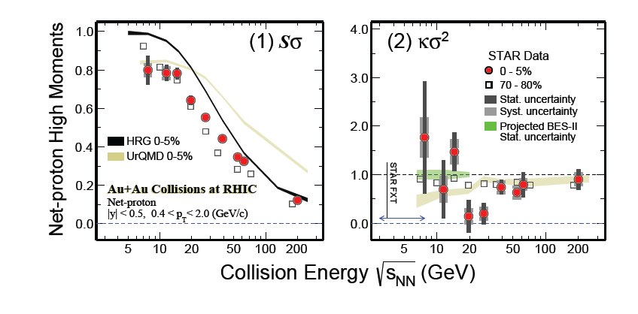
CEP, expectations and measurements
Evidence of non-monotonic variation in kurtosis of net proton number in
central Au+Au collisions at RHIC STAR 2001.02852, fig. 2211.08819

Slide 29

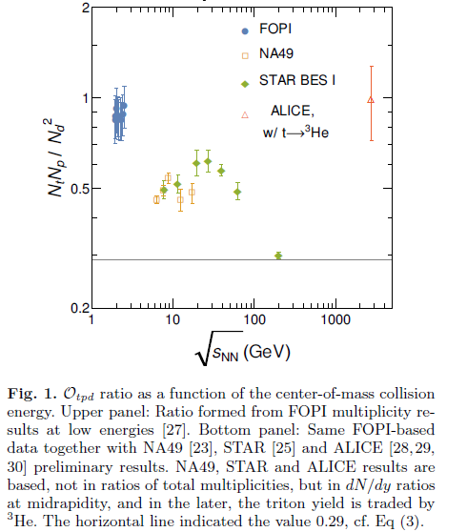


Anomaly in light nuclei production
(near CEP due to fluctuations ?)
From Shuryak, Torres-Rincon, EPJ 2020
莊周 Chuang Tzu IV c. BC
``Occations are not
occational as well as
7-th Sky Hight’’
Anomalous fluct. –
precursors of phase tr.
Trivial fugacity dependence cancels
neutron density fluctuations
Similar irregularity is expected for

Slide 30
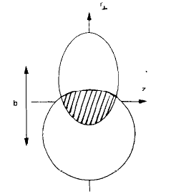
Other peculiarities of fluctuations in HIC
● finite size effects associated with fluctuations in peripheral HIC:
effectively reduced dimensionality ^{near CEP} :
^{coherence} ^{length in 3d, l} ^{~1/|T}_{cr}^{-T|1/2} ^{<R}
^{If l fulfills inequalities} ^{R}┴ ^{>l >R}║ ^{→2d geometry,}
^{for R}║ ^{> l >R}┴ ^{1d,}
^{0 d for l > R}
Depending on impact parameter in a vicinity of T_{c} fluctuations may behave as in case d<3 !
For d=3, C_{V}~ 1/|T_{cr}-T|^{1/2} , for d=0, C_{V}~ 1/|T_{cr}-T|²
Effects of different geometry for fluctuations in central and peripheral HIC (?)

Slide 31
Ultracold atoms typically below several tens of microkelvin
as in nucl. systems: elliptic flow, superfl.,vortex structures, viscosity
In nuclear matter strength of interaction is changed by varying n, T
Scattering length a, as function of magnetic field B
5000
834 gauss
2500
a, bohr
200
400
600
800
1000
1200
1400
1600
0
-2500
528 gauss
-5000
-7500
В, gauss
Varying mag. field, one changes strength and sign of interact. of atoms

Slide 32
Phys.Rev.A 87 (2013) 2, 021604
analog of tensor forces, p-wave πNN inter.
analog of NN correlations
Similarly, for

Slide 33
Conclusion
In-medium effects, shear and bulk viscosity, anomalies in fluctuations
! Rich theory permitting strong in-medium effects and still poor their experimental manifestations in HIC. More trick measurements are required.
! Description of strongly interacting matter in nuclei, compact stars, HIC requires interdisciplinary efforts.

Slide 36


Hadron porridge at T ~m_{π} and low baryon chemical potential (LHC cond.)
+…
DV NPA2004
Baryons (N, Δ etc) are heavy, π, K, σ are light
Multiple scattering of N on soft pions as on static impurities
As for electron-phonon interaction in doped
semiconductors: electrons-baryons, phonons-light bosons
Off-pole solution: for T>T_{bl}~ m_{π} baryon blurs (not quasiparticles, not resonances)+
pion hot Bose condensate at k=0 or even for k≠0 due to p-wave coupling.
HQ crossover continuity

Slide 37
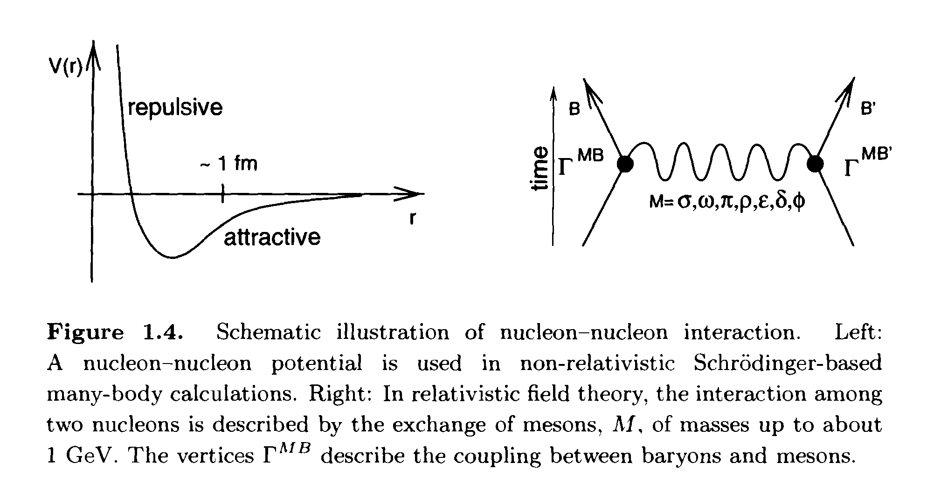
Triple role of mesons: collective excitations, mediators of baryon-baryon interact. and condensates of classical fields
Particle excitations radiate from matter to vac.
Pseudo-scalar light π (140 MeV) is responsible for long-distance tail of NN interaction, scalar σ (≈600MeV) - middle-distance NN attraction,
vector ω (780 MeV) ) - short-range NN repulsion, iso-vector-vector ρ (775) - symmetry energy, pseudo-scalar K(494 MeV) and vector φ(1019) exchange of strangeness. For σ, ω, ρ, φ there exist static mean-field (classical) solutions of Lagrange eqs. for all n, σ= σ_{cl}+ σ’, σ’-new meson excitations,
π- and K- condensates m.b. appear in dense nuclear matter at n>n_{c}^{(1.5-4)n}₀ ?

Slide 38
One of solutions: EoS with mass scalings in vector ω (KVORcut03), and isovector ρ (MKVOR) channels, HΔφ - hyperons and Delta are included
Maslov et al PhLB2015, NPA2016, Kolomeitsev et al NPA 2017
Next puzzle: HQ phase tr.: softer EoS--smaller M_{max} , cf. Grigorian talk
Other choice? smooth percolation HQ EoS (interpolation!),Baym et al, RepProgPh 2017,
Second CEP (?),
HQ-CFL vortex continuity,
again crossover for low T

Slide 39
More exotics: quarkyonic crystals, similar to p-wave pion and kaon condensates and A-smectic liquid crystals
Baryon-quarkyonic-quark Fermi seas
cf. Duarte et al., 2302.04781:
Pisarski, Skokov, Tsvelik PRD 2018
Baym et al, RepProgPh 2017: m.b. continues tr. from nucleon to quark pairing, two CEP points (?)

Slide 40
BEC of pions with dynamically fixed number at low momenta
For k << m_{π} pion path length λ~R
Soft-pion number is approx. conserved for T<130 MeV, mainly elastic collisions
increase of n _{π} (k << m_{π} ) and BEC at sufficiently rapid cooling of the system
D.V.1994, Kolomeitsev et al 2021
ALICE Collaboration (2014,2016) observed a significant suppression of three- and four-pion Bose–Einstein correlations in Pb-Pb collisions at 2.76TeV at the LHC: Begun, Florkowski 2015- about 5% of pions could stem from BEC.
Relevant problems: enhancement of pion variance in pp (Kokoulina et al 2012), gluon condensation in HIC (Blaizot et al. 2012)

Slide 41


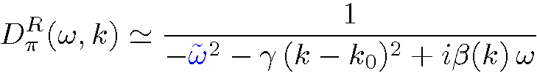
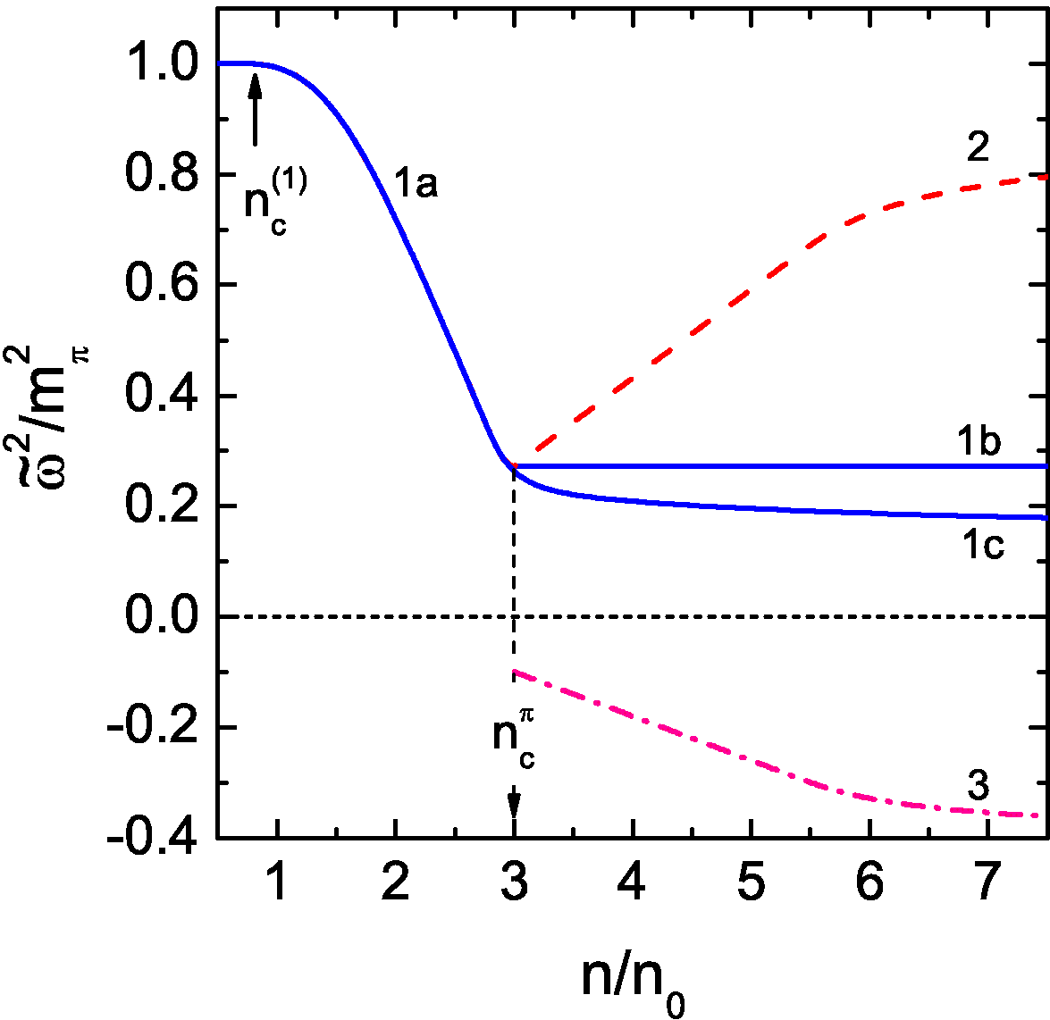

Pion softening, liquid and solid-like phases of pion cond.
Neutral pion propagator for
n _{c}^{π} >n> n _{c1}~0.5-0.7 n₀
Effective pion gap squared
≈ max. of NN interaction
amplitude for k~p_{F}(n),
n> n _{c1}~0.5-0.8 n₀
Liquid phase of π-condensation
reconstruction of pion spectrum
on top of the pion condensate
If LM parameters increase with density
-- saturation of pion softening and
no pion condensate
amplitude of the pion condensate
(liquid-crystal or m.b. ALS solid) , e.g.
Always first-order phase transition due to fluctuations at k≠0 !

Slide 42
Ratio of shear viscosity to entropy density
η/s [ADS/CFT]=1/4π absolute minimum
maps QGP to black hole formation in 5-ADS₅ space: rapid thermalization, entanglement entropy-rapidity window relation, cf. arXiv 2211.16265
-coupling constant
Not as was expected !!!
Even at LHC energies– not weakly interacting gas! Strongly interacting quark-gluon plasma (!), ɳ ≠0
State of pQGP is expected only for n_{B}>40n₀ or for T> 3 T_{c}

Slide 43
2301.13253

Slide 44



Baryon blurring in baryon-less hot matter
Strong interaction, heavy baryon -light boson
e.g. nucleon-antinucleon-pion state
DV, NPA,2004,2008
yield suppressed contribution due to isospin-spin summation
For
>>
$$→$$
JG=
G
cf. LPM effect, and
critical opalescence
$$→$$
F(T)~ >>1
Baryon blurs, not quasiparticles, not resonances, for T>T_{bl}~m_{π}
$$→$$
State of hot hadron-antihadron – quark-antiquark porridge

