Slide 1
Crust of accreting neutron stars
A.I. Chugunov
M.E. Gusakov, E.M. Kantor (Ioffe Institute)
N.N. Shchechilin (Université Libre de Bruxelles)
AIC & N.N. Shchechilin, MNRAS, 495, L32 (2020)
M.E. Gusakov & AIC, Phys. Rev. Lett. 124, 191101 (2020)
M.E. Gusakov & AIC, Phys. Rev. D, 103, L101301 (2021)
M.E. Gusakov, E.M. Kantor & AIC, Phys. Rev. D, 104, L081301 (2021)
N.N. Shchechilin, M.E. Gusakov & AIC, MNRAS, 507, 3860 (2021)
N.N. Shchechilin, M.E. Gusakov & AIC, MNRAS, 515, L6 (2022)
N.N. Shchechilin, M.E. Gusakov & AIC, MNRAS, submitted
…
INFINUM - 23
Dubna, JINR, February 27- March 3, 2023

Slide 2

Motivation
Models of the crust
(net energy release, its profile, composition, equation of state…)
are essential for interpretation of thermal emission,
which was observed from many accreting neutron stars
(inaccurate models can lead to bias in the results)
© Dany Page, UNAM

Slide 3
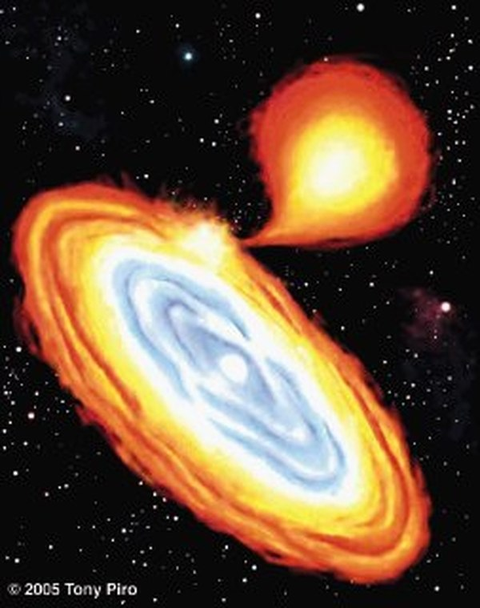
Motivation: accreting neutron stars
Many neutron stars are observed accreting, i.e. they are located in the close binary system with transfer of matter from (Roche-lobe overflow) companion star to the neutron star
What happens with matter after accretion?
How it affect observations?
Which information on superdense matter can be inferred from these observations?

Slide 4

Motivation: transiently accreting neutron stars
Compression of
accreted matter
Thermal emission
(detected!!!)
Nuclear reactions
Heating
Thermal emission just after accretion episode
(crust)
After thermal relaxation of the crust
(the NS core)
Figure from Wijnands et al. 2017
Shallow heating problem:
Models require a phenomenological heat source in shallow layers
Figure from Potekhin et al. 2019

Slide 5
Plan of the talk
Traditional model and its inconsistency
[AIC & N.N. Shchechilin, MNRAS 495, L32 (2020)]
Neutron hydrostatic/diffusion equilibrium(nHD) and its role in models of accreting neutron stars
[M.E. Gusakov & AIC, Phys. Rev. Lett. 124, 191101 (2020),
M.E. Gusakov, E.M. Kantor & AIC, Phys. Rev. D, 104, L081301 (2021),
N.N. Shchechilin, M.E. Gusakov & AIC, MNRAS (2021-….) ]
Deep crustal heating
[M.E. Gusakov and AIC, Phys. Rev. D, 103, L101301 (2021) ,
M.E. Gusakov, E.M. Kantor & AIC, Phys. Rev. D, 104, L081301 (2021),
N.N. Shchechilin, M.E. Gusakov & AIC, MNRAS (2021-….)]

Slide 6
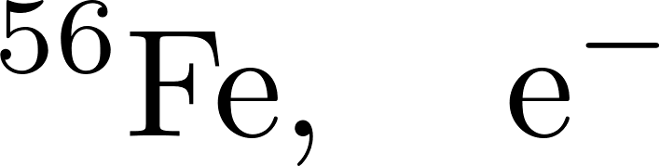
What happens with matter after accretion?
(traditional approach)
Thermonuclear burning in surface layers leads to formation of heavy elements («ashes»)
Traditional apporach [Sato 1979, Haensel&Zdunik 1990,….]:
Consider nuclear reaction on course of compression (increase of the pressure)

Slide 7
What happens with matter after accretion?
(traditional approach)
Thermonuclear burning in surface layers leads to formation of heavy elements («ashes»)
The subsequent portions of the accreted matter compress underlying layers after arrival to the surface
Traditional apporach [Sato 1979, Haensel&Zdunik 1990,….]:
Consider nuclear reaction on course of compression (increase of the pressure)

Slide 8
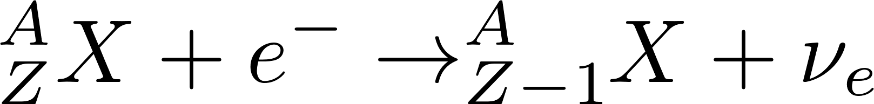
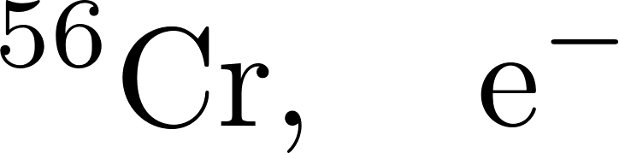
What happens with matter after accretion?
(traditional approach)
Thermonuclear burning in surface layers leads to formation of heavy elements («ashes»)
The subsequent portions of the accreted matter compress underlying layers after arrival to the surface
Compression leads to beta-captures
Traditional apporach [Sato 1979, Haensel&Zdunik 1990,….]:
Consider nuclear reaction on course of compression (increase of the pressure)

Slide 9
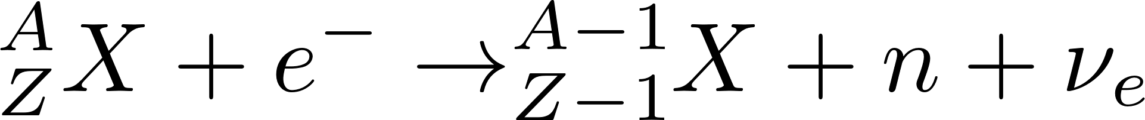
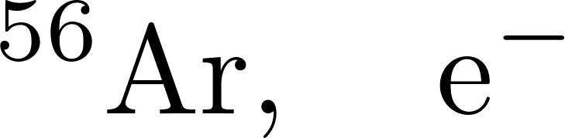
What happens with matter after accretion?
(traditional approach)
Thermonuclear burning in surface layers leads to formation of heavy elements («ashes»)
The subsequent portions of the accreted matter compress underlying layers after arrival to the surface
Compression leads to beta-captures
Beta-captures move nuclei to the neutron drip line and, finally, beta-capture is accompanied by neutron emission
Traditional apporach [Sato 1979, Haensel&Zdunik 1990,….]:
Consider nuclear reaction on course of compression (increase of the pressure)

Slide 10

What happens with matter after accretion?
(traditional approach)
Thermonuclear burning in surface layers leads to formation of heavy elements («ashes»)
The subsequent portions of the accreted matter compress underlying layers after arrival to the surface
Compression leads to beta-captures
Beta-captures move nuclei to the neutron drip line and, finally, beta-capture is accompanied by neutron emission
Traditional apporach [Sato 1979, Haensel&Zdunik 1990,….]:
Consider nuclear reaction on course of compression (increase of the pressure)

Slide 11
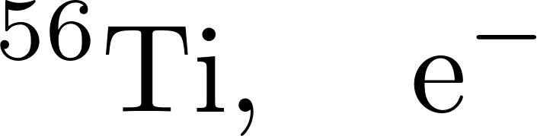
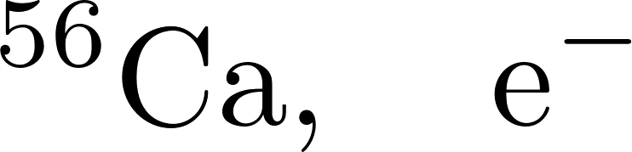


WThat happens with matter after accretion?
(traditional approach)
Thermonuclear burning in surface layers leads to formation of heavy elements («ashes»)
The subsequent portions of the accreted matter compress underlying layers after arrival to the surface
Compression leads to beta-captures
Beta-captures move nuclei to the neutron drip line and, finally, beta-capture is accompanied by neutron emission
Fully accreted crust is composed of matter at different compression stages
Initial value problem: initial composition determines whole evolution
Neutronization is associated with neutron drip

Slide 12
What happens with matter after accretion?
(traditional approach)
Thermonuclear burning in surface layers leads to formation of heavy elements («ashes»)
The subsequent portions of the accreted matter compress underlying layers after arrival to the surface
Compression leads to beta-captures
Beta-captures move nuclei to the neutron drip line and, finally, beta-capture is accompanied by neutron emission
Fully accreted crust is composed of matter at different compression stages
Unbound neutrons are not at the equilibrium at the inner crust
Their redistribution among crust layers is energetically favorable

Slide 13
What happens with matter after accretion?
(traditional approach)
Thermonuclear burning in surface layers leads to formation of heavy elements («ashes»)
The subsequent portions of the accreted matter compress underlying layers after arrival to the surface
Compression leads to beta-captures
Beta-captures move nuclei to the neutron drip line and, finally, beta-capture is accompanied by neutron emission
Fully accreted crust is composed of matter at different compression stages
The first indication of the importance of neutron diffusion
Bisnovatyi-Kogan G. S., Chechetkin V. M., 1979, UFN, 127, 263
Unbound neutrons are not at the equilibrium at the inner crust
Their redistribution among crust layers is energetically favorable

Slide 14


Thermodynamically consistent model:
neutron Hydrostatic/Diffusion equilibrium (nHD)
The statement of problem is crucially modified in the inner crust (=region, where free neutrons exist):
Instead of considering of nuclear reactions in compressing volume element one should consider whole inner crust, accounting for redistribution of neutrons between the layers
Two conditions:
General hydrostatic equation
neutron Hydrostatic/Diffusion equilibrium
Newtonian gravity
Transfer of a neutron from one layer to another does not lead to any energy gain

Slide 15
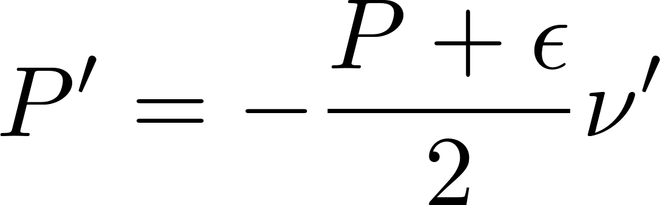
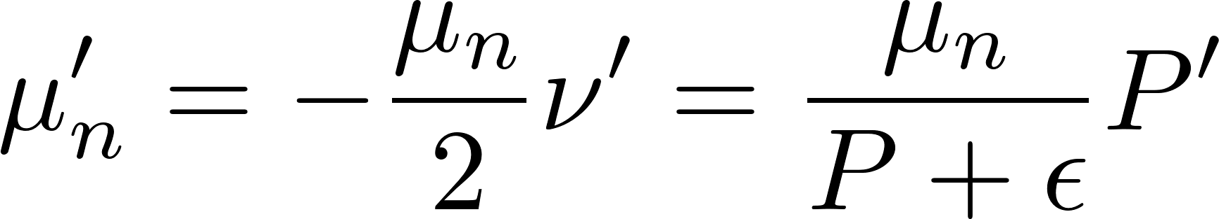

Thermodynamically consistent model:
neutron Hydrostatic/Diffusion equilibrium (nHD)
The statement of problem is crucially modified in the inner crust (=region, where free neutrons exist):
Instead of considering of nuclear reactions in compressing volume element one should consider whole inner crust, accounting for redistribution of neutrons between the layers
Two conditions:
General hydrostatic equation
neutron Hydrostatic/Diffusion equilibrium
General relativity
Transfer of a neutron from one layer to another does not lead to any energy gain

Slide 16

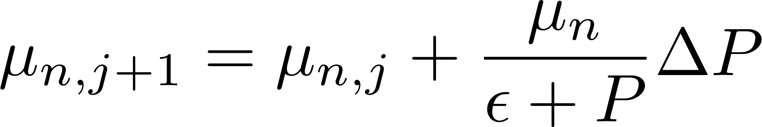
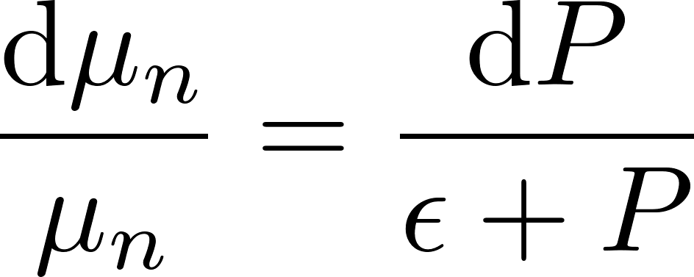


Modeling of fully accreted crust (schematically)
Traditional approach
(Haensel & Zdunik 1990, ….)
nHD approach (for P>P_{oi})
(Gusakov&AIC, Gusakov, Kantor&AIC)
Switch to the next, j+1, layer:
Increase of pressure
Switch to the next, j+1, layer:
Increase of pressure
and neutron chemical potential μ_{n}
TOV equation
+ nHD condition
Determine composition of this layer, specified by pressure P
Minimization of the Gibbs potential Φ
Determine composition of this layer, specified by pressure P
and neutron chemical potential μ_{n}
Minimization of the appropriate thermodynamic potential Ψ
Initial composition determines evolution
Family of models, parametrized by P_{oi}

Slide 17





Thermodynamics of nHD inner crust
Gusakov, Kantor, AIC (2021)
In the fully accreted inner crust nuclear reactions take place at the conditions, specific for a given layer:
Pressure (hydrostatic equilibrium with overlying layers)
Neutron chemical potential (nHD condition)
Appropriate thermodynamic potential is not the Gibbs energy , but:
Total number of baryons (beta equilibrium is assumed)
The heat release equals to the decrease of thermodynamic potential
Ground state:
(see GKA21 for ‘textbook’ proof)

Slide 18
Where does accreted crust end? At the instability!
Construction of the crust within nHD approach:
Increase P and μ_{n} + minimization of the appropriate thermodynamic potential Ψ
One component example:
ψ(Z) with grow of P
Can be minimized
Can not be minimized
Can not be minimized
Unstable
Strictly unstable
Stable
Instability:
Nuclei dissociation as a result of
beta-capture/neutron emission sequence
Similar instability without neutrons:
G. S. Bisnovatyi-Kogan&V. M. Chechetkin,
Astrophys. Space Sci. 26, 25 (1974).

Slide 19
How to chose P_{oi}? Fully accreted crust
Accretion supplies nuclei into the crust
Instability can dissociate nuclei => stationary state can exist
Our aim is to describe neutron star: the crust and the core should be connected in thermodynamically consistent way (continuity of the pressure and neutron chemical potential )
Accretion leads to the formation of fully accreted crust:
Instability is active (and compensate nuclei supply by accretion)
The crust in connected with the core

Slide 20
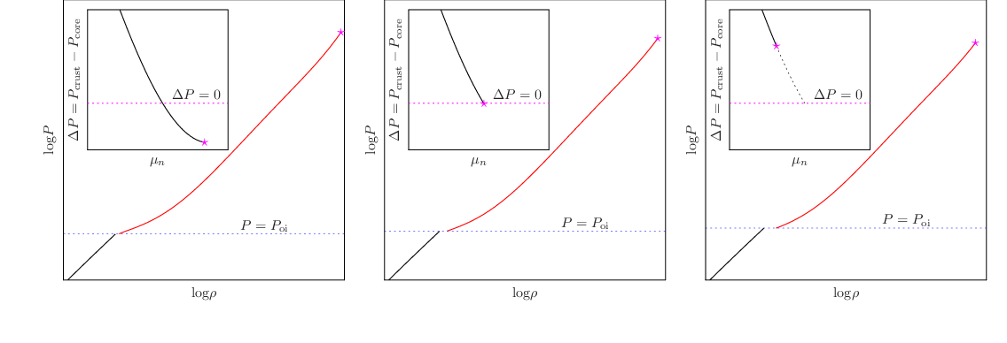
Construction of FAC model via shooting method
Depend on nuclear physics of innermost crustal layers. Example: (smooth) SLY4 case
Can not be FAC state
The instability does not take place in the crust
P_{oi} is too low
The FAC state
The instability take place exactly at the crust-core boundary
Can not be FAC state
The instability takes place, but crust EOS can not be connected with core
P_{oi} is too high

Slide 21
Few examples of FAC EOS
M.E. Gusakov & AIC, Phys. Rev. Lett. 124, 191101 (2020)
N.N. Shchechilin, M.E. Gusakov & AIC, submitted

Slide 22
Accreted neutron star crust within nHD models
(almost) everything is not as it was generally belived before
Inner and outer crust boundary is not associated with neutron drip-out from nuclei
The main reactions at the inner crust are: beta-decay (electron emission) and neutron captures (the reverse reactions were crucial within the traditional approach: electron captures and neutron emissions!)
There is upward diffusion/superfluid flow of neutrons, which supplies neutrons to the shallow layers of inner crust (to compensate neutron captures)
The instability threshold is reached at the bottom of the inner crust, which leads to dissociation of nuclei (via sequence of beta captures and neutron emissions). It allows stationary crust structure
It is this threshold, that determines position of the outer-inner crust interface
(Sorry, it is not the end of the talk. The remaining part is on energetics)

Slide 23
Reminder: transiently accreting neutron stars
Compression of
accreted matter
Thermal emission
(detected!!!)
Nuclear reactions
Heating
Thermal emission just after accretion episode
(crust)
After thermal relaxation of the crust
(the NS core)
Figure from Wijnands et al. 2017
Shallow heating problem:
Models require a phenomenological heat source in shallow layers
Figure from Potekhin et al. 2019

Slide 24
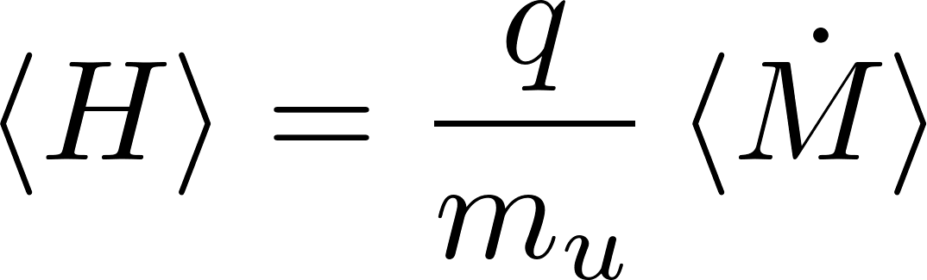

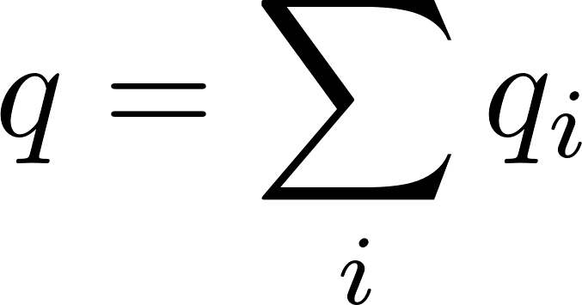
Efficiency of the deep crustal heating
Straightforward approach:
(applied previously)
Sum of the heat release over reactions:
Thermodynamic approach
(here)
Two assumptions:
Equilibrium composition of NS core
Fully accreted crust (stationary structure)
Almost no information on the reaction kinetics
Detailed information on the reaction kinetics is required
Neutrino energy is included into the heating
M.E. Gusakov & AIC
[Phys. Rev. D:Letters, 103 (2021), L101301]

Slide 25

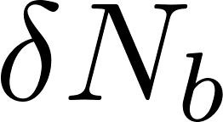
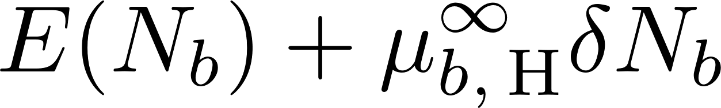
Heating efficiency: general consideration
Plane-parallel consideration (to simplify presentation)
Thought experiment I:
«The accretion process»
Accreted crust
NS (outer) core
(npe-matter)
Let us add baryons (in form of hydrogen) to the surface and keep them there `by hands’.
The energy of the system is
Hydrogen energy per baryon, including gravitational energy
Release the baryons
  The baryons compress the crust and core, initiate reactions, but total energy should be conserved

Slide 26
Heating efficiency: general consideration
Plane-parallel consideration (to simplify presentation)
Thought experiment II:
«The result of accretion»
Accreted crust
NS (outer) core
(npe-matter)
For fully accreted crust the EOS is fixed
  the number of baryons in the crust is fixed
  Additional baryons appear in the core of NS
The core is in equilibrium, thus the change of the energy is

Slide 27
Heating efficiency: general consideration
Plane-parallel consideration (to simplify presentation)
Thought experiment I:
«The accretion process»
Accreted crust
NS (outer) core
(npe-matter)
Thought experiment II:
«The result of accretion»
Which answer is the correct one?

Slide 28
Heating efficiency: general consideration
Plane-parallel consideration (for simplicity of the talk)
Thought experiment I:
«The accretion process»
Accreted crust
NS (outer) core
(npe-matter)
Thought experiment II:
«The result of accretion»
Which answer is the correct one?
Both are accurate!!!
The heat was released in the first experiment!

Slide 29
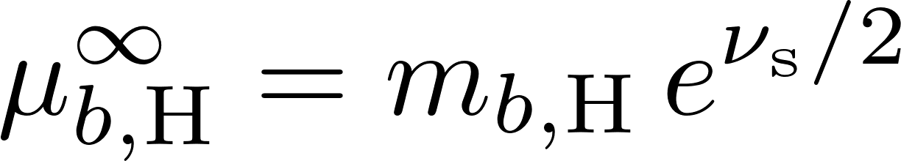
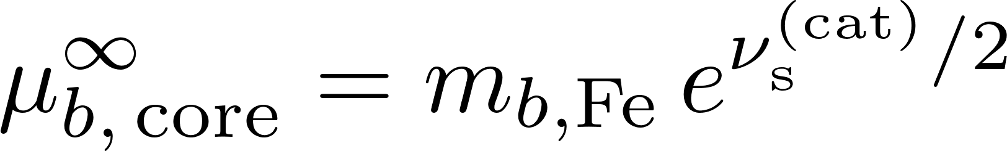
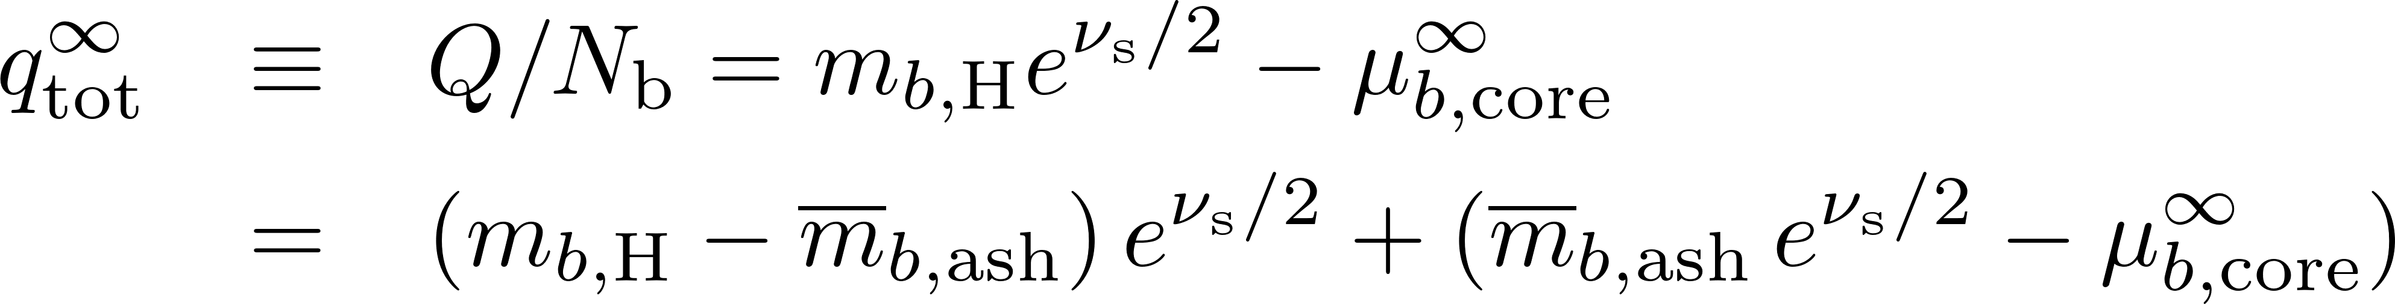

Heating efficiency: general consideration
The result is the same for a spherical general relativistic star
M.E. Gusakov & AIC [Phys. Rev. D:Letters, 103 (2021), L101301]
The «nuclear» part, associated with thermonuclear burning to the ashes (≈ ⁵⁶Fe).
Released from the surface, does not heat up the NS core
The gravitational energy, associated with larger thickness of the accreted crust. Released in the depths of the crust, heats up NS core
Catalyzed crust
Fully accreted crust

Slide 30
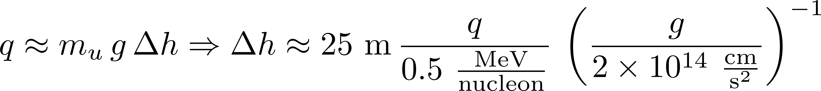
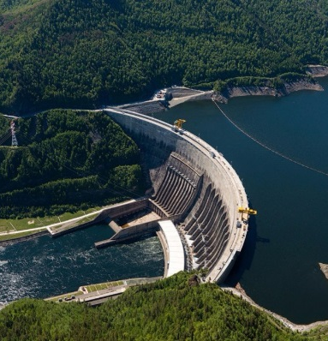
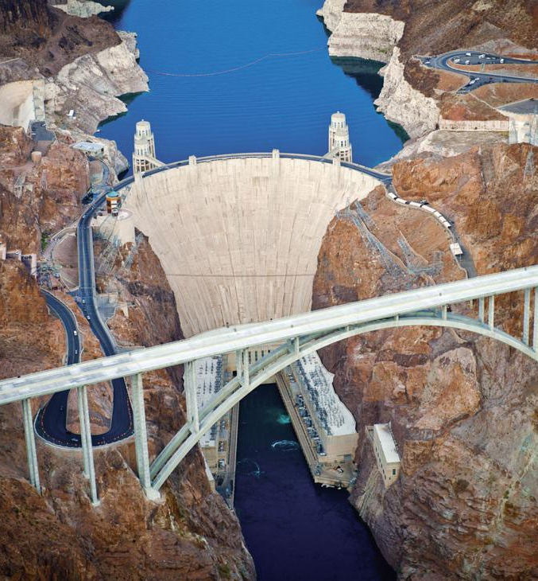
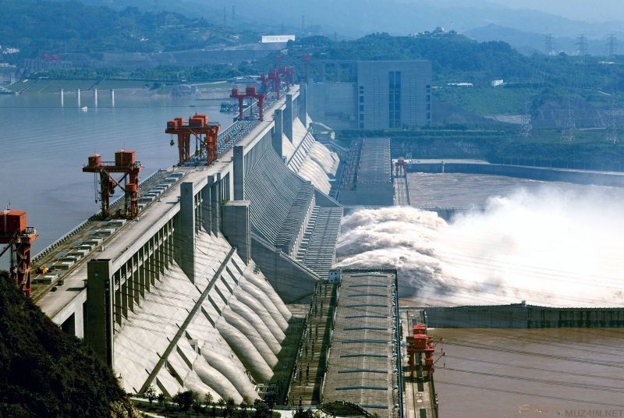
Heating efficiency: general consideration
Within traditional one component approach derived by Zdunik et al. [A&A, 599 (2017), 119]
Deep crustal heating: conversion of the gravitational energy into the heat
(in some sense similar to the gravity dams)
Sayano-Shushenskaya Dam
242 m
Hoover dam
221 m
Three Gorges Dam
181 m

Slide 31


Heating efficiency: nHD crust
Baryon chemical potential at the bottom of outer crust
For nHD crust the energy release is given by
EOS in the outer crust
Pressure at the outer-inner crust interface
(details on the inner crust EOS are not required!)

Slide 32
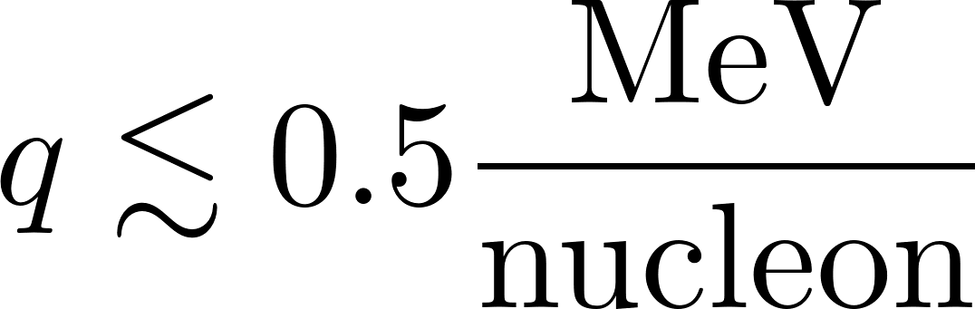
Heating efficiency: nHD crust
Deep crustal heating is factor of few less efficient,
than it was supposed in traditional models!
Shchechilin, Gusakov, AIC,
MNRAS: Letters, 515 (2022), L6

Slide 33
Results and conclusions
The accreted crust models, based on the traditional approach, are obsolete.
First nHD models have been constructed
Accretion leads to nonequilibrium (in thermodynamic sense), but static structure of the crust. Nuclei supply by accretion is compensated by the instability at the bottom of inner crust.
Microphysical constraints from thermal evolution of accreting neutron stars should be reconsidered. Shallow heating problem is not (yet) resolved (Potekhin et al., to be submitted)
On the construction of fully accreted neutron star crust
Schematic algorithm:
  Construct a set of candidate-models, parametrized by the pressure at the outer-inner crust boundary P_{oi} (initial problem for given P_{oi})
  Determine P_{oi} theoretically or observationally
Outer crust models can be applied to determine net heating as function of P_{oi}
Shell effect at the inner crust are important (but they are uncertain).
Current work is supported by Russian Science Foundation (grant № 22-12-00048)

