Slide 1
Reduction of shear modulus by nuclei finite size in the neutron star inner crust
N. A. Zemlyakov^{1,2}, A. I. Chugunov¹ ¹Ioffe Institute, St. Petersburg, Russia ²Peter the Great St. Petersburg Polytechnic University, St. Petersburg, Russia
Infinite and finite nuclear matter (INFINUM 2022)
Dubna
February 27 – March 3, 2023

Slide 2
Table of contents
I) Introduction
II) Elastic theory for neutron star crust
III) Nuclei finite size effect
IV) Results

Slide 3
I) Introduction.
What is a neutron star?
Neutron star – is a super star!
David Pines

Slide 4
I) Introduction.
What is a neutron star?
He is not the neutron star, but he was a super star!

Slide 5
I) Introduction.
What is a neutron star?
1) $M_{NS}\sim 1−2M_{ʘ}$, where $M_{ʘ}=2×{10}^{33}g$
2)$R_{NS}≈10−14 km$
3) $\left\langle ρ\right\rangle \sim {10}^{15} g cm^{−3}$
4) $ρ_{drip}≈4{×10}^{11}g cm^{−3}$
5) $ρ_{cc}≈1,4×{10}^{14}g cm^{−3}$
Outer crust
$$ρ_{drip}$$
Inner crust
$$ρ_{cc}$$
Core
Outer crust: (A,Z) + electrons
It is a crystal, so there are elastic properties.
Inner crust: (A,Z) + electrons + neutrons
Core: locally uniform nuclear matter (n, p, e, )

Slide 6
I) Introduction. Why is the elasticity of crust important?
Quasi-periodic oscillations after giant flares of magnetars
Glitches
Oscillations of neutron stars
Emission of gravitational waves
…

Slide 7
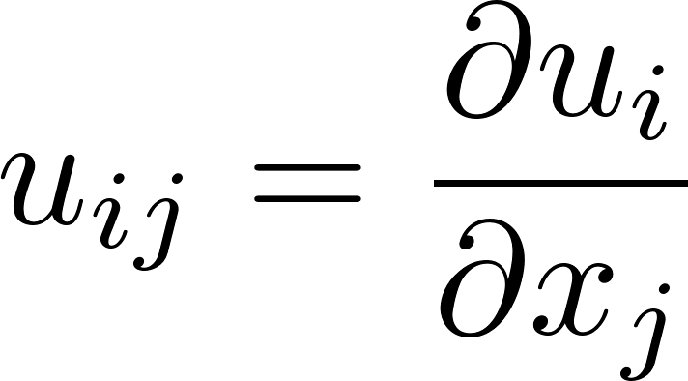
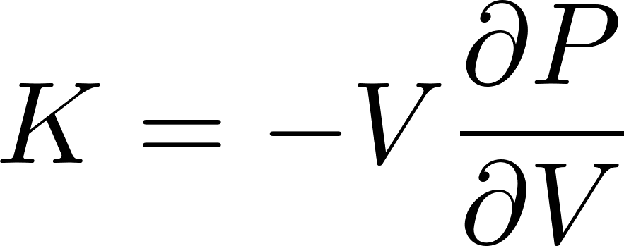
Introduction
Elastic theory for neutron star crust
To describe crust, we need to consider deformations with respect to the state at finite pressure
Elastic energy density due to deformation
Displacement gradient
Change of the stress tensor
in case of isotropic (polycrystalline) matter
The bulk modulus
Given by the equation of state
(and thus well known)
The shear modulus
Extensively calculated assuming point like nuclei
Static Coulomb crystal (Ogata&Ichimaru,1990; Baiko, 2011):
Corrections: nuclei motion: Baiko (2011, 2012), Horowitz&Hughto (2008)
electron screening: Horowitz&Kadau (2009), Baiko (2011, 2012), Kozhberov (2022), Chugunov (2022)

Slide 8
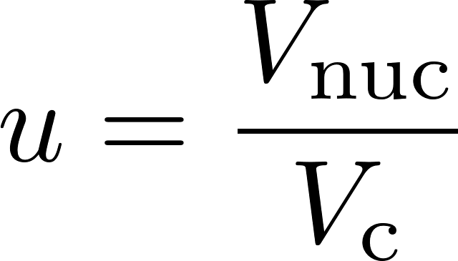
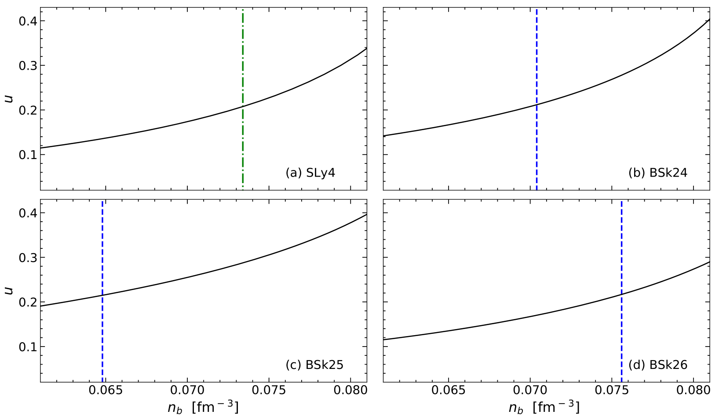
Is point-like nuclei approximation applicable?
Volume fraction, occupied by nuclei
becomes rather large at the deepest layers of the crust.
Point-like approximation becomes, at least, questionable!
To consider finite nuclei we should take into account nuclei structure, and thus appeal to nuclear physical models (finite nuclear matter)

Slide 9
Nuclear physical model: CLDM
(Minimal) liquid drop model for terrestrial nuclei
Only two parameters
A – mass number
Z – charge number
Compressible liquid drop model
(neutron star crust)
There are six parameters!
What are these parameters?
(Weizsäcker formula)

Slide 10
Nuclear physical model: CLDM
Wigner-Seitz cell
Nucleus
The crust is a periodic crystal, which can be split into elementary cells.
Each cell contains:
Nucleus (spherical within CLDM, proton number density $n_{pi}$ and neutron number density $n_{ni}$ )
Quasi-free neutrons outside the nucleus (number density $n_{no}$)
(Almost) uniform background of electrons (the cell is electrically neutral)
The elementary crystal cells (polyhedral) are replaced by independent spherical Wigner-Seitz cells. The quasi-neutrality of the cell is maintained by a homogeneous background of electrons.

Slide 11
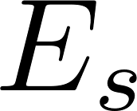
CLDM: surface energy
Wigner-Seitz cell
Nucleus
Surface energy
Including neutron adsorption
Without neutron adsorption
(applied within the talk for simplicity)

Slide 12
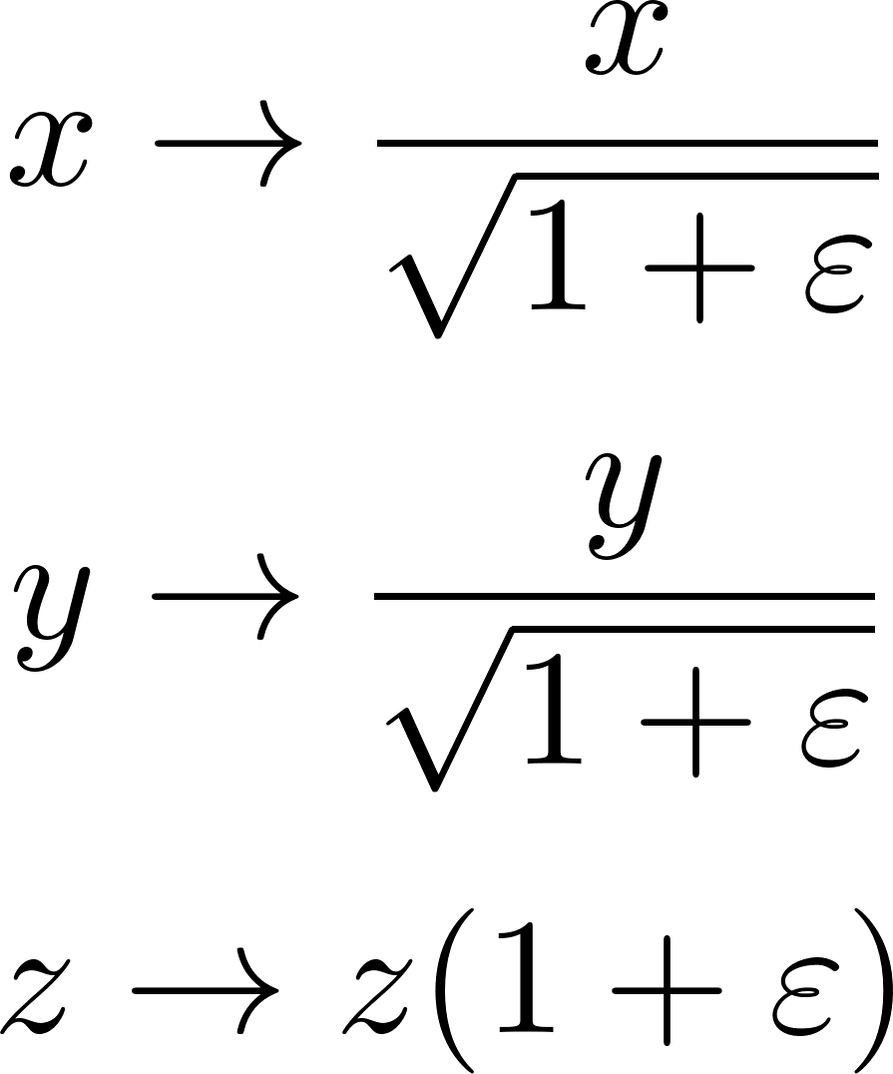
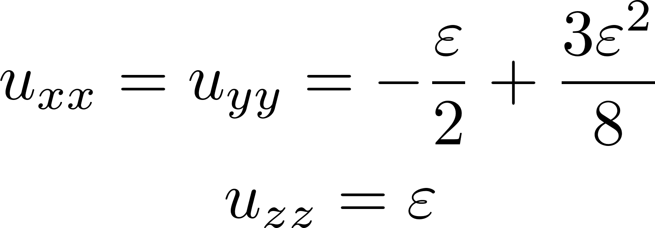
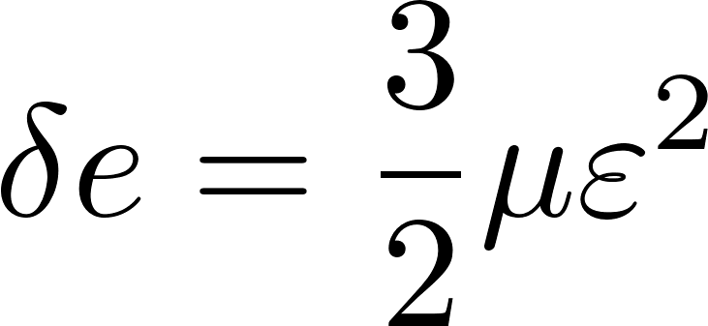
How to calculate shear modulus?
Calculate the energy in nondeformed state
Calculate the energy in deformed state (for given infinitesimal displacement gradient u_{ij})
Calculate the difference between these energies
Apply the relation which couples the energy change and the shear modulus
Incompressible shear deformation
(P and K are cancelled out)
Displacement gradients for shear deformation
Allows to calculate shear modulus, if the energy change is known

Slide 13
Ion spheroid model: test for point-like nuclei
Undeformed cell
Deformed cell
Wigner-Seitz cell
(ionic sphere)
Wigner-Seitz cell
Point-like nucleus
Point-like nucleus
Cell is a spheroid
with axes $r_{c}(1+ε)$ and $r_{c}/\sqrt{1+ε}$
$${ V}_{c}=const$$
Cell is a sphere with radius $r_{c}$
Nuclei energy is not modified by deformation (point-like nuclei approximation)
The idea is like in the ion sphere model:
replace the true elementary cell of the crystal (polyhedron) with a simpler shape

Slide 14
Ion spheroid model: test for point-like nuclei
Undeformed cell
Deformed cell
Wigner-Seitz cell
(ionic sphere)
Wigner-Seitz cell
Point-like nucleus
Point-like nucleus
Cell is a spheroid
with axes $r_{c}(1+ε)$ and $r_{c}/\sqrt{1+ε}$
$${ V}_{c}=const$$
Cell is a sphere with radius $r_{c}$
Reminder: accurate result
(Baiko D. A., 2011, MNRAS, 416, 22):
The ion spheroid model describes the shear modulus with excellent accuracy (difference at the 4th digit!!!)

Slide 15
Ion spheroid model: finite nuclei
Wigner-Seitz cell
(ionic sphere)
Wigner-Seitz cell
Nucleus
Nucleus
Cell is a sphere with radius $r_{c}$
Nucleus is a sphere with radius $R$
Cell is a spheroid
with axes $r_{c}(1+ε)$ and $r_{c}/\sqrt{1+ε}$
$${ V}_{c}=const$$
We have checked the finite size effect in framework of the ion spheroid model.

Slide 16
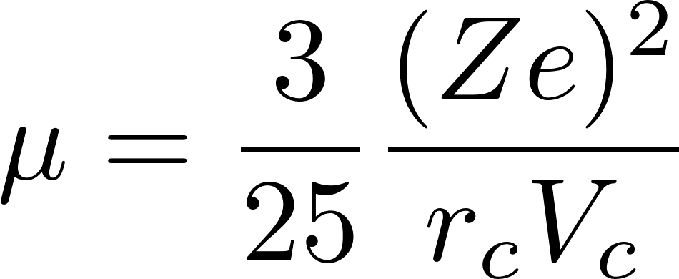
III) Nuclei finite size effect. Spherical nuclei
Wigner-Seitz cell
(ionic sphere)
Wigner-Seitz cell
Nucleus
Nucleus
Cell is a sphere with radius $r_{c}$
Nucleus is a sphere with radius $R$
Cell is a spheroid
with axes $r_{c}(1+ε)$ and $r_{c}/\sqrt{1+ε}$
$${ V}_{c}=const$$
The energy difference does not change
Exactly the same as for
for point-like nuclei!
This result can be predicted: interaction energy of spherically symmetric charge distributions is the same as for point like charges
But sorry, it is not the end of the story

Slide 17
III) Nuclei finite size effect. Spheroidal nuclei
Wigner-Seitz cell
(ionic sphere)
Wigner-Seitz cell
Nucleus
Nucleus
Cell is a sphere with radius $r_{c}$
Nucleus is a sphere with radius $R$
Cell is a spheroid
with axes $r_{c}(1+ε)$ and $r_{c}/\sqrt{1+ε}$
Nucleus is a spheroid with axes $R(1+ε_{p})$ and $R/\sqrt{1+ε_{p}}$
$${ V}_{c}=const$$
$${ V}_{nucleus}=const$$
When the crystal is deformed, the potential created by the surrounding nuclei in the vicinity of the lattice site is not spherically symmetric.
It can lead to deformation of the nuclei.
Here this effect is investigated in the ion ellipsoid model

Slide 18
III) Nuclei finite size effect. Spheroidal nuclei
CLDM energy
The bulk energy: not modified
Wigner-Seitz cell
The Coulomb energy:
to be calculated
Nucleus
Cell is a spheroid
with axes $r_{c}(1+ε)$ and $r_{c}/\sqrt{1+ε}$
Nucleus is a spheroid with axes $R(1+ε_{p})$ and $R/\sqrt{1+ε_{p}}$
$${ V}_{c}=const$$
$${ V}_{nucleus}=const$$
The surface energy: The surface area is increased
Virial theorem [Baym, Bethe, Pethick, Nucl. Phys. A 1971, 175, 225–271]
(Equilibrium by the number of nuclei=optimal size of the cell)

Slide 19
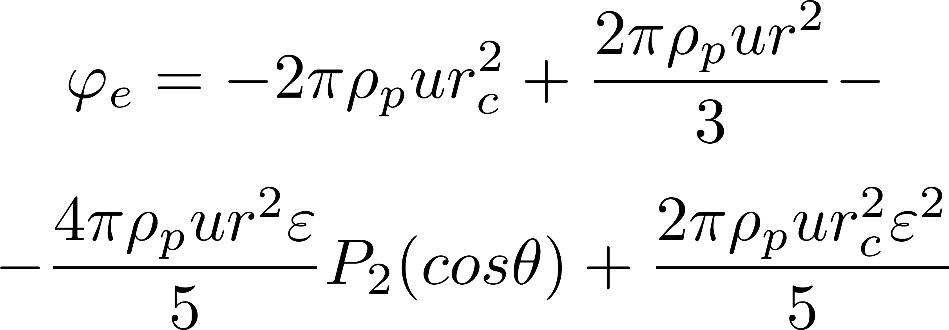
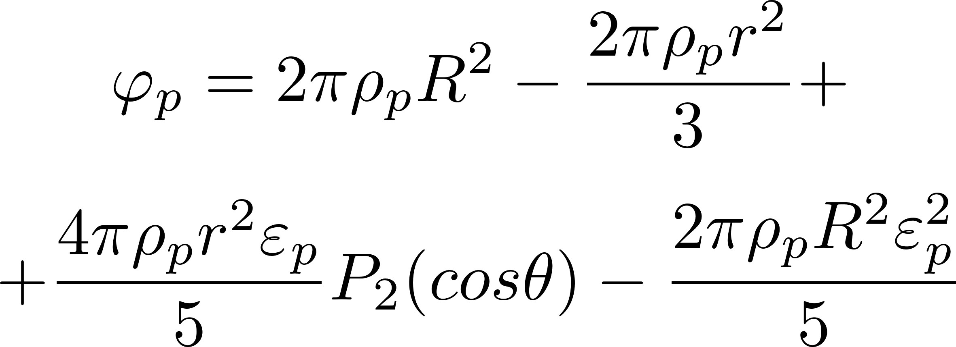
III) Nuclei finite size effect. Spheroidal nuclei
Coulomb energy
Simple electrostatic problem:
electrostatic energy of uniformly charged spheroid inside of uniformly charged spheroid
Wigner-Seitz cell
Nucleus
Cell is a spheroid
with axes $r_{c}(1+ε)$ and $r_{c}/\sqrt{1+ε}$
Nucleus is a spheroid with axes $R(1+ε_{p})$ and $R/\sqrt{1+ε_{p}}$
$${ V}_{c}=const$$
$${ V}_{nucleus}=const$$
Potential, which induces deformation of nucleus

Slide 20
III) Nuclei finite size effect. Spheroidal nuclei
CLDM energy
The bulk energy: not modified
Wigner-Seitz cell
The Coulomb energy: (previous slide)
Nucleus
Cell is a spheroid
with axes $r_{c}(1+ε)$ and $r_{c}/\sqrt{1+ε}$
Nucleus is a spheroid with axes $R(1+ε_{p})$ and $R/\sqrt{1+ε_{p}}$
$${ V}_{c}=const$$
$${ V}_{nucleus}=const$$
The surface energy: The surface area is increased
Virial theorem [Baym, Bethe, Pethick, Nucl. Phys. A 1971, 175, 225–271]
(Equilibrium by the number of nuclei=optimal size of the cell)

Slide 21
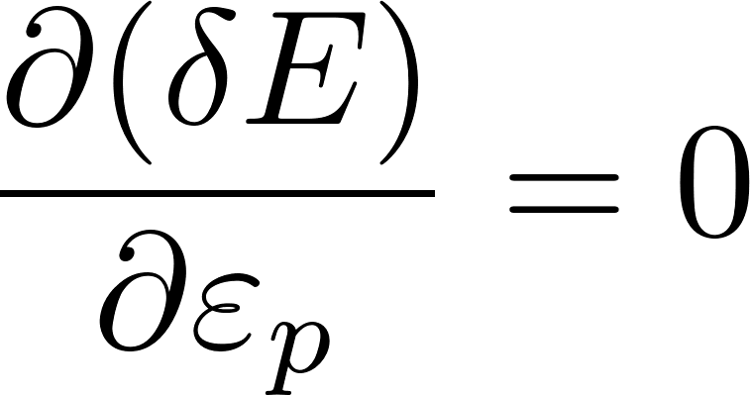
III) Nuclei finite size effect. Spheroidal nuclei
Optimal nuclei shape
Total energy change
We require the minimum of
total energy change
Stability condition

Slide 22
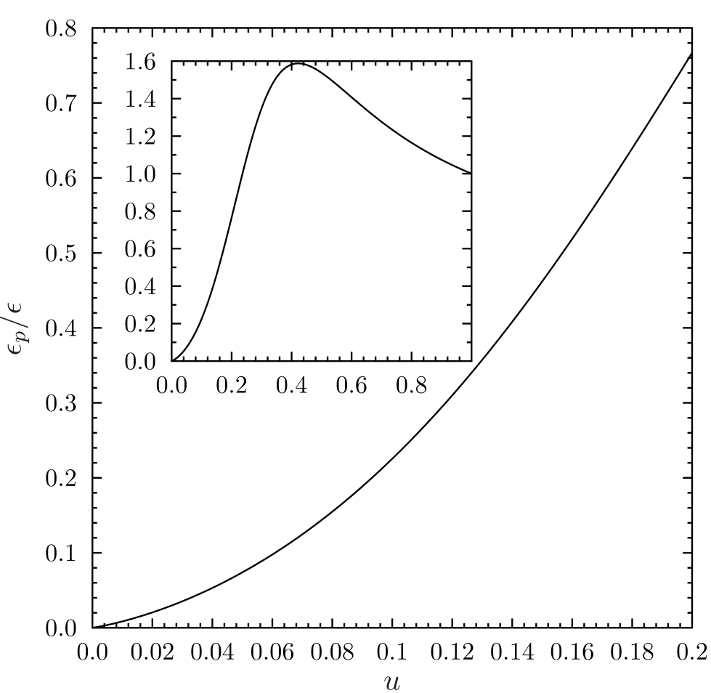
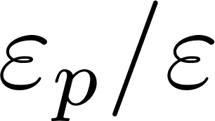
III) Results: nuclei shape
Perhaps important for
the transport properties of the crust

Slide 23
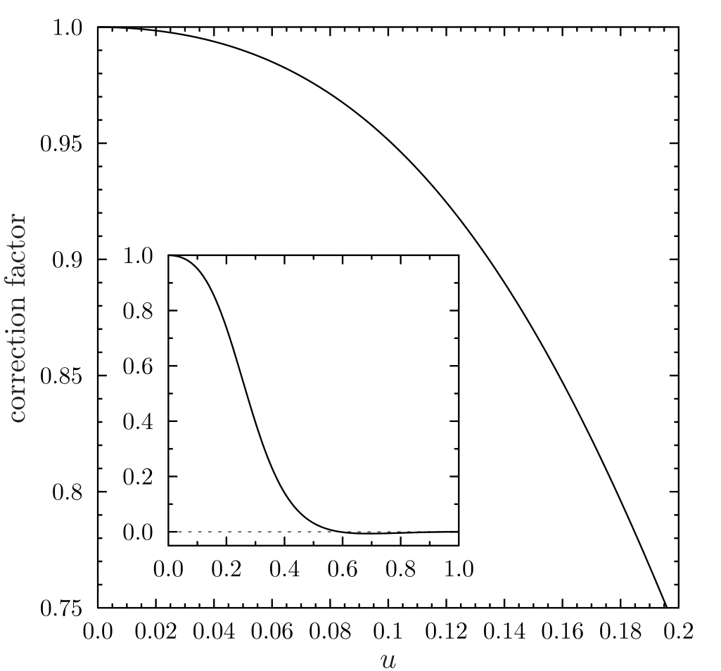
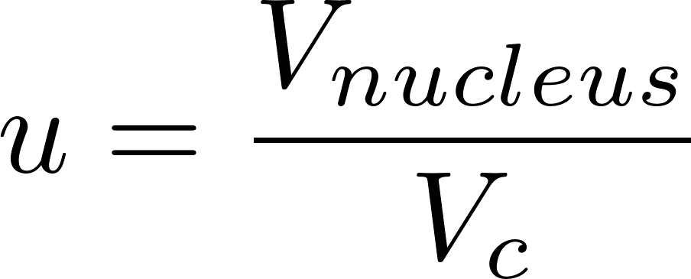
III) Results: the shear modulus
Shear modulus for point-like nuclei:
Shear modulus, accounting for nuclei deformation
correction factor

Slide 24
IV) Results
There are no finite size effects on the shear modulus in the inner crust of neutron stars, if we do not take into account nuclei deformation.
Crust deformation induces deformation of nuclei.
If we take into account nuclei deformation, there is a correction factor that decreases the shear modulus (for the deepest layers of inner crust the reduction of the shear modulus reaches ∼ 25 percent).
Within the adopted approach, the result is universal, i.e. it does not depend on the nucleon interaction model.
Although we have not accounted for neutron adsorption in this report, this effect does not affect the results [see NAZ, Chugunov, MNRAS 518, 3813 (2023)].

Slide 25
Post scriptum
What?
«Physics of Neutron Stars-2023»
Where?
Ioffe Institute, Saint Petersburg, Russia
When?
10 July 2023 – 14 July 2023

Slide 26
III) Nuclei finite size effect. Spheroidal nuclei
Wigner-Seitz cell
(ionic sphere)
Wigner-Seitz cell
Nucleus
Nucleus
Cell is a sphere with radius $r_{c}$
Nucleus is a sphere with radius $R$
Cell is a spheroid
with axes $r_{c}(1+ε)$ и $r_{c}/\sqrt{1+ε}$
Nucleus is a spheroid with axes $R(1+ε_{p})$ и $R/\sqrt{1+ε_{p}}$
$${ V}_{c}=const$$
$${ V}_{nucleus}=const$$
When the crystal is deformed, the potential created by the surrounding nuclei in the vicinity of the lattice cell is not spherically symmetric.
It can lead to deformation of the nuclei.
Here this effect is investigated in the ion ellipsoid model

Slide 27
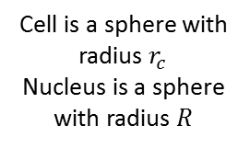
III) Nuclei finite size effect. Spheroidal nuclei
Wigner-Seitz cell
(ionic sphere)
Wigner-Seitz cell
Nucleus
Nucleus
Cell is a sphere with radius $r_{c}$
Nucleus is a sphere with radius $R$
Cell is a spheroid
with axes $r_{c}(1+ε)$ и $r_{c}/\sqrt{1+ε}$
Nucleus is a spheroid with axes $R(1+ε_{p})$ и $R/\sqrt{1+ε_{p}}$
$${ V}_{c}=const$$
$${ V}_{nucleus}=const$$
Energy change
The bulk energy: not modified
The surface energy: The surface area is increased
Virial theorem [Baym, Bethe, Pethick, Nucl. Phys. A 1971, 175, 225–271]
(Equilibrium by the number of nuclei=optimal size of the cell)

Slide 28
Introduction
Elastic theory for neutron star crust
Elastic energy density due deformation
Displacement gradient
The change of the stress tensor
for polycrystalline
(Baiko D. A., 2011, MNRAS, 416, 22)
Effective shear modulus for polycrystalline crust, as calculated assuming within point-like nuclei approximation
Some corrections are also known:
finite temperature (nuclei motion): Baiko (2011, 2012), Horowitz&Hughto (2008)
electron screening: Baiko (2011, 2012), Kozhberov (2022)
Only for point-like nuclei

Slide 29
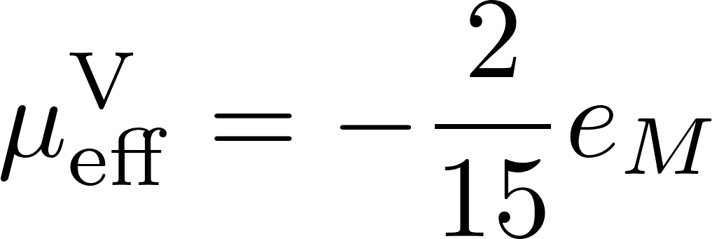
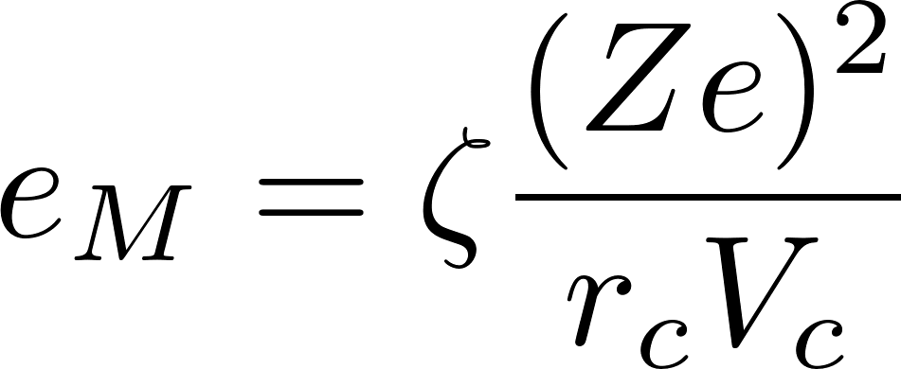
II) Elastic theory for neutron star crust
Universal relation for the Voigt averaged shear modulus of the
polycrystalline matterd and the Coulomb (Madelung) energy density of undeformed state
(point-like nuclei)
(Chugunov A.I., MNRAS 500, L17–L21, 2021)
– the Madelung constant undeformed state that depends on lattice type
(point-like nuclei)
(Baiko D. A., Potekhin A. Y., Yakovlev D. G., 2001, Phys. Rev. E, 64, 057402)
direct calculation
(Baiko D. A., 2011, MNRAS, 416, 22)

Slide 30
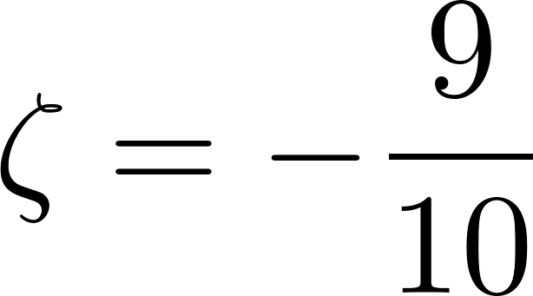
How to calculate the shear modulus?
On the one hand, ion sphere model
Wigner-Seitz cell
(ionic sphere)
(Chugunov A.I., 2021)
Point-like nucleus
Cell is a sphere with radius $r_{c}$
Ion sphere model:
Close values!
(Baiko D. A., 2011, MNRAS, 416, 22)

Slide 31
How to calculate the shear modulus?
On the one hand, ion sphere model
Wigner-Seitz cell
(ionic sphere)
(Chugunov A.I., 2021)
Point-like nucleus
Cell is a sphere with radius $r_{c}$
Ion sphere model:
Close values!
(Baiko D. A., 2011, MNRAS, 416, 22)

