Slide 1

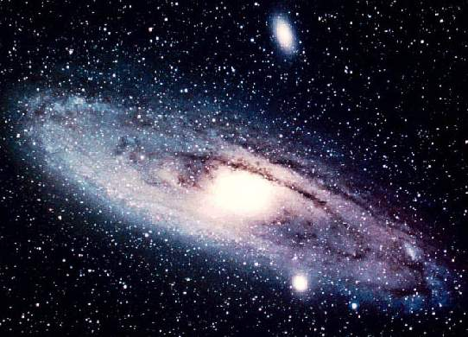
Department of Theoretical Astrophysics
P.S. Shternin, D.D. Ofengeim
Transport coefficients of magnetized neutron star cores
Shternin & Ofengeim EPJA 58, 42 (2022)
Infinite and Finite Nuclear Matter (INFINUM-2023)
JINR, Dubna, Feb 27 – Mar 03 2023

Slide 2
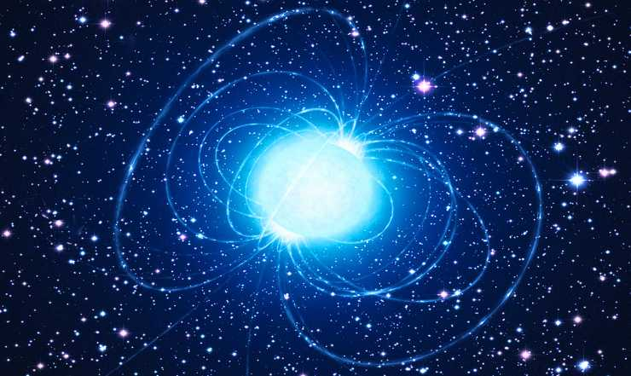
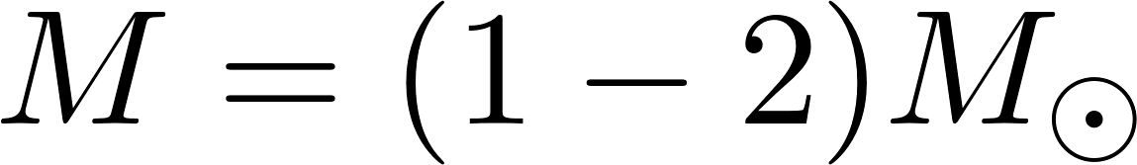
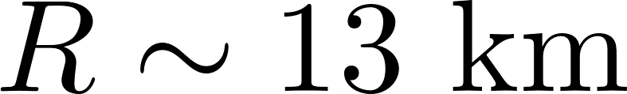
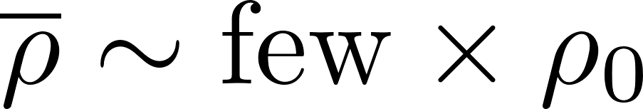
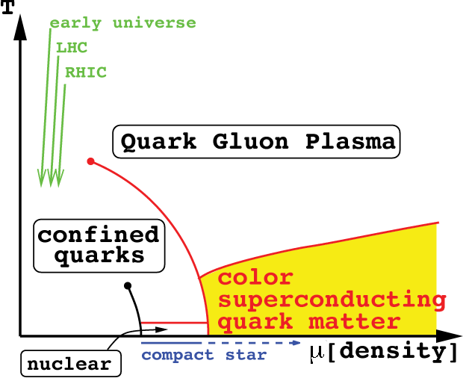


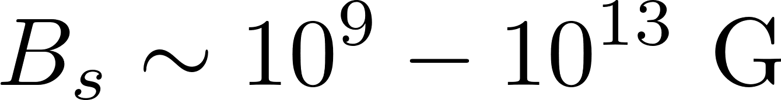
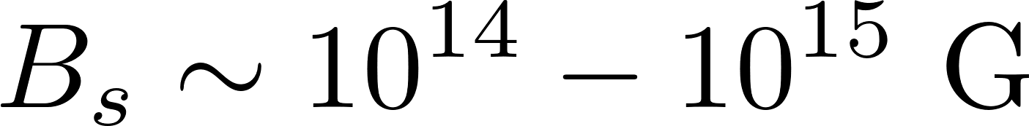
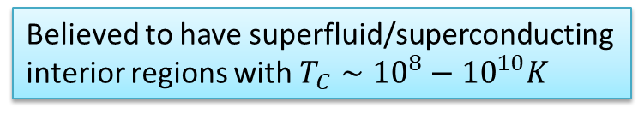
Introduction. NS parameters
Neutron stars are the densest stars in the Universe
Main properties
Supranuclear density
Temperatures
Magnetic fields
In magnetars
Probe cold and dense isospin asymmetric matter
Believed to have superfluid/superconducting interior regions with $T_{C}∼{10}^{8}−{10}^{10}K$

Slide 3
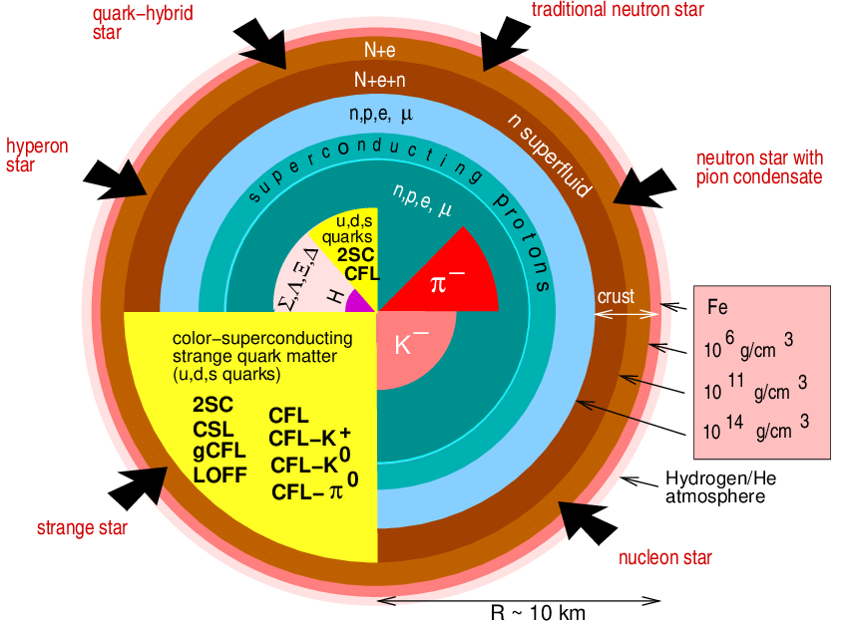
Introduction. NS parameters
Neutron star structure
Main properties
Supranuclear density
Temperatures
Magnetic fields
figure by F. Weber
In magnetars
Composition and equation of state (EOS) are not known
Believed to have superfluid/superconducting interior regions with $T_{C}∼{10}^{8}−{10}^{10}K$

Slide 4
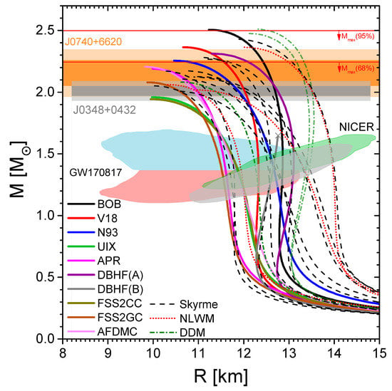
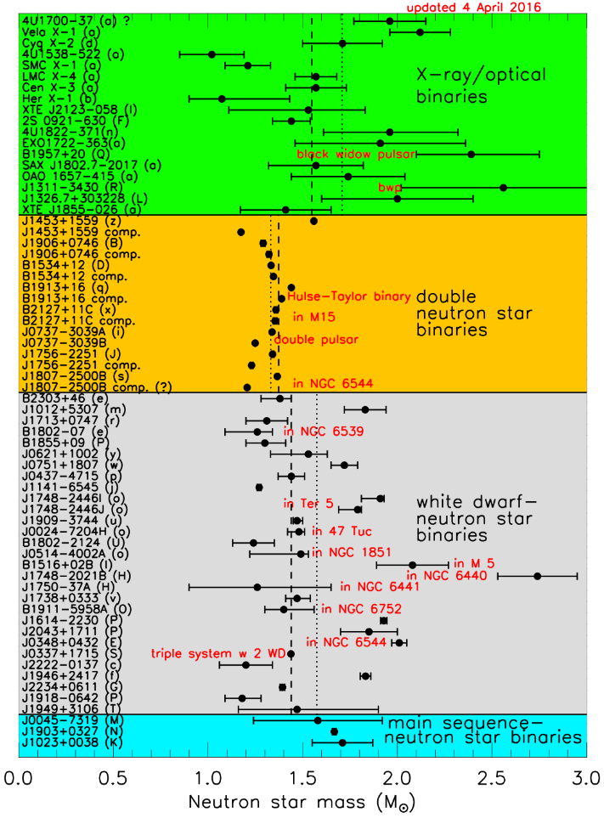
Introduction. Equilibrium properties (M and R)
TOV inversion: MR -> EOS
Masses and radii
Masses
figure from https://stellarcollapse.org/nsmasses
figure from Burgio et al. 2021

Slide 5
Non-equilibrium phenomena in NSs and transport
Modeling of various astrophysical phenomena requires various transport properties as ingredients
Phenomenon | Transport properties
oscillatory modes (r-modes) | shear & bulk viscosities
pulsar glitches | superfluid transport
thermal radiation | heat transport in outermost layers
cooling | neutrino emissivity, thermal conductivity
magnetic field evolution | magnetohydrodynamics, electrical & thermal conductivities, reaction rates
crust disruption (accretion, magnetar flares, X-ray bursts) | transport properties of the crust, crustal nuclear transmutations (deep crustal heating)
core-collapse supernovae | neutrino transport
neutron star mergers | high-temperature transport, viscous MHD

Slide 6
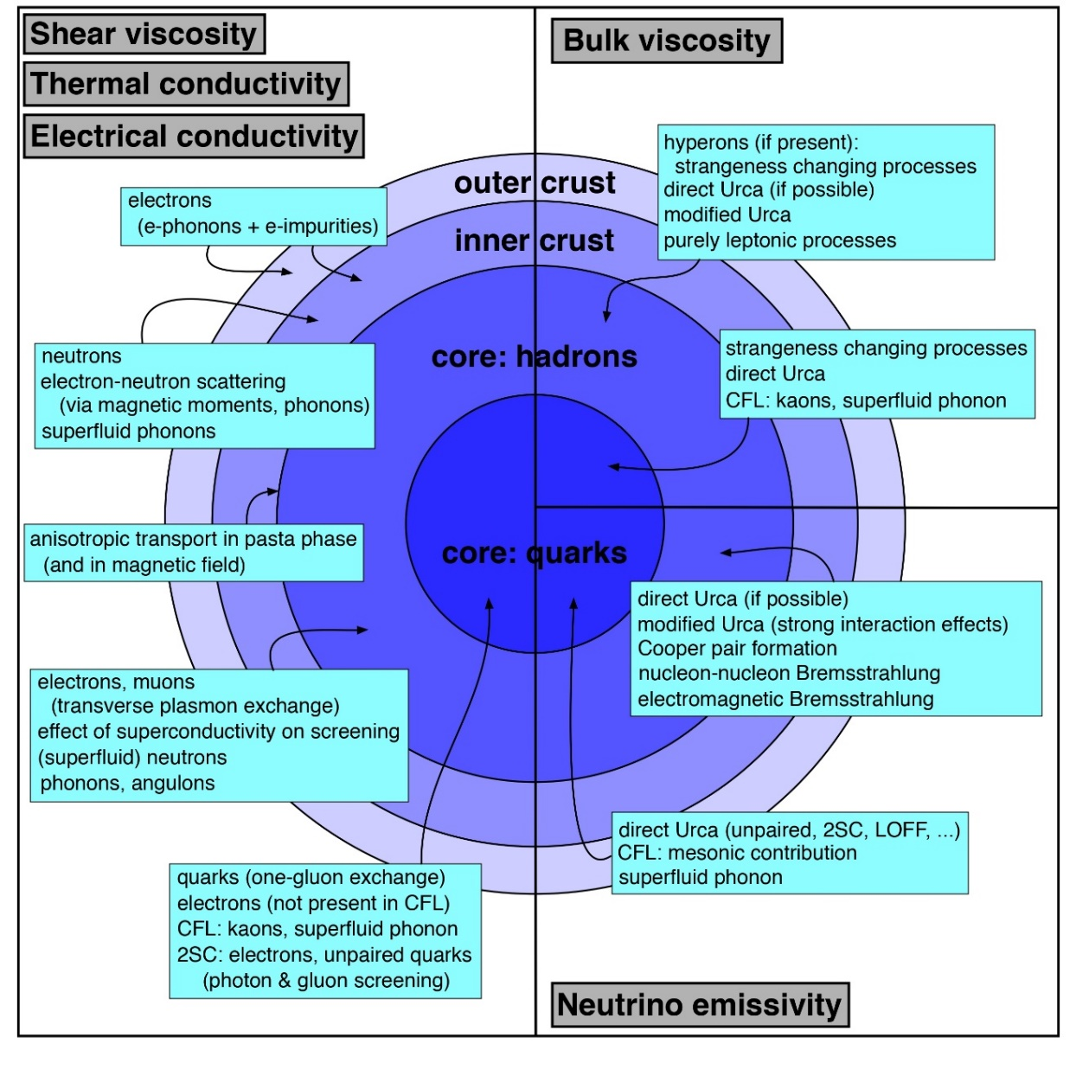
Diversity of transport properties of NSs
Main content of the talk
Dependence of transport properties on EOS
Transport in NS cores in magnetic field is less elaborated than in the crust
Essentially, diffusion (electric conductivity) in connection to the magnetic field evolution problem
Shternin & Ofengeim EPJA 58, 42 (2022)
CompOSE topical issue
See, e.g., Schmitt &Shternin (2018) for a review
figure by Andreas Schmitt

Slide 7
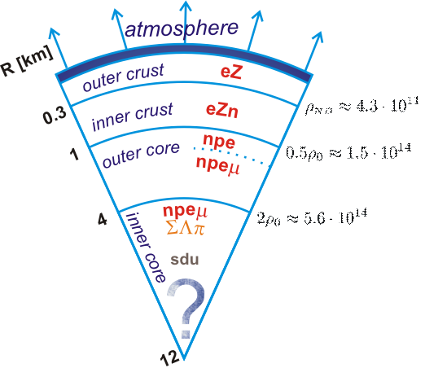
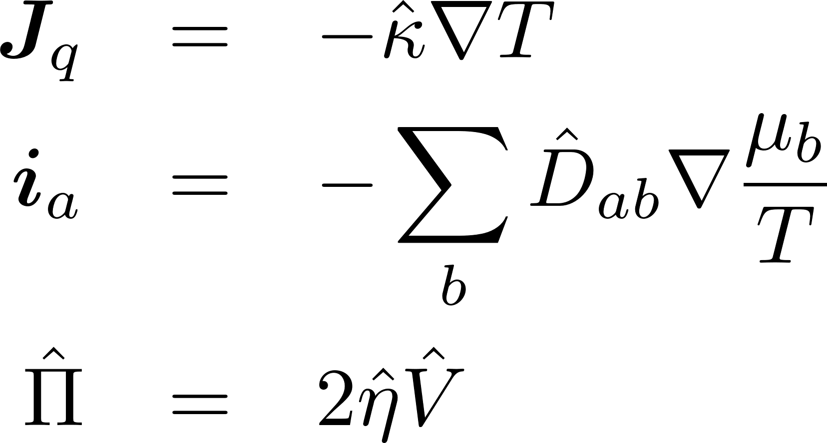
Transport coefficients in neutron star cores
Composition: npeμ matter in beta-equilibrium
Transport coefficients are mediated by quasiparticles collisions (weak coupling)
Strong interactions
Electromagnetic interactions
Thermal conductivity
Diffusion
Shear viscosity
No pairing
No reactions
Bulk viscosity is not considered
But, magnetic field is taken into account

Slide 8
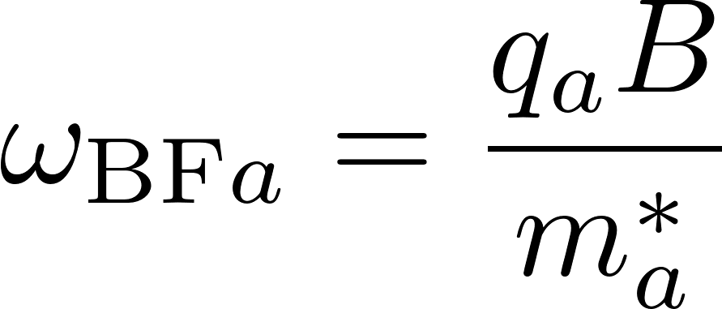
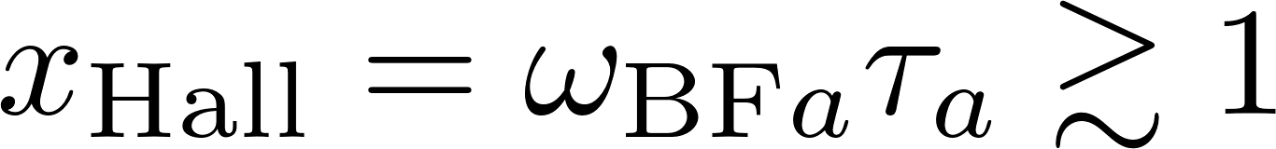
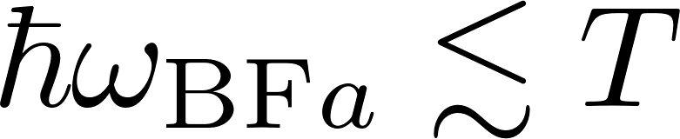
Transport in magnetic field
cyclotron frequency
magnetization
Non-quantizing B-field
Transport coefficients become tensors
Yakovlev & Shalybkov Ap&SS 176, 191 (1991)

Slide 9
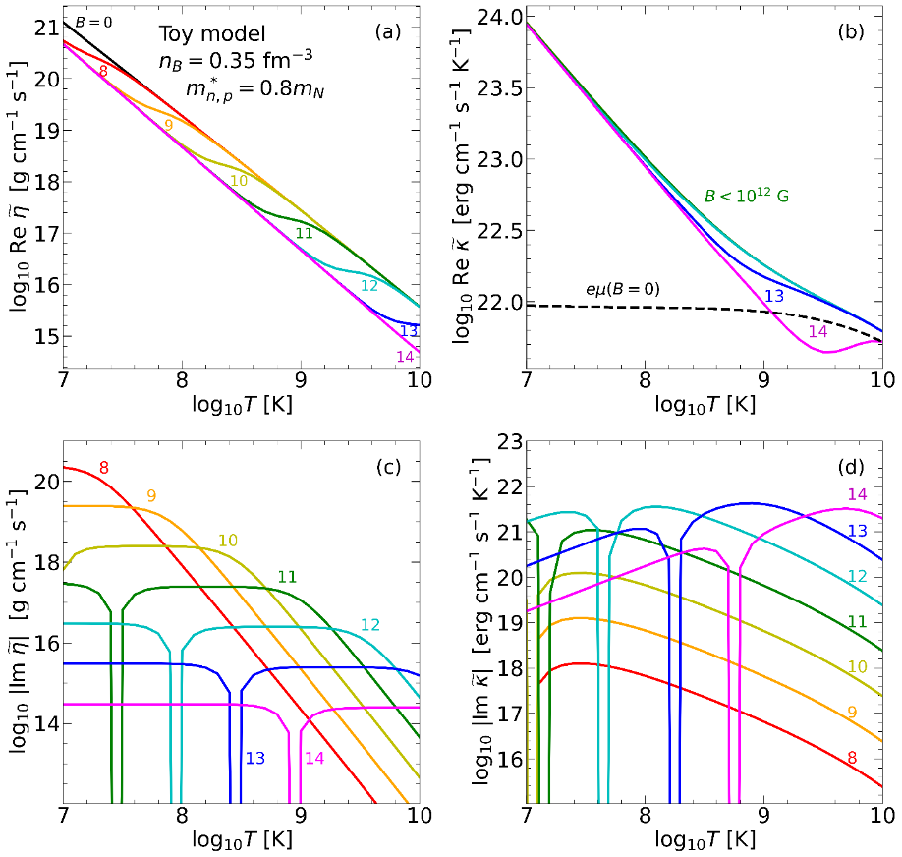
Plan of the talk
1. Formalism of the transport theory of multicomponent Fermi liquids in magnetic field.
complex transport coefficients.
relaxation time approximation
2. Results for a wide range of EOSs (COMPOSE+).
Strategies for in-medium scattering treatment for transport
Poor man approximations.
3. Results.
In the magnetized matter thermal conductivity is weakly modified, however the shear viscosity is affected strongly even in the moderate magnetic field.

Slide 10
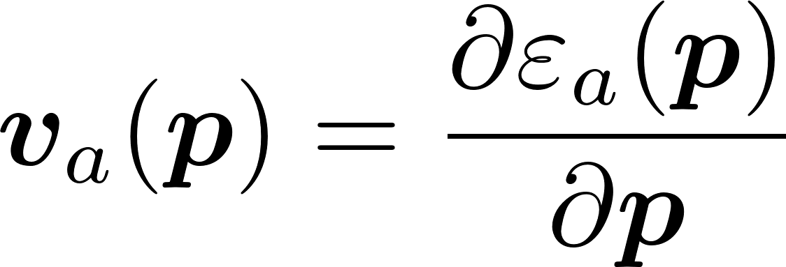
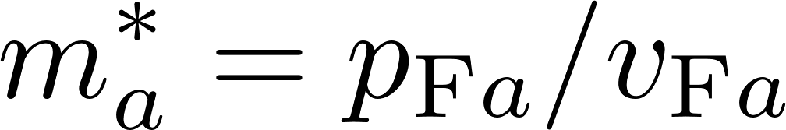
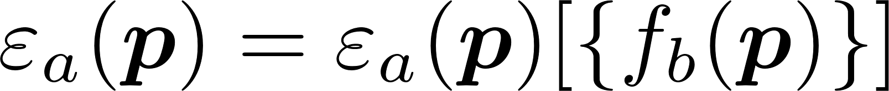
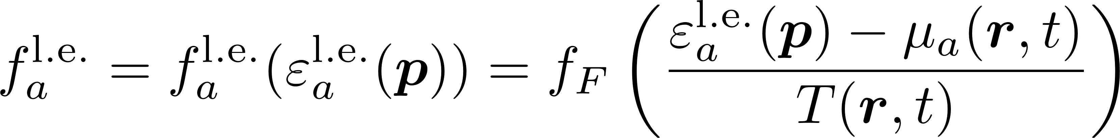
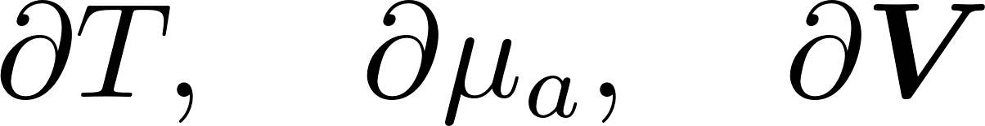
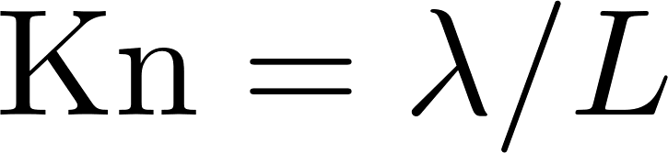
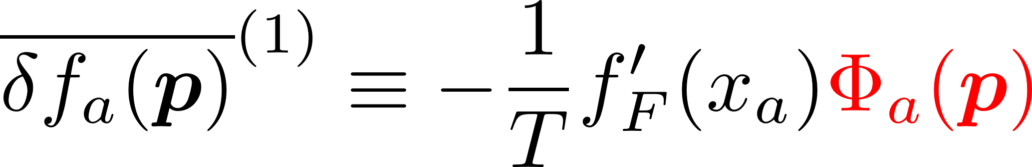
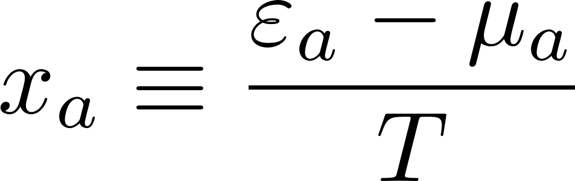
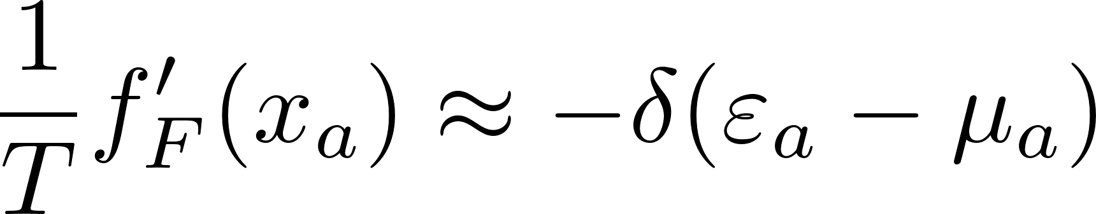

Formalism: Landau Fermi-Liquid theory
Landau Fermi-liquid theory for mixtures, $a=1…r$
Baym & Chin Nucl. Phys. A 262, 527 (1976)
In a local equilibrium (V=0)
Gradients of fields
Chapman-Enskog method

Slide 11
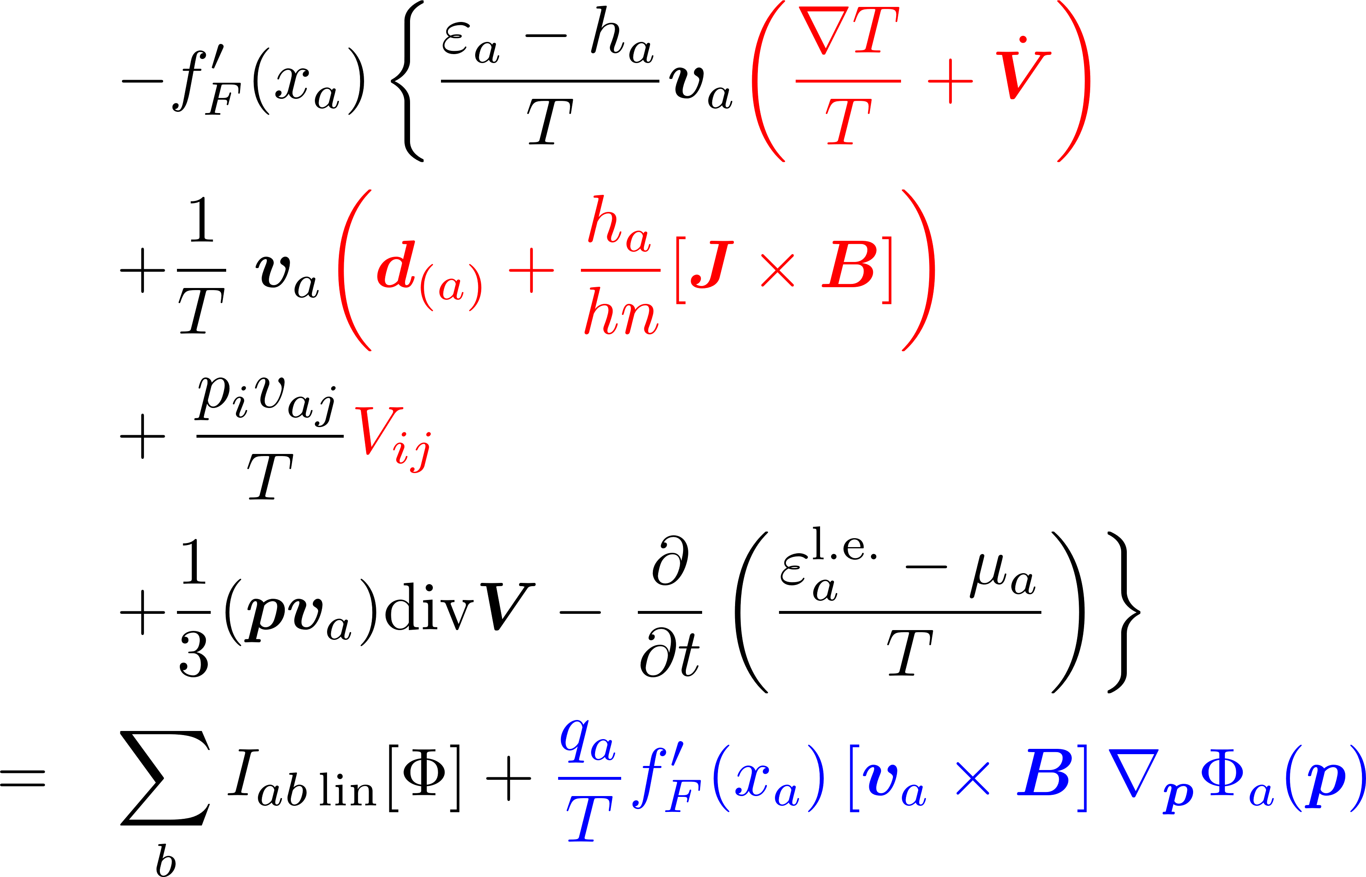
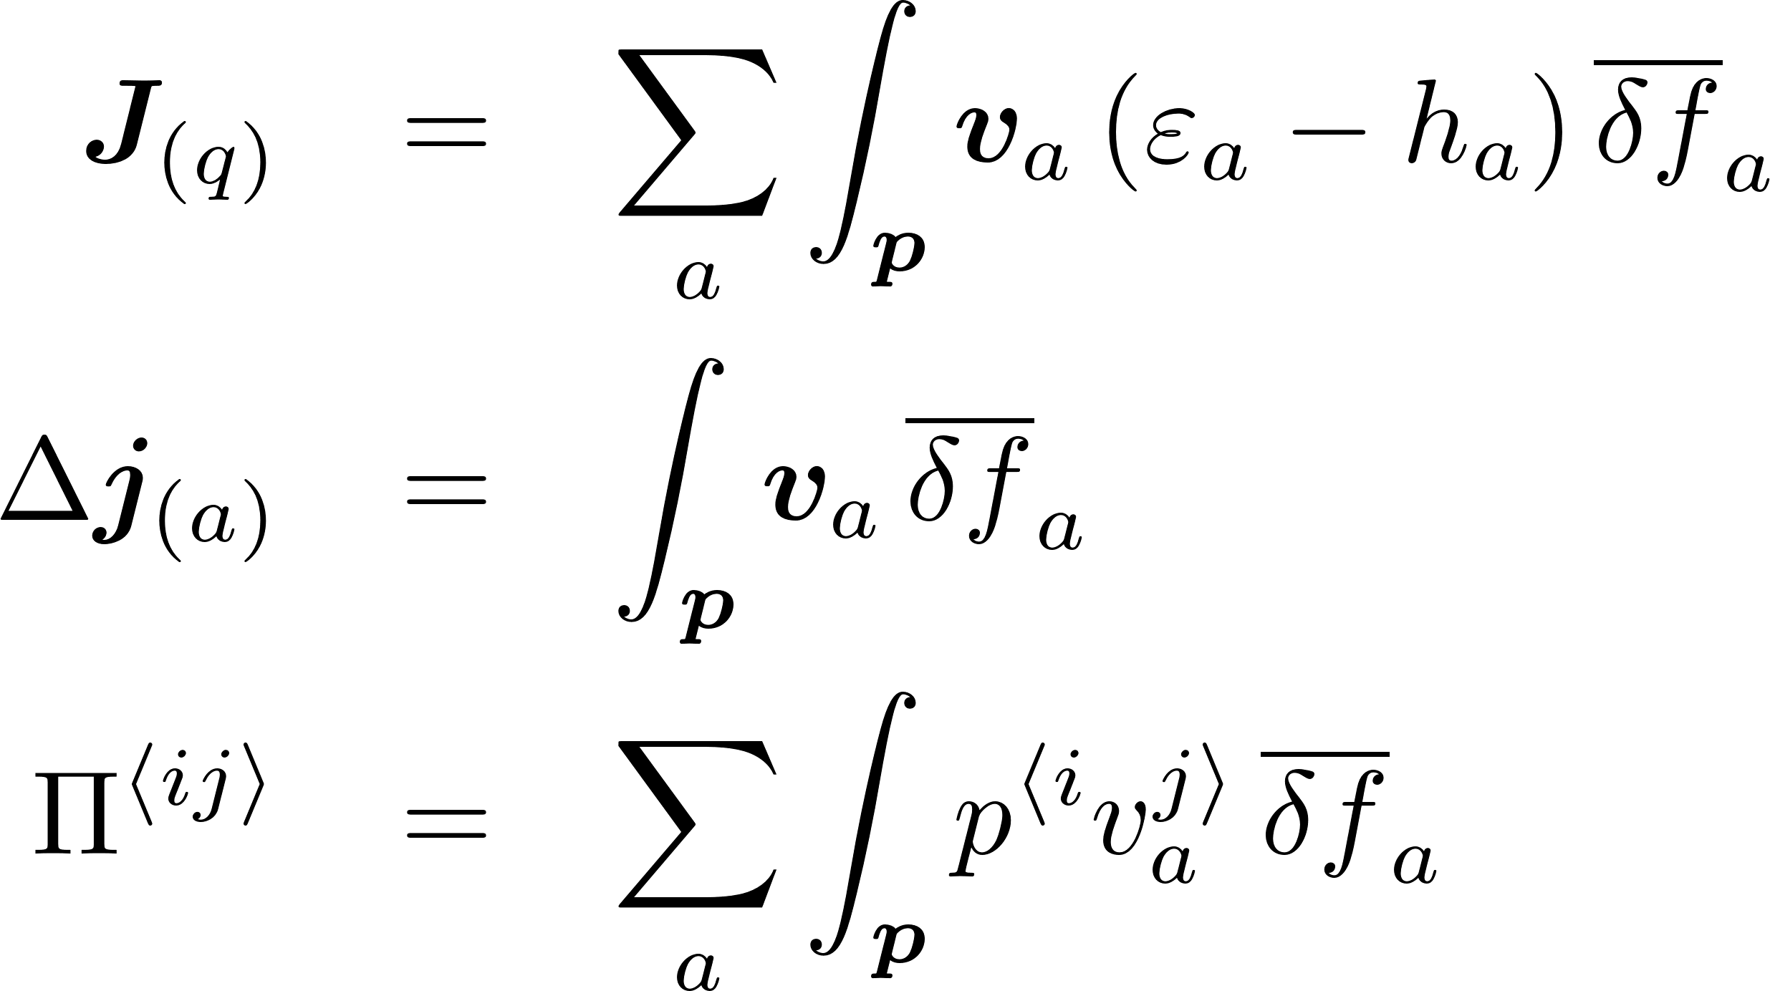
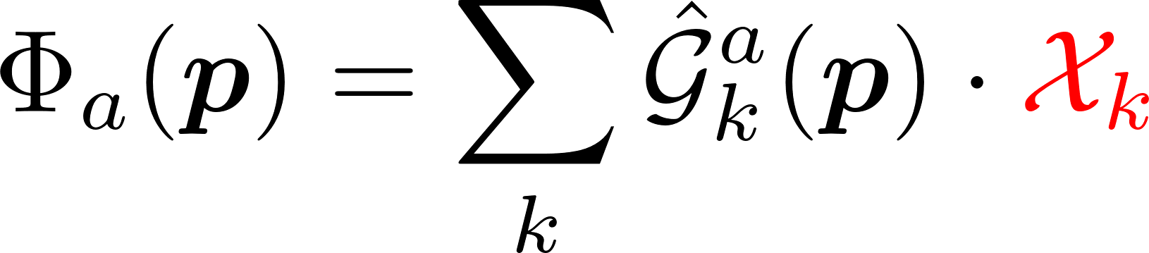
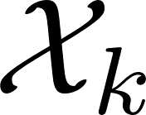
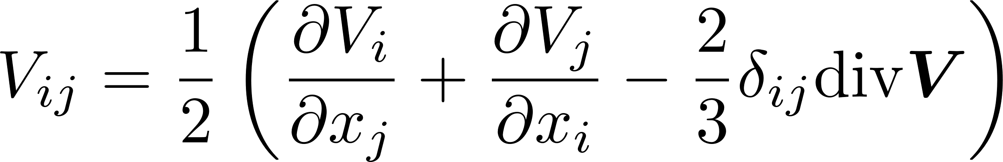
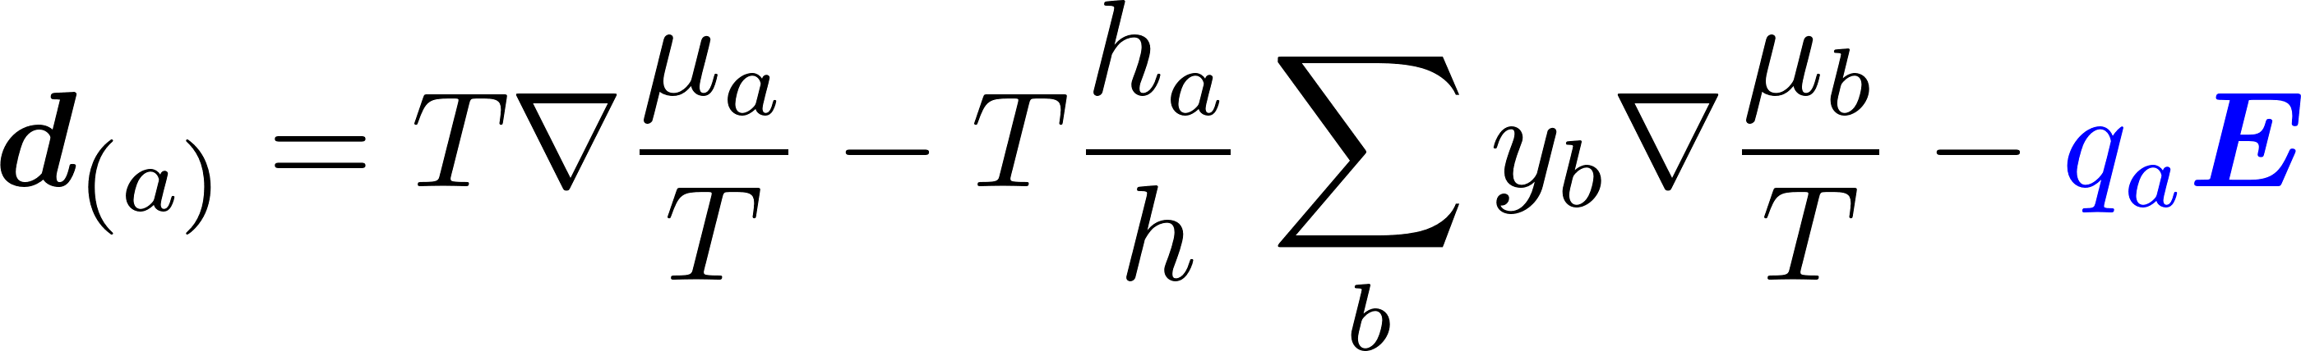
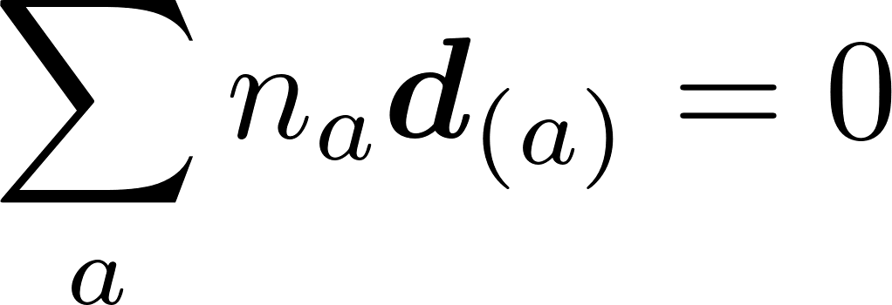
Linearized transport equation
Linearized transport equation in LRF (V=0)
Thermal conductivity
Diffusion
Shear viscosity
Bulk viscosity (not considered)
Linear equations
– thermodynamic forces
Rate-of-shear tensor
Generalized diffusion force

Slide 12
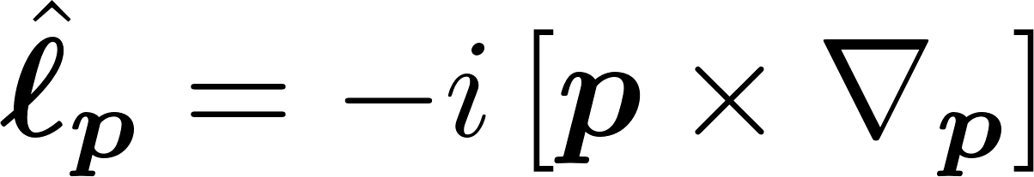
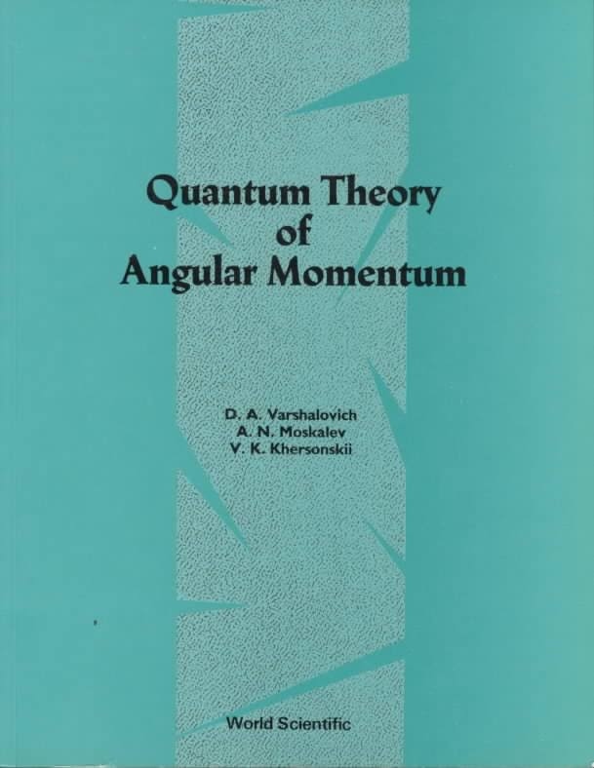
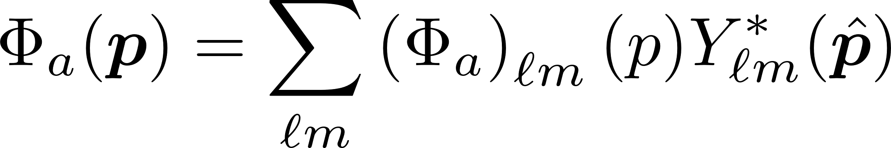
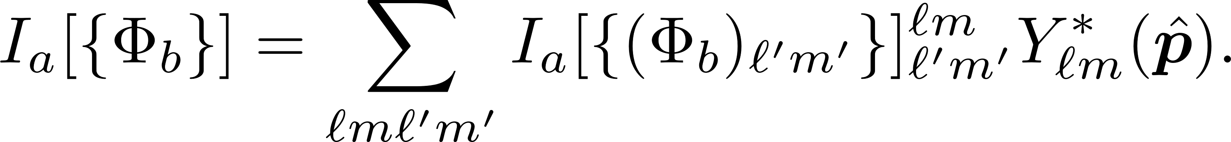
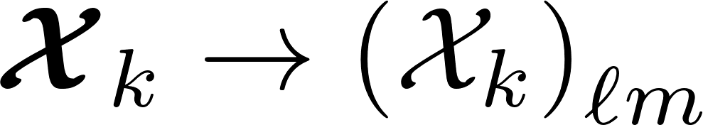
Tensor structure
Magnetic operator
Spherical harmonics expansion
Isotropic scattering
When Z is parallel to B equations diagonalize
It is convenient to use irreducible spherical tensors

Slide 13

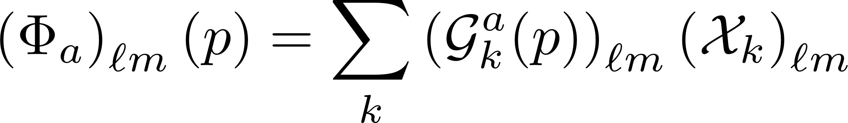
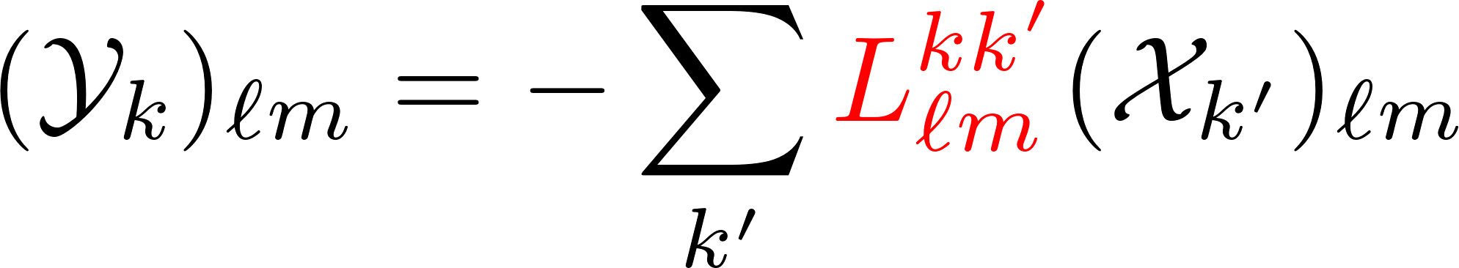
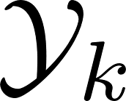
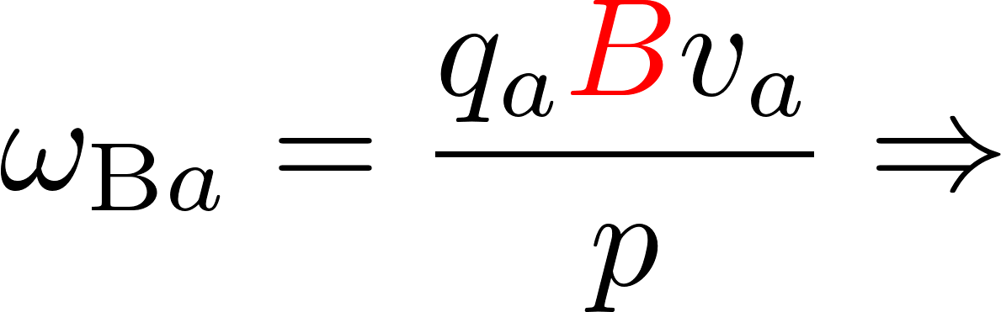
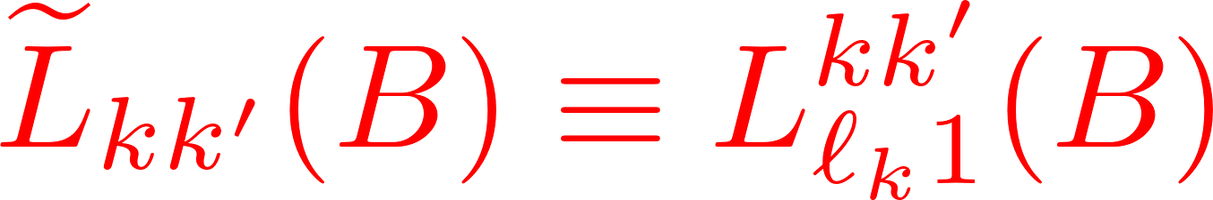
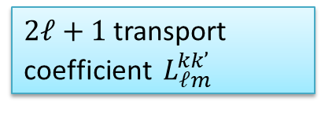
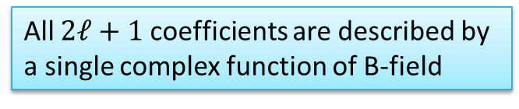
Transport equation in spherical basis
Decoupling of equations with different $ℓ$ and (in isotropic case),
$2ℓ+1$transport coefficient $L_{ℓm}^{kk’}$
Here denotes any flux
“Scaling”
All $2ℓ+1$ coefficients are described by a single complex function of B-field
NB: This is a known fact, but its derivation in Cartesian formalism is much more involved
e.g., Ferziger&Kaper 1972

Slide 14
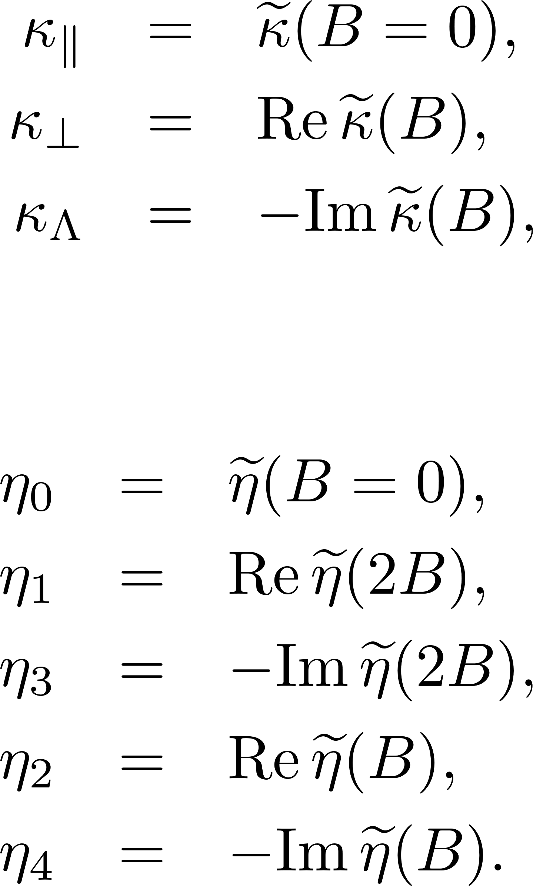
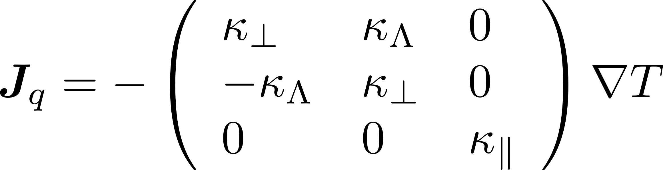
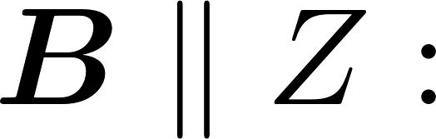


Relation to Cartesian formalism
Only one complex function of magnetic field is necessary for all components
Thermal conductivity
Shear viscosity
general frame
Lifshitz, Pitaevskii “Physical Kinetics” 1981

Slide 15





Tensor structure in general frame
Arbitrary orientation of the Local Rest Frame
Different (more symmetric) set of $2ℓ+1$ transport coefficient

Slide 16









Relaxation time approximation. Single-component fluid.
Relaxation time approximation does not work in NS cores, however it gives the qualitative understanding of the behavior of transport coefficients
Collision integral in r.t.a.
Solution
Degenerate matter
Thermal conductivity, $ℓ=1$
Shear viscosity, $ℓ=2$
Effective complex r.t.

Slide 17






Relaxation time approximation
Hall parameter
Strong magnetization limit

Slide 18




Multicomponent nuclear matter in NS cores
For NS cores relaxation time approximation does not work. One uses the full collision integral
It turns out that the simplest variational solution of the kinetic equation with a single (complex) variational parameter – effective complex mean free path – is enough.
The system of integral transport equations reduces to a system of linear equations.
Quite similar to r.t.a.
Transport matrix
Thermal conductivity
Shear viscosity

Slide 19






Diffusion. Simplest approximation.
Generalized diffusion force
Simplest approximate solution
Electric current
Diffusion velocity
Multiplying by $p_{1}$ and integrating,
one gets generalized Ohm law
Momentum transfer rates
The thermal diffusion is negligible for degenerate matter

Slide 20

Plan of the talk
1. Formalism of the transport theory of multicomponent Fermi liquids in magnetic field.
complex transport coefficients.
relaxation time approximation
2. Results for a wide range of EOSs (COMPOSE+).
Strategies for in-medium scattering treatment for transport
Poor man approximations.
3. Results.

Slide 21

EOS bank
CompOSE database http://compose.obspm.fr
We selected purely nucleonic models
Shternin & Ofengeim EPJA 58, 42 (2022) – a part of topical issue on CompOSE

Slide 22


EOS bank
20 CompOSE models
Proton fraction
+
6 BSk models (20—22; 24—26)
APR model and 4 variations (HHJ)
4 PAL models
Another 4 models
DDME2, NL3wr, SLy4, BHF (av14+uix)
=
39 models in total
Toy model
Ofengiem et al. PRD 96, 034002 (2017)

Slide 23





Transport coefficients in NS cores
“Transport equations”
Microscopic inputs: effective masses, scattering matrices
Selected composition: npeμ matter
“Fermi-liquid” behavior
Strong interaction (np)
Strong dependence on the model (EOS)
“non-Fermi-liquid” behavior
Electromagnetic interactions (peμ)
Controlled dependence on the EOS

Slide 24










Electromagnetic interactions
Charged particles: Coulomb + Ampere (relativistic contribution ${{|J}_{t}|}/{J^{\left(0\right)}}∝v/c$)
Different screening behavior
Small screening momenta ($q_{scr}∼ω^{1/3}∼T^{1/3}$)
Transverse channel dominates ($Λ_{t}≫Λ_{l}$)
Heiselberg et al. 1992
Heiselberg & Pethick 1993
Shternin & Yakovlev 2007, 2008

Slide 25






Transport matrix for em interaction
Non-diagonal matrix elements can be neglected
Result is similar to r.t.a.,
but with effective m.f.p.

Slide 26
Transport coefficients in NS cores
“Transport equations”
Microscopic inputs: effective masses, scattering matrices
Selected composition: npeμ matter
“Fermi-liquid” behavior
Strong interaction (np)
Strong dependence on the model (EOS)
“non-Fermi-liquid” behavior
Electromagnetic interactions (peμ)
Controlled dependence on the EOS

Slide 27
Possible strategies for nucleon (baryon) sector
IDEAL (HARD): calculate EOS and transport based on the same microscopic models
Not trying this today
CHEATING: calculate transport from some favorite microscopic model for in-medium scattering but using particle fractions (and probably m* if available) from all EOS
BHF calculations, 5 NN potentials, Interpolation of $Λ(n_{B},x_{p})$
Shternin & Baldo PRD 102, 063010 (2020)

Slide 28



Transport cross-sections
Vacuum (black and red) and in-medium (colored) transport cross-sections for 39 EOS
Only one many-body method: BHF calculations
5 NN potentials
Interpolation of $Λ(n_{B},x_{p})$
Shternin & Baldo PRD 102, 063010 (2020)
Unfortunate situation

Slide 29


Possible strategies for nucleon sector
IDEAL (HARD): calculate EOS and transport based on the same microscopic models
Not trying this today
CHEATING: calculate transport from some favorite microscopic model for in-medium scattering but using particle fractions (and probably m* if available) from all EOS
BHF calculations, 5 NN potentials, Interpolation of $Λ(n_{B},x_{p})$
Shternin & Baldo PRD 102, 063010 (2020)
QUALITATIVE: use in-vacuum NN cross-sections
We provide fitting expressions to use for any $(n_{B},x_{p})$
Flowers & Itoh (1979); Baiko et al. (2001); Shternin & Yakovlev (2008); Shternin (2008)
POOR MAN: use in-vacuum NN cross-sections and toy model EOS
Single-parameter fitting expressions $(n_{B})$

Slide 30





Transport matrix for strong interactions. Vacuum cross-sections
Protons weakly affect neutrons
Results are similar to r.t.a.

Slide 31
Plan of the talk
1. Formalism of the transport theory of multicomponent Fermi liquids in magnetic field.
complex transport coefficients.
relaxation time approximation
2. Results for a wide range of EOSs (COMPOSE+).
Strategies for in-medium scattering treatment for transport
Poor man approximations.
3. Results.

Slide 32





Longitudinal shear viscosity and thermal conductivity
Different EOSs (but vacuum cross-sections)

Slide 33

Partial contributions to shear viscosity and thermal conductivity
Leptons dominate
Neutrons dominate

Slide 34




Results. Toy model. T-dependence
numbers show $\log_{10}{B[G]}$
when leptons become magnetized, `perpendicular’ shear viscosity switches from lepton-dominated to neutron-dominated regime
Hall components change sign when protons become magnetized

Slide 35

Results. Toy model. B-dependence
cyclotron frequency
Hall parameter

Slide 36
Conclusions
Based on the irreducible spherical tensor expansion a convenient formalism for calculating transport coefficients in the multicomponent Fermi-liquid in NS cores is described.
A large bank of EOSs is analyzed. The “poor-man approximations” are introduced which allow to calculate transport coefficients of NS core matter.
In the absence of magnetic field, thermal conductivity is mediated by neutrons, while shear viscosity is mediated by leptons.
In the magnetized matter thermal conductivity is weakly modified, however the shear viscosity is affected strongly even in the moderate magnetic field.
In ideal world, NS EOS databases should also contain information allowing for the transport properties calculations.

Slide 37
Thank you!

Slide 38
EXTRA SLIDES

Slide 39


Pairing gaps
¹S₀ proton paring gaps
³P₂ neutron paring gaps
figures from Ho et al. PRC 91, 015806 (2015)
39

Slide 40


Superfluidity in NS cores. Zoo of the SF models
Singlet proton pairing
Triplet neutron pairing
Microscopic calculations result in pairing profiles peaked at low densities
Figures from Ho et al. 2015, PRC 91, 015806
40

Slide 41



Pairing
Baiko et al, 2001
Transport by Bogoliubov excitations
Collisions are suppressed
Only effect of gaps in spectrum is considered
Not elaborated up to now: accurate collision integral, including quasiparticle non-conservation; anisotropic transport in neutron superfluid
Collective modes (phonons, angulons)
Manuel, Tolos 2011,2013; Kolomeitsev, Voskresensky 2015; Bedaque, Reddy 2014

Slide 42






Electron transport in presence of proton pairing
Collisions with protons are suppressed at low T
But lepton collisions are also affected since proton contribution to screening changes
Longitudinal screening not affected
Transverse screening becomes static
Temperature dependence restores
42

Slide 43








Screening in SC matter
Proton pairing $T_{cp}∼{10}^{9} K$
Static transverse screening
P$hoton acquires Meissner mass q_{M} (at q→0)$
$ζ→0$ London limit
$ζ≫1$Pippard limit
Both London and Pippard limits realize inside NSs
BCS
43

Slide 44






Transport in NS cores. Paired protons
Relation between lepton and baryon transport coefficients persists
SC of the II kind
Do not depend on gap
Shternin, PRD 98, 063015 (2018)
44

Slide 45
Example: Momentum transfer rates

Slide 46




Results. B-dependence

Slide 47



Results. Hall coponents
leptonsc
neutrons
protons

Slide 48







Transport matrix
Explicit expressions
General structure

Slide 49



Strong interactions
1) OPE
2) in-vacuum cross-sections
Flowers & Itoh (1979); Baiko et al. (2001); Shternin & Yakovlev (2008); Shternin (2008)
3) in-medium interaction within the Brueckner-Hartree-Fock approach
Shternin & Baldo PRD 102, 063010 (2020)

Slide 50





Nuclear scattering. MOPE model
Senatorov & Voskresensky PLB 184, 119 (1987)
Migdal et al. Phys.Rep. 192, 179 (1990)
Effective pion gap for various models
Nucleons interact via medium-softened pion mode (also renormalized vertices)
Neutron shear viscosity
Pion polarization
Pion softening enhances $ν_{NN}$hence lowers $τ_{NN}, κ, η$
figures from Kolomeitsev & Voskresensky PRC 91, 025805(2015)

Slide 51






Strong interactions
in-vacuum cross-sections
Baiko, Haensel, Yakovlev (2001)
Effective transport cross-sections [mb]

Slide 52



Effective transport cross-sections
Transport matrix
Effective transport cross-sections [mb]

Slide 53
Brueckner-Hartree-Fock method
In-medium scattering G-matrix
Bethe-Salpiter equation
Energy (EOS)
Three-nucleon forces
Effective averaging over third particle
Defect function

Slide 54


EOS dependence
BHF equations can be solved on a grid n_{B} and x_{p} for each microscopic interaction
NS cores: beta-equilibrium gives $x_{p}=x_{p}(n_{B})$
Ideally
Self-consistent consideration of transport and EOS
Alternatively
Use some microscopic calculations for $x_{p}=x_{p}(n_{B})$ for the selected EOS
What to interpolate it this case?

Slide 55
Various interaction models
Two-nuleon potentials
Baldo et al. PRC, 89, 048801 (2014)
Argonne v18
Effective masses
Wiringa et al., 1995
CDBonn
Machleidt, 2001
Three-nuclear forces
Urbana IX
Carlson et al., 1983
Meson-exchange model
Av18+TBFmic
Grange et al., 1989, Li&Schulze 2008,2012,..
Shternin & Baldo PRD 102, 063010 (2020)

Slide 56


Effective cross-sections
Bsk21 EOS
5 NN potentials
Shternin & Baldo PRD 102, 063010 (2020)
We show

Slide 57



Fitting expressions
In-vacuum cross-sections
Toy model (poor man solutions)
We also constructed approximations for an arbitrary proton fraction

Slide 58

Effective transport cross-sections

Slide 59




General formalism
Chapman-Enskog method
Non-equilibrium fluxes
Heat current
Particle current
Viscous stress tensor
Define
$Φ\left(p\right)$– the function in question

Slide 60



General formalism
Linear relations
Entropy generation
Transport coefficients
– thermodynamic forces
– thermodynamic fluxes

Slide 61






Irreducible spherical tensors
Dyadic
Vector is a rank 1 tensor
Rank 2 tensor
LHS of the kinetic equation:

Slide 62




Solution steps
Transport equation
Scalar product
Test function expansion
Bubnov-Galerkin method
Not really a variational method in magnetized case
There exist exact solutions (in form of series) for Fermi systems
Brooker and Sykes, 1968; Hojgard Jensen et al., 1968
Fowers and Itoh, 1979; Anderson et al., 1987; Pethick, Schwenk 2009

Slide 63






Simplest approximation. Transport matrix
Quasiparticles at Fermi surface
Collision integral conserves x – parity
Simplest “variational” solution
Thermal conductivity

Slide 64



Simplest approximation. Transport matrix
Variational parameter (complex effective mean free path)
Transport matrix
Thermal conductivity
Shear viscosity

Slide 65





Exact solution of the linearized transport equations
Mathematical expression
Electromagnetic interactions result in apparently singular terms
Cylcotron term
Thermal conductivity
Shear viscosity
System of equations can be solved numerically, e.g. by the quadrature method

Slide 66




Results. B=0
Partial contributions
Exact and variational solutions
Vacuum cross-sections
Filled areas correspond to 39 EOSs
Shternin & Ofengeim 2022

Slide 67




Results. B>0. Thermal conductivity
Partial contributions
Exact and variational solutions

Slide 68




Results. B>0. Shear viscosity
Partial contributions
Exact and variational solutions

Slide 69




Integration of the Fermi-liquid equations

Slide 70








Relativistic hydrodynamics equations

Slide 71


Relativistic hydrodynamics equations

Slide 72





Relativistic hydrodynamics equations

Slide 73






Relativistic hydrodynamics equations (1st order)

Slide 74



Electrical conductivity
Entropy generation rate in diffusion
Inversion in non-magnetized case

Slide 75







Electrical conductivity
Inversion in magnetized case
Cyclic components
Inversion
In c.m. frame

