Slide 1
Workshop on Infinite and Finite Nuclear Matter (INFINUM-2023)
https://indico.jinr.ru/event/3433/, February 27 to March 3, 2023
Chiral Phase Structure and Magnetic Properties of QCD Phase Diagram at NICA Energies
Abdel Nasser Tawfik
Future University in Egypt (FUE) & Egyptian Center for Theoretical Physics (ECTP)
a.tawfik@fue.edu.eg
27th February 2023: 12:40 PM (Moscow Time)
Eur.Phys.J.A 57 (2021) 6, 200, Chin.Phys.C 43 (2019) 3, 034103, Phys.Rev.C 91 (2015) 1, 015204

Slide 2
Outline
Hadron-Quark Phase Transition: a short historical review
Polyakov linear-sigma model: a short introduction
A novel estimation of the finite Isospin asymmetry term
The inclusion of finite magnetic field
Results on phase structure and magnetic properties
Conclusions

Slide 3
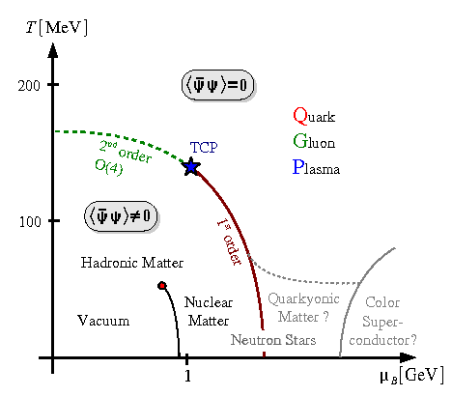
Hadron-Quark Phase Transition
Lepore and Stuart: general approach to calculate the phase volume and the consequences of including momentum conservation in the relativistic collisions.
Magalinski and Terletskii: general description for quantum statistics in systems with a variable number of ideal particles.
Hagedorn: hadronic matter is no longer stable, i.e., must either evaporate or convert into …
QCD: hadronic matter undergoes critical phase transition to form a new state of matter, colored quark-gluon plasma (QGP).

Slide 4
Polyakov Linear-Sigma Model
At finite isospin asymmetry in Minkowski space, the LSM Lagrangian density with Nf quark flavors can be incorporated with the Polyakov-loop potential
The first term in Eq. (1) stands for LSM Lagrangian density in chiral limit
where the first term counts for the contributions of the quarks (fermions) with Nc color dof, while the second term stands for the mesonic (bosonic) fields.

Slide 5
Polyakov Linear-Sigma Model

Slide 6
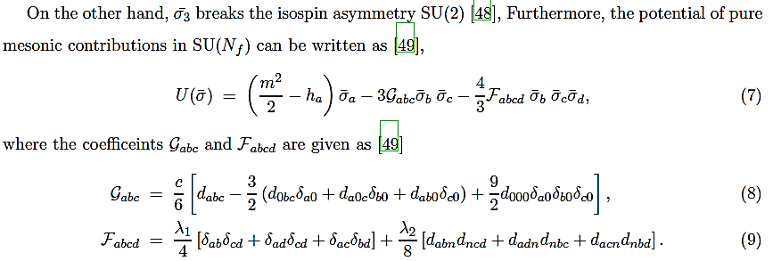
Polyakov Linear-Sigma Model

Slide 7
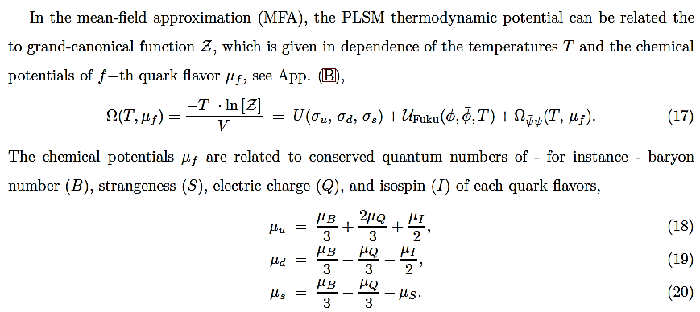
Polyakov Linear-Sigma Model

Slide 8
Polyakov Linear-Sigma Model

Slide 9
Polyakov Linear-Sigma Model

Slide 10
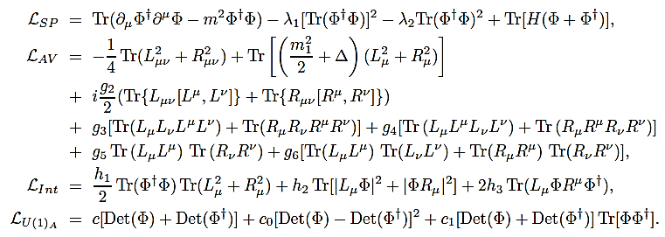
Polyakov Linear-Sigma Model

Slide 11
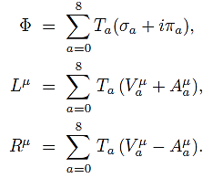
Polyakov Linear-Sigma Model
The Lagrangian representing the kinetic and potential terms for the scalar meson nonets
Explicit symmetry breaking defined
This Lagrangian creates scalar and pseudoscalar mesonic states defined in nonets,

Slide 12
Polyakov Linear-Sigma Model
The Lagrangian representing the vector meson nonets involving explicit symmetry breaking reads
Explicit symmetry breaking defined
It creates the vector and axial-vector mesonic states and the interactions between (pseudo)-scalar and (axial)-vector that shall be introduced.
The 3 × 3 matrix of the vector
meson nonets involves vector and axial-vector fields,

Slide 13
Polyakov Linear-Sigma Model
This is the interaction Lagrangian. As the symmetry is explicitly spontaneously broken, the anomaly term L_{U(1)A} in SU(3)_{R} x SU(3)_{L}
should be introduced into the effective Lagrangian and c, c₀, c₁ are parameters to be determined, experimentally.
The first two terms approximate the original axial anomaly term, while the third term is a mixed one. It is proportionally to the first term. The concept of choosing the first anomaly term is essential, in which the other terms are used to compare with other effects of the different anomaly terms on the hadronic structure.

Slide 14
Polyakov Linear-Sigma Model
L_{U(1)A} symmetry in QCD Lagrangian is anomalous, QCD vacuum anomaly, i.e., broken by quantum effects.
Without anomaly a ninth pseudoscalar Goldstone boson corresponding to the spontaneous breaking of the chiral SU(3)_{R} x SU(3)_{L} symmetry should unfold.
As the hadron theory is not fundamental, it is assumed to be valid at mass scale of 1 − 2 GeV and therefore, the local chiral symmetry would not cause big problem.
Nevertheless, the constraint terms are conjectured to affect such QCD approaches.
This well-known L_{U(1)A} problem of QCD is effectively controlled by the anomaly term c in the Lagrangian.
The squared tree-level masses of mesons m² and m₁² contain a contribution arising from the spontaneous symmetry breaking.

Slide 15
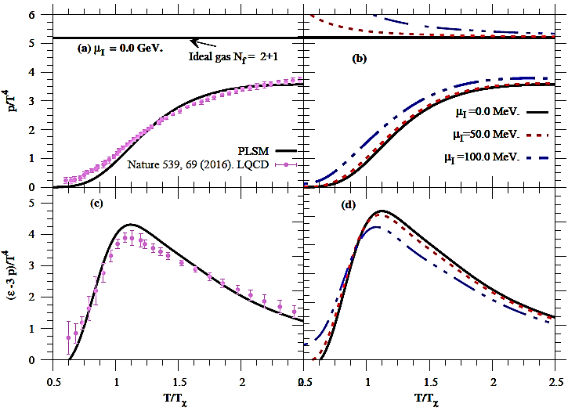
Polyakov Linear-Sigma Model

Slide 16
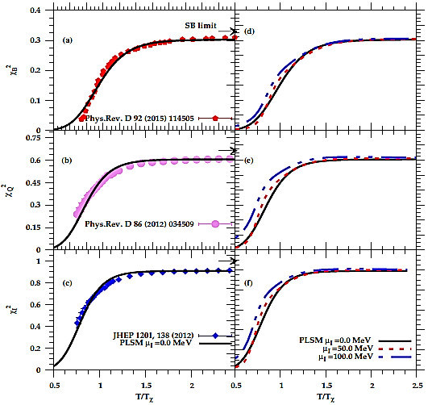
Polyakov Linear-Sigma Model

Slide 17
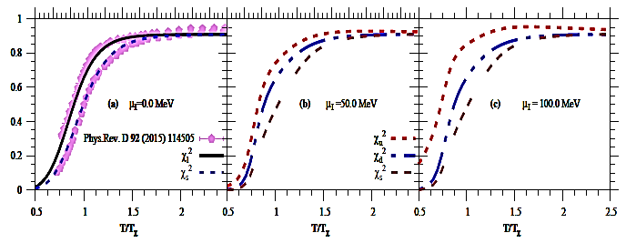
Polyakov Linear-Sigma Model

Slide 18
Finite Isospin Asymmetry
Hypothesis of Partially Conserved Axial-Vector Current

Slide 19
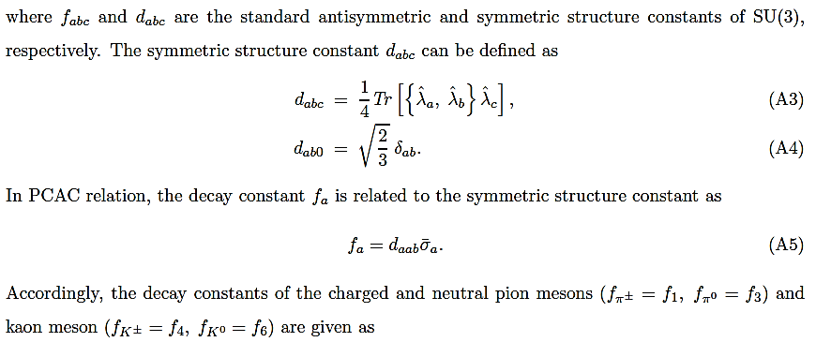
Finite Isospin Asymmetry

Slide 20
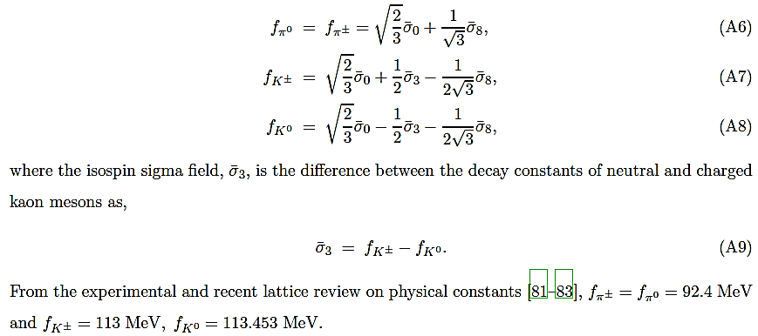
Finite Isospin Asymmetry

Slide 21
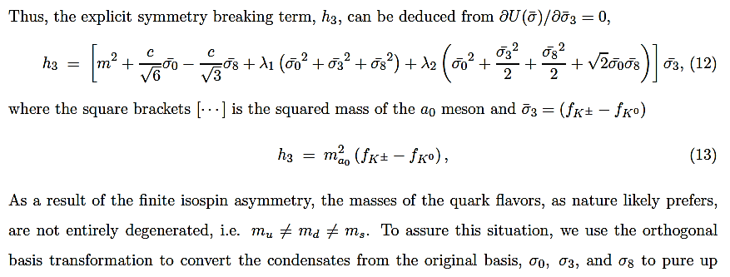
Finite Isospin Asymmetry

Slide 22
Finite Isospin Asymmetry
g is Yukawa coupling

Slide 23
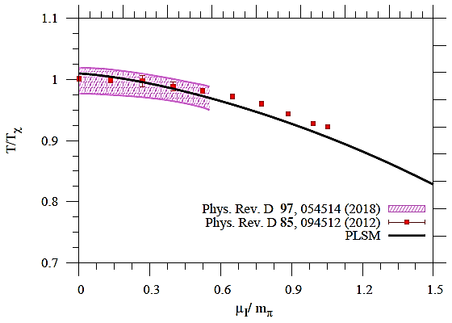
Finite Isospin Asymmetry

Slide 24
Finite Isospin Asymmetry
In SU(3), finite isospin asymmetry makes the mean sigma fields having nonzero diagonal generators as and the parameters of explicitly symmetry breaking are non-vanishing
This means that, the impacts of finite σ₃ and h₃ break SU(2) isospin asymmetry, where σ_{u} = σ_{l} + σ₃ and σ_{d} = σ_{l} − σ₃.
To this end, we first driven the thermodynamic potential of pure mesonic contributions in SU(3) in basis of σ_{u}, σ_{d} and σ_{s}.
Polyakov-loop potential in integrated in to assure integrating the gluonic dof in the chiral LSM and the gluon-quark interactions.

Slide 25
Finite Magnetic Field
At finite magnetic field, the dispersion relation contributes the Landau Level, so that
i.e., the dispersion relation is modified by a quantization number n, (Landau quantum number). Here, σ is related to the spin quantum number, Σ=±S_{z}/2 and m_{f} (q_{f} ) is the quark flavor mass (charge).
To fix the Landau quantization by the magnetic field, let us consider Fermi sphere filled with quarks. Such a system has discrete energy levels with respect to the momentum space. In magnetic field background the spin directions are aligned though the transverse magnetic field, so that polarization requires B=Be_{z}

Slide 26
Finite Magnetic Field
At finite magnetic field, the dispersion relation contributes the Landau Level, so that
With increasing magnetic field, the orders of the Fermi energy increase and the energy levels are discretized.
This discretization is known as ”Landau levels”.
Moreover, the phenomena of magnetic catalysis is mainly defined as an enhancement of the dynamical symmetry breaking by an external magnetic field.
For instance, upon increasing the magnetic field tends to enhance or ”catalysis” the quark–antiquark condensate

Slide 27
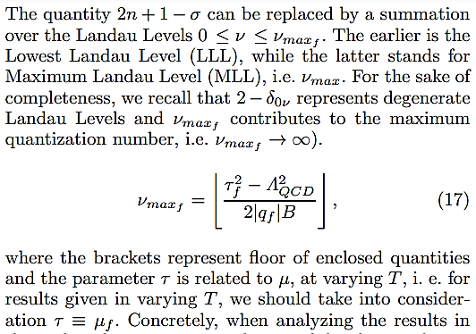
Finite Magnetic Field

Slide 28
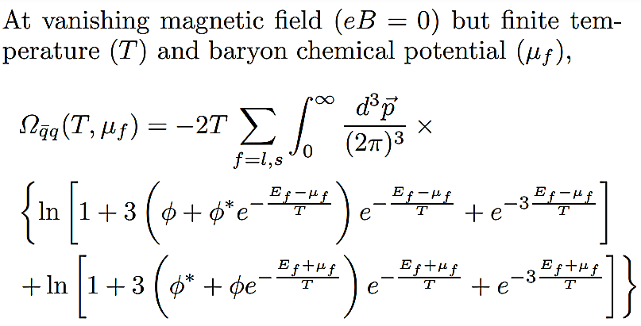
Finite Magnetic Field

Slide 29
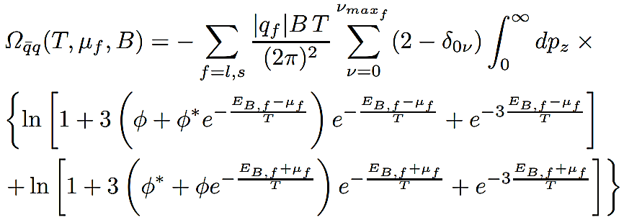
Finite Magnetic Field

Slide 30
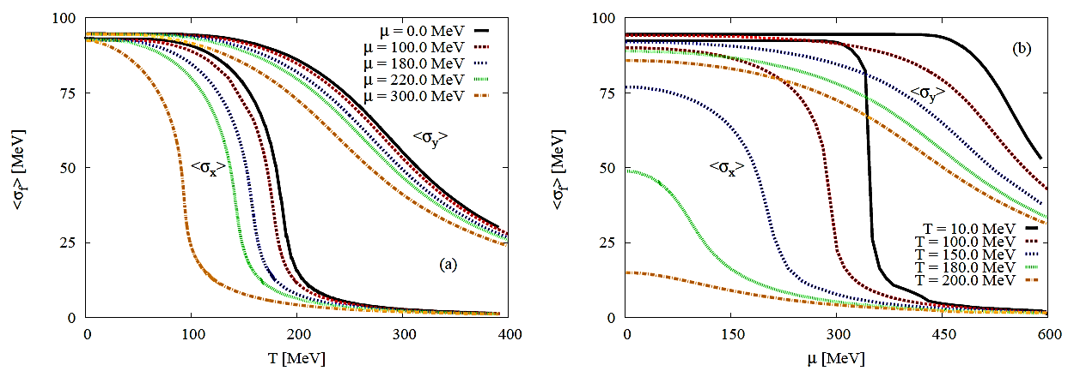
PLSM: Quark Condensates at vanishing eB

Slide 31
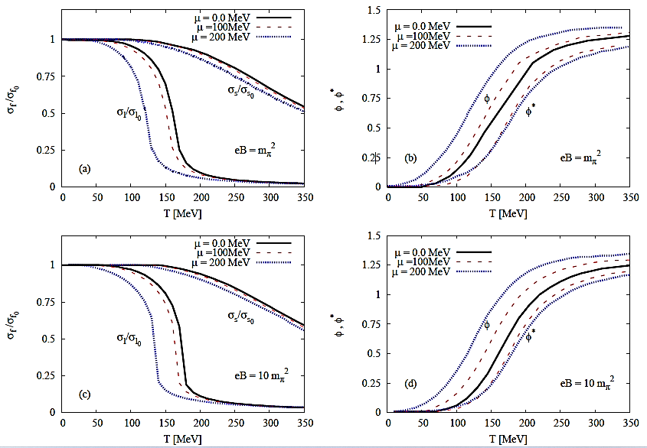
PLSM: Quark Condensates at finite eB

Slide 32
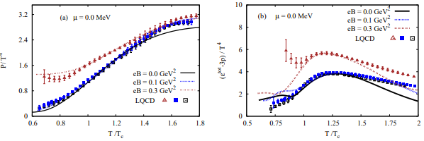
PLSM: Thermodynamics

Slide 33
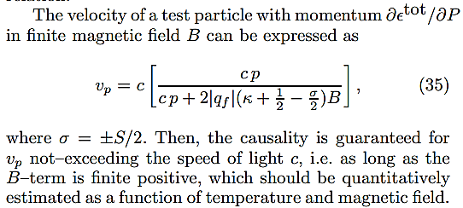
PLSM: Magnetization

Slide 34
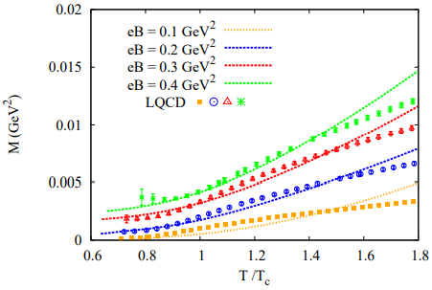
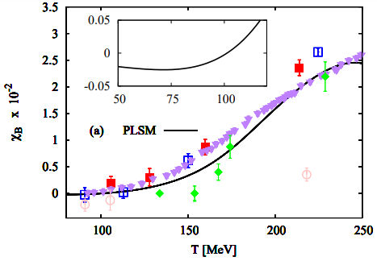
PLSM: Magnetization

Slide 35
PLSM: Magnetization
The relative magnetic permeability, µ_{r}, normalized to the vacuum magnetic permeability µ₀ can be translated as the magnetic effect in thermal QCD medium.
This relation agrees well with the lattice QCD simulations, in which the magnetic permeability is expressed in terms of the magnetic susceptibility,
where α_{m} = e²/4π is the fine structure constant. This expression distinguishes between dimensionless proportionality constants, namely external B^{exp} and E^{ind} induced magnetic field Bind.

Slide 36
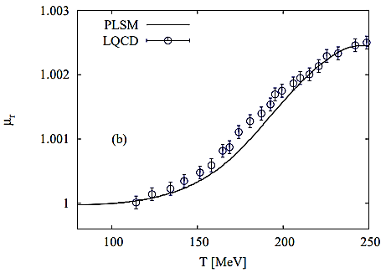
PLSM: Magnetization

Slide 37
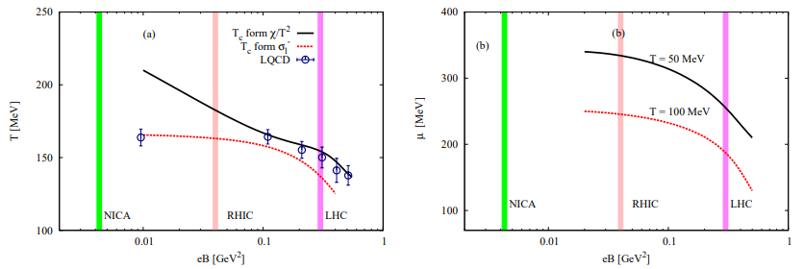
PLSM: QCD Phase Diagram
Indian J.Phys. 91 (2017) 1, 93-99

Slide 38
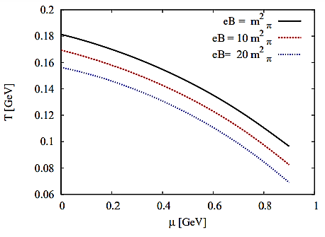
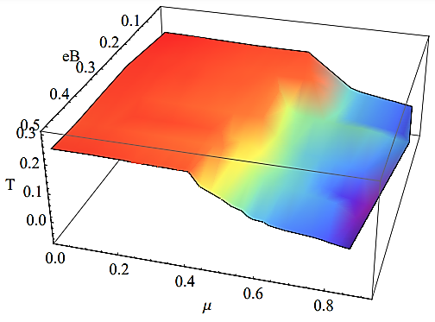
PLSM: QCD Phase Diagram

Slide 39
Conclusions
We estimated the critical temperatures based on quark condensates and the Polyakov order parameters.
We found that the chiral phase transition gets shifted to higher temperatures as a result of the inclusion of the Polyakov loop in LSM.
The magnetization remarkably affects the thermodynamic properties of the QCD matter.
The PLSM results give an evident on paramagnetic features of the hot QCD matter.
The magnetic susceptibility, at low temperatures, is negative indicating that the QCD matter is dia–magnetized.

Slide 40
Conclusions
In a wide range of temperatures, the magnetic permeability normalized to the vacuum value agrees well with the lattice QCD simulations, so that this quantity can be utilized as a magnetic order–parameter.
We conclude that the magnetic catalysis of the thermal QCD medium is inverse and an inverse interrelation between the chiral chemical potential and the magnetic field is obtained.
The chiral phase-diagram is shifted to lower temperatures due to the increase in the magnetic field.

Slide 41
Thank you!
Спасибо!

