Slide 1
The heavy-ion program at the upgraded Baryonic Matter at Nuclotron Experiment at NICA
Petr Parfenov
NRNU MEPhI, INR RAS
for the BM@N Collaboration
Infinite and Finite Nuclear Matter (INFINUM-2023)
02.03.2023, Dubna, Russia

Slide 2
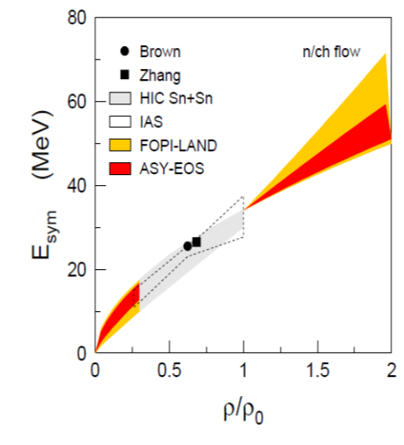
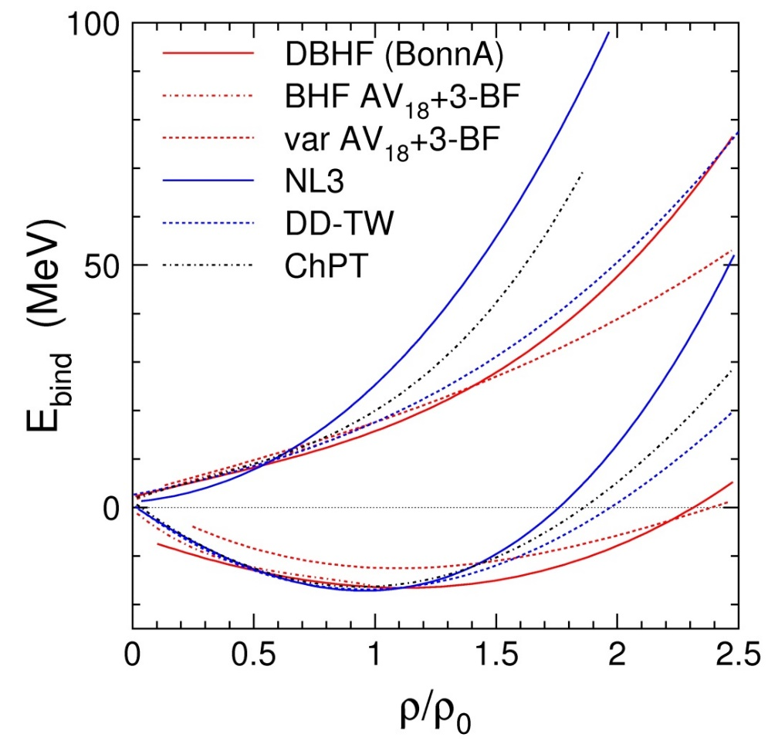
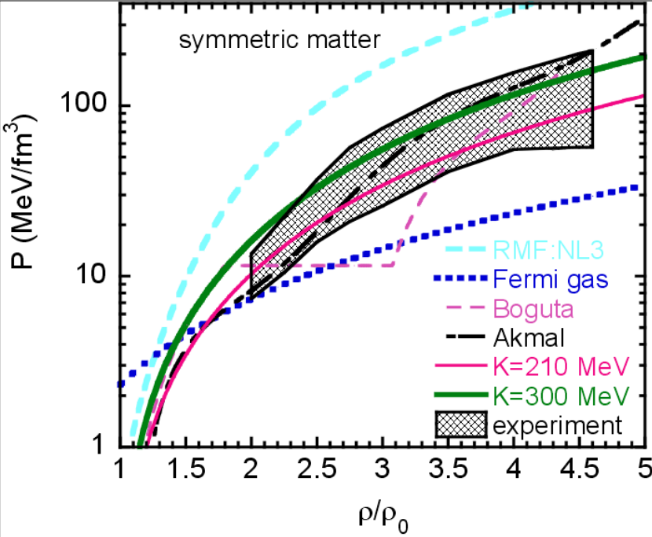
EOS for high baryon density matter
The binding energy per nucleon:
Isospin asymmetry:
Symmetric matter
Symmetry energy
Neutron matter
E/A
Au+Au 400A MeV
E_{sym}
Symmetric matter
E895: elliptic flow of protons
P. Danielewicz, R. Lacey, W.G. Lynch,
Science 298 (2002) 1592
ASY-EOS: Elliptic flow of neutrons/charged particles
Ch. Fuchs and H.H. Wolter, EPJA 30 (2006) 5
P. Russotto et al.,
Phys. Rev. C 94 (2016) 034608

Slide 3
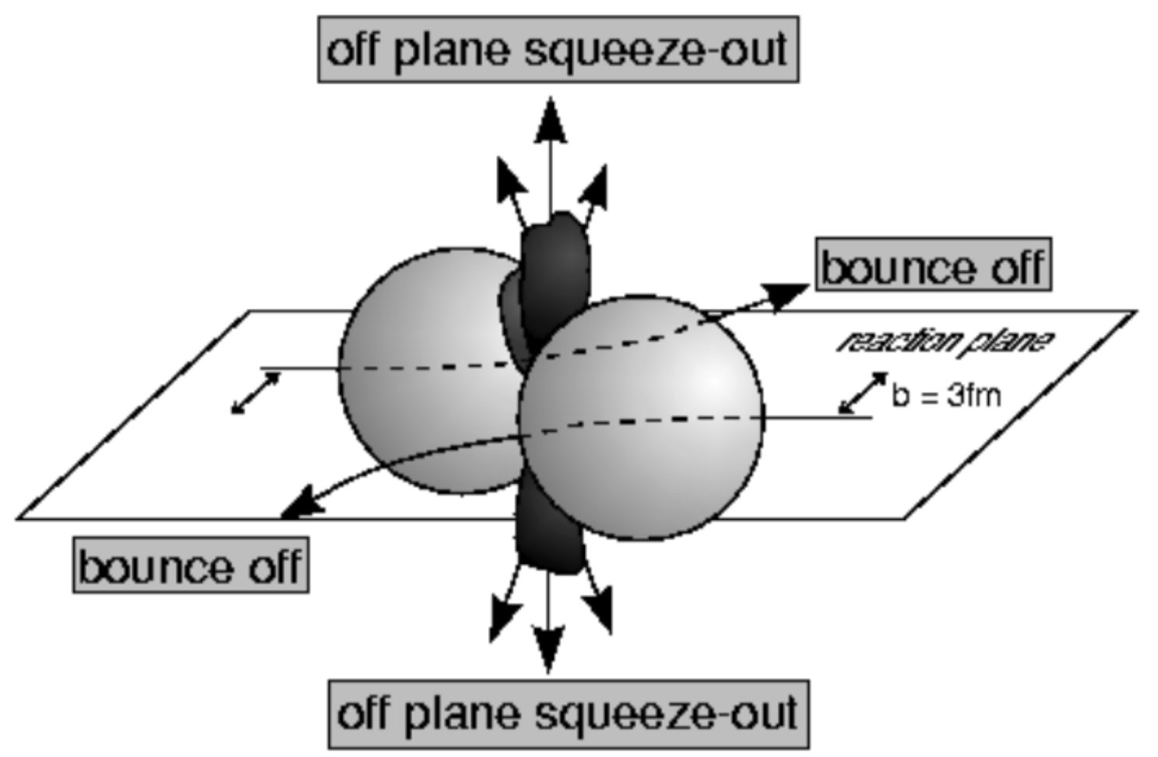
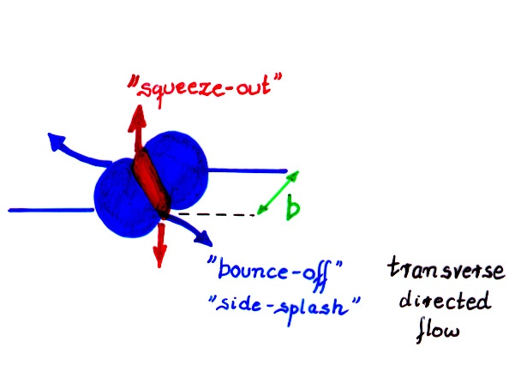
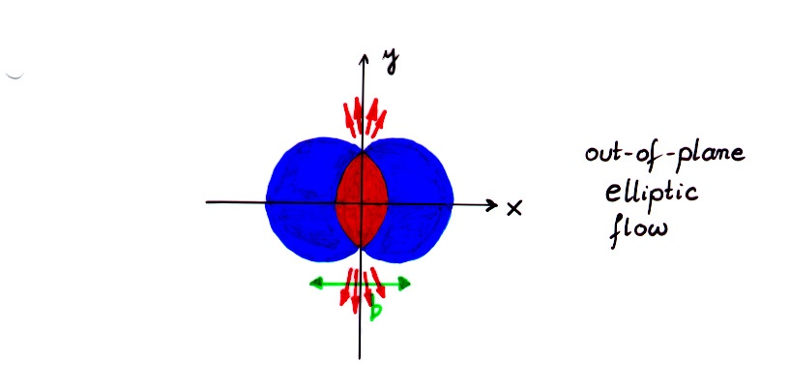
Sensitivity of the collective flow to the EOS
Azimuthal distribution of produced particles with respect to RP:
Coefficients of the decomposition are referred to as collective flow
v₁ is called directed and v₂ is called elliptic flow
Bounce-off
Squeeze-out
Collective flow is sensitive to:
Compressibility of the created in the collision matter
Time of the interaction between the matter within the overlap region and spectators
Notes:
One more way to study the properties of the matter created in the collision is through the lens of collective motion of created in the collision particles.
We can decompose the azimuthal distribution of produced particles with respect to RP in a FS
Coefficients …
The main mechanisms driving the direced and elliptic flow are
Bounce off for directed flow — when two nuclei collide, the remnants are deflected out from the overlap region and pull the matter created in the collision apart
Squeeze out for elliptic flow — when the remnants of colliding nuclei are pushing the matter within the overlap region and squeeze the produced particles out of reaction plane
Collective flow is sensitive to …

Slide 4
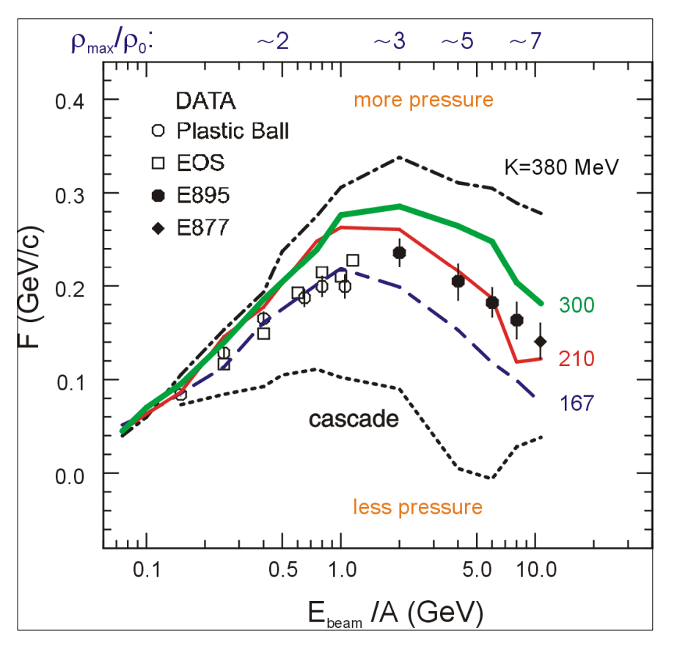
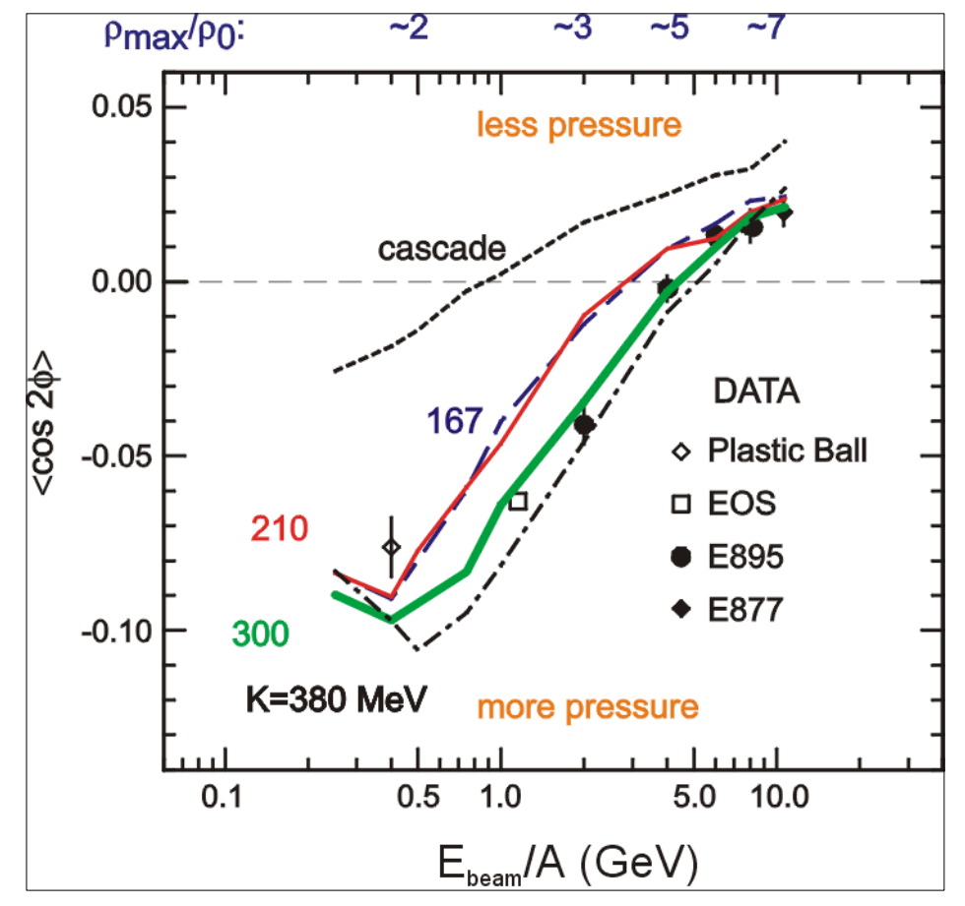
Interpretation of the previous flow data
P. DANIELEWICZ, R. LACEY, W. LYNCH
10.1126/science.1078070
The flow data from E895 experiment have ambiguous interpretation: v₁ suggests soft EOS while v₂ corresponds to hard EOS
Additional measurements are essential to clarify the previous measurements
Notes:
There were measurements of collective flow in the past and the results are ambiguous to interpret
On this slide a comparison between theoretical calculations on directed and elliptic flow on energy and actual experimental data is presented. As you can see, data points are on better agreement with hard EOS in the case of v1 and for v2 the situation is opposite.
Thus we need more precise measurements to clarify the previous data

Slide 5
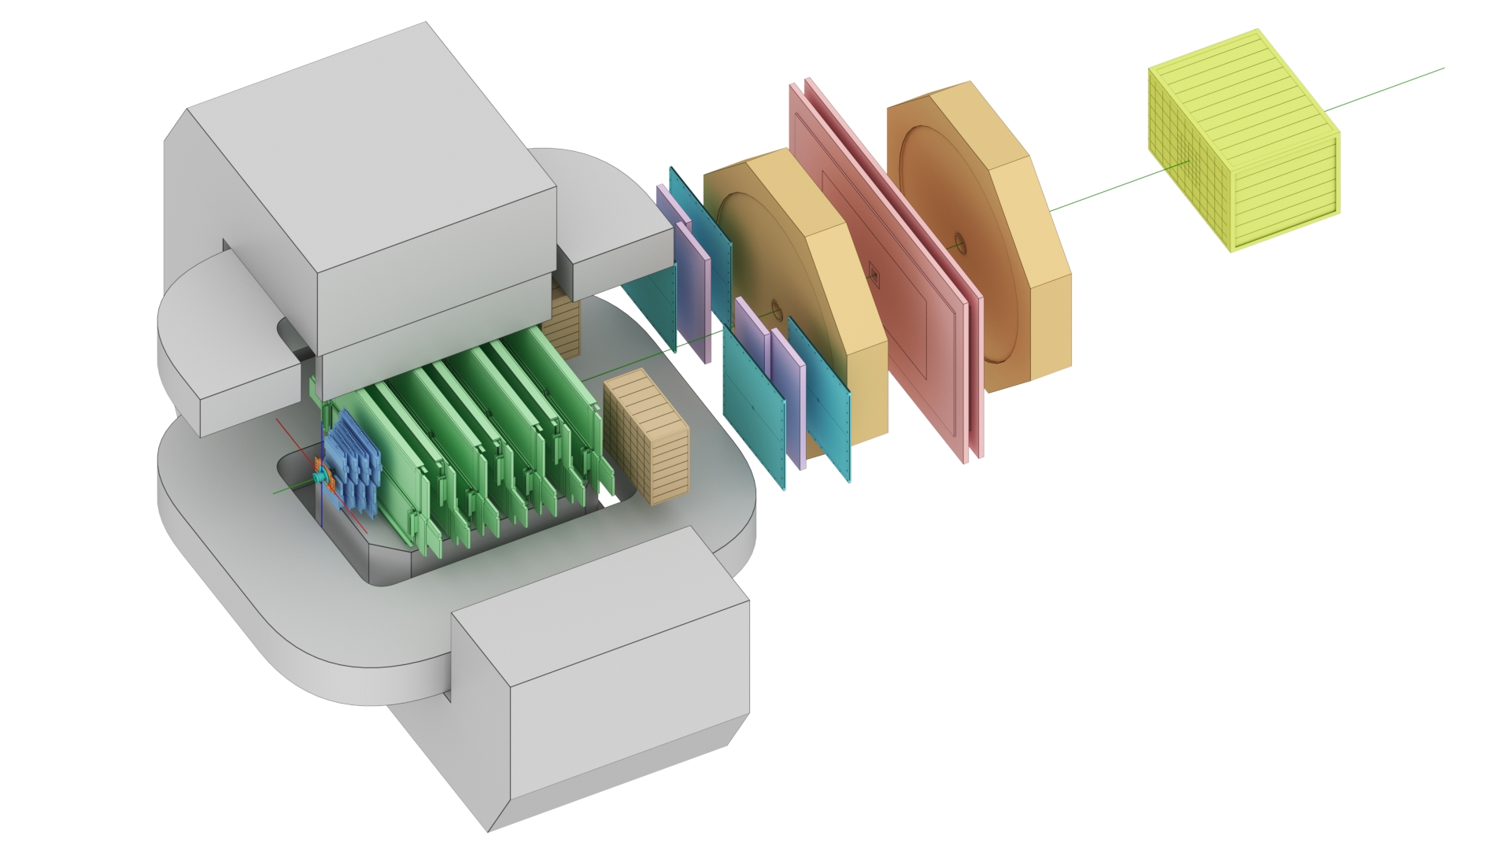
The BM@N experiment (JINR, Dubna)
FHCal
Silicon + GEM
TOF-700
54 modules of Forward Hadron Calorimeter for symmetry plane and centrality
TOF-400
3 stations of RPC for particle identification via TOF method
Nuclotron beam:
from p to Au
heavy ion energy 1- 3.8 GeV/n
Au intensity ~ few 10^6 Hz
4 silicon stations + 7 GEM stations within magnetic field for charged particles trajectories reconstruction
Notes:
The BM@N operates on the beam from nuclotron as the name suggests
The experiment consists of several subsystems
Tracking system comprising of … within the magnetic field to measure the momentum of particles based on the deflection in magnetic field
Particles identification will be carried out with TOF-method from the information of …
The FHCal is for …
On the slide the momentum resolution for different magnetic fields is presented

Slide 6
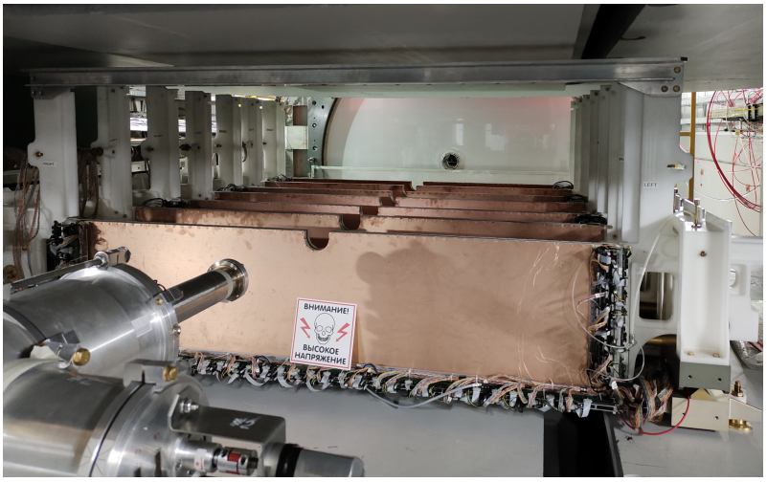
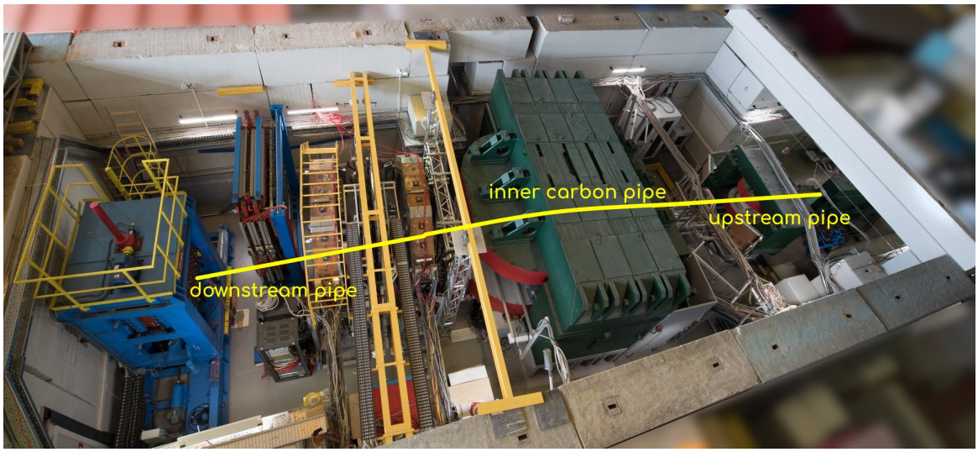
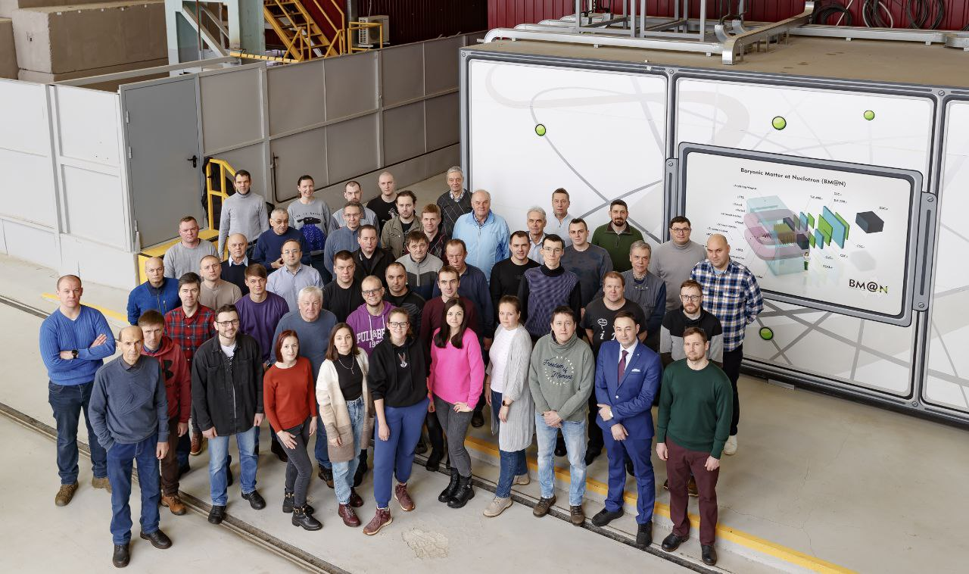
BM@N setup during the physical run Xe+Cs(I)
The tracking system have been upgraded to cover the full available acceptance
Scintillator wall and Silicon Hodoscope were added to the setup
Beam pipe with vacuum up to 10^-5 torr.
Previous runs:
C+C, C+Al, C+Cu @ 4 AGeV
First physical run:
Xe+Cs(I)
3.8 AGeV: 500 M events
3 AGeV: 50 M events
Notes:
For the recent physical high-statistics run the BM@N was upgraded:
Tracking system now covers the full available acceptance
The forward region is now equipped with …
The target is moved to the vacuumed beam pipe to suppress the background events

Slide 7
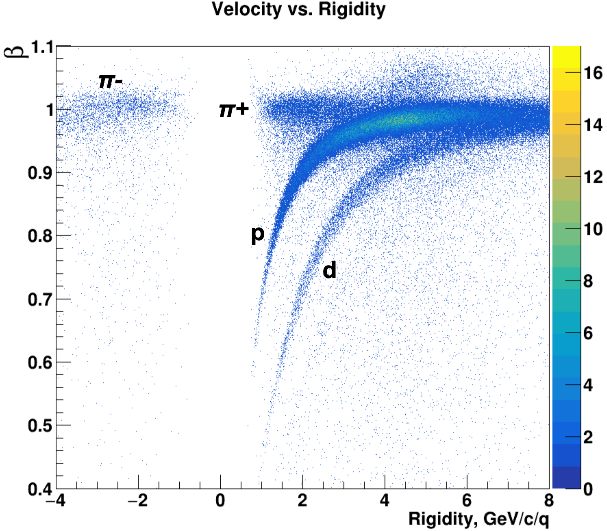
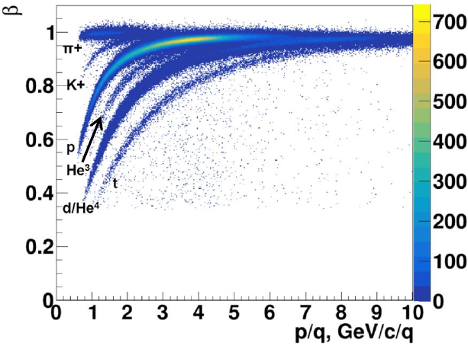
TOF-700 data from Ar+A and Xe+Cs(I) runs
Ar+A @ 3.2 AGeV (2018)
Xe+Cs(I) @ 3.8 AGeV (2023)
TOF-700
TOF-700
Raw online data
Without dedicated ToF calibration
Good PID capabilities
Notes:
For the recent physical high-statistics run the BM@N was upgraded:
Tracking system now covers the full available acceptance
The forward region is now equipped with …
The target is moved to the vacuumed beam pipe to suppress the background events

Slide 8
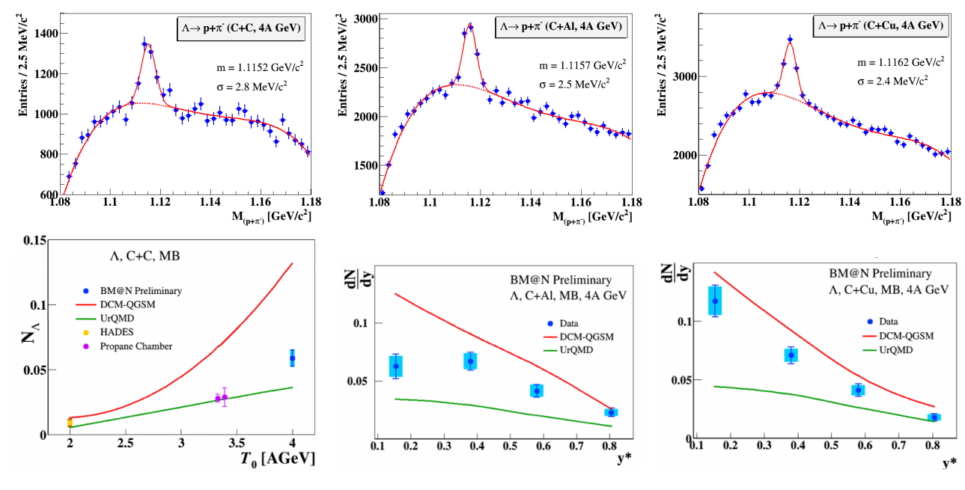
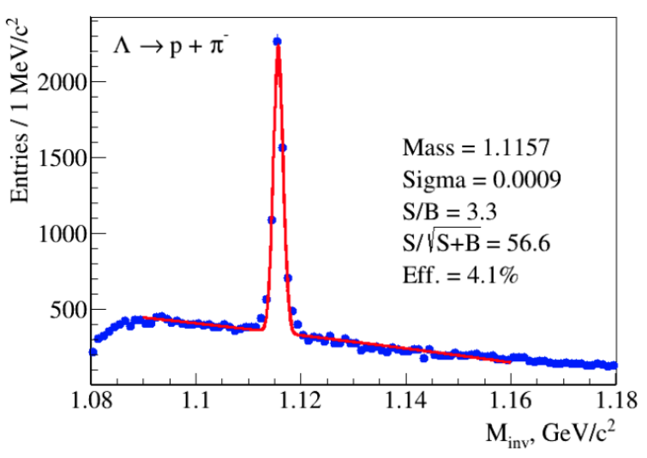
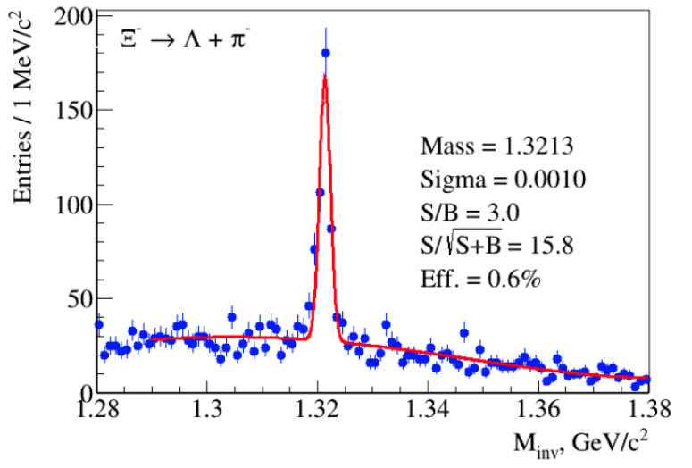
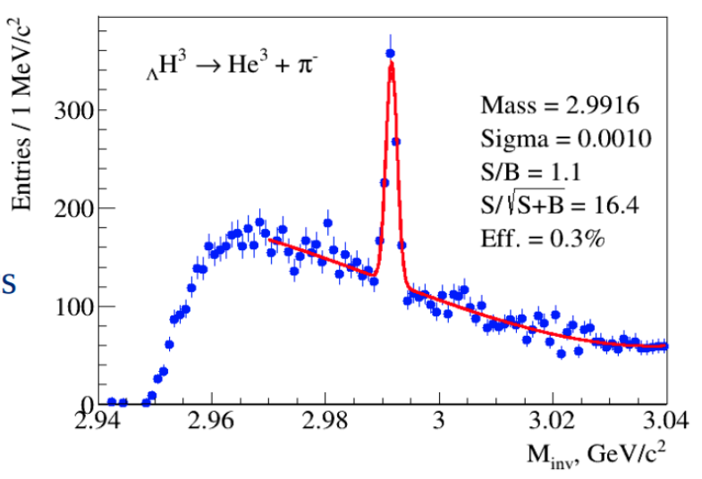
Hyperon extraction performance
Data from 2018 run
Xe+Cs(I)
Xe+Cs(I)
Xe+Cs(I)
убрать
убрать
Xe+Cs(I) performance
Improved performance for hyperon measurements is expected for the new Xe+Cs(I) run
Notes:
Moving on to the results from technical runs for particles reconstructed by the products of their decay. Here the invariant mass of lambda hyperons is presented. Previous data show we can reconstruct them on BM@N as well

Slide 9
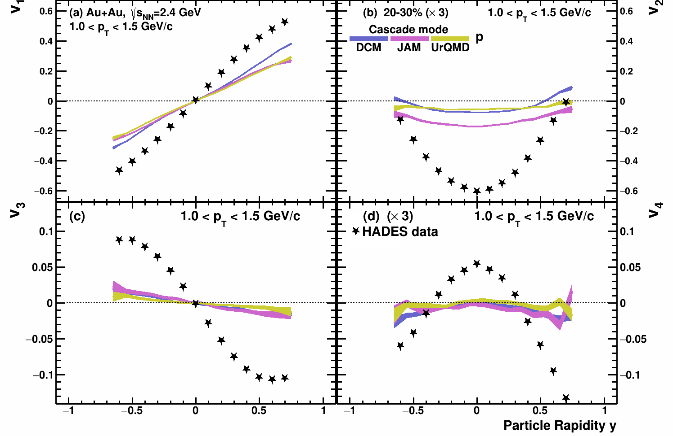
$v_{n}\left(y\right)$in Au+Au $\sqrt{s_{NN}}$=2.4 GeV: cascade models
Experimental data points:
Phys. Rev. Lett. 125 (2020) 262301
Kinematic cuts:
V_{1,3}(y): 1.0 < pT < 1.5 GeV/c
V_{2,4}(y): 1.0 < pT < 1.5 GeV/c
Cascade models fail to reproduce HADES experimental data

Slide 10
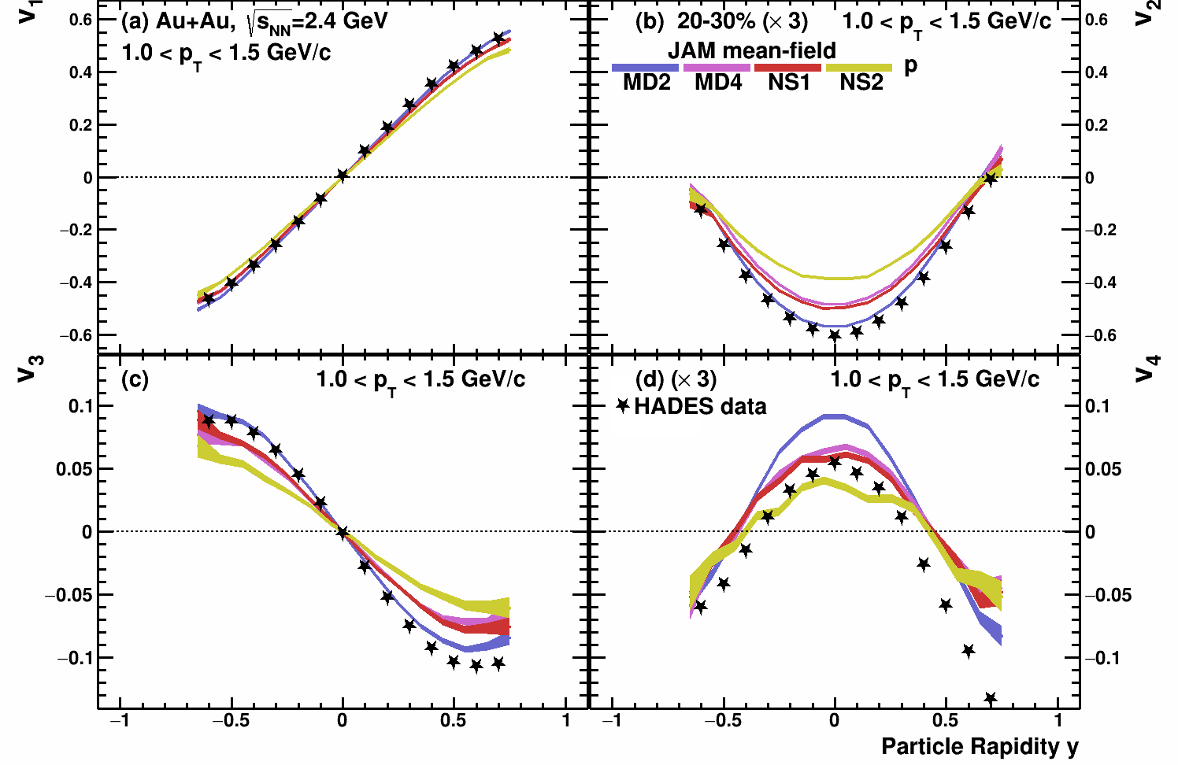
$v_{n}\left(y\right)$in Au+Au $\sqrt{s_{NN}}$=2.4 GeV: model vs. HADES data
Experimental data points:
Phys. Rev. Lett. 125 (2020) 262301
Kinematic cuts:
V_{1,3}(y): 1.0 < pT < 1.5 GeV/c
V_{2,4}(y): 1.0 < pT < 1.5 GeV/c
Reasonable agreement for $v_{n}\left(y\right)$
Higher harmonics are more sensitive to different EOS than $v_{1}$
More JAM results with different EOS are needed

Slide 11
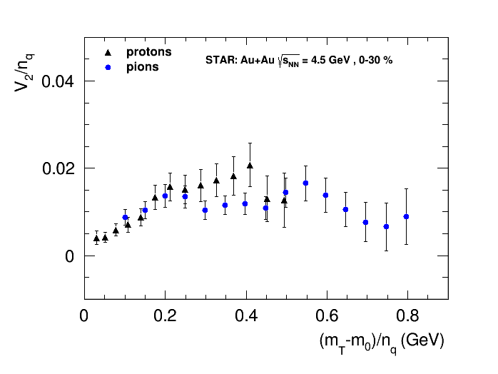
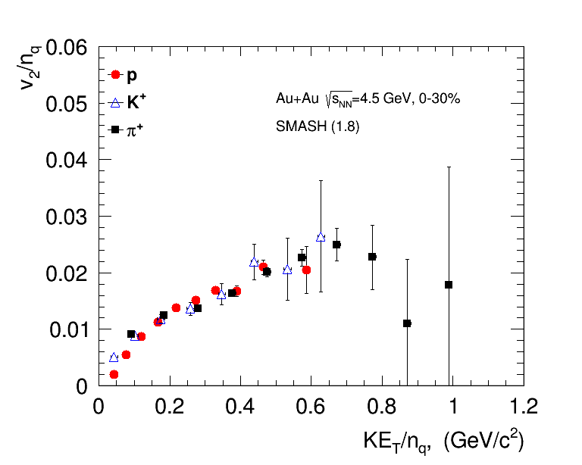
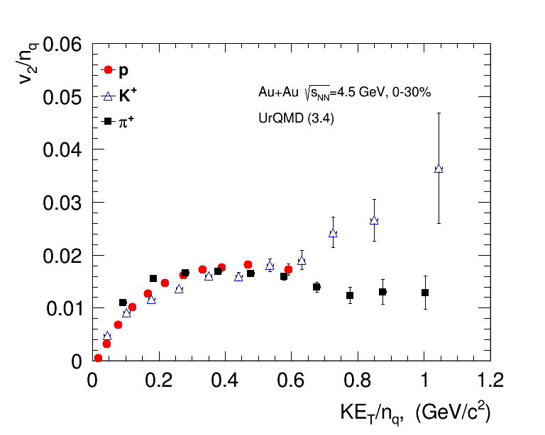
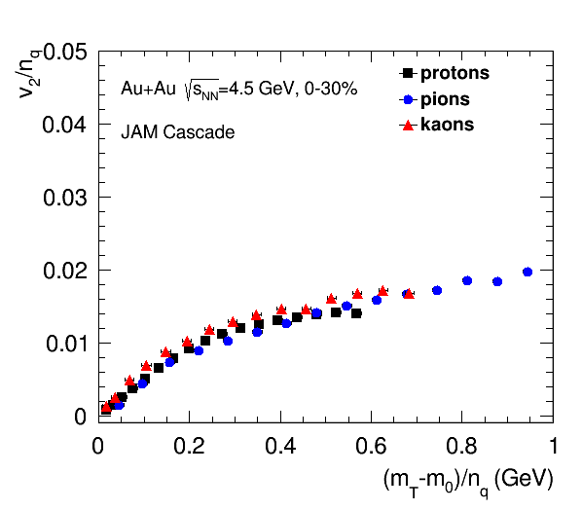
NCQ scaling: hybrid and cascade models
STAR Collaboration, arxiv.org/abs/2007.14005
NCQ scaling: $v_{n}\left(p_{T}\right)→{v_{n}}/{n_{q}^{n/2}}\left(\frac{KE_{T}}{n_{q}}\right) n_{q}=\left\{\begin{aligned}2 for mesons \\ 3 for baryons\end{aligned}\right. KE_{T}=\sqrt{m^{2}+p_{T}^{2}}−m$
Scaling holds up at 4.5 GeV in STAR data and pure string/hadronic cascade models (without partonic d.o.f.)
$KE_{T}/n_{q}$ scaling at 4.5 GeV might be accidental – more careful studies should be performed

Slide 12
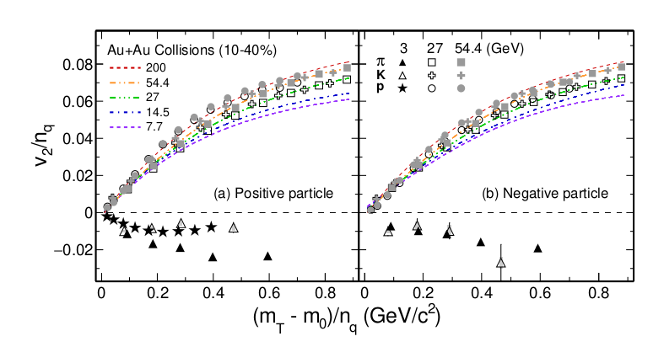
Dissapearence of partonic collectivity in $\sqrt{s_{NN}}=3$ GeV Au+Au collisions at RHIC
Phys. Lett. B 827, 137003 (2022)
Breaking of NCQ scaling at 3 GeV
“imply the vanishing of partonic collectivity and a new EOS, likely dominated by baryonic interactions in the high baryon density region”

Slide 13
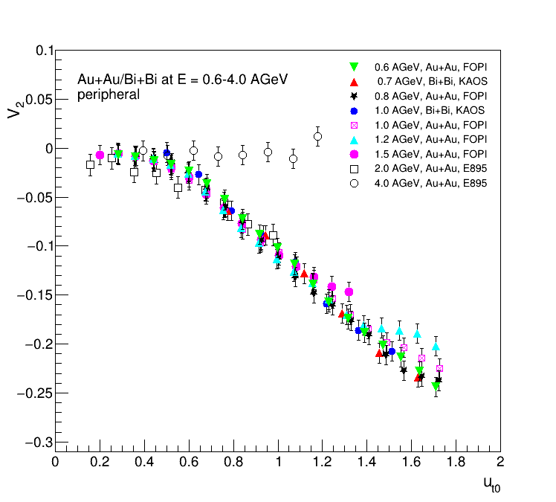
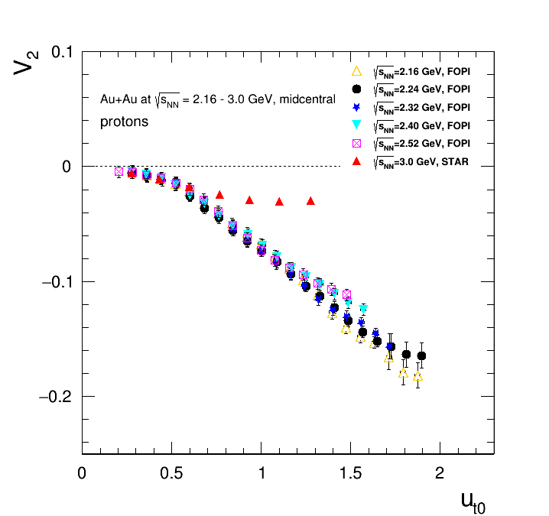
Scaling relations at SIS – scaling with passage time
$u_{t0}=\frac{p_{T}}{m_{0}β_{CM}γ_{CM}}≡\frac{p_{T}t_{pass}}{2Rm_{0}}$ $t_{pass}=\frac{2R}{β_{CM}γ_{CM}}$
Nucl. Phys A 876 (2012) 1-60
The rather good scaling observed suggests that $c_{s}$ does not change significantly over beam energy range $E_{kin}=0.4−2$ AGeV ($\sqrt{s_{NN}}=2−2.7$ GeV)
Scaling breaks at $E_{kin}=2.9$ AGeV ($\sqrt{s_{NN}}=3$ GeV)

Slide 14
$\left|v_{n}^{int}\right|$ scaling: JAM MD2 model – Nuclotron energies
$$\left|v_{n}^{int}\right|=\left|{\left\langle v_{n}\left(p_{T},y,centrality,PID\right)\right\rangle }_{p_{T},y}\right|$$
Scaling works for JAM model at $\sqrt{s_{NN}}=2.4$ GeV for Au+Au, Xe+Cs and Ag+Ag collisions
Provides a useful tool to make comparison of $v_{n}$ results from different colliding systems

Slide 15
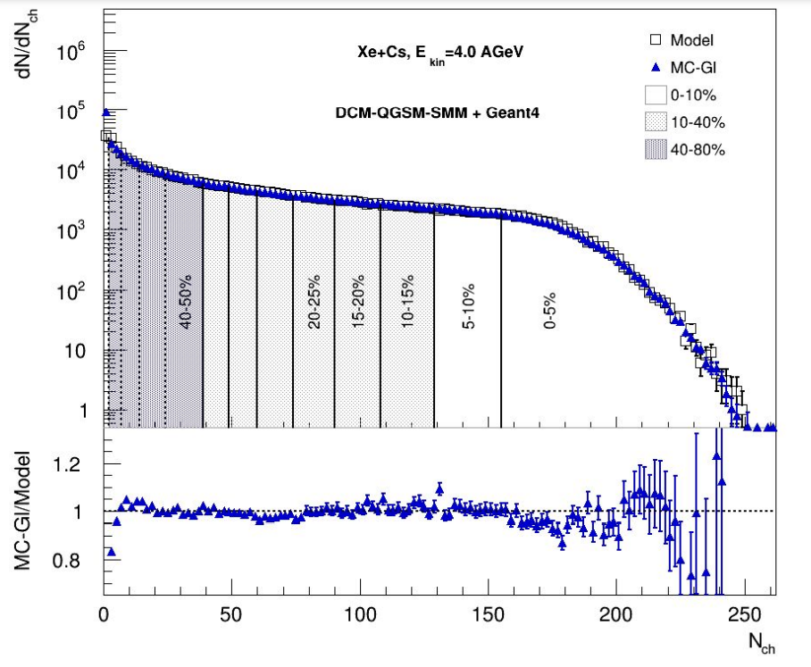
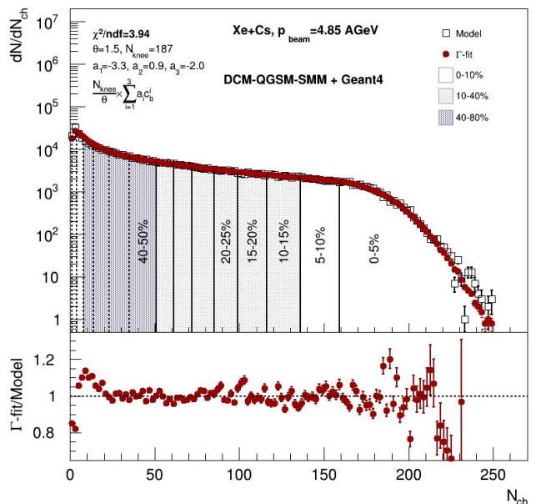
Centrality determination at BM@N
Fit results are good both for MC-Glauber and Inverse Г-fit methods
Impact parameter distributions in centrality classes are well-reproduced
Notes:
Centrality estimation based on number of produced particles have been done using two methods: MC-Glauber and inverse gamma-fit
Fit results …

Slide 16
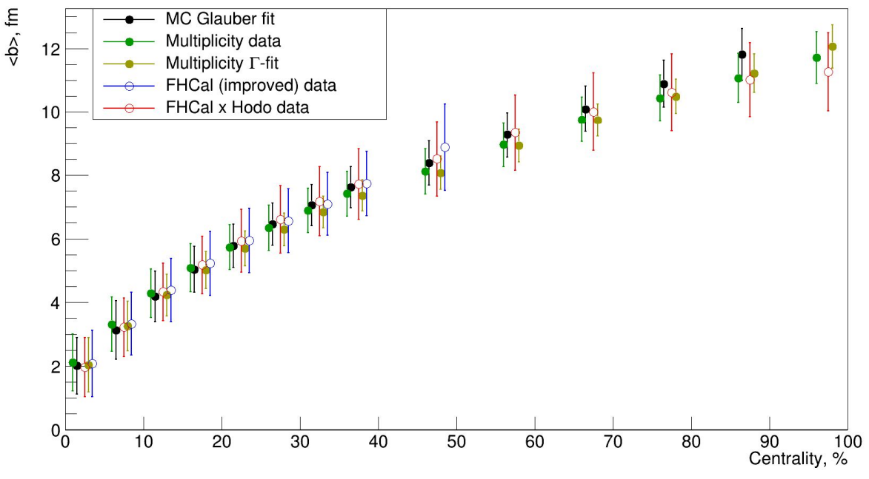
Comparison of different estimators and methods
Impact parameter distributions in different centrality classes are similar for different centrality classes
The distributions for spectators energy are wider because of the width of b and energy correlation
Notes:
See talk of I.Segal
On this slide a comparison of different centrality estimators and methods is presented
Impact parameter in each centrality class is shown on the picture.
…

Slide 17
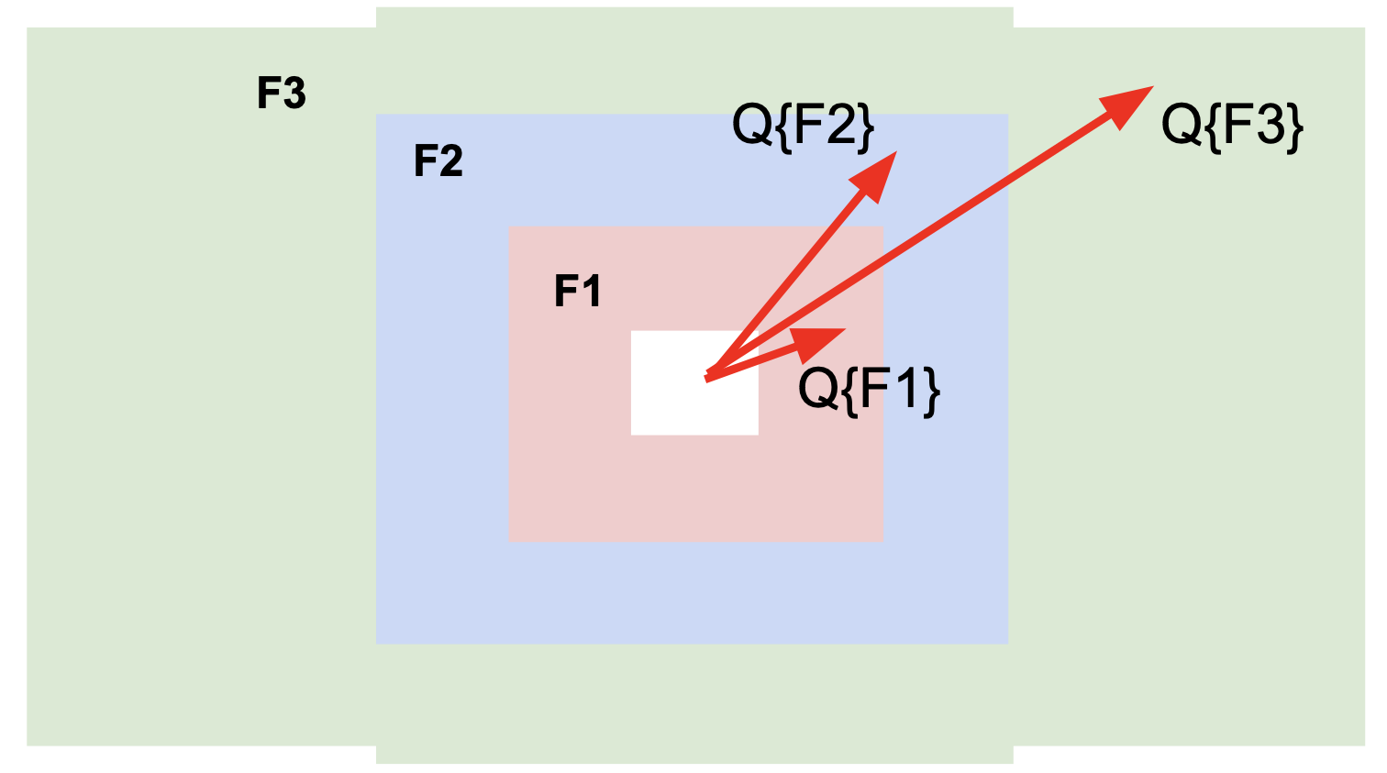
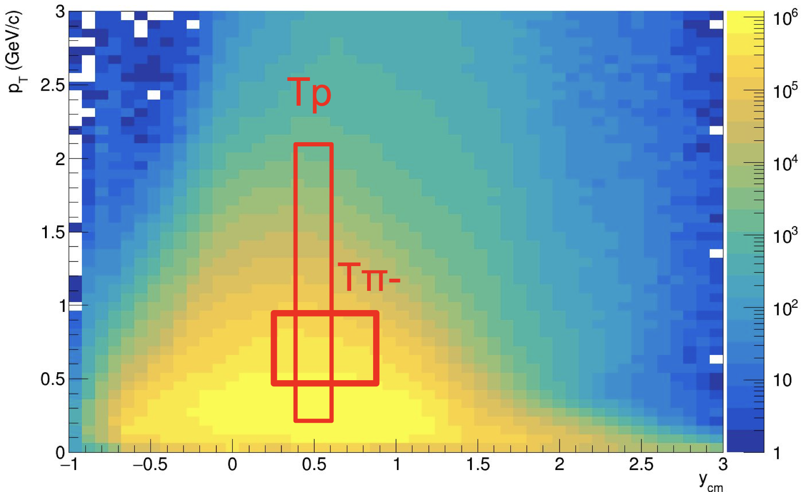
Flow vectors
From momentum of each measured particle one can define a u_{n}-vector in a transverse plane:
$$u_{n}=e^{inφ}$$
where 𝜑 is the azimuhtal angle of a particle
Q_{n}-vector can be defined as a sum of some group of u_{n}-vectors (subevent):
$$Q_{n}=\frac{\sum_{k=1}^{N}{w_{n}^{k}u_{n}}}{\sum_{k=1}^{N}{w_{n}^{k}}}=\left|Q_{n}\right|e^{inΨ_{n}^{EP}}$$
$Ψ_{n}^{EP}$ is the event plane
Additional subevents from tracks not pointing at FHCal:
Tp: p; 0.4<y<0.6; 0.2 < pT < 2 GeV/c; w=1/eff
Tπ: π-; 0.2<y<0.8; 0.1 < pT < 0.5 GeV/c; w=1/eff
T-: all negative; 1.0<η<2.0; 0.1 < pT < 0.5 GeV/c; w=1/eff
Notes:
Concerning the flow measurements at the BM@N experiment, BM@N has non-uniform azimuthal acceptance, since the tracking system is rectangular
Corrections are required
These corrections are
As we can see after all 3 correction steps applied this non-uniformity will not interfere the flow measurements

Slide 18
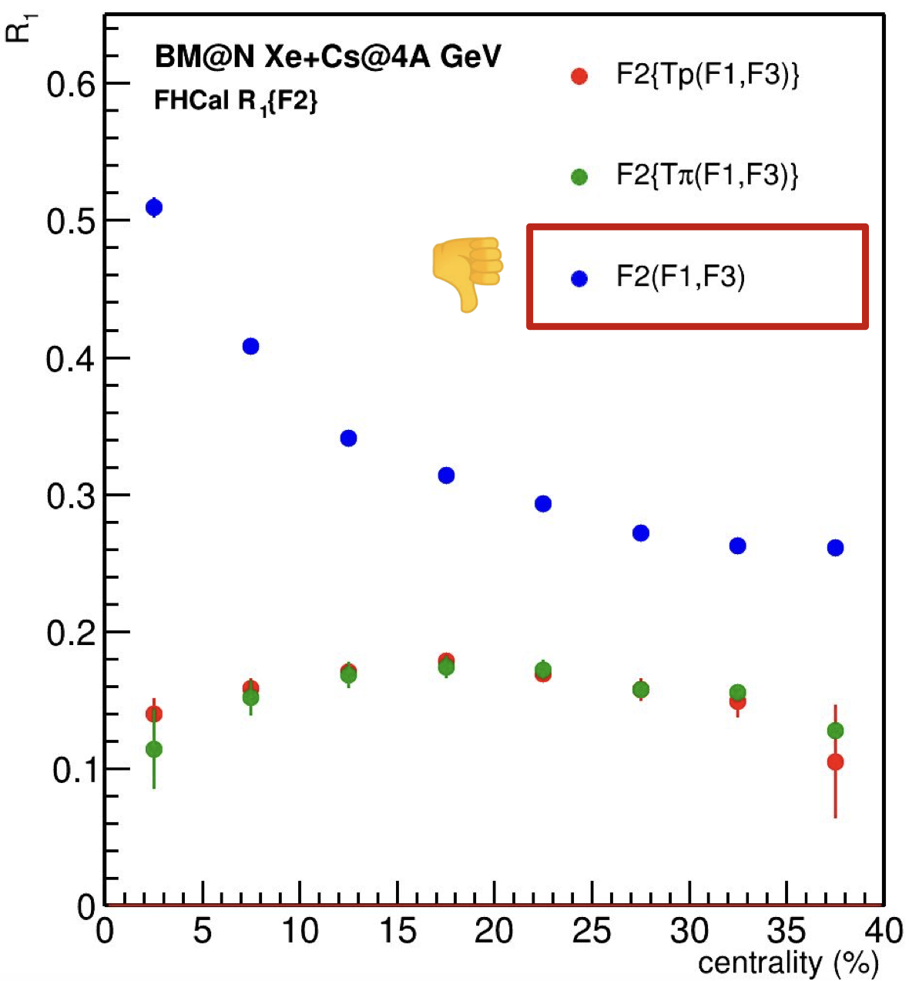
Methods for v_{n} calculation
Scalar product method:
$$v_{1}=\frac{\left\langle u_{1}Q_{1}^{F1}\right\rangle }{R_{1}^{F1}}, v_{2}=\frac{\left\langle u_{2}Q_{1}^{F1}Q_{1}^{F3}\right\rangle }{R_{1}^{F1}R_{1}^{F3}}$$
where $R_{1}$ is the resolution correction factor:
$$R_{1}=\left\langle \cos\left(Ψ_{1}^{EP}−Ψ_{RP}\right)\right\rangle$$
Symbol ”F2(F1,F3)” means $R_{1}$ is calculated for $Ψ_{1}^{F2}$ using 3 subevents F1, F2, F3:
$$R_{1}^{F2\left(F1,F3\right)}=\frac{\sqrt{\left\langle Q_{1}^{F2}Q_{1}^{F1}\right\rangle \left\langle Q_{1}^{F2}Q_{1}^{F3}\right\rangle }}{\sqrt{\left\langle Q_{1}^{F1}Q_{1}^{F3}\right\rangle }}$$
Symbol ”F2{Tp(F1,F3)}” means $R_{1}$ is calculated for $Ψ_{1}^{F2}$ using 4 subevents Tp, F1, F2, F3:
$$R_{1}^{F2\left\{Tp\left(F1,F3\right)\right\}}=\left\langle Q_{1}^{F2}Q_{1}^{Tp}\right\rangle \frac{\sqrt{\left\langle Q_{1}^{F1}Q_{1}^{F3}\right\rangle }}{\sqrt{\left\langle Q_{1}^{Tp}Q_{1}^{F1}\right\rangle \left\langle Q_{1}^{Tp}Q_{1}^{F3}\right\rangle }}$$
Notes:
Concerning the flow measurements at the BM@N experiment, BM@N has non-uniform azimuthal acceptance, since the tracking system is rectangular
Corrections are required
These corrections are
As we can see after all 3 correction steps applied this non-uniformity will not interfere the flow measurements

Slide 19
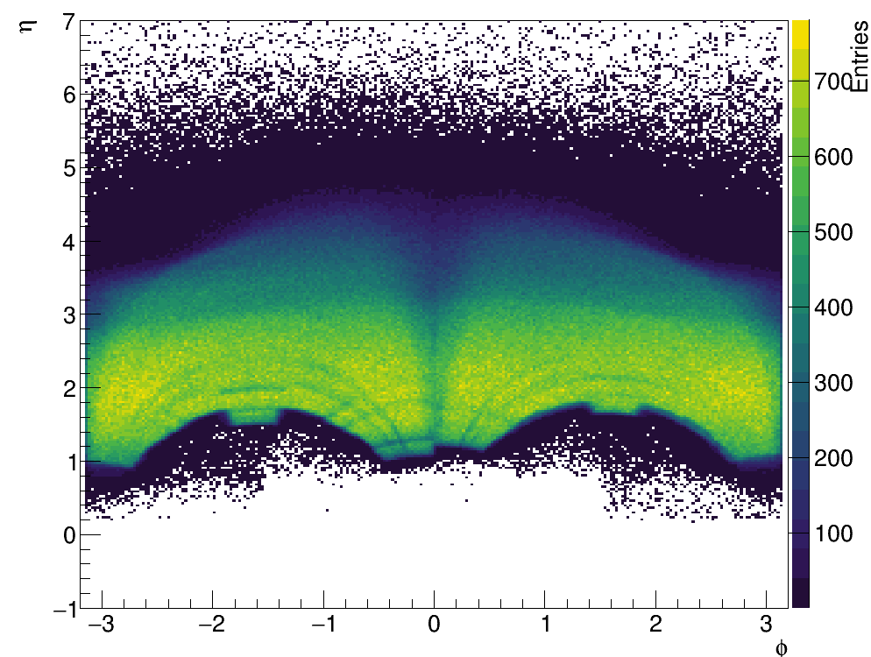
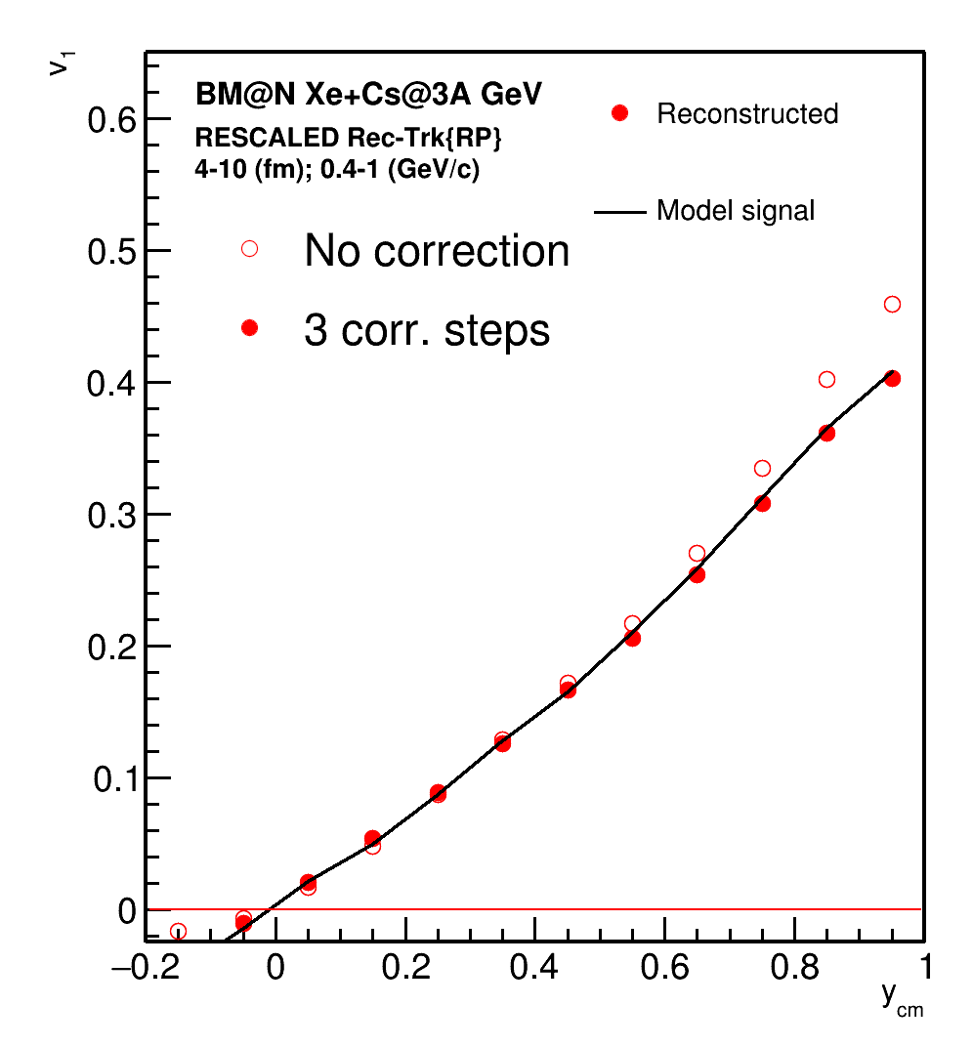
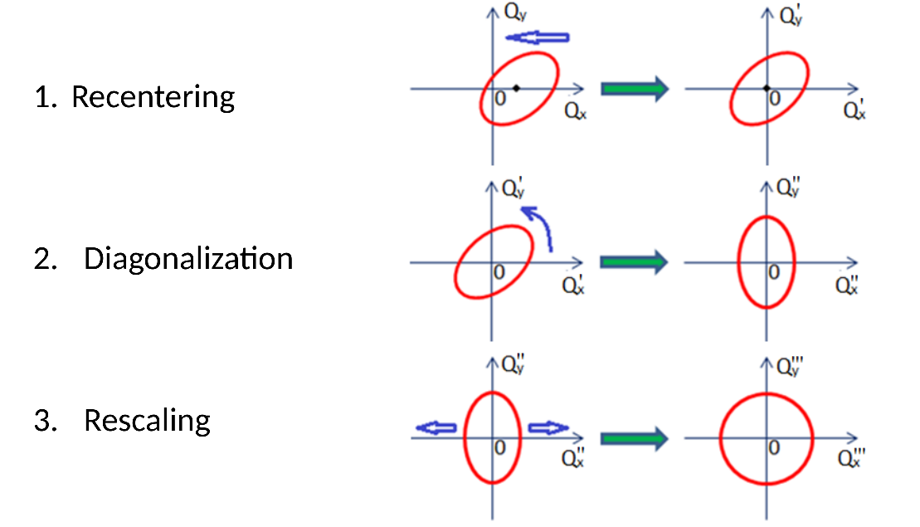
Azimuthal acceptance of the BM@N experiment
φ-η yield of protons
Corrections are based on method in: I. Selyuzhenkov and S. Voloshin PRC77, 034904 (2008)
Required corrections to reduce effects of non-uniform azimuthal acceptance
2. Twist
Better agreement after rescaling
Notes:
Concerning the flow measurements at the BM@N experiment, BM@N has non-uniform azimuthal acceptance, since the tracking system is rectangular
Corrections are required
These corrections are
As we can see after all 3 correction steps applied this non-uniformity will not interfere the flow measurements

Slide 20
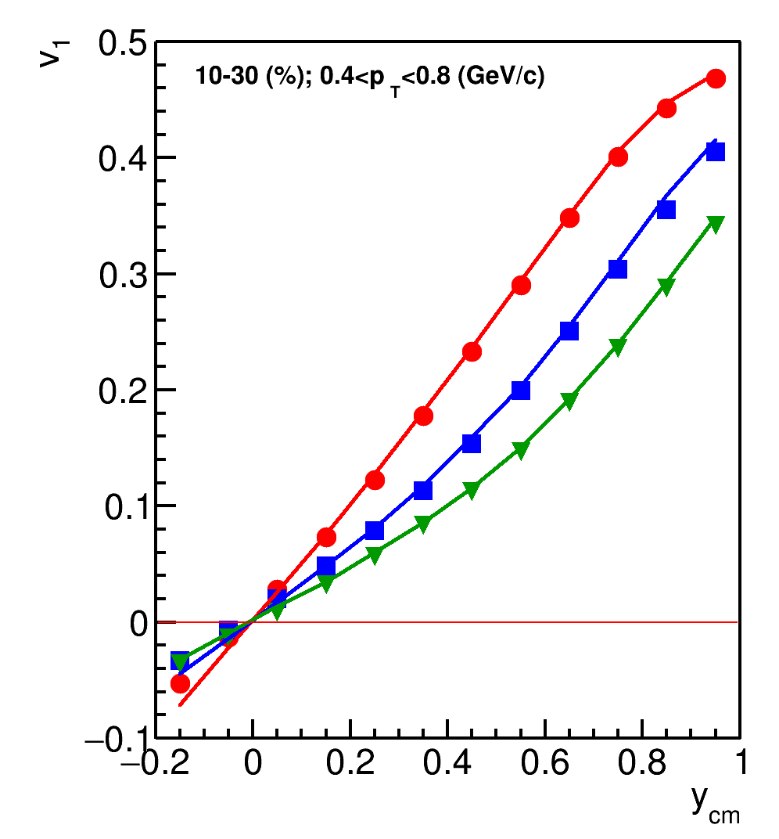
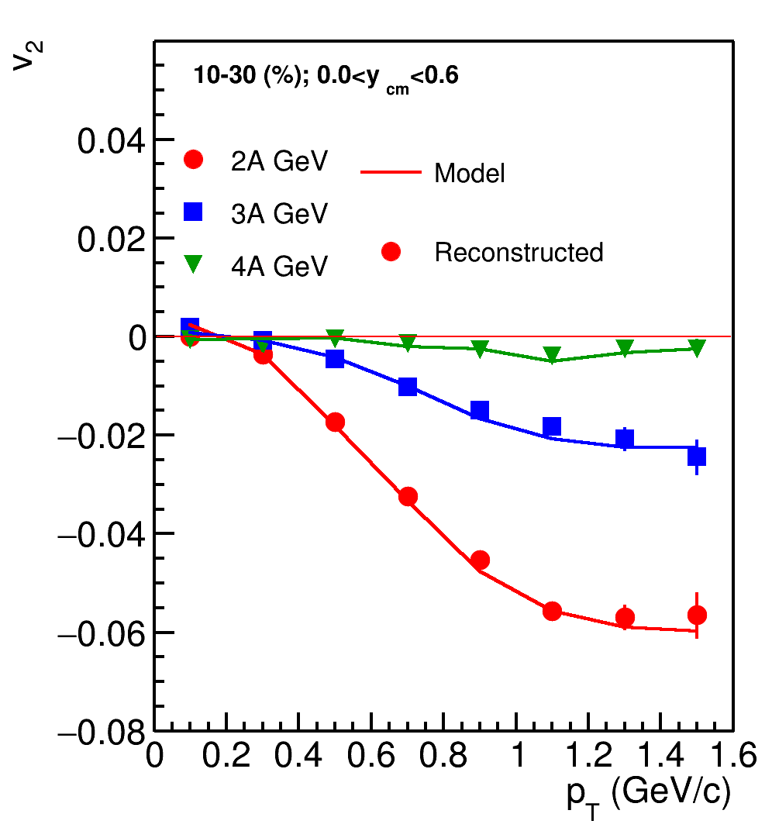
Directed and elliptic flow at BM@N
Xe+Cs(I)
Good agreement between reconstructed and model data
Approximately 250-300M events are required to perform multidifferential measurements of v_{n}
Notes:
On this slide the directed and elliptic flow are presented as a function of center-of-mass rapidity and pT. This is calculation from JAM model which reproduces the magnitude of flow signal at this energies well.
And we observe a good agreement between model and reconstructed data.
We are capable of measuring the signal of this amplitude.
Approximately …

Slide 21
Summary
The upgraded BM@N experiment offers the opportunity to explore nuclear matter at neutron star core densities in heavy-ion collisions at energies of up to 4A GeV. And study the EOS for high-density symmetric matter:
Collective flow of protons and light fragments in A+A collisions
Yields of multi-strange (anti-) hyperons from A+A collisions
Role of hyperons in neutron stars (ΛN and ΛNN interaction): hypernuclei
BM@N already recorded experimental data from a set of technical runs (carbon, argon-krypton) and recent physical run (Xe+CsI).
Physics analysis of the data is in its active phase, results expected to be published.
Preparation for the next experimental runs as well as the data processing from the first physical run (calibrations, physics feasibility studies ...) are ongoing.

Slide 22
Thank you for your attention!

Slide 23
Backup slides

Slide 24
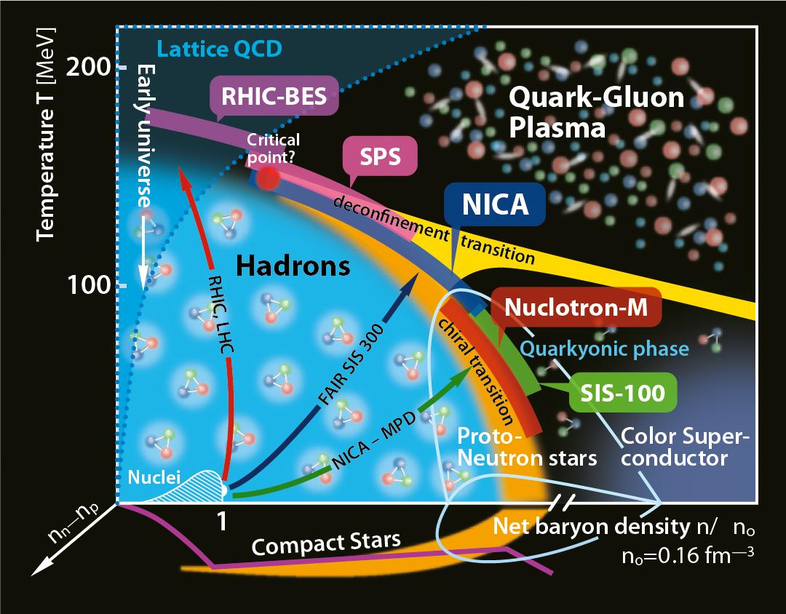
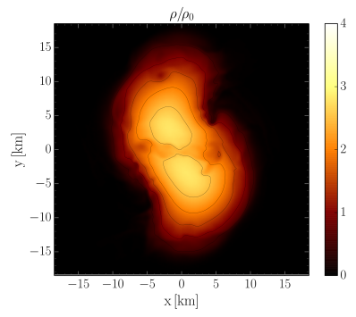
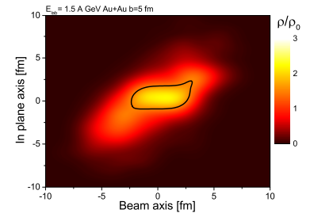
QCD Phase diagram: high baryon density region
Nuclotron energies: √s_{NN}= 2.3-3.5 GeV
Achievable Net Baryon densities: ~3-5ρ₀
ρ₀ is nuclear saturation density
Experimental data from BM@N can provide further constraints on the symmetric matter at similar densities
M. Hanauske et al., J. Phys.: Conf. Ser. 878 012031
The energy regime of the Nuclotron will test the region of the possible QCD phase transition
Notes:
In heavy ion collisions hot and dense matter is produced
State of the matter produced in the collisions can be represented with the diagram: On X-axis is net baryon density; on Y-axis temperature
There a lot of experiments on heavy ion collisions exist: each reaches its own area of phase diagram
RHIC in 2012 observed a new state of strongly interacting matter: Quark-Gluon plasma, which is special because quarks are not bound into hadrons within this matter. This state is characteristic for early universe
The Nuclotron accelerates nuclei up to 2.3-3.5 GeV
The matter produced in the collisions at this energy has density … This conditions are similar to those in the core of neutron stars

Slide 25
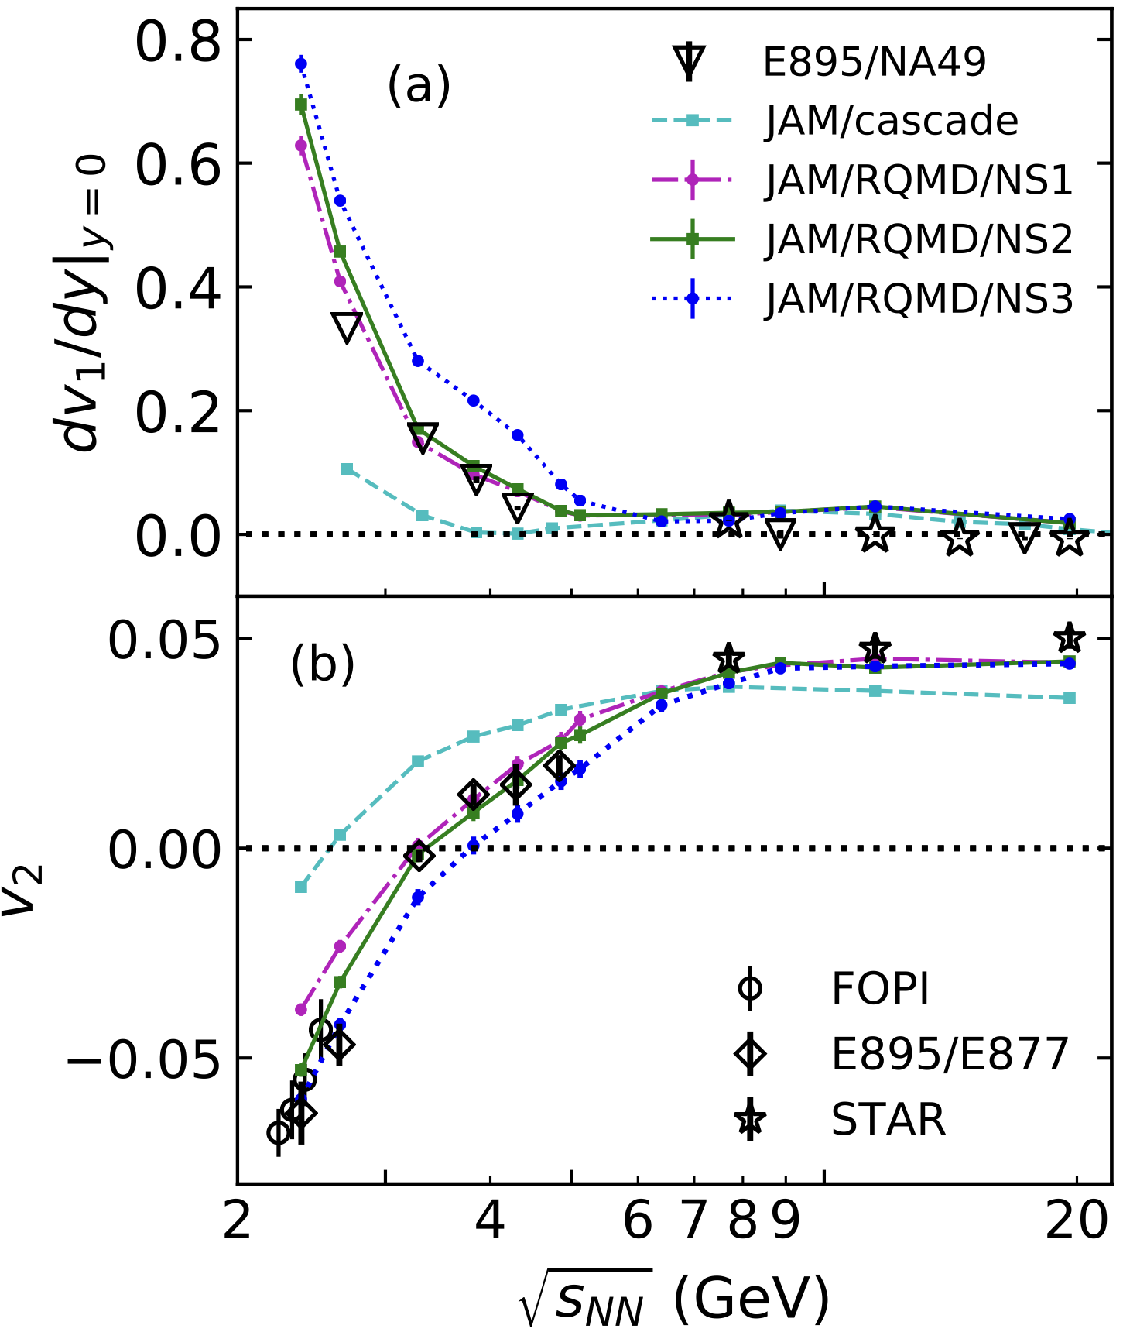
Anisotropic flow study at $\sqrt{s_{NN}}$=2-4 GeV with JAM model
Y.Nara, et al., Phys. Rev. C 100, 054902 (2019)
To study energy dependence of $v_{n}$, JAM microscopic model was selected (ver. 1.90597)
NN collisions are simulated by:
$\sqrt{s_{NN}}$<4 GeV: resonance production
4<$\sqrt{s_{NN}}$<50 GeV: soft string excitations
$\sqrt{s_{NN}}$>10 GeV: minijet production
We use RQMD with relativistic mean-field theory (non-linear $σ$-$ω$ model) implemented in JAM model
Different EOS were used:
MD2 (momentum-dependent potential): $K$=380 MeV, $m^{∗}/m$=0.65, $U_{opt}\left(∞\right)$=30
MD4 (momentum-dependent potential): $K$=210 MeV, $m^{∗}/m$=0.83, $U_{opt}\left(∞\right)$=67
NS1: $K$=380 MeV, $m^{∗}/m$=0.83, $U_{opt}\left(∞\right)$=95
NS2: $K$=210 MeV, $m^{∗}/m$=0.83, $U_{opt}\left(∞\right)$=98
Y.Nara, T.Maruyama, H.Stoecker Phys. Rev. C 102, 024913 (2020)
Y.Nara, H.Stoecker Phys. Rev. C 100, 054902 (2019)

Slide 26
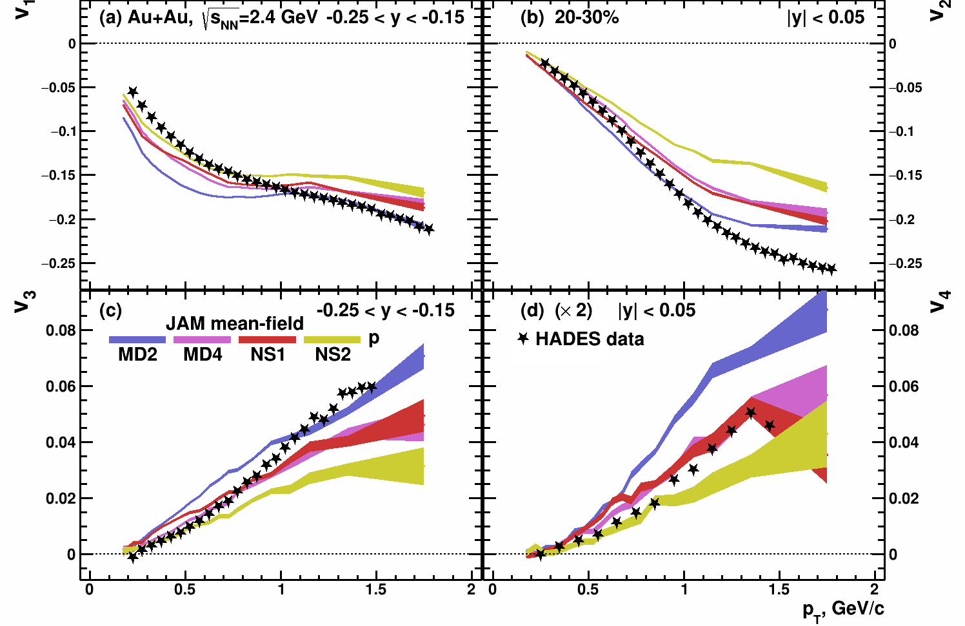
$v_{n}\left(p_{T}\right)$in Au+Au $\sqrt{s_{NN}}$=2.4 GeV: model vs. HADES data
Experimental data points:
Phys. Rev. Lett. 125 (2020) 262301
Kinematic cuts:
V_{1,3}(p_{T}): -0.25 < y < -0.15
V_{2,4}(p_{T}): -0.05 < y < 0.05
Reasonable agreement for $v_{n}(p_{T})$
$v_{3,4}$ are more sensitive to different EOS than $v_{1}$

Slide 27
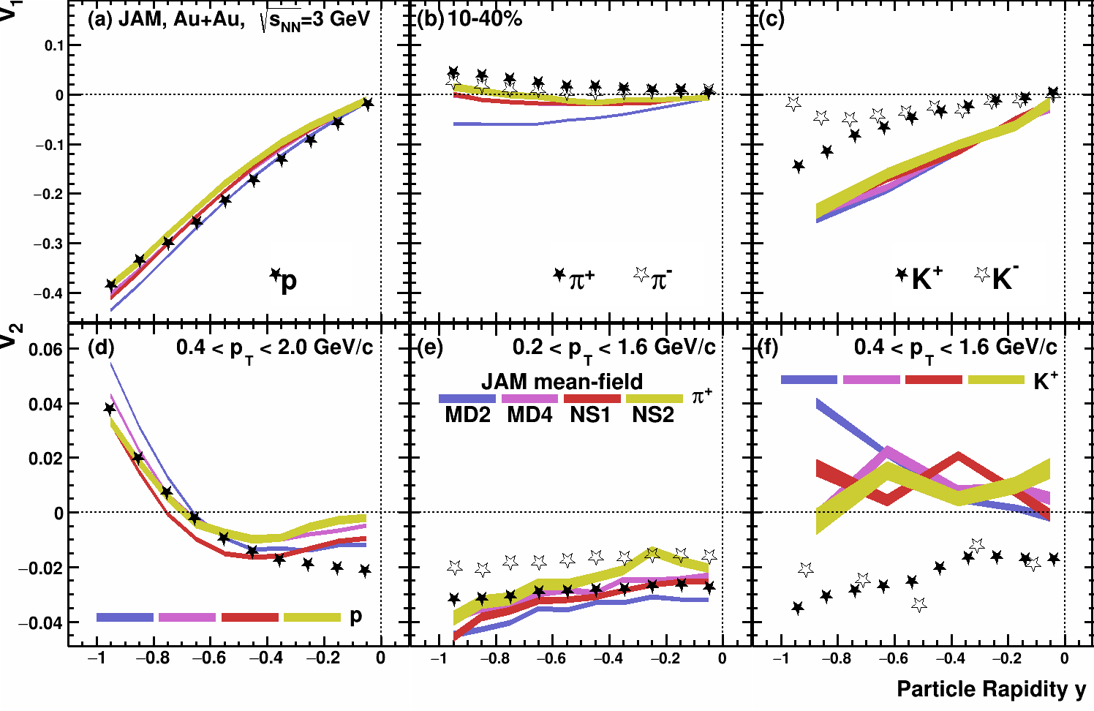
$v_{1,2}\left(y\right)$in Au+Au $\sqrt{s_{NN}}$=3 GeV: model vs. STAR data
Experimental points are taken from:
M. Abdallah et al. [STAR Collaboration] Phys.Lett.B 827 (2022) 137003
JAM does not describe all particle species equally well
$v_{1}$ of pions is most sensitive to different EOS

Slide 28
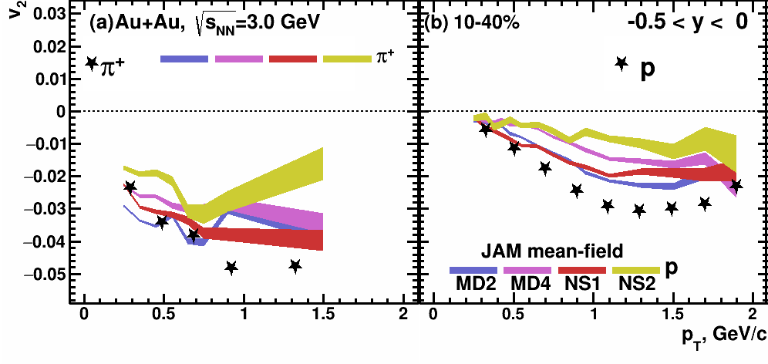
$v_{2}\left(p_{T} \right)$in Au+Au $\sqrt{s_{NN}}$=3 GeV: model vs. STAR data
$v_{2}$ of pions and protons is more sensitive to different EOS than $v_{1}$

Slide 29
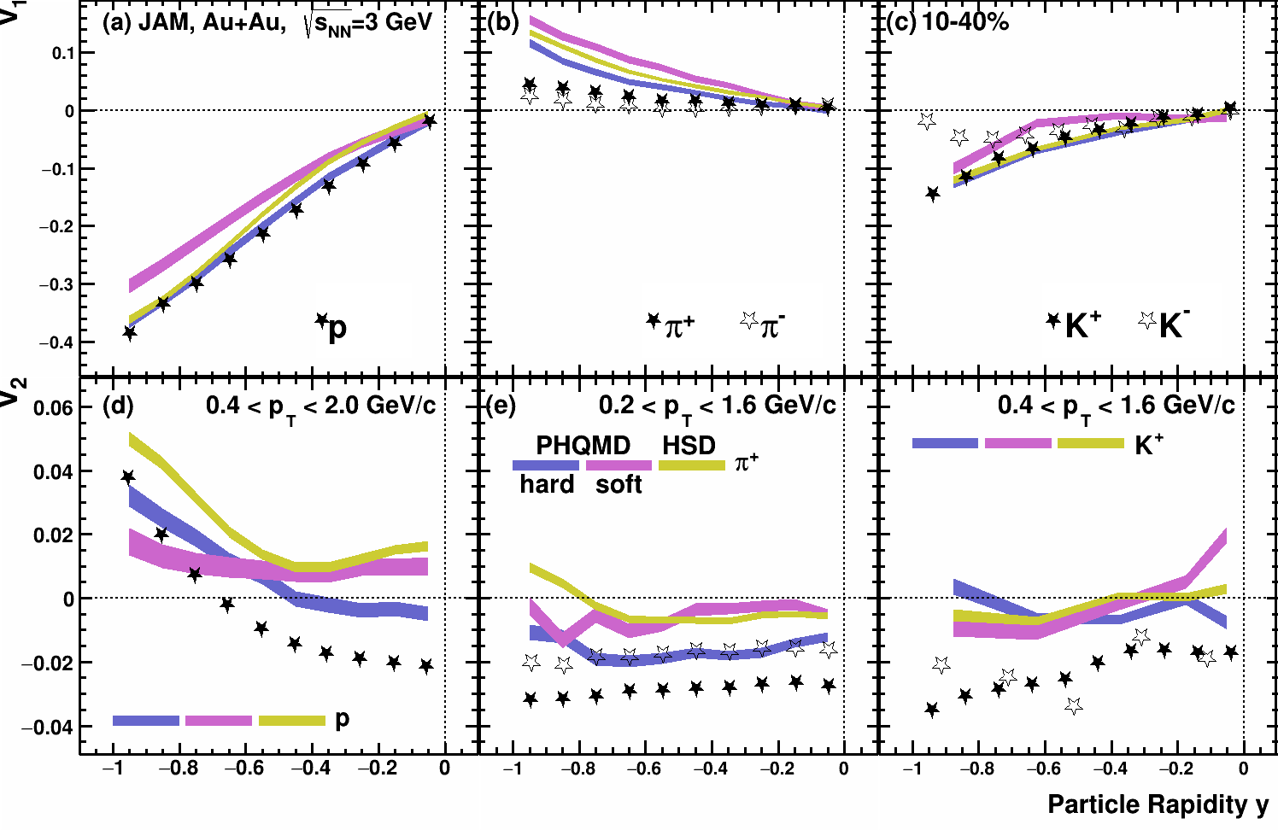
$v_{1,2}\left(y\right)$in Au+Au $\sqrt{s_{NN}}$=3 GeV: model vs. STAR data
Experimental points are taken from:
M. Abdallah et al. [STAR Collaboration] Phys.Lett.B 827 (2022) 137003
Both PHQMD and HSD cannot reproduce $v_{2}$ signal

Slide 30
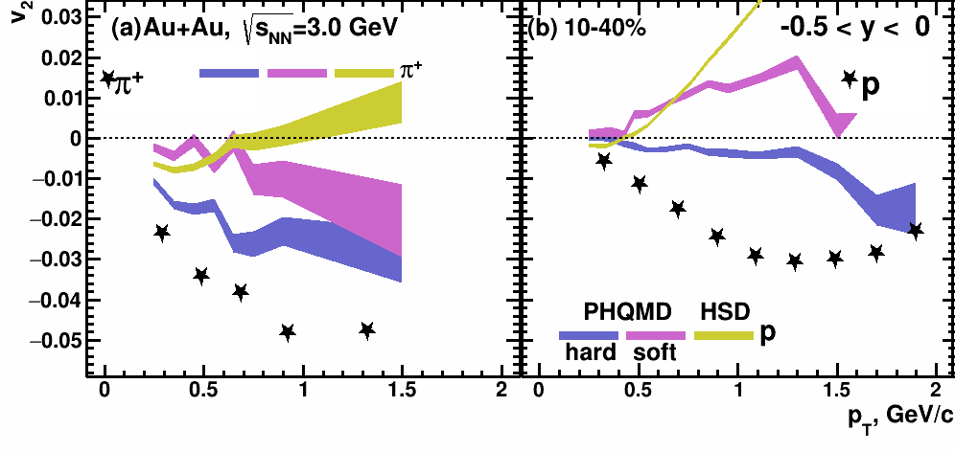
$v_{2}\left(p_{T} \right)$in Au+Au $\sqrt{s_{NN}}$=3 GeV: model vs. STAR data
PHQMD/HSD models cannot reproduce $v_{2}\left(p_{T}\right)$ of protons

Slide 31
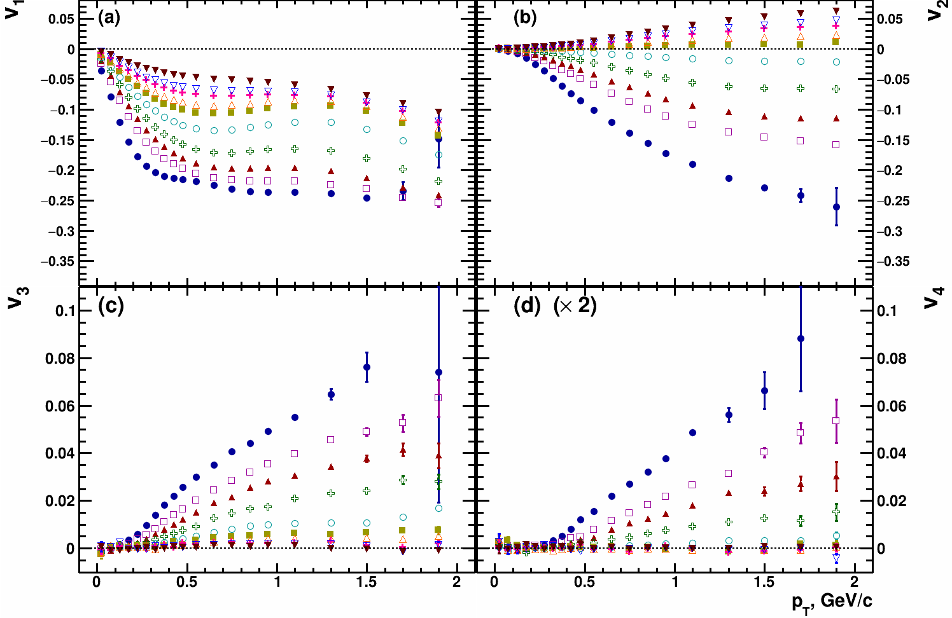
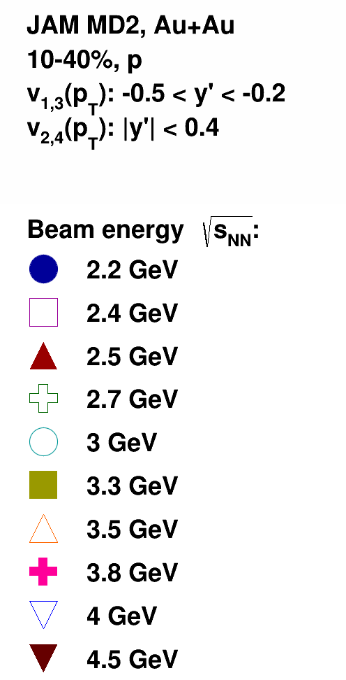
$v_{n}\left(p_{T}\right)$Au+Au $\sqrt{s_{NN}}$=2.4-4 GeV: JAM MD2
$v_{2}≈0$ in midrapirity at $\sqrt{s_{NN}}$=3.3 GeV
$\left|v_{1,3,4}\left\{Ψ_{1}\right\}\right|$ decreases with increasing collision energy
$v_{3,4}≈0$ at $\sqrt{s_{NN}}≥$ 3.3 GeV

Slide 32
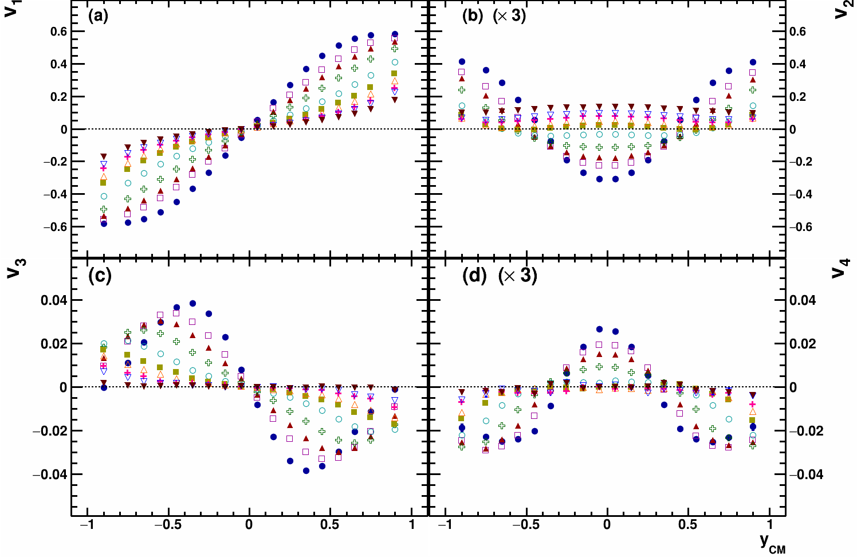
$v_{n}\left(y\right)$Au+Au $\sqrt{s_{NN}}$=2.4-4 GeV: JAM MD2
$v_{2}≈0$ in midrapirity at $\sqrt{s_{NN}}$=3.3 GeV
$\left|v_{1,3,4}\left\{Ψ_{1}\right\}\right|$ decreases with increasing collision energy
$v_{3,4}≈0$ at $\sqrt{s_{NN}}≥$ 3.3 GeV

Slide 33
$v_{n}\left(y\right)$Au+Au $\sqrt{s_{NN}}$=2.4-4 GeV: JAM MD2
$v_{2}≈0$ in midrapirity at $\sqrt{s_{NN}}$=3.3 GeV
$\left|v_{1,3,4}\left\{Ψ_{1}\right\}\right|$ decreases with increasing collision energy
$v_{3,4}≈0$ at $\sqrt{s_{NN}}≥$ 3.3 GeV

Slide 34
$y^{′}$ scaling: mean-field models
$$y^{′}=y/{y_{beam}}, t_{pass}=\frac{2R}{γ_{CM}β_{CM}}≡\frac{2R}{\sinh{y_{beam}}}$$
Scaled rapidity $y^{′}={y_{CM}}/{y_{beam}}$ dependence simplifies the energy dependence of $v_{n}\left(y\right)$ and may reflect the partial scaling of $v_{n}$ with $t_{pass}$

Slide 35
Elliptic flow at NICA energies: Models vs. Data comparison
Phys. Rev. C 103 (2021) 3, 034908
Pure String/Hadronic Cascade models give similar v₂ signal compared to STAR data for Au+Au $\sqrt{s_{NN}}$=4.5 GeV

Slide 36
Feasibility studies towards hyperon reconstruction
High statistics will enable for multidifferential measurements of (multi-) strange particles and hypernuclei
Colliding different systems may shed light on the mechanisms of strangeness production in the region of large baryon densities
Notes:
With improved tracking system we can achieve better signal to background ratio in measurements of strangeness production
Points from the slide

Slide 37
Sub-threshold multi-strange hyperons production
Kaon-nucleon strangeness exchange cross sections in UrQMD
PHQMD: J. Aichelin et al., Phys. Rev. C 101 (2020) 044905
Phys.Rev.C 90 (2014) 064909
Subthreshold production of multi-strange hyperons is sensitive to the EOS
Notes:
One of such observables is subthreshold production of multi-strange baryons.
The energy of the collision is relatively small and multi-strange hyperon cannot be produced in a direct nucleon-nucleon collision.
The mechanisms of the production involves the strangeness exchange. The hyperon is roughly speaking assembled in multiple rescatterings of hadrons within the overlap region.
On the left picture the cross-section of the reaction of strangeness exchange for different hyperons is presented as a function of sub-threshold energy.
The higher the density within the overlap region, the higher the probability of strangeness exchange and thus the higher the yield of produced hyperons.
Soft EOS allows for hadrons to be tightly packed together and we expect to see higher yields of multi-strange hyperons.
On the right picture the ratio of the yields of soft over hard EOS is presented for different particles. As you can see the difference can reach up to 2.5.
So, subthreshold production of hyperons is sensitive to the EOS

Slide 38
Hypernuclei production: Y-N interaction
arXiv:2209.05009v1
Enhanced yield of hypernuclei is expected at the beam energies of BM@N
Studying the Y-N interactions may help to establish the properties of dense matter
Notes:
At the beam energies of Nuclotron enhanced yield of hypernuclei is expected. Hypernucleus is a nucleus with one or multiple neutrons replaced by lambda-hyperons
Studying the characteristics of this nuclei for example, a lifetime we can study the hyperon-nucleon interaction.
This may shed light on the properties of dense matter within the core of neutron stars
On the right picture the double ratio of yields of hyper-triton to helium to lamdas over protons is presented
This ratio can constrain the bounding energy of hyper-nucleon system

Slide 39
Independent centrality estimation sources
HADES; Phys.Rev.C 102 (2020) 2, 024914
Projectile spectators can be utilized to estimate centrality independently to the multiplicity of the produced particles thus avoiding possible autocorrelations
A number of produced protons is stronger correlated with the number of produced particles (track & RPC+TOF hits) than with the total charge of spectator fragments (FW)
Notes:
The first thing a decent experiment needs is centrality estimation since a lot of observables depend on geometry of the collision
We can’t measure the impact parameter directly, so we can only determine centrality via values correlated with impact parameter: either number of produced particles or number of projectile spectators
The first method is classic and widely used in multiple experiments. Although it has a drawbacks such as this estimation may be source of autocorrelations
The HADES collaboration have shown …
The procedure of centrality estimation based on FHCal energy is now being developed in BM@N

Slide 40
MC-Glauber based centrality framework
MC Glauber data
Evaluate N_{a}:
N_{a} = fN_{part}+(1-f)N_{coll}
Call
NBD(μ,k) x N_{a}
Evaluate χ²
Build multiplicity
fitting function
Input multiplicity
distribution
Minimize χ² to find
f, μ, k
NBD – negative binomial distribution
Parameters of the fit:
f – fraction of the production from the soft component
μ – mean multiplicity value
k – width of the multiplicity distribution, can be connected to the fluctuations
This centrality procedure was used in CBM, NA49, and NA61/SHINE:
I. Segal, et al., J.Phys.Conf.Ser. 1690 (2020) 1, 012107
Implemantation for MPD and BM@N: https://github.com/FlowNICA/CentralityFramework
P. Parfenov, et al., Particles. 2021; 4(2):275-287
Notes:
This slide shows the main usage steps of centrality framework based on MC-Glauber
in the first step, events are generated by the Monte Carlo method according to the Woods Saxon distribution
In the next step evaluate(эвал-ю-айт) namber of anccestors and using NBD distribution build multiplicity fitting function
After that we take Input multiplicity distribution and calculate hi square
In last step we minimize hi square to find fit parameters
On the left picture ..

Slide 41
The Bayesian inversion method (Γ-fit): main assumptions
Relation between multiplicity Nch and impact parameter b is defined by the fluctuation kernel:
$$\begin{matrix}P\left(\left.N_{ch}\right|c_{b}\right)=\frac{1}{Γ\left(k\left(c_{b}\right)\right)θ^{k}}N_{ch}^{k\left(c_{b}\right)−1}e^{{−n}/θ}\end{matrix}$$
$$\begin{matrix}c_{b}=\int_{0}^{b}{P}\left(b′\right)db′≃\frac{πb^{2}}{σ_{inel}}\end{matrix}$$
– centrality based on impact parameter
The dependence of the average value of multiplicity on centrality and the results of its fit
The results of fitting the multiplicity distribution for a fixed impact parameter
Five fit parameters
R. Rogly, G. Giacalone and J. Y. Ollitrault, Phys.Rev. C98 (2018) no.2, 024902
Notes:
the ratio of the fluctuation to the average value is equal to a constant
In the ehd

Slide 42
Reconstruction of b
Normalized multiplicity distribution P(N_{ch})
$$P\left(N_{ch}\right)=\int_{0}^{1}{P\left(\left.N_{ch}\right|c_{b}\right)dc_{b}}$$
Find probability of b for fixed range of N_{ch} using Bayes’ theorem:
$$P\left(\left.b\right|n_{1}<N_{ch}<n_{2}\right)=P\left(b\right)\frac{\int_{n_{1}}^{n_{2}}{P}\left(\left.b\right|N_{ch}\right)dN_{ch}}{\int_{n_{1}}^{n_{2}}{P}\left(N_{ch}\right)dN_{ch}}$$
The Bayesian inversion method consists of 2 steps:
Fit normalized multiplicity distribution with P(N_{ch})
Construct P(b|N_{ch}) using Bayes’ theorem with
parameters from the fit
Parfenov, P., Idrisov, D., et. all. Relating Charged Particle Multiplicity to Impact Parameter
in Heavy-Ion Collisions at NICA Energies. (2021) PARTICLES, 4(2), 275-287.
Implementation in MPD and BM@N: https://github.com/Dim23/GammaFit

Slide 43
Rec R1: DCMQGCM-SMM Xe+Cs@4A GeV
F3
F2
F1
Using the additional sub-events from tracking provides a robust combination to calculate resolution
Notes:
Resolution for different groups of modules is presented on the slide
For each group we have 2 estimations which are in a good agreement between each other
We can conclude that we can reconstruct the resolution correction factor for each group without biases not correspondent to the initial asymmetry of the collision region

Slide 44
v₁: DCMQGCM-SMM Xe+Cs
Reasonable agreement between model and reconstructed data
Notes:
On the slide the comparison between signal of v1 extracted directly from model and simulation of BM@N experiment is presented.
We observe a reasonable agreement for all three energies of the collision
This suggests we can estimate the reaction plane of the collision using FHCal and use this estimation to measure flow relative to it

Slide 45
$\left|v_{2}^{int}\right|$ scaling: JAM MD2 model – Nuclotron energies
Scaling works for energy range $\sqrt{s_{NN}}=2.4−3$ GeV and breaks at $\sqrt{s_{NN}}=3.3$ GeV where $v_{2}$ changes sign

