Slide 1

Leonid Grigorenko
Flerov Laboratory of Nuclear
Reactions, JINR, Dubna, Russia
Prospects of the low-energy nuclear physics in Russia
Selected problems in the studies of light exotic nuclei.
Open questions for several extreme neutron-rich
systems – ⁴n, ⁶H, ⁷H, ²⁶O
Infinite and Finite Nuclear Matter (INFINUM-2023), BLTP, JINR, February 29 – March 3, 2023
Notes:
<номер>

Slide 2
Prospects of the low-energy
nuclear physics in Russia

Slide 3
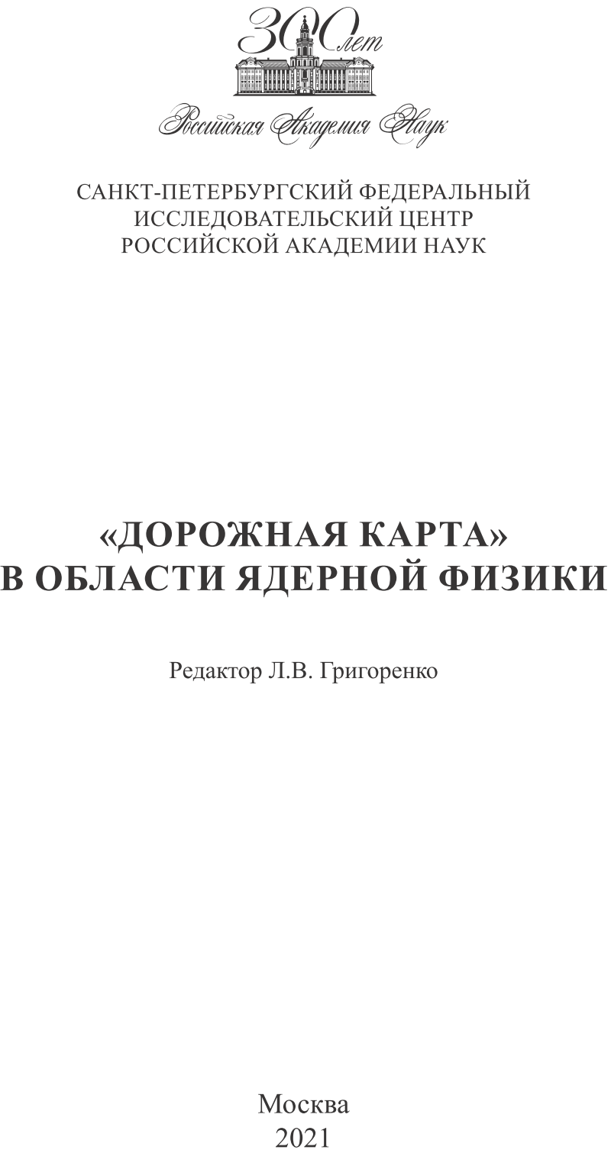
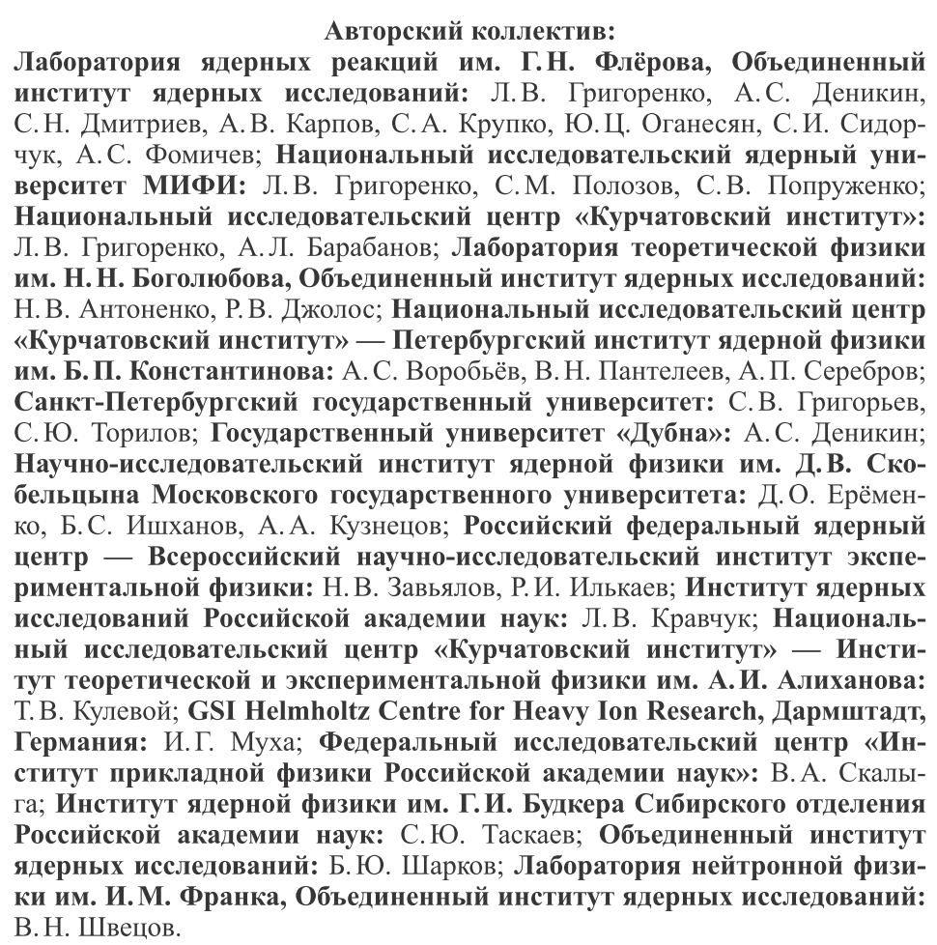
«Roadmap» in the field of low-energy nuclear physics

Slide 4
Situation in the fundamental low-energy nuclear physics
Sad overall situation
By the end of 80-th the scientific agenda with stable nuclear beams is
majorily exhausted
Aged Soviet era scientific infrastructure
Exhausting Soviet era human potential

Slide 5
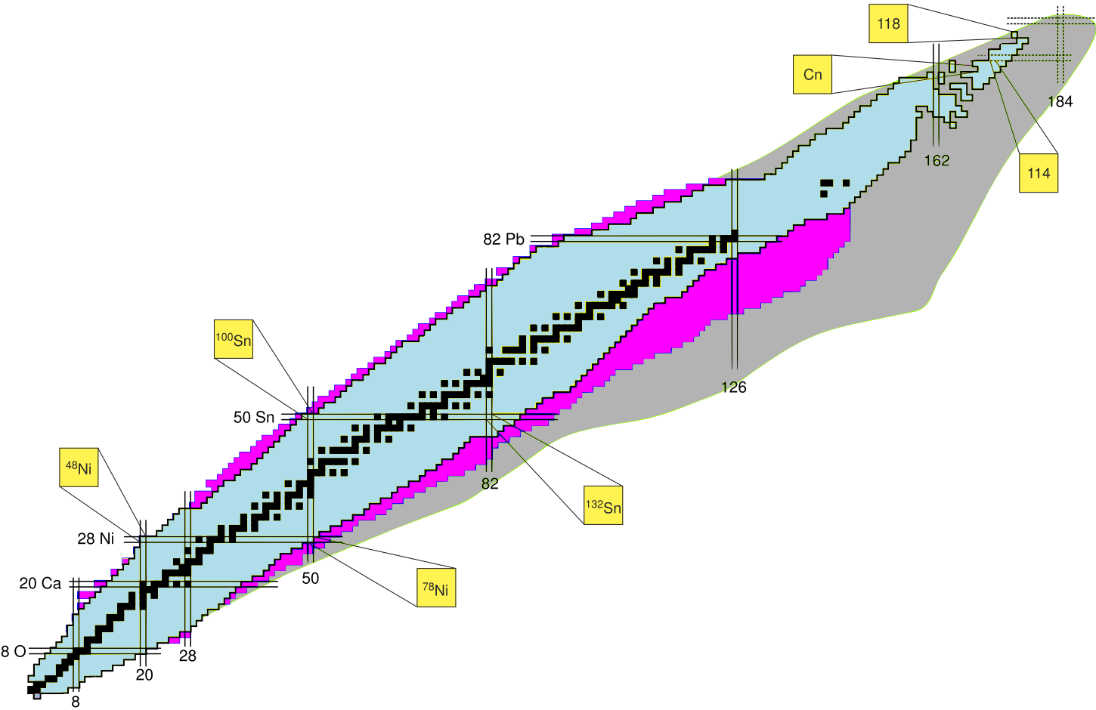
Какие фундаментальные задачи решают исследования РИ?
Карта нуклидов
- 254 стабильных изотопов,
- 339 есть в природе
- Свыше 3100 РИ известно
- Примерно 2500 не известно
Невиданно обширное поле для экстенсивного развития
Пределы существования ядерной структуры:
известны только для легчайших элементов
Протонная граница стабильности:
достигнута и изучена до Z<32
“Остров стабильности” сверхтяжелых:
коснулись краешка…
Экзотическая ядерная динамика и структура:
- Нейтронные/протонные гало
- Ядра с нейтронной «кожей»
- «Мягкие» моды возбуждения
- Разрушение стандартной
оболочечной структуры
- Новые магические числа
Нeйтротонная граница стабильности:
достигнута и изучена до N<20

Slide 6
Only largest projects (> 1 Geuro) in
the field of radioactive ion beam physics
RIBF (RIKEN) 370 AMeV in operation since 2008
SPIRAL 2 (Caen) 40 AMeV in operation since 2021
FAIR (Darmstadt) 1500 AMeV planned 2027
FRIB (MSU) 240 AMeV in operation since 2023
RAON (S.Korea) 200 AMeV planned 2025(???)
HIAF (China) 800 AMeV construction
Циклотрон КИ 35 MeV 1939 (1946)
Циклотрон МГУ 14 MeV
Циклотрон Гатчина 80 MeV 2017 (не работает)
ЛИНАК Троицк 240 МэВ (надо 1000 МэВ)
Циклотрон ЛЯР U-400 7 AMeV 1978
Циклотрон ЛЯР U-400M 40 AMeV 1988
Циклотрон ЛЯР DC-280 7 AMeV 2019

Slide 7
Situation in the fundamental low-energy nuclear physics
Sad overall situation
By the end of 80-th the scientific agenda with stable nuclear beams is
majorily exhausted
Aged Soviet era scientific infrastructure
Exhausting Soviet era human potential
Some advances
ACCULINNA-2 (FLNR)
Superheavy element factory (FLNR)
Heavy-ion irradiation center at Sarov
Participation in FAIR (Rosatom)
Prospective heavy ion research facility (DERICA?)
IRINA (PNPI)

Slide 8
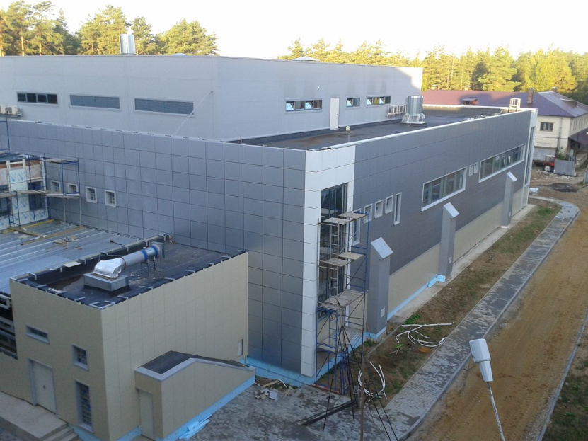
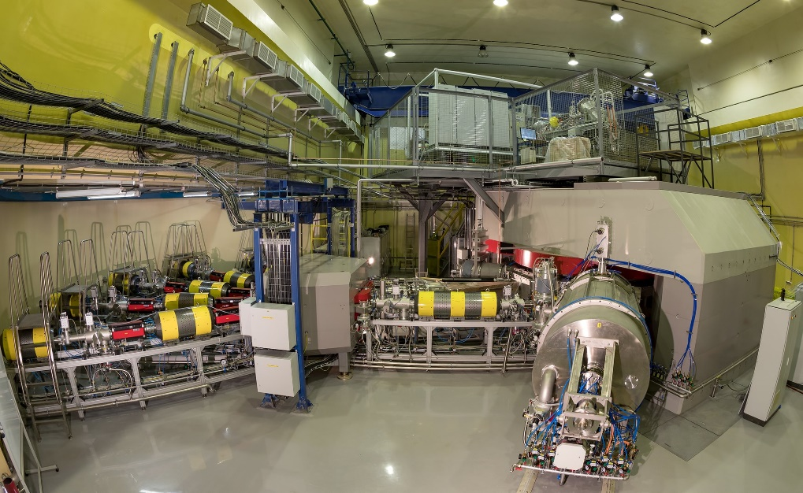
Фабрика сверхтяжелых
элементов (ЛЯР ОИЯИ)
Достижения «нобилевского класса»
Перспективы «завершить» таблицу Менделеева (Z=120)
Нишевые исследования:
Сверхтяжелые элементы

Slide 9
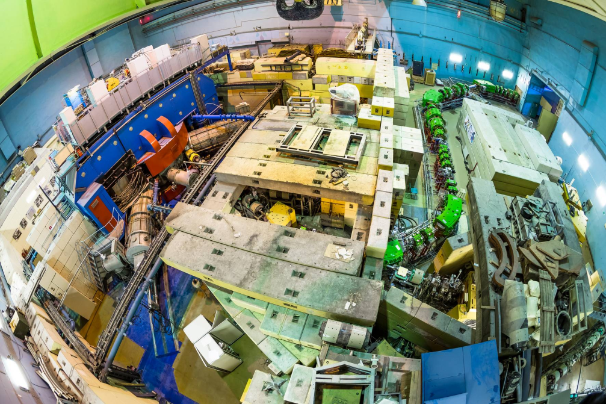
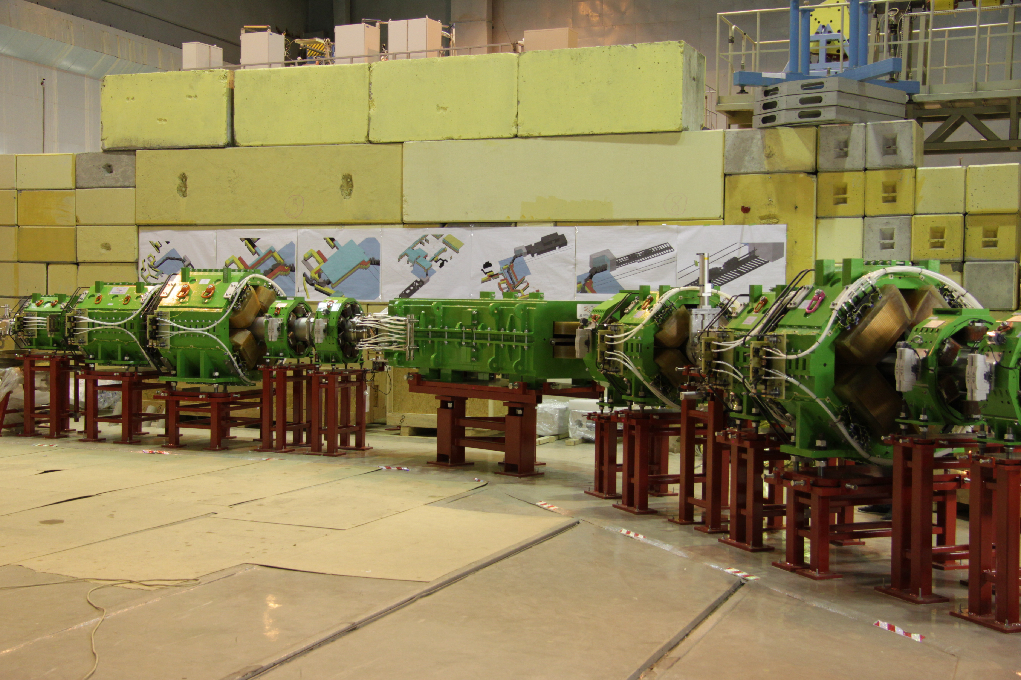
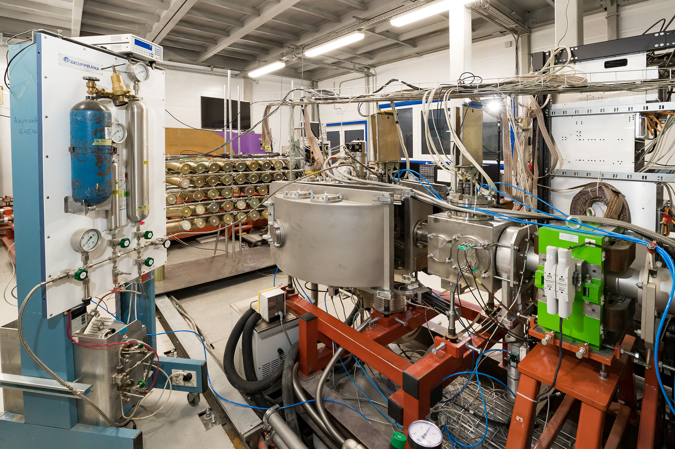
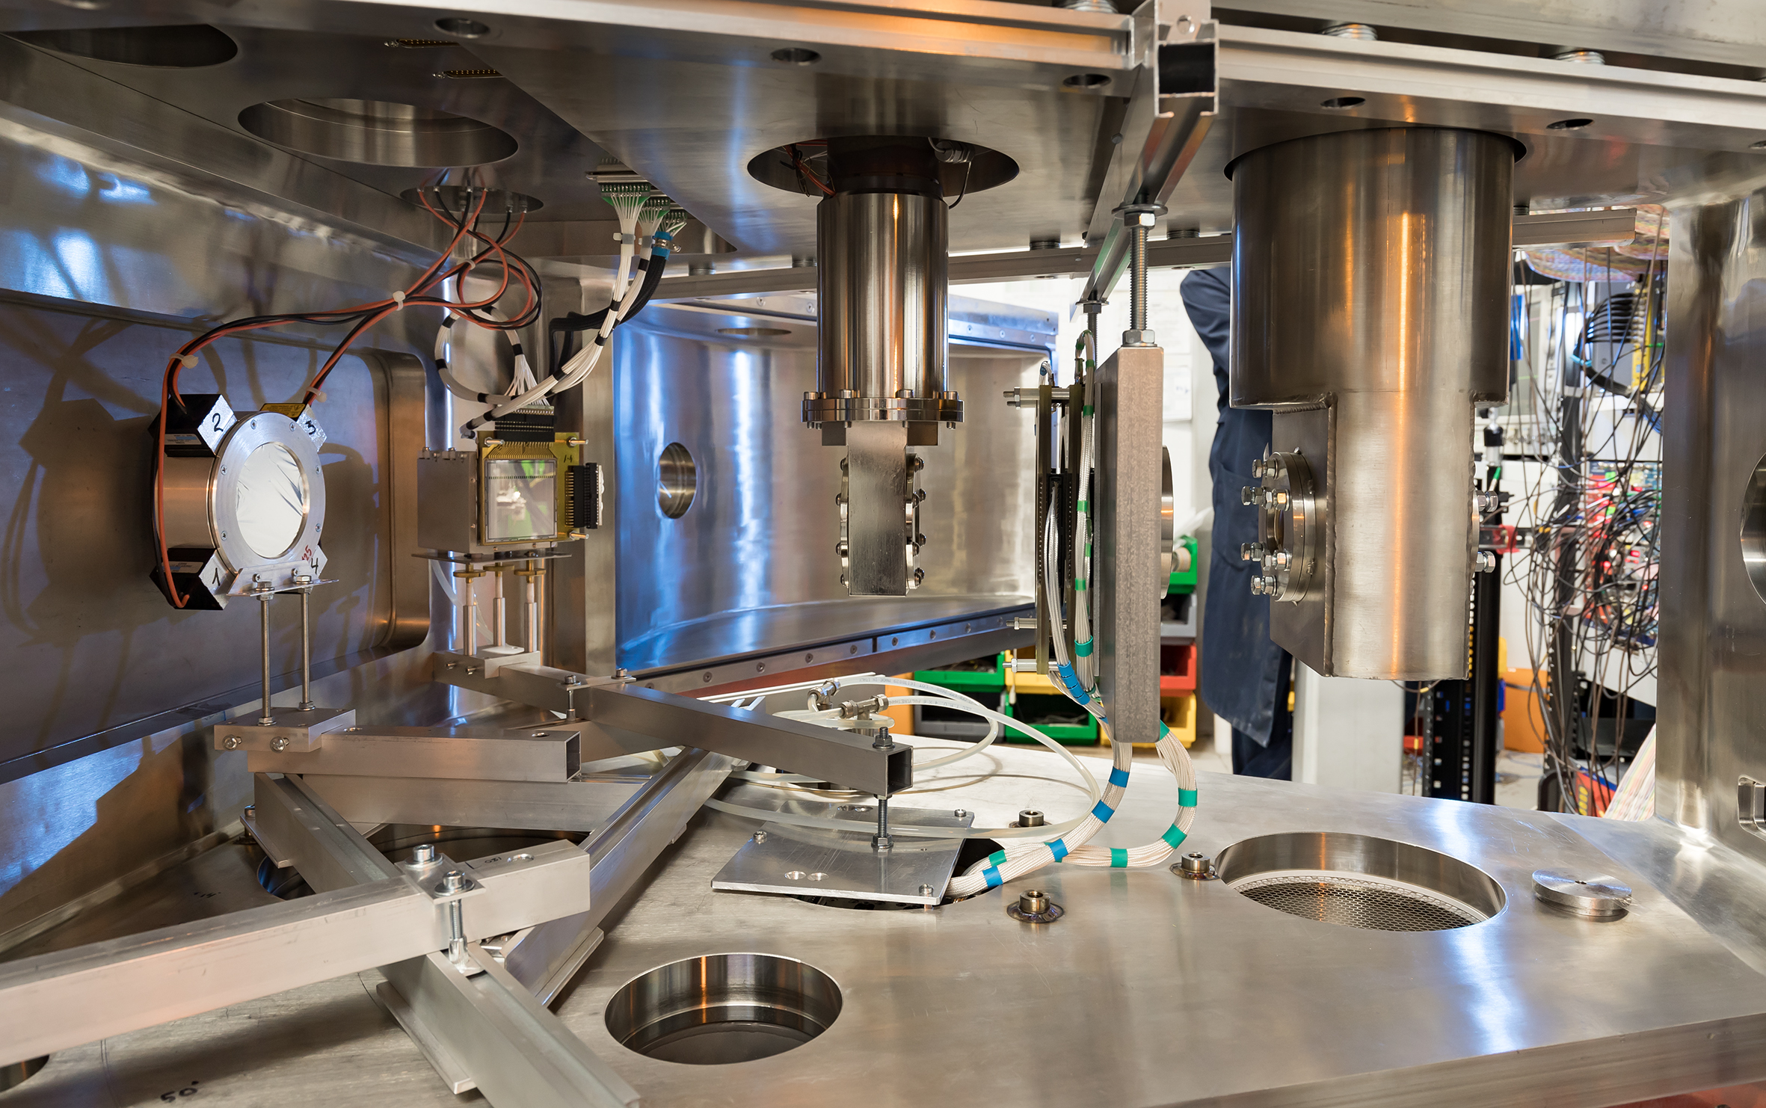
ACCULINNA-2 (ЛЯР ОИЯИ)
Программа мирового класса
Пример: решение 40-летней проблемы ⁷Н
Были бы “в топе” лет
20-25 назад
Нишевые исследования:
Легчайшие изотопы

Slide 10
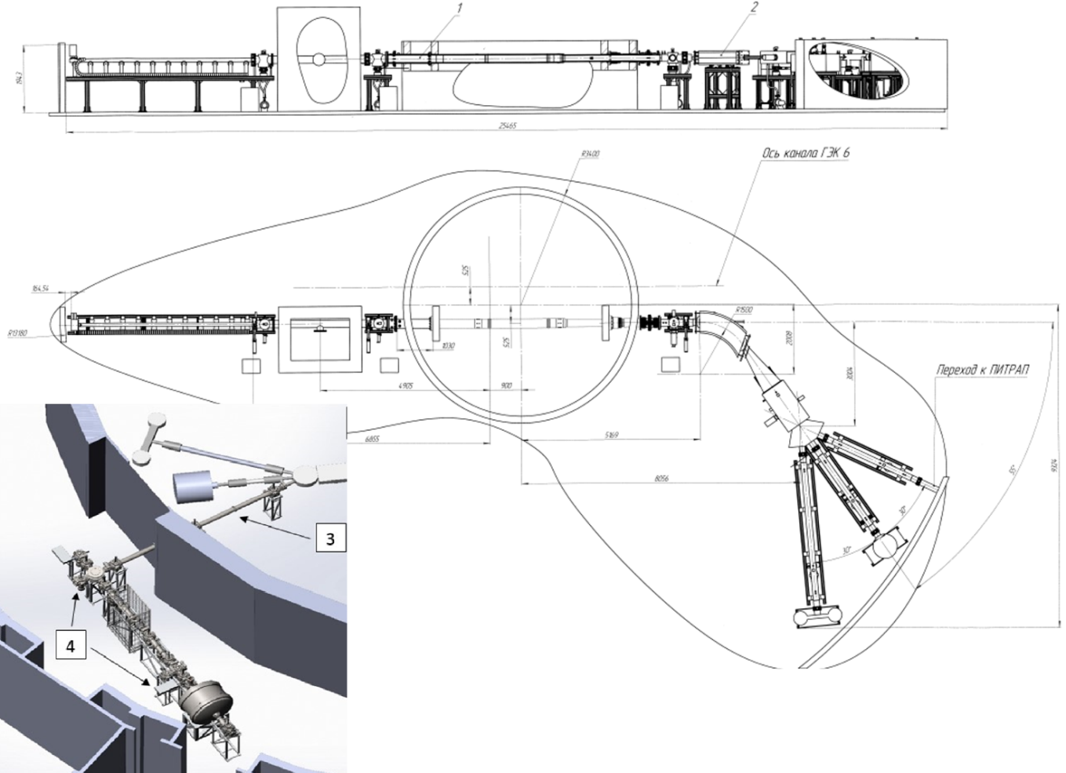
ИРИНА (ПИЯФ)
Для изотопов производимых методом ISOL – рекордные в мире интенсивности
Лучше CERN ISOLDE
В стороне от задач ПИК, мало места для научных инструментов

Slide 11
Тяжелоионный центр в ВНИИЭФ
Набор современных ускорителей
Мощный импульс к развитию тяжелоионных ускорительных технологий
Специфические задачи комплекса (тестирование электроники)

Slide 12
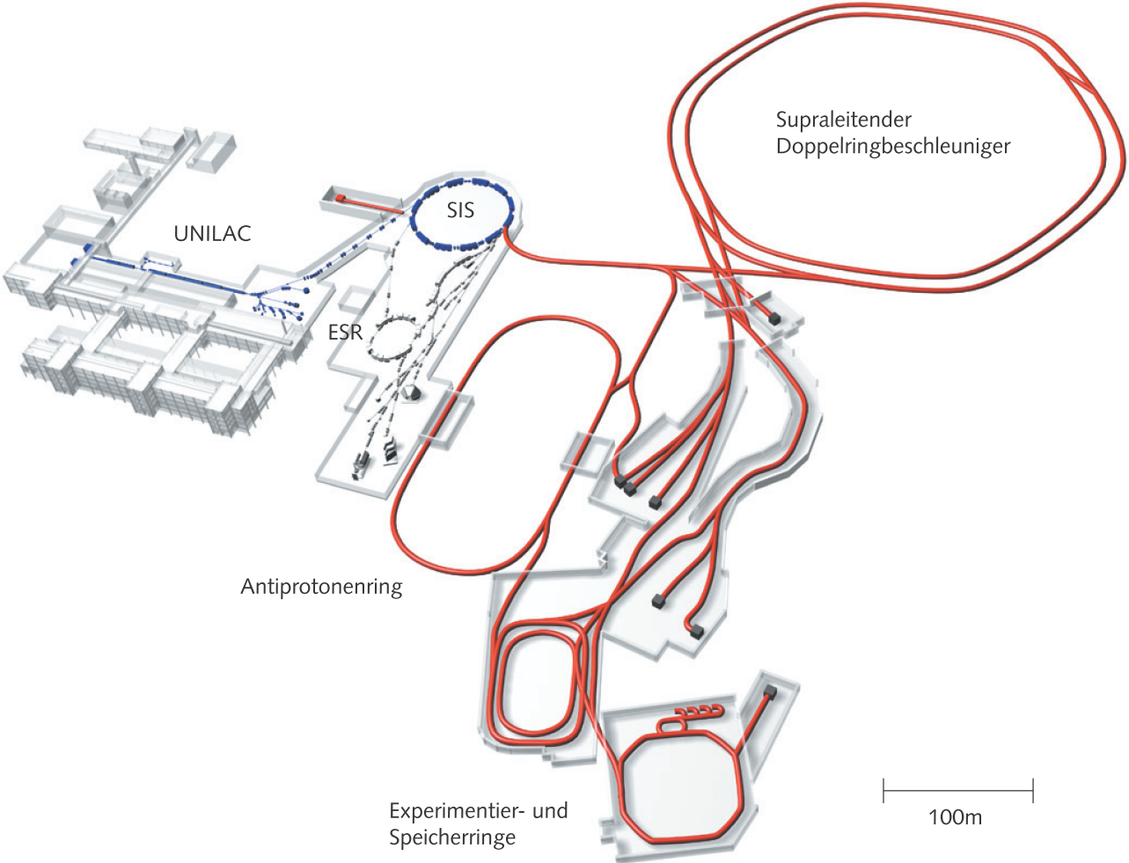
FAIR (GSI, Darmstadt)
Для сравнения
зал U-400M /
ACCULINNA-2
Когда (если) заработает то будет мировым лидером
Огромные задержки проекта и выход за смету
Русских попросили … с корабля
Важные российские “запчасти”. “Импортозамещение” займет 7-10 лет

Slide 13
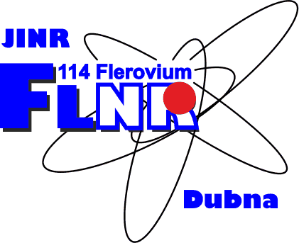

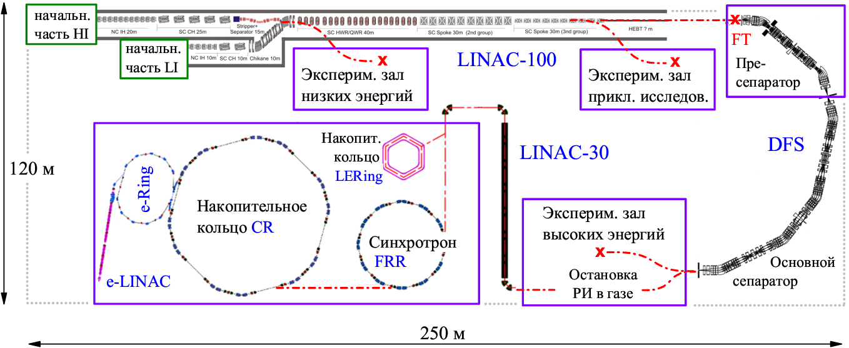
DERICA – Dubna Electron-
Radioactive Isotope Collider fAcility
Главное в проекте
Переускоренные пучки РИ, физика в накопительных кольцах e-RIB электронный коллайдер
Базовая установка
“Рекордный” высокоточный-тяжелоионный сверхпроводящий LINAC-100 непрерывного действия
Уникальная научная программа мирового класса
На ближайшие 2-3 года ключевые R&D в поддержаны рамках НЦФМ

Slide 14
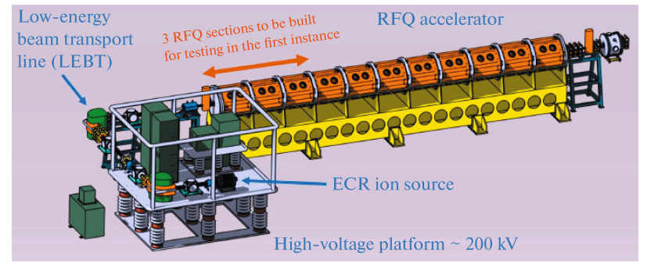
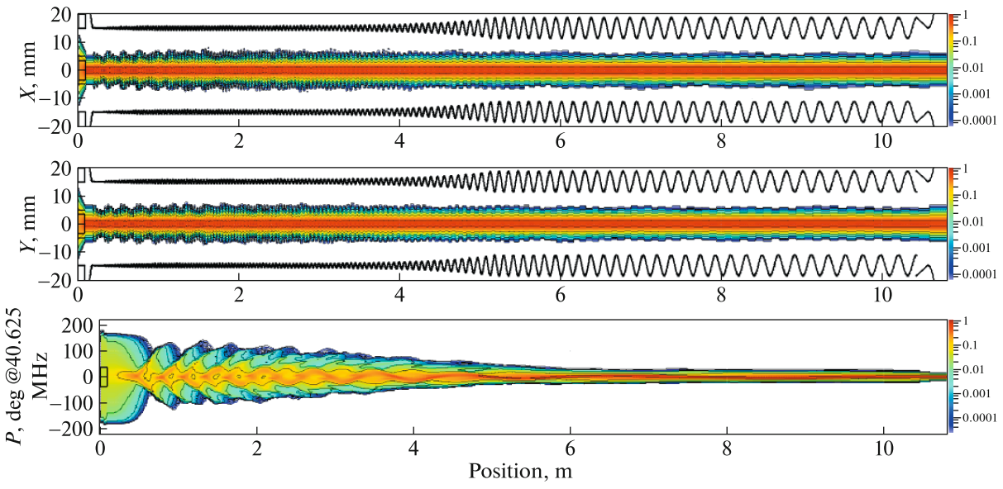
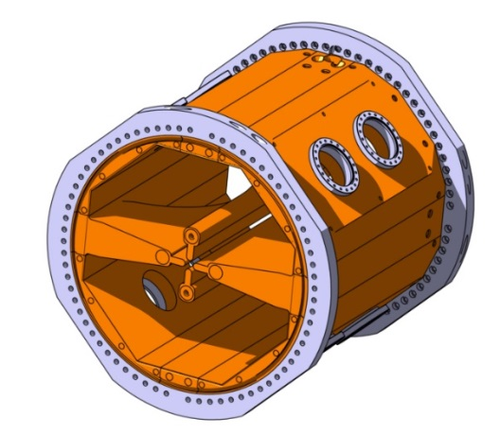
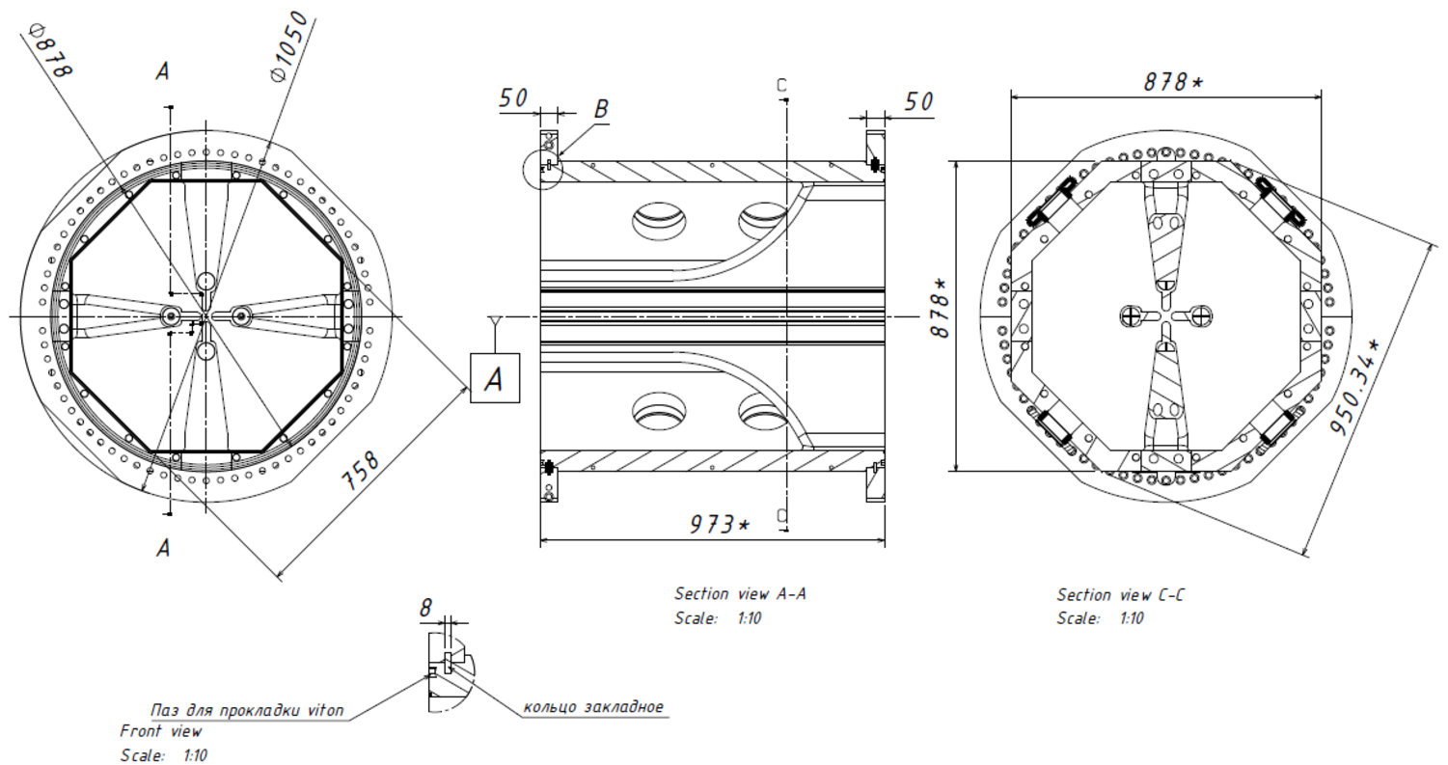
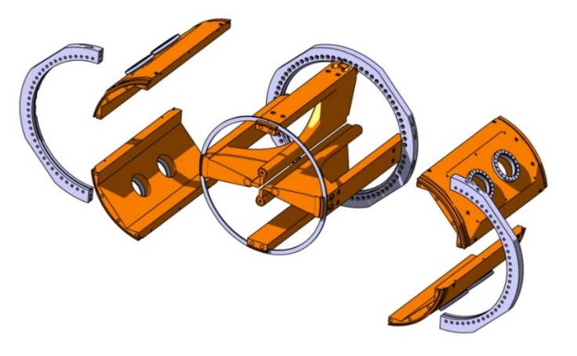
Front end LINAC-100
Challenges of LINAC-100 front end
- Ca beam ~3 emA, U beam ~1 emA
- Practically “lossless” RFQ operation
Design: T.V. Kulevoy,
G.N. Kropachev, ITEPh, Moscow
Production, VNIITF, Snezhinsk (?)

Slide 15
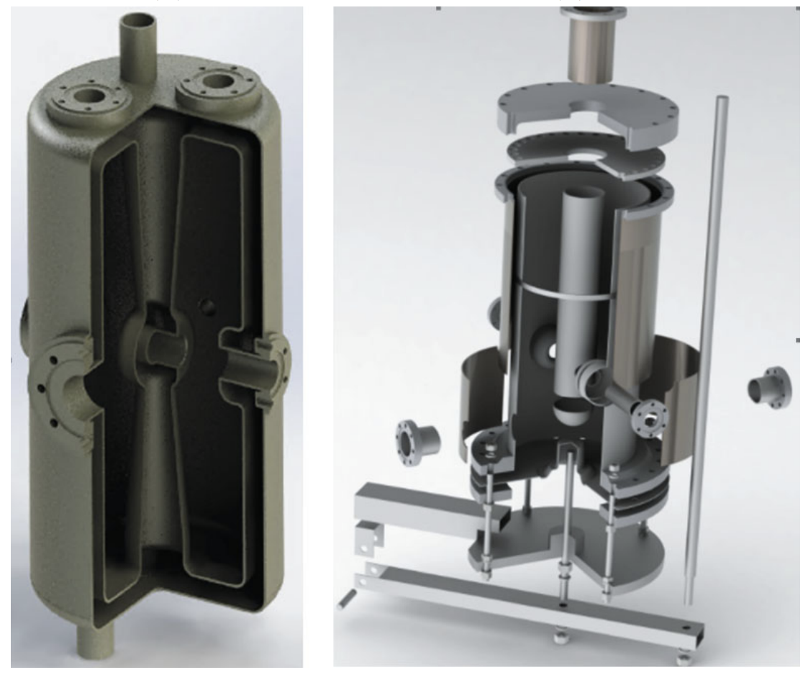
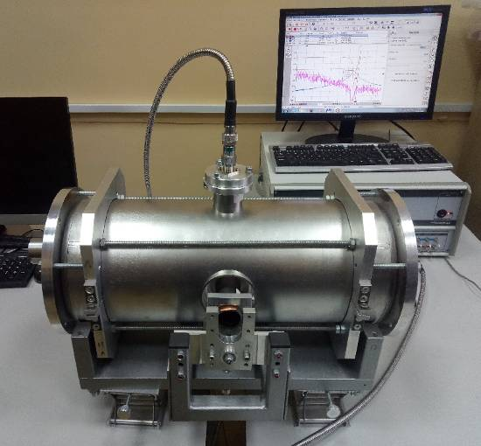
Superconducting developments for LINAC-100
Challenges of LINAC-100 design
- Ratio of normal/superconducting
- Strippers (1,2 ?), stripping energies
- Acceleration of several charge states
- One or two front ends
- Ca beam ~3 emA ~300 pμA 1500 kW beam
- U beam ~1 emA ~30 pμA 600 kW beam
- Lossless operation
Design: S.M. Polozov, MEPhI
“Recovery” of RF superconductivity technology in Russia
Production: V.G. Zelesski, FTI NAB, Minsk

Slide 16
“Big Sarov” project -
National Center for Physics and Mathematics

Slide 17
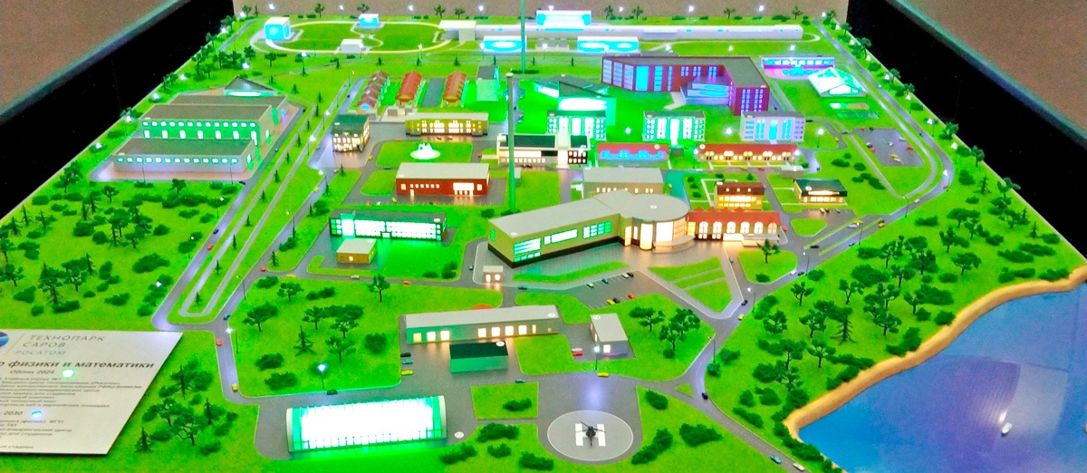
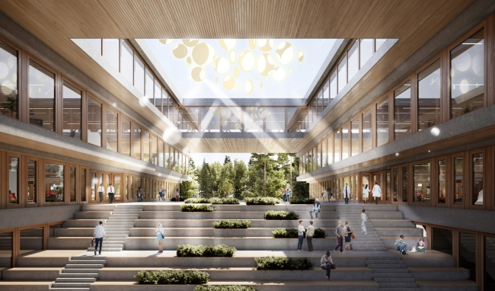
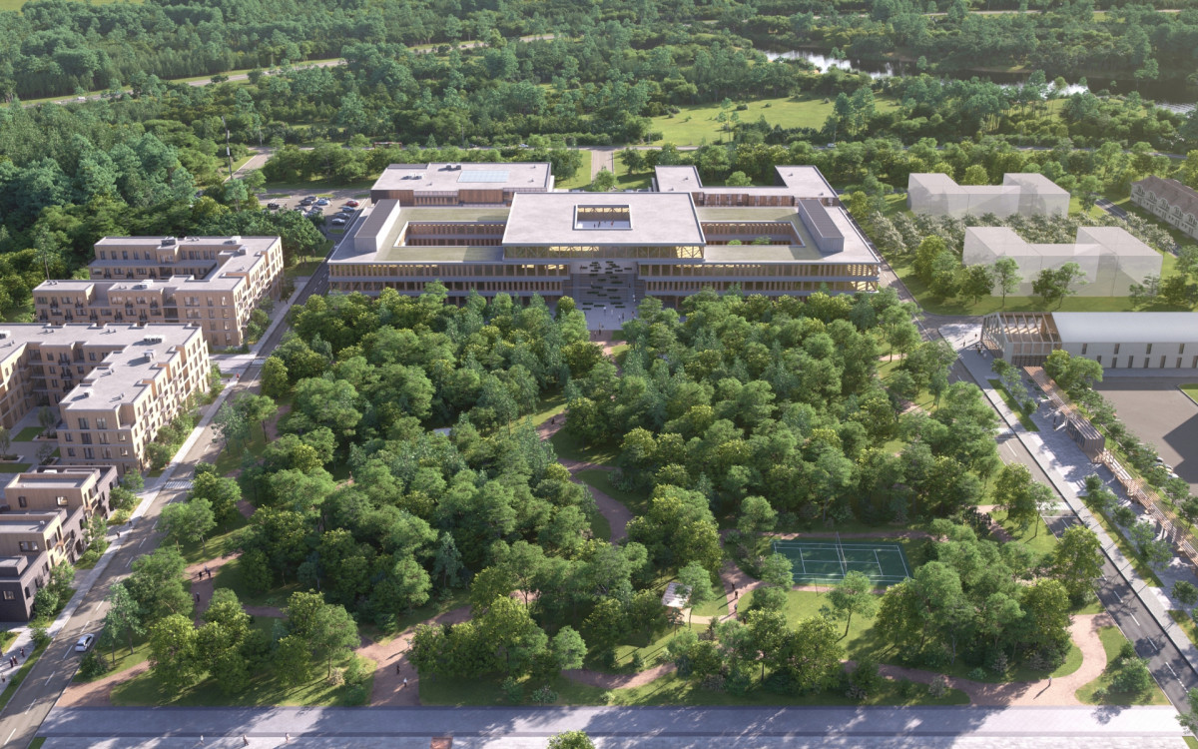
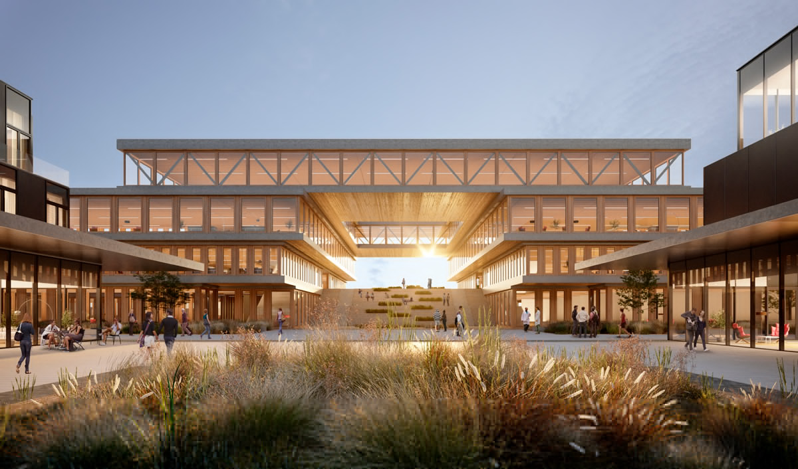
NCPM Satis (Sarov)
C-τ factory – heavy
c quark and heavy meson physics
XCELS – exawatt center for extreme light studies
Teraflop supercomputer

Slide 18
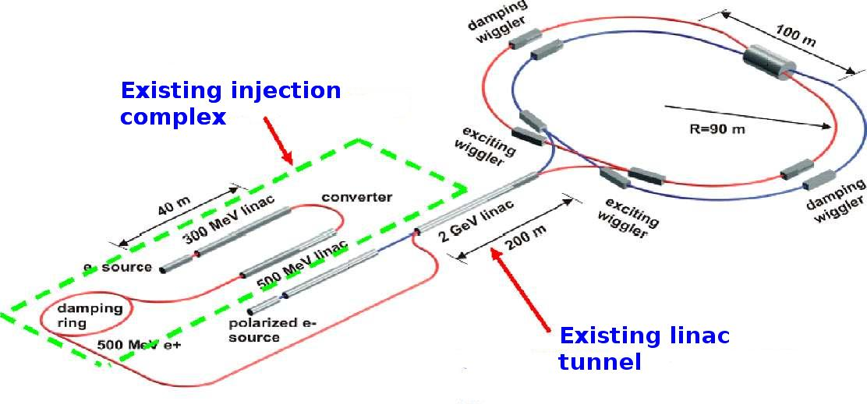
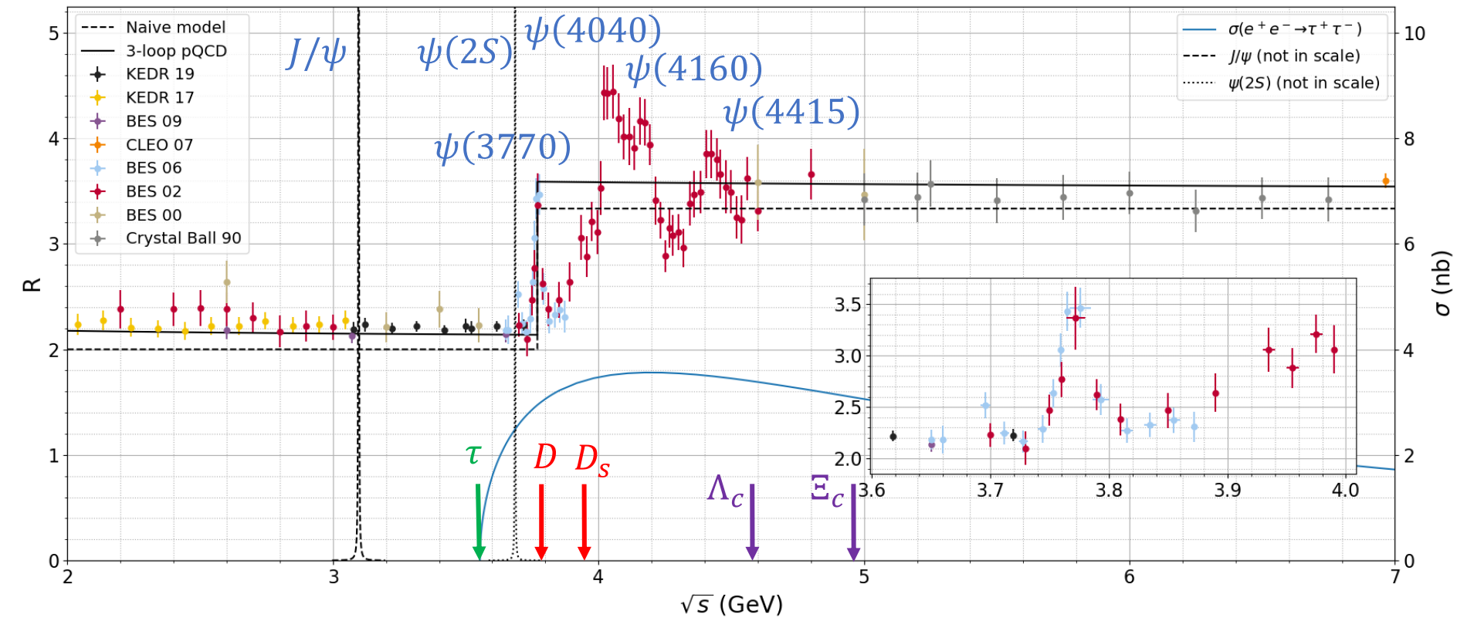
Super c-τ factory
Multifunctional
electron-positron collider
c.m. Eee+ ∼ 7 GeV
Low-cross-section and precision measuremets
Luminosity aim 2 orders of magnitude higher than at existing facilities

Slide 19
- Very expensive (~100 Grub)
- Time consuming (7-11 years)
- No infrastructure at Sarov

Slide 20
The first NCPM facility is complex of Compton sources of (quasi)monochromatic γ-radiation

Slide 21
Prospective scientific program for low-energy γ-s
Ee ∼ 50-70 MeV
Eγ < 0.1 MeV
Material science
Biology
Like synchrotron radiation source, but local scale and easy access facility
Technology / infrastructure development
Pedagogical activity to resolve staff problem of the future facilities

Slide 22
Prospective scientific program for «medium»-energy γ-s
Ee ∼ 500-1000 MeV
Eγ < 20 MeV
Brightness aim — at least 1 order of magnitude best in the world
High-precision experiments in nuclear photonics
Photodissociation for nuclear astrophysics
Nuclear spectroscopy
Isomer physics
Exotic excitation modes in the GDR energy range and above
Pigmi resonances
Fission physics
Experiments only with stable nuclides

Slide 23
Prospective scientific program for high-energy γ-s
Ee ∼ 1000-2000 MeV
Eγ < 300 MeV
High-energy compton
scattering
Hadron photonics
Not yet desided

Slide 24
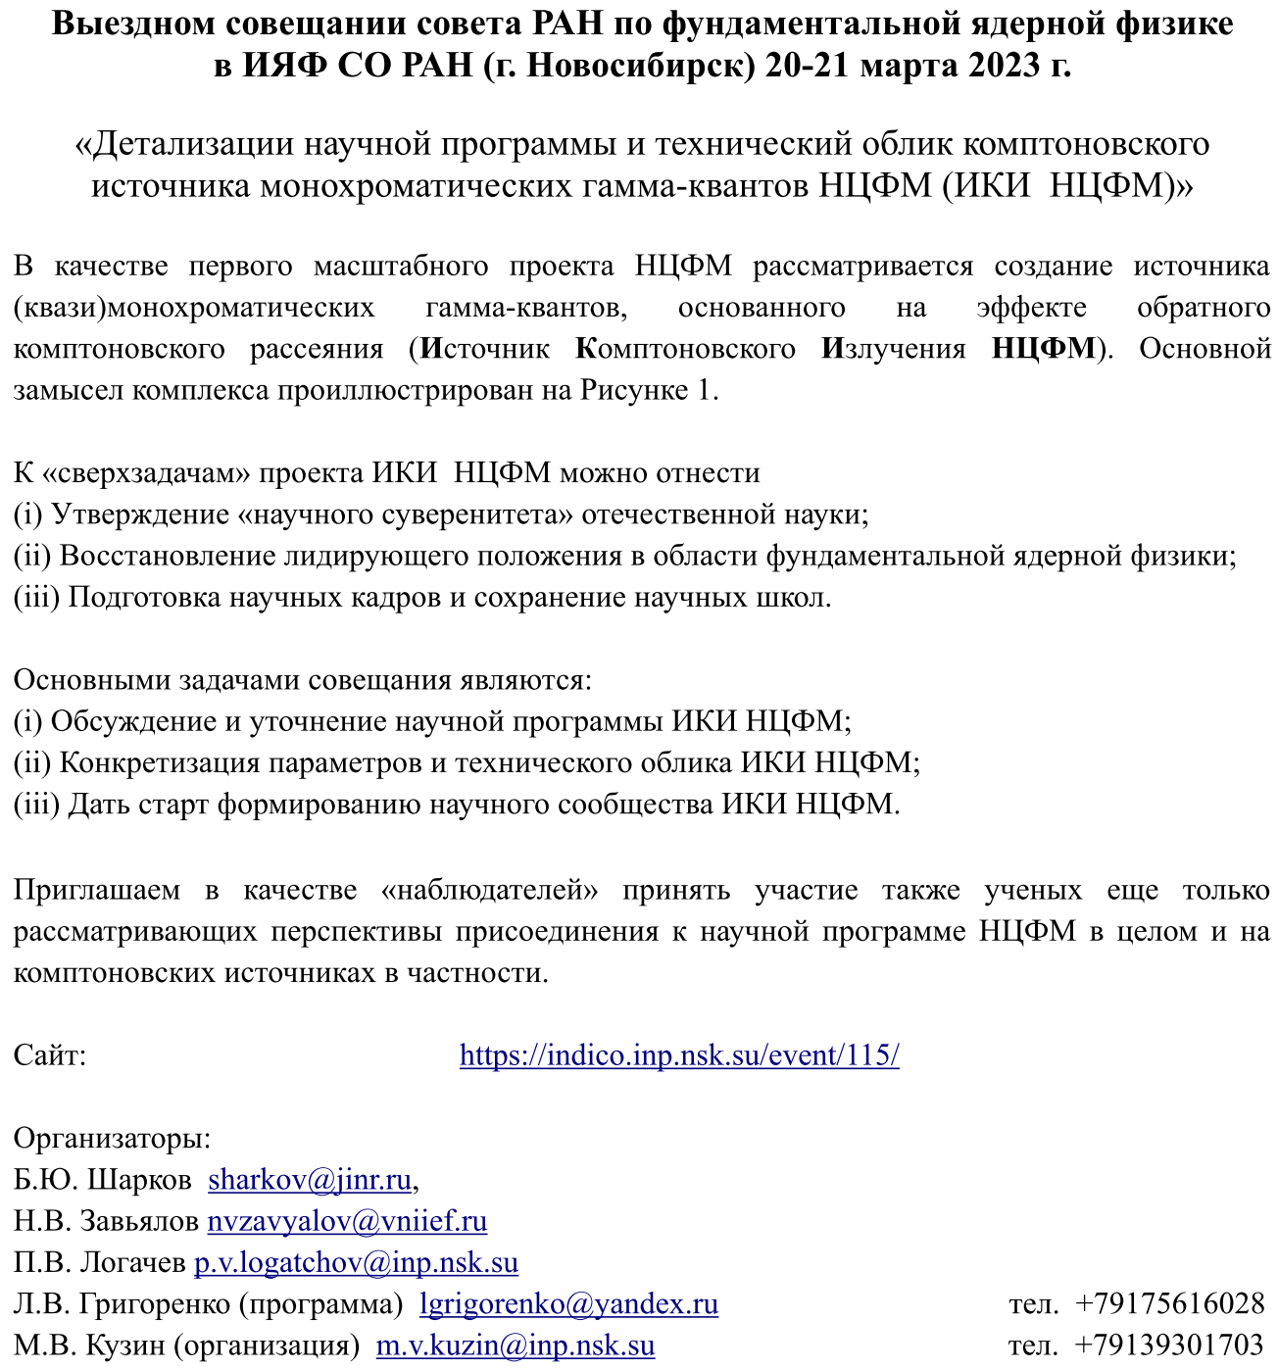
Workshop on
NCPM
Compton
source at
Novosibirsk
March 20-21

Slide 25
Conclusion
No systematic approach to the development of the fundamental low-energy nuclear physics
Several bright local projects. However, need for large-scale world-class facility
Important advances are very likely in the field of Compton sources.
Synergy with the project of c-tau factory is expected
Remineder: no systematic prospective activity is seen in the field of heavy-ion reserch….

Slide 26
DERICA – Dubna Electron-
Radioactive Isotope Collider fAcility
Главное в проекте
Переускоренные пучки РИ, физика в накопительных кольцах e-RIB электронный коллайдер
Базовая установка
“Рекордный” высокоточный-тяжелоионный сверхпроводящий LINAC-100 непрерывного действия
Уникальная научная программа мирового класса
На ближайшие 2-3 года ключевые R&D в поддержаны рамках НЦФМ

Slide 27
Selected problems in the studies
of light exotic nuclei

Slide 28
Open questions for several extreme
neutron-rich systems – ⁴n, ⁶H, ⁷H, ²⁶O
Few-body physics
- Collective motion in few-body systems
- Long-range aspect of few-body dynamics
- Specific few-body correlations and interplay of different correlation types

Slide 29
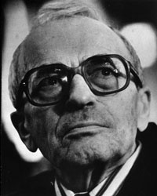
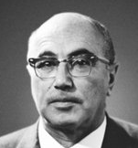

Двухпротонная радиоактивность
Zeldovich and Goldansky, 1960,
Predictions of p and 2p radioactivity
p-radioactivity – is natural generalization of
α-radioactivity
2p-radioactivity – is more complex genuine quantum mechanical phenomenon
M. Pfutzner, 2002, GSI:
2p-radioactivity of ⁴⁵Fe
About 4 decades were needed to get from predictions to investigation
Л.В. Григоренко, М.В. Жуков,
И. Томпсон, Р. Джонсон, 2000,
первая последовательная квантово-механическая теория 2p радиоактивности
Правильные теоретические расчеты сыграли критическую роль в открытии 2p радиоактивности

Slide 30
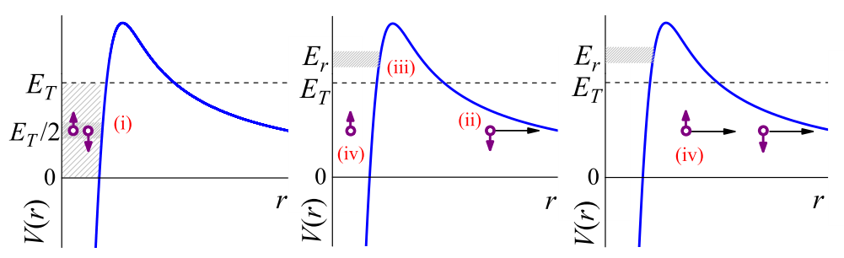
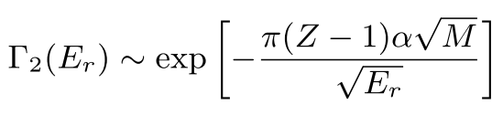
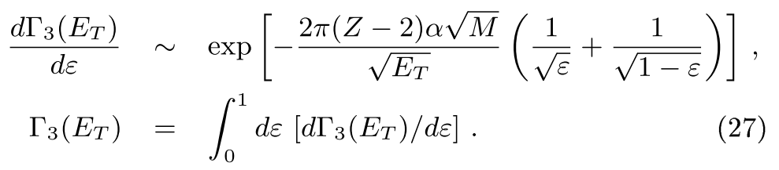
2p decay and “Goldansky-type” correlations
Proton decay
Two-proton decay. ONLY sharing of energy.
OTHERWISE protons are uncorrelated
Original estimate by Goldansky
G.N. Flerov, A.S. Ilyinov (1982)
Correlations within and beyond the vision of Goldansky

Slide 31

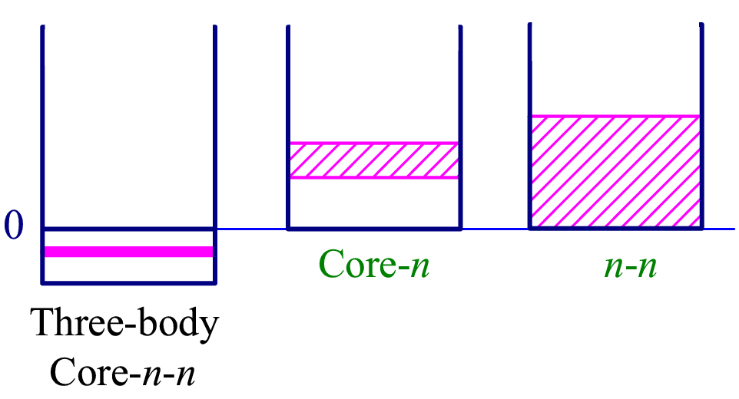
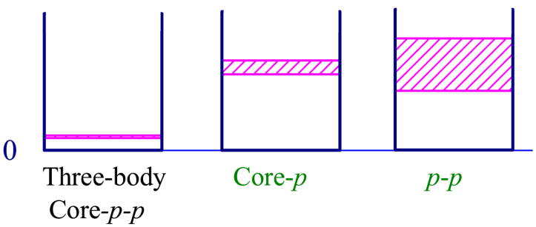
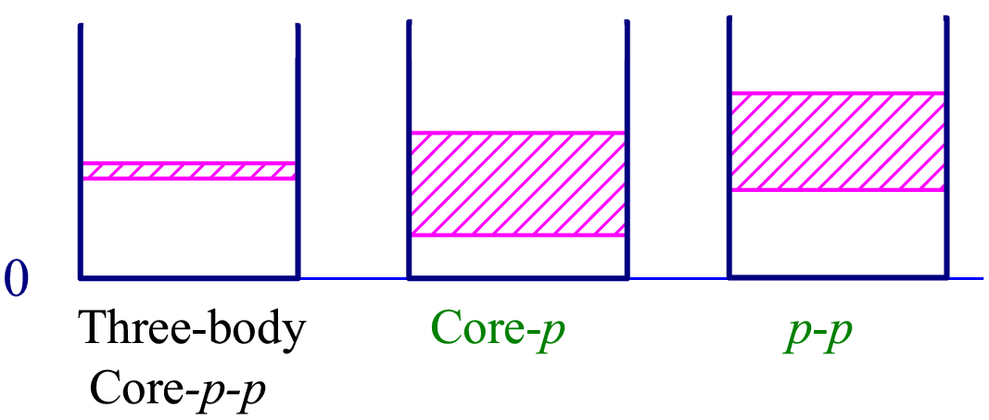
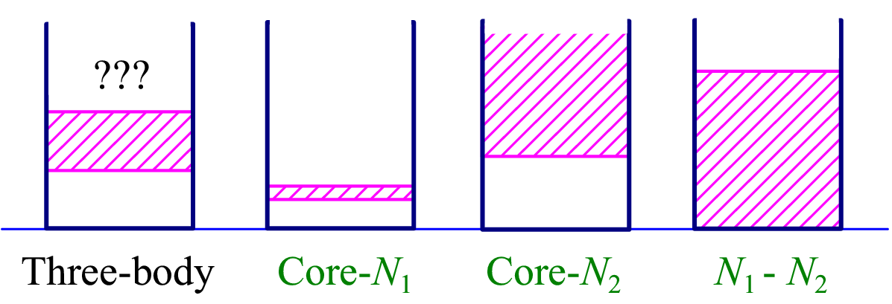
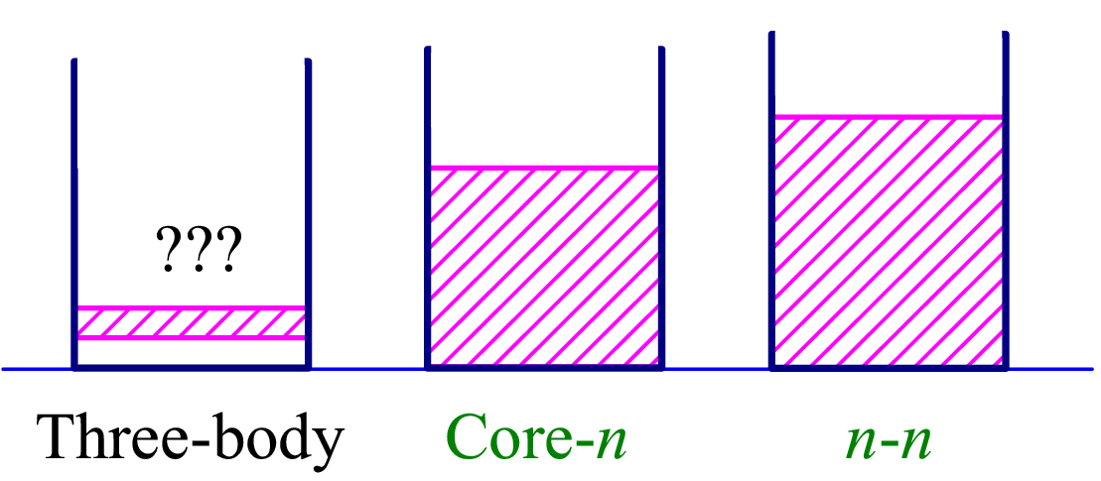
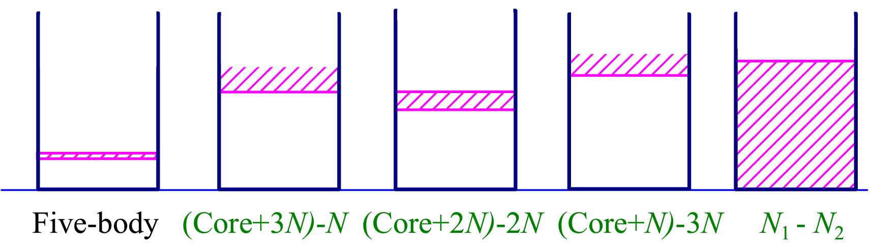
Energy conditions and few-body phenomena
Borromean 2n halo systems
2p radioactivity
True three-body decay
Democratic decays
“Soft excitations”
Three-body virtual states
True 5n-body decay (4n radioactivity)

Slide 32



Three-body decay in cluster model
Three-body Hyperspherical Harmonic method
Approximate boundary conditions of the three-body Coulomb problem
Classical extrapolation to improve momentum distributions
L.V. Grigorenko, R.C. Johnson, I.G. Mukha, I.J. Thompson, M.V. Zhukov, PRL 85 (2000) 22.
Decays:
Schrodinger equation with complex energy
“Natural” definition of width
Adopted to radioactive decay studies
Reactions:
Inhomogeneous Schrodinger equation with real energy
Source function formulation is straightforward for several types of direct reactions. E.g. for knockout reactions (⁶Be populated with ⁷Be beam):
Very precise results could be obtained for reactions with well defined “clean” mechanism.
Typical precision: stable solution for Γ/Ε_{Τ} > 10⁻³⁰
L.V. Grigorenko, Phys. of Part. and Nucl. 40 (2009) 674
M. Pfutzner, L.V. Grigorenko, M. Karny, and K. Riisager, Rev. Mod. Phys. 84 (2012) 567 [arXiv:1111.0482].

Slide 33
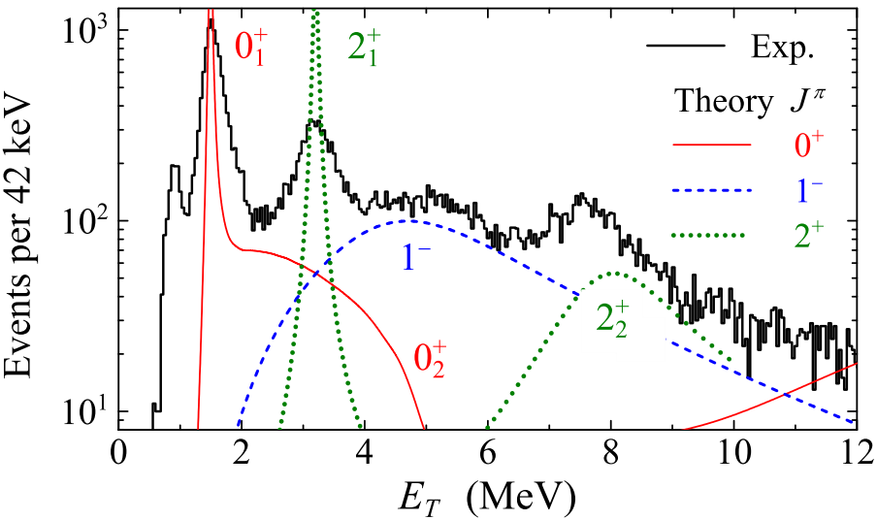
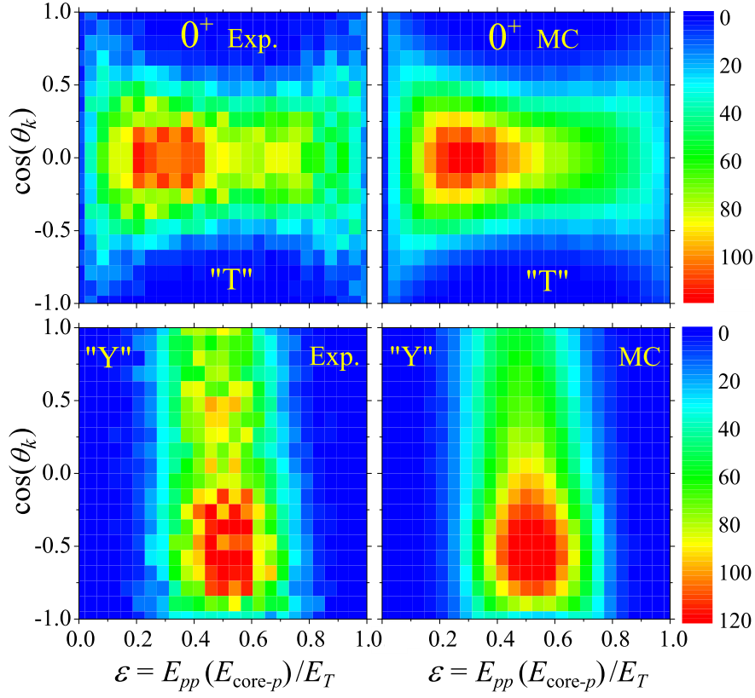
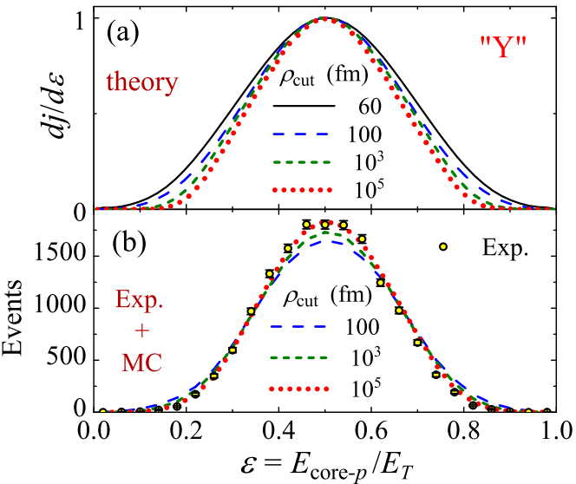
Long-range character of three-body Coulomb by example of ¹⁶Ne
¹⁶Ne g.s., E_{T} = 1.466 MeV
New level of experimental precision. MSU 2013: ¹⁶Ne populated in n knockout from ¹⁷Ne
The energy distribution in “Y” Jacobi system only reproduced for extreme range of calculation
K. Brown et al., PRL 113 (2014) 232501

Slide 34
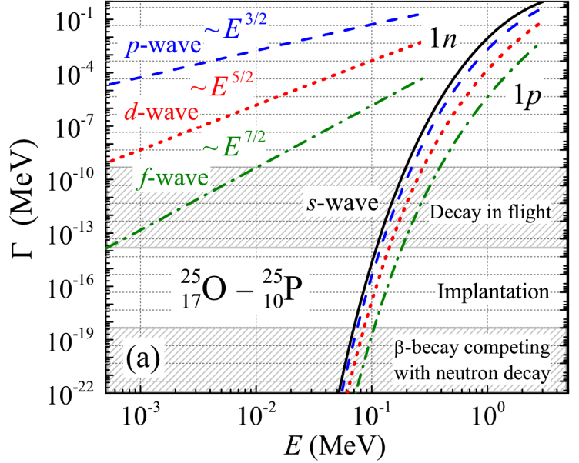
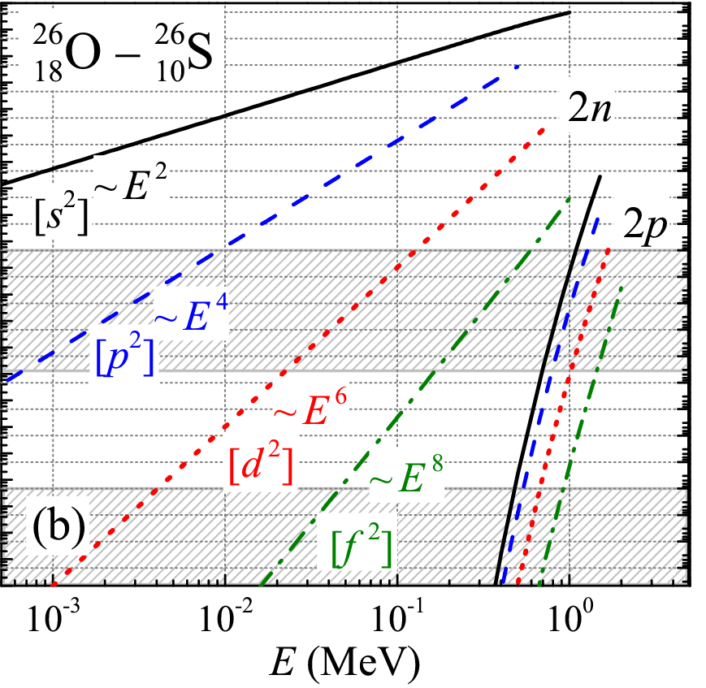
What about neutron radioactivity?
L.V. Grigorenko, I.G. Mukha, C. Scheidenberger, and M.V. Zhukov, PRC 84 (2011) 021303(R)
Since we realized that three-body “virtual state” is likely to form narrow peak…
Two-proton radioactivity is the long awaited and the most recently found
mode of the radioactive decay. Can neutron radioactivity exist?
Estimates: one-neutron radioactivity is highly unlikely.
There are additional effective few-body “centrifugal” barriers making few-body
emission relatively slower.
Long-living Two-neutron decay states are reasonably probable.

Slide 35
Collective tunneling in the hyperspherical harmonics method
Tunneling via collective (hyperspherical) barrier for A particles
For 2n emission the minimal effective HH momentum is 3/2
for minimal K=0
Lowest K=0 may be dynamically supressed due to Pauli principle
For 4n emission the minimal effective HH momentum is 15/2
for minimal K=2
K=0 is strictly prohibited due to Pauli principle

Slide 36
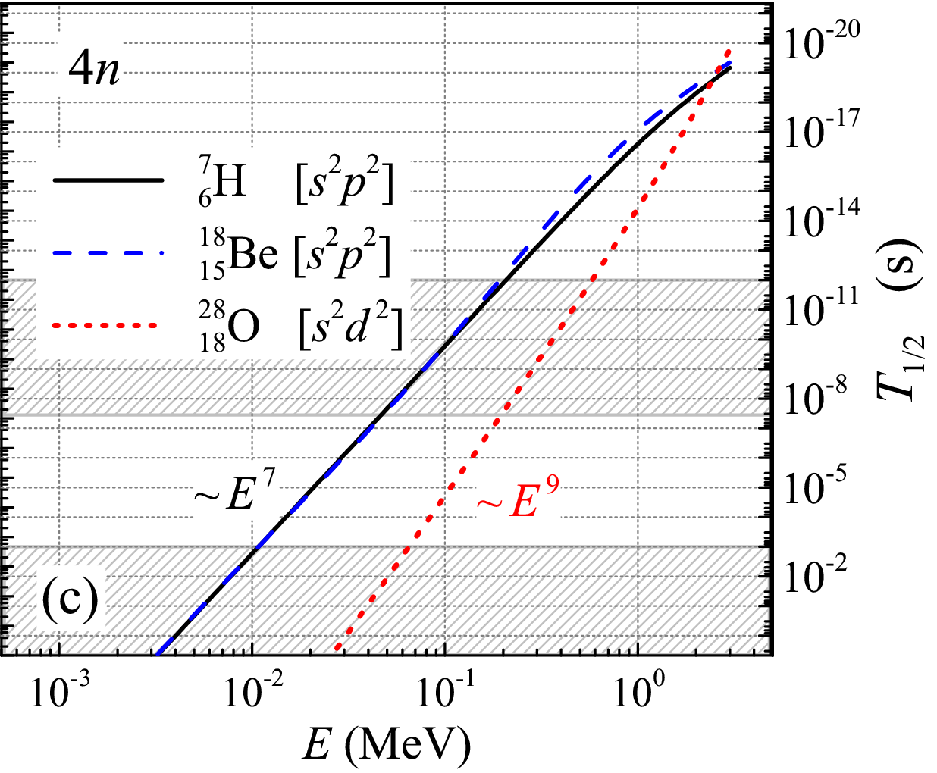
Two- (and more)-neutron radioactivity search prospects
L.V. Grigorenko, I.G. Mukha, C. Scheidenberger, and M.V. Zhukov, PRC 84 (2011) 021303(R)
Energy conditions for true 4n decay
Long-living true four-neutron decay states are most probable.
Nearest candidates for 4n radioactive decay: ⁷H, ¹⁸Be, ²⁸O

Slide 37
Quest for 2n radiactivity in ²⁶O

Slide 38
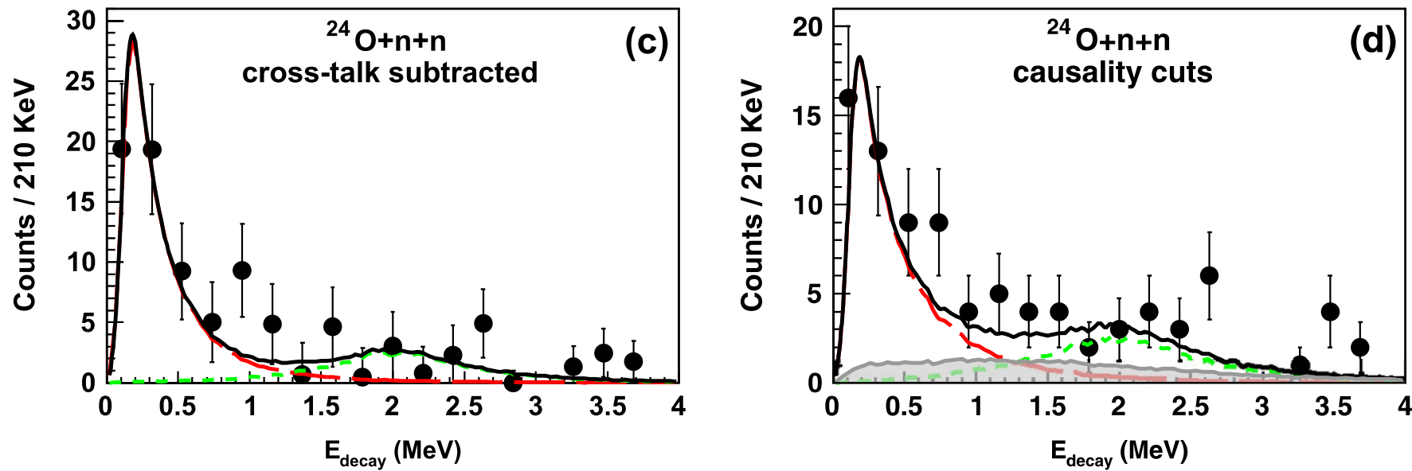
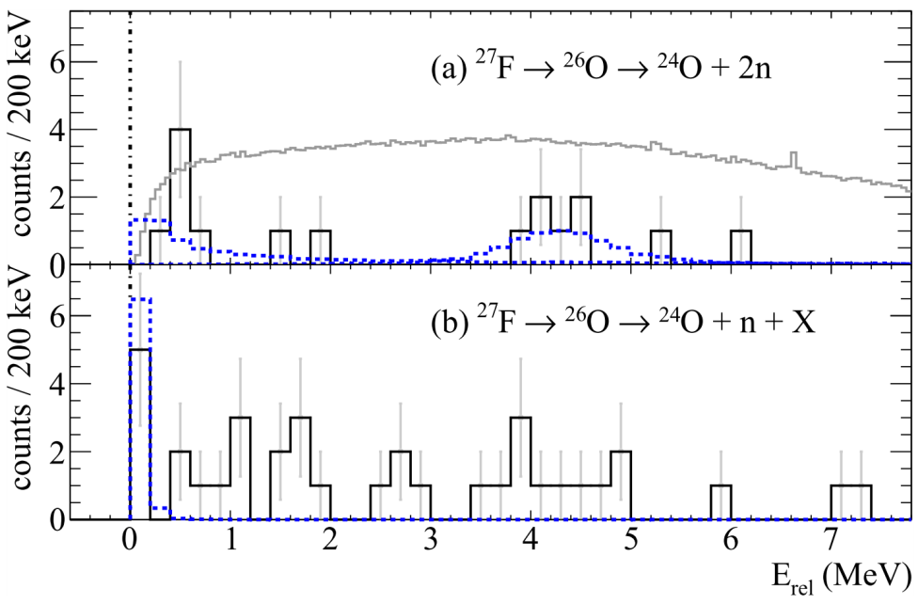
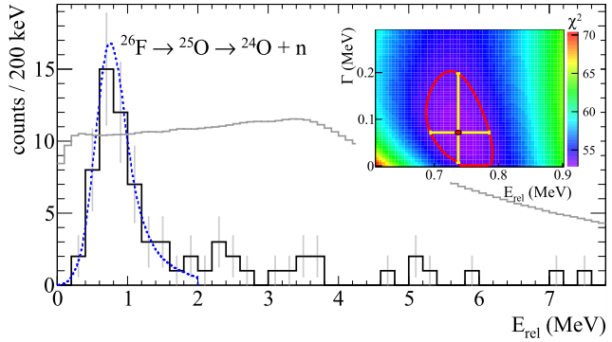
Progress of ²⁶O studies
²⁶O g.s. is somewhere quite low...
MSU: E. Lunderberg et al.,
PRL 108, 142503 (2012)
GSI: C. Caesar et al.,
PRC 88, 034313 (2013)
2n radioactivity is not impossible!
²⁶O g.s. is really at very low energy Q2n < 140 keV

Slide 39
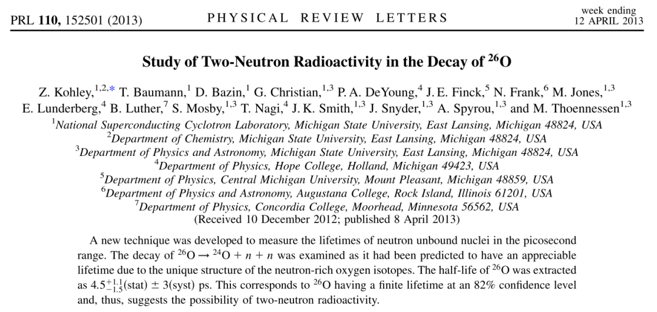
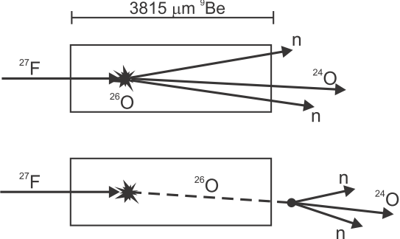
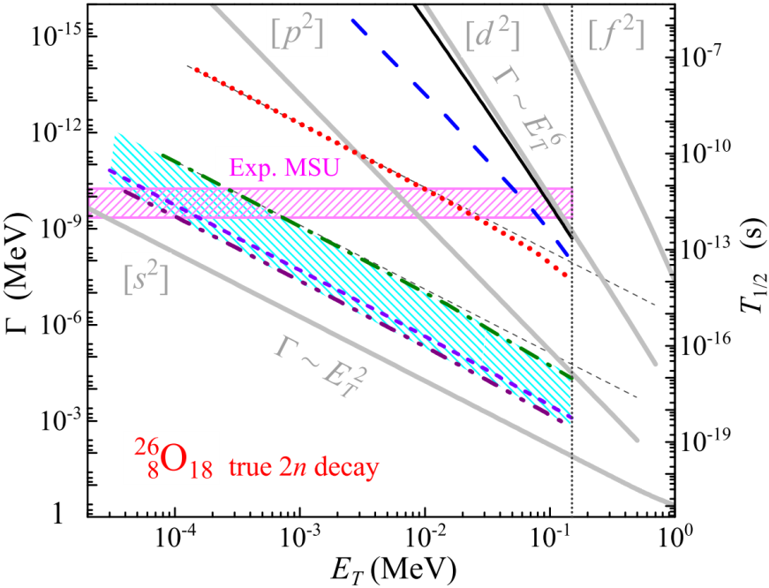


2n radioactivity in ²⁶O ?
L.V. Grigorenko, I.G. Mukha, M.V. Zhukov,
PRL 111 (2013) 042501
2p radioactivity:
Core recoil – negligible
Paring - factor 200-500
Importance of fine three-body effects
2n radioactivity:
Core recoil – factor 5-10
Paring - factor 2000-10000
T_{1/2} = 4.5 ps:
2n radioactivity discovered?
Extreme low-energy decay of ²⁶O should be inferred

Slide 40

From simplistic to precise studies of 2n decay in ²⁶O
L.V. Grigorenko, I.G. Mukha, M.V. Zhukov, PRL 111 (2013) 042501
Subbarrier tunneling to low-l configurations
Independent particle model
Core recoil is important in 2n (not in 2p)
“mini” NN FSI smooth correlations
full NN FSI wash out correlations

Slide 41



2n radioactivity in ²⁶O ?
Inconsistency between 3 results
Very precise experiemnent, but conclusion id MC-based
Q_{2n} = 22 keV:
2n radioactivity disproved?

Slide 42
Mini-conclusion
Quest for 2n radiactivity in ²⁶O is still opened
One out of three existing important results is wrong:
- Poor lifetime measurements (MSU)
- Overestimated invariant mass precision (RIKEN)
- Theoreticians do not well understand 2n penetration process (not impossible)

Slide 43
Quest for 4n radiactivity in ⁷H

Slide 44



⁷H studied in the ²H(⁸He, ³He)⁷H reaction
“Flagship“ experiment of ACCULINNA-2 facility
⁸He beam 26 AMeV, 10⁵ pps
2018, two weeks
Excited state at 6.5 MeV
Indication of ground state at 1.8 MeV
May be something at 12 MeV
Notes:
<номер>

Slide 45







⁷H studied in the ²H(⁸He, ³He)⁷H reaction. Second run.
⁸He beam 26 AMeV, 10⁵ pps
2019, 3 weeks
“Comming out party” for the neutron wall
Notes:
<номер>

Slide 46



⁷H data and spectrum

Slide 47


Example 4: data on ⁶H from ²H(⁸He,⁴He)⁶H
Double coincidences ⁴He-³H
Triple coincidences ⁴He-³H-n
Nikolskii et al.,
PRC 105, 064605
(2022)
− Setup is not specially suited for this experiment
− Higher cross section and high statistics (factor 10)
− Large backgrounds (accidental alphas)
− Neutron coincidence data

Slide 48


Сверхтяжелые водороды
Excitation spectra relative to ³H ground state
Analogies in the excitation spectra relative ³H and ⁵H, ⁴He and ⁶He ground states
Впервые изучен трехнейтронный распад легких ядер
Впервые наблюдался истинно пятичастичный (4n) распад

Slide 49
Open questions for ⁶H and ⁷H
Predictions: the ground state at 7-9 MeV, not at 2 MeV
No good systematic understanding of such systems (4 orbiting neutrons)
Poor convergence of the calculations
Cross section for ⁶H population
FRESCO: 200 μb/sr at 5-15 deg
Experiment: 190 μb/sr at 5-15 deg
Cross section for ⁷H population
FRESCO: 5 mb/sr at 5-10 deg
Experiment: 24 μb/sr at 5-10 deg

Slide 50
Mini-conclusion
The properties of ⁶H and ⁷H are studied at incredible level of precision
However, there is no understanding of the overall situation
«Decisive» experiments are still due for these nuclides
At ACCULINNA-2 after U-400M upgrade we have a good prerequivisites to «complete the mission»

Slide 51
Quest for 4n «nucleus»

Slide 52





Experiment on ⁴n

Slide 53


Recent theory
works on ⁴n

Slide 54






How to get real ⁴n?

Slide 55



Experiment ⁴n

Slide 56

ACCULINNA-2 data for ⁴n

Slide 57

Comparison of ⁴n data at ACCULINNA-2 and RIKEN

Slide 58
Conclusion
We reviewed the status of several extreme neutron-rich systems
Cases of complicated dynamics: 2n radioactivity, 4n emission, 5-body decay
Recent developments both in theory and in experiment are very important
Nevertheless there are NO rock-solid results in the field
It is often unclear, on which side is the problem – theory or experiment

Slide 59








Radioactivity “hall of fame”
G.N. Flerov and K.A. Petrzhak
spontaneous fission
F. Jouliot and I. Curie:
β⁺
Henri Becquerel: three classes of radioactivity - negative, positive, and electrically neutral
?
?
V.A. Karnaukhov and G.M. Ter-Akopian
β-delayed p
S. Hofmann:
p
M. Pfutzner:
2p
???
2n radioactivity
???
4n radioactivity

