Slide 1
Study of the radioprotective properties of the Damage Suppressor (Dsup) protein on a model organism D. melanogaster and human cell culture HEK293T
The project started 01.01.2021
Project leader Kravchenko Elena

Slide 2
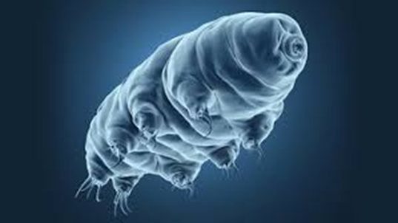
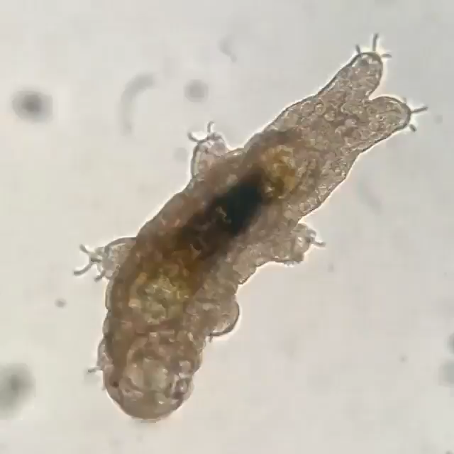
Tardigrades
Found in all biomes from the Arctic to the Antarctic, on mountain peaks, in deep-sea springs and cold mud springs in the west of Greenland.
Tardigrades have a well-developed nervous system, with the brain, muscle, digestive and other systems, consisting of differentiated tissues.
https://gfycat.com/fr/energeticcontentirishredandwhitesetter

Slide 3
Tardigrades belong to the group of the most radiation-resistant animals on Earth, able to survive after exposure to both rare and dense ionizing radiation
Resistance to γ-radiation for some species of organisms
Organism | LD₅₀ | Author
Homo sapiens | LD_{50/30d} =2.5–4.5 Gy | Bolus (2001)
Mouse | LD_{50/30d} = 4.5 Gy | Bolus (2001)
Gold fish | LD_{50/30d} = 8 Gy | Bolus (2001)
Cockroach | LD_{50/30d} = 50 Gy | Bolus (2001)
Drosophila melanogaster (Insecta) | LD_{50/3} = 1238–1339 Gy | Parashar et al. (2008)
Deinococcus radiodurans (Bacteria) | LD₅₀ = 10000 Gy | Makarova et al. (2001)
Escherichia coli (Bacteria) | LD₅₀ = 600 Gy | Krisko and Radman (2010)
Tardigrades | LD₅₀ = 1270–5000 Gy | Hashimoto and Kunieda (2017)
DLNP JINR Sector of Molecular Genetics of the Cell

Slide 4
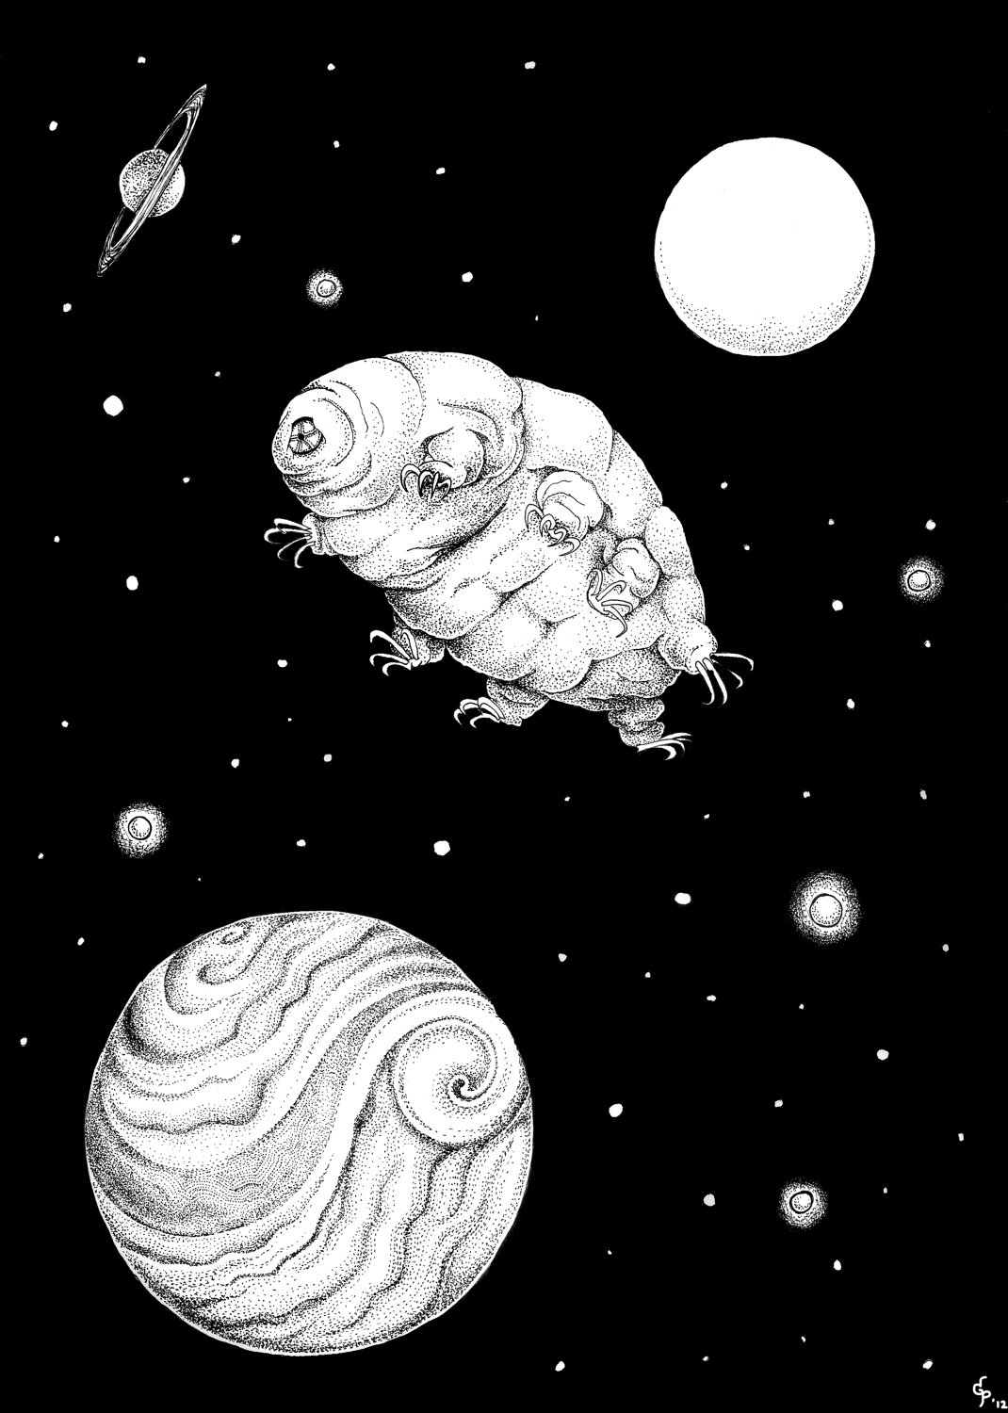
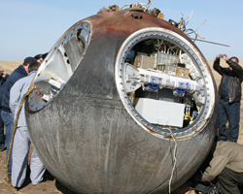
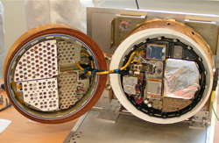
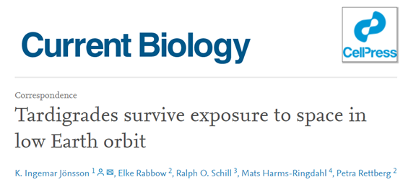
Tardigrades are a model organism for studying the influence of space conditions on living organisms
FOTON-M3 mission
Tardigrades in Space - tardigrades were exposed to space vacuum (10⁻⁶ Pa), space radiation (100 mGy) and UV radiation for 10 days.
Exposure to vacuum and cosmic radiation did not significantly affect survival. (Jönsson et al., 2016, 2008).
http://teamtardigrades.blogspot.com/
DLNP JINR Sector of Molecular Genetics of the Cell

Slide 5
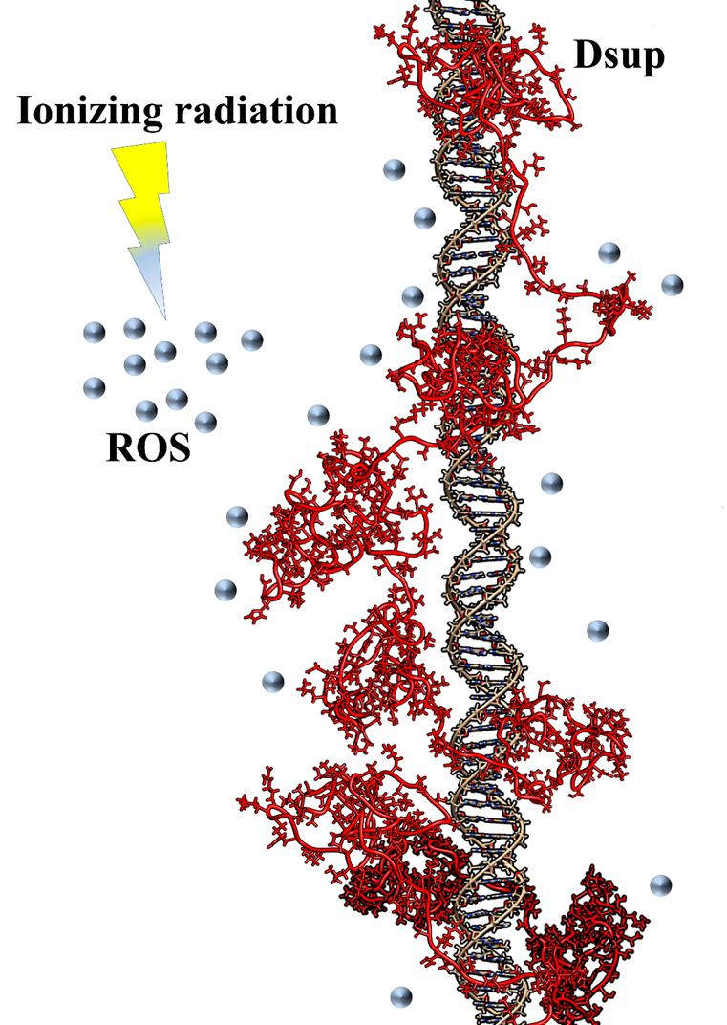
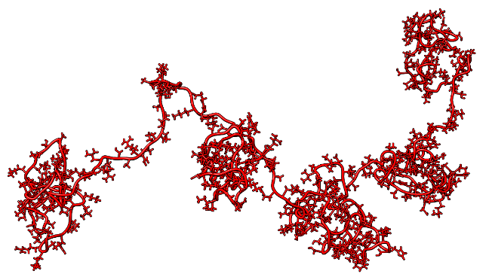
Molecular mechanisms of radioresistance in tardigrades
In 2016, the genome of Ramazzottius varieornatus, one of the most radioresistant tardigrade species, was sequenced (Hashimoto et al., 2016).
After comparing R. varieornatus proteins with all known proteins from other organisms, a unique Damage suppressor (Dsup) protein was found, which is present only in tardigrades. This protein is responsible for the unique radioresistance.
The structure of Dsup protein
modeling with I-TASSER
DLNP JINR Sector of Molecular Genetics of the Cell

Slide 6

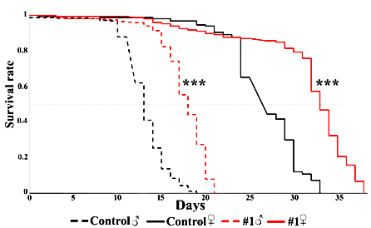
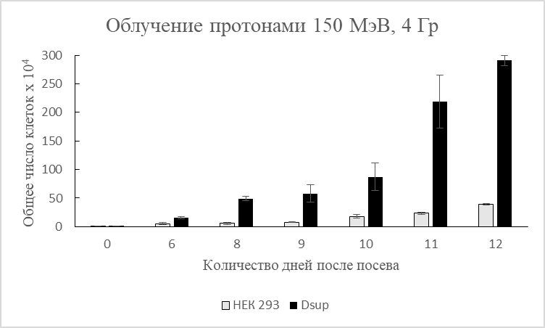
Fruit fly
Human cell culture
MT-25, FLNR JINR, γ, 500 Gy
Phasotron, DLNP JINR, p⁺, 4 Gy
DLNP JINR Sector of Molecular Genetics of the Cell

Slide 7
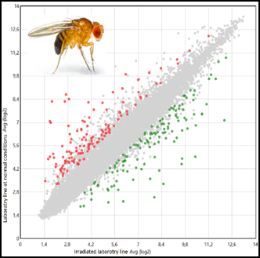
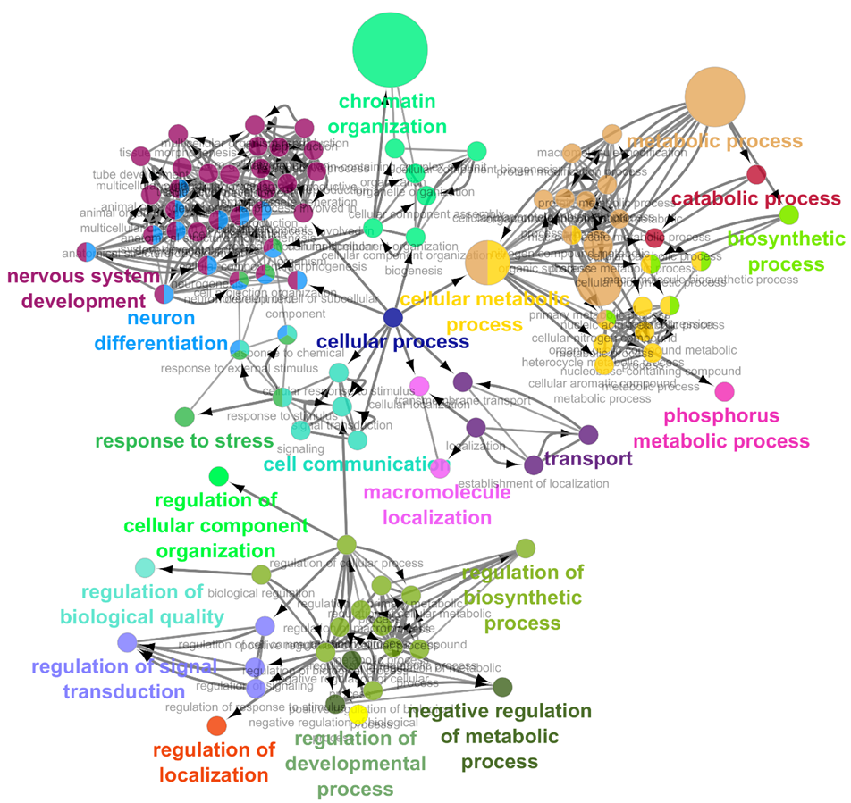
For the gene instructions to be carried out DNA must be transcribed into RNA. A transcriptome is a collection of all the RNA present in cells,
which reflects the current state of all processes occurring in the organism
Transcriptome analysis of Dsup expressing and control Drosophila lines demonstrated effect of Dsup protein on expression of genes involved in chromatin organization, regulation of transcription and neural system functioning
DLNP JINR Sector of Molecular Genetics of the Cell
Notes:
At the moment, there is no data on what happens at the level of interaction between genes and, as a consequence, biological processes in the case of the addition of the Dsup protein, which is not characteristic of Drosophila and human cells, which can affect a number of fundamental processes. Transcriptome analysis will allow the identification of genes that have become more or less active in the presence of Dsup.

Slide 8
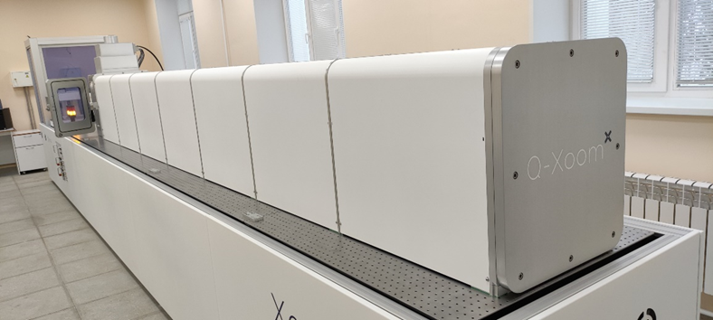
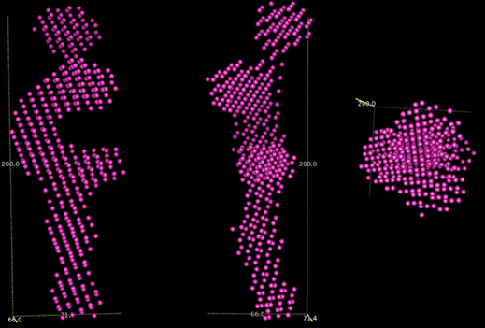
Model of Dsup structure derived from experimental data (DAMMIF package)
Experiments in collaboration with FLNP JINR (SAXS and DLS)
DLNP JINR Sector of Molecular Genetics of the Cell

Slide 9
Dsup can be used in
Biotechnology: for increasing of radiation resistance in agricultural and biotech organisms
Astrobiology&Spaceflight biology: development of model organisms for non-human space studies and pharmacological support of cosmonauts and their microbiomes
Pharmacy: stabilizer and cryoprotectant of vaccines and other DNA/RNA-containing pharmaceuticals for effective manufacturing, transportation and conservation
Medicine: antidote agent for radiotherapy, chemotherapy and other harsh medical procedures or as capsule for radiopharmaceuticals
Ecology: creation of biotechnological cultures for bioremediation of toxic solutions as wastes of nuclear industry
DLNP JINR Sector of Molecular Genetics of the Cell

Slide 10
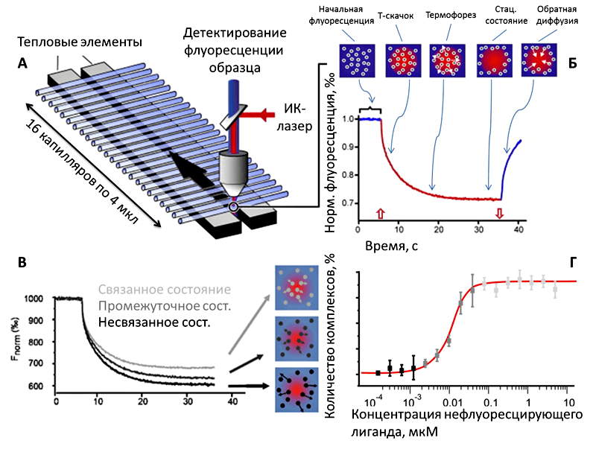
Изучение параметров комплекса белка Dsup-ДНК методом микроскопического термофореза (МФТИ)
https://biomolecula.ru/articles/termoforez

Slide 11
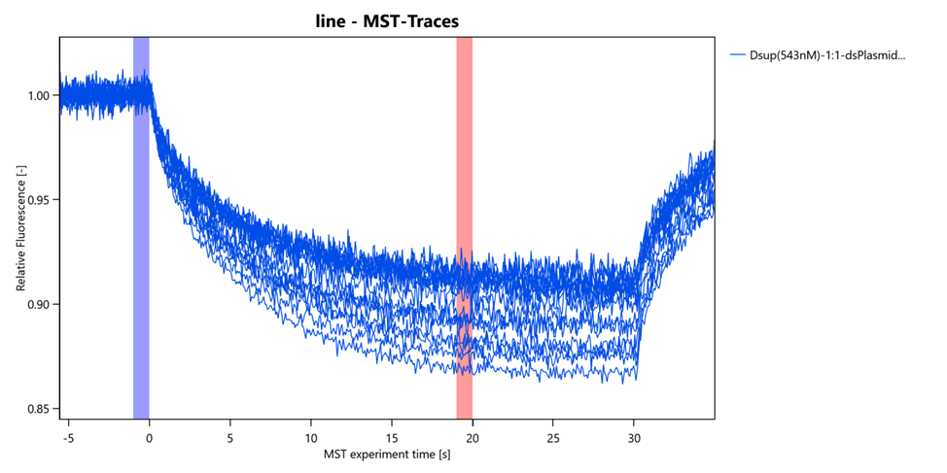
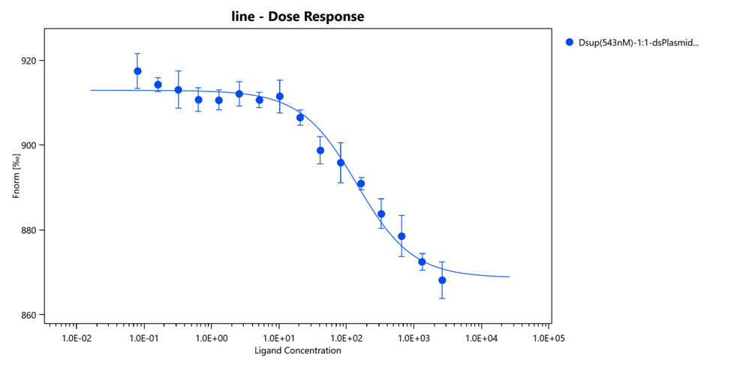

Slide 12
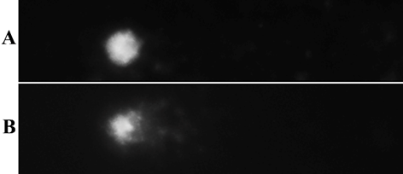
Comet assay гемоцитов D.melanogaster
Для оценки влияния белка Dsup на степень повреждения ядерной ДНК активными формами кислорода, был проведен Comet assay гемоцитов D.melanogaster в ходе воздействия перекиси водорода. Было показано значимое снижение (p<0.001) уровня повреждения ДНК активными формами кислорода в гемоцитах, экспрессирующих Dsup (~17%), что подтверждает протекторные свойства белка Dsup.
A – undamaged nucleus. B - damaged nucleus with
fragmented DNA in comet tail.

Slide 13
The main results of the project
-Dsup protein is an effective radioprotector that increases radioresistance of model organisms
-Dsup protein affects some other biological processes
-Dsup is rod-shaped DNA binding protein
Publications:
1. The tardigrade Dsup (damage suppressor) protein enhances radioresistance and oxidative stress tolerance in D.melanogaster and acts as an unspecific repressor of transcription. Mikhail Zarubin , Talyana Azorskaya, Olga Kuldoshina, Sergey Alekseev, Semen Mitrofanov, Elena Kravchenko*. iScience (IF - 6.107, Q1). Accepted for publication
2. Unique Radioprotective Damage Suppressor protein (Dsup): Comparative Sequence Analysis M. Zarubin, O. Kuldoshina, E. Kravchenko. Particles and Nuclei, Letters (PEPAN Letters) (IF – 0.565, Q4), 2022, 19, № 3(242). p. 212
International conferences:
1. M. Zarubin, E. Kravchenko. Radioprotective DNA-binding damage suppressor protein (Dsup) affects the functioning of neural system in D. melanogaster, 46th Congress of The Federation of European Biochemical Societies (FEBS). Lisbon, Portugal. 07.09.22-07.14.22
2. Zarubin M., Murugova T., Ivankov O., Ryzhykau Y., Soloviov D., Popov A., Kravchenko E. The insight into structural properties of unique tardigrade radioprotective damage suppressor protein (Dsup). Bioinformatics of Genome Regulation and Structure/Systems Biology” – BGRS/SB-2022, Institute of Cytology and Genetics of SB RAS, Novosibirsk, Russia, 07.04.22-07.08.22
Popular science activities:
1. Lecture at 2022 science festival “NAUKA 0+” “Ionizing radiation protection with unique tardigrade protein” by Kirill Tarasov.
2. RIA News podcast “We will all die. But not sure” - What does ionizing radiation do to DNA molecules and how does molecular genetics reveal that. Mikhail Zarubin and Kirill Tarasov. (https://ria.ru/20230112/genetiki-1844187060.html)

Slide 14
Protection against physical and chemical stresses with tardigrade proteins (TARDISS)
2024-2028

Slide 15
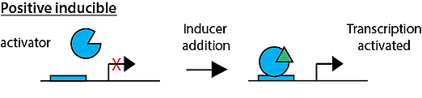
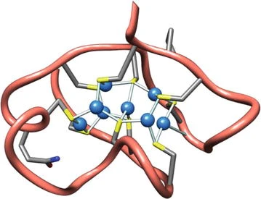
1. Создание регулируемой схемы экспрессии гена, кодирующего белок Dsup, в модельном объекте D.mealnogaster
Индуцируемая экспрессия гена позволяет синтезировать белок в ответ на определенный внешний стимул за счет быстрой активации транскрипции гена-мишени, а после устранения стимула индуцируемый ген быстро возвращается в исходное, неактивное состояние.
Экспрессия гена металлотионеина индуцируется не только таким стимулом, как воздействие металлов, но и окислительным стрессом.
InterPro Model

Slide 16
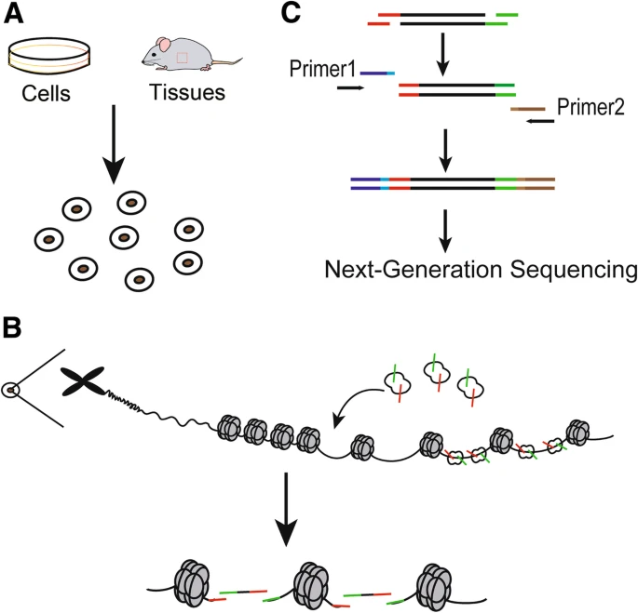
2. Оценка влияния белка Dsup на компактизацию хроматина в клетках, совмещенная с транскриптомным анализом
https://hereditasjournal.biomedcentral.com/articles/10.1186/s41065-019-0105-9

Slide 17
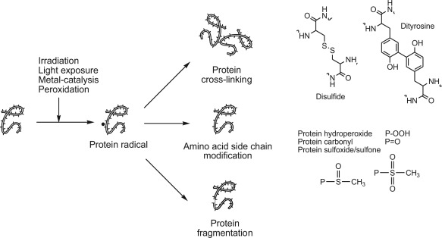
3. Изучение стабильности и свойств белка Dsup в ходе воздействия высоких температур и ионизирующего излучения
Препараты очищенного белка Dsup потенциально могут быть использованы для фармакологии и медицины, как криопротектор, консервант и стабилизатор ДНК\РНК содержащих препаратов и вакцин, а также как протекторный агент при радио- и химиотерапии.
Деградация и модификация аминокислот
Разрыв цепи
Перекрестные сшивки
Денатурация
Изменение растворимости
https://www.sciencedirect.com/book/9780128173800/chemical-changes-during-processing-and-storage-of-foods

Slide 18
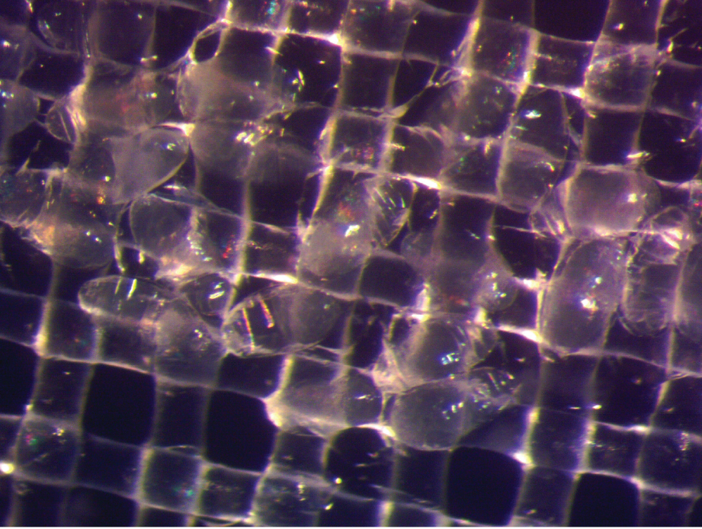
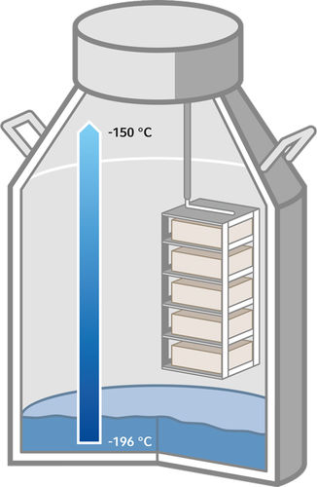
Drosophila embryos frozen in liquid nitrogen. Image courtesy of Dr. John Bischof, University of Minnesota.
https://handling-solutions.eppendorf.com/cell-handling/

Slide 19
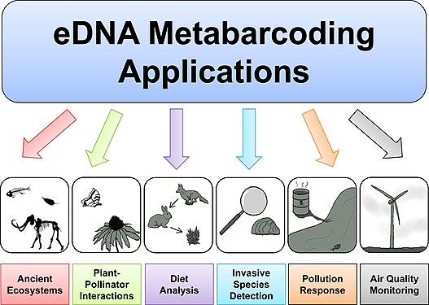
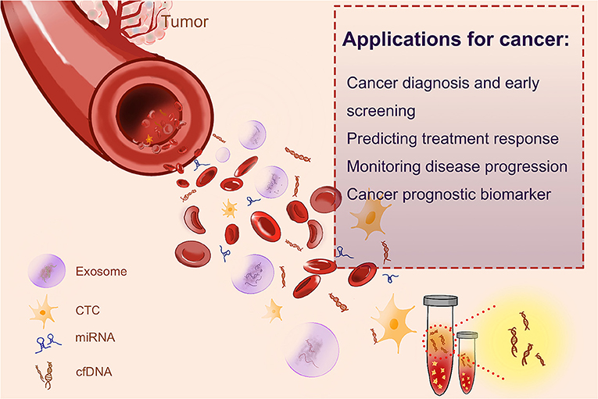
4. Разработка методики и материала для очистки растворов от нуклеиновых кислот и концентрирования ДНК и РНК из различных биологических жидкостей с помощью белка Dsup
- создание функциональных материалов, модифицированных белками экстремофильных организмов
https://en.wikipedia.org/wiki/Environmental_DNA
https://www.frontiersin.org/articles/10.3389/fcell.2021.639233/full

