Slide 1
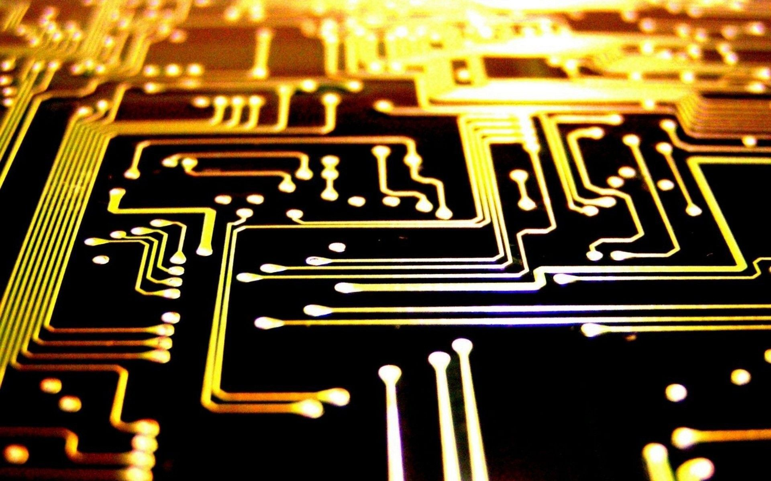
Development of BM@N trigger system,
status and upgrade plan
Victor Rogov
on behalf of BM@N L0 trigger group
10th Collaboration Meeting of the BM@N Experiment at the NICA Facility

Slide 2
Content
Discuss BM@N run 2022-2023
Trigger detector system
Electronic modules
Detector control system
Upgrade plan
Summary
10th Collaboration Meeting of the BM@N Experiment at the NICA Facility

Slide 3
Requirements for trigger system
Minimum materials
Minimum background
Minimum delay and jitter
Trigger processing time <100ns
High efficiency for selection of nucleus-nucleus collisions in target
Monitoring of beam conditions
GUI for control of the trigger and detector parameters
Compatibility with the DAQ system
10th Collaboration Meeting of the BM@N Experiment at the NICA Facility

Slide 4
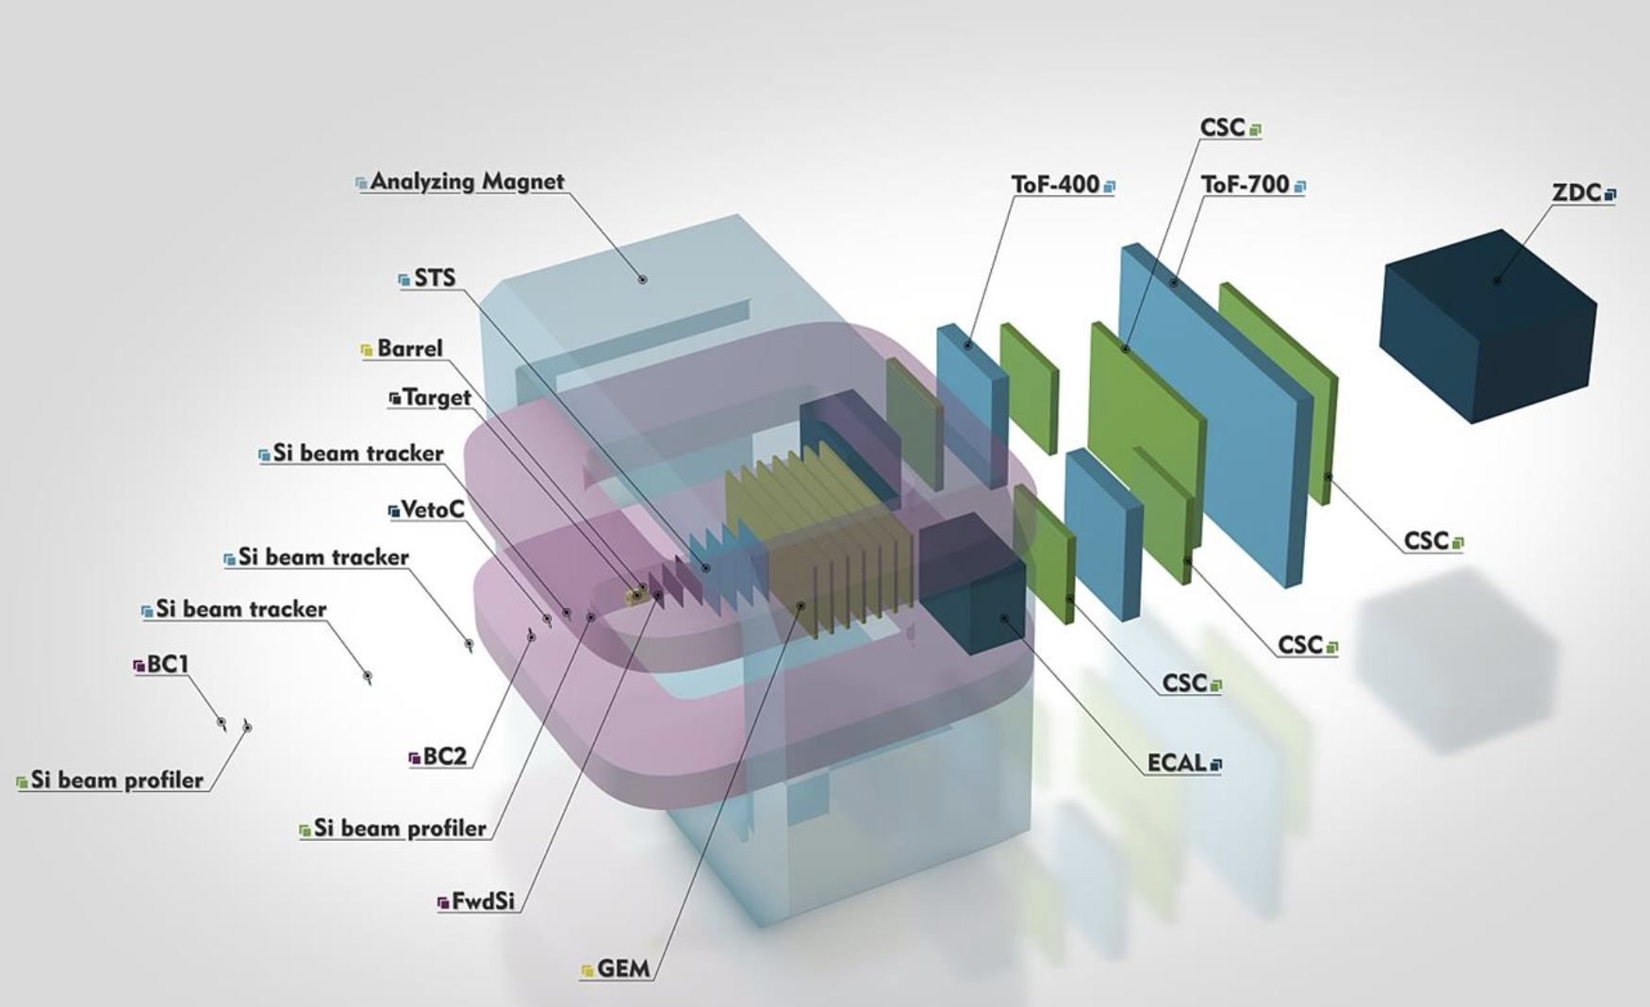
Trigger detector system at BM@N 2022-2023 run
Beam line detectors
BC1, BC2
VC (Veto-counter)
FD (Fragment detector)
Target area detector
BD (Barrel detector)
10th Collaboration Meeting of the BM@N Experiment at the NICA Facility

Slide 5
Trigger detector system at BM@N 2022-2023 run
Beam Trigger (BT) = BC1*BC2*VC(veto)
MBT = BT* FD(veto)
CCT1 = BT*BD(>N)
CCT2 = MBT*BD(>N)
10th Collaboration Meeting of the BM@N Experiment at the NICA Facility

Slide 6
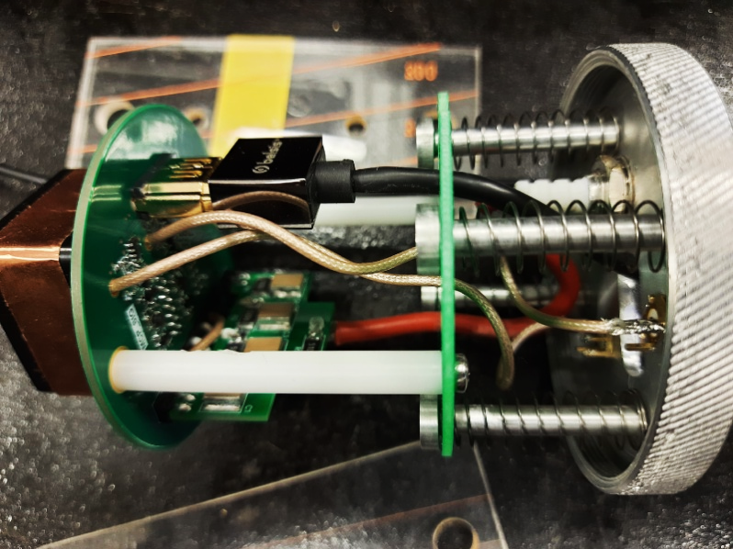
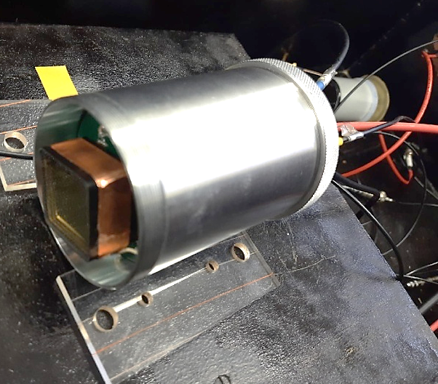
T0 detector
The functional scheme of T0 and BC2 detectors FEE is given in Fig. below. It consist of a low-noise input amplifier with BFR93 transistor, a pulse shaper minimizing signal to noise ratio, a RC chain filtering signal frequency, a fast amplifier and discriminator based on LMH 7220. Analog output pulses with ~ 2-ns rise time are transmitted to the readout electronics through a coaxial cable and the discriminator provides LVDS-level logic signals. The LVDS signal goes to the T0U via an HDMI cable. This cable is also used for FEE power supply lines.
10th Collaboration Meeting of the BM@N Experiment at the NICA Facility

Slide 7
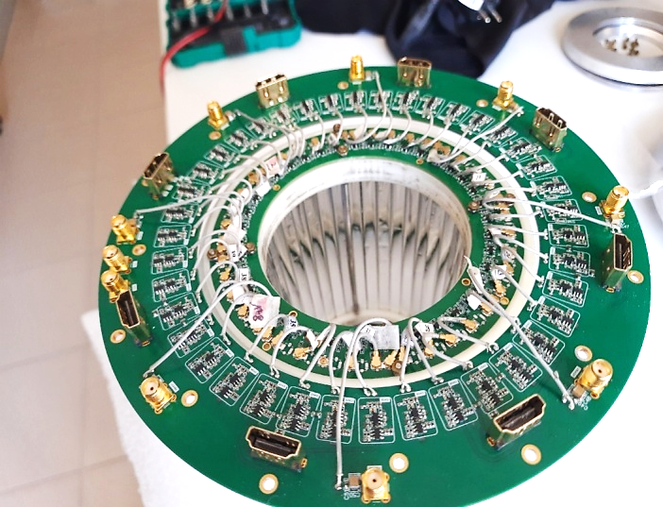
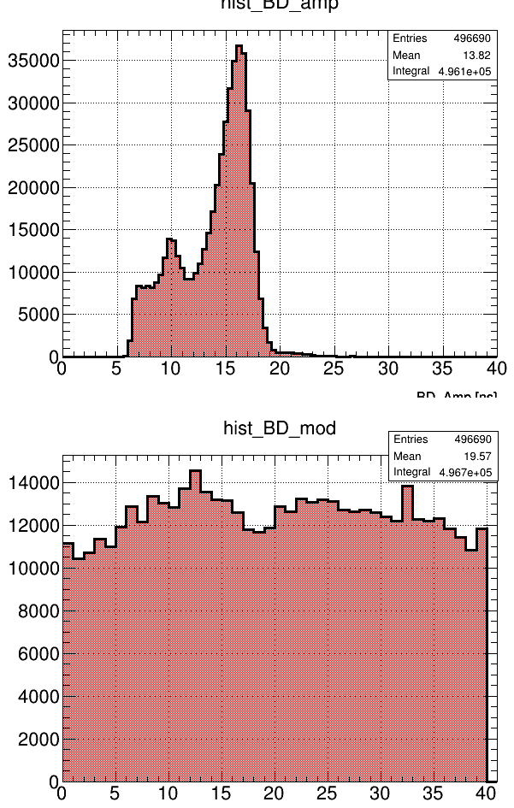
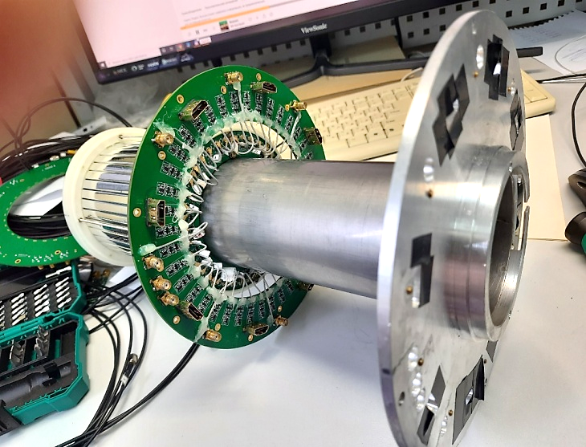
Barrel detector
Target area detector
The active area of the BD has a 45 mm radius and 150 mm length, and it consists of 40 150×7×7 mm³ strips made of polished BC-418 scintillator wrapped by Al Mylar. The scintillation light produced by charged particles is detected on single ends of the strips by SiPMs. The signals from the SiPMs are fed to the first stage low noise amplifiers and then to the FEE board, which performs amplification, and discrimination functions. A time over threshold comparator produces LVDS pulses for a trigger logic unit and TDC.
10th Collaboration Meeting of the BM@N Experiment at the NICA Facility

Slide 8
Electronic modules
TOU module
The T0U generates a trigger signal which is the output signal of a programmable logic based on FPGA with a suitable trigger interface. This module also provides control and monitoring of the front-end electronics power supplies. The T0U can process 100 input signals in total, 60 of them arrive from T0 FEE and up to 40 signals could be taken from other detectors or units
The T0U has a modular structure. It has a motherboard and 4 different type mezzanine boards.
The motherboard performs the following jobs:
distribution of input signals to external readout electronics (TDC32VL) and L0 trigger processor
L0 trigger generation by the trigger processor built on Altera Cyclone V GX FPGA,
powering, monitoring, and control of mezzanine cards including:
power supply board (PSB) for FEE of the detectors,
four discriminator cards (DIB),
four TTL-NIM convertor cards (TNB),
one Ethernet interface card (ETB),
accumulation of the trigger monitoring information.
The T0U output connectors for DAQ for TOF are Molex 76105-0585.
10th Collaboration Meeting of the BM@N Experiment at the NICA Facility

Slide 9
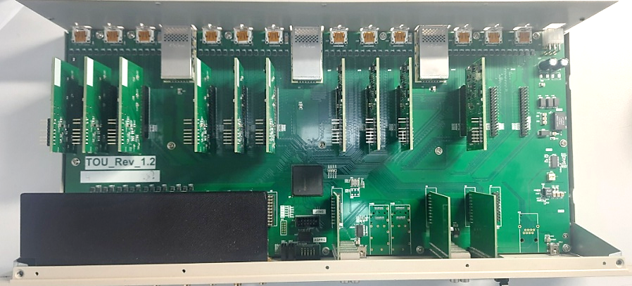
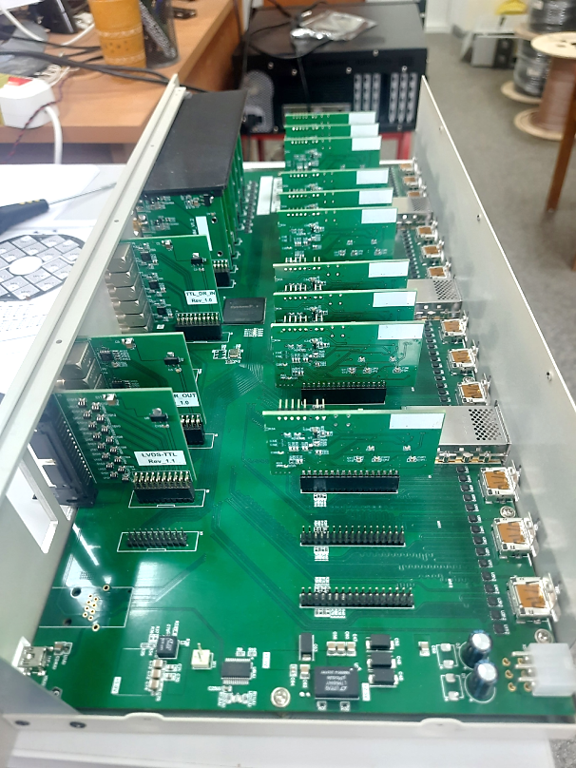
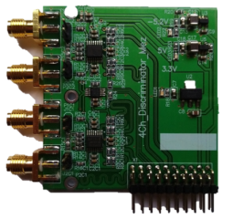
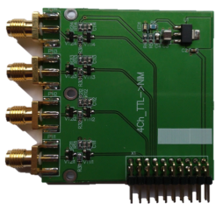
Electronic modules
TOU module
IO mez.brd
10th Collaboration Meeting of the BM@N Experiment at the NICA Facility

Slide 10
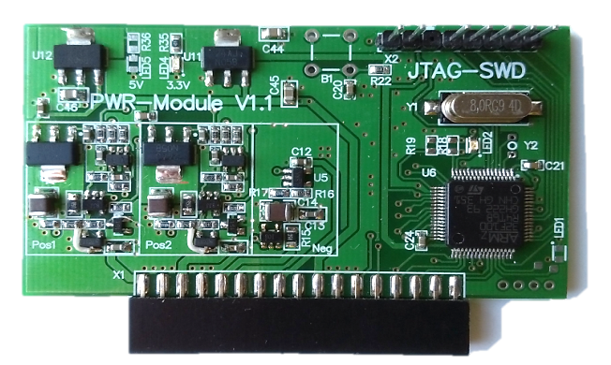
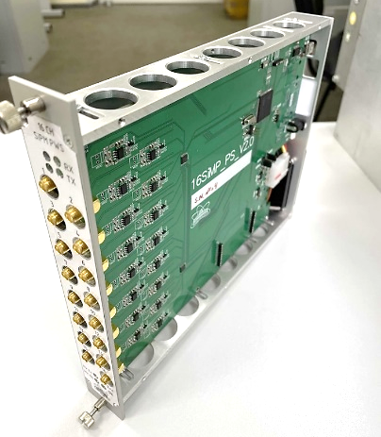
Electronic modules
Power supplies
The Power Supply Board (PSB) provides three independent voltages to supply detector FEE, those supplies are monitored and controlled with high precision. Each channel could be switched on/off independently.
The Negative voltage channel provides current up to 100 mA at -7.3V.
The Positive channels provide current up to 800 mA in a voltage range from 4.0V to 8.0V and could be adjusted with 1mV step.
12 bit DAC is used to adjust the voltage
The channel output voltages and currents are read back by 12-bit ADC.
The SiPMs power supply module provides bias voltage for the barrel detector photosensors and neutrons detector of the BM@N setup. Each of the 16 channels could be switched «On» or «Off» independently, the channel voltage range is 24 to 28 V with 1 mA current per channel and the output voltage could be adjusted with about 1 mV step.
The communication to the detector control system is done via USB 2.0, Ehternet or RS serial link.
10th Collaboration Meeting of the BM@N Experiment at the NICA Facility

Slide 11
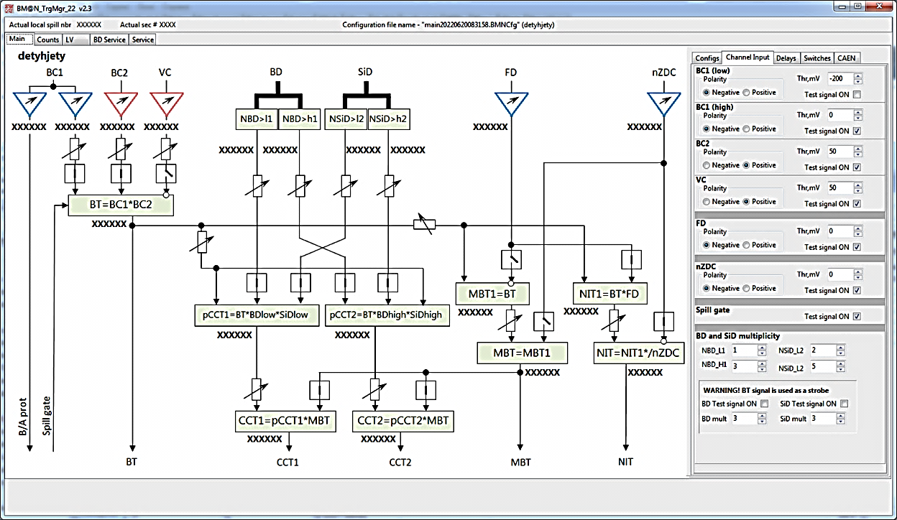
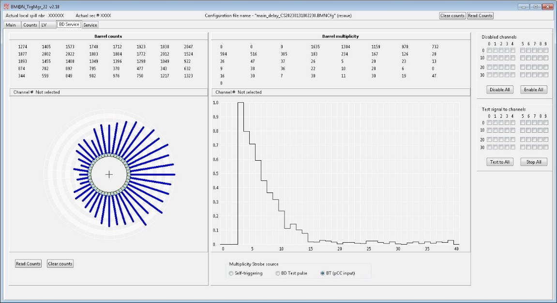
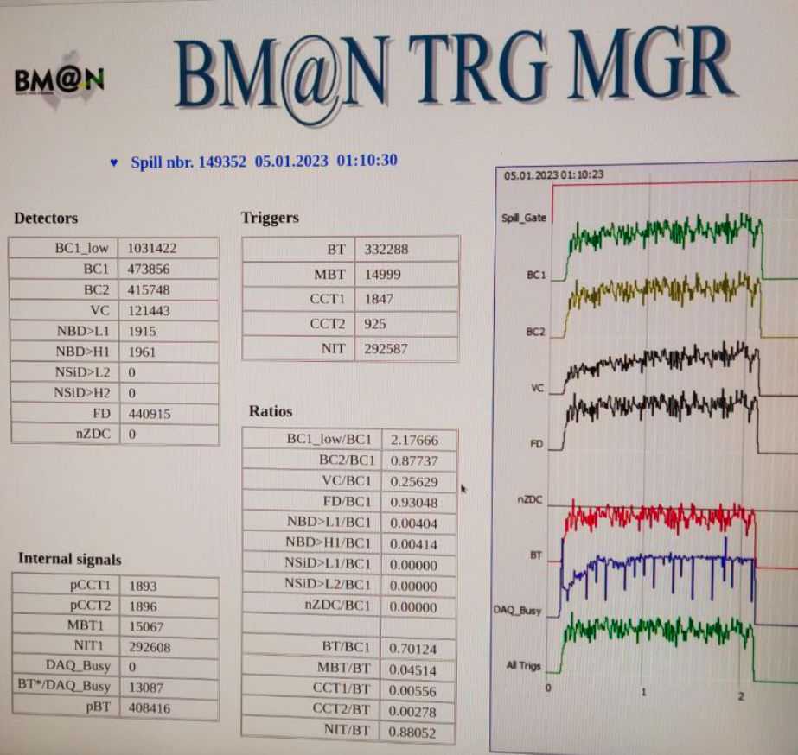
Detector control system
The Trigger System DCS performs following
Setting tens of parameters of the Trigger System to T0U using interactive GUI.
Control and monitoring of the Trigger system with data recording to local and remote log-files. The remote file data were put to the BM@N data stream
Control and monitoring of
HV for PMTs
Bias voltage for SiPM
LV for FEE
Data publishing to Web with web-server providing access to the run state to all interested
Trigger GUI
10th Collaboration Meeting of the BM@N Experiment at the NICA Facility

Slide 12
Upgrade plan
Detector electronics
Rise up the threshold of FEE comparators of BD
Add shaper to BD FEE to provide stable TDC readout (weight more then 10ns)
FETURE upgrade – Increase BD channels to 64, minimize scintillators dimension and new mechanics – divide BD to 2 pieces for easy installation around the vacuum pipe
TOU electronics
Develop a 2 threshold fast comparator mezzanine card for beam profile detectors
Detector control system
Modify BT input in CCT1, CCT2, MBT -> use switch instead of fixed
Multiplexed NIM output trigger for local DAQ via CAEN
Suppression of multiple beam ion events in TOU
10th Collaboration Meeting of the BM@N Experiment at the NICA Facility

Slide 13
Summary
The trigger system developed for BM@N experiment was successfully tested during the BM@N run 2022-2023. The time resolution of 40 ps was obtained for start pulse provided by BC2 detector. The obtained experience will be used in father development and upgrade of the trigger detectors, the electronics, and the control system.
10th Collaboration Meeting of the BM@N Experiment at the NICA Facility

Slide 14
Thank you for your attention
10th Collaboration Meeting of the BM@N Experiment at the NICA Facility

