Slide 1



Status of GEM and CSC detectors
Andrei Galavanov on behalf of BM@N Collaboration
10th Collaboration Meeting of the BM@N Experiment at the NICA Facility, 16.05.2023

Slide 2
BM@N Xe run
Small GEM
CSC 1×1 m²
7 GEM planes
CSC 2×1,5 m²
CSC 1×1 m²

Slide 3
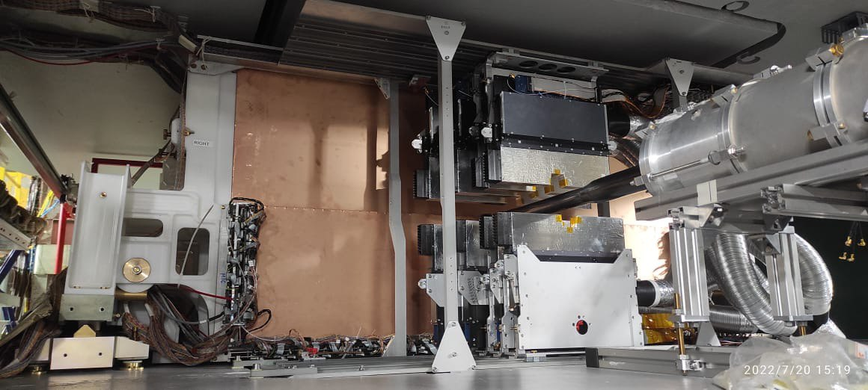
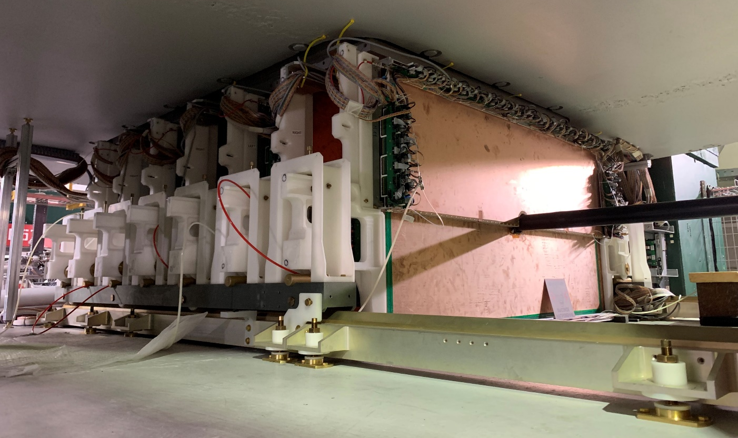
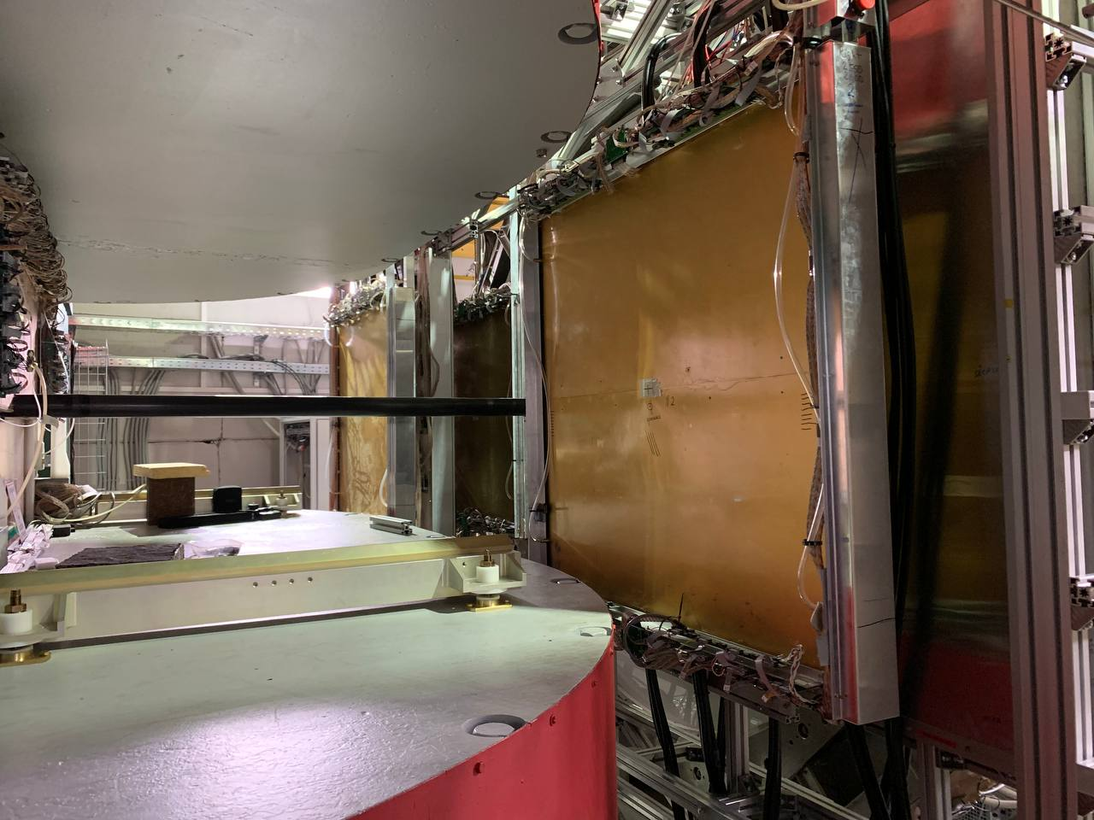
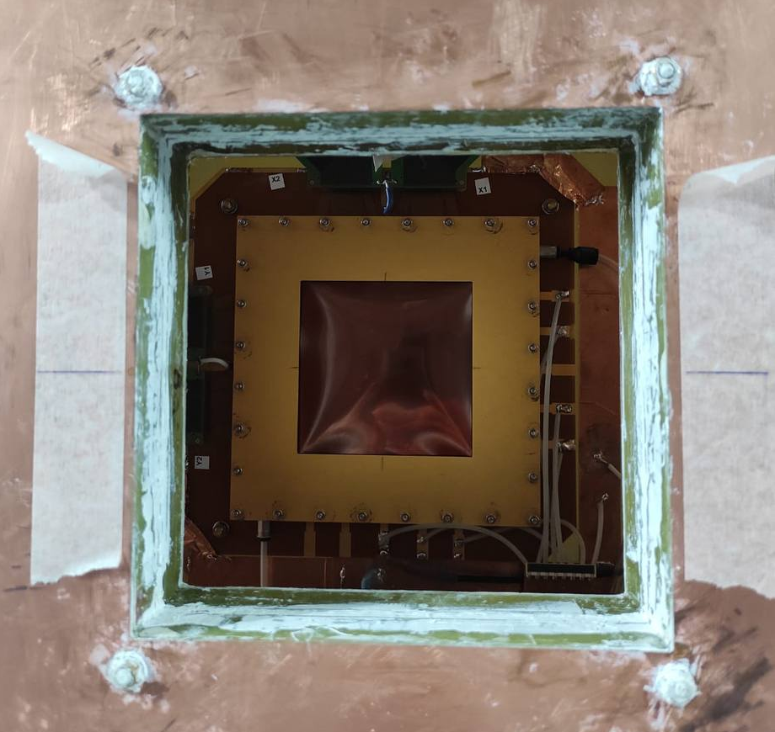
BM@N Xe run
GEM and CSC at Xe run:
7 GEM detectors 163×45 cm² – bottom halfplanes;
7 GEM detectors 163×39 cm² – top halfplanes;
4 CSC detectors 106×106 cm² – two arms, on both sides of TOF-400;
Small GEM 10×10 cm² – covers the beam acceptance at the end of beampipe;
1 CSC detector 217×145 cm² .

Slide 4
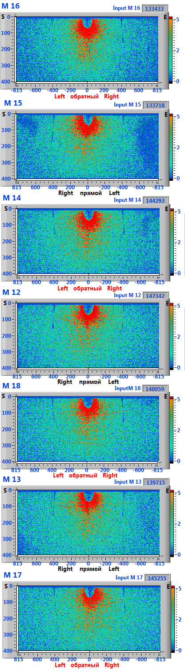
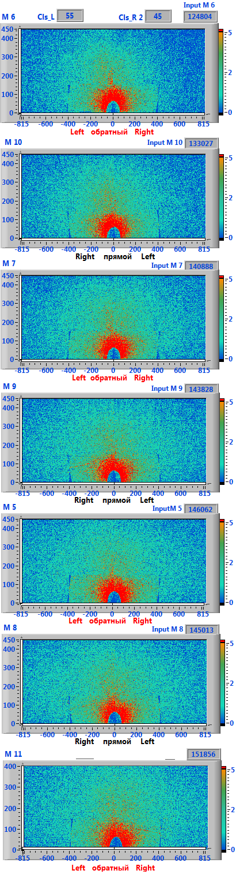
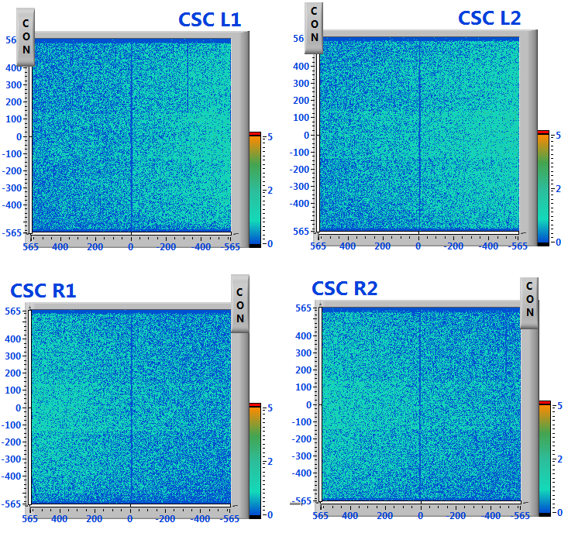
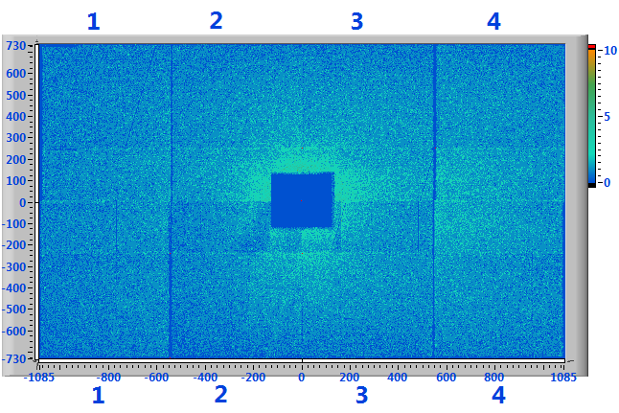
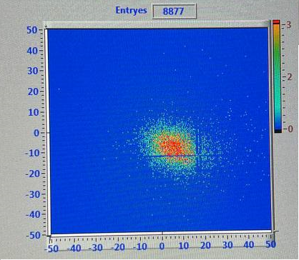
7 bottom GEMs
BM@N Xe run
7 top GEMs
4 CSC 1×1 m²
Plots of 2D distribution of signals in different detectors.
In general, during the Xe run:
CSC (both types) – without major problems;
Small GEM – a long tuned of working point, but works good;
Top GEMs – uniform distribution of signals at all detectors. Detector M7 stops operate at the end of Xe run.
Bottom GEMs – some detectors have a regions with less signals. Detector M15 stops operate at the end of Xe run.
CSC 2×1.5 m²
Small GEM

Slide 5
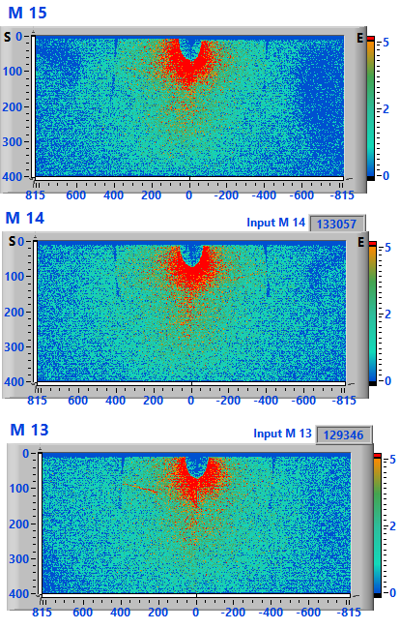
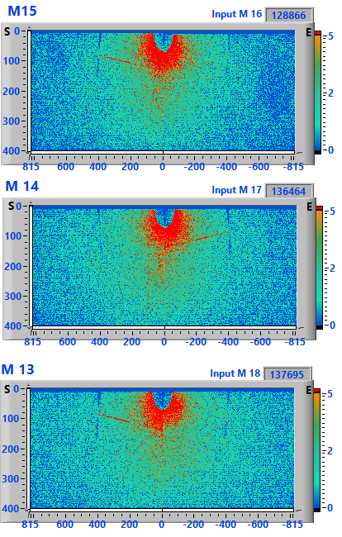
BM@N Xe run
I = 430 mkA
I = 440+ mkA
Problem of less signals regions in 163×39 cm² GEMs solved partly by increased of HV.
M16 I = 440 mkA
M15 I = 448 mkA
M14 I = 445 mkA
M12 I = 440 mkA
M18 I = 440 mkA
M13 I = 445 mkA
M17 I = 445 mkA
We don’t see the difference of horizontal/vertical detectors position or the influence of gas flow direction.
We don’t see the same regions in 163×45 cm² detectors – problem with design or assembly of this type of detectors.
We want to study it on next cosmic ray tests.

Slide 6
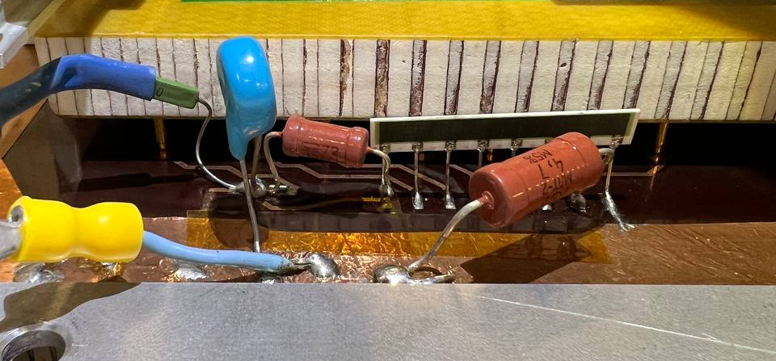
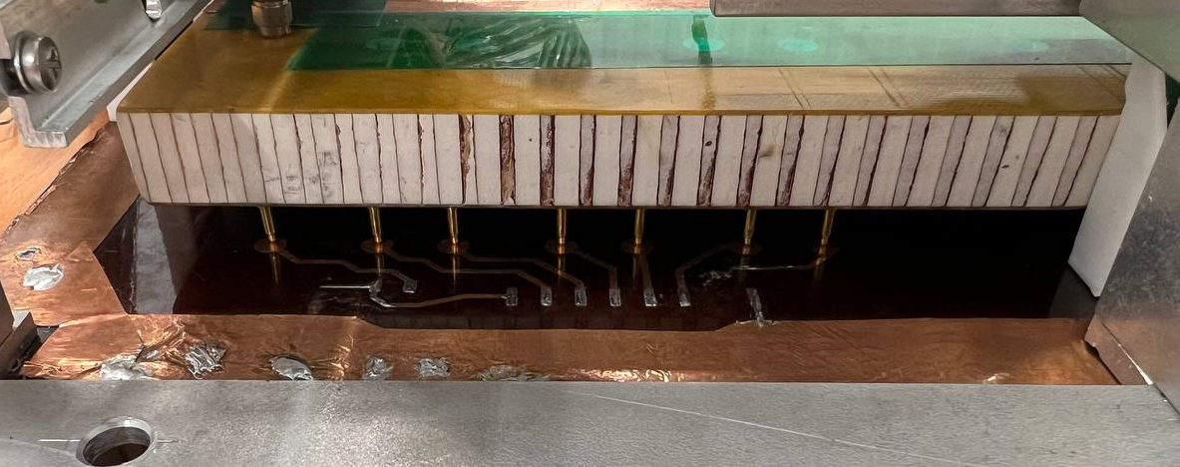
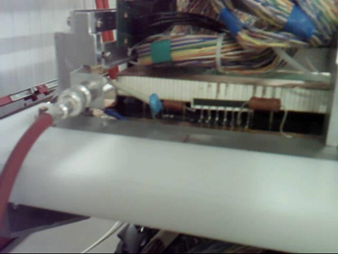
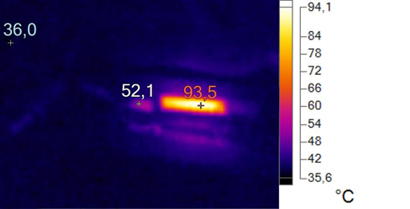
GEM’s HV divider
RC filter, ceramic HV divider, additional resistors
Pins for applying voltage to the GEM foils
This type of divider is hot, not protected from the environment (dust, atmosphere, touching) and can’t be replace inside the magnet.
A new type of HV divider is developed by S. Khabarov (electric part) and S. Novozhilov (mechanic part).
M15 bottom GEM started to correctly working after resoldering a HV divider.
Thermal and optical image of HV divider at the working point

Slide 7
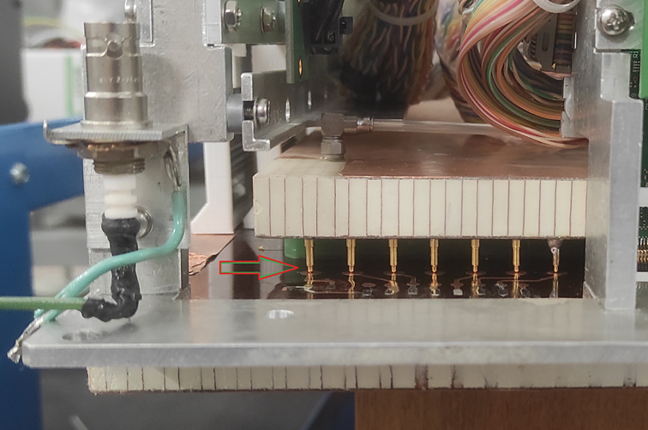
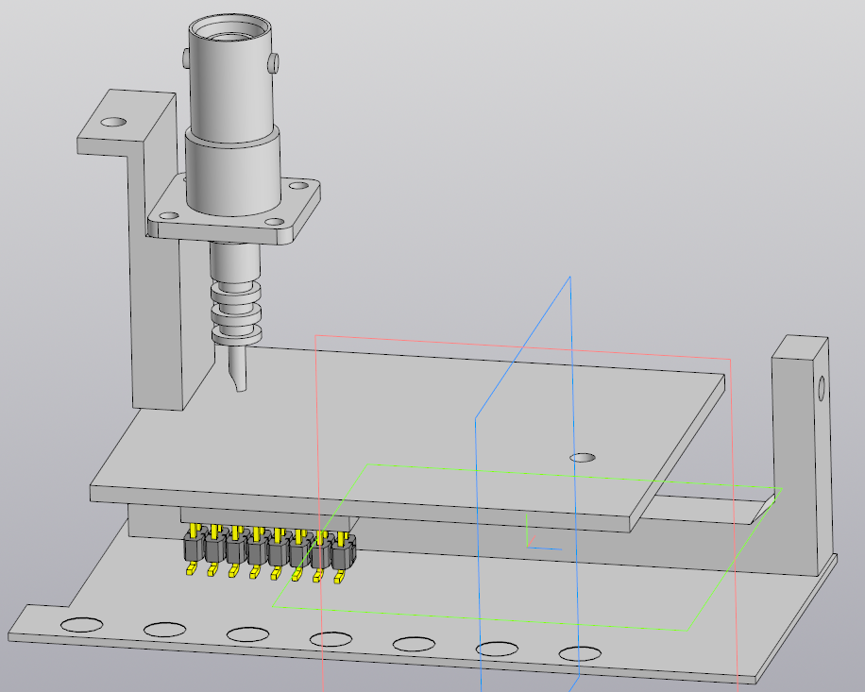
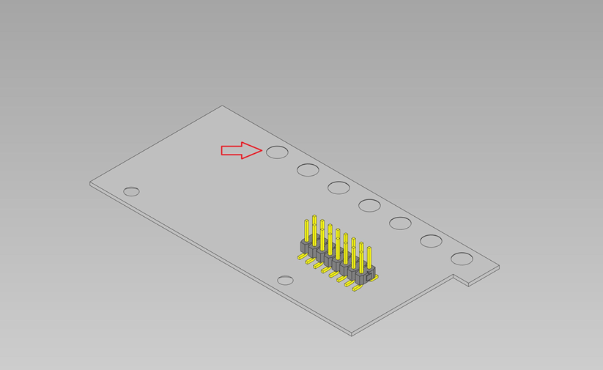
GEM’s HV divider
Overall model of new divider
Plane with connector

Slide 8
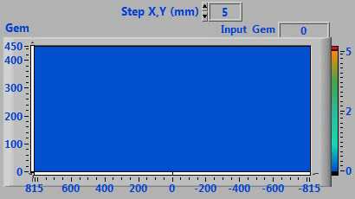

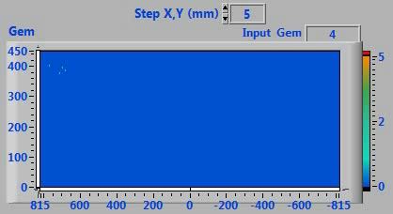
BM@N Xe run. M7 r/a source radiation
June 2022
After installation inside the magnet.
March 2023
First test after tracking system disassembly.
April 2023
After one month of different tests.
Works good
Rare discharges (HV trips) in detector.
Original HV divider
Weeks of stable operation with HV.
HV divider and all HV parts was changed step by step.
! Listen a sparks inside the detector !

Slide 9
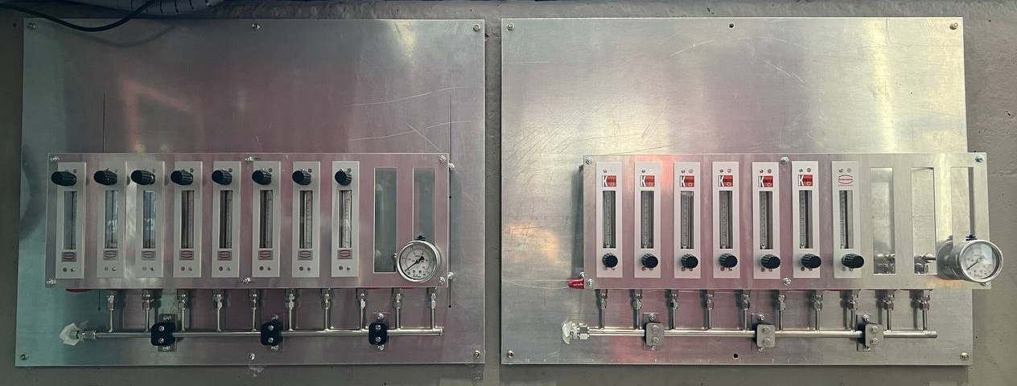
Gas system
Gas mixture: Argon (80)/Isobutane (20)
Gas cylinders
Multichannel gas mixer
H₂0 and 0₂ filter
0₂ analyzer
Distribution panel
GEM plane
0₂ analyzer
Oil gate
For one channel
End of May – works with two contractors:
OOO "Eltochpribor“ – mount new mass flow meters and new steel gas lines;
OOO “OSK” – mount new isobutane cabinets.
Distribution panels for GEM (left) and CSC (right) – mounted, but without gas lines yet

Slide 10
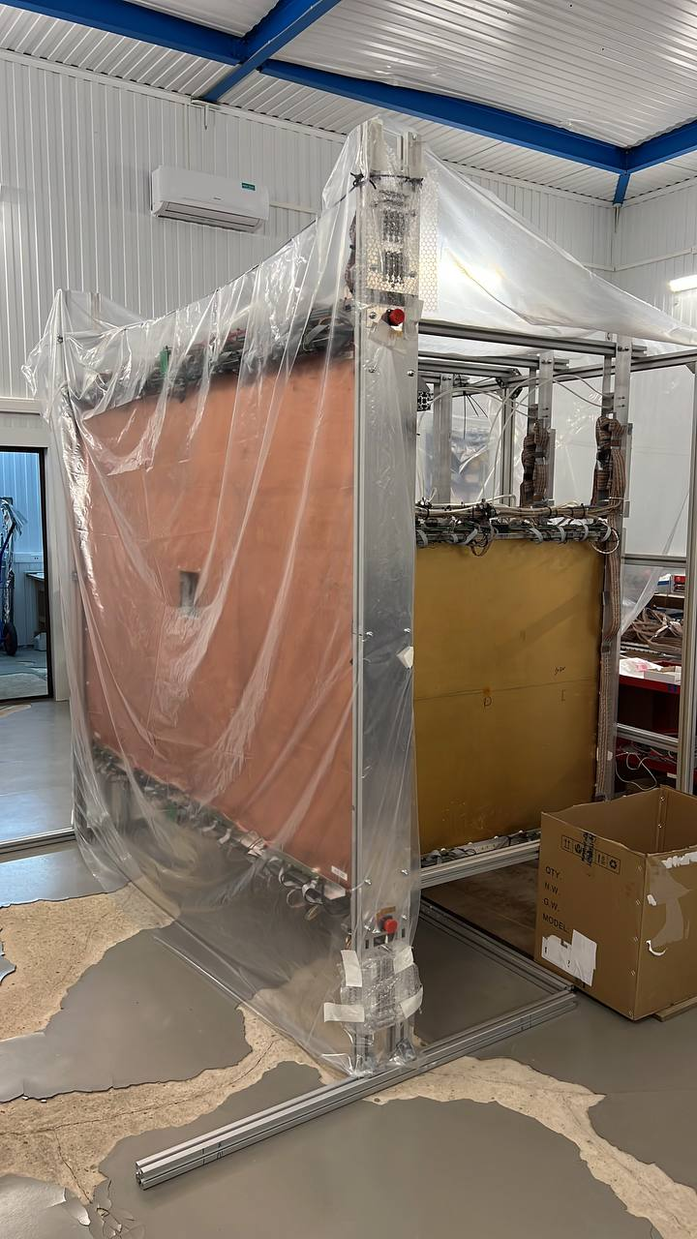
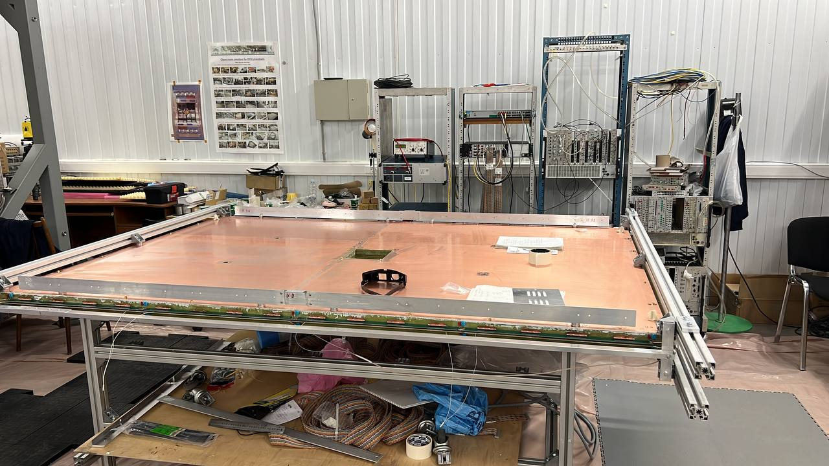
CSC
Second CSC 2×1.5 m² was produced and moved to test room. Passed HV stability tests on air (without gas mixture).
At next week detector will be equipped with front-end electronics, to check it perfomance.
4 CSC 1×1 m² and 1 CSC 2×1,5 m² were disassembly and moved to test room

Slide 11
Conclusions
All CSC at Xe run works without problems;
M7 and M15 GEM detectors was broken ;
M15 is fine – resoldered HV divider and it’s work good;
M7 is rather dead than alive – but we still try to resurrect it;
New HV divider is under development;
Gas system will be upgrade soon;
We have a plans for new cosmic ray test for GEMs;
Second CSC 2×1.5 m² was produced, and now it’s tests

Slide 12
Thanks you for your attention!

