Slide 1


Assembly accuracy of
Si-detectors in the modules and planes FwSD
E.V. Zubarev, O.G. Tarasov behalf on Forward Silicon Tracker team
10th Collaboration Meeting of the BM@N Experiment at the NICA Facility

Slide 2
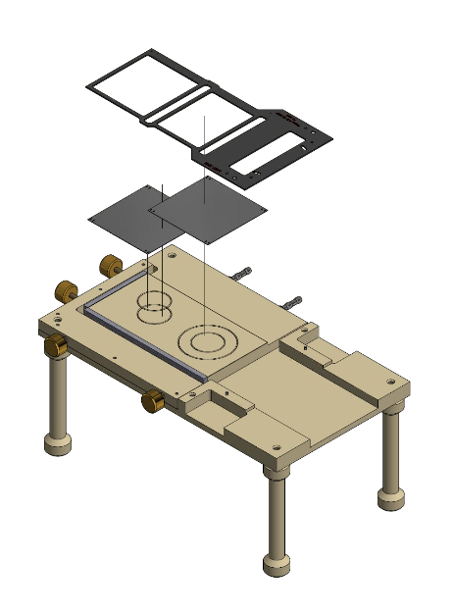
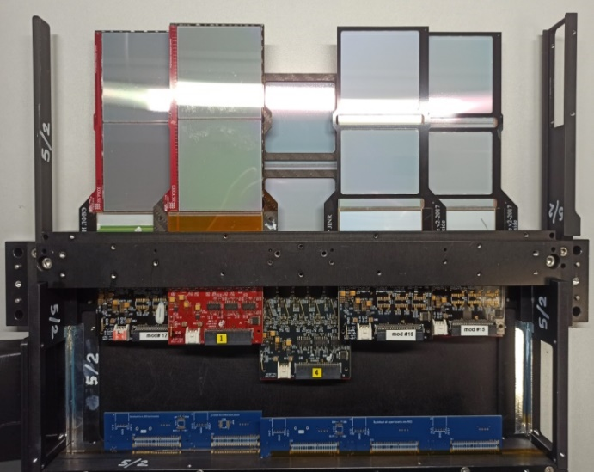
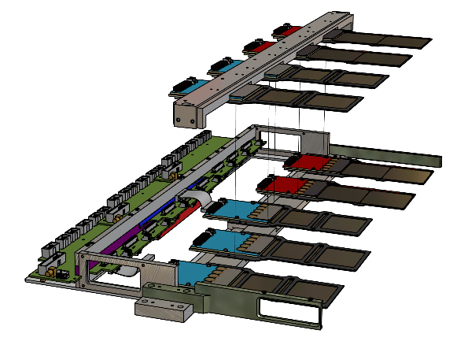
The accuracy of the assembly is based on:
On the accuracy of cutting Si-detectors using a diamond disc (through) - ±20 microns (measurement results slide # 4);
On the accuracy of assembly by the conductor of Si-detectors with a frame - ±30 μm (measurement results of the assembled modules, the inaccuracy of clause 1. is included in ±30 μm);
After assembling the plane, the true position of each Si-detector is measured on a video measuring microscope NVM II-5040D "NORGAU" with an accuracy of ±20 μm. Measurements are transmitted in the form of a file (table) to the physical group for analysis and reconstruction of "hits".
beam pipe position
module frame
Ø50
Si #2
Si #1
Y
+
Si #1
63 mm
Si #1
Si #2
Si #2
vacuum
X
126 mm
reference pin
reference pin
conductor
Assembling the module
Assembly of half-planes
Measurement of the true position of each Si-detector relative to the coordinate system (X,Y,Z) of the outer reference pins of the plane
The modules are installed in two levels with overlap.

Slide 3
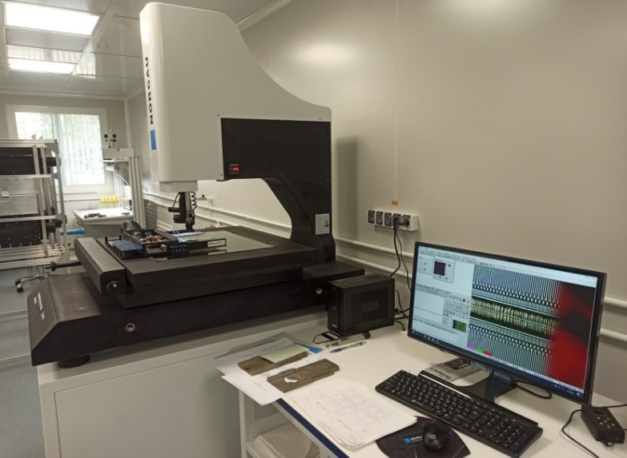
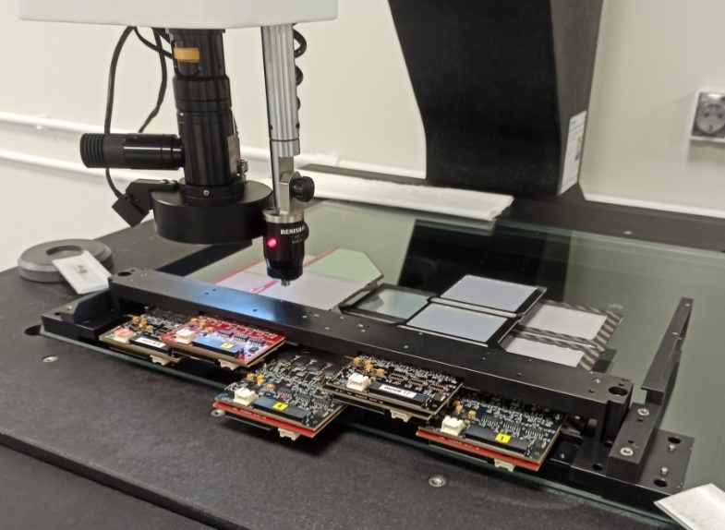
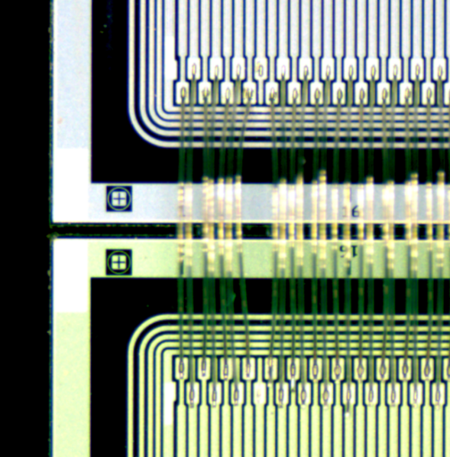
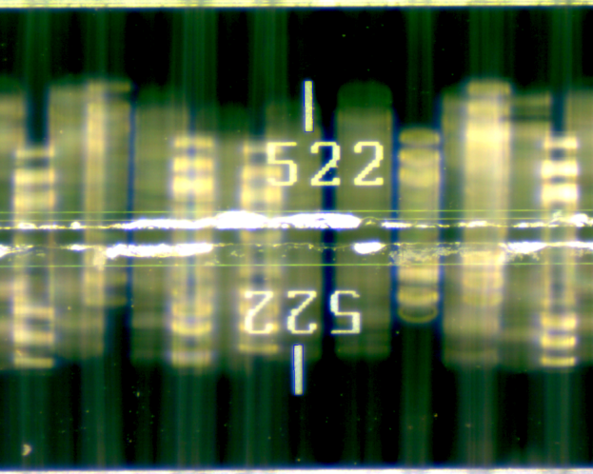
Measurements of the position of Si-detectors in modules and planes were carried out on a non-contact video measuring microscope "NORGAU" NVM II-5040D.
video measuring microscope
«NORGAU» NVM II-5040D
X- and Y-axis move range (mm) | 500 х 400
Z-axis move range (mm) | 250
Permissible absolute error of linear measurements along the X and Y axes (μm)* | ±(2.5+L/200)
Permissible absolute error of linear measurements along the Z-axis (μm)* | ±(2.5+L/100)
* L - measured length in mm
Operator's table
object to be measured
lens
Si #1
subject table
object to be measured (5 modules plane)
Si #2
Topological signs on the detector can be used as reference points
detector reference mark
no wire

Slide 4
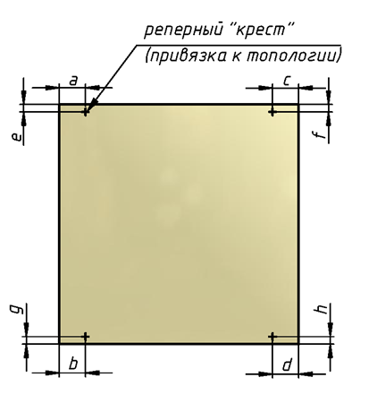
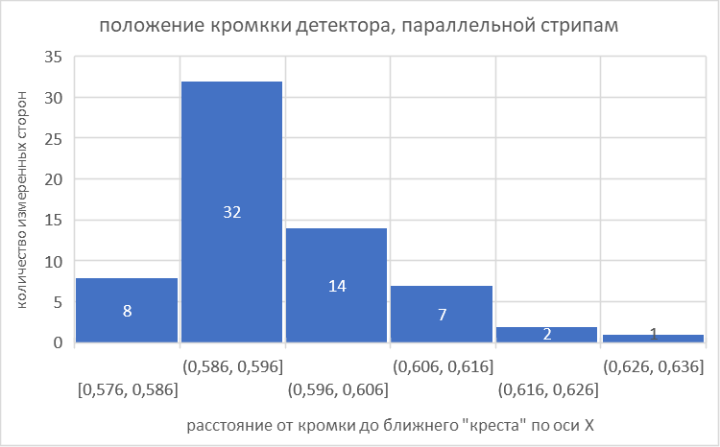
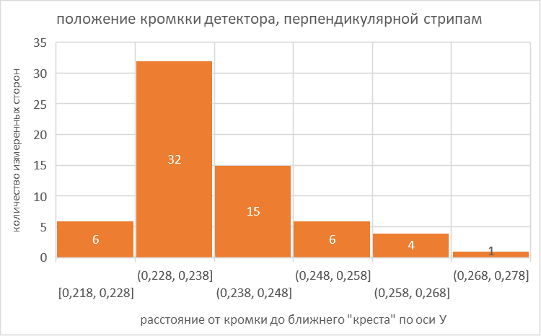
Measurement of cutting accuracy of Si detectors (mm)
sensor | a | b | c | d | e | f | g | h
#13в | 0,588 | 0,595 | 0,593 | 0,591 | 0,235 | 0,227 | 0,232 | 0,239
#13н | 0,598 | 0,603 | 0,587 | 0,581 | 0,244 | 0,247 | 0,238 | 0,236
#15/2016в | 0,595 | 0,596 | 0,592 | 0,591 | 0,234 | 0,236 | 0,233 | 0,236
#15/2016н | 0,595 | 0,594 | 0,591 | 0,595 | 0,233 | 0,233 | 0,235 | 0,232
#15в | 0,608 | 0,599 | 0,594 | 0,605 | 0,233 | 0,246 | 0,253 | 0,240
#15н | 0,603 | 0,606 | 0,588 | 0,587 | 0,234 | 0,233 | 0,251 | 0,258
#16/2017в | 0,600 | 0,595 | 0,589 | 0,591 | 0,232 | 0,230 | 0,234 | 0,234
#16/2017н | 0,602 | 0,601 | 0,581 | 0,587 | 0,242 | 0,244 | 0,225 | 0,244
#17/2016в | 0,595 | 0,593 | 0,595 | 0,597 | 0,231 | 0,232 | 0,236 | 0,240
#17/2016н | 0,595 | 0,597 | 0,593 | 0,593 | 0,234 | 0,236 | 0,230 | 0,230
#43в | 0,596 | 0,595 | 0,598 | 0,601 | 0,246 | 0,243 | 0,233 | 0,239
#43н | 0,607 | 0,603 | 0,596 | 0,592 | 0,253 | 0,249 | 0,236 | 0,238
#44в | 0,587 | 0,576 | 0,627 | 0,615 | 0,263 | 0,242 | 0,227 | 0,245
#44н | 0,584 | 0,579 | 0,612 | 0,609 | 0,259 | 0,256 | 0,220 | 0,222
#45в | 0,592 | 0,582 | 0,614 | 0,626 | 0,259 | 0,269 | 0,236 | 0,229
#45н | 0,585 | 0,576 | 0,609 | 0,622 | 0,246 | 0,261 | 0,232 | 0,218
detector reference mark
p⁺-strips
Side of p⁺-strips
Position of the detector cut line, parallel to the strips
The position of the detector cut line, perpendicular to the strips
10μm
10μm
number of measured sides
number of measured sides
595±20μm
Pads for US-bonding
distance from the cutting line to detector reference mark along the X axis
distance from the cutting line to detector reference mark along the Y axis
The spread of the position of the edge of the cutting line relative to the reference crosses is ± 20 μm
235±20μm
cutting line

Slide 5
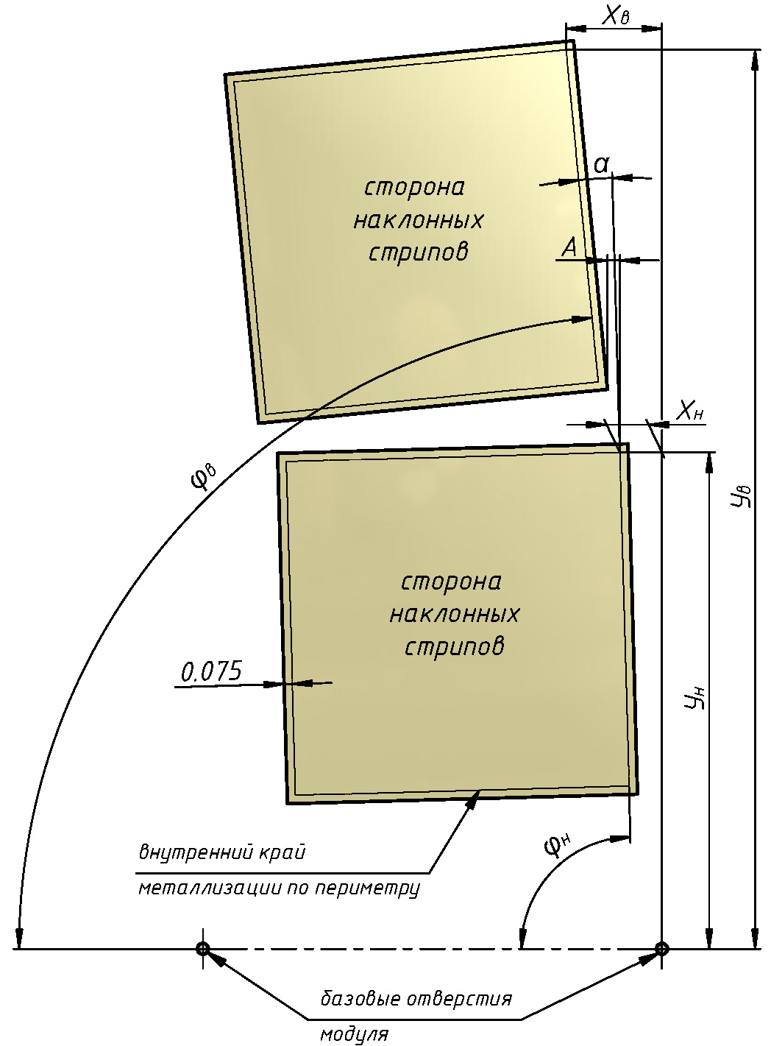
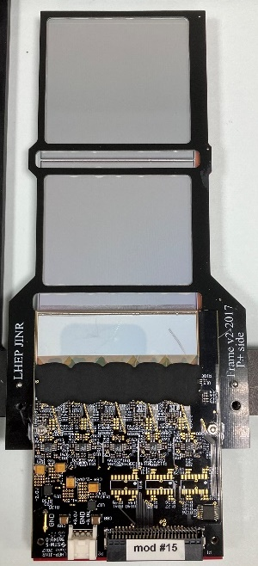
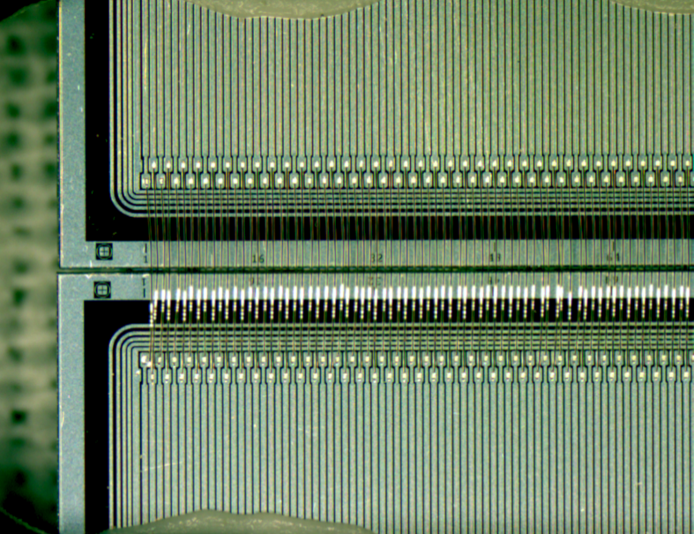
Measurement of the accuracy of the position of Si-detectors in the modules
module frame
Modul # | Хв (mm) | Ув (mm) | Хн (mm) | Ун (mm) | ϕв (deg.) | ϕн (deg.) | A (mm) | α (deg.)
#13 | 6.084 | 151.994 | 6.044 | 88.974 | 89.993 | 89.998 | 0.031 | 0.005
#15/2016 | 6.082 | 152.029 | 6.053 | 89.001 | 89.969 | 89.993 | -0.006 | 0.025
#15 | 6.094 | 152.003 | 6.046 | 88.978 | 89.974 | 89.988 | 0.019 | 0.014
#16/2017 | 6.079 | 152.031 | 6.047 | 88.987 | 89.973 | 89.994 | 0.002 | 0.021
#17/2016 | 6.112 | 152.032 | 6.038 | 88.980 | 89.960 | 89.997 | 0.031 | 0.037
#43 | 6.078 | 152.012 | 6.064 | 88.968 | 89.973 | 89.972 | -0.015 | -0.001
#44 | 6.122 | 152.026 | 6.101 | 88.972 | 89.936 | 89.954 | -0.028 | 0.018
#45 | 6.128 | 152.002 | 6.074 | 88.936 | 89.967 | 90.000 | 0.017 | 0.033
side of inclined strips
63 mm
Si #1
Si #2
side of inclined strips
126 mm
The accuracy of the assembly is ± 30 microns according to the measurement results.
Baseline through pins centers
20 μm
X-strip
ϕ_{в}
shift between reference marks ±30 μm
+0,02 °
- 0,04 °
ϕ = 89,98°
ϕ_{н}
Baseline through pins centers
alignment line

Slide 6
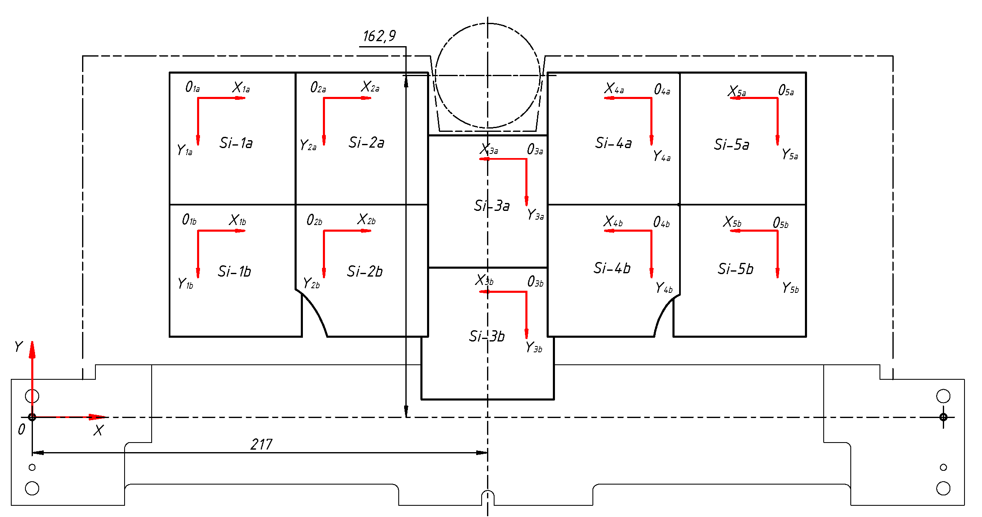
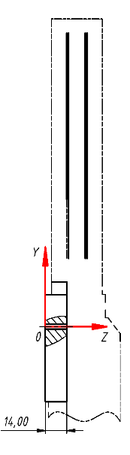
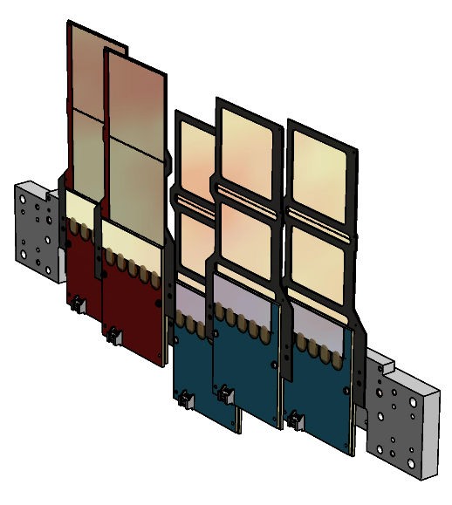
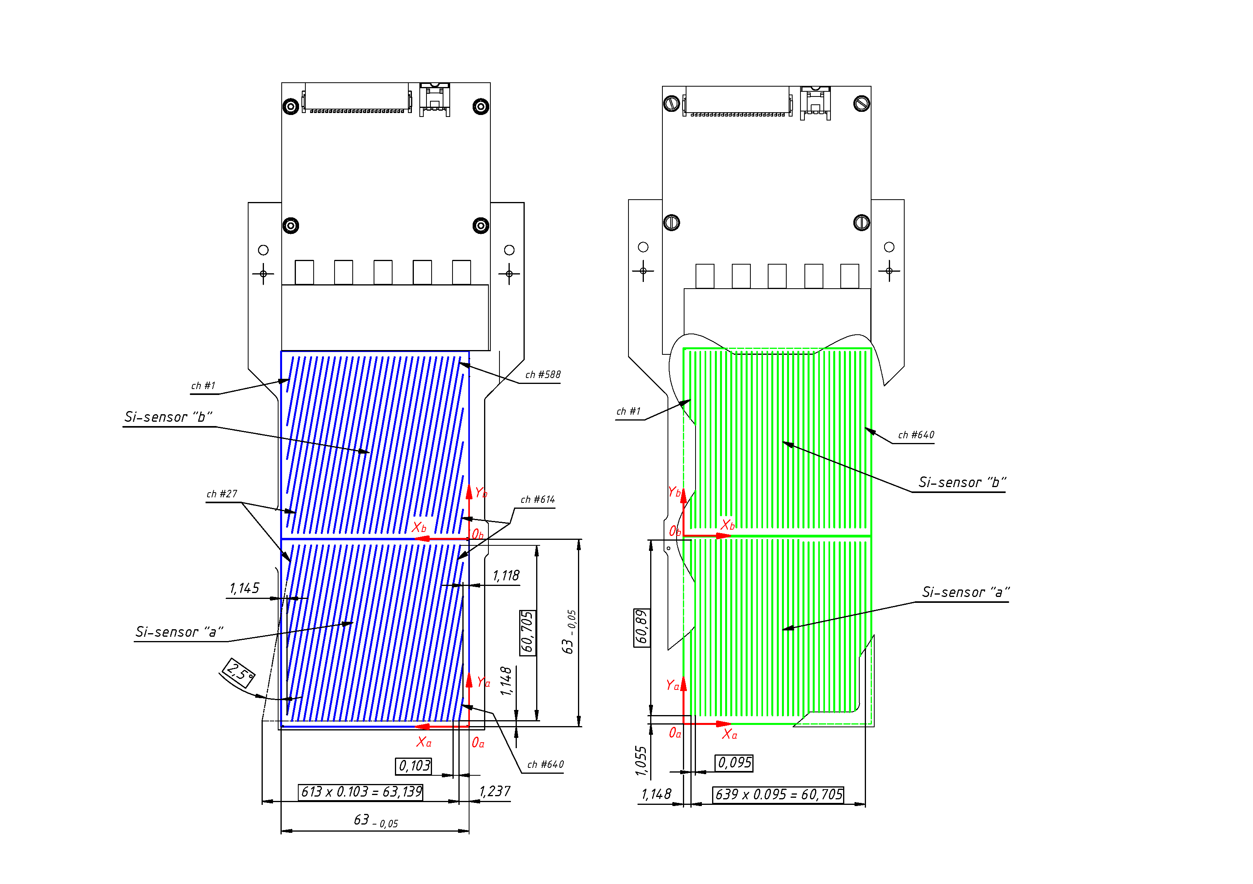
The true position of Si-detectors in the half-plane (5 modules).
(The measurement data is transmitted to the physical group).
#34
#16
#41
#24
Si-detectors
#21
base bar
reference pin
reference pin
base surface
Position of Si-detectors in the half-plane
# 5/2 (06.07.22)
Side of inclined strips (N+)
Side of parallel strips (P+)
detector location | X±0.02* (mm) | Y±0.02* (mm) | rotation in the plane 0XY (deg.) | Z±0.2** (mm) | Module Serial Number
Si-1a | 65.63 | 164.25 | 0.03 cw | 15.9 | #34
Si-1b | 65.64 | 101.26 | 0.01 cсw | 15.7
Si-2a | 125.54 | 164.23 | 0.04 cсw | 27.5 | #16
Si-2b | 125.61 | 101.26 | 0.01 сw | 27.5
Si-3a | 248.69 | 134.23 | 0.02 сw | 14.5 | #41
Si-3b | 248.60 | 71.23 | 0.03 сw | 14.2
Si-4a | 308.50 | 164.25 | 0.01 сw | 26.1 | #24
Si-4b | 308.51 | 101.26 | 0 | 26.0
Si-5a | 368.71 | 164.27 | 0.07 cw | 14.4 | #21
Si-5b | 368.61 | 101.27 | 0.03 cw | 14.2
*-position of the origin point of the Si-detectors in the coordinate plane 0XY (tied to the outer reference pins).
**-the distance from the base surface of the base bar to the middle of the Si-detector surface farthest from it.

Slide 7
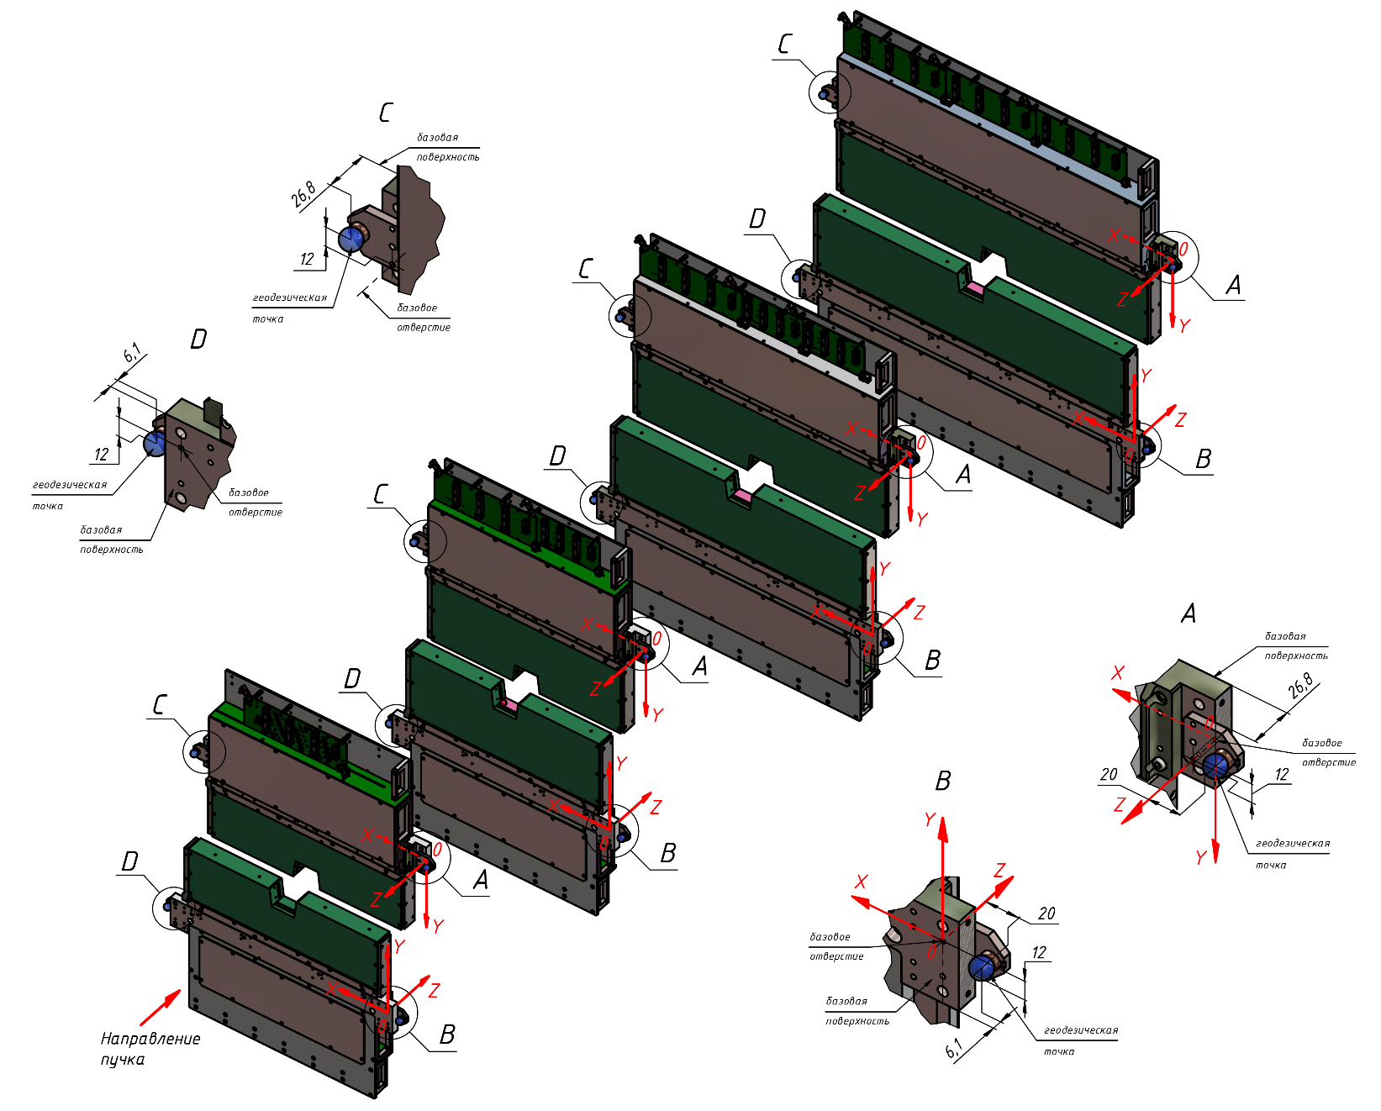
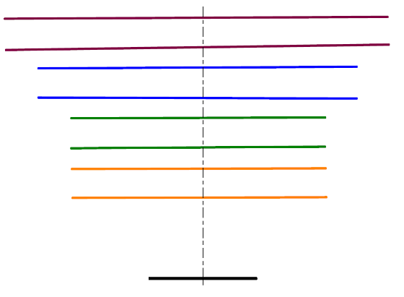
Results of measurements of the location of half-planes in the BM@N-2022 (physical session - run Xe).
Linking half-plane bases to geodetic measurement points
SC Description:
- origin point (0,0,0) is the geometric center of the edge of the lower pole of the magnet SP - 41.
- the Z axis is directed along the beam axis;
- the Y axis is directed upwards perpendicular to the horizon;
Measurements 07.02.2023
X= 369.33
Y= 177.75
Z= 451.16
Data from the report of LLC "Industrial Measurements " “Measurement of the actual position of the detectors of the BM@N installation and their alignment to the design position relative to the beam – 2022.”
X= 306.81
Y= 174.19
Z= 365.13
X= 367.06
Y= -177.24
Z= 396.97
X= -344.63
Y= 179.33
Z= 454.28
X= 306.77
Y= -175.32
Z= 314.48
X= 245.57
Y= 173.80
Z= 278.85
X= -346.93
Y= -174.45
Z= 406.22
X= 245.74
Y= -175.67
Z= 226.68
X= -287.07
Y= 173.01
Z= 367.79
X= -287.15
Y= -176.48
Z= 312.86
X= 244.49
Y= 140.28
Z= 190.76
X= -228.51
Y= 172.87
Z= 279.80
Top view
X= 243.22
Y= -143.73
Z= 140.71
0,25°
#9/2
0,74°
#9/1
X= -228.26
Y= -177.19
Z= 229.44
0,26°
#7/2
0,16°
#7/1
X= -229.46
Y= 141.92
Z= 191.76
0,11°
#5/2
0,33°
#5/1
Y
Z
0,12°
#3/2
X
0,13°
#3/1
X= -230.78
Y= -143.06
Z= 141.75
Z
X

Slide 8
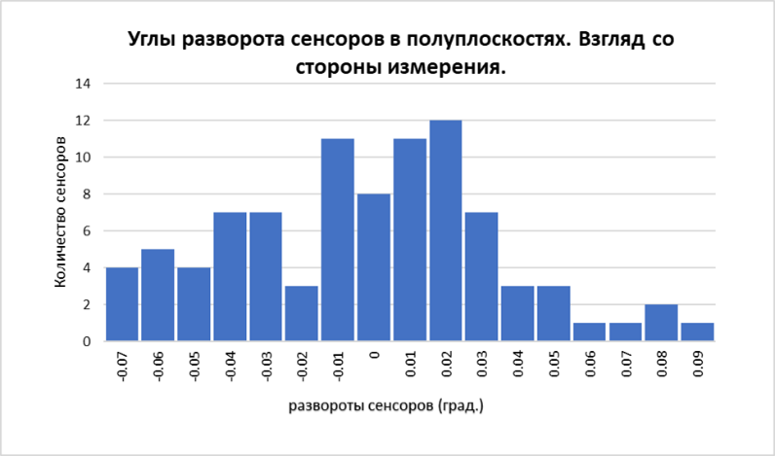
True positions of Si-detectors on all planes by session BM@N-2022 (physical session -run Xe). The data is transferred to the physical group.
Положение Si-сенсоров в полуплоскости
# 3/1 (12.07.22)
Положение Si-сенсоров в полуплоскости
# 3/2 (12.07.22)
Положение Si-сенсоров в полуплоскости # 7/1 (17.03.22)
Положение Si-сенсоров в полуплоскости # 7/2 (17.03.22)
Позиция сенсора | X±0.02* (мм) | Y±0.02* (мм) | Разворот в плоскости 0XY (град.)** | Z±0.2*** (мм) | Серийный номер модуля
Si-1 | 125.48 | 130.98 | 0.04 пр. час. | 27.9 | #3-0/22
Si-2 | 248.54 | 101.10 | 0.03 пр. час. | 14.0 | #2-0/22
Si-3 | 308.48 | 131.00 | 0 | 26.1 | #1-0/22
Позиция сенсора | X±0.02* (мм) | Y±0.02* (мм) | Разворот в плоскости 0XY (град.)** | Z±0.2*** (мм) | Серийный номер модуля
Si-1 | 125.56 | 130.86 | 0.02 пр. час. | 27.0 | #5-0/22
Si-2 | 248.52 | 101.13 | 0.04 пр. час. | 14.5 | #6-0/22
Si-3 | 308.50 | 131.12 | 0.01 по час. | 26.0 | #4-0/22
Позиция сенсора | X±0.02* (мм) | Y±0.02* (мм) | Разворот в плоскости 0XY (град.)** | Z±0.2*** (мм) | Серийный номер модуля
Si-1a | 65.59 | 164.17 | 0.05 пр. час. | 27.7 | #14
Si-1b | 65.48 | 101.15 | 0.05 пр. час. | 27.6
Si-2a | 125.53 | 164.26 | 0.06 пр. час. | 15.8 | #36
Si-2b | 125.57 | 101.28 | 0.05 пр. час. | 15.6
Si-3a | 185.55 | 164.18 | 0.07 пр. час. | 27.6 | #9
Si-3b | 185.57 | 101.18 | 0.06 пр. час. | 27.5
Si-4a | 308.56 | 134.28 | 0.03 по час. | 13.9 | #33
Si-4b | 308.47 | 71.31 | 0.03 пр. час. | 13.9
Si-5a | 368.61 | 164.27 | 0.02 по час. | 25.4 | #30
Si-5b | 368.53 | 101.27 | 0 | 25.9
Si-6a | 428.63 | 164.26 | 0.02 по час. | 14.2 | #15
Si-6b | 428.55 | 101.27 | 0.01 по час. | 14.0
Si-7a | 488.77 | 164.20 | 0.08 по час. | 25.6 | #29
Si-7b | 488.63 | 101.21 | 0.08 по час. | 26.0
Позиция сенсора | X±0.02* (мм) | Y±0.02* (мм) | Разворот в плоскости 0XY (град.)** | Z±0.2*** (мм) | Серийный номер модуля
Si-1a | 65.53 | 164.30 | 0 | 26.9 | #7
Si-1b | 65.53 | 101.32 | 0.02 по час. | 27.2
Si-2a | 125.36 | 164.20 | 0.07 пр. час. | 15.7 | #22
Si-2b | 125.43 | 101.20 | 0.03 пр. час. | 15.5
Si-3a | 185.55 | 164.31 | 0.01 пр. час. | 27.3 | #2-21
Si-3b | 185.56 | 101.29 | 0.01 по час. | 27.4
Si-4a | 308.44 | 134.11 | 0.02 по час. | 14.4 | #6-21
Si-4b | 308.41 | 71.12 | 0 | 14.1
Si-5a | 368.50 | 164.27 | 0.03 по час. | 27.1 | #4-21
Si-5b | 368.47 | 101.27 | 0.02 по час. | 26.2
Si-6a | 428.30 | 164.27 | 0.03 пр. час. | 14.0 | #31
Si-6b | 428.33 | 101.29 | 0.04 пр. час. | 13.9
Si-7a | 488.47 | 164.24 | 0.01 по час. | 26.0 | #1-20
Si-7b | 488.46 | 101.22 | 0.04 по час. | 25.9
Положение Si-сенсоров в полуплоскости
# 5/1 (11.07.22)
Положение Si-сенсоров в полуплоскости
# 5/2 (06.07.22)
Позиция сенсора | X±0.02* (мм) | Y±0.02* (мм) | Разворот в плоскости 0XY (град.)** | Z±0.2*** (мм) | Серийный номер модуля
Si-1a | 65.51 | 164.29 | 0.04 пр. час. | 14.9 | #35
Si-1b | 65.66 | 101.19 | 0.06 пр. час. | 15.3
Si-2a | 125.53 | 164.25 | 0.01 пo час. | 27.2 | #38
Si-2b | 125.57 | 101.18 | 0.01 пр. час. | 27.4
Si-3a | 248.43 | 134.28 | 0.04 пo час. | 14.6 | #42
Si-3b | 248.47 | 71.27 | 0.01 пo час. | 14.3
Si-4a | 308.52 | 164.23 | 0.03 пo час. | 25.9 | #27
Si-4b | 308.49 | 101.24 | 0.01 пo час. | 26.0
Si-5a | 368.43 | 164.32 | 0.01 пр. час. | 14.3 | #32
Si-5b | 368.42 | 101.32 | 0.07 пр. час. | 14.2
Позиция сенсора | X±0.02* (мм) | Y±0.02* (мм) | Разворот в плоскости 0XY (град.)** | Z±0.2*** (мм) | Серийный номер модуля
Si-1a | 65.63 | 164.25 | 0.03 пo час. | 15.9 | #34
Si-1b | 65.64 | 101.26 | 0.01 пр. час. | 15.7
Si-2a | 125.54 | 164.23 | 0.04 пр. час. | 27.5 | #16
Si-2b | 125.61 | 101.26 | 0.01 пo час. | 27.5
Si-3a | 248.69 | 134.23 | 0.02 пo час. | 14.5 | #41
Si-3b | 248.60 | 71.23 | 0.03 пo час. | 14.2
Si-4a | 308.50 | 164.25 | 0.01 пo час. | 26.1 | #24
Si-4b | 308.51 | 101.26 | 0 | 26.0
Si-5a | 368.71 | 164.27 | 0.07 пo час. | 14.4 | #21
Si-5b | 368.61 | 101.27 | 0.03 пo час. | 14.2
Положение Si-сенсоров в полуплоскости # 9/1 (31.03.22)
Положение Si-сенсоров в полуплоскости # 9/1 (31.03.22)
Позиция сенсора | X±0.03* (мм) | Y±0.05* (мм) | Разворот в плоскости 0XY (град.)** | Z±0.2*** (мм) | Серийный номер модуля
Si-1a | 65.56 | 164.26 | 0.03 пр. час. | 15.4 | #12
Si-1b | 65.50 | 101.26 | 0.05 пр. час. | 15.5
Si-2a | 125.57 | 164.19 | 0.04 пр. час. | 26.7 | #5-21
Si-2b | 125.52 | 101.27 | 0.03 пр. час. | 27.3
Si-3a | 185.64 | 164.34 | 0 | 15.8 | #25
Si-3b | 185.54 | 101.35 | 0.01 по час. | 15.7
Si-4a | 245.49 | 164.30 | 0.07 пр. час. | 27.4 | #18
Si-4b | 245.47 | 101.32 | 0.06 пр. час. | 27.5
Si-5a | 368.53 | 134.35 | 0.02 по час. | 14.7 | #31
Si-5b | 368.45 | 71.37 | 0.01 пр. час. | 14.4
Si-6a | 428.51 | 164.30 | 0 | 25.9 | #40
Si-6b | 428.45 | 101.30 | 0.01 пр. час. | 26.1
Si-7a | 488.70 | 164.33 | 0.03 по час. | 14.5 | #23
Si-7b | 488.56 | 101.33 | 0.05 по час. | 14.4
Si-8a | 548.54 | 164.33 | 0.01 пр. час. | 25.6 | #26
Si-8b | 548.46 | 101.34 | 0.01 пр. час. | 25.9
Si-9a | 608.68 | 164.30 | 0.05 по час. | 14.6 | #11
Si-9b | 608.55 | 101.28 | 0.02 по час. | 14.4
Позиция сенсора | X±0.03* (мм) | Y±0.05* (мм) | Разворот в плоскости 0XY (град.)** | Z±0.2*** (мм) | Серийный номер модуля
Si-1a | 65.61 | 164.27 | 0.01 пр. час. | 15.8 | #39
Si-1b | 65.61 | 101.24 | 0 | 15.7
Si-2a | 125.49 | 164.25 | 0.02 пр. час. | 27.6 | #8 #9-2017
Si-2b | 125.54 | 101.22 | 0.01 по час. | 27.6
Si-3a | 185.46 | 164.18 | 0.06 пр. час. | 15.9 | #28
Si-3b | 185.52 | 101.17 | 0.04 пр. час. | 15.7
Si-4a | 245.55 | 164.26 | 0.03 пр. час. | 27.5 | #20
Si-4b | 245.58 | 101.25 | 0.02 пр. час. | 27.6
Si-5a | 368.53 | 134.17 | 0.02 по час. | 14.3 | #10
Si-5b | 368.49 | 71.15 | 0.01 пр. час. | 14.1
Si-6a | 428.51 | 164.20 | 0.02 по час. | 26.1 | #19
Si-6b | 428.47 | 101.20 | 0.01 пр. час. | 26.0
Si-7a | 488.67 | 164.13 | 0.09 по час. | 14.9 | #3-21 #10-2017
Si-7b | 488.57 | 101.13 | 0.06 по час. | 14.3
Si-8a | 548.57 | 164.14 | 0.02 по час. | 26.1 | #13
Si-8b | 548.52 | 101.12 | 0.02 по час. | 26.1
Si-9a | 608.67 | 164.14 | 0.05 по час. | 14.1 | #17
Si-9b | 608.57 | 101.14 | 0.04 по час. | 14.0
*-положение точки начала координат Si-сенсора в координатной плоскости 0XY (привязана к наружным базовым отверстиям).
**-взгляд на лист.
***-расстояние от базовой поверхности базовой рейки до середины дальней от неё поверхности Si-сенсора.
The angles of rotation of the detectors in half-planes. View from the measurement side
number of detectors
Si-detectors rotations (deg.)

Slide 9
Conclusions:
The correct method of assembling Si-detectors into a module based on the positioning of Si-detectors by the cutting line on the conductor has been chosen;
Measuring the position of each Si-detector after assembling the planes compensates for inaccuracies in intermediate assembly operations;
In preparation for the next session of the BM@N experiment, the installation of planes should be carried out under the supervision of surveyors;
By the next session of the BM@N experiment, make changes to the design of the planes to install additional geodetic marks

Slide 10
Спасибо за внимание!

