Slide 1
Performance studies towards flow
measurements in BM@N
Mikhail Mamaev (MEPhI, INR RAS)
Petr Parfenov (MEPhI, INR DVA)
Arkady Taranenko (MEPhI, JINR)
This work is supported by: the Special Purpose Funding Programme within the NICA Megascience Project in 2023 and the RSF grant No. 22-12-00132
BM@N collaboration meeting, 16/05/2023

Slide 2
Anisotropic flow & spectators
The azimuthal angle distribution is decomposed in a Fourier series relative to reaction plane angle:
Anisotropic flow:
Anisotropic flow is sensitive to:
Time of the interaction between overlap region and spectators
Compressibility of the created matter
Notes:
At the first moment of the collision there’s the spatial anisotropy, of energy distribution inside the overlapping region. By means of the interaction of matter this asymmetry into anisotropic emission of produced particles
Reaction plane, it is a plane laying on vectors of beam direction and impact parameter. Expanding dense matter in the overlap region bounces off spectator fragments in the plane, that they can be used for symmetry plane estimation.
Decomposing the azimuthal angle distribution of produced particles in a Fourier series, one gets such an equation. The coefficients of this decomposition, “vn” are called the flow on n-th harmonic. First harmonic coefficient has specific name directed flow

Slide 3
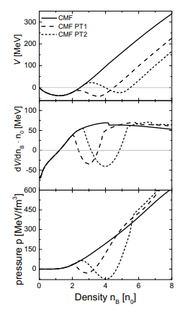
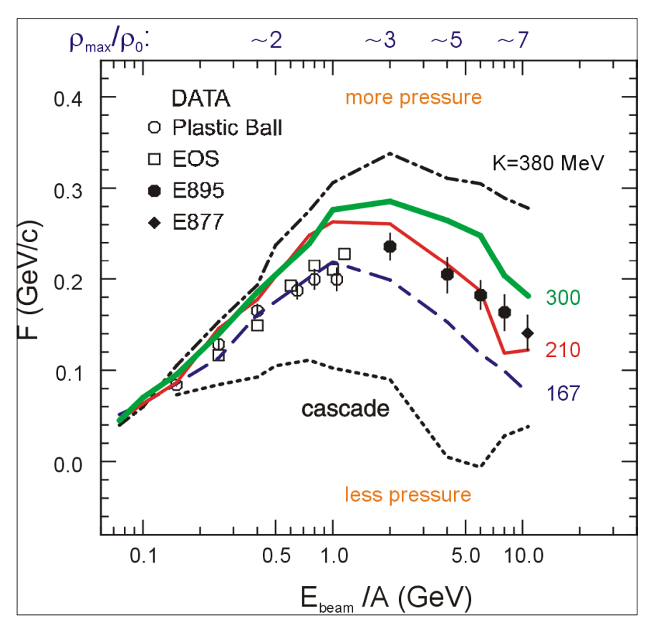
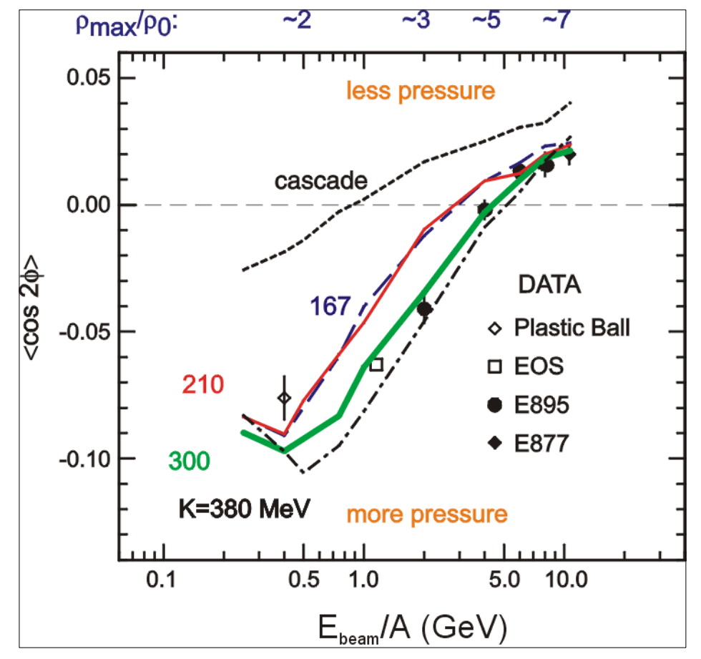
v_{n} as a function of collision energy
P. DANIELEWICZ, R. LACEY, W. LYNCH
10.1126/science.1078070
v₁ suggests softer EOS
v₂ suggests harder EOS
EPJ Web of Conferences 276, 01021 (2023)
Describing the high-density matter using the mean field
Flow measurements constrain the mean field
Discrepancy is probably due to non-flow correlations

Slide 4
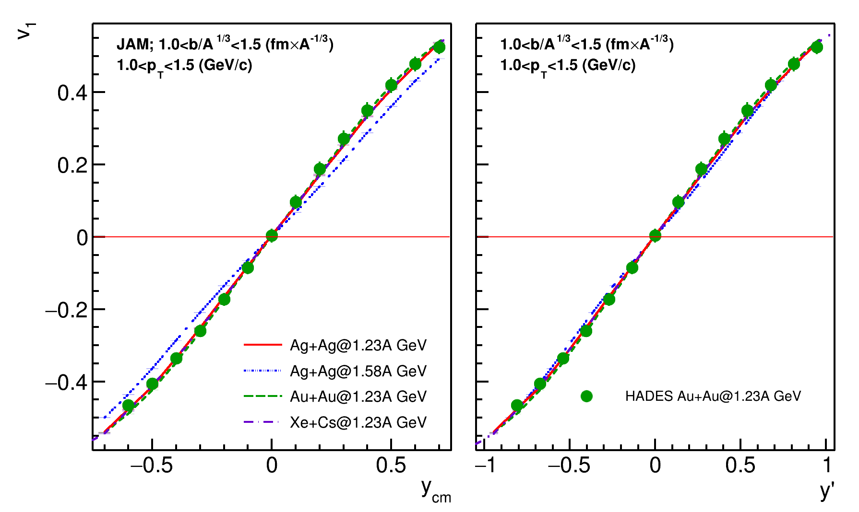
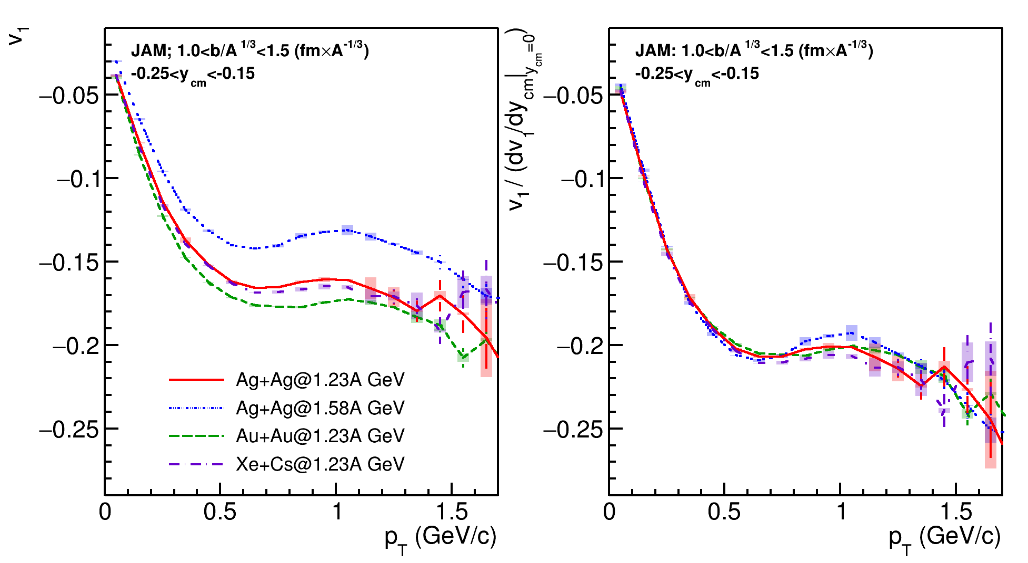
HADES: dv₁/dy scaling with collision energy and system size
Scaling with collision energy is observed in model and experimental data
Scaling with system size is observed in model and experimental data
We can compare the results with HIC-data from other experiments(e.g. STAR-FXT Au+Au

Slide 5
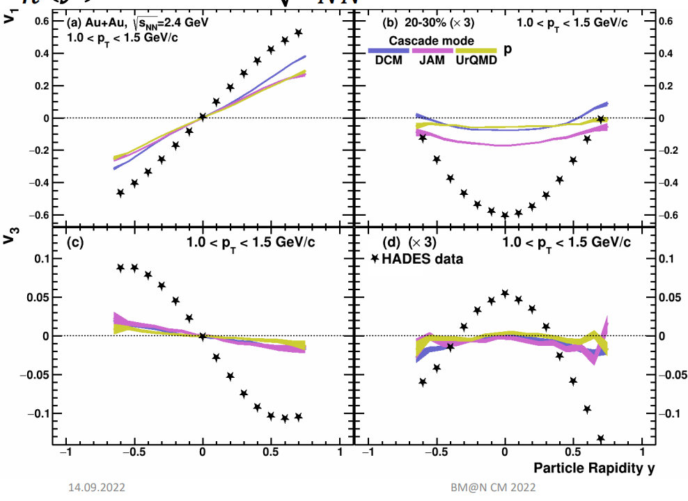
Simulation datasample
See talk of P.Parfenov
Xe+Cs nuclei collisions
DCMQGSM-SMM model (realistic yields of spectator fragments), describes flow poorly
JAM model (realistic flow signal)
Geant4 transport code (important for simulation of hadronic showers in the forward calorimeter)
 | 2A GeV | 3A GeV | 4A GeV
DCMQGSM-SMM | 6M | 6M | 2M
JAM MD2 | 3M | 3M | 5M

Slide 6
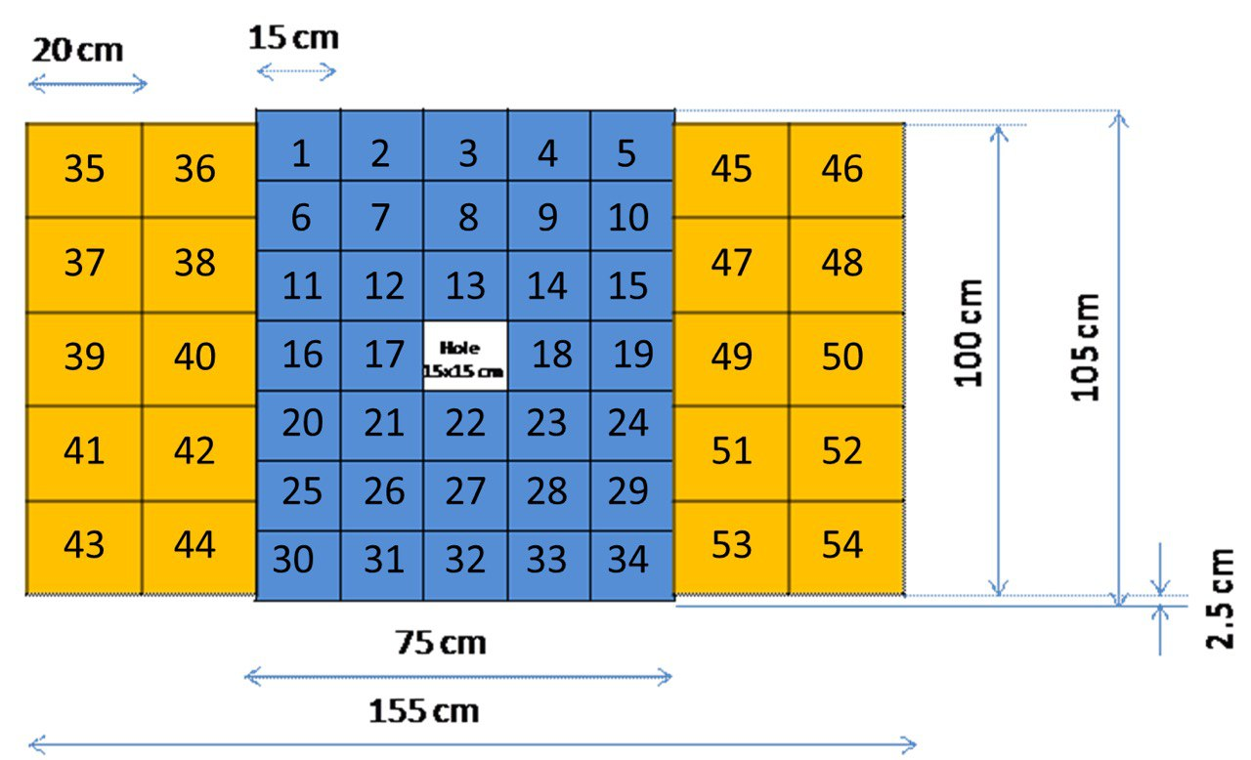
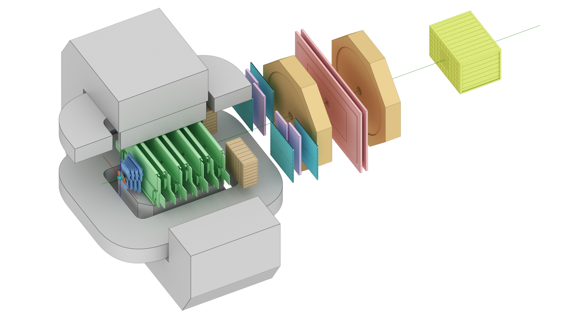
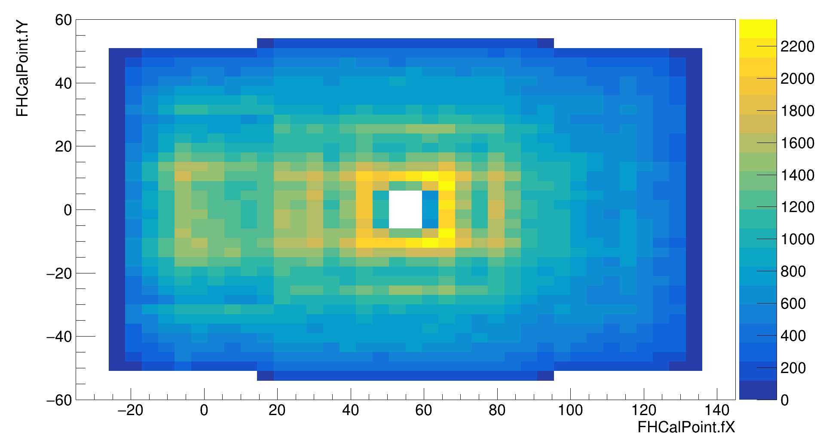
The BM@N experiment (GEANT4 simulation for RUN8)
FHCal
Silicon + GEM
TOF-700
TOF-400
neutron
x=0
ion
proton
L1 tracking was used together with true-MC PID
Symmetry plane estimation with the azimuthal asymmetry of projectile spector energy
Notes:
Схема эксперимента хадес на слайде.
Траектории рожденных частиц регистристрируются трекинговой системой, состоящей из …
Импульс восстанавливается по отклонению частиц в магнитном поле
Идентификация производится при помощи детекторов времени пролета … которые регистрируют время пролета. Зная длину траектории можно вычислить массу частицы.
Спектаторы регистрируются детектором FW. Поскольку они отклоняются в плоскости реакции материей в области перекрытия, спектаторы используются для оценки угла плоскости реакции.
Всего столько статистики ...

Slide 7
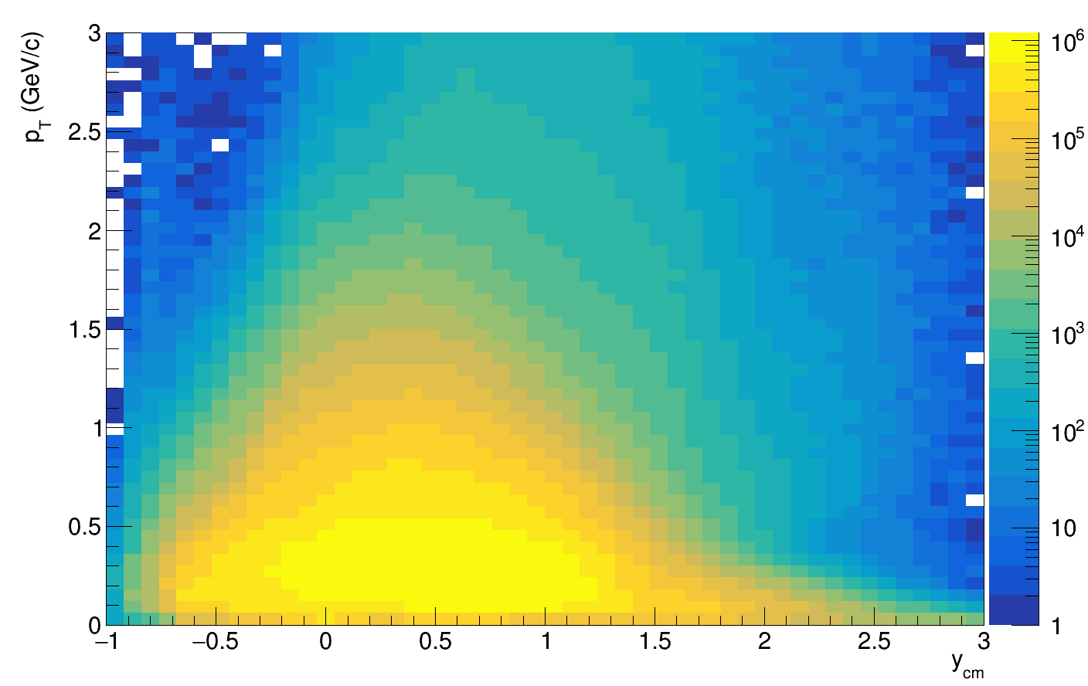
Flow vectors
F3
Q{F2}
Q{F3}
F2
F1
From momentum of each measured particle define a u_{n}-vector in transverse plane:
Q{F1}
where φ is the azimuthal angle
Sum over a group of u_{n}-vectors in one event forms Q_{n}-vector:
Tp
Tπ-
Additional subevents from tracks not pointing at FHCal:
Tp: p; 0.4<y<0.6; 0.2 < p_{T} < 2 GeV/c; w=1/eff
Tπ: π-; 0.2<y<0.8; 0.1 < p_{T} < 0.5 GeV/c; w=1/eff
T-: all negative; 1.0<η<2.0; 0.1 < p_{T} < 0.5 GeV/c; w=1/eff
Ψ_{n}^{EP} is the event plane angle
Notes:
Let’s introduce flow vectors. Every particle in event represent as un vector in transverse plane, where phi is azimuthal angle of particle’s momentum. Summation over this un-vectors results with Qn vector, which is directed to symmetry plane of the event. This plane is called Event plane, and the transverse angle of this plane is called event plane angle relatively.

Slide 8
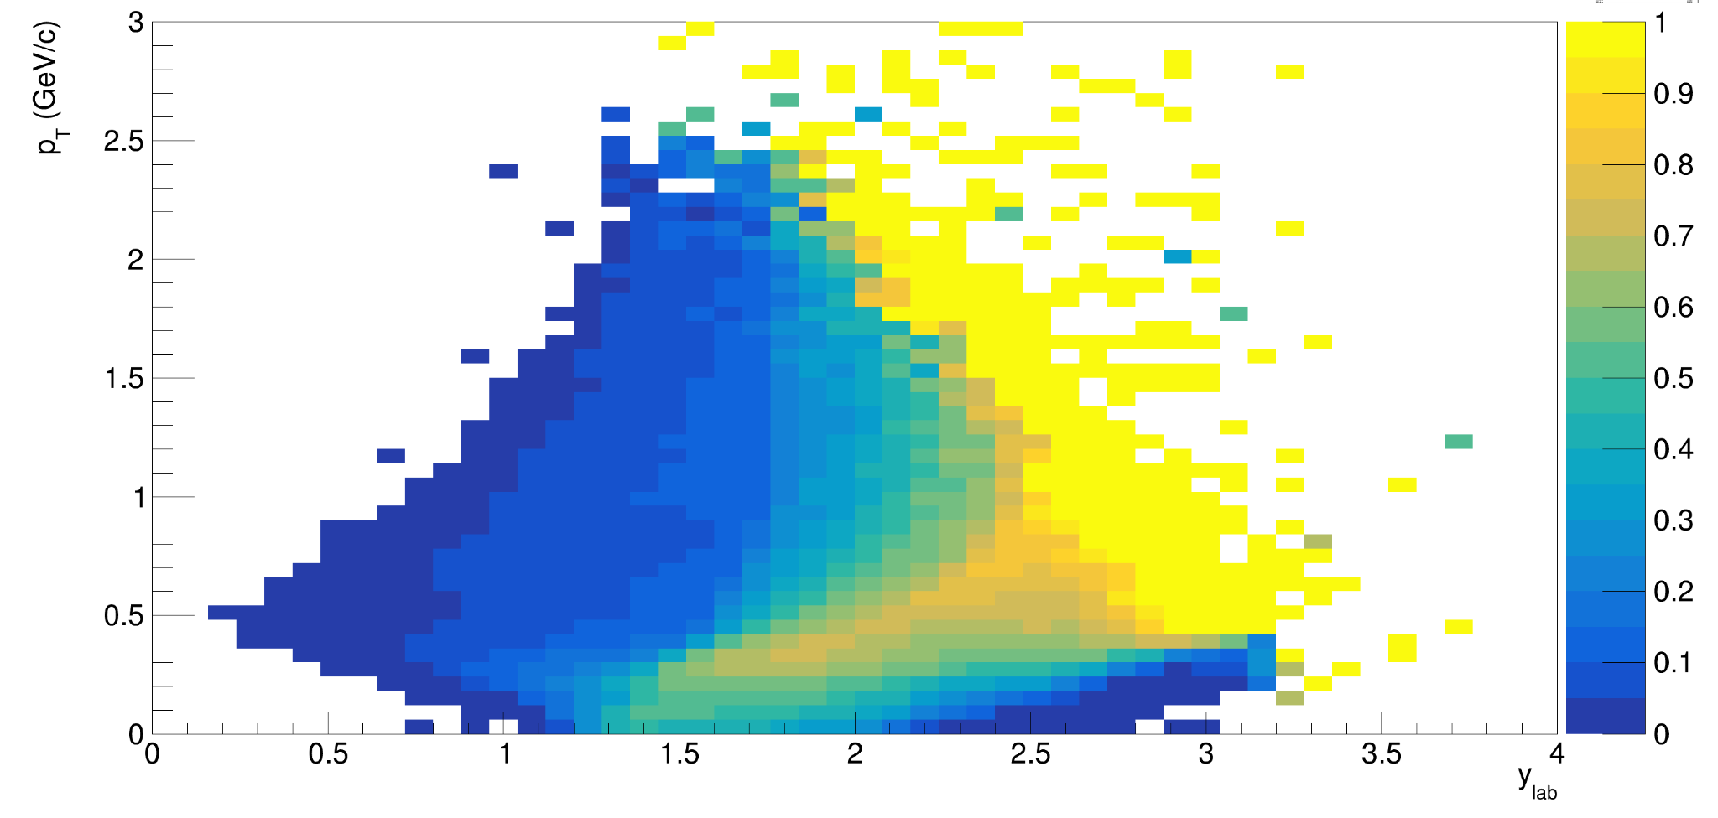
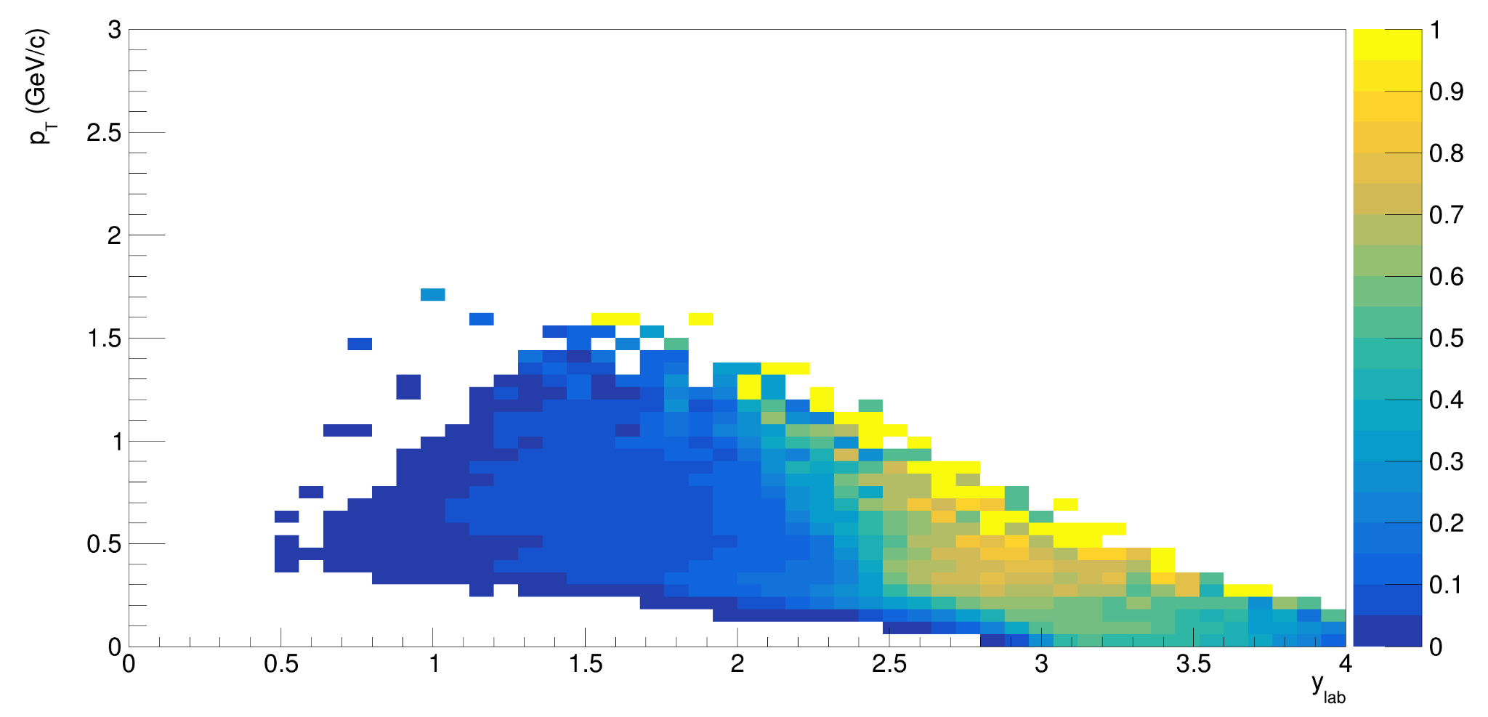
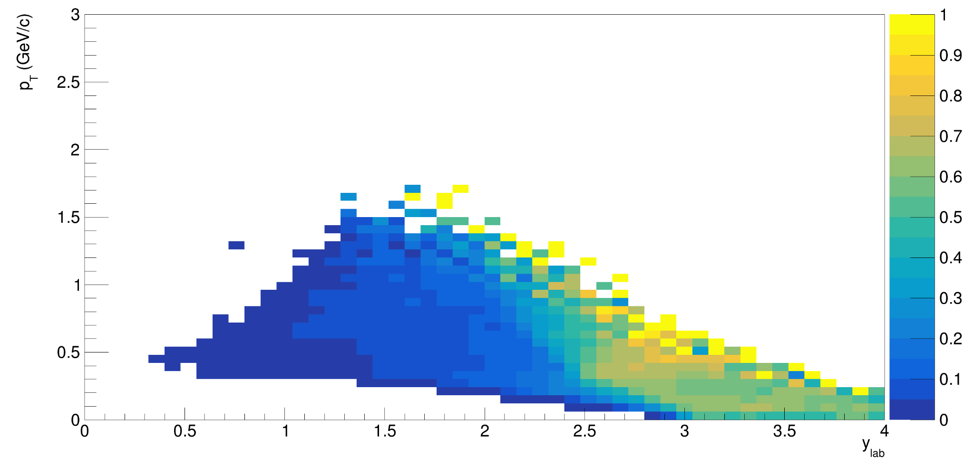
Tracking efficiency (matched to TOF-400 or TOF-700)
p
Measuring flow at midrapidity is crucial to compare with data from other experiment
We observe very low efficiency at midrapidity due to very narrow TOF acceptance
Optimization of TOF detectors position is required (maybe move TOF-700 closer to target?)
Very low efficiency
at y_{cm}=0
𝛑⁺
𝛑⁻
Almost no pions are identifiable at y=0
Even worse for TOF-matched tracks

Slide 9
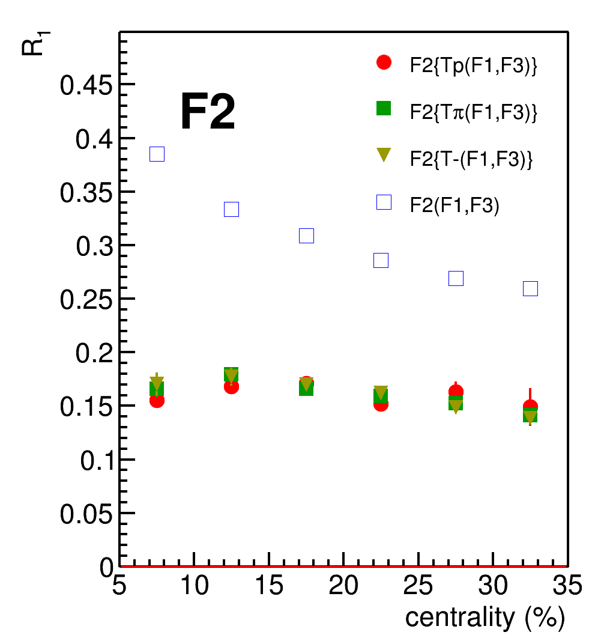
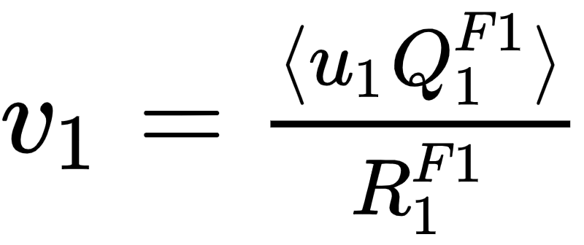
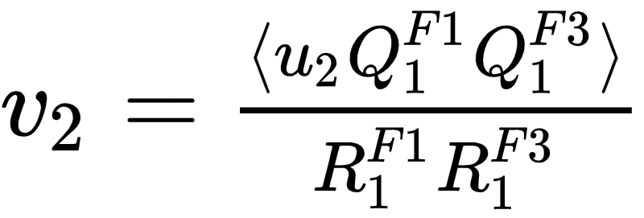
Flow methods for v_{n} calculation
Method helps to eliminate non-flow
Using 2-subevents doesn’t
Tested in HADES:
M Mamaev et al 2020 PPNuclei 53, 277–281
M Mamaev et al 2020 J. Phys.: Conf. Ser. 1690 012122
Scalar product (SP) method:
👎
Where R₁ is the resolution correction factor
Symbol “F2(F1,F3)” means R₁ calculated via (3S resolution):
Symbol “F2{Tp}(F1,F3)” means R₁ calculated via (4S resolution):
Notes:
In this work two methods of flow calculation are used: Event plane for cross-checks and scalar product for the analysis. In the first method, one estimates event plane angle and measures mean cosine of particles azimuthal angle. Then, resolution of event plane estimation is applied. Resolution is calculated with random sub event method. In the scalar product the correlation between flow vectors are calculated and then, the resolution correction is applied estimated with 3-sub event method.

Slide 10
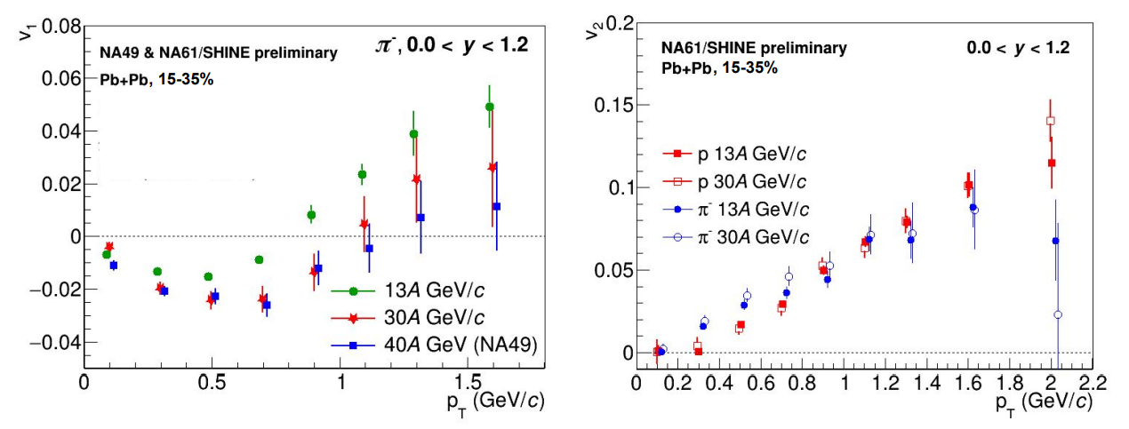
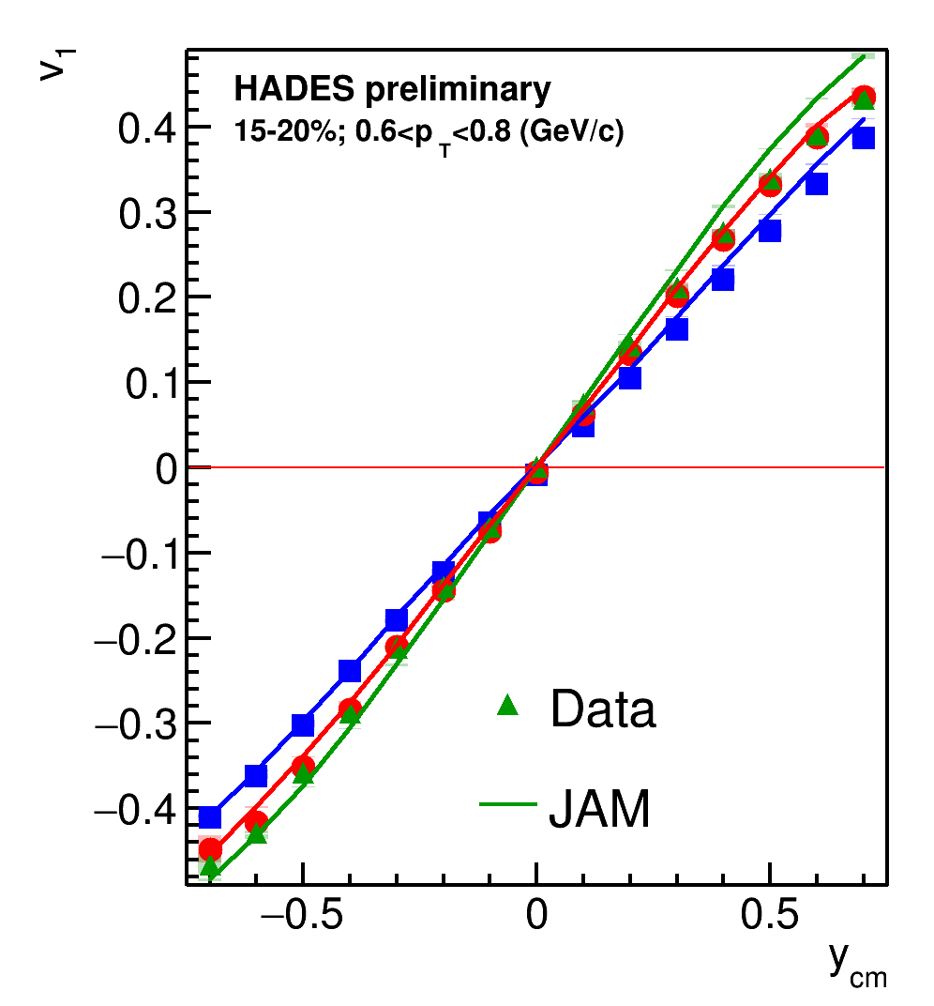
QnTools framework
All the methods used for performance study were carried out using QnTools framework: https://github.com/HeavyIonAnalysis/QnTools (well documented and well-tested)
Methods for flow measurements in fixed-target experiments were tested on experimental data from NA61/SHINE, HADES and ALICE
Tested and implemented in MPD root

Slide 11
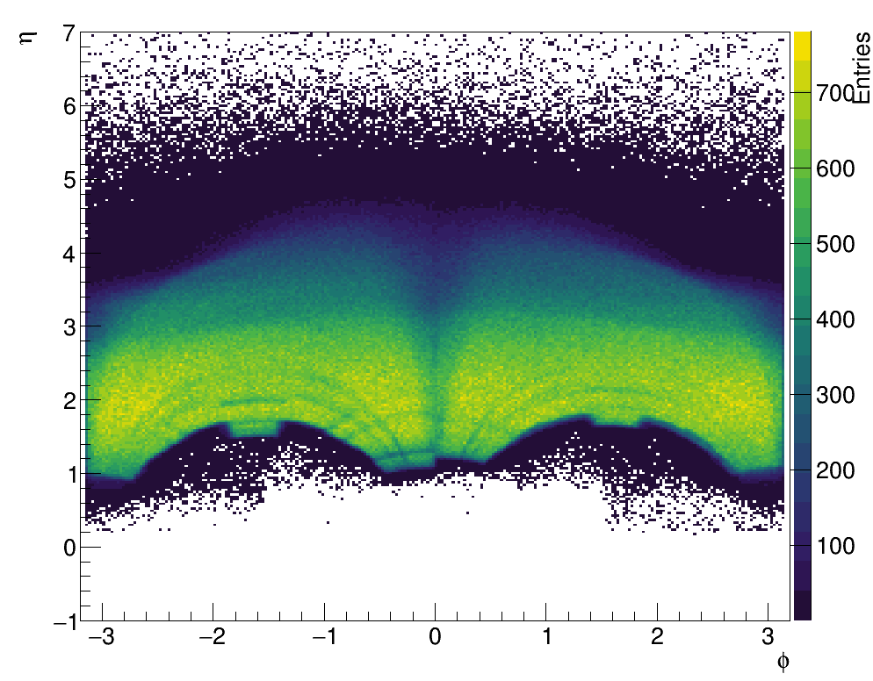
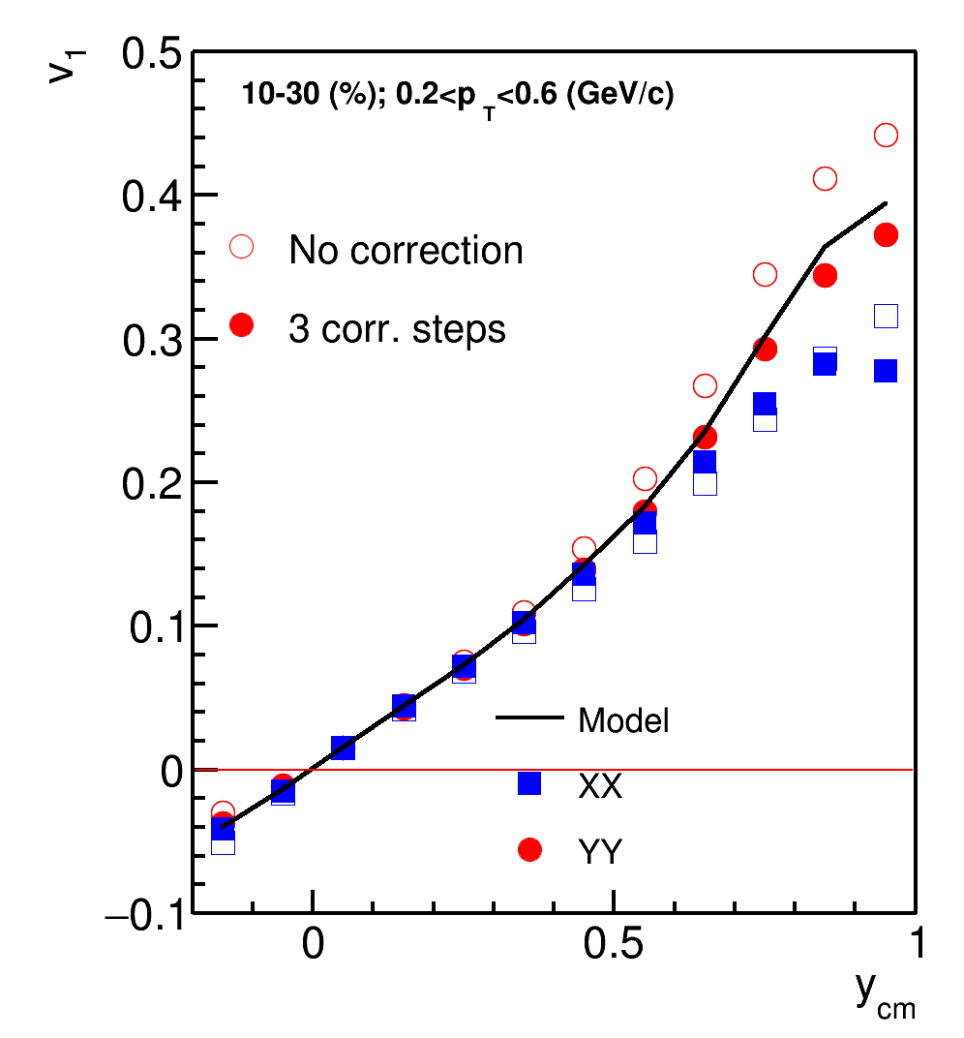
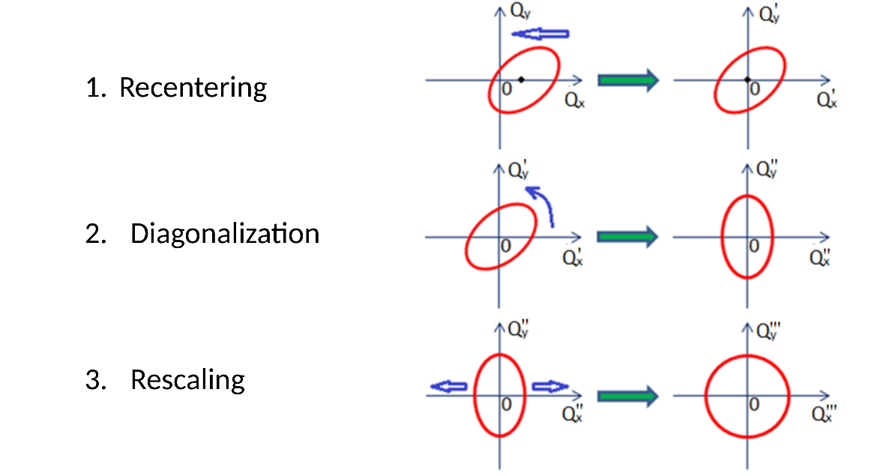
Azimuthal asymmetry of the BM@N acceptance
φ-η yield of protons
Corrections are based on method in: I. Selyuzhenkov and S. Voloshin PRC77, 034904 (2008)
Required corrections to reduce effects of non-uniform azimuthal acceptance
2. Twist
Better agreement after rescaling for YY
XX component has too large bias (due to magnetic field)
Notes:
The phi-rapidity distribution of protons is represented on the left of the slide. As you can notice, distribution along phi is not flat due to sector-based construction of tracking system. That is why, corrections on azimuthal non-uniformity is required. The effects of non-uniform distributions and corrections of the effects are described in the work of Ilya Selyuzhenkov and Sergey Voloshin. The corrections are recentring, twist and rescaling. They are schematically represented on the slide

Slide 12
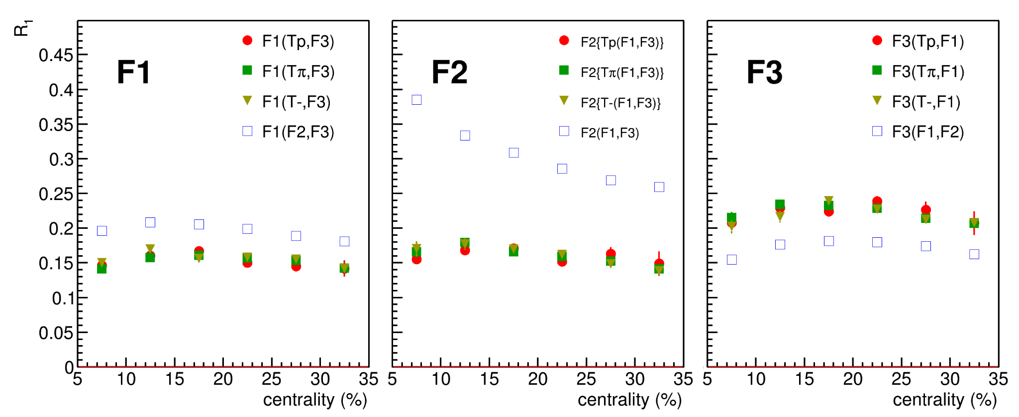
SP R1: DCMQGCM-SMM Xe+Cs@4A GeV
F3
F2
F1
SP gives unbiased estimation of v_{n} (root-mean-square)
EP gives biased estimation (somewhere between mean and RMS)
EP R₁ ~ 30%
Using random-sub method we integrate non-flow
to our results
Using the additional sub-events from tracking provides a robust combination to calculate resolution

Slide 13
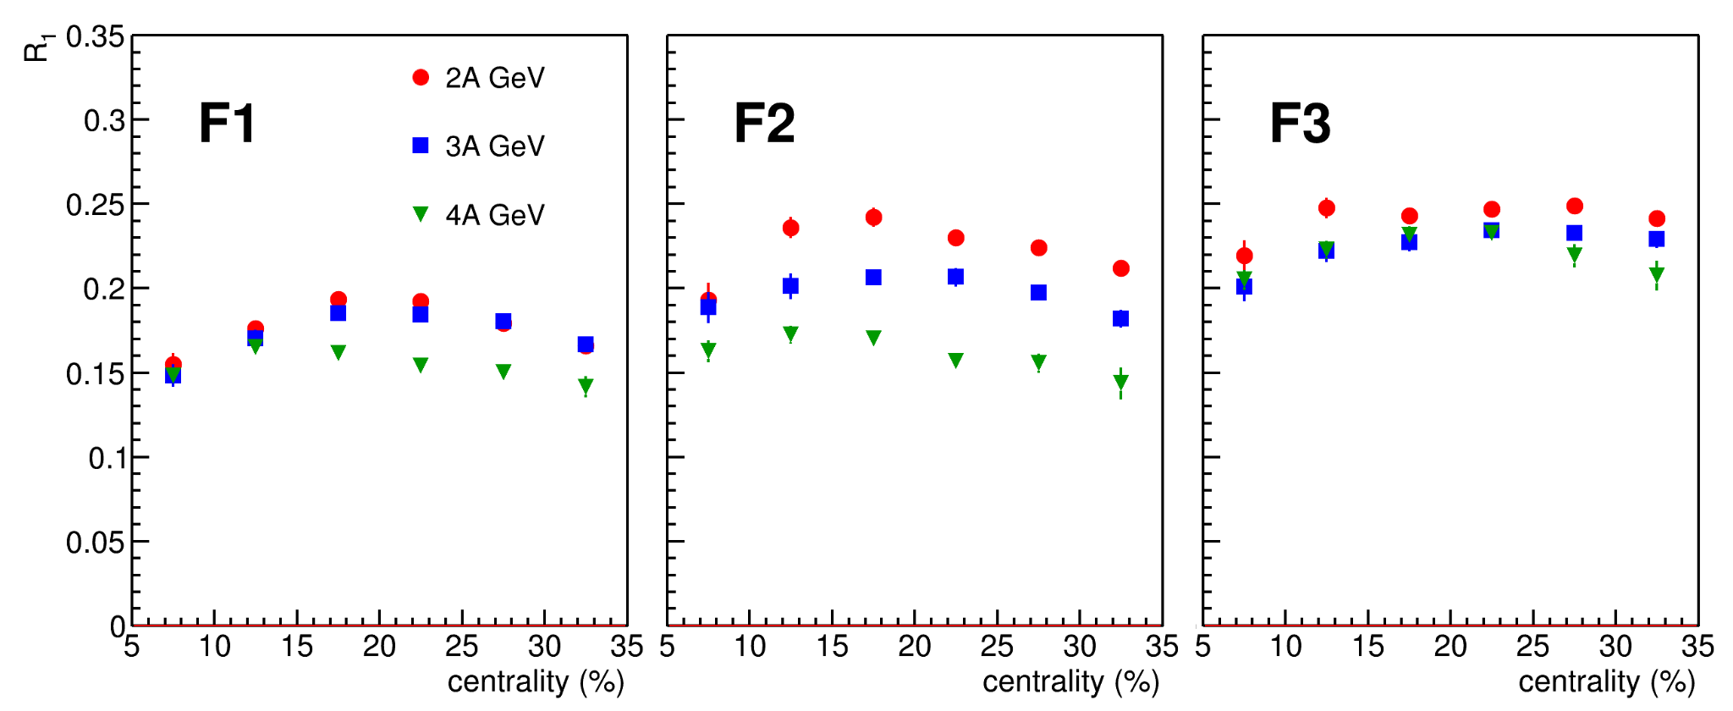
Rec R1: DCMQGCM-SMM Xe+Cs
F3
F2
F1
EP R₁ ~ 30%
Resolution is lower for higher energies due to lower v₁

Slide 14
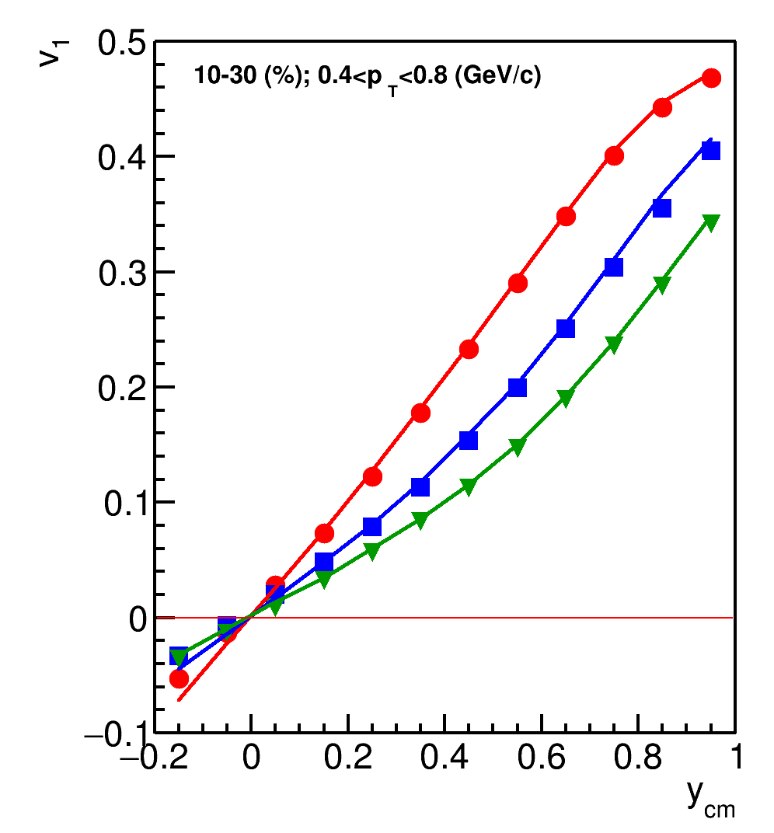
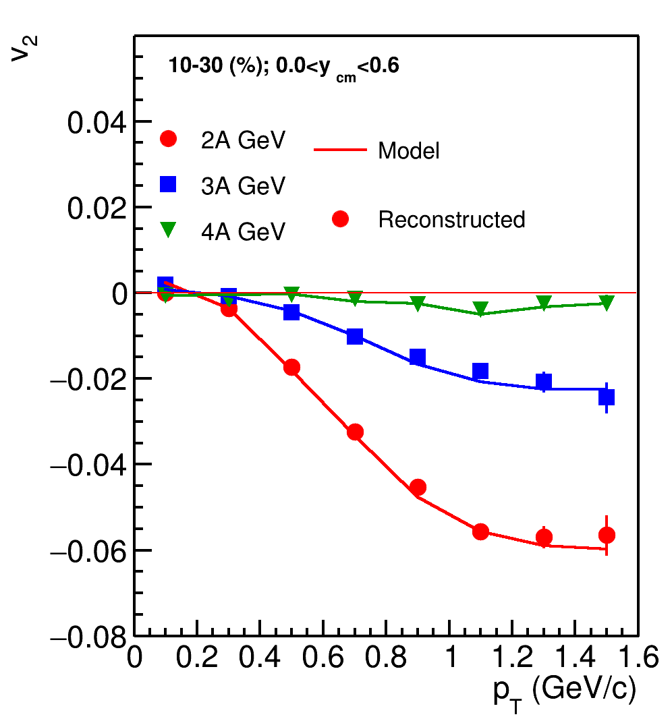
Directed and elliptic flow in Xe+Cs (JAM)
Optimization of TOF acceptance is required to perform identified hadron flow measurements
Azimuthal non-uniformity of detector needs to be investigated to use XX component of correlation
Good agreement between reconstructed and pure model data for all three energies
The results were shown on AYSS2022, ICPPA2022 and NICA2022 (proceedings are in publication)

Slide 15
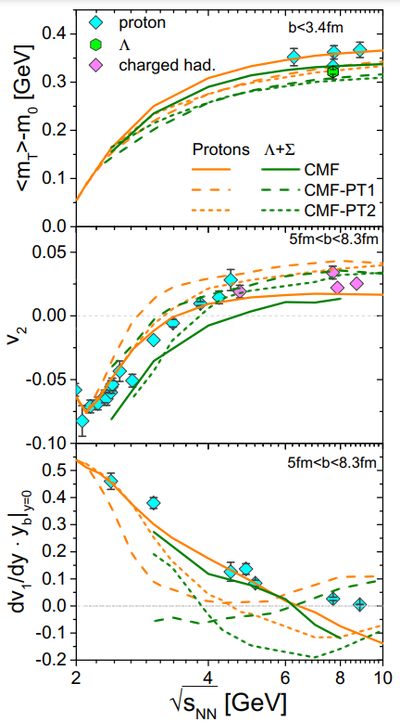
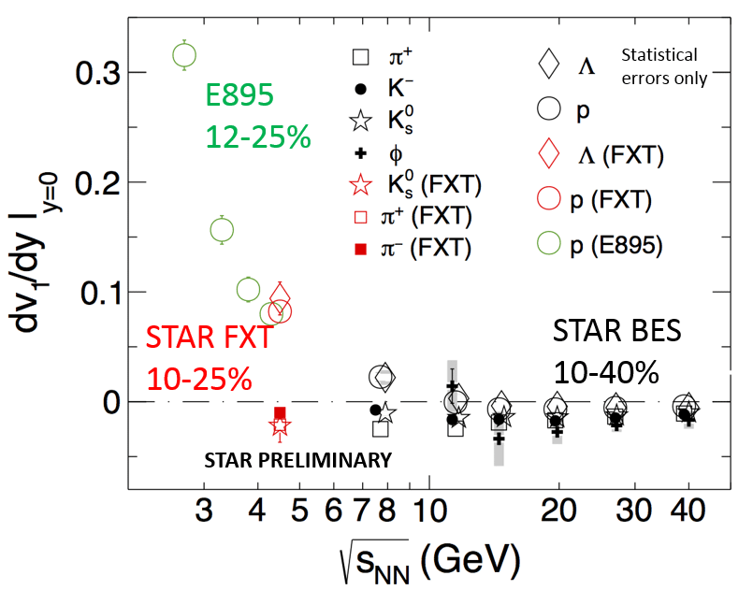
Motivation to study the flow of Λ
Nuclear Physics A
Volume 967, November 2017, Pages 808-811
EPJ Web of Conferences 276, 01021 (2023)
BM@N
Flow of Λ-hyperons is a sensitive probe of the hyperon-nuclei interactions
Flow of Λ-hyperons is sensitive to the EOS of dense matter

Slide 16
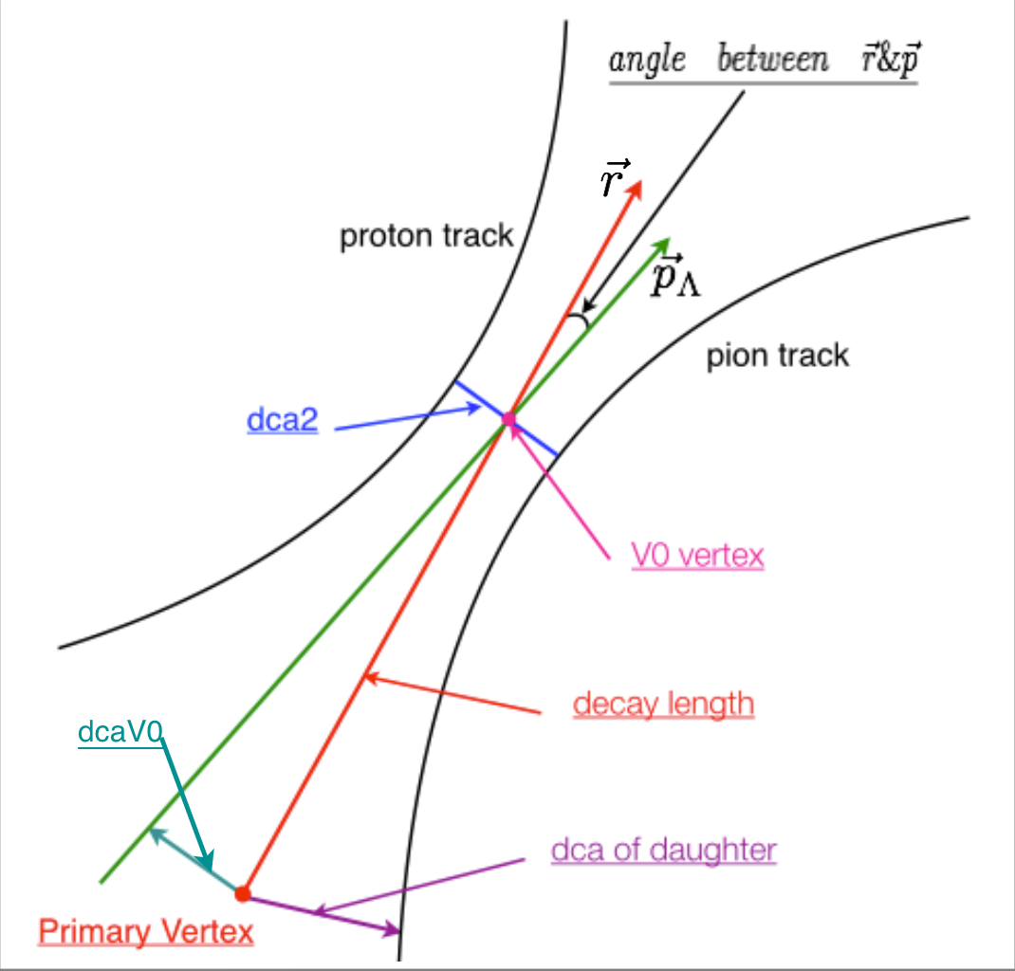
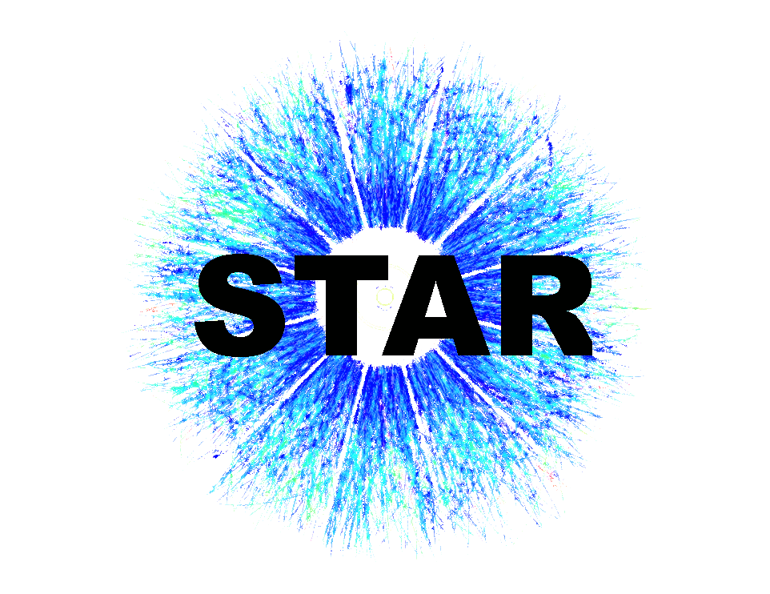
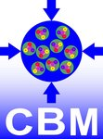
Lambda candidates reconstruction
DCMQGSM-SMM Xe+Cs@3.0AGeV
KFParticle framework: well tested and well documented. Used in:
Link to the framework: https://github.com/HeavyIonAnalysis/PFSimple
Link to the interface for BM@N data: https://github.com/mam-mih-val/bmn_particle_finder

Slide 17
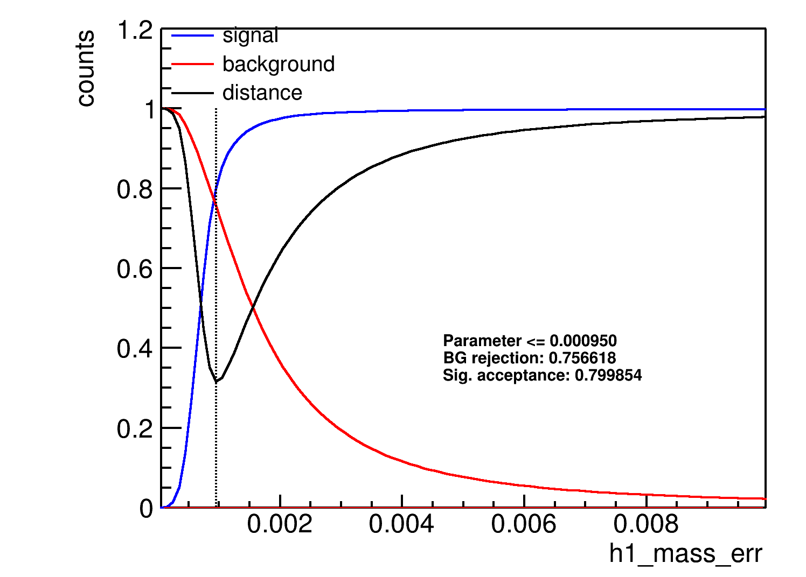
Lambda candidates selection criteria optimization
Cuts:
Decay length L>2.25
Reverse relative error L/dL>6.25
χ_{GEO} > 40
DCA > 0.728
Χ_{prim}{p} >50
cos(p_{p}p_{Λ}) > 0.99
Χ_{prim}{pi} >535
X_{TOPO}<51
Err{m2}<0.001
Optimal value
Signal is signal acceptance ratio (SA):
Background
is background rejection ratio (BR):
Distanse is (optimization function)
in the phase space from (1, 1):

Slide 18
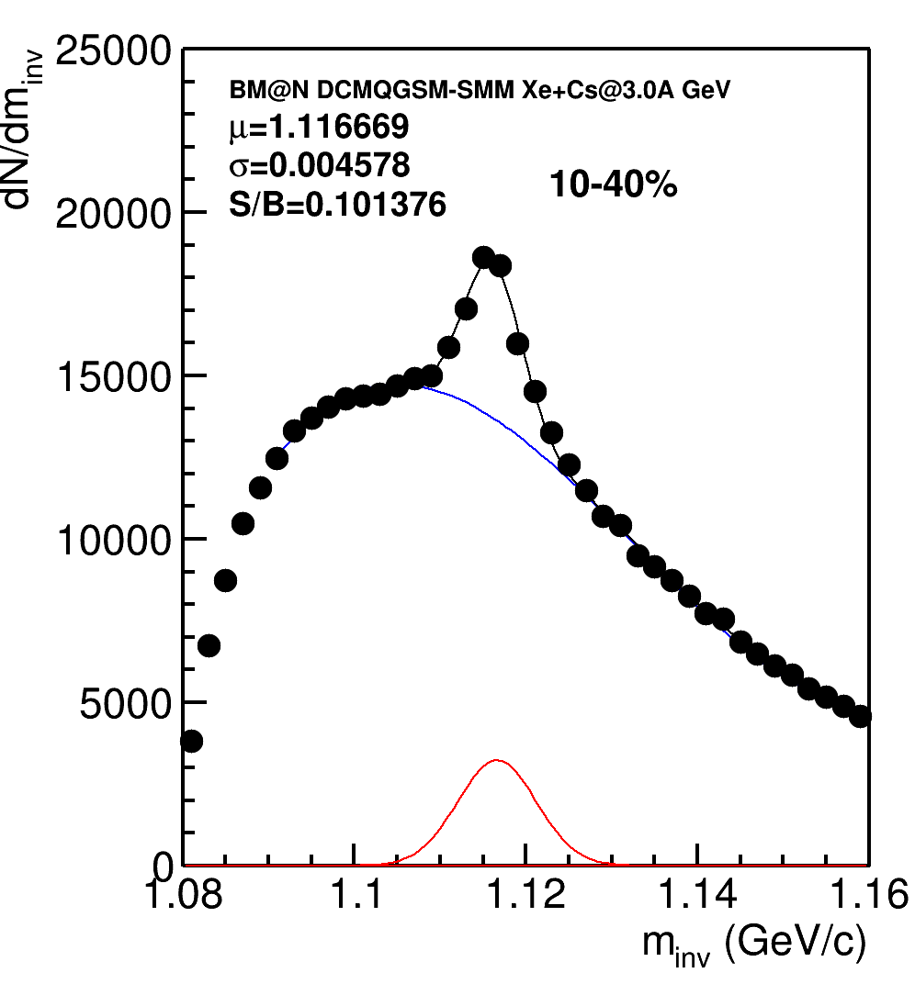
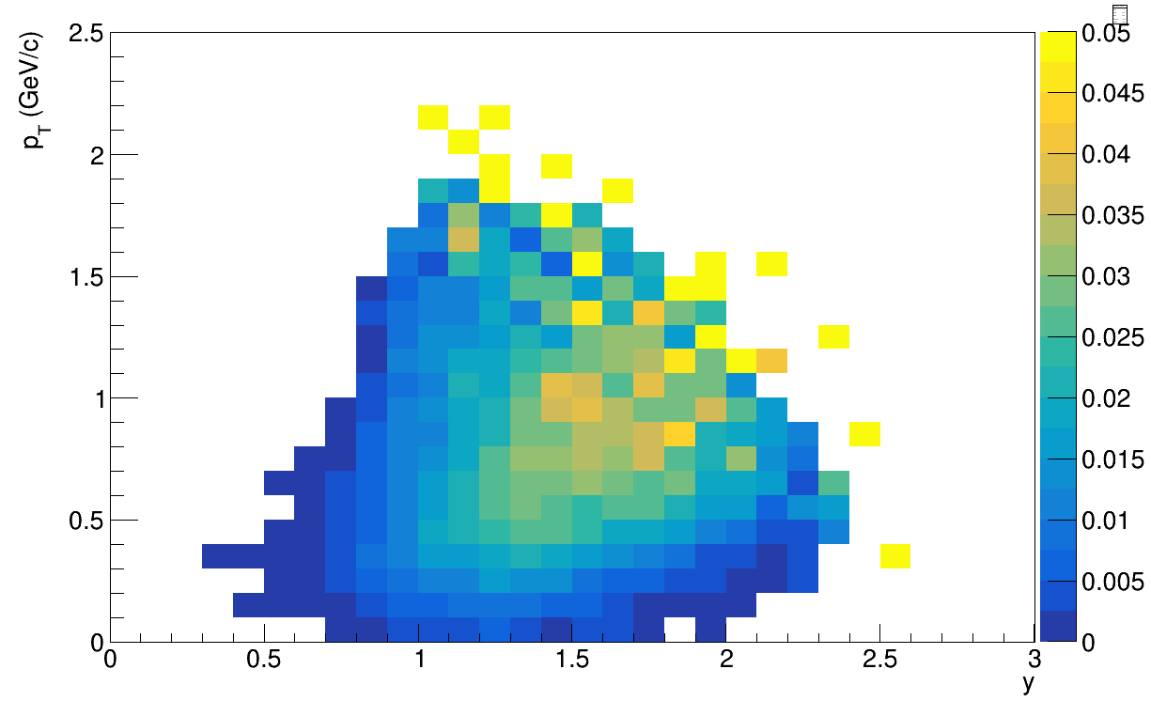
Lambda candidates invariant mass and efficiency
Midrapidity
Work in progress
~20K true Λ in 6M events
It is possible to achieve S/B~0.7, but it significantly reduces amount of statistics

Slide 19
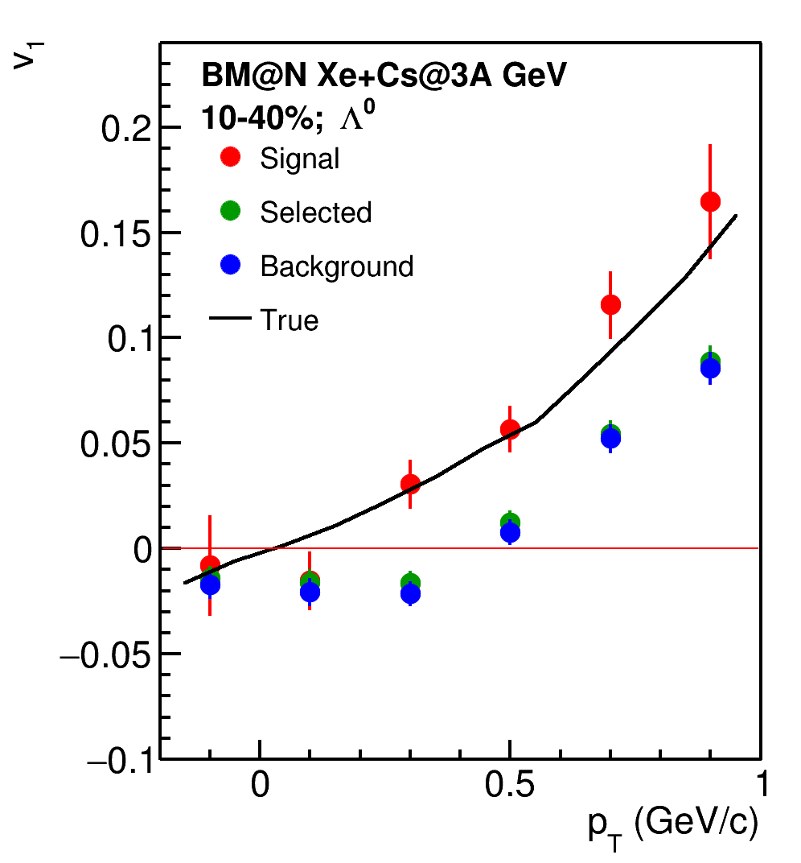
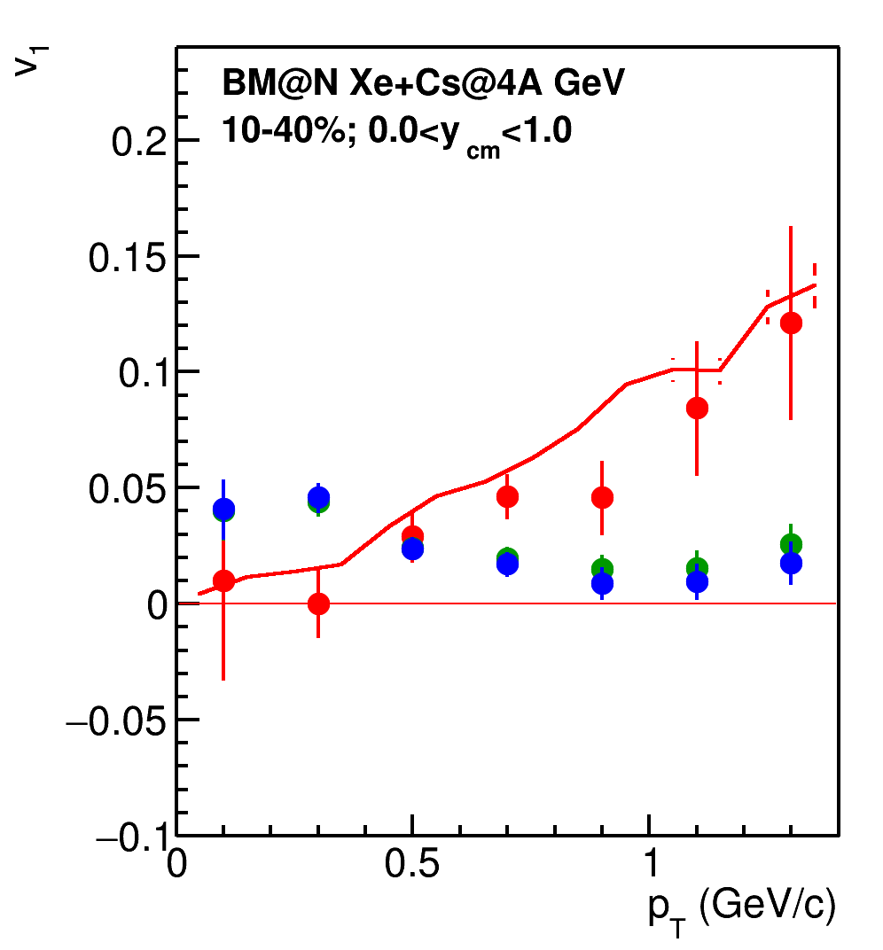
v₁ of lambda hyperons
Flow of signal is in a good agreement with model

Slide 20
Summary
Resolution correction factor is calculated for DCMQGSM-SMM Xe+Cs collisions at beam energies of 4A, 3A and 1.5A GeV:
Using only FHCal sub-events for resolution calculation gives biased estimation due to transverse hadronic showers propagation
Using additional sub-events from tracking provides with a robust estimation
Good agreement between model and reconstructed data is observed for v₁ and v₂ at 2A, 3A and 4A GeV
Results on the feasibility study towards proton v₁ and v₂ were presented on AYSS2022, ICPPA2022 and NICA2022
Lambda candidates were reconstructed for DCMQGSM-SMM Xe+Cs@3A GeV collisions with KFParticle
v₁ was measured for lambda candidates
Further fine-tuning is required for background suppression to separate flow of background and signal

Slide 21
Outlook
Improving S/B ratio as well as saving as much signal as possible
Fitting the v₁(m_{inv}) bin-by-bin to separate signal and background flow

Slide 22
BACKUP

Slide 23
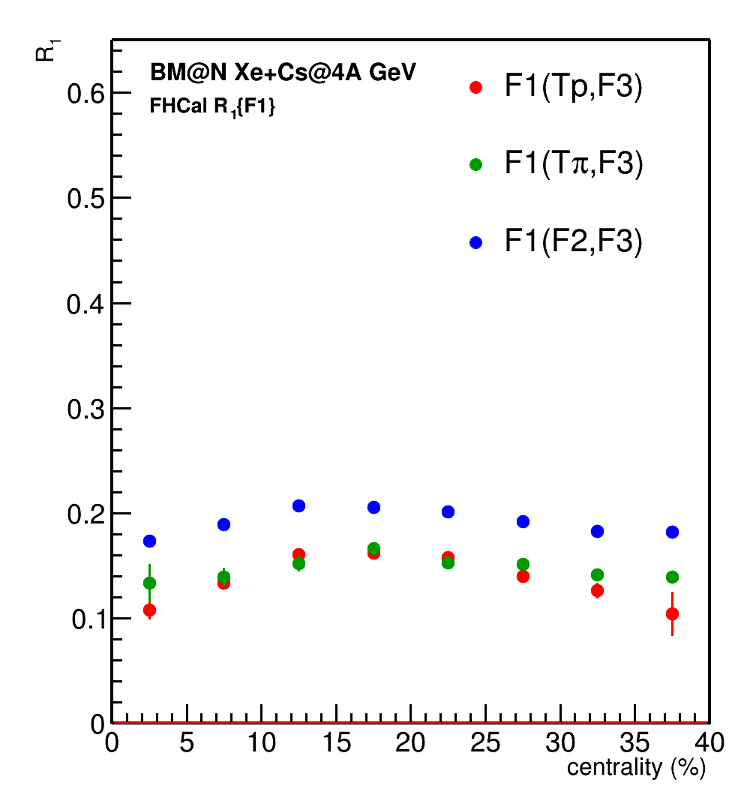
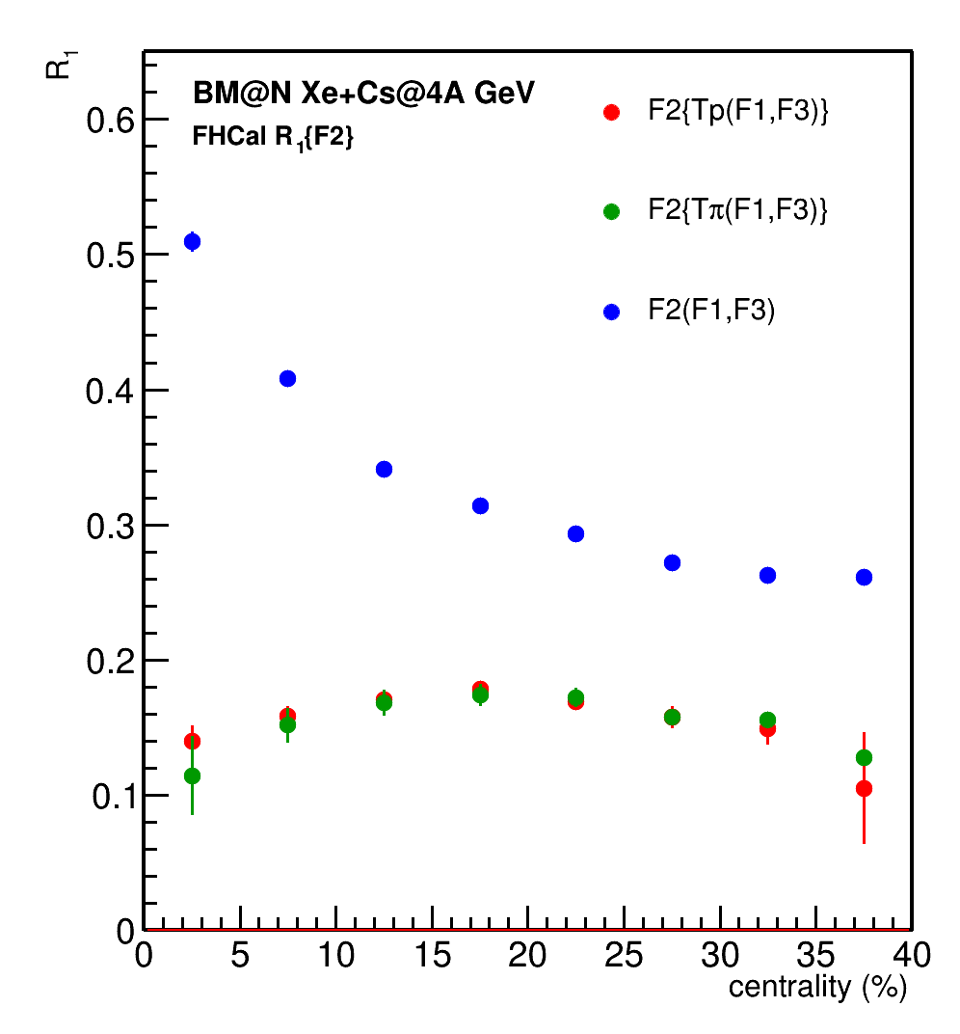
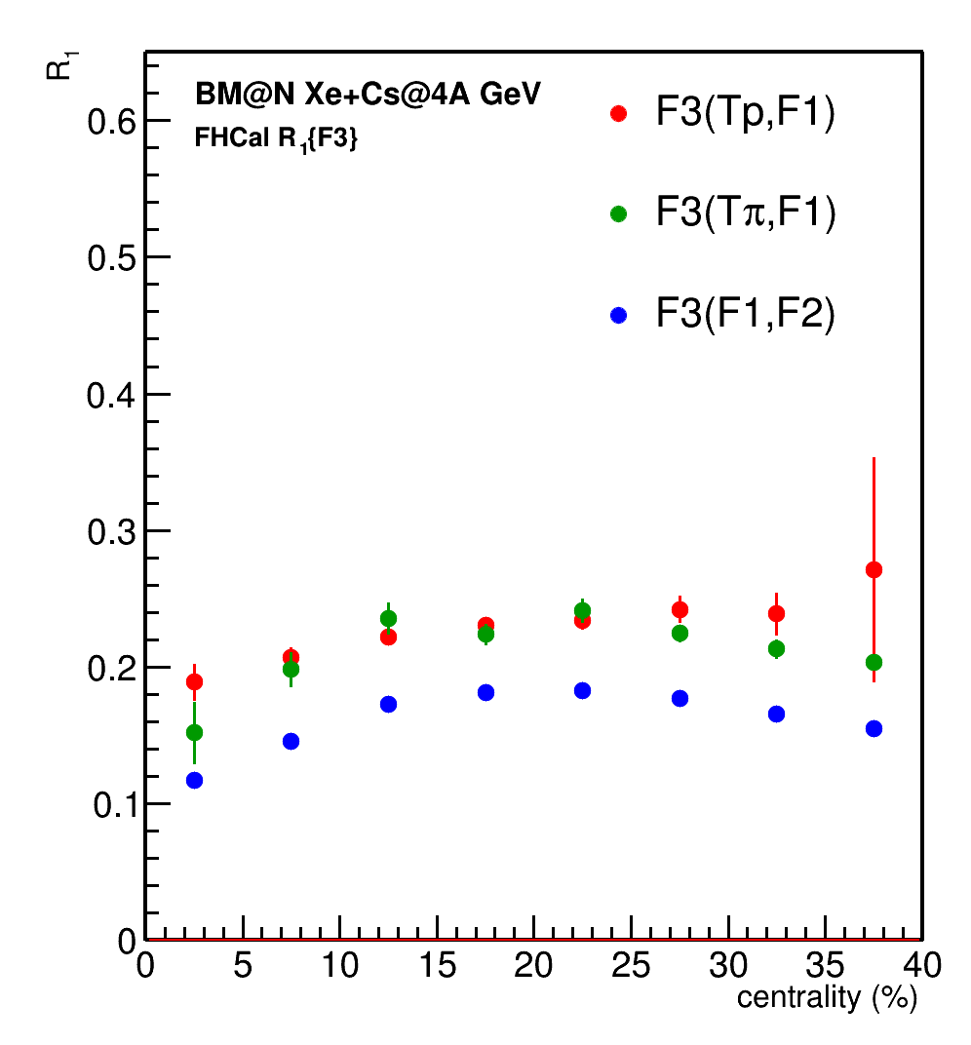
Rec R1: DCMQGCM-SMM Xe+Cs@4A GeV
👎
👎
👎
F3
F2
F1
Bias due to leakage of hadronic shower
between neighbouring FHCal subevents: we shall not use this resolution in the further analysis

Slide 24
Rec R1: DCMQGCM-SMM Xe+Cs@4A GeV
👎
👎
👎
F3
F2
F1
Bias due to leakage of hadronic shower
between neighbouring FHCal subevents: we shall not use this resolution in the further analysis

Slide 25
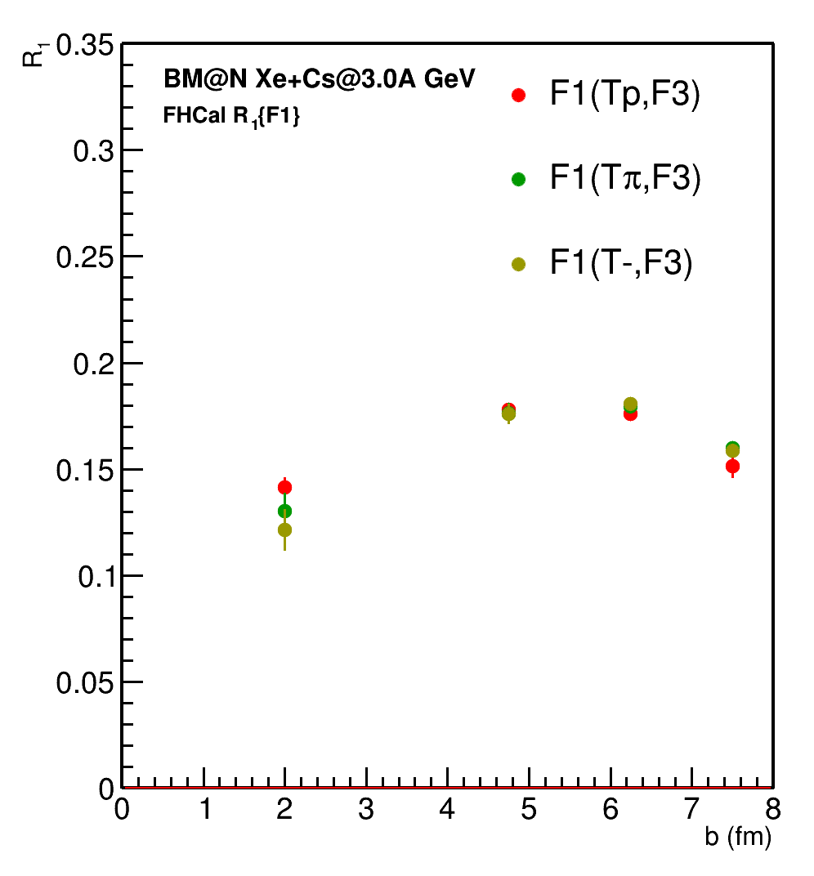
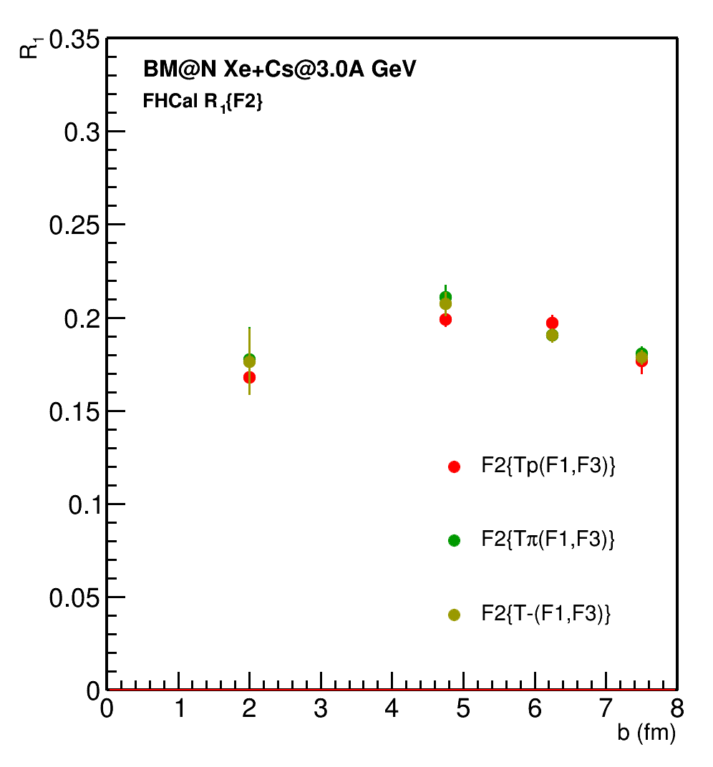
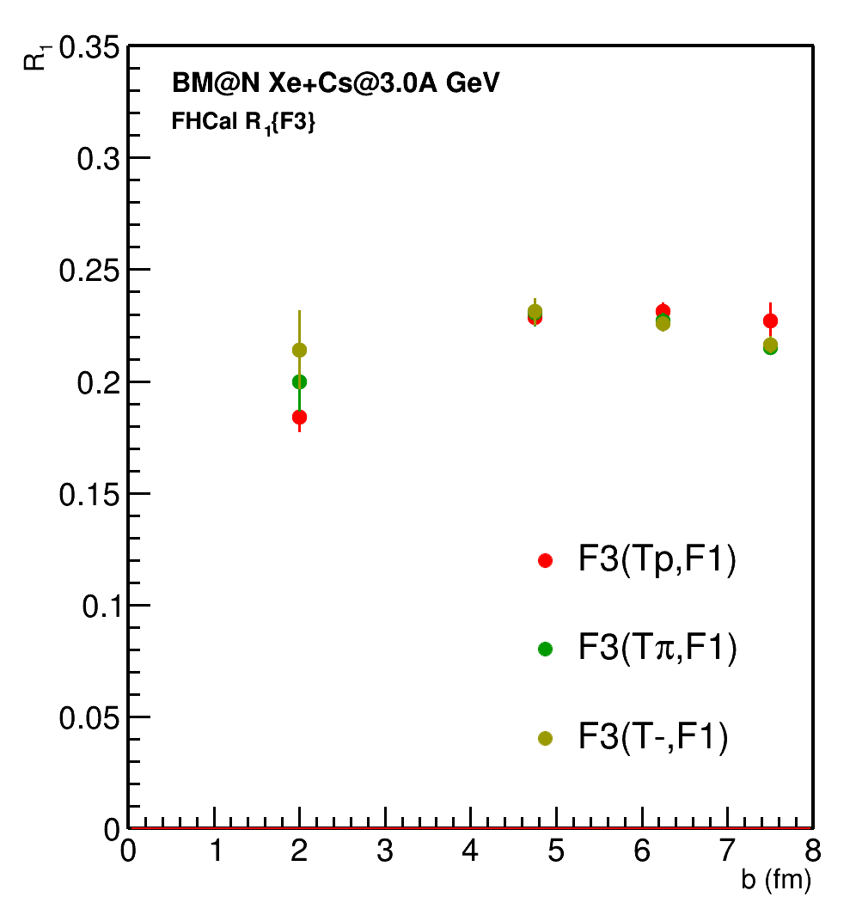
Rec R1: DCMQGCM-SMM Xe+Cs@3A GeV
👍
👍
👍
F3
F2
Additional subevents from tracks not pointing at FHCal:
Tp: p; 0.4<y<0.6; 0.2 < p_{T} < 2 GeV/c; w=1/eff
Tπ: π-; 0.2<y<0.8; 0.1 < p_{T} < 0.5 GeV/c; w=1/eff
T-: all negative; 1.0<η<2.0; 0.1 < p_{T} < 0.5 GeV/c; w=1/eff
F1

Slide 26
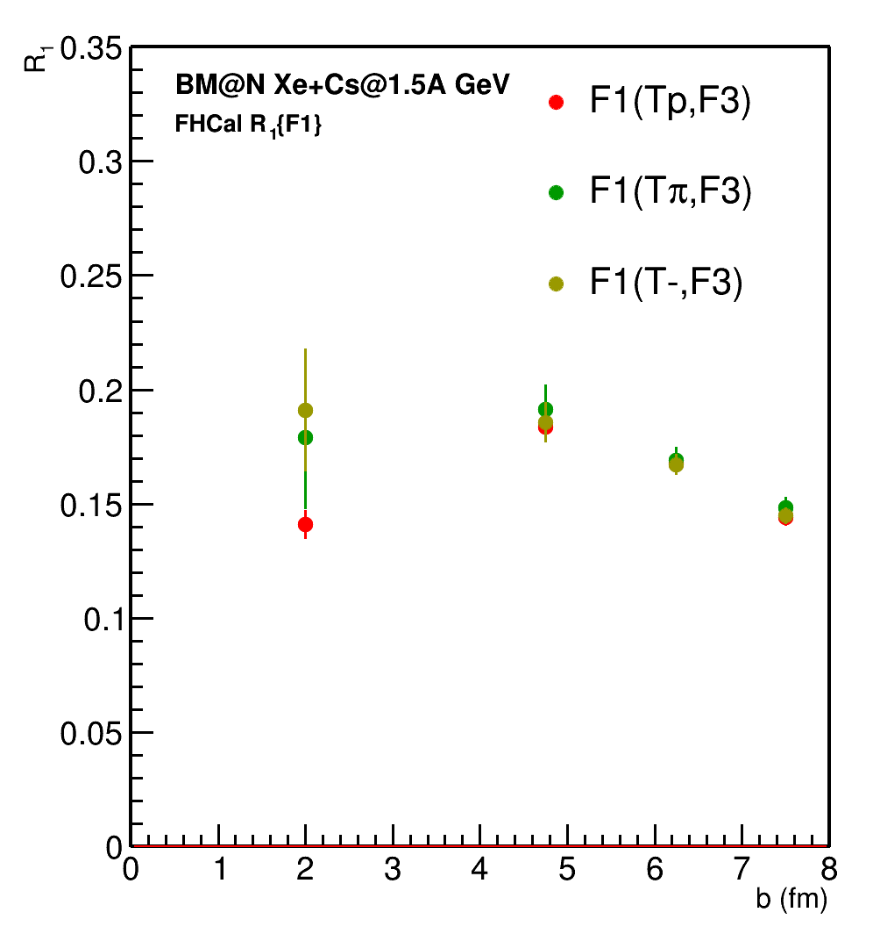
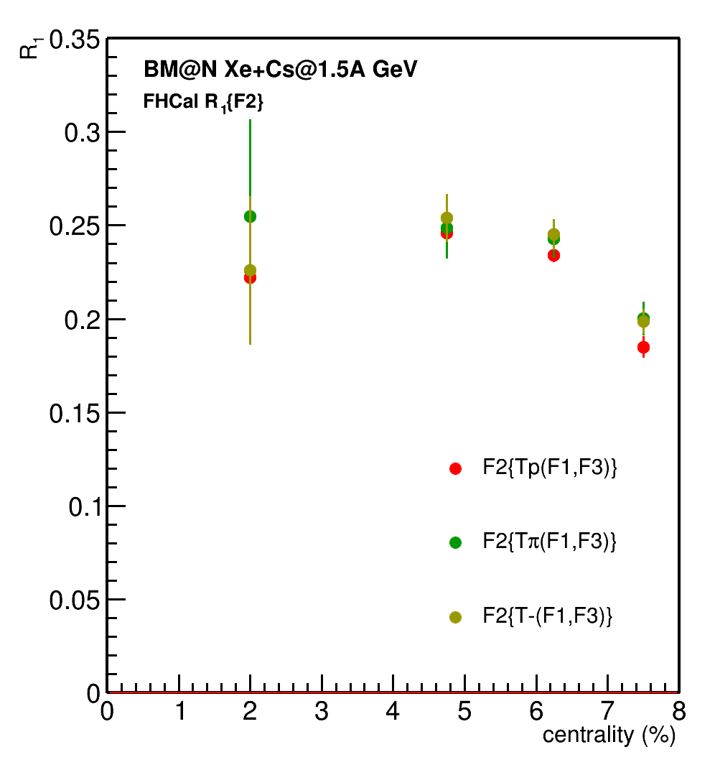
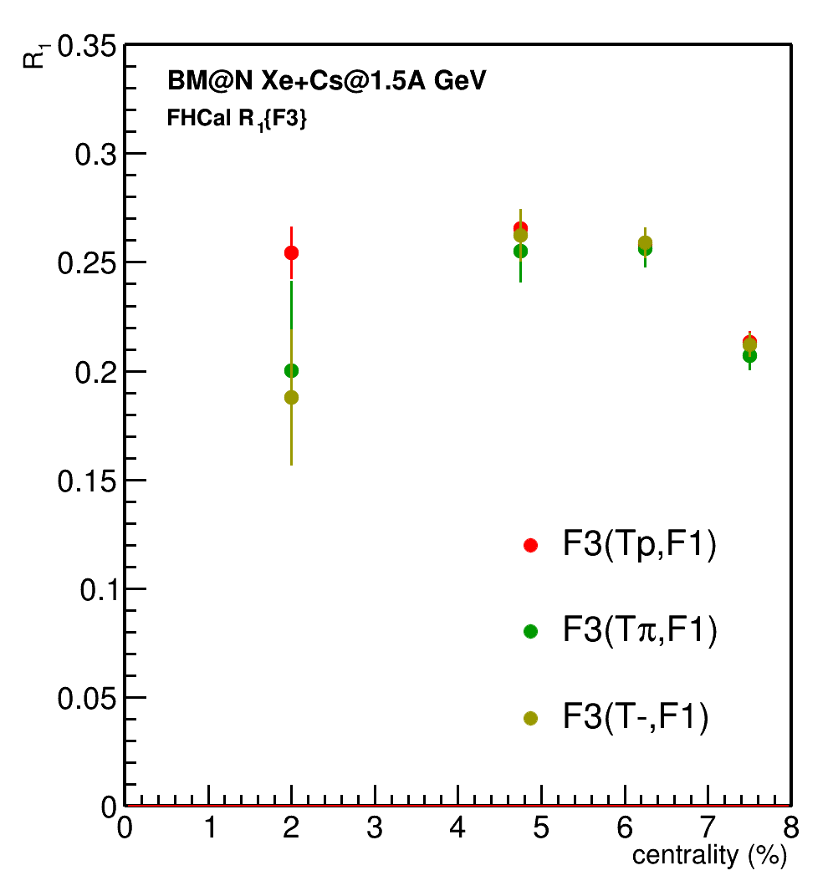
Rec R1: DCMQGCM-SMM Xe+Cs@1.5A GeV
👍
👍
👍
F3
F2
Additional subevents from tracks not pointing at FHCal:
Tp: p; 0.4<y<0.6; 0.2 < p_{T} < 2 GeV/c; w=1/eff
Tπ: π-; 0.2<y<0.8; 0.1 < p_{T} < 0.5 GeV/c; w=1/eff
T-: all negative; 1.0<η<2.0; 0.1 < p_{T} < 0.5 GeV/c; w=1/eff
F1

Slide 27
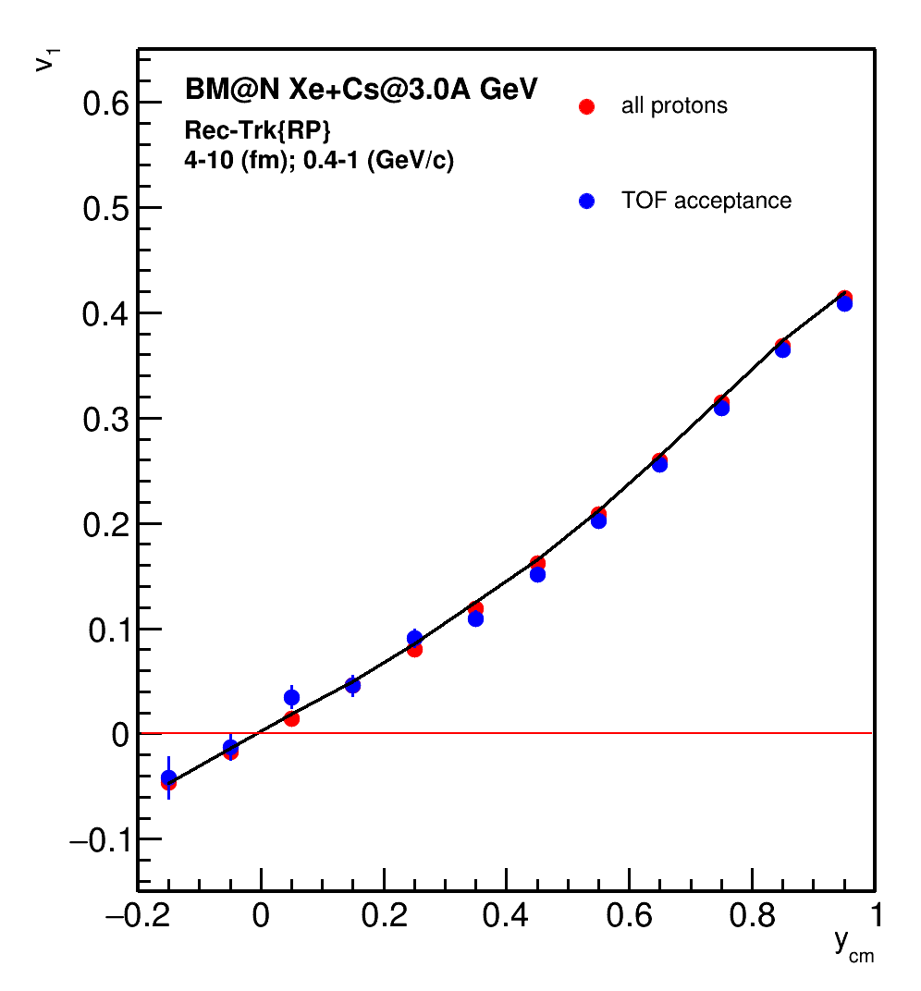
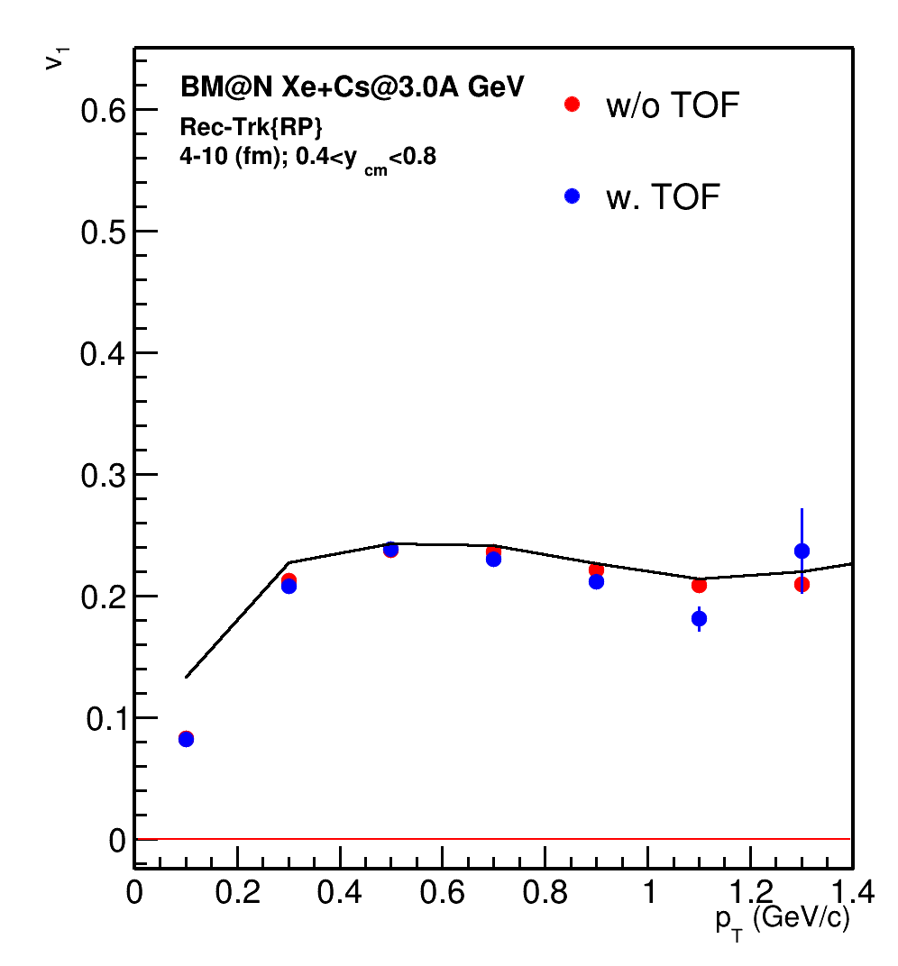
v₁: Xe+Cs@3.0A GeV: JAM (true momenta)

Slide 28
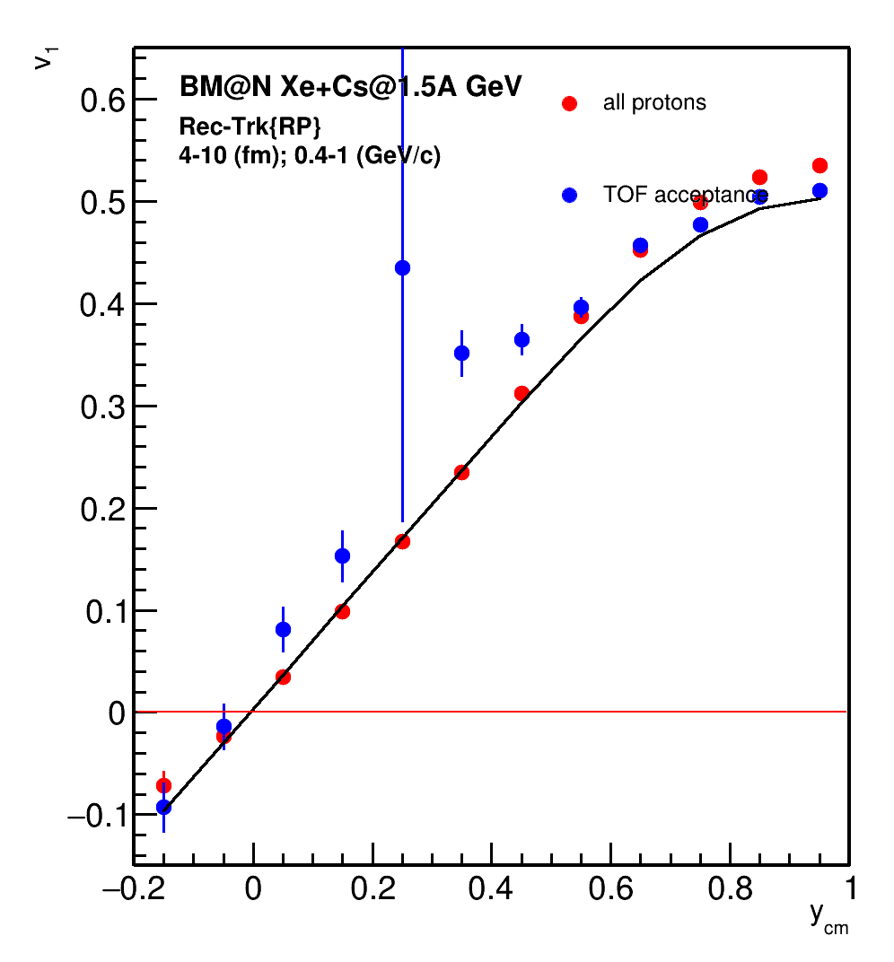
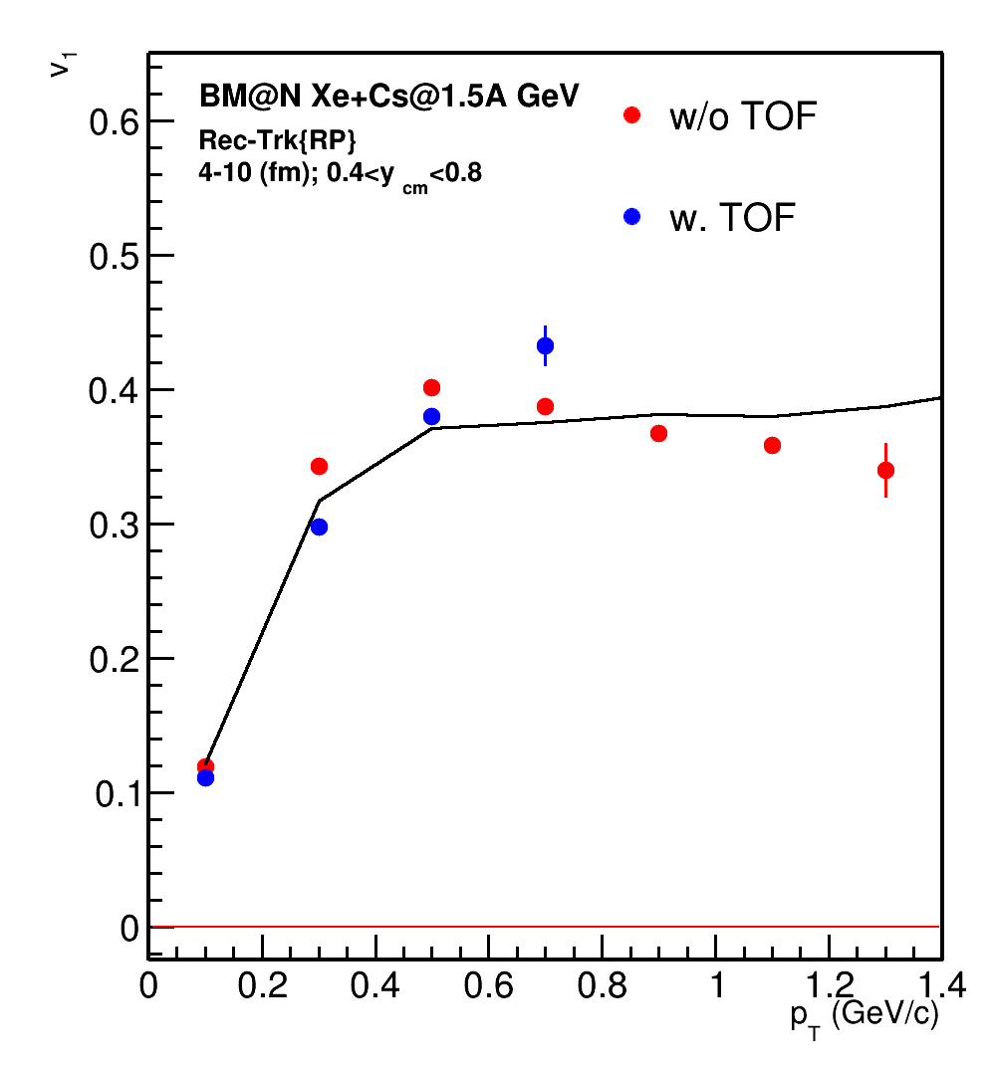
v₁: Xe+Cs@1.5A GeV: JAM (true momenta)

Slide 29
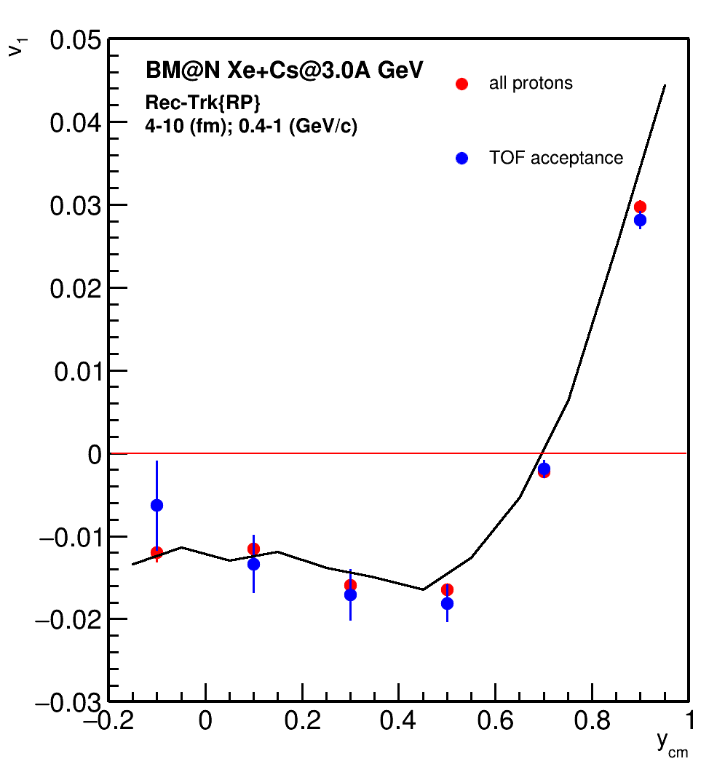
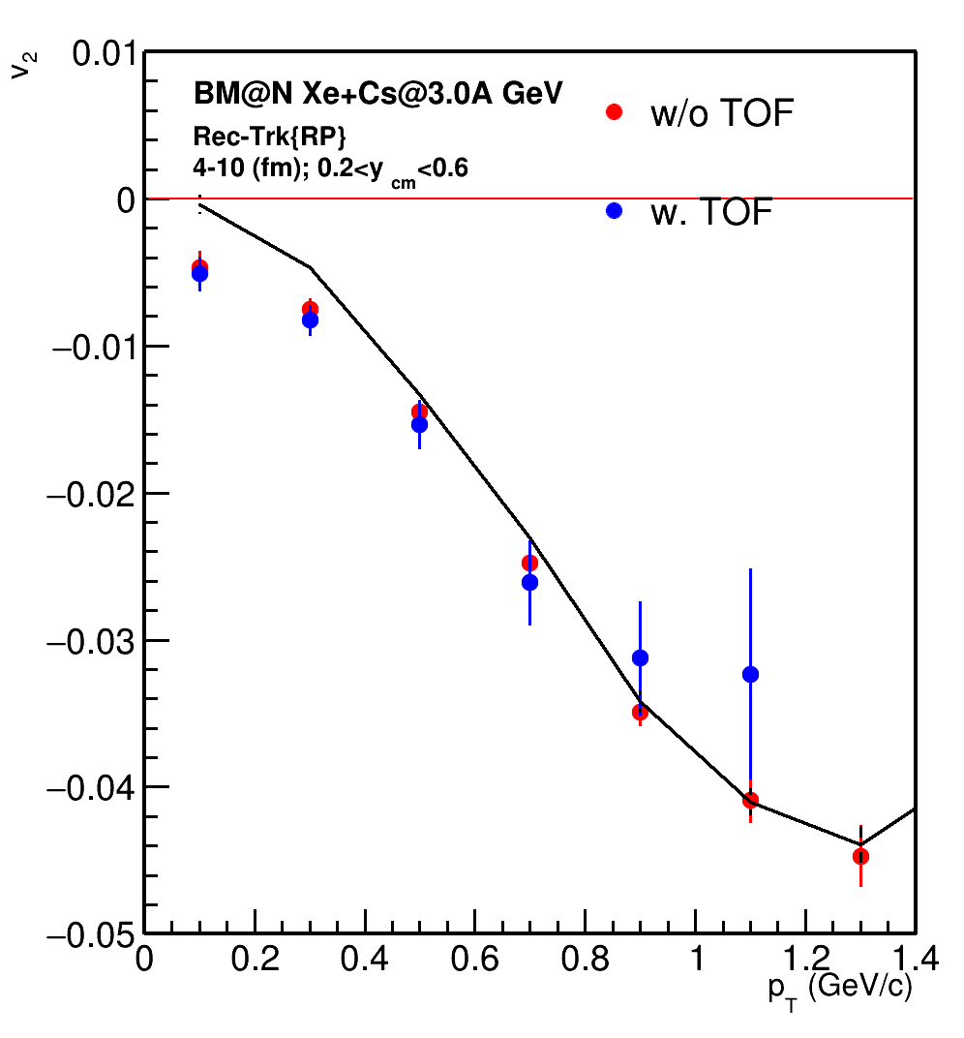
v₂: Xe+Cs@3.0A GeV: JAM (true momenta)

Slide 30
v₂: Xe+Cs@3.0A GeV: JAM (rec momenta)

Slide 31
Efficiency for proton reconstruction (JAM, Xe+Cs@1.5A GeV)
Without TOF acceptance
With TOF acceptance

Slide 32
Efficiency for proton reconstruction (JAM, Xe+Cs@3A GeV)
Without TOF acceptance
With TOF acceptance

Slide 33
v₁: Xe+Cs@3.0A GeV: JAM (true momenta)

Slide 34
v₁: Xe+Cs@1.5A GeV: JAM (true momenta)

Slide 35
Momentum reconstruction for protons in Xe+Cs@1.5A GeV
Px
pz
Py

Slide 36
Collision geometry and anisotropic transverse flow
Asymmetry in coordinate space converts (due to interaction & depending on the properties created matter) into momentum asymmetry with respect to the collision symmetry plane

Slide 37
Scalar product method for v_{n} measurement
u and Q-vectors:
Scalar product method: v_{n} with respect to symmetry plane Ψ_{S} estimated using group of particles “a”:
Rª_{1,i} - 1st order event plane resolution correction

Slide 38
QnTools framework
Corrections are based on method in: I. Selyuzhenkov and S. Voloshin PRC77, 034904 (2008)
Originally implemented as QnCorrections framework for ALICE experiment at CERN: J. Onderwaater, I. Selyuzhenkov, V. Gonzalez
QnTools analysis package: https://github.com/HeavyIonAnalysis/QnTools
Twist
QnTools configuration
Q-vector | Q_{n} weight | Correction axes | Correction steps | Error calculation | Q_{n} Normalization
Protons | 1 | p_{T} [ 0.0, 2.00], 5 bins y_{cm}[-0.1, 0.1], 20 bins b, 10 bins | Recentering Twist Rescaling | Bootstrapping, 100 samples | Sum of Weights (SP) Unity (EP)
Fragments | Module charge | b, 10 bins
Notes:
Due to uneven azimuthal acceptance of the detector, corrections of flow vectors are required. The corrections are described in the work of I. Selyuzhenkov and S. Voloshin and applyed in QnCorrections framework by Onderwaater, Selyuzhenkov, Gonzalez and then were completed by Lukas Kreis in QnTools framework. The link to the framework is on the slide. Configuration of QnTools used in analysis is on the slide.

Slide 39
True R1: DCMQGCM-SMM Xe+Cs@3A GeV

Slide 40
v₁: Xe+Cs: True momenta

Slide 41
v₂: Xe+Cs@3.0A GeV: JAM (true momenta)
4-8
Momentum reconstruction procedure requires refinement at lower energies

Slide 42
Collective flow in heavy-ion collisions
spatial asymmetry of the initial pressure distribution transforms into anisotropic emission of produced particles via interaction inside the overlapping region of colliding nuclei
Symmetry 13 (2021) 3, 400
Anisotropic flow measurements can constrain compressibility of the matter created in the collision
Notes:
Одной из таких наблюдаемых являются коллективные потоки.
Во время столкновения пространственная асимметрия распределения энергии трансформируется в импульсную анизотропию рожденных частиц
Взаимодействие происходит следующим образом
В области перекрытия создаётся плотная материя, которая расширяется и отталкивает остатки ядра — спектаторы. Частицы, которые взаимодействуют с областью перекрытия упруго.
Таким образом, импульсная анизотропия рожденных частиц чувствительна к времени взаимодействия спектаторов с областью перекрытия, а также к сжимаемости созданной материи. Таким образом, изучая импульсную анизотропию рожденных частиц, можно уточнить уравнение состояния вещества кхд-материи.
В частности, слева приведено сравнение теоретических предсказаний зависимости давления кхд-материи от барионной плотности для кхд вещества при слиянии нейтронных звёзд. Серой и оранжевой широкими линиями представлены вычисления на основе экспериментальных данных. Эти экспериментальные данные ограничивают теоретические модели.

Slide 43
Rec R1: DCMQGCM-SMM Xe+Cs@3A GeV
F3
F2
F1
We can use unidentified negatively charged tracks as well for resolution calculation

Slide 44
Rec R1: DCMQGCM-SMM Xe+Cs@1.5A GeV
F3
F2
F1
We can use unidentified negatively charged tracks as well for resolution calculation

Slide 45
v₁: DCMQGCM-SMM Xe+Cs w.r.t. Spectator plane
Reasonable agreement between model and reconstructed data

Slide 46
HADES: dv₁/dy scaling with collision energy and system size
y_{CM} → y’ = y_{CM} / y_{beam}
centrality → <b> / A^{1/3}
y’ = y_{CM}/y_{beam} + <b> / A^{1/3}
After correcting for dependence on the passing time (y_{beam}) dv₁/dy’ is independent of the size of colliding nuclei and collision energy and depends only on the relative impact parameter (<b> / A^{1/3})
Plotting dv₁/dy’ vs. <b>/A^{1/3} instead of centrality improves the scaling in central collisions

