Slide 1
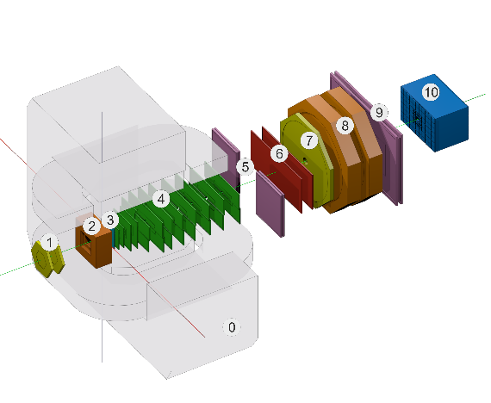
Preparation of the Online Configuration System for the next BM@N Run
E. Alexandrov¹, I. Alexandrov¹, A. Chebotov¹, I.Filozova¹, K.Gertsenberger¹, D.Priakhina¹, G.Shestakova¹, A. Yakovlev¹
¹JINR, Dubna
10th Collaboration Meeting of the BM@N Experiment at the NICA Facility, St Petersburg, 14-19 May, 2023
Joint Institute for Nuclear Research

Slide 2
Outline
Goals of the system
General Architecture of the BM@N Configuration System
Use of the Dynamic Deployment System (FAIR)
DB Object model
BM@N online processes to be controlled by Configuration manager
Configuration Manager: functionality
Configuration Manager: task states
Test environment
Web-interface: Configuration Manager and Task Monitor panels
Web-interface: Session logs
Online Configuration System: last upgrades
Status
Next steps

Slide 3
Goals of system
store and provide configuration data for online processing :
set of various detectors configuration parameters (working voltage etc.)
setup data including sequences of software tasks with their dependencies
should to be able to start, stop and monitor setup tasks during experiment sessions
Notes:
set of various configuration hardware parameters
required for setting the detectors into operation modes (like working voltage)

Slide 4
General Architecture of the BM@N Online Configuration System
Client
Apache http server, PHP
Web Server
PostgreSQL
HTTP
Database
backend
http pages
REST API
ROOT C++ connector
DDS server
Configuration Manager
DDS API
C++ 11

Slide 5
Use the Dynamic Deployment System for tasks management
DDS: tool-set that automates and significantly simplifies a deployment of user defined processes (tasks) and their dependencies
DDS: deploys agents to execute user tasks
DDS agent:
supports multiple tasks slots
is able to run and watchdog multiple tasks simultaneously

Slide 6
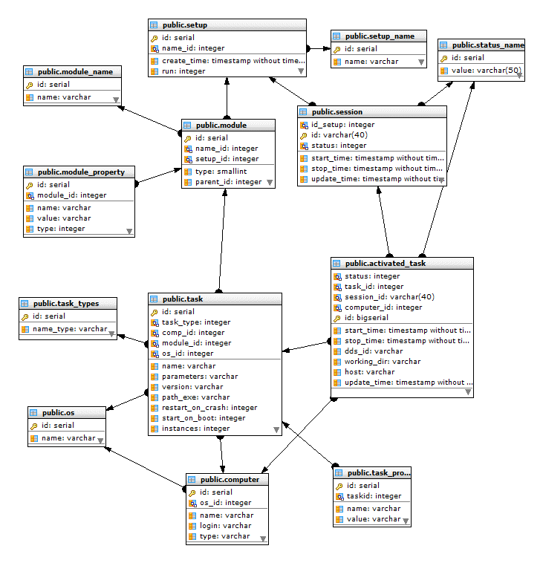
DB Object model

Slide 7
BM@N online processes to be controlled by Configuration manager

Slide 8
Configuration Manager: functionality
listens and performs commands (REST API in use)
Start all setup tasks
Stop all setup tasks
Update setup
Get log of the activated task
Check if configuration manager is alive
Stop configuration manager
Get session log
reads from DB setup data using setup ID
prepares tasks for start using DDS system (convert data into DDS topology form)
starts all tasks of topology using DDS
gets from DDS server info about all started tasks
stores in the DB the info about DDS session and tasks

Slide 9
Configuration Manager: session/task states
States of the session and its tasks
Starting
Configuration Manager (ConfigMan) got command to start setup, activated the command and have sent response to sender
NotInited
Problem with task start
Started
ConfigMan got response from DDS server that task was started and updated database with this info
Stopping
ConfigMan got command to stop setup, activated this operation and have sent response to sender
Stopped
ConfigMan got response from DDS server that task is stopped and updated databse with this info
Done
Task was finished
Crashed
Task was crashed

Slide 10
Test environment
Configuration manager that uses in test DB setup BMN Run7 (consists OnlineControl module) starts:
1
Configuration manager
root_digi_imit
vm221-87.jinr.ru
vps104.jinr.ru
Sends message
2
onlineHisto_imit
vps104.jinr.ru
Sends message and get reply
fastEventReco_imit
3
vm221-85.jinr.ru
Sends message
4
eventDisplay_imit
vps104.jinr.ru

Slide 11
Web-interface. Configuration Manager view

Slide 12
Web-interface. Configuration Manager and Task Monitor panels

Slide 13
Web-interface. Session logs

Slide 14
Online Configuration System: last upgrades
Configuration Manager upgrades:
Upgrades to support “SSH” plugin produced
Improvements for topology activation: detection of problems during setup(session) start improved. INIT_PROBLEM state added.
Host distributed Log support significantly improved. Several commands for getting different logs(from task, from session on host, from all hosts) added.
Multithread processing improved

Slide 15
Online Configuration System: last upgrades(2)
WEB Interface upgrades
Session Logs panel added
Control panel behavior updated
Data Base updated
No new tables, just new requested parameters added

Slide 16
Status
Online Configuration System is ready for use in next BM@N Run

Slide 17
Next steps
Web interface
improvements on the base of the experience of use
Configuration Manager
add new command to get all sessions logs as content of the tgz file
optimization of the usage a different DDS commands
Functionality tests including use of real online applications with test data on input
Moving to use REST API in all communications

