Slide 1


Status of the STS Project
E. Atkin, Yu. Bocharov, V. Butuzov, P. Ivanov,
M. Merkin D. Normanov, A. Serazetdinov, A.Voronin S. Yamaliev
10th BM@N Collaboration Meeting, St Petersburg 15 - 19/05/2023

Slide 2
Status of STS Components
Sensors
Low mass cables
ASICs

Slide 3
Sensors
Sensors for central part of ladders – totally we need 16 sensors with specific geometry.

Slide 4
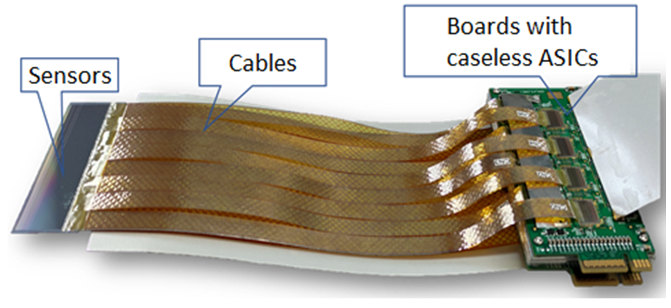
Low mass cables

Slide 5
ASIC
Specifications
Block diagram
Chronograms
Analog front-end
Mixed-signal part
Digital part
Outcomes

Slide 6
Chip Specifications
The prototype version must process signals with a maximum frequency of 100 kHz. It will use 2 triggers: L0 one at a frequency of 100 kHz with a signal arrival delay of up to 500 ns and L1 – at a frequency of 50 kHz having a signal arrival delay of up to 10 µs
Input signals of both polarities (electrons & holes)
Dynamic Range up to 30 MIPs (108 fC)
Typical input amplitude 1 MIP (3.6 fC)
ENC at detector capacitances ranging 10-30pF < 1500 el
Channel rate < 1 kHz (> 1 ms per event)
Programmable shaping time 200, 300 & 500 ns
Channel peak amplitude detection & 10 bit ADC
Prototype ASIC size 5 x 5 mm²
Forecast on power consumption for final chip version (128 chs.) < 600 mW

Slide 7
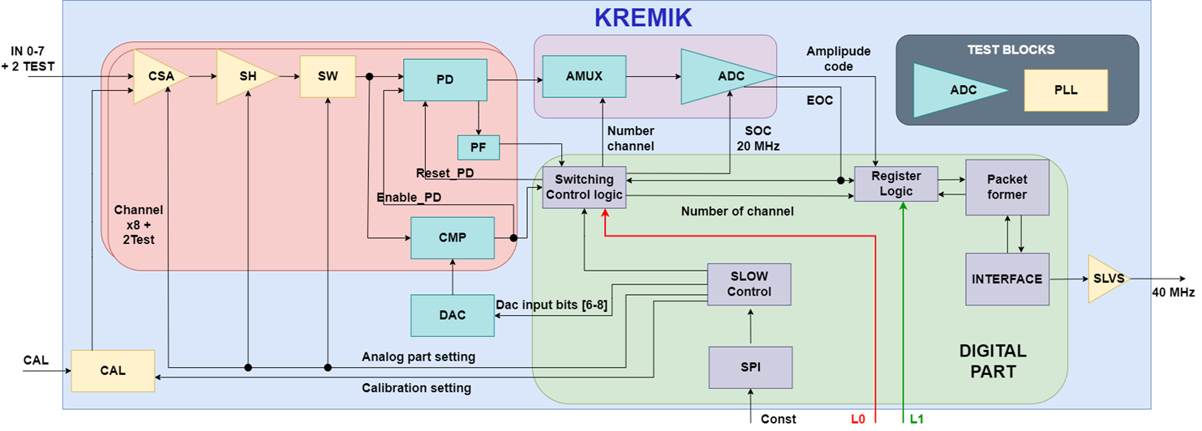
Block diagram of prototype
MAIN parts:
  Analog front-end
Mixed signal (analog & digital)
Digital
Supporting blocks for: calibration, control (parameter set), trimming, lab tests, backup solutions

Slide 8
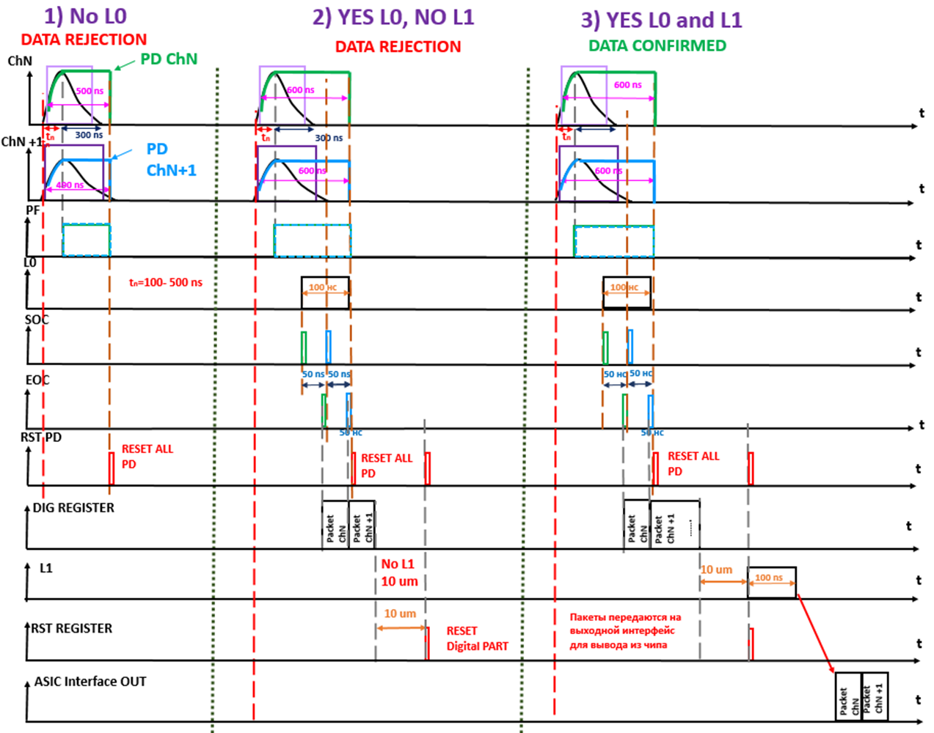
Typical signal chronograms

Slide 9
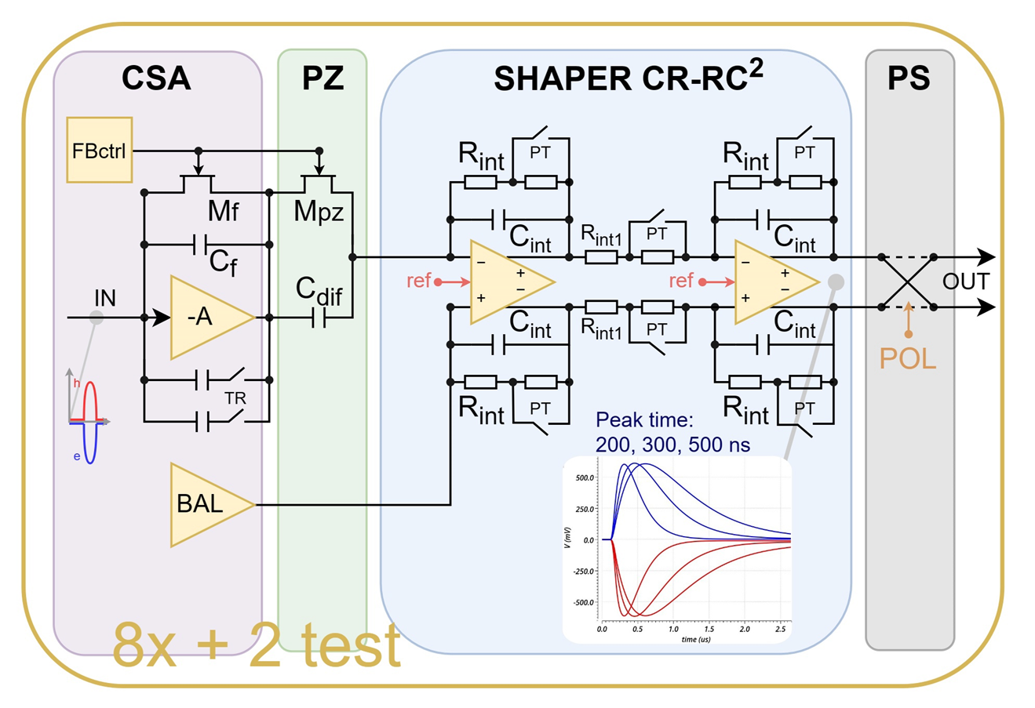
Analog front-end

Slide 10
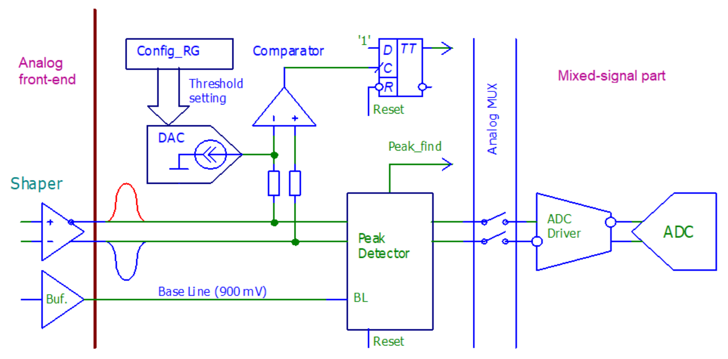
Mixed-signal part

Slide 11
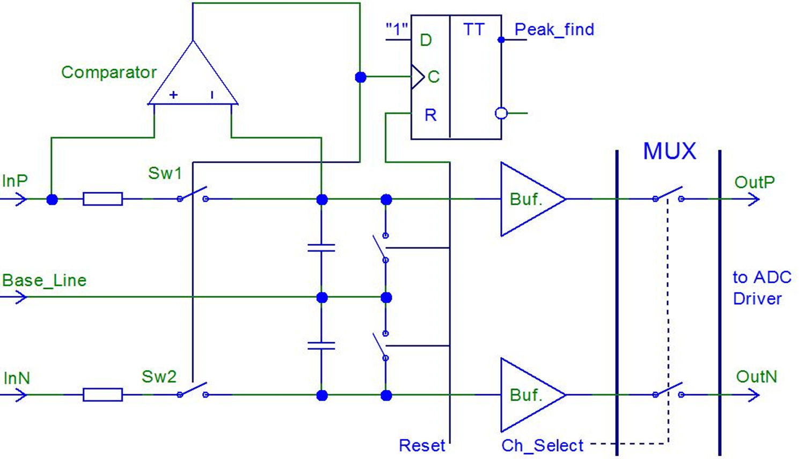
Peak Detector

Slide 12
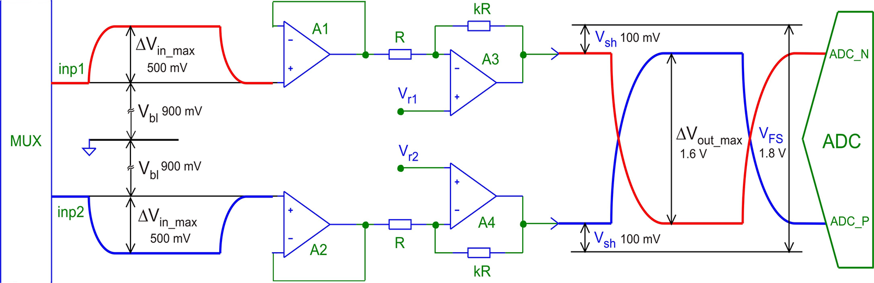
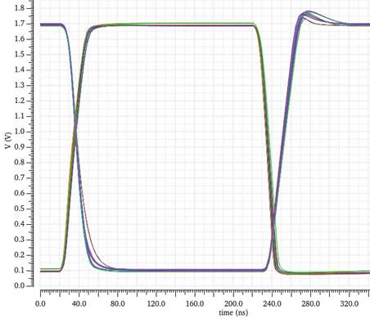
ADC Driver
An example of timing diagrams at the driver outputs when a signal with an amplitude of 500 mV is applied to its input.

Slide 13
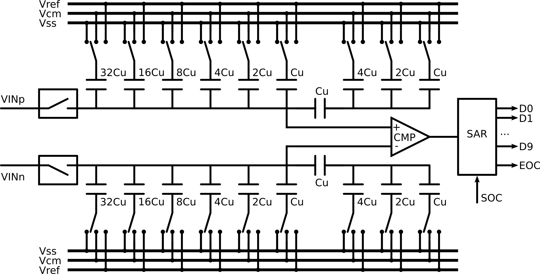
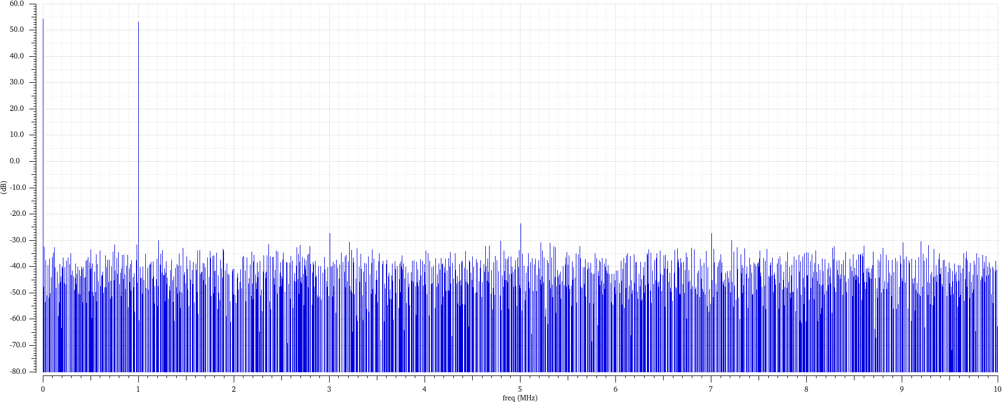
ADC structure and simulation results
Self-clocked SAR ADC
Resolution – 10 bits
Conversion time – 40 ns
ENOB@20MHz – 9.7 LSB
Power consumption – 2 mW
Spectrum
Notes:
Картинку со спектром обновлю, когда закончится моделирование

Slide 14
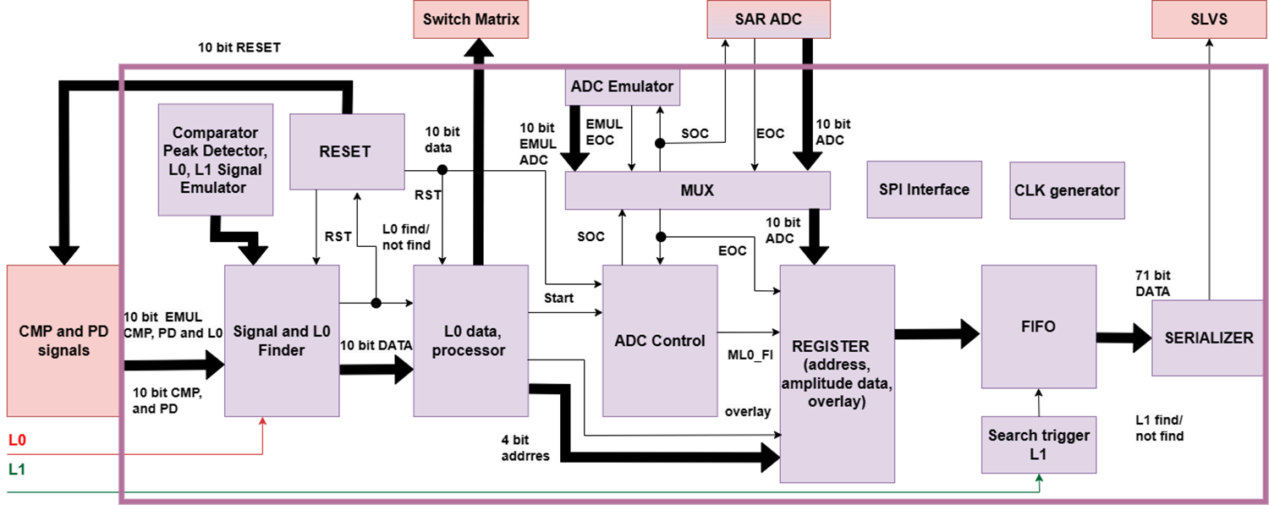

Digital part

Slide 15
Outcomes and plans
Design of the first prototype ASIC (10 channel) for silicon tracker is underway
Deadline for submission of the GDSII file for prototyping (tapeout for 180 nm CMOS process) is July 2023
JINR contract for manufacturing of first batch of chips (50+ pcs) is in negociation phase with Chinese MPW integrator company
Fabrication and in parallel measuring testbench development will be done in 6 months. The first lab functionality results are expected to be made in early 2024

