Slide 1
Status of Forward Hadron Calorimeter (FHCal)
A.Ivashkin
Institute for Nuclear Research RAS, Moscow
on behalf of the FHCal group
FHCal overview;
Status of FHCal modules;
FHCal subsystems and activity;
Integration to MPD
11th MPD collaboration meeting, Apr., 2023.

Slide 2
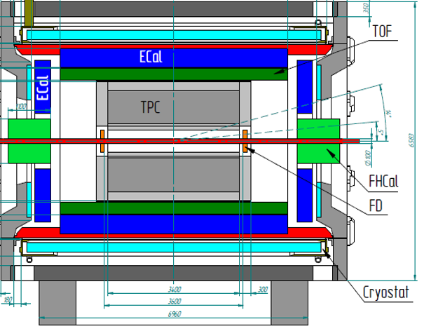
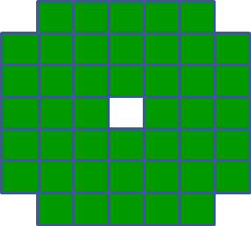
FHCal in MPD
FHCal modules
FHCal
FHCAL consists of 2x44 modules.
~1x1 m² each part.
Beam hole 15x15 cm².
Lead/scintillator sampling calorimeter.
Longitudinal segmentation;
Light readout- WLS-fibers;
7 sections/photodetectors in each module.
Two arms of hadron calorimeter at opposite sides in forward regions.
At the distance 3.2 meters from the interaction point.
Available acceptance corresponds to pseudorapidity 2.0<η <5.0

Slide 3
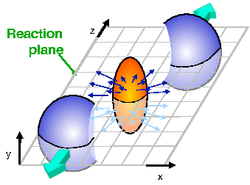

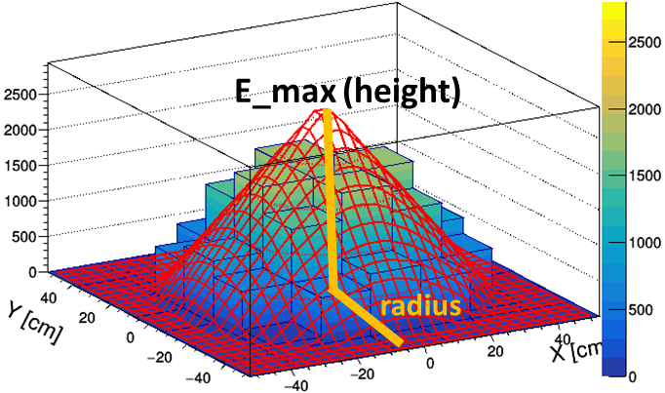
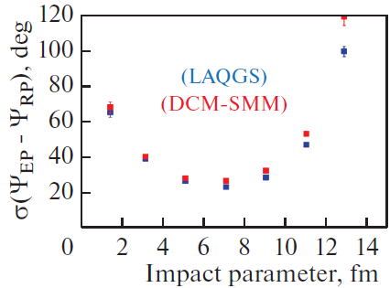
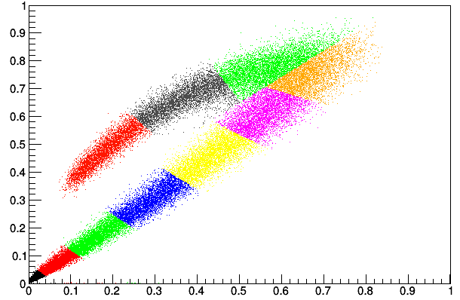
FHCal detects spectators to measure:
The centrality of the collision;
The reaction plane orientation;
Minimum bias trigger;
Physics in forward rapidity.
Centrality:
2D-Fit of energy distributions in FHCal modules
X
Edep [a.u]
central events
peripheral events
E_max [a.u]

Slide 4
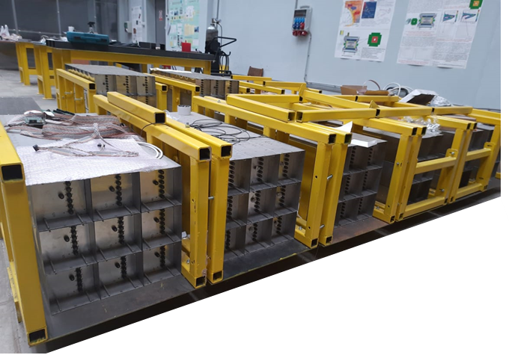
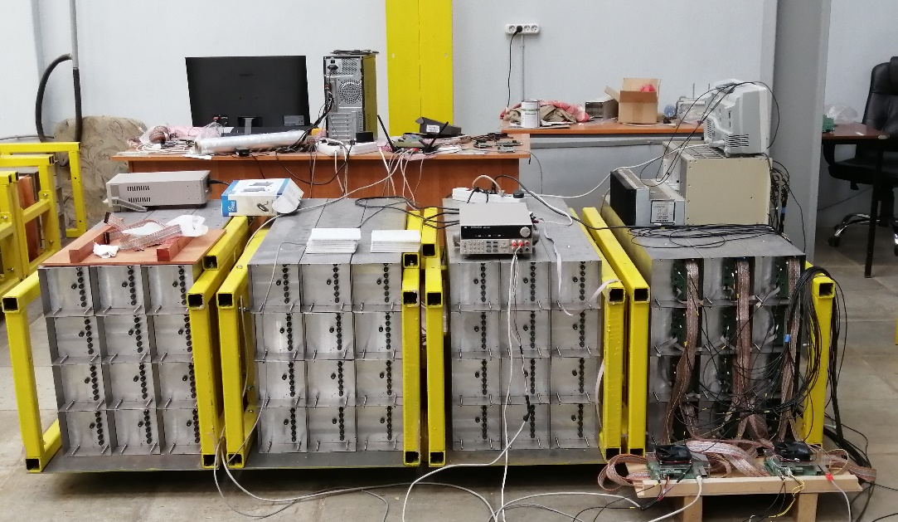
FHCal modules
All (90+spare) FHCal modules are assembled and tested with cosmic rays.
100 Front-End-Electronics (FEE) boards are produced and tested.
Modules are ready for the delivery at MPD site.
The activities with modules:
Calibration with cosmic muons;
Development of readout;
Development of FHCal trigger;
Development of Detector Control System;
Monitoring system.

Slide 5
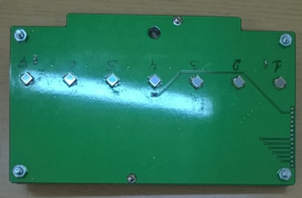
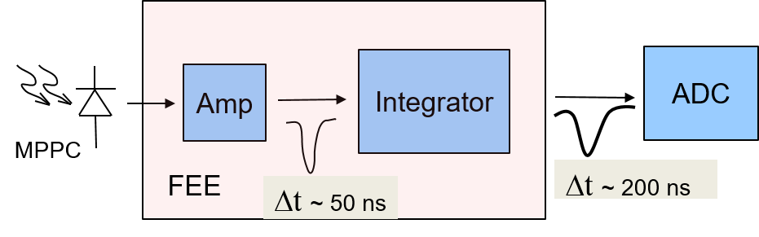
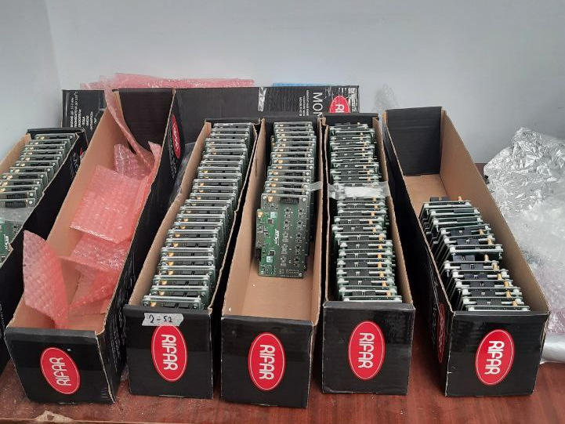
Front-End-Electronics
Two PCBs in each module with:
7 photodetectors ;
Photodetectors – MPPCs;
two-stage amplifiers;
HV channels;
LED calibration source.
MPPC: new type
S14160-3010PS
size – 3x3 mm²;
pixel -10x10 µm²;
PDE~18%.
100 units of FEE were produced and tested.

Slide 6
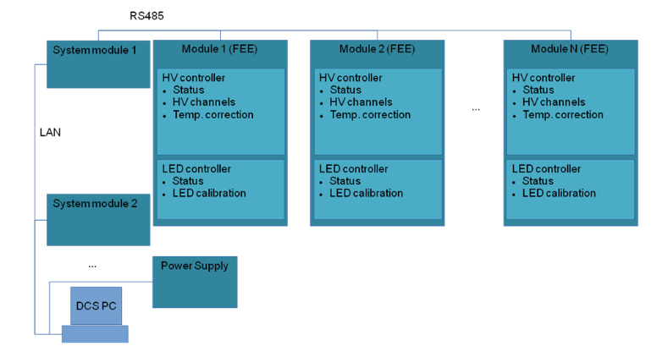
Detector Control System (DCS)
LAN
RS485
General
Slow Control
FHCal New Slow
Control (proxy)
System Module
FEE
FEE
DCS Tasks:
Control of HV at photodetectors (MPPC’s);
Temperature control of photodetectors;
Compensation of temperature drift of MPPC gain;
Monitoring of MPPC gain with stabilized light source.
Status of DCS:
It is practically fully operational;
Further improvements of functionality are going on.
FEE
System Module
FEE
Database
FEE
FEE
Connection diagram

Slide 7
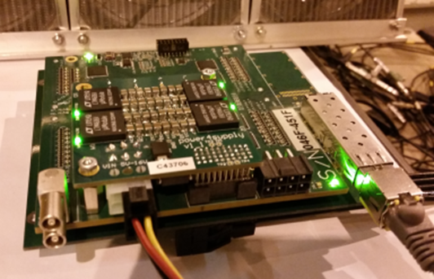
FHCal readout and control
FHCal arm
on detector
signal cables
1
FEE
near detector
~20m cables
DAQ
2
FEE
ADC64 (1)
(9 modules)
…
ADC64 (2)
(9 modules)
44
FEE
power supply
…
ADC64 (5)
(8 modules)
DCS Control box
HVsys
The readout electronics: FPGA based 64 channel ADC64 board, 62.5MS/s (AFI Electronics, JINR, Dubna).
- Ethernet
General Control System (Tango)
Both FHCal arms have the same readout scheme.

Slide 8
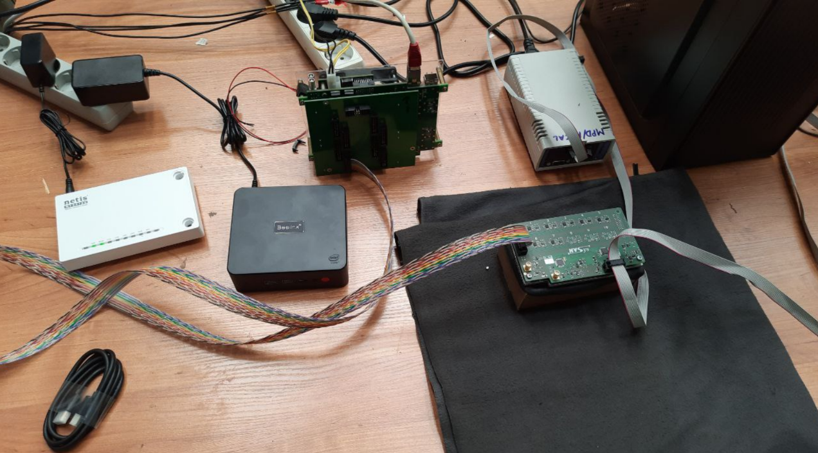
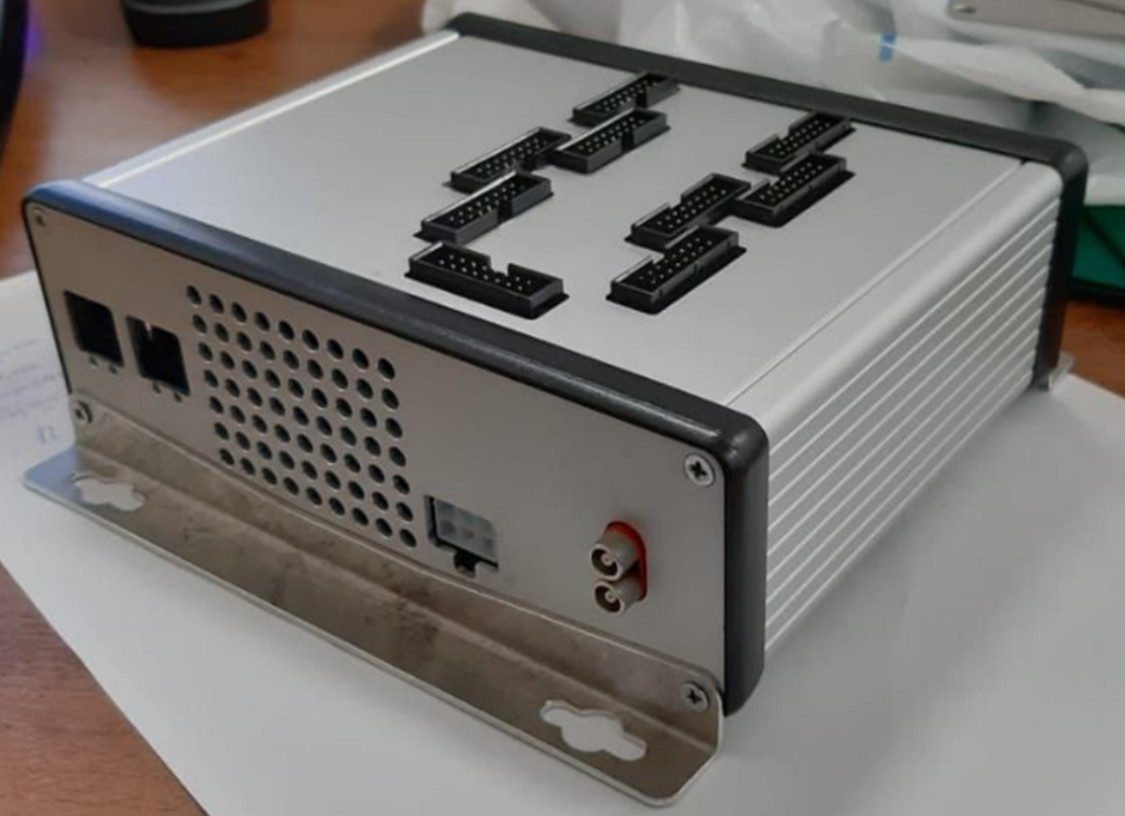
Preparation to the tests of ADCs
Test bench for ADC readout
FPGA based 64 channel ADC64 board, 62.5MS/s (AFI Electronics, JINR, Dubna).

Slide 9
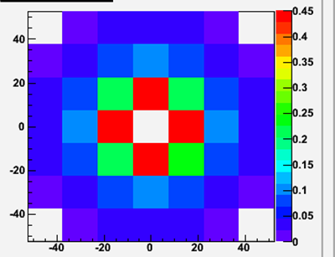
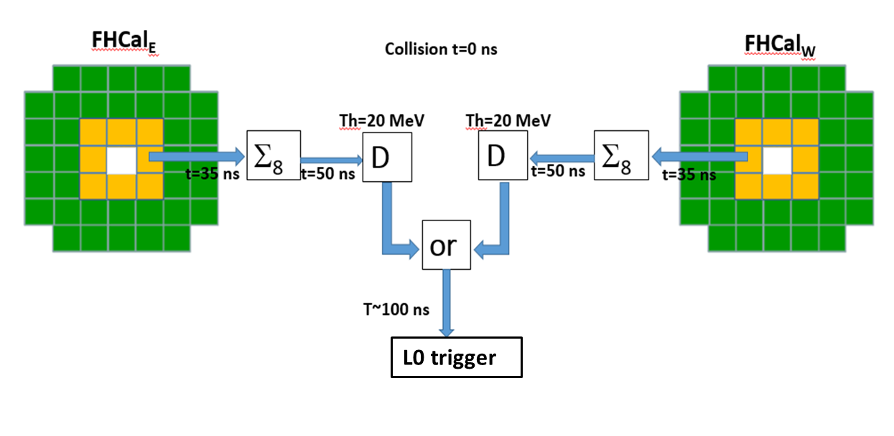
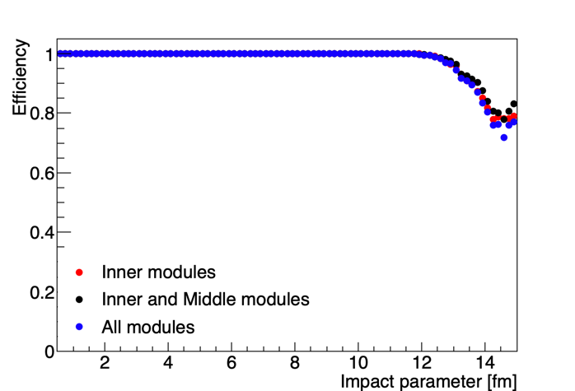
FHCal trigger
Scheme of FHCal trigger
Threshold 2 MeV/module
Trigger efficiency ~98%
Dependence of trigger efficiency on the configuration of modules (Au-Au 11 GeV).

Slide 10
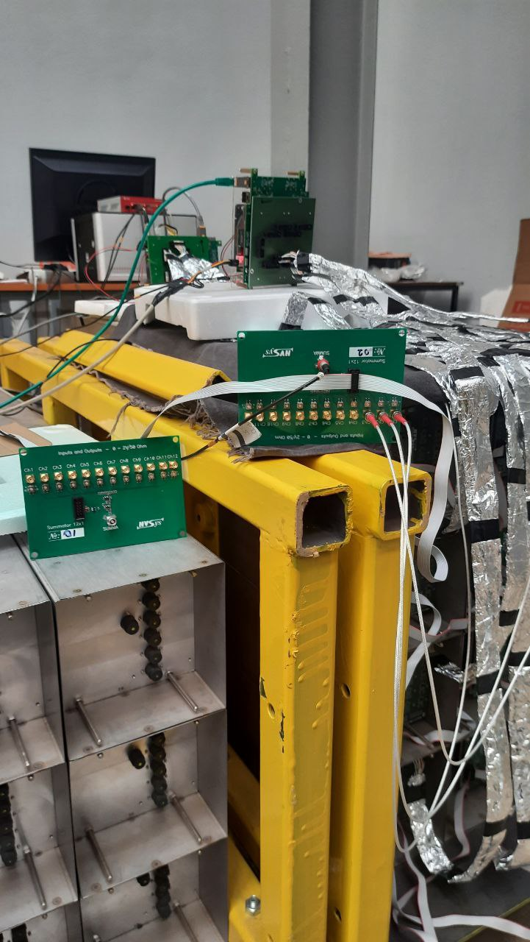
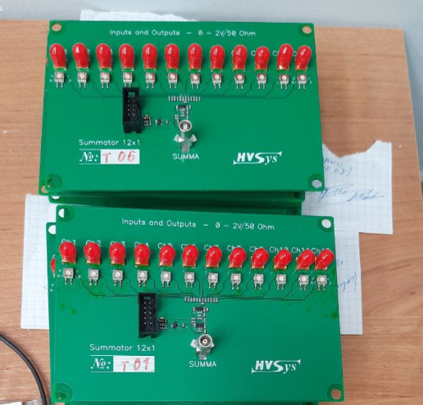
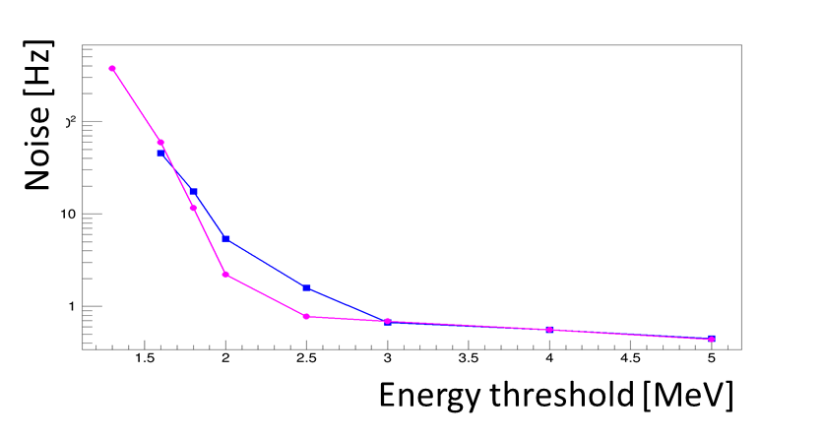
Preparations for FHCal trigger
Adders of analog signals from individual modules were produces for full FHCal.
The configuration of modules in trigger would depend on FEE and correlation noises. Flexible configuration is to be developed.
12-channels signal adders
Test of trigger noise on energy threshold in one module
All adders are working. The noises are under tests.

Slide 11
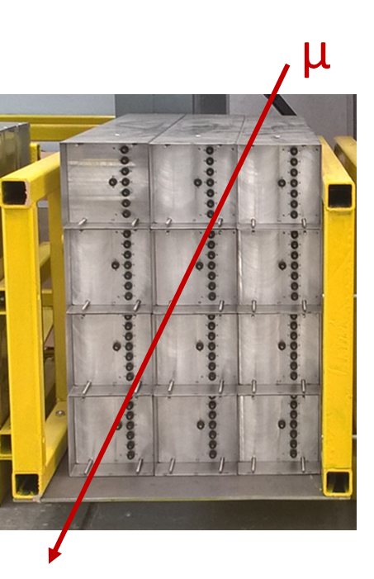
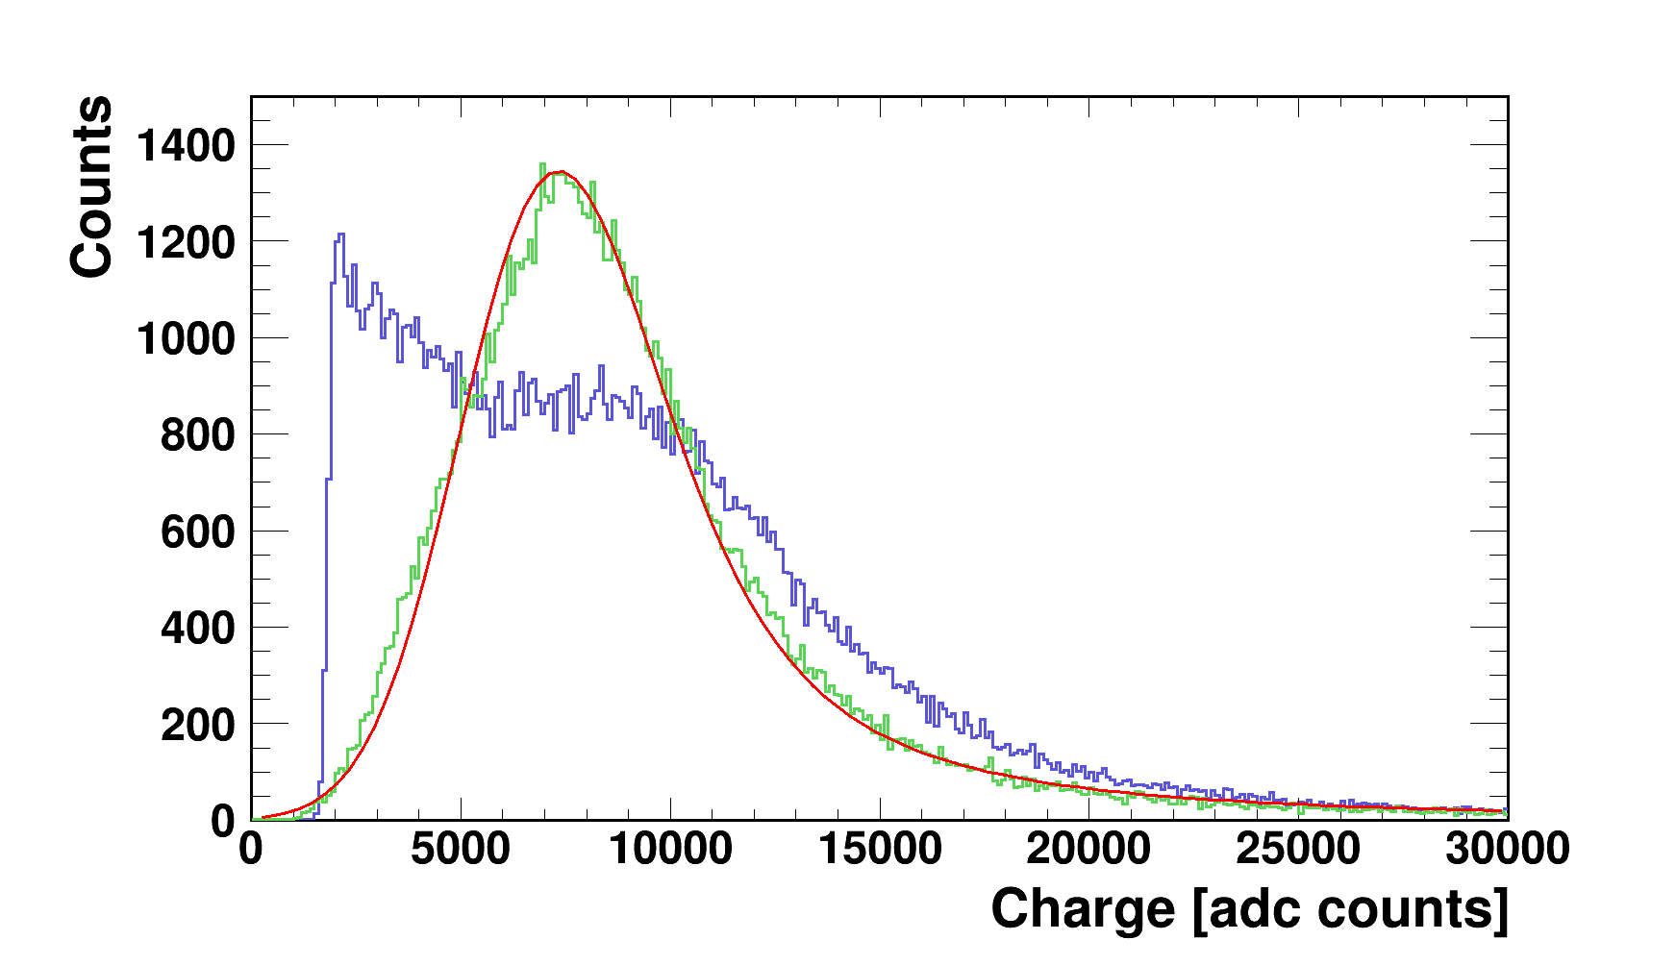
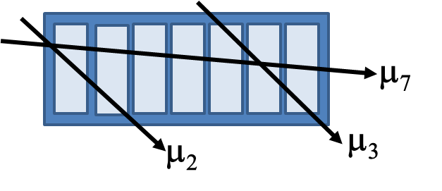
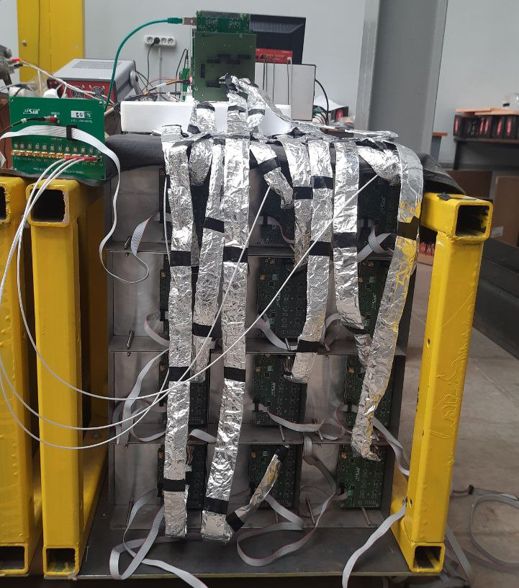
Energy calibration with cosmic nuons
Response of FHCal modules to cosmic muons with different track geometries.
Corrected to pass length in scintillators.
Raw spectrum without selection of tracks
~5 MeV
New MPPC type
The energy calibration is planned in self-triggering mode (without external muon trigger).
The different geometries of muon tracks are to be considered.
The selection of different muon tracks can be done by requiring the coincidence of muon signals in FHCal modules and longitudinal sections.
A new simplified version of energy calibration is under development.

Slide 12
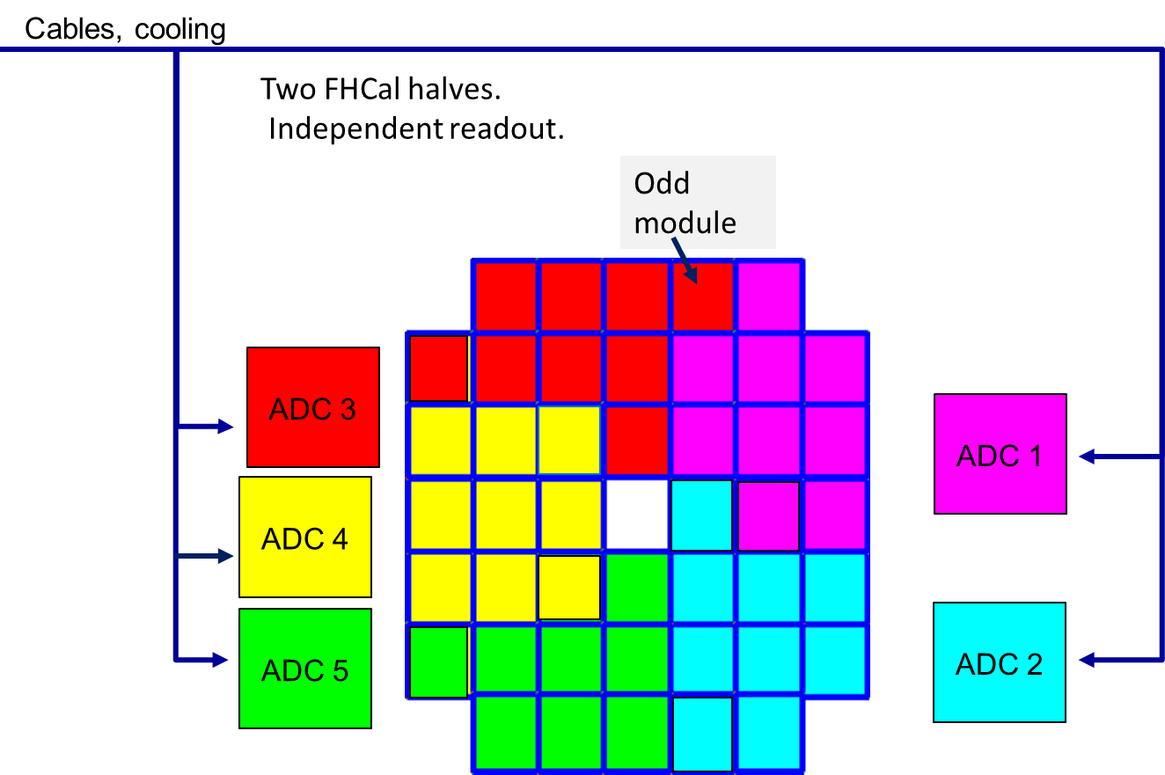
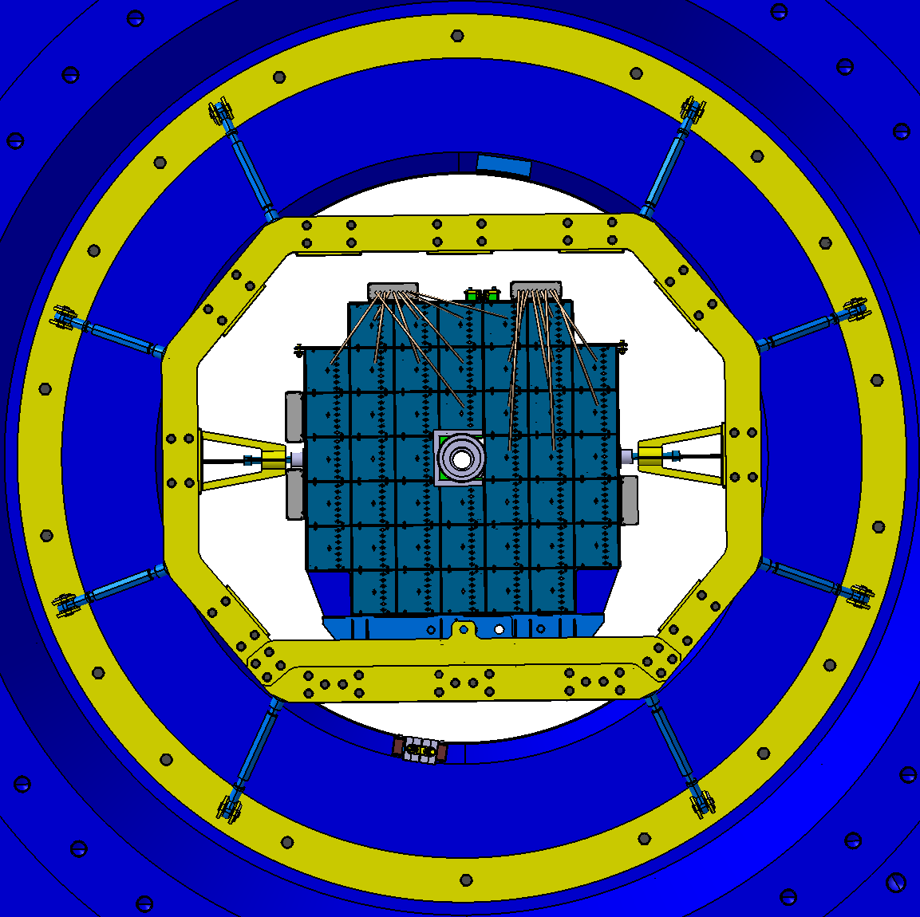
FHCal integration to MPD (ADC readout)
ADC boxes are placed at the lateral sides of FHCal support
Two halves of FHCal.
ADC cooling with compressed air is planned.
5 pipes from each side are to be available!

Slide 13
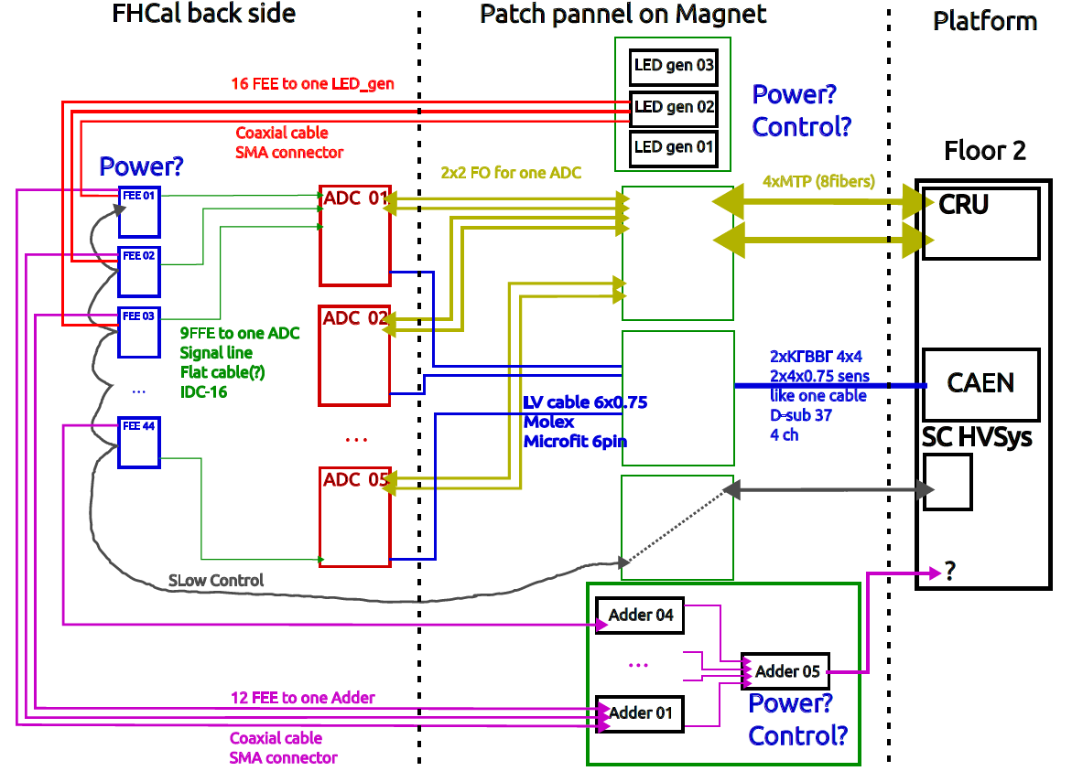
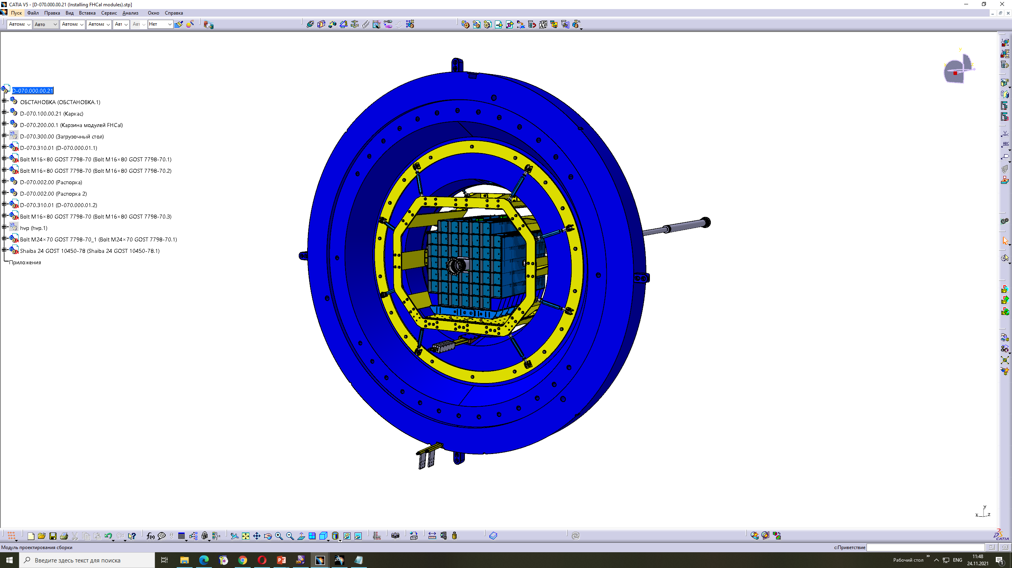
FHCal cabling
Prepared by
M. Rumyantsev

Slide 14
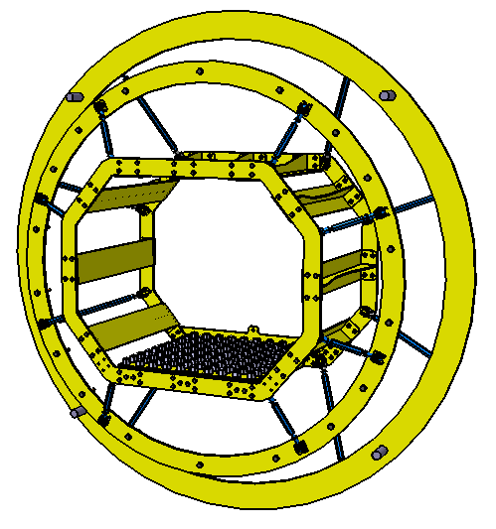
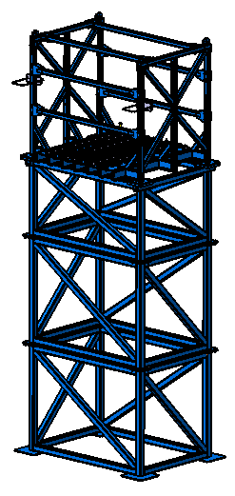
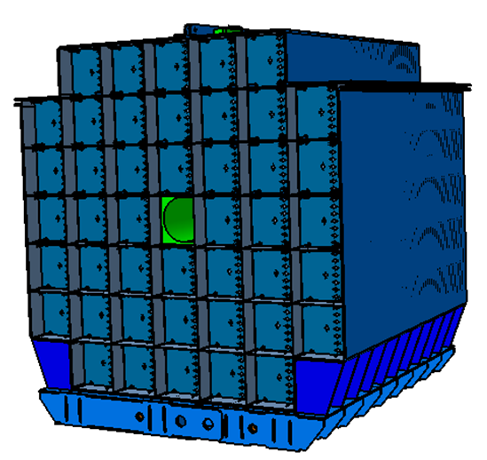
Mechanical support (main elements)
Support frame in magnet pole
Outer table
Basket of FHCal modules
Пластина
Design of all elements was finished a month ago!
The production starts now!

Slide 15
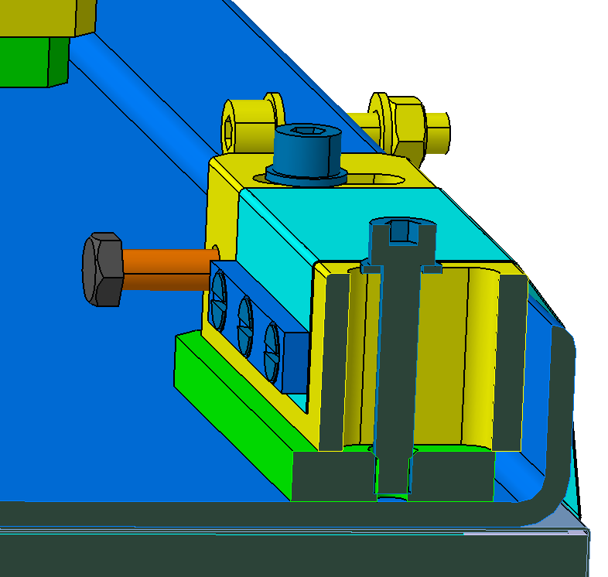
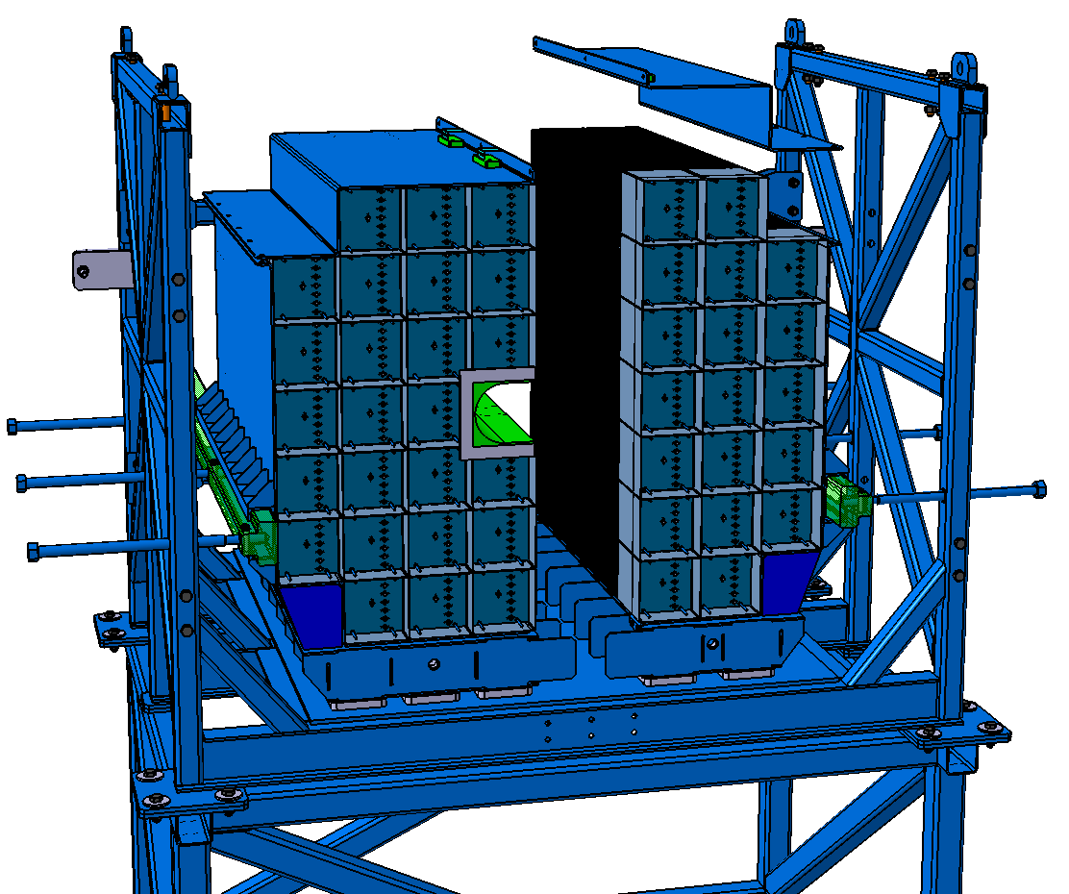
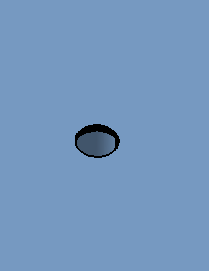
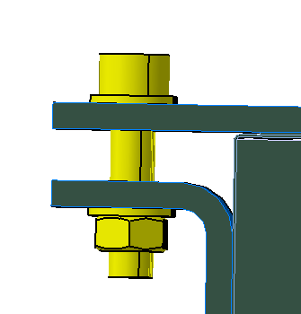
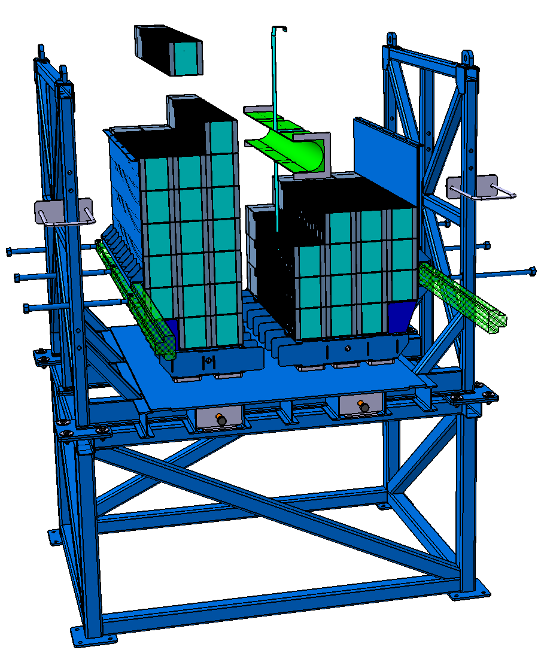
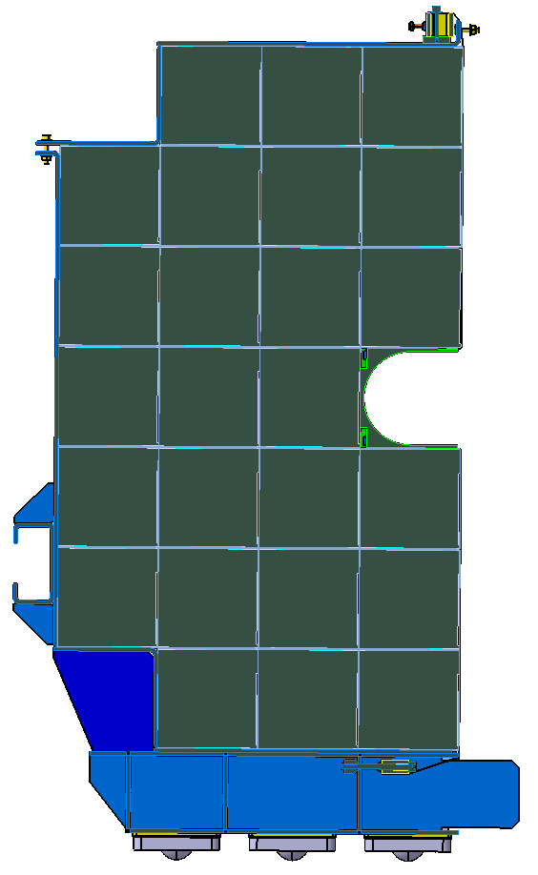
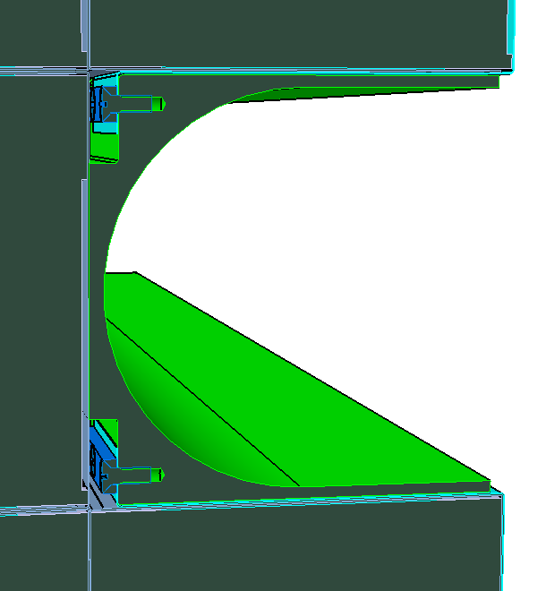
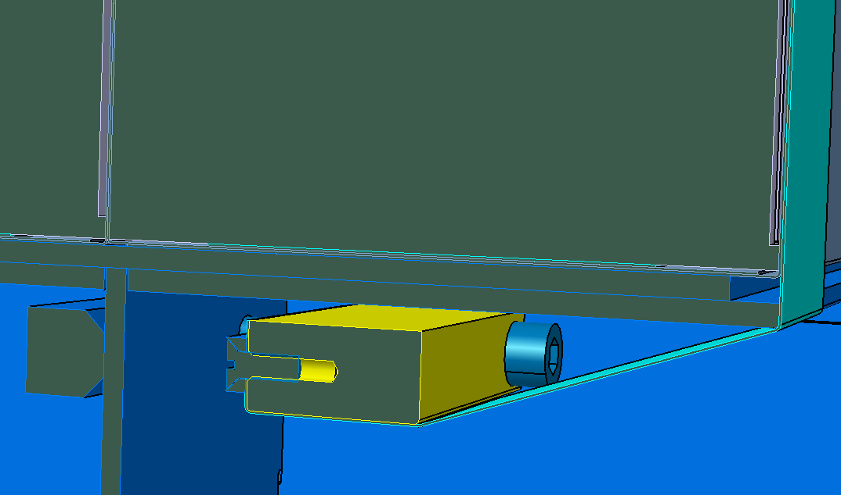
Assembling of FHCal modules in basket
М10 х30
M8
M6

Slide 16
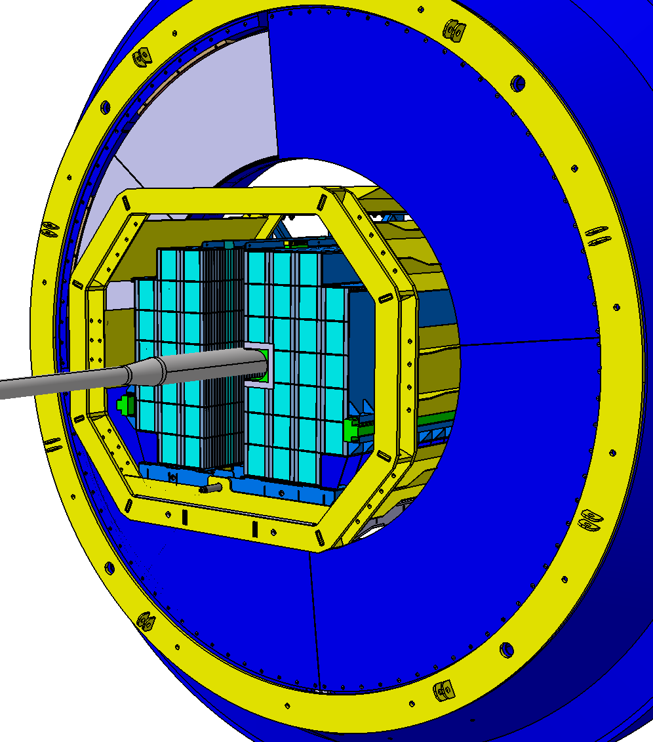
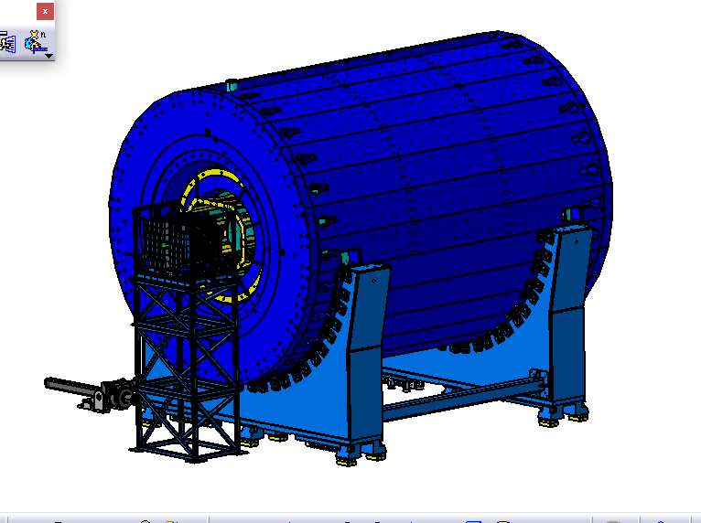
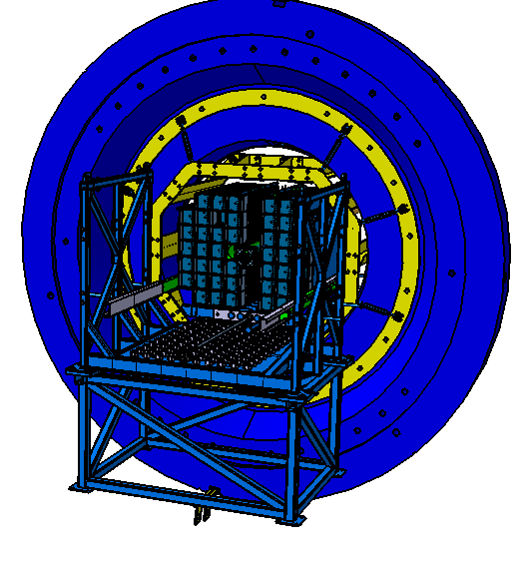
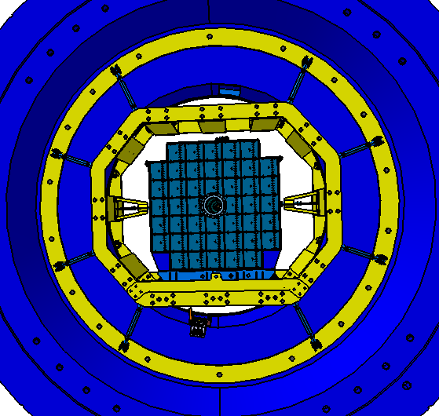
FHCal installation into magnet pole
Table with FHCal near pole
Main problem: beam pipe between two FHCal halves
FHCal inserted into pole
Two FHCal halves pressed together

Slide 17
Summary
All FHCal modules were tested and are ready for delivery at MPD site.
FEE was produced and tested.
Detector Control System is ready and is improved permanently.
Energy calibration procedure is under optimization.
FHCal trigger is under development. Flexible configuration of modules is considered.
The design of mechanical platform is finished. The production starts now!
We plan to be ready for the calorimeter assembling at MPD site in the middle of 2023.
The space an some infrastructure for FHCal assembling must be available!

Slide 18
Thank you!

